Slide 1
Core FB MC
Core Parallel Run KPI report
February 2021

Slide 2
Parallel Run KPI report
Introduction
Context
  According to Article 28(4) of the Core FB DA CCM, Core TSOs
    shall continuously monitor the effects and the performance of the application of this methodology during the parallel run
    shall develop, in coordination with the Core regulatory authorities, the Agency and stakeholders, the monitoring and performance criteria and report on the outcome of this monitoring on quarterly basis in a report
  Core TSOs & NEMOs have aligned on the
    Specific KPIs with NRAs and this alignment resulted in the format of this KPI report
    Frequency of provision of the report, which was increased to monthly, going beyond formal requirements
    Agreement to have the increased frequency reflected in the Core CCM amendment (November 2020)
In the next slide the overview of the KPIs covered in this monthly KPI report is provided:
  KPIs related to Capacity Calculation in blue
  KPIs related to Market Coupling simulations in green

Slide 3
Parallel Run KPI report
Overview of Core FB MC Parallel Run KPIs
  Adjustment for minimum RAM and LTA Inclusion | Slide 7 - 58
    Average maximum AMR per CNE per BD
    Average maximum AMR per TSO per BD
    Average maximum AMR+LTAmargin per CNE per BD
    Average maximum AMR+LTAmargin per TSO per BD
  TSOs’ adjustment after validation | Slide 59 - 70
    Share of MTUs with intervention per TSO
    Total IVA applied per BD for each CNE affected by TSO intervention
  Power System Impact Analysis | Slide 71 - 109
    Min & max Net Position per BZ hub
    Virtual margins at MCP per TSO, per BD Slide 162 - 193
    *RAM before and after RAO per TSO
    *Average sensitivity of RAs per TSO
    Flow deviation on non-Core borders
Market Impact Assessment (FB Plain) Slide 110 - 161
    Most often presolved CNEs (top 20)
    Most limiting CNEs (top 20)
    Clearing prices, price spread and price convergence
    CNECs with highest non-zero shadow price in each hour per day
    Core Social Welfare
    Paradoxically Rejected Block orders (PRB)
  *Note: Since NRAO is not implemented in the capacity calculation in the reporting period KPIs 15 & 16 are not included.
Note: Elia and PSE switched from EC (limitation on Core NP) to AC (limitation on SDAC NP) during the course of January. As the MinMax NP KPI cannot reflect ACs (contrary to ECs)
a change in the patterns for BE and PL is observed
this underlines the theoretical character of this KPI

Slide 4
Parallel Run KPI report
Reporting period (Business days covered)
Context
The progressive transition towards ext//run started on the 16th of November 2020.
TSOs daily calculate a final flow-based domain for 7 Business Days per week.
In the current stage only a selection of Business Days will be published that are deemed sufficiently representative. Based on this selection TSOs + NEMOs perform the market coupling simulations.
A Reading Guide with a description of the KPIs is available on JAO.
13 Business Days were deemed as sufficiently representative. The KPI report contains the following Business Days (highlighted in green):
February ‘21
M | T | W | T | F | S | S
1 | 2 | 3 | 4 | 5 | 6 | 7
8 | 9 | 10 | 11 | 12 | 13 | 14
15 | 16 | 17 | 18 | 19 | 20 | 21
22 | 23 | 24 | 25 | 26 | 27 | 28

Slide 5
Parallel Run KPI report
Overview limitations & assumptions
Core project parties maintain an overview on the JAO website with the assumptions and limitations for specific Business days during the parallel run – see JAO website (LINK).
No
Note:Unknown issues can be present and can be discovered in the future as analysis continues. This might lead to the ex-post conclusion that results for certain BDs are invalid. German TSO names uses abbreviations: D2: Tennet GmbH, D4: TransnetBW, D7: Amprion, D8: 50Hertz
Description of issue / limitation | FROM BD | TO BD
The maximum Zone-to-Zone PTDFs are not correctly calculated, which can inflate the max z2z PTDFs and hence influence the CNEC selection in relation to the 5% PTDF threshold | 16/11/2020 | 02/02/2021
Since BD 20201116, flow-based parameters calculated with the help of the spanning method according to CCM Article 22(a) are published in case the capacity calculation fails to provide the flow-based parameters for strictly less than three consecutive hours. The parameters RAM, F_(ref,init) and F_ref of the MTU for which spanning was applied are not correctly calculated in the initial computation. This issue has no impact on the final flow-based parameters nor on the market coupling. | 16/11/2020 | 02/02/2021
When Elia applies IVA, it is applied on the CNEC which is congested (correct behavior) as well as the CNEC in the opposite direction which is not congested (incorrect behavior). This artificially reduces the pre-solved domain in the market direction opposite to the best forecasted market direction (until BD Feb 17) | 16/11/2021 | 17/02/2021
The Elia AC is missing from BD 14/01 onwards, which can lead to a higher import position for BE than what is operationally feasible (until BD 19/02) | 14/01/2021 | 19/02/2021
Since BD 20210129 values related to the flow on the Monita cable are above maximum admissible power flow (600MW) for some of the timestamps as a consequence of BCI process (adaptations of Italy towards NPF target). BCI process works properly, but it includes nodes (represent the flow) of Monita cable in net position shifting process. There is a need for exclusion of the Monita nodes from BCI process to improve the quality of the published values that represent the flow on Monita. This issue was observed for BDs 20210129-20210202 (excluding 20210130) and may occur until this is solved. The impact on the results is not significantly influential. | 29/01/2021 | 18/03/2021
RTE fine validation process is still under implementation and will be ready by end of May 2021. A rough validation is already operational but triggered on a daily basis this validation would downgrade significantly the representativeness of the results. | 16/11/2020 | 31/05/2021
Elia experienced an issue with its local tooling. As a result any eventual IVA could not be detected/applied and resulting capacities on Elia CNECs might be higher than when the issue would not have occurred. Impacted BDs: Feb 4, Feb 6, Feb 17, Feb 21 | 04/02/2021 | TBD
Merging tool uses an incorrect net position for DE/LU. This incorrect net position is distributed throughout the CGM, thus leading to unintended deviations of generation between Core IGMs and CGM. | 16/11/2020 | TBD
NRAO is not implemented yet and therefore results are without this optimization | 16/11/2020 | TBD
As TSOs are in a learning phase in terms of process and tools, the outcome of the local validation might temporarily lead to limited application of IVA and/or incomplete information on its justification | 16/11/2020 | TBD
A number of TSOs apply a fractional Ramr, but only rounded values are considered in the computation. This leads to slight inconsistency with operational values. | 10/12/2020 | TBD
An issue occurred that prevented Elia applying minRAM reduction on its CNECs in relation to excessive loopflows. Impacted BDs: Jan 20, Feb 28, March 1, March 6 | 01/01/2021 | TBD
The DE-NO2 border is not included in the Non-Core Exchanges KPI but will be added as of April 2021 reporting. | 09/12/2020 | 31/03/2021
@Marius: to update

Slide 6
Parallel Run KPI report
Overview limitations & assumptions (part II)
Core project parties maintain an overview on the JAO website with the assumptions and limitations for specific Business days during the parallel run – see JAO website (LINK).
For the reporting period TSOs apply the following Ramr values:
TSOs | Ramr values |  | Comments
 | BDs | Value
APG | 01/02 – 28/02 | 18.4% | In line with linear trajectory in accordance with Action Plan.
CEPS | 01/02 – 28/02 | 70% | Static value
Eles | 01/02 – 28/02 | 70% | Static value
Elia | 01/02 – 28/02 | 70% minus excessive LF | In line with its derogation on loopflows, Elia defines the Ramr per CNEC per MTU taking 70% as a starting point and reducing in case of excessive loopflows
German TSOs | 01/02 – 28/02 | 21.3% | According to the German action plan: -Until BD 09/12: 11,5% (rounding required in CWE, therefore 12%) -From BD 10/12/2020 21,3%
HOPS | 01/02 – 28/02 | 70% | For majority of CNECs in the beginning, while for specific CNECs identified based on internal analysis (per ACER recommendation) will be defined differently (20% - 70%)
MAVIR | 01/02 – 28/02 | 30% - 70% | In a range of 30%-70%. 70% for the majority of the CNECs while 30%, 50% as well as 60% for a certain set of CNECs based on analysis. In parallel, a set of CNECs being close to high concentration of generation nodes has been set to MNECs as well
PSE | 01/02 – 28/02 | 5% - 40% | Calculated according ACER methodology for all CNECs
RTE | 01/02 – 28/02 | 70% | Static value
SEPS | 01/02 – 28/02 | 30% | Some CNECs can have higher Ramr value than 30%. Further updates towards the higher Ramr values are expected based on the derogation process.
TenneT NL | 01/02 – 28/02 | 20% - 70% | In line with action plan which defines Ramr per CNE in range 20-70%. In addition Ramr values per CNEC per MTU are updated to consider derogation on loopflows.
Transelectrica | 01/02 – 28/02 | 33% | Static value

Slide 7
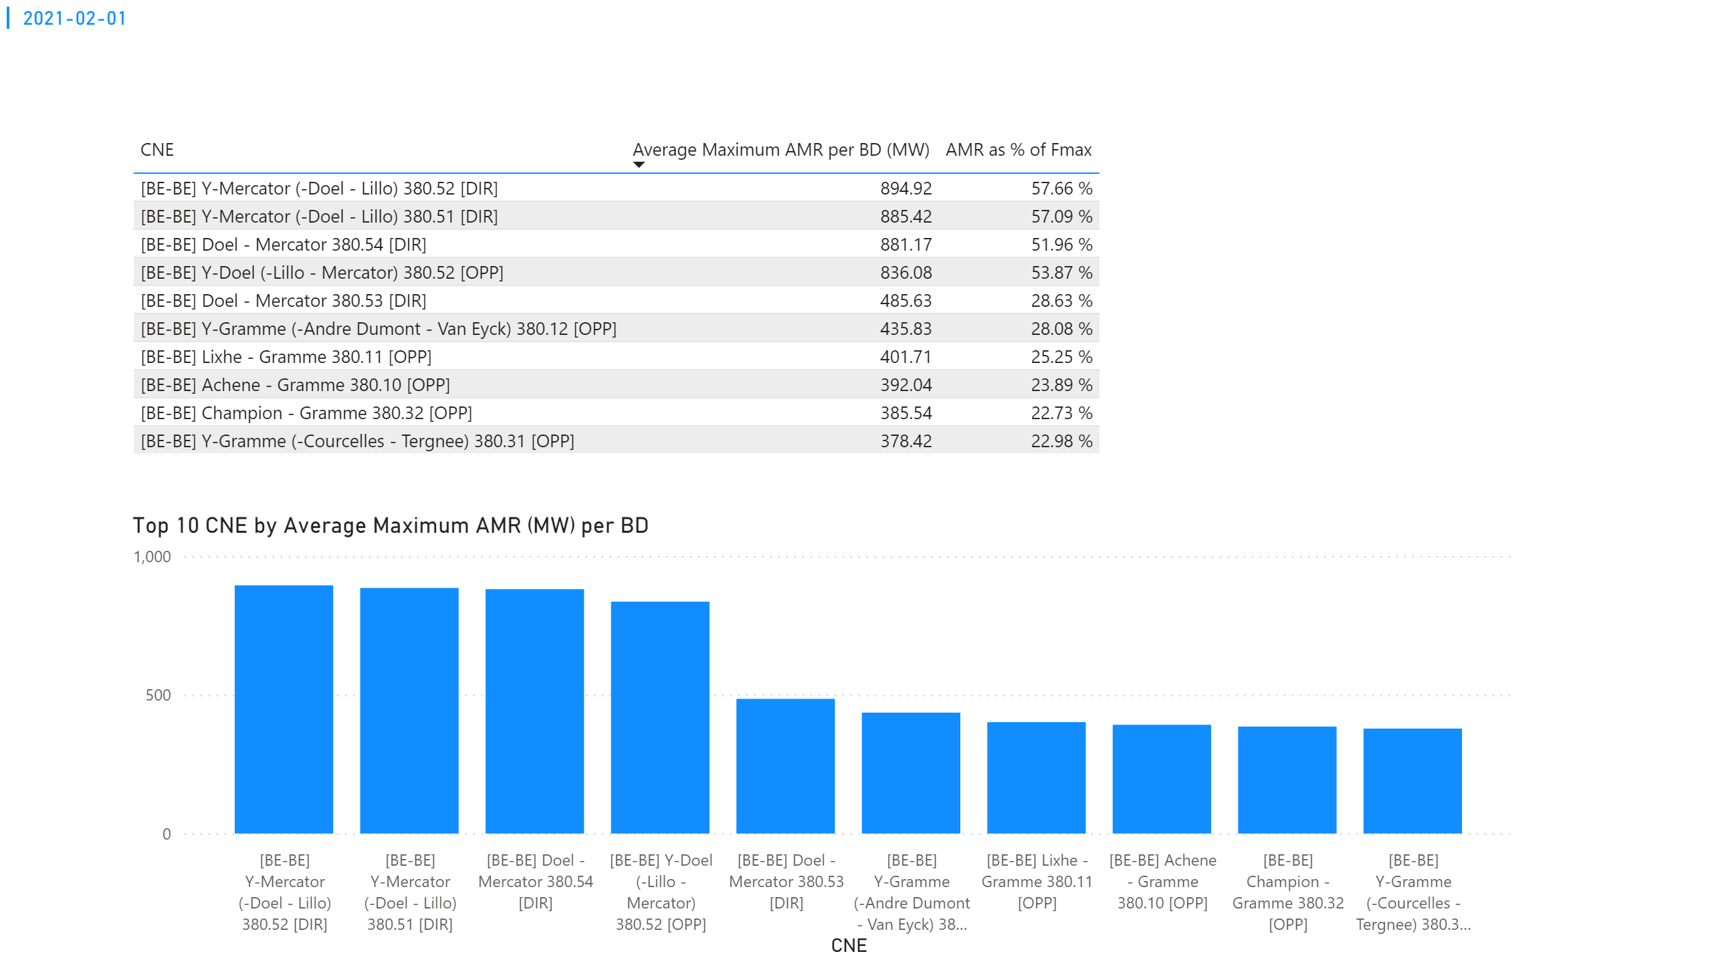
KPI 1
KPI 1: Average maximum AMR per CNE per BD
Notes:
tableEx
No alt text provided.
Top 10 CNE by Average Maximum AMR (MW) per BD
No alt text provided.
multiRowCard
No alt text provided.

Slide 8
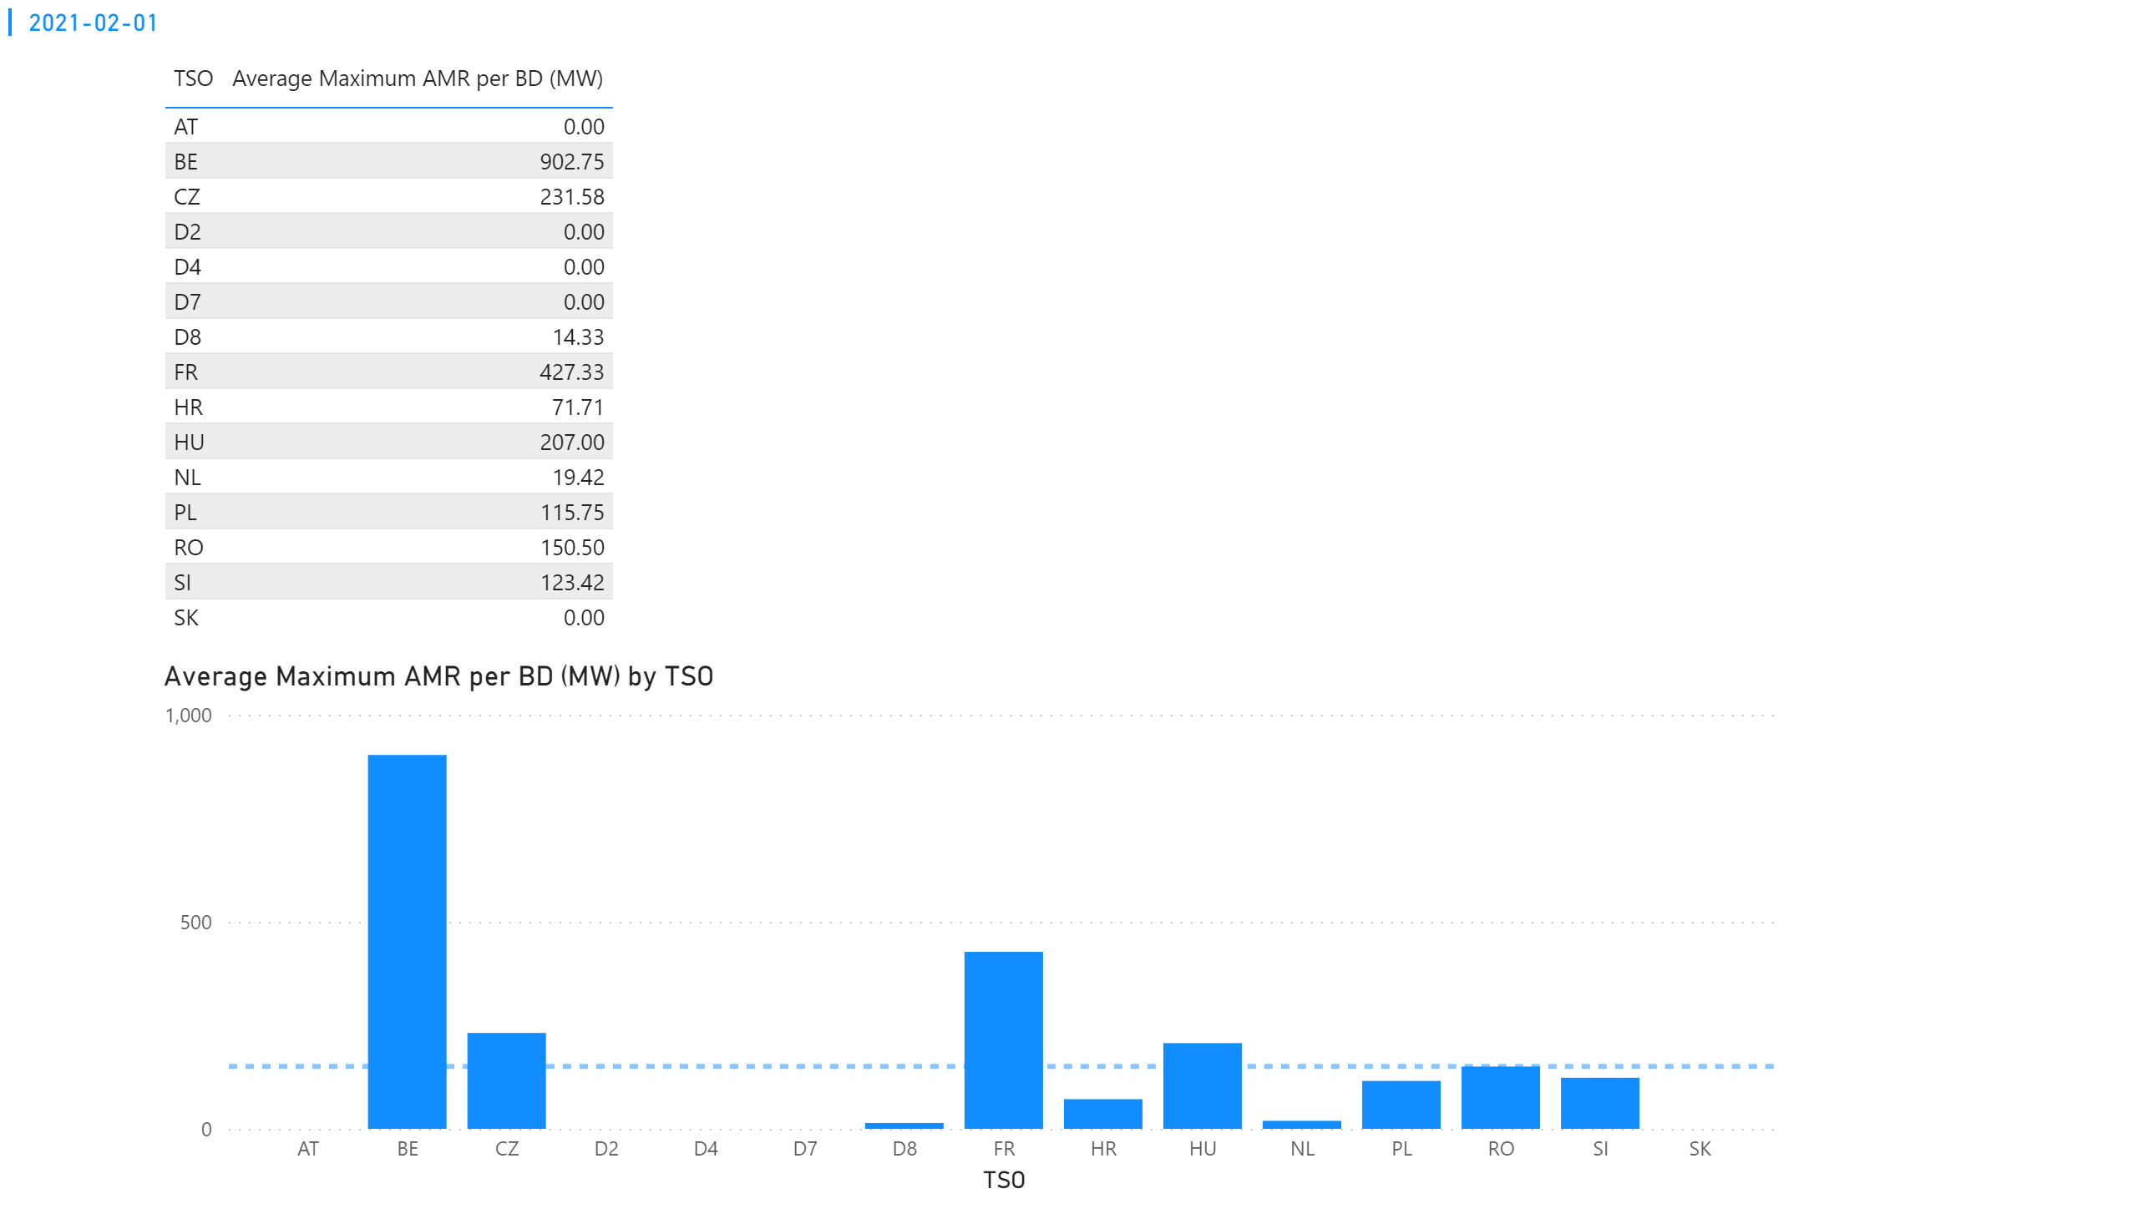
KPI 2
KPI 2: Average maximum AMR per CNE per TSO
Notes:
tableEx
No alt text provided.
Average Maximum AMR per BD (MW) by TSO
No alt text provided.
multiRowCard
No alt text provided.

Slide 9
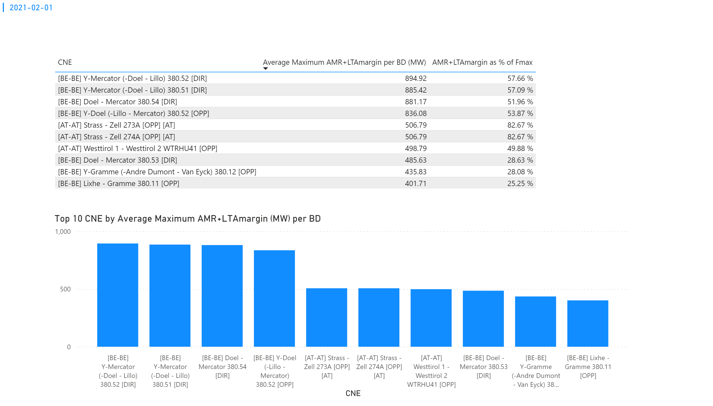
KPI 3
KPI 3: Average maximum AMR+LTAmargin per CNE per BD
Notes:
tableEx
No alt text provided.
Top 10 CNE by Average Maximum AMR+LTAmargin (MW) per BD
No alt text provided.
multiRowCard
No alt text provided.

Slide 10
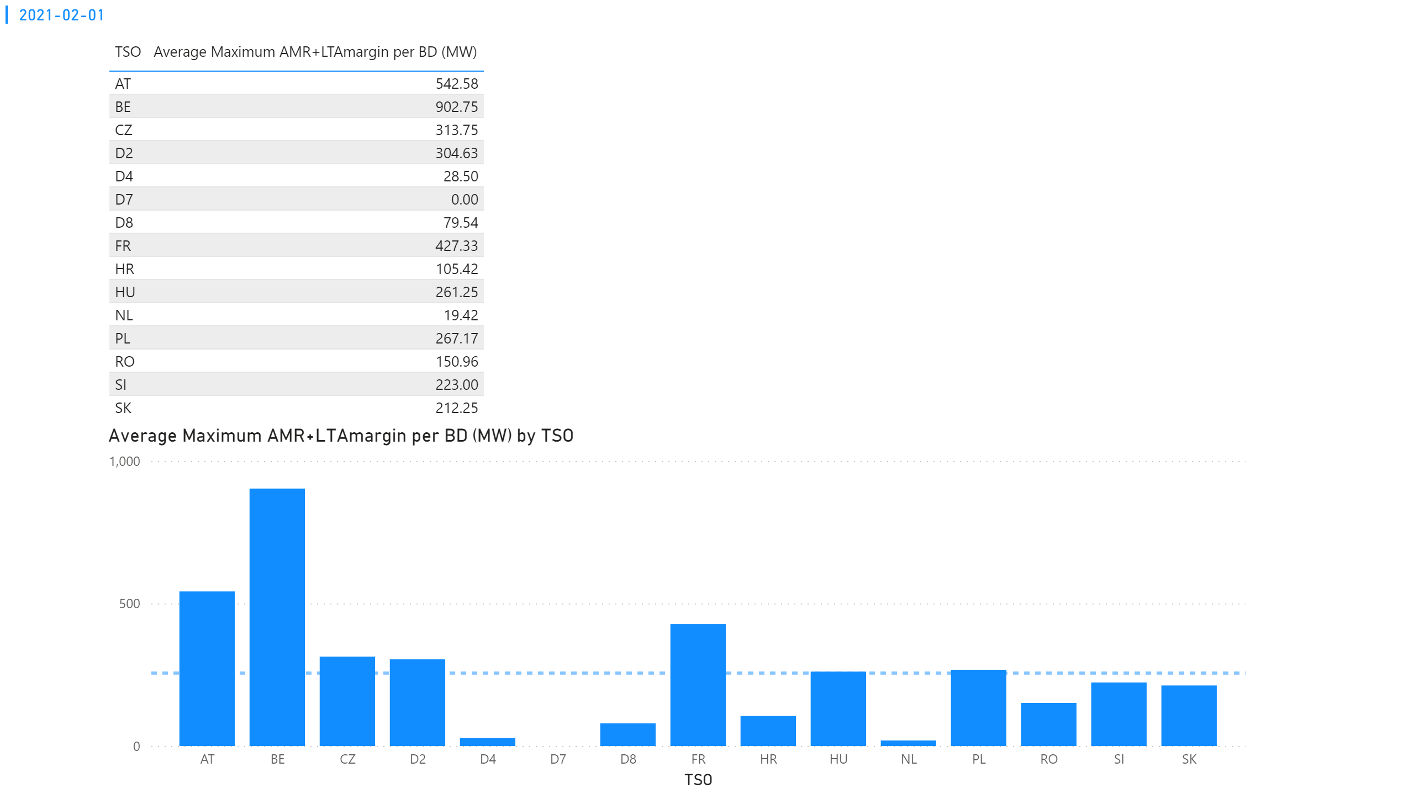
KPI 4
KPI 4: Average maximum AMR+LTAmargin per TSO per BD
Notes:
tableEx
No alt text provided.
multiRowCard
No alt text provided.
Average Maximum AMR+LTAmargin per BD (MW) by TSO
No alt text provided.

Slide 11
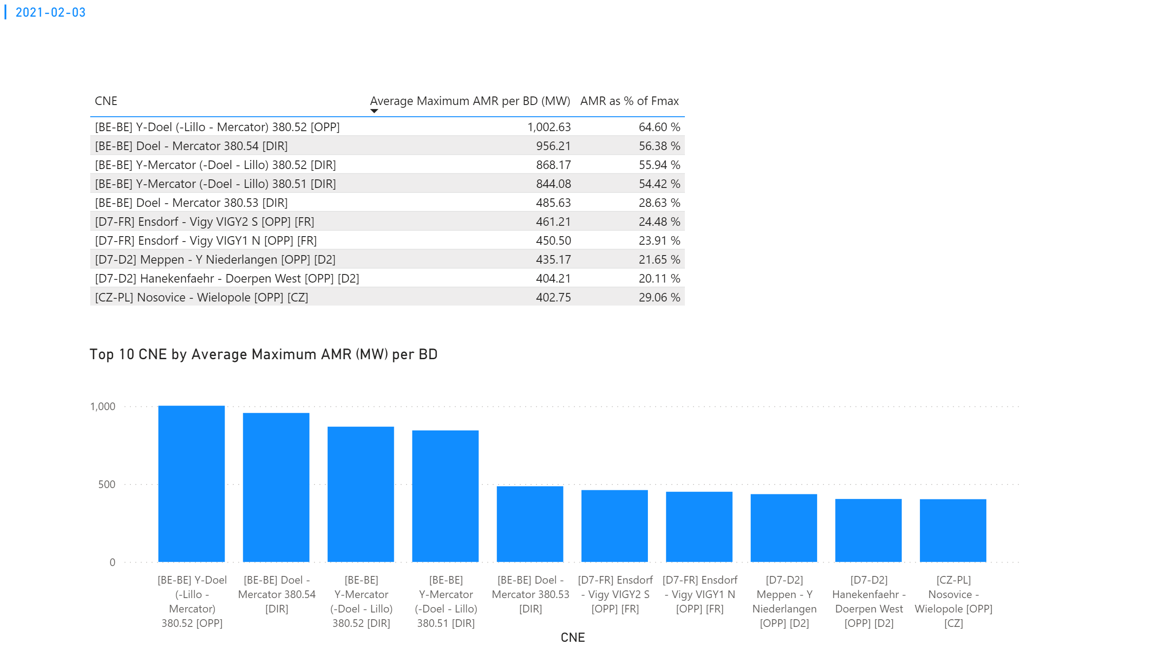
KPI 1
KPI 1: Average maximum AMR per CNE per BD
Notes:
tableEx
No alt text provided.
Top 10 CNE by Average Maximum AMR (MW) per BD
No alt text provided.
multiRowCard
No alt text provided.

Slide 12
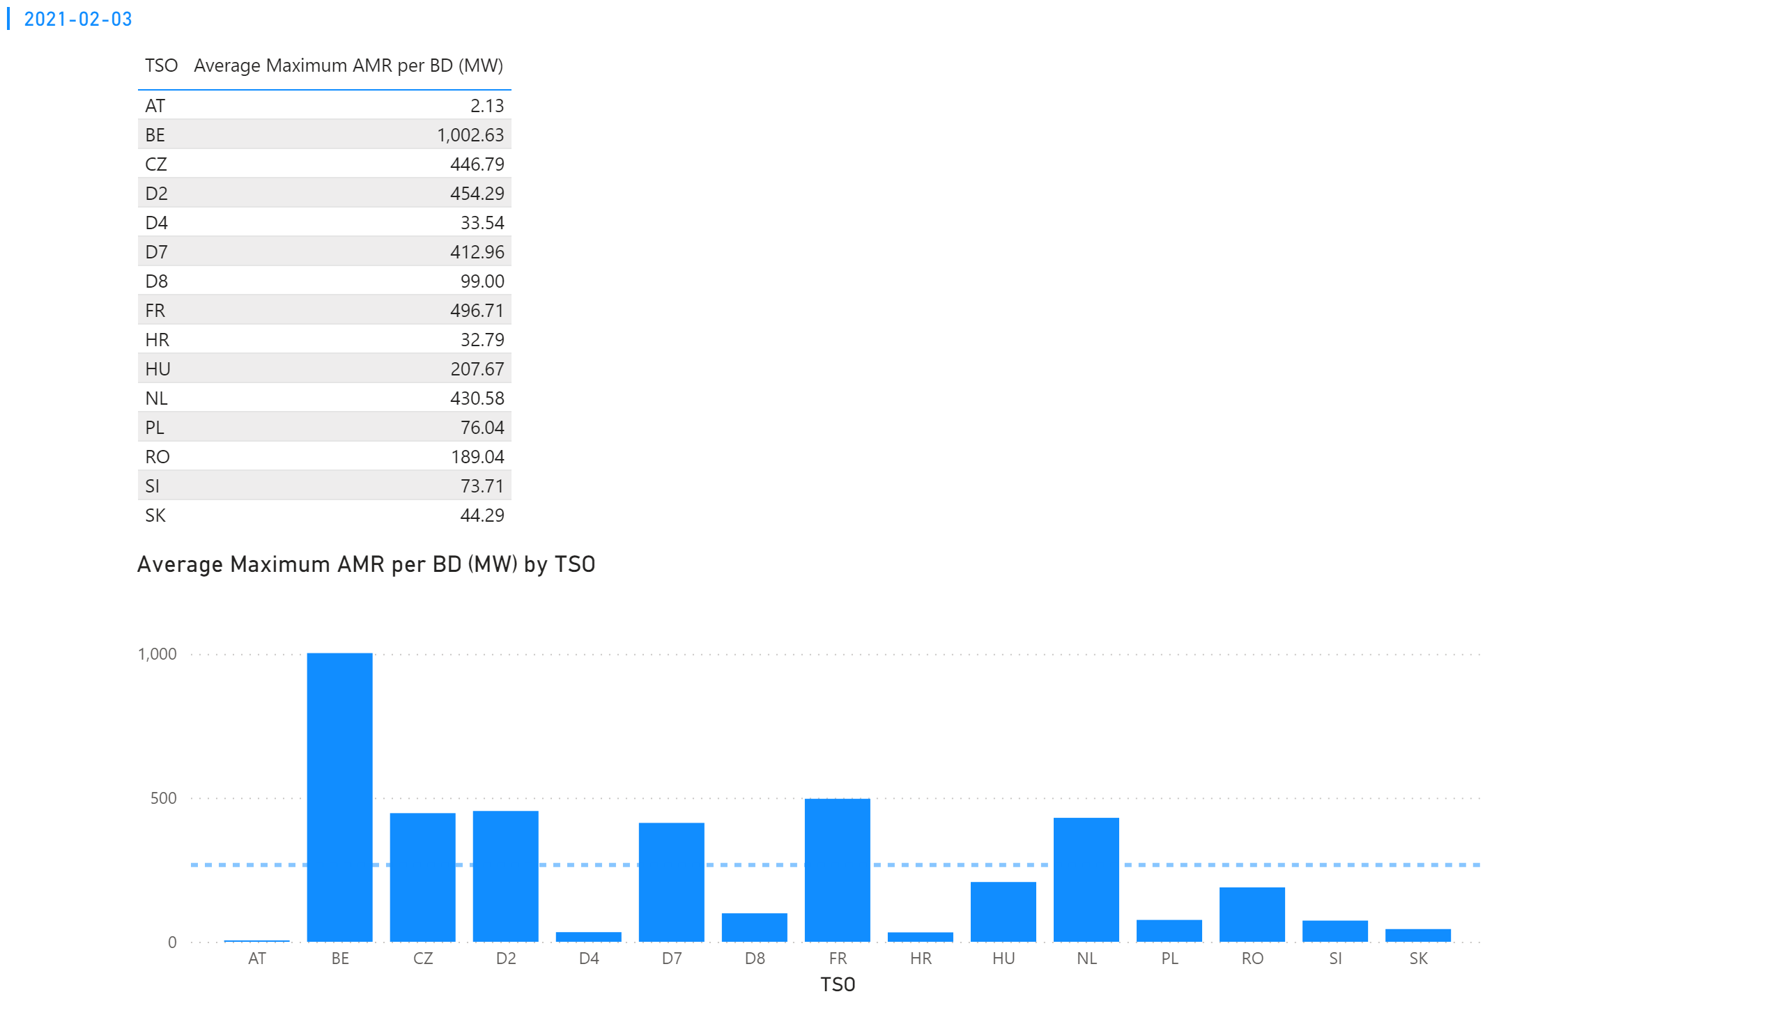
KPI 2
KPI 2: Average maximum AMR per CNE per TSO
Notes:
tableEx
No alt text provided.
Average Maximum AMR per BD (MW) by TSO
No alt text provided.
multiRowCard
No alt text provided.

Slide 13
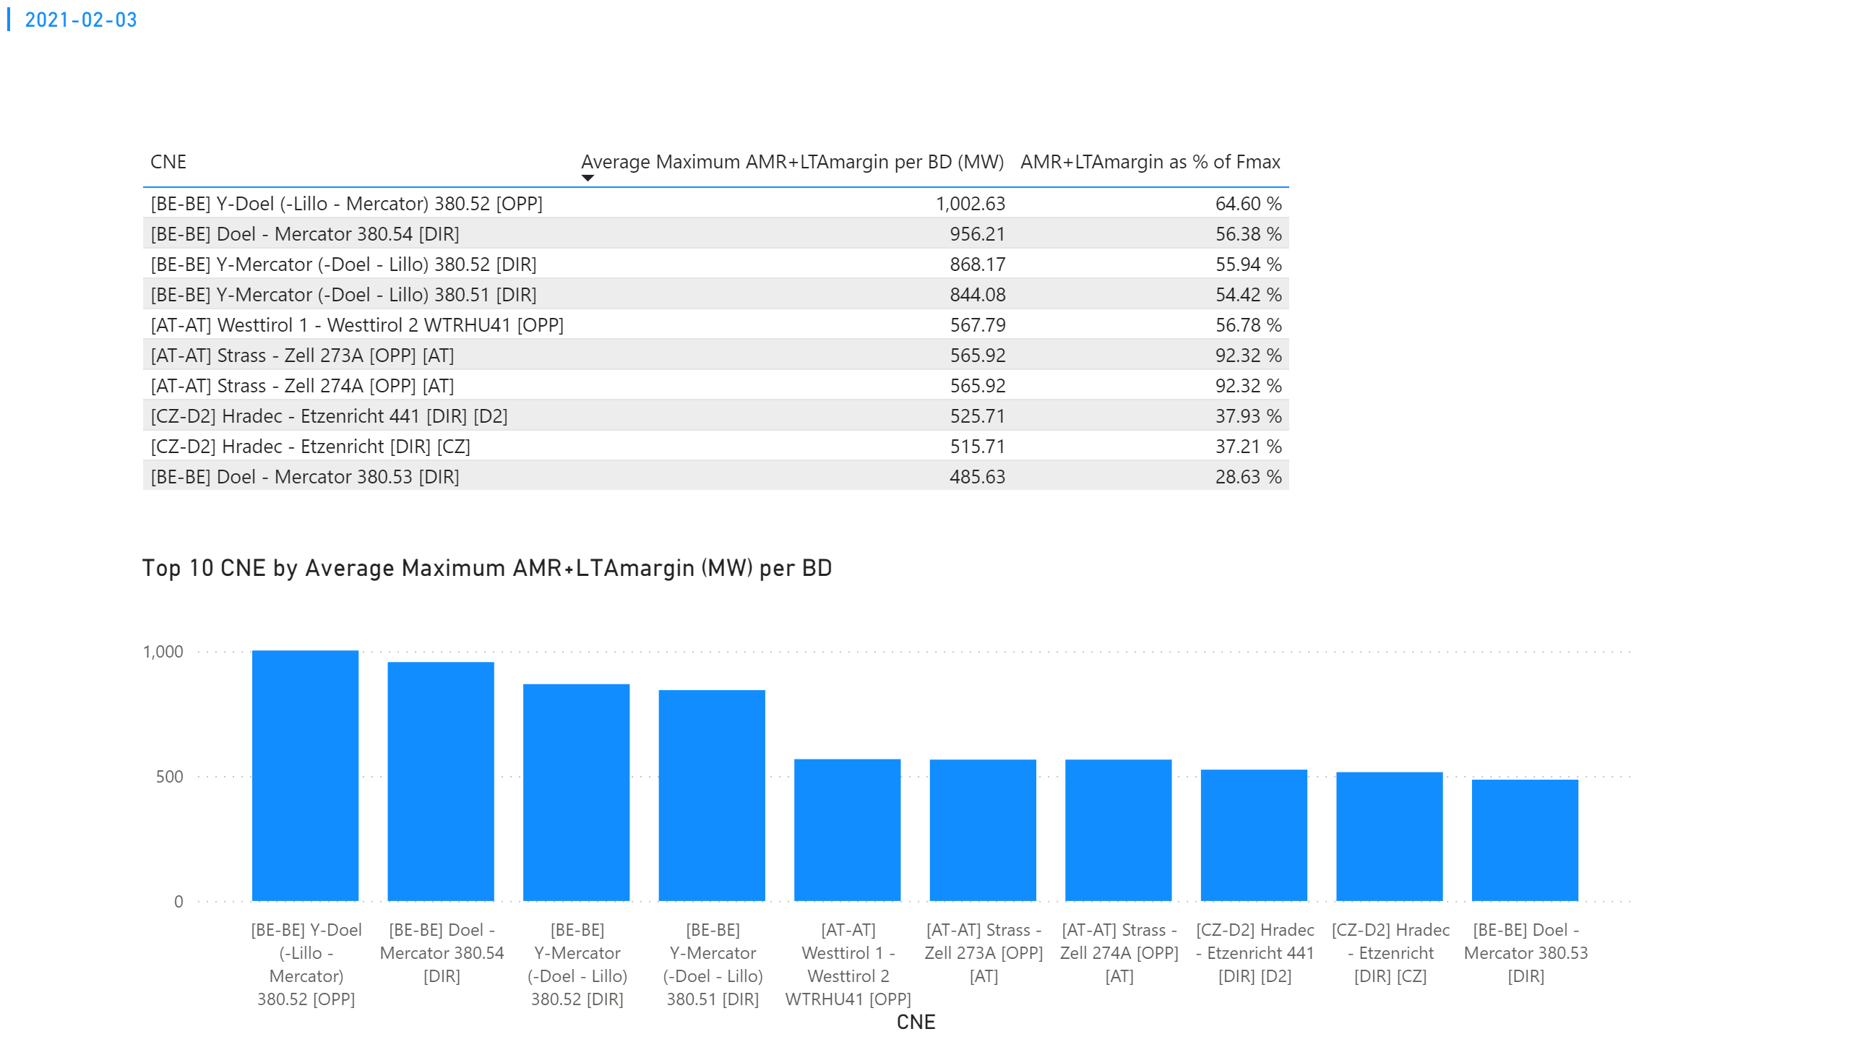
KPI 3
KPI 3: Average maximum AMR+LTAmargin per CNE per BD
Notes:
tableEx
No alt text provided.
Top 10 CNE by Average Maximum AMR+LTAmargin (MW) per BD
No alt text provided.
multiRowCard
No alt text provided.

Slide 14
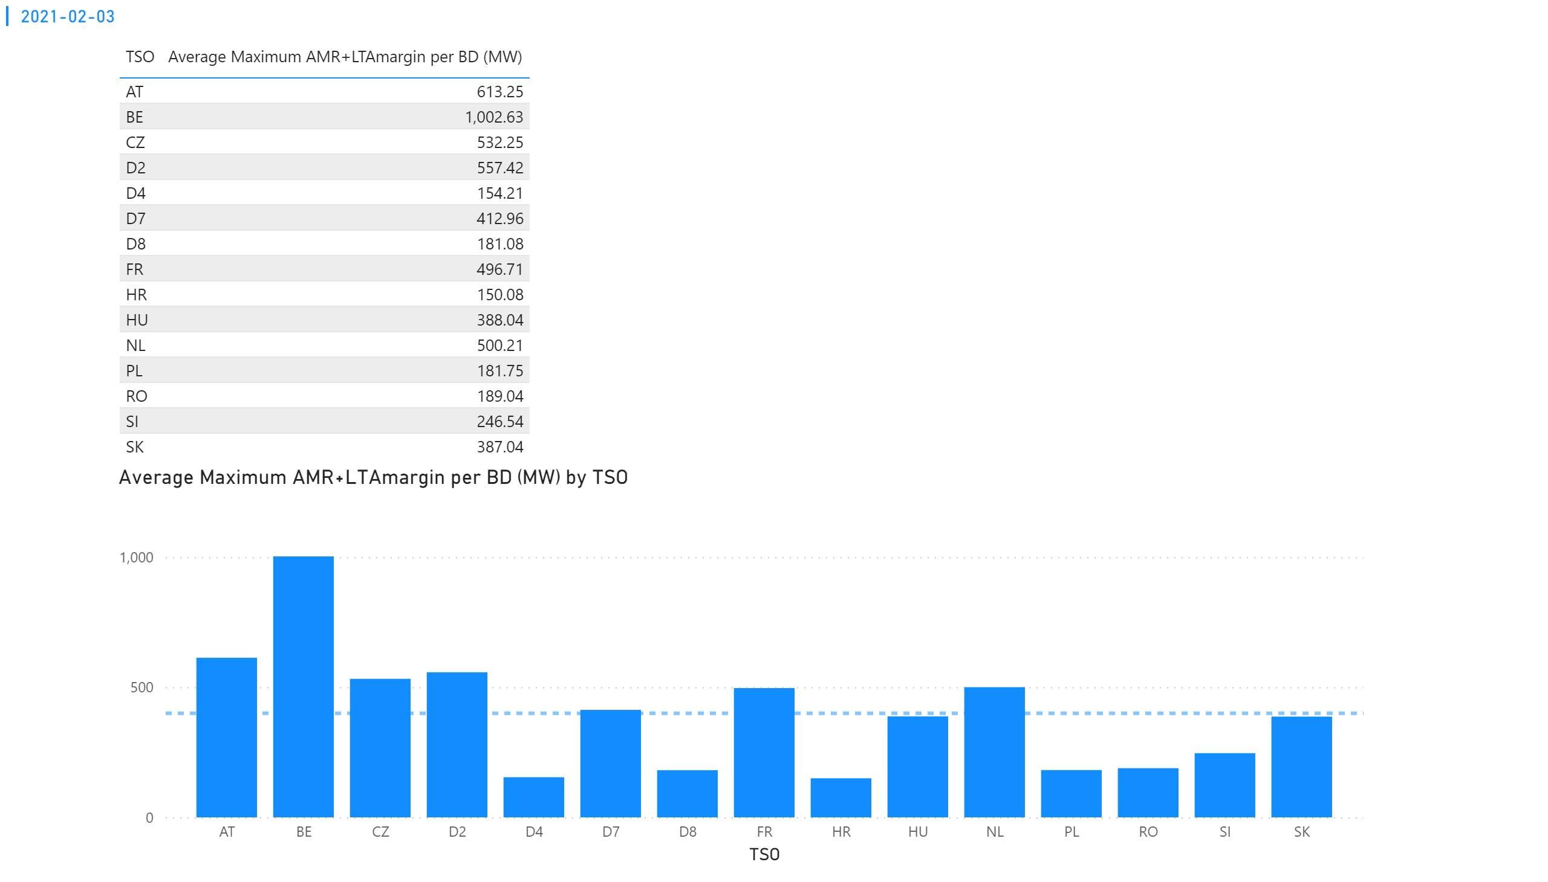
KPI 4
KPI 4: Average maximum AMR+LTAmargin per TSO per BD
Notes:
tableEx
No alt text provided.
multiRowCard
No alt text provided.
Average Maximum AMR+LTAmargin per BD (MW) by TSO
No alt text provided.

Slide 15
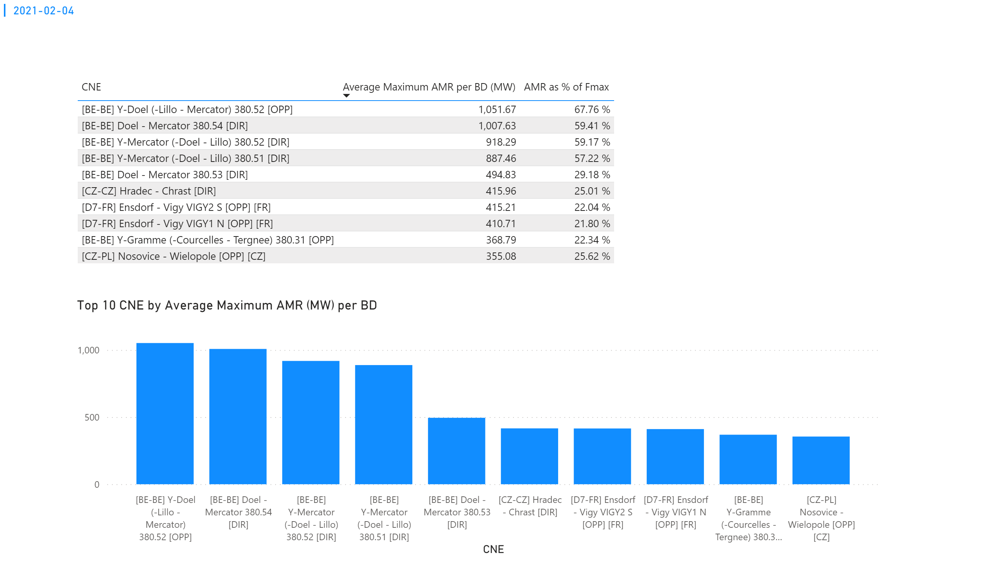
KPI 1
KPI 1: Average maximum AMR per CNE per BD
Notes:
tableEx
No alt text provided.
Top 10 CNE by Average Maximum AMR (MW) per BD
No alt text provided.
multiRowCard
No alt text provided.

Slide 16
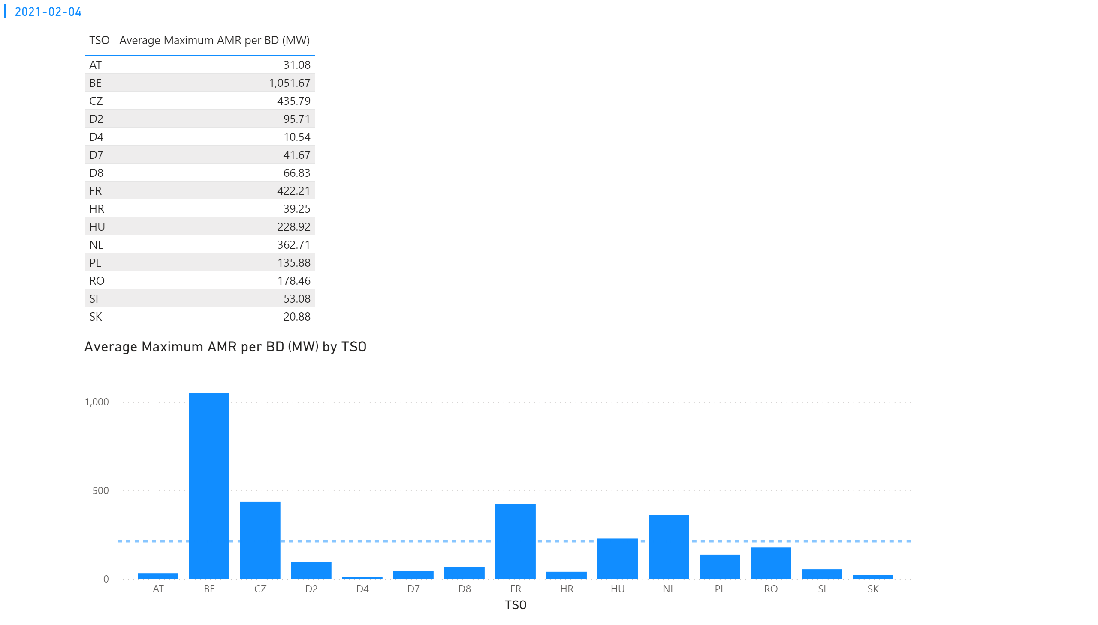
KPI 2
KPI 2: Average maximum AMR per CNE per TSO
Notes:
tableEx
No alt text provided.
Average Maximum AMR per BD (MW) by TSO
No alt text provided.
multiRowCard
No alt text provided.

Slide 17
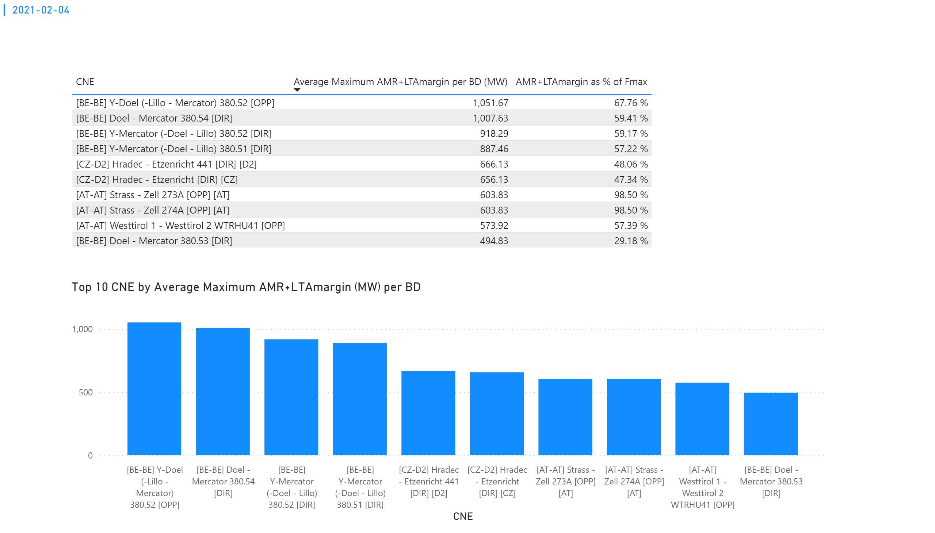
KPI 3
KPI 3: Average maximum AMR+LTAmargin per CNE per BD
Notes:
tableEx
No alt text provided.
Top 10 CNE by Average Maximum AMR+LTAmargin (MW) per BD
No alt text provided.
multiRowCard
No alt text provided.

Slide 18
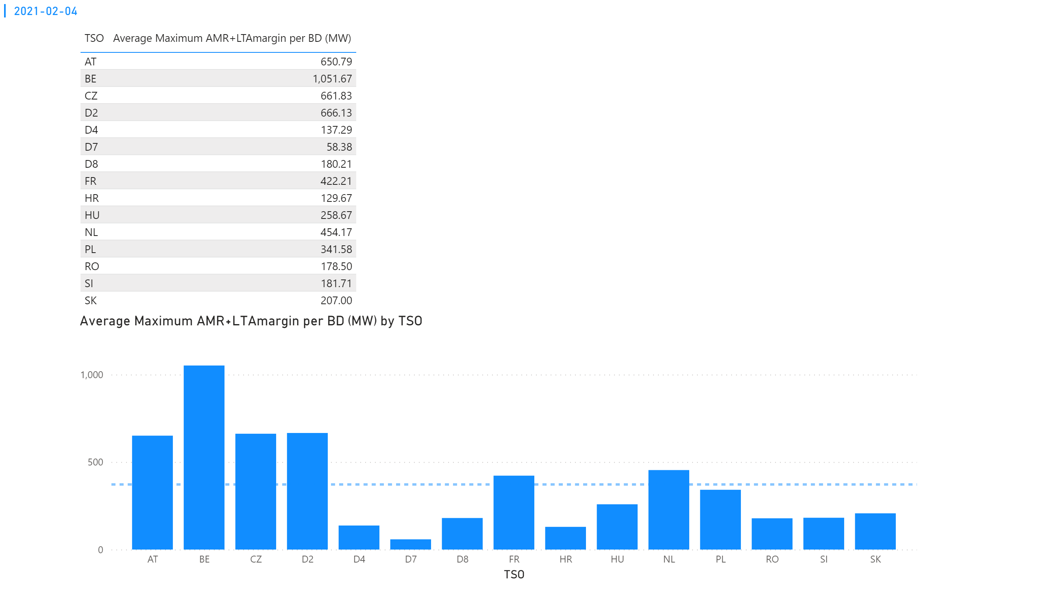
KPI 4
KPI 4: Average maximum AMR+LTAmargin per TSO per BD
Notes:
tableEx
No alt text provided.
multiRowCard
No alt text provided.
Average Maximum AMR+LTAmargin per BD (MW) by TSO
No alt text provided.

Slide 19
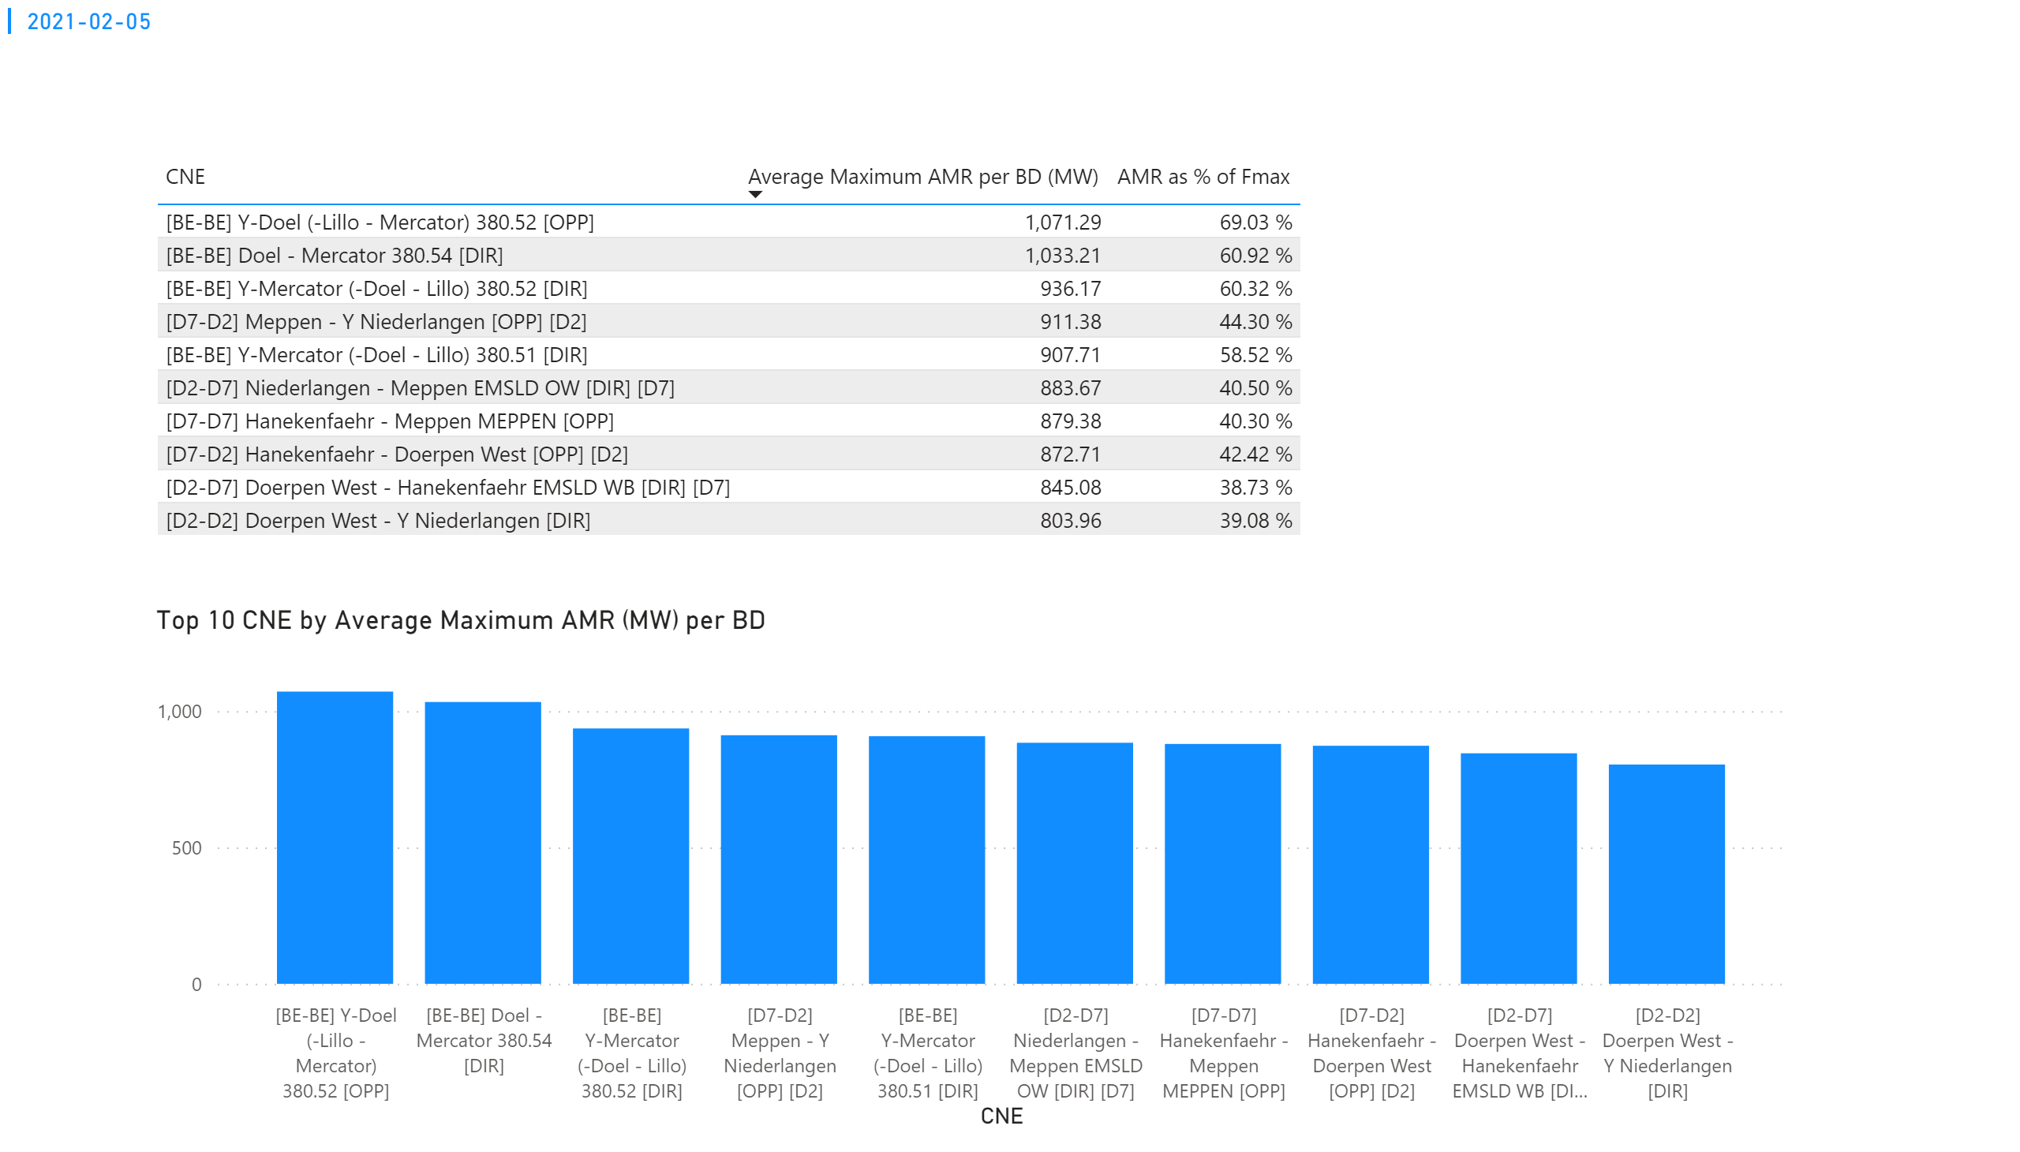
KPI 1
KPI 1: Average maximum AMR per CNE per BD
Notes:
tableEx
No alt text provided.
Top 10 CNE by Average Maximum AMR (MW) per BD
No alt text provided.
multiRowCard
No alt text provided.

Slide 20
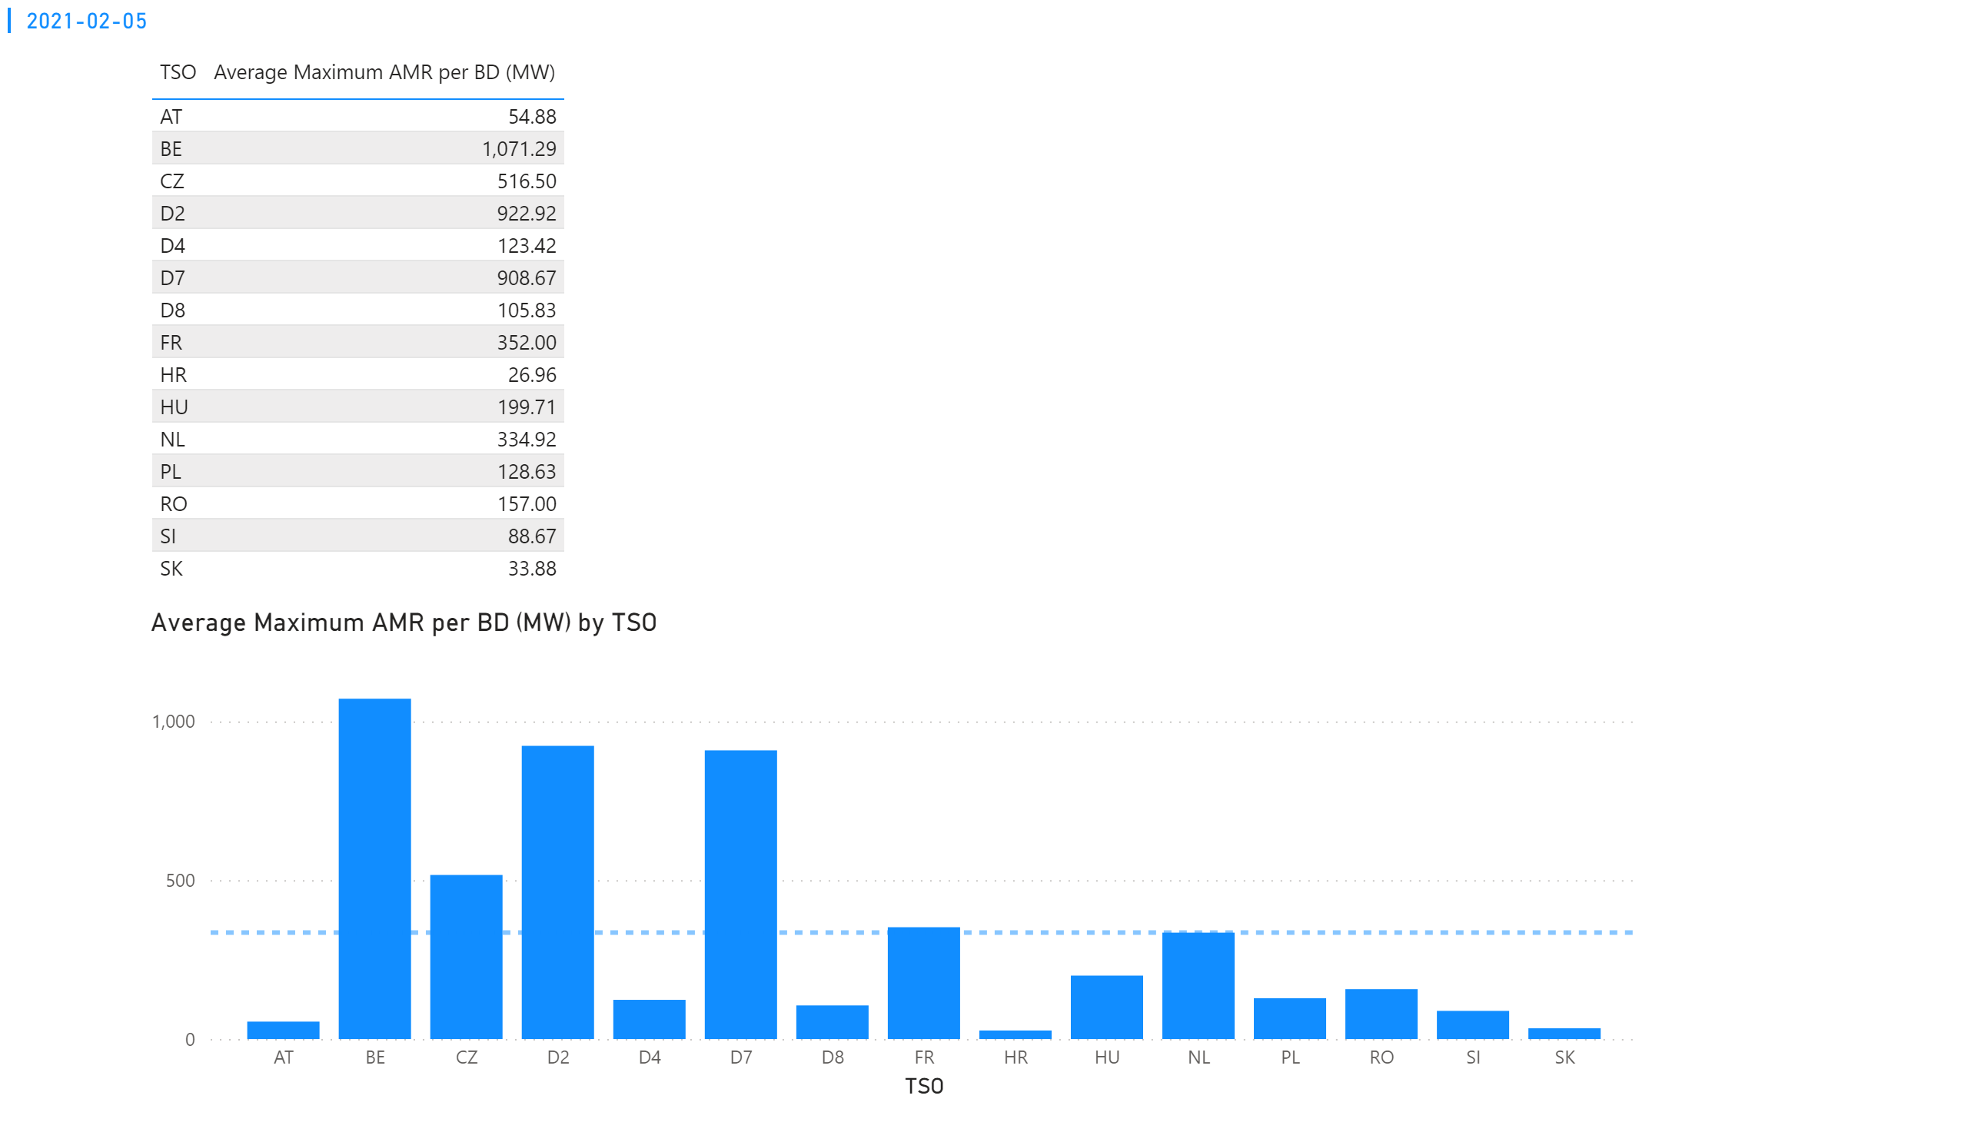
KPI 2
KPI 2: Average maximum AMR per CNE per TSO
Notes:
tableEx
No alt text provided.
Average Maximum AMR per BD (MW) by TSO
No alt text provided.
multiRowCard
No alt text provided.

Slide 21
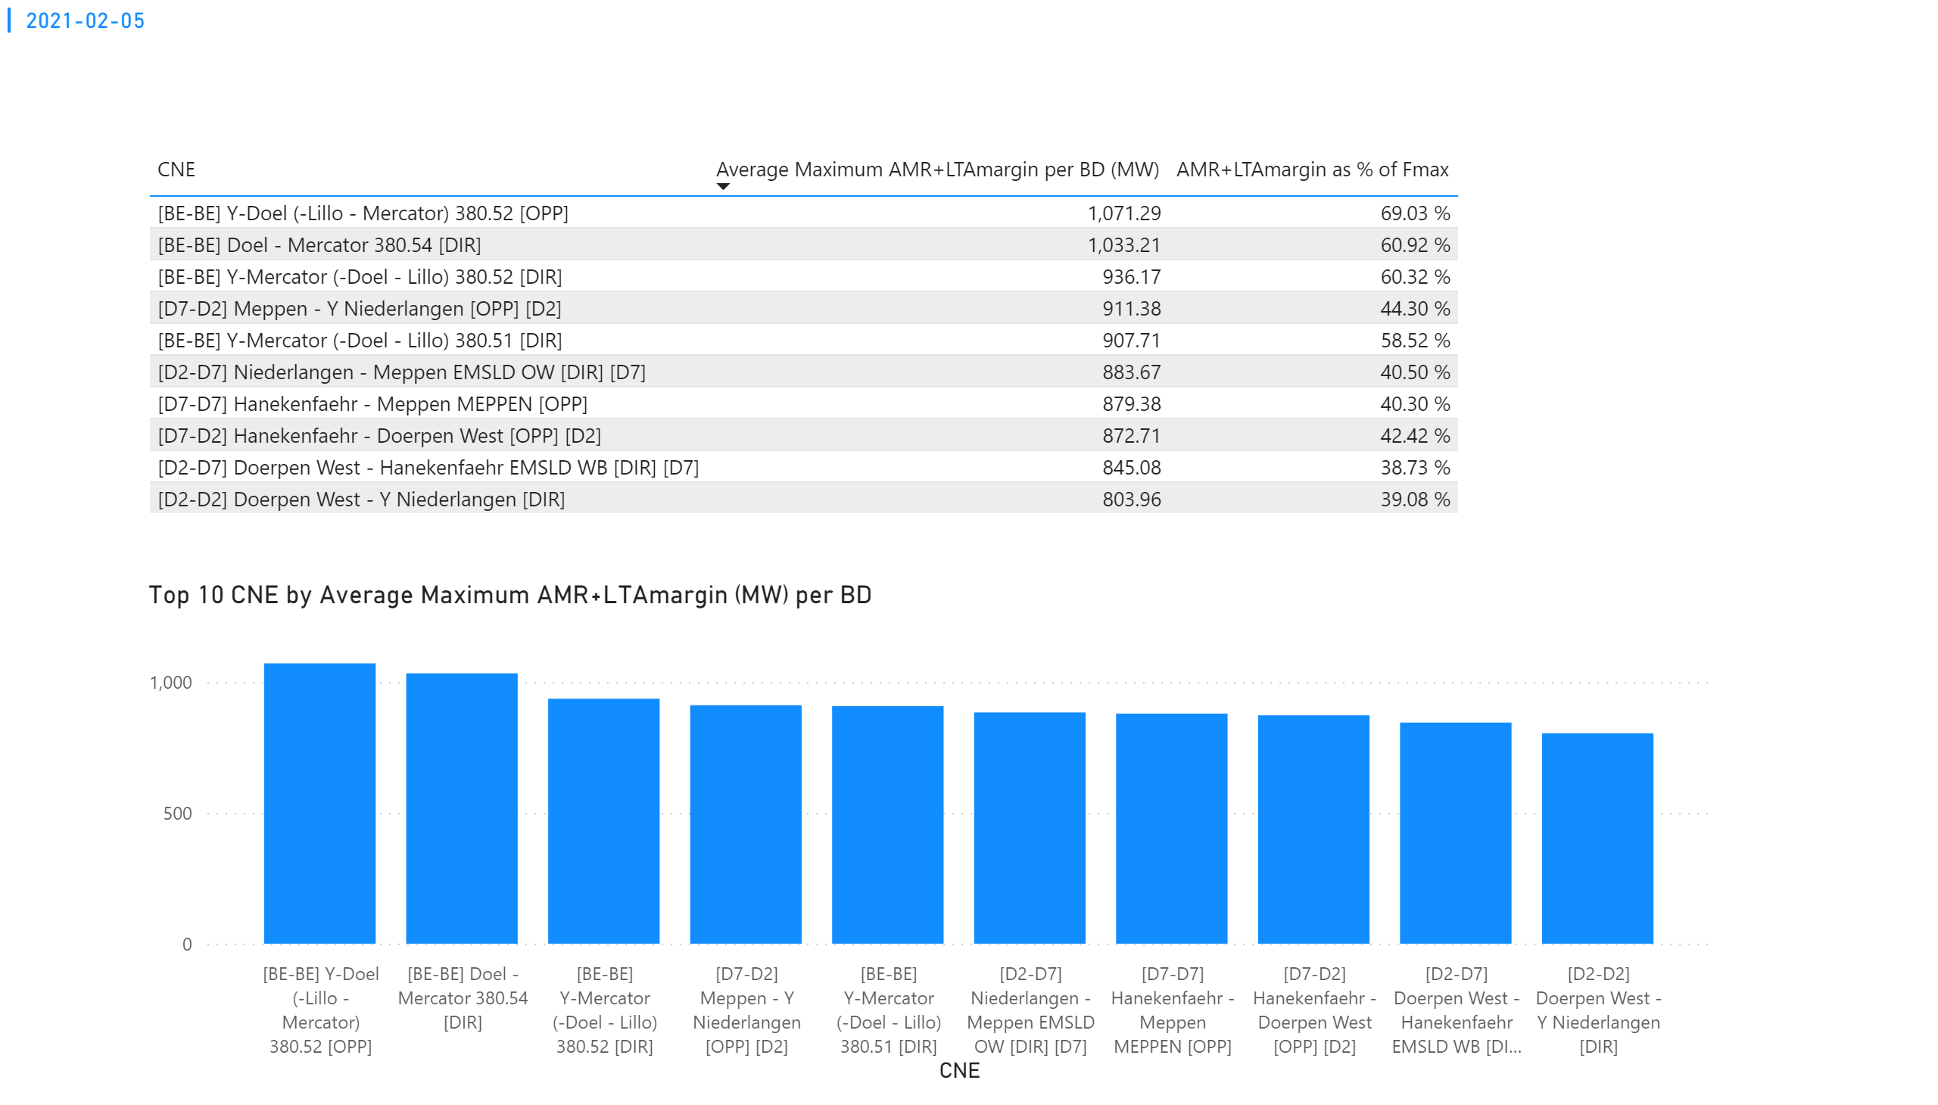
KPI 3
KPI 3: Average maximum AMR+LTAmargin per CNE per BD
Notes:
tableEx
No alt text provided.
Top 10 CNE by Average Maximum AMR+LTAmargin (MW) per BD
No alt text provided.
multiRowCard
No alt text provided.

Slide 22
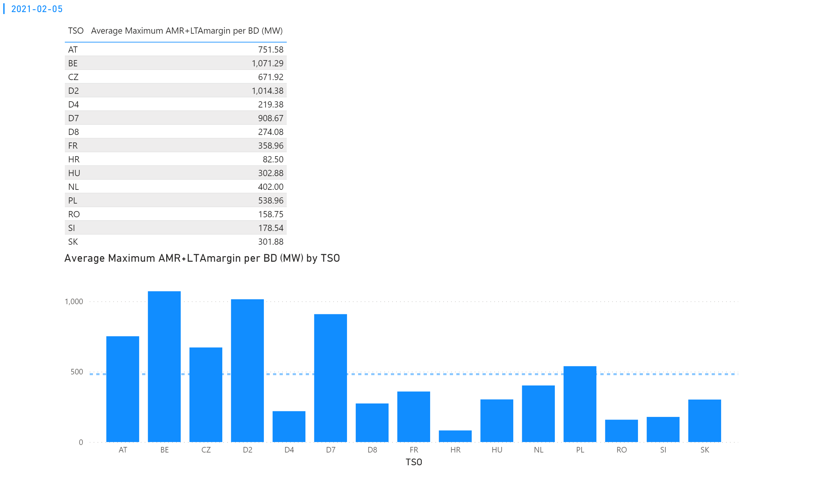
KPI 4
KPI 4: Average maximum AMR+LTAmargin per TSO per BD
Notes:
tableEx
No alt text provided.
multiRowCard
No alt text provided.
Average Maximum AMR+LTAmargin per BD (MW) by TSO
No alt text provided.

Slide 23
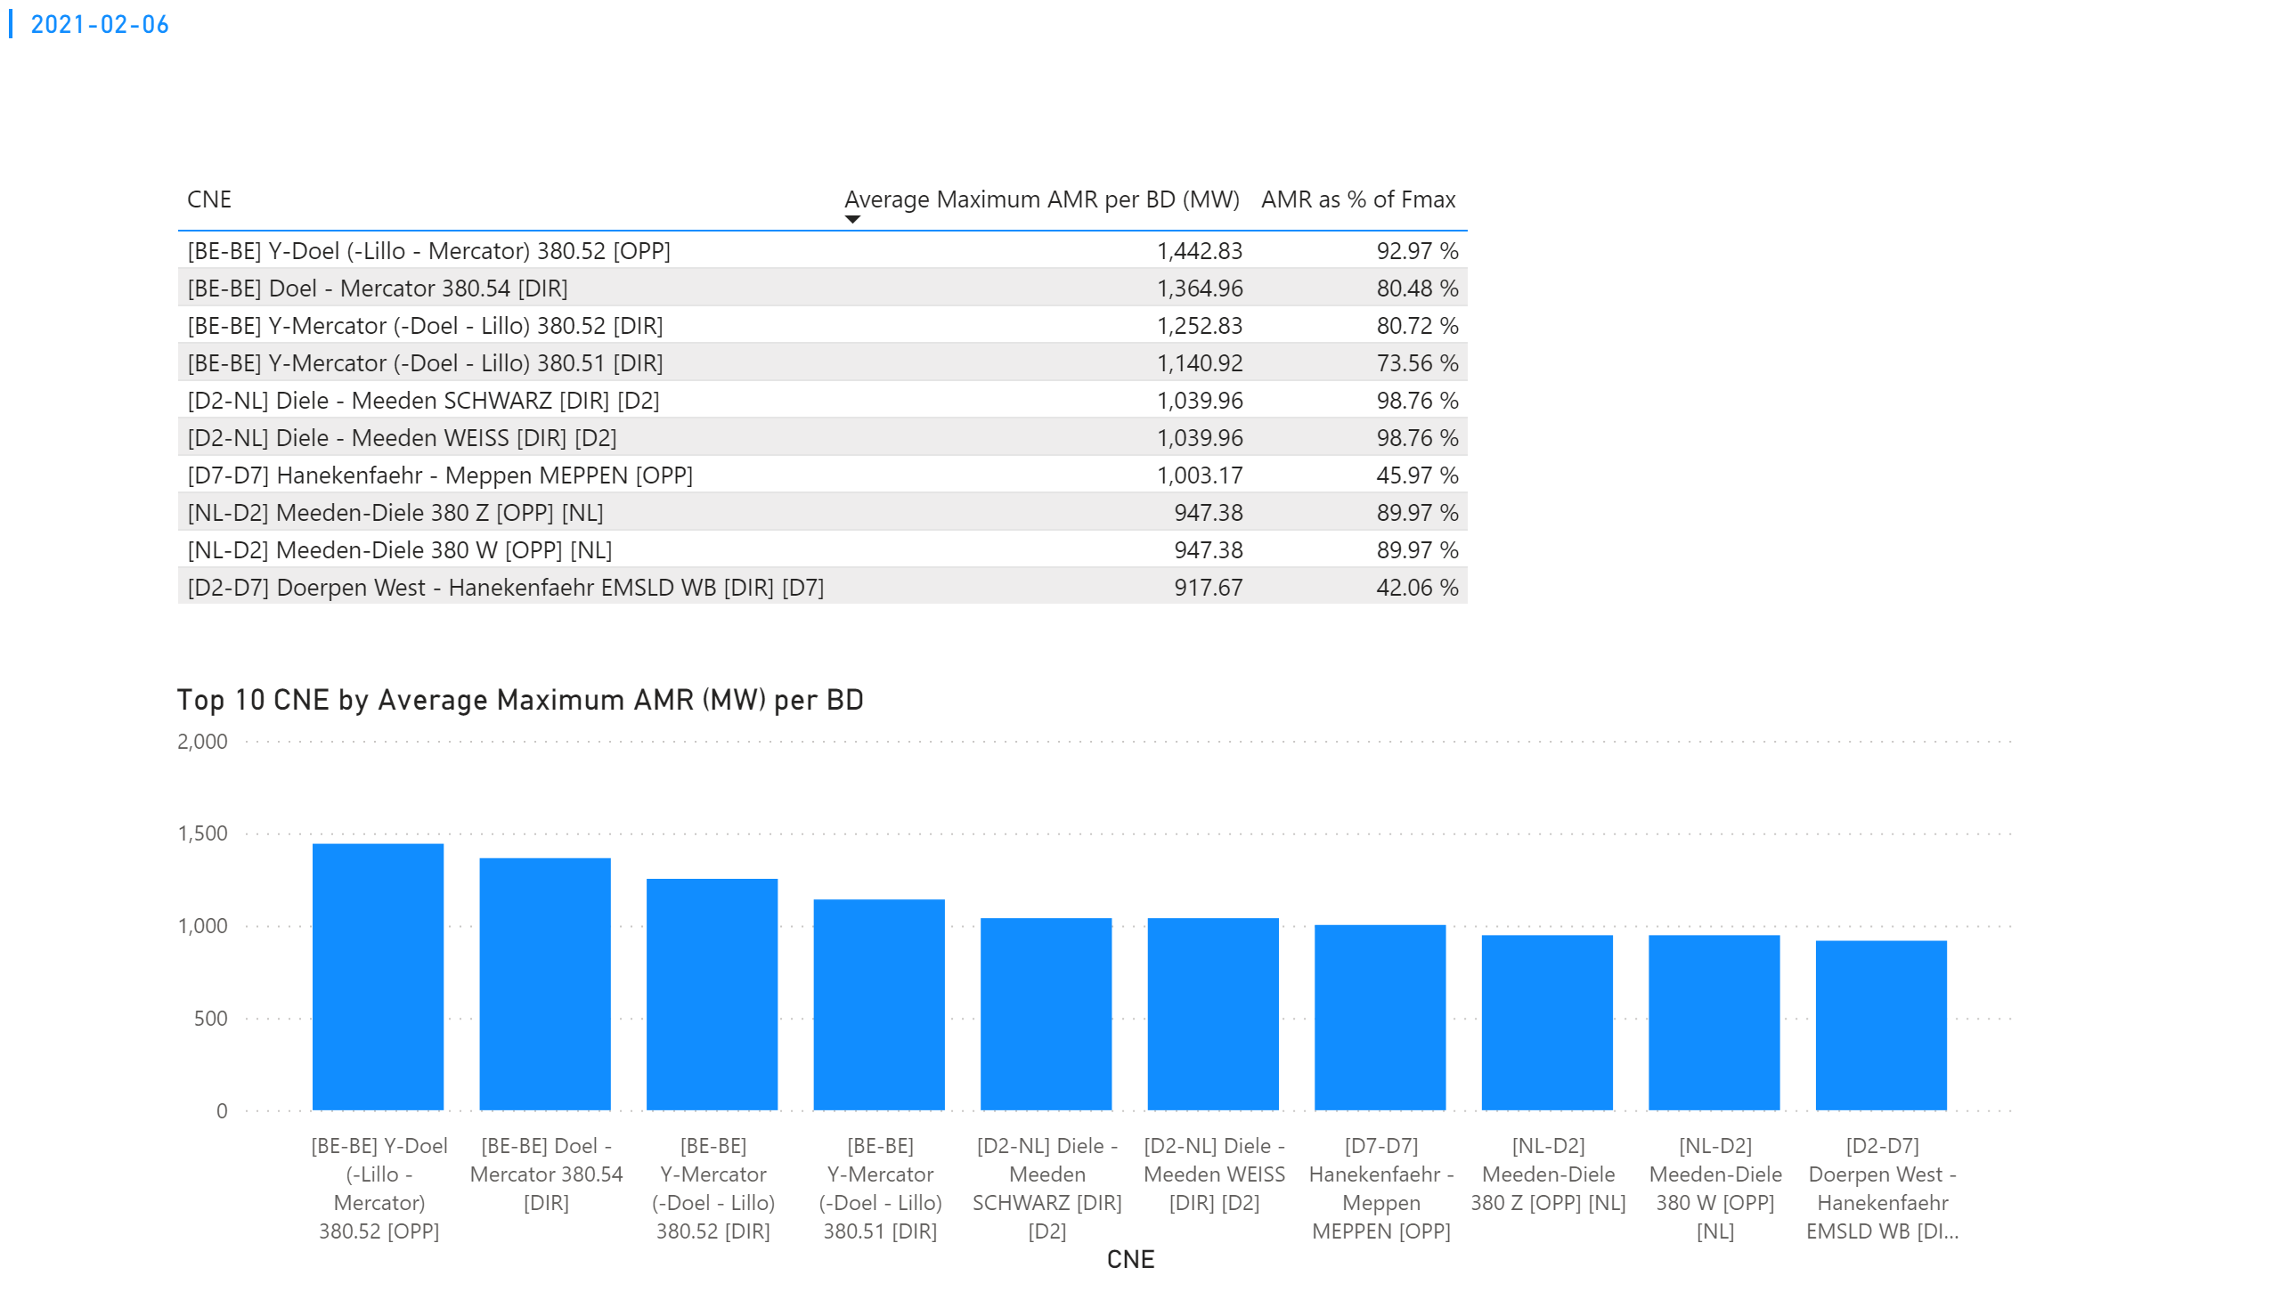
KPI 1
KPI 1: Average maximum AMR per CNE per BD
Notes:
tableEx
No alt text provided.
Top 10 CNE by Average Maximum AMR (MW) per BD
No alt text provided.
multiRowCard
No alt text provided.

Slide 24
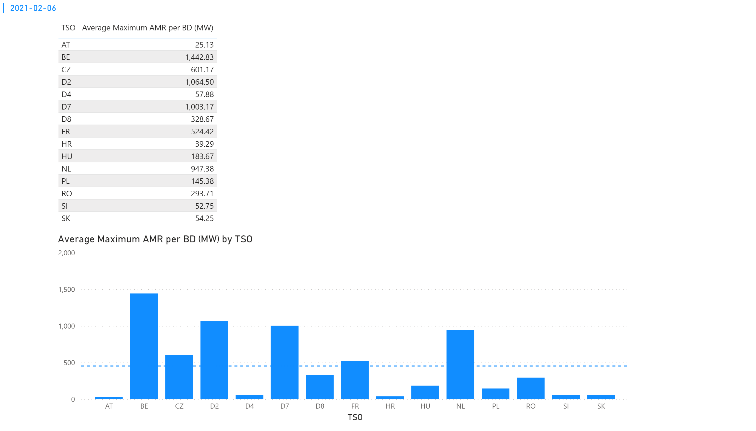
KPI 2
KPI 2: Average maximum AMR per CNE per TSO
Notes:
tableEx
No alt text provided.
Average Maximum AMR per BD (MW) by TSO
No alt text provided.
multiRowCard
No alt text provided.

Slide 25
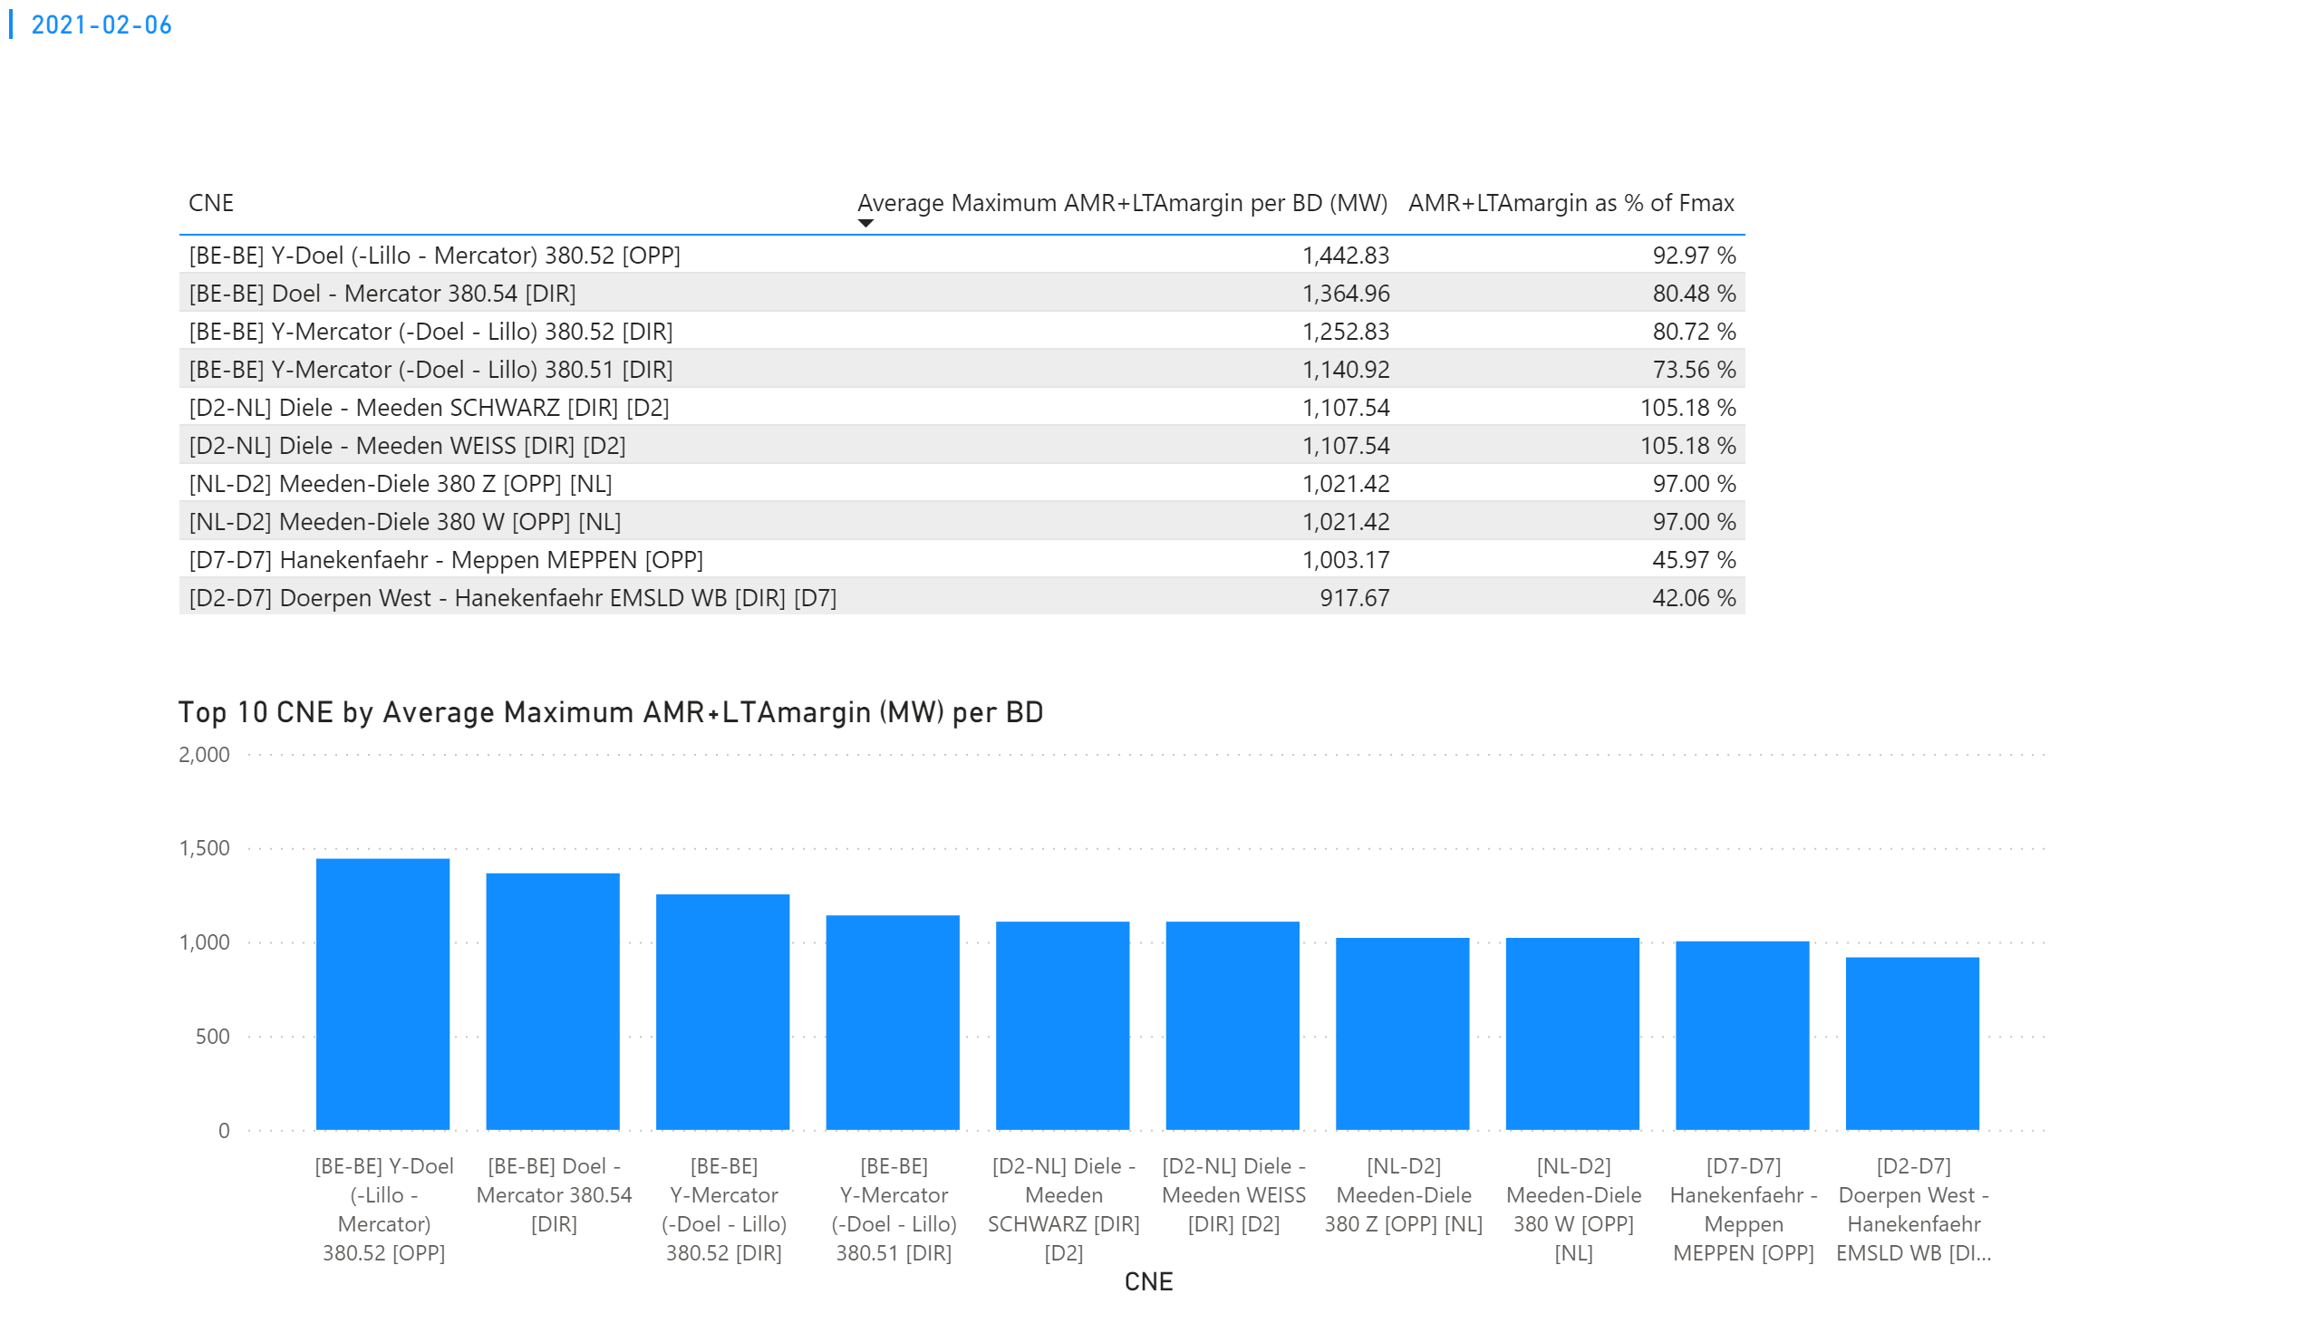
KPI 3
KPI 3: Average maximum AMR+LTAmargin per CNE per BD
Notes:
tableEx
No alt text provided.
Top 10 CNE by Average Maximum AMR+LTAmargin (MW) per BD
No alt text provided.
multiRowCard
No alt text provided.

Slide 26
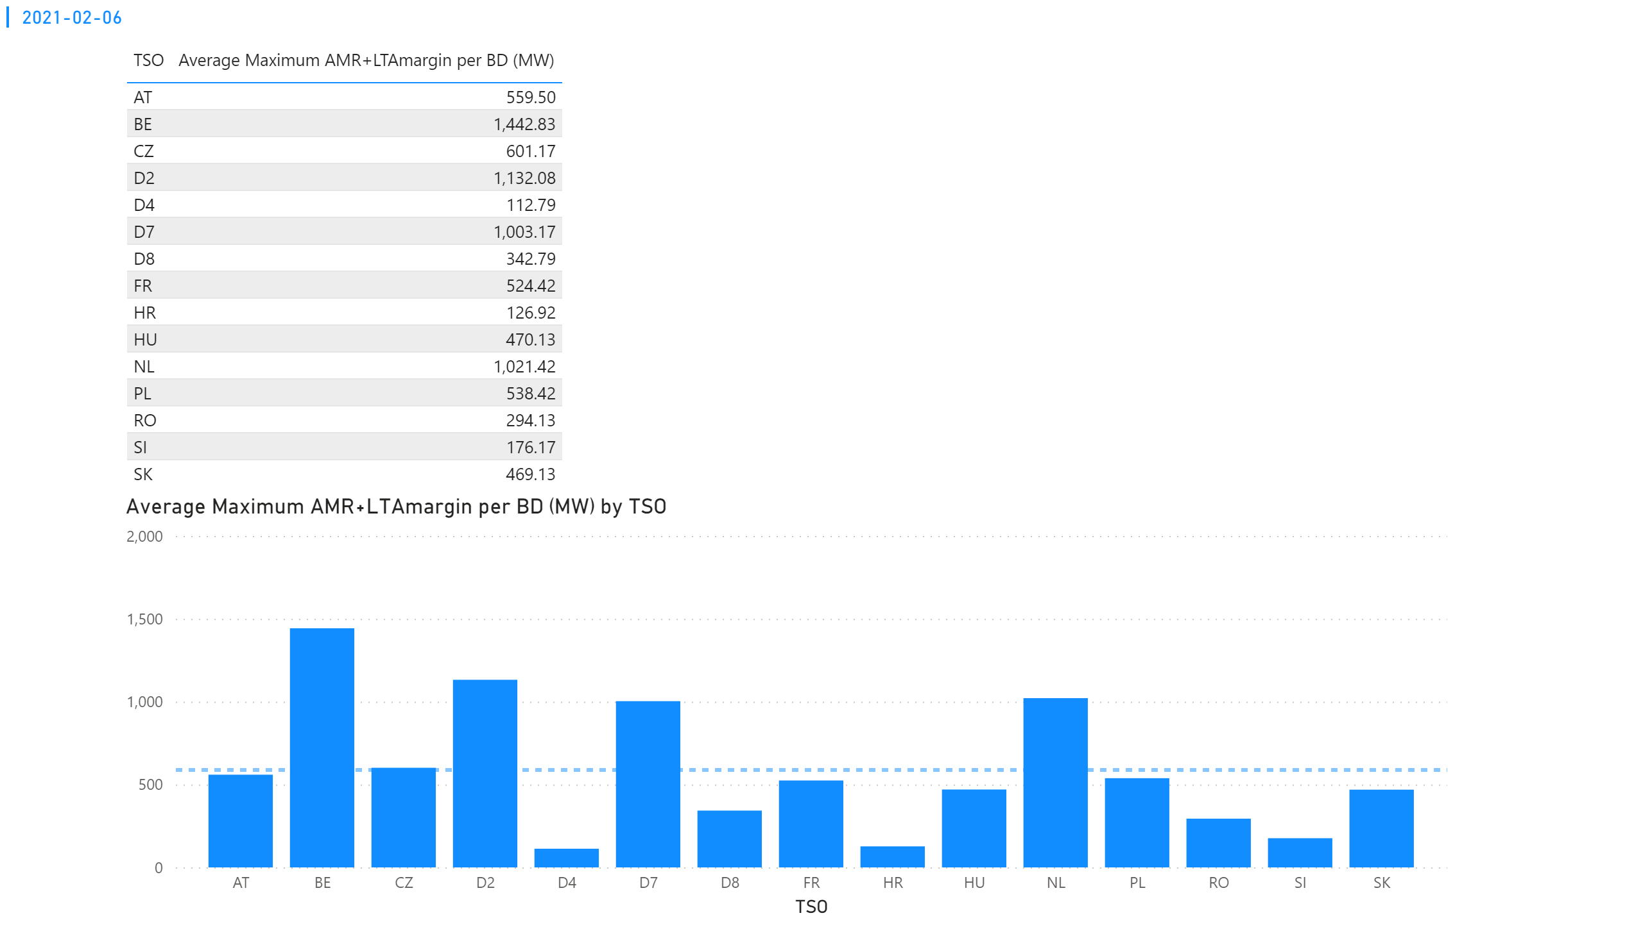
KPI 4
KPI 4: Average maximum AMR+LTAmargin per TSO per BD
Notes:
tableEx
No alt text provided.
multiRowCard
No alt text provided.
Average Maximum AMR+LTAmargin per BD (MW) by TSO
No alt text provided.

Slide 27
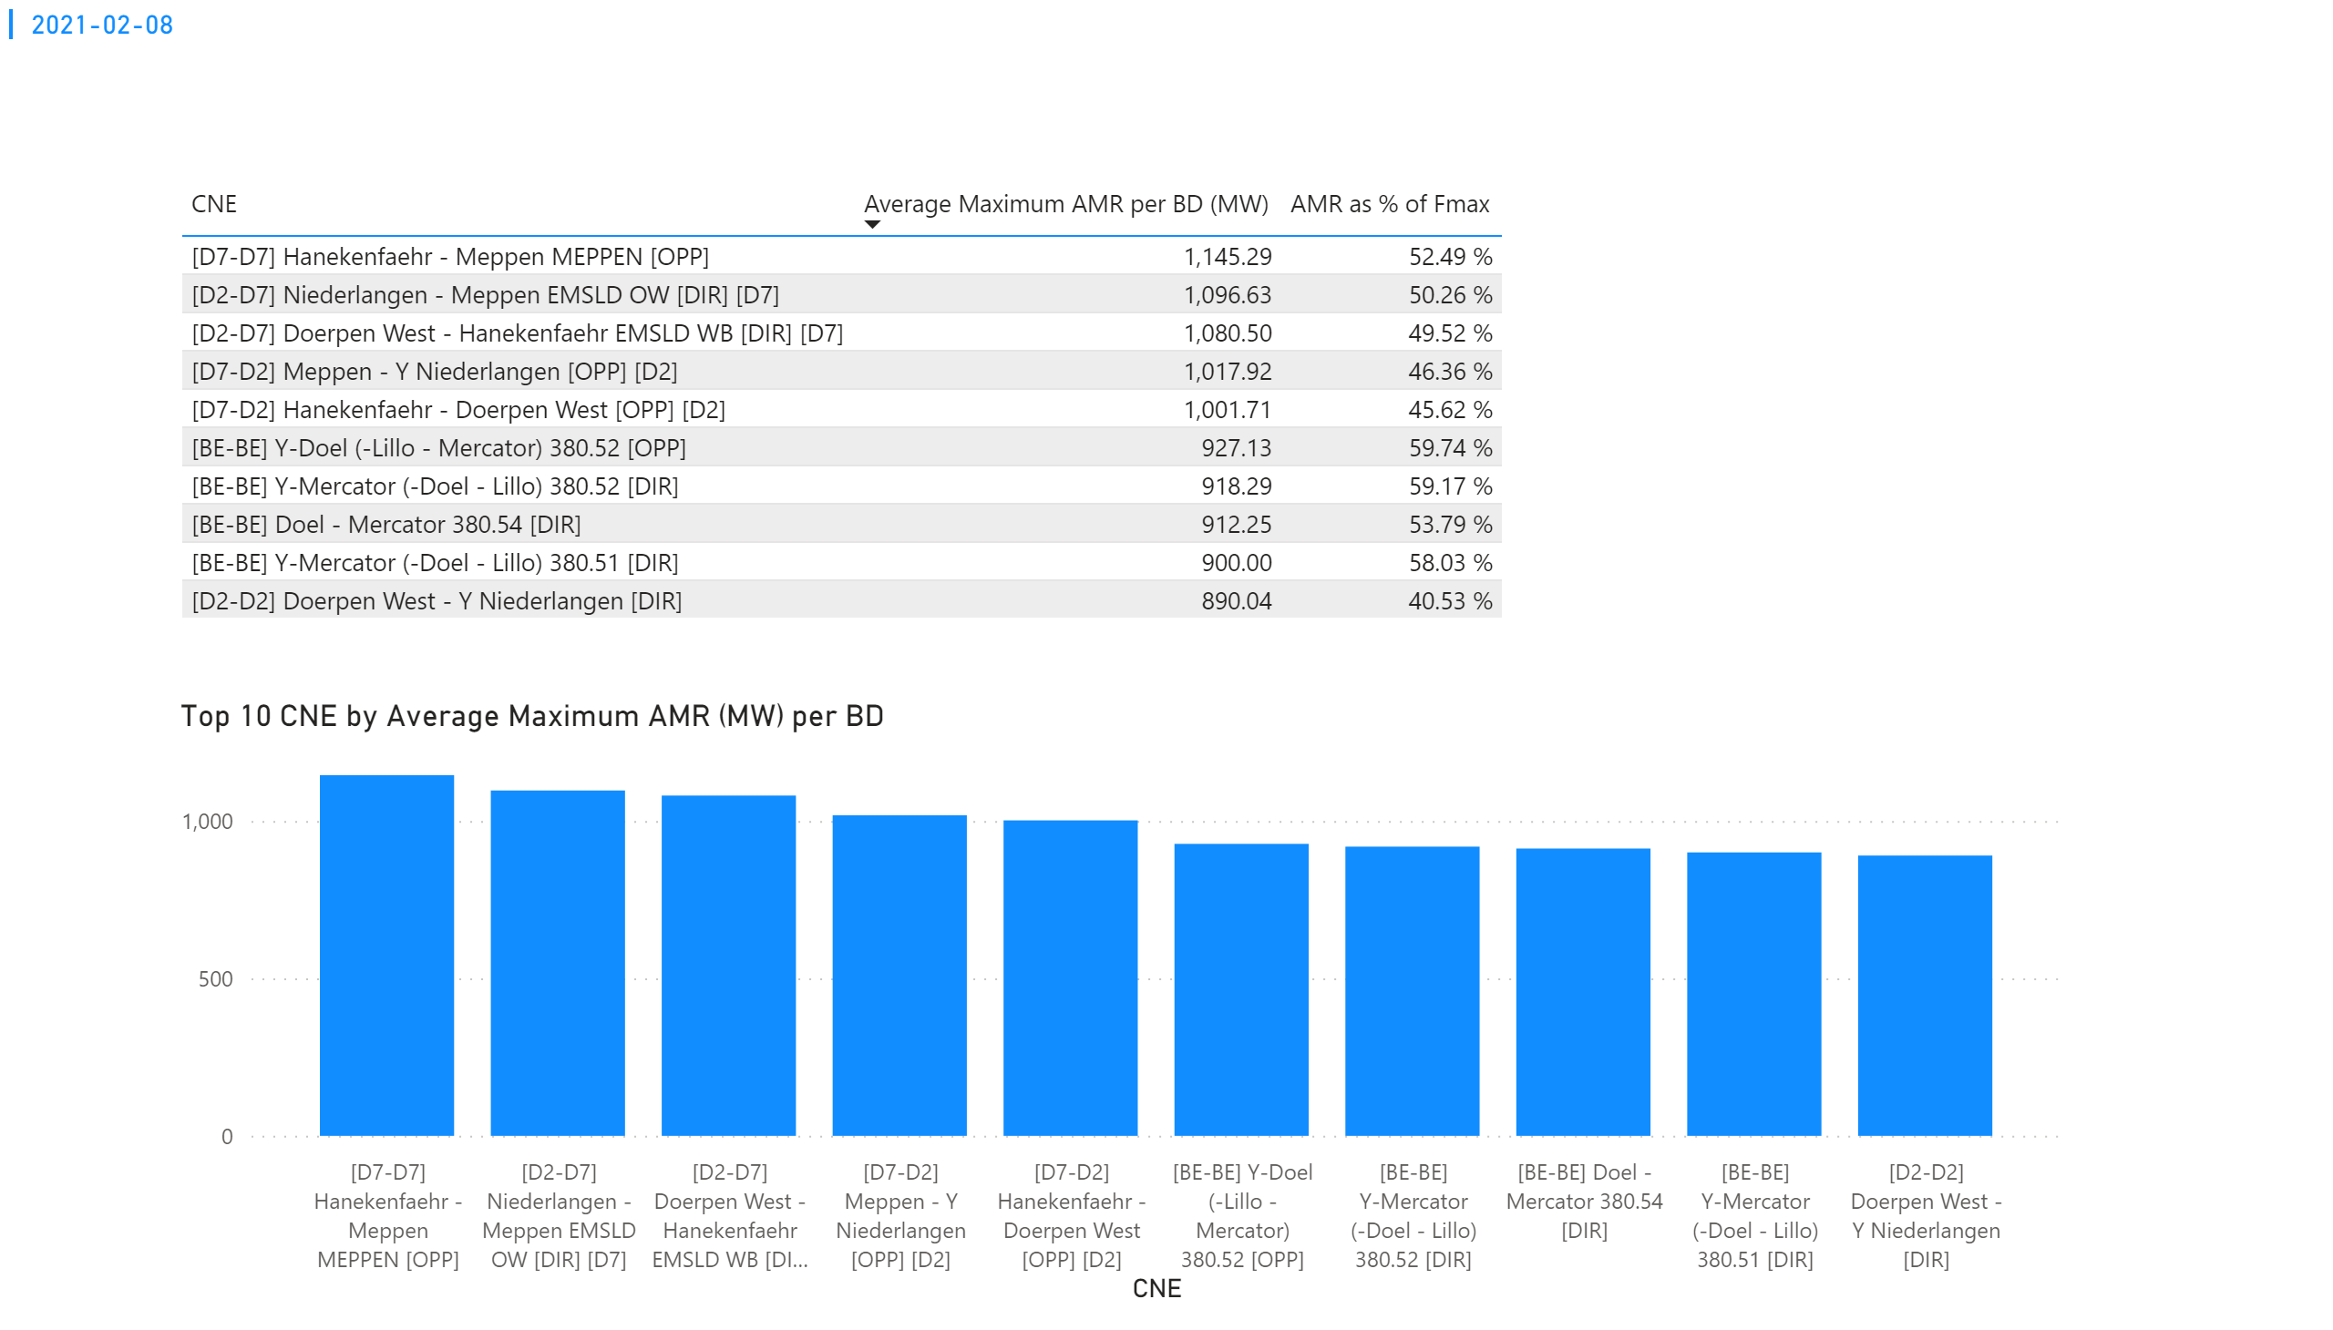
KPI 1
KPI 1: Average maximum AMR per CNE per BD
Notes:
tableEx
No alt text provided.
Top 10 CNE by Average Maximum AMR (MW) per BD
No alt text provided.
multiRowCard
No alt text provided.

Slide 28
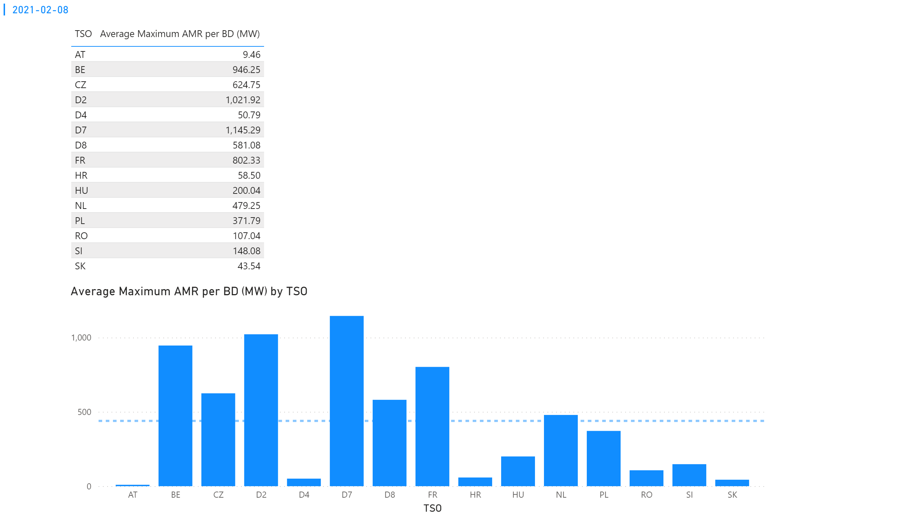
KPI 2
KPI 2: Average maximum AMR per CNE per TSO
Notes:
tableEx
No alt text provided.
Average Maximum AMR per BD (MW) by TSO
No alt text provided.
multiRowCard
No alt text provided.

Slide 29
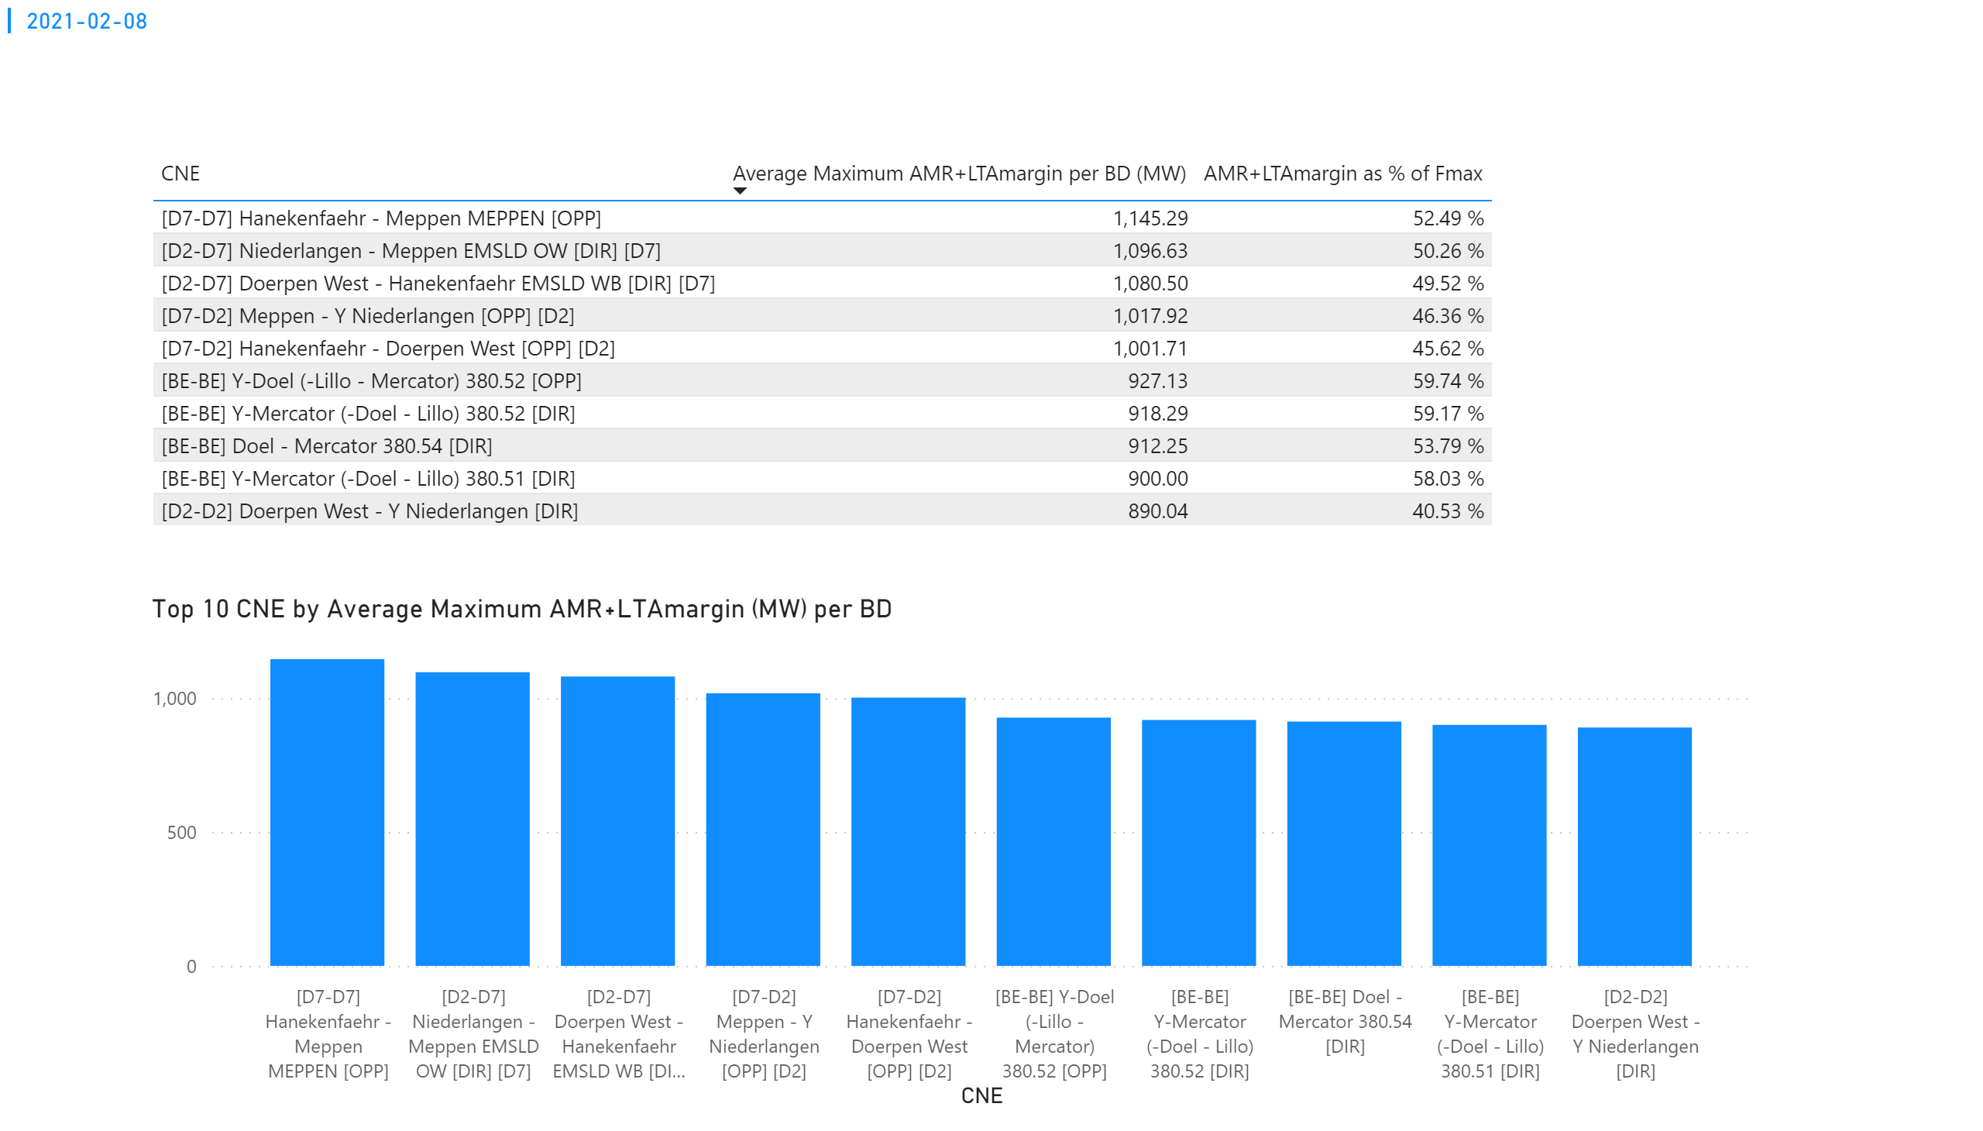
KPI 3
KPI 3: Average maximum AMR+LTAmargin per CNE per BD
Notes:
tableEx
No alt text provided.
Top 10 CNE by Average Maximum AMR+LTAmargin (MW) per BD
No alt text provided.
multiRowCard
No alt text provided.

Slide 30
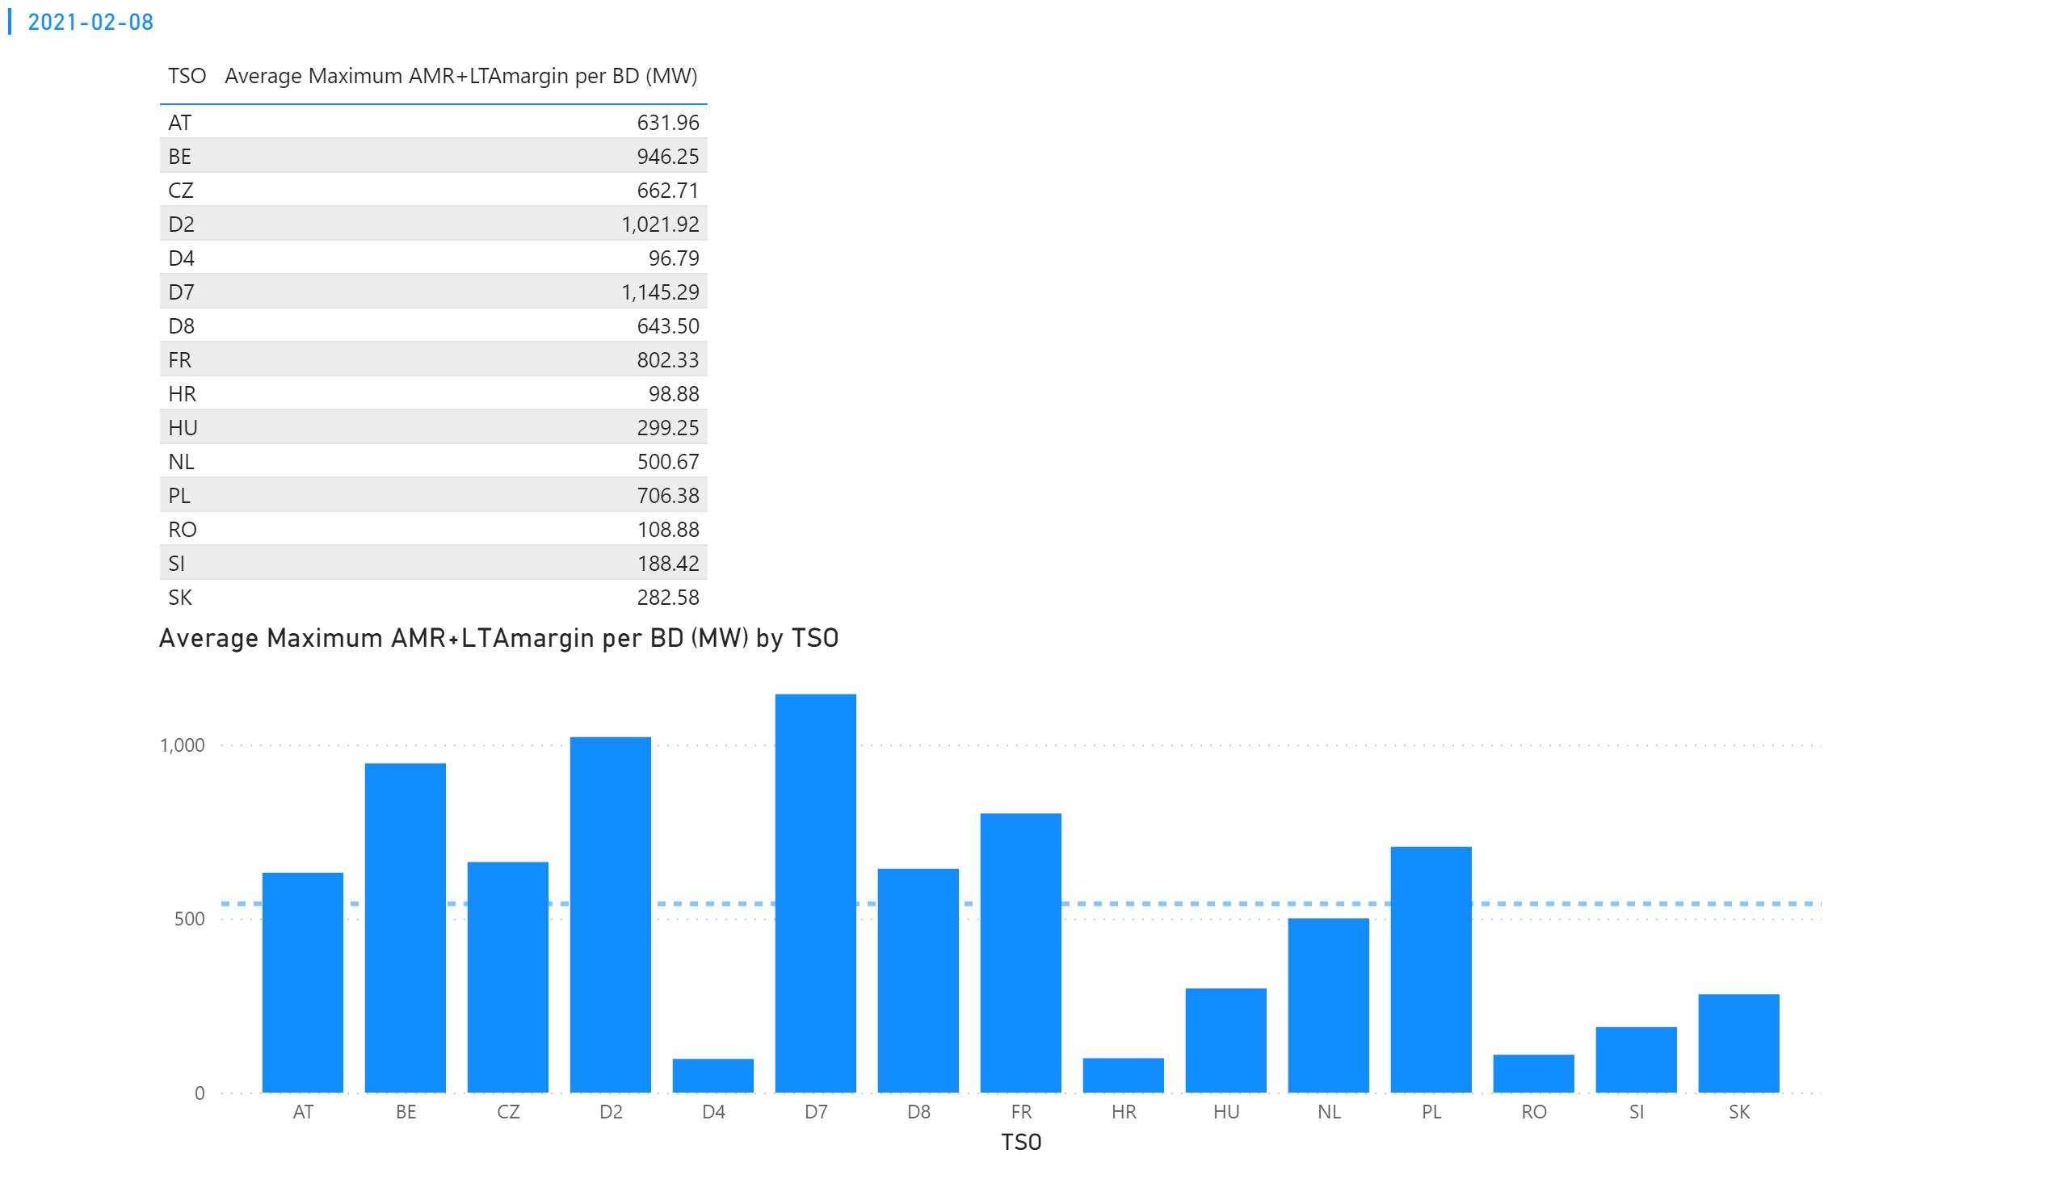
KPI 4
KPI 4: Average maximum AMR+LTAmargin per TSO per BD
Notes:
tableEx
No alt text provided.
multiRowCard
No alt text provided.
Average Maximum AMR+LTAmargin per BD (MW) by TSO
No alt text provided.

Slide 31
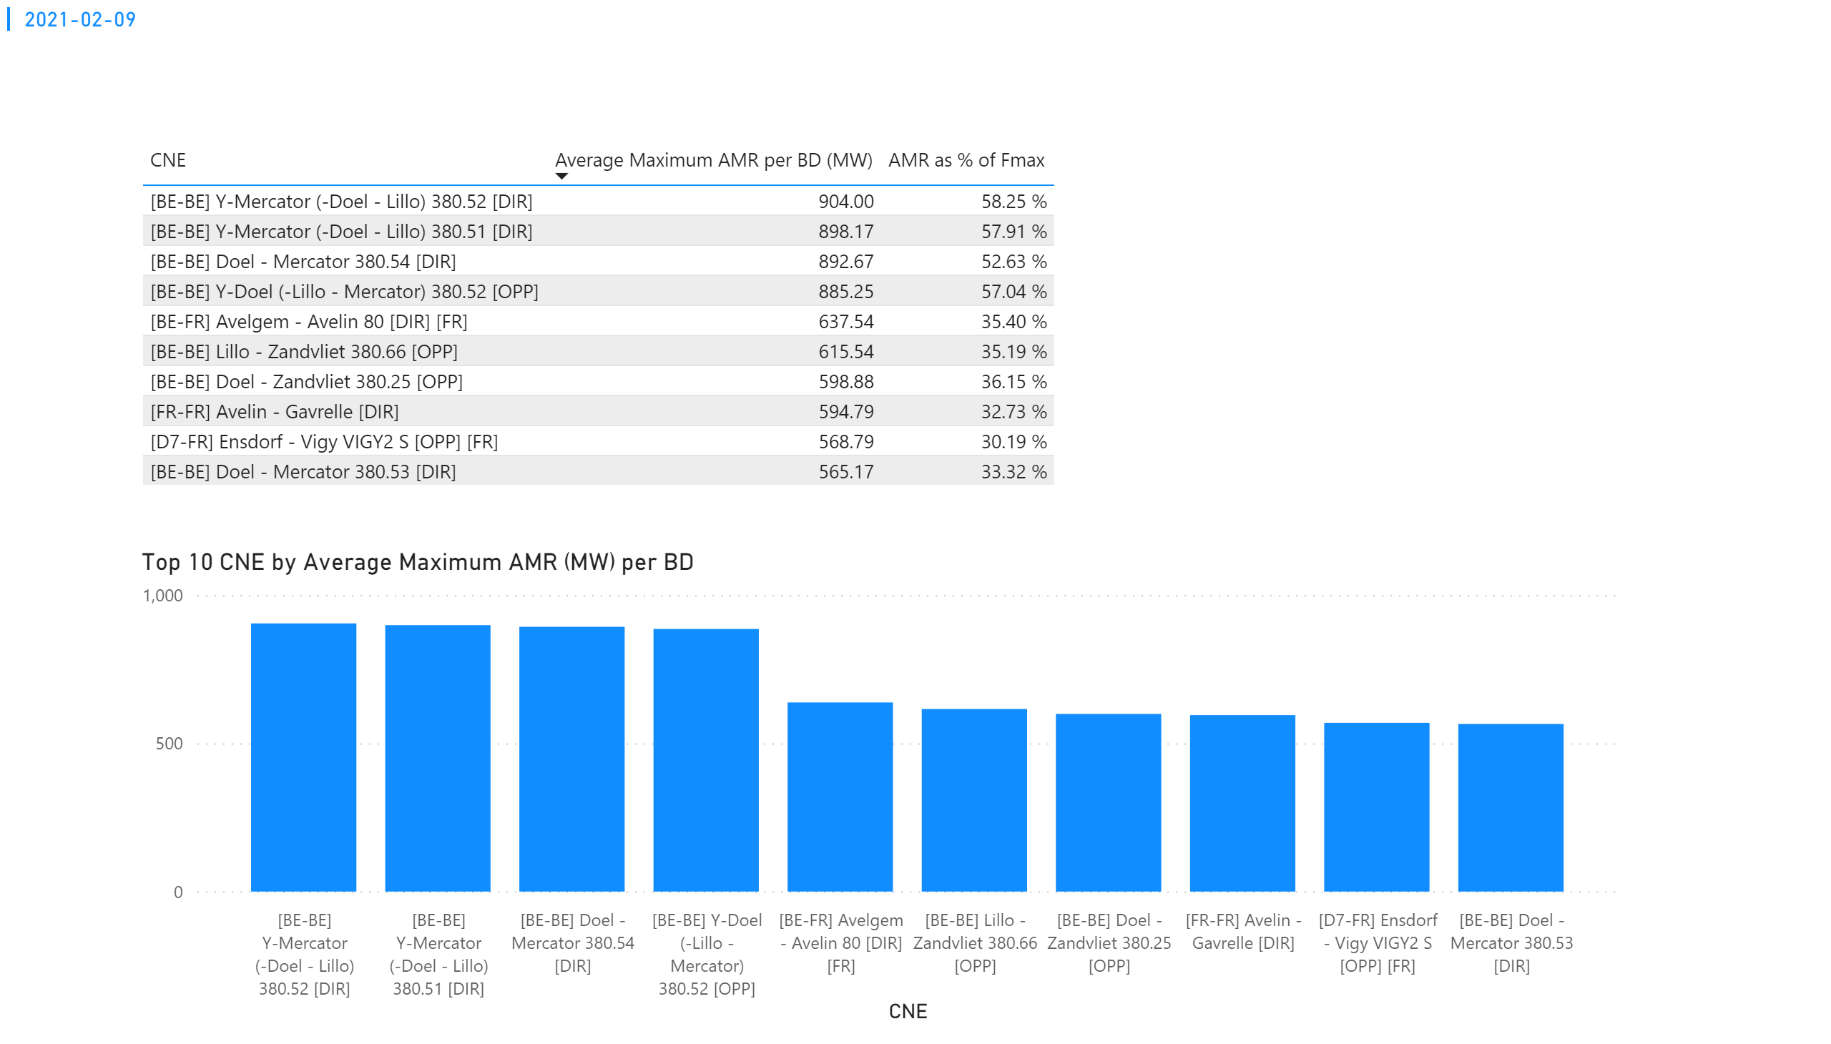
KPI 1
KPI 1: Average maximum AMR per CNE per BD
Notes:
tableEx
No alt text provided.
Top 10 CNE by Average Maximum AMR (MW) per BD
No alt text provided.
multiRowCard
No alt text provided.

Slide 32
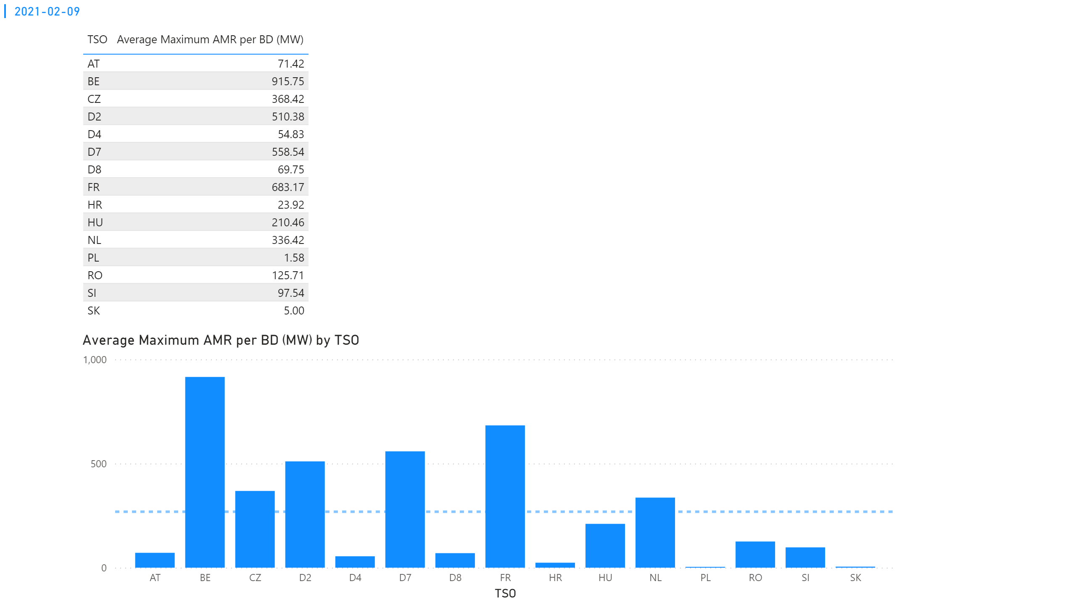
KPI 2
KPI 2: Average maximum AMR per CNE per TSO
Notes:
tableEx
No alt text provided.
Average Maximum AMR per BD (MW) by TSO
No alt text provided.
multiRowCard
No alt text provided.

Slide 33
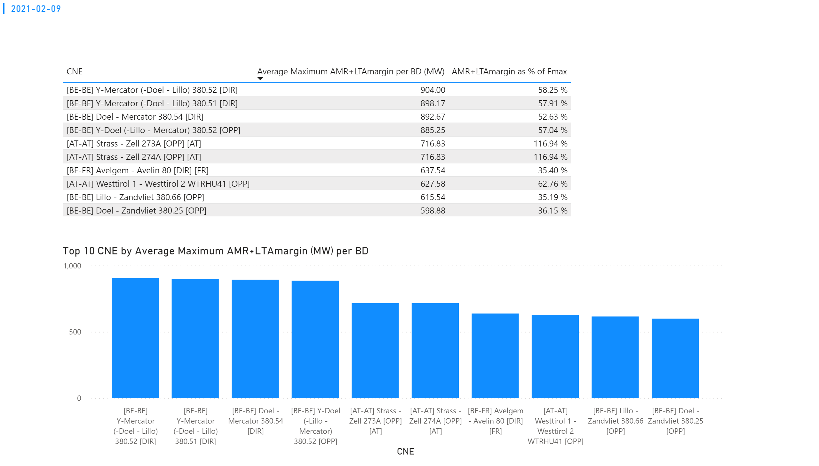
KPI 3
KPI 3: Average maximum AMR+LTAmargin per CNE per BD
Notes:
tableEx
No alt text provided.
Top 10 CNE by Average Maximum AMR+LTAmargin (MW) per BD
No alt text provided.
multiRowCard
No alt text provided.

Slide 34
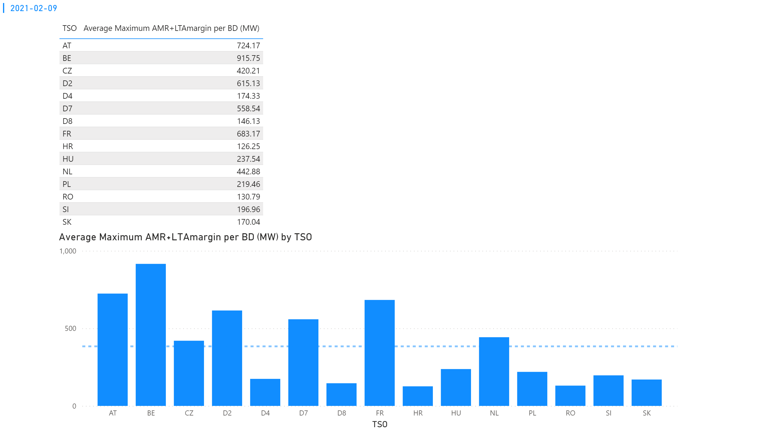
KPI 4
KPI 4: Average maximum AMR+LTAmargin per TSO per BD
Notes:
tableEx
No alt text provided.
multiRowCard
No alt text provided.
Average Maximum AMR+LTAmargin per BD (MW) by TSO
No alt text provided.

Slide 35
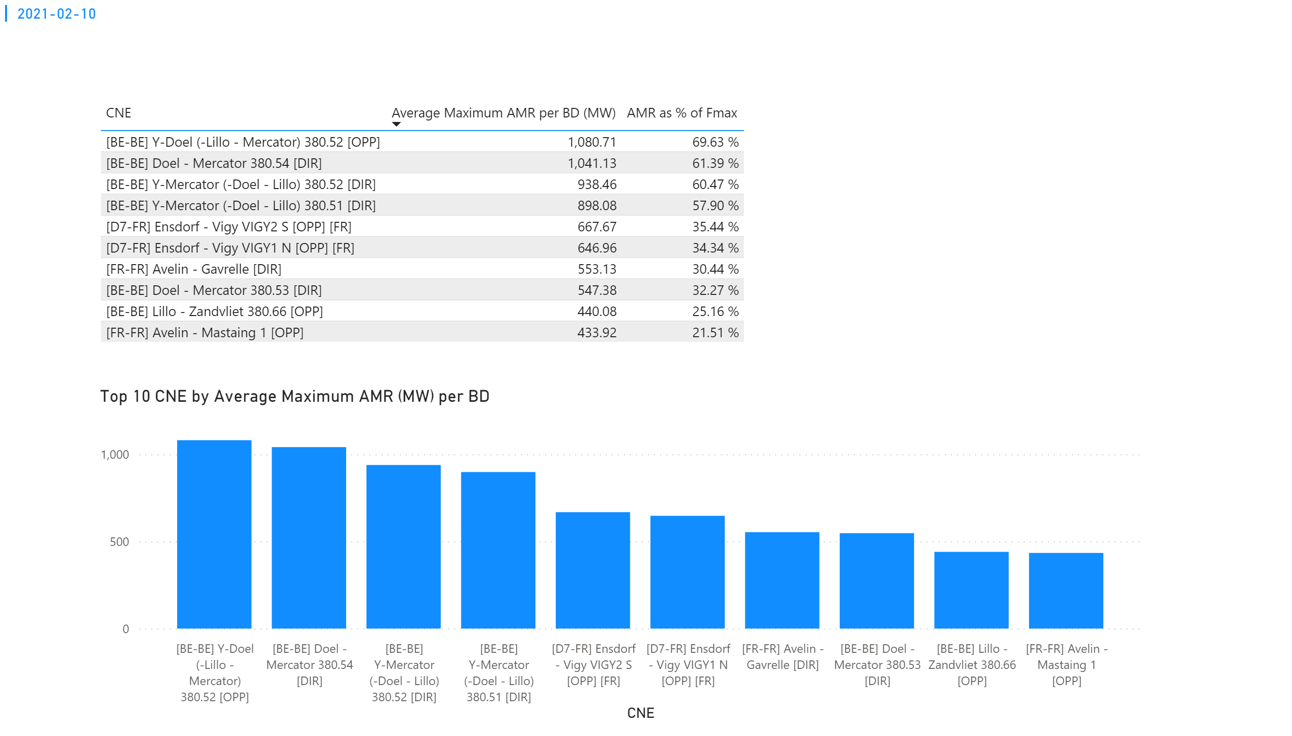
KPI 1
KPI 1: Average maximum AMR per CNE per BD
Notes:
tableEx
No alt text provided.
Top 10 CNE by Average Maximum AMR (MW) per BD
No alt text provided.
multiRowCard
No alt text provided.

Slide 36
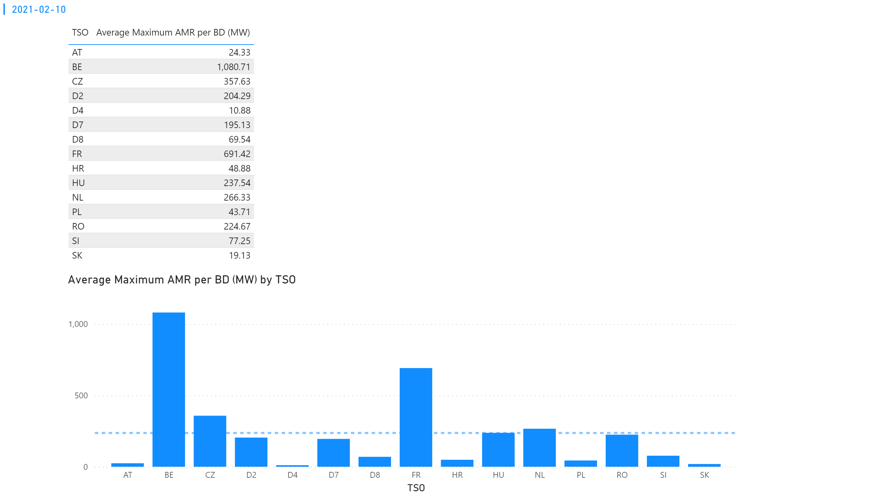
KPI 2
KPI 2: Average maximum AMR per CNE per TSO
Notes:
tableEx
No alt text provided.
Average Maximum AMR per BD (MW) by TSO
No alt text provided.
multiRowCard
No alt text provided.

Slide 37
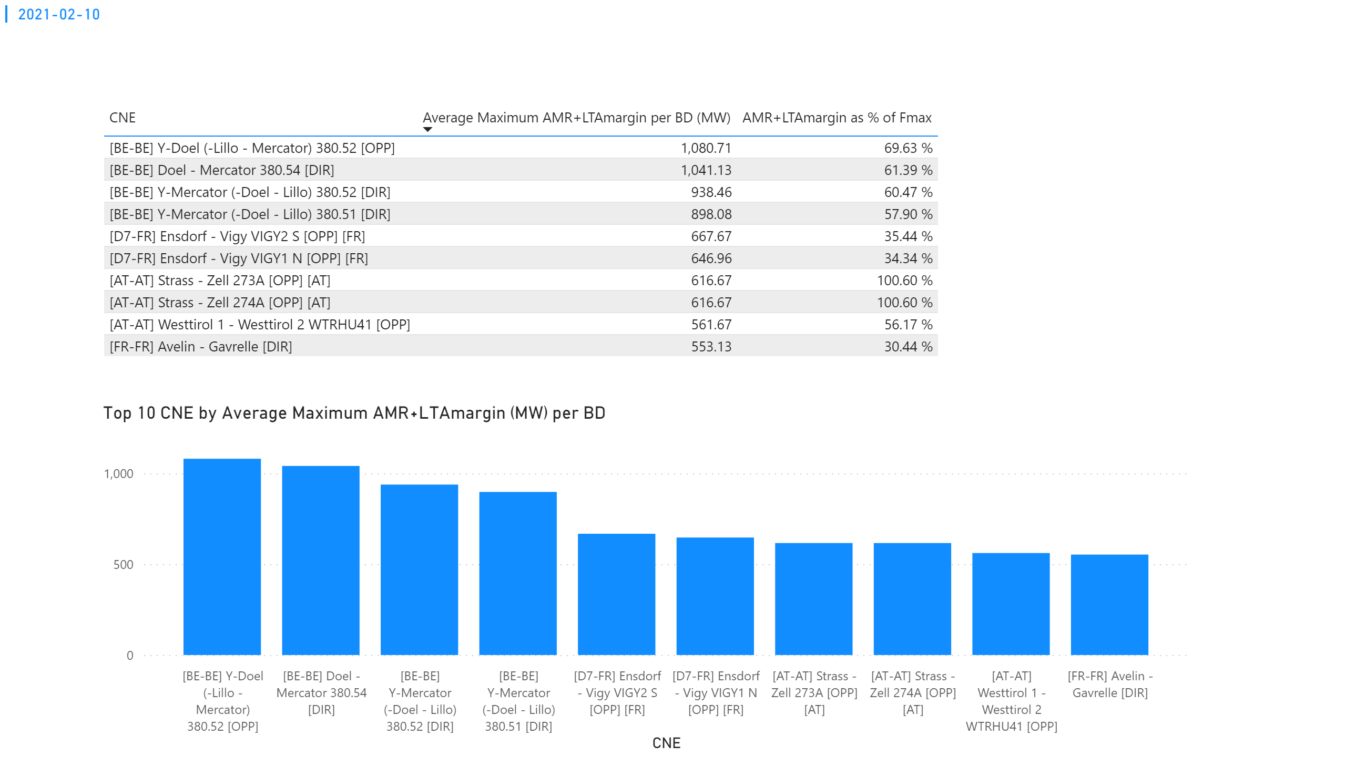
KPI 3
KPI 3: Average maximum AMR+LTAmargin per CNE per BD
Notes:
tableEx
No alt text provided.
Top 10 CNE by Average Maximum AMR+LTAmargin (MW) per BD
No alt text provided.
multiRowCard
No alt text provided.

Slide 38
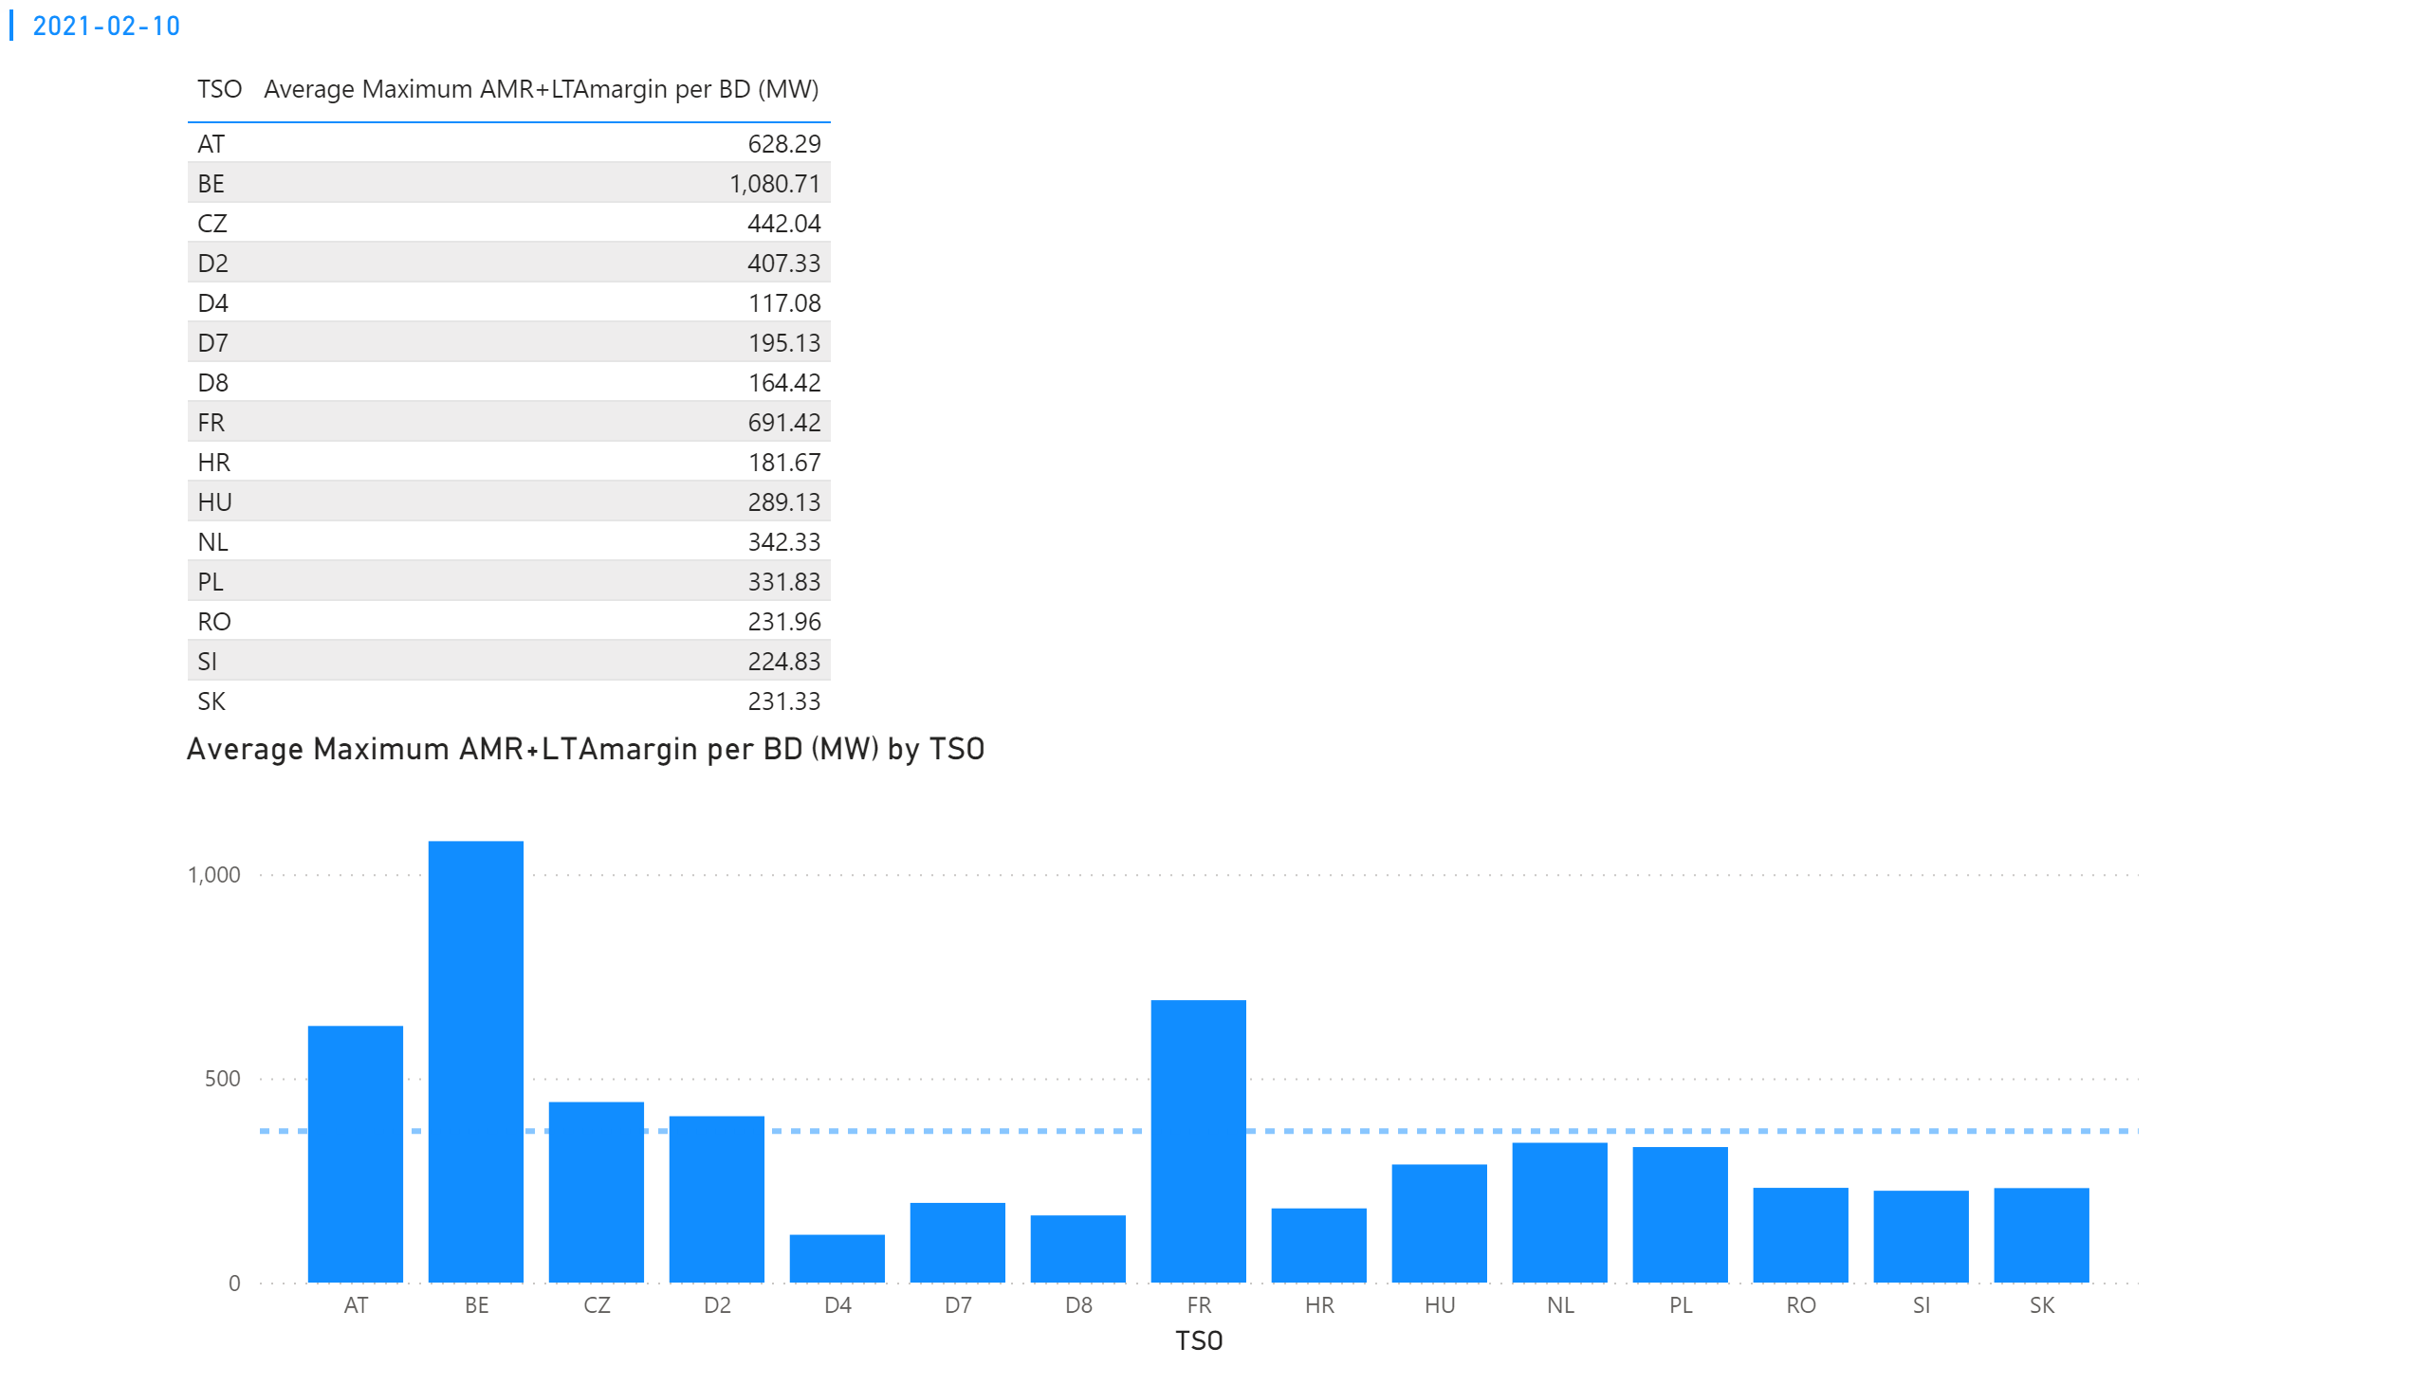
KPI 4
KPI 4: Average maximum AMR+LTAmargin per TSO per BD
Notes:
tableEx
No alt text provided.
multiRowCard
No alt text provided.
Average Maximum AMR+LTAmargin per BD (MW) by TSO
No alt text provided.

Slide 39
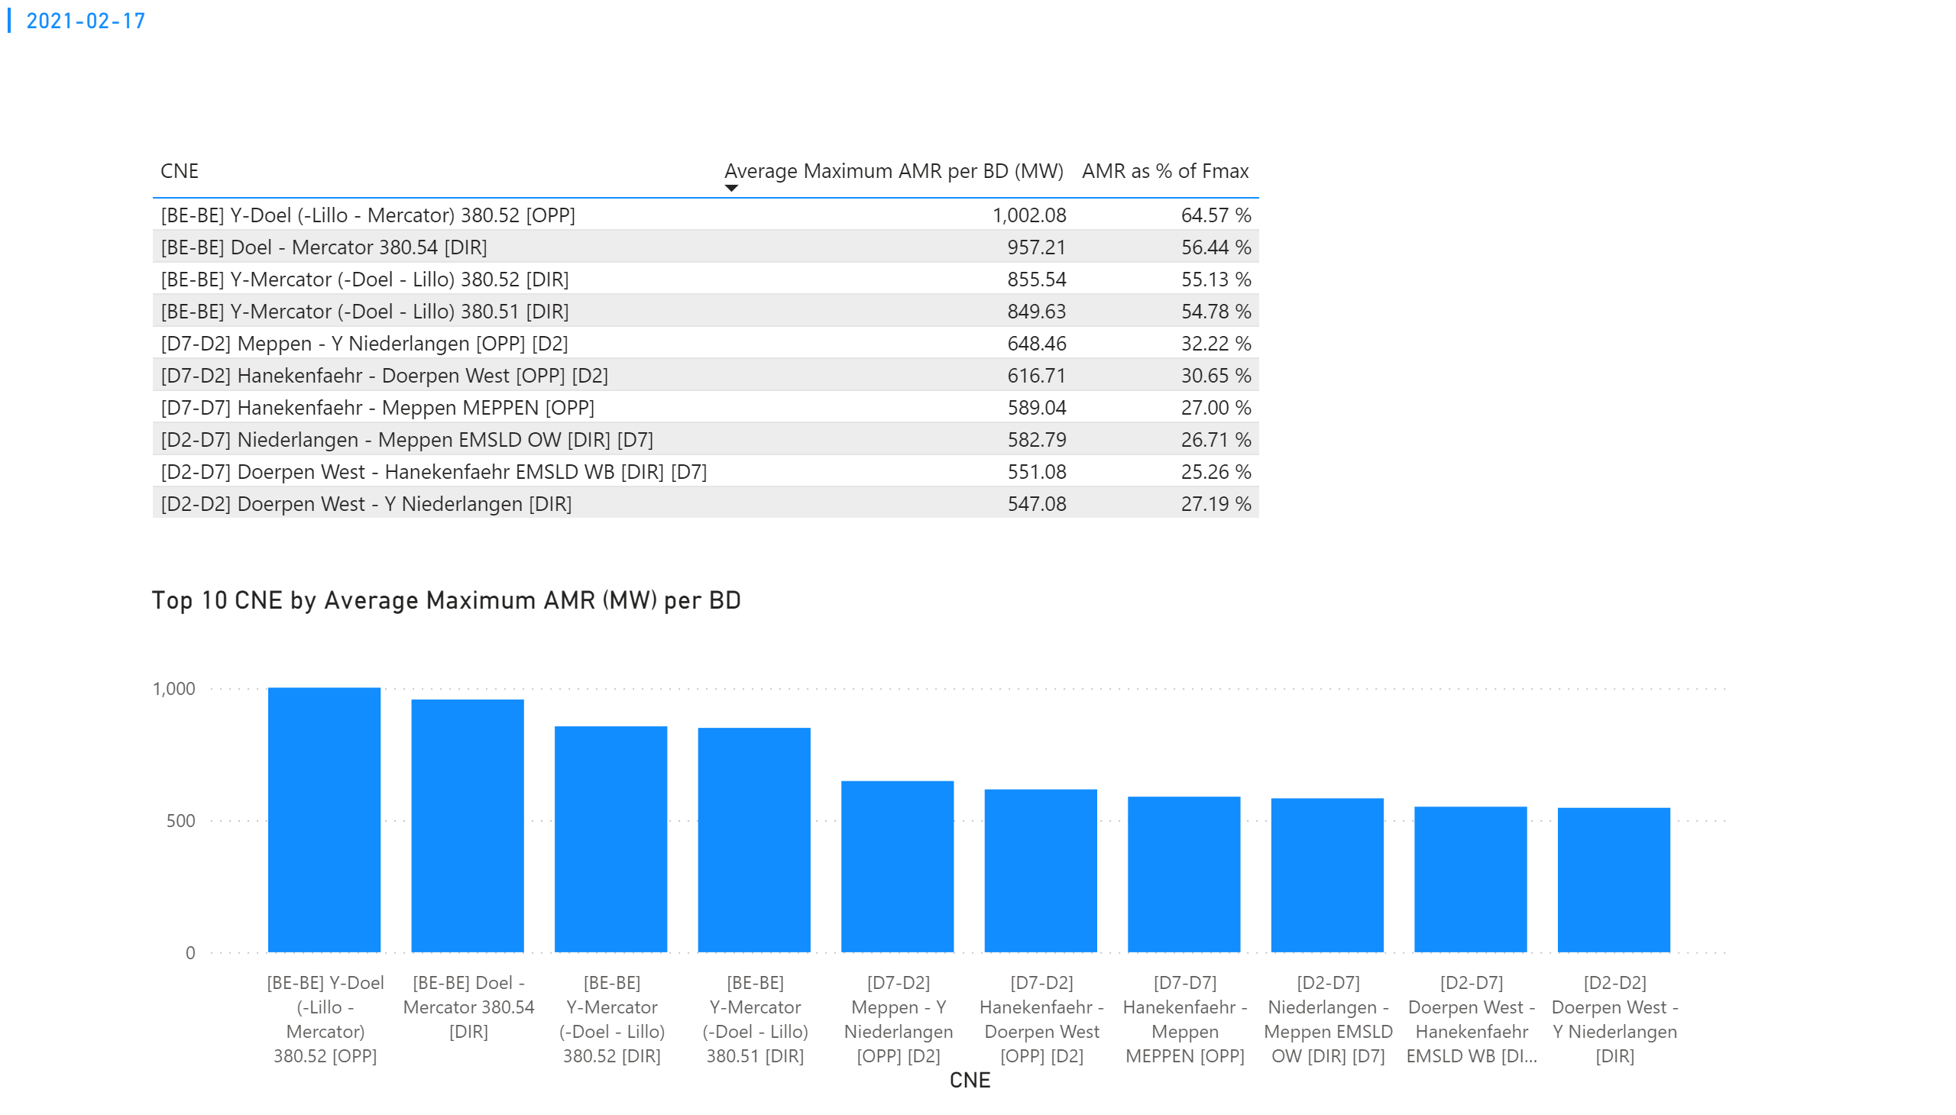
KPI 1
KPI 1: Average maximum AMR per CNE per BD
Notes:
tableEx
No alt text provided.
Top 10 CNE by Average Maximum AMR (MW) per BD
No alt text provided.
multiRowCard
No alt text provided.

Slide 40
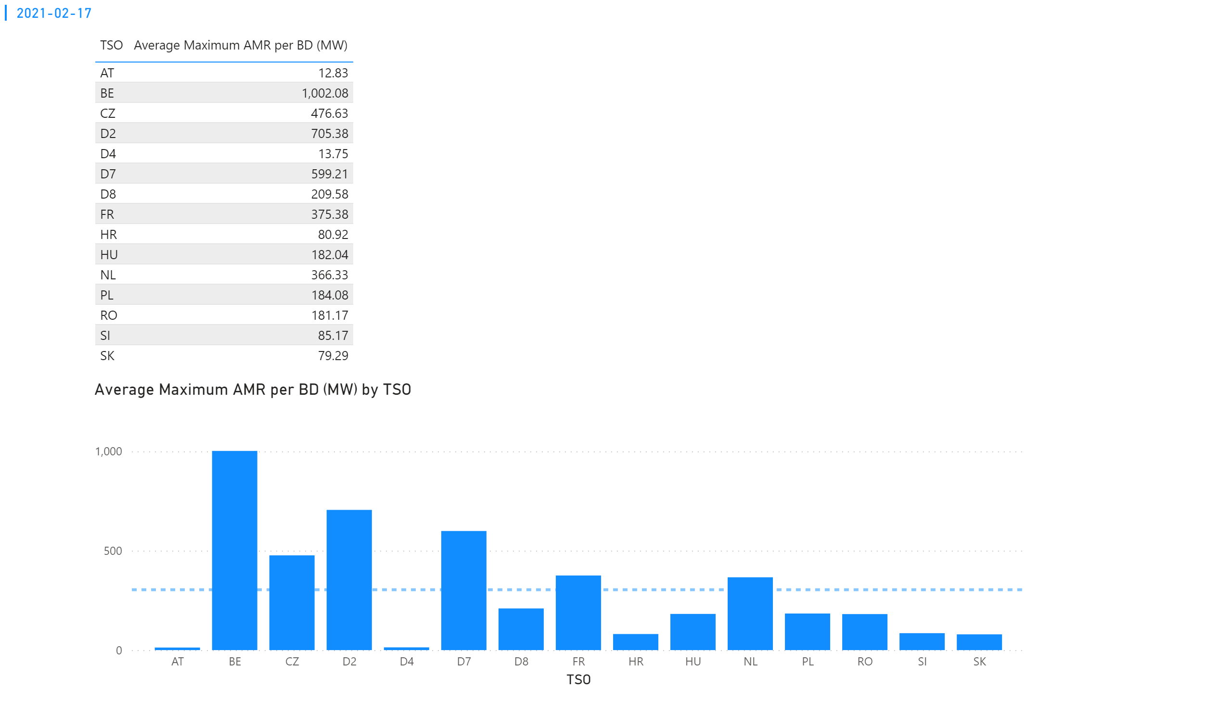
KPI 2
KPI 2: Average maximum AMR per CNE per TSO
Notes:
tableEx
No alt text provided.
Average Maximum AMR per BD (MW) by TSO
No alt text provided.
multiRowCard
No alt text provided.

Slide 41
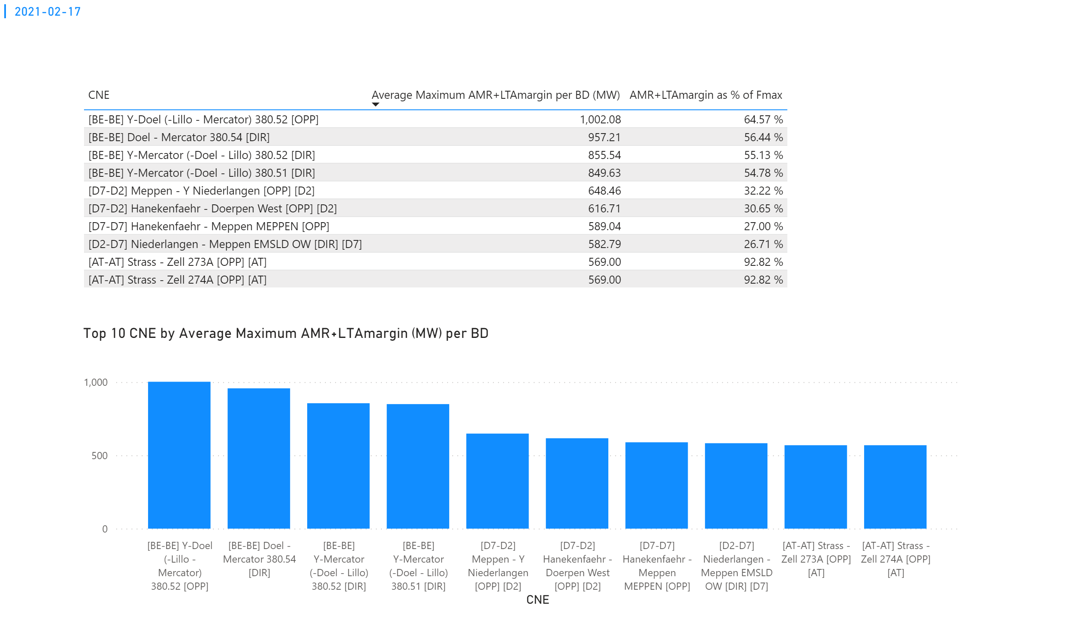
KPI 3
KPI 3: Average maximum AMR+LTAmargin per CNE per BD
Notes:
tableEx
No alt text provided.
Top 10 CNE by Average Maximum AMR+LTAmargin (MW) per BD
No alt text provided.
multiRowCard
No alt text provided.

Slide 42
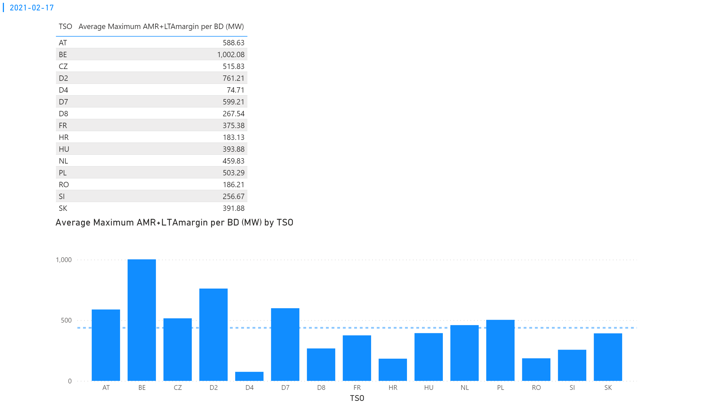
KPI 4
KPI 4: Average maximum AMR+LTAmargin per TSO per BD
Notes:
tableEx
No alt text provided.
multiRowCard
No alt text provided.
Average Maximum AMR+LTAmargin per BD (MW) by TSO
No alt text provided.

Slide 43
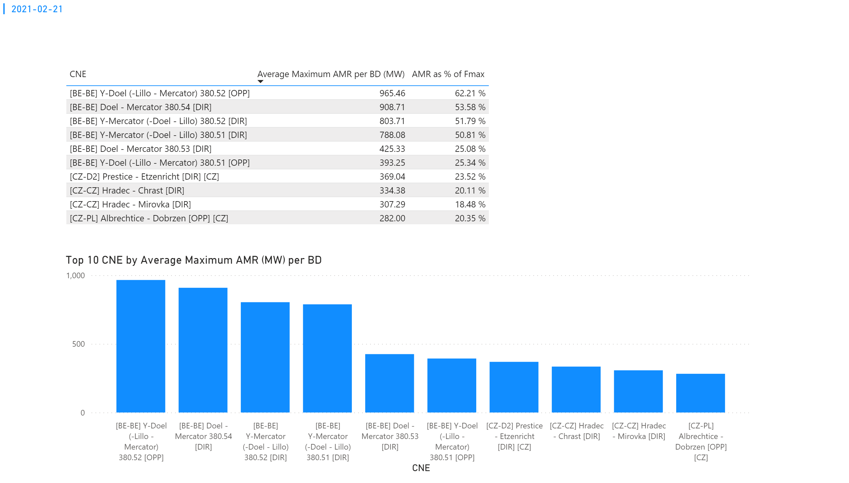
KPI 1
KPI 1: Average maximum AMR per CNE per BD
Notes:
tableEx
No alt text provided.
Top 10 CNE by Average Maximum AMR (MW) per BD
No alt text provided.
multiRowCard
No alt text provided.

Slide 44
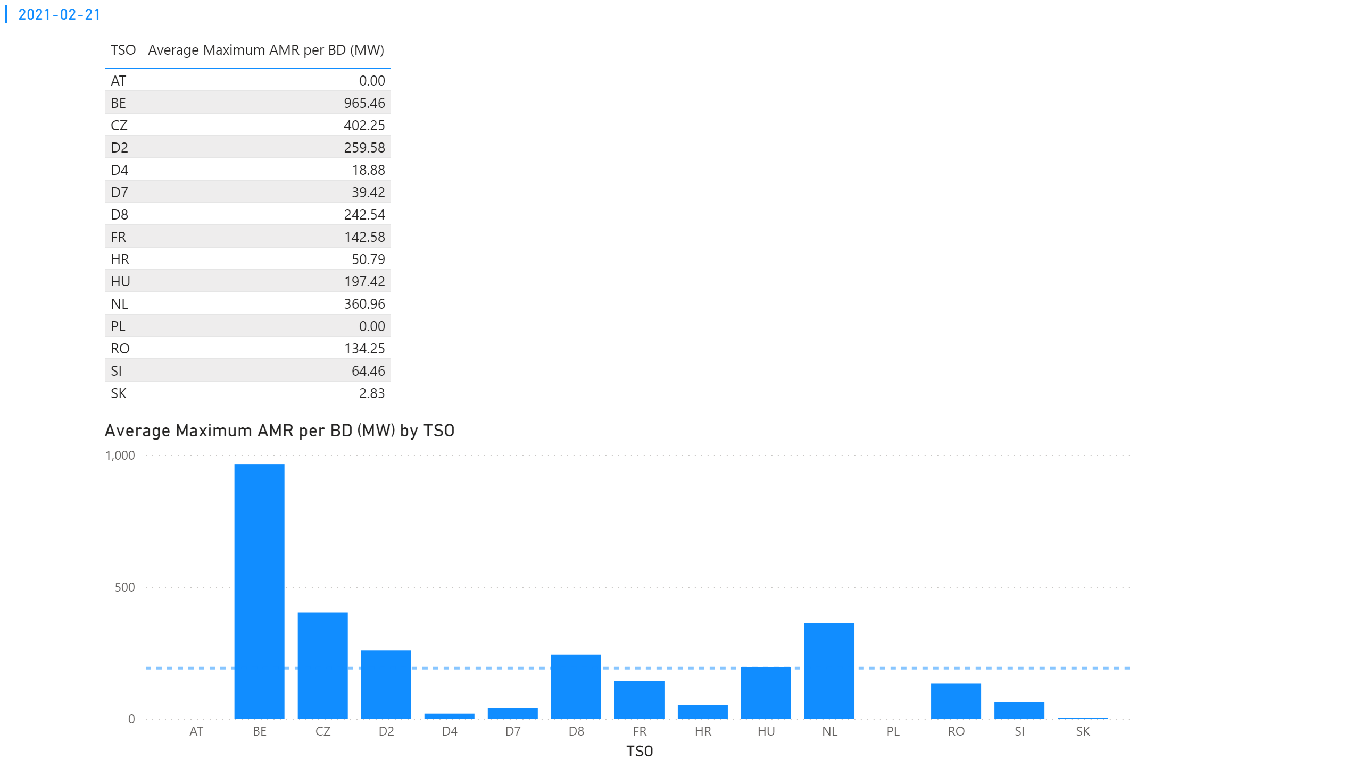
KPI 2
KPI 2: Average maximum AMR per CNE per TSO
Notes:
tableEx
No alt text provided.
Average Maximum AMR per BD (MW) by TSO
No alt text provided.
multiRowCard
No alt text provided.

Slide 45
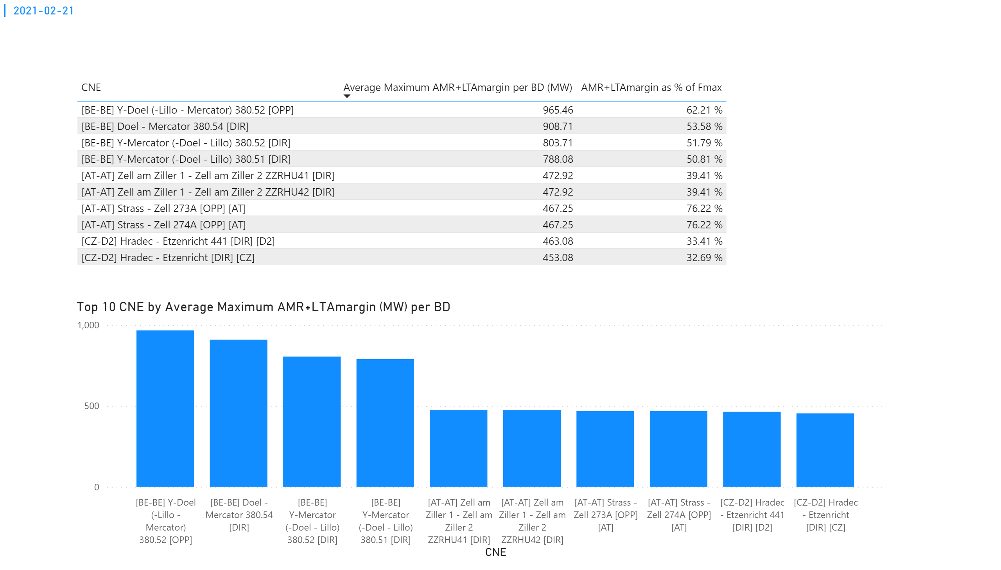
KPI 3
KPI 3: Average maximum AMR+LTAmargin per CNE per BD
Notes:
tableEx
No alt text provided.
Top 10 CNE by Average Maximum AMR+LTAmargin (MW) per BD
No alt text provided.
multiRowCard
No alt text provided.

Slide 46
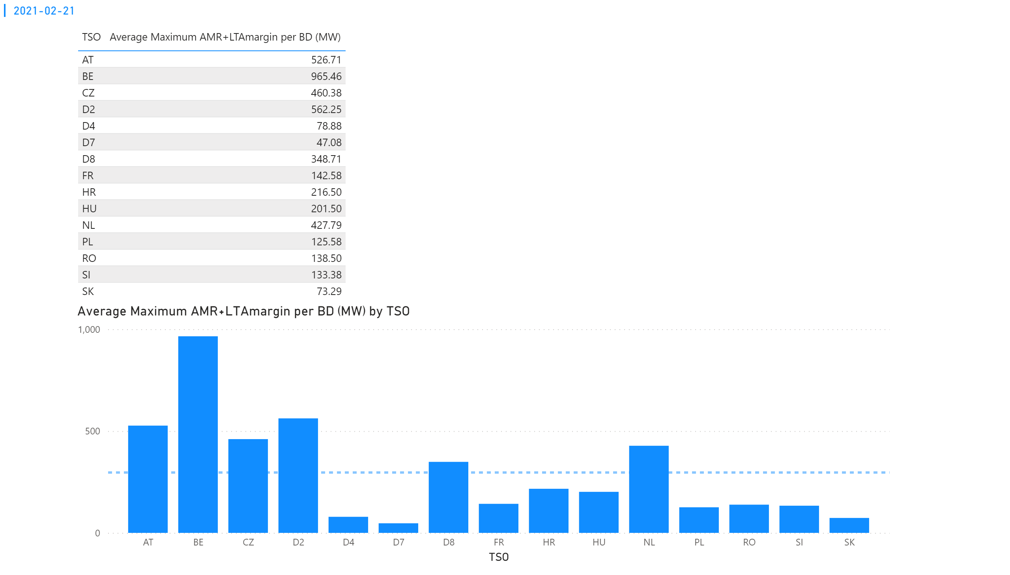
KPI 4
KPI 4: Average maximum AMR+LTAmargin per TSO per BD
Notes:
tableEx
No alt text provided.
multiRowCard
No alt text provided.
Average Maximum AMR+LTAmargin per BD (MW) by TSO
No alt text provided.

Slide 47
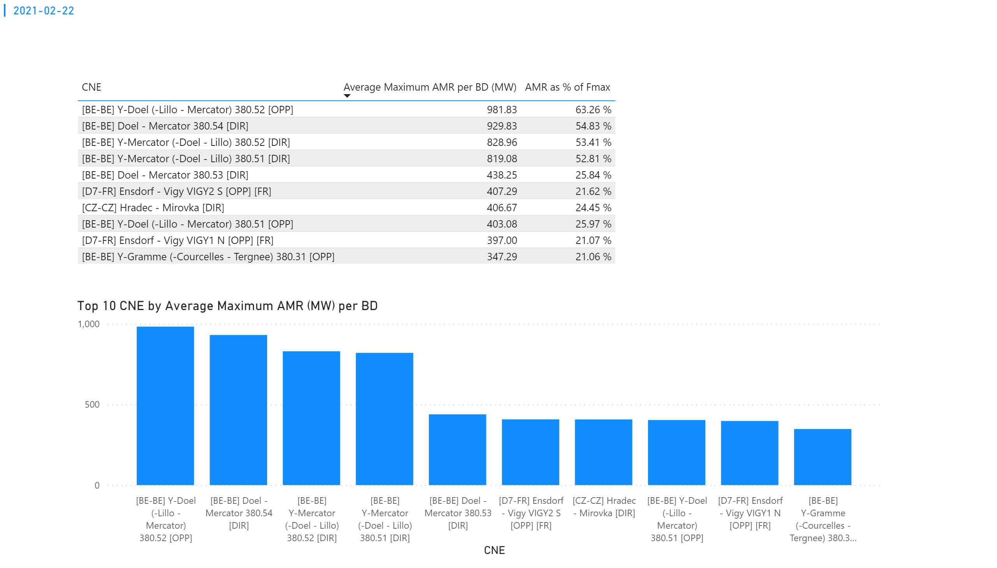
KPI 1
KPI 1: Average maximum AMR per CNE per BD
Notes:
tableEx
No alt text provided.
Top 10 CNE by Average Maximum AMR (MW) per BD
No alt text provided.
multiRowCard
No alt text provided.

Slide 48
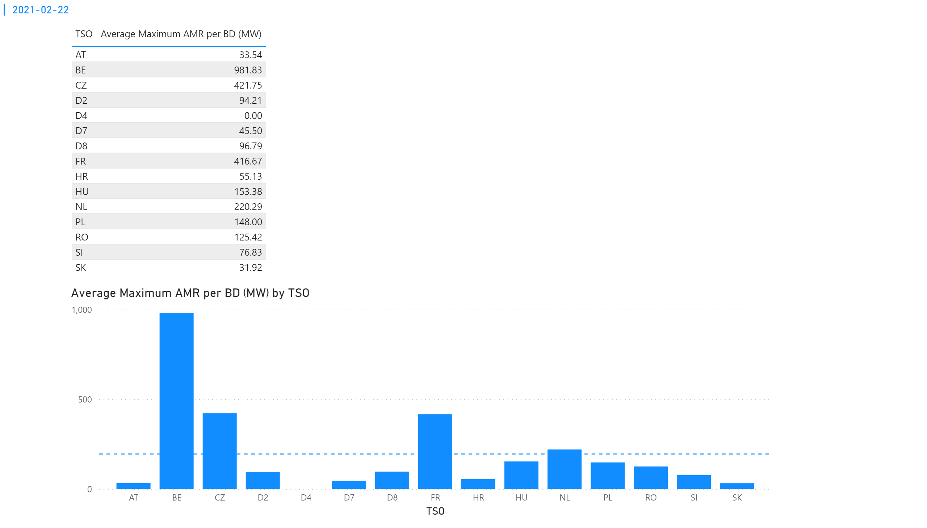
KPI 2
KPI 2: Average maximum AMR per CNE per TSO
Notes:
tableEx
No alt text provided.
Average Maximum AMR per BD (MW) by TSO
No alt text provided.
multiRowCard
No alt text provided.

Slide 49
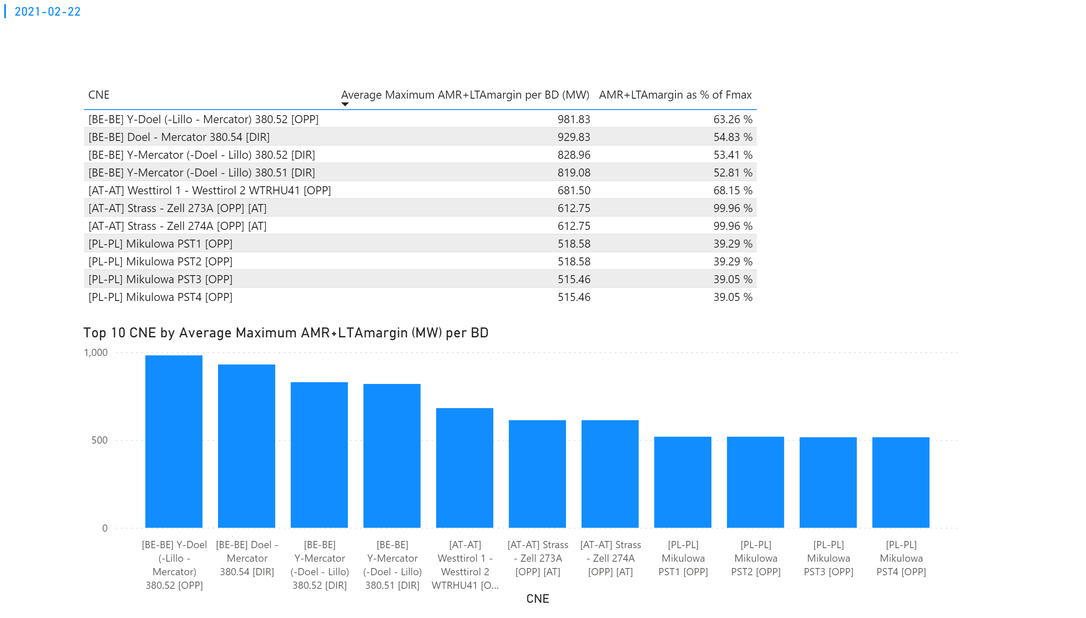
KPI 3
KPI 3: Average maximum AMR+LTAmargin per CNE per BD
Notes:
tableEx
No alt text provided.
Top 10 CNE by Average Maximum AMR+LTAmargin (MW) per BD
No alt text provided.
multiRowCard
No alt text provided.

Slide 50
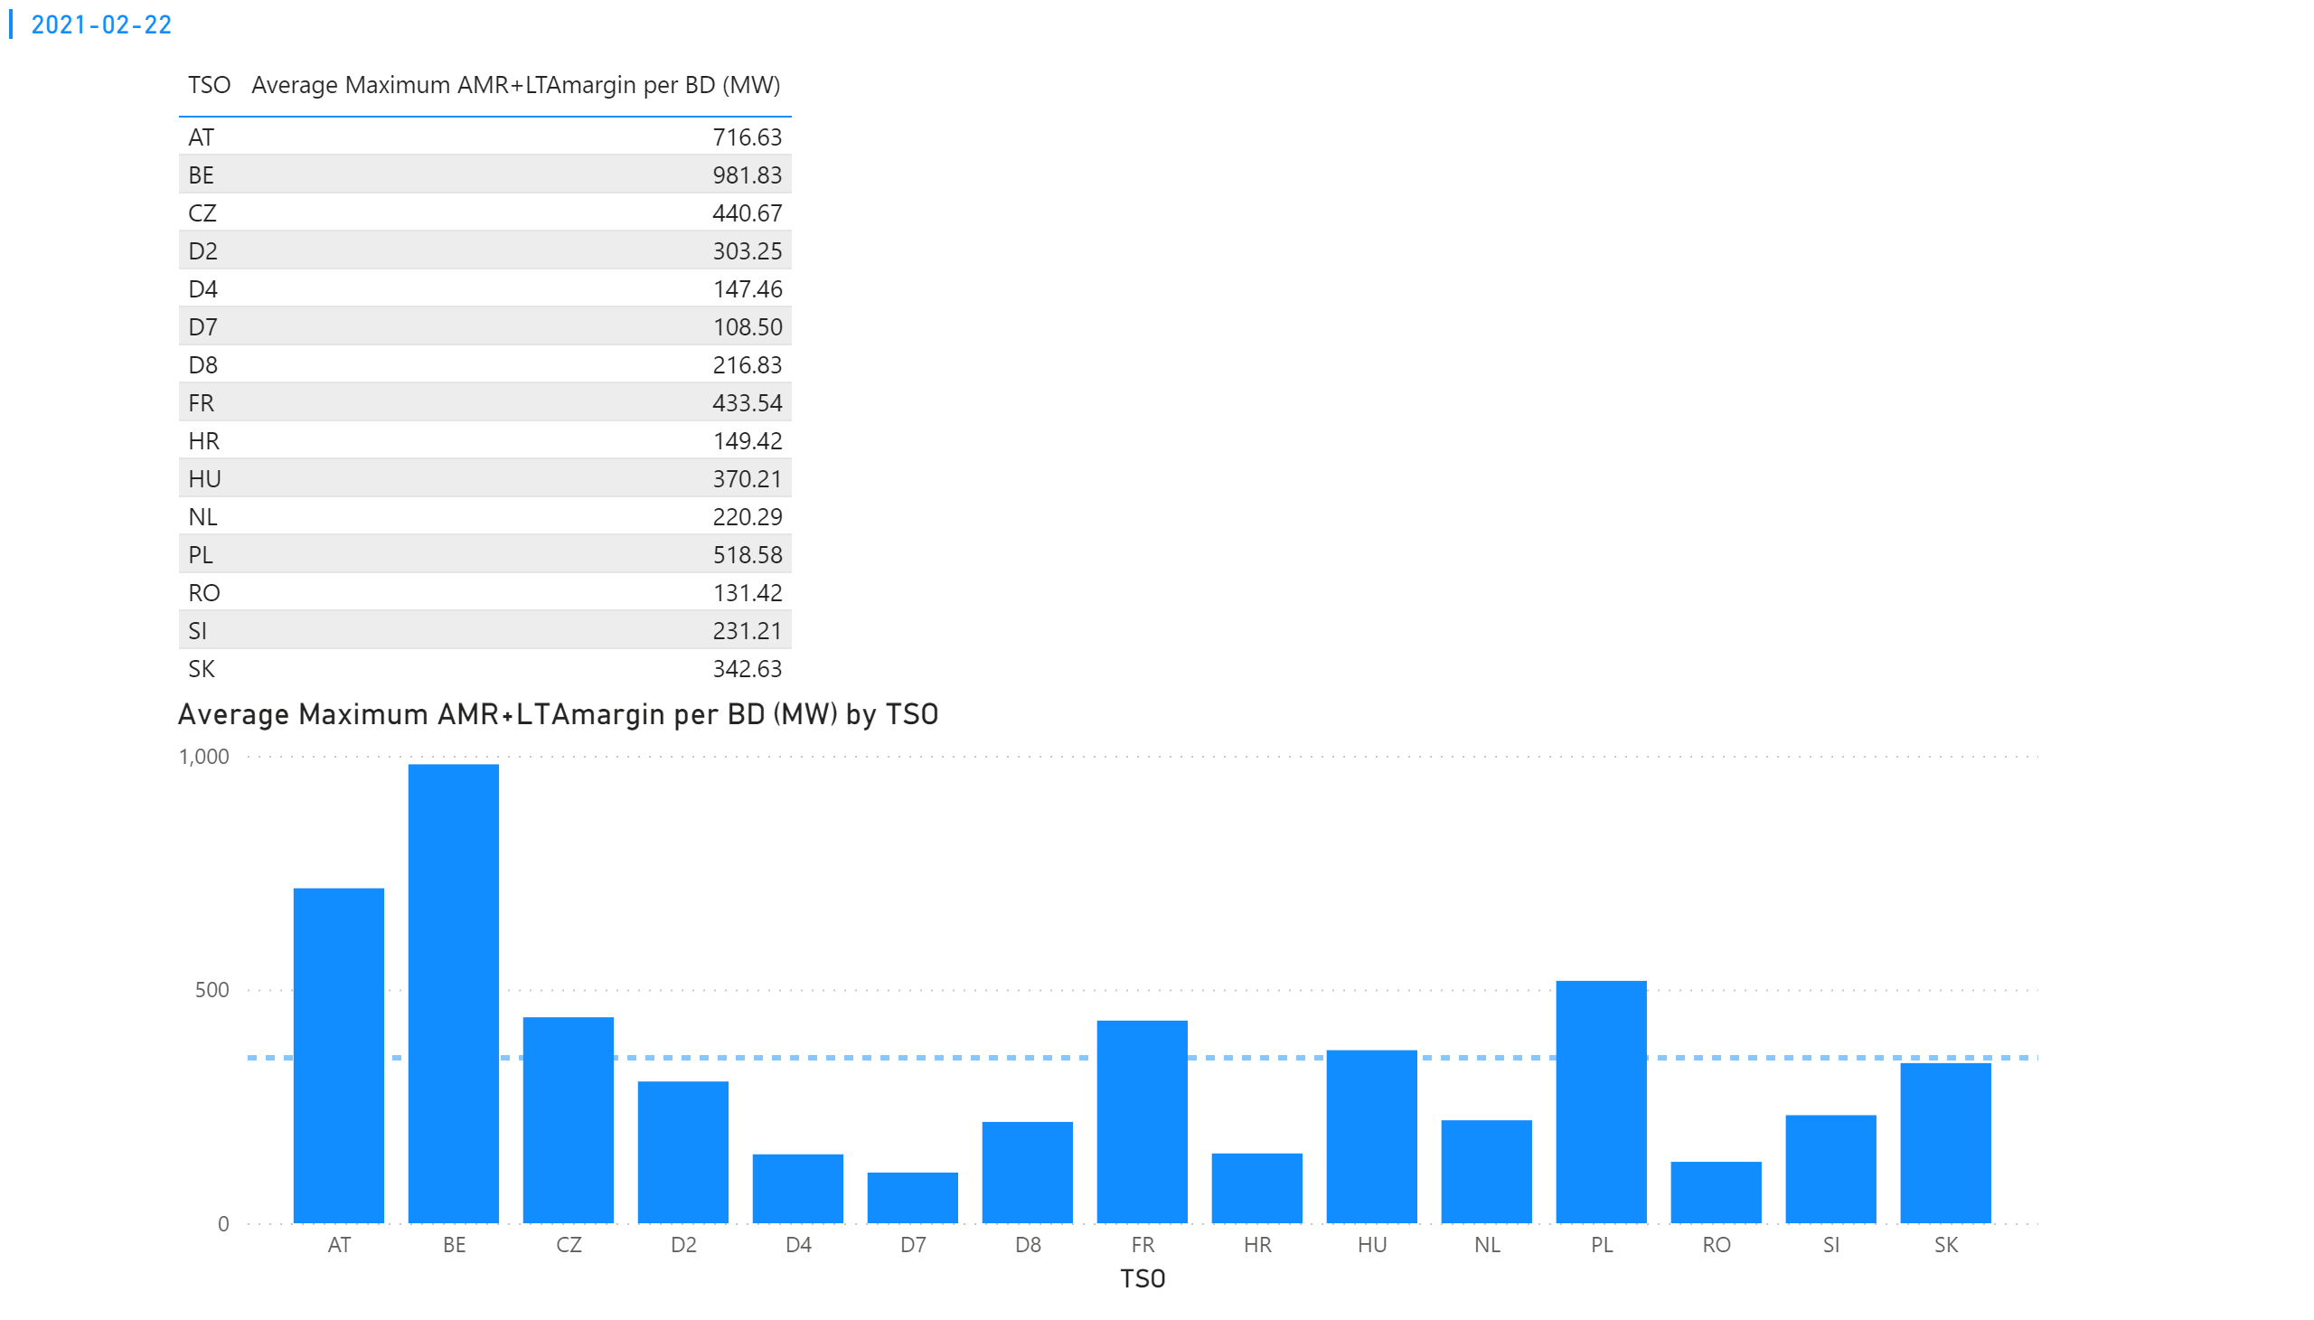
KPI 4
KPI 4: Average maximum AMR+LTAmargin per TSO per BD
Notes:
tableEx
No alt text provided.
multiRowCard
No alt text provided.
Average Maximum AMR+LTAmargin per BD (MW) by TSO
No alt text provided.

Slide 51
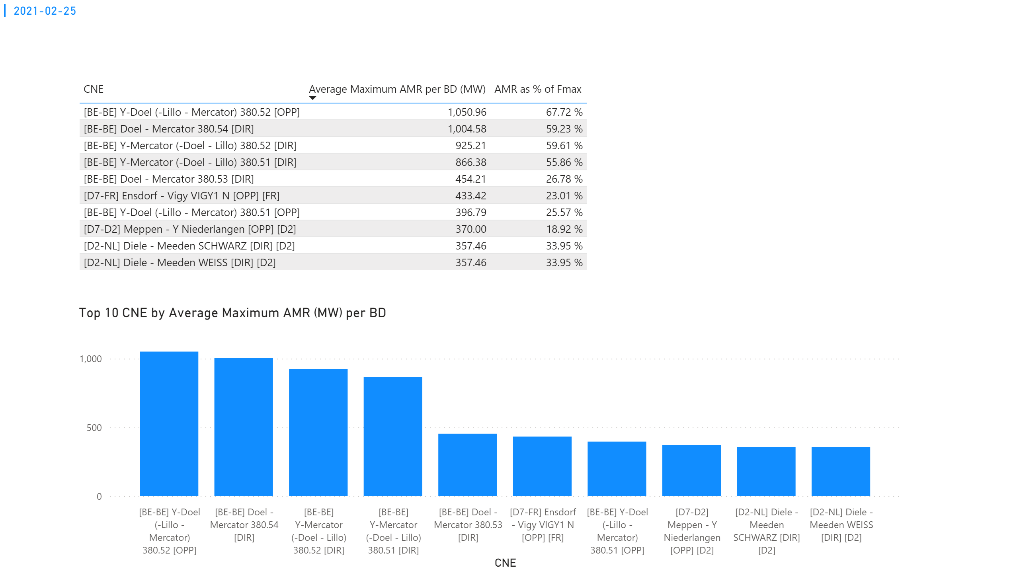
KPI 1
KPI 1: Average maximum AMR per CNE per BD
Notes:
tableEx
No alt text provided.
Top 10 CNE by Average Maximum AMR (MW) per BD
No alt text provided.
multiRowCard
No alt text provided.

Slide 52

KPI 2
KPI 2: Average maximum AMR per CNE per TSO
Notes:
tableEx
No alt text provided.
Average Maximum AMR per BD (MW) by TSO
No alt text provided.
multiRowCard
No alt text provided.

Slide 53
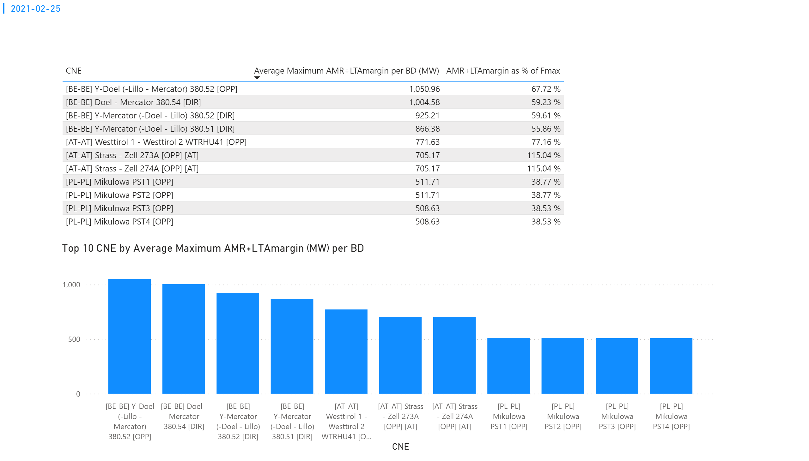
KPI 3
KPI 3: Average maximum AMR+LTAmargin per CNE per BD
Notes:
tableEx
No alt text provided.
Top 10 CNE by Average Maximum AMR+LTAmargin (MW) per BD
No alt text provided.
multiRowCard
No alt text provided.

Slide 54
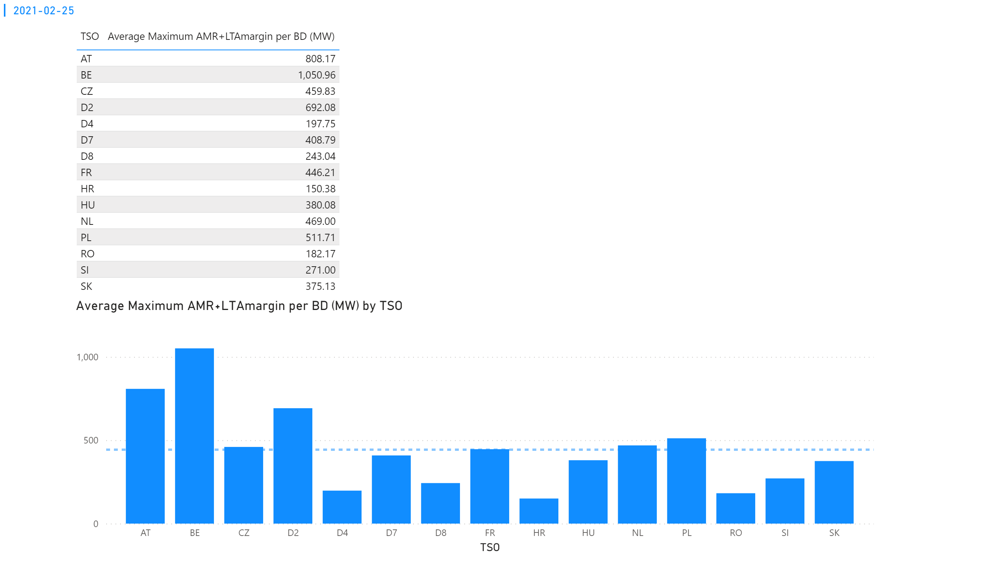
KPI 4
KPI 4: Average maximum AMR+LTAmargin per TSO per BD
Notes:
tableEx
No alt text provided.
multiRowCard
No alt text provided.
Average Maximum AMR+LTAmargin per BD (MW) by TSO
No alt text provided.

Slide 55
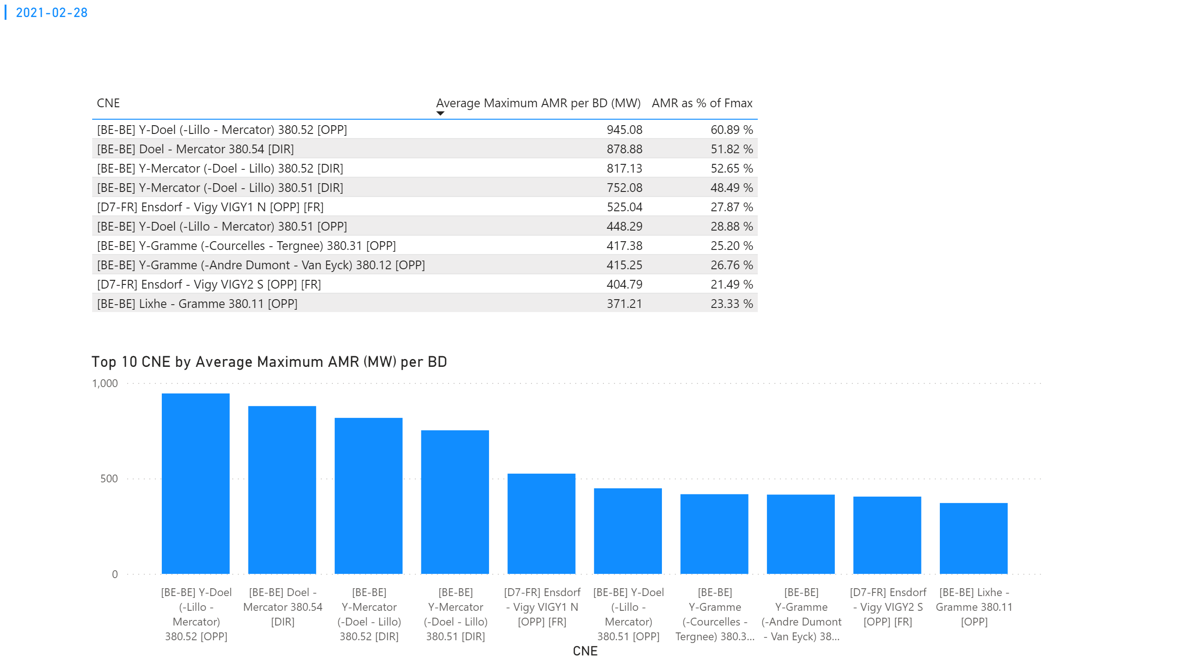
KPI 1
KPI 1: Average maximum AMR per CNE per BD
Notes:
tableEx
No alt text provided.
Top 10 CNE by Average Maximum AMR (MW) per BD
No alt text provided.
multiRowCard
No alt text provided.

Slide 56
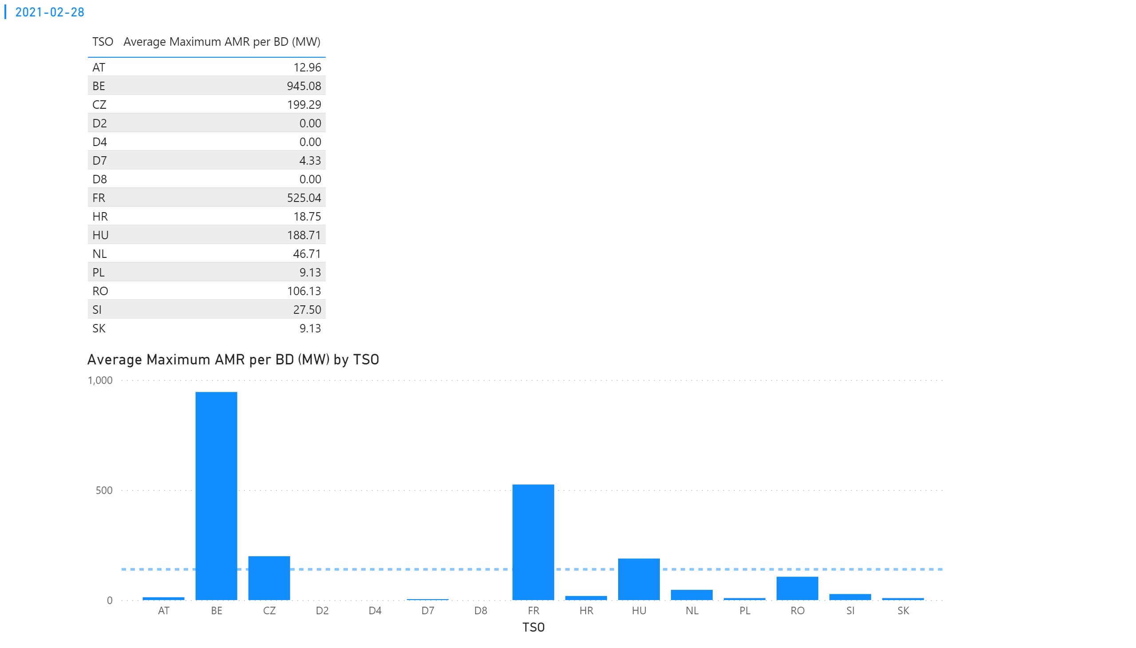
KPI 2
KPI 2: Average maximum AMR per CNE per TSO
Notes:
tableEx
No alt text provided.
Average Maximum AMR per BD (MW) by TSO
No alt text provided.
multiRowCard
No alt text provided.

Slide 57
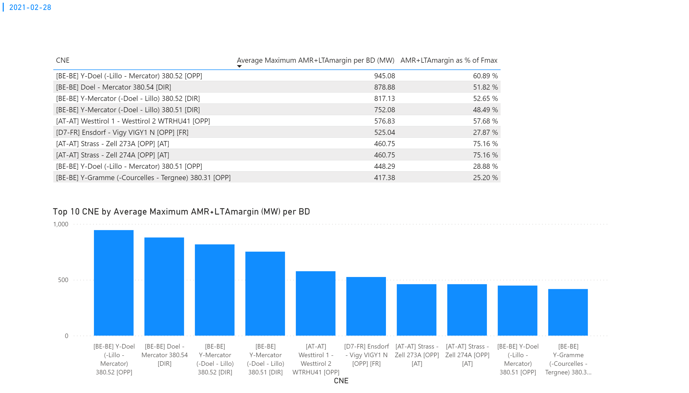
KPI 3
KPI 3: Average maximum AMR+LTAmargin per CNE per BD
Notes:
tableEx
No alt text provided.
Top 10 CNE by Average Maximum AMR+LTAmargin (MW) per BD
No alt text provided.
multiRowCard
No alt text provided.

Slide 58

KPI 4
KPI 4: Average maximum AMR+LTAmargin per TSO per BD
Notes:
tableEx
No alt text provided.
multiRowCard
No alt text provided.
Average Maximum AMR+LTAmargin per BD (MW) by TSO
No alt text provided.

Slide 59

KPI 5
KPI 5: Share of MTUs with intervention per TSO
Total MTUs = 312 (13 BDs * 24h) | None | AT | BE | D2 | D4 | D7 | D8 | NL | SK
Distinct MTUs with IVA | 135 | 30 | 149 | 11 | 5 | 27 | 11 | 32 | 24
Share | 43.27% | 9.62% | 47.75% | 3.53% | 1.60% | 8.65% | 3.53% | 10.25% | 7.69%
Notes:
clusteredColumnChart
No alt text provided.

Slide 60

KPI6_0201
    KPI 6: Total IVA applied per MTU for each CNE affected by TSO intervention
    BD: 20210201 (top: in MW, bottom: in % of Fmax)
Notes:
clusteredColumnChart
No alt text provided.
clusteredColumnChart
No alt text provided.

Slide 61

KPI6_0203
    KPI 6: Total IVA applied per MTU for each CNE affected by TSO intervention
    BD: 20210203 (top: in MW, bottom: in % of Fmax)
Notes:
clusteredColumnChart
No alt text provided.
clusteredColumnChart
No alt text provided.

Slide 62

KPI6_0205
    KPI 6: Total IVA applied per MTU for each CNE affected by TSO intervention
    BD: 20210205 (top: in MW, bottom: in % of Fmax)
Notes:
clusteredColumnChart
No alt text provided.
clusteredColumnChart
No alt text provided.

Slide 63

KPI6_0206
    KPI 6: Total IVA applied per MTU for each CNE affected by TSO intervention
    BD: 20210206 (top: in MW, bottom: in % of Fmax)
Notes:
clusteredColumnChart
No alt text provided.
clusteredColumnChart
No alt text provided.

Slide 64

KPI6_0208
    KPI 6: Total IVA applied per MTU for each CNE affected by TSO intervention
    BD: 20210208 (top: in MW, bottom: in % of Fmax)
Notes:
clusteredColumnChart
No alt text provided.
clusteredColumnChart
No alt text provided.

Slide 65

KPI6_0209
    KPI 6: Total IVA applied per MTU for each CNE affected by TSO intervention
    BD: 20210209 (top: in MW, bottom: in % of Fmax)
Notes:
clusteredColumnChart
No alt text provided.
clusteredColumnChart
No alt text provided.

Slide 66

KPI6_0210
    KPI 6: Total IVA applied per MTU for each CNE affected by TSO intervention
    BD: 20210210 (top: in MW, bottom: in % of Fmax)
Notes:
clusteredColumnChart
No alt text provided.
clusteredColumnChart
No alt text provided.

Slide 67

KPI6_0221
    KPI 6: Total IVA applied per MTU for each CNE affected by TSO intervention
    BD: 20210221 (top: in MW, bottom: in % of Fmax)
Notes:
clusteredColumnChart
No alt text provided.
clusteredColumnChart
No alt text provided.

Slide 68

KPI6_0222
    KPI 6: Total IVA applied per MTU for each CNE affected by TSO intervention
    BD: 20210222 (top: in MW, bottom: in % of Fmax)
Notes:
clusteredColumnChart
No alt text provided.
clusteredColumnChart
No alt text provided.

Slide 69

KPI6_0225
    KPI 6: Total IVA applied per MTU for each CNE affected by TSO intervention
    BD: 20210225 (top: in MW, bottom: in % of Fmax)
Notes:
clusteredColumnChart
No alt text provided.
clusteredColumnChart
No alt text provided.

Slide 70

KPI6_0228
    KPI 6: Total IVA applied per MTU for each CNE affected by TSO intervention
    BD: 20210228 (top: in MW, bottom: in % of Fmax)
Notes:
clusteredColumnChart
No alt text provided.
clusteredColumnChart
No alt text provided.

Slide 71

AT
KPI 13: Min Max Net Positions (in MW) per BZ per BD
Notes:
2021-02-03
No alt text provided.
2021-02-04
No alt text provided.
2021-02-08
No alt text provided.
2021-02-06
No alt text provided.
2021-02-05
No alt text provided.
2021-02-01
No alt text provided.
card
No alt text provided.

Slide 72

AT
KPI 13: Min Max Net Positions (in MW) per BZ per BD
Notes:
2021-02-10
No alt text provided.
2021-02-17
No alt text provided.
2021-02-25
No alt text provided.
2021-02-22
No alt text provided.
2021-02-21
No alt text provided.
2021-02-09
No alt text provided.
card
No alt text provided.

Slide 73

AT
KPI 13: Min Max Net Positions (in MW) per BZ per BD
Notes:
2021-02-28
No alt text provided.
card
No alt text provided.

Slide 74

BE
KPI 13: Min Max Net Positions (in MW) per BZ per BD
Notes:
2021-02-03
No alt text provided.
2021-02-04
No alt text provided.
2021-02-08
No alt text provided.
2021-02-06
No alt text provided.
2021-02-05
No alt text provided.
2021-02-01
No alt text provided.
card
No alt text provided.

Slide 75

BE
KPI 13: Min Max Net Positions (in MW) per BZ per BD
Notes:
2021-02-10
No alt text provided.
2021-02-17
No alt text provided.
2021-02-25
No alt text provided.
2021-02-22
No alt text provided.
2021-02-21
No alt text provided.
2021-02-09
No alt text provided.
card
No alt text provided.

Slide 76

BE
KPI 13: Min Max Net Positions (in MW) per BZ per BD
Notes:
2021-02-28
No alt text provided.
card
No alt text provided.

Slide 77

CZ
KPI 13: Min Max Net Positions (in MW) per BZ per BD
Notes:
2021-02-01
No alt text provided.
2021-02-03
No alt text provided.
2021-02-04
No alt text provided.
2021-02-08
No alt text provided.
2021-02-06
No alt text provided.
2021-02-05
No alt text provided.
card
No alt text provided.

Slide 78

CZ
KPI 13: Min Max Net Positions (in MW) per BZ per BD
Notes:
2021-02-09
No alt text provided.
2021-02-10
No alt text provided.
2021-02-17
No alt text provided.
2021-02-25
No alt text provided.
2021-02-22
No alt text provided.
2021-02-21
No alt text provided.
card
No alt text provided.

Slide 79

CZ
KPI 13: Min Max Net Positions (in MW) per BZ per BD
Notes:
2021-02-28
No alt text provided.
card
No alt text provided.

Slide 80

DE
KPI 13: Min Max Net Positions (in MW) per BZ per BD
Notes:
2021-02-01
No alt text provided.
2021-02-03
No alt text provided.
2021-02-04
No alt text provided.
2021-02-08
No alt text provided.
2021-02-06
No alt text provided.
2021-02-05
No alt text provided.
card
No alt text provided.

Slide 81

DE
KPI 13: Min Max Net Positions (in MW) per BZ per BD
Notes:
2021-02-09
No alt text provided.
2021-02-10
No alt text provided.
2021-02-17
No alt text provided.
2021-02-25
No alt text provided.
2021-02-22
No alt text provided.
2021-02-21
No alt text provided.
card
No alt text provided.

Slide 82

DE
KPI 13: Min Max Net Positions (in MW) per BZ per BD
Notes:
2021-02-28
No alt text provided.
card
No alt text provided.

Slide 83

FR
KPI 13: Min Max Net Positions (in MW) per BZ per BD
Notes:
2021-02-01
No alt text provided.
2021-02-03
No alt text provided.
2021-02-04
No alt text provided.
2021-02-08
No alt text provided.
2021-02-06
No alt text provided.
2021-02-05
No alt text provided.
card
No alt text provided.

Slide 84

FR
KPI 13: Min Max Net Positions (in MW) per BZ per BD
Notes:
2021-02-28
No alt text provided.
card
No alt text provided.

Slide 85

FR
KPI 13: Min Max Net Positions (in MW) per BZ per BD
Notes:
2021-02-09
No alt text provided.
2021-02-10
No alt text provided.
2021-02-17
No alt text provided.
2021-02-25
No alt text provided.
2021-02-22
No alt text provided.
2021-02-21
No alt text provided.
card
No alt text provided.

Slide 86

HR
KPI 13: Min Max Net Positions (in MW) per BZ per BD
Notes:
2021-02-03
No alt text provided.
2021-02-04
No alt text provided.
2021-02-08
No alt text provided.
2021-02-06
No alt text provided.
2021-02-05
No alt text provided.
2021-02-01
No alt text provided.
card
No alt text provided.

Slide 87

HR
KPI 13: Min Max Net Positions (in MW) per BZ per BD
Notes:
2021-02-28
No alt text provided.
card
No alt text provided.

Slide 88

HR
KPI 13: Min Max Net Positions (in MW) per BZ per BD
Notes:
2021-02-10
No alt text provided.
2021-02-17
No alt text provided.
2021-02-25
No alt text provided.
2021-02-22
No alt text provided.
2021-02-21
No alt text provided.
2021-02-09
No alt text provided.
card
No alt text provided.

Slide 89

HU
KPI 13: Min Max Net Positions (in MW) per BZ per BD
Notes:
2021-02-03
No alt text provided.
2021-02-04
No alt text provided.
2021-02-08
No alt text provided.
2021-02-06
No alt text provided.
2021-02-05
No alt text provided.
2021-02-01
No alt text provided.
card
No alt text provided.

Slide 90

HU
KPI 13: Min Max Net Positions (in MW) per BZ per BD
Notes:
2021-02-10
No alt text provided.
2021-02-17
No alt text provided.
2021-02-25
No alt text provided.
2021-02-22
No alt text provided.
2021-02-21
No alt text provided.
2021-02-09
No alt text provided.
card
No alt text provided.

Slide 91

HU
KPI 13: Min Max Net Positions (in MW) per BZ per BD
Notes:
2021-02-28
No alt text provided.
card
No alt text provided.

Slide 92

NL
KPI 13: Min Max Net Positions (in MW) per BZ per BD
Notes:
2021-02-03
No alt text provided.
2021-02-04
No alt text provided.
2021-02-08
No alt text provided.
2021-02-06
No alt text provided.
2021-02-05
No alt text provided.
2021-02-01
No alt text provided.
card
No alt text provided.

Slide 93

NL
KPI 13: Min Max Net Positions (in MW) per BZ per BD
Notes:
2021-02-10
No alt text provided.
2021-02-17
No alt text provided.
2021-02-25
No alt text provided.
2021-02-22
No alt text provided.
2021-02-21
No alt text provided.
2021-02-09
No alt text provided.
card
No alt text provided.

Slide 94

NL
KPI 13: Min Max Net Positions (in MW) per BZ per BD
Notes:
2021-02-28
No alt text provided.
card
No alt text provided.

Slide 95

PL
KPI 13: Min Max Net Positions (in MW) per BZ per BD
Notes:
2021-02-03
No alt text provided.
2021-02-04
No alt text provided.
2021-02-08
No alt text provided.
2021-02-06
No alt text provided.
2021-02-05
No alt text provided.
2021-02-01
No alt text provided.
card
No alt text provided.

Slide 96

PL
KPI 13: Min Max Net Positions (in MW) per BZ per BD
Notes:
2021-02-10
No alt text provided.
2021-02-17
No alt text provided.
2021-02-25
No alt text provided.
2021-02-22
No alt text provided.
2021-02-21
No alt text provided.
2021-02-09
No alt text provided.
card
No alt text provided.

Slide 97

PL
KPI 13: Min Max Net Positions (in MW) per BZ per BD
Notes:
2021-02-28
No alt text provided.
card
No alt text provided.

Slide 98

RO
KPI 13: Min Max Net Positions (in MW) per BZ per BD
Notes:
2021-02-03
No alt text provided.
2021-02-04
No alt text provided.
2021-02-08
No alt text provided.
2021-02-06
No alt text provided.
2021-02-05
No alt text provided.
2021-02-01
No alt text provided.
card
No alt text provided.

Slide 99

RO
KPI 13: Min Max Net Positions (in MW) per BZ per BD
Notes:
2021-02-10
No alt text provided.
2021-02-17
No alt text provided.
2021-02-25
No alt text provided.
2021-02-22
No alt text provided.
2021-02-21
No alt text provided.
2021-02-09
No alt text provided.
card
No alt text provided.

Slide 100

RO
KPI 13: Min Max Net Positions (in MW) per BZ per BD
Notes:
2021-02-28
No alt text provided.
card
No alt text provided.

Slide 101

SI
KPI 13: Min Max Net Positions (in MW) per BZ per BD
Notes:
2021-02-03
No alt text provided.
2021-02-04
No alt text provided.
2021-02-08
No alt text provided.
2021-02-06
No alt text provided.
2021-02-05
No alt text provided.
2021-02-01
No alt text provided.
card
No alt text provided.

Slide 102

SI
KPI 13: Min Max Net Positions (in MW) per BZ per BD
Notes:
2021-02-10
No alt text provided.
2021-02-17
No alt text provided.
2021-02-25
No alt text provided.
2021-02-22
No alt text provided.
2021-02-21
No alt text provided.
2021-02-09
No alt text provided.
card
No alt text provided.

Slide 103

SI
KPI 13: Min Max Net Positions (in MW) per BZ per BD
Notes:
2021-02-28
No alt text provided.
card
No alt text provided.

Slide 104

SK
KPI 13: Min Max Net Positions (in MW) per BZ per BD
Notes:
card
No alt text provided.
2021-02-01
No alt text provided.
2021-02-03
No alt text provided.
2021-02-08
No alt text provided.
2021-02-04
No alt text provided.
2021-02-05
No alt text provided.
2021-02-06
No alt text provided.

Slide 105

SK
KPI 13: Min Max Net Positions (in MW) per BZ per BD
Notes:
2021-02-22
No alt text provided.
2021-02-21
No alt text provided.
2021-02-10
No alt text provided.
2021-02-17
No alt text provided.
2021-02-25
No alt text provided.
card
No alt text provided.
2021-02-09
No alt text provided.

Slide 106

SK
KPI 13: Min Max Net Positions (in MW) per BZ per BD
Notes:
2021-02-28
No alt text provided.
card
No alt text provided.

Slide 107

Parallel Run KPI report
CORE TSOs
KPI 17: NCE KPI_delta flow

Slide 108

Parallel Run KPI report
CORE TSOs
KPI 17: NCE KPI_delta exchange

Slide 109

Parallel Run KPI report
CORE TSOs
KPI 17: Boxplot

Slide 110
Parallel Run KPI report
CORE FB MC
KPI 7: Most often presolved CNEs (TOP 20) 202102
Total BDs: 13 (312 hours)
CNE | Distinct Hours | Hours CNE was presolved | Average RAM | Max of RAM | Min of RAM | Max of z2zPTDF* | Max of sum z2z PTDF*
[SK-HU] Gabcikovo - Gyor [OPP] [HU] | 312 | 1368 | 103% | 141% | 74% | 0,15377 | 1,48319
[HU-HU] Paks - Sandorfalva [DIR] | 312 | 809 | 41% | 62% | 26% | 0,01753 | 0,45067
[HR-HR] 400kV Zerjavinec - Tumbri [OPP] | 312 | 605 | 83% | 100% | 62% | 0,28171 | 1,01307
[AT-AT] Westtirol 1 - Westtirol 2 WTRHU41 [OPP] | 312 | 1951 | 101% | 126% | 84% | 0,18551 | 0,82404
[SK-HU] Gabcikovo - Gyor [DIR] [HU] | 312 | 1266 | 78% | 92% | 61% | 0,44088 | 1,48319
[SK-SK] Bosaca - Varin [DIR] | 312 | 936 | 41% | 69% | 25% | 0,12 | 0,44244
[AT-AT] Westtirol 1 - Westtirol 2 WTRHU41 [DIR] | 311 | 1382 | 107% | 144% | 88% | 0,03161 | 0,82404
[AT-D2] St. Peter 2 - Pleinting 258 [OPP] [AT] | 308 | 972 | 81% | 114% | 66% | 0,0606 | 0,37865
[HU-HU] Gyor - Oroszlany [DIR] | 306 | 1014 | 59% | 67% | 50% | 0,09243 | 0,35192
[HR-SI] 400kV Melina - Divaca [DIR] [HR] | 303 | 684 | 59% | 83% | 48% | 0,39482 | 1,15313
[CZ-D2] Hradec - Etzenricht [DIR] [CZ] | 303 | 1018 | 83% | 122% | 64% | 0,35221 | 1,44966
[AT-D2] St. Peter 2 - Altheim 233_230 [DIR] [AT] | 294 | 714 | 82% | 107% | 72% | 0,0749 | 0,26661
[AT-AT] Westtirol 2 - Zell am Ziller 2 276 [OPP] | 289 | 610 | 72% | 90% | 59% | 0,11893 | 0,45738
[BE-BE] PST Van Eyck 2 [OPP] | 285 | 928 | 66% | 101% | 45% | 0,34581 | 0,79638
[D2-NL] Diele - Meeden SCHWARZ [DIR] [D2] | 274 | 885 | 35% | 131% | 19% | 0,25728 | 0,57076
[BE-FR] Aubange - Mont St Martin 220.514 [DIR] [BE] | 264 | 592 | 64% | 88% | 40% | 0,12042 | 0,27664
[SI-HR] 220kV Cirkovce - Zerjavinc [OPP] [SI] | 247 | 831 | 99% | 118% | 82% | 0,12562 | 0,31784
[SI-HR] 220kV Cirkovce - Zerjavinc [DIR] [SI] | 247 | 730 | 83% | 113% | 70% | 0,03144 | 0,3199
[CZ-D2] Hradec - Etzenricht 441 [DIR] [D2] | 236 | 777 | 75% | 103% | 58% | 0,29941 | 1,23175
[D8-PL] Vierraden - Krajnik 1 [OPP] [PL] | 212 | 1500 | 32% | 38% | 23% | 0,17702 | 0,64111
*Please note that the shown z2zPTDF values do not correspond to the maximum zone-to-zone PTDFs according to equation 5 of the Day-ahead CCM and hence are not the ones used for the CNEC Selection. The z2zPTDFs are calculated only between neighbouring BZs by the scripts used for external parallel run reporting. See KPI reading guide on JAO.

Slide 111
Parallel Run KPI report
CORE FB MC
KPI 8: Most limiting CNEs (TOP 20) 202102
Total BDs: 13 (312 hours)
CNE | Distinct Hours | Hours CNE has ShadowPrice | Max of Shadow Price | Average of RAM | Min of RAM | Max of RAM | Max of z2zPTDF* | Max of sum z2z PTDF*
DE_AL_import | 76 | 76 | 7,192 | 100% | 100% | 100% | 0 | 0
BE_AL_import | 61 | 61 | 21,325 | 100% | 100% | 100% | 0 | 0
[RO-RO] Resita - Timisoara c1 [DIR] | 46 | 46 | 444,266 | 30% | 24% | 43% | 0,10667 | 0,15364
[RO-RO] TR Portile de Fier 400 | 30 | 30 | 211,808 | 28% | 19% | 40% | 0,17397 | 0,1989
[PL-PL] Mikulowa AT1 [OPP] | 29 | 29 | 171,765 | 48% | 32% | 57% | 0,16847 | 0,59635
[D8-PL] Vierraden - Krajnik 1 [OPP] [PL] | 23 | 23 | 226,599 | 28% | 25% | 31% | 0,1545 | 0,55816
[D8-D8] Hagenwerder - Schmoelln 553 [OPP] | 21 | 21 | 95,016 | 38% | 35% | 42% | 0,32677 | 1,18792
[D8-PL] Hagenwerder - Mikulowa 567 [DIR] [D8] | 17 | 17 | 97,038 | 37% | 33% | 41% | 0,31862 | 1,15822
[SK-SK] V.Dur - Levice 2 [DIR] | 14 | 14 | 139,927 | 31% | 29% | 32% | 0,17946 | 0,69683
[FR-D7] Vigy - Ensdorf VIGY2 S [DIR] [D7] | 14 | 14 | 155,579 | 37% | 30% | 45% | 0,11105 | 0,52972
[NL-NL] Krimpen a | 11 | 11 | 52,552 | 48% | 37% | 66% | 0,47749 | 1,04047
[FR-D7] Vigy - Ensdorf VIGY1 N [DIR] [D7] | 10 | 10 | 69,636 | 34% | 24% | 44% | 0,10609 | 0,50444
[SK-SK] V.Dur - Levice 1 [DIR] | 10 | 10 | 281,758 | 30% | 28% | 31% | 0,17255 | 0,6923
[D8-PL] Hagenwerder - Mikulowa 568 [DIR] [D8] | 10 | 10 | 96,136 | 36% | 34% | 41% | 0,32048 | 1,16323
[NL-D7] Maasbracht - Oberzier SELFK WS [DIR] [D7] | 10 | 10 | 0,350 | 62% | 44% | 70% | 0,14255 | 0,51386
[D7-FR] Ensdorf - Vigy VIGY2 S [OPP] [FR] | 9 | 9 | 89,736 | 43% | 36% | 49% | 0,10894 | 0,51749
[BE-BE] PST Zandvliet 1 [DIR] | 8 | 8 | 14,770 | 57% | 54% | 60% | 0,10521 | 0,839
[NL-NL] Oostzaan-Diemen 380 G [OPP] | 8 | 8 | 103,405 | 20% | 20% | 20% | 0,06849 | 0,31583
[BE-FR] Avelgem - Avelin 380.80 [DIR] [BE] | 8 | 8 | 75,472 | 44% | 39% | 48% | 0,33218 | 0,77143
[D2-NL] Diele - Meeden SCHWARZ [DIR] [D2] | 8 | 8 | 71,711 | 29% | 23% | 37% | 0,14368 | 0,34138
*Please note that the shown z2zPTDF values do not correspond to the maximum zone-to-zone PTDFs according to equation 5 of the Day-ahead CCM and hence are not the ones used for the CNEC Selection. The z2zPTDFs are calculated only between neighbouring BZs by the scripts used for external parallel run reporting. See KPI reading guide on JAO.
The appearance of the ALEGrO virtual hubs (DE_AL_import & BE_AL_import) reflects how frequently the full capacity of the ALEGrO interconnector is used to optimize the exchanges during the market allocation. Indeed, ALEGrO is to be understood as a ‘market optimization variable’ and not as a ‘CNE limiting the FB domain’.

Slide 112


Parallel Run KPI report
KPI 9: Clearing prices, price spreads and price convergence
BD20210201

Slide 113


Parallel Run KPI report
KPI 9: Clearing prices, price spreads and price convergence
BD20210203

Slide 114


Parallel Run KPI report
KPI 9: Clearing prices, price spreads and price convergence
BD20210204

Slide 115


Parallel Run KPI report
KPI 9: Clearing prices, price spreads and price convergence
BD20210205

Slide 116


Parallel Run KPI report
KPI 9: Clearing prices, price spreads and price convergence
BD20210206

Slide 117


Parallel Run KPI report
KPI 9: Clearing prices, price spreads and price convergence
BD20210208

Slide 118


Parallel Run KPI report
KPI 9: Clearing prices, price spreads and price convergence
BD20210209

Slide 119


Parallel Run KPI report
KPI 9: Clearing prices, price spreads and price convergence
BD20210210

Slide 120


Parallel Run KPI report
KPI 9: Clearing prices, price spreads and price convergence
BD20210217

Slide 121


Parallel Run KPI report
KPI 9: Clearing prices, price spreads and price convergence
BD20210221

Slide 122


Parallel Run KPI report
KPI 9: Clearing prices, price spreads and price convergence
BD20210222

Slide 123


Parallel Run KPI report
KPI 9: Clearing prices, price spreads and price convergence
BD20210225

Slide 124


Parallel Run KPI report
KPI 9: Clearing prices, price spreads and price convergence
BD20210228

Slide 125
CORE FB MC
Parallel Run KPI report
KPI 10: Highest non-zero shadow prices in each hour for the simulated BD20210201
Hour | MAX of ShadowPrice | RAM %
1 | 32,66 | 41%
[RO-RO] Resita - Timisoara c1 [DIR] / N-1 Resita - Timisoara c2 | 32,66 | 41%
2 | 60,81 | 139%
BE_AL_import / BASECASE | 0,01 | 100%
[RO-RO] Resita - Timisoara c1 [DIR] / N-1 Resita - Timisoara c2 | 60,81 | 39%
3 | 70,69 | 143%
BE_AL_import / BASECASE | 0,01 | 100%
[RO-RO] Resita - Timisoara c1 [DIR] / N-1 Resita - Timisoara c2 | 70,69 | 43%
4 | 63,97 | 183%
[D7-FR] Ensdorf - Vigy VIGY2 S [OPP] [FR] / N-1 Ensdorf - Vigy VIGY1 N | 1,53 | 40%
BE_AL_import / BASECASE | 0,22 | 100%
[RO-RO] Resita - Timisoara c1 [DIR] / N-1 Resita - Timisoara c2 | 63,97 | 43%
5 | 62,39 | 172%
[D7-FR] Ensdorf - Vigy VIGY2 S [OPP] [FR] / N-1 Ensdorf - Vigy VIGY1 N | 14,43 | 36%
BE_AL_import / BASECASE | 2,01 | 100%
[RO-RO] Portile de Fier - Resita c1 [DIR] / N-1 Portile de Fier - Resita c2 | 62,39 | 36%
6 | 5,24 | 29%
[RO-RO] Resita - Timisoara c1 [DIR] / N-1 Resita - Timisoara c2 | 5,24 | 29%
7 | 19,03 | 30%
[RO-RO] Resita - Timisoara c1 [DIR] / N-1 Resita - Timisoara c2 | 19,03 | 30%
8 | 14,85 | 29%
[RO-RO] Resita - Timisoara c1 [DIR] / N-1 Resita - Timisoara c2 | 14,85 | 29%
16 | 4,03 | 144%
[FR-D7] Vigy - Ensdorf VIGY1 N [DIR] [D7] / N-1 Ensdorf - Vigy VIGY2 S | 4,03 | 44%
BE_AL_import / BASECASE | 0,54 | 100%
17 | 48,24 | 143%
[FR-D7] Vigy - Ensdorf VIGY1 N [DIR] [D7] / N-1 Ensdorf - Vigy VIGY2 S | 48,24 | 43%
BE_AL_import / BASECASE | 6,43 | 100%
18 | 55,27 | 138%
[FR-D7] Vigy - Ensdorf VIGY1 N [DIR] [D7] / N-1 Ensdorf - Vigy VIGY2 S | 55,27 | 38%
BE_AL_import / BASECASE | 7,32 | 100%
Total sum | 70,69 | 1190%

Slide 126
CORE FB MC
Parallel Run KPI report
KPI 10: Highest non-zero shadow prices in each hour for the simulated BD20210203 (part I)
Hour | MAX of ShadowPrice | RAM %
1 | 45,69 | 148%
[D7-FR] Ensdorf - Vigy VIGY2 S [OPP] [FR] / N-1 Ensdorf - Vigy VIGY1 N | 45,69 | 48%
BE_AL_import / BASECASE | 6,26 | 100%
2 | 77,49 | 149%
[D7-FR] Ensdorf - Vigy VIGY2 S [OPP] [FR] / N-1 Ensdorf - Vigy VIGY1 N | 77,49 | 49%
BE_AL_import / BASECASE | 10,62 | 100%
3 | 89,74 | 145%
[D7-FR] Ensdorf - Vigy VIGY2 S [OPP] [FR] / N-1 Ensdorf - Vigy VIGY1 N | 89,74 | 45%
BE_AL_import / BASECASE | 12,3 | 100%
4 | 121,92 | 142%
[FR-D7] Vigy - Ensdorf VIGY2 S [DIR] [D7] / N-1 Ensdorf - Vigy VIGY1 N | 121,92 | 42%
BE_AL_import / BASECASE | 16,71 | 100%
5 | 155,58 | 136%
[FR-D7] Vigy - Ensdorf VIGY2 S [DIR] [D7] / N-1 Ensdorf - Vigy VIGY1 N | 155,58 | 36%
BE_AL_import / BASECASE | 21,33 | 100%
6 | 126,02 | 138%
[FR-D7] Vigy - Ensdorf VIGY2 S [DIR] [D7] / N-1 Ensdorf - Vigy VIGY1 N | 126,02 | 38%
BE_AL_import / BASECASE | 17,27 | 100%
7 | 111,31 | 102%
[FR-D7] Vigy - Ensdorf VIGY2 S [DIR] [D7] / N-1 Ensdorf - Vigy VIGY1 N | 1,02 | 45%
[PL-PL] Mikulowa AT1 [OPP] / N-1 Mikulowa AT2 | 111,31 | 57%
8 | 53,32 | 156%
DE_AL_import / BASECASE | 0,07 | 100%
[PL-PL] Mikulowa AT1 [OPP] / N-1 Mikulowa AT2 | 53,32 | 56%
9 | 73,09 | 188%
DE_AL_import / BASECASE | 0,1 | 100%
[PL-PL] Mikulowa AT1 [OPP] / N-1 Mikulowa AT2 | 73,09 | 56%
[SK-SK] V.Dur - Levice 2 [DIR] / N-1 V.Dur - Levice 1 | 12,35 | 32%
10 | 73,13 | 188%
DE_AL_import / BASECASE | 0,09 | 100%
[PL-PL] Mikulowa AT1 [OPP] / N-1 Mikulowa AT2 | 73,13 | 56%
[SK-SK] V.Dur - Levice 2 [DIR] / N-1 V.Dur - Levice 1 | 8,6 | 32%
11 | 64,42 | 189%
[FR-D7] Vigy - Ensdorf VIGY2 S [DIR] [D7] / N-1 Ensdorf - Vigy VIGY1 N | 4,4 | 33%
BE_AL_import / BASECASE | 0,52 | 100%
[PL-PL] Mikulowa AT1 [OPP] / N-1 Mikulowa AT2 | 64,42 | 56%
12 | 29,42 | 188%
[FR-D7] Vigy - Ensdorf VIGY2 S [DIR] [D7] / N-1 Ensdorf - Vigy VIGY1 N | 15,98 | 32%
BE_AL_import / BASECASE | 2,15 | 100%
[PL-PL] Mikulowa AT1 [OPP] / N-1 Mikulowa AT2 | 29,42 | 56%
13 | 39,26 | 96%
[FR-D7] Vigy - Ensdorf VIGY2 S [DIR] [D7] / N-1 Ensdorf - Vigy VIGY1 N | 0,35 | 40%
[PL-PL] Mikulowa AT1 [OPP] / N-1 Mikulowa AT2 | 39,26 | 56%

Slide 127
CORE FB MC
Parallel Run KPI report
KPI 10: Highest non-zero shadow prices in each hour for the simulated BD20210203 (part II)
14 | 42,1 | 193%
[FR-D7] Vigy - Ensdorf VIGY2 S [DIR] [D7] / N-1 Ensdorf - Vigy VIGY1 N | 29,29 | 37%
BE_AL_import / BASECASE | 3,95 | 100%
[PL-PL] Mikulowa AT1 [OPP] / N-1 Mikulowa AT2 | 42,1 | 56%
15 | 67,78 | 291%
BE_AL_import / BASECASE | 3,43 | 100%
[PL-PL] Mikulowa AT1 [OPP] / N-1 Mikulowa AT2 | 67,78 | 56%
[NL-D7] Maasbracht - Oberzier SELFK WS [OPP] [D7] / N-1 Maasbracht - Siersdorf SELFK SW/Z | 1,15 | 96%
[FR-D7] Vigy - Ensdorf VIGY2 S [DIR] [D7] / N-1 Ensdorf - Uchtelfangen TAUBNT N | 29,93 | 39%
16 | 85,42 | 293%
[FR-D7] Vigy - Ensdorf VIGY2 S [DIR] [D7] / N-1 Ensdorf - Vigy VIGY1 N | 30,61 | 39%
BE_AL_import / BASECASE | 3,5 | 100%
[PL-PL] Mikulowa AT1 [OPP] / N-1 Mikulowa AT2 | 85,42 | 56%
[NL-D7] Maasbracht - Oberzier SELFK WS [OPP] [D7] / N-1 Maasbracht - Siersdorf SELFK SW/Z | 1,18 | 99%
17 | 135,83 | 221%
BE_AL_import / BASECASE | 0,84 | 100%
[PL-PL] Mikulowa AT1 [OPP] / N-1 Mikulowa AT2 | 135,83 | 56%
[FR-D7] Vigy - Ensdorf VIGY2 S [DIR] [D7] / N-1 Ensdorf - Uchtelfangen TAUBNT N | 7,33 | 35%
[SK-SK] V.Dur - Levice 1 [DIR] / N-1 V.Dur - Levice 2 | 0,35 | 31%
18 | 104,92 | 141%
[BE-BE] PST Van Eyck 2 [OPP] / N-1 [BE-BE] PST Van Eyck 1 | 0,32 | 56%
[PL-PL] Mikulowa AT1 [OPP] / N-1 Mikulowa AT2 | 104,92 | 55%
[SK-SK] V.Dur - Levice 1 [DIR] / N-1 V.Dur - Levice 2 | 59,15 | 30%
19 | 51,92 | 156%
DE_AL_import / BASECASE | 0,06 | 100%
[PL-PL] Mikulowa AT1 [OPP] / N-1 Mikulowa AT2 | 51,92 | 56%
20 | 52,04 | 156%
DE_AL_import / BASECASE | 0,07 | 100%
[PL-PL] Mikulowa AT1 [OPP] / N-1 Mikulowa AT2 | 52,04 | 56%
21 | 93,18 | 182%
DE_AL_import / BASECASE | 0,62 | 100%
[D2-NL] Diele - Meeden SCHWARZ [DIR] [D2] / N-1 Gronau - Hanekenfaehr GRONAU W | 34,05 | 26%
[PL-PL] Mikulowa AT1 [OPP] / N-1 Mikulowa AT2 | 93,18 | 56%
22 | 0,04 | 56%
[PL-PL] Mikulowa AT1 [OPP] / N-1 Mikulowa AT2 | 0,04 | 56%
23 | 31,12 | 129%
DE_AL_import / BASECASE | 0,46 | 100%
[D2-NL] Diele - Meeden SCHWARZ [DIR] [D2] / N-1 Gronau - Hanekenfaehr GRONAU W | 31,12 | 29%
24 | 47,54 | 129%
DE_AL_import / BASECASE | 0,7 | 100%
[D2-NL] Diele - Meeden SCHWARZ [DIR] [D2] / N-1 Gronau - Hanekenfaehr GRONAU W | 47,54 | 29%
Total sum | 155,58 | 3912%

Slide 128
CORE FB MC
Parallel Run KPI report
KPI 10: Highest non-zero shadow prices in each hour for the simulated BD20210204
Hour | MAX of ShadowPrice | RAM %
1 | 41,87 | 129%
DE_AL_import / BASECASE | 0,6 | 100%
[D2-NL] Diele - Meeden SCHWARZ [DIR] [D2] / N-1 Gronau - Hanekenfaehr GRONAU W | 41,87 | 29%
3 | 8,83 | 169%
[HR-HR] 220kV Zakucac - Konjsko [OPP] / N-1 Konjsko - Mostar | 8,19 | 46%
DE_AL_import / BASECASE | 0,11 | 100%
[D2-NL] Diele - Meeden SCHWARZ [DIR] [D2] / N-1 Hanekenfaehr - Doerpen West EMSLD WB | 8,83 | 23%
8 | 6,26 | 184%
[D4-AT] Buers - Meiningen gn [DIR] [D4] / N-1 Buers - Walgau or (405A) | 6,26 | 27%
DE_AL_import / BASECASE | 0,04 | 100%
[PL-PL] Mikulowa AT1 [OPP] / N-1 Mikulowa AT2 | 5,76 | 57%
10 | 37,78 | 123%
[D4-AT] Buers - Meiningen gn [DIR] [D4] / N-1 Buers - Walgau or (405A) | 37,78 | 23%
DE_AL_import / BASECASE | 0,22 | 100%
12 | 1,21 | 30%
[RO-RO] Resita - Timisoara c1 [DIR] / N-1 Resita - Timisoara c2 | 1,21 | 30%
13 | 24,17 | 153%
BE_AL_import / BASECASE | 0,08 | 100%
[RO-RO] Resita - Timisoara c1 [DIR] / N-1 Resita - Timisoara c2 | 24,17 | 28%
[NL-NL] Eemshaven-Eemshaven het Hogeland 380 Z [DIR] / N-1 Eemshaven-Meeden-Zwolle 380 W | 13,38 | 26%
14 | 28,37 | 29%
[RO-RO] Resita - Timisoara c1 [DIR] / N-1 Resita - Timisoara c2 | 28,37 | 29%
15 | 31,83 | 155%
BE_AL_import / BASECASE | 0,05 | 100%
[RO-RO] Resita - Timisoara c1 [DIR] / N-1 Resita - Timisoara c2 | 31,83 | 29%
[NL-NL] Eemshaven-Eemshaven het Hogeland 380 Z [DIR] / N-1 Eemshaven-Meeden-Zwolle 380 W | 7,13 | 26%
16 | 44,19 | 28%
[RO-RO] Resita - Timisoara c1 [DIR] / N-1 Resita - Timisoara c2 | 44,19 | 28%
17 | 17,15 | 159%
[FR-D7] Vigy - Ensdorf VIGY1 N [DIR] [D7] / N-1 Ensdorf - Vigy VIGY2 S | 2,1 | 31%
BE_AL_import / BASECASE | 0,29 | 100%
[RO-RO] Resita - Timisoara c1 [DIR] / N-1 Resita - Timisoara c2 | 17,15 | 28%
18 | 41,97 | 132%
BE_AL_import / BASECASE | 5,78 | 100%
[D7-D7] Ensdorf - Uchtelfangen TAUBNT N [DIR] / N-1 Ensdorf - Vigy VIGY2 S | 41,97 | 32%
22 | 10,49 | 37%
[RO-RO] TR Portile de Fier 400/220 3 [OPP] / N-1 Portile de Fier - Resita | 10,49 | 37%
23 | 15,4 | 35%
[RO-RO] TR Portile de Fier 400/220 3 [OPP] / N-1 Portile de Fier - Resita | 15,4 | 35%
24 | 32,11 | 28%
[RO-RO] TR Portile de Fier 400/220 3 [OPP] / N-1 Portile de Fier - Resita | 32,11 | 28%
Total sum | 44,19 | 1389%

Slide 129
CORE FB MC
Parallel Run KPI report
KPI 10: Highest non-zero shadow prices in each hour for the simulated BD20210205 (part I)
Hour | MAX of ShadowPrice | RAM %
1 | 67,56 | 22%
[RO-RO] TR Portile de Fier 400/220 3 [OPP] / N-1 Portile de Fier - Resita | 67,56 | 22%
2 | 61,05 | 27%
[RO-RO] TR Portile de Fier 400/220 3 [OPP] / N-1 Portile de Fier - Resita | 61,05 | 27%
3 | 27,12 | 34%
[RO-RO] TR Portile de Fier 400/220 3 [OPP] / N-1 Portile de Fier - Resita | 27,12 | 34%
4 | 10,45 | 28%
[RO-RO] Resita - Timisoara c1 [DIR] / N-1 Resita - Timisoara c2 | 10,45 | 28%
6 | 35,54 | 129%
DE_AL_import / BASECASE | 0,05 | 100%
[D8-PL] Vierraden - Krajnik 1 [OPP] [PL] / N-1 Gorzow - Lesniow | 35,54 | 29%
7 | 123,78 | 126%
[D8-PL] Vierraden - Krajnik 1 [OPP] [PL] / N-1 Kromolice - Ostrow | 123,78 | 26%
DE_AL_import / BASECASE | 0,16 | 100%
8 | 21,86 | 141%
[D8-PL] Hagenwerder - Mikulowa 568 [DIR] [D8] / N-1 Hagenwerder - Mikulowa 2 | 21,86 | 41%
DE_AL_import / BASECASE | 0,06 | 100%
9 | 17,3 | 71%
[D8-PL] Hagenwerder - Mikulowa 567 [DIR] [D8] / N-1 Hagenwerder - Mikulowa 1 | 17,3 | 41%
[NL-D7] Maasbracht-Oberzier 380 W [DIR] [NL] / N-1 Sechtem - Paffendorf - Oberzier SECHTM N | 0,07 | 30%
10 | 21,93 | 141%
[D8-PL] Hagenwerder - Mikulowa 567 [DIR] [D8] / N-1 Hagenwerder - Mikulowa 1 | 21,93 | 41%
DE_AL_import / BASECASE | 0,06 | 100%
11 | 26,63 | 142%
DE_AL_import / BASECASE | 0,08 | 100%
[D8-D8] Hagenwerder - Schmoelln 553 [OPP] / N-1 Hagenwerder - Schmoelln 554 | 26,63 | 42%
12 | 23,62 | 142%
DE_AL_import / BASECASE | 0,07 | 100%
[D8-D8] Hagenwerder - Schmoelln 553 [OPP] / N-1 Hagenwerder - Schmoelln 554 | 23,62 | 42%
13 | 21,35 | 142%
DE_AL_import / BASECASE | 0,06 | 100%
[D8-D8] Hagenwerder - Schmoelln 553 [OPP] / N-1 Hagenwerder - Schmoelln 554 | 21,35 | 42%

Slide 130
CORE FB MC
Parallel Run KPI report
KPI 10: Highest non-zero shadow prices in each hour for the simulated BD20210205 (part II)
14 | 32,64 | 169%
[D8-PL] Vierraden - Krajnik 1 [OPP] [PL] / N-1 Kromolice - Ostrow | 2,05 | 27%
DE_AL_import / BASECASE | 0,1 | 100%
[D8-D8] Hagenwerder - Schmoelln 553 [OPP] / N-1 Hagenwerder - Schmoelln 554 | 32,64 | 42%
15 | 46,71 | 142%
DE_AL_import / BASECASE | 0,13 | 100%
[D8-D8] Hagenwerder - Schmoelln 553 [OPP] / N-1 Hagenwerder - Schmoelln 554 | 46,71 | 42%
16 | 49,85 | 84%
[D7-FR] Ensdorf - Vigy VIGY2 S [OPP] [FR] / N-1 Ensdorf - Vigy VIGY1 N | 1,13 | 42%
[D8-D8] Hagenwerder - Schmoelln 553 [OPP] / N-1 Hagenwerder - Schmoelln 554 | 49,85 | 42%
17 | 60,45 | 80%
[D7-FR] Ensdorf - Vigy VIGY2 S [OPP] [FR] / N-1 Ensdorf - Vigy VIGY1 N | 1,34 | 39%
[D8-PL] Hagenwerder - Mikulowa 567 [DIR] [D8] / N-1 Hagenwerder - Mikulowa 1 | 60,45 | 41%
18 | 49,55 | 67%
[D7-D7] Ensdorf - Uchtelfangen TAUBNT N [DIR] / N-1 Ensdorf - Vigy VIGY2 S | 0,96 | 31%
[D8-D8] Hagenwerder - Schmoelln 553 [OPP] / N-1 Hagenwerder - Schmoelln 554 | 49,55 | 37%
19 | 33,12 | 147%
DE_AL_import / BASECASE | 0,09 | 100%
[PL-PL] Mikulowa PST1 [OPP] / N-1 Hagenwerder - Mikulowa 1 | 33,12 | 47%
20 | 17,27 | 137%
DE_AL_import / BASECASE | 0,05 | 100%
[D8-D8] Hagenwerder - Schmoelln 553 [OPP] / N-1 Hagenwerder - Schmoelln 554 | 17,27 | 37%
21 | 18,58 | 136%
[D8-PL] Hagenwerder - Mikulowa 567 [DIR] [D8] / N-1 Hagenwerder - Mikulowa 1 | 18,58 | 36%
DE_AL_import / BASECASE | 0,05 | 100%
22 | 0,02 | 55%
[D2-D7] Grosskrotzenburg - Urberach UMAIN N2 [DIR] [D7] / N-1 Dettingen - Grosskrotzenburg UMAIN S1 | 0,01 | 21%
[D4-AT] Buers - Meiningen gn [DIR] [D4] / N-1 Buers - Walgau or (405A) | 0,02 | 34%
24 | 47,38 | 126%
DE_AL_import / BASECASE | 1,15 | 100%
[D7-D7] Gronau - Gronau TR 441 E [OPP] / N-1 Gronau - Kusenhorst HAMALD | 47,38 | 26%
Total sum | 123,78 | 2288%

Slide 131
CORE FB MC
Parallel Run KPI report
KPI 10: Highest non-zero shadow prices in each hour for the simulated BD20210206 (part I)
Hour | MAX of ShadowPrice | RAM %
5 | 37,53 | 160%
[FR-D7] Vigy - Ensdorf VIGY2 S [DIR] [D7] / N-1 Ensdorf - Vigy VIGY1 N | 37,53 | 37%
BE_AL_import / BASECASE | 4,15 | 100%
[NL-D7] Maasbracht - Siersdorf SELFK SW [OPP] [D7] / N-1 [BE-FR] Achene - Lonny 380.19 | 8,12 | 22%
6 | 26,14 | 225%
[BE-FR] Avelgem - Avelin 80 [OPP] [FR] / N-1 [BE-FR] Avelgem - Mastaing 380.79 | 4,48 | 80%
[D7-FR] Ensdorf - Vigy VIGY2 S [OPP] [FR] / N-1 Ensdorf - Vigy VIGY1 N | 26,14 | 45%
BE_AL_import / BASECASE | 3,51 | 100%
7 | 16,22 | 82%
[D7-FR] Ensdorf - Vigy VIGY2 S [OPP] [FR] / N-1 Ensdorf - Vigy VIGY1 N | 0,31 | 46%
[D8-PL] Hagenwerder - Mikulowa 567 [DIR] [D8] / N-1 Hagenwerder - Mikulowa 1 | 16,22 | 36%
8 | 12,76 | 170%
DE_AL_import / BASECASE | 0,02 | 100%
[SK-SK] V.Dur - Levice 2 [DIR] / N-1 V.Dur - Levice 1 | 12,76 | 32%
[D8-D8] Hagenwerder - Schmoelln 553 [OPP] / N-1 Hagenwerder - Schmoelln 554 | 5,6 | 38%
9 | 44,59 | 192%
DE_AL_import / BASECASE | 0,13 | 100%
[NL-D2] Meeden-Diele 380 Z [OPP] [NL] / N-1 [BE-BE] PST Zandvliet 2 | 0,61 | 22%
[SK-SK] V.Dur - Levice 2 [DIR] / N-1 V.Dur - Levice 1 | 0,31 | 32%
[D8-D8] Hagenwerder - Schmoelln 553 [OPP] / N-1 Hagenwerder - Schmoelln 554 | 44,59 | 38%
10 | 67,26 | 193%
[D8-PL] Hagenwerder - Mikulowa 568 [DIR] [D8] / N-1 Hagenwerder - Mikulowa 2 | 67,26 | 36%
DE_AL_import / BASECASE | 0,38 | 100%
[SK-SK] V.Dur - Levice 2 [DIR] / N-1 V.Dur - Levice 1 | 57,18 | 32%
[NL-D2] Meeden-Diele 380 Z [OPP] [NL] / N-1 Zwolle-Hengelo 380 W | 11,64 | 24%
11 | 76,21 | 203%
[D8-PL] Hagenwerder - Mikulowa 567 [DIR] [D8] / N-1 Hagenwerder - Mikulowa 1 | 76,21 | 36%
DE_AL_import / BASECASE | 0,43 | 100%
[D2-NL] Diele - Meeden SCHWARZ [DIR] [D2] / N-1 Diele - Meeden WEISS/W | 10,56 | 37%
[SK-SK] V.Dur - Levice 1 [DIR] / N-1 V.Dur - Levice 2 | 29,57 | 31%
12 | 80,88 | 192%
[D8-PL] Hagenwerder - Mikulowa 568 [DIR] [D8] / N-1 Hagenwerder - Mikulowa 2 | 80,88 | 36%
DE_AL_import / BASECASE | 0,65 | 100%
[SK-SK] V.Dur - Levice 2 [DIR] / N-1 V.Dur - Levice 1 | 40,02 | 32%
[NL-D2] Meeden-Diele 380 Z [OPP] [NL] / N-1 Zwolle-Hengelo 380 W | 29,28 | 24%
13 | 78,36 | 207%
DE_AL_import / BASECASE | 0,91 | 100%
[SK-SK] V.Dur - Levice 2 [DIR] / N-1 V.Dur - Levice 1 | 10,02 | 32%
[D2-NL] Diele - Meeden SCHWARZ [DIR] [D2] / N-1 Diele - Meeden WEISS/W | 33,9 | 37%
[D8-D8] Hagenwerder - Schmoelln 553 [OPP] / N-1 Hagenwerder - Schmoelln 554 | 78,36 | 38%

Slide 132
CORE FB MC
Parallel Run KPI report
KPI 10: Highest non-zero shadow prices in each hour for the simulated BD20210206 (part II)
14 | 96,14 | 160%
[D8-PL] Hagenwerder - Mikulowa 568 [DIR] [D8] / N-1 Hagenwerder - Mikulowa 2 | 96,14 | 36%
DE_AL_import / BASECASE | 1,29 | 100%
[D2-NL] Diele - Meeden SCHWARZ [DIR] [D2] / N-1 Zwolle-Hengelo 380 W | 71,71 | 24%
15 | 89,36 | 160%
DE_AL_import / BASECASE | 0,49 | 100%
[NL-D2] Meeden-Diele 380 Z [OPP] [NL] / N-1 [BE-BE] PST Zandvliet 2 | 21,25 | 22%
[D8-D8] Hagenwerder - Schmoelln 553 [OPP] / N-1 Hagenwerder - Schmoelln 554 | 89,36 | 38%
16 | 97,04 | 167%
[D8-PL] Hagenwerder - Mikulowa 567 [DIR] [D8] / N-1 Hagenwerder - Mikulowa 1 | 97,04 | 36%
DE_AL_import / BASECASE | 0,28 | 100%
[SK-SK] V.Dur - Levice 1 [DIR] / N-1 V.Dur - Levice 2 | 32,77 | 31%
17 | 95,02 | 127%
[BE-BE] PST Van Eyck 2 [OPP] / N-1 [BE-BE] PST Van Eyck 1 | 0,61 | 59%
[D8-D8] Hagenwerder - Schmoelln 553 [OPP] / N-1 Hagenwerder - Schmoelln 554 | 95,02 | 38%
[SK-SK] V.Dur - Levice 1 [DIR] / N-1 V.Dur - Levice 2 | 86,32 | 31%
18 | 281,76 | 98%
[FR-D7] Vigy - Ensdorf VIGY2 S [DIR] [D7] / N-1 Ensdorf - Vigy VIGY1 N | 2,53 | 31%
[D8-PL] Hagenwerder - Mikulowa 568 [DIR] [D8] / N-1 Hagenwerder - Mikulowa 2 | 60,5 | 36%
[SK-SK] V.Dur - Levice 1 [DIR] / N-1 V.Dur - Levice 2 | 281,76 | 30%
19 | 141,14 | 168%
DE_AL_import / BASECASE | 0,22 | 100%
[D8-D8] Hagenwerder - Schmoelln 553 [OPP] / N-1 Hagenwerder - Schmoelln 554 | 47,57 | 37%
[SK-SK] V.Dur - Levice 1 [DIR] / N-1 V.Dur - Levice 2 | 141,14 | 31%
20 | 202,65 | 166%
[D8-PL] Hagenwerder - Mikulowa 568 [DIR] [D8] / N-1 Hagenwerder - Mikulowa 2 | 54,55 | 36%
DE_AL_import / BASECASE | 0,28 | 100%
[SK-SK] V.Dur - Levice 1 [DIR] / N-1 V.Dur - Levice 2 | 202,65 | 30%
21 | 139,93 | 168%
[D8-PL] Hagenwerder - Mikulowa 567 [DIR] [D8] / N-1 Hagenwerder - Mikulowa 1 | 13,17 | 36%
DE_AL_import / BASECASE | 0,13 | 100%
[SK-SK] V.Dur - Levice 2 [DIR] / N-1 V.Dur - Levice 1 | 139,93 | 32%
22 | 51,29 | 136%
[D8-PL] Hagenwerder - Mikulowa 567 [DIR] [D8] / N-1 Hagenwerder - Mikulowa 1 | 51,29 | 36%
DE_AL_import / BASECASE | 0,14 | 100%
23 | 25,28 | 138%
[D8-PL] Hagenwerder - Mikulowa 567 [DIR] [D8] / N-1 Hagenwerder - Mikulowa 1 | 25,28 | 38%
DE_AL_import / BASECASE | 0,07 | 100%
24 | 37,63 | 85%
[D7-D2] Urberach - Grosskrotzenburg [OPP] [D2] / N-1 Dettingen - Grosskrotzenburg UMAIN S1 | 37,63 | 20%
[BE-FR] Aubange - Mont St Martin 220.514 [DIR] [BE] / N-1 [BE-FR] Achene - Lonny 380.19 | 3,82 | 65%
Total sum | 281,76 | 3198%

Slide 133
CORE FB MC
Parallel Run KPI report
KPI 10: Highest non-zero shadow prices in each hour for the simulated BD20210208 (part I)
Hour | MAX of ShadowPrice | RAM %
1 | 108,09 | 149%
DE_AL_import / BASECASE | 7,11 | 100%
[D7-D7] Buerstadt - Lambsheim BUERST W [DIR] / N-1 Rheinau - Hoheneck KUGELB W | 108,09 | 26%
[RO-RO] TR Portile de Fier 400/220 3 [OPP] / N-1 Portile de Fier - Resita | 25,39 | 24%
2 | 75,47 | 82%
[D7-D7] Gronau - Gronau TR 441 E [OPP] / N-1 Gronau - Kusenhorst HAMALD | 9,76 | 21%
[NL-NL] Diemen-Lelystad 380 W [OPP] / N-1 Diemen-Lelystad 380 Z | 43,86 | 19%
[BE-FR] Avelgem - Avelin 380.80 [DIR] [BE] / N-1 [BE-FR] Avelgem - Mastaing 380.79 | 75,47 | 42%
3 | 7,64 | 72%
[NL-NL] Diemen-Lelystad 380 W [OPP] / N-1 Diemen-Lelystad 380 Z | 4,83 | 24%
[BE-FR] Avelgem - Avelin 380.80 [DIR] [BE] / N-1 [BE-FR] Avelgem - Mastaing 380.79 | 7,64 | 48%
7 | 6,21 | 158%
[D8-PL] Hagenwerder - Mikulowa 567 [DIR] [D8] / N-1 Hagenwerder - Mikulowa 1 | 6,21 | 37%
DE_AL_import / BASECASE | 0,02 | 100%
[NL-NL] Diemen-Lelystad 380 W [OPP] / N-1 Diemen-Lelystad 380 Z | 0,01 | 21%
8 | 90,91 | 259%
DE_AL_import / BASECASE | 5,92 | 100%
[BE-BE] PST Zandvliet 1 [DIR] / N-1 [BE-BE] PST Zandvliet 2 | 8,7 | 57%
[PL-PL] Mikulowa AT1 [OPP] / N-1 Czarna - Mikulowa | 90,91 | 35%
[BE-FR] Avelgem - Avelin 380.80 [DIR] [BE] / N-1 [BE-FR] Avelgem - Mastaing 380.79 | 12,79 | 47%
[NL-NL] Oostzaan-Diemen 380 G [OPP] / N-1 Krimpen a/d IJssel-Breukelen Kortrijk 380 W | 90,44 | 20%
9 | 86,85 | 173%
[AT-D4] Meiningen - Buers 406A [OPP] [AT] / N-1 Walgau - Werben | 8,18 | 29%
DE_AL_import / BASECASE | 0,13 | 100%
[PL-PL] Mikulowa AT1 [OPP] / N-1 Mikulowa - Pasikurowice | 86,85 | 44%
10 | 171,77 | 200%
DE_AL_import / BASECASE | 2,71 | 100%
[PL-PL] Mikulowa AT1 [OPP] / N-1 Czarna - Mikulowa | 171,77 | 34%
[BE-FR] Avelgem - Avelin 380.80 [DIR] [BE] / N-1 [BE-FR] Avelgem - Mastaing 380.79 | 17,4 | 46%
[NL-NL] Oostzaan-Diemen 380 G [OPP] / N-1 Krimpen a/d IJssel-Breukelen Kortrijk 380 W | 54,33 | 20%
11 | 125,73 | 154%
DE_AL_import / BASECASE | 6,14 | 100%
[PL-PL] Mikulowa AT1 [OPP] / N-1 Czarna - Mikulowa | 125,73 | 34%
[NL-NL] Oostzaan-Diemen 380 G [OPP] / N-1 Krimpen a/d IJssel-Breukelen Kortrijk 380 W | 103,4 | 20%
12 | 86,52 | 164%
DE_AL_import / BASECASE | 5,11 | 100%
[PL-PL] Mikulowa AT1 [OPP] / N-1 Mikulowa AT2 | 52,23 | 43%
[NL-NL] Oostzaan-Diemen 380 G [OPP] / N-1 Krimpen a/d IJssel-Breukelen Kortrijk 380 W | 86,52 | 20%
13 | 69,59 | 93%
[PL-PL] Mikulowa AT1 [OPP] / N-1 Czarna - Mikulowa | 69,59 | 34%
[BE-FR] Avelgem - Avelin 380.80 [DIR] [BE] / N-1 [BE-FR] Avelgem - Mastaing 380.79 | 33,37 | 39%
[NL-NL] Oostzaan-Diemen 380 G [OPP] / N-1 Krimpen a/d IJssel-Breukelen Kortrijk 380 W | 18,76 | 20%

Slide 134
CORE FB MC
Parallel Run KPI report
KPI 10: Highest non-zero shadow prices in each hour for the simulated BD20210208 (part II)
14 | 50,18 | 227%
DE_AL_import / BASECASE | 1,61 | 100%
[PL-PL] Mikulowa AT1 [OPP] / N-1 Czarna - Mikulowa | 50,18 | 35%
[RO-RO] Resita - Timisoara c1 [DIR] / N-1 Resita - Timisoara c2 | 25,25 | 28%
[BE-FR] Avelgem - Avelin 380.80 [DIR] [BE] / N-1 [BE-FR] Avelgem - Mastaing 380.79 | 9,08 | 44%
[NL-NL] Oostzaan-Diemen 380 G [OPP] / N-1 Krimpen a/d IJssel-Breukelen Kortrijk 380 W | 32,28 | 20%
15 | 120,44 | 242%
DE_AL_import / BASECASE | 7,19 | 100%
[BE-BE] PST Zandvliet 1 [DIR] / N-1 [BE-BE] PST Zandvliet 2 | 14,77 | 60%
[PL-PL] Mikulowa AT1 [OPP] / N-1 Czarna - Mikulowa | 91,79 | 36%
[RO-RO] Resita - Timisoara c1 [DIR] / N-1 Resita - Timisoara c2 | 120,44 | 26%
[NL-NL] Oostzaan-Diemen 380 G [OPP] / N-1 Krimpen a/d IJssel-Breukelen Kortrijk 380 W | 93,59 | 20%
16 | 213,46 | 81%
[PL-PL] Mikulowa AT1 [OPP] / N-1 Czarna - Mikulowa | 16,38 | 36%
[RO-RO] Resita - Timisoara c1 [DIR] / N-1 Resita - Timisoara c2 | 213,46 | 25%
[NL-NL] Oostzaan-Diemen 380 G [OPP] / N-1 Krimpen a/d IJssel-Breukelen Kortrijk 380 W | 0,08 | 20%
17 | 193,65 | 167%
DE_AL_import / BASECASE | 0,05 | 100%
[PL-PL] Mikulowa AT1 [OPP] / N-1 Czarna - Mikulowa | 84,69 | 37%
[RO-RO] Resita - Timisoara c1 [DIR] / N-1 Resita - Timisoara c2 | 193,65 | 29%
18 | 105,51 | 133%
BE_AL_import / BASECASE | 0,01 | 100%
[RO-RO] Resita - Timisoara c1 [DIR] / N-1 Resita - Timisoara c2 | 105,51 | 33%
19 | 119,62 | 112%
[BE-BE] PST Zandvliet 1 [DIR] / N-1 [BE-BE] PST Zandvliet 2 | 0,03 | 56%
[RO-RO] Resita - Timisoara c1 [DIR] / N-1 Resita - Timisoara c2 | 119,62 | 34%
[NL-NL] Diemen-Lelystad 380 W [OPP] / N-1 Diemen-Lelystad 380 Z | 0,11 | 21%
20 | 133,72 | 89%
[BE-BE] PST Zandvliet 1 [DIR] / N-1 [BE-BE] PST Zandvliet 2 | 0,1 | 56%
[RO-RO] Resita - Timisoara c1 [DIR] / N-1 Resita - Timisoara c2 | 133,72 | 33%
21 | 132,44 | 188%
DE_AL_import / BASECASE | 0,15 | 100%
[BE-BE] PST Zandvliet 1 [DIR] / N-1 [BE-BE] PST Zandvliet 2 | 1,43 | 56%
[RO-RO] Resita - Timisoara c1 [DIR] / N-1 Resita - Timisoara c2 | 132,44 | 32%
22 | 231,97 | 190%
DE_AL_import / BASECASE | 0,69 | 100%
[BE-BE] PST Zandvliet 1 [DIR] / N-1 [BE-BE] PST Zandvliet 2 | 6,08 | 60%
[RO-RO] Resita - Timisoara c1 [DIR] / N-1 Resita - Timisoara c2 | 231,97 | 30%
23 | 270,66 | 159%
DE_AL_import / BASECASE | 1,92 | 100%
[RO-RO] Portile de Fier - Resita c1 [DIR] / N-1 Portile de Fier - Resita c2 | 270,66 | 26%
[BE-BE] Y-Doel (-Lillo - Mercator) 380.52 [OPP] / N-1 [BE-BE] Doel - Mercator 380.54 | 28,42 | 33%
24 | 472,09 | 179%
DE_AL_import / BASECASE | 0,63 | 100%
[BE-BE] PST Zandvliet 1 [DIR] / N-1 [BE-BE] PST Zandvliet 2 | 5,73 | 54%
[RO-RO] Portile de Fier - Resita c1 [DIR] / N-1 Portile de Fier - Resita c2 | 472,09 | 25%
Total sum | 472,09 | 3271%

Slide 135
CORE FB MC
Parallel Run KPI report
KPI 10: Highest non-zero shadow prices in each hour for the simulated BD20210209 (part I)
Hour | MAX of ShadowPrice | RAM %
1 | 404,34 | 67%
[RO-RO] Portile de Fier - Resita c1 [DIR] / N-1 Portile de Fier - Resita c2 | 404,34 | 25%
[NL-BE] Rilland - Zandvliet 380 Grey/29 [DIR] [BE] / N-1 [BE-BE] PST Zandvliet 1 | 0,28 | 43%
2 | 476,34 | 125%
BE_AL_import / BASECASE | 0,04 | 100%
[RO-RO] Portile de Fier - Resita c1 [DIR] / N-1 Portile de Fier - Resita c2 | 476,34 | 25%
3 | 444,27 | 128%
BE_AL_import / BASECASE | 0,04 | 100%
[RO-RO] Resita - Timisoara c1 [DIR] / N-1 Resita - Timisoara c2 | 444,27 | 28%
4 | 437,7 | 128%
BE_AL_import / BASECASE | 0,04 | 100%
[RO-RO] Resita - Timisoara c1 [DIR] / N-1 Resita - Timisoara c2 | 437,7 | 28%
5 | 426,74 | 128%
BE_AL_import / BASECASE | 0,04 | 100%
[RO-RO] Resita - Timisoara c1 [DIR] / N-1 Resita - Timisoara c2 | 426,74 | 28%
6 | 269,83 | 127%
BE_AL_import / BASECASE | 0,03 | 100%
[RO-RO] Resita - Timisoara c1 [DIR] / N-1 Resita - Timisoara c2 | 269,83 | 27%
7 | 391,27 | 197%
DE_AL_import / BASECASE | 1,33 | 100%
[RO-RO] Resita - Timisoara c1 [DIR] / N-1 Resita - Timisoara c2 | 391,27 | 27%
[D8-D8] Hagenwerder - Schmoelln 553 [OPP] / N-1 Hagenwerder - Schmoelln 554 | 8,62 | 38%
[BE-BE] Y-Doel (-Lillo - Mercator) 380.52 [OPP] / N-1 [BE-BE] Doel - Mercator 380.54 | 19,55 | 32%
8 | 277,75 | 169%
BE_AL_import / BASECASE | 0,79 | 100%
[RO-RO] Resita - Timisoara c1 [DIR] / N-1 Resita - Timisoara c2 | 277,75 | 27%
[BE-FR] Avelgem - Avelin 380.80 [DIR] [BE] / N-1 [BE-FR] Avelgem - Mastaing 380.79 | 22,81 | 42%
9 | 175,56 | 132%
BE_AL_import / BASECASE | 0,02 | 100%
[RO-RO] Resita - Timisoara c1 [DIR] / N-1 Resita - Timisoara c2 | 175,56 | 32%
10 | 166,38 | 132%
BE_AL_import / BASECASE | 0,01 | 100%
[RO-RO] Resita - Timisoara c1 [DIR] / N-1 Resita - Timisoara c2 | 166,38 | 32%
11 | 188,43 | 133%
BE_AL_import / BASECASE | 0,02 | 100%
[RO-RO] Resita - Timisoara c1 [DIR] / N-1 Resita - Timisoara c2 | 188,43 | 33%
12 | 152,22 | 132%
BE_AL_import / BASECASE | 0,01 | 100%
[RO-RO] Resita - Timisoara c1 [DIR] / N-1 Resita - Timisoara c2 | 152,22 | 32%

Slide 136
CORE FB MC
Parallel Run KPI report
KPI 10: Highest non-zero shadow prices in each hour for the simulated BD20210209 (part II)
13 | 135,91 | 175%
BE_AL_import / BASECASE | 0,42 | 100%
[RO-RO] Resita - Timisoara c1 [DIR] / N-1 Resita - Timisoara c2 | 135,91 | 31%
[BE-FR] Avelgem - Avelin 380.80 [DIR] [BE] / N-1 [BE-FR] Avelgem - Mastaing 380.79 | 12,27 | 44%
14 | 171,8 | 128%
BE_AL_import / BASECASE | 0,02 | 100%
[RO-RO] Resita - Timisoara c1 [DIR] / N-1 Resita - Timisoara c2 | 171,8 | 28%
15 | 132,53 | 126%
BE_AL_import / BASECASE | 0,01 | 100%
[RO-RO] Resita - Timisoara c1 [DIR] / N-1 Resita - Timisoara c2 | 132,53 | 26%
16 | 99,03 | 127%
BE_AL_import / BASECASE | 0,01 | 100%
[RO-RO] Resita - Timisoara c1 [DIR] / N-1 Resita - Timisoara c2 | 99,03 | 27%
17 | 70,32 | 126%
BE_AL_import / BASECASE | 0,01 | 100%
[RO-RO] Resita - Timisoara c1 [DIR] / N-1 Resita - Timisoara c2 | 70,32 | 26%
18 | 54,05 | 26%
[RO-RO] Resita - Timisoara c1 [DIR] / N-1 Resita - Timisoara c2 | 54,05 | 26%
19 | 112,35 | 124%
BE_AL_import / BASECASE | 0,01 | 100%
[RO-RO] Portile de Fier - Resita c1 [DIR] / N-1 Portile de Fier - Resita c2 | 112,35 | 24%
20 | 42,28 | 30%
[RO-RO] TR Portile de Fier 400/220 3 [OPP] / N-1 Portile de Fier - Resita | 42,28 | 30%
21 | 49,06 | 24%
[RO-RO] TR Portile de Fier 400/220 3 [OPP] / N-1 Portile de Fier - Resita | 49,06 | 24%
22 | 111,3 | 167%
DE_AL_import / BASECASE | 0,03 | 100%
[RO-RO] TR Portile de Fier 400/220 1 [OPP] / N-1 Portile de Fier - Resita | 111,3 | 19%
[PL-PL] Mikulowa PST3 [OPP] / N-1 Hagenwerder - Mikulowa 2 | 12,15 | 48%
23 | 106,31 | 19%
[RO-RO] TR Portile de Fier 400/220 1 [OPP] / N-1 Portile de Fier - Resita | 106,31 | 19%
24 | 172,8 | 180%
DE_AL_import / BASECASE | 0,02 | 100%
[BE-BE] PST Zandvliet 1 [DIR] / N-1 [BE-BE] PST Zandvliet 2 | 0,19 | 56%
[RO-RO] TR Portile de Fier 400/220 3 [OPP] / N-1 Portile de Fier - Resita | 172,8 | 25%
Total sum | 476,34 | 2850%

Slide 137
CORE FB MC
Parallel Run KPI report
KPI 10: Highest non-zero shadow prices in each hour for the simulated BD20210210 (part I)
Hour | MAX of ShadowPrice | RAM %
1 | 160,19 | 25%
[RO-RO] TR Portile de Fier 400/220 3 [OPP] / N-1 Portile de Fier - Resita | 160,19 | 25%
2 | 142,97 | 25%
[RO-RO] TR Portile de Fier 400/220 3 [OPP] / N-1 Portile de Fier - Resita | 142,97 | 25%
3 | 203,24 | 25%
[RO-RO] TR Portile de Fier 400/220 3 [OPP] / N-1 Portile de Fier - Resita | 203,24 | 25%
4 | 211,81 | 25%
[RO-RO] TR Portile de Fier 400/220 3 [OPP] / N-1 Portile de Fier - Resita | 211,81 | 25%
5 | 178,5 | 25%
[RO-RO] TR Portile de Fier 400/220 3 [OPP] / N-1 Portile de Fier - Resita | 178,5 | 25%
6 | 97,85 | 23%
[RO-RO] TR Portile de Fier 400/220 3 [OPP] / N-1 Portile de Fier - Resita | 97,85 | 23%
7 | 151,8 | 169%
DE_AL_import / BASECASE | 0,01 | 100%
[RO-RO] TR Portile de Fier 400/220 3 [OPP] / N-1 Portile de Fier - Resita | 151,8 | 21%
[PL-PL] Mikulowa PST3 [OPP] / N-1 Hagenwerder - Mikulowa 2 | 2,94 | 48%
8 | 75,83 | 48%
[RO-RO] Portile de Fier - Resita c1 [DIR] / N-1 Portile de Fier - Resita c2 | 53,62 | 22%
[RO-RO] TR Portile de Fier 400/220 3 [OPP] / N-1 Portile de Fier - Resita | 75,83 | 26%
9 | 321,74 | 124%
BE_AL_import / BASECASE | 0,03 | 100%
[RO-RO] Resita - Timisoara c1 [DIR] / N-1 Resita - Timisoara c2 | 321,74 | 24%
10 | 436,19 | 124%
BE_AL_import / BASECASE | 0,03 | 100%
[RO-RO] Portile de Fier - Resita c1 [DIR] / N-1 Portile de Fier - Resita c2 | 436,19 | 24%
11 | 390,46 | 125%
BE_AL_import / BASECASE | 0,03 | 100%
[RO-RO] Resita - Timisoara c1 [DIR] / N-1 Resita - Timisoara c2 | 390,46 | 25%
12 | 350,57 | 125%
BE_AL_import / BASECASE | 0,03 | 100%
[RO-RO] Resita - Timisoara c1 [DIR] / N-1 Resita - Timisoara c2 | 350,57 | 25%

Slide 138
CORE FB MC
Parallel Run KPI report
KPI 10: Highest non-zero shadow prices in each hour for the simulated BD20210210 (part II)
13 | 293,97 | 126%
BE_AL_import / BASECASE | 0,02 | 100%
[RO-RO] Resita - Timisoara c1 [DIR] / N-1 Resita - Timisoara c2 | 293,97 | 26%
14 | 249,13 | 127%
BE_AL_import / BASECASE | 0,02 | 100%
[RO-RO] Resita - Timisoara c1 [DIR] / N-1 Resita - Timisoara c2 | 249,13 | 27%
15 | 176,02 | 129%
BE_AL_import / BASECASE | 0,01 | 100%
[RO-RO] Resita - Timisoara c1 [DIR] / N-1 Resita - Timisoara c2 | 176,02 | 29%
16 | 29,94 | 31%
[RO-RO] Resita - Timisoara c1 [DIR] / N-1 Resita - Timisoara c2 | 29,94 | 31%
22 | 60,52 | 26%
[RO-RO] TR Portile de Fier 400/220 3 [OPP] / N-1 Portile de Fier - Resita | 60,52 | 26%
23 | 96,51 | 154%
DE_AL_import / BASECASE | 2,14 | 100%
[RO-RO] TR Portile de Fier 400/220 3 [OPP] / N-1 Portile de Fier - Resita | 96,51 | 29%
[BE-BE] Y-Mercator (-Doel - Lillo) 380.52 [DIR] / N-1 [BE-BE] Doel - Mercator 380.54 | 35,66 | 25%
24 | 154,84 | 172%
DE_AL_import / BASECASE | 2,81 | 100%
[RO-RO] TR Portile de Fier 400/220 3 [OPP] / N-1 Portile de Fier - Resita | 154,84 | 25%
[BE-BE] Doel - Zandvliet 380.25 [OPP] / N-1 [BE-BE] PST Zandvliet 1 | 25,76 | 47%
Total sum | 436,19 | 1626%

Slide 139
CORE FB MC
Parallel Run KPI report
KPI 10: Highest non-zero shadow prices in each hour for the simulated BD20210217 (part I)
Hour | MAX of ShadowPrice | RAM %
1 | 55,24 | 93%
[D8-PL] Hagenwerder - Mikulowa 568 [DIR] [D8] / N-1 Hagenwerder - Mikulowa 2 | 55,24 | 36%
[BE-BE] Achene - Gramme 380.10 [OPP] / N-1 [BE-FR] Avelgem - Avelin 380.80 | 2,1 | 58%
2 | 4,05 | 37%
[D8-D8] Hagenwerder - Schmoelln 553 [OPP] / N-1 Hagenwerder - Schmoelln 554 | 4,05 | 37%
5 | 33,57 | 80%
[D8-PL] Hagenwerder - Mikulowa 568 [DIR] [D8] / N-1 Hagenwerder - Mikulowa 2 | 33,57 | 35%
[NL-D7] Maasbracht - Oberzier SELFK WS [DIR] [D7] / N-1 Maasbracht - Siersdorf SELFK SW/Z | 0,16 | 44%
6 | 90,86 | 58%
[D8-PL] Vierraden - Krajnik 1 [OPP] [PL] / N-1 Krajnik - Plewiska | 56,67 | 25%
[PL-PL] Mikulowa PST1 [OPP] / N-1 Vierraden - Krajnik 2 | 90,86 | 33%
7 | 567,26 | 110%
[D2-D2] Altheim - Sittling 219 [OPP] / N-1 Altheim - Sittling 220 | 56,45 | 83%
[D8-D8] Neuenhagen - Vierraden 304 [DIR] / N-1 Hagenwerder - Mikulowa 2 | 567,26 | 27%
8 | 443,6 | 72%
[SK-PL] Lemesany - Krosno Iskrz 2 [DIR] [PL] / N-1 Lemesany - Krosno Iskrz 1 | 17,13 | 39%
[D8-D8] Pasewalk - Vierraden 306 [DIR] / BASECASE | 443,6 | 33%
9 | 138,35 | 157%
[D8-PL] Vierraden - Krajnik 1 [OPP] [PL] / N-1 Kromolice - Ostrow | 138,35 | 28%
DE_AL_import / BASECASE | 0,19 | 100%
[SK-SK] V.Dur - Levice 2 [DIR] / N-1 V.Dur - Levice 1 | 19,69 | 29%
10 | 154,15 | 122%
[D8-PL] Vierraden - Krajnik 1 [OPP] [PL] / N-1 Kromolice - Ostrow | 154,15 | 28%
[SK-SK] V.Dur - Levice 2 [DIR] / N-1 V.Dur - Levice 1 | 26,01 | 29%
[BE-BE] Achene - Gramme 380.10 [OPP] / N-1 [BE-FR] Avelgem - Avelin 380.80 | 0,47 | 64%
11 | 189,71 | 28%
[D8-PL] Vierraden - Krajnik 1 [OPP] [PL] / N-1 Kromolice - Ostrow | 189,71 | 28%
12 | 177,63 | 31%
[D8-PL] Vierraden - Krajnik 1 [OPP] [PL] / N-1 Gorzow - Krajnik | 177,63 | 31%

Slide 140
CORE FB MC
Parallel Run KPI report
KPI 10: Highest non-zero shadow prices in each hour for the simulated BD20210217 (part II)
13 | 432,59 | 36%
[D8-D8] Neuenhagen - Vierraden 304 [DIR] / N-1 Vierraden - Pasewalk 306 | 432,59 | 36%
14 | 226,6 | 28%
[D8-PL] Vierraden - Krajnik 1 [OPP] [PL] / N-1 Kromolice - Ostrow | 226,6 | 28%
15 | 216,79 | 28%
[D8-PL] Vierraden - Krajnik 1 [OPP] [PL] / N-1 Kromolice - Ostrow | 216,79 | 28%
18 | 23,33 | 28%
[SK-SK] V.Dur - Levice 1 [DIR] / N-1 V.Dur - Levice 2 | 23,33 | 28%
19 | 24,3 | 129%
DE_AL_import / BASECASE | 0,02 | 100%
[SK-SK] V.Dur - Levice 2 [DIR] / N-1 V.Dur - Levice 1 | 24,3 | 29%
21 | 104,63 | 80%
[D8-PL] Vierraden - Krajnik 1 [OPP] [PL] / N-1 Kromolice - Ostrow | 104,63 | 28%
[BE-BE] Achene - Gramme 380.10 [OPP] / N-1 [BE-FR] Avelgem - Avelin 380.80 | 0,87 | 52%
22 | 38,28 | 64%
[D8-PL] Vierraden - Krajnik 1 [OPP] [PL] / N-1 Kromolice - Ostrow | 14,77 | 28%
[D8-D8] Hagenwerder - Schmoelln 553 [OPP] / N-1 Hagenwerder - Schmoelln 554 | 38,28 | 36%
23 | 46,36 | 36%
[D8-PL] Hagenwerder - Mikulowa 567 [DIR] [D8] / N-1 Hagenwerder - Mikulowa 1 | 46,36 | 36%
Total sum | 567,26 | 1215%

Slide 141
CORE FB MC
Parallel Run KPI report
KPI 10: Highest non-zero shadow prices in each hour for the simulated BD20210221
Hour | MAX of ShadowPrice | RAM %
1 | 3,09 | 25%
[D7-D7] Buerstadt - Lambsheim BUERST W [DIR] / N-1 Rheinau - Hoheneck KUGELB W | 3,09 | 25%
2 | 0,02 | 37%
[NL-BE] Maasbracht-Van Eyck 380 W [OPP] [NL] / N-1 [BE-BE] Achene - Gramme 380.10 | 0,02 | 37%
6 | 0,4 | 72%
[BE-BE] PST Van Eyck 2 [OPP] / N-1 [BE-FR] Achene - Lonny 380.19 | 0,4 | 72%
7 | 0,35 | 100%
DE_AL_import / BASECASE | 0,35 | 100%
8 | 2,07 | 20%
[NL-D7] Maasbracht - Siersdorf SELFK SW [DIR] [D7] / N-1 [BE-BE] Achene - Gramme 380.10 | 2,07 | 20%
10 | 0,14 | 100%
DE_AL_import / BASECASE | 0,14 | 100%
11 | 0,24 | 100%
DE_AL_import / BASECASE | 0,24 | 100%
12 | 0,25 | 100%
DE_AL_import / BASECASE | 0,25 | 100%
13 | 0,28 | 100%
DE_AL_import / BASECASE | 0,28 | 100%
14 | 0,52 | 25%
[NL-BE] Maasbracht-Van Eyck 380 W [OPP] [NL] / N-1 [BE-BE] Achene - Gramme 380.10 | 0,52 | 25%
15 | 0,5 | 35%
[NL-BE] Maasbracht-Van Eyck 380 W [OPP] [NL] / N-1 [BE-BE] Achene - Gramme 380.10 | 0,5 | 35%
16 | 90,93 | 206%
DE_AL_import / BASECASE | 0,09 | 100%
[NL-D7] Maasbracht - Oberzier SELFK WS [DIR] [D7] / N-1 Maasbracht - Siersdorf SELFK SW/Z | 0,26 | 60%
[PL-PL] Mikulowa PST1 [OPP] / N-1 Hagenwerder - Mikulowa 1 | 90,93 | 46%
17 | 71,49 | 105%
[BE-BE] PST Van Eyck 2 [OPP] / N-1 [BE-BE] PST Van Eyck 1 | 0,32 | 59%
[PL-PL] Mikulowa PST1 [OPP] / N-1 Hagenwerder - Mikulowa 1 | 71,49 | 46%
18 | 43,12 | 101%
[BE-BE] PST Van Eyck 2 [OPP] / N-1 [BE-BE] PST Van Eyck 1 | 0,23 | 56%
[PL-PL] Mikulowa PST1 [OPP] / N-1 Hagenwerder - Mikulowa 1 | 43,12 | 46%
20 | 14,7 | 103%
[NL-D7] Maasbracht - Oberzier SELFK WS [DIR] [D7] / N-1 Maasbracht - Siersdorf SELFK SW/Z | 0,07 | 57%
[PL-PL] Mikulowa PST1 [OPP] / N-1 Hagenwerder - Mikulowa 1 | 14,7 | 46%
22 | 0,23 | 57%
[NL-D7] Maasbracht - Oberzier SELFK WS [DIR] [D7] / N-1 Maasbracht - Siersdorf SELFK SW/Z | 0,23 | 57%
23 | 0,22 | 59%
[NL-D7] Maasbracht - Oberzier SELFK WS [DIR] [D7] / N-1 Maasbracht - Siersdorf SELFK SW/Z | 0,22 | 59%
Total sum | 90,93 | 1345%

Slide 142
CORE FB MC
Parallel Run KPI report
KPI 10: Highest non-zero shadow prices in each hour for the simulated BD20210222 (part I)
Hour | MAX of ShadowPrice | RAM %
6 | 29,38 | 143%
[BE-BE] PST Van Eyck 2 [OPP] / N-1 [BE-BE] PST Van Eyck 1 | 0,02 | 62%
[D8-PL] Hagenwerder - Mikulowa 567 [DIR] [D8] / N-1 Hagenwerder - Mikulowa 1 | 0,86 | 36%
[RO-RO] TR Rosiori 400/220 1 [DIR] / N-1 Rosiori - Gadalin | 29,38 | 46%
7 | 18,9 | 151%
[D8-D8] Pasewalk - Vierraden 306 [DIR] / N-1 Vierraden - Neuenhagen 304 | 2,19 | 41%
[RO-RO] TR Rosiori 400/220 1 [DIR] / N-1 Rosiori - Gadalin | 18,9 | 41%
[NL-D7] Maasbracht - Oberzier SELFK WS [DIR] [D7] / N-1 Maasbracht - Siersdorf SELFK SW/Z | 0,01 | 69%
8 | 147,57 | 199%
[FR-D7] Vigy - Ensdorf VIGY1 N [DIR] [D7] / N-1 Ensdorf - Vigy VIGY2 S | 1,13 | 30%
BE_AL_import / BASECASE | 0,07 | 100%
[D8-D8] Neuenhagen - Vierraden 304 [DIR] / N-1 Hagenwerder - Mikulowa 2 | 147,57 | 29%
[RO-RO] TR Rosiori 400/220 1 [DIR] / N-1 Rosiori - Gadalin | 1,85 | 40%
9 | 27,21 | 64%
[D8-PL] Hagenwerder - Mikulowa 567 [DIR] [D8] / N-1 Hagenwerder - Mikulowa 1 | 27,21 | 36%
[D7-D7] Ensdorf - Uchtelfangen TAUBNT N [DIR] / N-1 Ensdorf - Vigy VIGY2 S | 0,5 | 28%
10 | 103,63 | 129%
DE_AL_import / BASECASE | 0,13 | 100%
[D8-PL] Vierraden - Krajnik 1 [OPP] [PL] / N-1 Krajnik - Plewiska | 103,63 | 29%
11 | 74,51 | 100%
[D8-D8] Hagenwerder - Schmoelln 553 [OPP] / N-1 Hagenwerder - Schmoelln 554 | 74,51 | 35%
[NL-D7] Maasbracht - Oberzier SELFK WS [DIR] [D7] / N-1 Maasbracht - Siersdorf SELFK SW/Z | 0,33 | 66%
12 | 76,59 | 109%
[D8-D8] Hagenwerder - Schmoelln 553 [OPP] / N-1 Hagenwerder - Schmoelln 554 | 76,59 | 35%
[BE-FR] Aubange - Mont St Martin 220.514 [DIR] [BE] / N-1 [BE-BE] Achene - Gramme 380.10 | 2,09 | 74%
13 | 80,27 | 92%
[D8-PL] Hagenwerder - Mikulowa 567 [DIR] [D8] / N-1 Hagenwerder - Mikulowa 1 | 80,27 | 35%
[NL-D7] Maasbracht - Siersdorf SELFK SW [DIR] [D7] / N-1 Maasbracht - Oberzier SELFK WS/W | 0,59 | 58%
14 | 77,73 | 104%
[D8-PL] Hagenwerder - Mikulowa 567 [DIR] [D8] / N-1 Hagenwerder - Mikulowa 1 | 77,73 | 35%
[NL-D7] Maasbracht - Oberzier SELFK WS [DIR] [D7] / N-1 Maasbracht - Siersdorf SELFK SW/Z | 0,35 | 70%
15 | 66,29 | 105%
[D8-D8] Hagenwerder - Schmoelln 553 [OPP] / N-1 Hagenwerder - Schmoelln 554 | 66,29 | 35%
[NL-D7] Maasbracht - Oberzier SELFK WS [DIR] [D7] / N-1 Maasbracht - Siersdorf SELFK SW/Z | 0,3 | 70%

Slide 143
CORE FB MC
Parallel Run KPI report
KPI 10: Highest non-zero shadow prices in each hour for the simulated BD20210222 (part II)
16 | 44,59 | 85%
[D8-PL] Hagenwerder - Mikulowa 568 [DIR] [D8] / N-1 Hagenwerder - Mikulowa 2 | 44,59 | 34%
[NL-D7] Maasbracht - Siersdorf SELFK SW [DIR] [D7] / N-1 Maasbracht - Oberzier SELFK WS/W | 0,32 | 50%
17 | 38,14 | 165%
[FR-D7] Vigy - Ensdorf VIGY2 S [DIR] [D7] / N-1 Ensdorf - Vigy VIGY1 N | 38,14 | 30%
[D8-PL] Hagenwerder - Mikulowa 568 [DIR] [D8] / N-1 Hagenwerder - Mikulowa 2 | 22,61 | 34%
BE_AL_import / BASECASE | 5,17 | 100%
18 | 73,97 | 160%
[D8-PL] Hagenwerder - Mikulowa 567 [DIR] [D8] / N-1 Hagenwerder - Mikulowa 1 | 5,14 | 33%
BE_AL_import / BASECASE | 9,06 | 100%
[D7-D7] Ensdorf - Uchtelfangen TAUBNT N [DIR] / N-1 Ensdorf - Uchtelfangen TAUBNT S | 73,97 | 27%
19 | 44,75 | 159%
BE_AL_import / BASECASE | 6,02 | 100%
[SK-SK] V.Dur - Levice 2 [DIR] / N-1 V.Dur - Levice 1 | 8,06 | 30%
[D7-D7] Ensdorf - Uchtelfangen TAUBNT N [DIR] / N-1 Ensdorf - Vigy VIGY2 S | 44,75 | 29%
20 | 14,9 | 160%
DE_AL_import / BASECASE | 0,01 | 100%
[PL-PL] Mikulowa AT1 [OPP] / N-1 Czarna - Mikulowa | 14,9 | 32%
[SK-SK] V.Dur - Levice 1 [DIR] / N-1 V.Dur - Levice 2 | 3,37 | 29%
21 | 93,19 | 98%
[PL-PL] Mikulowa AT1 [OPP] / N-1 Czarna - Mikulowa | 93,19 | 32%
[NL-D7] Maasbracht - Oberzier SELFK WS [DIR] [D7] / N-1 Maasbracht - Siersdorf SELFK SW/Z | 0,1 | 66%
22 | 137,07 | 76%
[D8-PL] Vierraden - Krajnik 1 [OPP] [PL] / N-1 Krajnik - Plewiska | 137,07 | 25%
[NL-D7] Maasbracht - Siersdorf SELFK SW [DIR] [D7] / N-1 Maasbracht - Oberzier SELFK WS/W | 0,49 | 51%
23 | 307,74 | 73%
[NL-D7] Maasbracht - Siersdorf SELFK SW [DIR] [D7] / N-1 Maasbracht - Oberzier SELFK WS/W | 0,44 | 47%
[D8-D8] Neuenhagen - Vierraden 304 [DIR] / BASECASE | 307,74 | 26%
24 | 53,93 | 133%
DE_AL_import / BASECASE | 0,09 | 100%
[PL-PL] Mikulowa PST1 [OPP] / N-1 Vierraden - Krajnik 2 | 53,93 | 33%
Total sum | 307,74 | 2306%

Slide 144
CORE FB MC
Parallel Run KPI report
KPI 10: Highest non-zero shadow prices in each hour for the simulated BD20210225 (part I)
Hour | MAX of ShadowPrice | RAM %
2 | 26,98 | 99%
[BE-BE] PST Van Eyck 2 [OPP] / N-1 [BE-BE] Achene - Gramme 380.10 | 0,07 | 58%
[SK-PL] Lemesany - Krosno Iskrz 2 [DIR] [PL] / N-1 Lemesany - Krosno Iskrz 1 | 26,98 | 41%
3 | 23,99 | 141%
[SK-PL] Lemesany - Krosno Iskrz 2 [DIR] [PL] / N-1 Lemesany - Krosno Iskrz 1 | 23,99 | 41%
DE_AL_import / BASECASE | 0,03 | 100%
4 | 1,77 | 47%
[SK-PL] Lemesany - Krosno Iskrz 2 [DIR] [PL] / N-1 Lemesany - Krosno Iskrz 1 | 1,77 | 47%
5 | 1,93 | 79%
[D2-D2] Altheim - Sittling 219 [OPP] / N-1 Altheim - Sittling 220 | 1,93 | 79%
6 | 3,43 | 31%
[SK-SK] V.Dur - Levice 2 [DIR] / N-1 V.Dur - Levice 1 | 3,43 | 31%
7 | 137,35 | 66%
[D8-PL] Vierraden - Krajnik 1 [OPP] [PL] / N-1 Kromolice - Ostrow | 137,35 | 29%
[NL-D7] Maasbracht - Siersdorf SELFK SW [DIR] [D7] / N-1 Maasbracht - Oberzier SELFK WS/W | 0,56 | 38%
8 | 4,36 | 130%
[D8-PL] Vierraden - Krajnik 1 [OPP] [PL] / N-1 Kromolice - Ostrow | 4,36 | 30%
DE_AL_import / BASECASE | 0,01 | 100%
9 | 34,97 | 88%
[D8-PL] Vierraden - Krajnik 1 [OPP] [PL] / N-1 Krajnik - Plewiska | 34,97 | 28%
[BE-FR] Aubange - Mont St Martin 220.514 [DIR] [BE] / N-1 [BE-FR] Achene - Lonny 380.19 | 0,45 | 61%
10 | 56,08 | 97%
[D8-PL] Vierraden - Krajnik 1 [OPP] [PL] / N-1 Kromolice - Ostrow | 56,08 | 30%
[BE-FR] Aubange - Mont St Martin 220.514 [DIR] [BE] / N-1 [BE-BE] Achene - Gramme 380.10 | 0,93 | 67%
11 | 82,34 | 142%
[D8-PL] Vierraden - Krajnik 1 [OPP] [PL] / N-1 Kromolice - Ostrow | 82,34 | 30%
[D7-D7] Buerstadt - Lambsheim BUERST W [DIR] / N-1 Rheinau - Hoheneck KUGELB O | 0,11 | 46%
[BE-FR] Aubange - Mont St Martin 220.514 [DIR] [BE] / N-1 [BE-BE] Achene - Gramme 380.10 | 1,46 | 65%

Slide 145
CORE FB MC
Parallel Run KPI report
KPI 10: Highest non-zero shadow prices in each hour for the simulated BD20210225 (part II)
12 | 46,26 | 130%
[D8-PL] Vierraden - Krajnik 1 [OPP] [PL] / N-1 Kromolice - Ostrow | 46,26 | 30%
DE_AL_import / BASECASE | 0,07 | 100%
13 | 46,41 | 127%
DE_AL_import / BASECASE | 0,06 | 100%
[D8-PL] Vierraden - Krajnik 1 [OPP] [PL] / N-1 Krajnik - Plewiska | 46,41 | 27%
14 | 37,8 | 127%
DE_AL_import / BASECASE | 0,05 | 100%
[D8-PL] Vierraden - Krajnik 1 [OPP] [PL] / N-1 Krajnik - Plewiska | 37,8 | 27%
15 | 21,43 | 128%
DE_AL_import / BASECASE | 0,03 | 100%
[D8-PL] Vierraden - Krajnik 1 [OPP] [PL] / N-1 Krajnik - Plewiska | 21,43 | 28%
18 | 26,22 | 173%
[FR-D7] Vigy - Ensdorf VIGY1 N [DIR] [D7] / N-1 Ensdorf - Vigy VIGY2 S | 26,22 | 38%
BE_AL_import / BASECASE | 3,44 | 100%
[D8-D8] Hagenwerder - Schmoelln 553 [OPP] / N-1 Hagenwerder - Schmoelln 554 | 0,47 | 35%
19 | 13,52 | 93%
[FR-D7] Vigy - Ensdorf VIGY1 N [DIR] [D7] / N-1 Ensdorf - Vigy VIGY2 S | 2,89 | 38%
[BE-FR] Avelgem - Avelin 80 [OPP] [FR] / N-1 [BE-BE] Avelgem - Horta 380.102 | 13,52 | 56%
21 | 1,97 | 30%
[SK-SK] V.Dur - Levice 2 [DIR] / N-1 V.Dur - Levice 1 | 1,97 | 30%
Total sum | 137,35 | 1731%

Slide 146
CORE FB MC
Parallel Run KPI report
KPI 10: Highest non-zero shadow prices in each hour for the simulated BD20210228 (part I)
Hour | MAX of ShadowPrice | RAM %
1 | 2,77 | 56%
[NL-NL] Krimpen a/d IJssel-Geertruidenberg 380 W [OPP] / N-1 Krimpen a/d IJssel-Geertruidenberg 380 Z | 2,77 | 42%
[NL-D7] Maasbracht-Siersdorf 380 Z [OPP] [NL] / N-1 Sechtem - Paffendorf - Oberzier SECHTM S | 2,28 | 14%
3 | 43,44 | 56%
[NL-NL] Krimpen a/d IJssel-Geertruidenberg 380 W [OPP] / N-1 Krimpen a/d IJssel-Geertruidenberg 380 Z | 43,44 | 42%
[NL-D7] Maasbracht-Siersdorf 380 Z [OPP] [NL] / N-1 Sechtem - Paffendorf - Oberzier SECHTM S | 35,65 | 14%
4 | 36,22 | 150%
BE_AL_import / BASECASE | 2,63 | 100%
[NL-NL] Krimpen a/d IJssel-Geertruidenberg 380 W [OPP] / N-1 Krimpen a/d IJssel-Geertruidenberg 380 Z | 36,22 | 50%
5 | 4,14 | 186%
BE_AL_import / BASECASE | 0,3 | 100%
[NL-NL] Krimpen a/d IJssel-Geertruidenberg 380 W [OPP] / N-1 Krimpen a/d IJssel-Geertruidenberg 380 Z | 4,14 | 58%
[RO-RO] TR Portile de Fier 400/220 3 [OPP] / N-1 Portile de Fier - Resita | 3,1 | 28%
6 | 25,12 | 102%
[NL-NL] Krimpen a/d IJssel-Geertruidenberg 380 W [OPP] / N-1 Krimpen a/d IJssel-Geertruidenberg 380 Z | 25,12 | 57%
[RO-RO] TR Portile de Fier 400/220 3 [OPP] / N-1 TR Portile de Fier 400/220 1 | 0,76 | 32%
[NL-D7] Maasbracht-Siersdorf 380 Z [OPP] [NL] / N-1 Sechtem - Paffendorf - Oberzier SECHTM S | 20,61 | 14%
7 | 11,95 | 199%
[NL-NL] Krimpen a/d IJssel-Geertruidenberg 380 W [OPP] / N-1 Krimpen a/d IJssel-Geertruidenberg 380 Z | 0,13 | 66%
[AT-AT] Tauern - Weissenbach 221 [OPP] / N-1 Tauern - Weissenbach 221 | 11,95 | 106%
[RO-RO] TR Portile de Fier 400/220 3 [OPP] / N-1 Portile de Fier - Resita | 11,4 | 26%
9 | 52,55 | 92%
[NL-NL] Krimpen a/d IJssel-Geertruidenberg 380 W [OPP] / N-1 Krimpen a/d IJssel-Geertruidenberg 380 Z | 52,55 | 42%
[RO-RO] TR Portile de Fier 400/220 3 [OPP] / N-1 TR Portile de Fier 400/220 1 | 2,97 | 35%
[NL-D7] Maasbracht-Siersdorf 380 Z [OPP] [NL] / N-1 Sechtem - Paffendorf - Oberzier SECHTM S | 43,14 | 16%
10 | 5,73 | 40%
[RO-RO] TR Portile de Fier 400/220 3 [OPP] / N-1 Portile de Fier - Resita | 5,73 | 40%

Slide 147
CORE FB MC
Parallel Run KPI report
KPI 10: Highest non-zero shadow prices in each hour for the simulated BD20210228 (part II)
11 | 6,87 | 257%
BE_AL_import / BASECASE | 0,49 | 100%
[NL-NL] Krimpen a/d IJssel-Geertruidenberg 380 W [OPP] / N-1 Krimpen a/d IJssel-Geertruidenberg 380 Z | 6,77 | 43%
[AT-AT] Tauern - Weissenbach 221 [OPP] / N-1 Tauern - Weissenbach 221 | 6,87 | 114%
12 | 6,11 | 283%
BE_AL_import / BASECASE | 0,28 | 100%
[NL-NL] Krimpen a/d IJssel-Geertruidenberg 380 W [OPP] / N-1 Krimpen a/d IJssel-Geertruidenberg 380 Z | 3,88 | 40%
[AT-AT] Tauern - Weissenbach 221 [OPP] / N-1 Tauern - Weissenbach 221 | 4,18 | 106%
[RO-RO] TR Portile de Fier 400/220 3 [OPP] / N-1 TR Portile de Fier 400/220 1 | 6,11 | 36%
13 | 1,67 | 39%
[RO-RO] TR Portile de Fier 400/220 3 [OPP] / N-1 TR Portile de Fier 400/220 1 | 1,67 | 39%
16 | 16,75 | 174%
[FR-D7] Vigy - Ensdorf VIGY1 N [DIR] [D7] / N-1 Ensdorf - Vigy VIGY2 S | 16,75 | 30%
BE_AL_import / BASECASE | 2,77 | 100%
[NL-NL] Krimpen a/d IJssel-Geertruidenberg 380 W [OPP] / N-1 Krimpen a/d IJssel-Geertruidenberg 380 Z | 10,4 | 45%
17 | 46,97 | 127%
[FR-D7] Vigy - Ensdorf VIGY1 N [DIR] [D7] / N-1 Ensdorf - Vigy VIGY2 S | 46,97 | 27%
BE_AL_import / BASECASE | 5,63 | 100%
18 | 69,64 | 162%
BE_AL_import / BASECASE | 7,87 | 100%
[FR-D7] Vigy - Ensdorf VIGY1 N [DIR] [D7] / N-1 Ensdorf - Uchtelfangen TAUBNT S | 69,64 | 24%
[NL-NL] Krimpen a/d IJssel-Geertruidenberg 380 W [OPP] / N-1 Krimpen a/d IJssel-Geertruidenberg 380 Z | 4,3 | 37%
Total sum | 69,64 | 1925%

Slide 148


Parallel Run KPI report
KPI 11: Core Social Welfare
BD20210201

Slide 149


Parallel Run KPI report
KPI 11: Core Social Welfare
BD20210203

Slide 150


Parallel Run KPI report
KPI 11: Core Social Welfare
BD20210204

Slide 151


Parallel Run KPI report
KPI 11: Core Social Welfare
BD20210205

Slide 152


Parallel Run KPI report
KPI 11: Core Social Welfare
BD20210206

Slide 153


Parallel Run KPI report
KPI 11: Core Social Welfare
BD20210208

Slide 154


Parallel Run KPI report
KPI 11: Core Social Welfare
BD20210209

Slide 155


Parallel Run KPI report
KPI 11: Core Social Welfare
BD20210210

Slide 156


Parallel Run KPI report
KPI 11: Core Social Welfare
BD20210217

Slide 157


Parallel Run KPI report
KPI 11: Core Social Welfare
BD20210221

Slide 158


Parallel Run KPI report
KPI 11: Core Social Welfare
BD20210222

Slide 159


Parallel Run KPI report
KPI 11: Core Social Welfare
BD20210225

Slide 160


Parallel Run KPI report
KPI 11: Core Social Welfare
BD20210228

Slide 161

Parallel Run KPI report
KPI 12: Paradoxically rejected blocks (PRBs)

Slide 162




Parallel Run KPI report
CORE TSOs
KPI 14a: Highest virtual margins at market balance for CORE TSOs

Slide 163


Parallel Run KPI report
CORE TSOs
KPI 14a: Highest virtual margins at market balance for CORE TSOs

Slide 164




Parallel Run KPI report
CORE TSOs
KPI 14b: AT: Virtual margins at market balance

Slide 165


Parallel Run KPI report
CORE TSOs
KPI 14b: AT: Virtual margins at market balance

Slide 166




Parallel Run KPI report
CORE TSOs
KPI 14b: BE: Virtual margins at market balance

Slide 167


Parallel Run KPI report
CORE TSOs
KPI 14b: BE: Virtual margins at market balance

Slide 168




Parallel Run KPI report
CORE TSOs
KPI 14b: CZ: Virtual margins at market balance

Slide 169
Parallel Run KPI report
CORE TSOs
KPI 14b: CZ: Virtual margins at market balance
No virtual margins used for the period 22/02/2021-28/02/2021
No virtual margins used for the period 22/02/2021-28/02/2021

Slide 170




Parallel Run KPI report
CORE TSOs
KPI 14b: D2: Virtual margins at market balance

Slide 171


Parallel Run KPI report
CORE TSOs
KPI 14b: D2: Virtual margins at market balance

Slide 172




Parallel Run KPI report
CORE TSOs
KPI 14b: D4: Virtual margins at market balance

Slide 173
Parallel Run KPI report
CORE TSOs
KPI 14b: D4: Virtual margins at market balance
No virtual margins used for the period 22/02/2021-28/02/2021
No virtual margins used for the period 22/02/2021-28/02/2021

Slide 174




Parallel Run KPI report
CORE TSOs
KPI 14b: D7: Virtual margins at market balance

Slide 175


Parallel Run KPI report
CORE TSOs
KPI 14b: D7: Virtual margins at market balance

Slide 176




Parallel Run KPI report
CORE TSOs
KPI 14b: D8: Virtual margins at market balance

Slide 177


Parallel Run KPI report
CORE TSOs
KPI 14b: D8: Virtual margins at market balance

Slide 178




Parallel Run KPI report
CORE TSOs
KPI 14b: FR: Virtual margins at market balance

Slide 179


Parallel Run KPI report
CORE TSOs
KPI 14b: FR: Virtual margins at market balance

Slide 180




Parallel Run KPI report
CORE TSOs
KPI 14b: HR: Virtual margins at market balance

Slide 181


Parallel Run KPI report
CORE TSOs
KPI 14b: HR: Virtual margins at market balance

Slide 182




Parallel Run KPI report
CORE TSOs
KPI 14b: HU: Virtual margins at market balance

Slide 183


Parallel Run KPI report
CORE TSOs
KPI 14b: HU: Virtual margins at market balance

Slide 184




Parallel Run KPI report
CORE TSOs
KPI 14b: PL: Virtual margins at market balance

Slide 185


Parallel Run KPI report
CORE TSOs
KPI 14b: PL: Virtual margins at market balance

Slide 186




Parallel Run KPI report
CORE TSOs
KPI 14b: NL: Virtual margins at market balance

Slide 187


Parallel Run KPI report
CORE TSOs
KPI 14b: NL: Virtual margins at market balance

Slide 188




Parallel Run KPI report
CORE TSOs
KPI 14b: RO: Virtual margins at market balance

Slide 189


Parallel Run KPI report
CORE TSOs
KPI 14b: RO: Virtual margins at market balance

Slide 190




Parallel Run KPI report
CORE TSOs
KPI 14b: SI: Virtual margins at market balance

Slide 191


Parallel Run KPI report
CORE TSOs
KPI 14b: SI: Virtual margins at market balance

Slide 192


Parallel Run KPI report
CORE TSOs
KPI 14b: SK: Virtual margins at market balance
No virtual margins used for the period 08/02/2021-10/02/2021
No virtual margins used for the period 08/02/2021-10/02/2021

Slide 193


Parallel Run KPI report
CORE TSOs
KPI 14b: SK: Virtual margins at market balance

