Slide 1
Core FB MC
Core Parallel Run KPI report
August 2021

Slide 2
Parallel Run KPI report
Introduction
Context
  According to Article 28(4) of the Core FB DA CCM, Core TSOs
    shall continuously monitor the effects and the performance of the application of this methodology during the parallel run
    shall develop, in coordination with the Core regulatory authorities, the Agency and stakeholders, the monitoring and performance criteria and report on the outcome of this monitoring on quarterly basis in a report
  Core TSOs & NEMOs have aligned on the
    Specific KPIs with NRAs and this alignment resulted in the format of this KPI report
    Frequency of provision of the report, which was increased to monthly, going beyond formal requirements
    Agreement to have the increased frequency reflected in the Core CCM amendment (November 2020)
In the next slide the overview of the KPIs covered in this monthly KPI report is provided:
  KPIs related to Capacity Calculation in blue
  KPIs related to Market Coupling simulations in green

Slide 3
Parallel Run KPI report
Overview of Core FB MC Parallel Run KPIs
  Adjustment for minimum RAM and LTA Inclusion | Slide 7 - 34
    1. Average maximum AMR per CNE per BD
    2. Average maximum AMR per TSO per BD
    3. Average maximum AMR+LTAmargin per CNE per BD
    4. Average maximum AMR+LTAmargin per TSO per BD
  TSOs’ adjustment after validation | Slide 35 - 49
    5. Share of MTUs with intervention per TSO
    6. Total IVA applied per BD for each CNE affected by TSO intervention
  Power System Impact Analysis | Slide 50 - 75
    13. Min & max Net Position per BZ hub
    14. Virtual margins at MCP per TSO, per BD
    15. Flow deviation on non-Core borders
  Non-costly Remedial Action Optimization Analysis | Slide 76 - 83
    16. Relative Time Share of Applied RAs, by TSO, Type and Mode
    17. Most limiting CNEC per TSO
    18. Average variation of relative RAM before and after NRAO
Market Impact Assessment (FB Plain) | Slide 84 - 223
  7. Most often presolved CNEs (top 20)
  8a. Most limiting CNEs (top 20)
  8b. Allocation Constraints
  9. Clearing prices, price spread and price convergence
  10. CNECs with highest non-zero shadow price in each hour per day
  11. Core Social Welfare
    12. Paradoxically Rejected Block orders (PRB)

Slide 4
Parallel Run KPI report
Reporting period (Business days covered)
Context
The progressive transition towards ext//run started on the 16th of November 2020 and since 14th of April 2021 TSOs publish 7 out of 7 Business Days.
A Reading Guide with a description of the KPIs is available on JAO.
The KPI report contains the following 26 Business Days (highlighted in green, for the BDs highlighted in blue the capacity calculation resulted in Default Flow-based Parameters):
August ‘21
M | T | W | T | F | S | S
 |  |  |  |  |  | 1
2 | 3 | 4 | 5 | 6 | 7 | 8
9 | 10 | 11 | 12 | 13 | 14 | 15
16 | 17 | 18 | 19 | 20 | 21 | 22
23 | 24 | 25 | 26 | 27 | 28 | 29
30 | 31

Slide 5
Parallel Run KPI report
Overview limitations & assumptions
Core project parties maintain an overview on the JAO website with the assumptions and limitations for specific Business days during the parallel run – see JAO website (LINK).
Note:Unknown issues can be present and can be discovered in the future as analysis continues. This might lead to the ex-post conclusion that results for certain BDs are invalid. German TSO names uses abbreviations: D2: Tennet GmbH, D4: TransnetBW, D7: Amprion, D8: 50Hertz
Description of issue / limitation | FROM BD | TO BD
Due to operational issues at ELES, local validation failed and no fallback procedure was triggered. The impact of result is slightly higher capacities for borders adjacent to SI hub. | 13/08/2021 | 13/08/2021
BD20210820 was not validated by TSOs due to issues during the daily process, therefore capacities were not generated in accordance with the DA CCM and could be too optimistic. | 20/08/2021 | 20/08/2021
An issue occurred that prevented Elia applying minRAM reduction on (some of) its CNECs in relation to excessive loopflows. Impacted BDs: Jan 20, Feb 28, March 1, March 6, Mar 11, Apr 20, Apr 21, Apr 22, Apr 30, May 5, May 9, May 20, Jun 18, Jun 20, Jun 22, Jun 23, July 4, Sep 1, Sep 3, Sep 4, Sep 6, Sep 7, Sep 8, Sep 9, Sep 10, Sep 11, Sep 12, Sep 15, Sep 16, Sep 17, Sep 20 | 01/01/2021 | TBD
Following issues with the individual validation, fallback has been activated to reduce capacities as explained in the assumptions list. Until August, Elia experienced inconsistencies in the application of fallback capacities, leading to sometimes smaller values that were applied compared to the assumptions list. Impacted BDs (TSOs): Mar 15 (Elia), Mar 21 (Elia), Apr 5 (Elia), Apr 26 (Amprion, APG, TNG), May 10 (DAVinCy TSOs), May 12 (DAVinCy TSOs), May 15 (DAVinCy TSOs), June 4 (DAVinCy TSOs), June 11 (DAVinCy TSOs), June 23 (Elia), June 28 (DAVinCy TSOs), July 18 (DAVinCy TSOs), Sep 10 (DAVinCy TSOs), Sep 15 (DAVinCy TSOs), Sep 22 (Elia), Oct 10 (DAVinCy TSOs), Oct 11 (DAVinCy TSOs), Oct 12 (DAVinCy TSOs) | 16/11/2020 | TBD
Due to changes in node naming in the Italian IGM, in particular with regards to the nodes of the Monita cable and Padricano PST, both the Monita cable and the Padricano PST with its associated target flow (see Article 24 and Annex 3 here) are not included in the calculation for the business days since this change was first applied by TERNA (starting from June 2021). Since the Monita cale and the Padricano PST are not considered during these business days, a measurable impact on the results – in particular on the reference flows – for the most affected Core bidding zones (mainly HR, SI, AT, HU, RO) is expected. | 10/06/2021 | TBD

Slide 6
Parallel Run KPI report
Overview limitations & assumptions (part II)
Core project parties maintain an overview on the JAO website with the assumptions and limitations for specific Business days during the parallel run – see JAO website (LINK).
For the reporting period TSOs apply the following Ramr values:
TSOs | Ramr values |  | Comments
 | BDs | Value
APG | 01/08 – 31/08 | 18.4% | In line with linear trajectory in accordance with Action Plan.
CEPS | 01/08 – 31/08 | 70% | Static value
Eles | 01/08 – 31/08 | 70% | Static value
Elia | 01/08 – 31/08 | 70% minus excessive LF | In line with its derogation on loopflows, Elia defines the Ramr per CNEC per MTU taking 70% as a starting point and reducing in case of excessive loopflows
German TSOs | 01/08 – 31/08 | 21.3% | According to the German action plan: -Until BD 09/12: 11,5% (rounding required in CWE, therefore 12%) -From BD 10/12/2020 21,3%
HOPS | 01/08 – 31/08 | 70% | For majority of CNECs in the beginning, while for specific CNECs identified based on internal analysis (per ACER recommendation) will be defined differently (20% - 70%)
MAVIR | 01/08 – 31/08 | 30% - 70% | In a range of 30%-70%. 70% for the majority of the CNECs while 30%, 50% as well as 60% for a certain set of CNECs based on analysis. In parallel, a set of CNECs being close to high concentration of generation nodes has been set to MNECs as well
PSE | 01/08 – 31/08 | 5% - 40% | Calculated according ACER methodology for all CNECs
RTE | 01/08 – 31/08 | 70% | Static value
SEPS | 01/08 – 31/08 | 30% | Some CNECs can have higher Ramr value than 30%. Further updates towards the higher Ramr values are expected based on the derogation process.
TenneT NL | 01/08 – 31/08 | 20% - 70% | In line with action plan which defines Ramr per CNE in range 20-70%. In addition Ramr values per CNEC per MTU are updated to consider derogation on loopflows.
Transelectrica | 01/08 – 31/08 | 33% | Static value

Slide 7
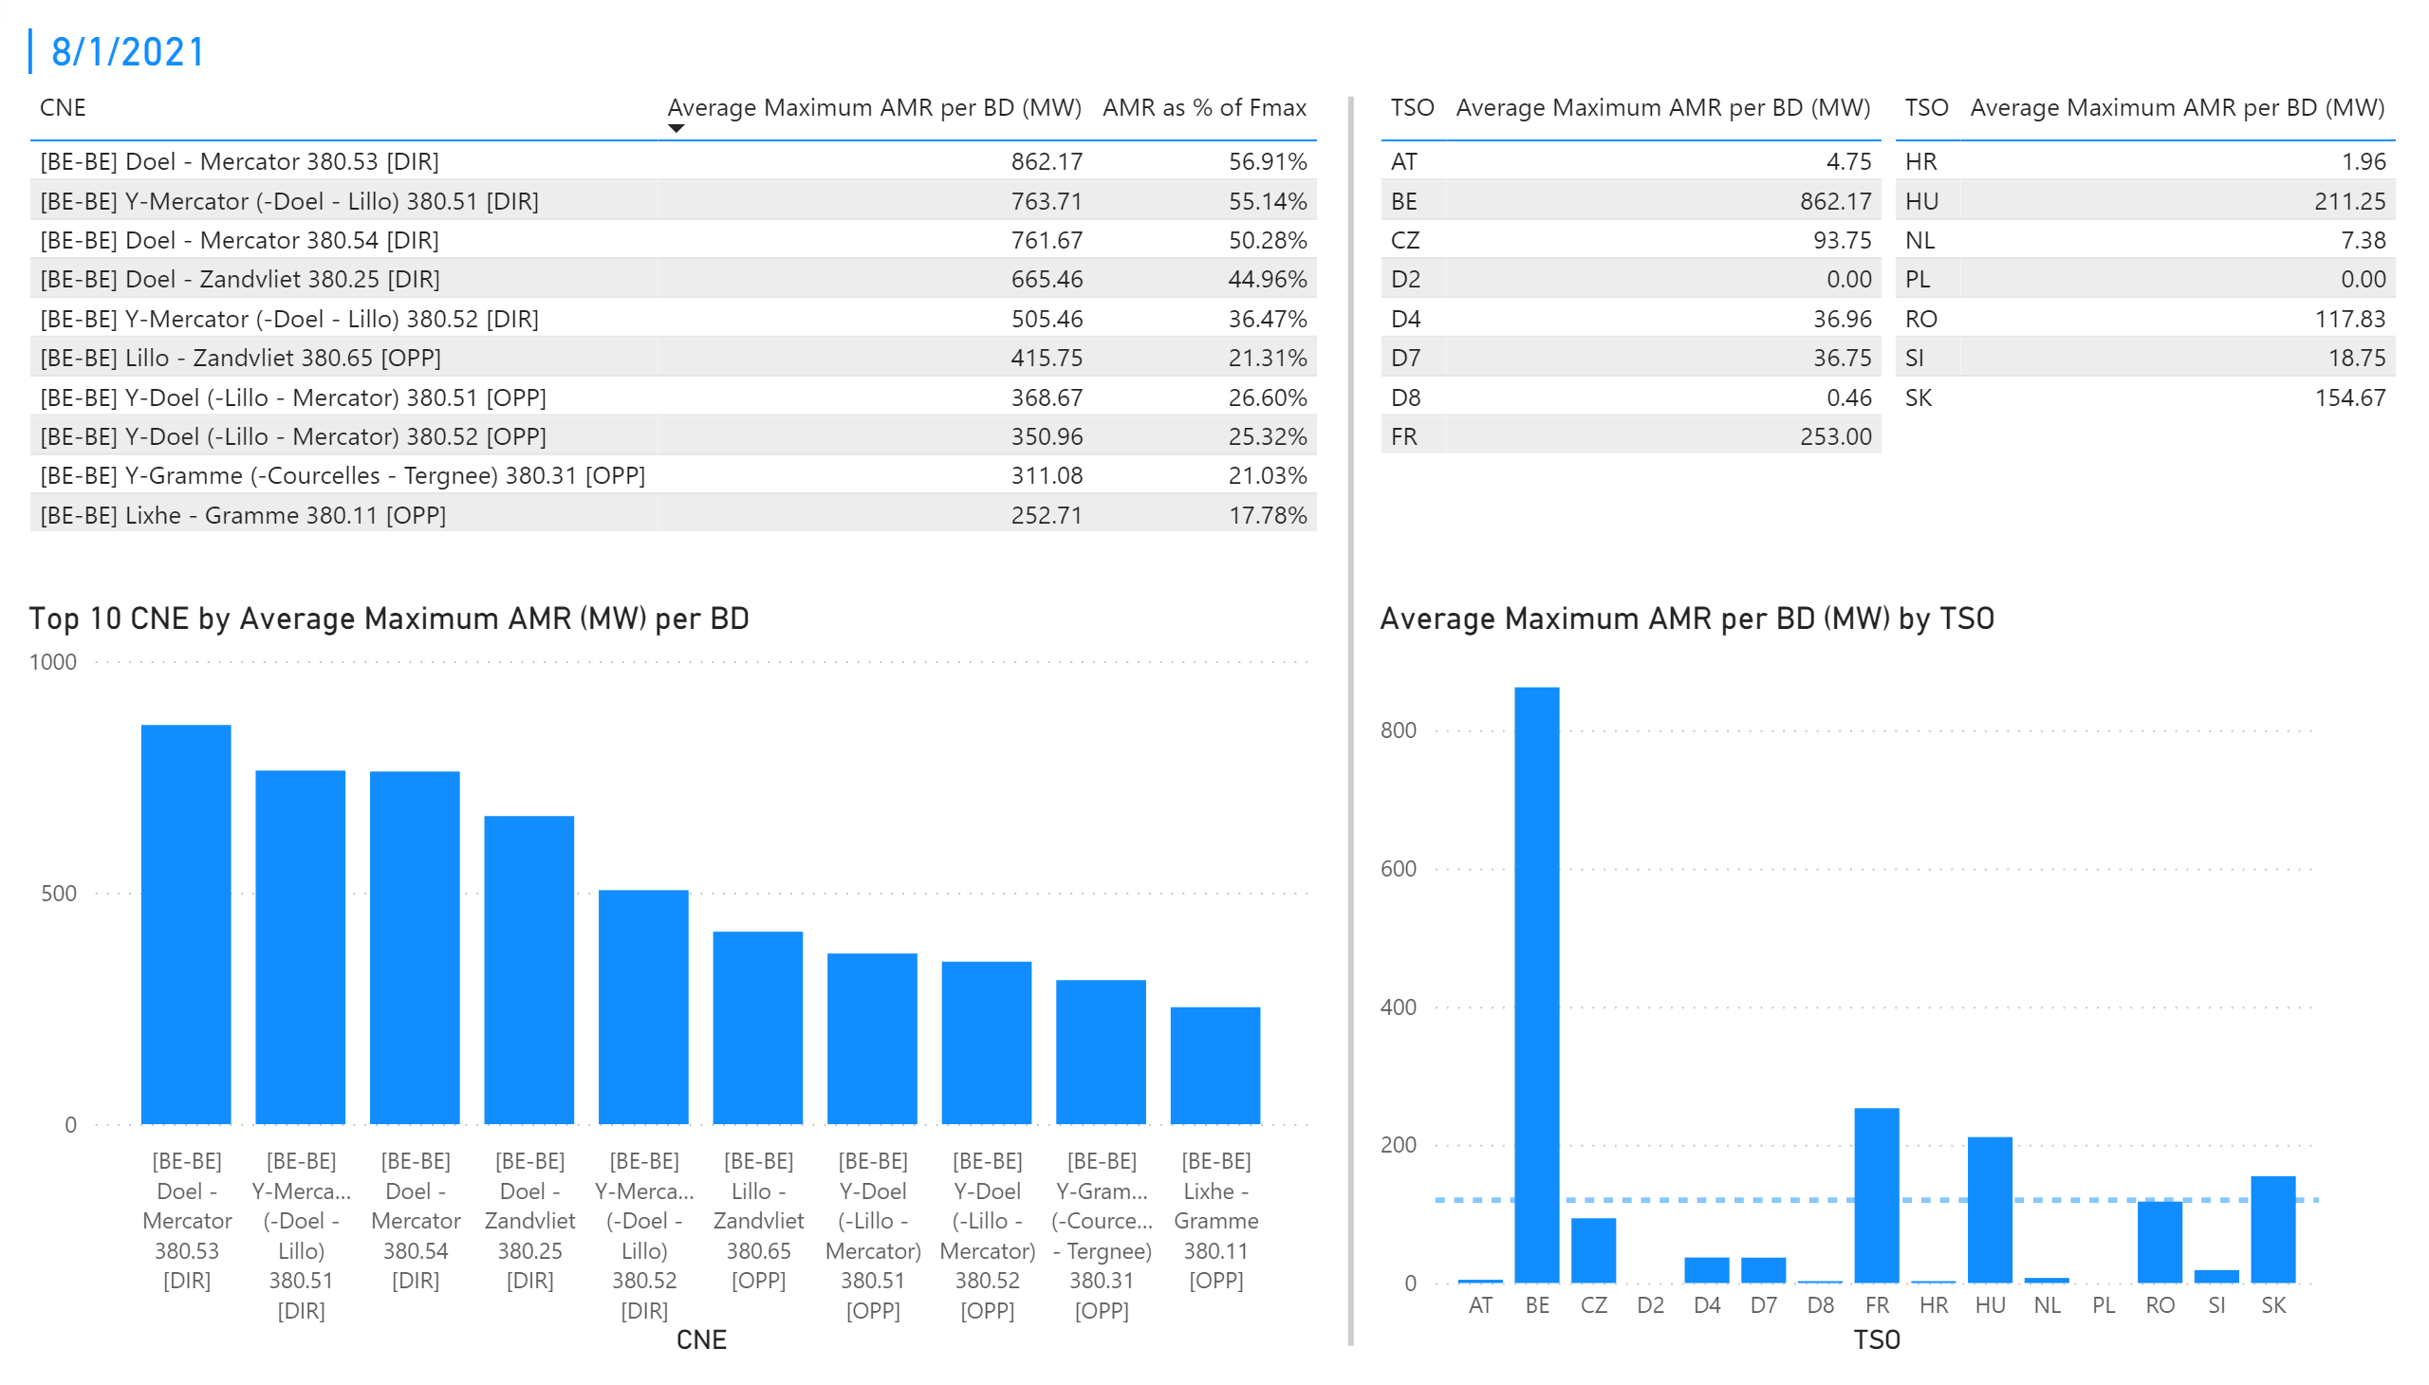
KPI 1 +2_1
KPI 1: Average maximum AMR per CNE per BD
KPI 2: Average maximum AMR per CNE per TSO
Notes:
tableEx
No alt text provided.
Top 10 CNE by Average Maximum AMR (MW) per BD
No alt text provided.
multiRowCard
No alt text provided.
tableEx
No alt text provided.
Average Maximum AMR per BD (MW) by TSO
No alt text provided.
tableEx
No alt text provided.
basicShape
No alt text provided.

Slide 8
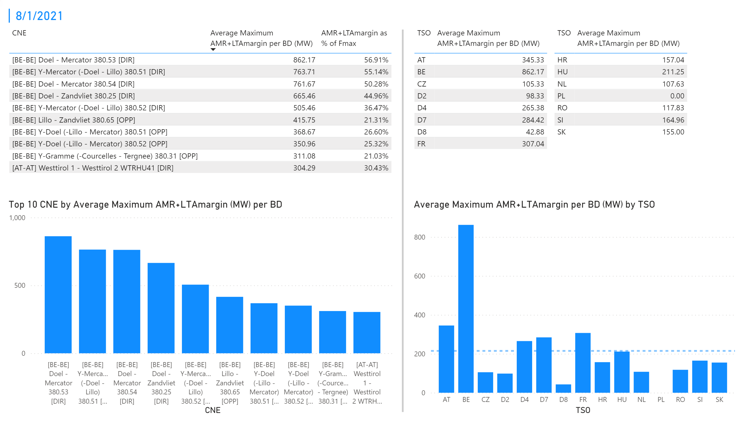
KPI 3 + 4_1
KPI 3: Average maximum AMR+LTAmargin per CNE per BD
KPI 4: Average maximum AMR+LTAmargin per TSO per BD
Notes:
tableEx
No alt text provided.
Top 10 CNE by Average Maximum AMR+LTAmargin (MW) per BD
No alt text provided.
multiRowCard
No alt text provided.
tableEx
No alt text provided.
tableEx
No alt text provided.
Average Maximum AMR+LTAmargin per BD (MW) by TSO
No alt text provided.
basicShape
No alt text provided.

Slide 9
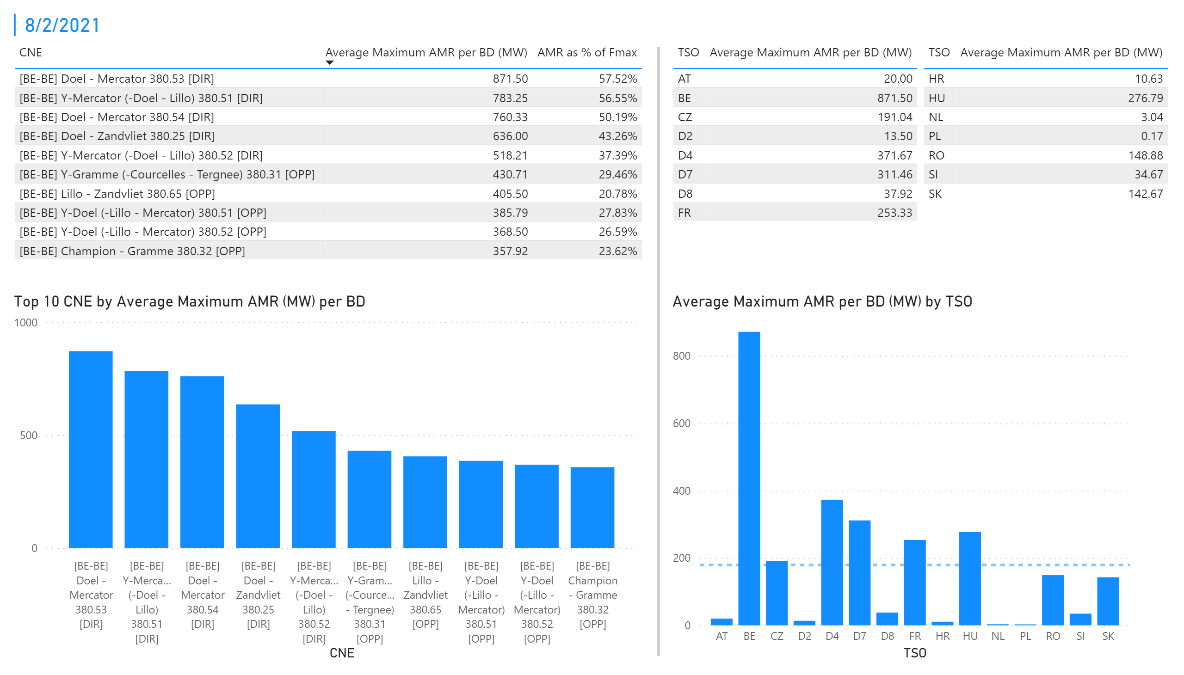
KPI 1 +2_2
KPI 1: Average maximum AMR per CNE per BD
KPI 2: Average maximum AMR per CNE per TSO
Notes:
tableEx
No alt text provided.
Top 10 CNE by Average Maximum AMR (MW) per BD
No alt text provided.
multiRowCard
No alt text provided.
tableEx
No alt text provided.
Average Maximum AMR per BD (MW) by TSO
No alt text provided.
tableEx
No alt text provided.
basicShape
No alt text provided.

Slide 10
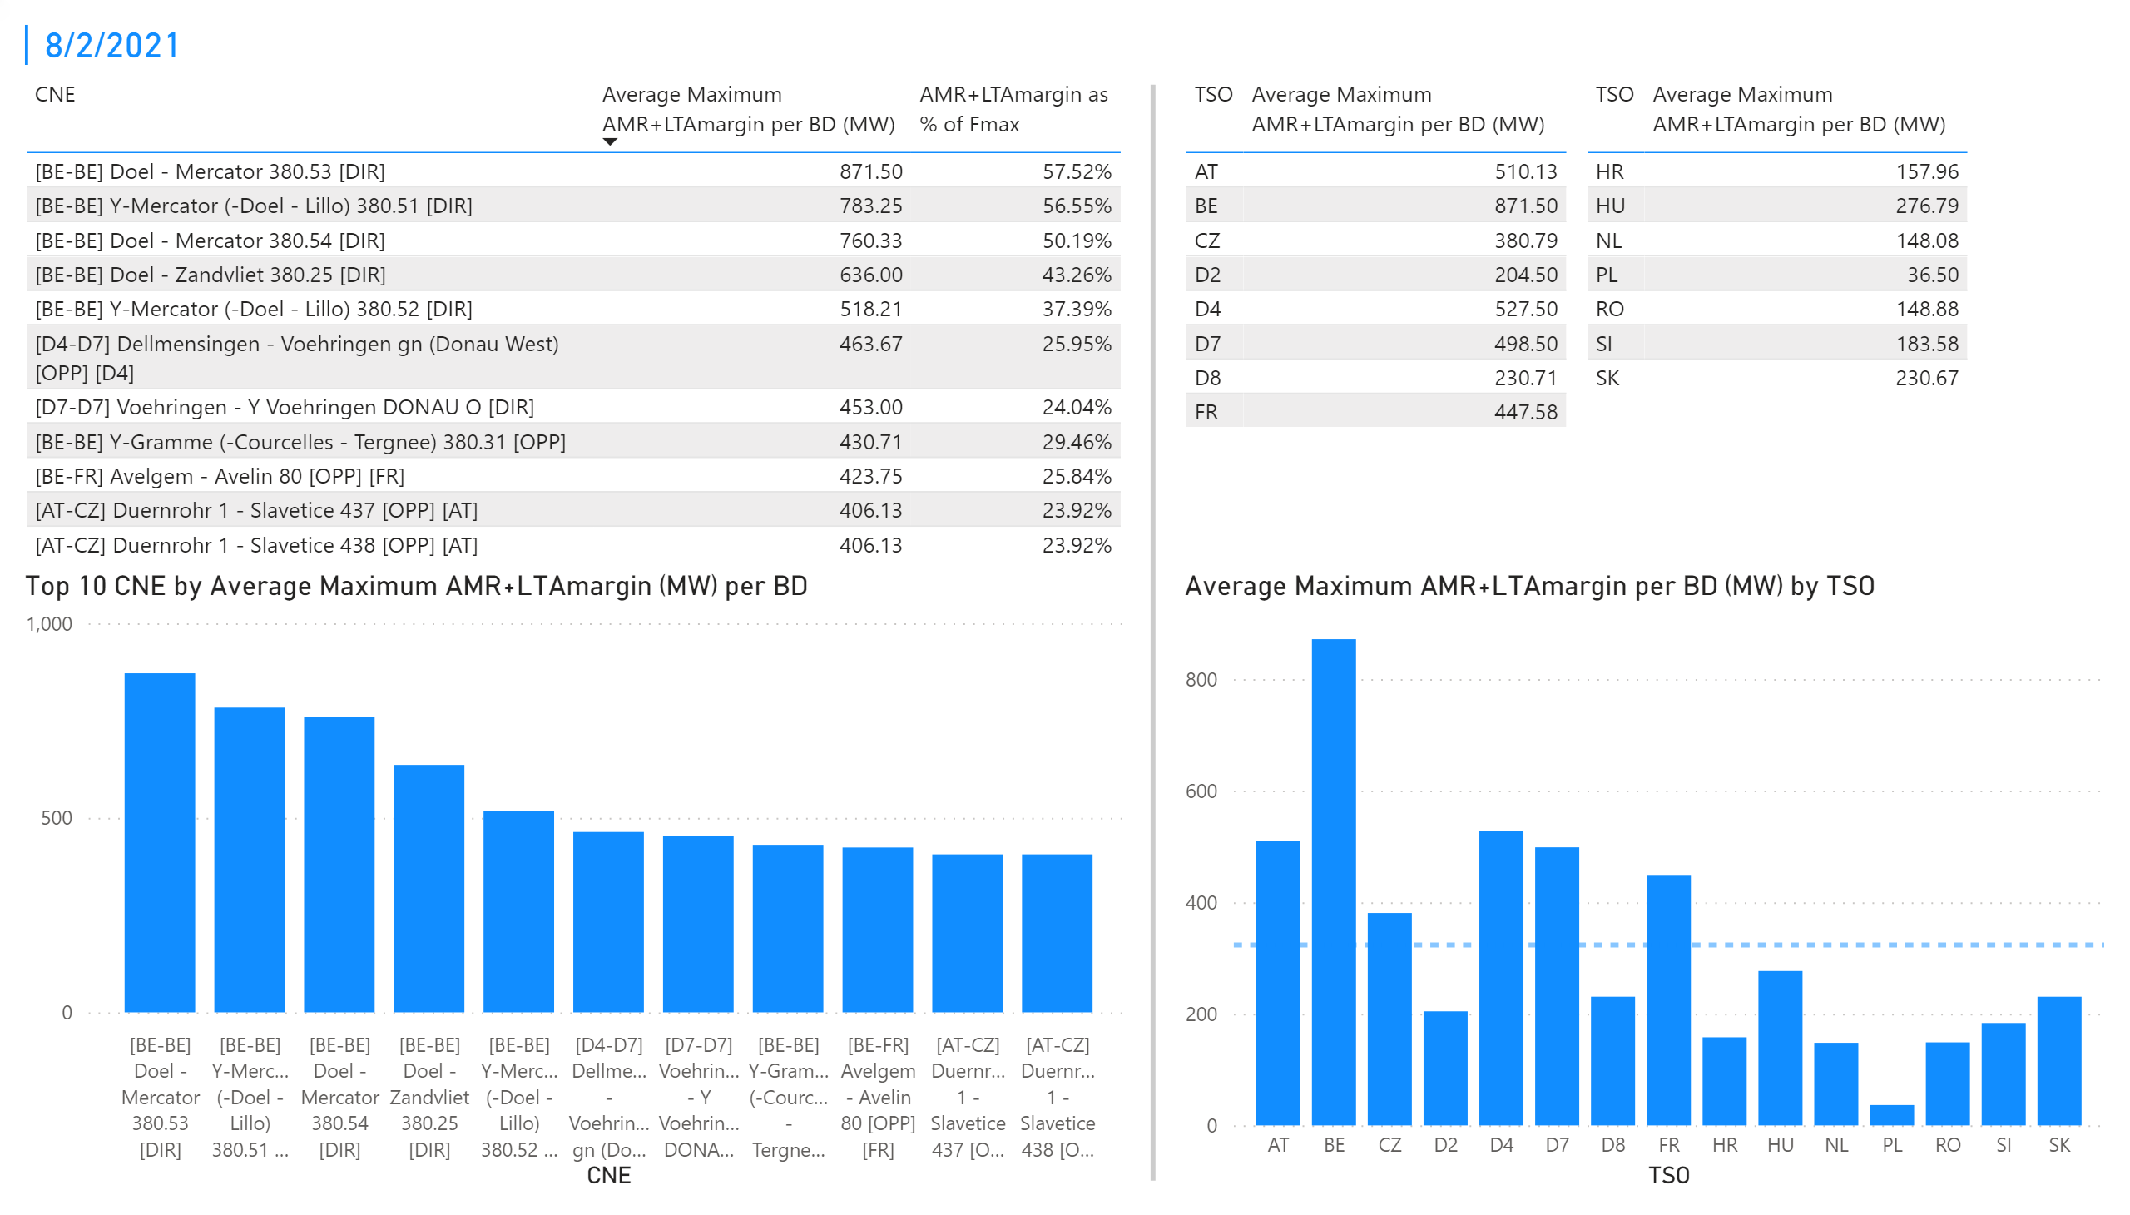
KPI 3 + 4_2
KPI 3: Average maximum AMR+LTAmargin per CNE per BD
KPI 4: Average maximum AMR+LTAmargin per TSO per BD
Notes:
tableEx
No alt text provided.
Top 10 CNE by Average Maximum AMR+LTAmargin (MW) per BD
No alt text provided.
multiRowCard
No alt text provided.
tableEx
No alt text provided.
tableEx
No alt text provided.
Average Maximum AMR+LTAmargin per BD (MW) by TSO
No alt text provided.
basicShape
No alt text provided.

Slide 11
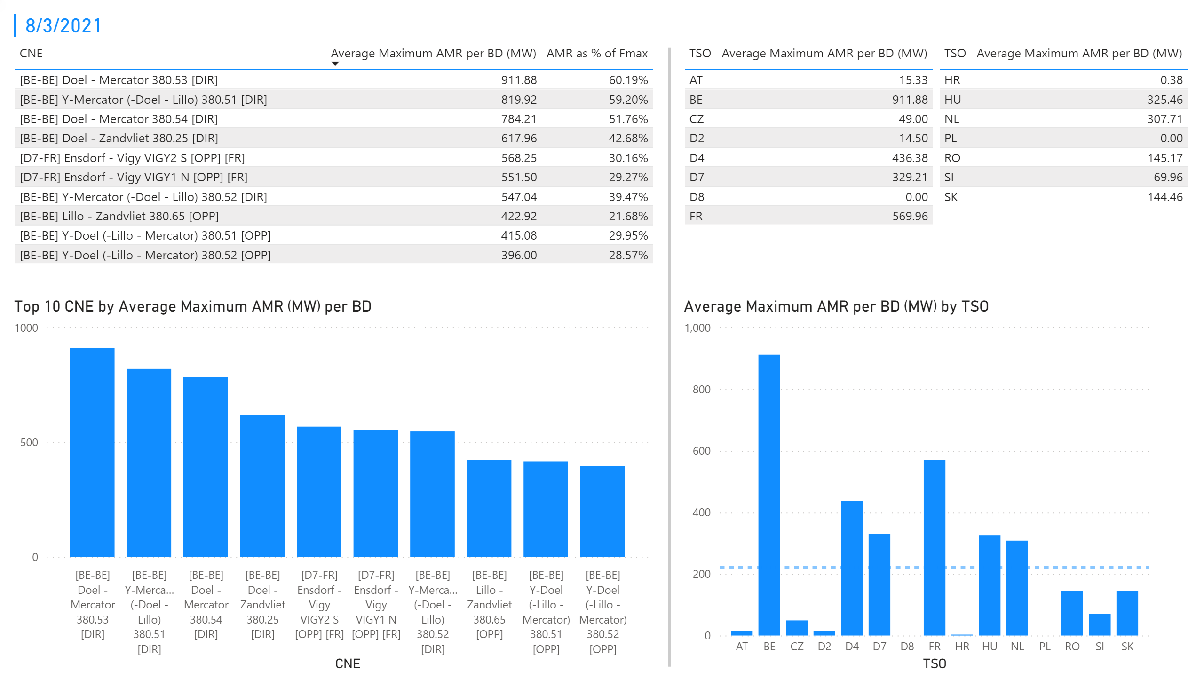
KPI 1 +2_3
KPI 1: Average maximum AMR per CNE per BD
KPI 2: Average maximum AMR per CNE per TSO
Notes:
tableEx
No alt text provided.
Top 10 CNE by Average Maximum AMR (MW) per BD
No alt text provided.
multiRowCard
No alt text provided.
tableEx
No alt text provided.
Average Maximum AMR per BD (MW) by TSO
No alt text provided.
tableEx
No alt text provided.
basicShape
No alt text provided.

Slide 12
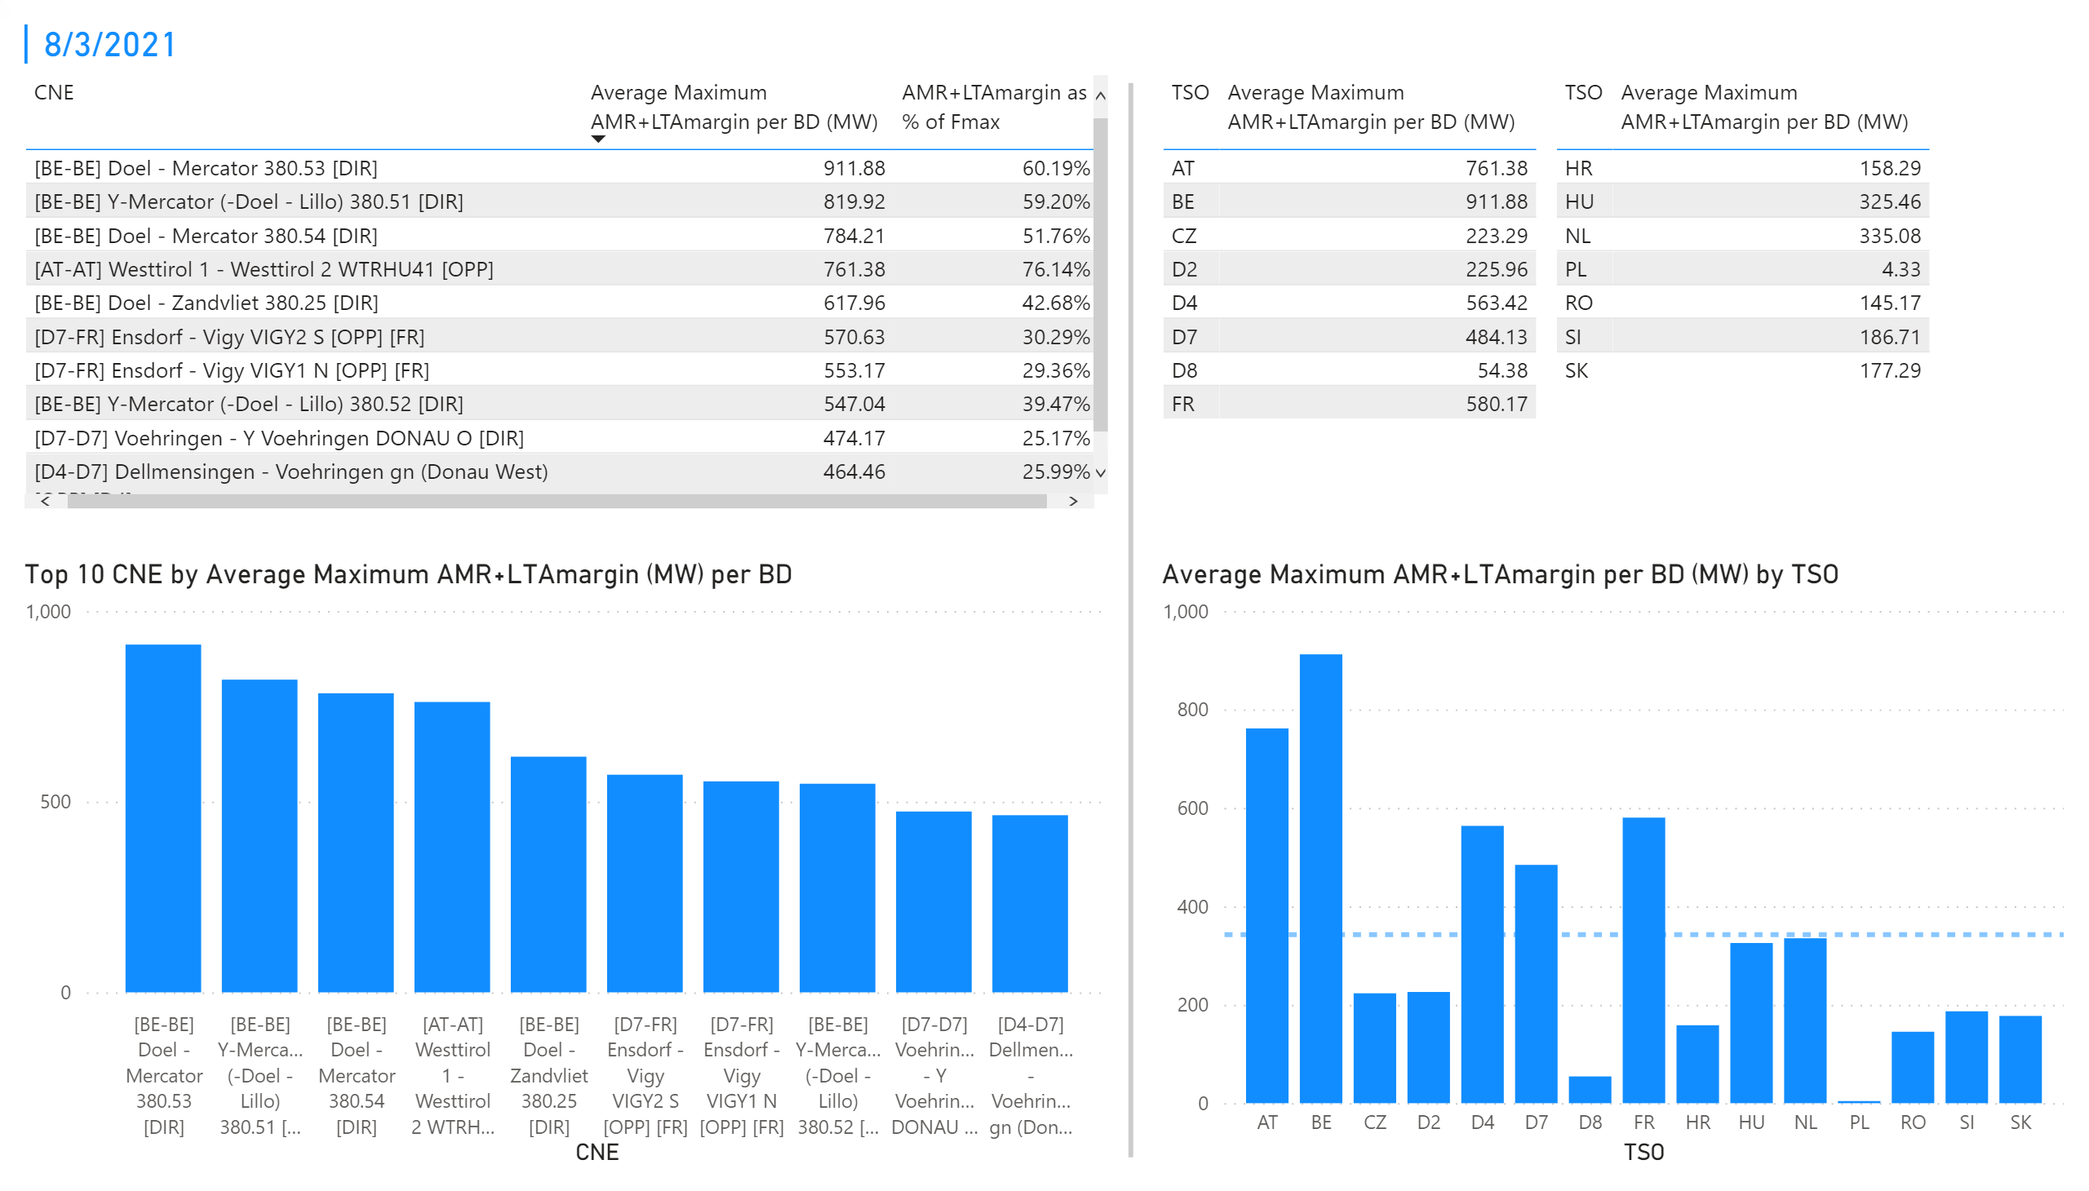
KPI 3 + 4_3
KPI 3: Average maximum AMR+LTAmargin per CNE per BD
KPI 4: Average maximum AMR+LTAmargin per TSO per BD
Notes:
tableEx
No alt text provided.
Top 10 CNE by Average Maximum AMR+LTAmargin (MW) per BD
No alt text provided.
multiRowCard
No alt text provided.
tableEx
No alt text provided.
tableEx
No alt text provided.
Average Maximum AMR+LTAmargin per BD (MW) by TSO
No alt text provided.
basicShape
No alt text provided.

Slide 13
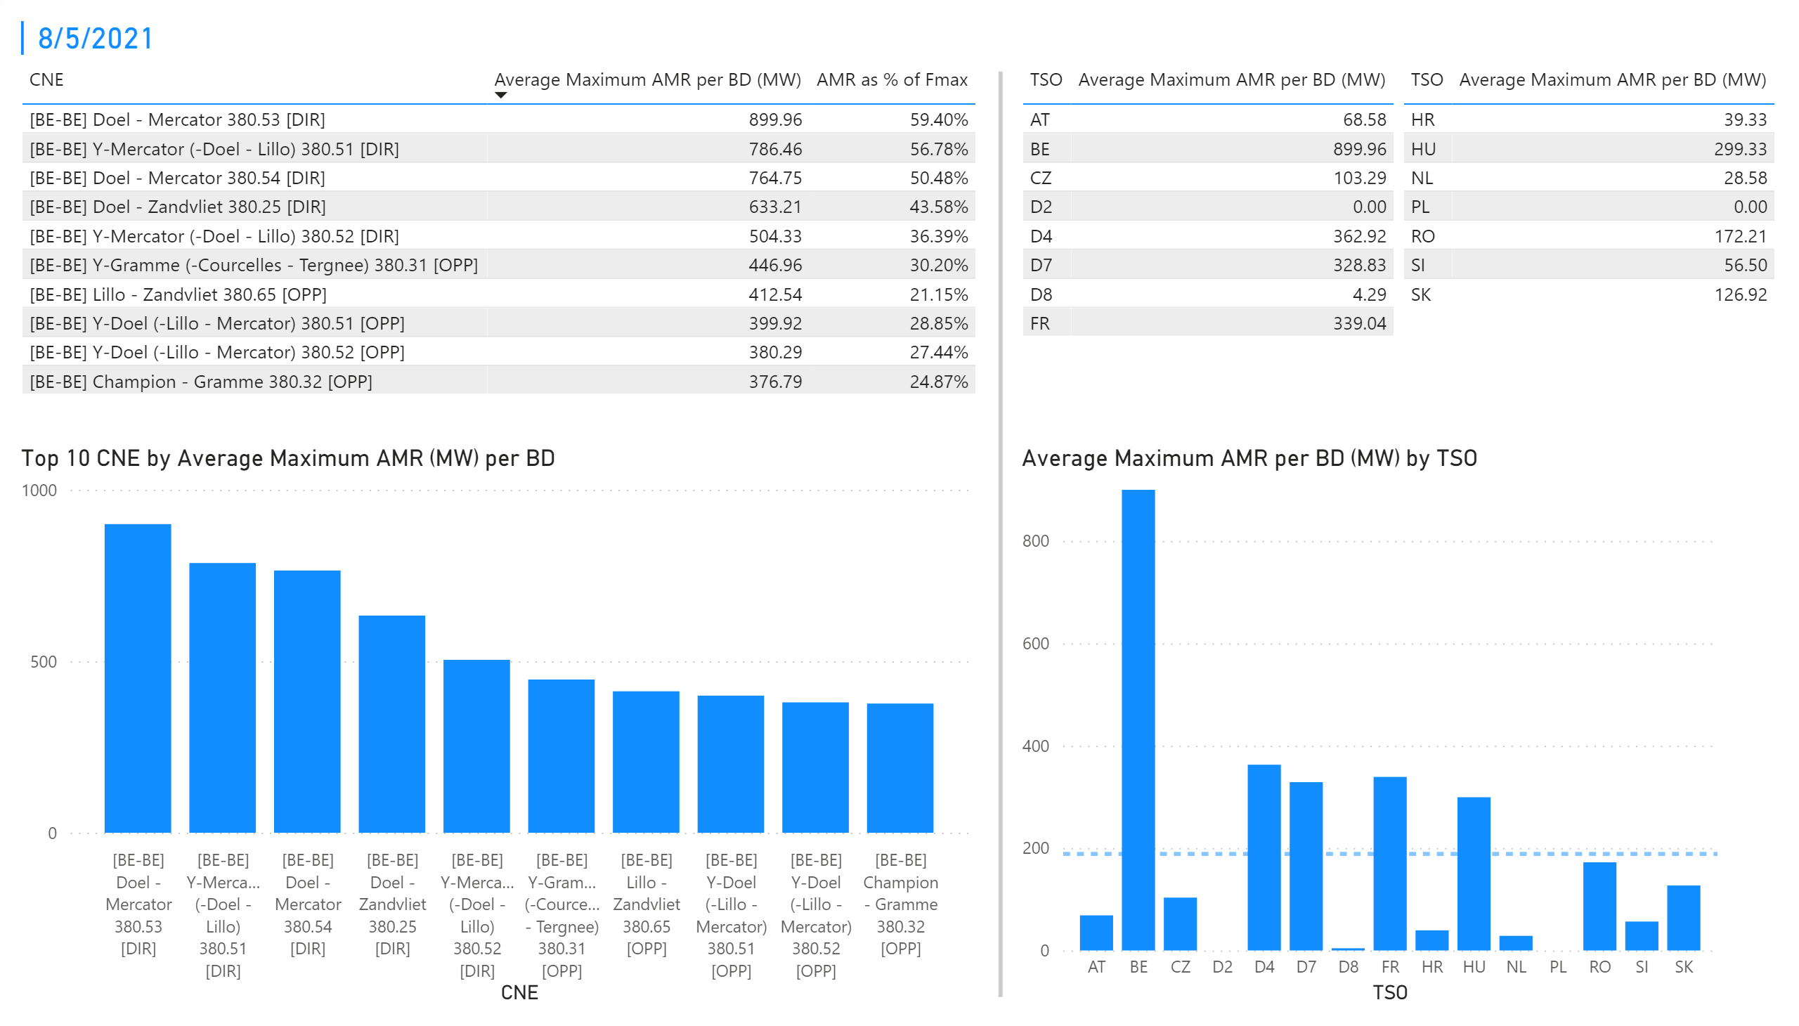
KPI 1 +2_5
KPI 1: Average maximum AMR per CNE per BD
KPI 2: Average maximum AMR per CNE per TSO
Notes:
tableEx
No alt text provided.
Top 10 CNE by Average Maximum AMR (MW) per BD
No alt text provided.
multiRowCard
No alt text provided.
tableEx
No alt text provided.
Average Maximum AMR per BD (MW) by TSO
No alt text provided.
tableEx
No alt text provided.
basicShape
No alt text provided.

Slide 14
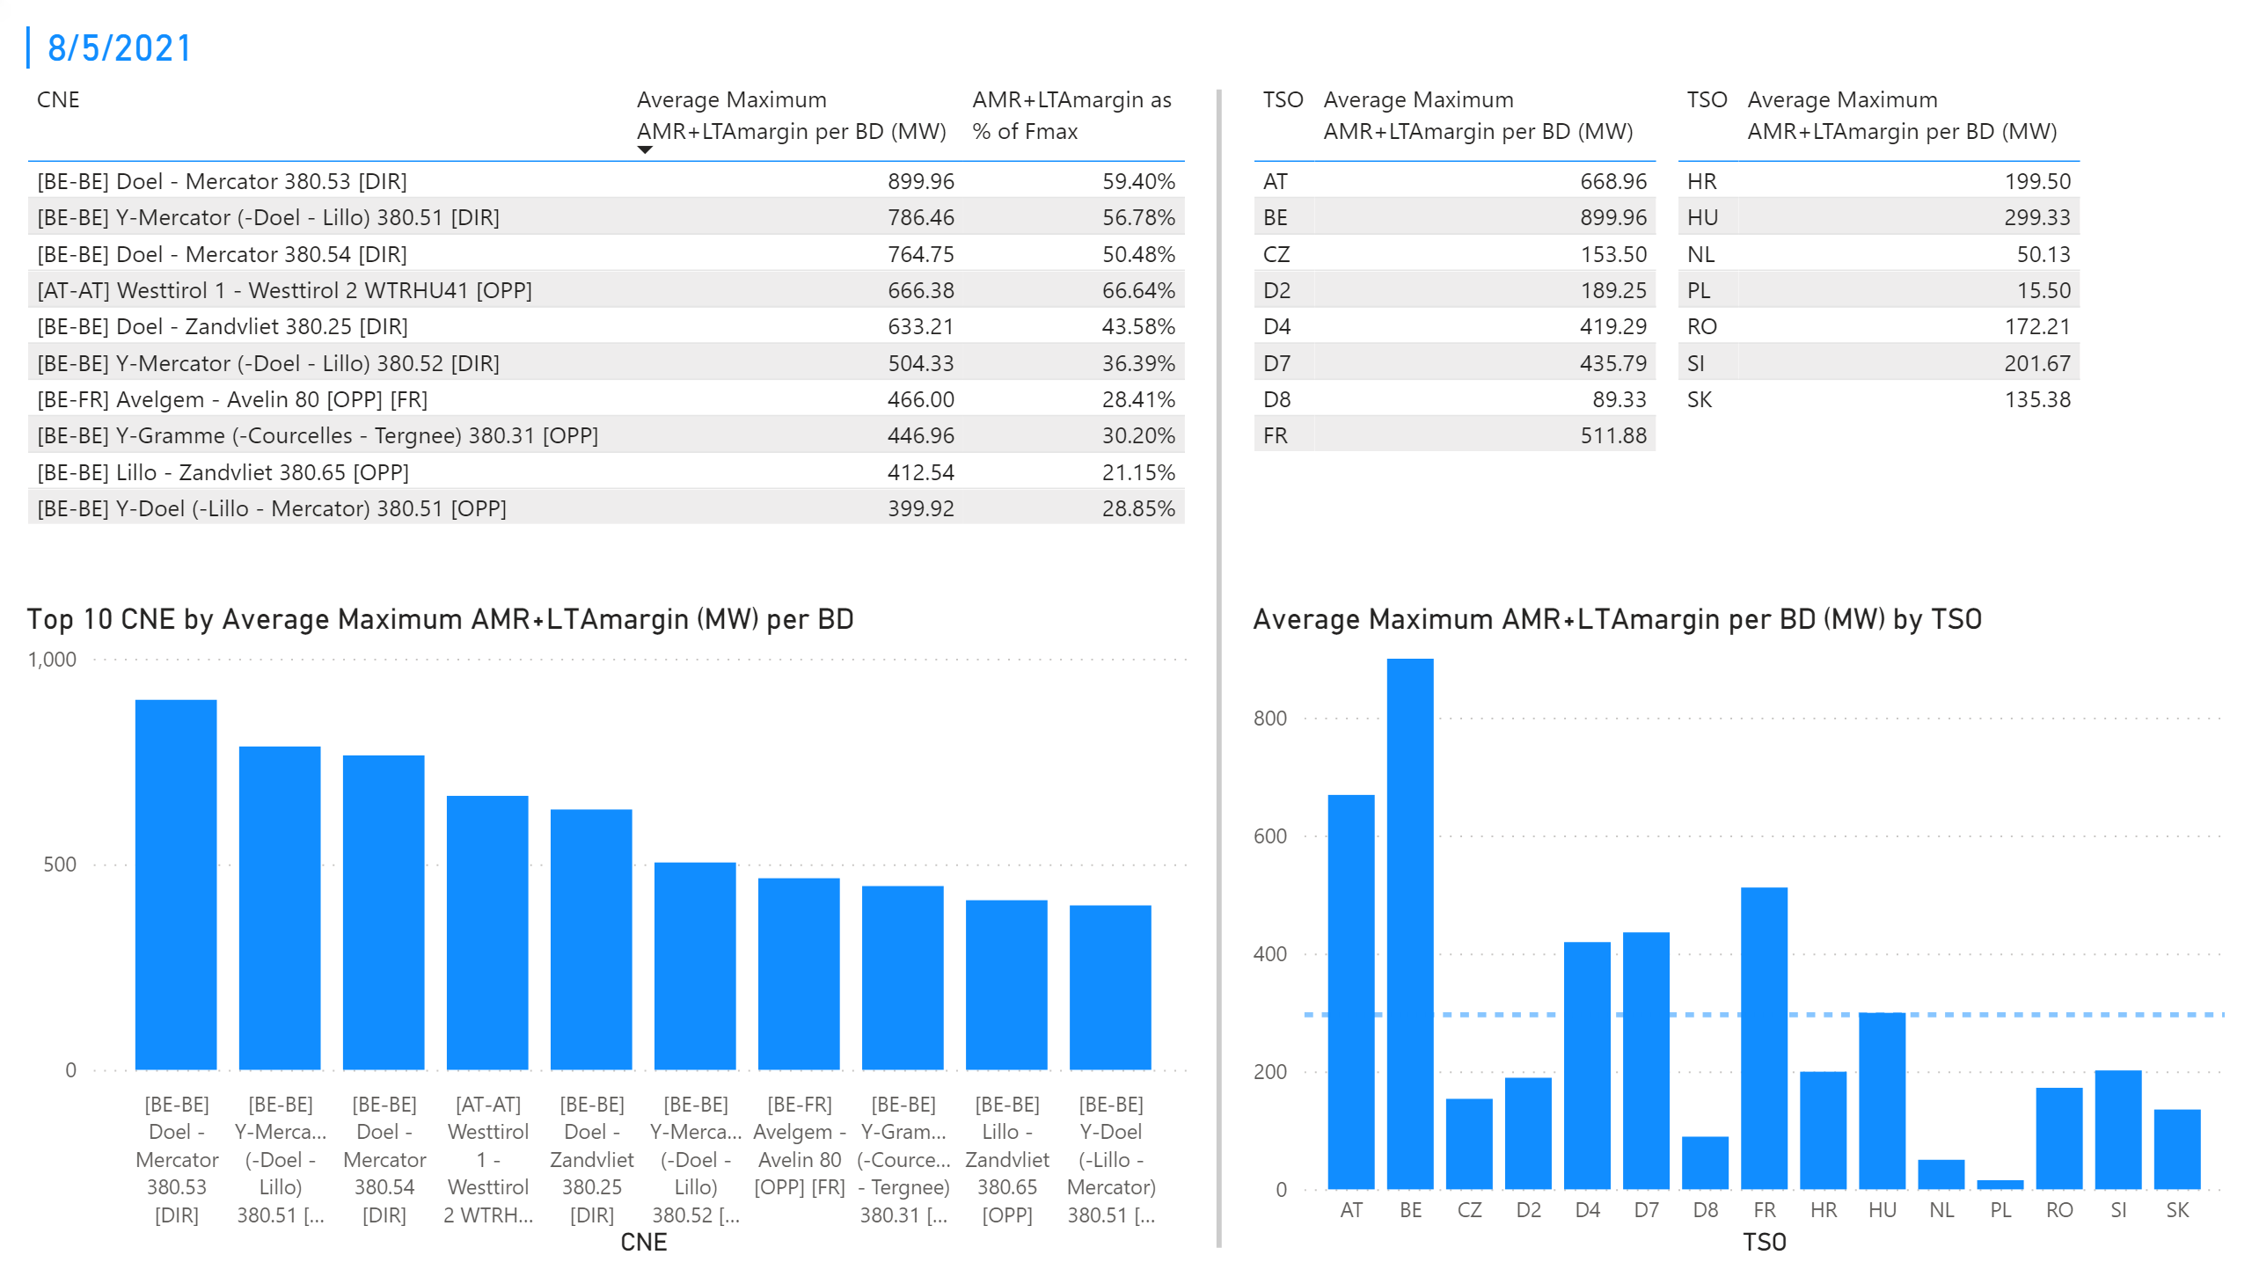
KPI 3 + 4_5
KPI 3: Average maximum AMR+LTAmargin per CNE per BD
KPI 4: Average maximum AMR+LTAmargin per TSO per BD
Notes:
tableEx
No alt text provided.
Top 10 CNE by Average Maximum AMR+LTAmargin (MW) per BD
No alt text provided.
multiRowCard
No alt text provided.
tableEx
No alt text provided.
tableEx
No alt text provided.
Average Maximum AMR+LTAmargin per BD (MW) by TSO
No alt text provided.
basicShape
No alt text provided.

Slide 15

KPI 1 +2_6
KPI 1: Average maximum AMR per CNE per BD
KPI 2: Average maximum AMR per CNE per TSO
Notes:
tableEx
No alt text provided.
Top 10 CNE by Average Maximum AMR (MW) per BD
No alt text provided.
multiRowCard
No alt text provided.
tableEx
No alt text provided.
Average Maximum AMR per BD (MW) by TSO
No alt text provided.
tableEx
No alt text provided.
basicShape
No alt text provided.

Slide 16
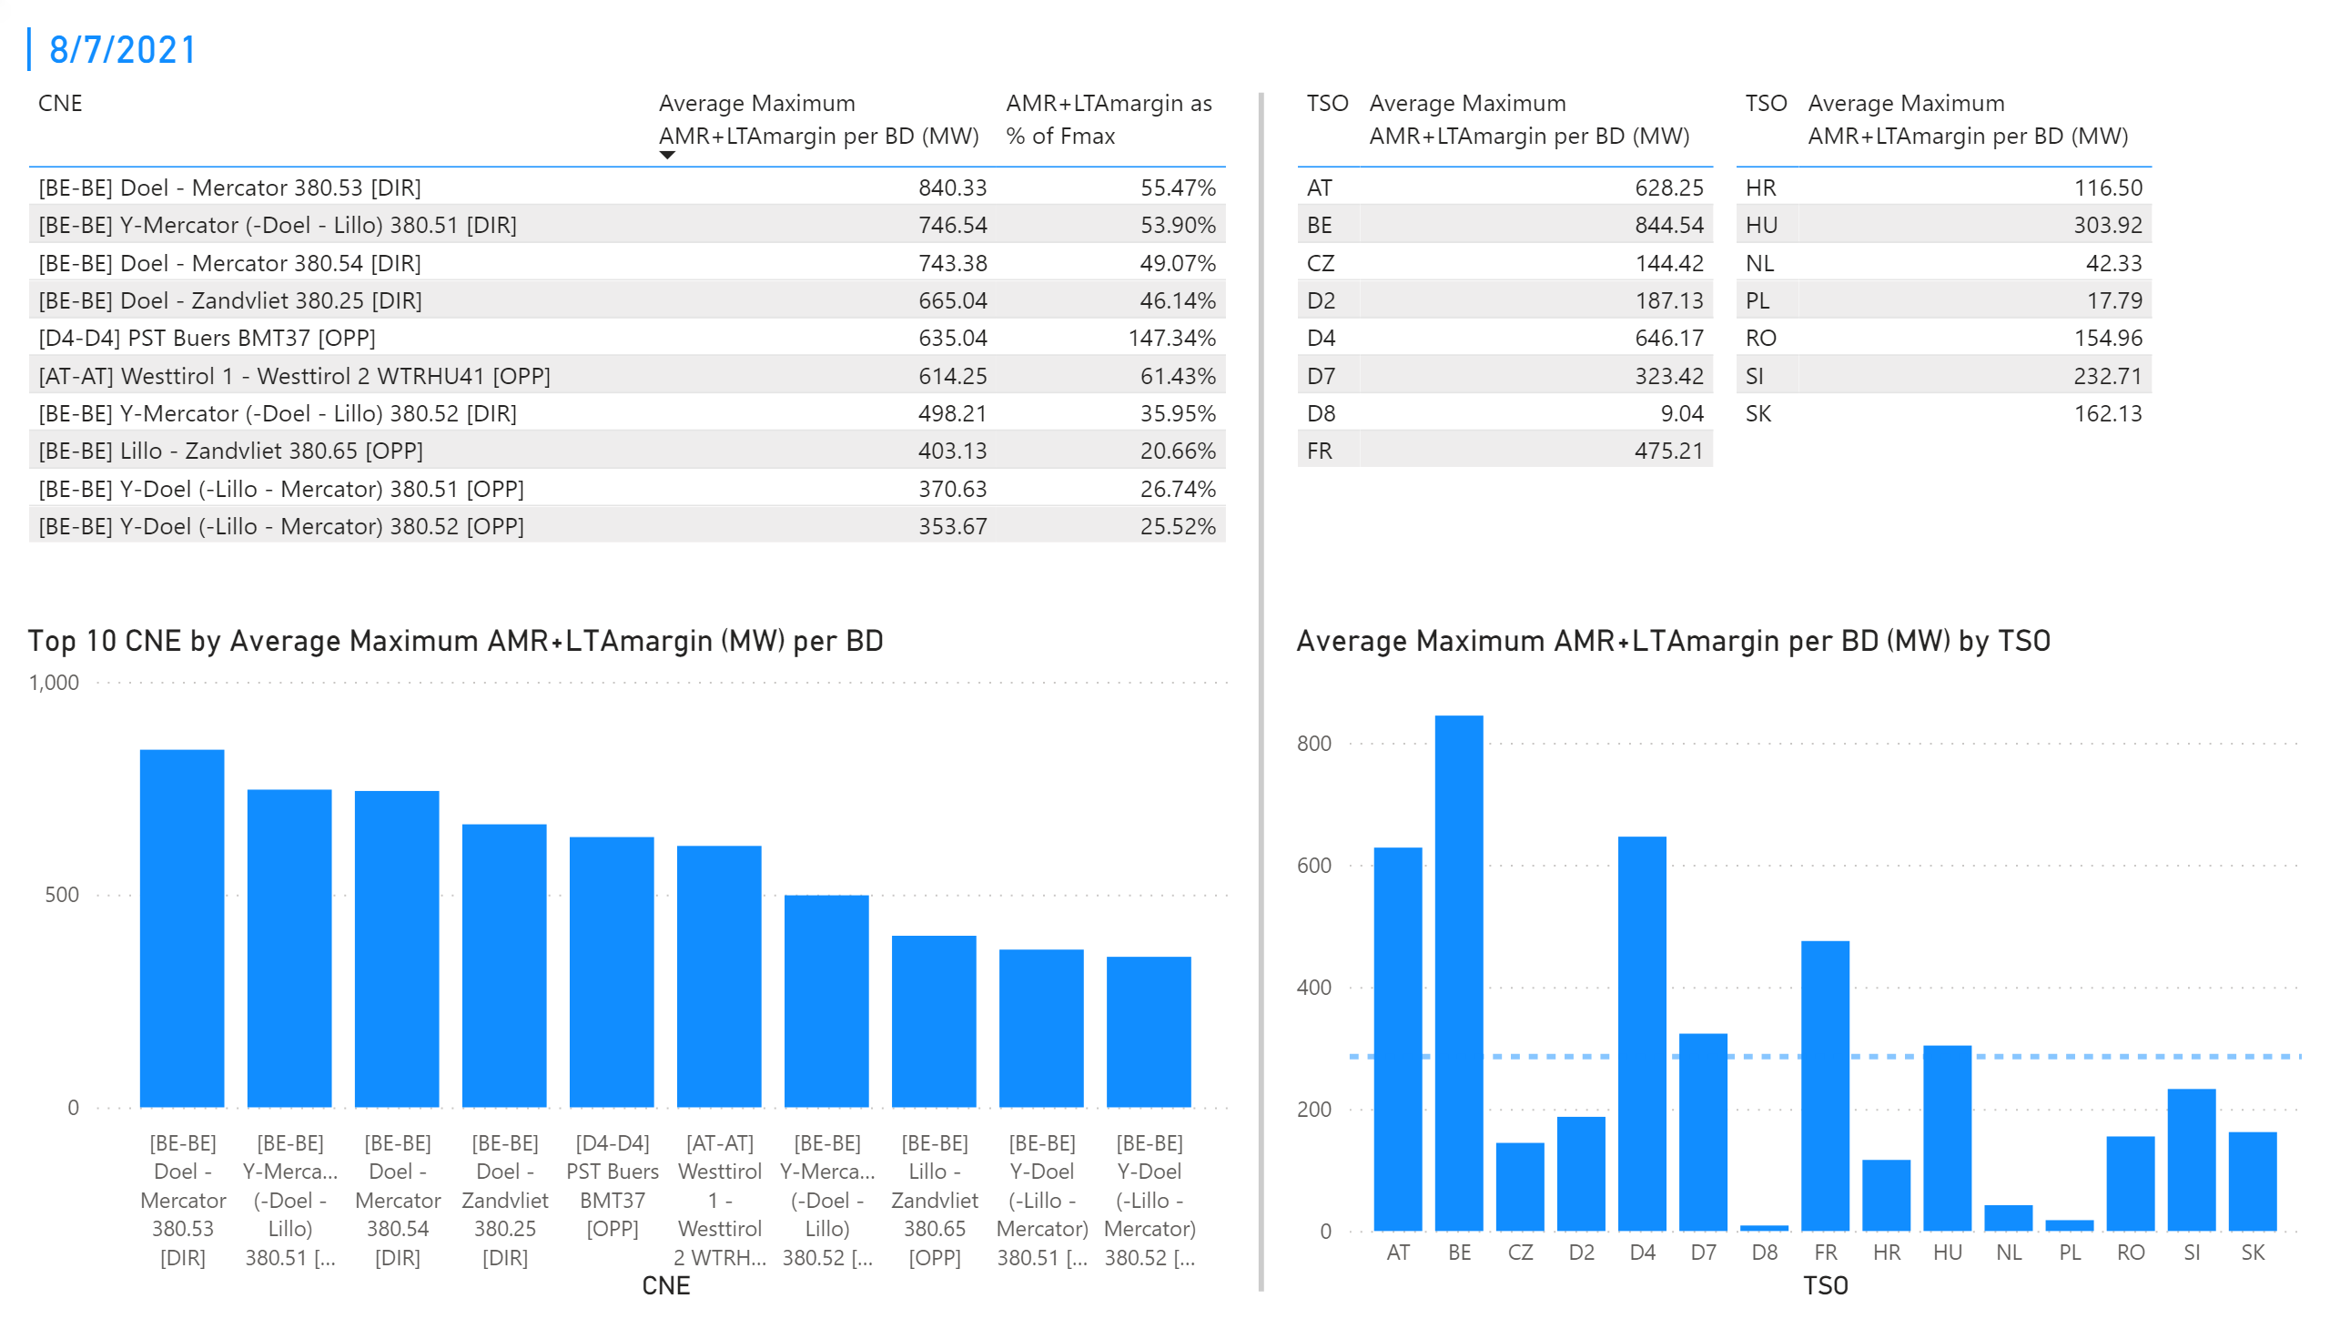
KPI 3 + 4_6
KPI 3: Average maximum AMR+LTAmargin per CNE per BD
KPI 4: Average maximum AMR+LTAmargin per TSO per BD
Notes:
tableEx
No alt text provided.
Top 10 CNE by Average Maximum AMR+LTAmargin (MW) per BD
No alt text provided.
multiRowCard
No alt text provided.
tableEx
No alt text provided.
tableEx
No alt text provided.
Average Maximum AMR+LTAmargin per BD (MW) by TSO
No alt text provided.
basicShape
No alt text provided.

Slide 17
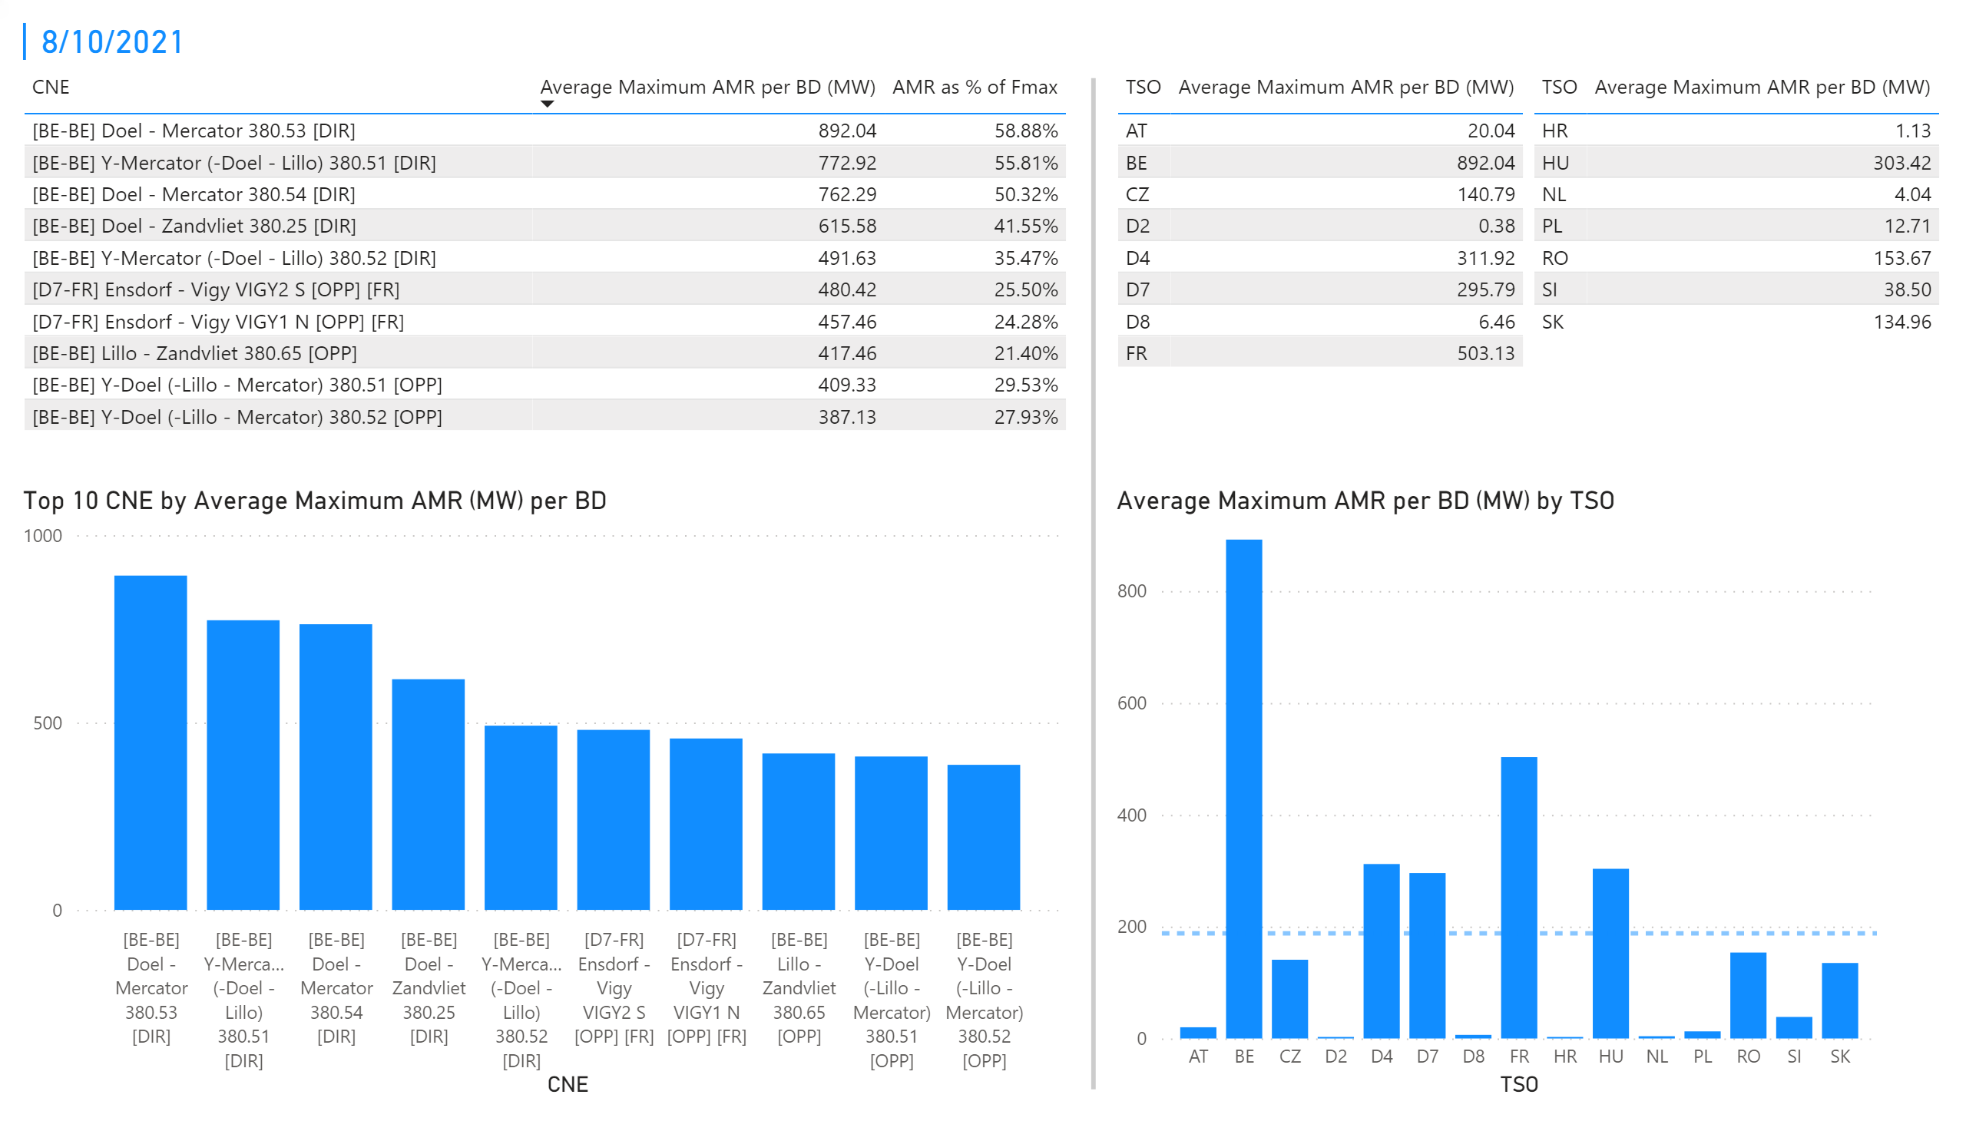
KPI 1 +2_7
KPI 1: Average maximum AMR per CNE per BD
KPI 2: Average maximum AMR per CNE per TSO
Notes:
tableEx
No alt text provided.
Top 10 CNE by Average Maximum AMR (MW) per BD
No alt text provided.
multiRowCard
No alt text provided.
tableEx
No alt text provided.
Average Maximum AMR per BD (MW) by TSO
No alt text provided.
tableEx
No alt text provided.
basicShape
No alt text provided.

Slide 18
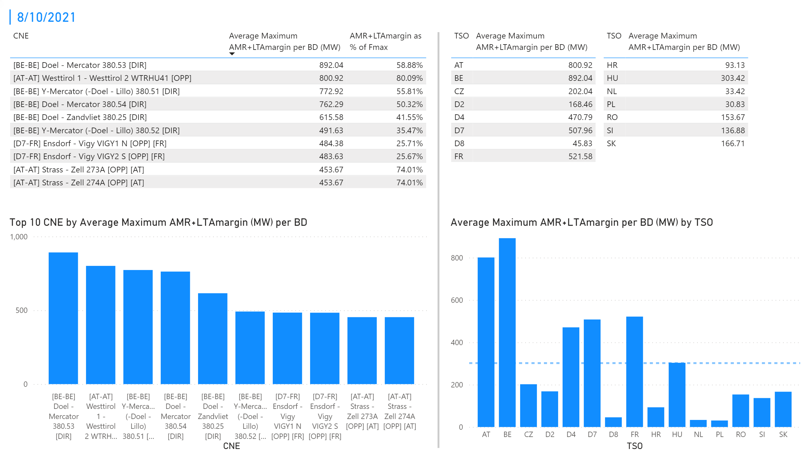
KPI 3 + 4_7
KPI 3: Average maximum AMR+LTAmargin per CNE per BD
KPI 4: Average maximum AMR+LTAmargin per TSO per BD
Notes:
tableEx
No alt text provided.
Top 10 CNE by Average Maximum AMR+LTAmargin (MW) per BD
No alt text provided.
multiRowCard
No alt text provided.
tableEx
No alt text provided.
tableEx
No alt text provided.
Average Maximum AMR+LTAmargin per BD (MW) by TSO
No alt text provided.
basicShape
No alt text provided.

Slide 19
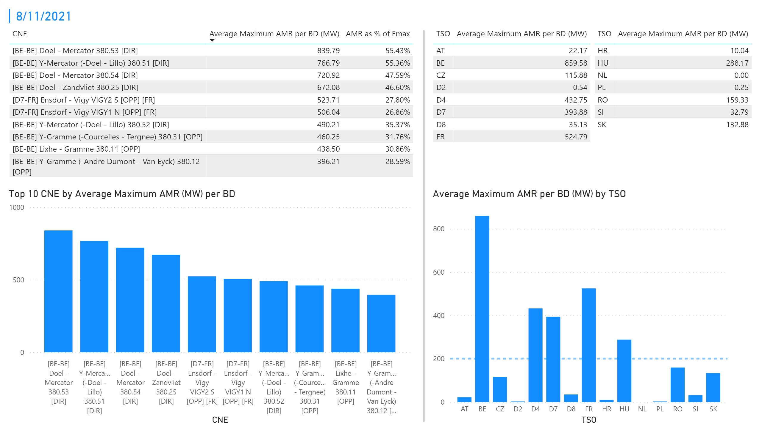
KPI 1 +2_8
KPI 1: Average maximum AMR per CNE per BD
KPI 2: Average maximum AMR per CNE per TSO
Notes:
tableEx
No alt text provided.
Top 10 CNE by Average Maximum AMR (MW) per BD
No alt text provided.
multiRowCard
No alt text provided.
tableEx
No alt text provided.
Average Maximum AMR per BD (MW) by TSO
No alt text provided.
tableEx
No alt text provided.
basicShape
No alt text provided.

Slide 20
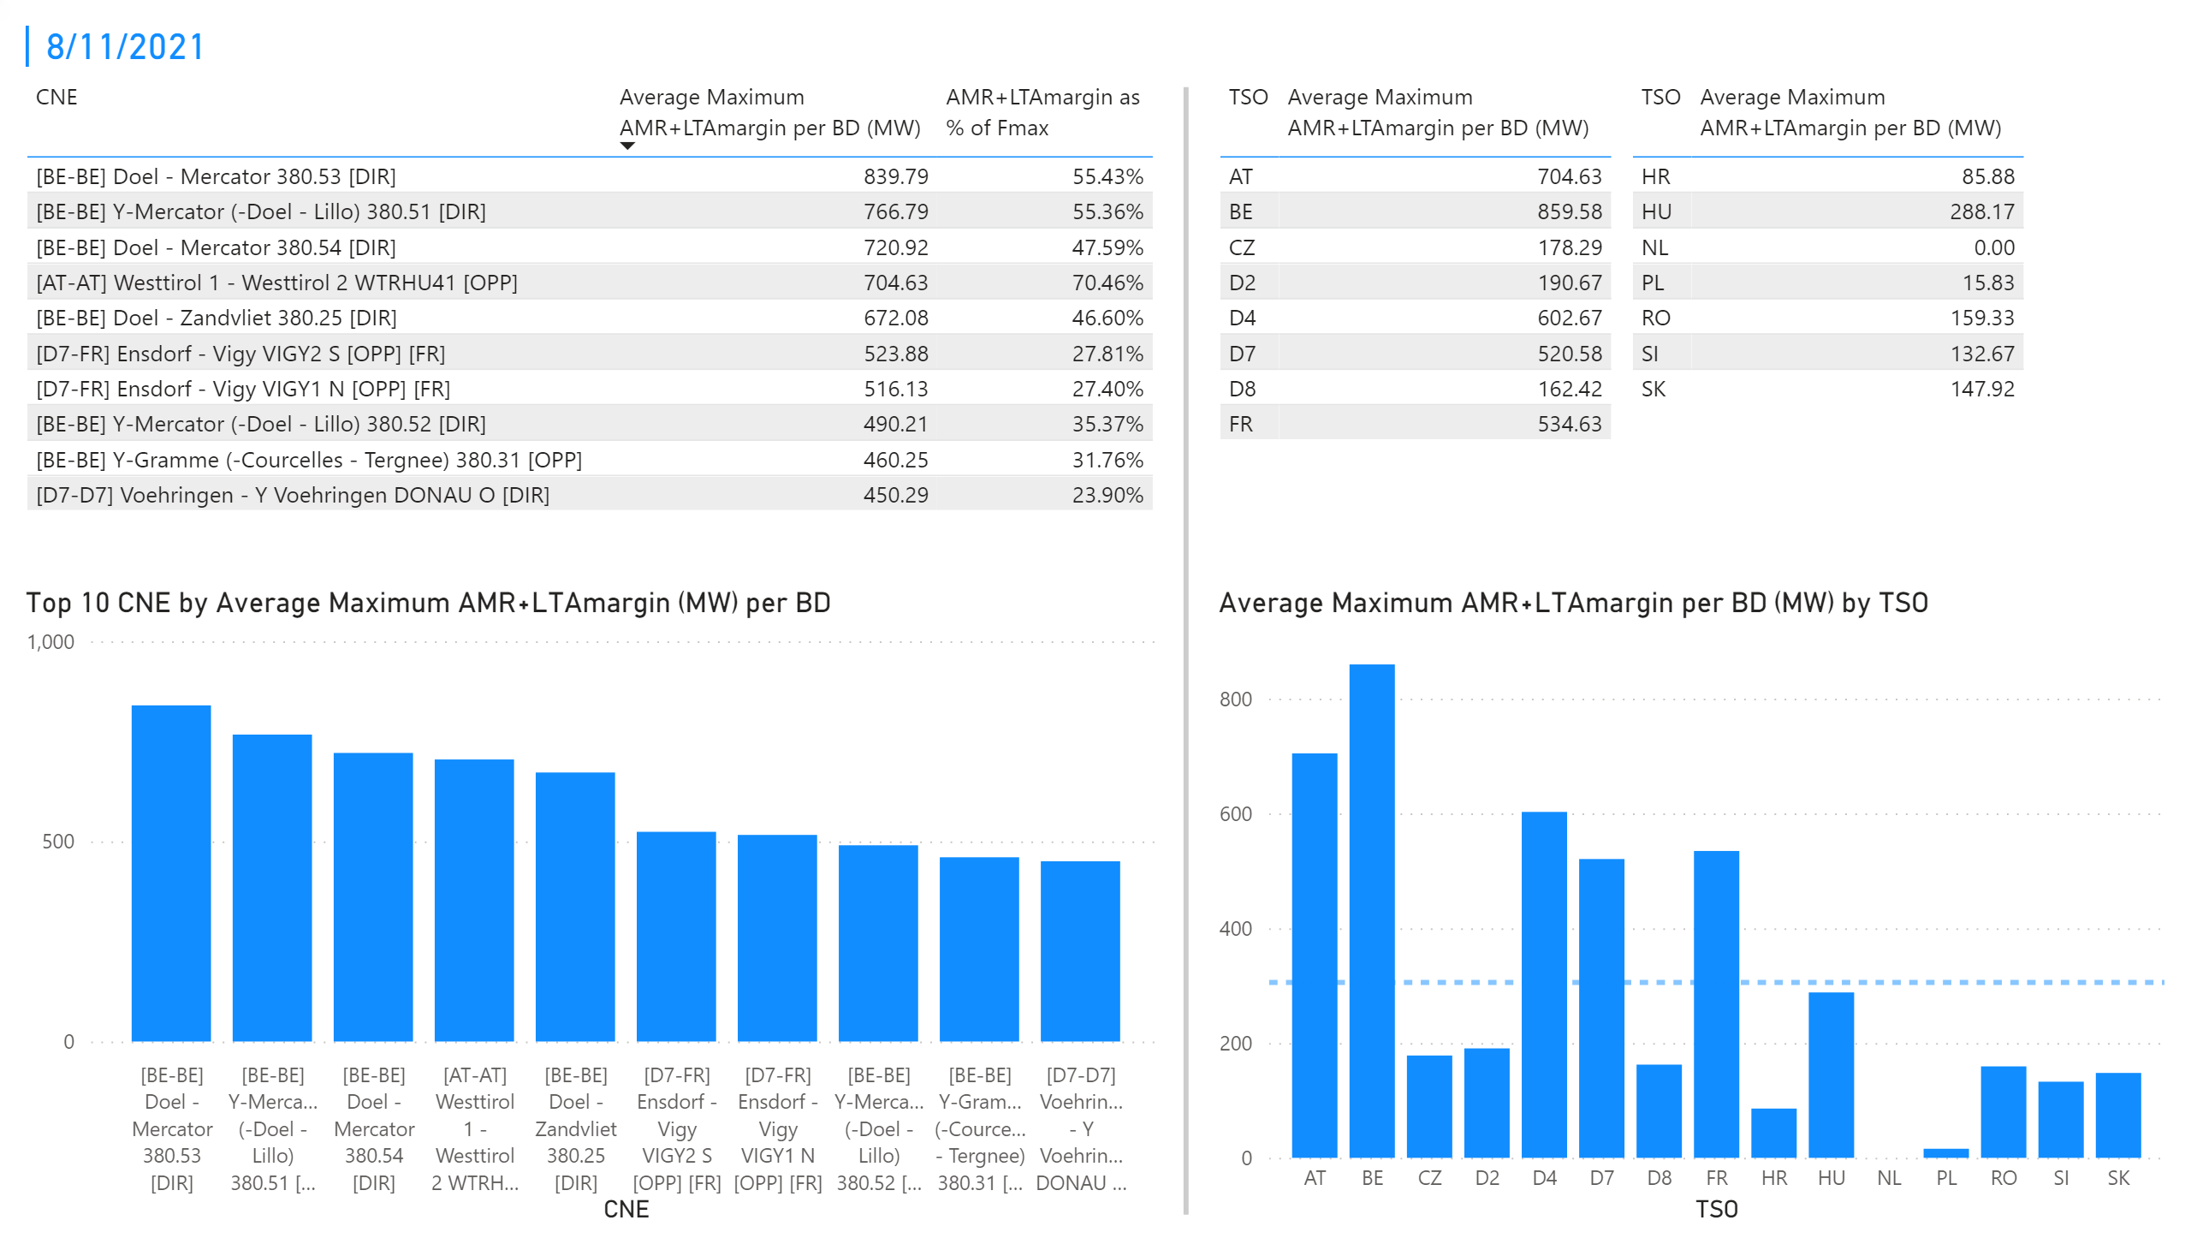
KPI 3 + 4_8
KPI 3: Average maximum AMR+LTAmargin per CNE per BD
KPI 4: Average maximum AMR+LTAmargin per TSO per BD
Notes:
tableEx
No alt text provided.
Top 10 CNE by Average Maximum AMR+LTAmargin (MW) per BD
No alt text provided.
multiRowCard
No alt text provided.
tableEx
No alt text provided.
tableEx
No alt text provided.
Average Maximum AMR+LTAmargin per BD (MW) by TSO
No alt text provided.
basicShape
No alt text provided.

Slide 21
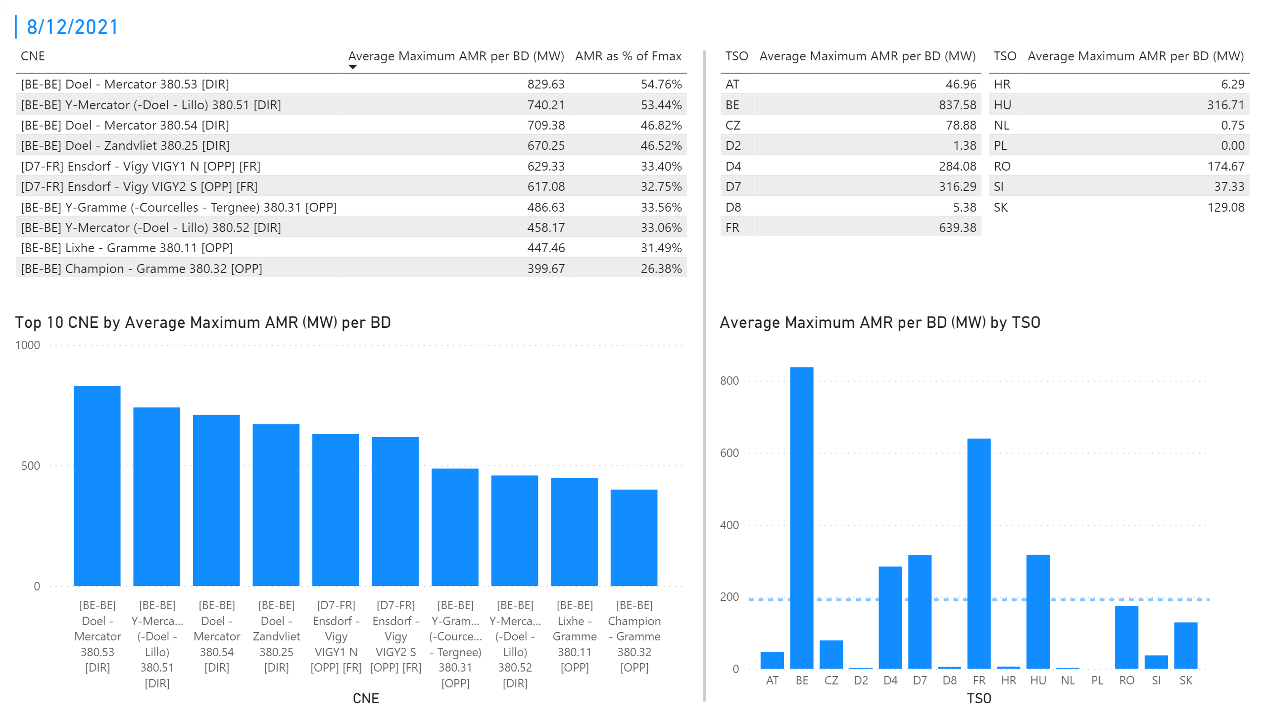
KPI 1 +2_9
KPI 1: Average maximum AMR per CNE per BD
KPI 2: Average maximum AMR per CNE per TSO
Notes:
tableEx
No alt text provided.
Top 10 CNE by Average Maximum AMR (MW) per BD
No alt text provided.
multiRowCard
No alt text provided.
tableEx
No alt text provided.
Average Maximum AMR per BD (MW) by TSO
No alt text provided.
tableEx
No alt text provided.
basicShape
No alt text provided.

Slide 22

KPI 3 + 4_9
KPI 3: Average maximum AMR+LTAmargin per CNE per BD
KPI 4: Average maximum AMR+LTAmargin per TSO per BD
Notes:
tableEx
No alt text provided.
Top 10 CNE by Average Maximum AMR+LTAmargin (MW) per BD
No alt text provided.
multiRowCard
No alt text provided.
tableEx
No alt text provided.
tableEx
No alt text provided.
Average Maximum AMR+LTAmargin per BD (MW) by TSO
No alt text provided.
basicShape
No alt text provided.

Slide 23
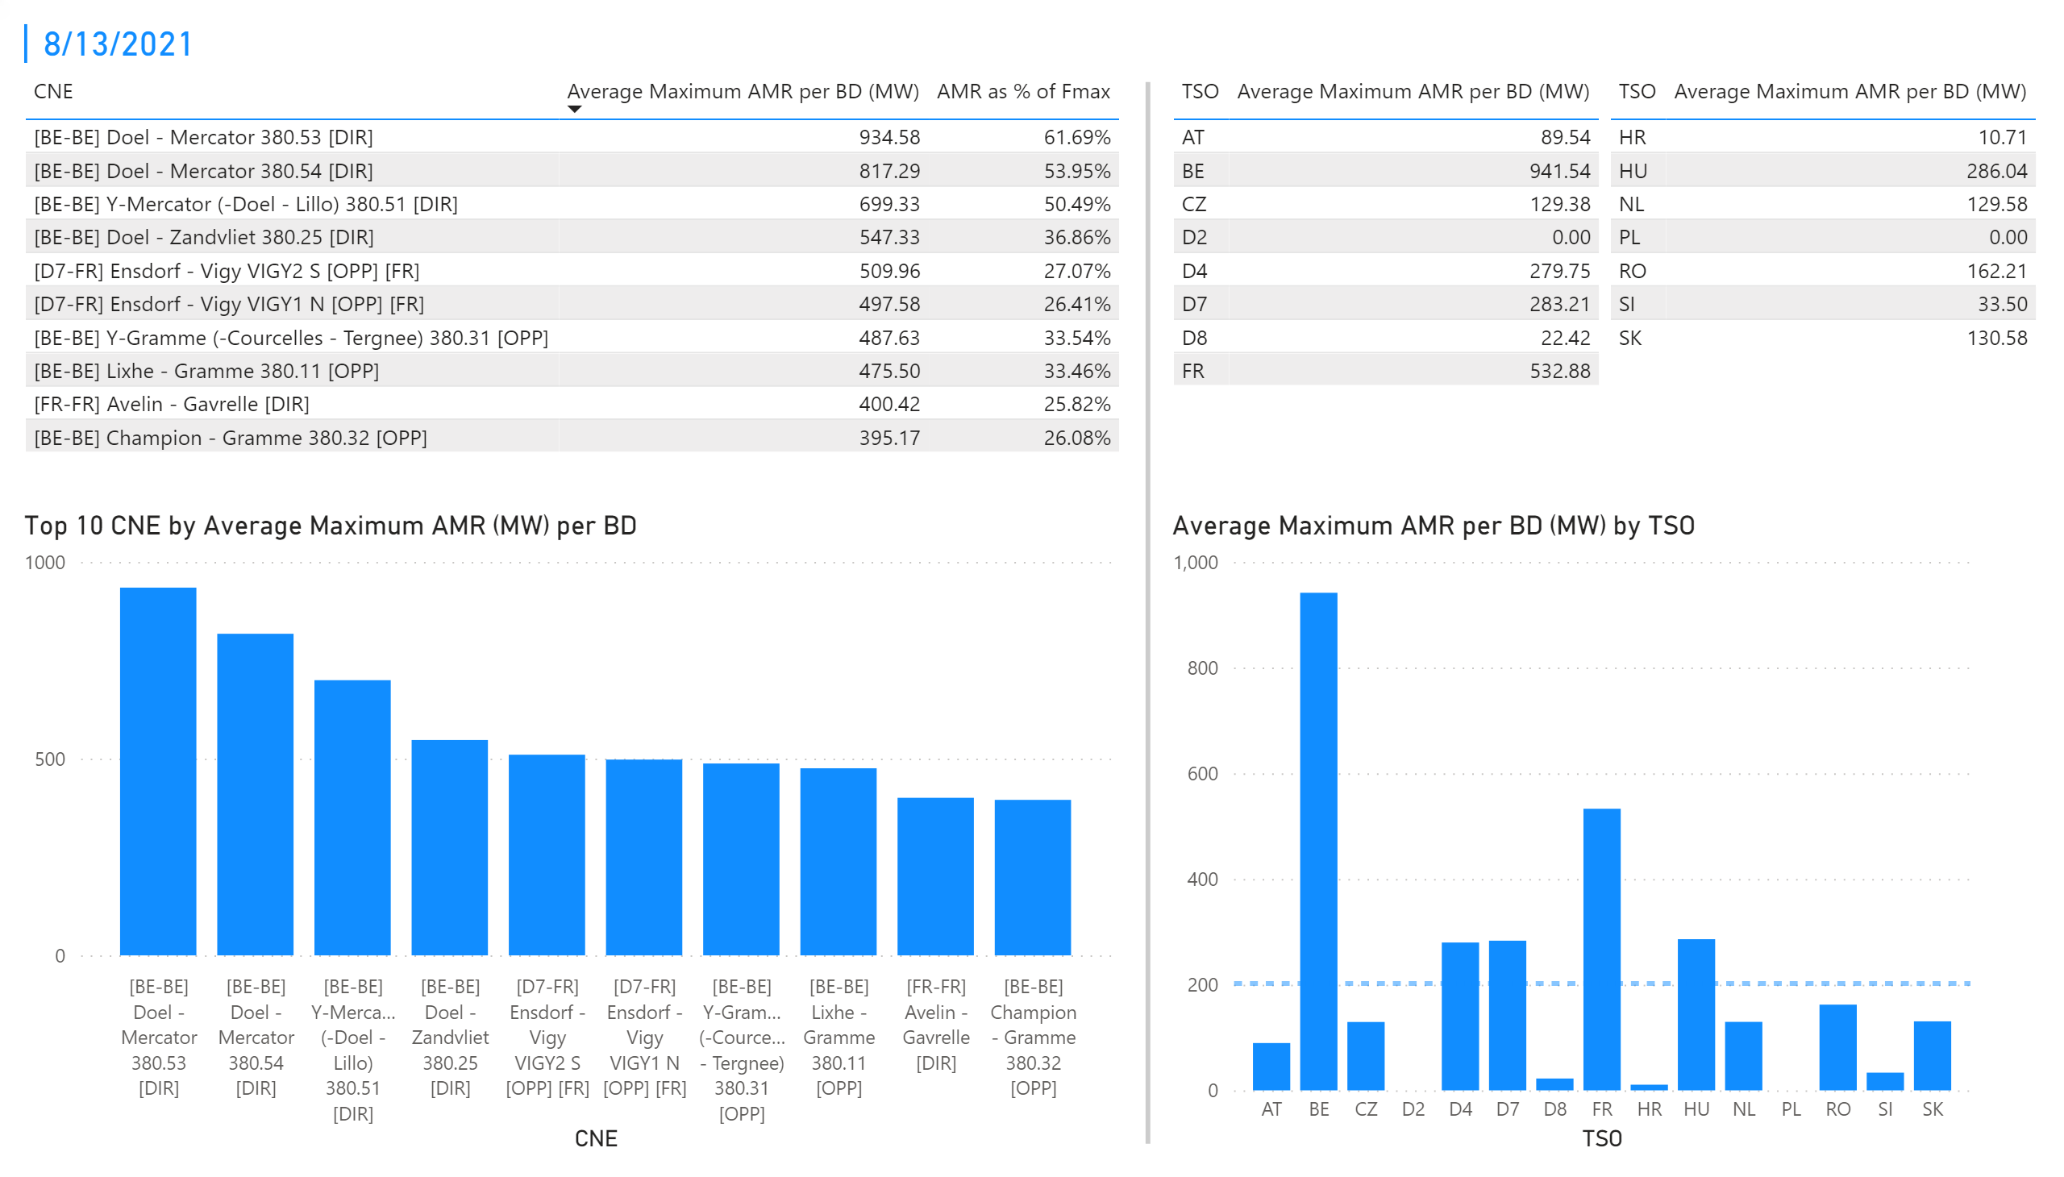
KPI 1 +2_10
KPI 1: Average maximum AMR per CNE per BD
KPI 2: Average maximum AMR per CNE per TSO
Notes:
tableEx
No alt text provided.
Top 10 CNE by Average Maximum AMR (MW) per BD
No alt text provided.
multiRowCard
No alt text provided.
tableEx
No alt text provided.
Average Maximum AMR per BD (MW) by TSO
No alt text provided.
tableEx
No alt text provided.
basicShape
No alt text provided.

Slide 24

KPI 3 + 4_10
KPI 3: Average maximum AMR+LTAmargin per CNE per BD
KPI 4: Average maximum AMR+LTAmargin per TSO per BD
Notes:
tableEx
No alt text provided.
Top 10 CNE by Average Maximum AMR+LTAmargin (MW) per BD
No alt text provided.
multiRowCard
No alt text provided.
tableEx
No alt text provided.
tableEx
No alt text provided.
Average Maximum AMR+LTAmargin per BD (MW) by TSO
No alt text provided.
basicShape
No alt text provided.

Slide 25
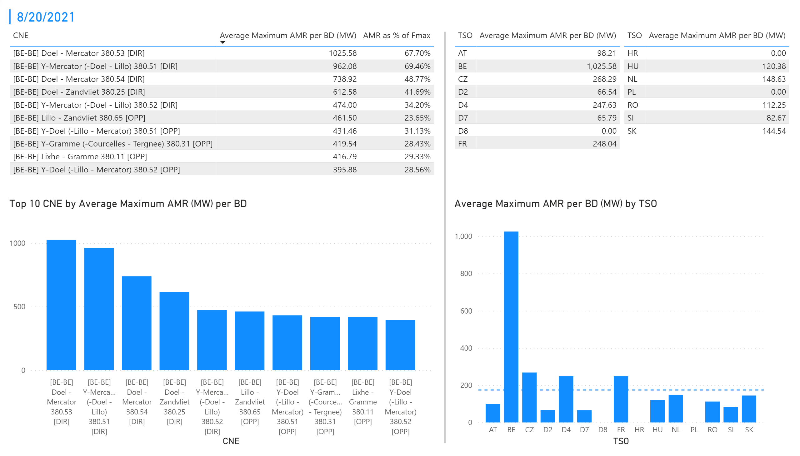
KPI 1 +2_1
KPI 1: Average maximum AMR per CNE per BD
KPI 2: Average maximum AMR per CNE per TSO
Notes:
tableEx
No alt text provided.
Top 10 CNE by Average Maximum AMR (MW) per BD
No alt text provided.
multiRowCard
No alt text provided.
tableEx
No alt text provided.
Average Maximum AMR per BD (MW) by TSO
No alt text provided.
tableEx
No alt text provided.
basicShape
No alt text provided.

Slide 26
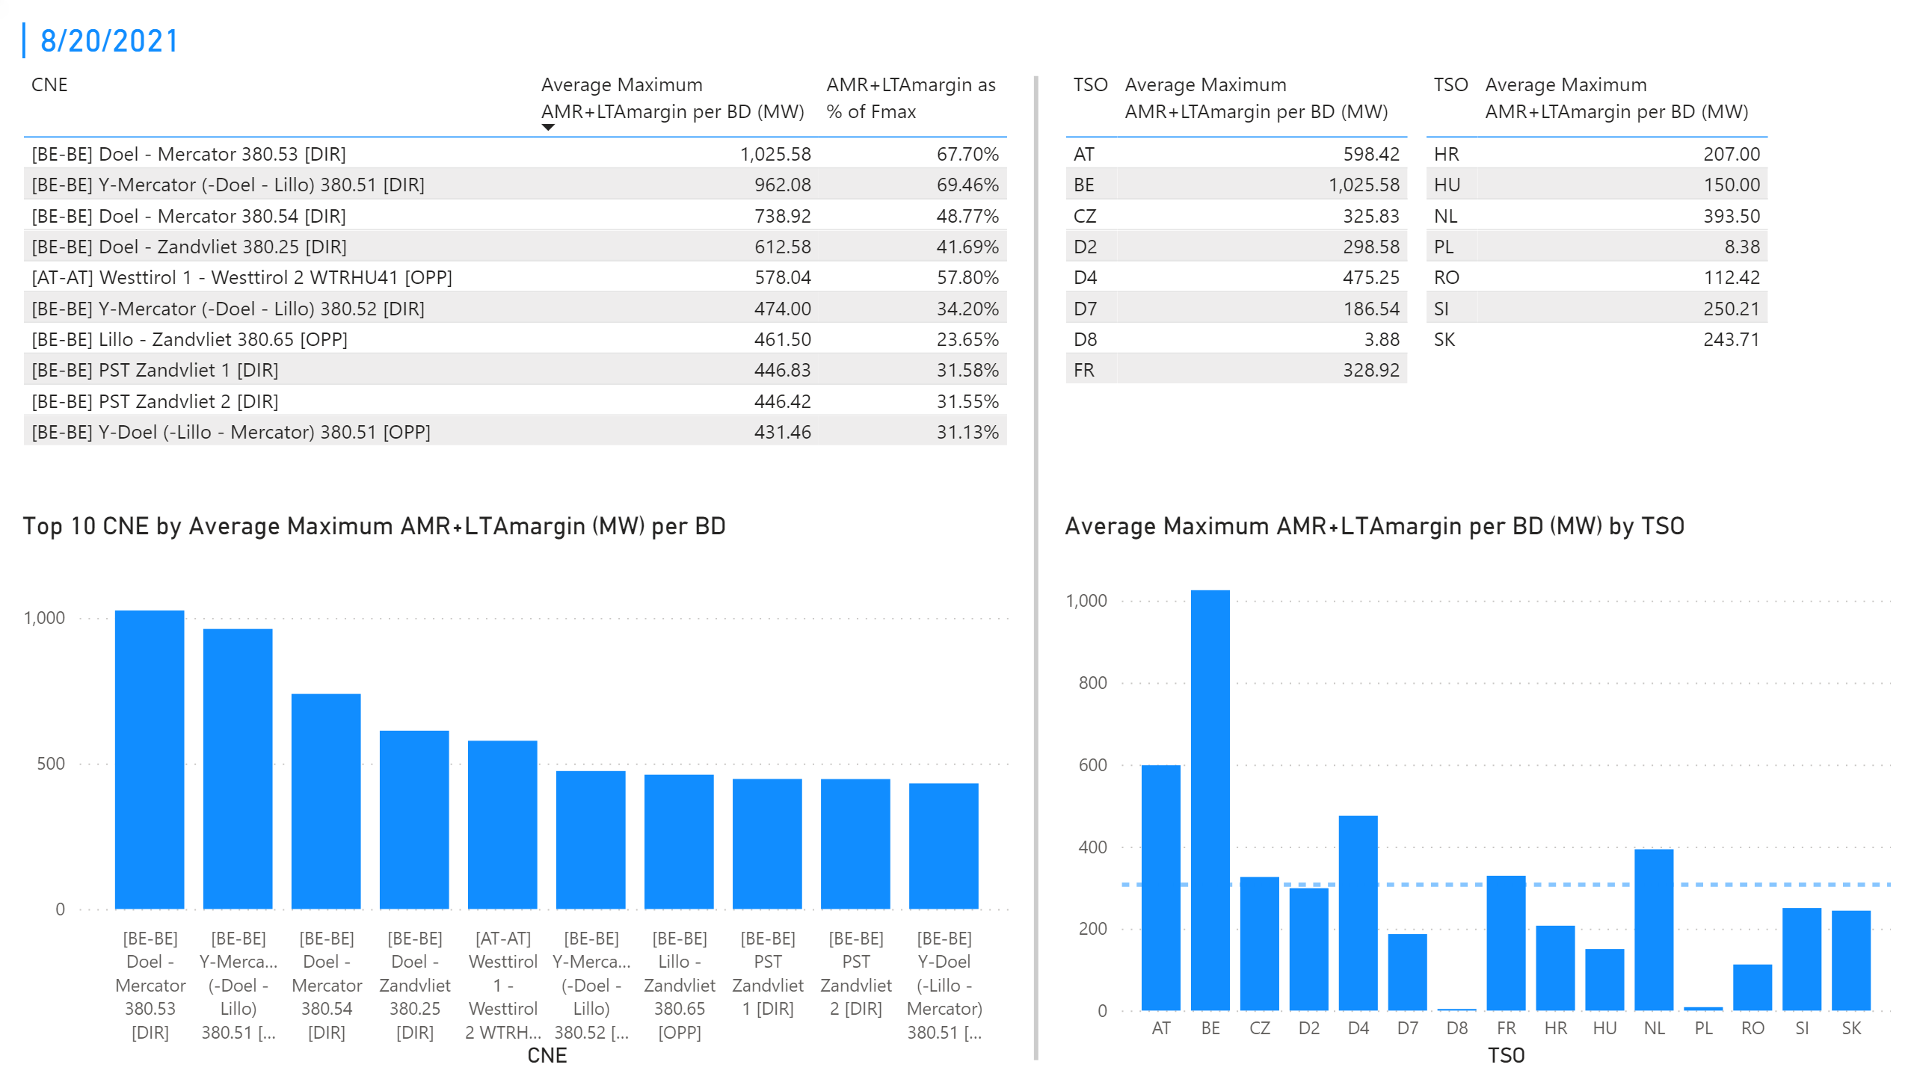
KPI 3 + 4_1
KPI 3: Average maximum AMR+LTAmargin per CNE per BD
KPI 4: Average maximum AMR+LTAmargin per TSO per BD
Notes:
tableEx
No alt text provided.
Top 10 CNE by Average Maximum AMR+LTAmargin (MW) per BD
No alt text provided.
multiRowCard
No alt text provided.
tableEx
No alt text provided.
tableEx
No alt text provided.
Average Maximum AMR+LTAmargin per BD (MW) by TSO
No alt text provided.
basicShape
No alt text provided.

Slide 27
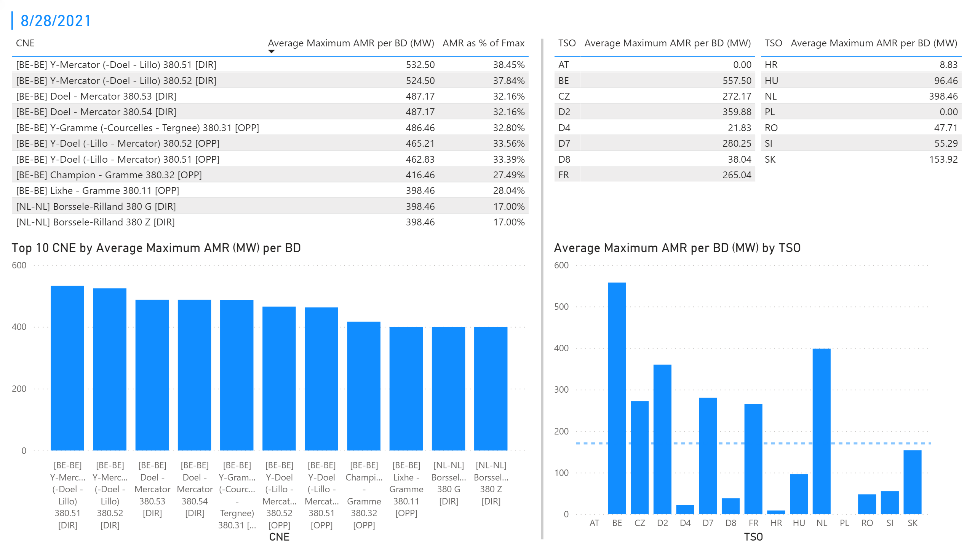
KPI 1 +2_2
KPI 1: Average maximum AMR per CNE per BD
KPI 2: Average maximum AMR per CNE per TSO
Notes:
tableEx
No alt text provided.
Top 10 CNE by Average Maximum AMR (MW) per BD
No alt text provided.
multiRowCard
No alt text provided.
tableEx
No alt text provided.
Average Maximum AMR per BD (MW) by TSO
No alt text provided.
tableEx
No alt text provided.
basicShape
No alt text provided.

Slide 28
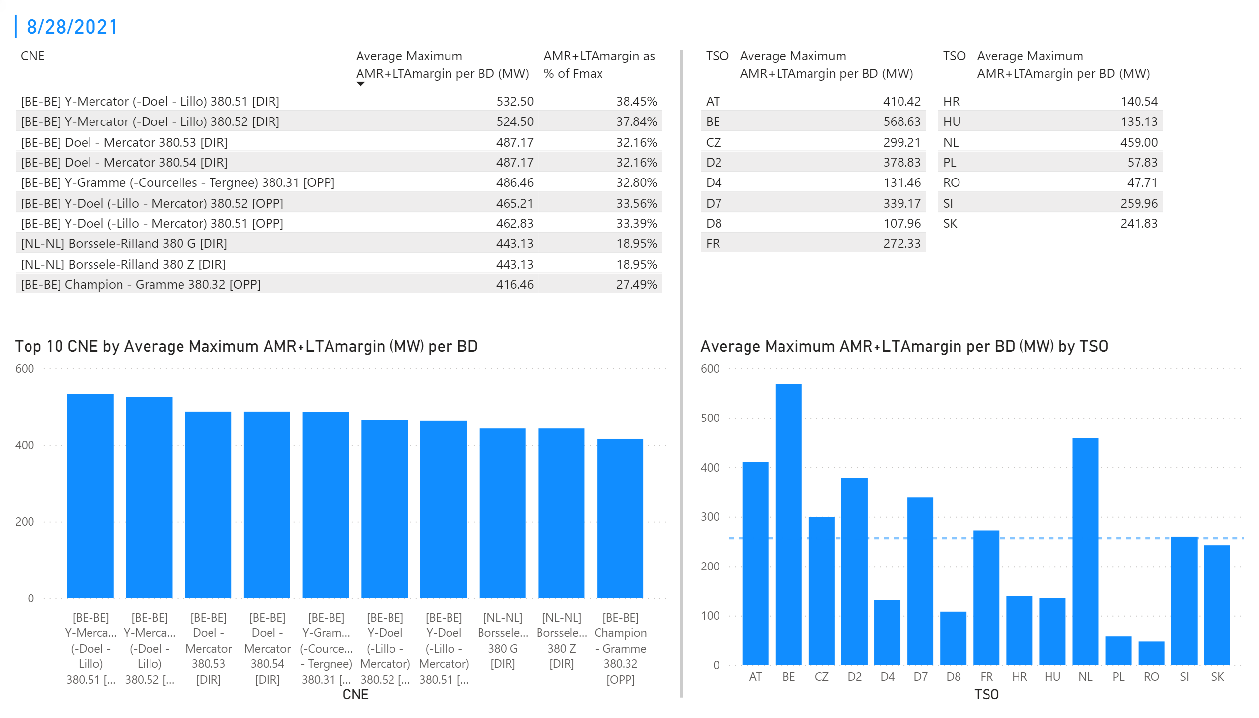
KPI 3 + 4_2
KPI 3: Average maximum AMR+LTAmargin per CNE per BD
KPI 4: Average maximum AMR+LTAmargin per TSO per BD
Notes:
tableEx
No alt text provided.
Top 10 CNE by Average Maximum AMR+LTAmargin (MW) per BD
No alt text provided.
multiRowCard
No alt text provided.
tableEx
No alt text provided.
tableEx
No alt text provided.
Average Maximum AMR+LTAmargin per BD (MW) by TSO
No alt text provided.
basicShape
No alt text provided.

Slide 29
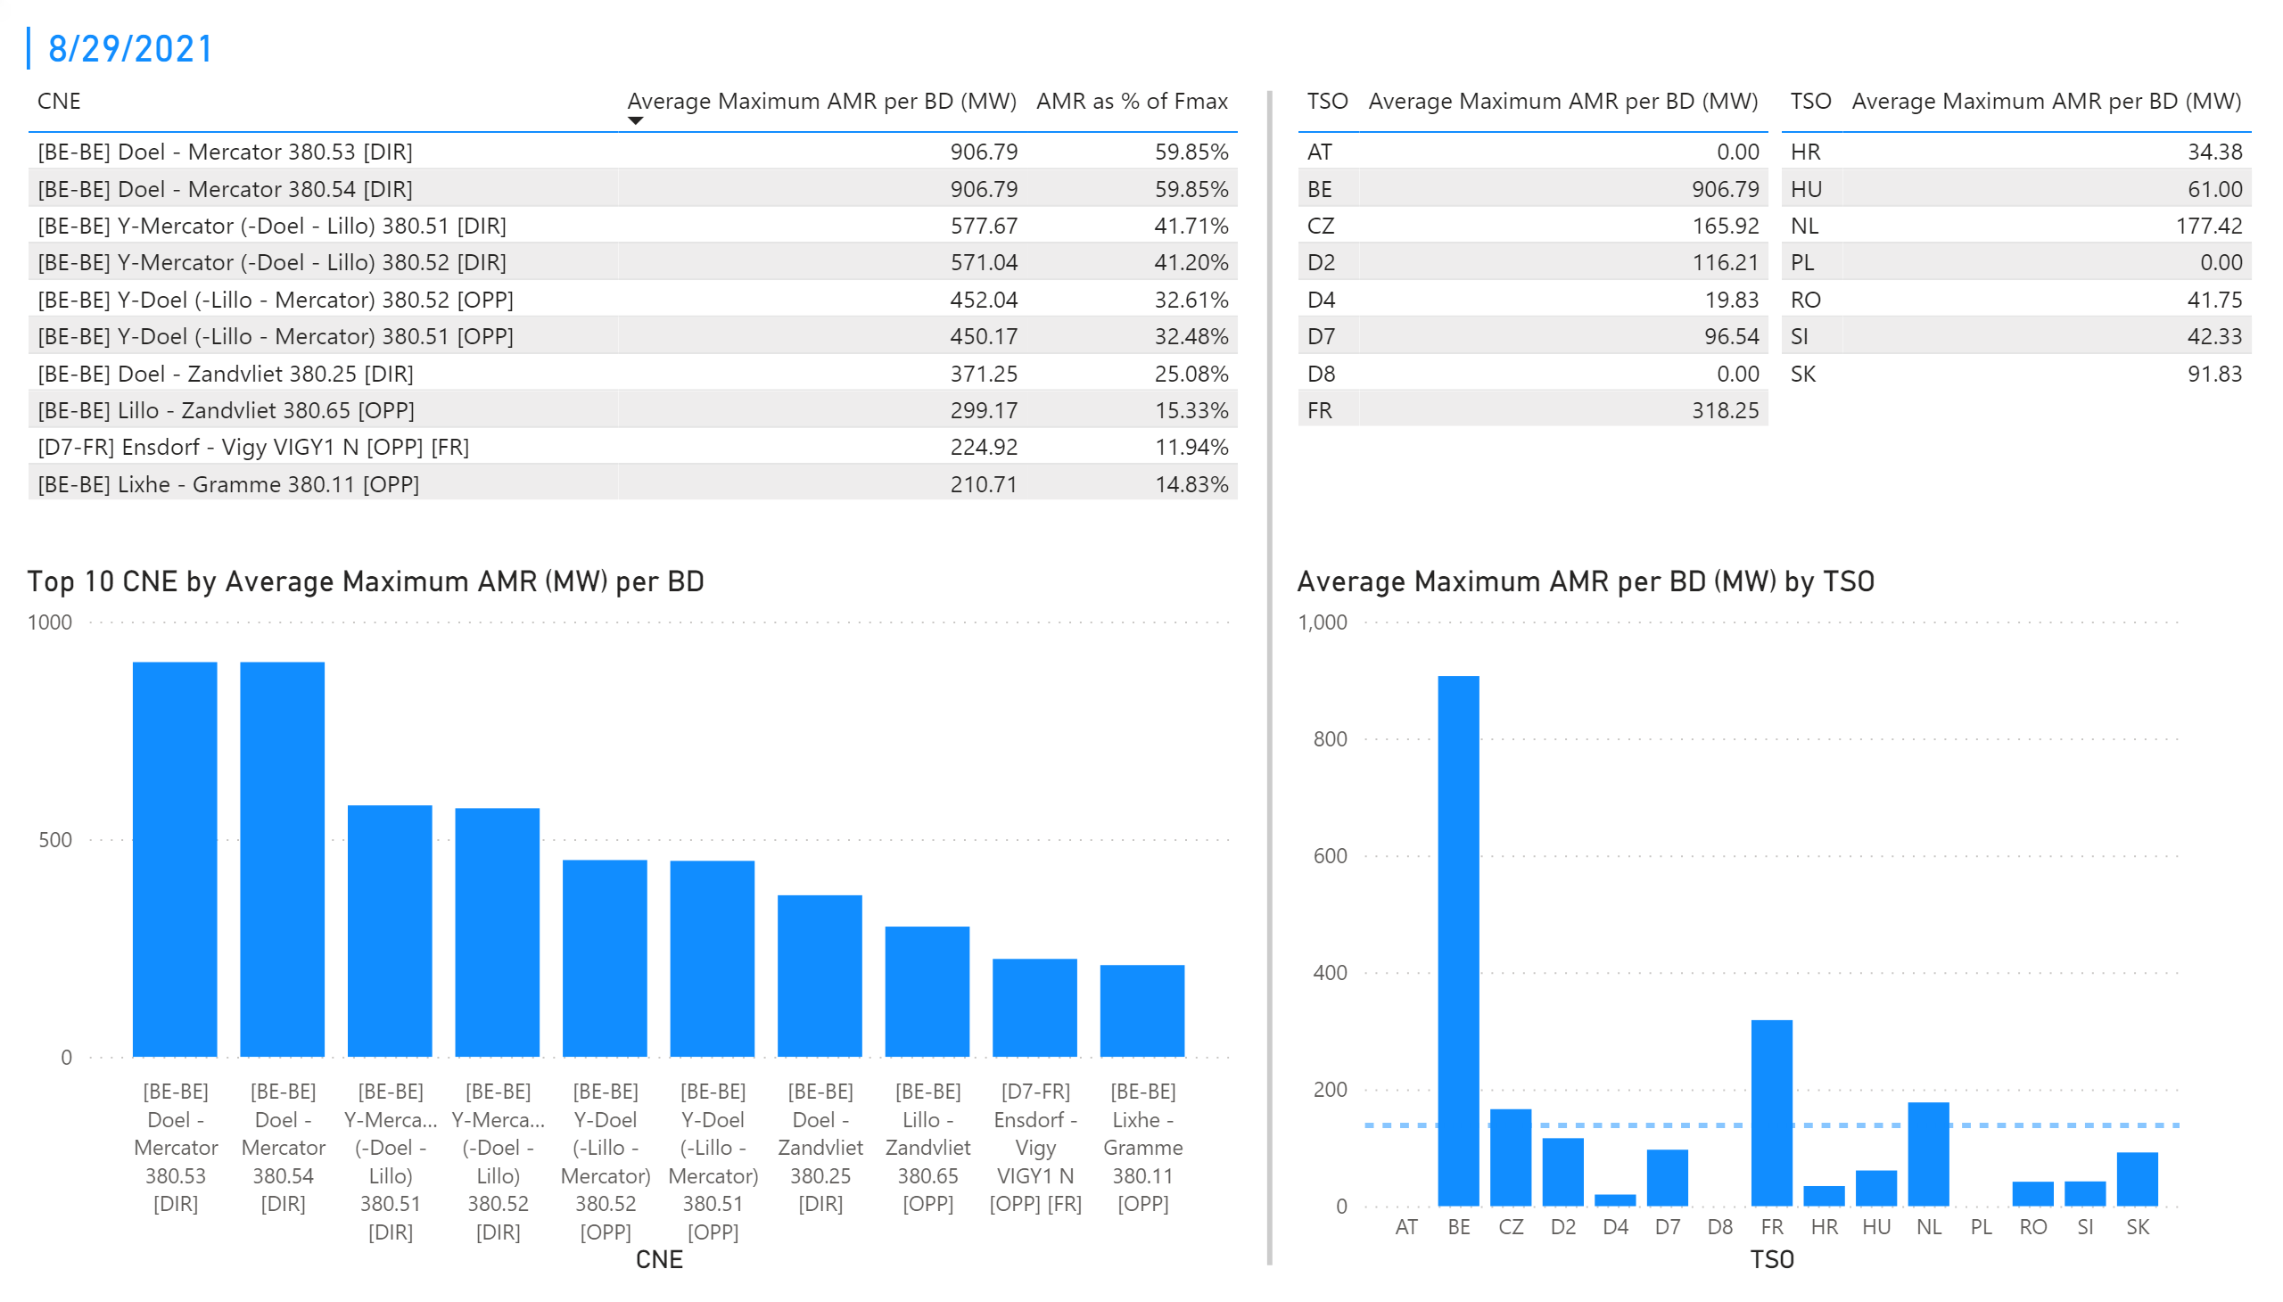
KPI 1 +2_3
KPI 1: Average maximum AMR per CNE per BD
KPI 2: Average maximum AMR per CNE per TSO
Notes:
tableEx
No alt text provided.
Top 10 CNE by Average Maximum AMR (MW) per BD
No alt text provided.
multiRowCard
No alt text provided.
tableEx
No alt text provided.
Average Maximum AMR per BD (MW) by TSO
No alt text provided.
tableEx
No alt text provided.
basicShape
No alt text provided.

Slide 30
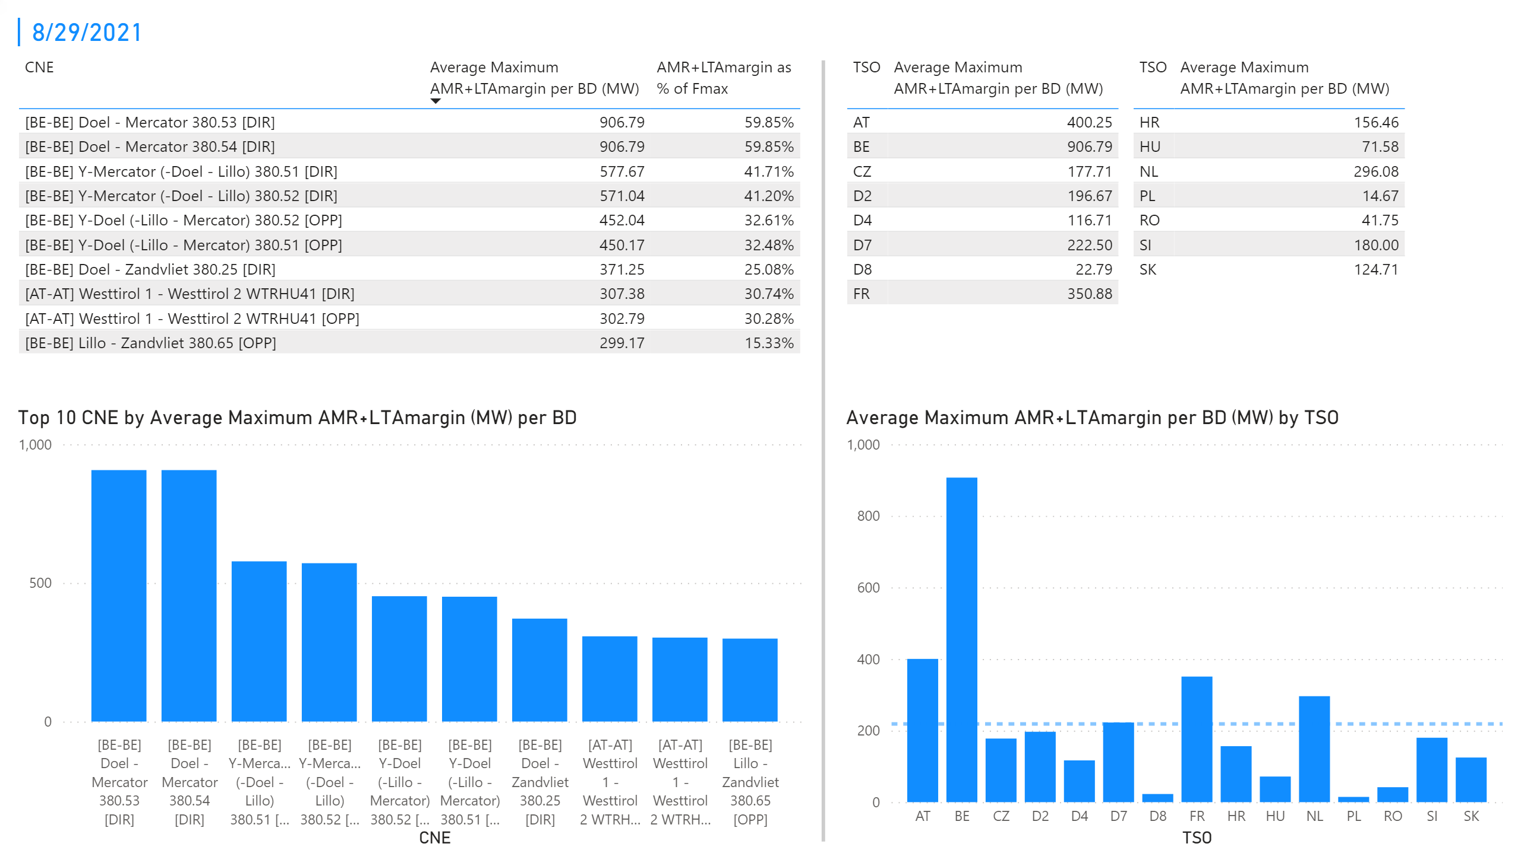
KPI 3 + 4_3
KPI 3: Average maximum AMR+LTAmargin per CNE per BD
KPI 4: Average maximum AMR+LTAmargin per TSO per BD
Notes:
tableEx
No alt text provided.
Top 10 CNE by Average Maximum AMR+LTAmargin (MW) per BD
No alt text provided.
multiRowCard
No alt text provided.
tableEx
No alt text provided.
tableEx
No alt text provided.
Average Maximum AMR+LTAmargin per BD (MW) by TSO
No alt text provided.
basicShape
No alt text provided.

Slide 31
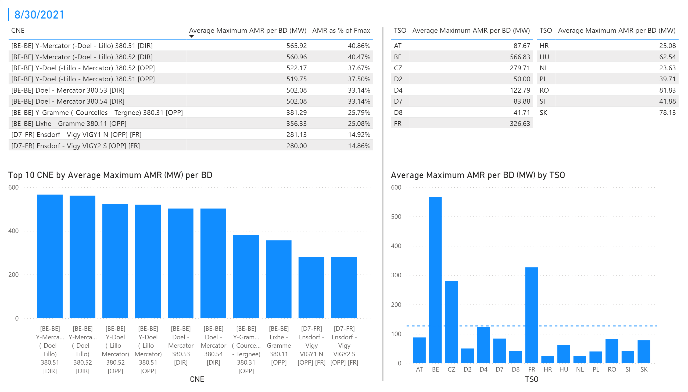
KPI 1 +2_4
KPI 1: Average maximum AMR per CNE per BD
KPI 2: Average maximum AMR per CNE per TSO
Notes:
tableEx
No alt text provided.
Top 10 CNE by Average Maximum AMR (MW) per BD
No alt text provided.
multiRowCard
No alt text provided.
tableEx
No alt text provided.
Average Maximum AMR per BD (MW) by TSO
No alt text provided.
tableEx
No alt text provided.
basicShape
No alt text provided.

Slide 32
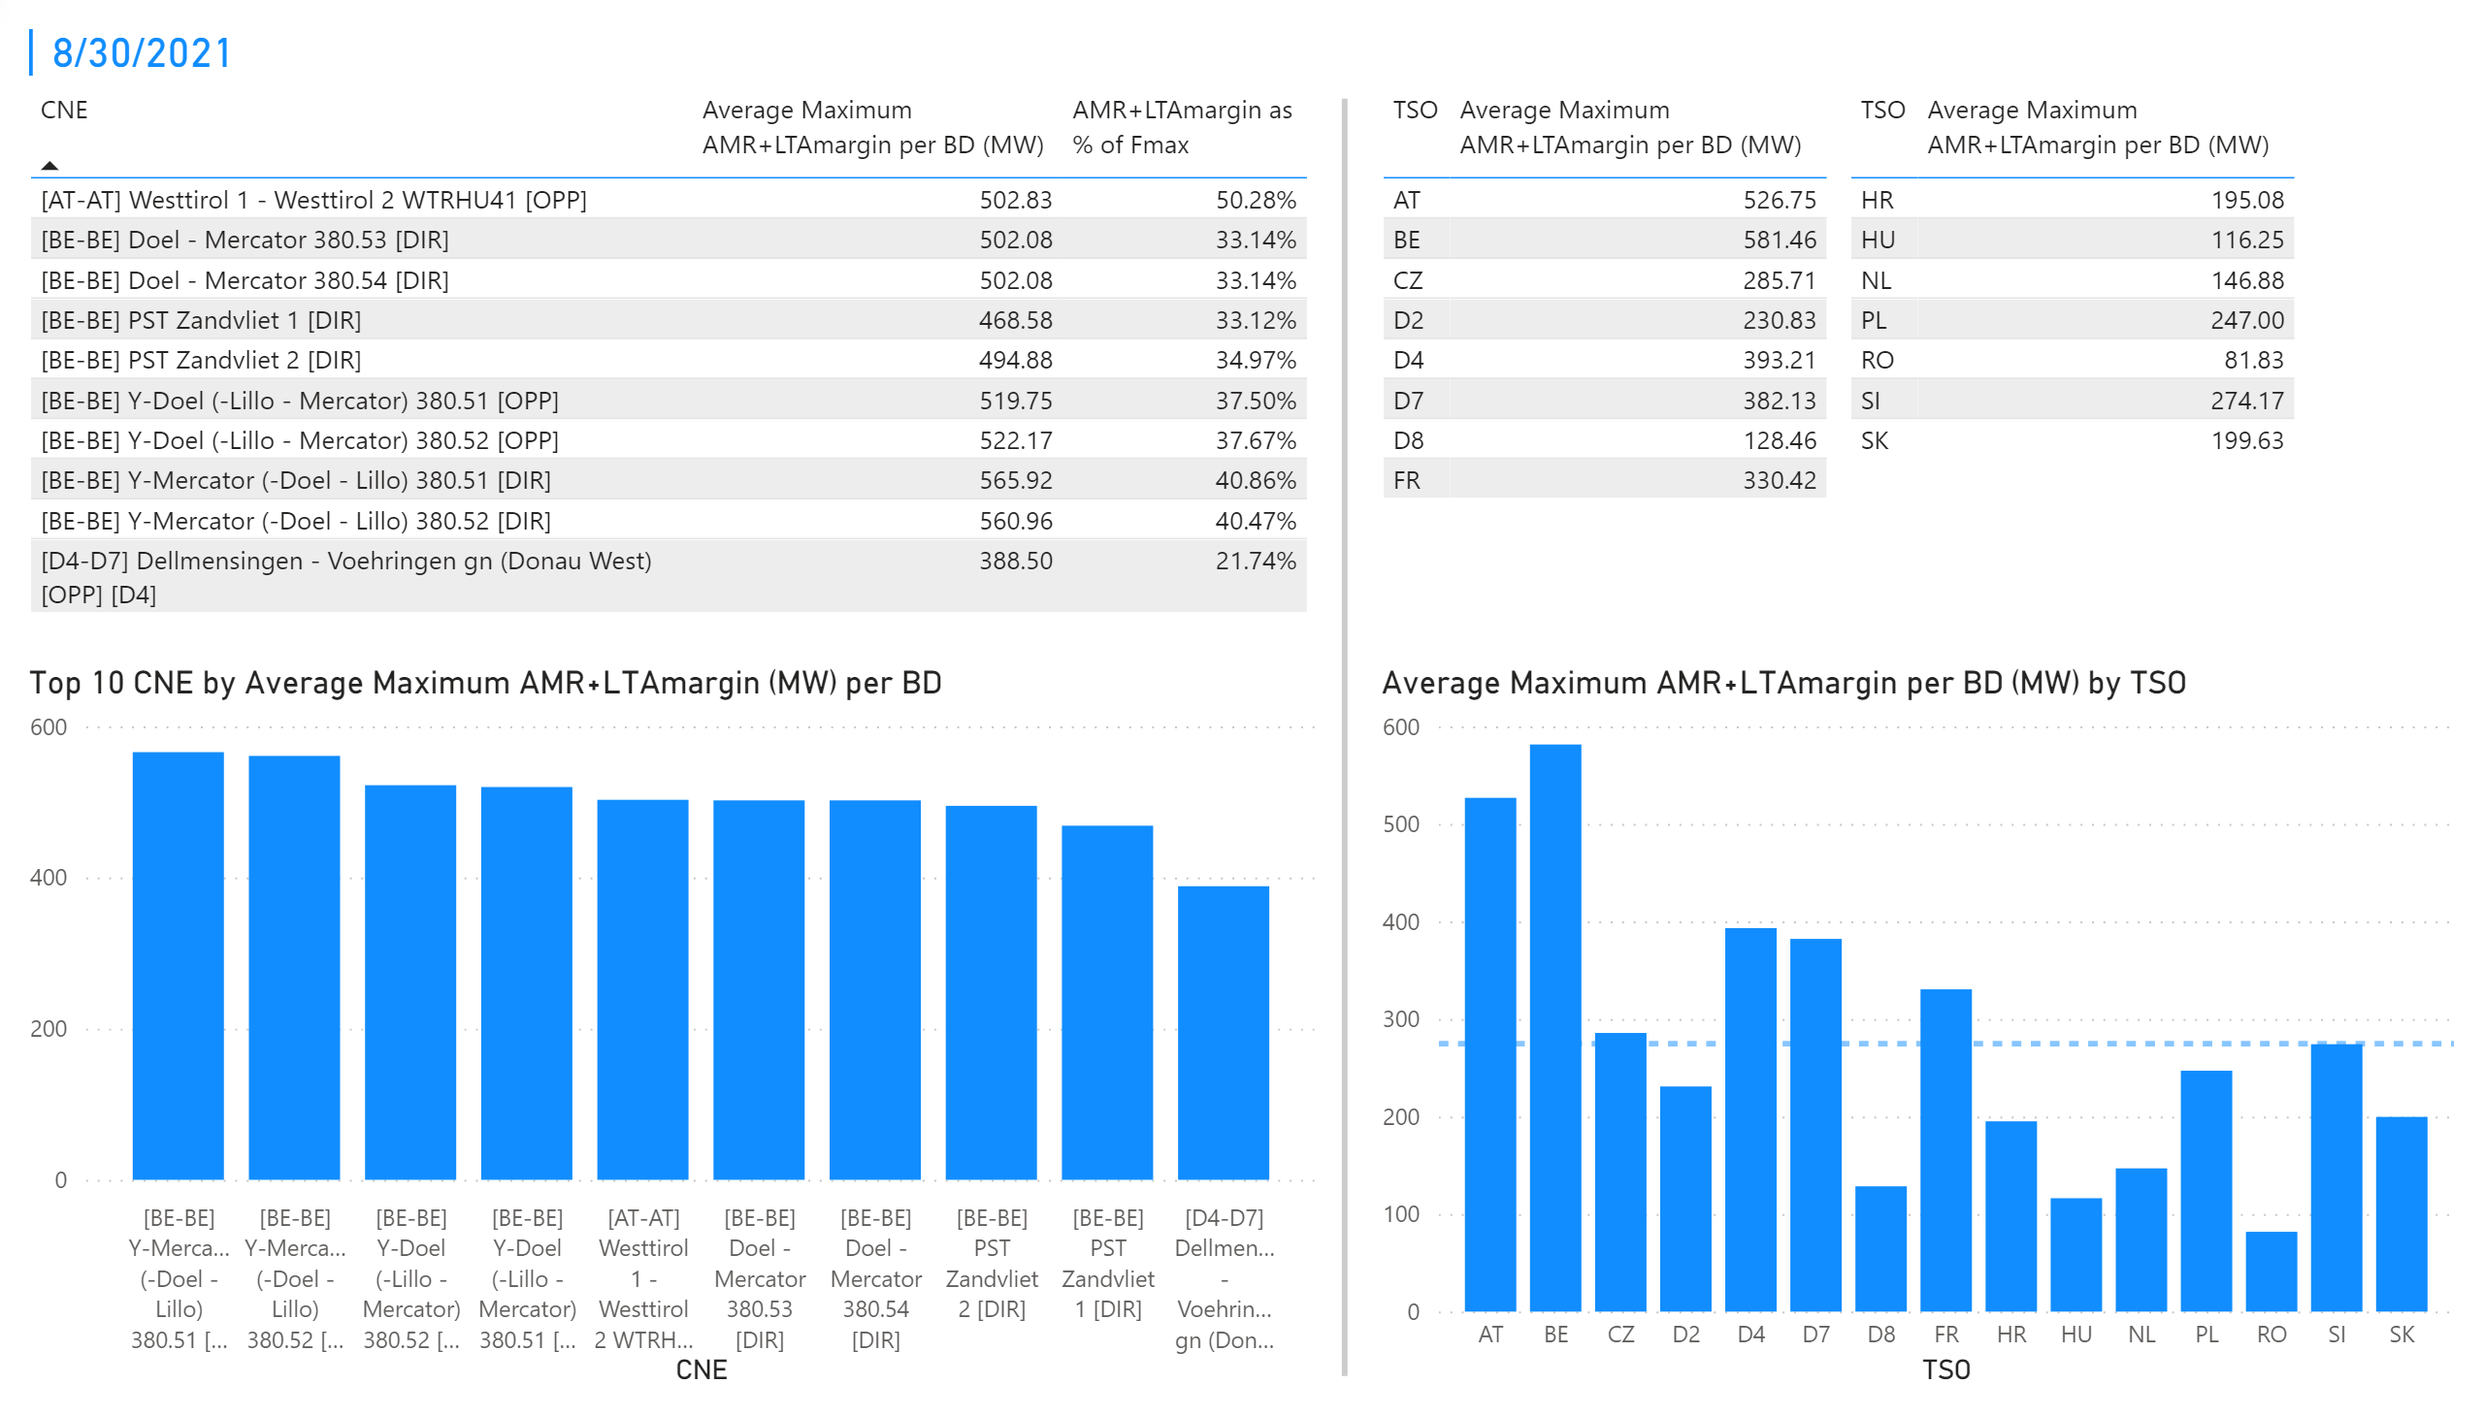
KPI 3 + 4_4
KPI 3: Average maximum AMR+LTAmargin per CNE per BD
KPI 4: Average maximum AMR+LTAmargin per TSO per BD
Notes:
tableEx
No alt text provided.
Top 10 CNE by Average Maximum AMR+LTAmargin (MW) per BD
No alt text provided.
multiRowCard
No alt text provided.
tableEx
No alt text provided.
tableEx
No alt text provided.
Average Maximum AMR+LTAmargin per BD (MW) by TSO
No alt text provided.
basicShape
No alt text provided.

Slide 33
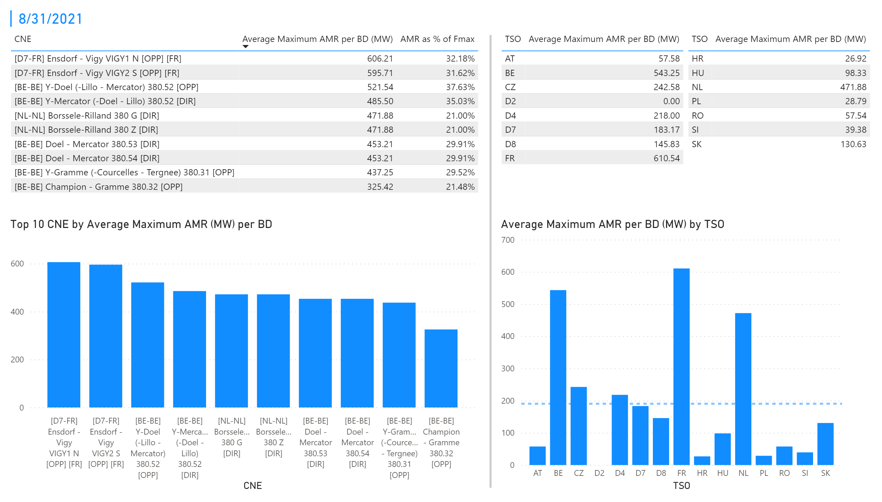
KPI 1 +2_5
KPI 1: Average maximum AMR per CNE per BD
KPI 2: Average maximum AMR per CNE per TSO
Notes:
tableEx
No alt text provided.
Top 10 CNE by Average Maximum AMR (MW) per BD
No alt text provided.
multiRowCard
No alt text provided.
tableEx
No alt text provided.
Average Maximum AMR per BD (MW) by TSO
No alt text provided.
tableEx
No alt text provided.
basicShape
No alt text provided.

Slide 34
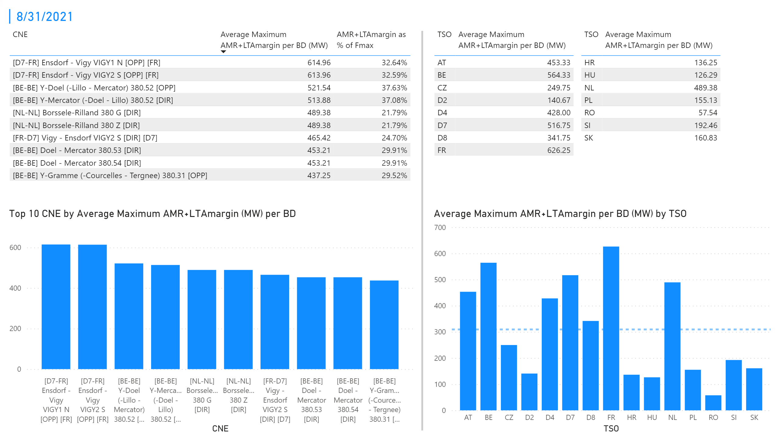
KPI 3 + 4_5
KPI 3: Average maximum AMR+LTAmargin per CNE per BD
KPI 4: Average maximum AMR+LTAmargin per TSO per BD
Notes:
tableEx
No alt text provided.
Top 10 CNE by Average Maximum AMR+LTAmargin (MW) per BD
No alt text provided.
multiRowCard
No alt text provided.
tableEx
No alt text provided.
tableEx
No alt text provided.
Average Maximum AMR+LTAmargin per BD (MW) by TSO
No alt text provided.
basicShape
No alt text provided.

Slide 35
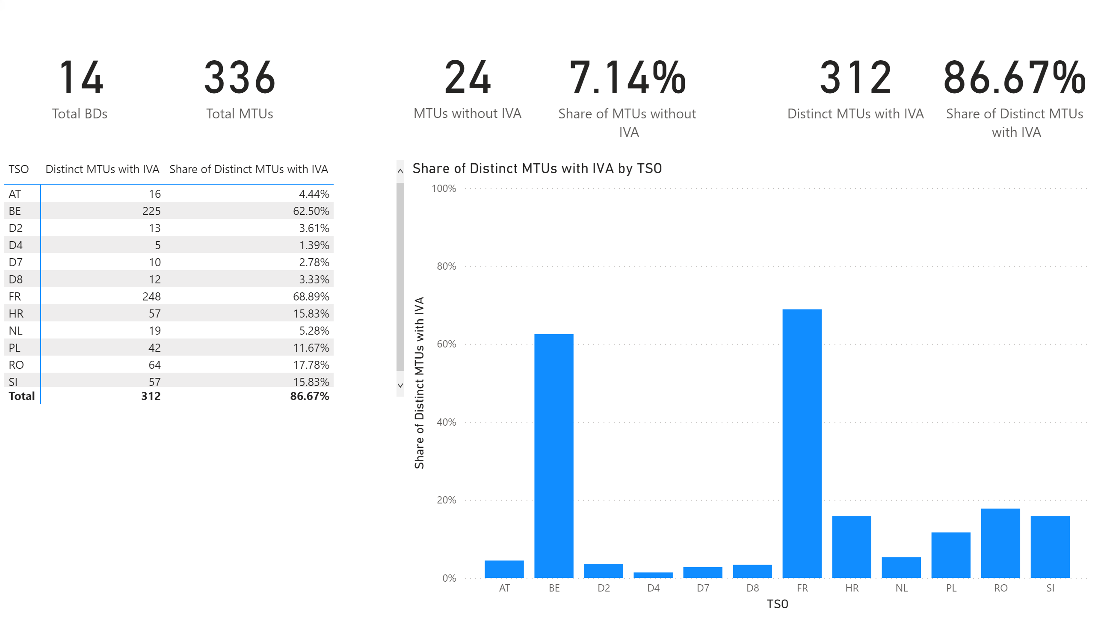
KPI 5
KPI 5: Share of MTUs with intervention per TSO
Notes:
pivotTable
No alt text provided.
clusteredColumnChart
No alt text provided.
card
No alt text provided.
card
No alt text provided.
card
No alt text provided.
card
No alt text provided.
card
No alt text provided.
card
No alt text provided.

Slide 36
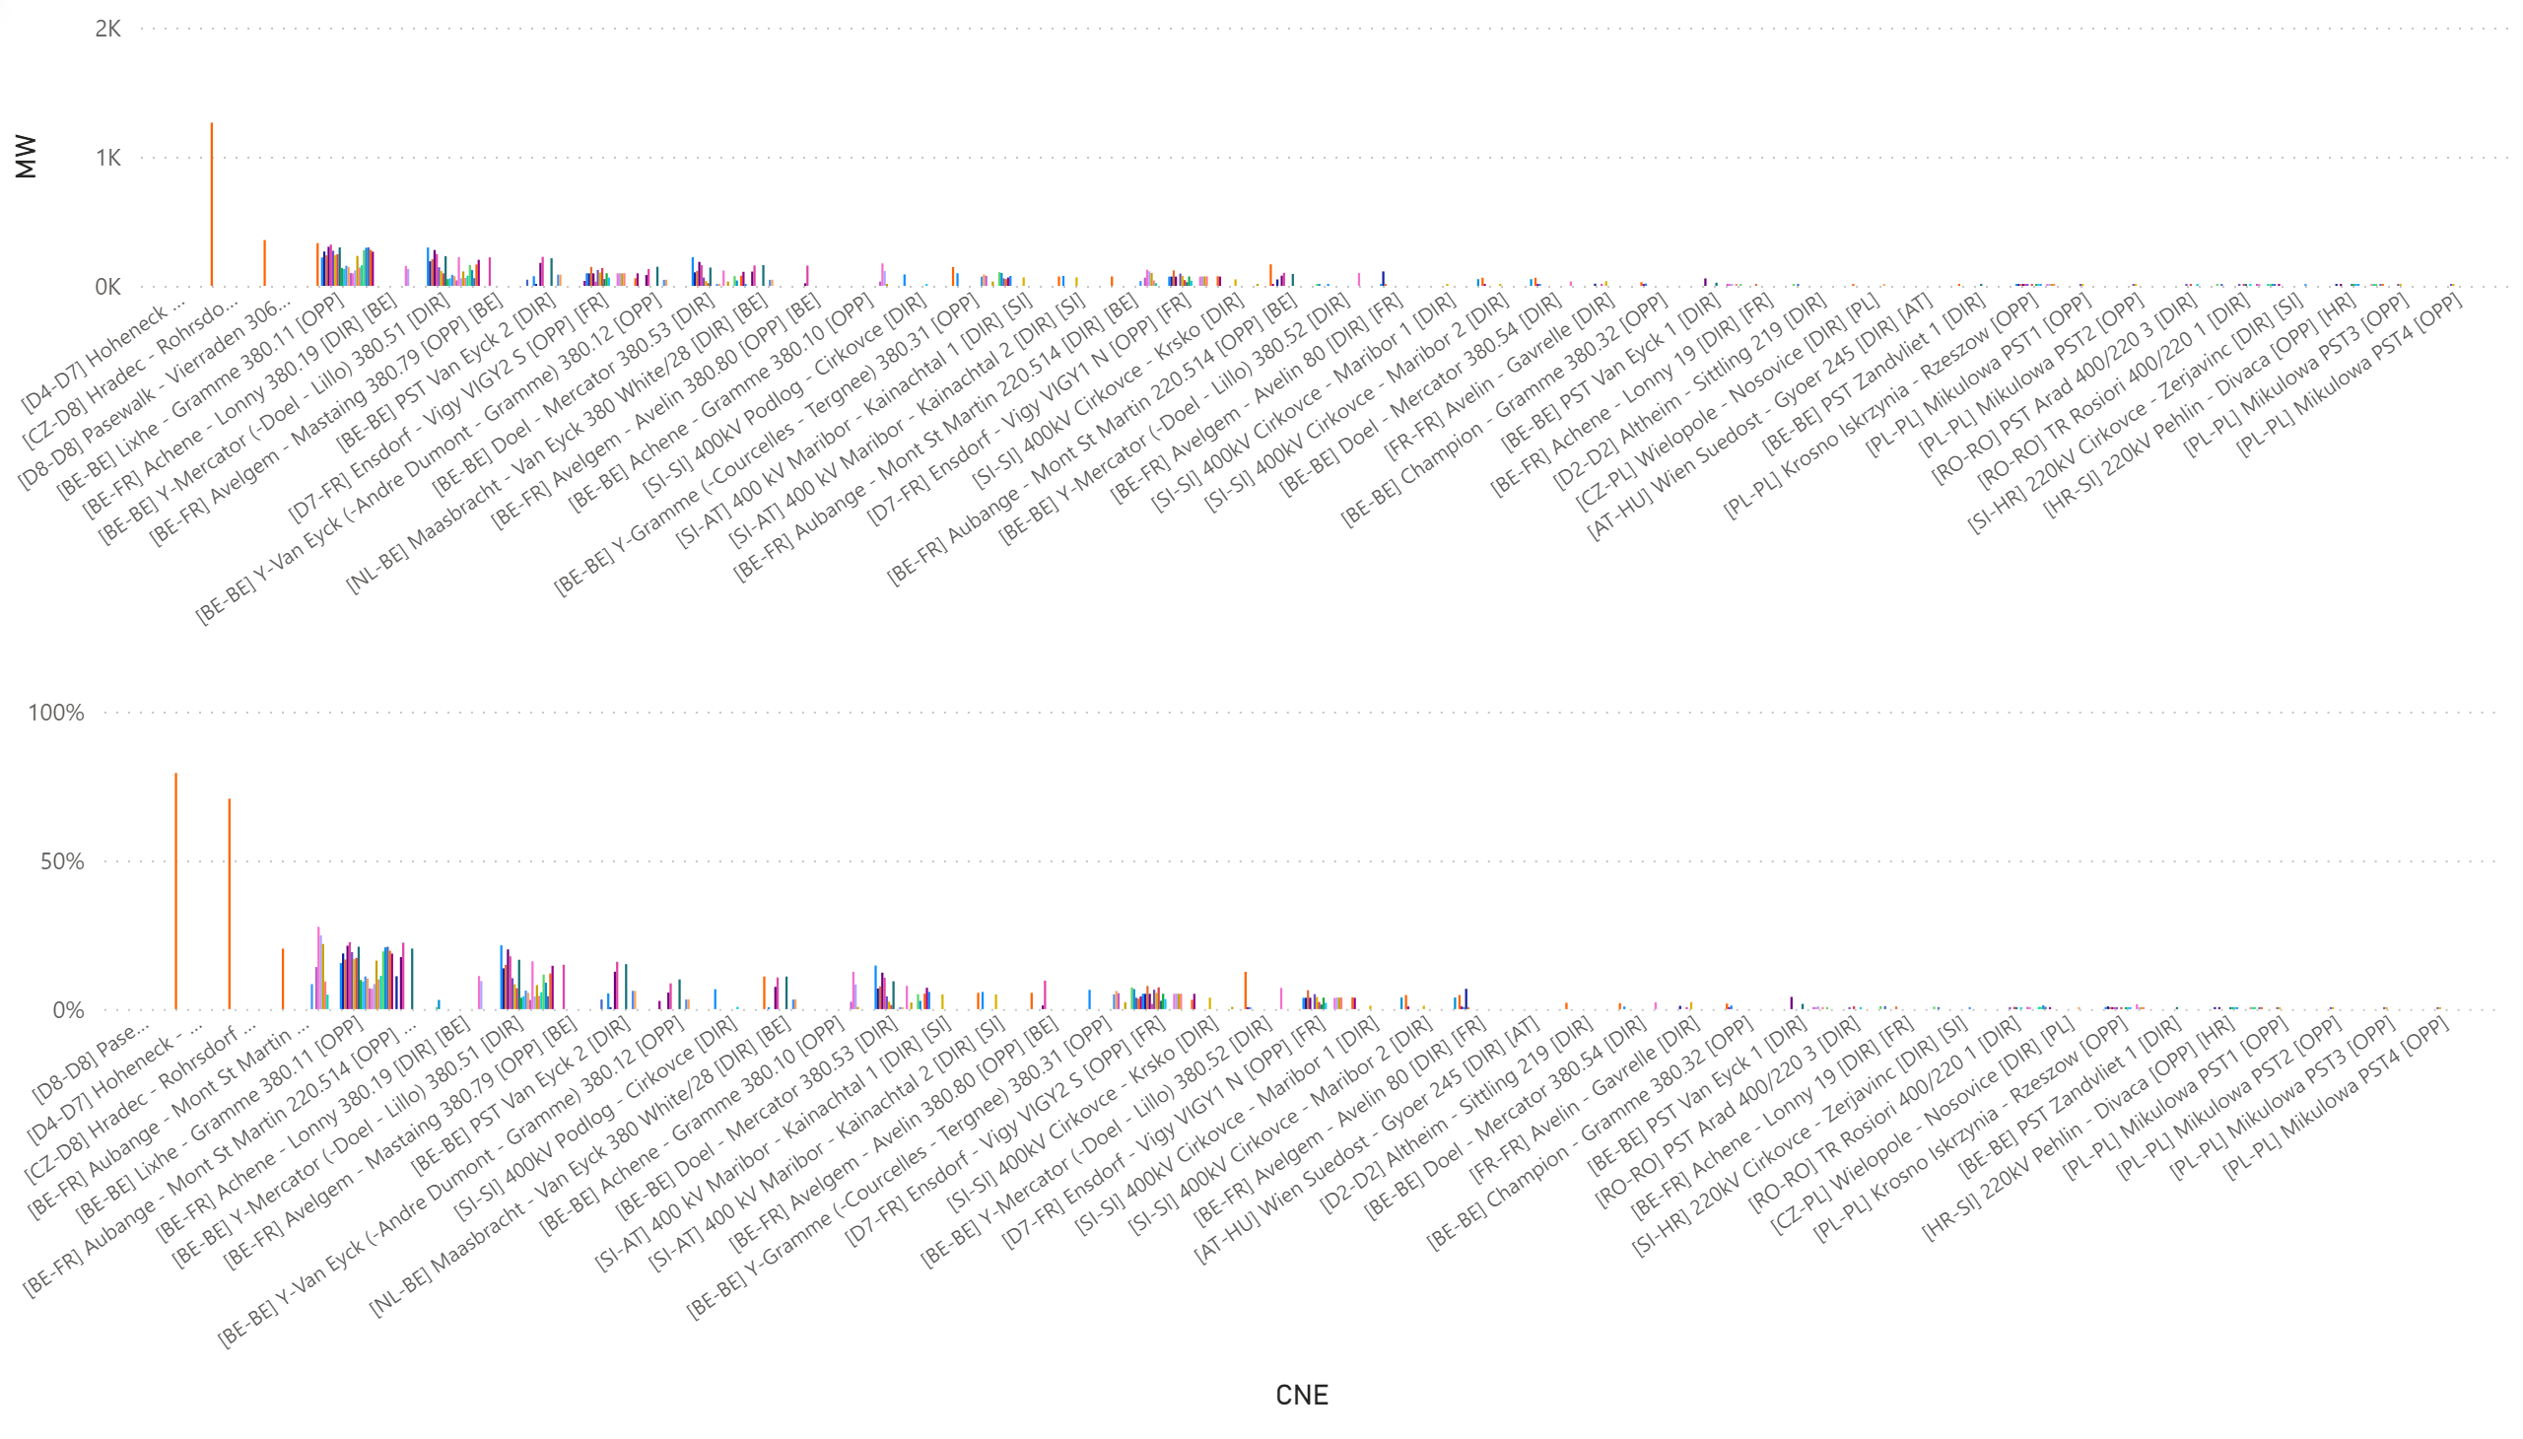
KPI6_0801
    KPI 6: Total IVA applied per MTU for each CNE affected by TSO intervention
    BD: 20210801 (top: in MW, bottom: in % of Fmax)
Notes:
clusteredColumnChart
No alt text provided.
clusteredColumnChart
No alt text provided.

Slide 37
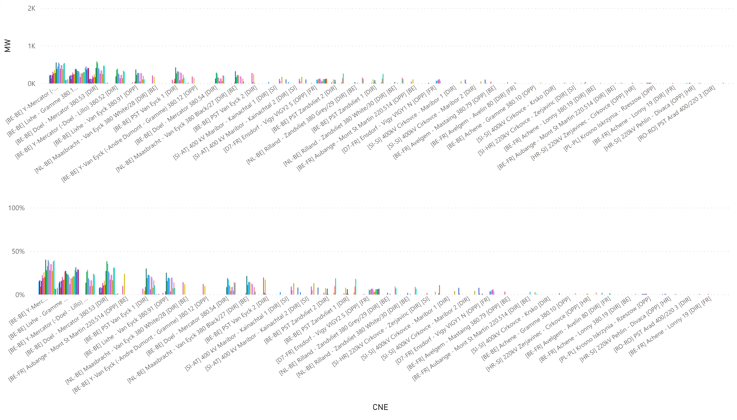
KPI6_0802
    KPI 6: Total IVA applied per MTU for each CNE affected by TSO intervention
    BD: 20210802 (top: in MW, bottom: in % of Fmax)
Notes:
clusteredColumnChart
No alt text provided.
clusteredColumnChart
No alt text provided.

Slide 38
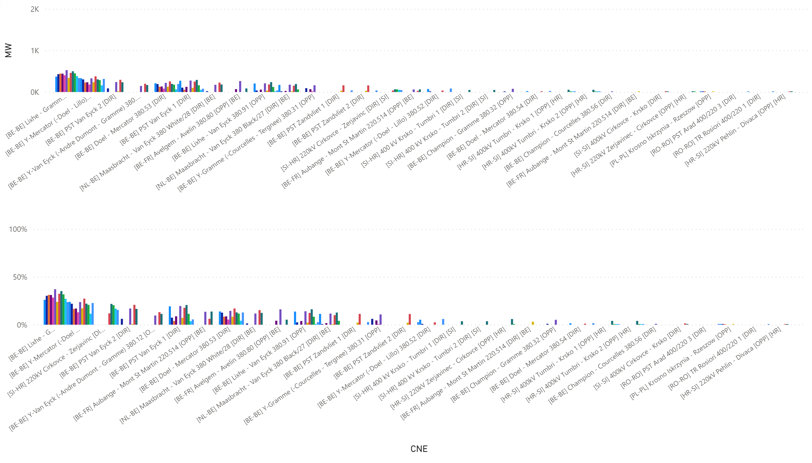
KPI6_0803_0-11
    KPI 6: Total IVA applied per MTU for each CNE affected by TSO intervention
    BD: 20210803_0-11 (top: in MW, bottom: in % of Fmax)
Notes:
clusteredColumnChart
No alt text provided.
clusteredColumnChart
No alt text provided.

Slide 39
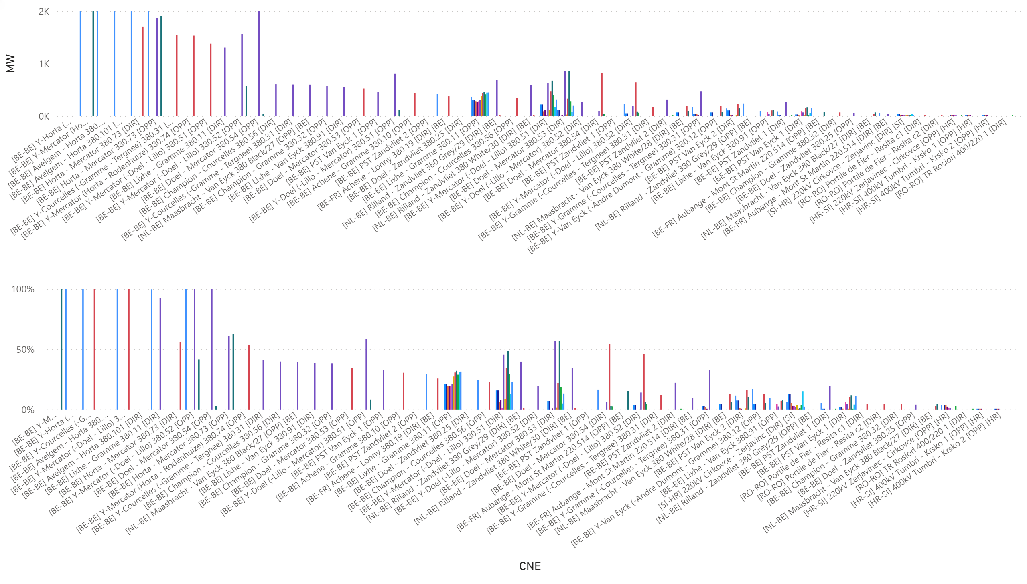
KPI6_0803_12-23
    KPI 6: Total IVA applied per MTU for each CNE affected by TSO intervention
    BD: 20210803_12-23 (top: in MW, bottom: in % of Fmax)
Notes:
clusteredColumnChart
No alt text provided.
clusteredColumnChart
No alt text provided.

Slide 40
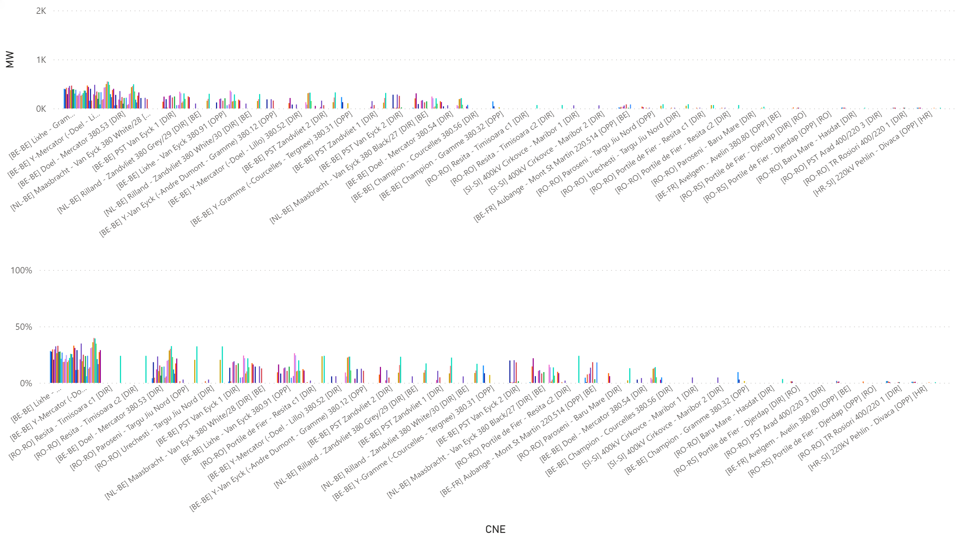
KPI6_0805
    KPI 6: Total IVA applied per MTU for each CNE affected by TSO intervention
    BD: 20210805 (top: in MW, bottom: in % of Fmax)
Notes:
clusteredColumnChart
No alt text provided.
clusteredColumnChart
No alt text provided.

Slide 41
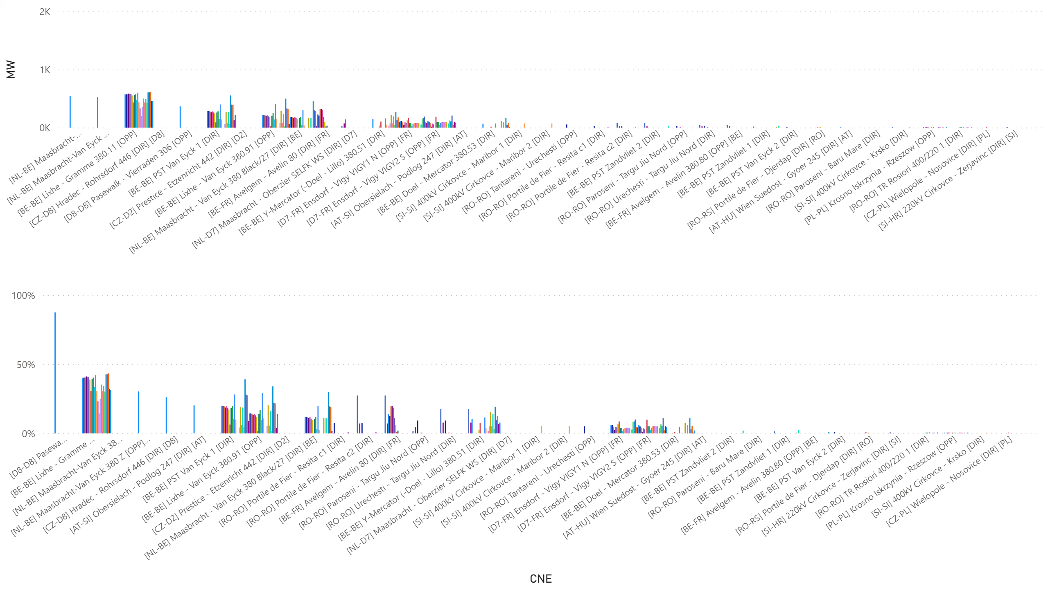
KPI6_0807
    KPI 6: Total IVA applied per MTU for each CNE affected by TSO intervention
    BD: 20210807 (top: in MW, bottom: in % of Fmax)
Notes:
clusteredColumnChart
No alt text provided.
clusteredColumnChart
No alt text provided.

Slide 42
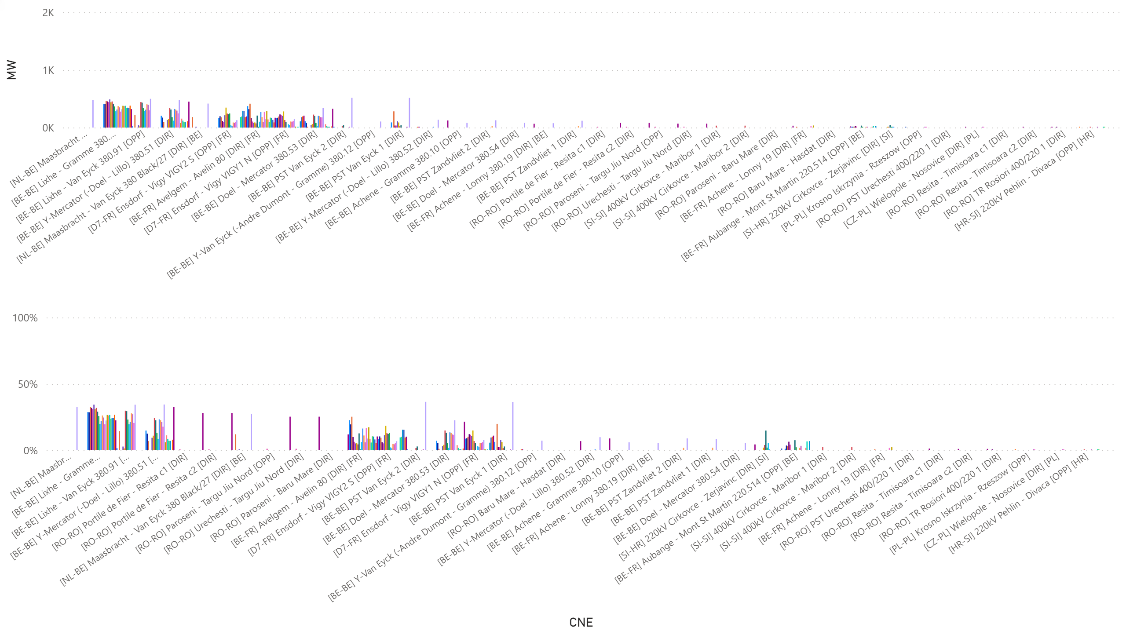
KPI6_0810
    KPI 6: Total IVA applied per MTU for each CNE affected by TSO intervention
    BD: 20210810 (top: in MW, bottom: in % of Fmax)
Notes:
clusteredColumnChart
No alt text provided.
clusteredColumnChart
No alt text provided.

Slide 43
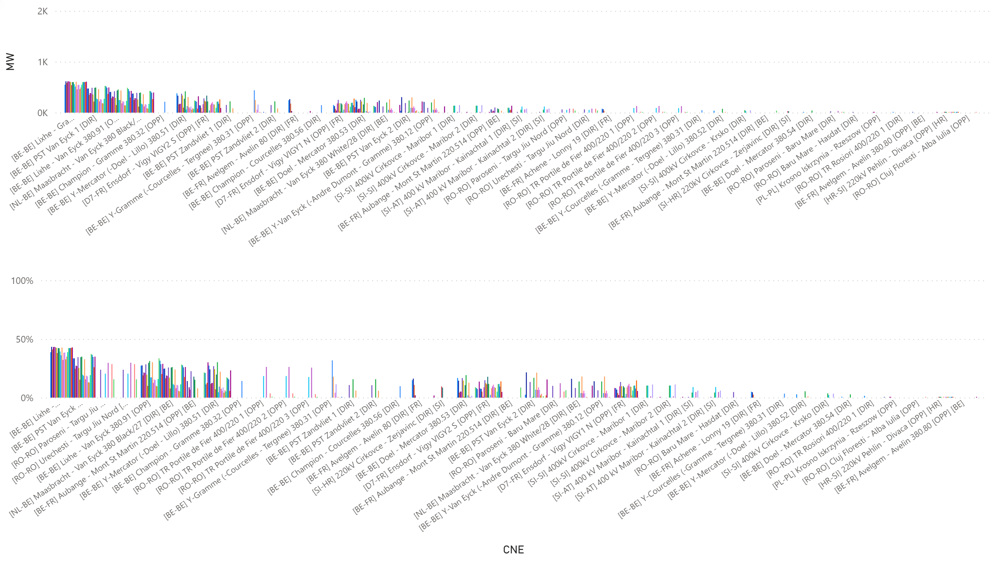
KPI6_0811
    KPI 6: Total IVA applied per MTU for each CNE affected by TSO intervention
    BD: 20210811 (top: in MW, bottom: in % of Fmax)
Notes:
clusteredColumnChart
No alt text provided.
clusteredColumnChart
No alt text provided.

Slide 44
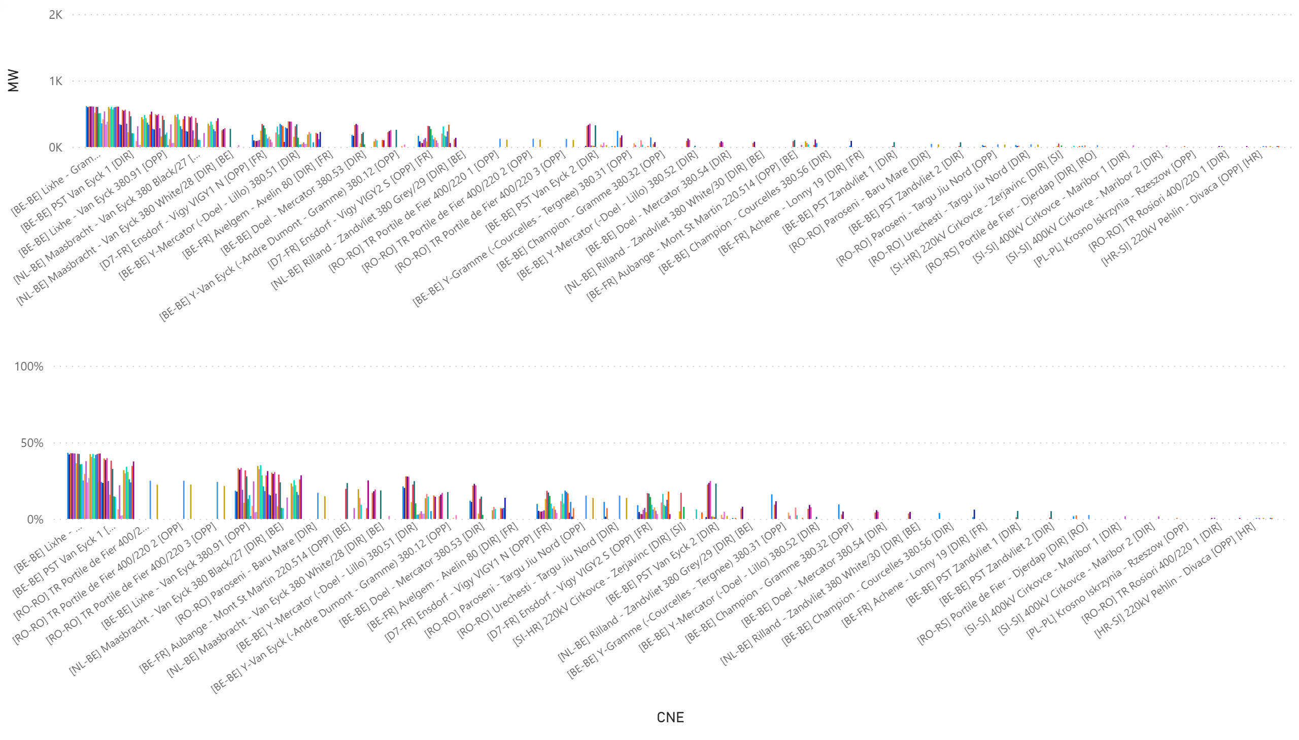
KPI6_0812
    KPI 6: Total IVA applied per MTU for each CNE affected by TSO intervention
    BD: 20210812 (top: in MW, bottom: in % of Fmax)
Notes:
clusteredColumnChart
No alt text provided.
clusteredColumnChart
No alt text provided.

Slide 45
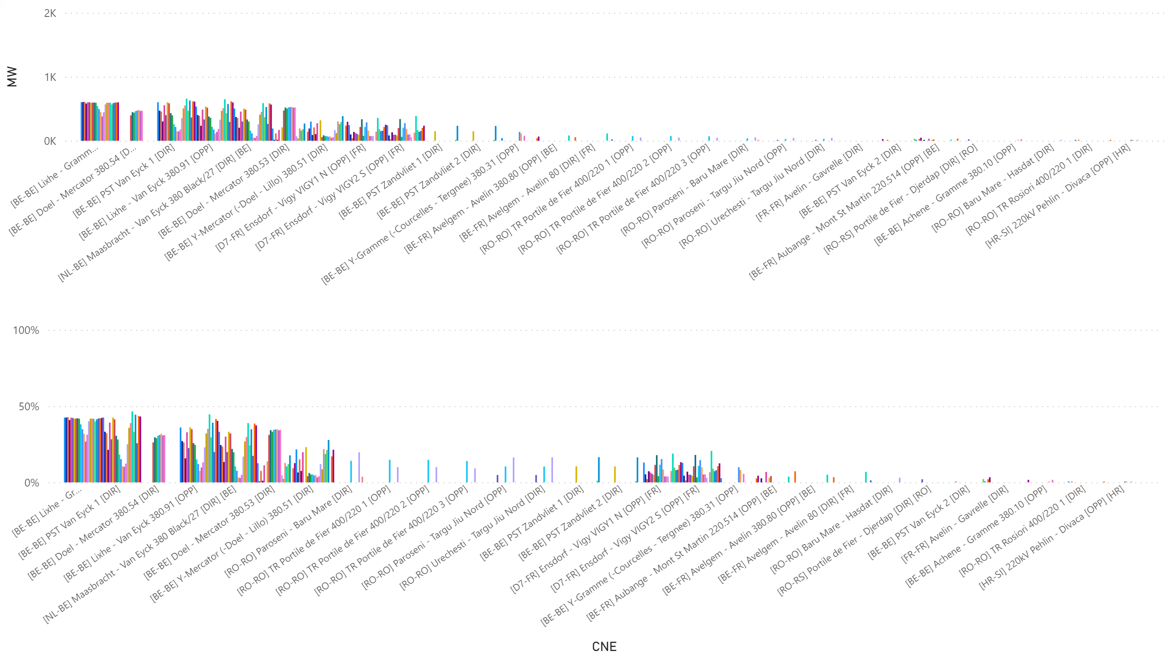
KPI6_0813
    KPI 6: Total IVA applied per MTU for each CNE affected by TSO intervention
    BD: 20210813 (top: in MW, bottom: in % of Fmax)
Notes:
clusteredColumnChart
No alt text provided.
clusteredColumnChart
No alt text provided.

Slide 46
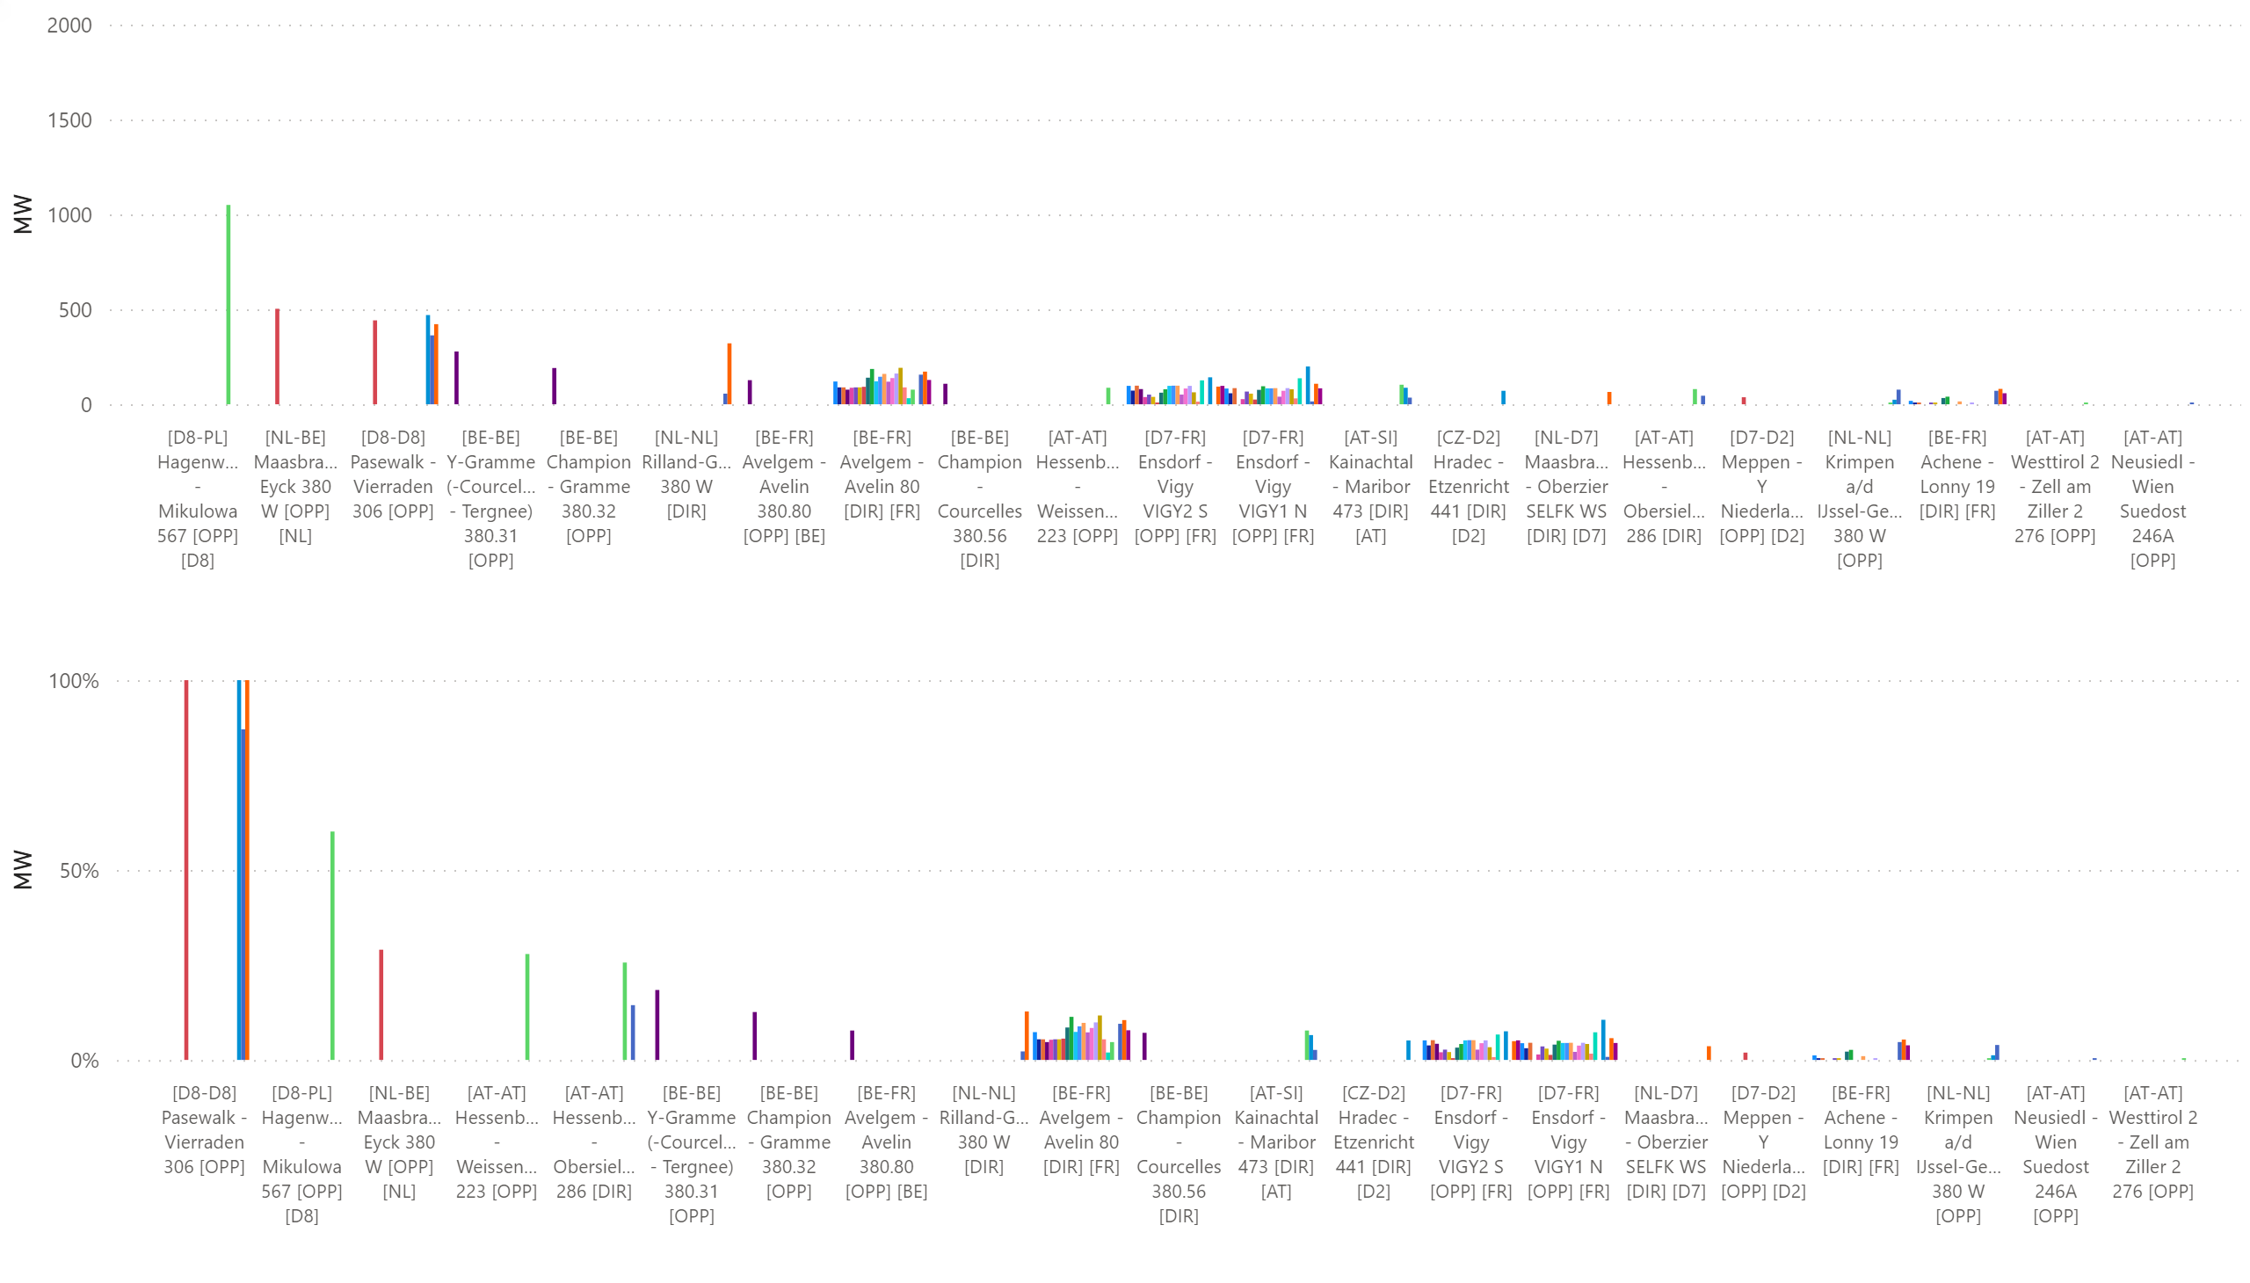
KPI6_0828
    KPI 6: Total IVA applied per MTU for each CNE affected by TSO intervention
    BD: 20210828 (top: in MW, bottom: in % of Fmax)
Notes:
clusteredColumnChart
No alt text provided.
clusteredColumnChart
No alt text provided.

Slide 47
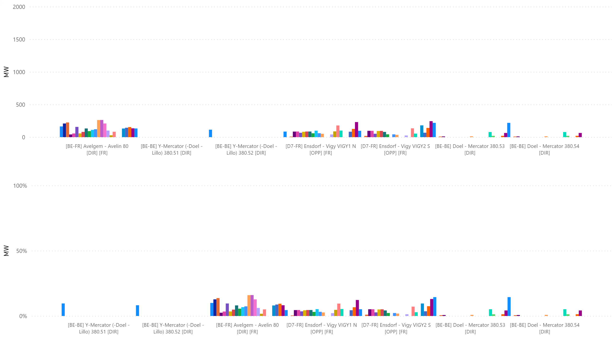
KPI6_0829
    KPI 6: Total IVA applied per MTU for each CNE affected by TSO intervention
    BD: 20210829 (top: in MW, bottom: in % of Fmax)
Notes:
clusteredColumnChart
No alt text provided.
clusteredColumnChart
No alt text provided.

Slide 48
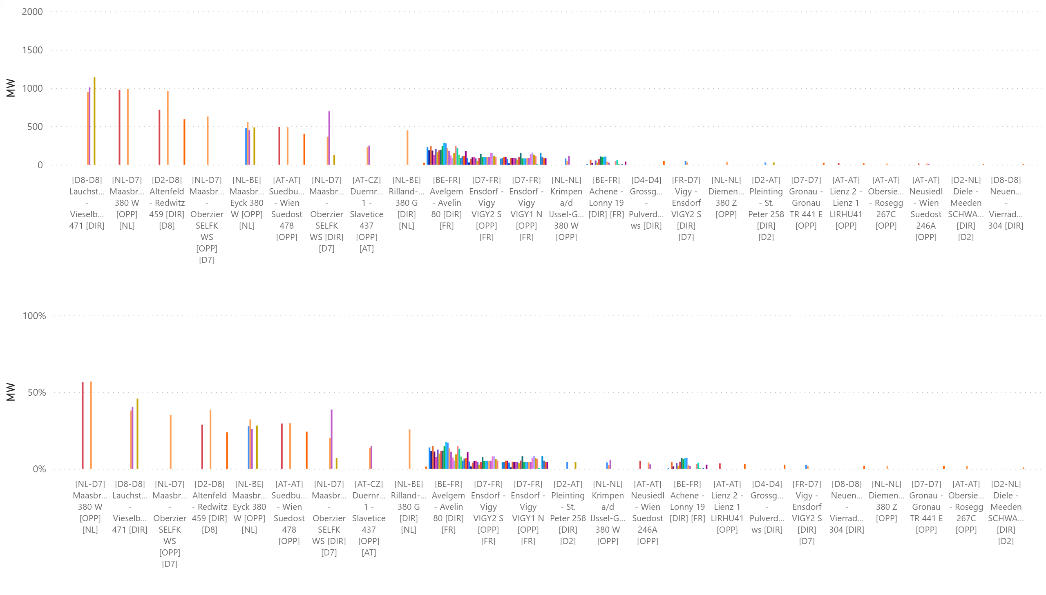
KPI6_0830
    KPI 6: Total IVA applied per MTU for each CNE affected by TSO intervention
    BD: 20210830 (top: in MW, bottom: in % of Fmax)
Notes:
clusteredColumnChart
No alt text provided.
clusteredColumnChart
No alt text provided.

Slide 49
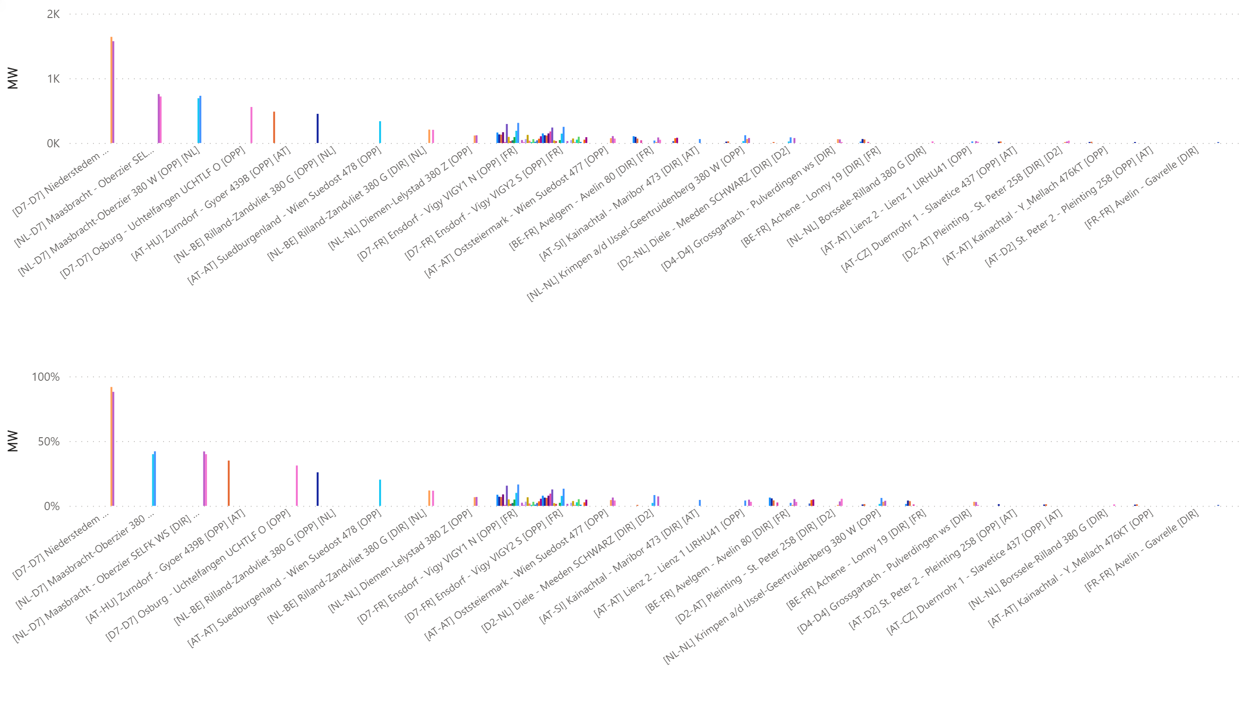
KPI6_0831
    KPI 6: Total IVA applied per MTU for each CNE affected by TSO intervention
    BD: 20210831 (top: in MW, bottom: in % of Fmax)
Notes:
clusteredColumnChart
No alt text provided.
clusteredColumnChart
No alt text provided.

Slide 50
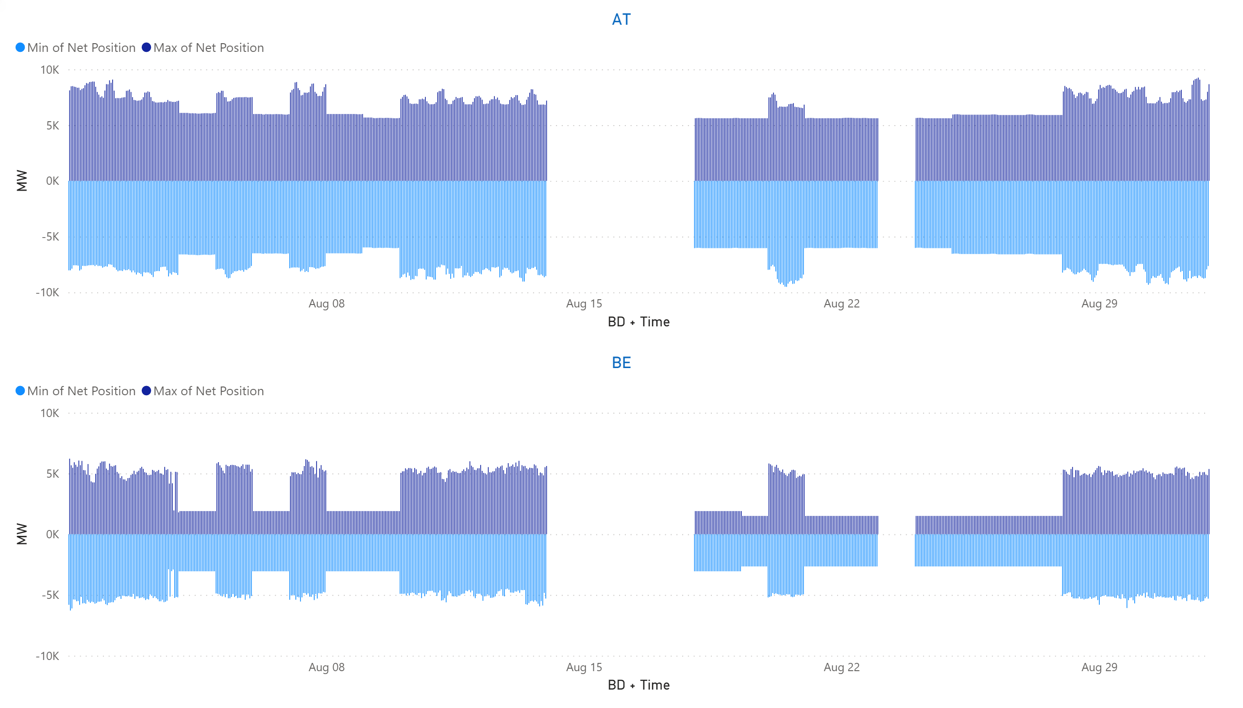
AT + BE
KPI 13: Min & max net positions per BZ hub
Notes:
AT
No alt text provided.
BE
No alt text provided.

Slide 51
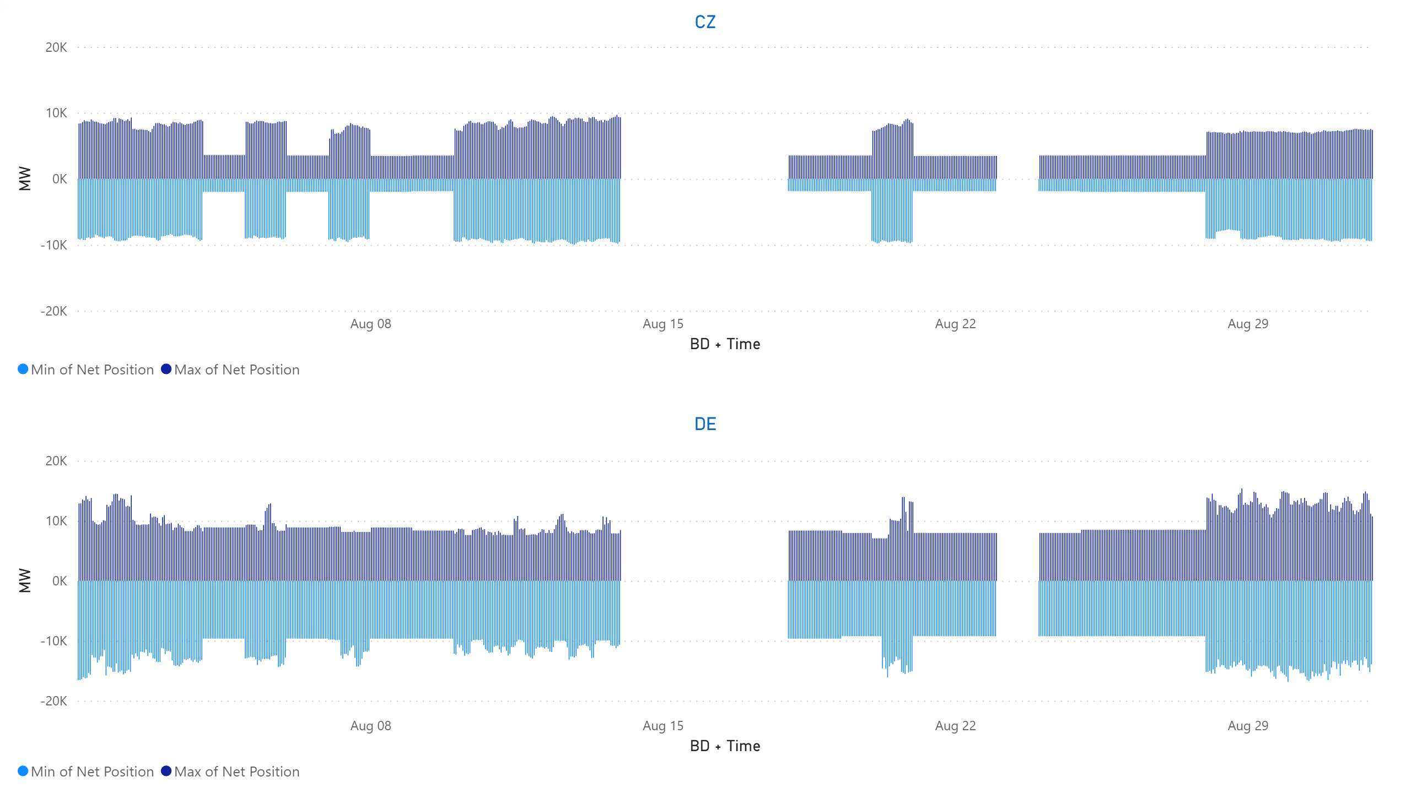
CZ+DE
KPI 13: Min & max net positions per BZ hub
Notes:
CZ
No alt text provided.
DE
No alt text provided.

Slide 52
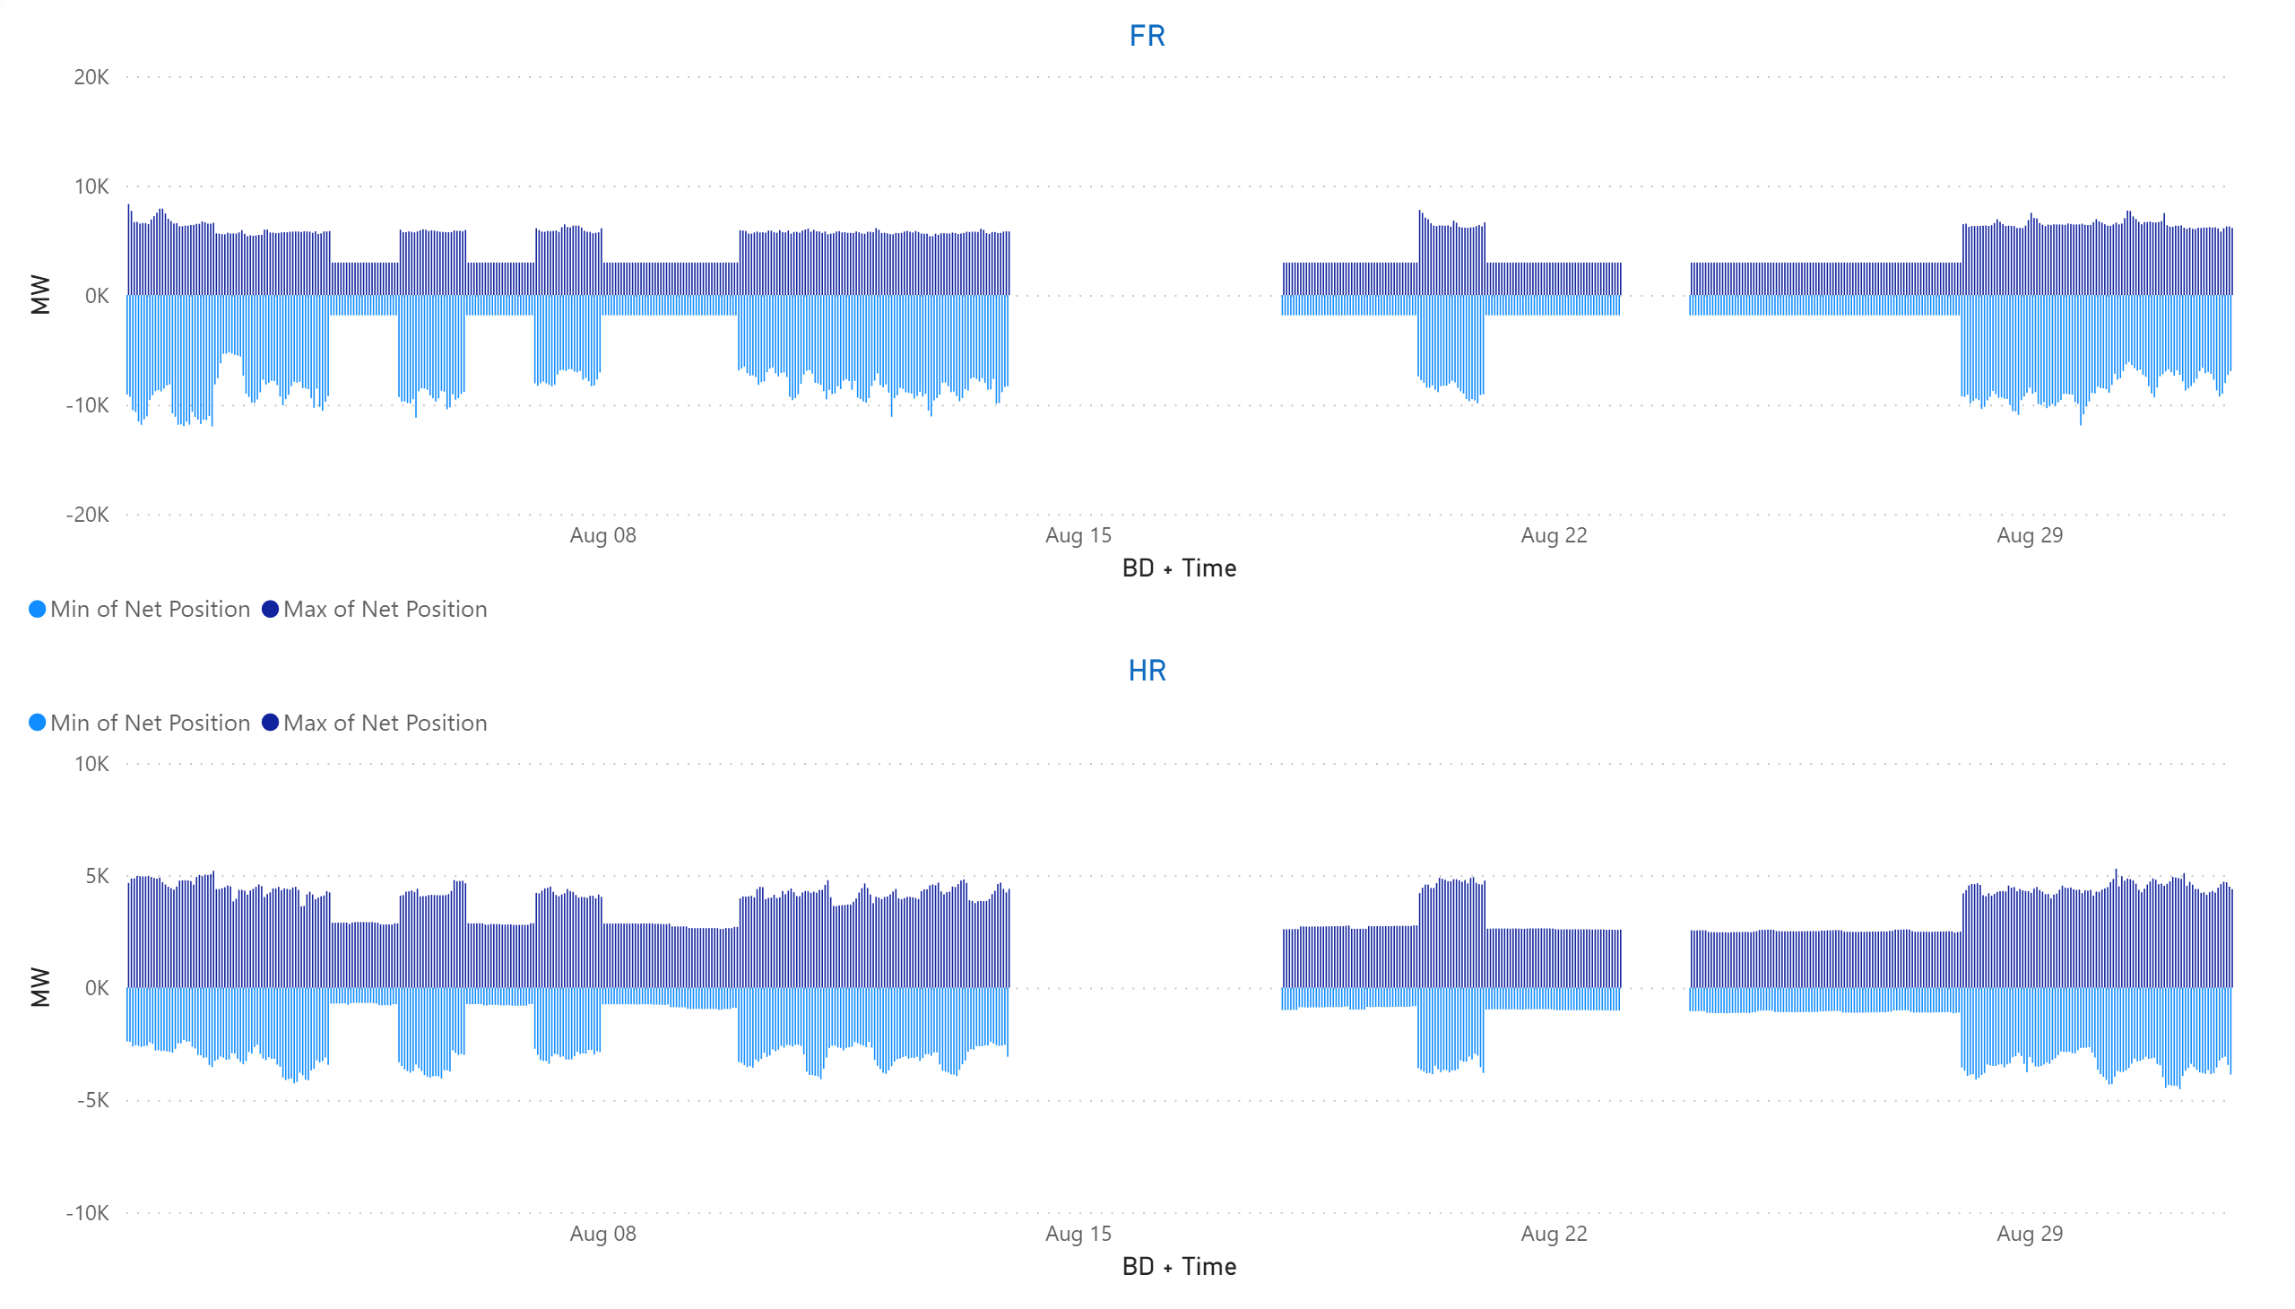
FR + HR
KPI 13: Min & max net positions per BZ hub
Notes:
FR
No alt text provided.
HR
No alt text provided.

Slide 53
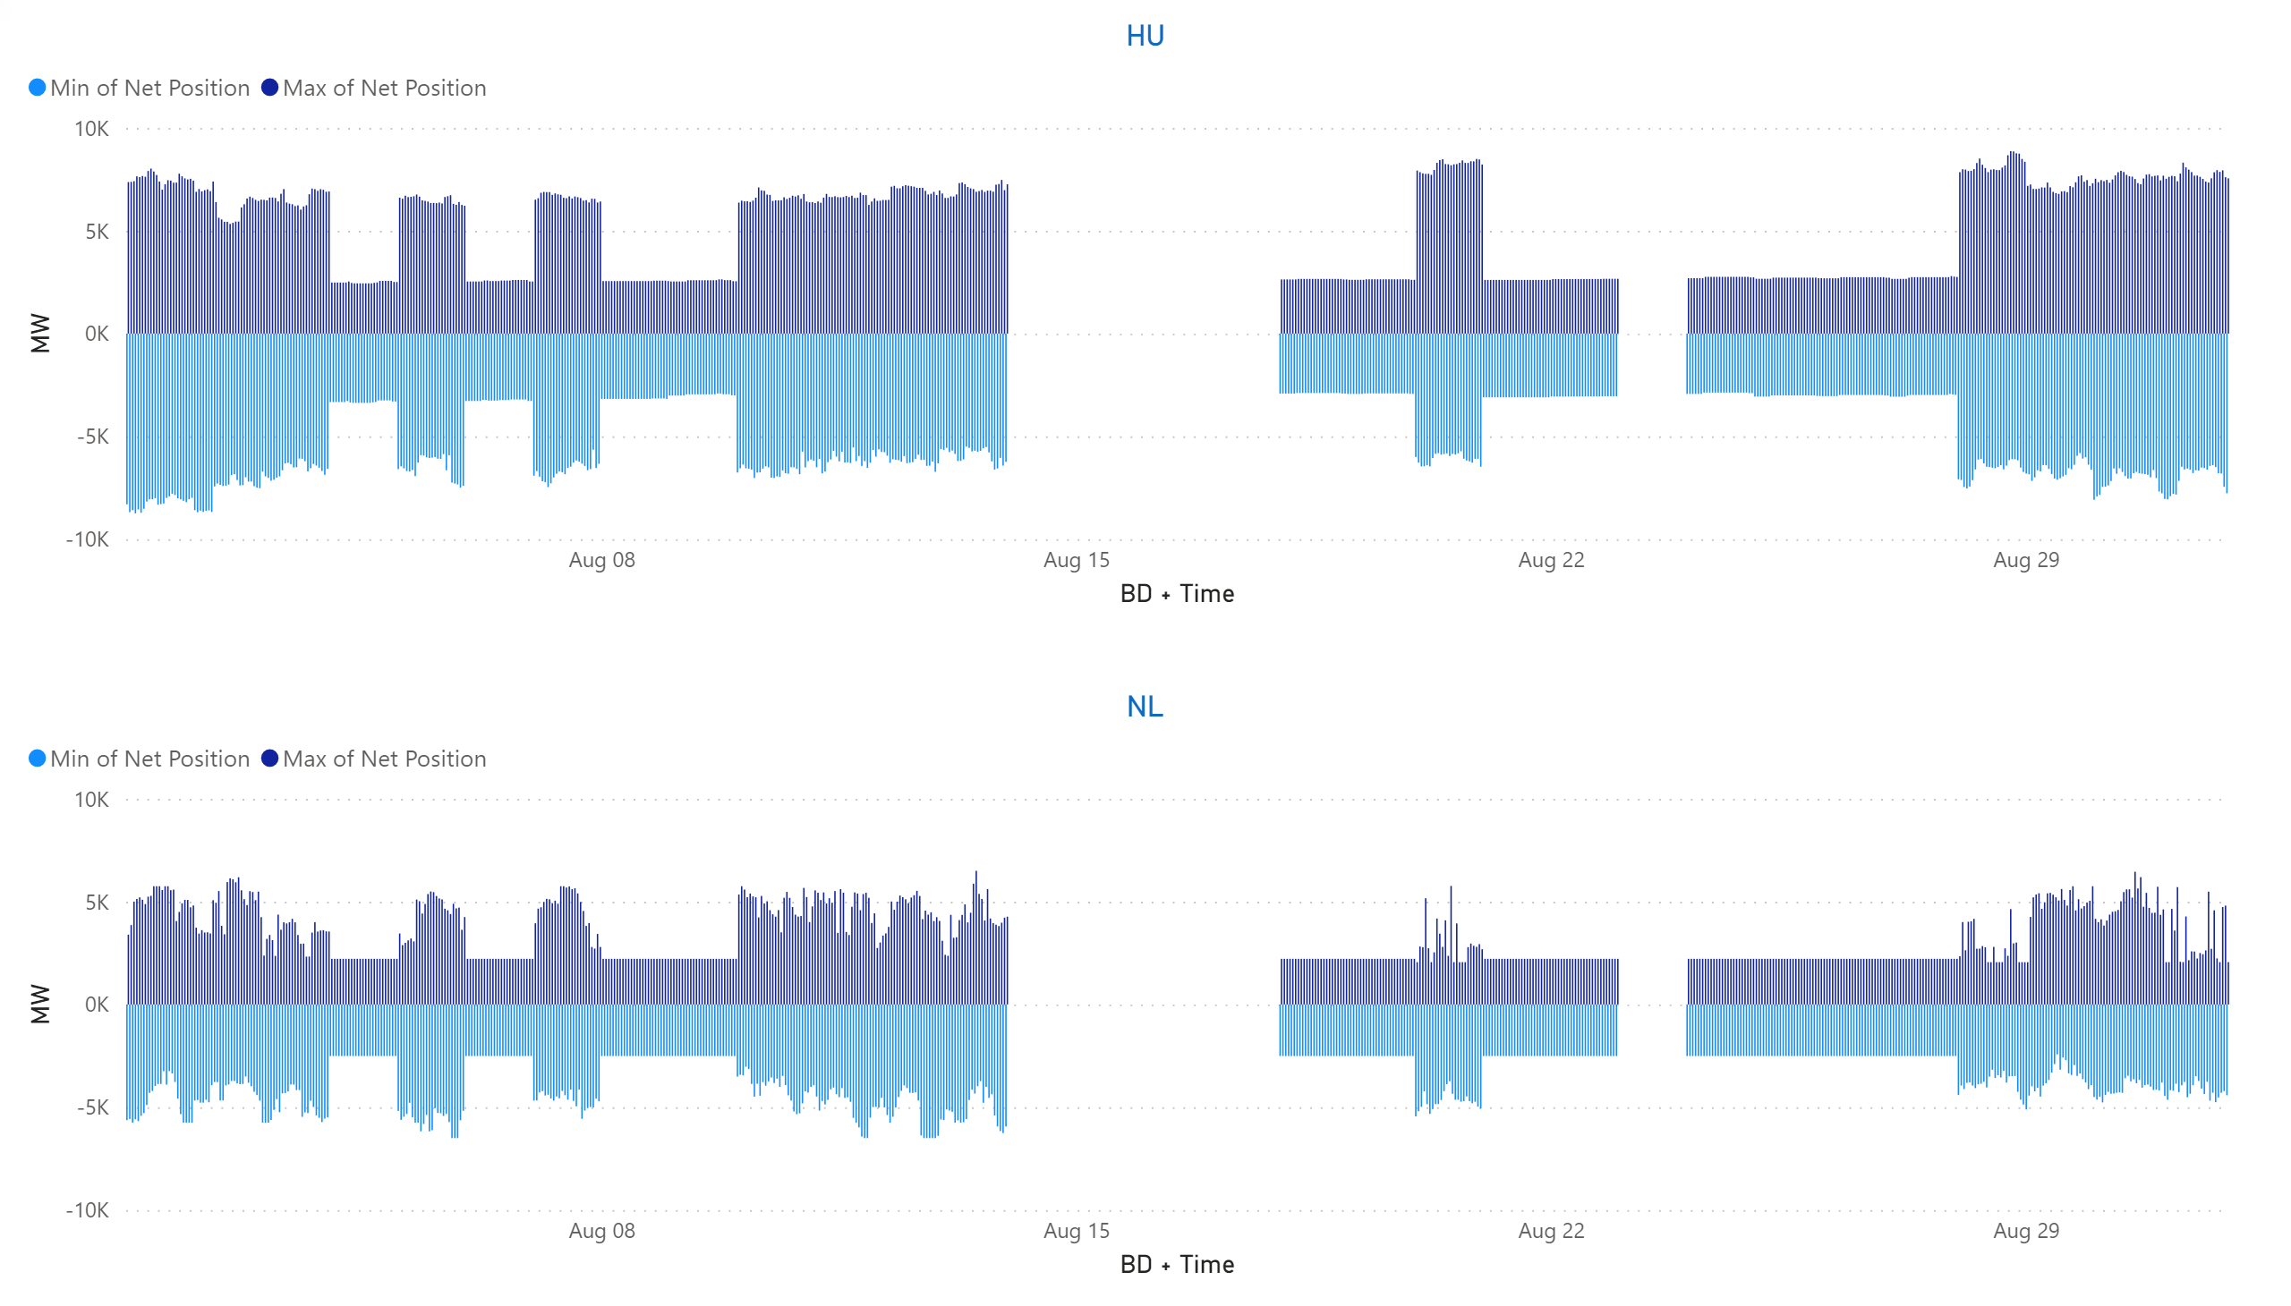
HU + NL
KPI 13: Min & max net positions per BZ hub
Notes:
HU
No alt text provided.
NL
No alt text provided.

Slide 54
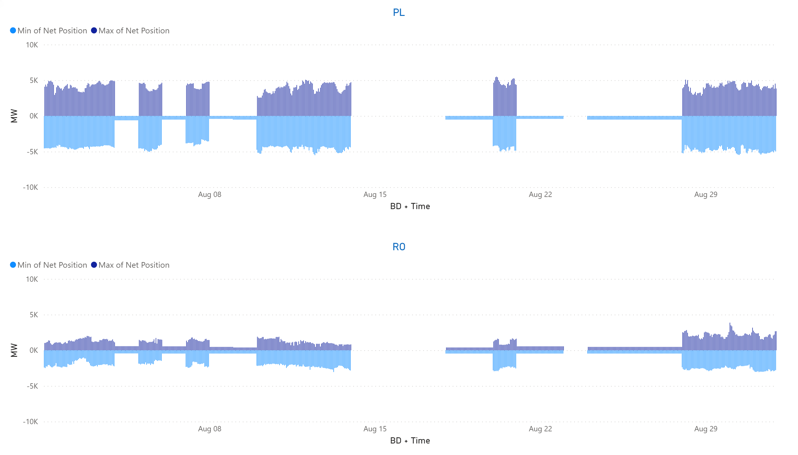
PL + RO
KPI 13: Min & max net positions per BZ hub
Notes:
PL
No alt text provided.
RO
No alt text provided.

Slide 55
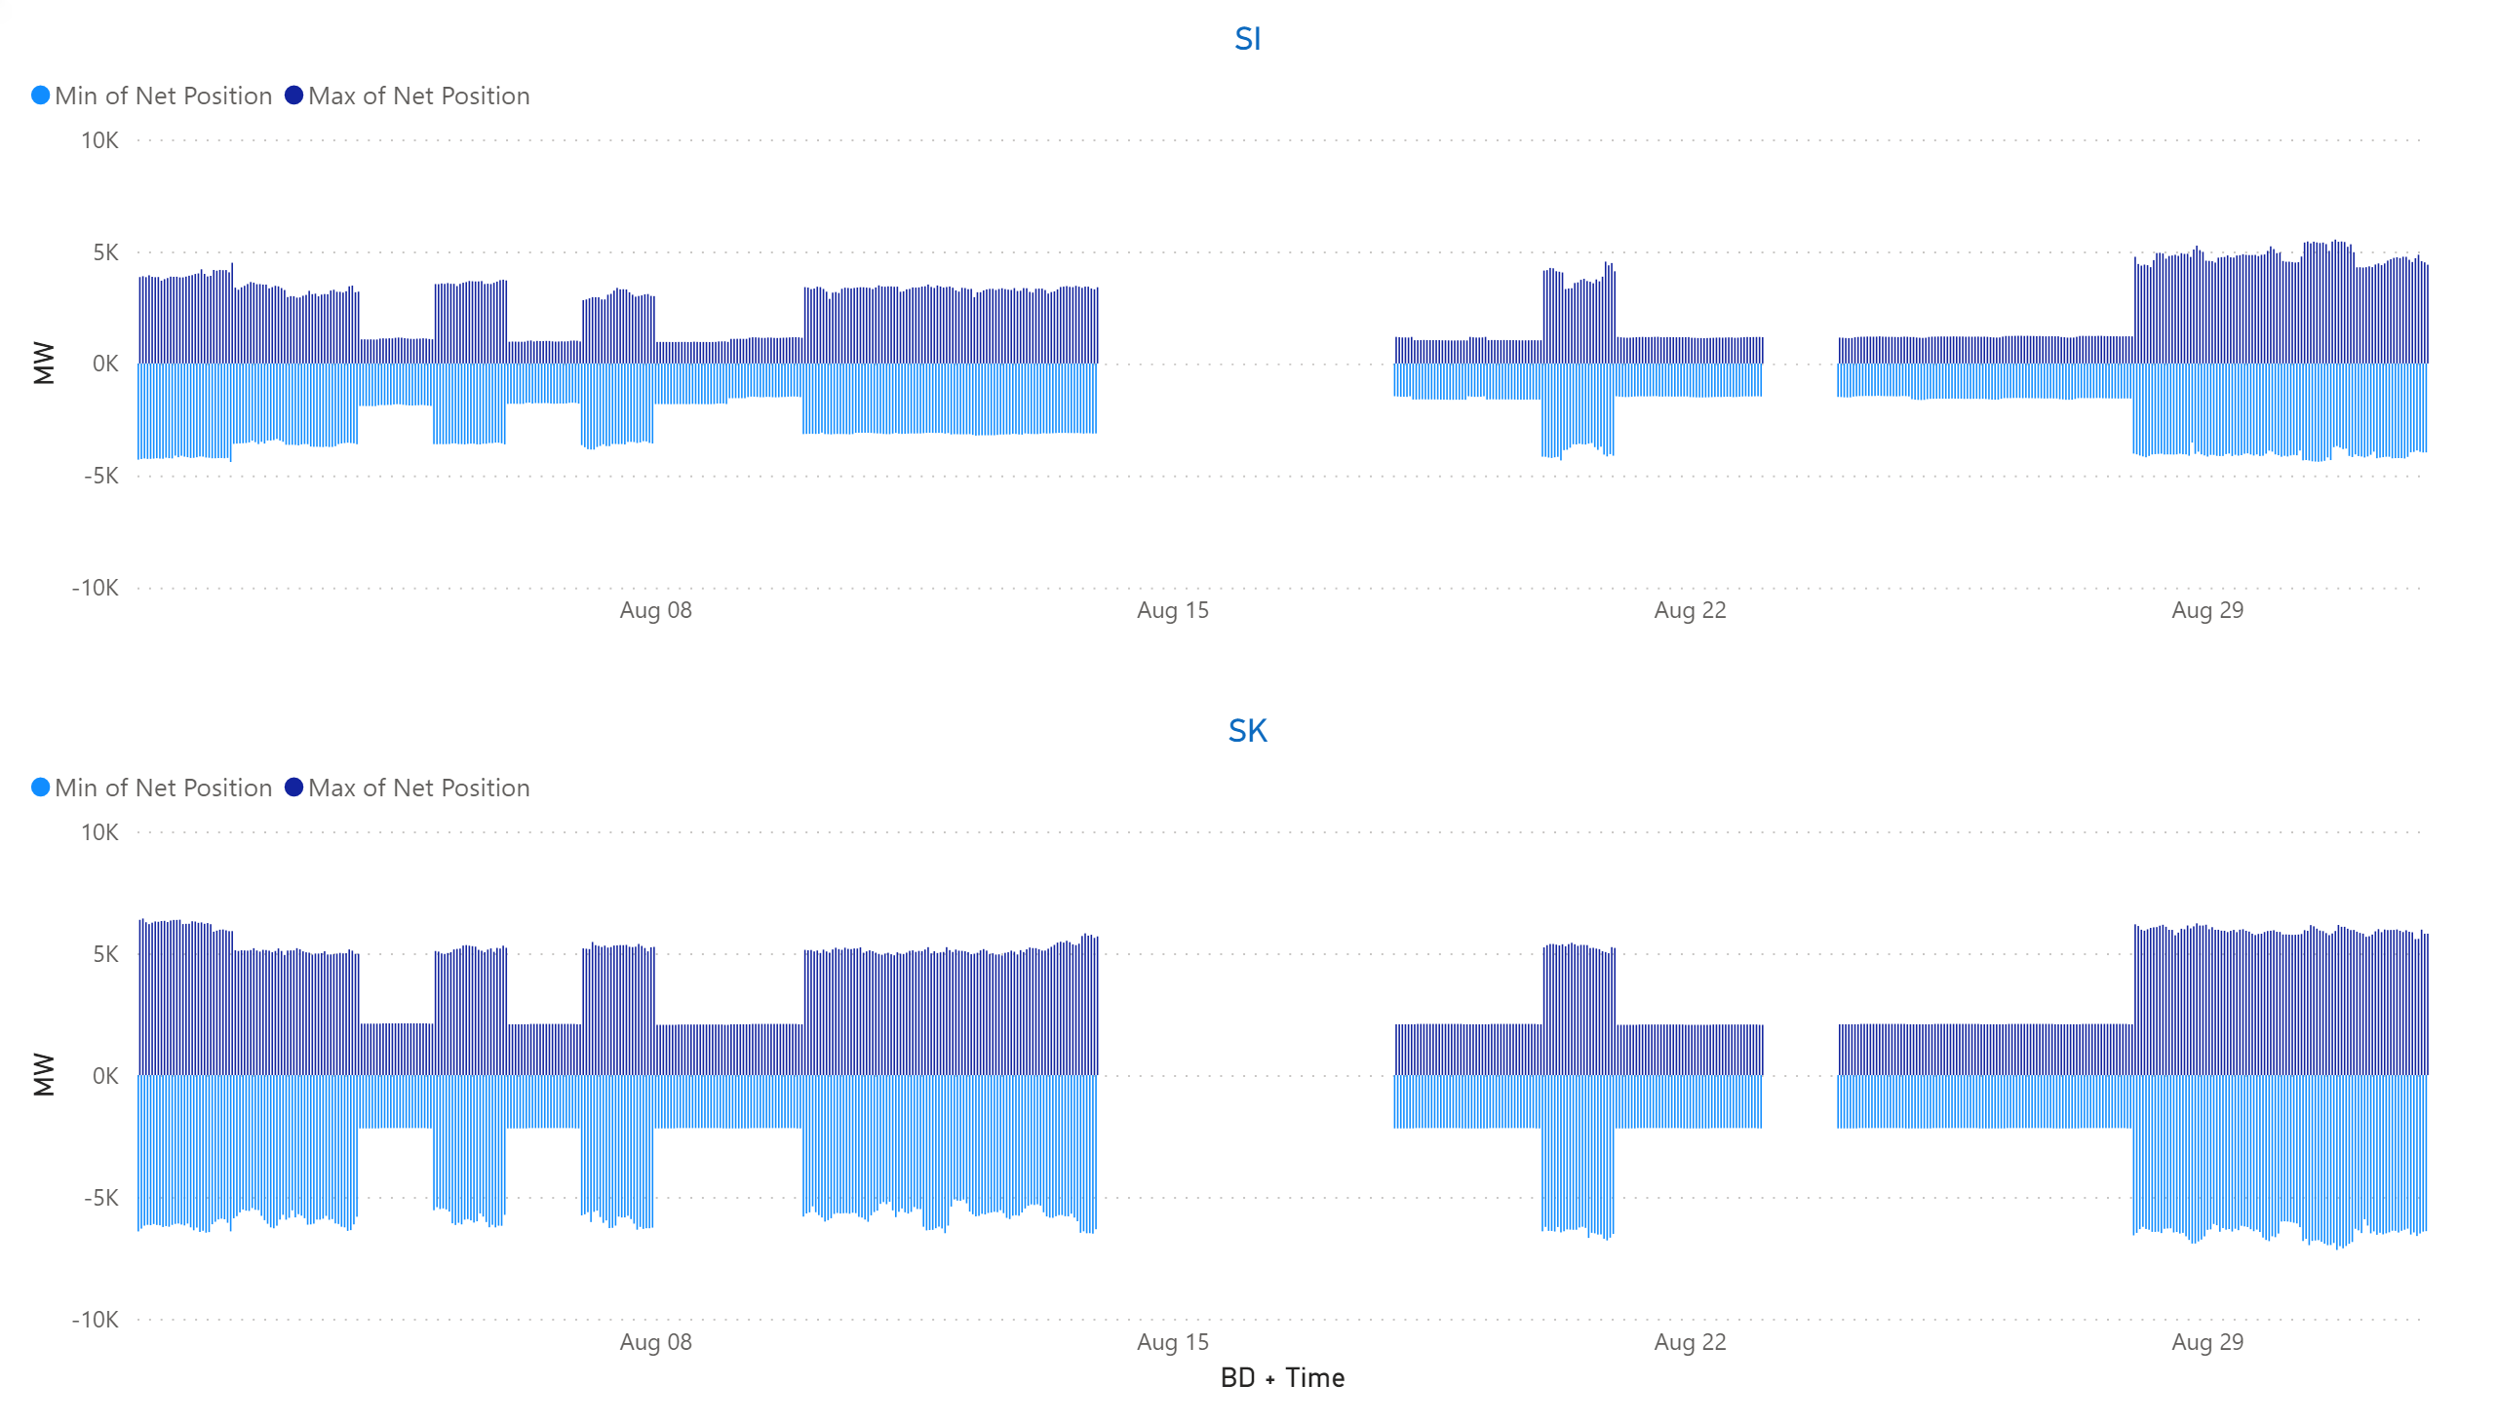
SI + SK
KPI 13: Min & max net positions per BZ hub
Notes:
SK
No alt text provided.
SI
No alt text provided.

Slide 56
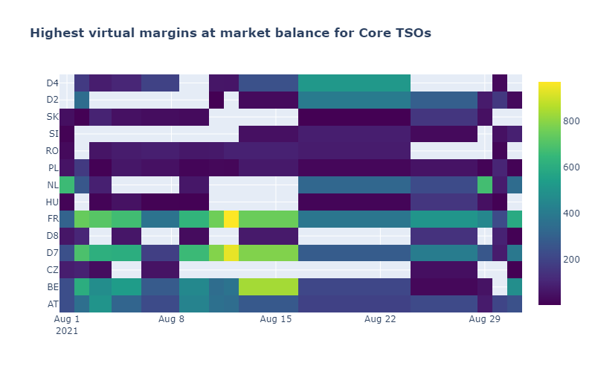
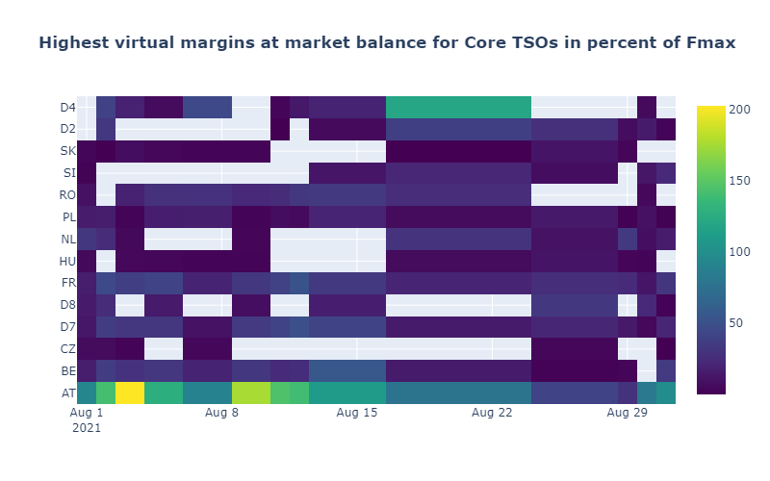
KPI 14a: Highest virtual margins at market balance for CORE TSOs
CORE TSOs

Slide 57
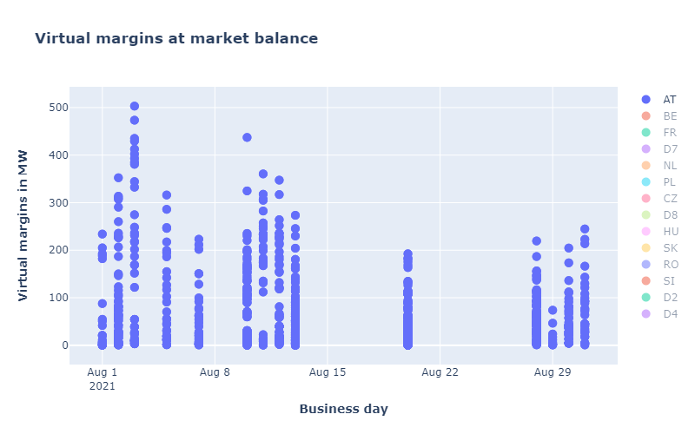
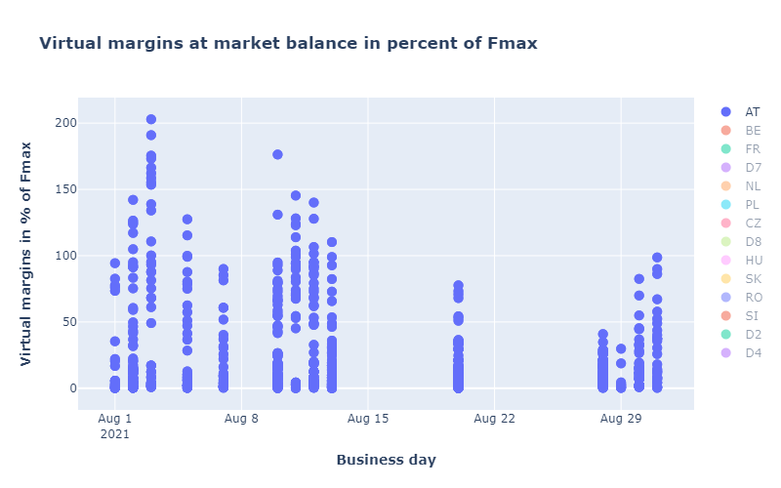
CORE TSOs
KPI 14b: AT: Virtual margins at market balance

Slide 58


KPI 14b: BE: Virtual margins at market balance
CORE TSOs

Slide 59


CORE TSOs
KPI 14b: CZ: Virtual margins at market balance

Slide 60


KPI 14b: D2: Virtual margins at market balance
CORE TSOs

Slide 61


CORE TSOs
KPI 14b: D4: Virtual margins at market balance

Slide 62


CORE TSOs
KPI 14b: D7: Virtual margins at market balance

Slide 63


CORE TSOs
KPI 14b: D8: Virtual margins at market balance

Slide 64


CORE TSOs
KPI 14b: FR: Virtual margins at market balance

Slide 65
KPI 14b: HR: Virtual margins at market balance
CORE TSOs
NO VIRTUAL MARGINS APPLIED

Slide 66


CORE TSOs
KPI 14b: HU: Virtual margins at market balance

Slide 67


KPI 14b: PL: Virtual margins at market balance
CORE TSOs

Slide 68


KPI 14b: NL: Virtual margins at market balance
CORE TSOs

Slide 69


CORE TSOs
KPI 14b: RO: Virtual margins at market balance

Slide 70


KPI 14b: SI: Virtual margins at market balance
CORE TSOs

Slide 71


KPI 14b: SK: Virtual margins at market balance
CORE TSOs

Slide 72

KPI 15: Non-Core exchanges delta flow
BD202100801 – BD20210831

Slide 73

KPI 15: Non-Core delta flow
BD20210801 – BD20210831
Note: BE-DE & DE-BE borders will be removed from this graph in the next report as these are Core borders

Slide 74

KPI 15: Non-Core delta exchanges
BD20210801– BD20210831

Slide 75

Boxplot recap

Slide 76

KPI 16: Relative Time Share of Applied RAs, by TSO, Type and Mode
  The total number of MTUs (720 hours) was distributed as shown in the pie chart
  In the following plots, the relative time share relates to the hours labeled ‘NRAO Ran and Applied RAs’ (374 hours)

Slide 77
KPI 16: Relative Time Share of Applied RAs, by TSO, Type and Mode

Slide 78

KPI 16: Relative Time Share of Applied RAs, by TSO, Type and Mode
Relative Time Share of Applied PSTs in Preventive Mode

Slide 79

KPI 16: Relative Time Share of Applied RAs, by TSO, Type and Mode
Relative Time Share of Applied Topological RAs in Preventive Mode

Slide 80

KPI 16: Relative Time Share of Applied RAs, by TSO, Type and Mode
Relative Time Share of Applied PSTs in Curative Mode

Slide 81

KPI 16: Relative Time Share of Applied RAs, by TSO, Type and Mode
Relative Time Share of Applied Topological RAs in Curative Mode

Slide 82
KPI 17: Most limiting CNEC per TSO (NRAO)
TSCNET
  The graph below shows the distribution of CNECs which are the most limiting from NRAO perspective, these are the CNECs with lowest relative RAM per MTUs.
  As expected, there is redistributing of the most limiting CNECs. This is because the application of Remedial Actions does not eliminate flows but re-routes, reducing the flows on some limiting CNECs and increasing the load on others, which at the end impacts also the RAM values.

Slide 83

KPI 18: Average variation of relative RAM before and after NRAO
TSCNET
  The graph shows average values of relative RAM before and after NRAO, per TSO on the most limiting CNECs from NRAO perspective. Selected CNECs before RAO are the same as after RAO, and average computed for MTUs when NRAO was used further in the process.
  Most limiting element from NRAO perspective is the one which has the lowest relRAM per MTU.
  To determent value of relative RAM, the following formula was used:
  $${RAM}_{rel}=\frac{{RAM}_{nrao}}{\sum_{\left(A, B\right) ∈ neighbouring Core bidding zones pairs }{\left|{PTDF}_{A→B, nrao}\right|}} if {RAM}_{nrao}≥0$$
  $${RAM}_{rel}={RAM}_{nrao} if {RAM}_{nrao}< 0$$
  The increment of relRAM values after RAO shows that the optimization performed did increase the capacity on some areas.
  In case of D2, D8, and PL it is obvious that RAM before RAO was negative and therefore relRAM= negativeRAM. After application of RAs, the flow on the element decreased leading to an increased RAM (equal or above 0), and this results in relRAM no longer being absolute (RAM) but proper calculated relative value.

Slide 84
Parallel Run KPI report
CORE FB MC
KPI 7: Most often presolved CNEs (TOP 20) 202108
Total BDs: 26 (624 hours)
CNE | Distinct Hours | Hours CNE was presolved | Average RAM | Max of RAM | Min of RAM | Max of z2zPTDF | Max of sum z2z PTDF
[SI-AT] 220 kV Podlog - Obersielach [DIR] [SI] | 336 | 1250 | 114% | 164% | 81% | 0.20913 | 0.59041
[HU-HU] Dunamenti - Oroszlany [DIR] | 336 | 1993 | 83% | 122% | 72% | 0.02315 | 0.30949
[HR-SI] 220kV Pehlin - Divaca [DIR] [HR] | 336 | 620 | 117% | 163% | 90% | 0.20292 | 0.5205
[AT-AT] Westtirol 1 - Westtirol 2 WTRHU41 [OPP] | 336 | 1886 | 98% | 128% | 54% | 0.1896 | 0.78818
[AT-D2] St. Peter 2 - Pleinting 258 [OPP] [AT] | 336 | 2325 | 99% | 133% | 73% | 0.07201 | 0.44336
[SI-HR] 220kV Cirkovce - Zerjavinc [DIR] [SI] | 336 | 1880 | 98% | 124% | 62% | 0.13373 | 0.35511
[HU-AT] Gyor - Zurndorf [OPP] [HU] | 333 | 633 | 91% | 109% | 68% | 0.29892 | 1.29715
[NL-D7] Maasbracht - Oberzier SELFK WS [DIR] [D7] | 330 | 862 | 65% | 99% | 30% | 0.22758 | 0.69983
[SK-HU] Levice - God [DIR] [HU] | 310 | 663 | 65% | 85% | 52% | 0.34686 | 1.10689
[AT-D2] St. Peter 2 - Pleinting 258 [DIR] [AT] | 309 | 1626 | 117% | 162% | 89% | 0.12606 | 0.44336
[BE-FR] Avelgem - Avelin 80 [OPP] [FR] | 297 | 651 | 73% | 108% | 60% | 0.17306 | 1.02857
[AT-AT] Westtirol 1 - Westtirol 2 WTRHU41 [DIR] | 295 | 1026 | 103% | 141% | 69% | 0.0585 | 0.78193
[AT-D2] St. Peter 2 - Altheim 233_230 [DIR] [AT] | 292 | 706 | 86% | 103% | 67% | 0.06522 | 0.22841
[D4-D4] PST Buers BMT37 [DIR] | 243 | 683 | 126% | 377% | 66% | 0.11096 | 0.5548
[D4-D4] PST Buers BMT37 [OPP] | 239 | 1055 | 94% | 176% | 38% | 0.10747 | 0.53735
[D2-AT] Pleinting - St. Peter 258 [DIR] [D2] | 238 | 749 | 76% | 91% | 54% | 0.06118 | 0.34023
[D4-AT] Buers - Meiningen gn [DIR] [D4] | 231 | 657 | 41% | 90% | 23% | 0.0692 | 0.33531
[BE-FR] Avelgem - Avelin 380.80 [OPP] [BE] | 230 | 1899 | 72% | 91% | 61% | 0.16428 | 1.03111
[BE-FR] Aubange - Mont St Martin 220.514 [OPP] [BE] | 213 | 824 | 74% | 113% | 53% | 0.04297 | 0.27684
[D8-PL] Krajnik - Vierraden 1 [OPP] [PL] | 98 | 660 | 34% | 46% | 26% | 0.19701 | 0.70538
*Please note that the shown z2zPTDF values do not correspond to the maximum zone-to-zone PTDFs according to equation 5 of the Day-ahead CCM and hence are not the ones used for the CNEC Selection. The z2zPTDFs are calculated only between neighbouring BZs by the scripts used for external parallel run reporting. See KPI reading guide on JAO.

Slide 85
Parallel Run KPI report
CORE FB MC
KPI 8a: Most limiting CNEs (TOP 20) 202108
Total BDs: 26 (624 hours)
CNE | Distinct Hours | Hours CNE has ShadowPrice | Max of Shadow Price | Average of RAM | Min of RAM | Max of RAM | Max of z2zPTDF | Max of sum z2z PTDF
Default_HU_Import | 273 | 273 | 224.914 | 0% | 0% | 0% | 1 | 4
Default_HR_Import | 273 | 273 | 224.914 | 0% | 0% | 0% | 0 | 2
Default_RO_Import | 269 | 269 | 224.914 | 0% | 0% | 0% | 0 | 1
Default_SI_Import | 217 | 217 | 183.009 | 0% | 0% | 0% | 1 | 2
Default_BE_AL_Import | 166 | 166 | 1187.379 | 0% | 0% | 0% | 0 | 0
Default_DE_AL_Import | 166 | 166 | 1187.379 | 0% | 0% | 0% | 0 | 0
Default_PL_Export | 156 | 156 | 1171.115 | 0% | 0% | 0% | 0 | 3
Default_BE_Export | 126 | 126 | 1214.147 | 0% | 0% | 0% | 1 | 2
Default_FR_Export | 124 | 124 | 1214.147 | 0% | 0% | 0% | 0 | 2
DE_AL_import | 114 | 114 | 1181.269 | 16% | 0% | 100% | 0 | 0
BE_AL_import | 108 | 108 | 1181.269 | 11% | 0% | 100% | 0 | 0
Default_SK_Import | 70 | 70 | 61.789 | 0% | 0% | 0% | 1 | 3
Default_NL_Import | 58 | 58 | 49.549 | 0% | 0% | 0% | 1 | 2
Default_CZ_Import | 57 | 57 | 61.789 | 0% | 0% | 0% | 1 | 4
[BE-BE] Lixhe - Gramme 380.11 [OPP] | 57 | 58 | 109.001 | 38% | 25% | 55% | 0.17536 | 0.4046
Default_PL_Import | 55 | 55 | 120.505 | 0% | 0% | 0% | 1 | 3
Default_DE_Export | 44 | 44 | 1171.115 | 0% | 0% | 0% | 1 | 5
Default_AT_Export | 42 | 42 | 1171.115 | 0% | 0% | 0% | 1 | 4
[FR-D7] Vigy - Ensdorf VIGY2 S [DIR] [D7] | 42 | 43 | 341.029 | 30% | 21% | 39% | 0.10868 | 0.53898
Default_FR_Import | 35 | 35 | 26.913 | 0% | 0% | 0% | 1 | 2
*Please note that the shown z2zPTDF values do not correspond to the maximum zone-to-zone PTDFs according to equation 5 of the Day-ahead CCM and hence are not the ones used for the CNEC Selection. The z2zPTDFs are calculated only between neighbouring BZs by the scripts used for external parallel run reporting. See KPI reading guide on JAO.
The appearance of the ALEGrO virtual hubs (DE_AL_import & BE_AL_import) reflects how frequently the full capacity of the ALEGrO interconnector is used to optimize the exchanges during the market allocation. Indeed, ALEGrO is to be understood as a ‘market optimization variable’ and not as a ‘CNE limiting the FB domain’.
The appearance of „Default_Hub_Import/Export“ is due to Default FB parameters being used as a backup measure on TSO side. In such case, only the LTA domain and an empty FB domain is delivered to Euphemia for MC.

Slide 86


Parallel Run KPI report
CORE FB MC
KPI 8b: Allocation Constraints 202108
Please note that Belgium only uses import constraints. The average, maximum and minimum values refer to the MTUs when an Allocation Constraint was limiting, and if the AC was not limiting the average values refer to all MTUs.

Slide 87


Parallel Run KPI report
KPI 9: Clearing prices, price spreads and price convergence
BD20210801

Slide 88


Parallel Run KPI report
KPI 9: Clearing prices, price spreads and price convergence
BD20210802

Slide 89


Parallel Run KPI report
KPI 9: Clearing prices, price spreads and price convergence
BD20210803

Slide 90


Parallel Run KPI report
KPI 9: Clearing prices, price spreads and price convergence
BD20210804

Slide 91


Parallel Run KPI report
KPI 9: Clearing prices, price spreads and price convergence
BD20210805

Slide 92


Parallel Run KPI report
KPI 9: Clearing prices, price spreads and price convergence
BD20210806

Slide 93


Parallel Run KPI report
KPI 9: Clearing prices, price spreads and price convergence
BD20210807

Slide 94


Parallel Run KPI report
KPI 9: Clearing prices, price spreads and price convergence
BD20210808

Slide 95


Parallel Run KPI report
KPI 9: Clearing prices, price spreads and price convergence
BD20210809

Slide 96


Parallel Run KPI report
KPI 9: Clearing prices, price spreads and price convergence
BD20210810

Slide 97


Parallel Run KPI report
KPI 9: Clearing prices, price spreads and price convergence
BD20210811

Slide 98


Parallel Run KPI report
KPI 9: Clearing prices, price spreads and price convergence
BD20210812

Slide 99


Parallel Run KPI report
KPI 9: Clearing prices, price spreads and price convergence
BD20210813

Slide 100


Parallel Run KPI report
KPI 9: Clearing prices, price spreads and price convergence
BD20210818

Slide 101


Parallel Run KPI report
KPI 9: Clearing prices, price spreads and price convergence
BD20210819

Slide 102


Parallel Run KPI report
KPI 9: Clearing prices, price spreads and price convergence
BD20210820

Slide 103


Parallel Run KPI report
KPI 9: Clearing prices, price spreads and price convergence
BD20210821

Slide 104


Parallel Run KPI report
KPI 9: Clearing prices, price spreads and price convergence
BD20210822

Slide 105


Parallel Run KPI report
KPI 9: Clearing prices, price spreads and price convergence
BD20210824

Slide 106


Parallel Run KPI report
KPI 9: Clearing prices, price spreads and price convergence
BD20210825

Slide 107


Parallel Run KPI report
KPI 9: Clearing prices, price spreads and price convergence
BD20210826

Slide 108


Parallel Run KPI report
KPI 9: Clearing prices, price spreads and price convergence
BD20210827

Slide 109


Parallel Run KPI report
KPI 9: Clearing prices, price spreads and price convergence
BD20210828

Slide 110


Parallel Run KPI report
KPI 9: Clearing prices, price spreads and price convergence
BD20210829

Slide 111


Parallel Run KPI report
KPI 9: Clearing prices, price spreads and price convergence
BD20210830

Slide 112


Parallel Run KPI report
KPI 9: Clearing prices, price spreads and price convergence
BD20210831

Slide 113
CORE FB MC
Parallel Run KPI report
KPI 10: Highest non-zero shadow prices in each hour for the simulated BD20210801 (part I)
Hour | MAX of ShadowPrice | RAM %
4 | 33.09 | 83%
[FR-D7] Vigy - Ensdorf VIGY2 S [DIR] [D7] / N-1 Ensdorf - Vigy VIGY1 N | 33.09 | 34%
[BE-BE] Lixhe - Gramme 380.11 [OPP] / N-1 Lixhe - Van Eyck 380.91 | 6.43 | 48%
5 | 95.6 | 79%
[FR-D7] Vigy - Ensdorf VIGY2 S [DIR] [D7] / N-1 Ensdorf - Uchtelfangen TAUBNT N | 95.6 | 32%
[BE-BE] Lixhe - Gramme 380.11 [OPP] / N-1 Lixhe - Van Eyck 380.91 | 18.57 | 47%
6 | 138.25 | 132%
[FR-D7] Vigy - Ensdorf VIGY1 N [DIR] [D7] / N-1 Ensdorf - Vigy VIGY2 S | 138.25 | 32%
BE_AL_import / BASECASE | 17.98 | 100%
7 | 114.43 | 227%
[FR-D7] Vigy - Ensdorf VIGY2 S [DIR] [D7] / N-1 Ensdorf - Vigy VIGY1 N | 114.43 | 32%
BE_AL_import / BASECASE | 15.15 | 100%
[NL-NL] Krimpen a/d IJssel-Geertruidenberg 380 W [OPP] / N-1 Krimpen a/d IJssel-Geertruidenberg 380 Z | 0.51 | 95%
8 | 79.15 | 214%
BE_AL_import / BASECASE | 9.65 | 100%
[FR-D7] Vigy - Ensdorf VIGY1 N [DIR] [D7] / N-1 Ensdorf - Uchtelfangen TAUBNT S | 79.15 | 29%
[NL-NL] Krimpen a/d IJssel-Geertruidenberg 380 W [OPP] / N-1 Krimpen a/d IJssel-Geertruidenberg 380 Z | 2.23 | 85%
9 | 77.68 | 157%
[D7-FR] Ensdorf - Vigy VIGY2 S [OPP] [FR] / N-1 Ensdorf - Vigy VIGY1 N | 77.68 | 37%
[NL-NL] Krimpen a/d IJssel-Geertruidenberg 380 W [OPP] / N-1 Krimpen a/d IJssel-Geertruidenberg 380 Z | 14.45 | 72%
[BE-BE] Lixhe - Gramme 380.11 [OPP] / N-1 Lixhe - Van Eyck 380.91 | 16.94 | 48%
10 | 72.43 | 200%
[D7-FR] Ensdorf - Vigy VIGY2 S [OPP] [FR] / N-1 Ensdorf - Vigy VIGY1 N | 65.22 | 38%
BE_AL_import / BASECASE | 13.76 | 100%
[NL-NL] Krimpen a/d IJssel-Geertruidenberg 380 W [OPP] / N-1 Krimpen a/d IJssel-Geertruidenberg 380 Z | 72.43 | 62%
11 | 72.23 | 157%
BE_AL_import / BASECASE | 4.9 | 100%
[NL-NL] Krimpen a/d IJssel-Geertruidenberg 380 W [OPP] / N-1 Krimpen a/d IJssel-Geertruidenberg 380 Z | 72.23 | 57%
12 | 62.97 | 157%
BE_AL_import / BASECASE | 4.27 | 100%
[NL-NL] Krimpen a/d IJssel-Geertruidenberg 380 W [OPP] / N-1 Krimpen a/d IJssel-Geertruidenberg 380 Z | 62.97 | 57%
13 | 31.33 | 157%
BE_AL_import / BASECASE | 2.12 | 100%
[NL-NL] Krimpen a/d IJssel-Geertruidenberg 380 W [OPP] / N-1 Krimpen a/d IJssel-Geertruidenberg 380 Z | 31.33 | 57%
14 | 3.71 | 156%
BE_AL_import / BASECASE | 0.25 | 100%
[NL-NL] Krimpen a/d IJssel-Geertruidenberg 380 W [OPP] / N-1 Krimpen a/d IJssel-Geertruidenberg 380 Z | 3.71 | 56%

Slide 114
CORE FB MC
Parallel Run KPI report
KPI 10: Highest non-zero shadow prices in each hour for the simulated BD20210801 (part II)
15 | 53.14 | 240%
[D7-FR] Ensdorf - Vigy VIGY2 S [OPP] [FR] / N-1 Ensdorf - Vigy VIGY1 N | 20.76 | 41%
[D8-D8] Pasewalk - Vierraden 306 [DIR] / N-1 Vierraden - Neuenhagen 304 | 53.14 | 42%
BE_AL_import / BASECASE | 4.82 | 100%
[NL-NL] Krimpen a/d IJssel-Geertruidenberg 380 W [OPP] / N-1 Krimpen a/d IJssel-Geertruidenberg 380 Z | 31.25 | 56%
16 | 201.72 | 231%
[D7-FR] Ensdorf - Vigy VIGY2 S [OPP] [FR] / N-1 Ensdorf - Vigy VIGY1 N | 135.06 | 39%
[D8-D8] Neuenhagen - Vierraden 304 [DIR] / N-1 Vierraden - Pasewalk 306 | 201.72 | 35%
BE_AL_import / BASECASE | 20.52 | 100%
[NL-NL] Krimpen a/d IJssel-Geertruidenberg 380 W [OPP] / N-1 Krimpen a/d IJssel-Geertruidenberg 380 Z | 41.14 | 56%
17 | 122.49 | 226%
[D8-D8] Neuenhagen - Vierraden 304 [DIR] / N-1 Vierraden - Pasewalk 306 | 122.49 | 35%
[FR-D7] Vigy - Ensdorf VIGY2 S [DIR] [D7] / N-1 Ensdorf - Vigy VIGY1 N | 112.1 | 34%
BE_AL_import / BASECASE | 18.63 | 100%
[NL-NL] Krimpen a/d IJssel-Geertruidenberg 380 W [OPP] / N-1 Krimpen a/d IJssel-Geertruidenberg 380 Z | 57.44 | 57%
18 | 128.45 | 257%
[D7-FR] Ensdorf - Vigy VIGY2 S [OPP] [FR] / N-1 Ensdorf - Vigy VIGY1 N | 128.45 | 34%
BE_AL_import / BASECASE | 21.54 | 100%
[SK-SK] V.Dur - Levice 2 [DIR] / N-1 V.Dur - Levice 1 | 82.13 | 43%
[NL-NL] Krimpen a/d IJssel-Geertruidenberg 380 W [OPP] / N-1 Krimpen a/d IJssel-Geertruidenberg 380 Z | 67.53 | 80%
19 | 381.42 | 76%
[AT-HU] Wien Suedost - Gyoer 245 [DIR] [AT] / N-1 Gyor - Neusiedl | 381.42 | 76%
21 | 136.2 | 78%
[AT-HU] Neusiedl - Gyoer 246B [DIR] [AT] / N-1 Gyor - Wien | 136.2 | 78%
22 | 135.95 | 133%
[AT-HU] Neusiedl - Gyoer 246B [DIR] [AT] / N-1 Gyor - Wien | 135.95 | 79%
[D2-NL] Diele - Meeden SCHWARZ [DIR] [D2] / N-1 Diele - Meeden WEISS/W | 0.12 | 55%
Total sum | 381.42 | 2960%

Slide 115
CORE FB MC
Parallel Run KPI report
KPI 10: Highest non-zero shadow prices in each hour for the simulated BD20210802 (part I)
Hour | MAX of ShadowPrice | RAM %
1 | 138.36 | 139%
DE_AL_import / BASECASE | 3.13 | 100%
[D2-NL] Diele - Meeden SCHWARZ [DIR] [D2] / N-1 Diele - Meeden WEISS/W | 138.36 | 39%
2 | 89.82 | 138%
DE_AL_import / BASECASE | 2.03 | 100%
[D2-NL] Diele - Meeden SCHWARZ [DIR] [D2] / N-1 Diele - Meeden WEISS/W | 89.82 | 38%
3 | 138.54 | 138%
DE_AL_import / BASECASE | 3.14 | 100%
[D2-NL] Diele - Meeden SCHWARZ [DIR] [D2] / N-1 Diele - Meeden WEISS/W | 138.54 | 38%
4 | 24.51 | 138%
DE_AL_import / BASECASE | 0.55 | 100%
[D2-NL] Diele - Meeden SCHWARZ [DIR] [D2] / N-1 Diele - Meeden WEISS/W | 24.51 | 38%
5 | 13.52 | 137%
DE_AL_import / BASECASE | 0.31 | 100%
[D2-NL] Diele - Meeden SCHWARZ [DIR] [D2] / N-1 Diele - Meeden WEISS/W | 13.52 | 37%
6 | 38.89 | 137%
DE_AL_import / BASECASE | 0.88 | 100%
[D2-NL] Diele - Meeden SCHWARZ [DIR] [D2] / N-1 Diele - Meeden WEISS/W | 38.89 | 37%
7 | 23.44 | 149%
DE_AL_import / BASECASE | 0.53 | 100%
[D2-NL] Diele - Meeden SCHWARZ [DIR] [D2] / N-1 Diele - Meeden WEISS/W | 23.44 | 49%
11 | 83.34 | 138%
DE_AL_import / BASECASE | 0.57 | 100%
[D4-D4] PST Buers BMT37 [OPP] / N-1 Buers - Westtirol ws (421) | 83.34 | 38%
12 | 138.93 | 138%
DE_AL_import / BASECASE | 0.96 | 100%
[D4-D4] PST Buers BMT37 [OPP] / N-1 Buers - Westtirol ws (421) | 138.93 | 38%
13 | 509.73 | 168%
DE_AL_import / BASECASE | 3.53 | 100%
[RO-RO] TR Rosiori 400/220 1 [DIR] / N-1 Rosiori - Gadalin | 303.09 | 30%
[D4-D4] PST Buers BMT37 [OPP] / N-1 Buers - Westtirol ws (421) | 509.73 | 38%
14 | 324.07 | 175%
DE_AL_import / BASECASE | 2.23 | 100%
[RO-RO] PST Arad 400/220 3 [DIR] / N-1 Portile de Fier - Djerdap | 64.09 | 37%
[D4-D4] PST Buers BMT37 [OPP] / N-1 Buers - Westtirol ws (421) | 324.07 | 38%
15 | 327.82 | 171%
DE_AL_import / BASECASE | 2.26 | 100%
[RO-RO] TR Rosiori 400/220 1 [DIR] / N-1 Rosiori - Gadalin | 112.88 | 33%
[D4-D4] PST Buers BMT37 [OPP] / N-1 Buers - Westtirol ws (421) | 327.82 | 38%
16 | 310.94 | 202%
DE_AL_import / BASECASE | 0.5 | 100%
[RO-RO] TR Rosiori 400/220 1 [DIR] / N-1 Rosiori - Gadalin | 310.94 | 28%
[D4-D4] PST Buers BMT37 [OPP] / N-1 Buers - Westtirol ws (421) | 67.54 | 38%
[D8-PL] Krajnik - Vierraden 1 [OPP] [PL] / N-1 Hagenwerder - Mikulowa 2 | 7.5 | 36%
17 | 271.48 | 162%
DE_AL_import / BASECASE | 0.04 | 100%
[RO-RO] TR Rosiori 400/220 1 [DIR] / N-1 Rosiori - Gadalin | 271.48 | 28%
[D8-PL] Krajnik - Vierraden 1 [OPP] [PL] / N-1 Mikulowa AT1 | 12.49 | 34%
21 | 29.92 | 99%
[D7-D7] Ensdorf - Uchtelfangen TAUBNT N [DIR] / N-1 Ensdorf - Vigy VIGY2 S | 29.92 | 26%
[BE-FR] Achene - Lonny 380.19 [OPP] [BE] / N-1 Avelgem - Avelin 380.80 | 25.75 | 72%
22 | 19.45 | 97%
[D7-D7] Ensdorf - Uchtelfangen TAUBNT N [DIR] / N-1 Ensdorf - Vigy VIGY2 S | 19.45 | 26%
[BE-FR] Achene - Lonny 380.19 [OPP] [BE] / N-1 Avelgem - Avelin 380.80 | 16.73 | 71%
Total sum | 509.73 | 2325%

Slide 116
CORE FB MC
Parallel Run KPI report
KPI 10: Highest non-zero shadow prices in each hour for the simulated BD20210803 (part I)
Hour | MAX of ShadowPrice | RAM %
1 | 138.36 | 139%
DE_AL_import / BASECASE | 3.13 | 100%
[D2-NL] Diele - Meeden SCHWARZ [DIR] [D2] / N-1 Diele - Meeden WEISS/W | 138.36 | 39%
2 | 89.82 | 138%
DE_AL_import / BASECASE | 2.03 | 100%
[D2-NL] Diele - Meeden SCHWARZ [DIR] [D2] / N-1 Diele - Meeden WEISS/W | 89.82 | 38%
3 | 138.54 | 138%
DE_AL_import / BASECASE | 3.14 | 100%
[D2-NL] Diele - Meeden SCHWARZ [DIR] [D2] / N-1 Diele - Meeden WEISS/W | 138.54 | 38%
4 | 24.51 | 138%
DE_AL_import / BASECASE | 0.55 | 100%
[D2-NL] Diele - Meeden SCHWARZ [DIR] [D2] / N-1 Diele - Meeden WEISS/W | 24.51 | 38%
5 | 13.52 | 137%
DE_AL_import / BASECASE | 0.31 | 100%
[D2-NL] Diele - Meeden SCHWARZ [DIR] [D2] / N-1 Diele - Meeden WEISS/W | 13.52 | 37%
6 | 38.89 | 137%
DE_AL_import / BASECASE | 0.88 | 100%
[D2-NL] Diele - Meeden SCHWARZ [DIR] [D2] / N-1 Diele - Meeden WEISS/W | 38.89 | 37%
7 | 23.44 | 149%
DE_AL_import / BASECASE | 0.53 | 100%
[D2-NL] Diele - Meeden SCHWARZ [DIR] [D2] / N-1 Diele - Meeden WEISS/W | 23.44 | 49%
11 | 83.34 | 138%
DE_AL_import / BASECASE | 0.57 | 100%
[D4-D4] PST Buers BMT37 [OPP] / N-1 Buers - Westtirol ws (421) | 83.34 | 38%
12 | 138.93 | 138%
DE_AL_import / BASECASE | 0.96 | 100%
[D4-D4] PST Buers BMT37 [OPP] / N-1 Buers - Westtirol ws (421) | 138.93 | 38%
13 | 509.73 | 168%
DE_AL_import / BASECASE | 3.53 | 100%
[RO-RO] TR Rosiori 400/220 1 [DIR] / N-1 Rosiori - Gadalin | 303.09 | 30%
[D4-D4] PST Buers BMT37 [OPP] / N-1 Buers - Westtirol ws (421) | 509.73 | 38%
14 | 324.07 | 175%
DE_AL_import / BASECASE | 2.23 | 100%
[RO-RO] PST Arad 400/220 3 [DIR] / N-1 Portile de Fier - Djerdap | 64.09 | 37%
[D4-D4] PST Buers BMT37 [OPP] / N-1 Buers - Westtirol ws (421) | 324.07 | 38%
15 | 327.82 | 171%
DE_AL_import / BASECASE | 2.26 | 100%
[RO-RO] TR Rosiori 400/220 1 [DIR] / N-1 Rosiori - Gadalin | 112.88 | 33%
[D4-D4] PST Buers BMT37 [OPP] / N-1 Buers - Westtirol ws (421) | 327.82 | 38%
16 | 310.94 | 202%
DE_AL_import / BASECASE | 0.5 | 100%
[RO-RO] TR Rosiori 400/220 1 [DIR] / N-1 Rosiori - Gadalin | 310.94 | 28%
[D4-D4] PST Buers BMT37 [OPP] / N-1 Buers - Westtirol ws (421) | 67.54 | 38%
[D8-PL] Krajnik - Vierraden 1 [OPP] [PL] / N-1 Hagenwerder - Mikulowa 2 | 7.5 | 36%
17 | 271.48 | 162%
DE_AL_import / BASECASE | 0.04 | 100%
[RO-RO] TR Rosiori 400/220 1 [DIR] / N-1 Rosiori - Gadalin | 271.48 | 28%
[D8-PL] Krajnik - Vierraden 1 [OPP] [PL] / N-1 Mikulowa AT1 | 12.49 | 34%
21 | 29.92 | 99%
[D7-D7] Ensdorf - Uchtelfangen TAUBNT N [DIR] / N-1 Ensdorf - Vigy VIGY2 S | 29.92 | 26%
[BE-FR] Achene - Lonny 380.19 [OPP] [BE] / N-1 Avelgem - Avelin 380.80 | 25.75 | 72%
22 | 19.45 | 97%
[D7-D7] Ensdorf - Uchtelfangen TAUBNT N [DIR] / N-1 Ensdorf - Vigy VIGY2 S | 19.45 | 26%
[BE-FR] Achene - Lonny 380.19 [OPP] [BE] / N-1 Avelgem - Avelin 380.80 | 16.73 | 71%
Total sum | 509.73 | 2325%

Slide 117
CORE FB MC
Parallel Run KPI report
KPI 10: Highest non-zero shadow prices in each hour for the simulated BD20210804 (part I)
Hour | MAX of ShadowPrice | RAM %
1 | 81.43 | 0%
Default_HR_Import / | 81.43 | 0%
Default_HU_Import / | 81.43 | 0%
Default_PL_Export / | 16.74 | 0%
Default_RO_Import / | 81.43 | 0%
2 | 37.63 | 0%
Default_HR_Import / | 37.63 | 0%
Default_HU_Import / | 37.63 | 0%
Default_NL_Import / | 3.71 | 0%
Default_PL_Export / | 14.32 | 0%
Default_RO_Import / | 37.63 | 0%
3 | 22.82 | 0%
Default_HR_Import / | 22.82 | 0%
Default_HU_Import / | 22.82 | 0%
Default_PL_Export / | 12.3 | 0%
Default_RO_Import / | 22.82 | 0%
4 | 19 | 0%
Default_FR_Export / | 19 | 0%
Default_HR_Import / | 17.54 | 0%
Default_HU_Import / | 17.54 | 0%
Default_PL_Export / | 14.3 | 0%
Default_RO_Import / | 17.54 | 0%
5 | 43.17 | 0%
Default_FR_Export / | 43.17 | 0%
Default_HR_Import / | 19.83 | 0%
Default_HU_Import / | 19.83 | 0%
Default_PL_Export / | 16.41 | 0%
Default_RO_Import / | 19.83 | 0%
6 | 34.84 | 0%
Default_FR_Export / | 26.47 | 0%
Default_HR_Import / | 34.84 | 0%
Default_HU_Import / | 34.84 | 0%
Default_PL_Export / | 16.86 | 0%
Default_RO_Import / | 34.84 | 0%
7 | 64.02 | 0%
Default_FR_Export / | 11.09 | 0%
Default_HR_Import / | 64.02 | 0%
Default_HU_Import / | 64.02 | 0%
Default_PL_Export / | 16.23 | 0%
Default_RO_Import / | 64.02 | 0%
8 | 95.55 | 0%
Default_FR_Export / | 19.97 | 0%
Default_HR_Import / | 95.55 | 0%
Default_HU_Import / | 95.55 | 0%
Default_RO_Import / | 95.55 | 0%

Slide 118
CORE FB MC
Parallel Run KPI report
KPI 10: Highest non-zero shadow prices in each hour for the simulated BD20210804 (part II)
9 | 83.12 | 0%
Default_FR_Export / | 6.25 | 0%
Default_HR_Import / | 83.12 | 0%
Default_HU_Import / | 83.12 | 0%
Default_RO_Import / | 83.12 | 0%
10 | 89.36 | 0%
Default_HR_Import / | 89.36 | 0%
Default_HU_Import / | 89.36 | 0%
Default_RO_Import / | 89.36 | 0%
11 | 80.11 | 0%
Default_HR_Import / | 80.11 | 0%
Default_HU_Import / | 80.11 | 0%
Default_RO_Import / | 80.11 | 0%
12 | 98.13 | 0%
Default_FR_Import / | 6.02 | 0%
Default_HR_Import / | 98.13 | 0%
Default_HU_Import / | 90.35 | 0%
Default_RO_Import / | 90.35 | 0%
13 | 103.81 | 0%
Default_FR_Import / | 13.74 | 0%
Default_HR_Import / | 103.81 | 0%
Default_HU_Import / | 96.94 | 0%
Default_RO_Import / | 96.94 | 0%
14 | 103.36 | 0%
Default_BE_Export / | 0.91 | 0%
Default_FR_Import / | 9.63 | 0%
Default_HR_Import / | 103.36 | 0%
Default_HU_Import / | 103.36 | 0%
Default_NL_Export / | 0.91 | 0%
Default_RO_Import / | 103.36 | 0%
15 | 107.07 | 0%
Default_FR_Import / | 1.57 | 0%
Default_HR_Import / | 107.07 | 0%
Default_HU_Import / | 107.07 | 0%
Default_RO_Import / | 107.07 | 0%
16 | 112.33 | 0%
Default_HR_Import / | 112.33 | 0%
Default_HU_Import / | 112.33 | 0%
Default_RO_Import / | 112.33 | 0%
17 | 114.6 | 0%
Default_HR_Import / | 114.6 | 0%
Default_HU_Import / | 114.6 | 0%
Default_RO_Import / | 114.6 | 0%

Slide 119
CORE FB MC
Parallel Run KPI report
KPI 10: Highest non-zero shadow prices in each hour for the simulated BD20210804 (part III)
18 | 108.01 | 0%
Default_HR_Import / | 108.01 | 0%
Default_HU_Import / | 108.01 | 0%
Default_RO_Import / | 108.01 | 0%
19 | 121.06 | 0%
Default_FR_Export / | 2.14 | 0%
Default_HR_Import / | 121.06 | 0%
Default_HU_Import / | 121.06 | 0%
Default_RO_Import / | 102.65 | 0%
20 | 81.96 | 0%
Default_FR_Export / | 17.88 | 0%
Default_HR_Import / | 81.96 | 0%
Default_HU_Import / | 81.96 | 0%
Default_PL_Export / | 2.98 | 0%
Default_RO_Import / | 81.96 | 0%
21 | 91.46 | 0%
Default_FR_Export / | 9.01 | 0%
Default_HR_Import / | 91.46 | 0%
Default_HU_Import / | 91.46 | 0%
Default_PL_Export / | 2.81 | 0%
Default_RO_Import / | 91.46 | 0%
22 | 98.41 | 0%
Default_FR_Export / | 4.03 | 0%
Default_HR_Import / | 98.41 | 0%
Default_HU_Import / | 98.41 | 0%
Default_PL_Export / | 14.82 | 0%
Default_RO_Import / | 98.41 | 0%
23 | 104.08 | 0%
Default_HR_Import / | 104.08 | 0%
Default_HU_Import / | 104.08 | 0%
Default_PL_Export / | 16.33 | 0%
Default_RO_Import / | 104.08 | 0%
24 | 102.03 | 0%
Default_HR_Import / | 102.03 | 0%
Default_HU_Import / | 102.03 | 0%
Default_PL_Export / | 20.13 | 0%
Default_RO_Import / | 102.03 | 0%
Total sum | 121.06 | 0%

Slide 120
CORE FB MC
Parallel Run KPI report
KPI 10: Highest non-zero shadow prices in each hour for the simulated BD20210805 (part I)
Hour | MAX of ShadowPrice | RAM %
7 | 0.5 | 101%
[FR-D7] Vigy - Ensdorf VIGY2 S [DIR] [D7] / N-1 Ensdorf - Vigy VIGY1 N | 0.5 | 32%
[BE-FR] Achene - Lonny 380.19 [OPP] [BE] / N-1 Avelgem - Avelin 380.80 | 0.46 | 69%
8 | 57 | 66%
[FR-D7] Vigy - Ensdorf VIGY2 S [DIR] [D7] / N-1 Ensdorf - Vigy VIGY1 N | 57 | 30%
[BE-BE] Lixhe - Gramme 380.11 [OPP] / N-1 Lixhe - Van Eyck 380.91 | 10.42 | 36%
9 | 35.19 | 71%
[FR-D7] Vigy - Ensdorf VIGY2 S [DIR] [D7] / N-1 Ensdorf - Vigy VIGY1 N | 35.19 | 30%
[BE-BE] Lixhe - Gramme 380.11 [OPP] / N-1 Lixhe - Van Eyck 380.91 | 6.43 | 41%
12 | 6.82 | 38%
[SK-SK] V.Dur - Levice 2 [DIR] / N-1 V.Dur - Levice 1 | 6.82 | 38%
13 | 19.74 | 37%
[SK-SK] V.Dur - Levice 2 [DIR] / N-1 V.Dur - Levice 1 | 19.74 | 37%
14 | 69.36 | 81%
[SK-SK] V.Dur - Levice 2 [DIR] / N-1 V.Dur - Levice 1 | 69.36 | 36%
[BE-BE] PST Van Eyck 1 [OPP] / N-1 PST Van Eyck 2 | 0.02 | 46%
15 | 75.87 | 80%
[SK-SK] V.Dur - Levice 2 [DIR] / N-1 V.Dur - Levice 1 | 75.87 | 37%
[BE-BE] PST Van Eyck 1 [OPP] / N-1 PST Van Eyck 2 | 0.02 | 44%
16 | 83.55 | 111%
[FR-D7] Vigy - Ensdorf VIGY2 S [DIR] [D7] / N-1 Ensdorf - Vigy VIGY1 N | 12.69 | 31%
[SK-SK] V.Dur - Levice 2 [DIR] / N-1 V.Dur - Levice 1 | 83.55 | 37%
[BE-BE] Lixhe - Gramme 380.11 [OPP] / N-1 Y-Andre Dumont (-Gramme - Van Eyck) 380.12 | 4.86 | 42%
17 | 70.49 | 116%
[FR-D7] Vigy - Ensdorf VIGY2 S [DIR] [D7] / N-1 Ensdorf - Vigy VIGY1 N | 70.49 | 30%
[SK-SK] V.Dur - Levice 2 [DIR] / N-1 V.Dur - Levice 1 | 57.02 | 38%
[BE-BE] Lixhe - Gramme 380.11 [OPP] / N-1 Y-Andre Dumont (-Gramme - Van Eyck) 380.12 | 25.92 | 49%
18 | 56.32 | 80%
[FR-D7] Vigy - Ensdorf VIGY2 S [DIR] [D7] / N-1 Ensdorf - Vigy VIGY1 N | 56.32 | 32%
[BE-BE] Lixhe - Gramme 380.11 [OPP] / N-1 Lixhe - Van Eyck 380.91 | 10.75 | 48%
19 | 57.29 | 78%
[FR-D7] Vigy - Ensdorf VIGY2 S [DIR] [D7] / N-1 Ensdorf - Vigy VIGY1 N | 57.29 | 32%
[BE-BE] Lixhe - Gramme 380.11 [OPP] / N-1 Lixhe - Van Eyck 380.91 | 10.93 | 46%
21 | 33.62 | 161%
[FR-D7] Vigy - Ensdorf VIGY2 S [DIR] [D7] / N-1 Ensdorf - Vigy VIGY1 N | 26.85 | 33%
[BE-BE] Lixhe - Gramme 380.11 [OPP] / N-1 Lixhe - Van Eyck 380.91 | 0.36 | 43%
[BE-FR] Avelgem - Avelin 380.80 [OPP] [BE] / N-1 Achene - Lonny 380.19 | 33.62 | 84%
22 | 18.35 | 79%
[FR-D7] Vigy - Ensdorf VIGY1 N [DIR] [D7] / N-1 Ensdorf - Vigy VIGY2 S | 18.35 | 33%
[BE-BE] Lixhe - Gramme 380.11 [OPP] / N-1 Lixhe - Van Eyck 380.91 | 3.62 | 46%
Total sum | 83.55 | 1100%

Slide 121
CORE FB MC
Parallel Run KPI report
KPI 10: Highest non-zero shadow prices in each hour for the simulated BD20210806 (part I)
Hour | MAX of ShadowPrice | RAM %
1 | 63.34 | 0%
Default_BE_Export / | 63.34 | 0%
Default_FR_Export / | 63.34 | 0%
Default_HR_Import / | 11.55 | 0%
Default_HU_Import / | 11.55 | 0%
Default_NL_Import / | 9.57 | 0%
Default_RO_Import / | 11.55 | 0%
2 | 62.6 | 0%
Default_BE_Export / | 62.6 | 0%
Default_FR_Export / | 62.58 | 0%
Default_HR_Import / | 22.46 | 0%
Default_HU_Import / | 22.46 | 0%
Default_NL_Import / | 2.3 | 0%
Default_PL_Export / | 1.5 | 0%
Default_RO_Import / | 22.46 | 0%
3 | 82.12 | 0%
Default_BE_Export / | 82.12 | 0%
Default_FR_Export / | 62.21 | 0%
Default_HR_Import / | 10.88 | 0%
Default_HU_Import / | 10.88 | 0%
Default_NL_Import / | 0.19 | 0%
Default_PL_Export / | 6.41 | 0%
Default_RO_Import / | 10.88 | 0%
4 | 97.85 | 0%
Default_BE_Export / | 97.85 | 0%
Default_FR_Export / | 97.85 | 0%
Default_HR_Import / | 22.9 | 0%
Default_HU_Import / | 22.9 | 0%
Default_NL_Import / | 0.19 | 0%
Default_PL_Export / | 7 | 0%
Default_RO_Import / | 22.9 | 0%
5 | 112 | 0%
Default_BE_Export / | 112 | 0%
Default_FR_Export / | 112 | 0%
Default_HR_Import / | 34.63 | 0%
Default_HU_Import / | 34.63 | 0%
Default_NL_Import / | 0.19 | 0%
Default_PL_Export / | 6.9 | 0%
Default_RO_Import / | 34.63 | 0%
6 | 78.52 | 0%
Default_BE_Export / | 78.52 | 0%
Default_FR_Export / | 78.52 | 0%
Default_HR_Import / | 37.34 | 0%
Default_HU_Import / | 37.34 | 0%
Default_PL_Export / | 1.54 | 0%
Default_RO_Import / | 37.34 | 0%

Slide 122
CORE FB MC
Parallel Run KPI report
KPI 10: Highest non-zero shadow prices in each hour for the simulated BD20210806 (part II)
7 | 77.55 | 0%
Default_BE_Export / | 77.55 | 0%
Default_FR_Export / | 77.55 | 0%
Default_HR_Import / | 72.57 | 0%
Default_HU_Import / | 72.57 | 0%
Default_RO_Import / | 72.57 | 0%
8 | 131.55 | 0%
Default_BE_Export / | 85.5 | 0%
Default_FR_Export / | 85.5 | 0%
Default_HR_Import / | 131.55 | 0%
Default_HU_Import / | 131.55 | 0%
Default_PL_Export / | 1.8 | 0%
Default_RO_Import / | 131.55 | 0%
9 | 122.9 | 0%
Default_BE_Export / | 80.42 | 0%
Default_FR_Export / | 80.42 | 0%
Default_HR_Import / | 122.9 | 0%
Default_HU_Import / | 122.9 | 0%
Default_PL_Export / | 2.17 | 0%
Default_RO_Import / | 122.9 | 0%
10 | 135.91 | 0%
Default_BE_Export / | 84.14 | 0%
Default_FR_Export / | 70.89 | 0%
Default_HR_Import / | 135.91 | 0%
Default_HU_Import / | 124.27 | 0%
Default_RO_Import / | 124.27 | 0%
11 | 145.11 | 0%
Default_BE_Export / | 114.94 | 0%
Default_FR_Export / | 64.05 | 0%
Default_HR_Import / | 145.11 | 0%
Default_HU_Import / | 128.98 | 0%
Default_PL_Import / | 6.79 | 0%
Default_RO_Import / | 128.98 | 0%
12 | 150.24 | 0%
Default_BE_Export / | 129.81 | 0%
Default_FR_Export / | 62.66 | 0%
Default_HR_Import / | 150.24 | 0%
Default_HU_Import / | 134.12 | 0%
Default_PL_Import / | 14.31 | 0%
Default_RO_Import / | 134.12 | 0%

Slide 123
CORE FB MC
Parallel Run KPI report
KPI 10: Highest non-zero shadow prices in each hour for the simulated BD20210806 (part III)
13 | 156.6 | 0%
Default_BE_Export / | 93.55 | 0%
Default_FR_Export / | 45.65 | 0%
Default_HR_Import / | 156.6 | 0%
Default_HU_Import / | 141.9 | 0%
Default_PL_Import / | 21 | 0%
Default_RO_Import / | 141.9 | 0%
14 | 158.9 | 0%
Default_BE_Export / | 121.13 | 0%
Default_CZ_Import / | 0.44 | 0%
Default_FR_Export / | 56.37 | 0%
Default_HR_Import / | 158.9 | 0%
Default_HU_Import / | 142.79 | 0%
Default_PL_Import / | 22.63 | 0%
Default_RO_Import / | 142.79 | 0%
Default_SK_Import / | 0.44 | 0%
15 | 162 | 0%
Default_BE_Export / | 128.01 | 0%
Default_FR_Export / | 56.97 | 0%
Default_HR_Import / | 162 | 0%
Default_HU_Import / | 149.78 | 0%
Default_PL_Import / | 25.1 | 0%
Default_RO_Import / | 149.78 | 0%
Default_SI_Import / | 0.19 | 0%
16 | 155.01 | 0%
Default_AT_Export / | 9.12 | 0%
Default_BE_Export / | 139.99 | 0%
Default_DE_Export / | 9.12 | 0%
Default_FR_Export / | 65 | 0%
Default_HR_Import / | 155.01 | 0%
Default_HU_Import / | 148.7 | 0%
Default_NL_Export / | 9.12 | 0%
Default_PL_Import / | 18.06 | 0%
Default_RO_Import / | 148.7 | 0%
Default_SI_Export / | 6.79 | 0%
Default_BE_AL_Export / | 9.12 | 0%
Default_DE_AL_Export / | 9.12 | 0%
17 | 158.54 | 0%
Default_BE_Export / | 129.01 | 0%
Default_CZ_Import / | 5.98 | 0%
Default_FR_Export / | 54.07 | 0%
Default_HR_Import / | 158.54 | 0%
Default_HU_Import / | 158.54 | 0%
Default_PL_Import / | 24.05 | 0%
Default_RO_Import / | 158.54 | 0%
Default_SK_Import / | 5.98 | 0%

Slide 124
CORE FB MC
Parallel Run KPI report
KPI 10: Highest non-zero shadow prices in each hour for the simulated BD20210806 (part IV)
18 | 154.62 | 0%
Default_BE_Export / | 137.93 | 0%
Default_FR_Export / | 53.27 | 0%
Default_HR_Import / | 154.62 | 0%
Default_HU_Import / | 154.62 | 0%
Default_PL_Import / | 20.1 | 0%
Default_RO_Import / | 154.62 | 0%
19 | 175.24 | 0%
Default_BE_Export / | 104 | 0%
Default_FR_Export / | 42.8 | 0%
Default_HR_Import / | 175.24 | 0%
Default_HU_Import / | 175.24 | 0%
Default_PL_Import / | 7.66 | 0%
Default_RO_Import / | 149.65 | 0%
20 | 162.73 | 0%
Default_BE_Export / | 93.62 | 0%
Default_FR_Export / | 28.42 | 0%
Default_HR_Import / | 162.73 | 0%
Default_HU_Import / | 162.73 | 0%
Default_RO_Import / | 133.93 | 0%
21 | 167.29 | 0%
Default_BE_Export / | 36.64 | 0%
Default_FR_Export / | 8.5 | 0%
Default_HR_Import / | 167.29 | 0%
Default_HU_Import / | 167.29 | 0%
Default_RO_Import / | 143.54 | 0%

Slide 125
CORE FB MC
Parallel Run KPI report
KPI 10: Highest non-zero shadow prices in each hour for the simulated BD20210806 (part V)
22 | 141.93 | 0%
Default_AT_Import / | 1.86 | 0%
Default_BE_Export / | 18.12 | 0%
Default_CZ_Import / | 1.86 | 0%
Default_DE_Import / | 1.86 | 0%
Default_FR_Import / | 1.86 | 0%
Default_HR_Import / | 141.93 | 0%
Default_HU_Import / | 141.93 | 0%
Default_NL_Import / | 1.86 | 0%
Default_RO_Import / | 139.43 | 0%
Default_SI_Import / | 1.86 | 0%
Default_SK_Import / | 1.86 | 0%
Default_BE_AL_Import / | 1.86 | 0%
Default_DE_AL_Import / | 1.86 | 0%
23 | 126.79 | 0%
Default_BE_Export / | 19.04 | 0%
Default_HR_Import / | 126.79 | 0%
Default_HU_Import / | 126.79 | 0%
Default_RO_Import / | 126.79 | 0%
24 | 137.91 | 0%
Default_BE_Export / | 6.06 | 0%
Default_FR_Import / | 10.95 | 0%
Default_HR_Import / | 137.91 | 0%
Default_HU_Import / | 137.91 | 0%
Default_PL_Import / | 3.73 | 0%
Default_RO_Import / | 137.91 | 0%
Total sum | 175.24 | 0%

Slide 126
CORE FB MC
Parallel Run KPI report
KPI 10: Highest non-zero shadow prices in each hour for the simulated BD20210807 (part I)
Hour | MAX of ShadowPrice | RAM %
4 | 40.37 | 58%
[FR-D7] Vigy - Ensdorf VIGY2 S [DIR] [D7] / N-1 Ensdorf - Uchtelfangen TAUBNT N | 40.37 | 31%
[BE-BE] Lixhe - Gramme 380.11 [OPP] / N-1 Lixhe - Van Eyck 380.91 | 7.42 | 27%
5 | 85.7 | 58%
[FR-D7] Vigy - Ensdorf VIGY2 S [DIR] [D7] / N-1 Ensdorf - Uchtelfangen TAUBNT N | 85.7 | 31%
[BE-BE] Lixhe - Gramme 380.11 [OPP] / N-1 Lixhe - Van Eyck 380.91 | 15.74 | 27%
6 | 14.05 | 58%
[FR-D7] Vigy - Ensdorf VIGY2 S [DIR] [D7] / N-1 Ensdorf - Uchtelfangen TAUBNT N | 14.05 | 31%
[BE-BE] Lixhe - Gramme 380.11 [OPP] / N-1 Lixhe - Van Eyck 380.91 | 2.58 | 27%
7 | 15.95 | 137%
[FR-D7] Vigy - Ensdorf VIGY2 S [DIR] [D7] / N-1 Ensdorf - Uchtelfangen TAUBNT N | 15.95 | 31%
[BE-BE] PST Zandvliet 2 [OPP] / N-1 PST Zandvliet 1 | 4.06 | 76%
[BE-BE] Lixhe - Gramme 380.11 [OPP] / N-1 Lixhe - Van Eyck 380.91 | 3.44 | 29%
8 | 93 | 149%
[FR-D7] Vigy - Ensdorf VIGY2 S [DIR] [D7] / N-1 Ensdorf - Vigy VIGY1 N | 59.44 | 28%
[BE-BE] Lixhe - Gramme 380.11 [OPP] / N-1 Y-Andre Dumont (-Gramme - Van Eyck) 380.12 | 44.96 | 54%
[BE-BE] PST Zandvliet 2 [OPP] / N-1 PST Zandvliet 1 | 93 | 67%
9 | 57.33 | 57%
[FR-D7] Vigy - Ensdorf VIGY2 S [DIR] [D7] / N-1 Ensdorf - Vigy VIGY1 N | 57.33 | 28%
[BE-BE] Lixhe - Gramme 380.11 [OPP] / N-1 Lixhe - Van Eyck 380.91 | 9.96 | 28%
10 | 24.59 | 166%
[PL-PL] Mikulowa AT1 [DIR] / N-1 Czarna - Mikulowa | 0.14 | 61%
[BE-BE] Y-Gramme (-Andre Dumont - Van Eyck) 380.12 [OPP] / N-1 Gramme - Lixhe 380.11 | 24.59 | 52%
[BE-BE] Y-Gramme (-Andre Dumont - Van Eyck) 380.12 [OPP] / N-1 Lixhe - Van Eyck 380.91 | 6.11 | 53%
11 | 13.52 | 115%
[PL-PL] Mikulowa AT1 [DIR] / N-1 Czarna - Mikulowa | 13.52 | 55%
[BE-BE] Y-Gramme (-Andre Dumont - Van Eyck) 380.12 [OPP] / N-1 Lixhe - Van Eyck 380.91 | 0.04 | 61%
12 | 173.17 | 163%
[PL-PL] Mikulowa AT1 [DIR] / N-1 Czarna - Mikulowa | 43.03 | 56%
[BE-BE] Y-Gramme (-Andre Dumont - Van Eyck) 380.12 [OPP] / N-1 Gramme - Lixhe 380.11 | 173.17 | 51%
[BE-BE] Y-Gramme (-Andre Dumont - Van Eyck) 380.12 [OPP] / N-1 Lixhe - Van Eyck 380.91 | 43.17 | 56%
13 | 34.51 | 97%
[D7-FR] Ensdorf - Vigy VIGY2 S [OPP] [FR] / N-1 Ensdorf - Vigy VIGY1 N | 0.18 | 35%
[PL-PL] Mikulowa AT1 [DIR] / N-1 Czarna - Mikulowa | 34.51 | 62%
14 | 66.58 | 156%
[D7-FR] Ensdorf - Vigy VIGY2 S [OPP] [FR] / N-1 Ensdorf - Vigy VIGY1 N | 29.71 | 36%
[PL-PL] Mikulowa AT1 [DIR] / N-1 Czarna - Mikulowa | 23.61 | 67%
[BE-BE] Y-Gramme (-Andre Dumont - Van Eyck) 380.12 [OPP] / N-1 Gramme - Lixhe 380.11 | 66.58 | 52%

Slide 127
CORE FB MC
Parallel Run KPI report
KPI 10: Highest non-zero shadow prices in each hour for the simulated BD20210807 (part II)
15 | 159.96 | 144%
[D7-FR] Ensdorf - Vigy VIGY2 S [OPP] [FR] / N-1 Ensdorf - Vigy VIGY1 N | 114.33 | 36%
[BE-BE] Lixhe - Gramme 380.11 [OPP] / N-1 Y-Andre Dumont (-Gramme - Van Eyck) 380.12 | 15.07 | 55%
[BE-BE] Y-Gramme (-Andre Dumont - Van Eyck) 380.12 [OPP] / N-1 Gramme - Lixhe 380.11 | 159.96 | 52%
16 | 181.24 | 210%
[D7-FR] Ensdorf - Vigy VIGY2 S [OPP] [FR] / N-1 Ensdorf - Vigy VIGY1 N | 154.03 | 37%
[PL-PL] Mikulowa AT1 [DIR] / N-1 Czarna - Mikulowa | 6.54 | 66%
[BE-BE] Lixhe - Gramme 380.11 [OPP] / N-1 Y-Andre Dumont (-Gramme - Van Eyck) 380.12 | 25.23 | 55%
[BE-BE] Y-Gramme (-Andre Dumont - Van Eyck) 380.12 [OPP] / N-1 Gramme - Lixhe 380.11 | 181.24 | 53%
17 | 427.93 | 284%
[FR-D7] Vigy - Ensdorf VIGY2 S [DIR] [D7] / N-1 Ensdorf - Vigy VIGY1 N | 210.78 | 35%
[HU-HU] Dunamenti - Oroszlany [OPP] / N-1 Bicske Del - Martonvasar | 427.93 | 90%
[BE-BE] Lixhe - Gramme 380.11 [OPP] / N-1 Y-Andre Dumont (-Gramme - Van Eyck) 380.12 | 67.01 | 55%
[BE-BE] PST Zandvliet 2 [OPP] / N-1 PST Zandvliet 1 | 98.65 | 71%
[BE-BE] Lixhe - Gramme 380.11 [OPP] / N-1 Lixhe - Van Eyck 380.91 | 16.09 | 32%
18 | 315.21 | 155%
[HU-HU] Gyor - Oroszlany [DIR] / N-1 Levice - God | 315.21 | 69%
[FR-D7] Vigy - Ensdorf VIGY2 S [DIR] [D7] / N-1 Ensdorf - Uchtelfangen TAUBNT N | 298.63 | 33%
[BE-BE] Lixhe - Gramme 380.11 [OPP] / N-1 Y-Andre Dumont (-Gramme - Van Eyck) 380.12 | 109 | 52%
19 | 550.92 | 327%
[HU-HU] Gyor - Oroszlany [DIR] / N-1 Levice - God | 550.92 | 70%
[SK-HU] Levice - God [DIR] [HU] / N-1 V.Kapusany - Mukachevo (WPS) | 8.67 | 75%
[SK-SK] V.Dur - Levice 2 [DIR] / N-1 V.Dur - Levice 1 | 38.05 | 41%
[FR-D7] Vigy - Ensdorf VIGY2 S [DIR] [D7] / N-1 Ensdorf - Uchtelfangen TAUBNT N | 261.86 | 31%
[BE-BE] PST Zandvliet 2 [OPP] / N-1 PST Zandvliet 1 | 48.14 | 76%
[BE-BE] Lixhe - Gramme 380.11 [OPP] / N-1 Lixhe - Van Eyck 380.91 | 54.09 | 34%
20 | 646.22 | 146%
[FR-D7] Vigy - Ensdorf VIGY2 S [DIR] [D7] / N-1 Ensdorf - Vigy VIGY1 N | 52.6 | 29%
[AT-HU] Wien Suedost - Gyoer 245 [DIR] [AT] / N-1 Neusiedl - Wien Suedost 246A | 646.22 | 68%
[BE-BE] Y-Gramme (-Andre Dumont - Van Eyck) 380.12 [OPP] / N-1 Gramme - Lixhe 380.11 | 116.82 | 48%
21 | 947.28 | 234%
[HU-HU] Gyor - Oroszlany [DIR] / N-1 Levice - God | 947.28 | 72%
[SK-HU] Levice - God [DIR] [HU] / N-1 V.Kapusany - Mukachevo (WPS) | 45.32 | 70%
[BE-BE] Y-Gramme (-Andre Dumont - Van Eyck) 380.12 [OPP] / N-1 Gramme - Lixhe 380.11 | 72.62 | 46%
[BE-BE] Y-Gramme (-Andre Dumont - Van Eyck) 380.12 [OPP] / N-1 Lixhe - Van Eyck 380.91 | 18.47 | 47%
22 | 965.89 | 228%
[HU-HU] Gyor - Oroszlany [DIR] / N-1 Levice - God | 965.89 | 69%
[SK-HU] Levice - God [DIR] [HU] / N-1 V.Kapusany - Mukachevo (WPS) | 2.78 | 67%
[BE-BE] PST Van Eyck 2 [OPP] / N-1 Lixhe - Van Eyck 380.91 | 2.62 | 47%
[BE-BE] Y-Gramme (-Andre Dumont - Van Eyck) 380.12 [OPP] / N-1 Gramme - Lixhe 380.11 | 15.42 | 44%
23 | 723.34 | 122%
[HU-HU] Dunamenti - Oroszlany [OPP] / N-1 Bicske Del - Martonvasar | 723.34 | 97%
[BE-BE] Lixhe - Gramme 380.11 [OPP] / N-1 Lixhe - Van Eyck 380.91 | 0.08 | 25%
24 | 329.05 | 132%
[HU-HU] Dunamenti - Oroszlany [OPP] / N-1 Bicske Del - Martonvasar | 329.05 | 96%
[BE-BE] Lixhe - Gramme 380.11 [OPP] / N-1 Lixhe - Van Eyck 380.91 | 0.03 | 37%
Total sum | 965.89 | 3196%

Slide 128
CORE FB MC
Parallel Run KPI report
KPI 10: Highest non-zero shadow prices in each hour for the simulated BD20210808 (part I)
Hour | MAX of ShadowPrice | RAM %
1 | 110.07 | 0%
Default_BE_Export / | 100.03 | 0%
Default_FR_Export / | 40.08 | 0%
Default_HR_Import / | 110.07 | 0%
Default_HU_Import / | 110.07 | 0%
Default_NL_Import / | 1.17 | 0%
Default_PL_Import / | 19.78 | 0%
Default_RO_Import / | 110.07 | 0%
Default_SI_Import / | 110.07 | 0%
2 | 116.84 | 0%
Default_BE_Export / | 72.65 | 0%
Default_FR_Export / | 8.32 | 0%
Default_HR_Import / | 116.84 | 0%
Default_HU_Import / | 116.84 | 0%
Default_RO_Import / | 116.84 | 0%
Default_SI_Import / | 111.85 | 0%
3 | 117.35 | 0%
Default_BE_Export / | 76.08 | 0%
Default_FR_Export / | 1.02 | 0%
Default_HR_Import / | 117.35 | 0%
Default_HU_Import / | 117.35 | 0%
Default_RO_Import / | 117.35 | 0%
Default_SI_Import / | 117.35 | 0%
4 | 124.97 | 0%
Default_BE_Export / | 90.05 | 0%
Default_FR_Export / | 3.72 | 0%
Default_HR_Import / | 124.97 | 0%
Default_HU_Import / | 124.97 | 0%
Default_RO_Import / | 124.97 | 0%
Default_SI_Import / | 120.05 | 0%
5 | 106.64 | 0%
Default_BE_Export / | 70.01 | 0%
Default_FR_Export / | 4.96 | 0%
Default_HR_Import / | 106.64 | 0%
Default_HU_Import / | 106.64 | 0%
Default_RO_Import / | 106.64 | 0%
Default_SI_Import / | 106.64 | 0%
6 | 81.59 | 0%
Default_BE_Export / | 70.01 | 0%
Default_FR_Export / | 0.1 | 0%
Default_HR_Import / | 81.59 | 0%
Default_HU_Import / | 81.59 | 0%
Default_RO_Import / | 81.59 | 0%
Default_SI_Import / | 81.59 | 0%

Slide 129
CORE FB MC
Parallel Run KPI report
KPI 10: Highest non-zero shadow prices in each hour for the simulated BD20210808 (part II)
7 | 99.5 | 0%
Default_BE_Export / | 80 | 0%
Default_FR_Export / | 12.28 | 0%
Default_HR_Import / | 99.5 | 0%
Default_HU_Import / | 99.5 | 0%
Default_PL_Import / | 0.02 | 0%
Default_RO_Import / | 99.5 | 0%
Default_SI_Import / | 99.5 | 0%
8 | 148.42 | 0%
Default_BE_Export / | 90 | 0%
Default_FR_Export / | 8.85 | 0%
Default_HR_Import / | 148.42 | 0%
Default_HU_Import / | 148.42 | 0%
Default_PL_Import / | 0.09 | 0%
Default_RO_Import / | 148.42 | 0%
Default_SI_Import / | 99.5 | 0%
9 | 120.11 | 0%
Default_BE_Export / | 89.91 | 0%
Default_HR_Import / | 120.11 | 0%
Default_HU_Import / | 120.11 | 0%
Default_PL_Import / | 2.99 | 0%
Default_RO_Import / | 120.11 | 0%
Default_SI_Import / | 120.11 | 0%
10 | 163.84 | 0%
Default_AT_Export / | 42.38 | 0%
Default_BE_Export / | 163.84 | 0%
Default_DE_Export / | 42.38 | 0%
Default_FR_Export / | 38.91 | 0%
Default_HR_Import / | 70.55 | 0%
Default_HU_Import / | 70.55 | 0%
Default_NL_Export / | 42.38 | 0%
Default_PL_Import / | 20.26 | 0%
Default_RO_Import / | 70.55 | 0%
Default_SI_Import / | 70.55 | 0%
Default_BE_AL_Export / | 42.38 | 0%
Default_DE_AL_Export / | 42.38 | 0%
11 | 150 | 0%
Default_AT_Export / | 25.66 | 0%
Default_BE_Export / | 150 | 0%
Default_DE_Export / | 25.66 | 0%
Default_FR_Export / | 9.92 | 0%
Default_HR_Import / | 110.05 | 0%
Default_HU_Import / | 110.05 | 0%
Default_NL_Export / | 25.66 | 0%
Default_PL_Import / | 48.76 | 0%
Default_RO_Import / | 110.05 | 0%
Default_SI_Import / | 110.05 | 0%
Default_BE_AL_Export / | 25.66 | 0%
Default_DE_AL_Export / | 25.66 | 0%

Slide 130
CORE FB MC
Parallel Run KPI report
KPI 10: Highest non-zero shadow prices in each hour for the simulated BD20210808 (part III)
12 | 138.79 | 0%
Default_BE_Export / | 131.35 | 0%
Default_CZ_Import / | 17.73 | 0%
Default_FR_Import / | 18.75 | 0%
Default_HR_Import / | 138.79 | 0%
Default_HU_Import / | 138.79 | 0%
Default_PL_Import / | 76.72 | 0%
Default_RO_Import / | 138.79 | 0%
Default_SI_Import / | 138.79 | 0%
Default_SK_Import / | 17.73 | 0%
13 | 138.78 | 0%
Default_AT_Export / | 23.73 | 0%
Default_BE_Export / | 138.78 | 0%
Default_DE_Export / | 23.73 | 0%
Default_FR_Export / | 2.86 | 0%
Default_HR_Import / | 121.26 | 0%
Default_HU_Import / | 121.26 | 0%
Default_NL_Export / | 23.73 | 0%
Default_PL_Import / | 59.09 | 0%
Default_RO_Import / | 121.26 | 0%
Default_SI_Import / | 121.26 | 0%
Default_BE_AL_Export / | 23.73 | 0%
Default_DE_AL_Export / | 23.73 | 0%
14 | 123.78 | 0%
Default_AT_Export / | 48.71 | 0%
Default_BE_Export / | 123.78 | 0%
Default_DE_Export / | 48.71 | 0%
Default_FR_Export / | 27.09 | 0%
Default_HR_Import / | 112.32 | 0%
Default_HU_Import / | 112.32 | 0%
Default_NL_Export / | 48.71 | 0%
Default_PL_Import / | 58.99 | 0%
Default_RO_Import / | 112.32 | 0%
Default_SI_Import / | 112.32 | 0%
Default_BE_AL_Export / | 48.71 | 0%
Default_DE_AL_Export / | 48.71 | 0%
15 | 183.01 | 0%
Default_BE_Export / | 76.99 | 0%
Default_CZ_Import / | 61.79 | 0%
Default_HR_Import / | 183.01 | 0%
Default_HU_Import / | 183.01 | 0%
Default_PL_Import / | 120.5 | 0%
Default_RO_Import / | 183.01 | 0%
Default_SI_Import / | 183.01 | 0%
Default_SK_Import / | 61.79 | 0%

Slide 131
CORE FB MC
Parallel Run KPI report
KPI 10: Highest non-zero shadow prices in each hour for the simulated BD20210808 (part IV)
16 | 149.01 | 0%
Default_AT_Export / | 53.57 | 0%
Default_BE_Export / | 149.01 | 0%
Default_DE_Export / | 53.57 | 0%
Default_FR_Export / | 55.82 | 0%
Default_HR_Import / | 101.81 | 0%
Default_HU_Import / | 101.81 | 0%
Default_NL_Export / | 53.57 | 0%
Default_PL_Import / | 58.38 | 0%
Default_RO_Import / | 101.81 | 0%
Default_SI_Import / | 101.81 | 0%
Default_BE_AL_Export / | 53.57 | 0%
Default_DE_AL_Export / | 53.57 | 0%
17 | 224.91 | 0%
Default_BE_Export / | 125.18 | 0%
Default_CZ_Import / | 23.69 | 0%
Default_FR_Export / | 2.71 | 0%
Default_HR_Import / | 224.91 | 0%
Default_HU_Import / | 224.91 | 0%
Default_PL_Import / | 84.63 | 0%
Default_RO_Import / | 224.91 | 0%
Default_SI_Import / | 167.01 | 0%
Default_SK_Import / | 23.69 | 0%
18 | 203.37 | 0%
Default_BE_Export / | 136.71 | 0%
Default_CZ_Import / | 2.07 | 0%
Default_FR_Export / | 1.67 | 0%
Default_HR_Import / | 203.37 | 0%
Default_HU_Import / | 203.37 | 0%
Default_PL_Import / | 65.76 | 0%
Default_RO_Import / | 203.37 | 0%
Default_SI_Import / | 6.79 | 0%
Default_SK_Import / | 2.07 | 0%
19 | 164.29 | 0%
Default_BE_Export / | 105 | 0%
Default_FR_Export / | 44.72 | 0%
Default_HR_Import / | 164.29 | 0%
Default_HU_Import / | 164.29 | 0%
Default_PL_Import / | 25.69 | 0%
Default_RO_Import / | 164.29 | 0%
20 | 122.53 | 0%
Default_BE_Export / | 73.56 | 0%
Default_FR_Export / | 31.99 | 0%
Default_HR_Import / | 122.53 | 0%
Default_HU_Import / | 122.53 | 0%
Default_PL_Import / | 8.92 | 0%
Default_RO_Import / | 122.53 | 0%
Default_SI_Import / | 78.64 | 0%

Slide 132
CORE FB MC
Parallel Run KPI report
KPI 10: Highest non-zero shadow prices in each hour for the simulated BD20210808 (part V)
21 | 137.17 | 0%
Default_BE_Export / | 60.62 | 0%
Default_FR_Export / | 2.46 | 0%
Default_HR_Import / | 137.17 | 0%
Default_HU_Import / | 137.17 | 0%
Default_PL_Import / | 13.99 | 0%
Default_RO_Import / | 137.17 | 0%
Default_SI_Import / | 75.28 | 0%
22 | 137.16 | 0%
Default_BE_Export / | 62.33 | 0%
Default_HR_Import / | 137.16 | 0%
Default_HU_Import / | 137.16 | 0%
Default_PL_Import / | 14.88 | 0%
Default_RO_Import / | 137.16 | 0%
Default_SI_Import / | 76.87 | 0%
23 | 61.32 | 0%
Default_BE_Export / | 60.31 | 0%
Default_HR_Import / | 61.32 | 0%
Default_HU_Import / | 61.32 | 0%
Default_PL_Import / | 5.89 | 0%
Default_RO_Import / | 61.32 | 0%
Default_SI_Import / | 61.32 | 0%
24 | 48.07 | 0%
Default_BE_Export / | 48.07 | 0%
Default_FR_Import / | 26.91 | 0%
Default_HR_Import / | 43.03 | 0%
Default_HU_Import / | 43.03 | 0%
Default_PL_Import / | 8.12 | 0%
Default_RO_Import / | 43.03 | 0%
Default_SI_Import / | 43.03 | 0%
Total sum | 224.91 | 0%

Slide 133
CORE FB MC
Parallel Run KPI report
KPI 10: Highest non-zero shadow prices in each hour for the simulated BD20210809 (part I)
Hour | MAX of ShadowPrice | RAM %
1 | 89.02 | 0%
Default_BE_Export / | 73.06 | 0%
Default_CZ_Import / | 17.54 | 0%
Default_HR_Import / | 89.02 | 0%
Default_HU_Import / | 89.02 | 0%
Default_PL_Import / | 17.54 | 0%
Default_RO_Import / | 89.02 | 0%
Default_SI_Import / | 89.02 | 0%
Default_SK_Import / | 17.54 | 0%
2 | 94.59 | 0%
Default_BE_Export / | 65.37 | 0%
Default_CZ_Import / | 14.61 | 0%
Default_HR_Import / | 94.59 | 0%
Default_HU_Import / | 94.59 | 0%
Default_PL_Import / | 18.75 | 0%
Default_RO_Import / | 94.59 | 0%
Default_SI_Import / | 94.59 | 0%
Default_SK_Import / | 14.61 | 0%
3 | 71.44 | 0%
Default_BE_Export / | 49.46 | 0%
Default_FR_Export / | 14.38 | 0%
Default_HR_Import / | 71.44 | 0%
Default_HU_Import / | 71.44 | 0%
Default_RO_Import / | 71.44 | 0%
Default_SI_Import / | 71.44 | 0%
4 | 69.91 | 0%
Default_BE_Export / | 44.95 | 0%
Default_FR_Export / | 31.76 | 0%
Default_HR_Import / | 69.91 | 0%
Default_HU_Import / | 69.91 | 0%
Default_RO_Import / | 69.91 | 0%
Default_SI_Import / | 69.91 | 0%
5 | 80.82 | 0%
Default_BE_Export / | 41.38 | 0%
Default_FR_Export / | 41.38 | 0%
Default_HR_Import / | 80.82 | 0%
Default_HU_Import / | 80.82 | 0%
Default_PL_Import / | 4.8 | 0%
Default_RO_Import / | 80.82 | 0%
Default_SI_Import / | 80.82 | 0%

Slide 134
CORE FB MC
Parallel Run KPI report
KPI 10: Highest non-zero shadow prices in each hour for the simulated BD20210809 (part II)
6 | 78.08 | 0%
Default_BE_Export / | 32.47 | 0%
Default_FR_Export / | 32.47 | 0%
Default_HR_Import / | 78.08 | 0%
Default_HU_Import / | 78.08 | 0%
Default_PL_Import / | 2.34 | 0%
Default_RO_Import / | 78.08 | 0%
Default_SI_Import / | 78.08 | 0%
7 | 110.87 | 0%
Default_BE_Export / | 8.59 | 0%
Default_FR_Export / | 8.59 | 0%
Default_HR_Import / | 110.87 | 0%
Default_HU_Import / | 110.87 | 0%
Default_PL_Import / | 5.35 | 0%
Default_RO_Import / | 110.87 | 0%
Default_SI_Import / | 110.87 | 0%
8 | 103.88 | 0%
Default_HR_Import / | 103.88 | 0%
Default_HU_Import / | 103.88 | 0%
Default_RO_Import / | 103.88 | 0%
Default_SI_Import / | 103.88 | 0%
9 | 108.14 | 0%
Default_HR_Import / | 108.14 | 0%
Default_HU_Import / | 108.14 | 0%
Default_RO_Import / | 108.14 | 0%
Default_SI_Import / | 108.14 | 0%
10 | 107.62 | 0%
Default_HR_Import / | 107.62 | 0%
Default_HU_Import / | 107.62 | 0%
Default_PL_Import / | 6.9 | 0%
Default_RO_Import / | 107.62 | 0%
Default_SI_Import / | 107.62 | 0%
11 | 121.49 | 0%
Default_FR_Import / | 11.25 | 0%
Default_HR_Import / | 121.49 | 0%
Default_HU_Import / | 121.49 | 0%
Default_PL_Import / | 19.75 | 0%
Default_RO_Import / | 121.49 | 0%
Default_SI_Import / | 121.49 | 0%
12 | 143.02 | 0%
Default_FR_Import / | 11.8 | 0%
Default_HR_Import / | 143.02 | 0%
Default_HU_Import / | 143.02 | 0%
Default_NL_Import / | 5.97 | 0%
Default_PL_Import / | 27.45 | 0%
Default_RO_Import / | 143.02 | 0%
Default_SI_Import / | 143.02 | 0%

Slide 135
CORE FB MC
Parallel Run KPI report
KPI 10: Highest non-zero shadow prices in each hour for the simulated BD20210809 (part III)
13 | 149.89 | 0%
Default_FR_Import / | 16.73 | 0%
Default_HR_Import / | 149.89 | 0%
Default_HU_Import / | 149.89 | 0%
Default_NL_Import / | 7.06 | 0%
Default_PL_Import / | 28.94 | 0%
Default_RO_Import / | 149.89 | 0%
Default_SI_Import / | 149.89 | 0%
14 | 148.17 | 0%
Default_AT_Export / | 4.42 | 0%
Default_BE_Export / | 30.31 | 0%
Default_CZ_Export / | 4.42 | 0%
Default_DE_Export / | 4.42 | 0%
Default_HR_Import / | 148.17 | 0%
Default_HU_Import / | 148.17 | 0%
Default_NL_Import / | 3.91 | 0%
Default_PL_Import / | 24.71 | 0%
Default_RO_Import / | 148.17 | 0%
Default_SI_Import / | 148.17 | 0%
Default_SK_Export / | 4.42 | 0%
Default_BE_AL_Export / | 4.42 | 0%
Default_DE_AL_Export / | 4.42 | 0%
15 | 152.66 | 0%
Default_BE_Export / | 60.82 | 0%
Default_HR_Import / | 152.66 | 0%
Default_HU_Import / | 152.66 | 0%
Default_NL_Import / | 8.01 | 0%
Default_PL_Import / | 26.39 | 0%
Default_RO_Import / | 152.66 | 0%
Default_SI_Import / | 152.66 | 0%
16 | 159.89 | 0%
Default_BE_Export / | 64.38 | 0%
Default_HR_Import / | 159.89 | 0%
Default_HU_Import / | 159.89 | 0%
Default_NL_Import / | 0.1 | 0%
Default_PL_Import / | 27.06 | 0%
Default_RO_Import / | 159.89 | 0%
Default_SI_Import / | 159.89 | 0%
17 | 157.56 | 0%
Default_BE_Export / | 66.91 | 0%
Default_HR_Import / | 157.56 | 0%
Default_HU_Import / | 157.56 | 0%
Default_PL_Import / | 26.89 | 0%
Default_RO_Import / | 157.56 | 0%
Default_SI_Import / | 157.56 | 0%

Slide 136
CORE FB MC
Parallel Run KPI report
KPI 10: Highest non-zero shadow prices in each hour for the simulated BD20210809 (part IV)
18 | 145.22 | 0%
Default_BE_Export / | 2.65 | 0%
Default_FR_Export / | 2.65 | 0%
Default_HR_Import / | 145.22 | 0%
Default_HU_Import / | 145.22 | 0%
Default_PL_Import / | 11.55 | 0%
Default_RO_Import / | 145.22 | 0%
Default_SI_Import / | 145.22 | 0%
19 | 148.62 | 0%
Default_HR_Import / | 148.62 | 0%
Default_HU_Import / | 148.62 | 0%
Default_RO_Import / | 130.72 | 0%
Default_SI_Import / | 148.62 | 0%
20 | 149.14 | 0%
Default_HR_Import / | 149.14 | 0%
Default_HU_Import / | 149.14 | 0%
Default_PL_Export / | 2.42 | 0%
Default_RO_Import / | 117.25 | 0%
Default_SI_Import / | 149.14 | 0%
21 | 145.03 | 0%
Default_HR_Import / | 145.03 | 0%
Default_HU_Import / | 145.03 | 0%
Default_PL_Export / | 2.52 | 0%
Default_RO_Import / | 113.13 | 0%
Default_SI_Import / | 145.03 | 0%
22 | 146.03 | 0%
Default_HR_Import / | 146.03 | 0%
Default_HU_Import / | 146.03 | 0%
Default_PL_Export / | 7.32 | 0%
Default_RO_Import / | 116.88 | 0%
Default_SI_Import / | 146.03 | 0%
23 | 123.58 | 0%
Default_HR_Import / | 123.58 | 0%
Default_HU_Import / | 123.58 | 0%
Default_PL_Export / | 9.78 | 0%
Default_RO_Import / | 117.92 | 0%
Default_SI_Import / | 123.58 | 0%
24 | 115.37 | 0%
Default_FR_Import / | 16.63 | 0%
Default_HR_Import / | 115.37 | 0%
Default_HU_Import / | 115.37 | 0%
Default_PL_Export / | 1.87 | 0%
Default_RO_Import / | 115.37 | 0%
Default_SI_Import / | 115.37 | 0%
Total sum | 159.89 | 0%

Slide 137
CORE FB MC
Parallel Run KPI report
KPI 10: Highest non-zero shadow prices in each hour for the simulated BD20210810 (part I)
Hour | MAX of ShadowPrice | RAM %
1 | 0.41 | 68%
[SK-HU] Levice - God [DIR] [HU] / N-1 V.Kapusany - Mukachevo (WPS) | 0.41 | 68%
4 | 341.03 | 115%
[FR-D7] Vigy - Ensdorf VIGY2 S [DIR] [D7] / N-1 Ensdorf - Vigy VIGY1 N | 341.03 | 22%
[NL-NL] Krimpen a/d IJssel-Geertruidenberg 380 W [OPP] / N-1 Krimpen a/d IJssel-Geertruidenberg 380 Z | 38.38 | 57%
[BE-BE] Lixhe - Gramme 380.11 [OPP] / N-1 Lixhe - Van Eyck 380.91 | 59.03 | 37%
5 | 259.23 | 119%
[FR-D7] Vigy - Ensdorf VIGY2 S [DIR] [D7] / N-1 Ensdorf - Vigy VIGY1 N | 259.23 | 22%
[NL-NL] Krimpen a/d IJssel-Geertruidenberg 380 W [OPP] / N-1 Krimpen a/d IJssel-Geertruidenberg 380 Z | 29.17 | 60%
[BE-BE] Lixhe - Gramme 380.11 [OPP] / N-1 Lixhe - Van Eyck 380.91 | 44.87 | 38%
6 | 2.58 | 56%
[FR-D7] Vigy - Ensdorf VIGY2 S [DIR] [D7] / N-1 Ensdorf - Vigy VIGY1 N | 2.58 | 21%
[BE-BE] Lixhe - Gramme 380.11 [OPP] / N-1 Lixhe - Van Eyck 380.91 | 0.41 | 34%
13 | 250.67 | 86%
[AT-AT] Hessenberg - Weissenbach 223 [OPP] / N-1 Hessenberg - Weissenbach 224 | 250.67 | 43%
[BE-BE] Lixhe - Gramme 380.11 [OPP] / N-1 Lixhe - Van Eyck 380.91 | 0.14 | 43%
14 | 550 | 87%
[AT-AT] Hessenberg - Weissenbach 223 [OPP] / N-1 Hessenberg - Weissenbach 224 | 550 | 43%
[BE-BE] Lixhe - Gramme 380.11 [OPP] / N-1 Lixhe - Van Eyck 380.91 | 0.29 | 44%
15 | 677.94 | 91%
[AT-AT] Hessenberg - Weissenbach 223 [OPP] / N-1 Hessenberg - Weissenbach 224 | 677.94 | 42%
[BE-BE] Lixhe - Gramme 380.11 [OPP] / N-1 Lixhe - Van Eyck 380.91 | 0.37 | 49%
16 | 704.77 | 89%
[AT-AT] Hessenberg - Weissenbach 223 [OPP] / N-1 Hessenberg - Weissenbach 224 | 704.77 | 42%
[BE-BE] Lixhe - Gramme 380.11 [OPP] / N-1 Lixhe - Van Eyck 380.91 | 0.38 | 46%
17 | 698.5 | 82%
[AT-AT] Hessenberg - Weissenbach 223 [OPP] / N-1 Hessenberg - Weissenbach 224 | 698.5 | 40%
[BE-BE] Lixhe - Gramme 380.11 [OPP] / N-1 Lixhe - Van Eyck 380.91 | 0.4 | 42%
19 | 146.91 | 108%
[AT-HU] Wien Suedost - Gyoer 245 [DIR] [AT] / N-1 Neusiedl - Wien Suedost 246A | 146.91 | 66%
[BE-BE] Lixhe - Gramme 380.11 [OPP] / N-1 Lixhe - Van Eyck 380.91 | 0.02 | 42%
20 | 842.63 | 109%
[AT-HU] Wien Suedost - Gyoer 245 [DIR] [AT] / N-1 Neusiedl - Wien Suedost 246A | 842.63 | 65%
[BE-BE] Lixhe - Gramme 380.11 [OPP] / N-1 Lixhe - Van Eyck 380.91 | 0.1 | 45%
21 | 1255.54 | 135%
[D7-D7] Ensdorf - Uchtelfangen TAUBNT N [DIR] / N-1 Ensdorf - Vigy VIGY2 S | 59.62 | 26%
[AT-HU] Wien Suedost - Gyoer 245 [DIR] [AT] / N-1 Neusiedl - Wien Suedost 246A | 1255.54 | 65%
[BE-BE] Lixhe - Gramme 380.11 [OPP] / N-1 Lixhe - Van Eyck 380.91 | 11.55 | 44%
22 | 567.12 | 109%
[AT-HU] Wien Suedost - Gyoer 245 [DIR] [AT] / N-1 Neusiedl - Wien Suedost 246A | 567.12 | 65%
[BE-BE] Lixhe - Gramme 380.11 [OPP] / N-1 Lixhe - Van Eyck 380.91 | 0.07 | 44%
24 | 7.41 | 127%
[PL-PL] Mikulowa AT1 [OPP] / N-1 Mikulowa AT2 | 7.41 | 79%
[D2-NL] Diele - Meeden SCHWARZ [DIR] [D2] / N-1 Diele - Meeden WEISS/W | 0.01 | 47%
Total sum | 1255.54 | 1381%

Slide 138
CORE FB MC
Parallel Run KPI report
KPI 10: Highest non-zero shadow prices in each hour for the simulated BD20210811 (part I)
Hour | MAX of ShadowPrice | RAM %
1 | 17.19 | 156%
[PL-PL] Mikulowa AT1 [OPP] / N-1 Mikulowa AT2 | 17.19 | 84%
[D2-NL] Diele - Meeden SCHWARZ [DIR] [D2] / N-1 Diele - Meeden WEISS/W | 0.04 | 42%
[BE-BE] Lixhe - Gramme 380.11 [OPP] / N-1 Lixhe - Van Eyck 380.91 | 0.01 | 30%
8 | 104.29 | 53%
[BE-BE] Lixhe - Gramme 380.11 [OPP] / N-1 Lixhe - Van Eyck 380.91 | 11.27 | 29%
[FR-D7] Vigy - Ensdorf VIGY2 S [DIR] [D7] / N-1 Avelgem - Avelin 380.80 | 104.29 | 23%
15 | 84.77 | 80%
[AT-AT] Hessenberg - Weissenbach 223 [OPP] / N-1 Hessenberg - Weissenbach 224 | 84.77 | 50%
[BE-BE] Lixhe - Gramme 380.11 [OPP] / N-1 Lixhe - Van Eyck 380.91 | 0.04 | 30%
20 | 11.89 | 47%
[FR-D7] Vigy - Ensdorf VIGY2 S [DIR] [D7] / N-1 Ensdorf - Vigy VIGY1 N | 11.89 | 21%
[BE-BE] Lixhe - Gramme 380.11 [OPP] / N-1 Lixhe - Van Eyck 380.91 | 1.75 | 25%
21 | 71.67 | 52%
[D7-D7] Ensdorf - Uchtelfangen TAUBNT N [DIR] / N-1 Ensdorf - Vigy VIGY2 S | 71.67 | 26%
[BE-BE] Lixhe - Gramme 380.11 [OPP] / N-1 Lixhe - Van Eyck 380.91 | 12.58 | 25%
Total sum | 104.29 | 387%

Slide 139
CORE FB MC
Parallel Run KPI report
KPI 10: Highest non-zero shadow prices in each hour for the simulated BD20210812 (part I)
Hour | MAX of ShadowPrice | RAM %
1 | 18.65 | 166%
DE_AL_import / BASECASE | 0.01 | 100%
[PL-PL] Krosno Iskrzynia - Rzeszow [OPP] / N-1 Krosno Iskrzynia - Tarnow | 18.65 | 66%
19 | 22.78 | 47%
[FR-D7] Vigy - Ensdorf VIGY1 N [DIR] [D7] / N-1 Ensdorf - Vigy VIGY2 S | 22.78 | 21%
[BE-BE] Lixhe - Gramme 380.11 [OPP] / N-1 Lixhe - Van Eyck 380.91 | 3.31 | 25%
20 | 100.9 | 72%
[BE-BE] Lixhe - Gramme 380.11 [OPP] / N-1 Lixhe - Van Eyck 380.91 | 12.31 | 28%
[FR-D7] Vigy - Ensdorf VIGY2 S [DIR] [D7] / N-1 Avelgem - Avelin 380.80 | 100.9 | 23%
[FR-D7] Vigy - Ensdorf VIGY2 S [DIR] [D7] / N-1 Achene - Gramme 380.10 | 16.39 | 21%
21 | 109.46 | 48%
[BE-BE] Lixhe - Gramme 380.11 [OPP] / N-1 Lixhe - Van Eyck 380.91 | 11.26 | 25%
[FR-D7] Vigy - Ensdorf VIGY1 N [DIR] [D7] / N-1 Avelgem - Avelin 380.80 | 109.46 | 22%
22 | 2.33 | 55%
[FR-D7] Vigy - Ensdorf VIGY2 S [DIR] [D7] / N-1 Ensdorf - Vigy VIGY1 N | 2.33 | 30%
[BE-BE] Lixhe - Gramme 380.11 [OPP] / N-1 Lixhe - Van Eyck 380.91 | 0.41 | 25%
Total sum | 109.46 | 388%

Slide 140
CORE FB MC
Parallel Run KPI report
KPI 10: Highest non-zero shadow prices in each hour for the simulated BD20210813 (part I)
Hour | MAX of ShadowPrice | RAM %
1 | 27.24 | 171%
DE_AL_import / BASECASE | 0.02 | 100%
[PL-PL] Krosno Iskrzynia - Rzeszow [OPP] / N-1 Krosno Iskrzynia - Tarnow | 27.24 | 71%
7 | 87.16 | 50%
[BE-BE] Lixhe - Gramme 380.11 [OPP] / N-1 Lixhe - Van Eyck 380.91 | 9.26 | 26%
[FR-D7] Vigy - Ensdorf VIGY2 S [DIR] [D7] / N-1 Avelgem - Avelin 380.80 | 87.16 | 24%
8 | 12.74 | 53%
[D7-FR] Ensdorf - Vigy VIGY1 N [OPP] [FR] / N-1 Ensdorf - Vigy VIGY2 S | 12.74 | 28%
[BE-BE] Lixhe - Gramme 380.11 [OPP] / N-1 Lixhe - Van Eyck 380.91 | 2.34 | 26%
13 | 39.91 | 178%
[D8-D8] Pasewalk - Vierraden 306 [DIR] / N-1 Vierraden - Neuenhagen 304 | 39.91 | 41%
[D4-D4] PST Buers BMT37 [OPP] / N-1 Buers - Westtirol ws (421) | 3.49 | 58%
[BE-BE] Achene - Gramme 380.10 [OPP] / N-1 Avelgem - Avelin 380.80 | 0.14 | 79%
14 | 80.67 | 110%
[BE-BE] Achene - Gramme 380.10 [OPP] / N-1 Avelgem - Avelin 380.80 | 0.28 | 78%
[D8-PL] Krajnik - Vierraden 1 [OPP] [PL] / N-1 Hradec - Rohrsdorf 2 | 80.67 | 32%
15 | 190.85 | 119%
[D8-D8] Pasewalk - Vierraden 306 [DIR] / N-1 Vierraden - Neuenhagen 304 | 190.85 | 41%
[BE-BE] Achene - Gramme 380.10 [OPP] / N-1 Avelgem - Avelin 380.80 | 0.23 | 78%
16 | 233.69 | 114%
[D8-D8] Pasewalk - Vierraden 306 [DIR] / N-1 Vierraden - Neuenhagen 304 | 114.01 | 41%
[AT-AT] Hessenberg - Weissenbach 223 [OPP] / N-1 Hessenberg - Weissenbach 224 | 233.69 | 45%
[BE-BE] Lixhe - Gramme 380.11 [OPP] / N-1 Lixhe - Van Eyck 380.91 | 0.07 | 28%
17 | 126.99 | 175%
[D8-D8] Neuenhagen - Vierraden 304 [DIR] / N-1 Vierraden - Pasewalk 306 | 70.87 | 34%
[D8-D8] Pasewalk - Vierraden 306 [DIR] / N-1 Vierraden - Neuenhagen 304 | 126.99 | 41%
DE_AL_import / BASECASE | 0.05 | 100%
18 | 376.09 | 75%
[AT-AT] Hessenberg - Weissenbach 223 [OPP] / N-1 Hessenberg - Weissenbach 224 | 376.09 | 49%
[BE-BE] Lixhe - Gramme 380.11 [OPP] / N-1 Lixhe - Van Eyck 380.91 | 0.16 | 26%
19 | 158.49 | 74%
[AT-AT] Hessenberg - Weissenbach 223 [OPP] / N-1 Hessenberg - Weissenbach 224 | 158.49 | 48%
[BE-BE] Lixhe - Gramme 380.11 [OPP] / N-1 Lixhe - Van Eyck 380.91 | 0.07 | 26%
21 | 44.61 | 75%
[AT-HU] Wien Suedost - Gyoer 245 [DIR] [AT] / N-1 Neusiedl - Wien Suedost 246A | 44.61 | 75%
22 | 64.2 | 132%
[SK-HU] Levice - God [DIR] [HU] / N-1 V.Kapusany - Mukachevo (WPS) | 16.92 | 65%
[AT-HU] Wien Suedost - Gyoer 245 [DIR] [AT] / N-1 Neusiedl - Wien Suedost 246A | 64.2 | 67%
24 | 31.18 | 186%
[SK-UA] V.Kapusany - Mukachevo (WPS) [DIR] [SK] / N-1 Levice - God | 31.18 | 86%
DE_AL_import / BASECASE | 0.02 | 100%
Total sum | 376.09 | 1512%

Slide 141
CORE FB MC
Parallel Run KPI report
KPI 10: Highest non-zero shadow prices in each hour for the simulated BD20210818 (part I)
Hour | MAX of ShadowPrice | RAM %
1 | 118.84 | 0%
Default_HR_Import / | 118.84 | 0%
Default_HU_Import / | 118.84 | 0%
Default_NL_Import / | 11.14 | 0%
Default_PL_Export / | 6.24 | 0%
Default_RO_Import / | 71.6 | 0%
Default_SI_Import / | 48.73 | 0%
2 | 57.48 | 0%
Default_BE_Export / | 3.1 | 0%
Default_FR_Export / | 3.1 | 0%
Default_HR_Import / | 57.48 | 0%
Default_HU_Import / | 57.48 | 0%
Default_NL_Import / | 28.93 | 0%
Default_PL_Export / | 45.05 | 0%
Default_RO_Import / | 57.48 | 0%
Default_SI_Import / | 44.74 | 0%
3 | 57.16 | 0%
Default_BE_Export / | 1.98 | 0%
Default_FR_Export / | 1.98 | 0%
Default_HR_Import / | 57.16 | 0%
Default_HU_Import / | 57.16 | 0%
Default_NL_Import / | 19.16 | 0%
Default_PL_Export / | 56.13 | 0%
Default_RO_Import / | 57.16 | 0%
Default_SI_Import / | 41.16 | 0%
4 | 91.58 | 0%
Default_AT_Import / | 35.69 | 0%
Default_CZ_Import / | 35.69 | 0%
Default_DE_Import / | 35.69 | 0%
Default_HR_Import / | 91.58 | 0%
Default_HU_Import / | 91.58 | 0%
Default_NL_Import / | 49.55 | 0%
Default_PL_Export / | 23.22 | 0%
Default_RO_Import / | 91.58 | 0%
Default_SI_Import / | 74.35 | 0%
Default_SK_Import / | 35.69 | 0%
Default_BE_AL_Import / | 35.69 | 0%
Default_DE_AL_Import / | 35.69 | 0%

Slide 142
CORE FB MC
Parallel Run KPI report
KPI 10: Highest non-zero shadow prices in each hour for the simulated BD20210818 (part II)
5 | 51.96 | 0%
Default_FR_Export / | 37.68 | 0%
Default_HR_Import / | 51.96 | 0%
Default_HU_Import / | 51.96 | 0%
Default_NL_Import / | 7.86 | 0%
Default_PL_Export / | 5.99 | 0%
Default_RO_Import / | 51.96 | 0%
Default_SI_Import / | 41.85 | 0%
6 | 56.25 | 0%
Default_FR_Export / | 21.86 | 0%
Default_HR_Import / | 56.25 | 0%
Default_HU_Import / | 56.25 | 0%
Default_NL_Import / | 12.45 | 0%
Default_PL_Export / | 16.71 | 0%
Default_RO_Import / | 56.25 | 0%
Default_SI_Import / | 39.25 | 0%
7 | 46.04 | 0%
Default_BE_Import / | 3.3 | 0%
Default_FR_Export / | 10.17 | 0%
Default_HR_Import / | 46.04 | 0%
Default_HU_Import / | 46.04 | 0%
Default_NL_Import / | 9 | 0%
Default_PL_Export / | 16.18 | 0%
Default_RO_Import / | 46.04 | 0%
Default_SI_Import / | 28.99 | 0%
Default_BE_AL_Import / | 3.3 | 0%
Default_DE_AL_Import / | 3.3 | 0%
8 | 101.51 | 0%
Default_BE_Import / | 0.37 | 0%
Default_HR_Import / | 101.51 | 0%
Default_HU_Import / | 101.51 | 0%
Default_NL_Import / | 0.37 | 0%
Default_PL_Export / | 26.06 | 0%
Default_RO_Import / | 101.51 | 0%
Default_SI_Import / | 13.78 | 0%
Default_BE_AL_Import / | 0.37 | 0%
Default_DE_AL_Import / | 0.37 | 0%
9 | 98.68 | 0%
Default_HR_Import / | 98.68 | 0%
Default_HU_Import / | 98.68 | 0%
Default_PL_Export / | 28.31 | 0%
Default_RO_Import / | 98.68 | 0%
Default_SI_Import / | 8.09 | 0%

Slide 143
CORE FB MC
Parallel Run KPI report
KPI 10: Highest non-zero shadow prices in each hour for the simulated BD20210818 (part III)
10 | 101.14 | 0%
Default_HR_Import / | 101.14 | 0%
Default_HU_Import / | 101.14 | 0%
Default_PL_Export / | 22.8 | 0%
Default_RO_Import / | 101.14 | 0%
Default_SI_Import / | 11.09 | 0%
11 | 81.45 | 0%
Default_HR_Import / | 81.45 | 0%
Default_HU_Import / | 81.45 | 0%
Default_PL_Export / | 28.9 | 0%
Default_RO_Import / | 81.45 | 0%
Default_SI_Import / | 6.41 | 0%
12 | 74.28 | 0%
Default_BE_Import / | 4.02 | 0%
Default_FR_Import / | 4.02 | 0%
Default_HR_Import / | 74.28 | 0%
Default_HU_Import / | 74.28 | 0%
Default_NL_Import / | 4.02 | 0%
Default_PL_Export / | 26.66 | 0%
Default_RO_Import / | 74.28 | 0%
Default_SI_Import / | 9.43 | 0%
Default_BE_AL_Import / | 4.02 | 0%
Default_DE_AL_Import / | 4.02 | 0%
13 | 91.05 | 0%
Default_AT_Export / | 6 | 0%
Default_BE_Import / | 16.92 | 0%
Default_DE_Export / | 6 | 0%
Default_FR_Import / | 16.92 | 0%
Default_HR_Import / | 91.05 | 0%
Default_HU_Import / | 91.05 | 0%
Default_NL_Import / | 5.78 | 0%
Default_PL_Export / | 16.1 | 0%
Default_RO_Import / | 91.05 | 0%
Default_SI_Import / | 16.92 | 0%
Default_BE_AL_Import / | 16.92 | 0%
Default_DE_AL_Import / | 16.92 | 0%
14 | 102.91 | 0%
Default_AT_Export / | 8.55 | 0%
Default_CZ_Export / | 2.69 | 0%
Default_DE_Export / | 8.55 | 0%
Default_HR_Import / | 102.91 | 0%
Default_HU_Import / | 102.91 | 0%
Default_PL_Export / | 10.26 | 0%
Default_RO_Import / | 102.91 | 0%
Default_SI_Import / | 26.22 | 0%
Default_SK_Export / | 2.69 | 0%

Slide 144
CORE FB MC
Parallel Run KPI report
KPI 10: Highest non-zero shadow prices in each hour for the simulated BD20210818 (part IV)
15 | 103.04 | 0%
Default_AT_Export / | 9.21 | 0%
Default_CZ_Export / | 8.76 | 0%
Default_DE_Export / | 9.21 | 0%
Default_HR_Import / | 103.04 | 0%
Default_HU_Import / | 103.04 | 0%
Default_PL_Export / | 10.84 | 0%
Default_RO_Import / | 103.04 | 0%
Default_SI_Import / | 30.85 | 0%
Default_SK_Export / | 8.76 | 0%
16 | 134.95 | 0%
Default_BE_Import / | 8.45 | 0%
Default_CZ_Import / | 3.42 | 0%
Default_FR_Import / | 8.45 | 0%
Default_HR_Import / | 134.95 | 0%
Default_HU_Import / | 134.95 | 0%
Default_NL_Import / | 8.45 | 0%
Default_RO_Import / | 134.95 | 0%
Default_SI_Import / | 41.71 | 0%
Default_SK_Import / | 3.42 | 0%
Default_BE_AL_Import / | 8.45 | 0%
Default_DE_AL_Import / | 8.45 | 0%
17 | 133.56 | 0%
Default_AT_Export / | 0.97 | 0%
Default_CZ_Import / | 2.16 | 0%
Default_DE_Export / | 0.97 | 0%
Default_HR_Import / | 133.56 | 0%
Default_HU_Import / | 133.56 | 0%
Default_NL_Import / | 3.46 | 0%
Default_PL_Export / | 0.97 | 0%
Default_RO_Import / | 133.56 | 0%
Default_SI_Import / | 45.01 | 0%
Default_SK_Import / | 2.16 | 0%
18 | 127.48 | 0%
Default_BE_Import / | 9.14 | 0%
Default_HR_Import / | 127.48 | 0%
Default_HU_Import / | 127.48 | 0%
Default_NL_Import / | 9.14 | 0%
Default_PL_Export / | 1.43 | 0%
Default_RO_Import / | 127.48 | 0%
Default_SI_Import / | 41.43 | 0%
Default_BE_AL_Import / | 9.14 | 0%
Default_DE_AL_Import / | 9.14 | 0%
19 | 93.22 | 0%
Default_BE_Import / | 8 | 0%
Default_FR_Import / | 0.74 | 0%
Default_HR_Import / | 93.22 | 0%
Default_HU_Import / | 93.22 | 0%
Default_NL_Import / | 8 | 0%
Default_PL_Export / | 9.22 | 0%
Default_RO_Import / | 93.22 | 0%
Default_SI_Import / | 36.12 | 0%
Default_BE_AL_Import / | 8 | 0%
Default_DE_AL_Import / | 8 | 0%

Slide 145
CORE FB MC
Parallel Run KPI report
KPI 10: Highest non-zero shadow prices in each hour for the simulated BD20210818 (part V)
20 | 81.08 | 0%
Default_BE_Import / | 1.1 | 0%
Default_FR_Import / | 1.1 | 0%
Default_HR_Import / | 81.08 | 0%
Default_HU_Import / | 81.08 | 0%
Default_NL_Import / | 1.1 | 0%
Default_PL_Export / | 23.51 | 0%
Default_RO_Import / | 81.08 | 0%
Default_SI_Import / | 33 | 0%
Default_BE_AL_Import / | 1.1 | 0%
Default_DE_AL_Import / | 1.1 | 0%
21 | 102.6 | 0%
Default_HR_Import / | 102.6 | 0%
Default_HU_Import / | 102.6 | 0%
Default_NL_Import / | 2.16 | 0%
Default_PL_Export / | 23.31 | 0%
Default_RO_Import / | 102.6 | 0%
Default_SI_Import / | 31.53 | 0%
22 | 74.66 | 0%
Default_BE_Import / | 1.26 | 0%
Default_FR_Import / | 1.26 | 0%
Default_HR_Import / | 74.66 | 0%
Default_HU_Import / | 74.66 | 0%
Default_NL_Import / | 13.96 | 0%
Default_PL_Export / | 23 | 0%
Default_RO_Import / | 74.66 | 0%
Default_SI_Import / | 32.04 | 0%
Default_BE_AL_Import / | 1.26 | 0%
Default_DE_AL_Import / | 1.26 | 0%
23 | 91.4 | 0%
Default_AT_Export / | 22.03 | 0%
Default_CZ_Export / | 22.03 | 0%
Default_DE_Export / | 22.03 | 0%
Default_FR_Export / | 16.7 | 0%
Default_HR_Import / | 91.4 | 0%
Default_HU_Import / | 91.4 | 0%
Default_PL_Export / | 29.43 | 0%
Default_RO_Import / | 91.4 | 0%
Default_SI_Import / | 16 | 0%
Default_SK_Export / | 22.03 | 0%
24 | 31.6 | 0%
Default_AT_Export / | 28.51 | 0%
Default_CZ_Export / | 28.51 | 0%
Default_DE_Export / | 28.51 | 0%
Default_HR_Import / | 28.68 | 0%
Default_HU_Import / | 28.68 | 0%
Default_PL_Export / | 31.6 | 0%
Default_RO_Import / | 14.98 | 0%
Default_SI_Import / | 18.24 | 0%
Default_SK_Export / | 28.51 | 0%
Total sum | 134.95 | 0%

Slide 146
CORE FB MC
Parallel Run KPI report
KPI 10: Highest non-zero shadow prices in each hour for the simulated BD20210819 (part I)
Hour | MAX of ShadowPrice | RAM %
1 | 34.1 | 0%
Default_AT_Export / | 6.02 | 0%
Default_CZ_Export / | 6.02 | 0%
Default_DE_Export / | 6.02 | 0%
Default_HR_Import / | 34.1 | 0%
Default_HU_Import / | 34.1 | 0%
Default_PL_Export / | 13.27 | 0%
Default_RO_Import / | 34.1 | 0%
Default_SI_Import / | 34.1 | 0%
Default_SK_Export / | 6.02 | 0%
2 | 30.99 | 0%
Default_HR_Import / | 30.99 | 0%
Default_HU_Import / | 30.99 | 0%
Default_NL_Import / | 6.03 | 0%
Default_PL_Export / | 12.47 | 0%
Default_RO_Import / | 14.54 | 0%
Default_SI_Import / | 30.99 | 0%
3 | 34.34 | 0%
Default_HR_Import / | 34.34 | 0%
Default_HU_Import / | 34.34 | 0%
Default_NL_Import / | 9.37 | 0%
Default_PL_Export / | 12.23 | 0%
Default_RO_Export / | 10.73 | 0%
Default_SI_Import / | 34.34 | 0%
4 | 33.12 | 0%
Default_HR_Import / | 33.12 | 0%
Default_HU_Import / | 33.12 | 0%
Default_NL_Import / | 14.16 | 0%
Default_PL_Export / | 11.81 | 0%
Default_RO_Export / | 11.63 | 0%
Default_SI_Import / | 33.12 | 0%
5 | 27.29 | 0%
Default_BE_Export / | 0.39 | 0%
Default_FR_Export / | 0.39 | 0%
Default_HR_Import / | 27.29 | 0%
Default_HU_Import / | 27.29 | 0%
Default_NL_Import / | 14.49 | 0%
Default_PL_Export / | 12.21 | 0%
Default_RO_Export / | 9.43 | 0%
Default_SI_Import / | 27.29 | 0%

Slide 147
CORE FB MC
Parallel Run KPI report
KPI 10: Highest non-zero shadow prices in each hour for the simulated BD20210819 (part II)
6 | 35.95 | 0%
Default_HR_Import / | 35.95 | 0%
Default_HU_Import / | 35.95 | 0%
Default_NL_Import / | 5.14 | 0%
Default_PL_Export / | 9.98 | 0%
Default_RO_Import / | 32.05 | 0%
Default_SI_Import / | 35.95 | 0%
7 | 15.97 | 0%
Default_HR_Import / | 15.74 | 0%
Default_HU_Import / | 15.74 | 0%
Default_PL_Export / | 15.97 | 0%
Default_RO_Export / | 10.65 | 0%
Default_SI_Import / | 15.74 | 0%
8 | 1146.81 | 0%
Default_BE_Import / | 26.81 | 0%
Default_HR_Import / | 7.09 | 0%
Default_HU_Import / | 7.09 | 0%
Default_NL_Import / | 26.81 | 0%
Default_PL_Export / | 24 | 0%
Default_RO_Import / | 7.09 | 0%
Default_SI_Import / | 7.09 | 0%
Default_BE_AL_Import / | 1146.81 | 0%
Default_DE_AL_Import / | 1146.81 | 0%
9 | 1142.93 | 0%
Default_BE_Import / | 20.4 | 0%
Default_HR_Import / | 4.77 | 0%
Default_HU_Import / | 4.77 | 0%
Default_NL_Import / | 20.4 | 0%
Default_PL_Export / | 23.26 | 0%
Default_RO_Import / | 4.77 | 0%
Default_SI_Import / | 4.77 | 0%
Default_BE_AL_Import / | 1142.93 | 0%
Default_DE_AL_Import / | 1142.93 | 0%
10 | 1167.92 | 0%
Default_AT_Export / | 1146.6 | 0%
Default_BE_Export / | 1122 | 0%
Default_CZ_Export / | 1146.6 | 0%
Default_DE_Export / | 1146.6 | 0%
Default_FR_Export / | 1143.83 | 0%
Default_HR_Export / | 1141.91 | 0%
Default_HU_Export / | 1141.91 | 0%
Default_NL_Export / | 1122 | 0%
Default_PL_Export / | 1167.92 | 0%
Default_RO_Export / | 1141.91 | 0%
Default_SI_Export / | 1141.91 | 0%
Default_SK_Export / | 1146.6 | 0%

Slide 148
CORE FB MC
Parallel Run KPI report
KPI 10: Highest non-zero shadow prices in each hour for the simulated BD20210819 (part III)
11 | 1169.61 | 0%
Default_AT_Export / | 1153.93 | 0%
Default_BE_Export / | 1125.01 | 0%
Default_CZ_Export / | 1153.93 | 0%
Default_DE_Export / | 1153.93 | 0%
Default_FR_Export / | 1146.88 | 0%
Default_HR_Export / | 1143.63 | 0%
Default_HU_Export / | 1143.63 | 0%
Default_NL_Export / | 1125.01 | 0%
Default_PL_Export / | 1169.61 | 0%
Default_RO_Export / | 1143.63 | 0%
Default_SI_Export / | 1143.63 | 0%
Default_SK_Export / | 1153.93 | 0%
12 | 1144 | 0%
Default_AT_Export / | 10 | 0%
Default_BE_Import / | 8 | 0%
Default_CZ_Export / | 10 | 0%
Default_DE_Export / | 10 | 0%
Default_FR_Export / | 4.03 | 0%
Default_NL_Import / | 8 | 0%
Default_PL_Export / | 21.47 | 0%
Default_SK_Export / | 10 | 0%
Default_BE_AL_Import / | 1144 | 0%
Default_DE_AL_Import / | 1144 | 0%
13 | 1164.18 | 0%
Default_AT_Export / | 1156.78 | 0%
Default_BE_Export / | 1144 | 0%
Default_CZ_Export / | 1156.78 | 0%
Default_DE_Export / | 1156.78 | 0%
Default_FR_Export / | 1144 | 0%
Default_HR_Export / | 1144 | 0%
Default_HU_Export / | 1144 | 0%
Default_NL_Export / | 1144 | 0%
Default_PL_Export / | 1164.18 | 0%
Default_RO_Export / | 1144 | 0%
Default_SI_Export / | 1144 | 0%
Default_SK_Export / | 1156.78 | 0%

Slide 149
CORE FB MC
Parallel Run KPI report
KPI 10: Highest non-zero shadow prices in each hour for the simulated BD20210819 (part IV)
14 | 1149 | 0%
Default_AT_Export / | 6.3 | 0%
Default_BE_Export / | 2.49 | 0%
Default_DE_Export / | 6.3 | 0%
Default_FR_Export / | 2.49 | 0%
Default_HR_Import / | 5 | 0%
Default_HU_Import / | 5 | 0%
Default_NL_Export / | 2.49 | 0%
Default_PL_Export / | 15.11 | 0%
Default_RO_Import / | 5 | 0%
Default_SI_Import / | 5 | 0%
Default_BE_AL_Import / | 1149 | 0%
Default_DE_AL_Import / | 1149 | 0%
15 | 1154.39 | 0%
Default_AT_Export / | 4.79 | 0%
Default_CZ_Export / | 4.79 | 0%
Default_DE_Export / | 4.79 | 0%
Default_HR_Import / | 20.05 | 0%
Default_HU_Import / | 20.05 | 0%
Default_PL_Export / | 9.73 | 0%
Default_RO_Import / | 20.05 | 0%
Default_SI_Import / | 14.55 | 0%
Default_SK_Export / | 4.79 | 0%
Default_BE_AL_Import / | 1154.39 | 0%
Default_DE_AL_Import / | 1154.39 | 0%
16 | 1153.41 | 0%
Default_AT_Export / | 6.53 | 0%
Default_CZ_Export / | 6.53 | 0%
Default_DE_Export / | 6.53 | 0%
Default_HR_Import / | 14.14 | 0%
Default_HU_Import / | 14.14 | 0%
Default_PL_Export / | 9.66 | 0%
Default_RO_Import / | 14.14 | 0%
Default_SI_Import / | 14.14 | 0%
Default_SK_Import / | 14.14 | 0%
Default_BE_AL_Import / | 1153.41 | 0%
Default_DE_AL_Import / | 1153.41 | 0%
17 | 1158.79 | 0%
Default_HR_Import / | 34.62 | 0%
Default_HU_Import / | 34.62 | 0%
Default_PL_Export / | 5.21 | 0%
Default_RO_Import / | 34.62 | 0%
Default_SI_Import / | 21.45 | 0%
Default_SK_Import / | 34.62 | 0%
Default_BE_AL_Import / | 1158.79 | 0%
Default_DE_AL_Import / | 1158.79 | 0%

Slide 150
CORE FB MC
Parallel Run KPI report
KPI 10: Highest non-zero shadow prices in each hour for the simulated BD20210819 (part V)
18 | 1162.33 | 0%
Default_AT_Export / | 1150.75 | 0%
Default_BE_Export / | 1149.8 | 0%
Default_CZ_Export / | 1148.75 | 0%
Default_DE_Export / | 1150.75 | 0%
Default_FR_Export / | 1150.75 | 0%
Default_HR_Export / | 1113.83 | 0%
Default_HU_Export / | 1113.83 | 0%
Default_NL_Export / | 1149.8 | 0%
Default_PL_Export / | 1162.33 | 0%
Default_RO_Export / | 1113.83 | 0%
Default_SI_Export / | 1135 | 0%
Default_SK_Export / | 1113.83 | 0%
19 | 1135.63 | 0%
Default_HR_Import / | 32.4 | 0%
Default_HU_Import / | 32.4 | 0%
Default_PL_Export / | 25.33 | 0%
Default_RO_Import / | 32.4 | 0%
Default_SI_Import / | 9.96 | 0%
Default_BE_AL_Import / | 1135.63 | 0%
Default_DE_AL_Import / | 1135.63 | 0%
20 | 1124.1 | 0%
Default_HR_Import / | 43.17 | 0%
Default_HU_Import / | 43.17 | 0%
Default_PL_Export / | 32.68 | 0%
Default_RO_Import / | 43.17 | 0%
Default_SI_Import / | 1.13 | 0%
Default_BE_AL_Import / | 1124.1 | 0%
Default_DE_AL_Import / | 1124.1 | 0%
21 | 1122.5 | 0%
Default_HR_Import / | 73.58 | 0%
Default_HU_Import / | 73.58 | 0%
Default_NL_Import / | 2.5 | 0%
Default_PL_Export / | 31.83 | 0%
Default_RO_Import / | 73.58 | 0%
Default_BE_AL_Import / | 1122.5 | 0%
Default_DE_AL_Import / | 1122.5 | 0%

Slide 151
CORE FB MC
Parallel Run KPI report
KPI 10: Highest non-zero shadow prices in each hour for the simulated BD20210819 (part VI)
22 | 1132 | 0%
Default_HR_Import / | 43.25 | 0%
Default_HU_Import / | 43.25 | 0%
Default_NL_Import / | 9.96 | 0%
Default_PL_Export / | 29.32 | 0%
Default_RO_Import / | 43.25 | 0%
Default_SI_Import / | 5 | 0%
Default_BE_AL_Import / | 1132 | 0%
Default_DE_AL_Import / | 1132 | 0%
23 | 1139.71 | 0%
Default_HR_Import / | 59.79 | 0%
Default_HU_Import / | 59.79 | 0%
Default_PL_Export / | 27.45 | 0%
Default_RO_Import / | 59.79 | 0%
Default_BE_AL_Import / | 1139.71 | 0%
Default_DE_AL_Import / | 1139.71 | 0%
24 | 1147.51 | 0%
Default_AT_Export / | 0.75 | 0%
Default_CZ_Export / | 0.75 | 0%
Default_DE_Export / | 0.75 | 0%
Default_HR_Import / | 22.44 | 0%
Default_HU_Import / | 22.44 | 0%
Default_PL_Export / | 29.22 | 0%
Default_RO_Import / | 22.44 | 0%
Default_SI_Import / | 5.11 | 0%
Default_SK_Export / | 0.75 | 0%
Default_BE_AL_Import / | 1147.51 | 0%
Default_DE_AL_Import / | 1147.51 | 0%
Total sum | 1169.61 | 0%

Slide 152
CORE FB MC
Parallel Run KPI report
KPI 10: Highest non-zero shadow prices in each hour for the simulated BD20210820 (part I)
Hour | MAX of ShadowPrice | RAM %
1 | 3.55 | 89%
[SK-PL] Lemesany - Krosno Iskrz 1 [OPP] [PL] / N-1 Lemesany - Krosno Iskrz 2 | 3.55 | 89%
8 | 12.32 | 35%
[FR-D7] Vigy - Ensdorf VIGY2 S [DIR] [D7] / N-1 Ensdorf - Vigy VIGY1 N | 12.32 | 35%
21 | 45.24 | 81%
[HU-HU] Dunamenti - Oroszlany [OPP] / N-1 Bicske Del - Martonvasar | 45.24 | 81%
23 | 19.55 | 57%
[SK-HU] Levice - God [DIR] [HU] / N-1 V.Kapusany - Mukachevo (WPS) | 19.55 | 57%
24 | 24.76 | 57%
[CZ-PL] Wielopole - Nosovice [DIR] [PL] / N-1 Albrechtice - Nosovice | 24.76 | 57%
Total sum | 45.24 | 319%

Slide 153
CORE FB MC
Parallel Run KPI report
KPI 10: Highest non-zero shadow prices in each hour for the simulated BD20210821 (part I)
Hour | MAX of ShadowPrice | RAM %
1 | 1142 | 0%
Default_HR_Import / | 22.03 | 0%
Default_HU_Import / | 22.03 | 0%
Default_PL_Export / | 26.25 | 0%
Default_RO_Import / | 22.03 | 0%
Default_BE_AL_Import / | 1142 | 0%
Default_DE_AL_Import / | 1142 | 0%
2 | 1150 | 0%
Default_PL_Export / | 24.4 | 0%
Default_BE_AL_Import / | 1150 | 0%
Default_DE_AL_Import / | 1150 | 0%
3 | 1157.85 | 0%
Default_PL_Export / | 18.54 | 0%
Default_BE_AL_Import / | 1157.85 | 0%
Default_DE_AL_Import / | 1157.85 | 0%
4 | 1164.71 | 0%
Default_BE_Export / | 3.32 | 0%
Default_FR_Export / | 3.32 | 0%
Default_HR_Import / | 4.19 | 0%
Default_HU_Import / | 4.19 | 0%
Default_PL_Export / | 12.23 | 0%
Default_RO_Import / | 4.19 | 0%
Default_SI_Import / | 4.19 | 0%
Default_BE_AL_Import / | 1164.71 | 0%
Default_DE_AL_Import / | 1164.71 | 0%
5 | 1166.01 | 0%
Default_BE_Export / | 18.78 | 0%
Default_FR_Export / | 18.78 | 0%
Default_HR_Import / | 5.73 | 0%
Default_HU_Import / | 5.73 | 0%
Default_PL_Export / | 6.61 | 0%
Default_RO_Import / | 5.73 | 0%
Default_SI_Import / | 5.73 | 0%
Default_BE_AL_Import / | 1166.01 | 0%
Default_DE_AL_Import / | 1166.01 | 0%
6 | 1161.29 | 0%
Default_BE_Export / | 21.37 | 0%
Default_FR_Export / | 21.37 | 0%
Default_HR_Import / | 1.53 | 0%
Default_HU_Import / | 1.53 | 0%
Default_PL_Export / | 12.42 | 0%
Default_RO_Import / | 1.53 | 0%
Default_SI_Import / | 1.53 | 0%
Default_BE_AL_Import / | 1161.29 | 0%
Default_DE_AL_Import / | 1161.29 | 0%

Slide 154
CORE FB MC
Parallel Run KPI report
KPI 10: Highest non-zero shadow prices in each hour for the simulated BD20210821 (part II)
7 | 1157.56 | 0%
Default_BE_Export / | 9.66 | 0%
Default_FR_Export / | 9.66 | 0%
Default_PL_Export / | 8.51 | 0%
Default_BE_AL_Import / | 1157.56 | 0%
Default_DE_AL_Import / | 1157.56 | 0%
8 | 1157 | 0%
Default_HR_Import / | 3.44 | 0%
Default_HU_Import / | 3.44 | 0%
Default_PL_Export / | 6.24 | 0%
Default_RO_Import / | 3.44 | 0%
Default_BE_AL_Import / | 1157 | 0%
Default_DE_AL_Import / | 1157 | 0%
9 | 1154.08 | 0%
Default_HR_Import / | 9.03 | 0%
Default_HU_Import / | 9.03 | 0%
Default_PL_Export / | 2.3 | 0%
Default_RO_Import / | 16.26 | 0%
Default_SI_Import / | 0.4 | 0%
Default_BE_AL_Import / | 1154.08 | 0%
Default_DE_AL_Import / | 1154.08 | 0%
10 | 1159.26 | 0%
Default_HR_Import / | 14.22 | 0%
Default_HU_Import / | 14.22 | 0%
Default_RO_Import / | 24.95 | 0%
Default_SI_Import / | 1.66 | 0%
Default_BE_AL_Import / | 1159.26 | 0%
Default_DE_AL_Import / | 1159.26 | 0%
11 | 1169.5 | 0%
Default_HR_Import / | 19.98 | 0%
Default_HU_Import / | 19.98 | 0%
Default_RO_Import / | 19.98 | 0%
Default_SI_Import / | 12.39 | 0%
Default_BE_AL_Import / | 1169.5 | 0%
Default_DE_AL_Import / | 1169.5 | 0%
12 | 1170.36 | 0%
Default_HR_Import / | 20.81 | 0%
Default_HU_Import / | 20.81 | 0%
Default_RO_Import / | 24.37 | 0%
Default_SI_Import / | 8.66 | 0%
Default_BE_AL_Import / | 1170.36 | 0%
Default_DE_AL_Import / | 1170.36 | 0%

Slide 155
CORE FB MC
Parallel Run KPI report
KPI 10: Highest non-zero shadow prices in each hour for the simulated BD20210821 (part III)
13 | 1172.33 | 0%
Default_BE_Import / | 2.92 | 0%
Default_FR_Import / | 2.92 | 0%
Default_HR_Import / | 22.25 | 0%
Default_HU_Import / | 22.25 | 0%
Default_RO_Import / | 30.25 | 0%
Default_SI_Import / | 10.64 | 0%
Default_BE_AL_Import / | 1172.33 | 0%
Default_DE_AL_Import / | 1172.33 | 0%
14 | 1173.91 | 0%
Default_HR_Import / | 24.04 | 0%
Default_HU_Import / | 24.04 | 0%
Default_RO_Import / | 27.17 | 0%
Default_SI_Import / | 9.08 | 0%
Default_BE_AL_Import / | 1173.91 | 0%
Default_DE_AL_Import / | 1173.91 | 0%
15 | 1173.92 | 0%
Default_HR_Import / | 24.1 | 0%
Default_HU_Import / | 24.1 | 0%
Default_RO_Import / | 27.58 | 0%
Default_SI_Import / | 10.42 | 0%
Default_BE_AL_Import / | 1173.92 | 0%
Default_DE_AL_Import / | 1173.92 | 0%
16 | 1173.38 | 0%
Default_HR_Import / | 28.81 | 0%
Default_HU_Import / | 28.81 | 0%
Default_RO_Import / | 42.95 | 0%
Default_SI_Import / | 11.23 | 0%
Default_BE_AL_Import / | 1173.38 | 0%
Default_DE_AL_Import / | 1173.38 | 0%
17 | 1171.15 | 0%
Default_HR_Import / | 26.4 | 0%
Default_HU_Import / | 26.4 | 0%
Default_PL_Import / | 0.71 | 0%
Default_RO_Import / | 73.34 | 0%
Default_SI_Import / | 13.43 | 0%
Default_BE_AL_Import / | 1171.15 | 0%
Default_DE_AL_Import / | 1171.15 | 0%

Slide 156
CORE FB MC
Parallel Run KPI report
KPI 10: Highest non-zero shadow prices in each hour for the simulated BD20210821 (part IV)
18 | 1154.12 | 0%
Default_BE_Export / | 3.87 | 0%
Default_FR_Export / | 3.87 | 0%
Default_HR_Import / | 17.05 | 0%
Default_HU_Import / | 17.05 | 0%
Default_PL_Export / | 3.01 | 0%
Default_RO_Import / | 17.92 | 0%
Default_SI_Import / | 0.1 | 0%
Default_BE_AL_Import / | 1154.12 | 0%
Default_DE_AL_Import / | 1154.12 | 0%
19 | 1140.05 | 0%
Default_FR_Export / | 5.06 | 0%
Default_HR_Import / | 10.79 | 0%
Default_HU_Import / | 10.79 | 0%
Default_PL_Export / | 19.48 | 0%
Default_RO_Import / | 23.1 | 0%
Default_SI_Import / | 10.05 | 0%
Default_BE_AL_Import / | 1140.05 | 0%
Default_DE_AL_Import / | 1140.05 | 0%
20 | 1135.21 | 0%
Default_HR_Import / | 32.17 | 0%
Default_HU_Import / | 32.17 | 0%
Default_PL_Export / | 22.06 | 0%
Default_RO_Import / | 43.26 | 0%
Default_SI_Import / | 6.81 | 0%
Default_BE_AL_Import / | 1135.21 | 0%
Default_DE_AL_Import / | 1135.21 | 0%
21 | 1137.54 | 0%
Default_HR_Import / | 81.95 | 0%
Default_HU_Import / | 81.95 | 0%
Default_PL_Export / | 15.44 | 0%
Default_RO_Import / | 81.95 | 0%
Default_SI_Import / | 10.69 | 0%
Default_BE_AL_Import / | 1137.54 | 0%
Default_DE_AL_Import / | 1137.54 | 0%

Slide 157
CORE FB MC
Parallel Run KPI report
KPI 10: Highest non-zero shadow prices in each hour for the simulated BD20210821 (part V)
22 | 1140.08 | 0%
Default_HR_Import / | 46.1 | 0%
Default_HU_Import / | 46.1 | 0%
Default_PL_Export / | 16.58 | 0%
Default_RO_Import / | 46.1 | 0%
Default_SI_Import / | 10.08 | 0%
Default_BE_AL_Import / | 1140.08 | 0%
Default_DE_AL_Import / | 1140.08 | 0%
23 | 1141.07 | 0%
Default_HR_Import / | 29.08 | 0%
Default_HU_Import / | 29.08 | 0%
Default_PL_Export / | 20.97 | 0%
Default_RO_Import / | 29.08 | 0%
Default_SI_Import / | 6.07 | 0%
Default_BE_AL_Import / | 1141.07 | 0%
Default_DE_AL_Import / | 1141.07 | 0%
24 | 1151.28 | 0%
Default_BE_Import / | 1.4 | 0%
Default_FR_Import / | 1.4 | 0%
Default_HR_Import / | 21.99 | 0%
Default_HU_Import / | 21.99 | 0%
Default_PL_Export / | 15.39 | 0%
Default_RO_Import / | 21.99 | 0%
Default_SI_Import / | 6.28 | 0%
Default_BE_AL_Import / | 1151.28 | 0%
Default_DE_AL_Import / | 1151.28 | 0%
Total sum | 1173.92 | 0%

Slide 158
CORE FB MC
Parallel Run KPI report
KPI 10: Highest non-zero shadow prices in each hour for the simulated BD20210822 (part I)
Hour | MAX of ShadowPrice | RAM %
1 | 1163.9 | 0%
Default_HR_Import / | 44.83 | 0%
Default_HU_Import / | 44.83 | 0%
Default_PL_Export / | 2.07 | 0%
Default_RO_Import / | 44.83 | 0%
Default_SI_Import / | 5.86 | 0%
Default_BE_AL_Import / | 1163.9 | 0%
Default_DE_AL_Import / | 1163.9 | 0%
2 | 1172.38 | 0%
Default_HR_Import / | 23.73 | 0%
Default_HU_Import / | 23.73 | 0%
Default_PL_Export / | 1.86 | 0%
Default_RO_Import / | 23.73 | 0%
Default_SI_Import / | 10.88 | 0%
Default_BE_AL_Import / | 1172.38 | 0%
Default_DE_AL_Import / | 1172.38 | 0%
3 | 1175.51 | 0%
Default_BE_Export / | 3.47 | 0%
Default_FR_Export / | 3.47 | 0%
Default_HR_Import / | 21.3 | 0%
Default_HU_Import / | 21.3 | 0%
Default_PL_Export / | 1.79 | 0%
Default_RO_Import / | 21.3 | 0%
Default_SI_Import / | 13.91 | 0%
Default_BE_AL_Import / | 1175.51 | 0%
Default_DE_AL_Import / | 1175.51 | 0%
4 | 1176.04 | 0%
Default_BE_Export / | 26.53 | 0%
Default_FR_Export / | 26.53 | 0%
Default_HR_Import / | 23.38 | 0%
Default_HU_Import / | 23.38 | 0%
Default_NL_Import / | 0.23 | 0%
Default_RO_Import / | 23.38 | 0%
Default_SI_Import / | 14.25 | 0%
Default_BE_AL_Import / | 1176.04 | 0%
Default_DE_AL_Import / | 1176.04 | 0%
5 | 1177.03 | 0%
Default_BE_Export / | 45.81 | 0%
Default_FR_Export / | 45.81 | 0%
Default_HR_Import / | 19.27 | 0%
Default_HU_Import / | 19.27 | 0%
Default_NL_Import / | 0.23 | 0%
Default_PL_Export / | 1.75 | 0%
Default_RO_Import / | 19.27 | 0%
Default_SI_Import / | 15.7 | 0%
Default_BE_AL_Import / | 1177.03 | 0%
Default_DE_AL_Import / | 1177.03 | 0%

Slide 159
CORE FB MC
Parallel Run KPI report
KPI 10: Highest non-zero shadow prices in each hour for the simulated BD20210822 (part II)
6 | 1178.21 | 0%
Default_BE_Export / | 58.18 | 0%
Default_FR_Export / | 58.18 | 0%
Default_HR_Import / | 20.62 | 0%
Default_HU_Import / | 20.62 | 0%
Default_NL_Import / | 0.22 | 0%
Default_PL_Export / | 1.72 | 0%
Default_RO_Import / | 20.62 | 0%
Default_SI_Import / | 20.62 | 0%
Default_BE_AL_Import / | 1178.21 | 0%
Default_DE_AL_Import / | 1178.21 | 0%
7 | 1178.03 | 0%
Default_BE_Export / | 48.28 | 0%
Default_FR_Export / | 48.28 | 0%
Default_HR_Import / | 20.54 | 0%
Default_HU_Import / | 20.54 | 0%
Default_NL_Import / | 0.22 | 0%
Default_RO_Import / | 20.54 | 0%
Default_SI_Import / | 20.54 | 0%
Default_BE_AL_Import / | 1178.03 | 0%
Default_DE_AL_Import / | 1178.03 | 0%
8 | 1176.53 | 0%
Default_BE_Export / | 49.27 | 0%
Default_FR_Export / | 49.27 | 0%
Default_HR_Import / | 21.2 | 0%
Default_HU_Import / | 21.2 | 0%
Default_RO_Import / | 21.2 | 0%
Default_SI_Import / | 15.93 | 0%
Default_BE_AL_Import / | 1176.53 | 0%
Default_DE_AL_Import / | 1176.53 | 0%
9 | 1173.85 | 0%
Default_BE_Export / | 34.36 | 0%
Default_FR_Export / | 34.36 | 0%
Default_HR_Import / | 21.77 | 0%
Default_HU_Import / | 21.77 | 0%
Default_RO_Import / | 21.77 | 0%
Default_SI_Import / | 12.35 | 0%
Default_BE_AL_Import / | 1173.85 | 0%
Default_DE_AL_Import / | 1173.85 | 0%

Slide 160
CORE FB MC
Parallel Run KPI report
KPI 10: Highest non-zero shadow prices in each hour for the simulated BD20210822 (part III)
10 | 1171.97 | 0%
Default_BE_Export / | 25.64 | 0%
Default_FR_Export / | 25.64 | 0%
Default_HR_Import / | 17.05 | 0%
Default_HU_Import / | 17.05 | 0%
Default_RO_Import / | 17.05 | 0%
Default_SI_Import / | 7.37 | 0%
Default_BE_AL_Import / | 1171.97 | 0%
Default_DE_AL_Import / | 1171.97 | 0%
11 | 1173.21 | 0%
Default_BE_Export / | 17.37 | 0%
Default_FR_Export / | 17.37 | 0%
Default_HR_Import / | 15.52 | 0%
Default_HU_Import / | 15.52 | 0%
Default_RO_Import / | 15.52 | 0%
Default_SI_Import / | 8.51 | 0%
Default_BE_AL_Import / | 1173.21 | 0%
Default_DE_AL_Import / | 1173.21 | 0%
12 | 1201.41 | 0%
Default_AT_Export / | 1171.11 | 0%
Default_BE_Export / | 1201.41 | 0%
Default_CZ_Export / | 1171.11 | 0%
Default_DE_Export / | 1171.11 | 0%
Default_FR_Export / | 1201.41 | 0%
Default_HR_Export / | 1162 | 0%
Default_HU_Export / | 1162 | 0%
Default_NL_Export / | 1171.11 | 0%
Default_PL_Export / | 1171.11 | 0%
Default_RO_Export / | 1162 | 0%
Default_SI_Export / | 1164.7 | 0%
Default_SK_Export / | 1165 | 0%
13 | 1173 | 0%
Default_BE_Export / | 12 | 0%
Default_FR_Export / | 12 | 0%
Default_HR_Import / | 14.07 | 0%
Default_HU_Import / | 14.07 | 0%
Default_RO_Import / | 14.07 | 0%
Default_SI_Import / | 8.3 | 0%
Default_SK_Import / | 14.07 | 0%
Default_BE_AL_Import / | 1173 | 0%
Default_DE_AL_Import / | 1173 | 0%

Slide 161
CORE FB MC
Parallel Run KPI report
KPI 10: Highest non-zero shadow prices in each hour for the simulated BD20210822 (part IV)
14 | 1176.67 | 0%
Default_BE_Export / | 23.37 | 0%
Default_FR_Export / | 23.37 | 0%
Default_HR_Import / | 21.72 | 0%
Default_HU_Import / | 21.72 | 0%
Default_RO_Import / | 21.72 | 0%
Default_SI_Import / | 3.16 | 0%
Default_SK_Import / | 21.72 | 0%
Default_BE_AL_Import / | 1176.67 | 0%
Default_DE_AL_Import / | 1176.67 | 0%
15 | 1179.95 | 0%
Default_BE_Export / | 41.9 | 0%
Default_FR_Export / | 41.9 | 0%
Default_HR_Import / | 29.89 | 0%
Default_HU_Import / | 29.89 | 0%
Default_RO_Import / | 29.89 | 0%
Default_SI_Import / | 8.08 | 0%
Default_SK_Import / | 29.89 | 0%
Default_BE_AL_Import / | 1179.95 | 0%
Default_DE_AL_Import / | 1179.95 | 0%
16 | 1178.4 | 0%
Default_BE_Export / | 59.31 | 0%
Default_FR_Export / | 59.31 | 0%
Default_HR_Import / | 41.46 | 0%
Default_HU_Import / | 41.46 | 0%
Default_RO_Import / | 41.46 | 0%
Default_SI_Import / | 13.7 | 0%
Default_SK_Import / | 41.46 | 0%
Default_BE_AL_Import / | 1178.4 | 0%
Default_DE_AL_Import / | 1178.4 | 0%
17 | 1175 | 0%
Default_BE_Export / | 40 | 0%
Default_FR_Export / | 40 | 0%
Default_HR_Import / | 44.92 | 0%
Default_HU_Import / | 44.92 | 0%
Default_RO_Import / | 44.92 | 0%
Default_SI_Import / | 16.3 | 0%
Default_SK_Import / | 10 | 0%
Default_BE_AL_Import / | 1175 | 0%
Default_DE_AL_Import / | 1175 | 0%

Slide 162
CORE FB MC
Parallel Run KPI report
KPI 10: Highest non-zero shadow prices in each hour for the simulated BD20210822 (part V)
18 | 1167.8 | 0%
Default_BE_Export / | 27.49 | 0%
Default_FR_Export / | 27.49 | 0%
Default_HR_Import / | 41.75 | 0%
Default_HU_Import / | 41.75 | 0%
Default_RO_Import / | 41.75 | 0%
Default_SI_Import / | 22.8 | 0%
Default_SK_Import / | 41.75 | 0%
Default_BE_AL_Import / | 1167.8 | 0%
Default_DE_AL_Import / | 1167.8 | 0%
19 | 1163.28 | 0%
Default_BE_Export / | 6.69 | 0%
Default_FR_Export / | 6.69 | 0%
Default_HR_Import / | 58.28 | 0%
Default_HU_Import / | 58.28 | 0%
Default_PL_Export / | 1.1 | 0%
Default_RO_Import / | 58.28 | 0%
Default_SI_Import / | 25.9 | 0%
Default_SK_Import / | 58.28 | 0%
Default_BE_AL_Import / | 1163.28 | 0%
Default_DE_AL_Import / | 1163.28 | 0%
20 | 1156 | 0%
Default_HR_Import / | 58.01 | 0%
Default_HU_Import / | 58.01 | 0%
Default_PL_Export / | 2.33 | 0%
Default_RO_Import / | 58.01 | 0%
Default_SI_Import / | 32.65 | 0%
Default_SK_Import / | 52 | 0%
Default_BE_AL_Import / | 1156 | 0%
Default_DE_AL_Import / | 1156 | 0%

Slide 163
CORE FB MC
Parallel Run KPI report
KPI 10: Highest non-zero shadow prices in each hour for the simulated BD20210822 (part VI)
21 | 1152.95 | 0%
Default_HR_Import / | 83.05 | 0%
Default_HU_Import / | 83.05 | 0%
Default_PL_Export / | 2.33 | 0%
Default_RO_Import / | 83.05 | 0%
Default_SI_Import / | 37.57 | 0%
Default_SK_Import / | 48.95 | 0%
Default_BE_AL_Import / | 1152.95 | 0%
Default_DE_AL_Import / | 1152.95 | 0%
22 | 1155.08 | 0%
Default_HR_Import / | 84.64 | 0%
Default_HU_Import / | 84.64 | 0%
Default_PL_Export / | 2.43 | 0%
Default_RO_Import / | 84.64 | 0%
Default_SI_Import / | 32.73 | 0%
Default_SK_Import / | 51.08 | 0%
Default_BE_AL_Import / | 1155.08 | 0%
Default_DE_AL_Import / | 1155.08 | 0%
23 | 1158.83 | 0%
Default_HR_Import / | 65.85 | 0%
Default_HU_Import / | 65.85 | 0%
Default_PL_Export / | 8.14 | 0%
Default_RO_Import / | 65.85 | 0%
Default_SI_Import / | 28.48 | 0%
Default_BE_AL_Import / | 1158.83 | 0%
Default_DE_AL_Import / | 1158.83 | 0%
24 | 1168.19 | 0%
Default_HR_Import / | 48.17 | 0%
Default_HU_Import / | 48.17 | 0%
Default_PL_Export / | 10.22 | 0%
Default_RO_Import / | 48.17 | 0%
Default_SI_Import / | 25.84 | 0%
Default_BE_AL_Import / | 1168.19 | 0%
Default_DE_AL_Import / | 1168.19 | 0%
Total sum | 1201.41 | 0%

Slide 164
CORE FB MC
Parallel Run KPI report
KPI 10: Highest non-zero shadow prices in each hour for the simulated BD20210824 (part I)
Hour | MAX of ShadowPrice | RAM %
1 | 1165.91 | 0%
Default_BE_Export / | 4.09 | 0%
Default_FR_Export / | 4.09 | 0%
Default_HR_Import / | 39.19 | 0%
Default_HU_Import / | 39.19 | 0%
Default_PL_Export / | 12.67 | 0%
Default_RO_Import / | 39.19 | 0%
Default_SI_Import / | 14.17 | 0%
Default_BE_AL_Import / | 1165.91 | 0%
Default_DE_AL_Import / | 1165.91 | 0%
2 | 1169.22 | 0%
Default_BE_Export / | 18.48 | 0%
Default_FR_Export / | 18.48 | 0%
Default_HR_Import / | 11.56 | 0%
Default_HU_Import / | 11.56 | 0%
Default_PL_Export / | 19.24 | 0%
Default_RO_Import / | 11.56 | 0%
Default_SI_Import / | 11.56 | 0%
Default_BE_AL_Import / | 1169.22 | 0%
Default_DE_AL_Import / | 1169.22 | 0%
3 | 1170.05 | 0%
Default_BE_Export / | 28.74 | 0%
Default_FR_Export / | 28.74 | 0%
Default_HR_Import / | 11.71 | 0%
Default_HU_Import / | 11.71 | 0%
Default_PL_Export / | 19.33 | 0%
Default_RO_Import / | 11.71 | 0%
Default_SI_Import / | 11.71 | 0%
Default_BE_AL_Import / | 1170.05 | 0%
Default_DE_AL_Import / | 1170.05 | 0%
4 | 1169.76 | 0%
Default_BE_Export / | 43.1 | 0%
Default_FR_Export / | 43.1 | 0%
Default_HR_Import / | 11.27 | 0%
Default_HU_Import / | 11.27 | 0%
Default_PL_Export / | 19.82 | 0%
Default_RO_Import / | 11.27 | 0%
Default_SI_Import / | 11.27 | 0%
Default_BE_AL_Import / | 1169.76 | 0%
Default_DE_AL_Import / | 1169.76 | 0%

Slide 165
CORE FB MC
Parallel Run KPI report
KPI 10: Highest non-zero shadow prices in each hour for the simulated BD20210824 (part II)
5 | 1168.89 | 0%
Default_BE_Export / | 69.57 | 0%
Default_FR_Export / | 69.57 | 0%
Default_HR_Import / | 10.89 | 0%
Default_HU_Import / | 10.89 | 0%
Default_PL_Export / | 18.14 | 0%
Default_RO_Import / | 10.89 | 0%
Default_SI_Import / | 10.89 | 0%
Default_BE_AL_Import / | 1168.89 | 0%
Default_DE_AL_Import / | 1168.89 | 0%
6 | 1160.95 | 0%
Default_BE_Export / | 19.83 | 0%
Default_FR_Export / | 19.83 | 0%
Default_HR_Import / | 5.44 | 0%
Default_HU_Import / | 5.44 | 0%
Default_PL_Export / | 19.3 | 0%
Default_RO_Import / | 5.44 | 0%
Default_SI_Import / | 5.44 | 0%
Default_BE_AL_Import / | 1160.95 | 0%
Default_DE_AL_Import / | 1160.95 | 0%
7 | 1144.08 | 0%
Default_BE_Export / | 23 | 0%
Default_FR_Export / | 23 | 0%
Default_HR_Import / | 6.08 | 0%
Default_HU_Import / | 6.08 | 0%
Default_PL_Export / | 32.91 | 0%
Default_RO_Import / | 6.08 | 0%
Default_SI_Import / | 6.08 | 0%
Default_BE_AL_Import / | 1144.08 | 0%
Default_DE_AL_Import / | 1144.08 | 0%
8 | 1131.74 | 0%
Default_AT_Export / | 6.3 | 0%
Default_BE_Export / | 27.24 | 0%
Default_CZ_Export / | 6.3 | 0%
Default_DE_Export / | 6.3 | 0%
Default_FR_Export / | 27.24 | 0%
Default_HR_Import / | 6.63 | 0%
Default_HU_Import / | 6.63 | 0%
Default_PL_Export / | 35.18 | 0%
Default_RO_Import / | 6.63 | 0%
Default_SI_Export / | 0.22 | 0%
Default_SK_Export / | 6.3 | 0%
Default_BE_AL_Import / | 1131.74 | 0%
Default_DE_AL_Import / | 1131.74 | 0%

Slide 166
CORE FB MC
Parallel Run KPI report
KPI 10: Highest non-zero shadow prices in each hour for the simulated BD20210824 (part III)
9 | 1137.91 | 0%
Default_AT_Import / | 5.99 | 0%
Default_CZ_Import / | 5.99 | 0%
Default_DE_Import / | 5.99 | 0%
Default_HR_Import / | 21.92 | 0%
Default_HU_Import / | 21.92 | 0%
Default_NL_Import / | 15.83 | 0%
Default_PL_Export / | 24.79 | 0%
Default_RO_Import / | 21.92 | 0%
Default_SI_Import / | 18.17 | 0%
Default_SK_Import / | 5.99 | 0%
Default_BE_AL_Import / | 1137.91 | 0%
Default_DE_AL_Import / | 1137.91 | 0%
10 | 1144.24 | 0%
Default_CZ_Import / | 28.8 | 0%
Default_HR_Import / | 28.8 | 0%
Default_HU_Import / | 28.8 | 0%
Default_PL_Export / | 18.38 | 0%
Default_RO_Import / | 28.8 | 0%
Default_SI_Import / | 24.24 | 0%
Default_SK_Import / | 28.8 | 0%
Default_BE_AL_Import / | 1144.24 | 0%
Default_DE_AL_Import / | 1144.24 | 0%
11 | 1118.97 | 0%
Default_AT_Export / | 32.13 | 0%
Default_BE_Export / | 32.13 | 0%
Default_DE_Export / | 32.13 | 0%
Default_FR_Export / | 32.13 | 0%
Default_NL_Export / | 32.13 | 0%
Default_PL_Export / | 43.65 | 0%
Default_SI_Export / | 14.75 | 0%
Default_BE_AL_Import / | 1118.97 | 0%
Default_DE_AL_Import / | 1118.97 | 0%
12 | 1154.52 | 0%
Default_CZ_Import / | 39.03 | 0%
Default_HR_Import / | 39.03 | 0%
Default_HU_Import / | 39.03 | 0%
Default_PL_Export / | 8.11 | 0%
Default_RO_Import / | 39.03 | 0%
Default_SI_Import / | 19.52 | 0%
Default_SK_Import / | 39.03 | 0%
Default_BE_AL_Import / | 1154.52 | 0%
Default_DE_AL_Import / | 1154.52 | 0%

Slide 167
CORE FB MC
Parallel Run KPI report
KPI 10: Highest non-zero shadow prices in each hour for the simulated BD20210824 (part IV)
13 | 1164.04 | 0%
Default_CZ_Import / | 46.8 | 0%
Default_HR_Import / | 46.8 | 0%
Default_HU_Import / | 46.8 | 0%
Default_RO_Import / | 46.8 | 0%
Default_SI_Import / | 27.04 | 0%
Default_SK_Import / | 46.8 | 0%
Default_BE_AL_Import / | 1164.04 | 0%
Default_DE_AL_Import / | 1164.04 | 0%
14 | 1165.65 | 0%
Default_AT_Export / | 3.42 | 0%
Default_BE_Export / | 38.35 | 0%
Default_CZ_Import / | 40.65 | 0%
Default_DE_Export / | 3.42 | 0%
Default_FR_Export / | 18.65 | 0%
Default_HR_Import / | 40.65 | 0%
Default_HU_Import / | 40.65 | 0%
Default_NL_Export / | 3.42 | 0%
Default_RO_Import / | 40.65 | 0%
Default_SI_Import / | 28.95 | 0%
Default_SK_Import / | 40.65 | 0%
Default_BE_AL_Import / | 1165.65 | 0%
Default_DE_AL_Import / | 1165.65 | 0%
15 | 1169.29 | 0%
Default_BE_Export / | 80.71 | 0%
Default_CZ_Import / | 41.28 | 0%
Default_FR_Export / | 33.54 | 0%
Default_HR_Import / | 41.28 | 0%
Default_HU_Import / | 41.28 | 0%
Default_PL_Import / | 3.64 | 0%
Default_RO_Import / | 41.28 | 0%
Default_SI_Import / | 34.29 | 0%
Default_SK_Import / | 41.28 | 0%
Default_BE_AL_Import / | 1169.29 | 0%
Default_DE_AL_Import / | 1169.29 | 0%
16 | 1127.1 | 0%
Default_AT_Export / | 42.17 | 0%
Default_BE_Export / | 106.9 | 0%
Default_DE_Export / | 42.17 | 0%
Default_FR_Export / | 93.16 | 0%
Default_NL_Export / | 42.17 | 0%
Default_PL_Export / | 37.91 | 0%
Default_SI_Export / | 6.09 | 0%
Default_BE_AL_Import / | 1127.1 | 0%
Default_DE_AL_Import / | 1127.1 | 0%

Slide 168
CORE FB MC
Parallel Run KPI report
KPI 10: Highest non-zero shadow prices in each hour for the simulated BD20210824 (part V)
17 | 1125 | 0%
Default_AT_Export / | 37.71 | 0%
Default_BE_Export / | 111.84 | 0%
Default_DE_Export / | 37.71 | 0%
Default_FR_Export / | 111.84 | 0%
Default_HR_Import / | 8.92 | 0%
Default_HU_Import / | 8.92 | 0%
Default_NL_Export / | 37.71 | 0%
Default_PL_Export / | 37.71 | 0%
Default_RO_Import / | 8.92 | 0%
Default_SI_Export / | 5 | 0%
Default_BE_AL_Import / | 1125 | 0%
Default_DE_AL_Import / | 1125 | 0%
18 | 1214.15 | 0%
Default_AT_Export / | 1147.8 | 0%
Default_BE_Export / | 1214.15 | 0%
Default_CZ_Export / | 1128 | 0%
Default_DE_Export / | 1147.8 | 0%
Default_FR_Export / | 1214.15 | 0%
Default_HR_Export / | 1111.95 | 0%
Default_HU_Export / | 1111.95 | 0%
Default_NL_Export / | 1147.8 | 0%
Default_PL_Export / | 1161.92 | 0%
Default_RO_Export / | 1111.95 | 0%
Default_SI_Export / | 1119.95 | 0%
Default_SK_Export / | 1128 | 0%
19 | 1144 | 0%
Default_BE_Export / | 32.06 | 0%
Default_CZ_Import / | 14 | 0%
Default_FR_Export / | 32.06 | 0%
Default_HR_Import / | 42.96 | 0%
Default_HU_Import / | 42.96 | 0%
Default_PL_Export / | 15.26 | 0%
Default_RO_Import / | 42.96 | 0%
Default_SI_Import / | 30.91 | 0%
Default_SK_Import / | 14 | 0%
Default_BE_AL_Import / | 1144 | 0%
Default_DE_AL_Import / | 1144 | 0%

Slide 169
CORE FB MC
Parallel Run KPI report
KPI 10: Highest non-zero shadow prices in each hour for the simulated BD20210824 (part VI)
20 | 1110 | 0%
Default_AT_Export / | 20.19 | 0%
Default_BE_Export / | 31.07 | 0%
Default_CZ_Export / | 20.19 | 0%
Default_DE_Export / | 20.19 | 0%
Default_FR_Export / | 31.07 | 0%
Default_HR_Import / | 33.78 | 0%
Default_HU_Import / | 33.78 | 0%
Default_NL_Export / | 20.19 | 0%
Default_PL_Export / | 42.63 | 0%
Default_RO_Import / | 33.78 | 0%
Default_SK_Export / | 20.19 | 0%
Default_BE_AL_Import / | 1110 | 0%
Default_DE_AL_Import / | 1110 | 0%
21 | 1136.54 | 0%
Default_BE_Export / | 5.76 | 0%
Default_CZ_Import / | 1.04 | 0%
Default_FR_Export / | 5.76 | 0%
Default_HR_Import / | 80.71 | 0%
Default_HU_Import / | 80.71 | 0%
Default_PL_Export / | 13.23 | 0%
Default_RO_Import / | 80.71 | 0%
Default_SI_Import / | 31.02 | 0%
Default_SK_Import / | 1.04 | 0%
Default_BE_AL_Import / | 1136.54 | 0%
Default_DE_AL_Import / | 1136.54 | 0%
22 | 1140 | 0%
Default_AT_Export / | 4.92 | 0%
Default_BE_Export / | 4.95 | 0%
Default_DE_Export / | 4.92 | 0%
Default_FR_Export / | 4.95 | 0%
Default_HR_Import / | 30.37 | 0%
Default_HU_Import / | 30.37 | 0%
Default_NL_Import / | 15 | 0%
Default_PL_Export / | 21.97 | 0%
Default_RO_Import / | 30.37 | 0%
Default_SI_Import / | 20.26 | 0%
Default_BE_AL_Import / | 1140 | 0%
Default_DE_AL_Import / | 1140 | 0%

Slide 170
CORE FB MC
Parallel Run KPI report
KPI 10: Highest non-zero shadow prices in each hour for the simulated BD20210824 (part VII)
23 | 1149.08 | 0%
Default_HR_Import / | 22.02 | 0%
Default_HU_Import / | 22.02 | 0%
Default_PL_Export / | 23.7 | 0%
Default_RO_Import / | 22.02 | 0%
Default_SI_Import / | 19.08 | 0%
Default_BE_AL_Import / | 1149.08 | 0%
Default_DE_AL_Import / | 1149.08 | 0%
24 | 1157.2 | 0%
Default_HR_Import / | 19.6 | 0%
Default_HU_Import / | 19.6 | 0%
Default_PL_Export / | 21.73 | 0%
Default_RO_Import / | 19.6 | 0%
Default_SI_Import / | 19.6 | 0%
Default_BE_AL_Import / | 1157.2 | 0%
Default_DE_AL_Import / | 1157.2 | 0%
Total sum | 1214.15 | 0%

Slide 171
CORE FB MC
Parallel Run KPI report
KPI 10: Highest non-zero shadow prices in each hour for the simulated BD20210825 (part I)
Hour | MAX of ShadowPrice | RAM %
1 | 1160 | 0%
Default_BE_Export / | 22.51 | 0%
Default_FR_Export / | 22.51 | 0%
Default_HR_Import / | 12.2 | 0%
Default_HU_Import / | 12.2 | 0%
Default_PL_Export / | 9.19 | 0%
Default_RO_Import / | 12.2 | 0%
Default_SI_Import / | 7.42 | 0%
Default_BE_AL_Import / | 1160 | 0%
Default_DE_AL_Import / | 1160 | 0%
2 | 1166.23 | 0%
Default_BE_Export / | 34.97 | 0%
Default_FR_Export / | 34.97 | 0%
Default_HR_Import / | 9.63 | 0%
Default_HU_Import / | 9.63 | 0%
Default_PL_Export / | 11.84 | 0%
Default_RO_Import / | 9.63 | 0%
Default_SI_Import / | 9.63 | 0%
Default_BE_AL_Import / | 1166.23 | 0%
Default_DE_AL_Import / | 1166.23 | 0%
3 | 1166.21 | 0%
Default_BE_Export / | 34.81 | 0%
Default_FR_Export / | 34.81 | 0%
Default_HR_Import / | 5.71 | 0%
Default_HU_Import / | 5.71 | 0%
Default_PL_Export / | 12.77 | 0%
Default_RO_Import / | 5.71 | 0%
Default_SI_Import / | 5.71 | 0%
Default_BE_AL_Import / | 1166.21 | 0%
Default_DE_AL_Import / | 1166.21 | 0%
4 | 1179.1 | 0%
Default_AT_Import / | 13.11 | 0%
Default_BE_Export / | 29.89 | 0%
Default_CZ_Import / | 13.11 | 0%
Default_DE_Import / | 13.11 | 0%
Default_FR_Export / | 29.89 | 0%
Default_HR_Import / | 13.11 | 0%
Default_HU_Import / | 13.11 | 0%
Default_NL_Import / | 13.11 | 0%
Default_RO_Import / | 13.11 | 0%
Default_SI_Import / | 13.11 | 0%
Default_SK_Import / | 13.11 | 0%
Default_BE_AL_Import / | 1179.1 | 0%
Default_DE_AL_Import / | 1179.1 | 0%
5 | 1167.14 | 0%
Default_BE_Export / | 57.99 | 0%
Default_FR_Export / | 57.99 | 0%
Default_HR_Import / | 1.26 | 0%
Default_HU_Import / | 1.26 | 0%
Default_PL_Export / | 11.36 | 0%
Default_RO_Import / | 1.26 | 0%
Default_SI_Import / | 1.26 | 0%
Default_BE_AL_Import / | 1167.14 | 0%
Default_DE_AL_Import / | 1167.14 | 0%

Slide 172
CORE FB MC
Parallel Run KPI report
KPI 10: Highest non-zero shadow prices in each hour for the simulated BD20210825 (part II)
6 | 1157.09 | 0%
Default_BE_Export / | 23.88 | 0%
Default_FR_Export / | 23.88 | 0%
Default_PL_Export / | 18.81 | 0%
Default_BE_AL_Import / | 1157.09 | 0%
Default_DE_AL_Import / | 1157.09 | 0%
7 | 1145 | 0%
Default_BE_Export / | 2.22 | 0%
Default_FR_Export / | 2.22 | 0%
Default_HR_Import / | 6.76 | 0%
Default_HU_Import / | 6.76 | 0%
Default_NL_Import / | 15.05 | 0%
Default_PL_Export / | 24.92 | 0%
Default_RO_Import / | 6.76 | 0%
Default_BE_AL_Import / | 1145 | 0%
Default_DE_AL_Import / | 1145 | 0%
8 | 1142.96 | 0%
Default_BE_Import / | 12.96 | 0%
Default_CZ_Import / | 3.96 | 0%
Default_HR_Import / | 13.76 | 0%
Default_HU_Import / | 13.76 | 0%
Default_NL_Import / | 22.96 | 0%
Default_PL_Export / | 22.44 | 0%
Default_RO_Import / | 19.76 | 0%
Default_SK_Import / | 3.96 | 0%
Default_BE_AL_Import / | 1142.96 | 0%
Default_DE_AL_Import / | 1142.96 | 0%
9 | 1136 | 0%
Default_AT_Export / | 7.43 | 0%
Default_CZ_Export / | 3 | 0%
Default_DE_Export / | 7.43 | 0%
Default_HR_Import / | 15.97 | 0%
Default_HU_Import / | 15.97 | 0%
Default_PL_Export / | 24.07 | 0%
Default_RO_Import / | 30.89 | 0%
Default_SI_Import / | 2.78 | 0%
Default_SK_Export / | 3 | 0%
Default_BE_AL_Import / | 1136 | 0%
Default_DE_AL_Import / | 1136 | 0%
10 | 1149.93 | 0%
Default_AT_Export / | 5.04 | 0%
Default_CZ_Import / | 7.93 | 0%
Default_DE_Export / | 5.04 | 0%
Default_HR_Import / | 26.84 | 0%
Default_HU_Import / | 26.84 | 0%
Default_PL_Export / | 12.17 | 0%
Default_RO_Import / | 39.08 | 0%
Default_SI_Import / | 13.14 | 0%
Default_SK_Import / | 7.93 | 0%
Default_BE_AL_Import / | 1149.93 | 0%
Default_DE_AL_Import / | 1149.93 | 0%

Slide 173
CORE FB MC
Parallel Run KPI report
KPI 10: Highest non-zero shadow prices in each hour for the simulated BD20210825 (part III)
11 | 1159.4 | 0%
Default_AT_Export / | 8.43 | 0%
Default_CZ_Import / | 15.4 | 0%
Default_DE_Export / | 8.43 | 0%
Default_HR_Import / | 30.33 | 0%
Default_HU_Import / | 30.33 | 0%
Default_PL_Export / | 8.43 | 0%
Default_RO_Import / | 48.71 | 0%
Default_SI_Import / | 18.99 | 0%
Default_SK_Import / | 15.4 | 0%
Default_BE_AL_Import / | 1159.4 | 0%
Default_DE_AL_Import / | 1159.4 | 0%
12 | 1172 | 0%
Default_CZ_Import / | 33 | 0%
Default_FR_Import / | 16.8 | 0%
Default_HR_Import / | 40.95 | 0%
Default_HU_Import / | 40.95 | 0%
Default_PL_Import / | 3.4 | 0%
Default_RO_Import / | 72.75 | 0%
Default_SI_Import / | 29.9 | 0%
Default_SK_Import / | 33 | 0%
Default_BE_AL_Import / | 1172 | 0%
Default_DE_AL_Import / | 1172 | 0%
13 | 1176.03 | 0%
Default_BE_Export / | 1.03 | 0%
Default_CZ_Import / | 37.03 | 0%
Default_DE_Export / | 1.03 | 0%
Default_FR_Import / | 24.59 | 0%
Default_HR_Import / | 47.16 | 0%
Default_HU_Import / | 47.16 | 0%
Default_NL_Export / | 1.03 | 0%
Default_PL_Import / | 4.83 | 0%
Default_RO_Import / | 78.26 | 0%
Default_SI_Import / | 30.66 | 0%
Default_SK_Import / | 37.03 | 0%
Default_BE_AL_Import / | 1176.03 | 0%
Default_DE_AL_Import / | 1176.03 | 0%
14 | 1178.75 | 0%
Default_AT_Import / | 2.68 | 0%
Default_BE_Export / | 3.23 | 0%
Default_CZ_Import / | 33.75 | 0%
Default_DE_Export / | 3.23 | 0%
Default_FR_Import / | 20.6 | 0%
Default_HR_Import / | 53.07 | 0%
Default_HU_Import / | 53.07 | 0%
Default_NL_Export / | 3.23 | 0%
Default_RO_Import / | 80.97 | 0%
Default_SI_Import / | 33.4 | 0%
Default_SK_Import / | 33.75 | 0%
Default_BE_AL_Import / | 1178.75 | 0%
Default_DE_AL_Import / | 1178.75 | 0%

Slide 174
CORE FB MC
Parallel Run KPI report
KPI 10: Highest non-zero shadow prices in each hour for the simulated BD20210825 (part IV)
15 | 1159.95 | 0%
Default_AT_Export / | 17.95 | 0%
Default_BE_Export / | 5.05 | 0%
Default_DE_Export / | 27.39 | 0%
Default_FR_Export / | 0.23 | 0%
Default_HR_Import / | 39.89 | 0%
Default_HU_Import / | 39.89 | 0%
Default_NL_Export / | 5.05 | 0%
Default_PL_Export / | 22.21 | 0%
Default_RO_Import / | 61.97 | 0%
Default_SI_Import / | 16.01 | 0%
Default_BE_AL_Import / | 1159.95 | 0%
Default_DE_AL_Import / | 1159.95 | 0%
16 | 1187.38 | 0%
Default_AT_Import / | 11.3 | 0%
Default_CZ_Import / | 42.38 | 0%
Default_HR_Import / | 67.65 | 0%
Default_HU_Import / | 67.65 | 0%
Default_PL_Import / | 5.54 | 0%
Default_RO_Import / | 85.68 | 0%
Default_SI_Import / | 43.86 | 0%
Default_SK_Import / | 42.38 | 0%
Default_BE_AL_Import / | 1187.38 | 0%
Default_DE_AL_Import / | 1187.38 | 0%
17 | 1116.59 | 0%
Default_AT_Export / | 59.43 | 0%
Default_BE_Export / | 50.62 | 0%
Default_CZ_Export / | 27.41 | 0%
Default_DE_Export / | 63.44 | 0%
Default_FR_Export / | 50.62 | 0%
Default_NL_Export / | 50.62 | 0%
Default_PL_Export / | 63.44 | 0%
Default_SI_Export / | 26.56 | 0%
Default_SK_Export / | 27.41 | 0%
Default_BE_AL_Import / | 1116.59 | 0%
Default_DE_AL_Import / | 1116.59 | 0%
18 | 1172.9 | 0%
Default_BE_Import / | 14.7 | 0%
Default_CZ_Import / | 33.9 | 0%
Default_FR_Import / | 14.7 | 0%
Default_HR_Import / | 61.6 | 0%
Default_HU_Import / | 61.6 | 0%
Default_NL_Import / | 14.7 | 0%
Default_PL_Import / | 3.15 | 0%
Default_RO_Import / | 61.6 | 0%
Default_SI_Import / | 34.86 | 0%
Default_SK_Import / | 33.9 | 0%
Default_BE_AL_Import / | 1172.9 | 0%
Default_DE_AL_Import / | 1172.9 | 0%

Slide 175
CORE FB MC
Parallel Run KPI report
KPI 10: Highest non-zero shadow prices in each hour for the simulated BD20210825 (part V)
19 | 1148.73 | 0%
Default_AT_Export / | 13.71 | 0%
Default_CZ_Import / | 9.73 | 0%
Default_DE_Export / | 13.71 | 0%
Default_HR_Import / | 45.12 | 0%
Default_HU_Import / | 45.12 | 0%
Default_PL_Export / | 16.86 | 0%
Default_RO_Import / | 45.12 | 0%
Default_SI_Import / | 21.73 | 0%
Default_SK_Import / | 9.73 | 0%
Default_BE_AL_Import / | 1148.73 | 0%
Default_DE_AL_Import / | 1148.73 | 0%
20 | 1135 | 0%
Default_AT_Export / | 19.09 | 0%
Default_BE_Import / | 1.12 | 0%
Default_DE_Export / | 19.09 | 0%
Default_FR_Import / | 1.12 | 0%
Default_HR_Import / | 47.53 | 0%
Default_HU_Import / | 47.53 | 0%
Default_NL_Import / | 1.12 | 0%
Default_PL_Export / | 29.88 | 0%
Default_RO_Import / | 47.53 | 0%
Default_SI_Import / | 12.66 | 0%
Default_BE_AL_Import / | 1135 | 0%
Default_DE_AL_Import / | 1135 | 0%
21 | 1152.97 | 0%
Default_BE_Import / | 14.66 | 0%
Default_CZ_Import / | 22.97 | 0%
Default_FR_Import / | 14.66 | 0%
Default_HR_Import / | 75.26 | 0%
Default_HU_Import / | 75.26 | 0%
Default_NL_Import / | 14.66 | 0%
Default_PL_Export / | 11.14 | 0%
Default_RO_Import / | 75.26 | 0%
Default_SI_Import / | 31.88 | 0%
Default_SK_Import / | 22.97 | 0%
Default_BE_AL_Import / | 1152.97 | 0%
Default_DE_AL_Import / | 1152.97 | 0%
22 | 1154.04 | 0%
Default_BE_Import / | 11.1 | 0%
Default_CZ_Import / | 10.04 | 0%
Default_FR_Import / | 11.1 | 0%
Default_HR_Import / | 40.7 | 0%
Default_HU_Import / | 40.7 | 0%
Default_NL_Import / | 11.1 | 0%
Default_PL_Export / | 12.47 | 0%
Default_RO_Import / | 40.7 | 0%
Default_SI_Import / | 19.01 | 0%
Default_SK_Import / | 10.04 | 0%
Default_BE_AL_Import / | 1154.04 | 0%
Default_DE_AL_Import / | 1154.04 | 0%

Slide 176
CORE FB MC
Parallel Run KPI report
KPI 10: Highest non-zero shadow prices in each hour for the simulated BD20210825 (part VI)
23 | 1121.54 | 0%
Default_AT_Export / | 48.91 | 0%
Default_BE_Export / | 26.74 | 0%
Default_CZ_Export / | 48.91 | 0%
Default_DE_Export / | 48.91 | 0%
Default_FR_Export / | 26.74 | 0%
Default_NL_Export / | 26.74 | 0%
Default_PL_Export / | 49.67 | 0%
Default_SI_Export / | 23.46 | 0%
Default_SK_Export / | 48.91 | 0%
Default_BE_AL_Import / | 1121.54 | 0%
Default_DE_AL_Import / | 1121.54 | 0%
24 | 1175.46 | 0%
Default_BE_Import / | 23.4 | 0%
Default_FR_Import / | 23.4 | 0%
Default_HR_Import / | 40.38 | 0%
Default_HU_Import / | 40.38 | 0%
Default_NL_Import / | 23.4 | 0%
Default_PL_Export / | 10.19 | 0%
Default_RO_Import / | 40.38 | 0%
Default_SI_Import / | 26.92 | 0%
Default_BE_AL_Import / | 1175.46 | 0%
Default_DE_AL_Import / | 1175.46 | 0%
Total sum | 1187.38 | 0%

Slide 177
CORE FB MC
Parallel Run KPI report
KPI 10: Highest non-zero shadow prices in each hour for the simulated BD20210826 (part I)
Hour | MAX of ShadowPrice | RAM %
1 | 1177.4 | 0%
Default_BE_Import / | 10.45 | 0%
Default_FR_Import / | 10.45 | 0%
Default_HR_Import / | 46.76 | 0%
Default_HU_Import / | 46.76 | 0%
Default_NL_Import / | 10.45 | 0%
Default_PL_Export / | 3.08 | 0%
Default_RO_Import / | 46.76 | 0%
Default_SI_Import / | 46.76 | 0%
Default_BE_AL_Import / | 1177.4 | 0%
Default_DE_AL_Import / | 1177.4 | 0%
2 | 1180.06 | 0%
Default_HR_Import / | 42.05 | 0%
Default_HU_Import / | 42.05 | 0%
Default_PL_Export / | 43.04 | 0%
Default_RO_Import / | 42.05 | 0%
Default_SI_Import / | 42.05 | 0%
Default_BE_AL_Import / | 1180.06 | 0%
Default_DE_AL_Import / | 1180.06 | 0%
3 | 1180.22 | 0%
Default_HR_Import / | 36.35 | 0%
Default_HU_Import / | 36.35 | 0%
Default_PL_Export / | 19.87 | 0%
Default_RO_Import / | 36.35 | 0%
Default_SI_Import / | 36.35 | 0%
Default_BE_AL_Import / | 1180.22 | 0%
Default_DE_AL_Import / | 1180.22 | 0%
4 | 1181.21 | 0%
Default_BE_Export / | 10.7 | 0%
Default_CZ_Import / | 1.6 | 0%
Default_FR_Export / | 10.7 | 0%
Default_HR_Import / | 32.81 | 0%
Default_HU_Import / | 32.81 | 0%
Default_PL_Export / | 8.83 | 0%
Default_RO_Import / | 32.81 | 0%
Default_SI_Import / | 32.81 | 0%
Default_SK_Import / | 1.6 | 0%
Default_BE_AL_Import / | 1181.21 | 0%
Default_DE_AL_Import / | 1181.21 | 0%
5 | 1179.01 | 0%
Default_BE_Export / | 31.93 | 0%
Default_CZ_Import / | 9.02 | 0%
Default_FR_Export / | 31.93 | 0%
Default_HR_Import / | 34.93 | 0%
Default_HU_Import / | 34.93 | 0%
Default_PL_Export / | 1.48 | 0%
Default_RO_Import / | 34.93 | 0%
Default_SI_Import / | 34.93 | 0%
Default_SK_Import / | 9.02 | 0%
Default_BE_AL_Import / | 1179.01 | 0%
Default_DE_AL_Import / | 1179.01 | 0%

Slide 178
CORE FB MC
Parallel Run KPI report
KPI 10: Highest non-zero shadow prices in each hour for the simulated BD20210826 (part II)
6 | 1173.42 | 0%
Default_BE_Export / | 2.49 | 0%
Default_FR_Export / | 2.49 | 0%
Default_HR_Import / | 35.6 | 0%
Default_HU_Import / | 35.6 | 0%
Default_PL_Export / | 6.25 | 0%
Default_RO_Import / | 35.6 | 0%
Default_SI_Import / | 35.6 | 0%
Default_BE_AL_Import / | 1173.42 | 0%
Default_DE_AL_Import / | 1173.42 | 0%
7 | 1152.06 | 0%
Default_CZ_Import / | 8.06 | 0%
Default_HR_Import / | 32.11 | 0%
Default_HU_Import / | 32.11 | 0%
Default_PL_Export / | 21.6 | 0%
Default_RO_Import / | 32.11 | 0%
Default_SI_Import / | 32.11 | 0%
Default_SK_Import / | 8.06 | 0%
Default_BE_AL_Import / | 1152.06 | 0%
Default_DE_AL_Import / | 1152.06 | 0%
8 | 1141.42 | 0%
Default_CZ_Import / | 7.42 | 0%
Default_HR_Import / | 28.98 | 0%
Default_HU_Import / | 28.98 | 0%
Default_RO_Import / | 28.98 | 0%
Default_SI_Import / | 28.98 | 0%
Default_SK_Import / | 7.42 | 0%
Default_BE_AL_Import / | 1141.42 | 0%
Default_DE_AL_Import / | 1141.42 | 0%
9 | 1129.89 | 0%
Default_CZ_Import / | 6.89 | 0%
Default_HR_Import / | 18.98 | 0%
Default_HU_Import / | 18.98 | 0%
Default_RO_Import / | 18.98 | 0%
Default_SI_Import / | 18.98 | 0%
Default_SK_Import / | 6.89 | 0%
Default_BE_AL_Import / | 1129.89 | 0%
Default_DE_AL_Import / | 1129.89 | 0%
10 | 1140.92 | 0%
Default_CZ_Import / | 20.92 | 0%
Default_HR_Import / | 21.9 | 0%
Default_HU_Import / | 21.9 | 0%
Default_RO_Import / | 21.9 | 0%
Default_SI_Import / | 21.9 | 0%
Default_SK_Import / | 20.92 | 0%
Default_BE_AL_Import / | 1140.92 | 0%
Default_DE_AL_Import / | 1140.92 | 0%

Slide 179
CORE FB MC
Parallel Run KPI report
KPI 10: Highest non-zero shadow prices in each hour for the simulated BD20210826 (part III)
11 | 1147.89 | 0%
Default_CZ_Import / | 27.89 | 0%
Default_HR_Import / | 27.89 | 0%
Default_HU_Import / | 27.89 | 0%
Default_RO_Import / | 27.89 | 0%
Default_SI_Import / | 27.89 | 0%
Default_SK_Import / | 27.89 | 0%
Default_BE_AL_Import / | 1147.89 | 0%
Default_DE_AL_Import / | 1147.89 | 0%
12 | 1150.1 | 0%
Default_CZ_Import / | 30.2 | 0%
Default_HR_Import / | 30.2 | 0%
Default_HU_Import / | 30.2 | 0%
Default_RO_Import / | 30.2 | 0%
Default_SI_Import / | 30.2 | 0%
Default_SK_Import / | 30.2 | 0%
Default_BE_AL_Import / | 1150.1 | 0%
Default_DE_AL_Import / | 1150.1 | 0%
13 | 1154.06 | 0%
Default_CZ_Import / | 31.06 | 0%
Default_HR_Import / | 31.06 | 0%
Default_HU_Import / | 31.06 | 0%
Default_RO_Import / | 31.06 | 0%
Default_SI_Import / | 28.05 | 0%
Default_SK_Import / | 31.06 | 0%
Default_BE_AL_Import / | 1154.06 | 0%
Default_DE_AL_Import / | 1154.06 | 0%
14 | 1160.94 | 0%
Default_CZ_Import / | 35.88 | 0%
Default_HR_Import / | 35.88 | 0%
Default_HU_Import / | 35.88 | 0%
Default_PL_Import / | 0.75 | 0%
Default_RO_Import / | 35.88 | 0%
Default_SI_Import / | 34.94 | 0%
Default_SK_Import / | 35.88 | 0%
Default_BE_AL_Import / | 1160.94 | 0%
Default_DE_AL_Import / | 1160.94 | 0%
15 | 1167.15 | 0%
Default_CZ_Import / | 44.15 | 0%
Default_HR_Import / | 44.15 | 0%
Default_HU_Import / | 44.15 | 0%
Default_PL_Import / | 6.99 | 0%
Default_RO_Import / | 44.15 | 0%
Default_SI_Import / | 44.15 | 0%
Default_SK_Import / | 44.15 | 0%
Default_BE_AL_Import / | 1167.15 | 0%
Default_DE_AL_Import / | 1167.15 | 0%

Slide 180
CORE FB MC
Parallel Run KPI report
KPI 10: Highest non-zero shadow prices in each hour for the simulated BD20210826 (part IV)
16 | 1171.3 | 0%
Default_CZ_Import / | 46.68 | 0%
Default_HR_Import / | 46.68 | 0%
Default_HU_Import / | 46.68 | 0%
Default_PL_Import / | 9.53 | 0%
Default_RO_Import / | 46.68 | 0%
Default_SI_Import / | 46.68 | 0%
Default_SK_Import / | 46.68 | 0%
Default_BE_AL_Import / | 1171.3 | 0%
Default_DE_AL_Import / | 1171.3 | 0%
17 | 1171.96 | 0%
Default_CZ_Import / | 48.88 | 0%
Default_HR_Import / | 48.88 | 0%
Default_HU_Import / | 48.88 | 0%
Default_PL_Import / | 10.11 | 0%
Default_RO_Import / | 48.88 | 0%
Default_SI_Import / | 48.88 | 0%
Default_SK_Import / | 48.88 | 0%
Default_BE_AL_Import / | 1171.96 | 0%
Default_DE_AL_Import / | 1171.96 | 0%
18 | 1123 | 0%
Default_AT_Export / | 39.14 | 0%
Default_BE_Export / | 39.14 | 0%
Default_DE_Export / | 39.14 | 0%
Default_FR_Export / | 39.14 | 0%
Default_HR_Import / | 7.27 | 0%
Default_HU_Import / | 7.27 | 0%
Default_NL_Export / | 39.14 | 0%
Default_PL_Export / | 39.14 | 0%
Default_RO_Import / | 7.27 | 0%
Default_SI_Import / | 7.27 | 0%
Default_BE_AL_Import / | 1123 | 0%
Default_DE_AL_Import / | 1123 | 0%
19 | 1152.28 | 0%
Default_CZ_Import / | 27.29 | 0%
Default_HR_Import / | 53.38 | 0%
Default_HU_Import / | 53.38 | 0%
Default_RO_Import / | 53.38 | 0%
Default_SI_Import / | 42.82 | 0%
Default_SK_Import / | 27.29 | 0%
Default_BE_AL_Import / | 1152.28 | 0%
Default_DE_AL_Import / | 1152.28 | 0%
20 | 1145.14 | 0%
Default_CZ_Import / | 11.14 | 0%
Default_HR_Import / | 60.21 | 0%
Default_HU_Import / | 60.21 | 0%
Default_RO_Import / | 60.21 | 0%
Default_SI_Import / | 45.14 | 0%
Default_SK_Import / | 11.14 | 0%
Default_BE_AL_Import / | 1145.14 | 0%
Default_DE_AL_Import / | 1145.14 | 0%

Slide 181
CORE FB MC
Parallel Run KPI report
KPI 10: Highest non-zero shadow prices in each hour for the simulated BD20210826 (part V)
21 | 1144.61 | 0%
Default_CZ_Import / | 7.04 | 0%
Default_HR_Import / | 70.9 | 0%
Default_HU_Import / | 70.9 | 0%
Default_RO_Import / | 70.9 | 0%
Default_SI_Import / | 43.01 | 0%
Default_SK_Import / | 7.04 | 0%
Default_BE_AL_Import / | 1144.61 | 0%
Default_DE_AL_Import / | 1144.61 | 0%
22 | 1153.79 | 0%
Default_AT_Import / | 4.87 | 0%
Default_BE_Import / | 4.87 | 0%
Default_CZ_Import / | 10.79 | 0%
Default_DE_Import / | 4.87 | 0%
Default_FR_Import / | 4.87 | 0%
Default_HR_Import / | 42.77 | 0%
Default_HU_Import / | 42.77 | 0%
Default_NL_Import / | 4.87 | 0%
Default_RO_Import / | 42.77 | 0%
Default_SI_Import / | 40.85 | 0%
Default_SK_Import / | 10.79 | 0%
Default_BE_AL_Import / | 1153.79 | 0%
Default_DE_AL_Import / | 1153.79 | 0%
23 | 1154.02 | 0%
Default_HR_Import / | 36.1 | 0%
Default_HU_Import / | 36.1 | 0%
Default_PL_Export / | 8.4 | 0%
Default_RO_Import / | 36.1 | 0%
Default_SI_Import / | 34.29 | 0%
Default_BE_AL_Import / | 1154.02 | 0%
Default_DE_AL_Import / | 1154.02 | 0%
24 | 1166.42 | 0%
Default_BE_Import / | 10.34 | 0%
Default_FR_Import / | 10.34 | 0%
Default_HR_Import / | 40.99 | 0%
Default_HU_Import / | 40.99 | 0%
Default_NL_Import / | 10.34 | 0%
Default_RO_Import / | 40.99 | 0%
Default_SI_Import / | 40.99 | 0%
Default_BE_AL_Import / | 1166.42 | 0%
Default_DE_AL_Import / | 1166.42 | 0%
Total sum | 1181.21 | 0%

Slide 182
CORE FB MC
Parallel Run KPI report
KPI 10: Highest non-zero shadow prices in each hour for the simulated BD20210827 (part I)
Hour | MAX of ShadowPrice | RAM %
1 | 1161.49 | 0%
Default_HR_Import / | 33.24 | 0%
Default_HU_Import / | 33.24 | 0%
Default_PL_Export / | 5.41 | 0%
Default_RO_Import / | 33.24 | 0%
Default_SI_Import / | 20.3 | 0%
Default_BE_AL_Import / | 1161.49 | 0%
Default_DE_AL_Import / | 1161.49 | 0%
2 | 1169.99 | 0%
Default_HR_Import / | 24.92 | 0%
Default_HU_Import / | 24.92 | 0%
Default_PL_Export / | 3.45 | 0%
Default_RO_Import / | 24.92 | 0%
Default_SI_Import / | 24.92 | 0%
Default_BE_AL_Import / | 1169.99 | 0%
Default_DE_AL_Import / | 1169.99 | 0%
3 | 1171.65 | 0%
Default_HR_Import / | 22.02 | 0%
Default_HU_Import / | 22.02 | 0%
Default_PL_Export / | 5.87 | 0%
Default_RO_Import / | 22.02 | 0%
Default_SI_Import / | 22.02 | 0%
Default_BE_AL_Import / | 1171.65 | 0%
Default_DE_AL_Import / | 1171.65 | 0%
4 | 1172.19 | 0%
Default_HR_Import / | 21.69 | 0%
Default_HU_Import / | 21.69 | 0%
Default_RO_Import / | 21.69 | 0%
Default_SI_Import / | 21.69 | 0%
Default_BE_AL_Import / | 1172.19 | 0%
Default_DE_AL_Import / | 1172.19 | 0%
5 | 1172.11 | 0%
Default_CZ_Import / | 3.62 | 0%
Default_HR_Import / | 21.98 | 0%
Default_HU_Import / | 21.98 | 0%
Default_PL_Export / | 3.02 | 0%
Default_RO_Import / | 21.98 | 0%
Default_SI_Import / | 21.98 | 0%
Default_SK_Import / | 3.62 | 0%
Default_BE_AL_Import / | 1172.11 | 0%
Default_DE_AL_Import / | 1172.11 | 0%
6 | 1168.62 | 0%
Default_HR_Import / | 30.28 | 0%
Default_HU_Import / | 30.28 | 0%
Default_RO_Import / | 30.28 | 0%
Default_SI_Import / | 22.23 | 0%
Default_BE_AL_Import / | 1168.62 | 0%
Default_DE_AL_Import / | 1168.62 | 0%

Slide 183
CORE FB MC
Parallel Run KPI report
KPI 10: Highest non-zero shadow prices in each hour for the simulated BD20210827 (part II)
7 | 1149.18 | 0%
Default_HR_Import / | 14.98 | 0%
Default_HU_Import / | 14.98 | 0%
Default_PL_Export / | 13.58 | 0%
Default_RO_Import / | 14.98 | 0%
Default_SI_Import / | 14.18 | 0%
Default_BE_AL_Import / | 1149.18 | 0%
Default_DE_AL_Import / | 1149.18 | 0%
8 | 1141.03 | 0%
Default_HR_Import / | 20.95 | 0%
Default_HU_Import / | 20.95 | 0%
Default_RO_Import / | 20.95 | 0%
Default_SI_Import / | 7.64 | 0%
Default_BE_AL_Import / | 1141.03 | 0%
Default_DE_AL_Import / | 1141.03 | 0%
9 | 1134.32 | 0%
Default_HR_Import / | 34.63 | 0%
Default_HU_Import / | 34.63 | 0%
Default_RO_Import / | 34.63 | 0%
Default_SI_Import / | 5.84 | 0%
Default_BE_AL_Import / | 1134.32 | 0%
Default_DE_AL_Import / | 1134.32 | 0%
10 | 1143.47 | 0%
Default_CZ_Import / | 2.47 | 0%
Default_HR_Import / | 38.47 | 0%
Default_HU_Import / | 38.47 | 0%
Default_RO_Import / | 38.47 | 0%
Default_SI_Import / | 14.12 | 0%
Default_SK_Import / | 2.47 | 0%
Default_BE_AL_Import / | 1143.47 | 0%
Default_DE_AL_Import / | 1143.47 | 0%
11 | 1141 | 0%
Default_AT_Export / | 7 | 0%
Default_BE_Export / | 5.58 | 0%
Default_DE_Export / | 7 | 0%
Default_FR_Export / | 5.58 | 0%
Default_HR_Import / | 42.62 | 0%
Default_HU_Import / | 42.62 | 0%
Default_NL_Export / | 7 | 0%
Default_PL_Export / | 7 | 0%
Default_RO_Import / | 42.62 | 0%
Default_SI_Import / | 7 | 0%
Default_BE_AL_Import / | 1141 | 0%
Default_DE_AL_Import / | 1141 | 0%
12 | 1151.87 | 0%
Default_BE_Import / | 1.71 | 0%
Default_CZ_Import / | 14.88 | 0%
Default_FR_Import / | 1.71 | 0%
Default_HR_Import / | 53.16 | 0%
Default_HU_Import / | 53.16 | 0%
Default_RO_Import / | 53.16 | 0%
Default_SI_Import / | 16.87 | 0%
Default_SK_Import / | 14.88 | 0%
Default_BE_AL_Import / | 1151.87 | 0%
Default_DE_AL_Import / | 1151.87 | 0%

Slide 184
CORE FB MC
Parallel Run KPI report
KPI 10: Highest non-zero shadow prices in each hour for the simulated BD20210827 (part III)
13 | 1157.09 | 0%
Default_CZ_Import / | 37.09 | 0%
Default_FR_Import / | 7.33 | 0%
Default_HR_Import / | 59.01 | 0%
Default_HU_Import / | 59.01 | 0%
Default_RO_Import / | 59.01 | 0%
Default_SI_Import / | 17.46 | 0%
Default_SK_Import / | 42.09 | 0%
Default_BE_AL_Import / | 1157.09 | 0%
Default_DE_AL_Import / | 1157.09 | 0%
14 | 1162.86 | 0%
Default_CZ_Import / | 32.86 | 0%
Default_FR_Import / | 5.31 | 0%
Default_HR_Import / | 38.06 | 0%
Default_HU_Import / | 38.06 | 0%
Default_RO_Import / | 38.06 | 0%
Default_SI_Import / | 21.05 | 0%
Default_SK_Import / | 37.86 | 0%
Default_BE_AL_Import / | 1162.86 | 0%
Default_DE_AL_Import / | 1162.86 | 0%
15 | 1168.05 | 0%
Default_CZ_Import / | 24.05 | 0%
Default_HR_Import / | 36 | 0%
Default_HU_Import / | 36 | 0%
Default_PL_Import / | 0.27 | 0%
Default_RO_Import / | 36 | 0%
Default_SI_Import / | 29.11 | 0%
Default_SK_Import / | 28.05 | 0%
Default_BE_AL_Import / | 1168.05 | 0%
Default_DE_AL_Import / | 1168.05 | 0%
16 | 1168.67 | 0%
Default_CZ_Import / | 22.67 | 0%
Default_HR_Import / | 34.63 | 0%
Default_HU_Import / | 34.63 | 0%
Default_PL_Import / | 0.9 | 0%
Default_RO_Import / | 34.63 | 0%
Default_SI_Import / | 33.06 | 0%
Default_SK_Import / | 34.63 | 0%
Default_BE_AL_Import / | 1168.67 | 0%
Default_DE_AL_Import / | 1168.67 | 0%
17 | 1166.9 | 0%
Default_CZ_Import / | 20.9 | 0%
Default_HR_Import / | 38.84 | 0%
Default_HU_Import / | 38.84 | 0%
Default_RO_Import / | 38.84 | 0%
Default_SI_Import / | 31.9 | 0%
Default_SK_Import / | 38.84 | 0%
Default_BE_AL_Import / | 1166.9 | 0%
Default_DE_AL_Import / | 1166.9 | 0%

Slide 185
CORE FB MC
Parallel Run KPI report
KPI 10: Highest non-zero shadow prices in each hour for the simulated BD20210827 (part IV)
18 | 1156.07 | 0%
Default_HR_Import / | 33.62 | 0%
Default_HU_Import / | 33.62 | 0%
Default_RO_Import / | 33.62 | 0%
Default_SI_Import / | 21.99 | 0%
Default_BE_AL_Import / | 1156.07 | 0%
Default_DE_AL_Import / | 1156.07 | 0%
19 | 1147.1 | 0%
Default_HR_Import / | 33.24 | 0%
Default_HU_Import / | 33.24 | 0%
Default_RO_Import / | 33.24 | 0%
Default_SI_Import / | 15.35 | 0%
Default_BE_AL_Import / | 1147.1 | 0%
Default_DE_AL_Import / | 1147.1 | 0%
20 | 1140.68 | 0%
Default_HR_Import / | 44.38 | 0%
Default_HU_Import / | 44.38 | 0%
Default_RO_Import / | 44.38 | 0%
Default_SI_Import / | 15.48 | 0%
Default_BE_AL_Import / | 1140.68 | 0%
Default_DE_AL_Import / | 1140.68 | 0%
21 | 1141 | 0%
Default_HR_Import / | 53.53 | 0%
Default_HU_Import / | 53.53 | 0%
Default_RO_Import / | 53.53 | 0%
Default_SI_Import / | 14.34 | 0%
Default_SK_Import / | 10.2 | 0%
Default_BE_AL_Import / | 1141 | 0%
Default_DE_AL_Import / | 1141 | 0%
22 | 1147.1 | 0%
Default_HR_Import / | 24.5 | 0%
Default_HU_Import / | 24.5 | 0%
Default_PL_Export / | 2.47 | 0%
Default_RO_Import / | 24.5 | 0%
Default_SI_Import / | 14.32 | 0%
Default_BE_AL_Import / | 1147.1 | 0%
Default_DE_AL_Import / | 1147.1 | 0%
23 | 1152.03 | 0%
Default_HR_Import / | 30.79 | 0%
Default_HU_Import / | 30.79 | 0%
Default_PL_Export / | 5.67 | 0%
Default_RO_Import / | 30.79 | 0%
Default_SI_Import / | 17.03 | 0%
Default_BE_AL_Import / | 1152.03 | 0%
Default_DE_AL_Import / | 1152.03 | 0%
24 | 1162.44 | 0%
Default_BE_Import / | 5.75 | 0%
Default_FR_Import / | 5.75 | 0%
Default_HR_Import / | 33.99 | 0%
Default_HU_Import / | 33.99 | 0%
Default_NL_Import / | 5.75 | 0%
Default_PL_Export / | 2.69 | 0%
Default_RO_Import / | 33.99 | 0%
Default_SI_Import / | 22.22 | 0%
Default_BE_AL_Import / | 1162.44 | 0%
Default_DE_AL_Import / | 1162.44 | 0%
Total sum | 1172.19 | 0%

Slide 186
CORE FB MC
Parallel Run KPI report
KPI 10: Highest non-zero shadow prices in each hour for the simulated BD20210828 (part I)
Hour | MAX of ShadowPrice | RAM %
1 | 1160.44 | 0%
BE_AL_import / BASECASE | 1160.44 | 0%
DE_AL_import / BASECASE | 1160.44 | 0%
2 | 1166.09 | 0%
BE_AL_import / BASECASE | 1166.09 | 0%
DE_AL_import / BASECASE | 1166.09 | 0%
3 | 1172.23 | 0%
BE_AL_import / BASECASE | 1172.23 | 0%
DE_AL_import / BASECASE | 1172.23 | 0%
4 | 1173.54 | 0%
BE_AL_import / BASECASE | 1173.54 | 0%
DE_AL_import / BASECASE | 1173.54 | 0%
5 | 1172.19 | 35%
[D7-FR] Ensdorf - Vigy VIGY2 S [OPP] [FR] / N-1 Ensdorf - Vigy VIGY1 N | 187.61 | 35%
BE_AL_import / BASECASE | 1172.19 | 0%
DE_AL_import / BASECASE | 1172.19 | 0%
6 | 1173.38 | 35%
BE_AL_import / BASECASE | 1173.38 | 0%
DE_AL_import / BASECASE | 1173.38 | 0%
[D7-FR] Ensdorf - Vigy VIGY1 N [OPP] [FR] / N-1 Ensdorf - Vigy VIGY2 S | 60.54 | 35%
7 | 1172.24 | 35%
[FR-D7] Vigy - Ensdorf VIGY1 N [DIR] [D7] / N-1 Ensdorf - Vigy VIGY2 S | 31.51 | 35%
BE_AL_import / BASECASE | 1172.24 | 0%
DE_AL_import / BASECASE | 1172.24 | 0%
8 | 1165.14 | 36%
[FR-D7] Vigy - Ensdorf VIGY2 S [DIR] [D7] / N-1 Ensdorf - Vigy VIGY1 N | 73.11 | 36%
BE_AL_import / BASECASE | 1165.14 | 0%
DE_AL_import / BASECASE | 1165.14 | 0%
9 | 1159.85 | 0%
BE_AL_import / BASECASE | 1159.85 | 0%
DE_AL_import / BASECASE | 1159.85 | 0%
10 | 1158.17 | 0%
BE_AL_import / BASECASE | 1158.17 | 0%
DE_AL_import / BASECASE | 1158.17 | 0%
11 | 1153.37 | 35%
[D8-D8] Neuenhagen - Vierraden 304 [DIR] / N-1 Vierraden - Pasewalk 306 | 121.71 | 35%
BE_AL_import / BASECASE | 1153.37 | 0%
DE_AL_import / BASECASE | 1153.37 | 0%
12 | 1150.86 | 35%
[D8-D8] Neuenhagen - Vierraden 304 [DIR] / N-1 Vierraden - Pasewalk 306 | 180.14 | 35%
BE_AL_import / BASECASE | 1150.86 | 0%
DE_AL_import / BASECASE | 1150.86 | 0%
13 | 1154.87 | 41%
[D8-D8] Pasewalk - Vierraden 306 [DIR] / N-1 Vierraden - Neuenhagen 304 | 162.79 | 41%
BE_AL_import / BASECASE | 1154.87 | 0%
DE_AL_import / BASECASE | 1154.87 | 0%

Slide 187
CORE FB MC
Parallel Run KPI report
KPI 10: Highest non-zero shadow prices in each hour for the simulated BD20210828 (part II)
14 | 1159.59 | 47%
BE_AL_import / BASECASE | 1159.59 | 0%
DE_AL_import / BASECASE | 1159.59 | 0%
[PL-PL] Mikulowa PST1 [OPP] / N-1 Hagenwerder - Mikulowa 1 | 56.22 | 47%
15 | 1157.87 | 84%
BE_AL_import / BASECASE | 1157.87 | 0%
DE_AL_import / BASECASE | 1157.87 | 0%
[D8-D8] Neuenhagen - Vierraden 304 [DIR] / N-1 Hagenwerder - Mikulowa 2 | 483.64 | 31%
[PL-PL] Krosno Iskrzynia - Rzeszow [OPP] / N-1 Krosno Iskrzynia - Tarnow | 53.16 | 52%
16 | 1157.43 | 206%
[D7-FR] Ensdorf - Vigy VIGY2 S [OPP] [FR] / N-1 Ensdorf - Vigy VIGY1 N | 17 | 37%
[D8-D8] Pasewalk - Vierraden 306 [DIR] / N-1 Vierraden - Neuenhagen 304 | 386.49 | 42%
BE_AL_import / BASECASE | 1157.43 | 0%
DE_AL_import / BASECASE | 1157.43 | 0%
[D2-AT] Pleinting - St. Peter 258 [DIR] [D2] / N-1 Pleinting - Plattling - Schwandorf 465 | 8.94 | 76%
[PL-PL] Krosno Iskrzynia - Rzeszow [OPP] / N-1 Krosno Iskrzynia - Tarnow | 37.38 | 50%
17 | 1157.35 | 77%
[D8-D8] Pasewalk - Vierraden 306 [DIR] / N-1 Vierraden - Neuenhagen 304 | 230.76 | 41%
[FR-D7] Vigy - Ensdorf VIGY2 S [DIR] [D7] / N-1 Ensdorf - Vigy VIGY1 N | 71.66 | 36%
BE_AL_import / BASECASE | 1157.35 | 0%
DE_AL_import / BASECASE | 1157.35 | 0%
18 | 1158.17 | 72%
[D8-D8] Neuenhagen - Vierraden 304 [DIR] / N-1 Vierraden - Pasewalk 306 | 2.08 | 36%
[FR-D7] Vigy - Ensdorf VIGY2 S [DIR] [D7] / N-1 Ensdorf - Vigy VIGY1 N | 235.3 | 36%
BE_AL_import / BASECASE | 1158.17 | 0%
DE_AL_import / BASECASE | 1158.17 | 0%

Slide 188
CORE FB MC
Parallel Run KPI report
KPI 10: Highest non-zero shadow prices in each hour for the simulated BD20210828 (part III)
19 | 1153.24 | 108%
[FR-D7] Vigy - Ensdorf VIGY2 S [DIR] [D7] / N-1 Ensdorf - Vigy VIGY1 N | 59.66 | 35%
[HU-HU] Dunamenti - Oroszlany [OPP] / N-1 Bicske Del - Martonvasar | 2.5 | 73%
BE_AL_import / BASECASE | 1153.24 | 0%
DE_AL_import / BASECASE | 1153.24 | 0%
20 | 1150.09 | 122%
[HU-HU] Dunamenti - Oroszlany [OPP] / N-1 Bicske Del - Martonvasar | 296.22 | 73%
BE_AL_import / BASECASE | 1150.09 | 0%
DE_AL_import / BASECASE | 1150.09 | 0%
[PL-PL] Krosno Iskrzynia - Rzeszow [OPP] / N-1 Krosno Iskrzynia - Tarnow | 17.09 | 48%
21 | 1142.94 | 74%
[HU-HU] Dunamenti - Oroszlany [OPP] / N-1 Bicske Del - Martonvasar | 538.11 | 74%
BE_AL_import / BASECASE | 1142.94 | 0%
DE_AL_import / BASECASE | 1142.94 | 0%
22 | 1153.49 | 0%
BE_AL_import / BASECASE | 1153.49 | 0%
DE_AL_import / BASECASE | 1153.49 | 0%
23 | 1157.57 | 0%
BE_AL_import / BASECASE | 1157.57 | 0%
DE_AL_import / BASECASE | 1157.57 | 0%
24 | 1165.57 | 0%
BE_AL_import / BASECASE | 1165.57 | 0%
DE_AL_import / BASECASE | 1165.57 | 0%
Total sum | 1173.54 | 1042%

Slide 189
CORE FB MC
Parallel Run KPI report
KPI 10: Highest non-zero shadow prices in each hour for the simulated BD20210829 (part I)
Hour | MAX of ShadowPrice | RAM %
1 | 1168.9 | 0%
BE_AL_import / BASECASE | 1168.9 | 0%
DE_AL_import / BASECASE | 1168.9 | 0%
2 | 1175.77 | 0%
BE_AL_import / BASECASE | 1175.77 | 0%
DE_AL_import / BASECASE | 1175.77 | 0%
3 | 1179.75 | 0%
BE_AL_import / BASECASE | 1179.75 | 0%
DE_AL_import / BASECASE | 1179.75 | 0%
4 | 1181.21 | 39%
[FR-D7] Vigy - Ensdorf VIGY2 S [DIR] [D7] / N-1 Ensdorf - Vigy VIGY1 N | 5.21 | 39%
BE_AL_import / BASECASE | 1181.21 | 0%
DE_AL_import / BASECASE | 1181.21 | 0%
5 | 1181.09 | 37%
[D7-FR] Ensdorf - Vigy VIGY2 S [OPP] [FR] / N-1 Ensdorf - Vigy VIGY1 N | 63.74 | 37%
BE_AL_import / BASECASE | 1181.09 | 0%
DE_AL_import / BASECASE | 1181.09 | 0%
6 | 1181.27 | 36%
[D7-FR] Ensdorf - Vigy VIGY2 S [OPP] [FR] / N-1 Ensdorf - Vigy VIGY1 N | 62.75 | 36%
BE_AL_import / BASECASE | 1181.27 | 0%
DE_AL_import / BASECASE | 1181.27 | 0%
7 | 1178.96 | 36%
[D7-FR] Ensdorf - Vigy VIGY2 S [OPP] [FR] / N-1 Ensdorf - Vigy VIGY1 N | 10.96 | 36%
BE_AL_import / BASECASE | 1178.96 | 0%
DE_AL_import / BASECASE | 1178.96 | 0%
8 | 1176.34 | 35%
[D7-FR] Ensdorf - Vigy VIGY2 S [OPP] [FR] / N-1 Ensdorf - Vigy VIGY1 N | 55.36 | 35%
BE_AL_import / BASECASE | 1176.34 | 0%
DE_AL_import / BASECASE | 1176.34 | 0%
9 | 1171.42 | 35%
[D7-FR] Ensdorf - Vigy VIGY2 S [OPP] [FR] / N-1 Ensdorf - Vigy VIGY1 N | 66.2 | 35%
BE_AL_import / BASECASE | 1171.42 | 0%
DE_AL_import / BASECASE | 1171.42 | 0%
10 | 1169.62 | 35%
[FR-D7] Vigy - Ensdorf VIGY2 S [DIR] [D7] / N-1 Ensdorf - Vigy VIGY1 N | 63.93 | 35%
BE_AL_import / BASECASE | 1169.62 | 0%
DE_AL_import / BASECASE | 1169.62 | 0%

Slide 190
CORE FB MC
Parallel Run KPI report
KPI 10: Highest non-zero shadow prices in each hour for the simulated BD20210829 (part II)
11 | 1169.04 | 36%
BE_AL_import / BASECASE | 1169.04 | 0%
DE_AL_import / BASECASE | 1169.04 | 0%
[FR-D7] Vigy - Ensdorf VIGY2 S [DIR] [D7] / N-1 Ensdorf - Uchtelfangen TAUBNT N | 29.85 | 36%
12 | 1165.88 | 65%
BE_AL_import / BASECASE | 1165.88 | 0%
DE_AL_import / BASECASE | 1165.88 | 0%
[D7-FR] Ensdorf - Vigy VIGY1 N [OPP] [FR] / N-1 Ensdorf - Vigy VIGY2 S | 54.36 | 35%
[NL-NL] Krimpen a/d IJssel-Geertruidenberg 380 W [OPP] / N-1 Diemen-Lelystad 380 Z | 7.44 | 29%
13 | 1166.67 | 0%
BE_AL_import / BASECASE | 1166.67 | 0%
DE_AL_import / BASECASE | 1166.67 | 0%
14 | 1170.46 | 83%
[D7-FR] Ensdorf - Vigy VIGY2 S [OPP] [FR] / N-1 Ensdorf - Vigy VIGY1 N | 55.32 | 38%
[D8-D8] Pasewalk - Vierraden 306 [DIR] / N-1 Vierraden - Neuenhagen 304 | 0.76 | 45%
BE_AL_import / BASECASE | 1170.46 | 0%
DE_AL_import / BASECASE | 1170.46 | 0%
15 | 1172.14 | 83%
BE_AL_import / BASECASE | 1172.14 | 0%
DE_AL_import / BASECASE | 1172.14 | 0%
[D7-FR] Ensdorf - Vigy VIGY1 N [OPP] [FR] / N-1 Ensdorf - Vigy VIGY2 S | 94.33 | 36%
[PL-PL] Mikulowa PST1 [OPP] / N-1 Hagenwerder - Mikulowa 1 | 0.39 | 46%
16 | 1170.81 | 83%
[D7-FR] Ensdorf - Vigy VIGY2 S [OPP] [FR] / N-1 Ensdorf - Vigy VIGY1 N | 153.07 | 35%
BE_AL_import / BASECASE | 1170.81 | 0%
DE_AL_import / BASECASE | 1170.81 | 0%
[PL-PL] Mikulowa PST1 [OPP] / N-1 Hagenwerder - Mikulowa 1 | 0.62 | 47%
17 | 1167.57 | 80%
BE_AL_import / BASECASE | 1167.57 | 0%
DE_AL_import / BASECASE | 1167.57 | 0%
[FR-D7] Vigy - Ensdorf VIGY2 S [DIR] [D7] / N-1 Ensdorf - Uchtelfangen TAUBNT N | 201.56 | 36%
[PL-PL] Mikulowa PST1 [OPP] / N-1 Hagenwerder - Mikulowa 1 | 0.83 | 45%

Slide 191
CORE FB MC
Parallel Run KPI report
KPI 10: Highest non-zero shadow prices in each hour for the simulated BD20210829 (part III)
18 | 1162.35 | 113%
[FR-D7] Vigy - Ensdorf VIGY2 S [DIR] [D7] / N-1 Ensdorf - Vigy VIGY1 N | 96.22 | 35%
[HU-HU] Dunamenti - Oroszlany [OPP] / N-1 Bicske Del - Martonvasar | 13.41 | 78%
BE_AL_import / BASECASE | 1162.35 | 0%
DE_AL_import / BASECASE | 1162.35 | 0%
19 | 1157.33 | 143%
[HU-HU] Dunamenti - Oroszlany [OPP] / N-1 Bicske Del - Martonvasar | 101.2 | 80%
[SK-HU] Levice - God [DIR] [HU] / N-1 V.Kapusany - Mukachevo (WPS) | 42.68 | 63%
BE_AL_import / BASECASE | 1157.33 | 0%
DE_AL_import / BASECASE | 1157.33 | 0%
20 | 1150.23 | 136%
[HU-HU] Dunamenti - Oroszlany [OPP] / N-1 Bicske Del - Martonvasar | 545.21 | 78%
[SK-HU] Levice - God [DIR] [HU] / N-1 V.Kapusany - Mukachevo (WPS) | 95.35 | 58%
BE_AL_import / BASECASE | 1150.23 | 0%
DE_AL_import / BASECASE | 1150.23 | 0%
21 | 1149.08 | 137%
[HU-HU] Dunamenti - Oroszlany [OPP] / N-1 Bicske Del - Martonvasar | 759.05 | 77%
[SK-UA] V.Kapusany - Mukachevo (WPS) [DIR] [SK] / N-1 Levice - God | 96.56 | 60%
BE_AL_import / BASECASE | 1149.08 | 0%
DE_AL_import / BASECASE | 1149.08 | 0%
22 | 1157.34 | 134%
[HU-HU] Dunamenti - Oroszlany [OPP] / N-1 Bicske Del - Martonvasar | 451.74 | 76%
[SK-HU] Levice - God [DIR] [HU] / N-1 V.Kapusany - Mukachevo (WPS) | 112.92 | 58%
BE_AL_import / BASECASE | 1157.34 | 0%
DE_AL_import / BASECASE | 1157.34 | 0%
23 | 1160.27 | 62%
[SK-HU] Levice - God [DIR] [HU] / N-1 V.Kapusany - Mukachevo (WPS) | 41.14 | 62%
BE_AL_import / BASECASE | 1160.27 | 0%
DE_AL_import / BASECASE | 1160.27 | 0%
24 | 1163 | 0%
BE_AL_import / BASECASE | 1163 | 0%
DE_AL_import / BASECASE | 1163 | 0%
Total sum | 1181.27 | 1408%

Slide 192
CORE FB MC
Parallel Run KPI report
KPI 10: Highest non-zero shadow prices in each hour for the simulated BD20210830 (part I)
Hour | MAX of ShadowPrice | RAM %
1 | 1169.96 | 0%
BE_AL_import / BASECASE | 1169.96 | 0%
DE_AL_import / BASECASE | 1169.96 | 0%
2 | 1171.95 | 0%
BE_AL_import / BASECASE | 1171.95 | 0%
DE_AL_import / BASECASE | 1171.95 | 0%
3 | 1174.89 | 0%
BE_AL_import / BASECASE | 1174.89 | 0%
DE_AL_import / BASECASE | 1174.89 | 0%
4 | 1176.2 | 124%
[D7-FR] Ensdorf - Vigy VIGY2 S [OPP] [FR] / N-1 Ensdorf - Vigy VIGY1 N | 32.58 | 37%
BE_AL_import / BASECASE | 1176.2 | 0%
DE_AL_import / BASECASE | 1176.2 | 0%
[BE-FR] Avelgem - Avelin 80 [OPP] [FR] / N-1 Achene - Lonny 380.19 | 8.8 | 87%
5 | 1177.04 | 123%
[D7-FR] Ensdorf - Vigy VIGY2 S [OPP] [FR] / N-1 Ensdorf - Vigy VIGY1 N | 20.58 | 37%
BE_AL_import / BASECASE | 1177.04 | 0%
DE_AL_import / BASECASE | 1177.04 | 0%
[BE-FR] Avelgem - Avelin 80 [OPP] [FR] / N-1 Achene - Lonny 380.19 | 6.89 | 86%
6 | 1170.34 | 36%
[D7-FR] Ensdorf - Vigy VIGY2 S [OPP] [FR] / N-1 Ensdorf - Vigy VIGY1 N | 9.88 | 36%
BE_AL_import / BASECASE | 1170.34 | 0%
DE_AL_import / BASECASE | 1170.34 | 0%
7 | 1141.79 | 0%
BE_AL_import / BASECASE | 1141.79 | 0%
DE_AL_import / BASECASE | 1141.79 | 0%
8 | 1124.43 | 0%
BE_AL_import / BASECASE | 1124.43 | 0%
DE_AL_import / BASECASE | 1124.43 | 0%
9 | 1119.04 | 0%
BE_AL_import / BASECASE | 1119.04 | 0%
DE_AL_import / BASECASE | 1119.04 | 0%

Slide 193
CORE FB MC
Parallel Run KPI report
KPI 10: Highest non-zero shadow prices in each hour for the simulated BD20210830 (part II)
10 | 1118.03 | 0%
BE_AL_import / BASECASE | 1118.03 | 0%
DE_AL_import / BASECASE | 1118.03 | 0%
11 | 1121.73 | 0%
BE_AL_import / BASECASE | 1121.73 | 0%
DE_AL_import / BASECASE | 1121.73 | 0%
12 | 1124.99 | 0%
BE_AL_import / BASECASE | 1124.99 | 0%
DE_AL_import / BASECASE | 1124.99 | 0%
13 | 1129.97 | 0%
BE_AL_import / BASECASE | 1129.97 | 0%
DE_AL_import / BASECASE | 1129.97 | 0%
14 | 1137.81 | 0%
BE_AL_import / BASECASE | 1137.81 | 0%
DE_AL_import / BASECASE | 1137.81 | 0%
15 | 1144.09 | 0%
BE_AL_import / BASECASE | 1144.09 | 0%
DE_AL_import / BASECASE | 1144.09 | 0%
16 | 1148.56 | 0%
BE_AL_import / BASECASE | 1148.56 | 0%
DE_AL_import / BASECASE | 1148.56 | 0%
17 | 1149 | 0%
BE_AL_import / BASECASE | 1149 | 0%
DE_AL_import / BASECASE | 1149 | 0%

Slide 194
CORE FB MC
Parallel Run KPI report
KPI 10: Highest non-zero shadow prices in each hour for the simulated BD20210830 (part III)
18 | 1134.61 | 29%
BE_AL_import / BASECASE | 1134.61 | 0%
DE_AL_import / BASECASE | 1134.61 | 0%
[AT-AT] Hessenberg - Weissenbach 224 [OPP] / BASECASE | 450.05 | 29%
19 | 1133.71 | 0%
BE_AL_import / BASECASE | 1133.71 | 0%
DE_AL_import / BASECASE | 1133.71 | 0%
20 | 1121.26 | 0%
BE_AL_import / BASECASE | 1121.26 | 0%
DE_AL_import / BASECASE | 1121.26 | 0%
21 | 1119.86 | 0%
BE_AL_import / BASECASE | 1119.86 | 0%
DE_AL_import / BASECASE | 1119.86 | 0%
22 | 1134.19 | 39%
BE_AL_import / BASECASE | 1134.19 | 0%
DE_AL_import / BASECASE | 1134.19 | 0%
[D2-NL] Diele - Meeden SCHWARZ [DIR] [D2] / N-1 Diele - Meeden WEISS/W | 38.65 | 39%
23 | 1144.53 | 48%
BE_AL_import / BASECASE | 1144.53 | 0%
DE_AL_import / BASECASE | 1144.53 | 0%
[D2-NL] Diele - Meeden SCHWARZ [DIR] [D2] / N-1 Diele - Meeden WEISS/W | 70.77 | 48%
24 | 1156.54 | 66%
BE_AL_import / BASECASE | 1156.54 | 0%
DE_AL_import / BASECASE | 1156.54 | 0%
[D2-NL] Diele - Meeden SCHWARZ [DIR] [D2] / N-1 Diele - Meeden WEISS/W | 96.62 | 66%
Total sum | 1177.04 | 465%

Slide 195
CORE FB MC
Parallel Run KPI report
KPI 10: Highest non-zero shadow prices in each hour for the simulated BD20210831 (part I)
Hour | MAX of ShadowPrice | RAM %
1 | 1157.05 | 58%
BE_AL_import / BASECASE | 1157.05 | 0%
DE_AL_import / BASECASE | 1157.05 | 0%
[CZ-PL] Wielopole - Nosovice [DIR] [PL] / N-1 Albrechtice - Dobrzen | 0.2 | 58%
2 | 1161 | 0%
BE_AL_import / BASECASE | 1161 | 0%
DE_AL_import / BASECASE | 1161 | 0%
3 | 1162.99 | 0%
BE_AL_import / BASECASE | 1162.99 | 0%
DE_AL_import / BASECASE | 1162.99 | 0%
4 | 1164.6 | 0%
BE_AL_import / BASECASE | 1164.6 | 0%
DE_AL_import / BASECASE | 1164.6 | 0%
5 | 1164.48 | 86%
BE_AL_import / BASECASE | 1164.48 | 0%
DE_AL_import / BASECASE | 1164.48 | 0%
[BE-FR] Avelgem - Avelin 80 [OPP] [FR] / N-1 Achene - Lonny 380.19 | 28.28 | 86%
6 | 1158.86 | 0%
BE_AL_import / BASECASE | 1158.86 | 0%
DE_AL_import / BASECASE | 1158.86 | 0%
7 | 1134 | 72%
BE_AL_import / BASECASE | 1134 | 0%
DE_AL_import / BASECASE | 1134 | 0%
[BE-FR] Avelgem - Avelin 380.80 [OPP] [BE] / N-1 Y-Courcelles (-Gramme - Tergnee) 380.31 | 2.04 | 72%
8 | 1114.93 | 74%
BE_AL_import / BASECASE | 1114.93 | 0%
DE_AL_import / BASECASE | 1114.93 | 0%
[BE-FR] Avelgem - Avelin 380.80 [OPP] [BE] / N-1 Y-Courcelles (-Gramme - Tergnee) 380.31 | 10.02 | 74%
9 | 1112.38 | 0%
BE_AL_import / BASECASE | 1112.38 | 0%
DE_AL_import / BASECASE | 1112.38 | 0%
10 | 1114.16 | 0%
BE_AL_import / BASECASE | 1114.16 | 0%
DE_AL_import / BASECASE | 1114.16 | 0%
11 | 1122.3 | 0%
BE_AL_import / BASECASE | 1122.3 | 0%
DE_AL_import / BASECASE | 1122.3 | 0%

Slide 196
CORE FB MC
Parallel Run KPI report
KPI 10: Highest non-zero shadow prices in each hour for the simulated BD20210831 (part II)
12 | 1132.2 | 0%
BE_AL_import / BASECASE | 1132.2 | 0%
DE_AL_import / BASECASE | 1132.2 | 0%
13 | 1135.8 | 0%
BE_AL_import / BASECASE | 1135.8 | 0%
DE_AL_import / BASECASE | 1135.8 | 0%
14 | 1143.89 | 0%
BE_AL_import / BASECASE | 1143.89 | 0%
DE_AL_import / BASECASE | 1143.89 | 0%
15 | 1151 | 0%
BE_AL_import / BASECASE | 1151 | 0%
DE_AL_import / BASECASE | 1151 | 0%
16 | 1153.38 | 0%
BE_AL_import / BASECASE | 1153.38 | 0%
DE_AL_import / BASECASE | 1153.38 | 0%
17 | 1153.01 | 0%
BE_AL_import / BASECASE | 1153.01 | 0%
DE_AL_import / BASECASE | 1153.01 | 0%
18 | 1138.3 | 0%
BE_AL_import / BASECASE | 1138.3 | 0%
DE_AL_import / BASECASE | 1138.3 | 0%
19 | 1125.25 | 0%
BE_AL_import / BASECASE | 1125.25 | 0%
DE_AL_import / BASECASE | 1125.25 | 0%

Slide 197
CORE FB MC
Parallel Run KPI report
KPI 10: Highest non-zero shadow prices in each hour for the simulated BD20210831 (part III)
20 | 1115 | 0%
BE_AL_import / BASECASE | 1115 | 0%
DE_AL_import / BASECASE | 1115 | 0%
21 | 1114.96 | 0%
BE_AL_import / BASECASE | 1114.96 | 0%
DE_AL_import / BASECASE | 1114.96 | 0%
22 | 1129.68 | 88%
BE_AL_import / BASECASE | 1129.68 | 0%
DE_AL_import / BASECASE | 1129.68 | 0%
[BE-FR] Avelgem - Avelin 380.80 [OPP] [BE] / N-1 Achene - Lonny 380.19 | 16.73 | 88%
23 | 1150.75 | 105%
[SK-HU] Levice - God [DIR] [HU] / N-1 V.Kapusany - Mukachevo (WPS) | 94.36 | 63%
BE_AL_import / BASECASE | 1150.75 | 0%
DE_AL_import / BASECASE | 1150.75 | 0%
[D2-NL] Diele - Meeden SCHWARZ [DIR] [D2] / N-1 Diele - Meeden WEISS/W | 6.63 | 42%
24 | 1157.43 | 102%
[SK-HU] Levice - God [DIR] [HU] / N-1 V.Kapusany - Mukachevo (WPS) | 41.12 | 63%
BE_AL_import / BASECASE | 1157.43 | 0%
DE_AL_import / BASECASE | 1157.43 | 0%
[D2-NL] Diele - Meeden SCHWARZ [DIR] [D2] / N-1 Diele - Meeden WEISS/W | 31.68 | 39%
Total sum | 1164.6 | 585%

Slide 198


Parallel Run KPI report
KPI 11: Core Social Welfare
BD20210801
BD20210801

Slide 199


Parallel Run KPI report
KPI 11: Core Social Welfare
BD20210802

Slide 200


Parallel Run KPI report
KPI 11: Core Social Welfare
BD20210803

Slide 201


Parallel Run KPI report
KPI 11: Core Social Welfare
BD20210804

Slide 202


Parallel Run KPI report
KPI 11: Core Social Welfare
BD20210805

Slide 203


Parallel Run KPI report
KPI 11: Core Social Welfare
BD20210806

Slide 204


Parallel Run KPI report
KPI 11: Core Social Welfare
BD20210807

Slide 205


Parallel Run KPI report
KPI 11: Core Social Welfare
BD20210808

Slide 206


Parallel Run KPI report
KPI 11: Core Social Welfare
BD20210809

Slide 207


Parallel Run KPI report
KPI 11: Core Social Welfare
BD20210810

Slide 208


Parallel Run KPI report
KPI 11: Core Social Welfare
BD20210811

Slide 209


Parallel Run KPI report
KPI 11: Core Social Welfare
BD20210812

Slide 210


Parallel Run KPI report
KPI 11: Core Social Welfare
BD20210813

Slide 211


Parallel Run KPI report
KPI 11: Core Social Welfare
BD20210818

Slide 212


Parallel Run KPI report
KPI 11: Core Social Welfare
BD20210819

Slide 213


Parallel Run KPI report
KPI 11: Core Social Welfare
BD20210820

Slide 214


Parallel Run KPI report
KPI 11: Core Social Welfare
BD20210821

Slide 215


Parallel Run KPI report
KPI 11: Core Social Welfare
BD20210822

Slide 216


Parallel Run KPI report
KPI 11: Core Social Welfare
BD20210824

Slide 217

Parallel Run KPI report
KPI 11: Core Social Welfare
BD20210825

Slide 218


Parallel Run KPI report
KPI 11: Core Social Welfare
BD20210826

Slide 219


Parallel Run KPI report
KPI 11: Core Social Welfare
BD20210827

Slide 220


Parallel Run KPI report
KPI 11: Core Social Welfare
BD20210828

Slide 221


Parallel Run KPI report
KPI 11: Core Social Welfare
BD20210829

Slide 222


Parallel Run KPI report
KPI 11: Core Social Welfare
BD20210830

Slide 223


Parallel Run KPI report
KPI 11: Core Social Welfare
BD20210831

Slide 224
Parallel Run KPI report
KPI 12: Paradoxically rejected blocks (PRBs)

