Slide 1
ING InsideBusiness

Slide 2
Introduction
As a registered market participant, JAO assigned you a dedicated business account at ING Luxembourg. You can monitor the movements on your business account on the e-banking platform ING InsideBusiness.
In this presentation, we will walk you through key aspects of ING InsideBusiness:
Access: We will explain you the procedure in order to get access.
Registration process: Key steps of the registration process.
Technical support: Who to contact depending on the nature of the issue.
User guide: how to basically navigate the platform. How to check your account’s balance and download reports such as statements.

Slide 3
How to get access
The login to ING InsideBusiness will be linked to an individual of your choice from your company. Registration is limited to 2 users per company.
Every user has to provide personal information on the User Access Form and a copy of his/her ID card or passport. The form is available on JAO’s website on the section Documents/Resource center/Collateral and Auction Tool Forms: http://www.jao.eu/resource-center/registration
Note that the form has to be filled out electronically, signed by a company’s legal representative and the ID/passport needs to contain a visible signature.
Both documents have to be submitted via the Service desk of JAO (https://servicedesk.jao.eu).

Slide 4
Registration process
Once JAO collects the user access form duly filled in and signed together with a copy of the user’s ID card or passport, the registration process can start:
JAO’s corporate administrator will initiate the process by creating the user on ING’s InsideBusiness platform.
The user will then receive his/her I-Dentity package containing an I-Dentity card together with the card reader by mail. The user will need to sign an acceptance form (included in the package) and send it by email to ibp.cards@ing.com
Upon receipt of the signed acceptance form and some security checks, the user’s I-Dentity card will be activated.
The user will be able to log in.

Slide 5
Technical support
You need to contact the support team of ING in the following situations:
Forgot your password
I-Dentity card is blocked (after several wrong connection attempts)
I-Dentity card/card reader is stolen, lost or can no longer be used
The support team of ING can be reached as follows:
You can call the general support team of ING depending on your country here: https://www.ingwb.com/online-applications/contact or
You can directly contact the general support team of ING via email: InsideBusiness.Support@ing.com

Slide 6
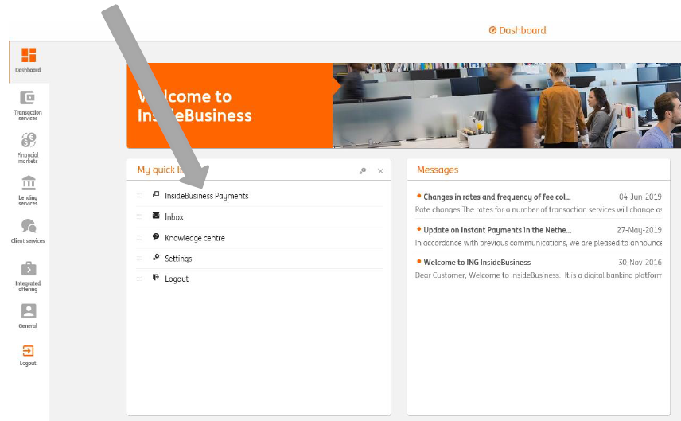
User guide
ING Inside Business is a view-only platform, therefore users will only be able to see their balances, produce and download bank statements. In order to do so, the process is as it follows:
Log into ING InsideBusiness: at the home page on InsideBusiness portal (the administrative part of the tool) → https://insidebusiness.ingwb.com/access#/view_user_details
Click on InsideBusiness Payments in order to have access to your account:

Slide 7
User guide
Click on reporting on the top left side of the screen:
Here you can view the balances of your accounts, the transactions related or create reports:

