Slide 1
Core FB MC
Core Parallel Run KPI report
February 2022

Slide 2
Parallel Run KPI report
Introduction
Context
  According to Article 28(4) of the Core FB DA CCM, Core TSOs
    shall continuously monitor the effects and the performance of the application of this methodology during the parallel run
    shall develop, in coordination with the Core regulatory authorities, the Agency and stakeholders, the monitoring and performance criteria and report on the outcome of this monitoring on quarterly basis in a report
  Core TSOs & NEMOs have aligned on the
    Specific KPIs with NRAs and this alignment resulted in the format of this KPI report
    Frequency of provision of the report, which was increased to monthly, going beyond formal requirements
    Agreement to have the increased frequency reflected in the Core CCM amendment (November 2020)
In the next slide the overview of the KPIs covered in this monthly KPI report is provided:
  KPIs related to Capacity Calculation in blue
  KPIs related to Market Coupling simulations in green

Slide 3
Parallel Run KPI report
Overview of Core FB MC Parallel Run KPIs
  Adjustment for minimum RAM and LTA Inclusion | Slide 7 - 33
    1. Average maximum AMR per CNE per BD
    2. Average maximum AMR per TSO per BD
    3. Average maximum AMR+LTAmargin per CNE per BD
    4. Average maximum AMR+LTAmargin per TSO per BD
  TSOs’ adjustment after validation | Slide 34
    5. Share of MTUs with intervention per TSO
    6. Total IVA applied per BD for each CNE affected by TSO intervention (The information is available on JAO).
  Power System Impact Analysis | Slide 35 - 59
    13. Min & max Net Position per BZ hub
    14. Virtual margins at MCP per TSO, per BD
    15. Flow deviation on non-Core borders
  Non-costly Remedial Action Optimization Analysis | Slide 60 - 67
    16. Relative Time Share of Applied RAs, by TSO, Type and Mode
    17. Most limiting CNEC per TSO (NRAO)
    18. Average variation of relative RAM before and after NRAO
Market Impact Assessment (FB Plain) | Slide 68 - 219
    7. Most often presolved CNEs (top 20)
    8a. Most limiting CNEs (top 20)
    8b. Allocation Constraints
    9. Clearing prices, price spread and price convergence
    10. CNECs with highest non-zero shadow price in each hour per day
    11. Core Social Welfare
    12. Paradoxically Rejected Block orders (PRB)

Slide 4
Parallel Run KPI report
Reporting period (Business days covered)
Context
The progressive transition towards ext//run started on the 16th of November 2020 and since 14th of April 2021 TSOs publish 7 out of 7 Business Days.
A Reading Guide with a description of the KPIs is available on JAO.
The KPI report contains the following 24 Business Days (highlighted in green):
Normal Business Days are highlighted in green. Business Days with Default Flow-based Parameters are highlighted in blue, Business Days for which the MC simulation failed* are marked in yellow, Business days with failed CC marked in red):
07.02, 10.02, 23.02, 28.02 BDs were excluded from the report due to no solution found in SF (highlighted in yellow)*.
February ‘22
M | T | W | T | F | S | S
 | 1 | 2 | 3 | 4 | 5 | 6
7 | 8 | 9 | 10 | 11 | 12 | 13
13 | 15 | 16 | 17 | 18 | 19 | 20
21 | 22 | 23 | 24 | 25 | 26 | 27
28
* These BDs were excluded from the report as these days were simulated in the Euphemia Test environment instead of the Simulation Facility as in the latter (technical) issues were faced when processing these days. We are unable to include in the KPI reports the BDs calculated from Euphemia Test environment as an automatized process is used for the ext//run and the outputs of the Euphemia Test environment are not completely the same.

Slide 5
Parallel Run KPI report
Overview limitations & assumptions
Core project parties maintain an overview on the JAO website with the assumptions and limitations for specific Business days during the parallel run – see JAO website (LINK).
Note:Unknown issues can be present and can be discovered in the future as analysis continues. This might lead to the ex-post conclusion that results for certain BDs are invalid. German TSO names uses abbreviations: D2: Tennet GmbH, D4: TransnetBW, D7: Amprion, D8: 50Hertz
Description of issue / limitation | FROM BD | TO BD
An issue occurred that prevented Elia applying minRAM reduction on (some of) its CNECs in relation to excessive loopflows. Impacted BDs: Feb 1, Feb 2, Feb 3, Feb 4 | 01/01/2021 | TBD
Following issues with the individual validation, fallback has been activated to reduce capacities as explained in the assumptions list. Until August, Elia experienced inconsistencies in the application of fallback capacities, leading to sometimes smaller values that were applied compared to the assumptions list. Impacted BDs (TSOs): Feb 1 (PSE), Feb 9 (Elia), Feb 10 (DAVinCy TSOs) Feb 12 (DAVinCy TSOs) | 16/11/2020 | TBD
BDs since 01/01/2022 for which ultimate fallback was applied for the following BDs by the following TSOs, leading to results similar to DFP domains: Feb 1 (PSE, 3 TS), Feb 10-12 (DAVinCy TSOs, 24TS) | 01/01/2022 | 02/03/2022
There is a modelling issue for the power exchange between DE and DK2 via the Combined Grid Solution (HVDC). This issue inhibits all shifts of this net position for loop-flow and Fuaf calculation. | 15/04/2021 | TBD
For BD 22/02, one element for which MNEC was not respected in NRAO due to filtering, which can lead to application of more remedial actions than should be applied, leading to larger domains | 22/02/2022 | 18/03/2022
A quality issue in the CGM for several TS has led to significant misestimation of capacities (probably overestimation of DE import and other countries export capability + underestimation of DE export and other countries import capability) Impacted BDs (TS): Feb 8 (7 TS) | 01/12/2021 | 27/03/2022

Slide 6
Parallel Run KPI report
Overview limitations & assumptions (part II)
Core project parties maintain an overview on the JAO website with the assumptions and limitations for specific Business days during the parallel run – see JAO website (LINK).
For the reporting period TSOs apply the following Ramr values:
TSOs | Ramr values |  | Comments
 | BDs | Value
APG | 01/12/2021 - 30/11/2022 | 28.7% | In line with AT Action Plan
CEPS | Remaining EXT // run 2022 & | 70%
 | After Core FBDA Go Live
Eles | During EXT // run | 70% | For now, we are still investigating the possibility to apply for derogation for special cases like validation tool failure or special situations in the grid/market. (decision to be taken in Nov-Dec 2021)
 | & After FBMC go-live
Elia | Whole year | 70% minus excessive LF | In line with its derogation on loopflows, Elia defines the Ramr per CNEC per MTU taking 70% as a starting point and reducing in case of excessive loopflows
German TSOs | until BD 31/12/2021 | 21.3% | According to the German action plan linear trajectory each year: 2020: 11,5%, 2021: 21,3%, 2022: 31%, 2023: 40%, 2024: 50,5%, 2025: 60,3%, 2026: 70%
 | from BD 01/01/2022 | 31.0%
 |  |  | German Action Plan
HOPS |  | 70% | For majority of CNECs, while for specific CNECs identified based on internal analysis will be defined differently (20% - 70%). The start of the action plan is still under consideration (not yet defined). Derogation submitted for 2022.
MAVIR | During EXT // run | 70 % (for most CNEs) | Action plan to be adapted in Nov-Dec, 2021
 | & After FBMC go-live | 25-33% for selected CNEs
 |  | as described in action plan
PSE | During EXT // run | 14%-41% | linear trajectory till 2026 (70%). If element is commisioned, its Ramr = 0 for that year
 | & After FBMC go-live
RTE | whole year | 70%
SEPS | During EXT // run | 40-70% for vast majority of CNECs | Derogation submitted and approved for 2022
 | & After FBMC go-live | 30% for certain CNECs listed in the derogation ( min. 30% applies for at least 80% of all MTUs in 2022 )
TenneT NL | Whole year | 20% - 70% | Ramr values of action plan per CNEC per MTU are updated to consider derogation on loopflows.
 |  |  | From BD16/12/2021 the linear trajectory values of 2022 will be used
Transelectrica | 01.01.2022-31.12.2022 | 33% | Ramr value is updated each year taking into consideration our Action Plan. For 2022 Transelectrica will have a derogation for keeping the minimum capacity that is stated for the year 2021 in the Action Plan, which is 33%.

Slide 7
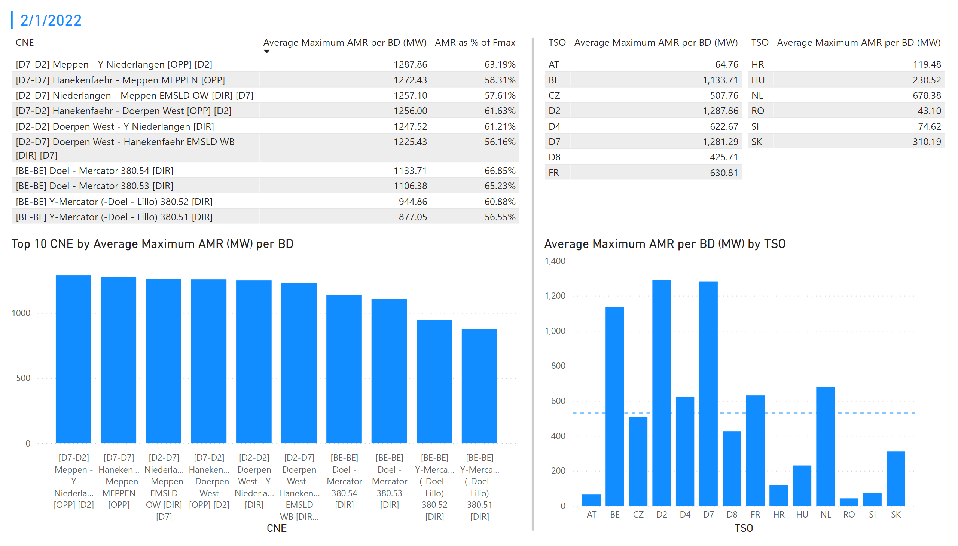
KPI 1 +2_1
KPI 1: Average maximum AMR per CNE per BD
KPI 2: Average maximum AMR per CNE per TSO
Notes:
tableEx
No alt text provided
Top 10 CNE by Average Maximum AMR (MW) per BD
No alt text provided
multiRowCard
No alt text provided
tableEx
No alt text provided
Average Maximum AMR per BD (MW) by TSO
No alt text provided
tableEx
No alt text provided
basicShape
No alt text provided

Slide 8
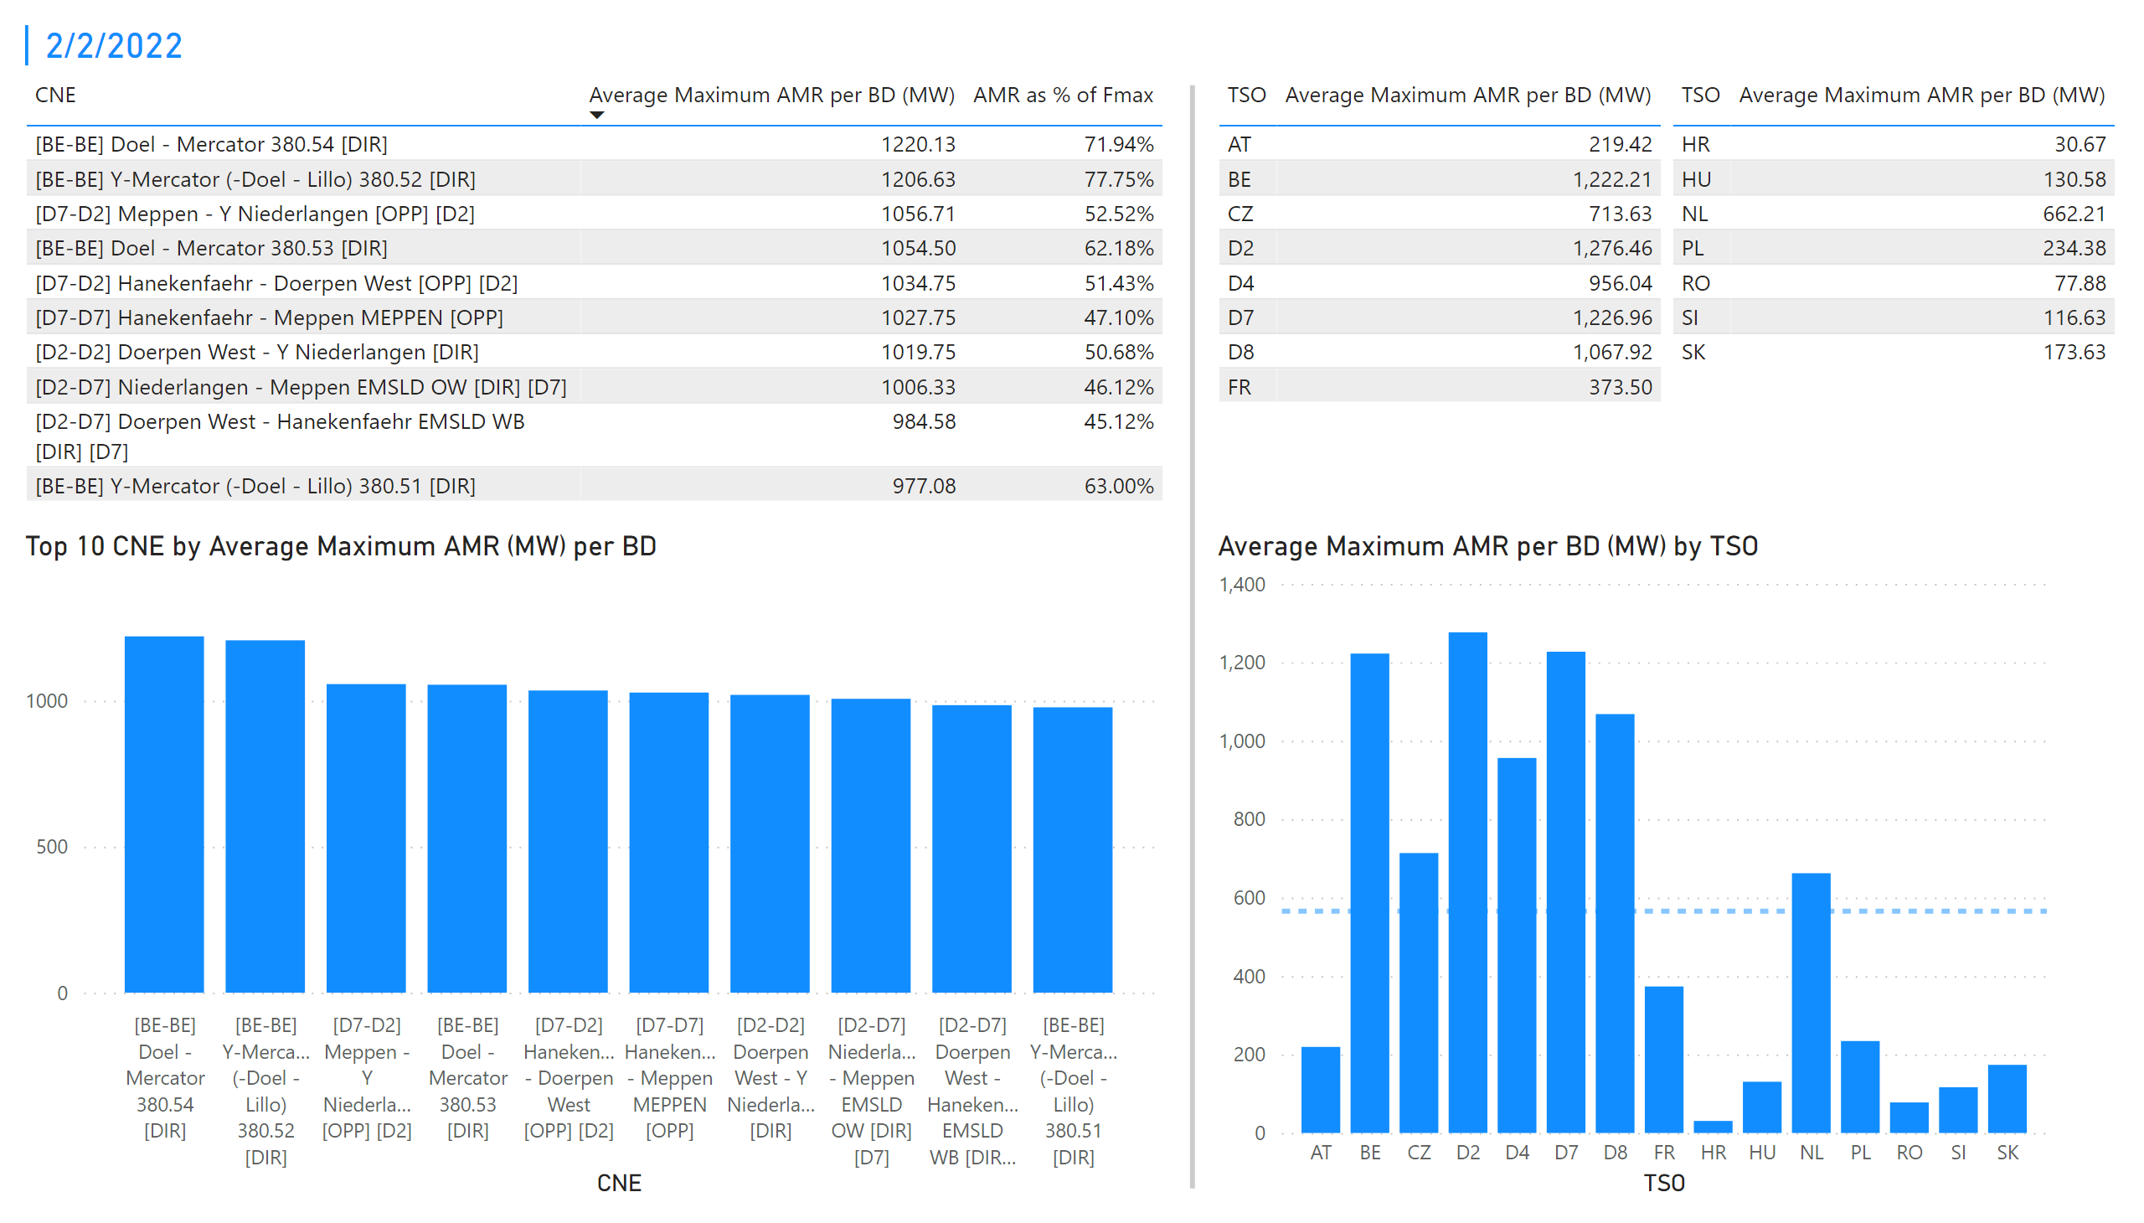
KPI 1 +2_2
KPI 1: Average maximum AMR per CNE per BD
KPI 2: Average maximum AMR per CNE per TSO
Notes:
tableEx
No alt text provided
Top 10 CNE by Average Maximum AMR (MW) per BD
No alt text provided
multiRowCard
No alt text provided
tableEx
No alt text provided
Average Maximum AMR per BD (MW) by TSO
No alt text provided
tableEx
No alt text provided
basicShape
No alt text provided

Slide 9
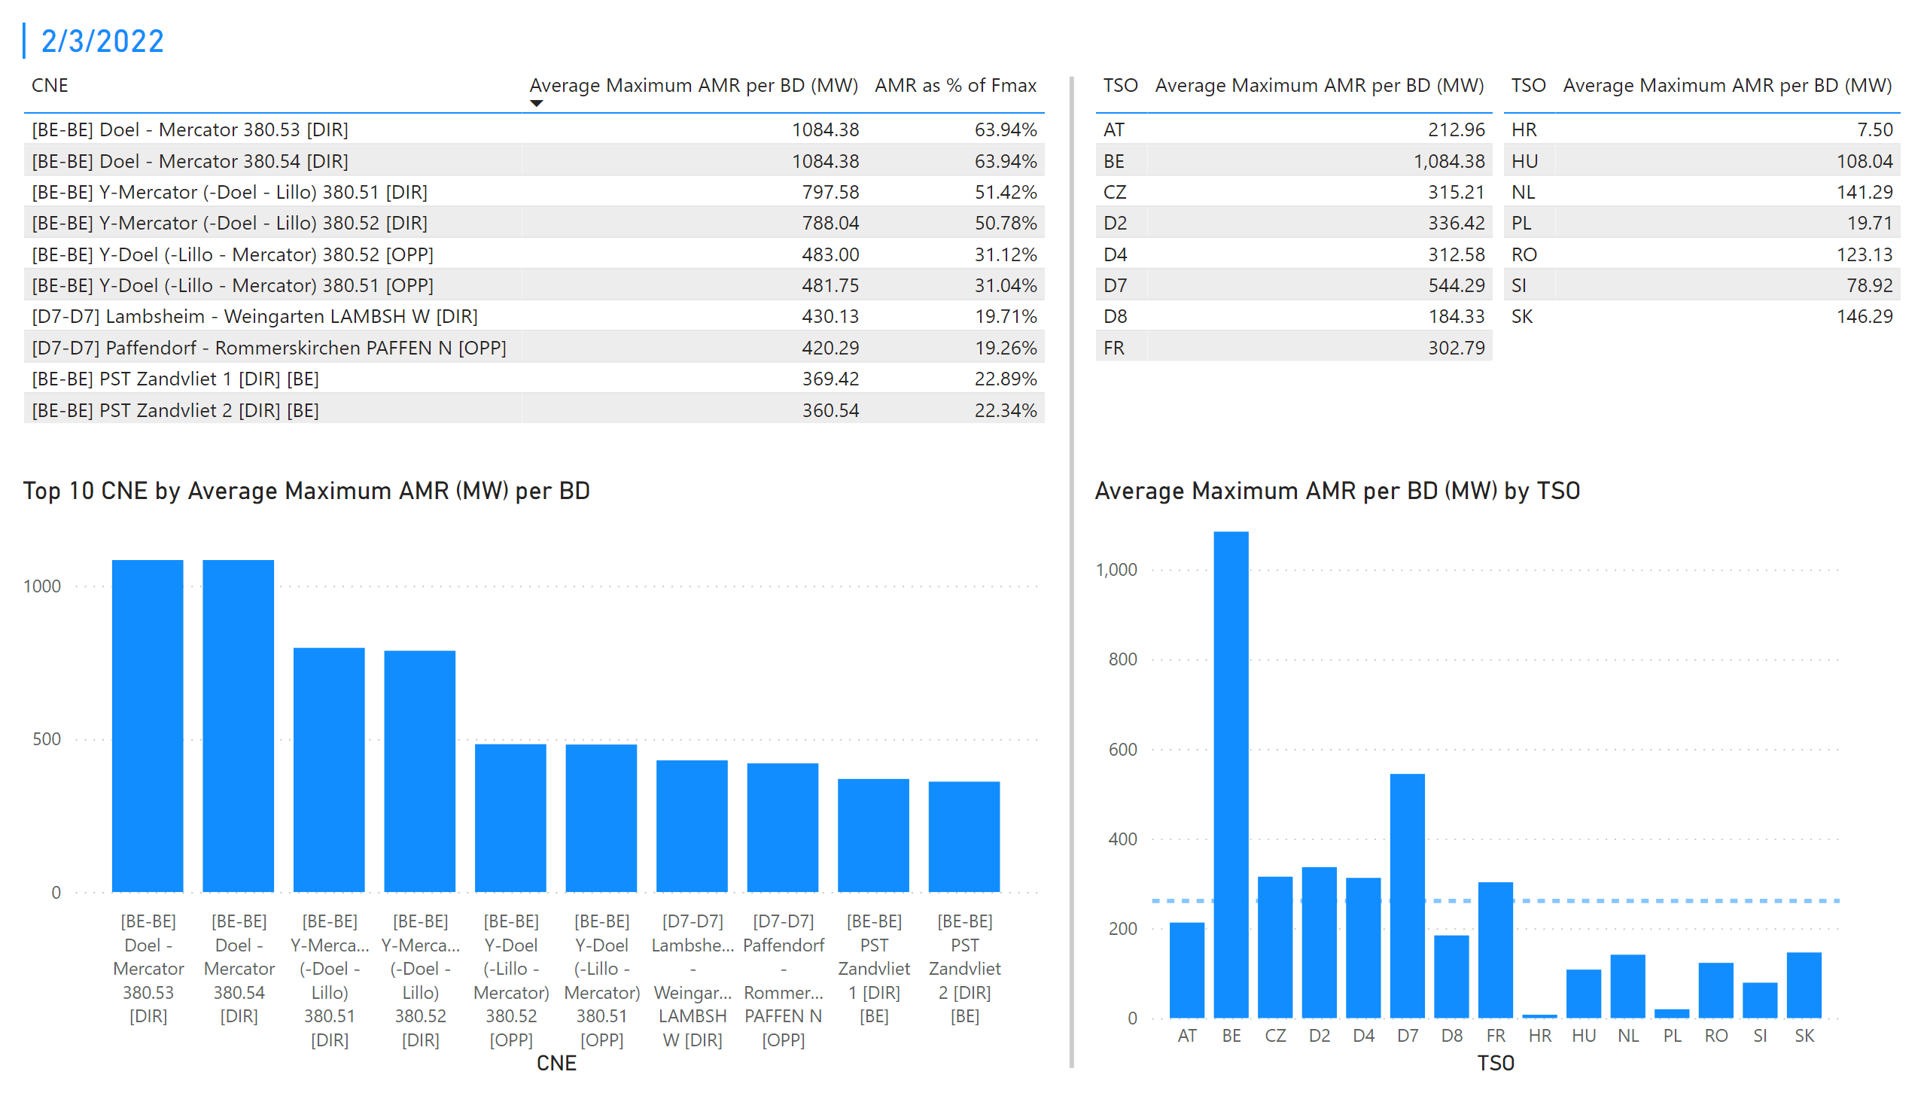
KPI 1 +2_3
KPI 1: Average maximum AMR per CNE per BD
KPI 2: Average maximum AMR per CNE per TSO
Notes:
tableEx
No alt text provided
Top 10 CNE by Average Maximum AMR (MW) per BD
No alt text provided
multiRowCard
No alt text provided
tableEx
No alt text provided
Average Maximum AMR per BD (MW) by TSO
No alt text provided
tableEx
No alt text provided
basicShape
No alt text provided

Slide 10
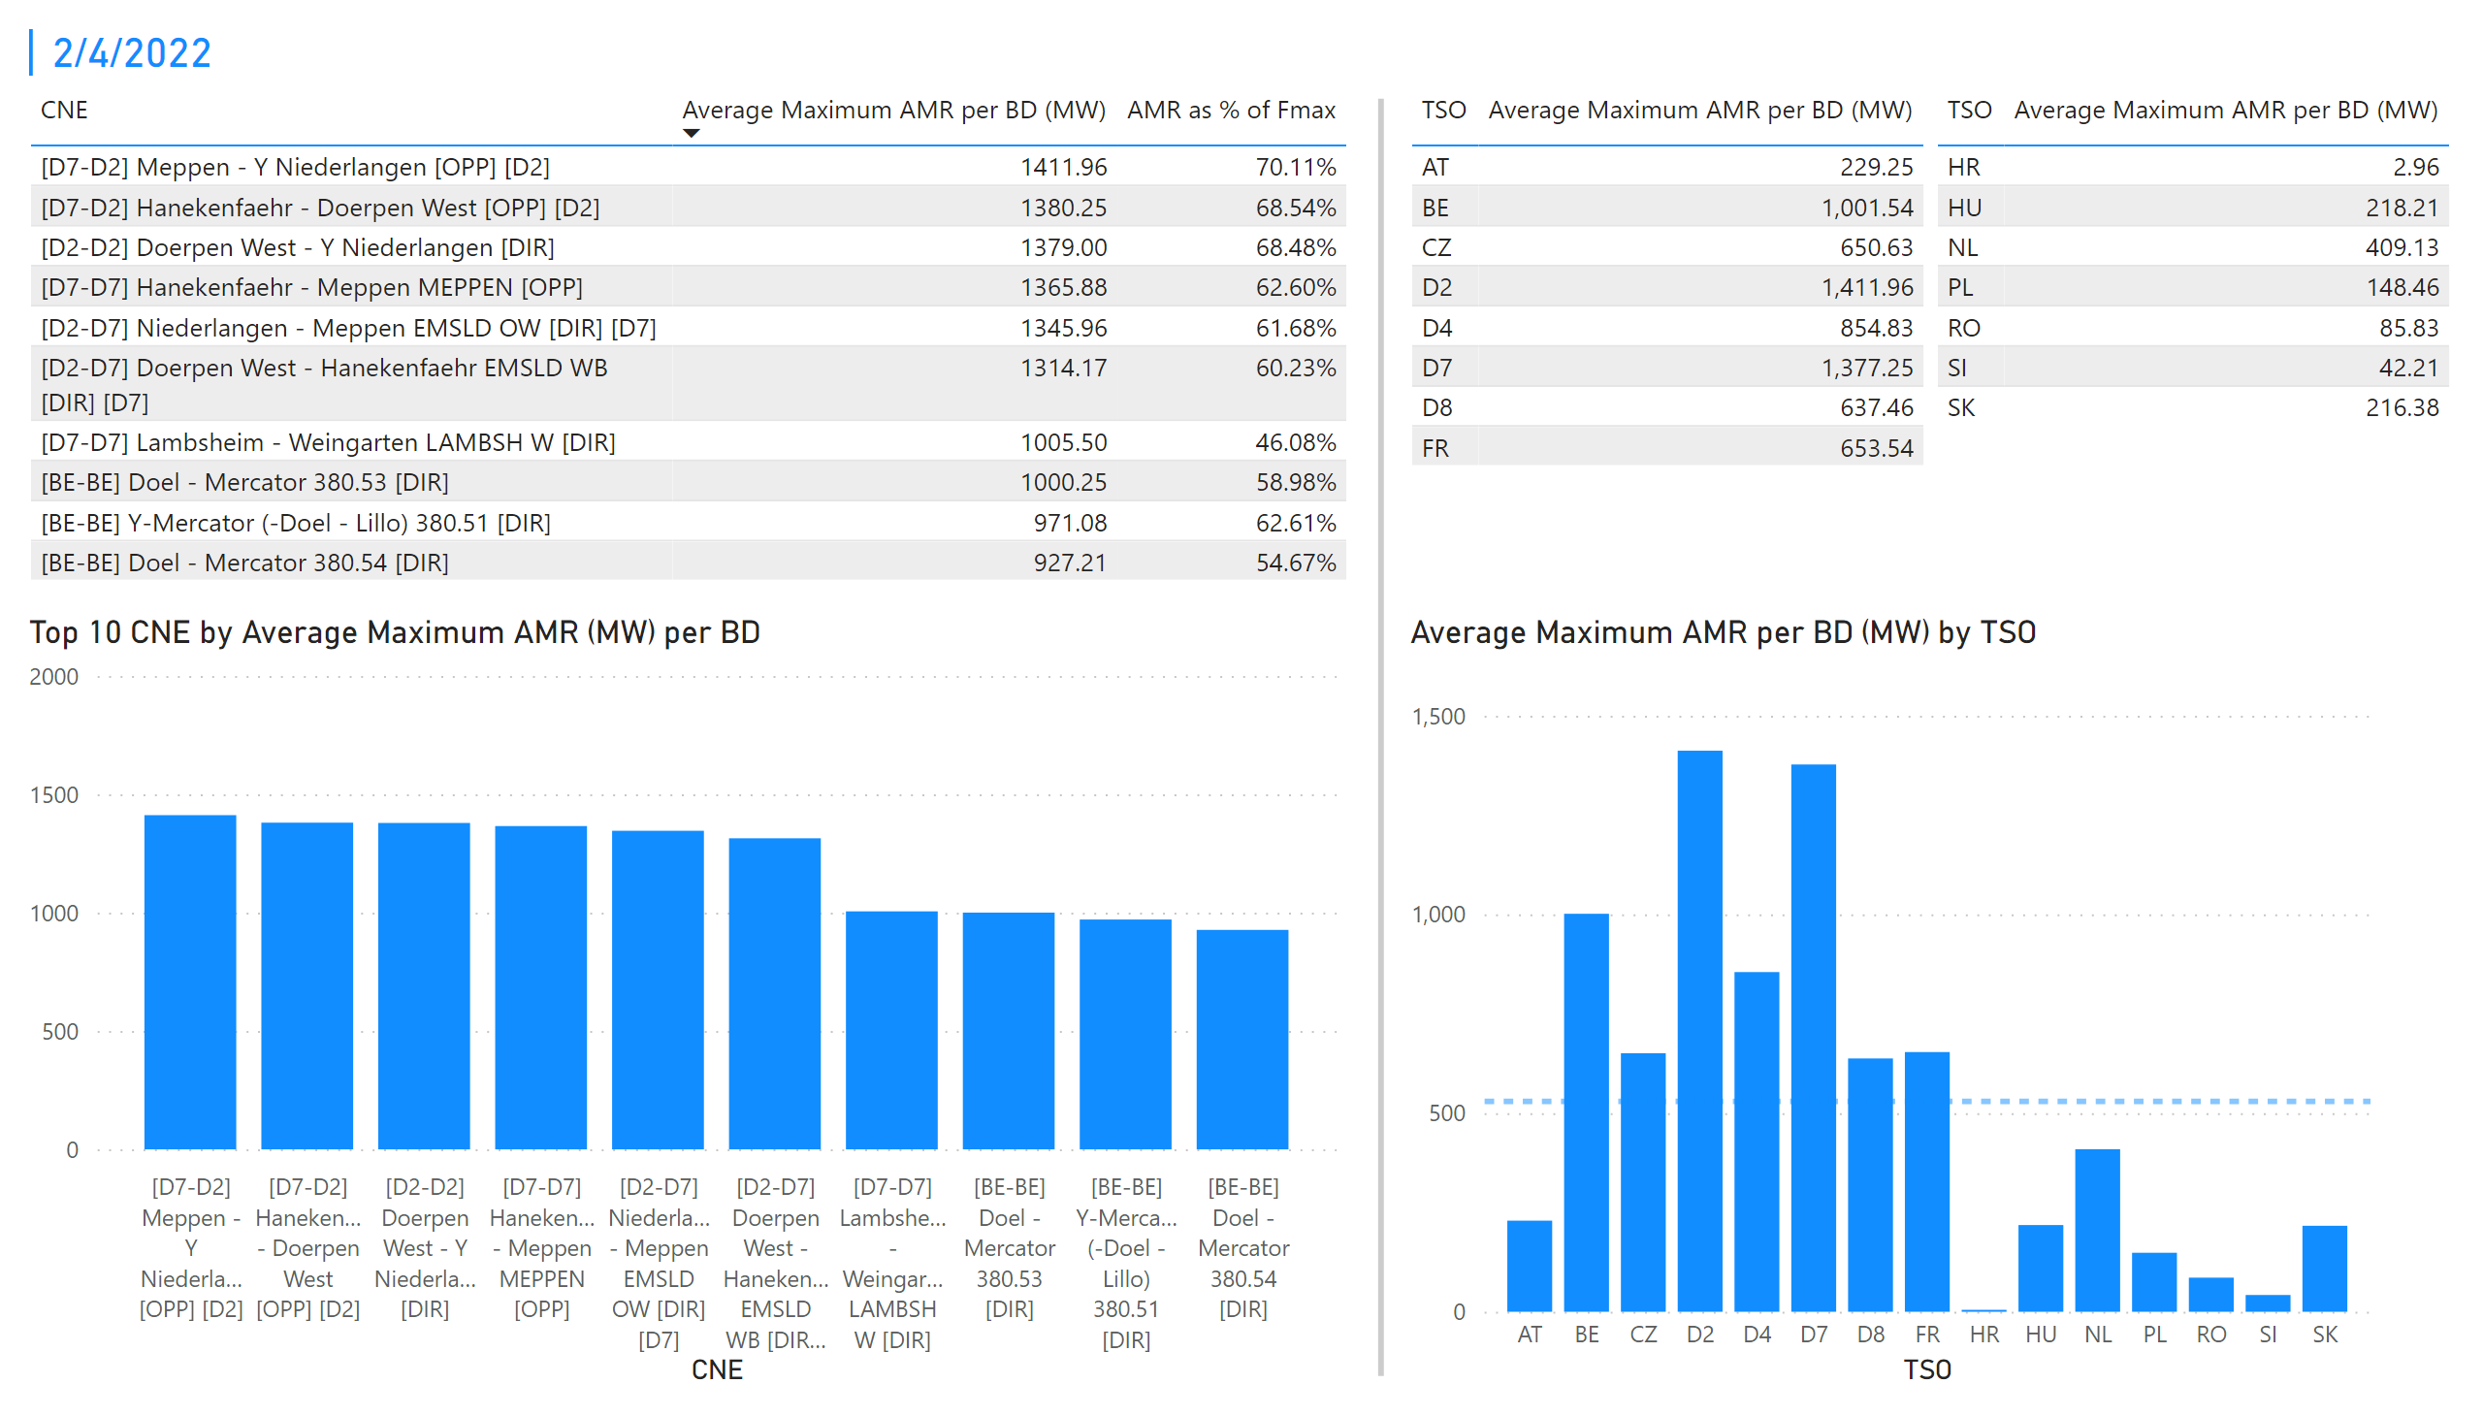
KPI 1 +2_4
KPI 1: Average maximum AMR per CNE per BD
KPI 2: Average maximum AMR per CNE per TSO
Notes:
tableEx
No alt text provided
Top 10 CNE by Average Maximum AMR (MW) per BD
No alt text provided
multiRowCard
No alt text provided
tableEx
No alt text provided
Average Maximum AMR per BD (MW) by TSO
No alt text provided
tableEx
No alt text provided
basicShape
No alt text provided

Slide 11
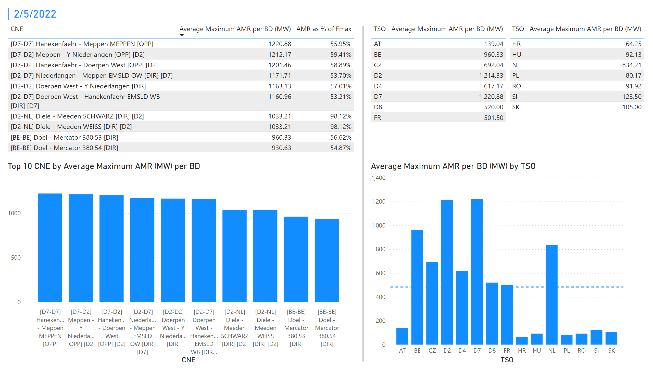
KPI 1 +2_5
KPI 1: Average maximum AMR per CNE per BD
KPI 2: Average maximum AMR per CNE per TSO
Notes:
tableEx
No alt text provided
Top 10 CNE by Average Maximum AMR (MW) per BD
No alt text provided
multiRowCard
No alt text provided
tableEx
No alt text provided
Average Maximum AMR per BD (MW) by TSO
No alt text provided
tableEx
No alt text provided
basicShape
No alt text provided

Slide 12
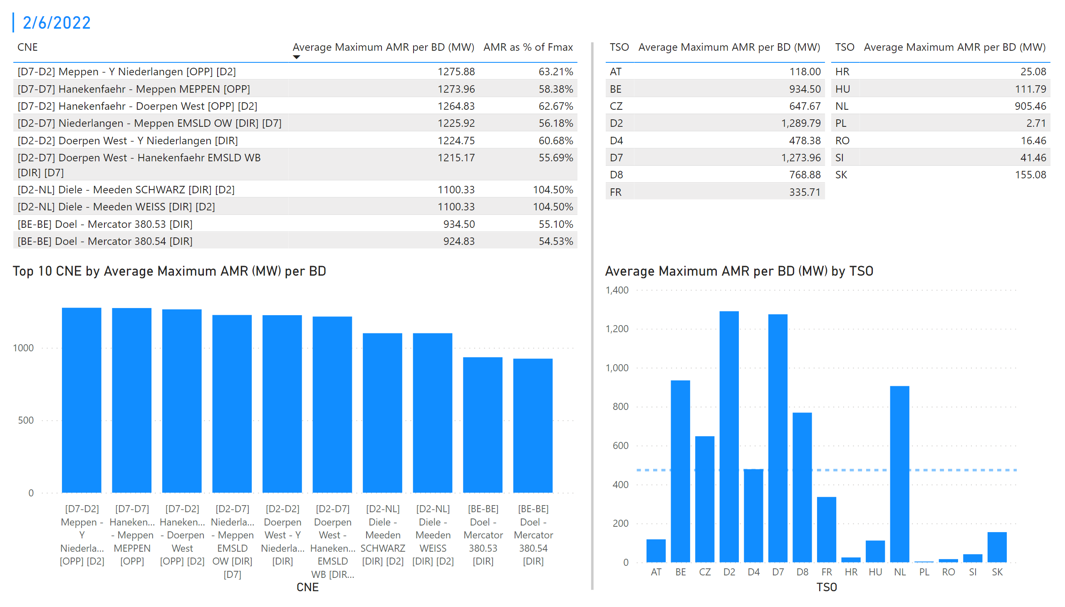
KPI 1 +2_6
KPI 1: Average maximum AMR per CNE per BD
KPI 2: Average maximum AMR per CNE per TSO
Notes:
tableEx
No alt text provided
Top 10 CNE by Average Maximum AMR (MW) per BD
No alt text provided
multiRowCard
No alt text provided
tableEx
No alt text provided
Average Maximum AMR per BD (MW) by TSO
No alt text provided
tableEx
No alt text provided
basicShape
No alt text provided

Slide 13
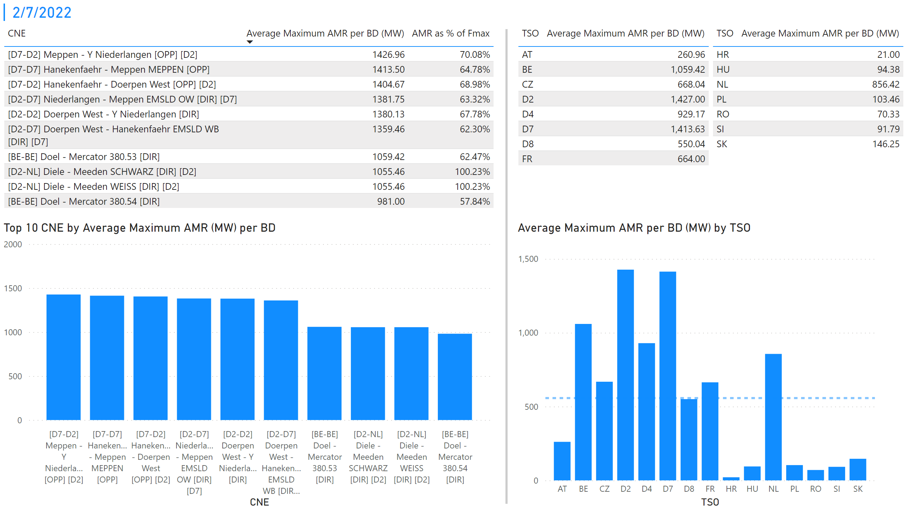
KPI 1 +2_7
KPI 1: Average maximum AMR per CNE per BD
KPI 2: Average maximum AMR per CNE per TSO
Notes:
tableEx
No alt text provided
Top 10 CNE by Average Maximum AMR (MW) per BD
No alt text provided
multiRowCard
No alt text provided
tableEx
No alt text provided
Average Maximum AMR per BD (MW) by TSO
No alt text provided
tableEx
No alt text provided
basicShape
No alt text provided

Slide 14
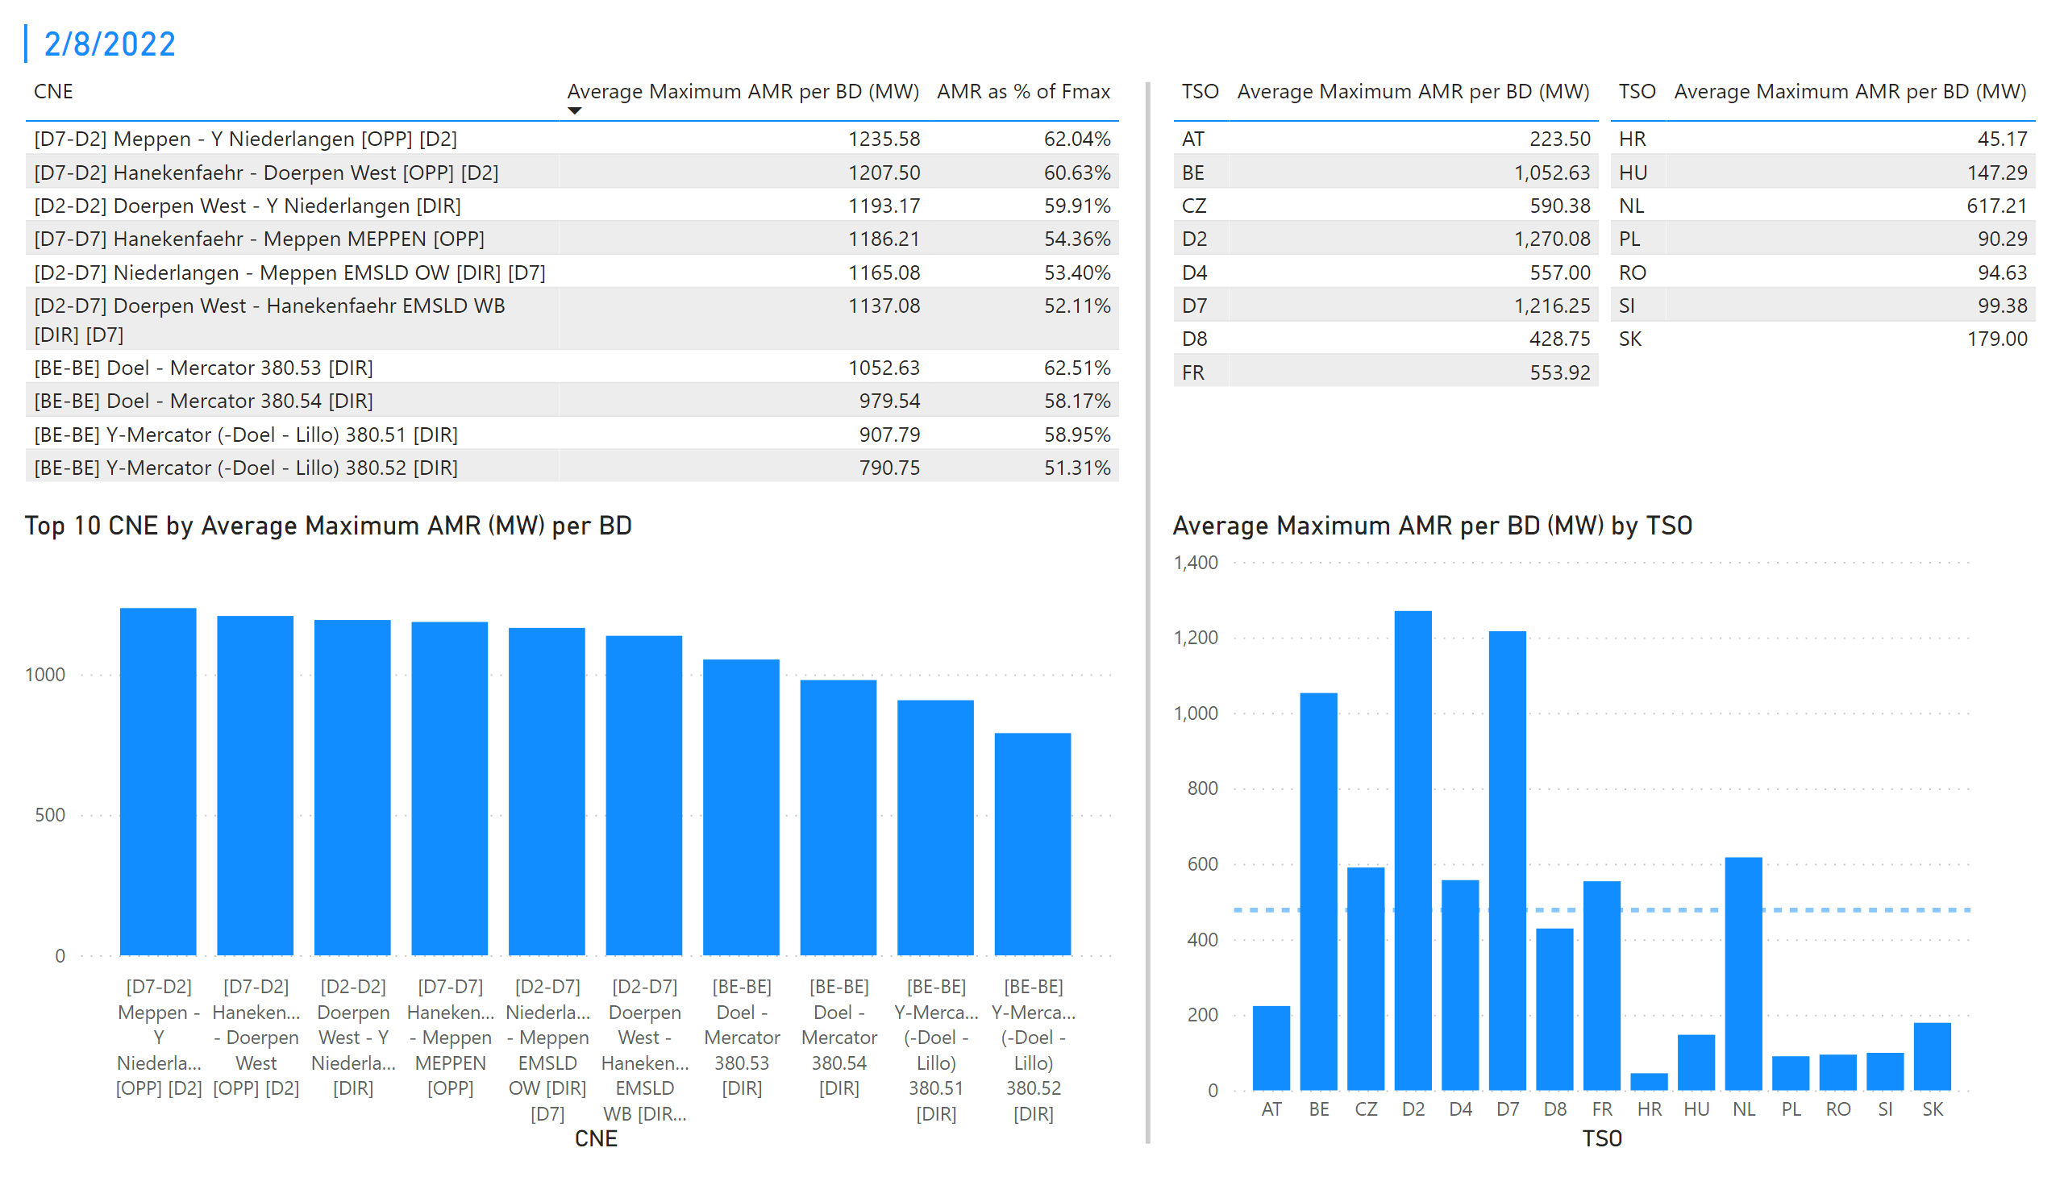
KPI 1 +2_8
KPI 1: Average maximum AMR per CNE per BD
KPI 2: Average maximum AMR per CNE per TSO
Notes:
tableEx
No alt text provided
Top 10 CNE by Average Maximum AMR (MW) per BD
No alt text provided
multiRowCard
No alt text provided
tableEx
No alt text provided
Average Maximum AMR per BD (MW) by TSO
No alt text provided
tableEx
No alt text provided
basicShape
No alt text provided

Slide 15
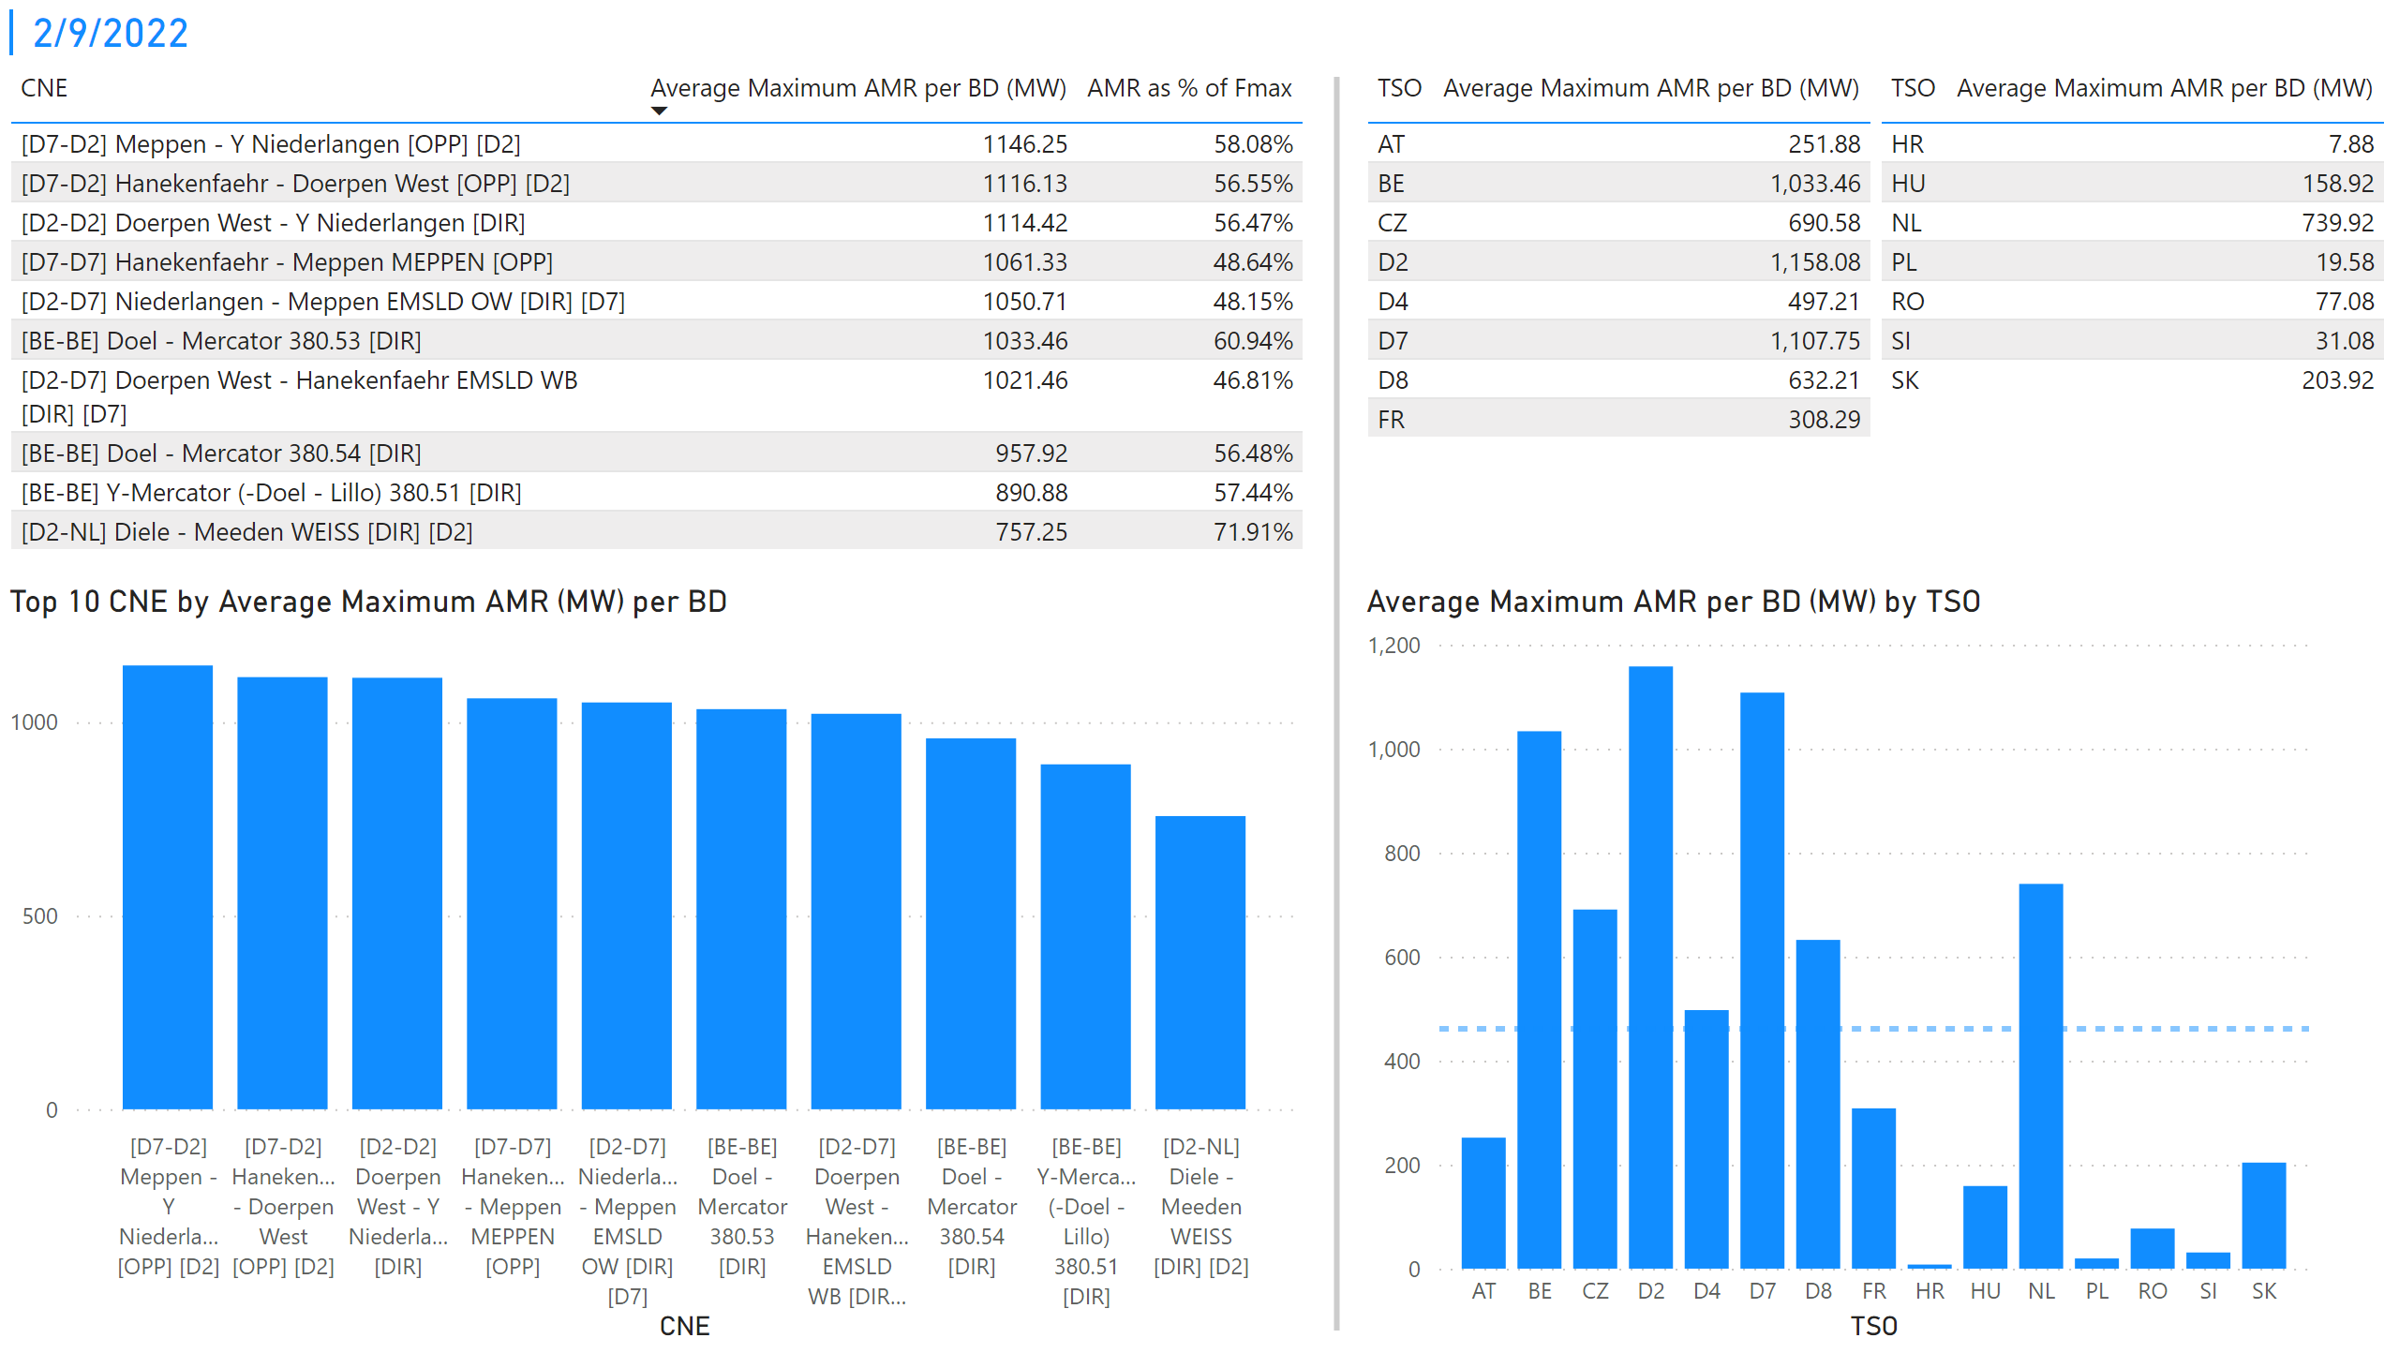
KPI 1 +2_9
KPI 1: Average maximum AMR per CNE per BD
KPI 2: Average maximum AMR per CNE per TSO
Notes:
tableEx
No alt text provided
Top 10 CNE by Average Maximum AMR (MW) per BD
No alt text provided
multiRowCard
No alt text provided
tableEx
No alt text provided
Average Maximum AMR per BD (MW) by TSO
No alt text provided
tableEx
No alt text provided
basicShape
No alt text provided

Slide 16
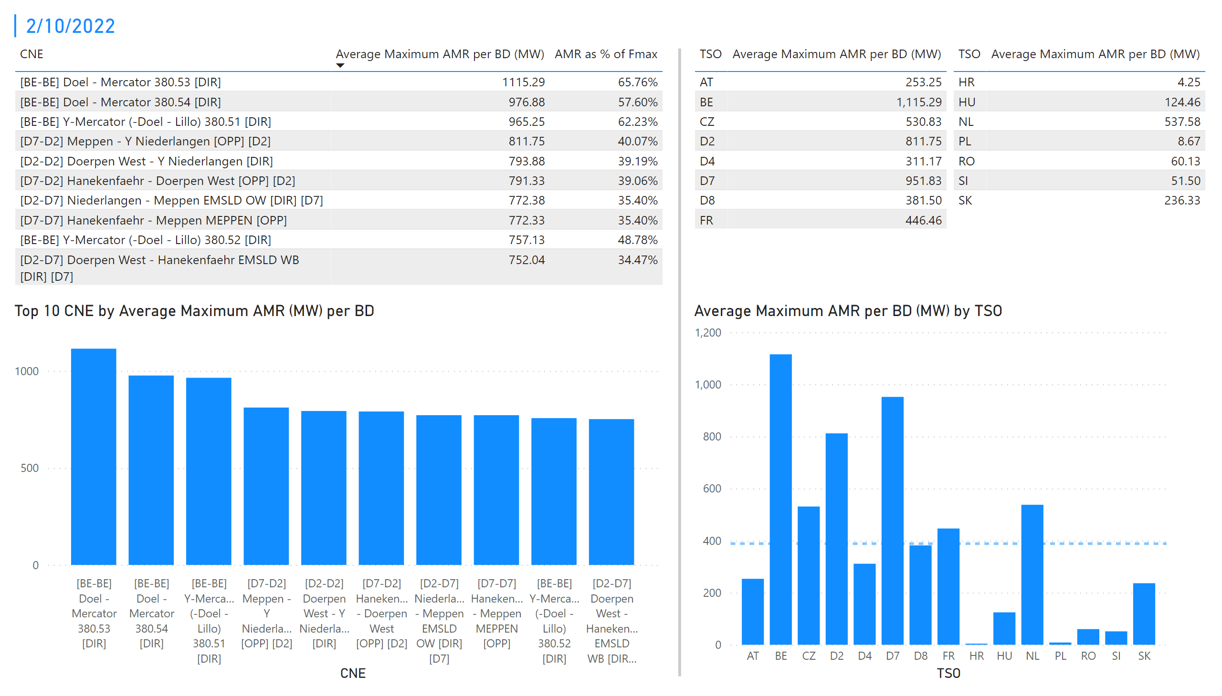
KPI 1 +2_10
KPI 1: Average maximum AMR per CNE per BD
KPI 2: Average maximum AMR per CNE per TSO
Notes:
tableEx
No alt text provided
Top 10 CNE by Average Maximum AMR (MW) per BD
No alt text provided
multiRowCard
No alt text provided
tableEx
No alt text provided
Average Maximum AMR per BD (MW) by TSO
No alt text provided
tableEx
No alt text provided
basicShape
No alt text provided

Slide 17
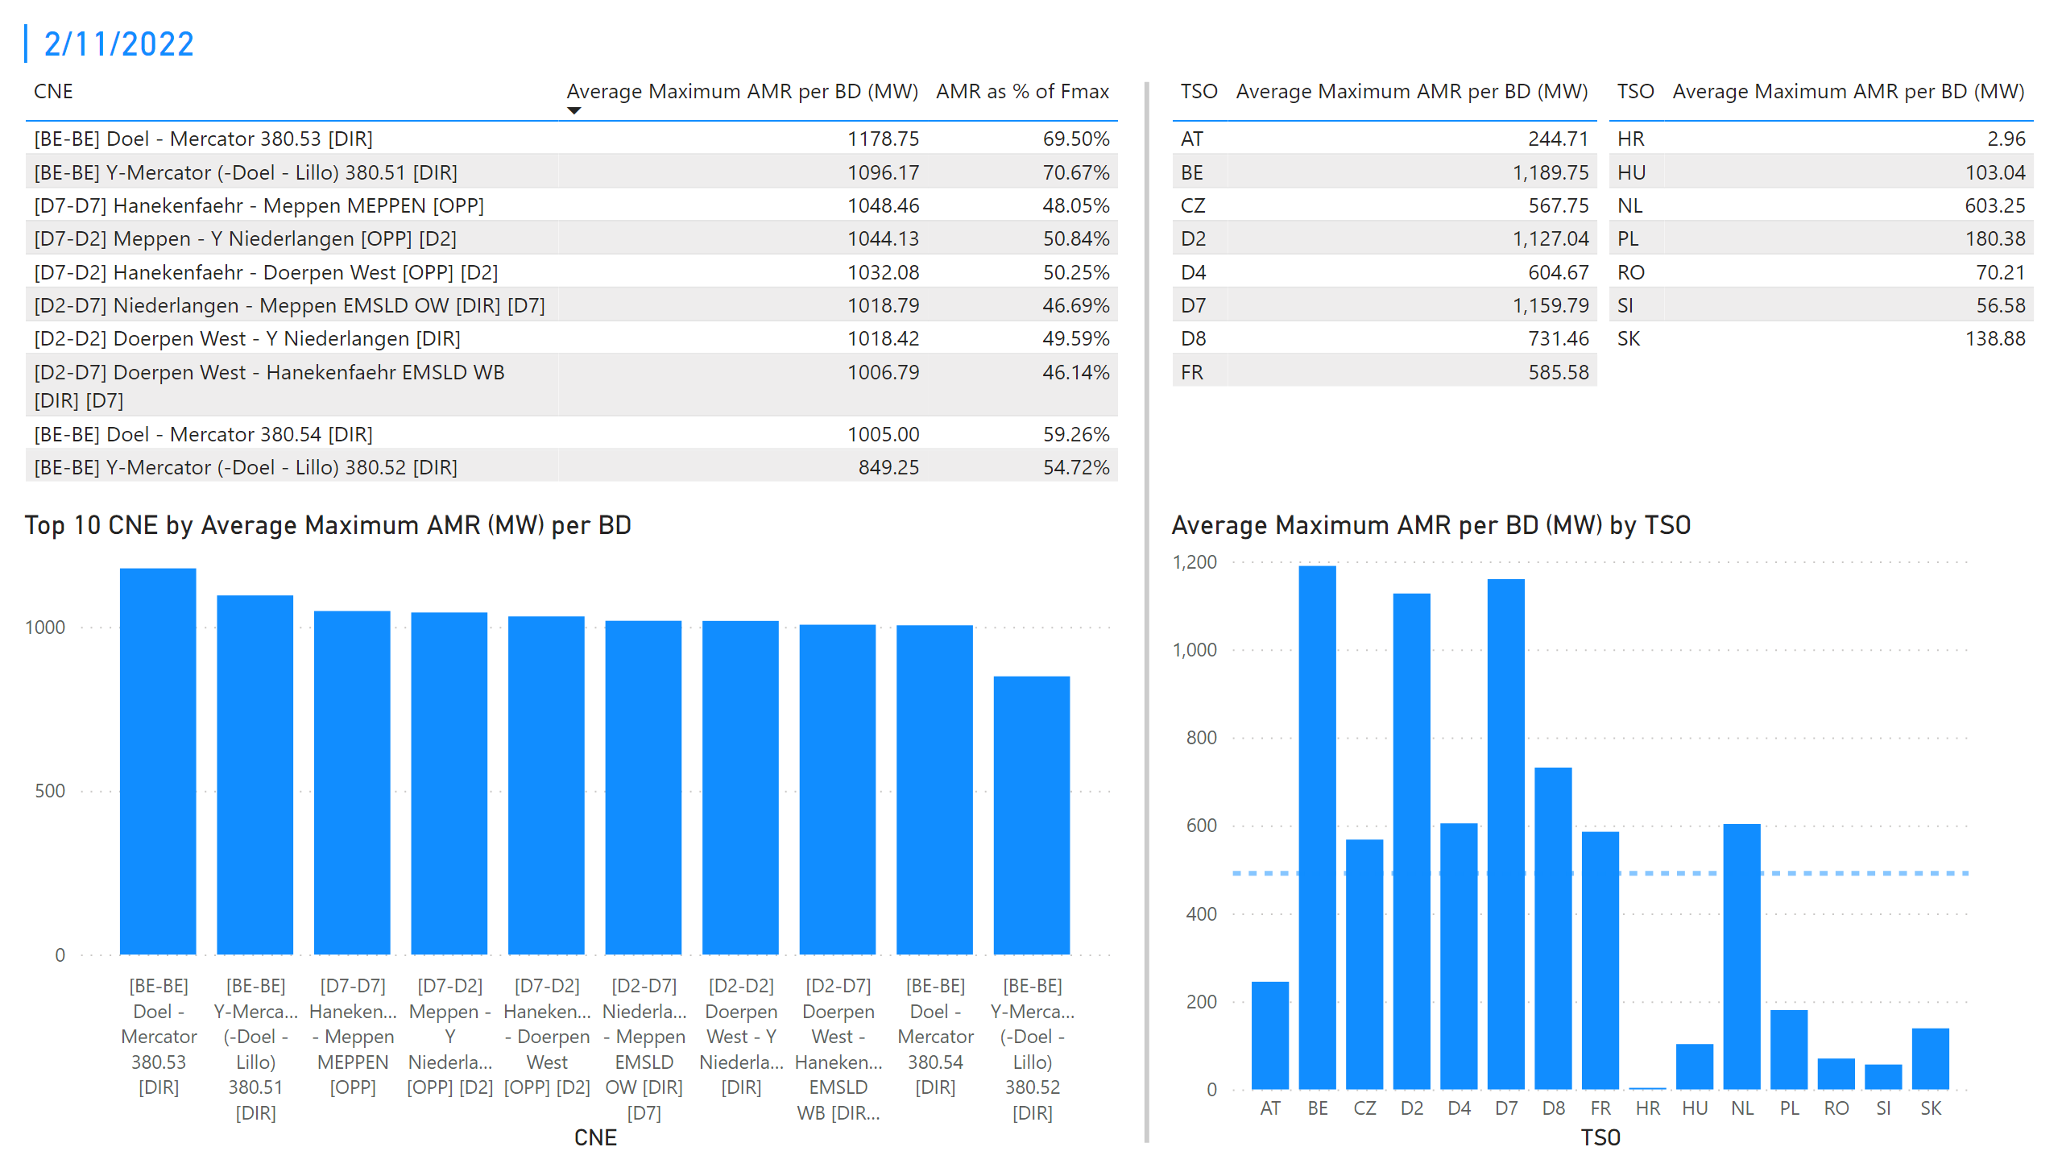
KPI 1 +2_11
KPI 1: Average maximum AMR per CNE per BD
KPI 2: Average maximum AMR per CNE per TSO
Notes:
tableEx
No alt text provided
Top 10 CNE by Average Maximum AMR (MW) per BD
No alt text provided
multiRowCard
No alt text provided
tableEx
No alt text provided
Average Maximum AMR per BD (MW) by TSO
No alt text provided
tableEx
No alt text provided
basicShape
No alt text provided

Slide 18
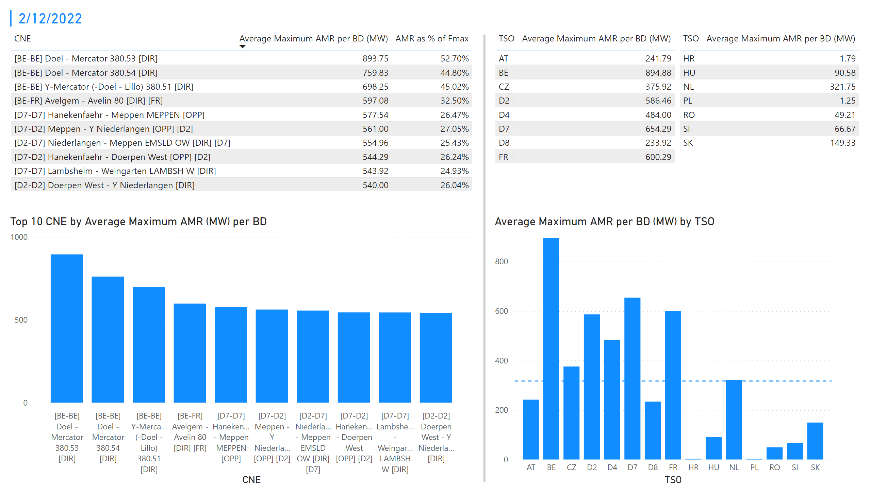
KPI 1 +2_12
KPI 1: Average maximum AMR per CNE per BD
KPI 2: Average maximum AMR per CNE per TSO
Notes:
tableEx
No alt text provided
Top 10 CNE by Average Maximum AMR (MW) per BD
No alt text provided
multiRowCard
No alt text provided
tableEx
No alt text provided
Average Maximum AMR per BD (MW) by TSO
No alt text provided
tableEx
No alt text provided
basicShape
No alt text provided

Slide 19
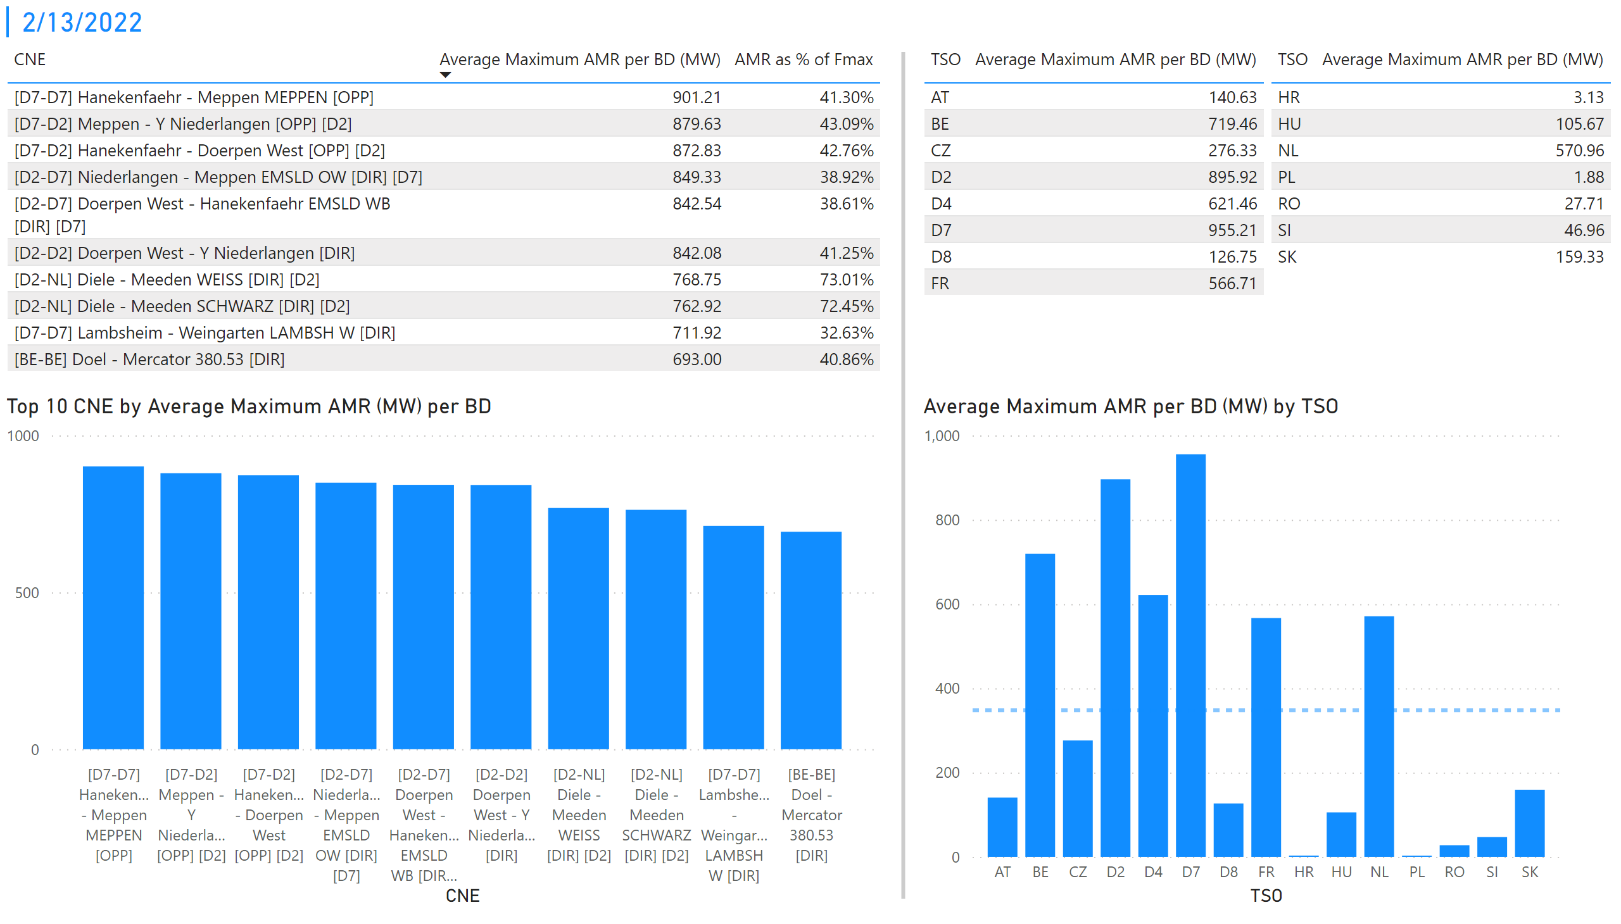
KPI 1 +2_13
KPI 1: Average maximum AMR per CNE per BD
KPI 2: Average maximum AMR per CNE per TSO
Notes:
tableEx
No alt text provided
Top 10 CNE by Average Maximum AMR (MW) per BD
No alt text provided
multiRowCard
No alt text provided
tableEx
No alt text provided
Average Maximum AMR per BD (MW) by TSO
No alt text provided
tableEx
No alt text provided
basicShape
No alt text provided

Slide 20
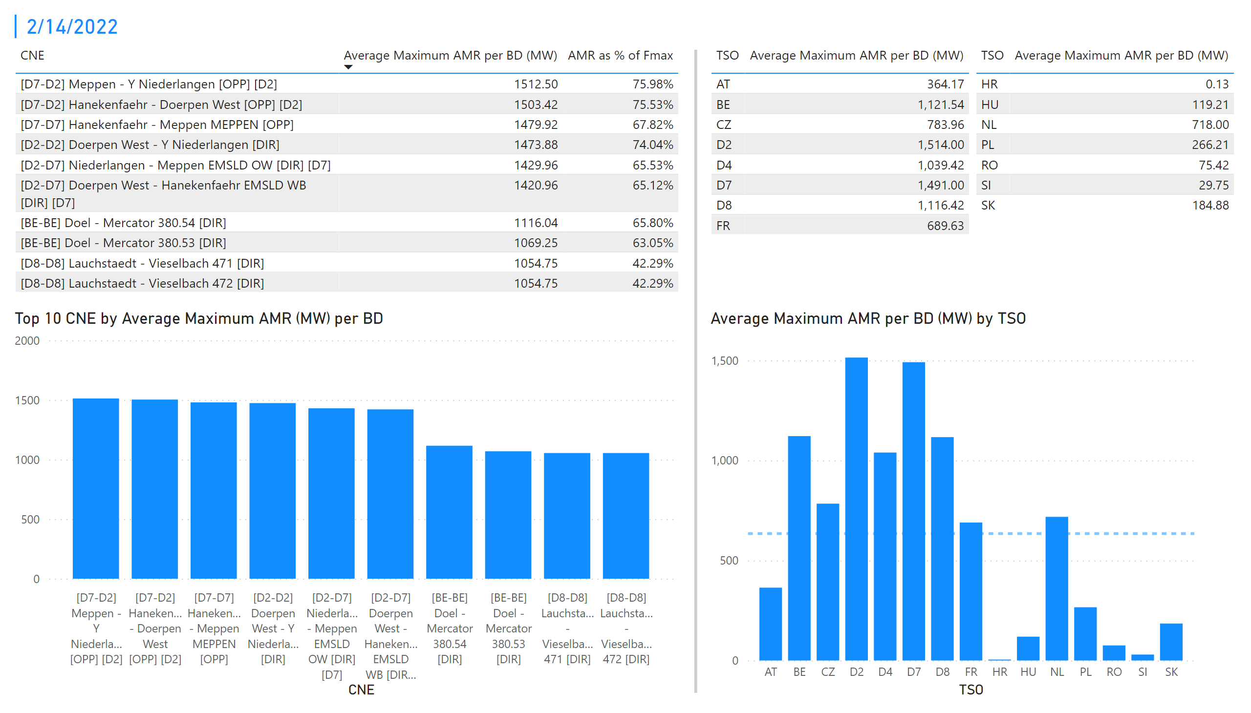
KPI 1 +2_14
KPI 1: Average maximum AMR per CNE per BD
KPI 2: Average maximum AMR per CNE per TSO
Notes:
tableEx
No alt text provided
Top 10 CNE by Average Maximum AMR (MW) per BD
No alt text provided
multiRowCard
No alt text provided
tableEx
No alt text provided
Average Maximum AMR per BD (MW) by TSO
No alt text provided
tableEx
No alt text provided
basicShape
No alt text provided

Slide 21
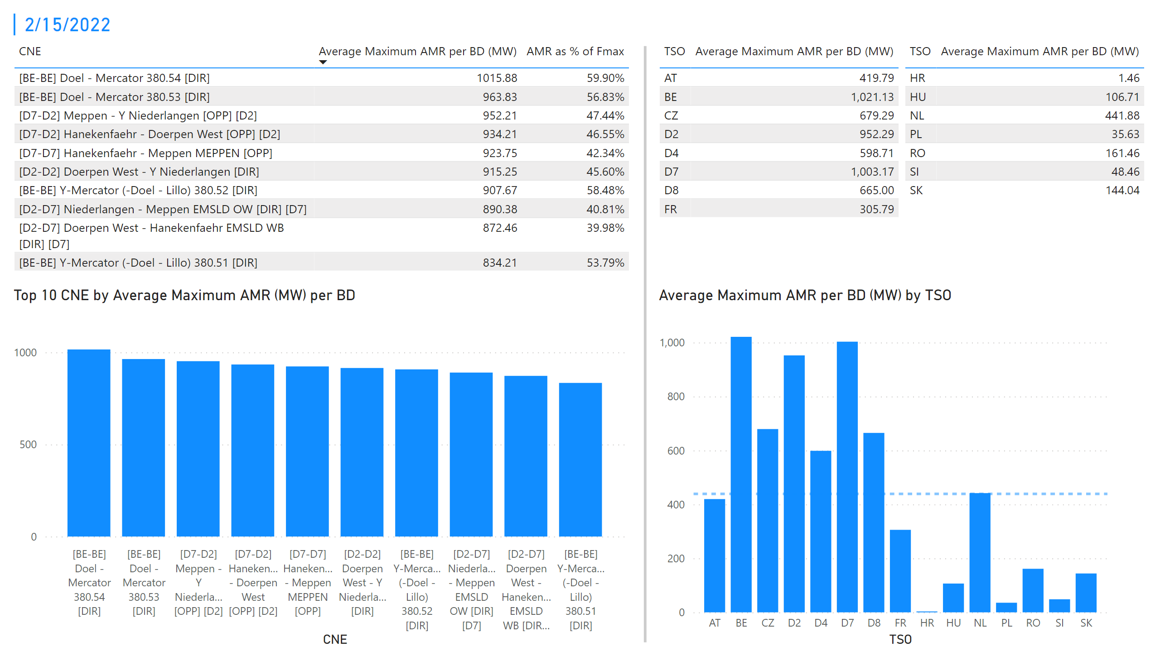
KPI 1 +2_15
KPI 1: Average maximum AMR per CNE per BD
KPI 2: Average maximum AMR per CNE per TSO
Notes:
tableEx
No alt text provided
Top 10 CNE by Average Maximum AMR (MW) per BD
No alt text provided
multiRowCard
No alt text provided
tableEx
No alt text provided
Average Maximum AMR per BD (MW) by TSO
No alt text provided
tableEx
No alt text provided
basicShape
No alt text provided

Slide 22
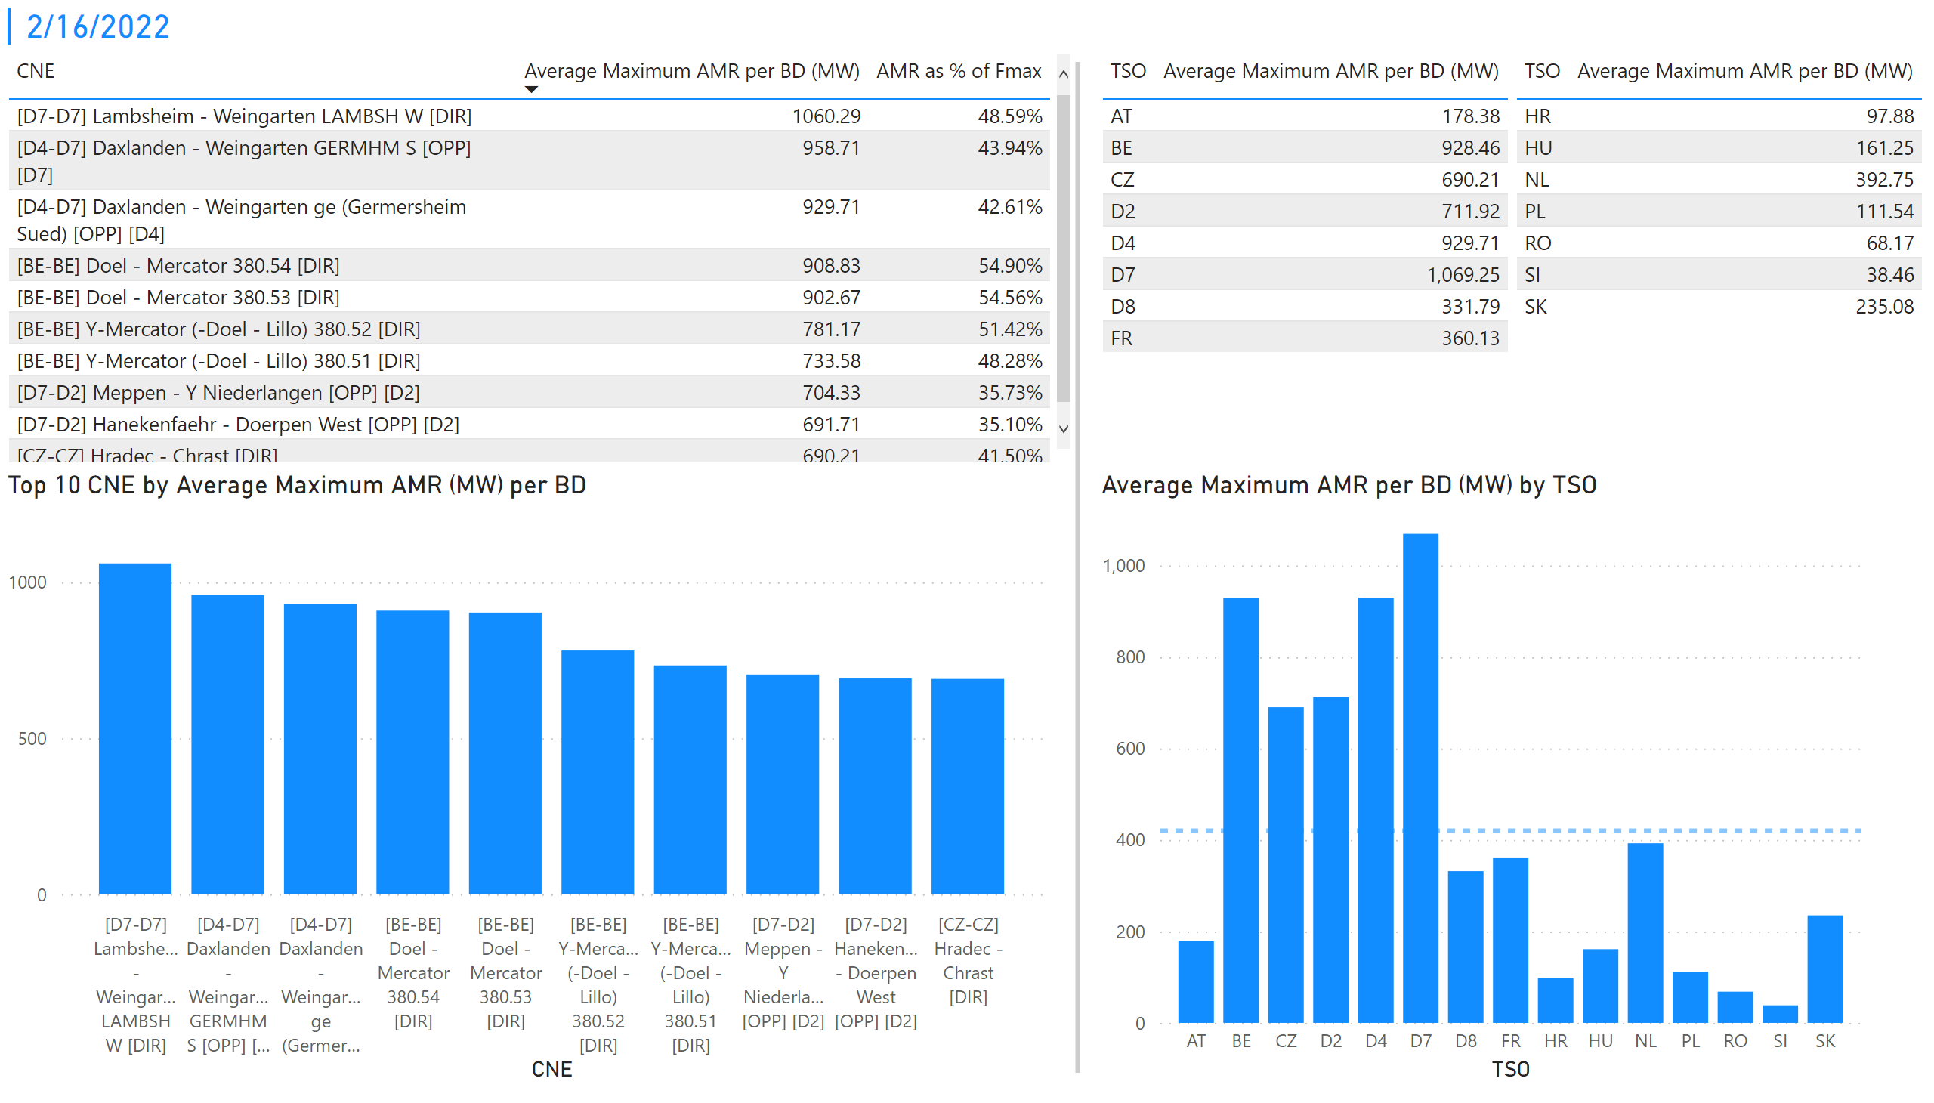
KPI 1 +2_16
KPI 1: Average maximum AMR per CNE per BD
KPI 2: Average maximum AMR per CNE per TSO
Notes:
tableEx
No alt text provided
Top 10 CNE by Average Maximum AMR (MW) per BD
No alt text provided
multiRowCard
No alt text provided
tableEx
No alt text provided
Average Maximum AMR per BD (MW) by TSO
No alt text provided
tableEx
No alt text provided
basicShape
No alt text provided

Slide 23
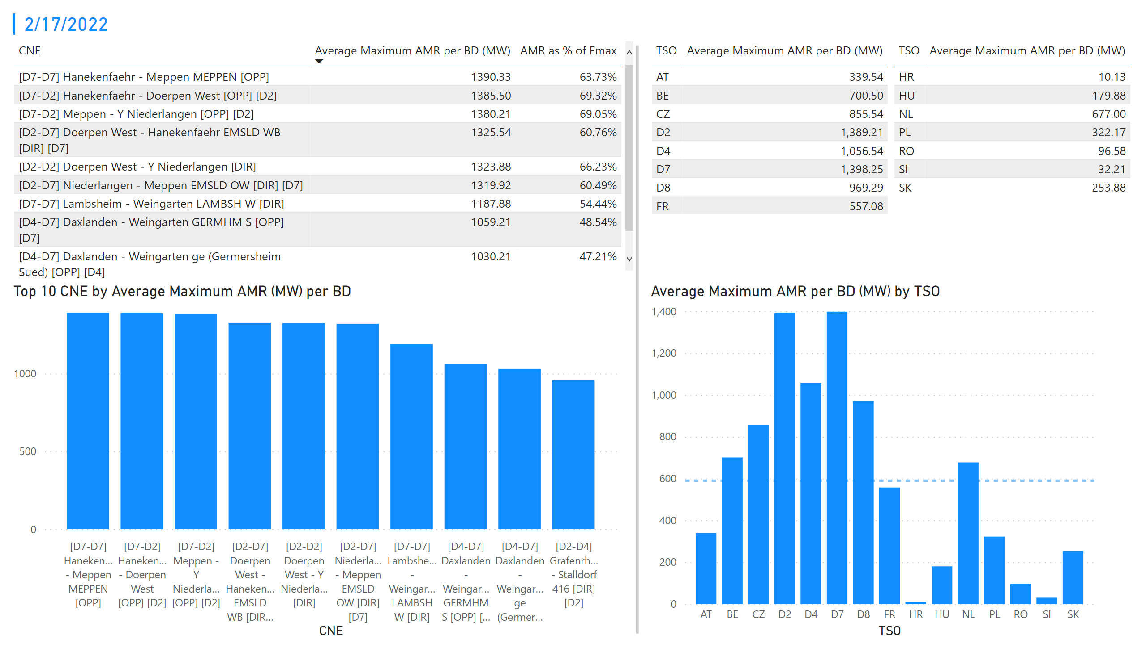
KPI 1 +2_17
KPI 1: Average maximum AMR per CNE per BD
KPI 2: Average maximum AMR per CNE per TSO
Notes:
tableEx
No alt text provided
Top 10 CNE by Average Maximum AMR (MW) per BD
No alt text provided
multiRowCard
No alt text provided
tableEx
No alt text provided
Average Maximum AMR per BD (MW) by TSO
No alt text provided
tableEx
No alt text provided
basicShape
No alt text provided

Slide 24
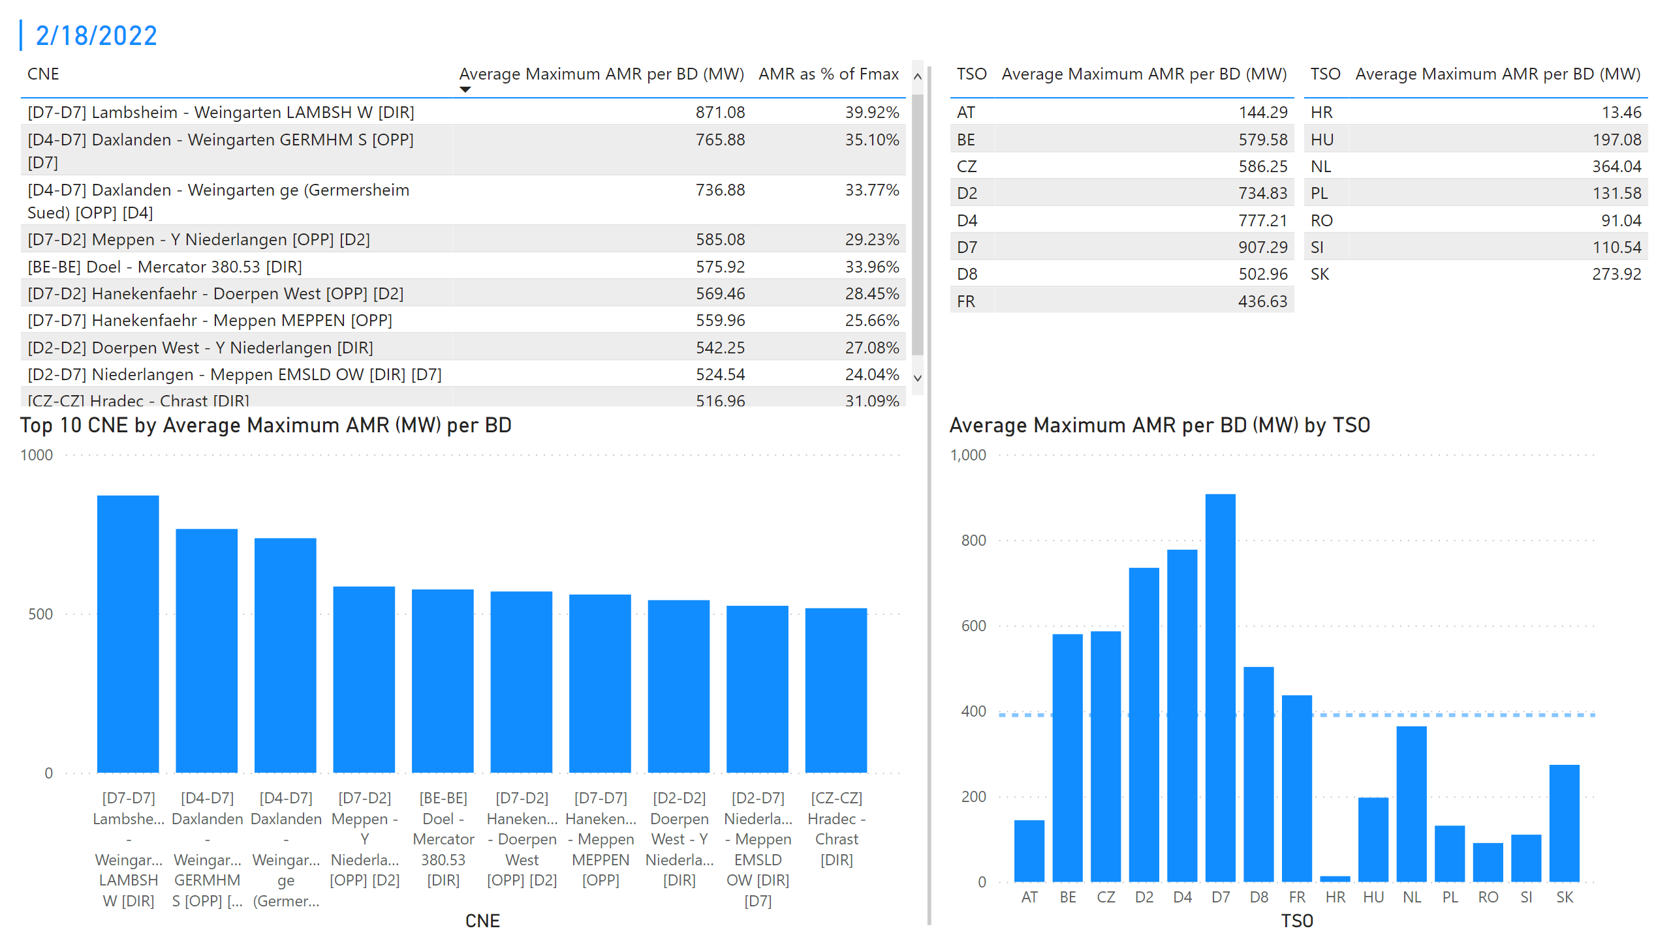
KPI 1 +2_18
KPI 1: Average maximum AMR per CNE per BD
KPI 2: Average maximum AMR per CNE per TSO
Notes:
tableEx
No alt text provided
Top 10 CNE by Average Maximum AMR (MW) per BD
No alt text provided
multiRowCard
No alt text provided
tableEx
No alt text provided
Average Maximum AMR per BD (MW) by TSO
No alt text provided
tableEx
No alt text provided
basicShape
No alt text provided

Slide 25
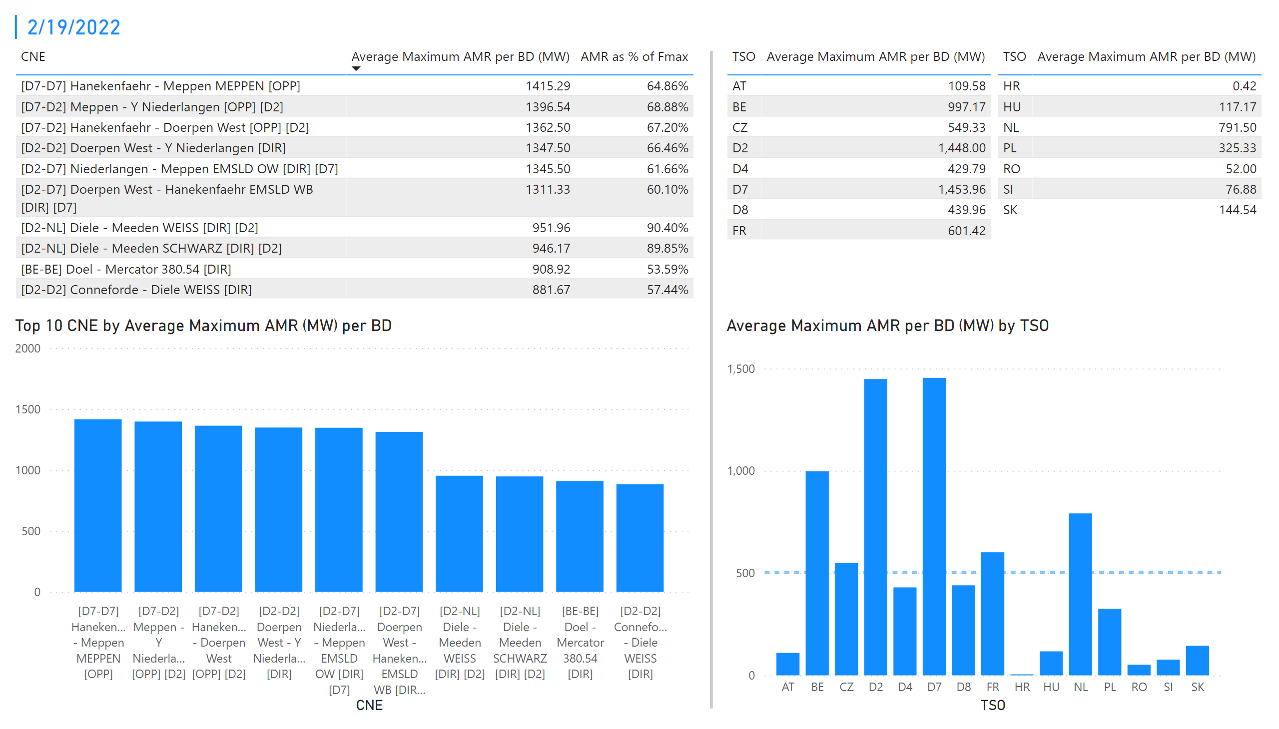
KPI 1 +2_19
KPI 1: Average maximum AMR per CNE per BD
KPI 2: Average maximum AMR per CNE per TSO
Notes:
tableEx
No alt text provided
Top 10 CNE by Average Maximum AMR (MW) per BD
No alt text provided
multiRowCard
No alt text provided
tableEx
No alt text provided
Average Maximum AMR per BD (MW) by TSO
No alt text provided
tableEx
No alt text provided
basicShape
No alt text provided

Slide 26
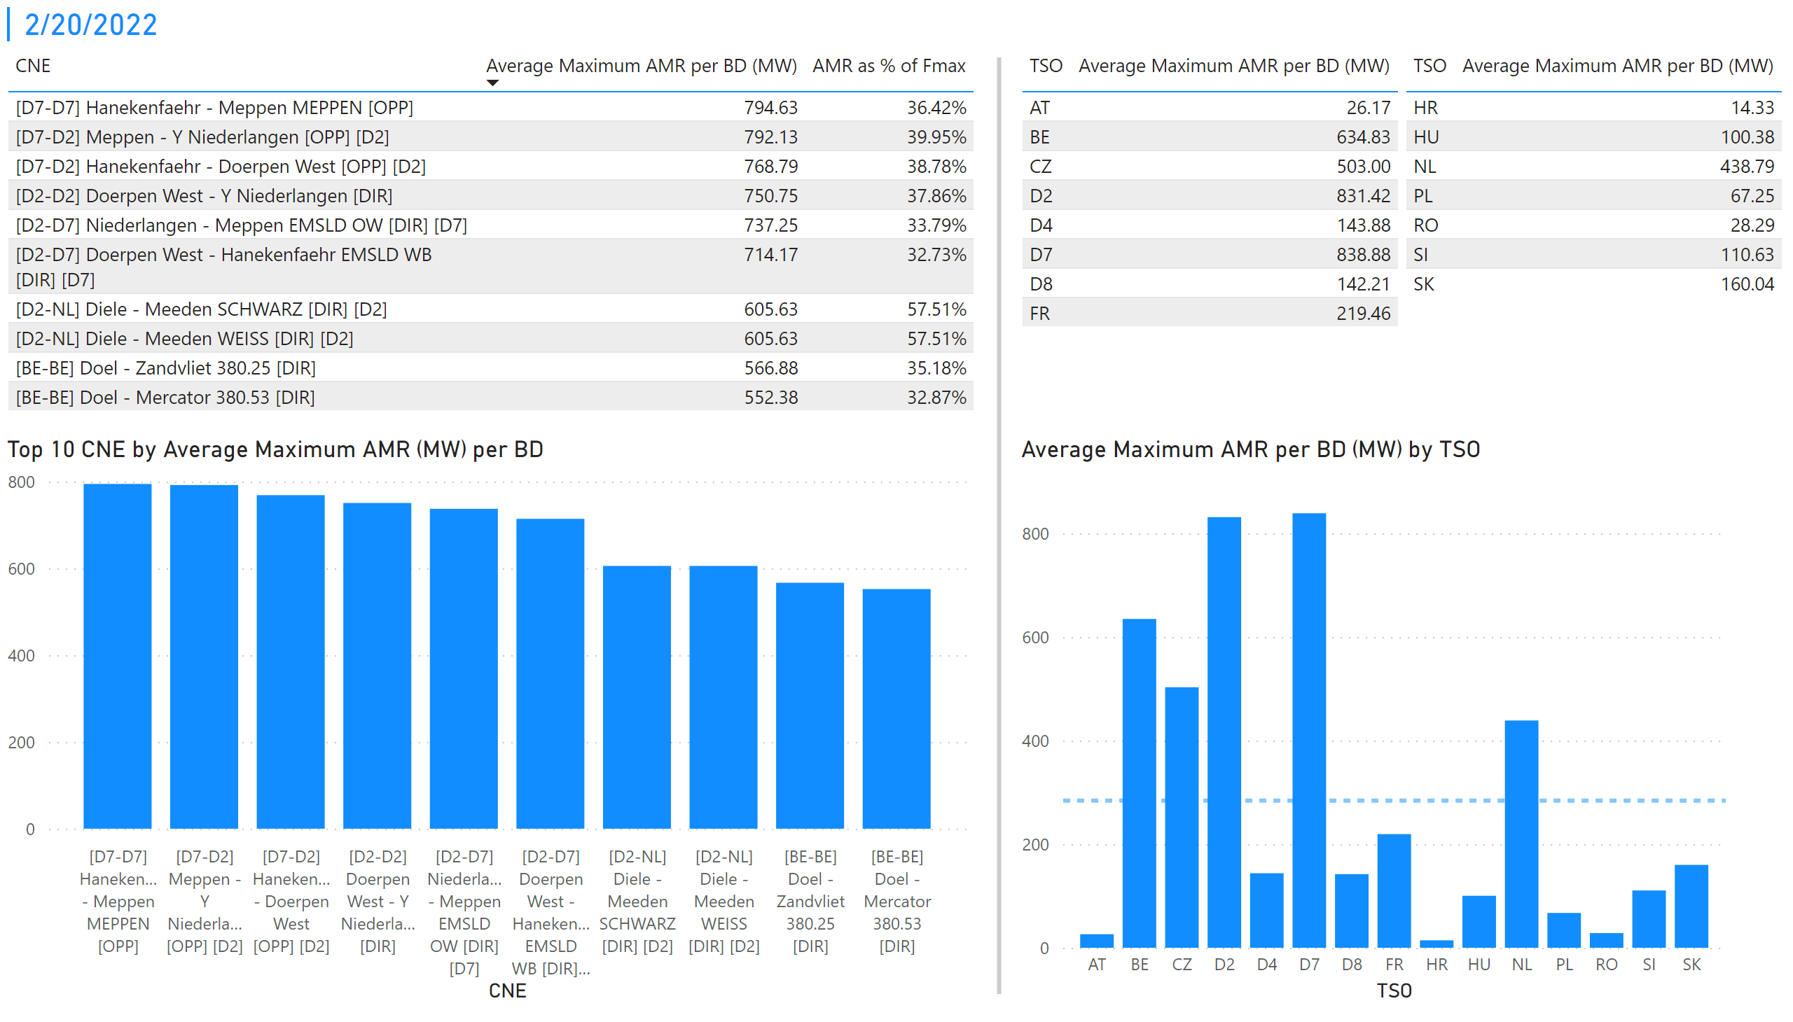
KPI 1 +2_20
KPI 1: Average maximum AMR per CNE per BD
KPI 2: Average maximum AMR per CNE per TSO
Notes:
tableEx
No alt text provided
Top 10 CNE by Average Maximum AMR (MW) per BD
No alt text provided
multiRowCard
No alt text provided
tableEx
No alt text provided
Average Maximum AMR per BD (MW) by TSO
No alt text provided
tableEx
No alt text provided
basicShape
No alt text provided

Slide 27

KPI 1 +2_21
KPI 1: Average maximum AMR per CNE per BD
KPI 2: Average maximum AMR per CNE per TSO
Notes:
tableEx
No alt text provided
Top 10 CNE by Average Maximum AMR (MW) per BD
No alt text provided
multiRowCard
No alt text provided
tableEx
No alt text provided
Average Maximum AMR per BD (MW) by TSO
No alt text provided
tableEx
No alt text provided
basicShape
No alt text provided

Slide 28
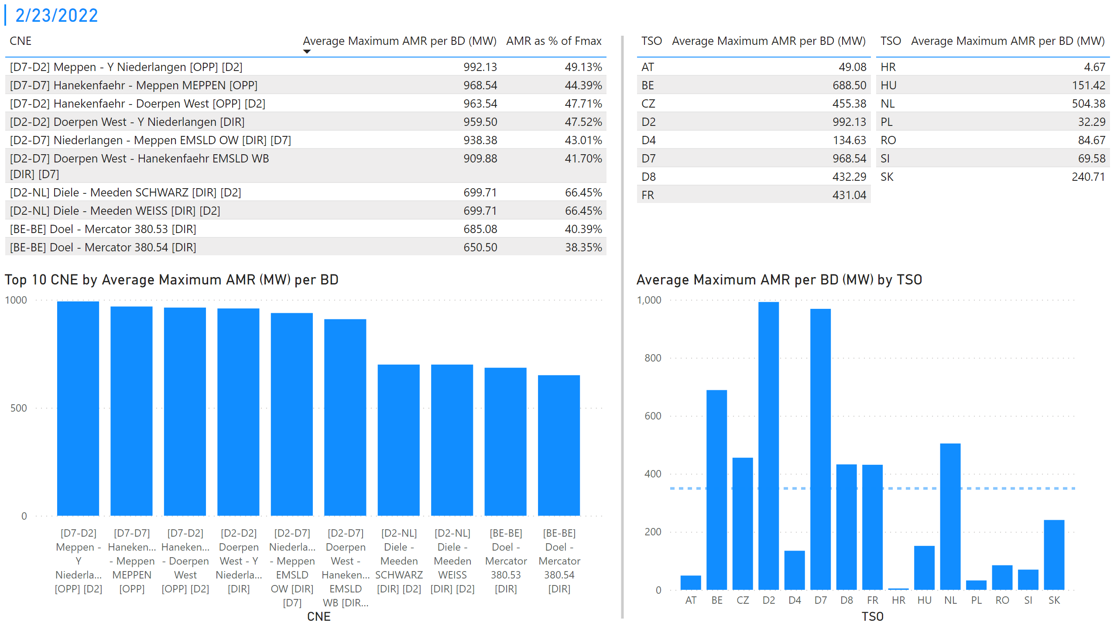
KPI 1 +2_23
KPI 1: Average maximum AMR per CNE per BD
KPI 2: Average maximum AMR per CNE per TSO
Notes:
tableEx
No alt text provided
Top 10 CNE by Average Maximum AMR (MW) per BD
No alt text provided
multiRowCard
No alt text provided
tableEx
No alt text provided
Average Maximum AMR per BD (MW) by TSO
No alt text provided
tableEx
No alt text provided
basicShape
No alt text provided

Slide 29
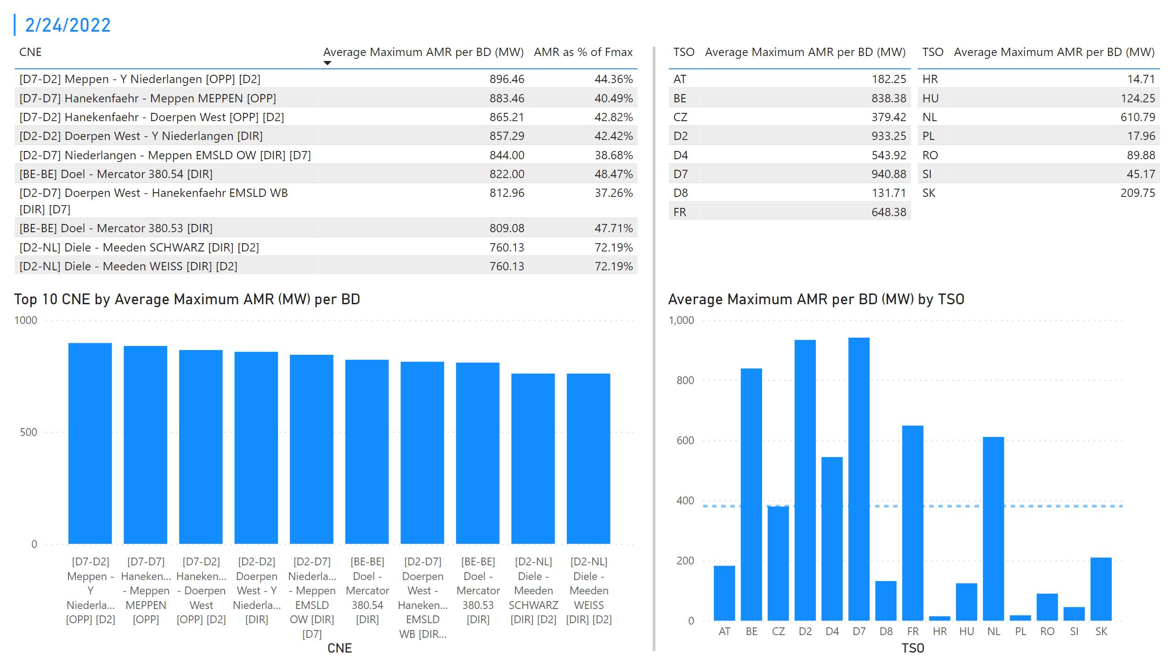
KPI 1 +2_24
KPI 1: Average maximum AMR per CNE per BD
KPI 2: Average maximum AMR per CNE per TSO
Notes:
tableEx
No alt text provided
Top 10 CNE by Average Maximum AMR (MW) per BD
No alt text provided
multiRowCard
No alt text provided
tableEx
No alt text provided
Average Maximum AMR per BD (MW) by TSO
No alt text provided
tableEx
No alt text provided
basicShape
No alt text provided

Slide 30

KPI 1 +2_25
KPI 1: Average maximum AMR per CNE per BD
KPI 2: Average maximum AMR per CNE per TSO
Notes:
tableEx
No alt text provided
Top 10 CNE by Average Maximum AMR (MW) per BD
No alt text provided
multiRowCard
No alt text provided
tableEx
No alt text provided
Average Maximum AMR per BD (MW) by TSO
No alt text provided
tableEx
No alt text provided
basicShape
No alt text provided

Slide 31
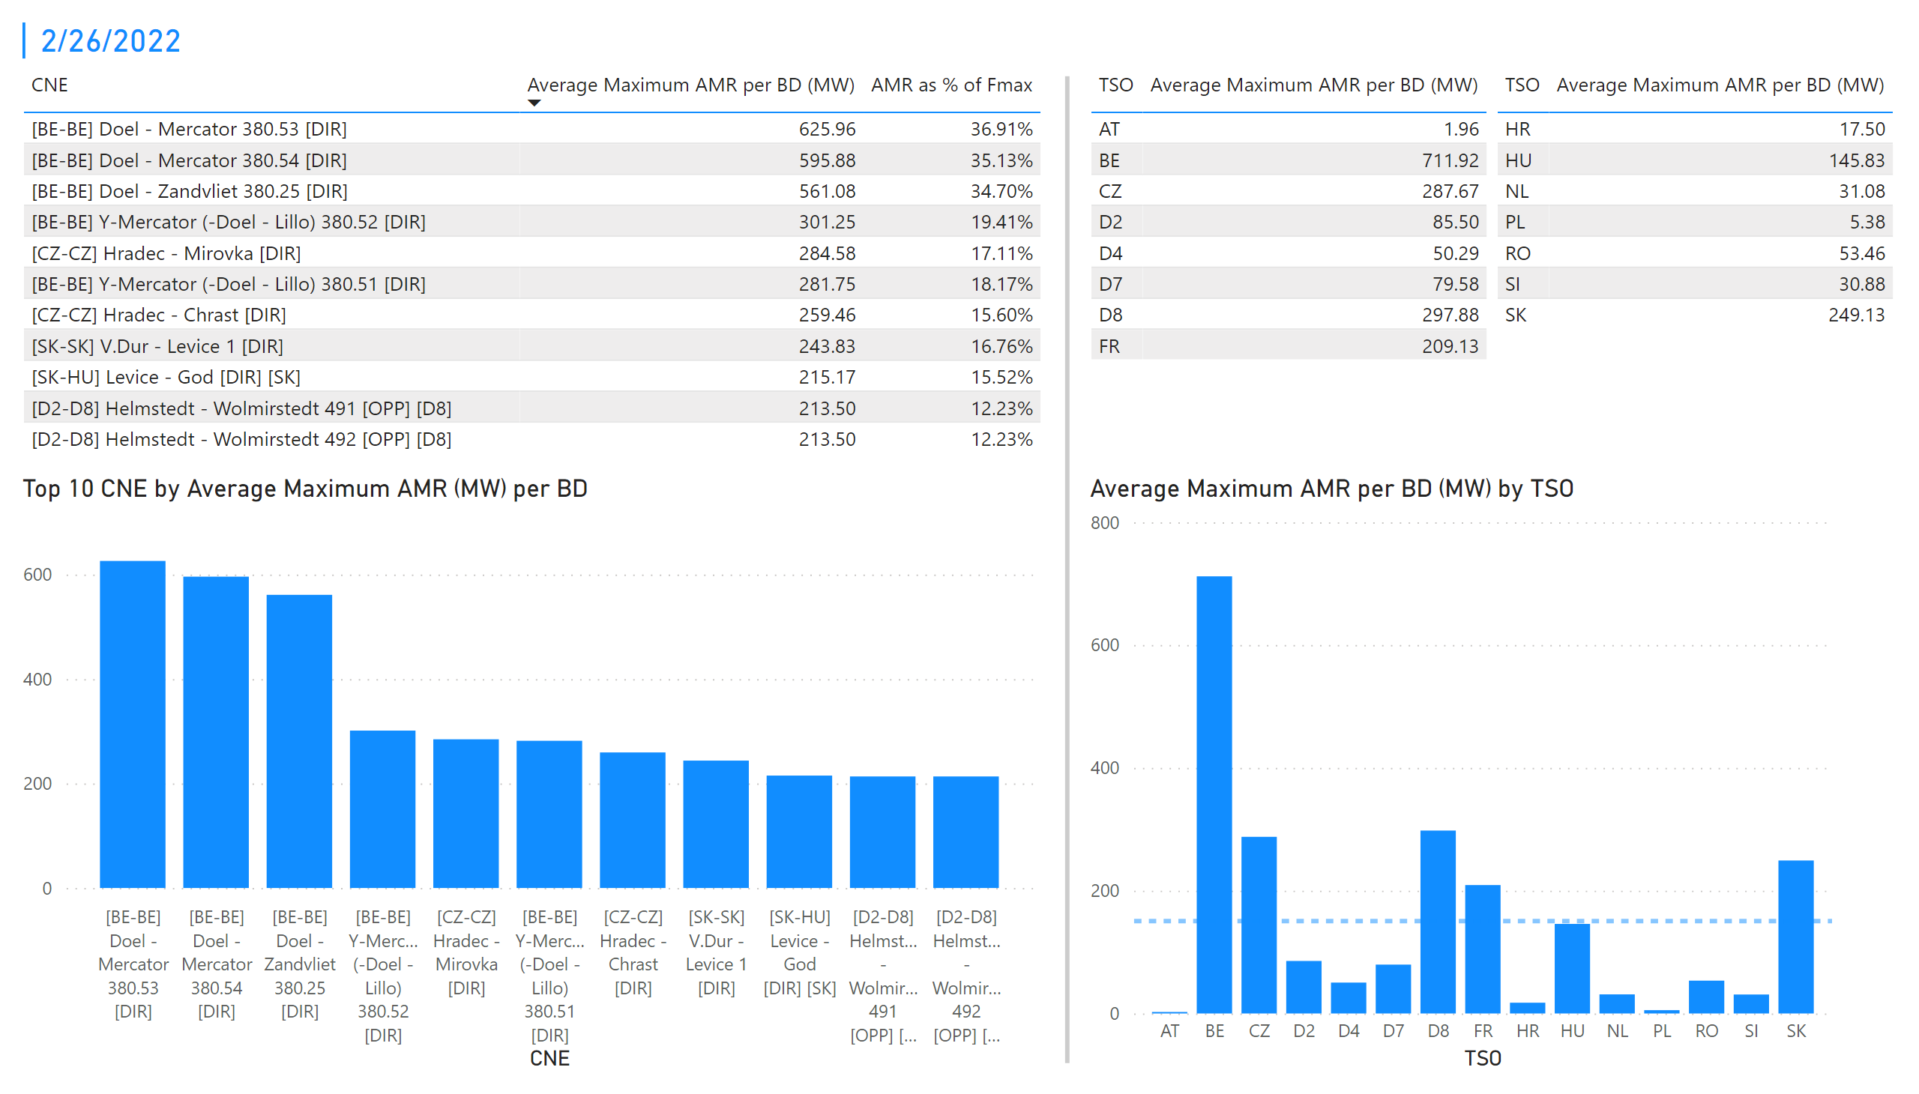
KPI 1 +2_26
KPI 1: Average maximum AMR per CNE per BD
KPI 2: Average maximum AMR per CNE per TSO
Notes:
tableEx
No alt text provided
Top 10 CNE by Average Maximum AMR (MW) per BD
No alt text provided
multiRowCard
No alt text provided
tableEx
No alt text provided
Average Maximum AMR per BD (MW) by TSO
No alt text provided
tableEx
No alt text provided
basicShape
No alt text provided

Slide 32
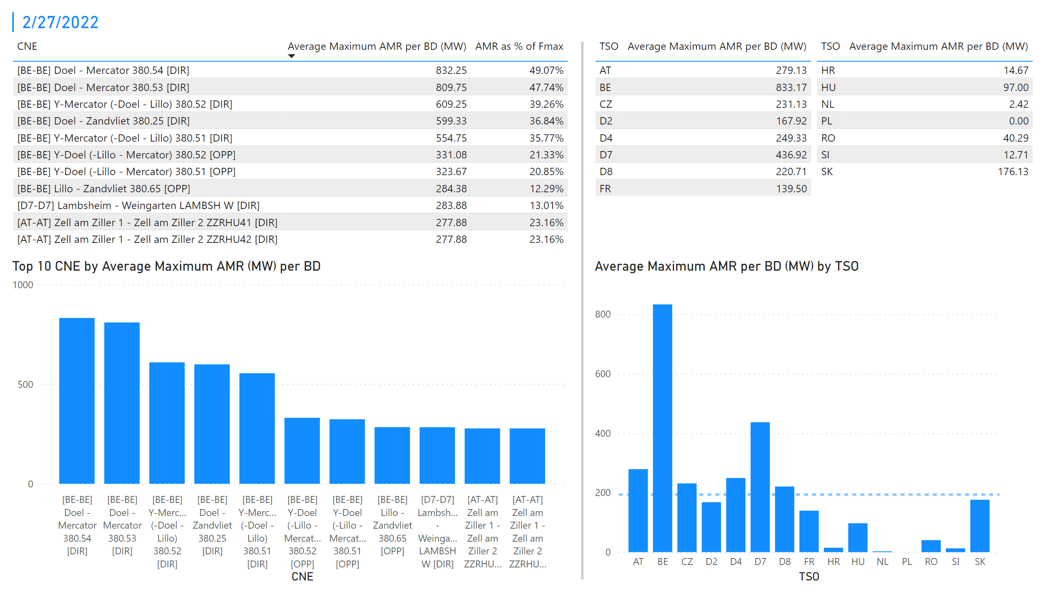
KPI 1 +2_28
KPI 1: Average maximum AMR per CNE per BD
KPI 2: Average maximum AMR per CNE per TSO
Notes:
tableEx
No alt text provided
Top 10 CNE by Average Maximum AMR (MW) per BD
No alt text provided
multiRowCard
No alt text provided
tableEx
No alt text provided
Average Maximum AMR per BD (MW) by TSO
No alt text provided
tableEx
No alt text provided
basicShape
No alt text provided

Slide 33
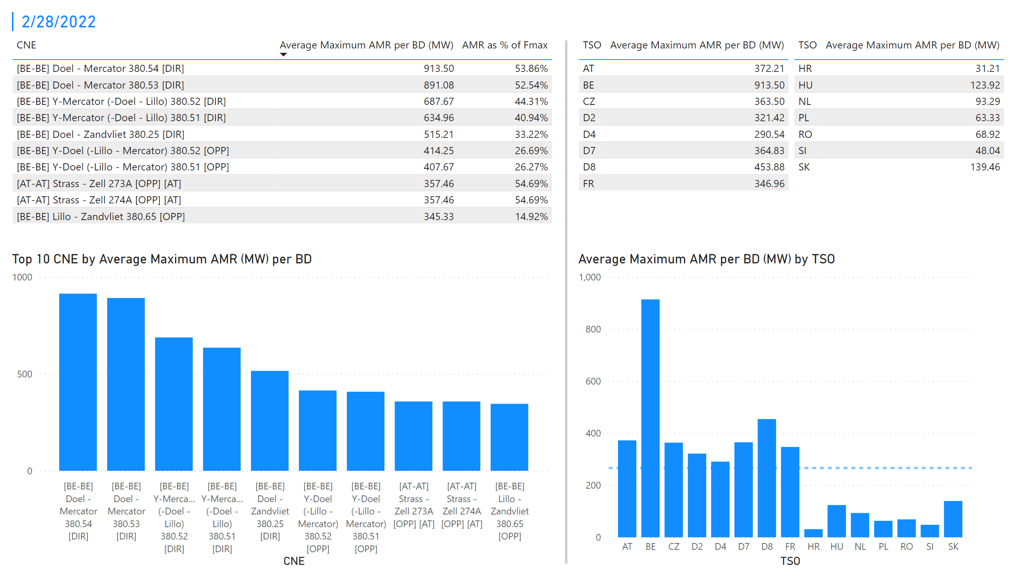
KPI 1 +2_29
KPI 1: Average maximum AMR per CNE per BD
KPI 2: Average maximum AMR per CNE per TSO
Notes:
basicShape
No alt text provided
tableEx
No alt text provided
tableEx
No alt text provided
multiRowCard
No alt text provided
Average Maximum AMR per BD (MW) by TSO
No alt text provided
Top 10 CNE by Average Maximum AMR (MW) per BD
No alt text provided
tableEx
No alt text provided

Slide 34
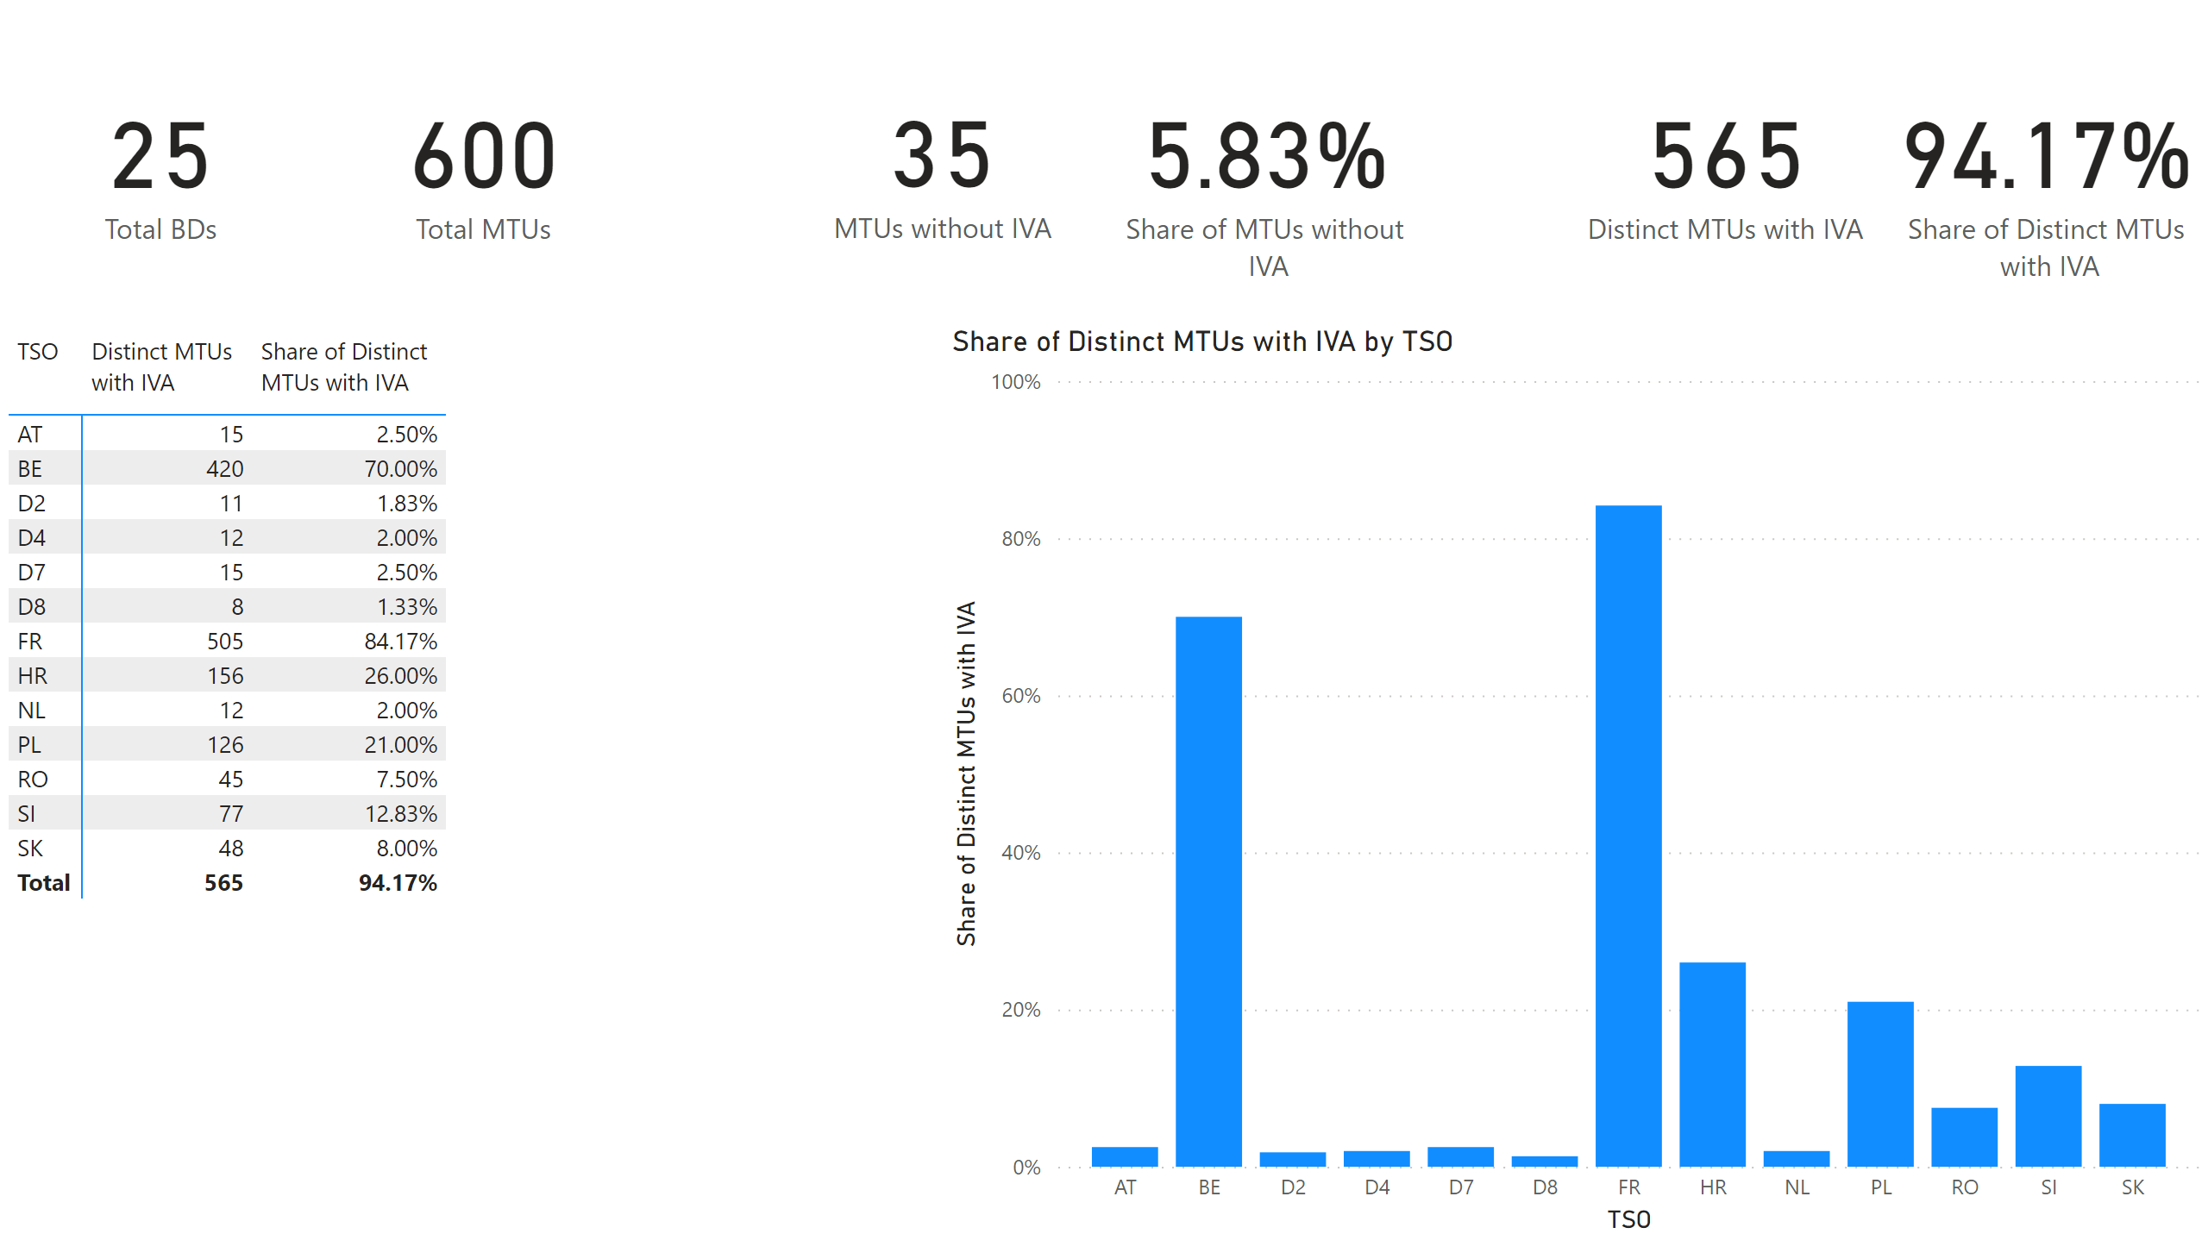
KPI 5
KPI 5: Share of MTUs with intervention per TSO
Notes:
pivotTable
No alt text provided
clusteredColumnChart
No alt text provided
card
No alt text provided
card
No alt text provided
card
No alt text provided
card
No alt text provided
card
No alt text provided
card
No alt text provided

Slide 35
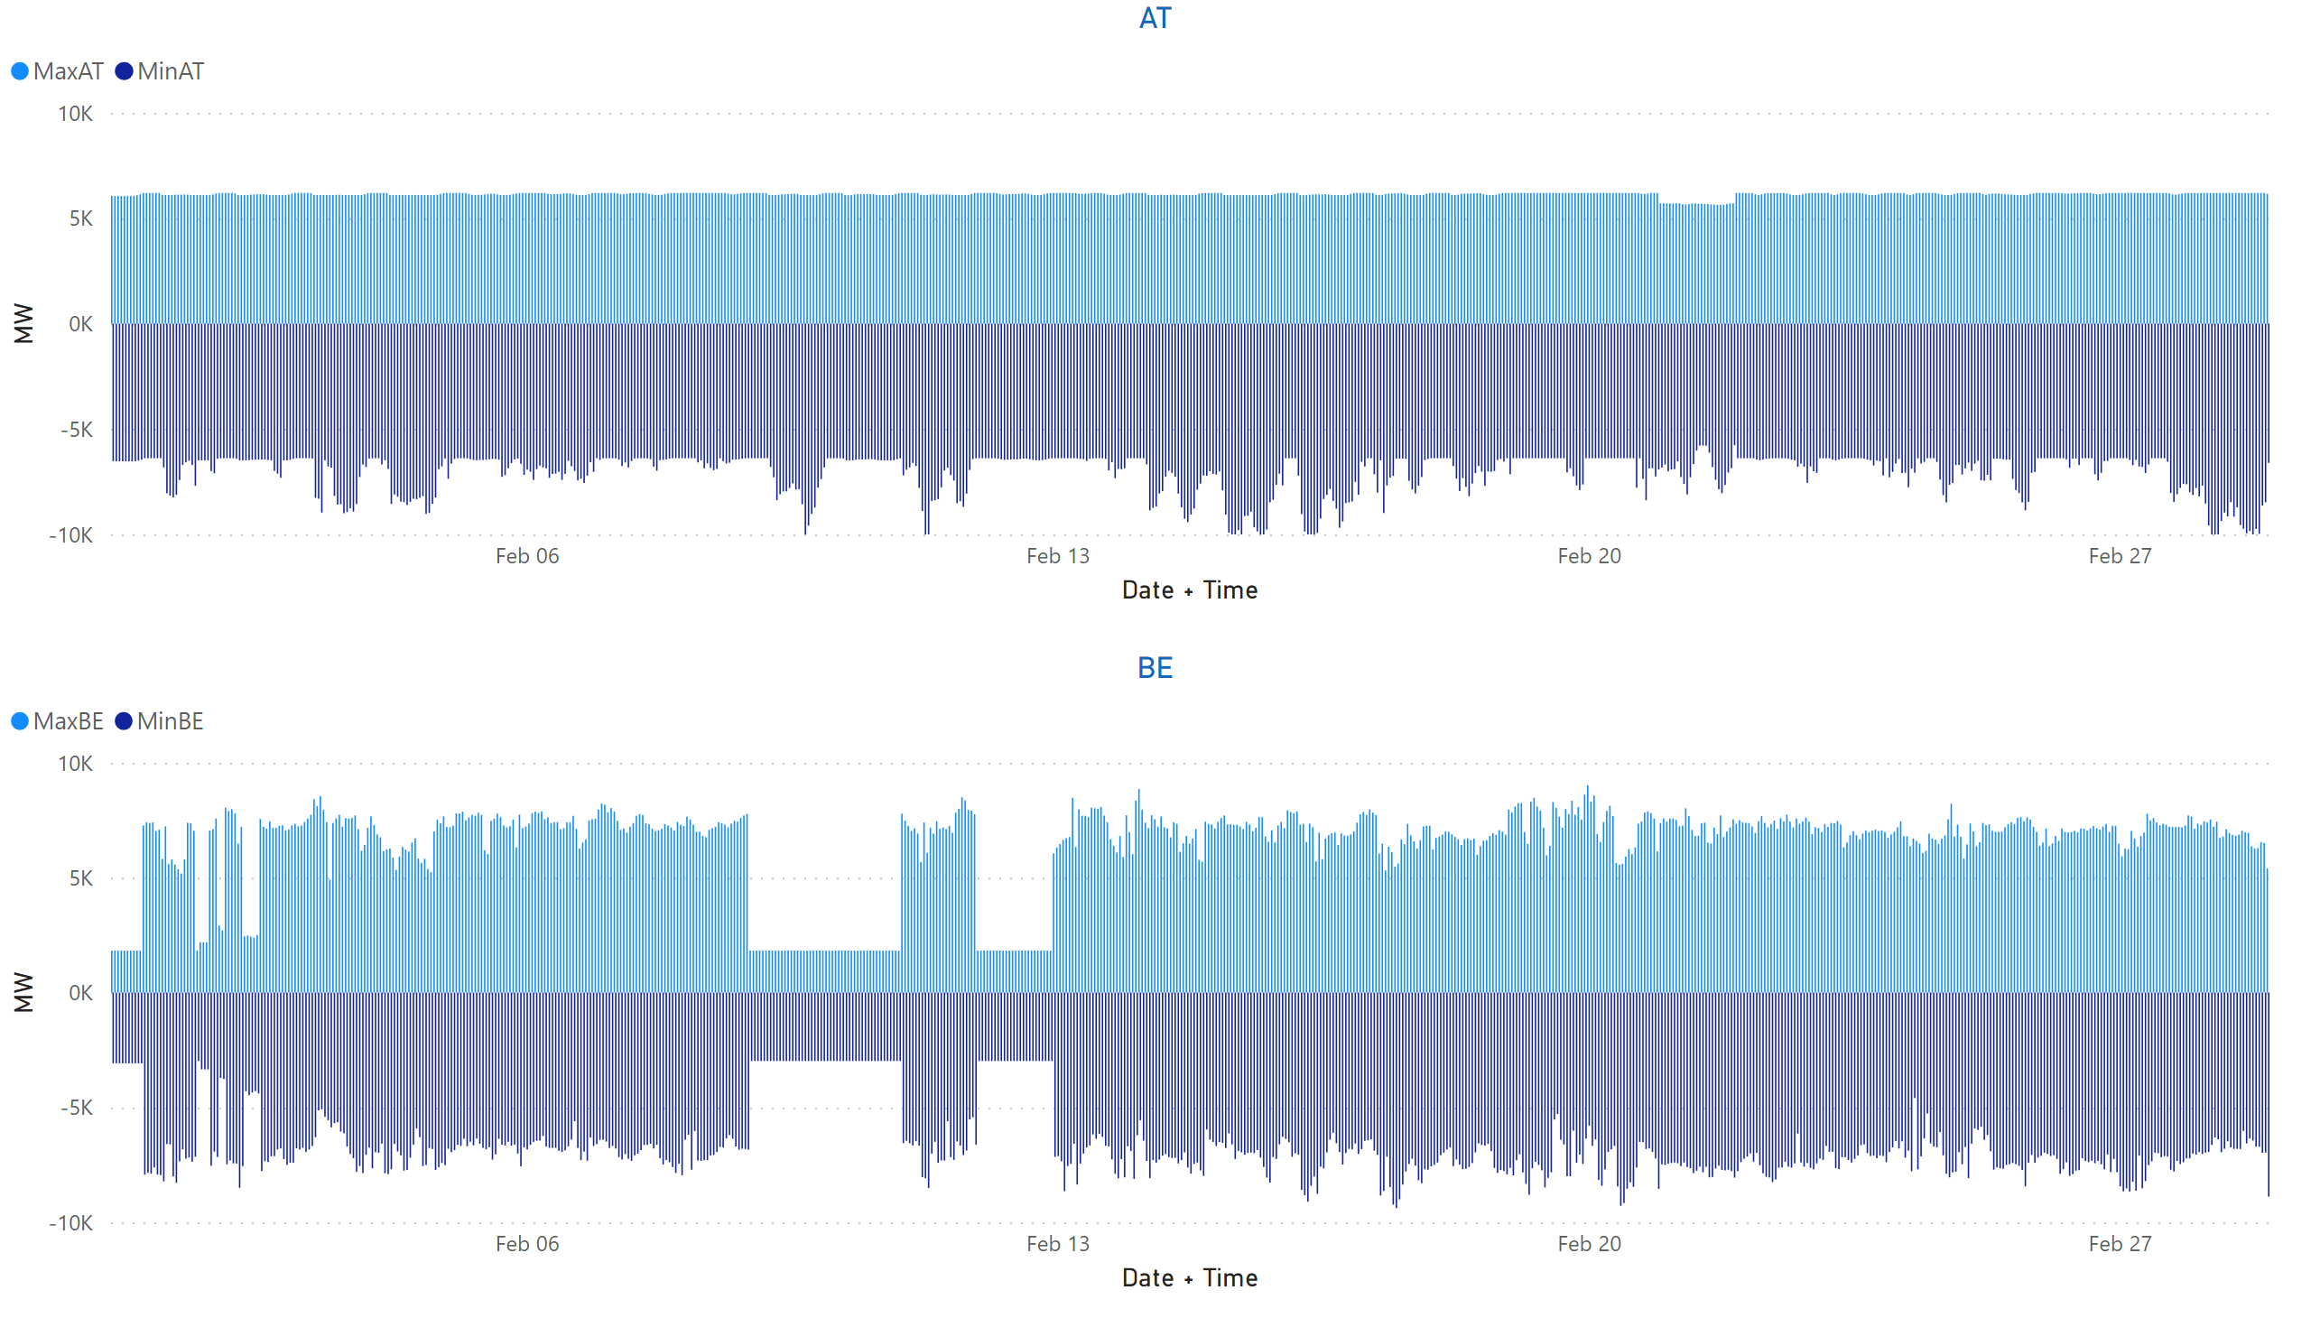
AT + BE
KPI 13: Min & max net positions per BZ hub
Notes:
AT
No alt text provided
BE
No alt text provided

Slide 36
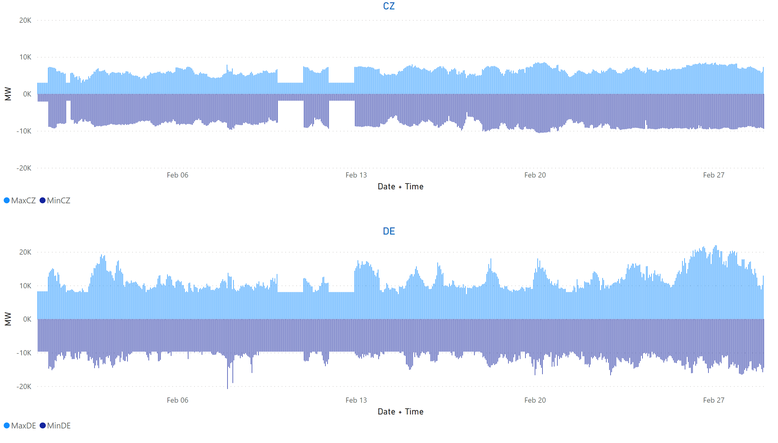
CZ+DE
KPI 13: Min & max net positions per BZ hub
Notes:
CZ
No alt text provided
DE
No alt text provided

Slide 37
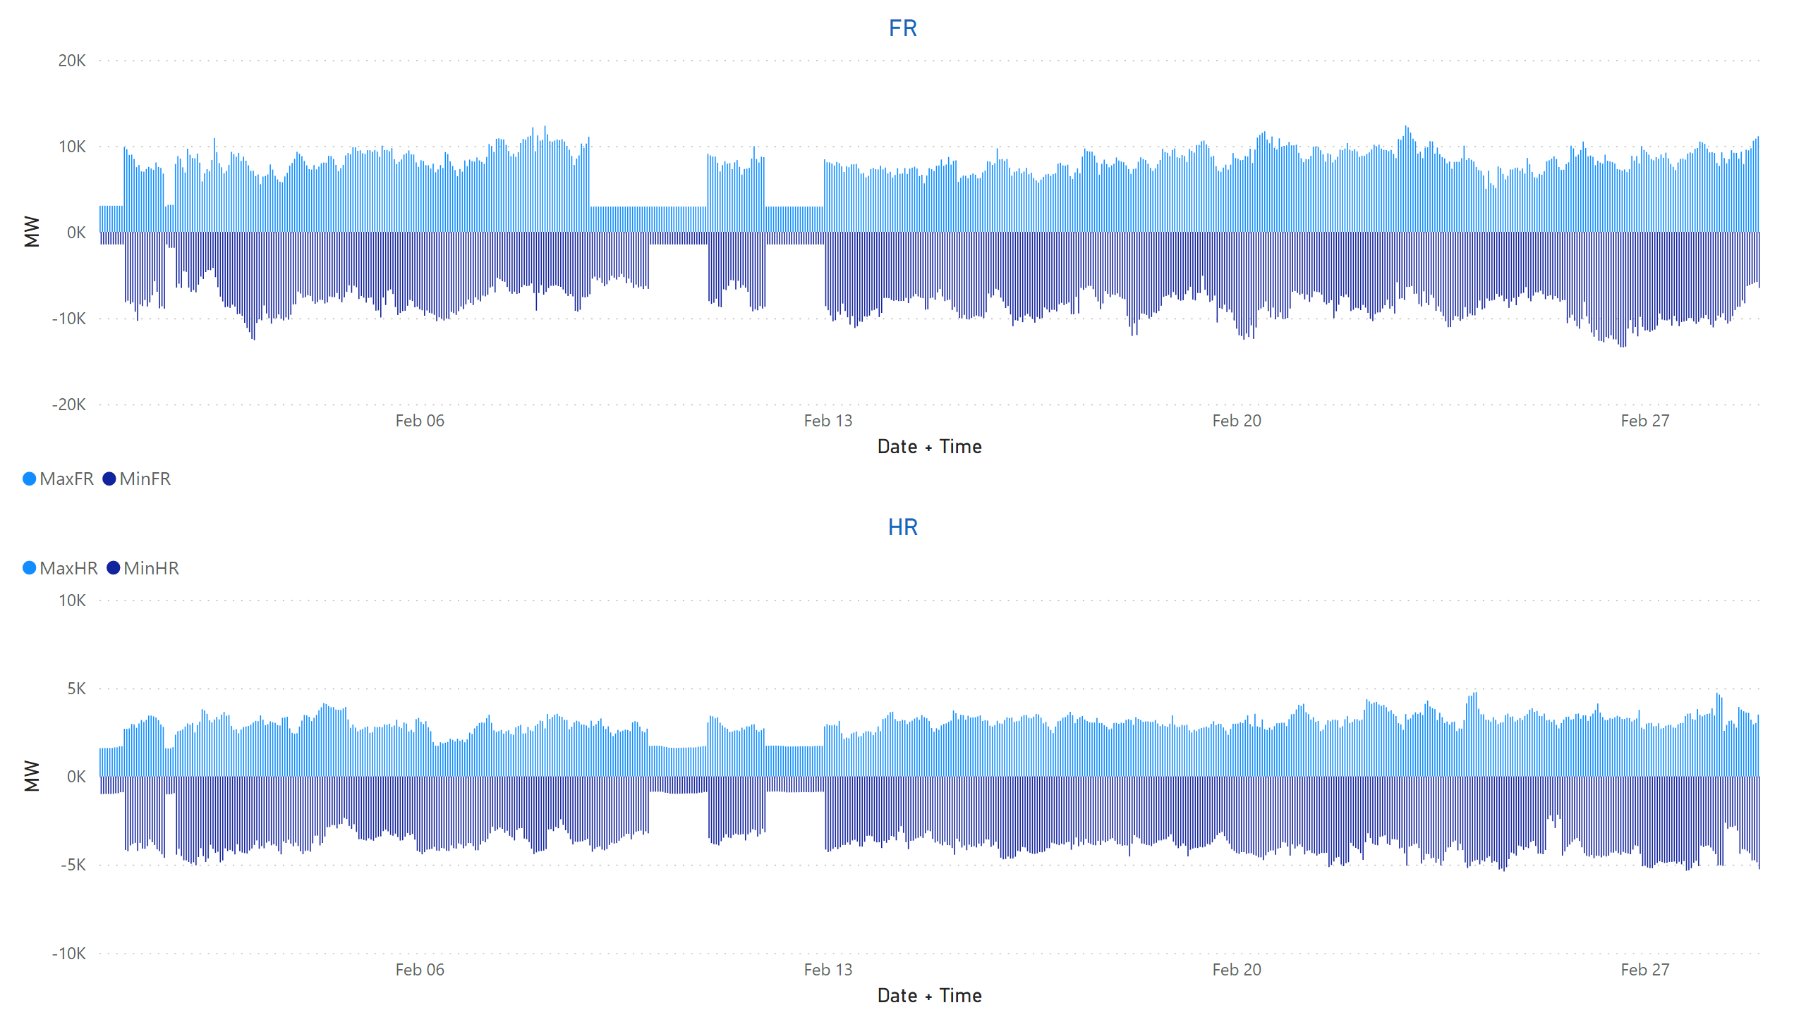
FR + HR
KPI 13: Min & max net positions per BZ hub
Notes:
FR
No alt text provided
HR
No alt text provided

Slide 38
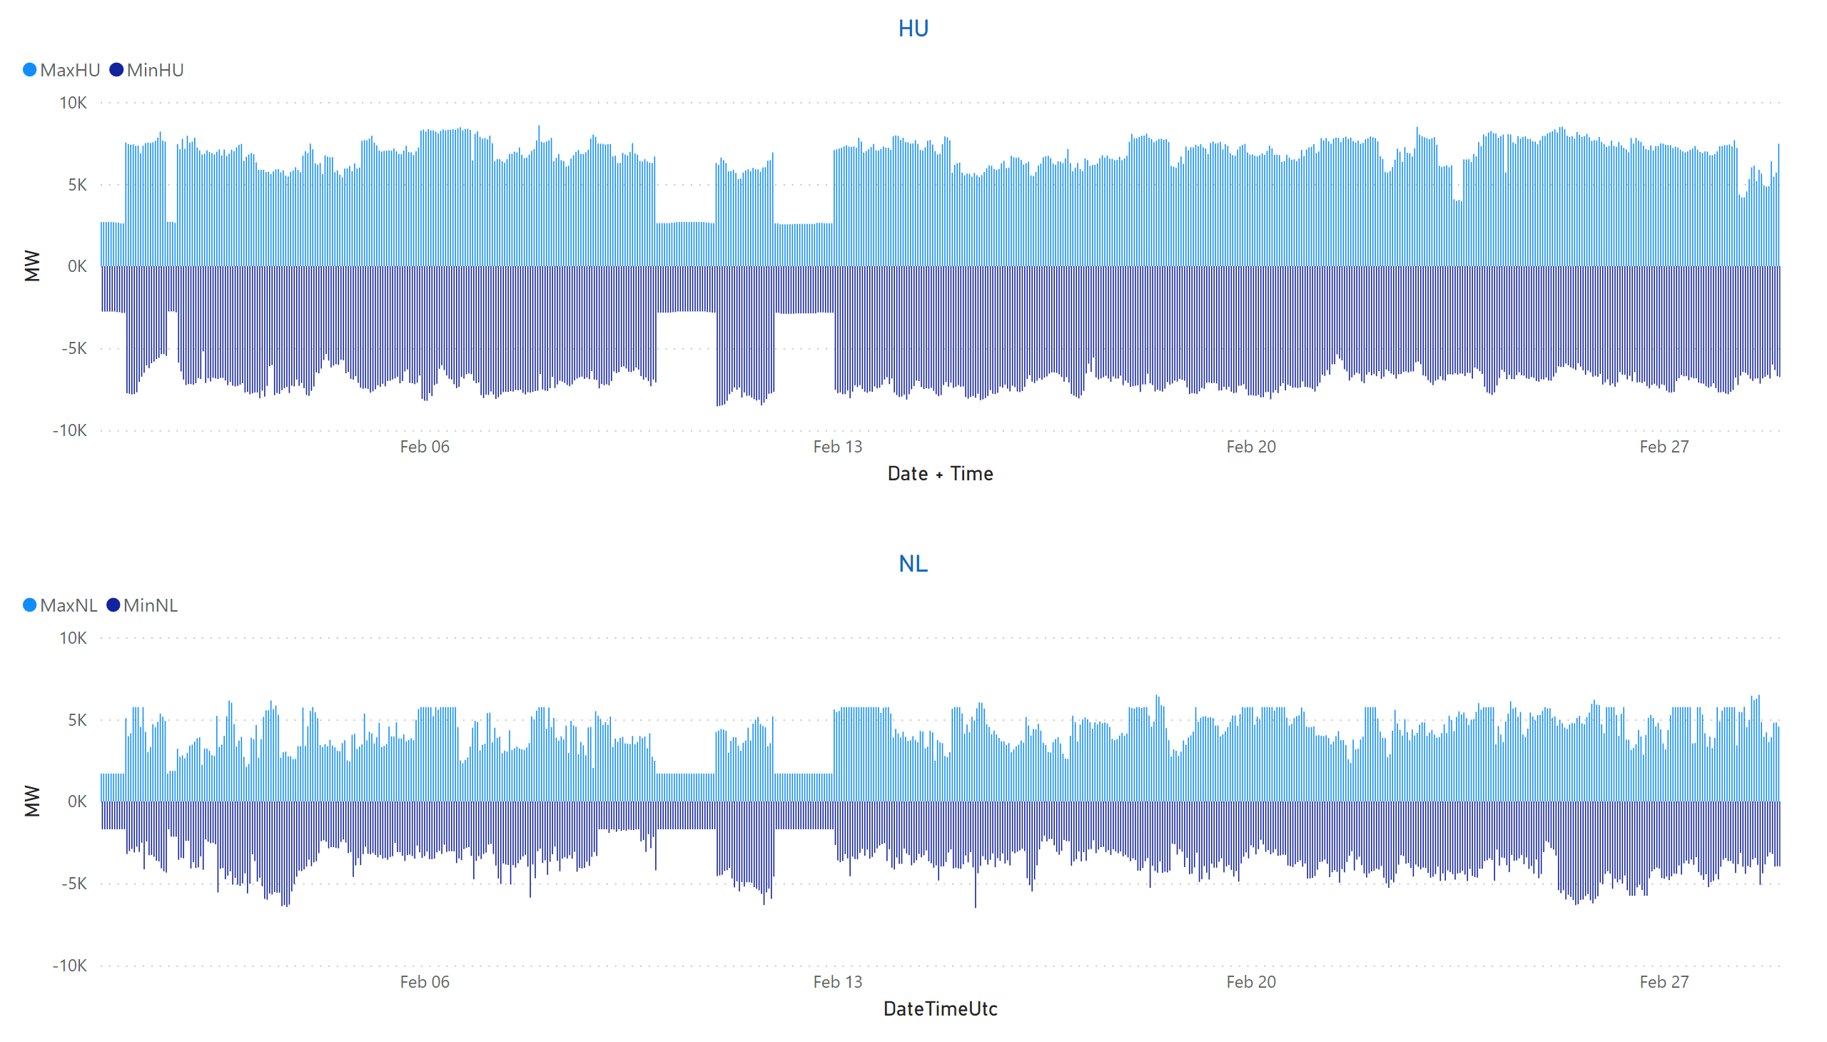
HU + NL
KPI 13: Min & max net positions per BZ hub
Notes:
HU
No alt text provided
NL
No alt text provided

Slide 39
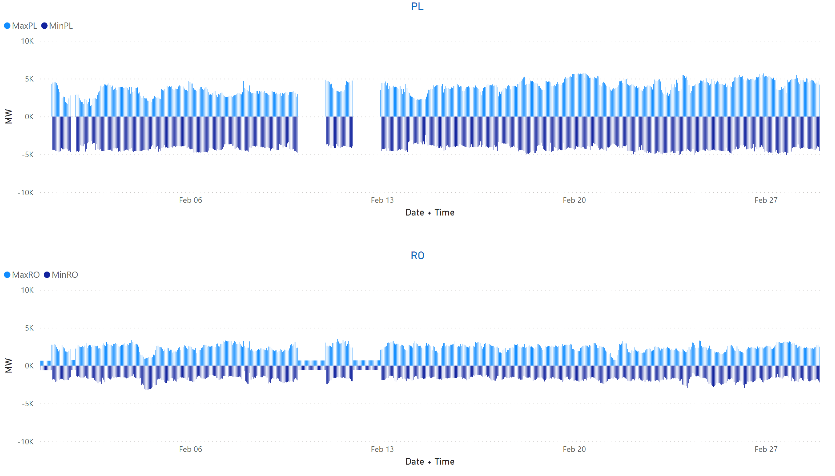
PL + RO
KPI 13: Min & max net positions per BZ hub
Notes:
PL
No alt text provided
RO
No alt text provided

Slide 40
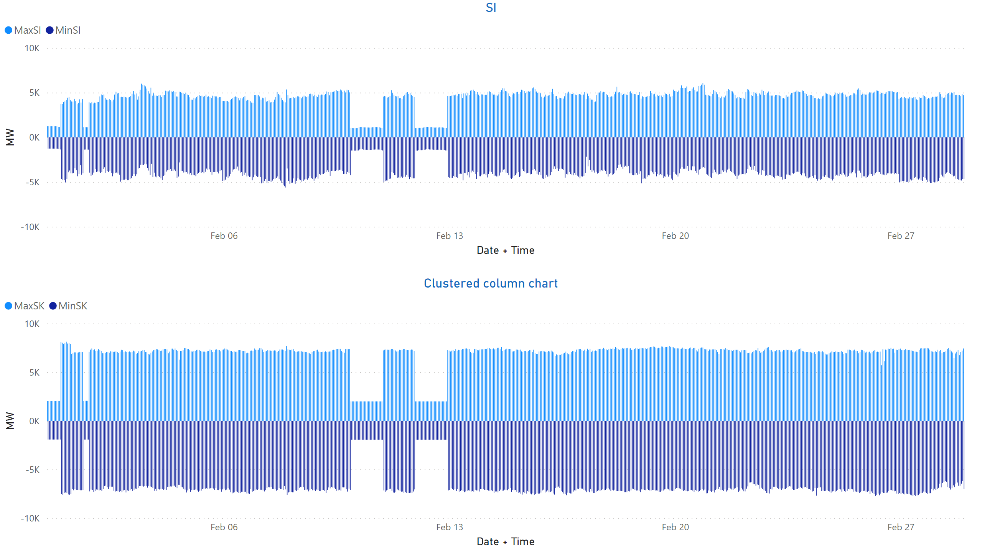
SI + SK
KPI 13: Min & max net positions per BZ hub
Notes:
clusteredColumnChart
No alt text provided
SI
No alt text provided

Slide 41
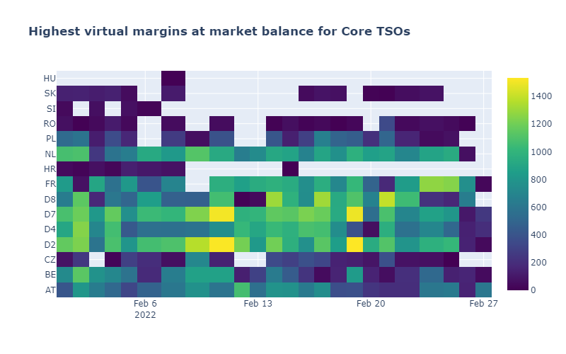
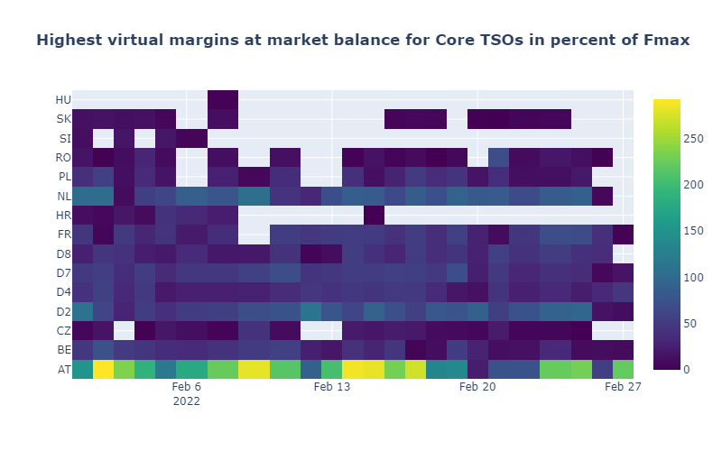
KPI 14a: Highest virtual margins at market balance for CORE TSOs
CORE TSOs

Slide 42
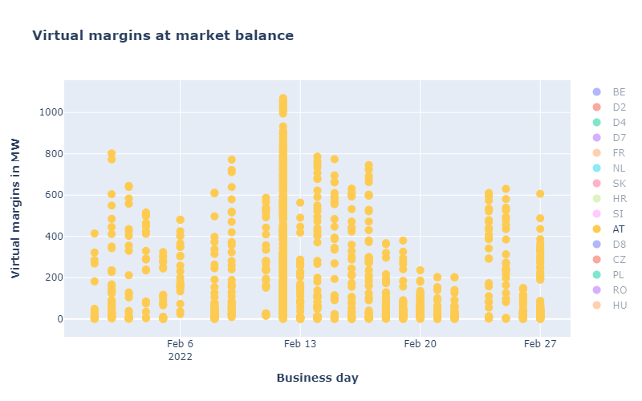
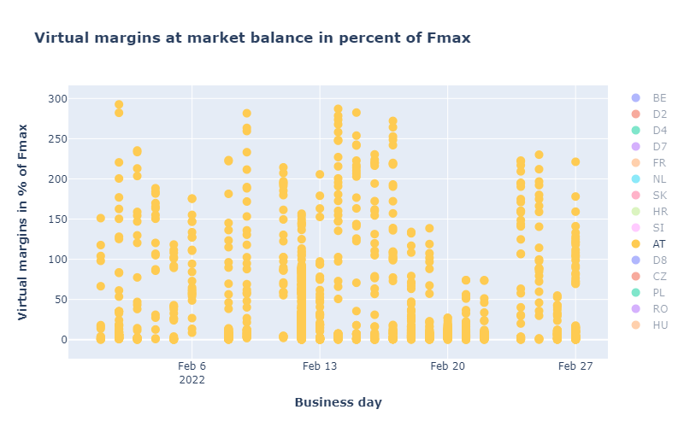
CORE TSOs
KPI 14b: AT: Virtual margins at market balance

Slide 43
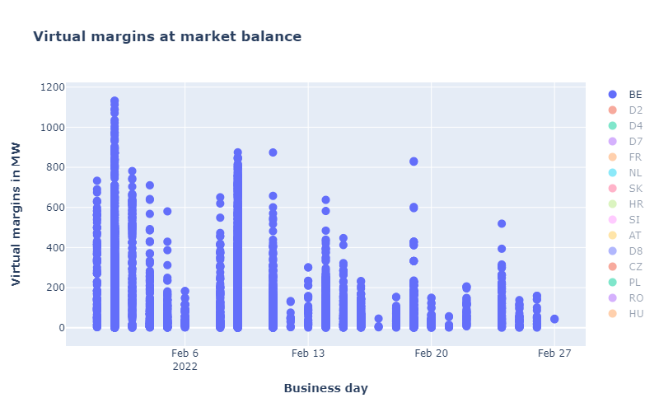
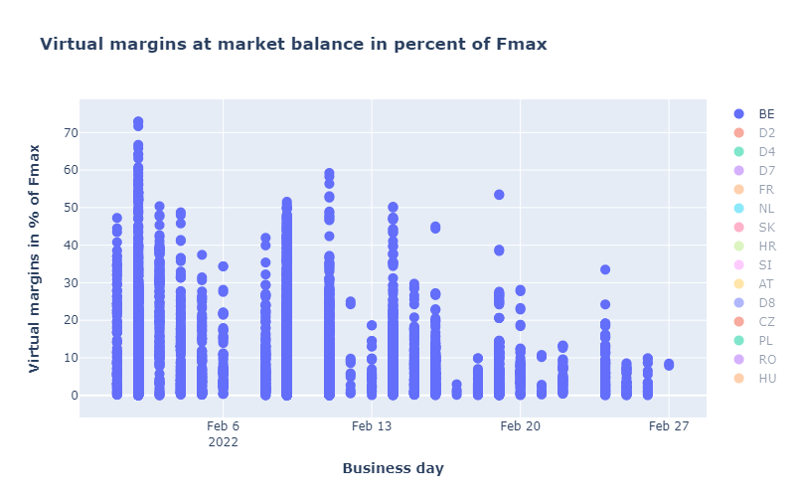
KPI 14b: BE: Virtual margins at market balance
CORE TSOs

Slide 44
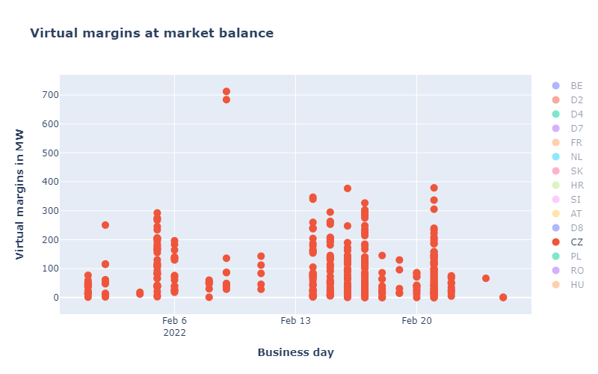
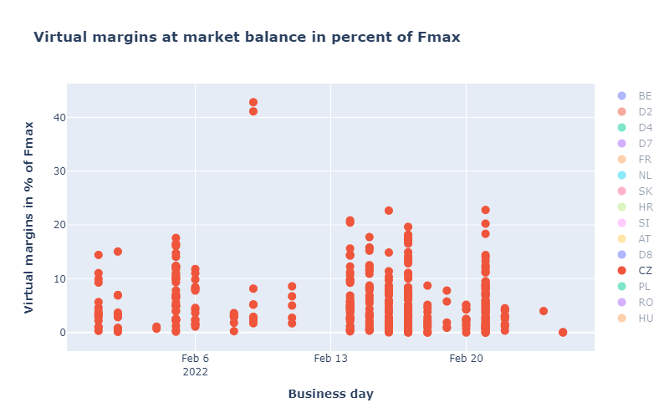
CORE TSOs
KPI 14b: CZ: Virtual margins at market balance

Slide 45
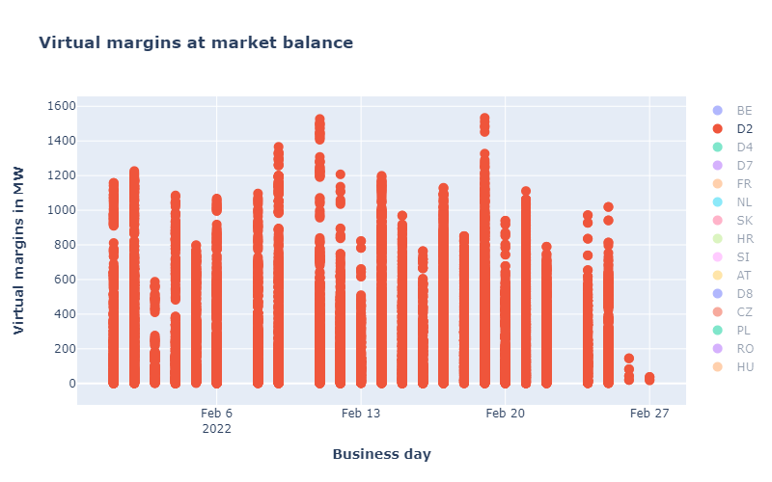
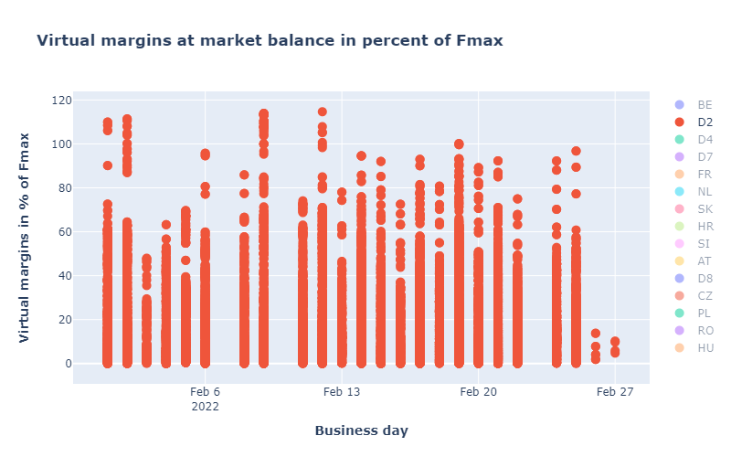
KPI 14b: D2: Virtual margins at market balance
CORE TSOs

Slide 46
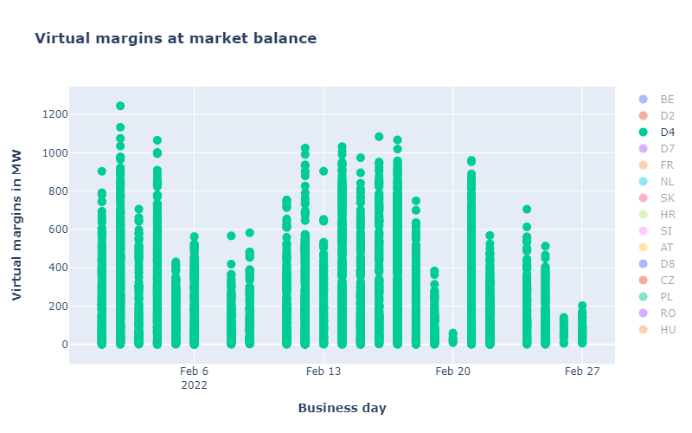
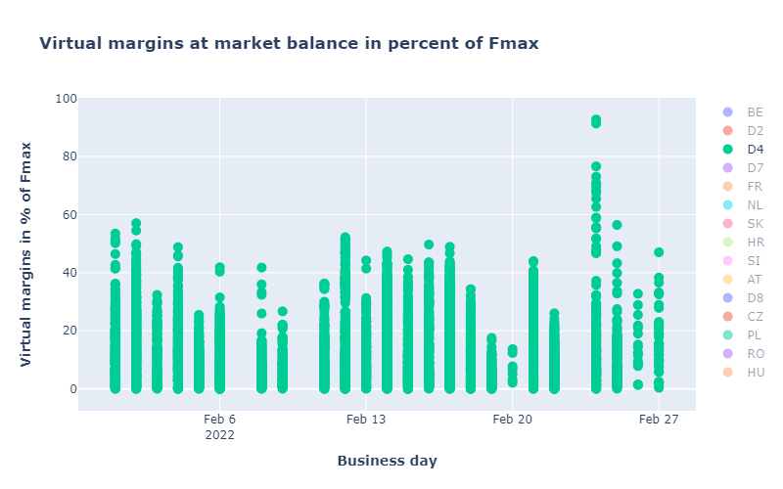
CORE TSOs
KPI 14b: D4: Virtual margins at market balance

Slide 47
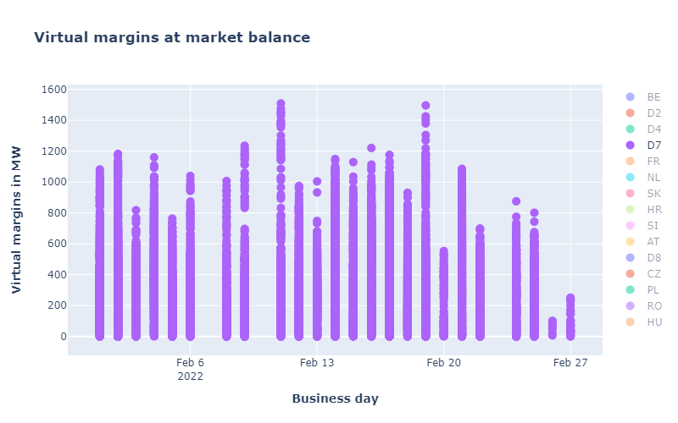
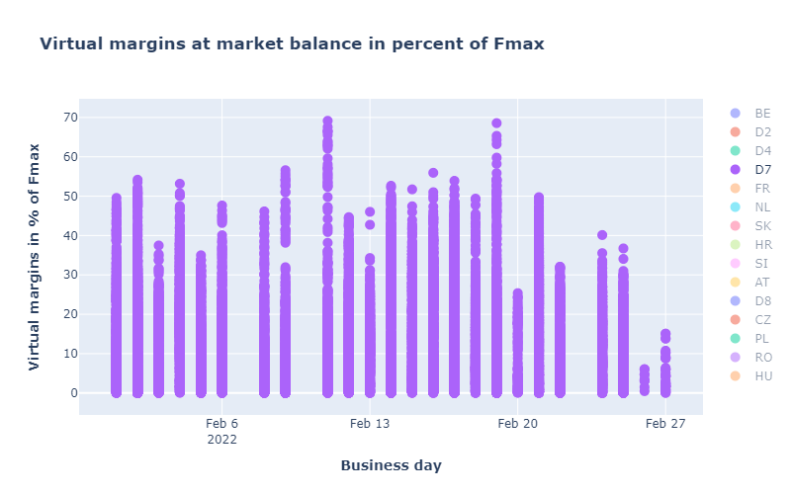
CORE TSOs
KPI 14b: D7: Virtual margins at market balance

Slide 48
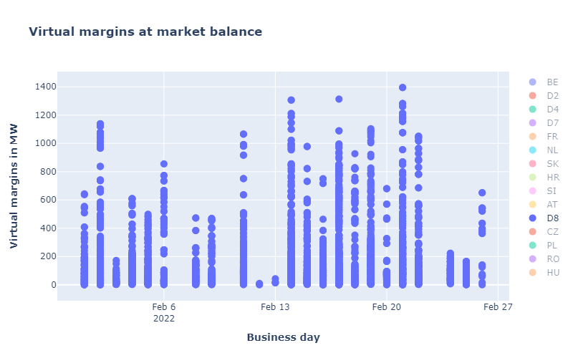
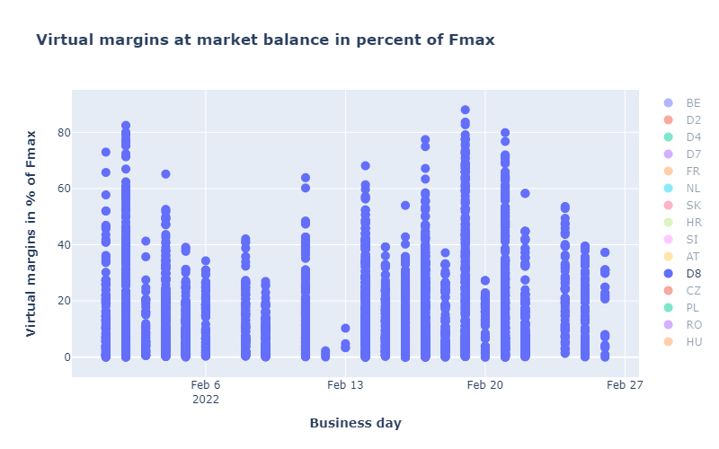
CORE TSOs
KPI 14b: D8: Virtual margins at market balance

Slide 49
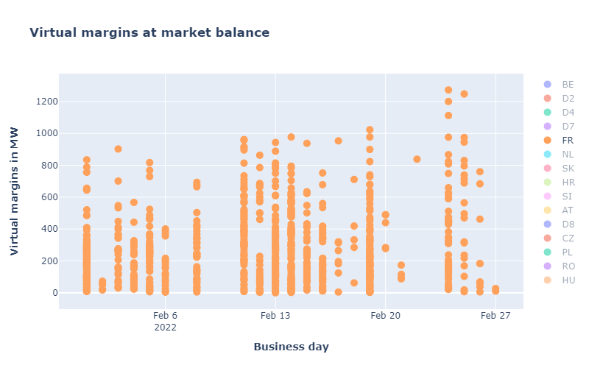
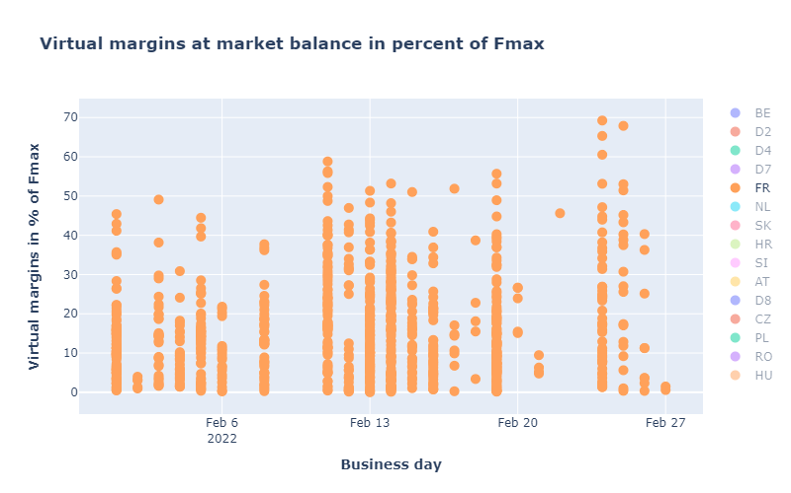
CORE TSOs
KPI 14b: FR: Virtual margins at market balance

Slide 50


CORE TSOs
KPI 14b: HR: Virtual margins at market balance

Slide 51


KPI 14b: HU: Virtual margins at market balance
CORE TSOs

Slide 52


KPI 14b: PL: Virtual margins at market balance
CORE TSOs

Slide 53


KPI 14b: NL: Virtual margins at market balance
CORE TSOs

Slide 54


CORE TSOs
KPI 14b: RO: Virtual margins at market balance

Slide 55


KPI 14b: SI: Virtual margins at market balance
CORE TSOs

Slide 56


KPI 14b: SK: Virtual margins at market balance
CORE TSOs

Slide 57

KPI 15: Non-Core exchanges delta flow
BD20220201 – BD20220228

Slide 58

KPI 15: Non-Core exchanges delta flow
BD20220201 – BD20220228

Slide 59

KPI 15: Non-Core delta exchanges
BD20220201 – BD20220228

Slide 60

Óverview
NRAO – Applied Remedial Actions
On the analysis:
  The total number of MTUs (672hours)
  was distributed as shown in the pie chart
  In the following plots, the relative time share
  relates to the hours labeled
  ‘NRAO Ran and Applied RAs’ (595 hours)

Slide 61

KPI 16: Relative Time Share of Applied RAs, by TSO, Type and Mode
NRAO – Applied Remedial Actions

Slide 62

KPI 16: Relative Time Share of Applied RAs, by TSO, Type and Mode
Relative Time Share of Applied PSTs in Preventive Mode

Slide 63

KPI 16: Relative Time Share of Applied RAs, by TSO, Type and Mode
Relative Time Share of Applied Topological RAs in Preventive Mode

Slide 64

KPI 16: Relative Time Share of Applied RAs, by TSO, Type and Mode
Relative Time Share of Applied PSTs in Curative Mode

Slide 65

KPI 16: Relative Time Share of Applied RAs, by TSO, Type and Mode
Relative Time Share of Applied Topological RAs in Curative Mode

Slide 66
KPI 17: Most limiting CNEC per TSO (NRAO)
TSCNET
Most limiting CNEC per TSO – February 2022
  The graph below shows the distribution of CNECs which are the most limiting from NRAO perspective, these are the CNECs with lowest relative RAM per MTUs.
  As expected, there is redistributing of the most limiting CNECs. This is because the application of Remedial Actions does not eliminate flows but re-routes, reducing the flows on some limiting CNECs and increasing the load on others, which at the end impacts also the RAM values.
  In case of CZ, D4, HR and SI, there were no most limiting elements from NRAO perspective.
  In case of HU, there is 1 most limiting element from NRAO perspective.

Slide 67

KPI 18: Average variation of relative RAM before and after NRAO
TSCNET
  The graph shows average values of relative RAM before and after NRAO, per TSO on the most limiting CNECs from NRAO perspective. Selected CNECs before RAO are the same as after RAO, and average computed for MTUs when NRAO was used further in the process.
  Most limiting element from NRAO perspective is the one which has the lowest relRAM per MTU.
  To determent value of relative RAM, the following formula was used:
  $${RAM}_{rel}=\frac{{RAM}_{nrao}}{\sum_{\left(A, B\right) ∈ neighbouring Core bidding zones pairs }{\left|{PTDF}_{A→B, nrao}\right|}} if {RAM}_{nrao}≥0$$
  $${RAM}_{rel}={RAM}_{nrao} if {RAM}_{nrao}< 0$$
  The increment of relRAM values after RAO shows that the optimization performed did increase the capacity on some areas.
  In case of RO, relRAM after RAO is not 0, but a small positive value (thus it cannot be properly viewed on the graph).
  In case of CZ, D4, HR and SI, there were no most limiting elements from NRAO perspective.

Slide 68
Parallel Run KPI report
CORE FB MC
KPI 7: Most often presolved CNEs (TOP 20) 202202
Total BDs: 24 (576 hours)
Note 1: the shown z2zPTDF values do not correspond to the maximum zone-to-zone PTDFs according to equation 5 of the Day-ahead CCM and hence are not the ones used for the CNEC Selection. The z2zPTDFs are calculated only between neighbouring BZs by the scripts used for external parallel run reporting. See KPI reading guide on JAO.
Note 2: RAM for Core exchanges can be higher than 100% due to the relieving effect of Fuaf: RAM_Core = CEP_target - Fuaf. So if Fuaf is very negative you can get above 100%.

Slide 69
Parallel Run KPI report
CORE FB MC
KPI 8a: Most limiting CNEs (TOP 20) 202202
Total BDs: 24 (576 hours)
Note 1: the shown z2zPTDF values do not correspond to the maximum zone-to-zone PTDFs according to equation 5 of the Day-ahead CCM and hence are not the ones used for the CNEC Selection. The z2zPTDFs are calculated only between neighbouring BZs by the scripts used for external parallel run reporting. See KPI reading guide on JAO.
Note 2: RAM for Core exchanges can be higher than 100% due to the relieving effect of Fuaf: RAM_Core = CEP_target - Fuaf. So if Fuaf is very negative you can get above 100%.
Note 3: on few BDs application of IVA (due to inability to verify FB domain by given TSO) led to results where there are many active CNECs with large shadow prices and 0 RAM, however in the observed cases it didn’t lead to observable price spikes

Slide 70


Parallel Run KPI report
CORE FB MC
KPI 8b: Allocation Constraints 202202
0
Please note that Belgium only uses import constraints.

Slide 71


Parallel Run KPI report
KPI 9: Clearing prices, price spreads and price convergence
BD20220201

Slide 72


Parallel Run KPI report
KPI 9: Clearing prices, price spreads and price convergence
BD20220202

Slide 73


Parallel Run KPI report
KPI 9: Clearing prices, price spreads and price convergence
BD20220203

Slide 74


Parallel Run KPI report
KPI 9: Clearing prices, price spreads and price convergence
BD20220204

Slide 75


Parallel Run KPI report
KPI 9: Clearing prices, price spreads and price convergence
BD20220205

Slide 76


Parallel Run KPI report
KPI 9: Clearing prices, price spreads and price convergence
BD20220206

Slide 77


Parallel Run KPI report
KPI 9: Clearing prices, price spreads and price convergence
BD20220208

Slide 78


Parallel Run KPI report
KPI 9: Clearing prices, price spreads and price convergence
BD20220209

Slide 79


Parallel Run KPI report
KPI 9: Clearing prices, price spreads and price convergence
BD20220211

Slide 80


Parallel Run KPI report
KPI 9: Clearing prices, price spreads and price convergence
BD20220212

Slide 81


Parallel Run KPI report
KPI 9: Clearing prices, price spreads and price convergence
BD20220213

Slide 82


Parallel Run KPI report
KPI 9: Clearing prices, price spreads and price convergence
BD20220214

Slide 83


Parallel Run KPI report
KPI 9: Clearing prices, price spreads and price convergence
BD20220215

Slide 84


Parallel Run KPI report
KPI 9: Clearing prices, price spreads and price convergence
BD20220216

Slide 85


Parallel Run KPI report
KPI 9: Clearing prices, price spreads and price convergence
BD20220217

Slide 86


Parallel Run KPI report
KPI 9: Clearing prices, price spreads and price convergence
BD20220218

Slide 87


Parallel Run KPI report
KPI 9: Clearing prices, price spreads and price convergence
BD20220219

Slide 88


Parallel Run KPI report
KPI 9: Clearing prices, price spreads and price convergence
BD20220220

Slide 89


Parallel Run KPI report
KPI 9: Clearing prices, price spreads and price convergence
BD20220221

Slide 90


Parallel Run KPI report
KPI 9: Clearing prices, price spreads and price convergence
BD20220222

Slide 91


Parallel Run KPI report
KPI 9: Clearing prices, price spreads and price convergence
BD20220224

Slide 92


Parallel Run KPI report
KPI 9: Clearing prices, price spreads and price convergence
BD20220225

Slide 93


Parallel Run KPI report
KPI 9: Clearing prices, price spreads and price convergence
BD20220226

Slide 94


Parallel Run KPI report
KPI 9: Clearing prices, price spreads and price convergence
BD20220227

Slide 95
CORE FB MC
Parallel Run KPI report
KPI 10: Highest non-zero shadow prices in each hour for the simulated BD20220201 (part I)

Slide 96
CORE FB MC
Parallel Run KPI report
KPI 10: Highest non-zero shadow prices in each hour for the simulated BD20220201 (part II)

Slide 97
CORE FB MC
Parallel Run KPI report
KPI 10: Highest non-zero shadow prices in each hour for the simulated BD20220201 (part III)

Slide 98
CORE FB MC
Parallel Run KPI report
KPI 10: Highest non-zero shadow prices in each hour for the simulated BD20220201 (part IV)

Slide 99
CORE FB MC
Parallel Run KPI report
KPI 10: Highest non-zero shadow prices in each hour for the simulated BD20220202 (part I)

Slide 100
CORE FB MC
Parallel Run KPI report
KPI 10: Highest non-zero shadow prices in each hour for the simulated BD20220202 (part II)

Slide 101
CORE FB MC
Parallel Run KPI report
KPI 10: Highest non-zero shadow prices in each hour for the simulated BD20220202 (part III)

Slide 102
CORE FB MC
Parallel Run KPI report
KPI 10: Highest non-zero shadow prices in each hour for the simulated BD20220202 (part IV)

Slide 103
CORE FB MC
Parallel Run KPI report
KPI 10: Highest non-zero shadow prices in each hour for the simulated BD20220202 (part V)

Slide 104
CORE FB MC
Parallel Run KPI report
KPI 10: Highest non-zero shadow prices in each hour for the simulated BD20220203 (part I)

Slide 105
CORE FB MC
Parallel Run KPI report
KPI 10: Highest non-zero shadow prices in each hour for the simulated BD20220203 (part II)

Slide 106
CORE FB MC
Parallel Run KPI report
KPI 10: Highest non-zero shadow prices in each hour for the simulated BD20220203 (part III)

Slide 107
CORE FB MC
Parallel Run KPI report
KPI 10: Highest non-zero shadow prices in each hour for the simulated BD20220203 (part IV)

Slide 108
CORE FB MC
Parallel Run KPI report
KPI 10: Highest non-zero shadow prices in each hour for the simulated BD20220204 (part I)

Slide 109
CORE FB MC
Parallel Run KPI report
KPI 10: Highest non-zero shadow prices in each hour for the simulated BD20220204 (part II)

Slide 110
CORE FB MC
Parallel Run KPI report
KPI 10: Highest non-zero shadow prices in each hour for the simulated BD20220204 (part III)

Slide 111
CORE FB MC
Parallel Run KPI report
KPI 10: Highest non-zero shadow prices in each hour for the simulated BD20220204 (part IV)

Slide 112
CORE FB MC
Parallel Run KPI report
KPI 10: Highest non-zero shadow prices in each hour for the simulated BD20220204 (part V)

Slide 113
CORE FB MC
Parallel Run KPI report
KPI 10: Highest non-zero shadow prices in each hour for the simulated BD20220205 (part I)

Slide 114
CORE FB MC
Parallel Run KPI report
KPI 10: Highest non-zero shadow prices in each hour for the simulated BD20220205 (part II)

Slide 115
CORE FB MC
Parallel Run KPI report
KPI 10: Highest non-zero shadow prices in each hour for the simulated BD20220205 (part III)

Slide 116
CORE FB MC
Parallel Run KPI report
KPI 10: Highest non-zero shadow prices in each hour for the simulated BD20220205 (part IV)

Slide 117
CORE FB MC
Parallel Run KPI report
KPI 10: Highest non-zero shadow prices in each hour for the simulated BD20220206 (part I)

Slide 118
CORE FB MC
Parallel Run KPI report
KPI 10: Highest non-zero shadow prices in each hour for the simulated BD20220206 (part II)

Slide 119
CORE FB MC
Parallel Run KPI report
KPI 10: Highest non-zero shadow prices in each hour for the simulated BD20220206 (part III)

Slide 120
CORE FB MC
Parallel Run KPI report
KPI 10: Highest non-zero shadow prices in each hour for the simulated BD20220206 (part IV)

Slide 121
CORE FB MC
Parallel Run KPI report
KPI 10: Highest non-zero shadow prices in each hour for the simulated BD20220206 (part V)

Slide 122
CORE FB MC
Parallel Run KPI report
KPI 10: Highest non-zero shadow prices in each hour for the simulated BD20220208 (part I)

Slide 123
CORE FB MC
Parallel Run KPI report
KPI 10: Highest non-zero shadow prices in each hour for the simulated BD20220208 (part II)

Slide 124
CORE FB MC
Parallel Run KPI report
KPI 10: Highest non-zero shadow prices in each hour for the simulated BD20220208 (part III)

Slide 125
CORE FB MC
Parallel Run KPI report
KPI 10: Highest non-zero shadow prices in each hour for the simulated BD20220209 (part I)

Slide 126
CORE FB MC
Parallel Run KPI report
KPI 10: Highest non-zero shadow prices in each hour for the simulated BD20220209 (part II)

Slide 127
CORE FB MC
Parallel Run KPI report
KPI 10: Highest non-zero shadow prices in each hour for the simulated BD20220209 (part III)

Slide 128
CORE FB MC
Parallel Run KPI report
KPI 10: Highest non-zero shadow prices in each hour for the simulated BD20220209 (part IV)

Slide 129
CORE FB MC
Parallel Run KPI report
KPI 10: Highest non-zero shadow prices in each hour for the simulated BD20220211 (part I)

Slide 130
CORE FB MC
Parallel Run KPI report
KPI 10: Highest non-zero shadow prices in each hour for the simulated BD20220211 (part II)

Slide 131
CORE FB MC
Parallel Run KPI report
KPI 10: Highest non-zero shadow prices in each hour for the simulated BD20220211 (part III)

Slide 132
CORE FB MC
Parallel Run KPI report
KPI 10: Highest non-zero shadow prices in each hour for the simulated BD20220212 (part I)

Slide 133
CORE FB MC
Parallel Run KPI report
KPI 10: Highest non-zero shadow prices in each hour for the simulated BD20220212 (part II)

Slide 134
CORE FB MC
Parallel Run KPI report
KPI 10: Highest non-zero shadow prices in each hour for the simulated BD20220212 (part III)

Slide 135
CORE FB MC
Parallel Run KPI report
KPI 10: Highest non-zero shadow prices in each hour for the simulated BD20220212 (part IV)

Slide 136
CORE FB MC
Parallel Run KPI report
KPI 10: Highest non-zero shadow prices in each hour for the simulated BD20220212 (part V)

Slide 137
CORE FB MC
Parallel Run KPI report
KPI 10: Highest non-zero shadow prices in each hour for the simulated BD20220212 (part VI)

Slide 138
CORE FB MC
Parallel Run KPI report
KPI 10: Highest non-zero shadow prices in each hour for the simulated BD20220212 (part VII)

Slide 139
CORE FB MC
Parallel Run KPI report
KPI 10: Highest non-zero shadow prices in each hour for the simulated BD20220212 (part VIII)

Slide 140
CORE FB MC
Parallel Run KPI report
KPI 10: Highest non-zero shadow prices in each hour for the simulated BD20220213 (part I)

Slide 141
CORE FB MC
Parallel Run KPI report
KPI 10: Highest non-zero shadow prices in each hour for the simulated BD20220213 (part II)

Slide 142
CORE FB MC
Parallel Run KPI report
KPI 10: Highest non-zero shadow prices in each hour for the simulated BD20220213 (part III)

Slide 143
CORE FB MC
Parallel Run KPI report
KPI 10: Highest non-zero shadow prices in each hour for the simulated BD20220213 (part IV)

Slide 144
CORE FB MC
Parallel Run KPI report
KPI 10: Highest non-zero shadow prices in each hour for the simulated BD20220214 (part I)

Slide 145
CORE FB MC
Parallel Run KPI report
KPI 10: Highest non-zero shadow prices in each hour for the simulated BD20220214 (part II)

Slide 146
CORE FB MC
Parallel Run KPI report
KPI 10: Highest non-zero shadow prices in each hour for the simulated BD20220214 (part III)

Slide 147
CORE FB MC
Parallel Run KPI report
KPI 10: Highest non-zero shadow prices in each hour for the simulated BD20220214 (part IV)

Slide 148
CORE FB MC
Parallel Run KPI report
KPI 10: Highest non-zero shadow prices in each hour for the simulated BD20220214 (part V)

Slide 149
CORE FB MC
Parallel Run KPI report
KPI 10: Highest non-zero shadow prices in each hour for the simulated BD20220215 (part I)

Slide 150
CORE FB MC
Parallel Run KPI report
KPI 10: Highest non-zero shadow prices in each hour for the simulated BD20220215 (part II)

Slide 151
CORE FB MC
Parallel Run KPI report
KPI 10: Highest non-zero shadow prices in each hour for the simulated BD20220215 (part III)

Slide 152
CORE FB MC
Parallel Run KPI report
KPI 10: Highest non-zero shadow prices in each hour for the simulated BD20220216 (part I)

Slide 153
CORE FB MC
Parallel Run KPI report
KPI 10: Highest non-zero shadow prices in each hour for the simulated BD20220216 (part II)

Slide 154
CORE FB MC
Parallel Run KPI report
KPI 10: Highest non-zero shadow prices in each hour for the simulated BD20220216 (part III)

Slide 155
CORE FB MC
Parallel Run KPI report
KPI 10: Highest non-zero shadow prices in each hour for the simulated BD20220216 (part IV)

Slide 156
CORE FB MC
Parallel Run KPI report
KPI 10: Highest non-zero shadow prices in each hour for the simulated BD20220217 (part I)

Slide 157
CORE FB MC
Parallel Run KPI report
KPI 10: Highest non-zero shadow prices in each hour for the simulated BD20220217 (part II)

Slide 158
CORE FB MC
Parallel Run KPI report
KPI 10: Highest non-zero shadow prices in each hour for the simulated BD20220217 (part III)

Slide 159
CORE FB MC
Parallel Run KPI report
KPI 10: Highest non-zero shadow prices in each hour for the simulated BD20220217 (part IV)

Slide 160
CORE FB MC
Parallel Run KPI report
KPI 10: Highest non-zero shadow prices in each hour for the simulated BD20220217 (part V)

Slide 161
CORE FB MC
Parallel Run KPI report
KPI 10: Highest non-zero shadow prices in each hour for the simulated BD20220218 (part I)

Slide 162
CORE FB MC
Parallel Run KPI report
KPI 10: Highest non-zero shadow prices in each hour for the simulated BD20220218 (part II)

Slide 163
CORE FB MC
Parallel Run KPI report
KPI 10: Highest non-zero shadow prices in each hour for the simulated BD20220218 (part III)

Slide 164
CORE FB MC
Parallel Run KPI report
KPI 10: Highest non-zero shadow prices in each hour for the simulated BD20220219 (part I)

Slide 165
CORE FB MC
Parallel Run KPI report
KPI 10: Highest non-zero shadow prices in each hour for the simulated BD20220219 (part II)

Slide 166
CORE FB MC
Parallel Run KPI report
KPI 10: Highest non-zero shadow prices in each hour for the simulated BD20220219 (part III)

Slide 167
CORE FB MC
Parallel Run KPI report
KPI 10: Highest non-zero shadow prices in each hour for the simulated BD20220219 (part IV)

Slide 168
CORE FB MC
Parallel Run KPI report
KPI 10: Highest non-zero shadow prices in each hour for the simulated BD20220220 (part I)

Slide 169
CORE FB MC
Parallel Run KPI report
KPI 10: Highest non-zero shadow prices in each hour for the simulated BD20220220 (part II)

Slide 170
CORE FB MC
Parallel Run KPI report
KPI 10: Highest non-zero shadow prices in each hour for the simulated BD20220220 (part III)

Slide 171
CORE FB MC
Parallel Run KPI report
KPI 10: Highest non-zero shadow prices in each hour for the simulated BD20220220 (part IV)

Slide 172
CORE FB MC
Parallel Run KPI report
KPI 10: Highest non-zero shadow prices in each hour for the simulated BD20220221 (part I)

Slide 173
CORE FB MC
Parallel Run KPI report
KPI 10: Highest non-zero shadow prices in each hour for the simulated BD20220221 (part II)

Slide 174
CORE FB MC
Parallel Run KPI report
KPI 10: Highest non-zero shadow prices in each hour for the simulated BD20220221 (part III)

Slide 175
CORE FB MC
Parallel Run KPI report
KPI 10: Highest non-zero shadow prices in each hour for the simulated BD20220221 (part IV)

Slide 176
CORE FB MC
Parallel Run KPI report
KPI 10: Highest non-zero shadow prices in each hour for the simulated BD20220221 (part V)

Slide 177
CORE FB MC
Parallel Run KPI report
KPI 10: Highest non-zero shadow prices in each hour for the simulated BD20220222 (part I)

Slide 178
CORE FB MC
Parallel Run KPI report
KPI 10: Highest non-zero shadow prices in each hour for the simulated BD20220222 (part II)

Slide 179
CORE FB MC
Parallel Run KPI report
KPI 10: Highest non-zero shadow prices in each hour for the simulated BD20220222 (part III)

Slide 180
CORE FB MC
Parallel Run KPI report
KPI 10: Highest non-zero shadow prices in each hour for the simulated BD20220222 (part IV)

Slide 181
CORE FB MC
Parallel Run KPI report
KPI 10: Highest non-zero shadow prices in each hour for the simulated BD20220224 (part I)

Slide 182
CORE FB MC
Parallel Run KPI report
KPI 10: Highest non-zero shadow prices in each hour for the simulated BD20220224 (part II)

Slide 183
CORE FB MC
Parallel Run KPI report
KPI 10: Highest non-zero shadow prices in each hour for the simulated BD20220224 (part III)

Slide 184
CORE FB MC
Parallel Run KPI report
KPI 10: Highest non-zero shadow prices in each hour for the simulated BD20220224 (part IV)

Slide 185
CORE FB MC
Parallel Run KPI report
KPI 10: Highest non-zero shadow prices in each hour for the simulated BD20220225 (part I)

Slide 186
CORE FB MC
Parallel Run KPI report
KPI 10: Highest non-zero shadow prices in each hour for the simulated BD20220225 (part II)

Slide 187
CORE FB MC
Parallel Run KPI report
KPI 10: Highest non-zero shadow prices in each hour for the simulated BD20220225 (part III)

Slide 188
CORE FB MC
Parallel Run KPI report
KPI 10: Highest non-zero shadow prices in each hour for the simulated BD20220225 (part IV)

Slide 189
CORE FB MC
Parallel Run KPI report
KPI 10: Highest non-zero shadow prices in each hour for the simulated BD20220226 (part I)

Slide 190
CORE FB MC
Parallel Run KPI report
KPI 10: Highest non-zero shadow prices in each hour for the simulated BD20220226 (part II)

Slide 191
CORE FB MC
Parallel Run KPI report
KPI 10: Highest non-zero shadow prices in each hour for the simulated BD20220226 (part III)

Slide 192
CORE FB MC
Parallel Run KPI report
KPI 10: Highest non-zero shadow prices in each hour for the simulated BD20220227 (part I)

Slide 193
CORE FB MC
Parallel Run KPI report
KPI 10: Highest non-zero shadow prices in each hour for the simulated BD20220227 (part II)

Slide 194
CORE FB MC
Parallel Run KPI report
KPI 10: Highest non-zero shadow prices in each hour for the simulated BD20220227 (part III)

Slide 195


Parallel Run KPI report
KPI 11: Core Social Welfare
BD20220201

Slide 196


Parallel Run KPI report
KPI 11: Core Social Welfare
BD20220202

Slide 197


Parallel Run KPI report
KPI 11: Core Social Welfare
BD20220203

Slide 198


Parallel Run KPI report
KPI 11: Core Social Welfare
BD20220204

Slide 199


Parallel Run KPI report
KPI 11: Core Social Welfare
BD20220205

Slide 200


Parallel Run KPI report
KPI 11: Core Social Welfare
BD20220206

Slide 201


Parallel Run KPI report
KPI 11: Core Social Welfare
BD20220208

Slide 202


Parallel Run KPI report
KPI 11: Core Social Welfare
BD20220209

Slide 203


Parallel Run KPI report
KPI 11: Core Social Welfare
BD20220211

Slide 204


Parallel Run KPI report
KPI 11: Core Social Welfare
BD20220212

Slide 205


Parallel Run KPI report
KPI 11: Core Social Welfare
BD20220213

Slide 206


Parallel Run KPI report
KPI 11: Core Social Welfare
BD20220214

Slide 207


Parallel Run KPI report
KPI 11: Core Social Welfare
BD20220215

Slide 208


Parallel Run KPI report
KPI 11: Core Social Welfare
BD20220216

Slide 209


Parallel Run KPI report
KPI 11: Core Social Welfare
BD20220217

Slide 210


Parallel Run KPI report
KPI 11: Core Social Welfare
BD20220218

Slide 211


Parallel Run KPI report
KPI 11: Core Social Welfare
BD20220219

Slide 212


Parallel Run KPI report
KPI 11: Core Social Welfare
BD20220220

Slide 213


Parallel Run KPI report
KPI 11: Core Social Welfare
BD20220221

Slide 214


Parallel Run KPI report
KPI 11: Core Social Welfare
BD20220222

Slide 215


Parallel Run KPI report
KPI 11: Core Social Welfare
BD20220224

Slide 216


Parallel Run KPI report
KPI 11: Core Social Welfare
BD20220225

Slide 217


Parallel Run KPI report
KPI 11: Core Social Welfare
BD20220226

Slide 218


Parallel Run KPI report
KPI 11: Core Social Welfare
BD20220227

Slide 219

Parallel Run KPI report
KPI 12: Paradoxically rejected blocks (PRBs)

