Slide 1
Core FB MC
Core Parallel Run KPI report
March 2022

Slide 2
Parallel Run KPI report
Introduction
Context
  According to Article 28(4) of the Core FB DA CCM, Core TSOs
    shall continuously monitor the effects and the performance of the application of this methodology during the parallel run
    shall develop, in coordination with the Core regulatory authorities, the Agency and stakeholders, the monitoring and performance criteria and report on the outcome of this monitoring on quarterly basis in a report
  Core TSOs & NEMOs have aligned on the
    Specific KPIs with NRAs and this alignment resulted in the format of this KPI report
    Frequency of provision of the report, which was increased to monthly, going beyond formal requirements
    Agreement to have the increased frequency reflected in the Core CCM amendment (November 2020)
In the next slide the overview of the KPIs covered in this monthly KPI report is provided:
  KPIs related to Capacity Calculation in blue
  KPIs related to Market Coupling simulations in green

Slide 3
Parallel Run KPI report
Overview of Core FB MC Parallel Run KPIs
  Adjustment for minimum RAM and LTA Inclusion | Slide 7 - 37
    1. Average maximum AMR per CNE per BD
    2. Average maximum AMR per TSO per BD
    3. Average maximum AMR+LTAmargin per CNE per BD
    4. Average maximum AMR+LTAmargin per TSO per BD
  TSOs’ adjustment after validation | Slide 38 - 39
    5. Share of MTUs with intervention per TSO
    6. Total IVA applied per BD for each CNE affected by TSO intervention
  Power System Impact Analysis | Slide 40 - 64
    13. Min & max Net Position per BZ hub
    14. Virtual margins at MCP per TSO, per BD
    15. Flow deviation on non-Core borders
  Non-costly Remedial Action Optimization Analysis | Slide 65 - 72
    16. Relative Time Share of Applied RAs, by TSO, Type and Mode
    17. RAM before and after RAO per TSO
    18. Average sensitivity of RAs per TSO
Market Impact Assessment (FB Plain) | Slide 73 - 220
  7. Most often presolved CNEs (top 20)
  8a. Most limiting CNEs (top 20)
  8b. Allocation Constraints
  9. Clearing prices, price spread and price convergence
  10. CNECs with highest non-zero shadow price in each hour per day
  11. Core Social Welfare
    12. Paradoxically Rejected Block orders (PRB)

Slide 4
Parallel Run KPI report
Reporting period (Business days covered)
Context
The progressive transition towards ext//run started on the 16th of November 2020 and since 14th of April 2021 TSOs publish 7 out of 7 Business Days.
A Reading Guide with a description of the KPIs is available on JAO.
The KPI report contains the following 27 Business Days (highlighted in green)
09.03, 12.03, 18.03, 31.03. BDs were excluded from the report due to no solution found in SF (highlighted in yellow)*
Mar ‘22
S | M | T | W | T | F | S
 |  | 1 | 2 | 3 | 4 | 5
6 | 7 | 8 | 9 | 10 | 11 | 12
13 | 14 | 15 | 16 | 17 | 18 | 19
20 | 21 | 22 | 23 | 24 | 25 | 26
27 | 28 | 29 | 30 | 31
* These BDs were excluded from the report as these days were simulated in the Euphemia Test environment instead of the Simulation Facility as in the latter (technical) issues were faced when processing these days. We are unable to include in the KPI reports the BDs calculated from Euphemia Test environment as an automatized process is used for the ext//run and the outputs of the Euphemia Test environment are not completely the same.

Slide 5
Parallel Run KPI report
Overview limitations & assumptions
Core project parties maintain an overview on the JAO website with the assumptions and limitations for specific Business days during the parallel run – see JAO website (LINK).
Note:Unknown issues can be present and can be discovered in the future as analysis continues. This might lead to the ex-post conclusion that results for certain BDs are invalid. German TSO names uses abbreviations: D2: Tennet GmbH, D4: TransnetBW, D7: Amprion, D8: 50Hertz
Description of issue / limitation | FROM BD | TO BD
An issue occurred that prevented Elia applying minRAM reduction on (some of) its CNECs in relation to excessive loopflows. Impacted BDs: Mar 3, May 30 | 01.01.2021 | 30.05.2022
An issue occurred resulting in overestimated capacities, as both individual validation and the fallback for individual validation was not applied. Impacted BDs (TSOs): Mar 3 (RTE), Mar 3 (Elia) | 01.09.2021 | 03.03.2022
There is a modelling issue for the power exchange between DE and DK2 via the Combined Grid Solution (HVDC). This issue inhibits all shifts of this net position for loop-flow and Fuaf calculation. | 15.04.2021 | 09.04.2022
TSOs were not able to validate results for TS 16, which can lead to overestimated capacities for this timestamp | 05.03.2022 | 05.03.2022
For BD 22/02, one element for which MNEC was not respected in NRAO due to filtering, which can lead to application of more remedial actions than should be applied, leading to larger domains | 22.02.2022 | 18.03.2022
Due to an issue in the process, the results for BD 24/03 were available later than they should have been. In an operational situation, this would have led to application of DFPs | 24.03.2022 | 24.03.2022
Core TSOs recently discovered an inconsistency in the CGM impacting the Net Positions of Germany, Belgium and Poland in the CGM. As a consequence, the zero-balanced flows, RAMs and other relevant parameters of the capacity calculation are affected, especially for CNECs in and close to the affected bidding zones. |  | 09.04.2022
On 16th of March the entire grid of Ukraine and Moldovia have been synchronized with EU synchronous area. As the new connected TSOs are currently not sending their IGMs on a daily basis, it can lead to the incorrect F0,all and Fuaf flows calculation. Main impact is on the Core CNECs that are located in the vicinity of UA &MD. | 16.03.2022 | 06.04.2022
Application of ultimate fallback by DAVinCy TSOs leading to reduced capacities with DFP-like results for several hubs Impacted BDs: Mar 10, Mar 11, Mar 12, Mar 18 | 03.03.2022 | 20.04.2022

Slide 6
Parallel Run KPI report
Overview limitations & assumptions (part II)
Core project parties maintain an overview on the JAO website with the assumptions and limitations for specific Business days during the parallel run – see JAO website (LINK).
For the reporting period TSOs apply the following Ramr values:
TSOs | Ramr values |  | Comments
 | BDs | Value
APG | 01/12/2021 - 30/11/2022 | 28.7% | In line with AT Action Plan
CEPS | Remaining EXT // run 2022 & | 70%
 | After Core FBDA Go Live
Eles | During EXT // run | 70% | For now, we are still investigating the possibility to apply for derogation for special cases like validation tool failure or special situations in the grid/market. (decision to be taken in Nov-Dec 2021)
 | & After FBMC go-live
Elia | Whole year | 70% minus excessive LF | In line with its derogation on loopflows, Elia defines the Ramr per CNEC per MTU taking 70% as a starting point and reducing in case of excessive loopflows
German TSOs | until BD 31/12/2021 | 21.3% | According to the German action plan linear trajectory each year: 2020: 11,5%, 2021: 21,3%, 2022: 31%, 2023: 40%, 2024: 50,5%, 2025: 60,3%, 2026: 70%
 | from BD 01/01/2022 | 31.0%
 |  |  | German Action Plan
HOPS |  | 70% | For majority of CNECs, while for specific CNECs identified based on internal analysis will be defined differently (20% - 70%). The start of the action plan is still under consideration (not yet defined). Derogation submitted for 2022.
MAVIR | During EXT // run | 70 % (for most CNEs) | Action plan to be adapted in Nov-Dec, 2021
 | & After FBMC go-live | 25-33% for selected CNEs
 |  | as described in action plan
PSE | During EXT // run | 14%-41% | linear trajectory till 2026 (70%). If element is commisioned, its Ramr = 0 for that year
 | & After FBMC go-live
RTE | whole year | 70%
SEPS | During EXT // run | 40-70% for vast majority of CNECs | Derogation submitted and approved for 2022
 | & After FBMC go-live | 30% for certain CNECs listed in the derogation ( min. 30% applies for at least 80% of all MTUs in 2022 )
TenneT NL | Whole year | 20% - 70% | Ramr values of action plan per CNEC per MTU are updated to consider derogation on loopflows.
 |  |  | From BD16/12/2021 the linear trajectory values of 2022 will be used
Transelectrica | 01.01.2022-31.12.2022 | 33% | Ramr value is updated each year taking into consideration our Action Plan. For 2022 Transelectrica will have a derogation for keeping the minimum capacity that is stated for the year 2021 in the Action Plan, which is 33%.

Slide 7
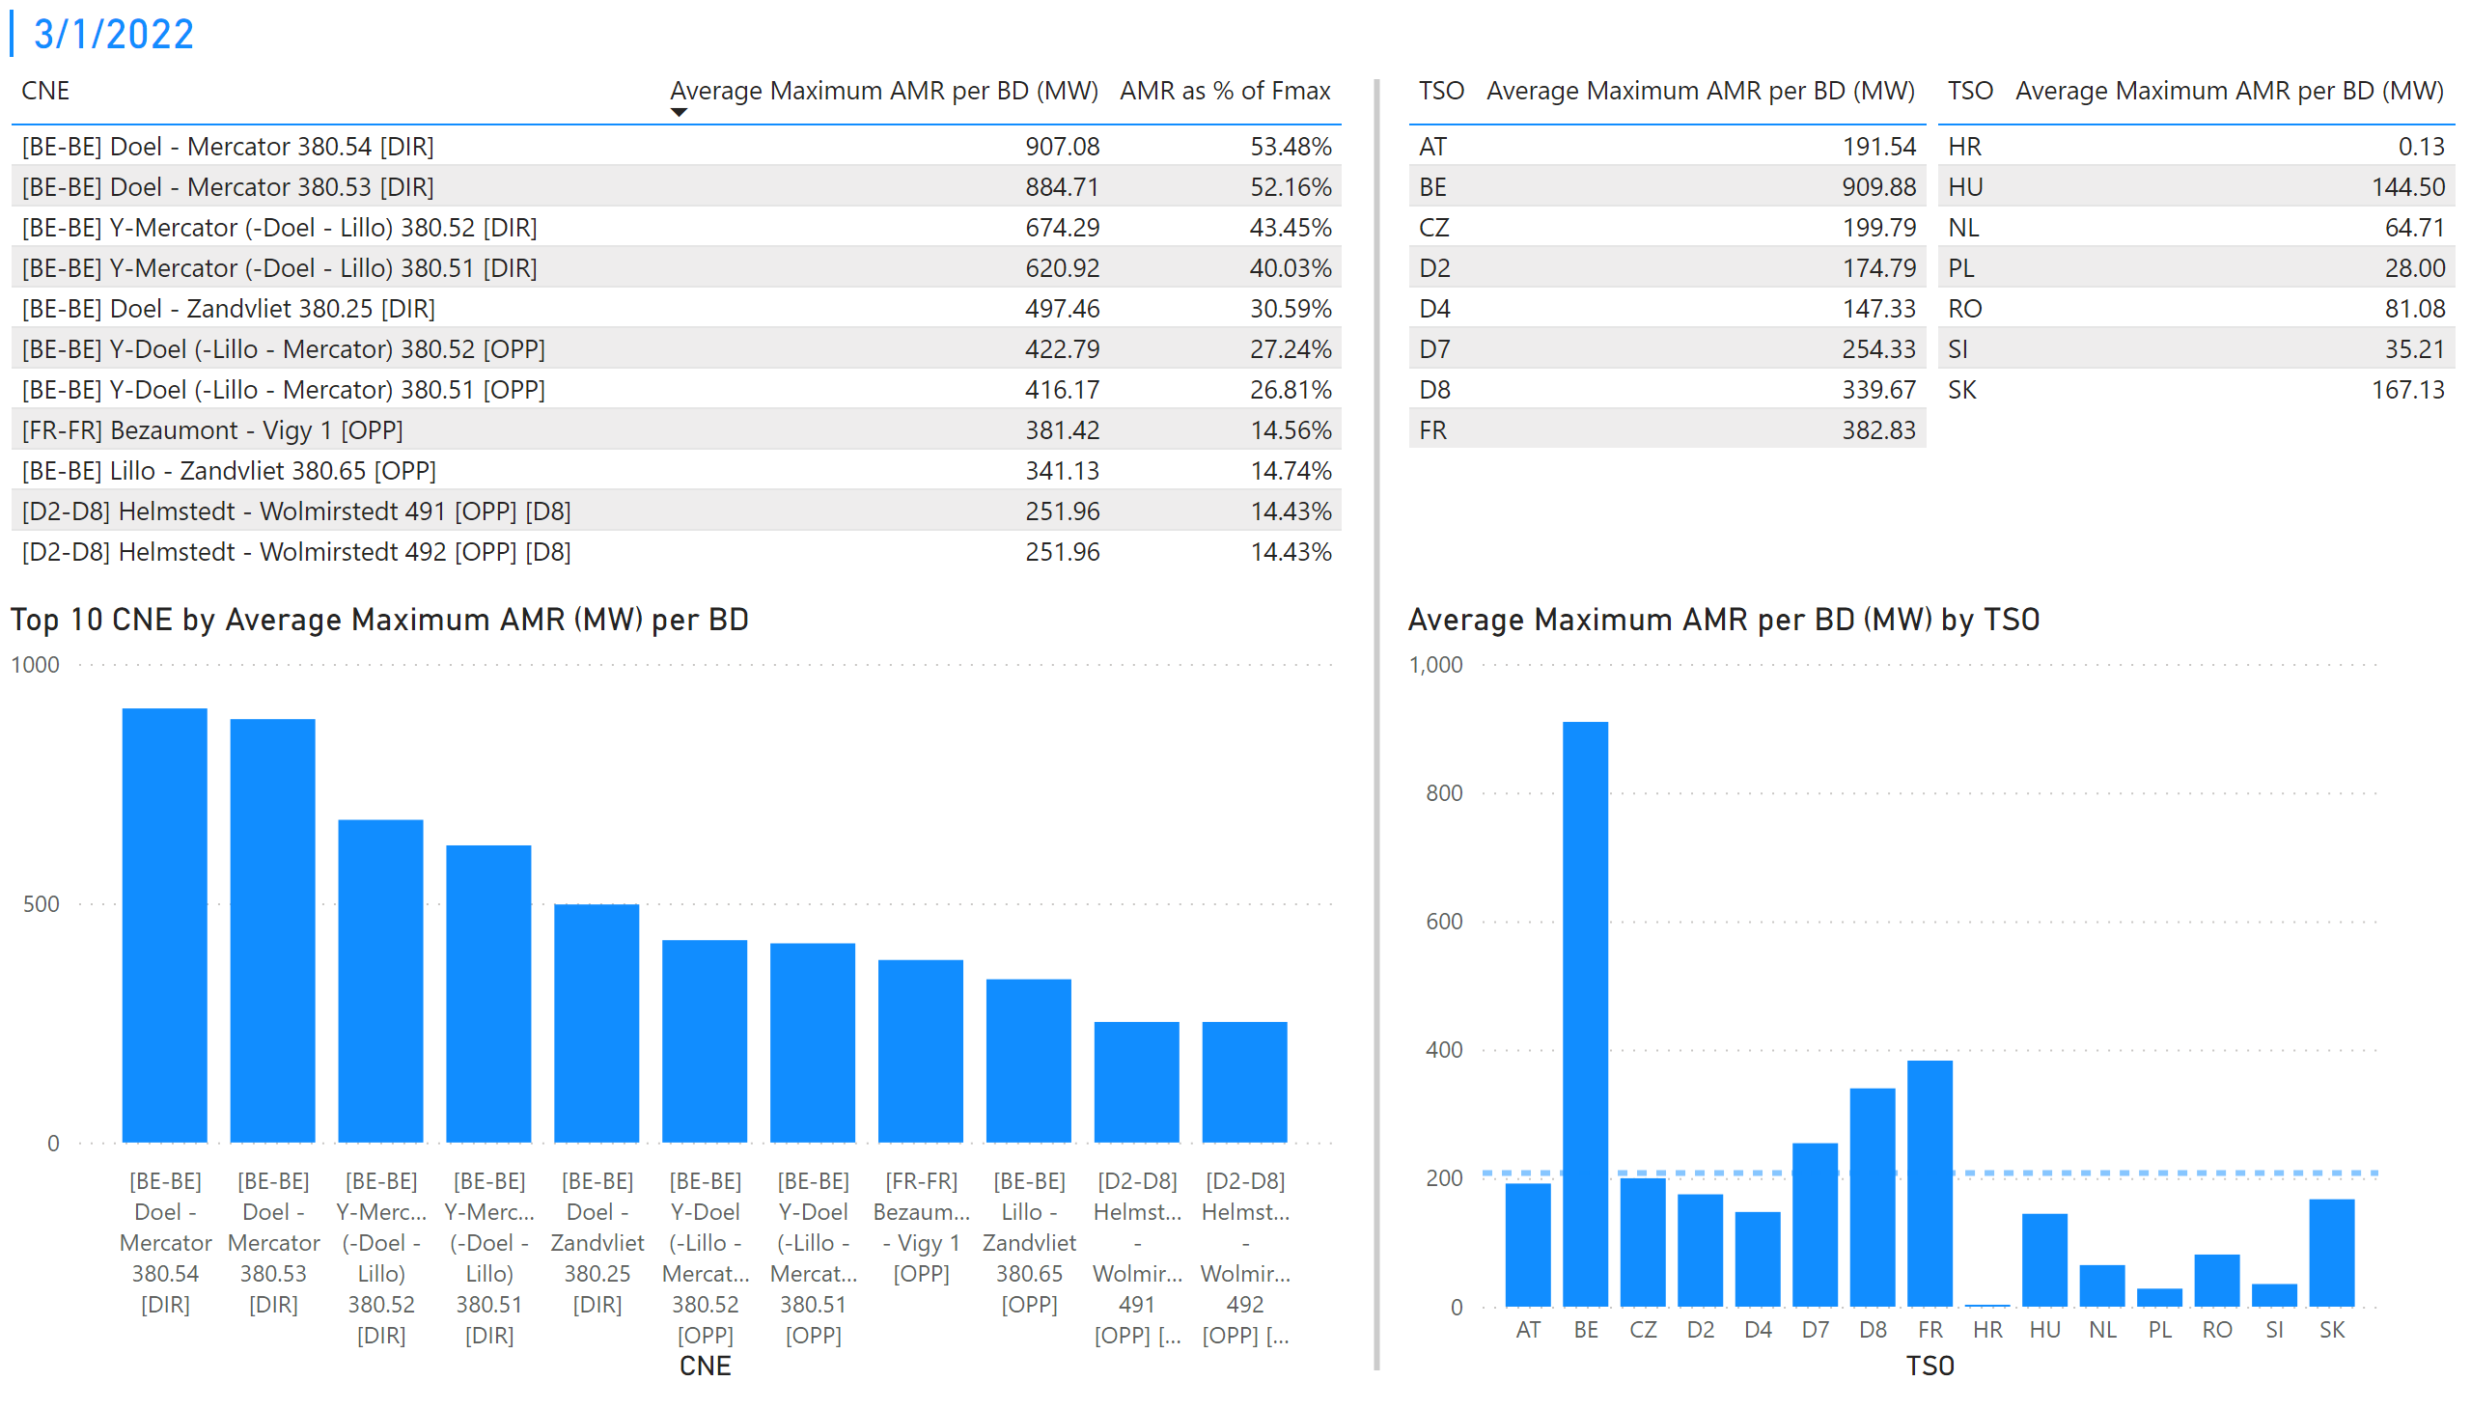
KPI 1 +2_1
KPI 1: Average maximum AMR per CNE per BD
KPI 2: Average maximum AMR per CNE per TSO
Notes:
tableEx
No alt text provided
Top 10 CNE by Average Maximum AMR (MW) per BD
No alt text provided
multiRowCard
No alt text provided
tableEx
No alt text provided
Average Maximum AMR per BD (MW) by TSO
No alt text provided
tableEx
No alt text provided
basicShape
No alt text provided

Slide 8
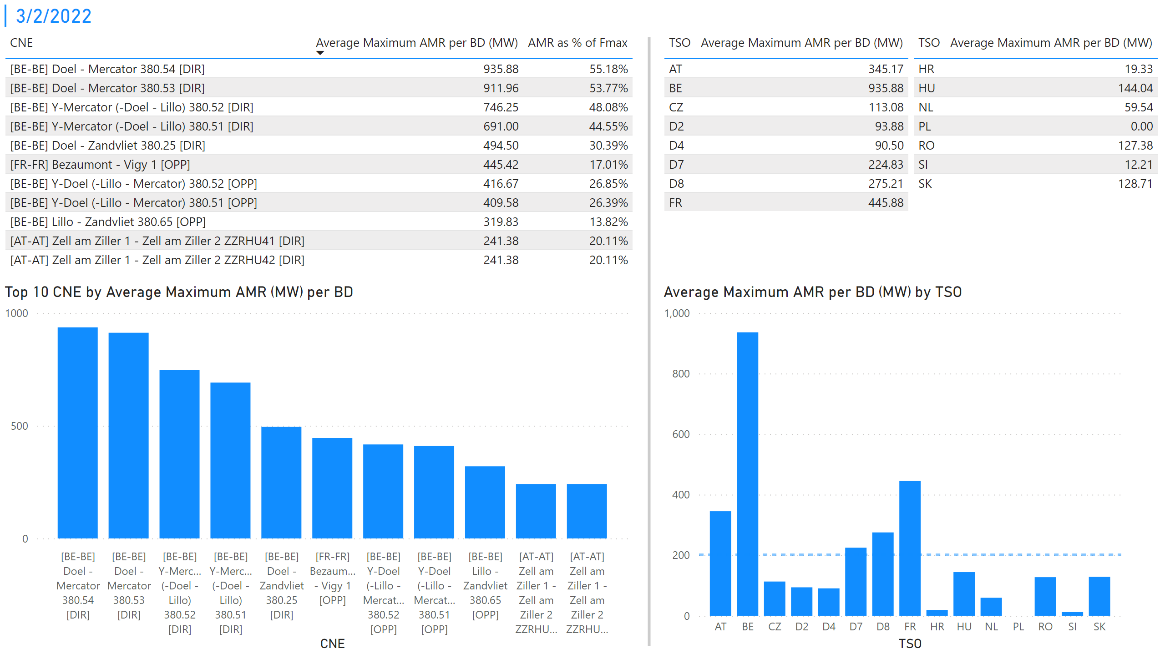
KPI 1 +2_2
KPI 1: Average maximum AMR per CNE per BD
KPI 2: Average maximum AMR per CNE per TSO
Notes:
tableEx
No alt text provided
Top 10 CNE by Average Maximum AMR (MW) per BD
No alt text provided
multiRowCard
No alt text provided
tableEx
No alt text provided
Average Maximum AMR per BD (MW) by TSO
No alt text provided
tableEx
No alt text provided
basicShape
No alt text provided

Slide 9
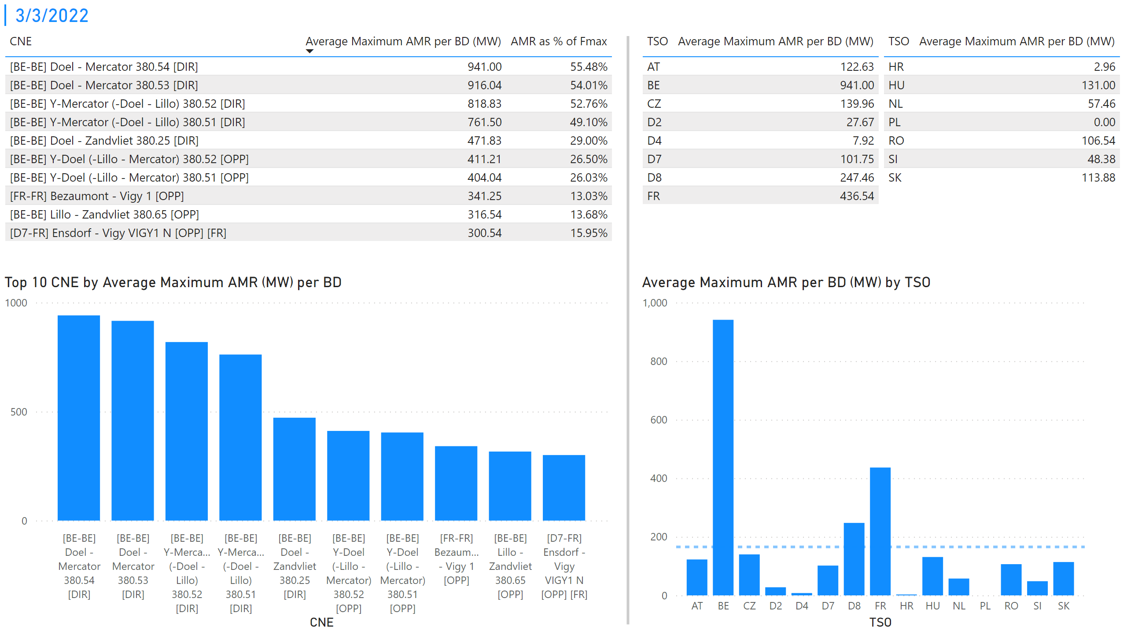
KPI 1 +2_3
KPI 1: Average maximum AMR per CNE per BD
KPI 2: Average maximum AMR per CNE per TSO
Notes:
tableEx
No alt text provided
Top 10 CNE by Average Maximum AMR (MW) per BD
No alt text provided
multiRowCard
No alt text provided
tableEx
No alt text provided
Average Maximum AMR per BD (MW) by TSO
No alt text provided
tableEx
No alt text provided
basicShape
No alt text provided

Slide 10
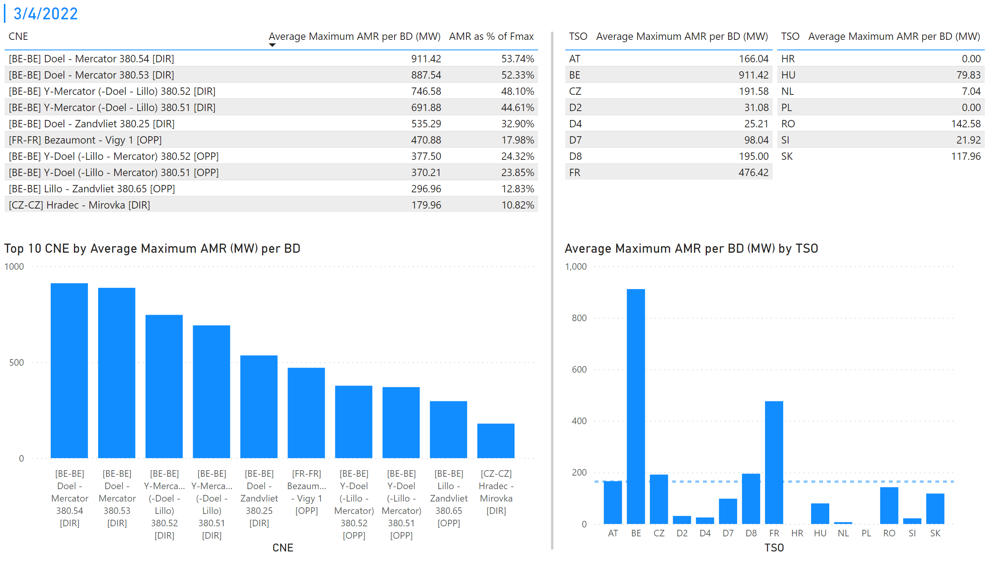
KPI 1 +2_4
KPI 1: Average maximum AMR per CNE per BD
KPI 2: Average maximum AMR per CNE per TSO
Notes:
tableEx
No alt text provided
Top 10 CNE by Average Maximum AMR (MW) per BD
No alt text provided
multiRowCard
No alt text provided
tableEx
No alt text provided
Average Maximum AMR per BD (MW) by TSO
No alt text provided
tableEx
No alt text provided
basicShape
No alt text provided

Slide 11
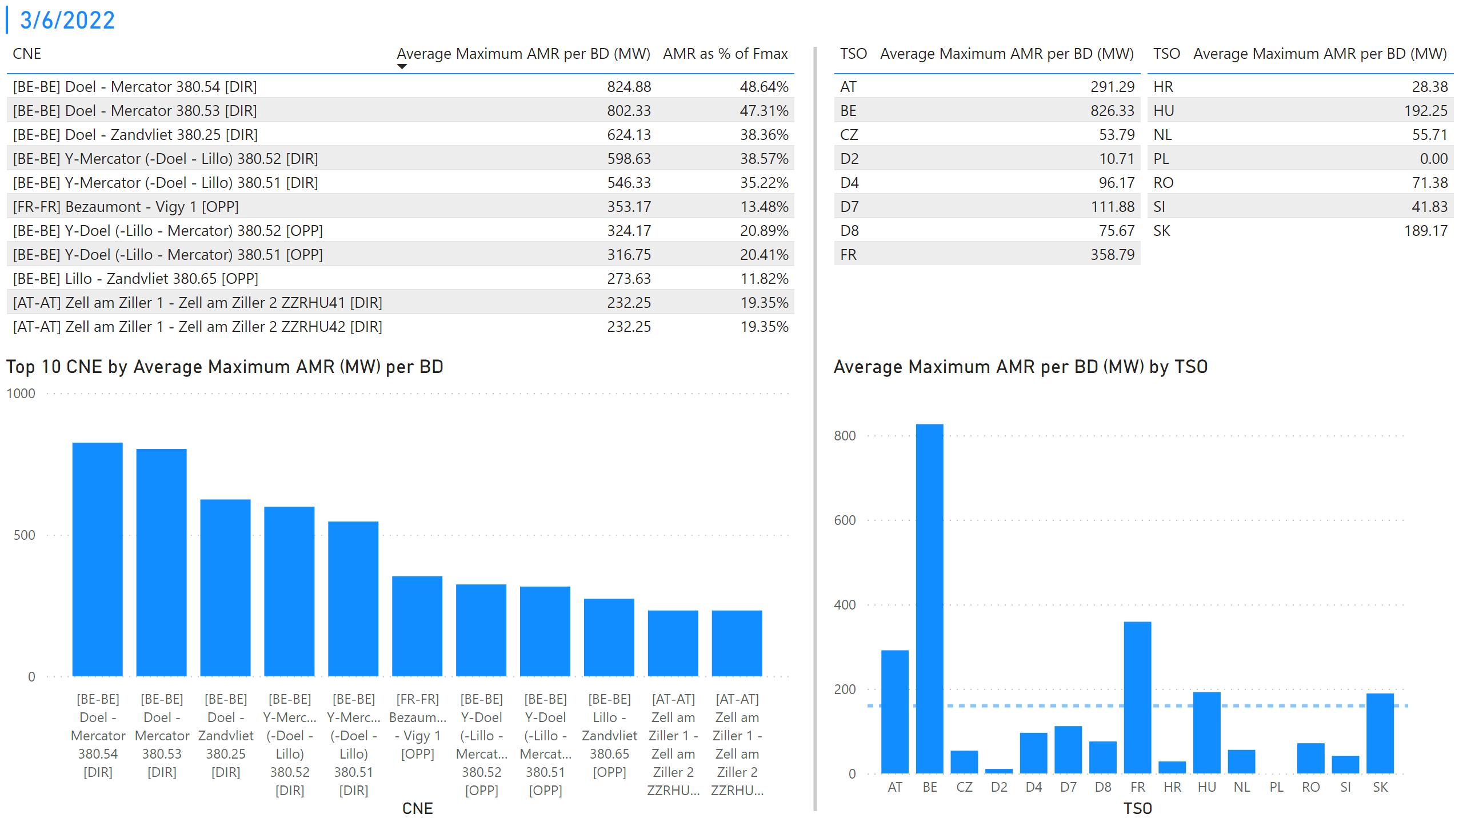
KPI 1 +2_5
KPI 1: Average maximum AMR per CNE per BD
KPI 2: Average maximum AMR per CNE per TSO
Notes:
tableEx
No alt text provided
Top 10 CNE by Average Maximum AMR (MW) per BD
No alt text provided
multiRowCard
No alt text provided
tableEx
No alt text provided
Average Maximum AMR per BD (MW) by TSO
No alt text provided
tableEx
No alt text provided
basicShape
No alt text provided

Slide 12
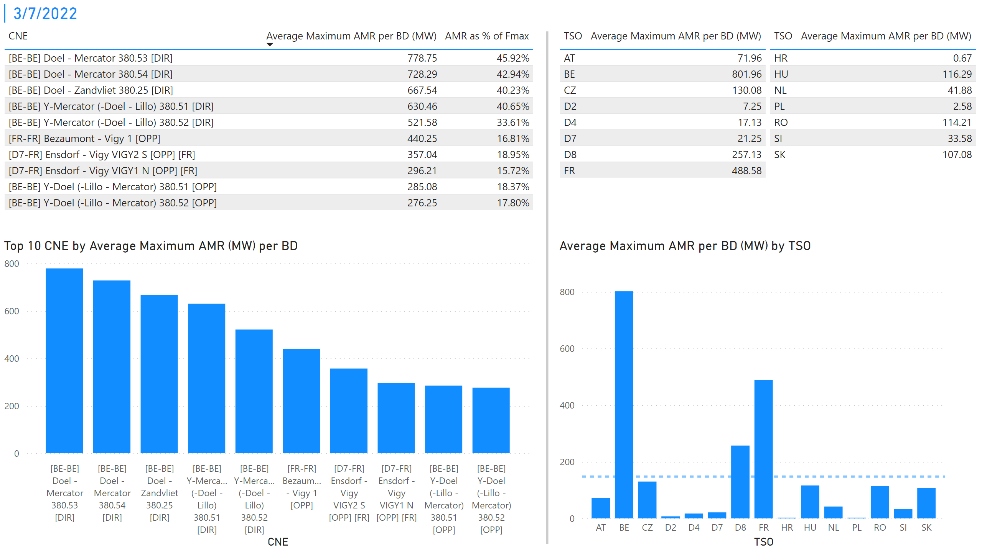
KPI 1 +2_6
KPI 1: Average maximum AMR per CNE per BD
KPI 2: Average maximum AMR per CNE per TSO
Notes:
tableEx
No alt text provided
Top 10 CNE by Average Maximum AMR (MW) per BD
No alt text provided
multiRowCard
No alt text provided
tableEx
No alt text provided
Average Maximum AMR per BD (MW) by TSO
No alt text provided
tableEx
No alt text provided
basicShape
No alt text provided

Slide 13
KPI 1 +2_7
KPI 1: Average maximum AMR per CNE per BD
KPI 2: Average maximum AMR per CNE per TSO
Notes:
tableEx
No alt text provided
Top 10 CNE by Average Maximum AMR (MW) per BD
No alt text provided
multiRowCard
No alt text provided
tableEx
No alt text provided
Average Maximum AMR per BD (MW) by TSO
No alt text provided
tableEx
No alt text provided
basicShape
No alt text provided

Slide 14
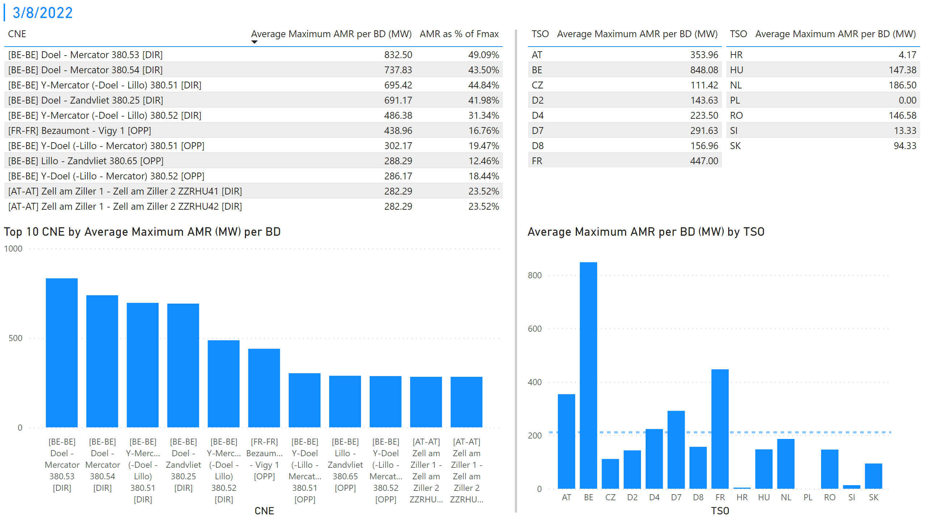
KPI 1 +2_8
KPI 1: Average maximum AMR per CNE per BD
KPI 2: Average maximum AMR per CNE per TSO
Notes:
tableEx
No alt text provided
Top 10 CNE by Average Maximum AMR (MW) per BD
No alt text provided
multiRowCard
No alt text provided
tableEx
No alt text provided
Average Maximum AMR per BD (MW) by TSO
No alt text provided
tableEx
No alt text provided
basicShape
No alt text provided

Slide 15
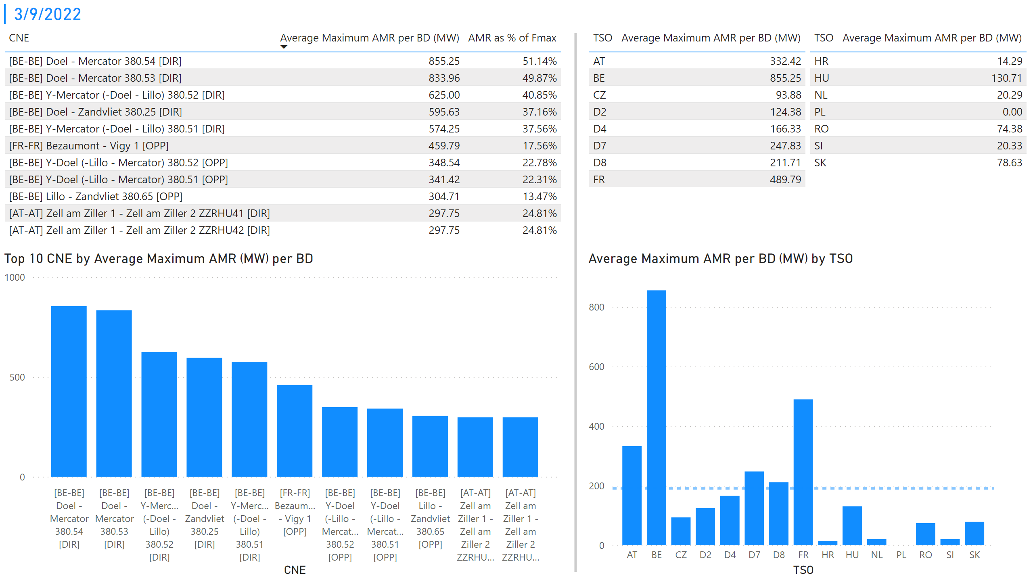
KPI 1 +2_9
KPI 1: Average maximum AMR per CNE per BD
KPI 2: Average maximum AMR per CNE per TSO
Notes:
tableEx
No alt text provided
Top 10 CNE by Average Maximum AMR (MW) per BD
No alt text provided
multiRowCard
No alt text provided
tableEx
No alt text provided
Average Maximum AMR per BD (MW) by TSO
No alt text provided
tableEx
No alt text provided
basicShape
No alt text provided

Slide 16
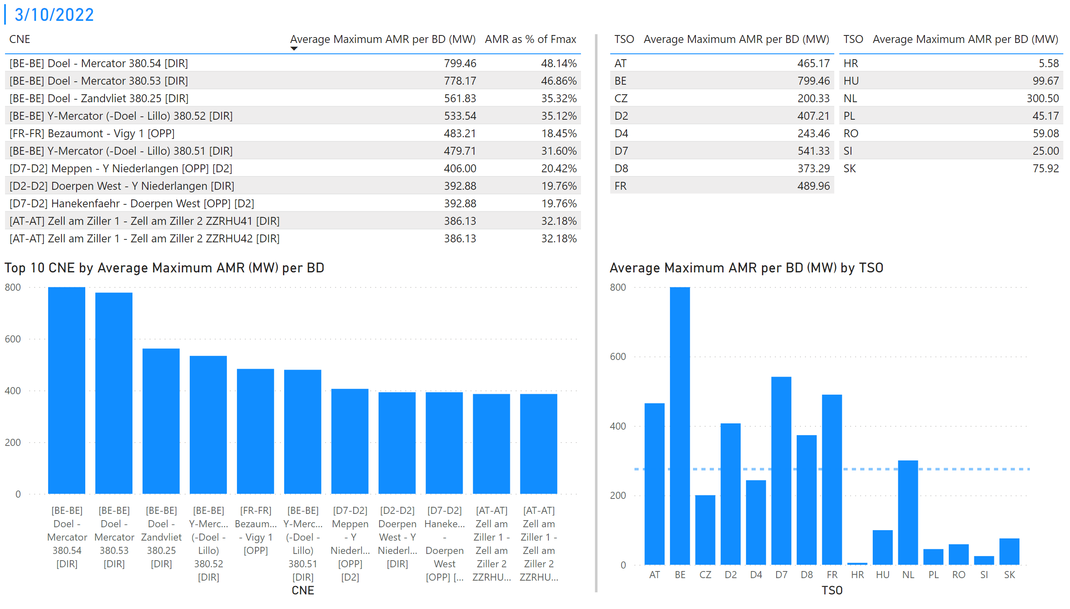
KPI 1 +2_10
KPI 1: Average maximum AMR per CNE per BD
KPI 2: Average maximum AMR per CNE per TSO
Notes:
tableEx
No alt text provided
Top 10 CNE by Average Maximum AMR (MW) per BD
No alt text provided
multiRowCard
No alt text provided
tableEx
No alt text provided
Average Maximum AMR per BD (MW) by TSO
No alt text provided
tableEx
No alt text provided
basicShape
No alt text provided

Slide 17
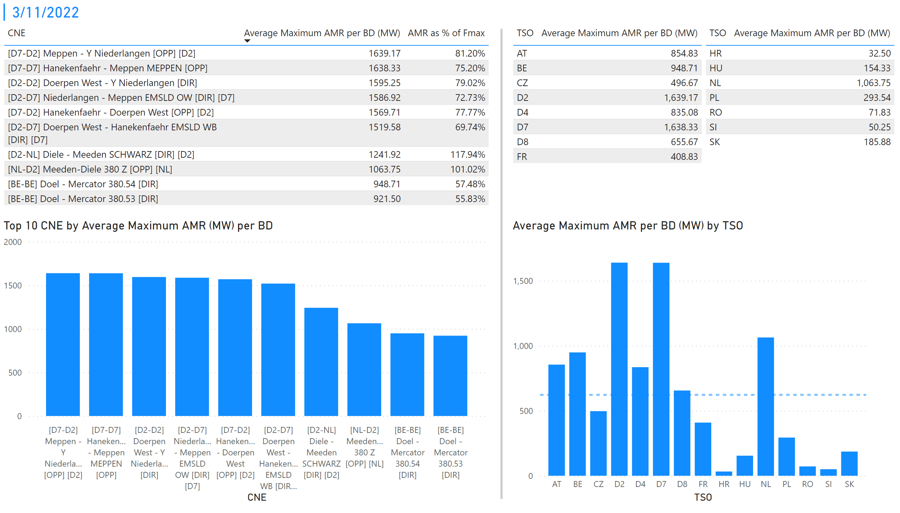
KPI 1 +2_11
KPI 1: Average maximum AMR per CNE per BD
KPI 2: Average maximum AMR per CNE per TSO
Notes:
tableEx
No alt text provided
Top 10 CNE by Average Maximum AMR (MW) per BD
No alt text provided
multiRowCard
No alt text provided
tableEx
No alt text provided
Average Maximum AMR per BD (MW) by TSO
No alt text provided
tableEx
No alt text provided
basicShape
No alt text provided

Slide 18
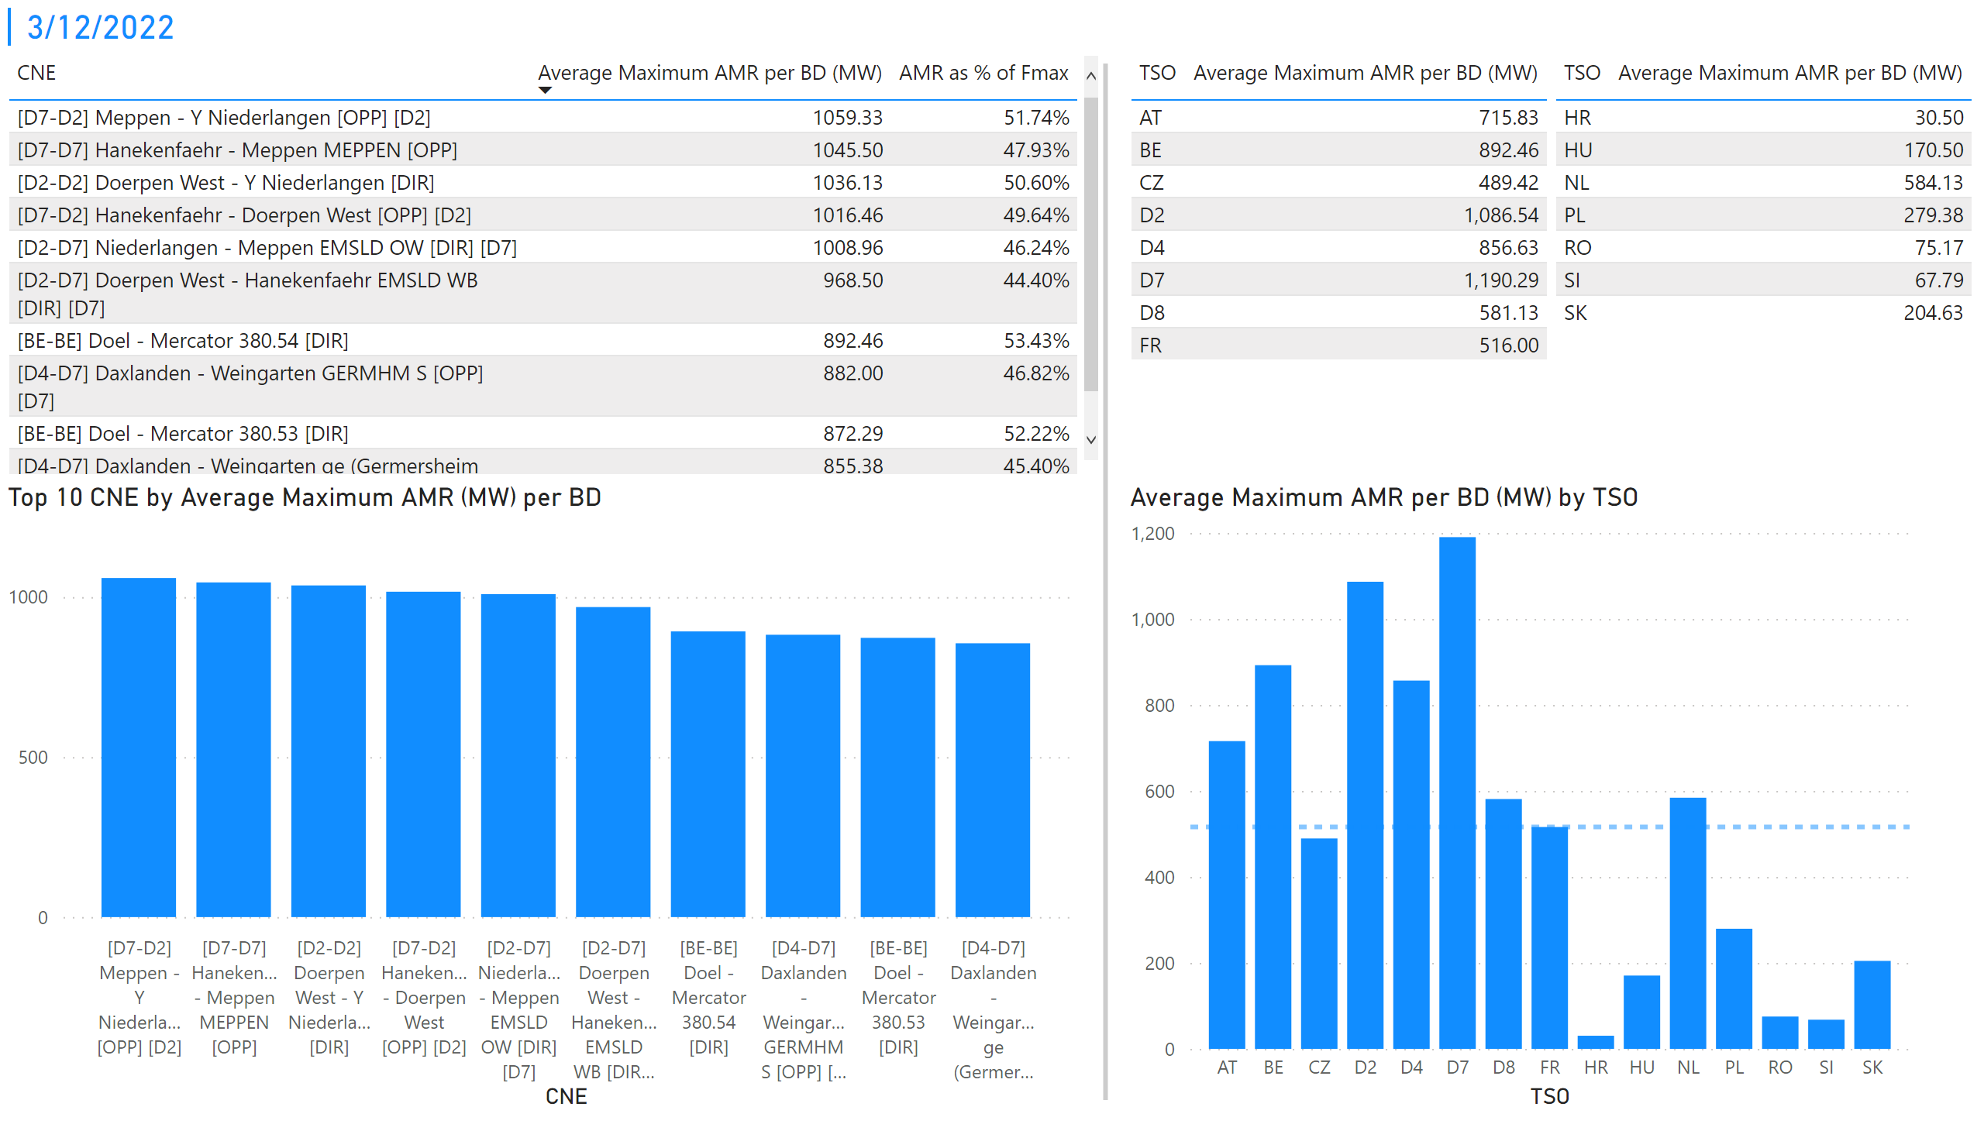
KPI 1 +2_12
KPI 1: Average maximum AMR per CNE per BD
KPI 2: Average maximum AMR per CNE per TSO
Notes:
tableEx
No alt text provided
Top 10 CNE by Average Maximum AMR (MW) per BD
No alt text provided
multiRowCard
No alt text provided
tableEx
No alt text provided
Average Maximum AMR per BD (MW) by TSO
No alt text provided
tableEx
No alt text provided
basicShape
No alt text provided

Slide 19
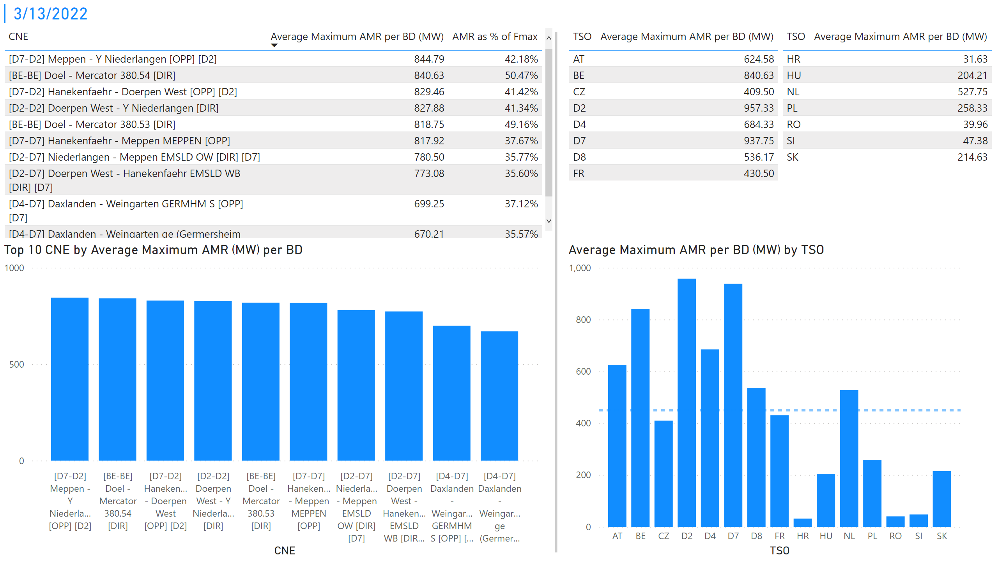
KPI 1 +2_13
KPI 1: Average maximum AMR per CNE per BD
KPI 2: Average maximum AMR per CNE per TSO
Notes:
tableEx
No alt text provided
Top 10 CNE by Average Maximum AMR (MW) per BD
No alt text provided
multiRowCard
No alt text provided
tableEx
No alt text provided
Average Maximum AMR per BD (MW) by TSO
No alt text provided
tableEx
No alt text provided
basicShape
No alt text provided

Slide 20
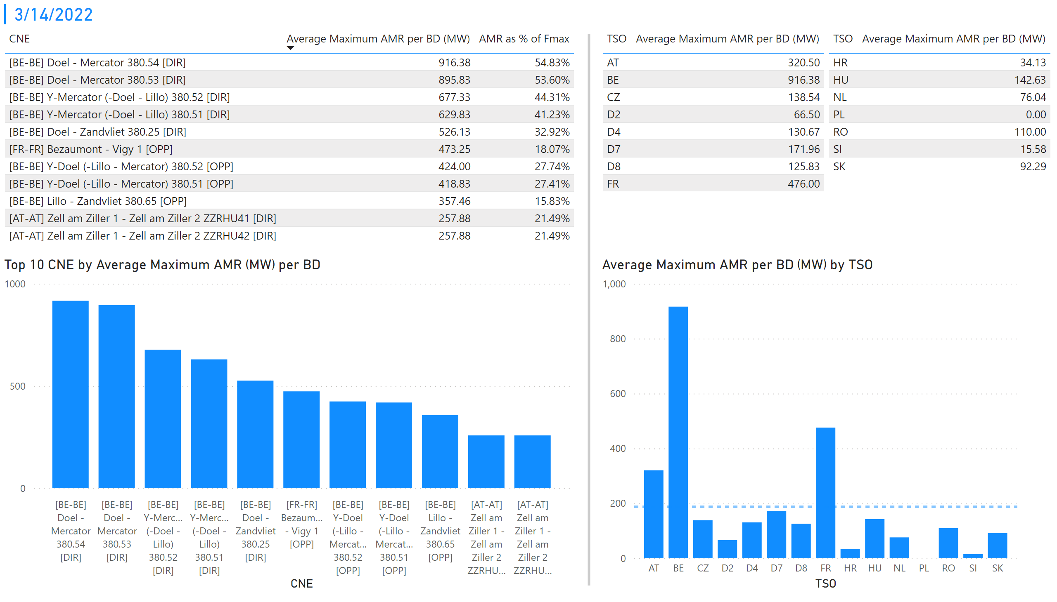
KPI 1 +2_14
KPI 1: Average maximum AMR per CNE per BD
KPI 2: Average maximum AMR per CNE per TSO
Notes:
tableEx
No alt text provided
Top 10 CNE by Average Maximum AMR (MW) per BD
No alt text provided
multiRowCard
No alt text provided
tableEx
No alt text provided
Average Maximum AMR per BD (MW) by TSO
No alt text provided
tableEx
No alt text provided
basicShape
No alt text provided

Slide 21
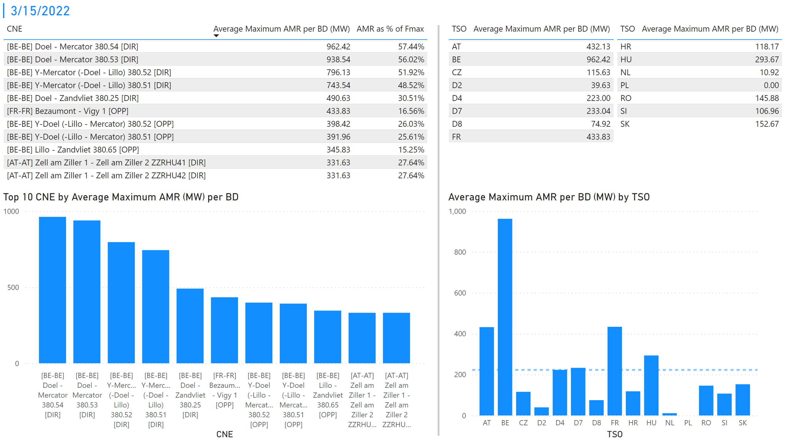
KPI 1 +2_15
KPI 1: Average maximum AMR per CNE per BD
KPI 2: Average maximum AMR per CNE per TSO
Notes:
tableEx
No alt text provided
Top 10 CNE by Average Maximum AMR (MW) per BD
No alt text provided
multiRowCard
No alt text provided
tableEx
No alt text provided
Average Maximum AMR per BD (MW) by TSO
No alt text provided
tableEx
No alt text provided
basicShape
No alt text provided

Slide 22
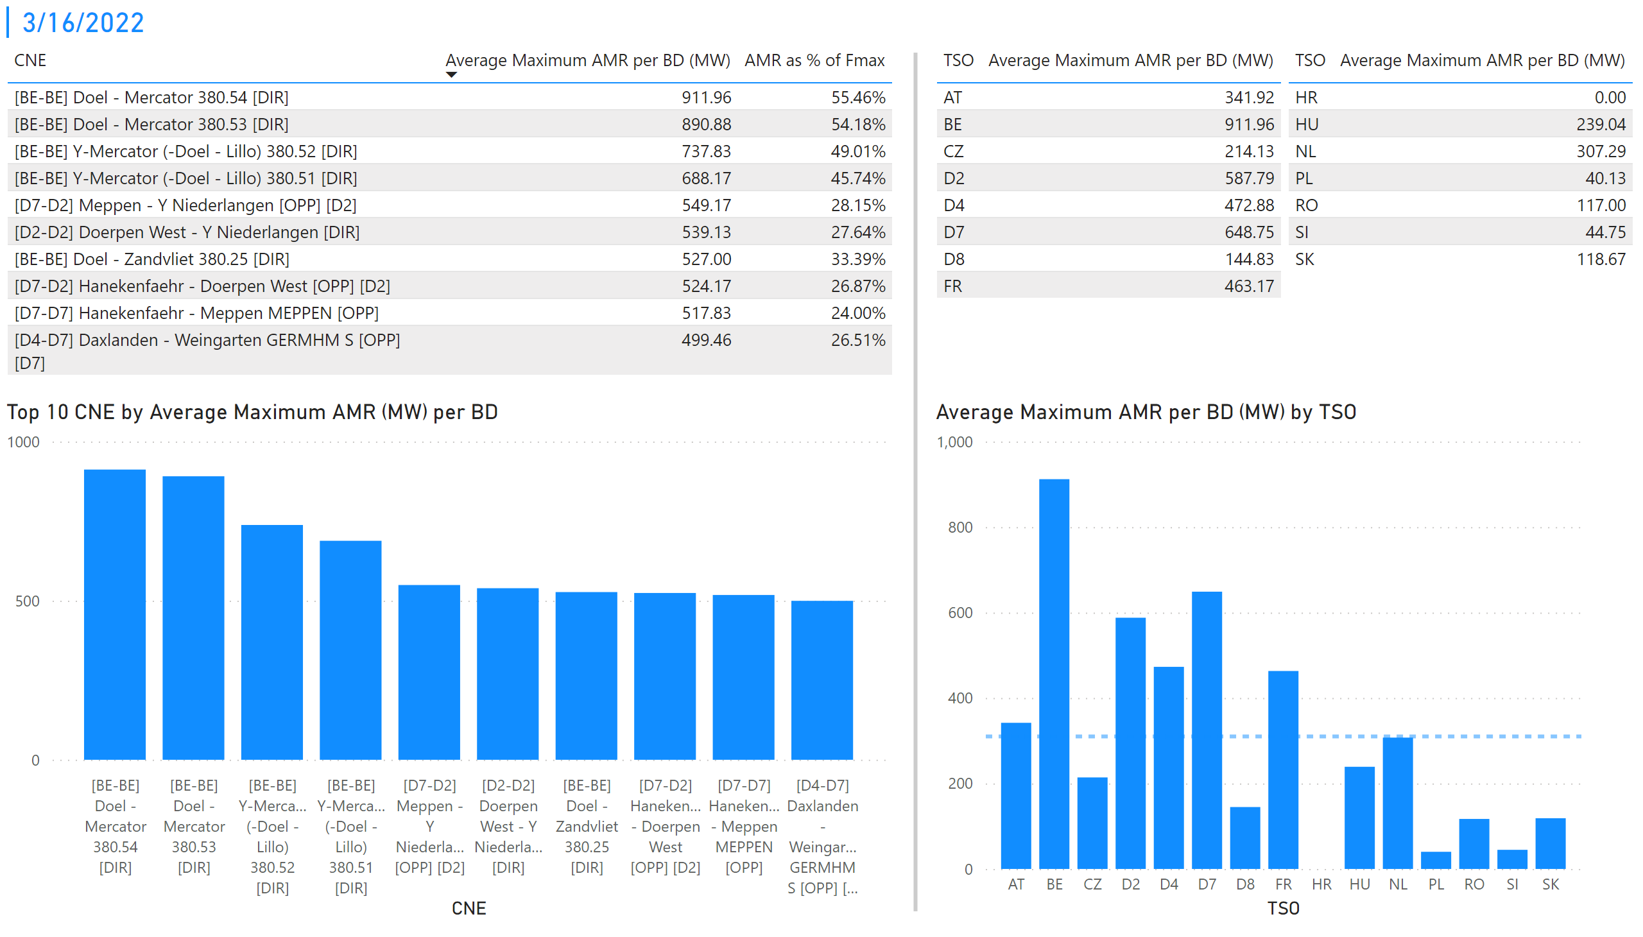
KPI 1 +2_16
KPI 1: Average maximum AMR per CNE per BD
KPI 2: Average maximum AMR per CNE per TSO
Notes:
tableEx
No alt text provided
Top 10 CNE by Average Maximum AMR (MW) per BD
No alt text provided
multiRowCard
No alt text provided
tableEx
No alt text provided
Average Maximum AMR per BD (MW) by TSO
No alt text provided
tableEx
No alt text provided
basicShape
No alt text provided

Slide 23
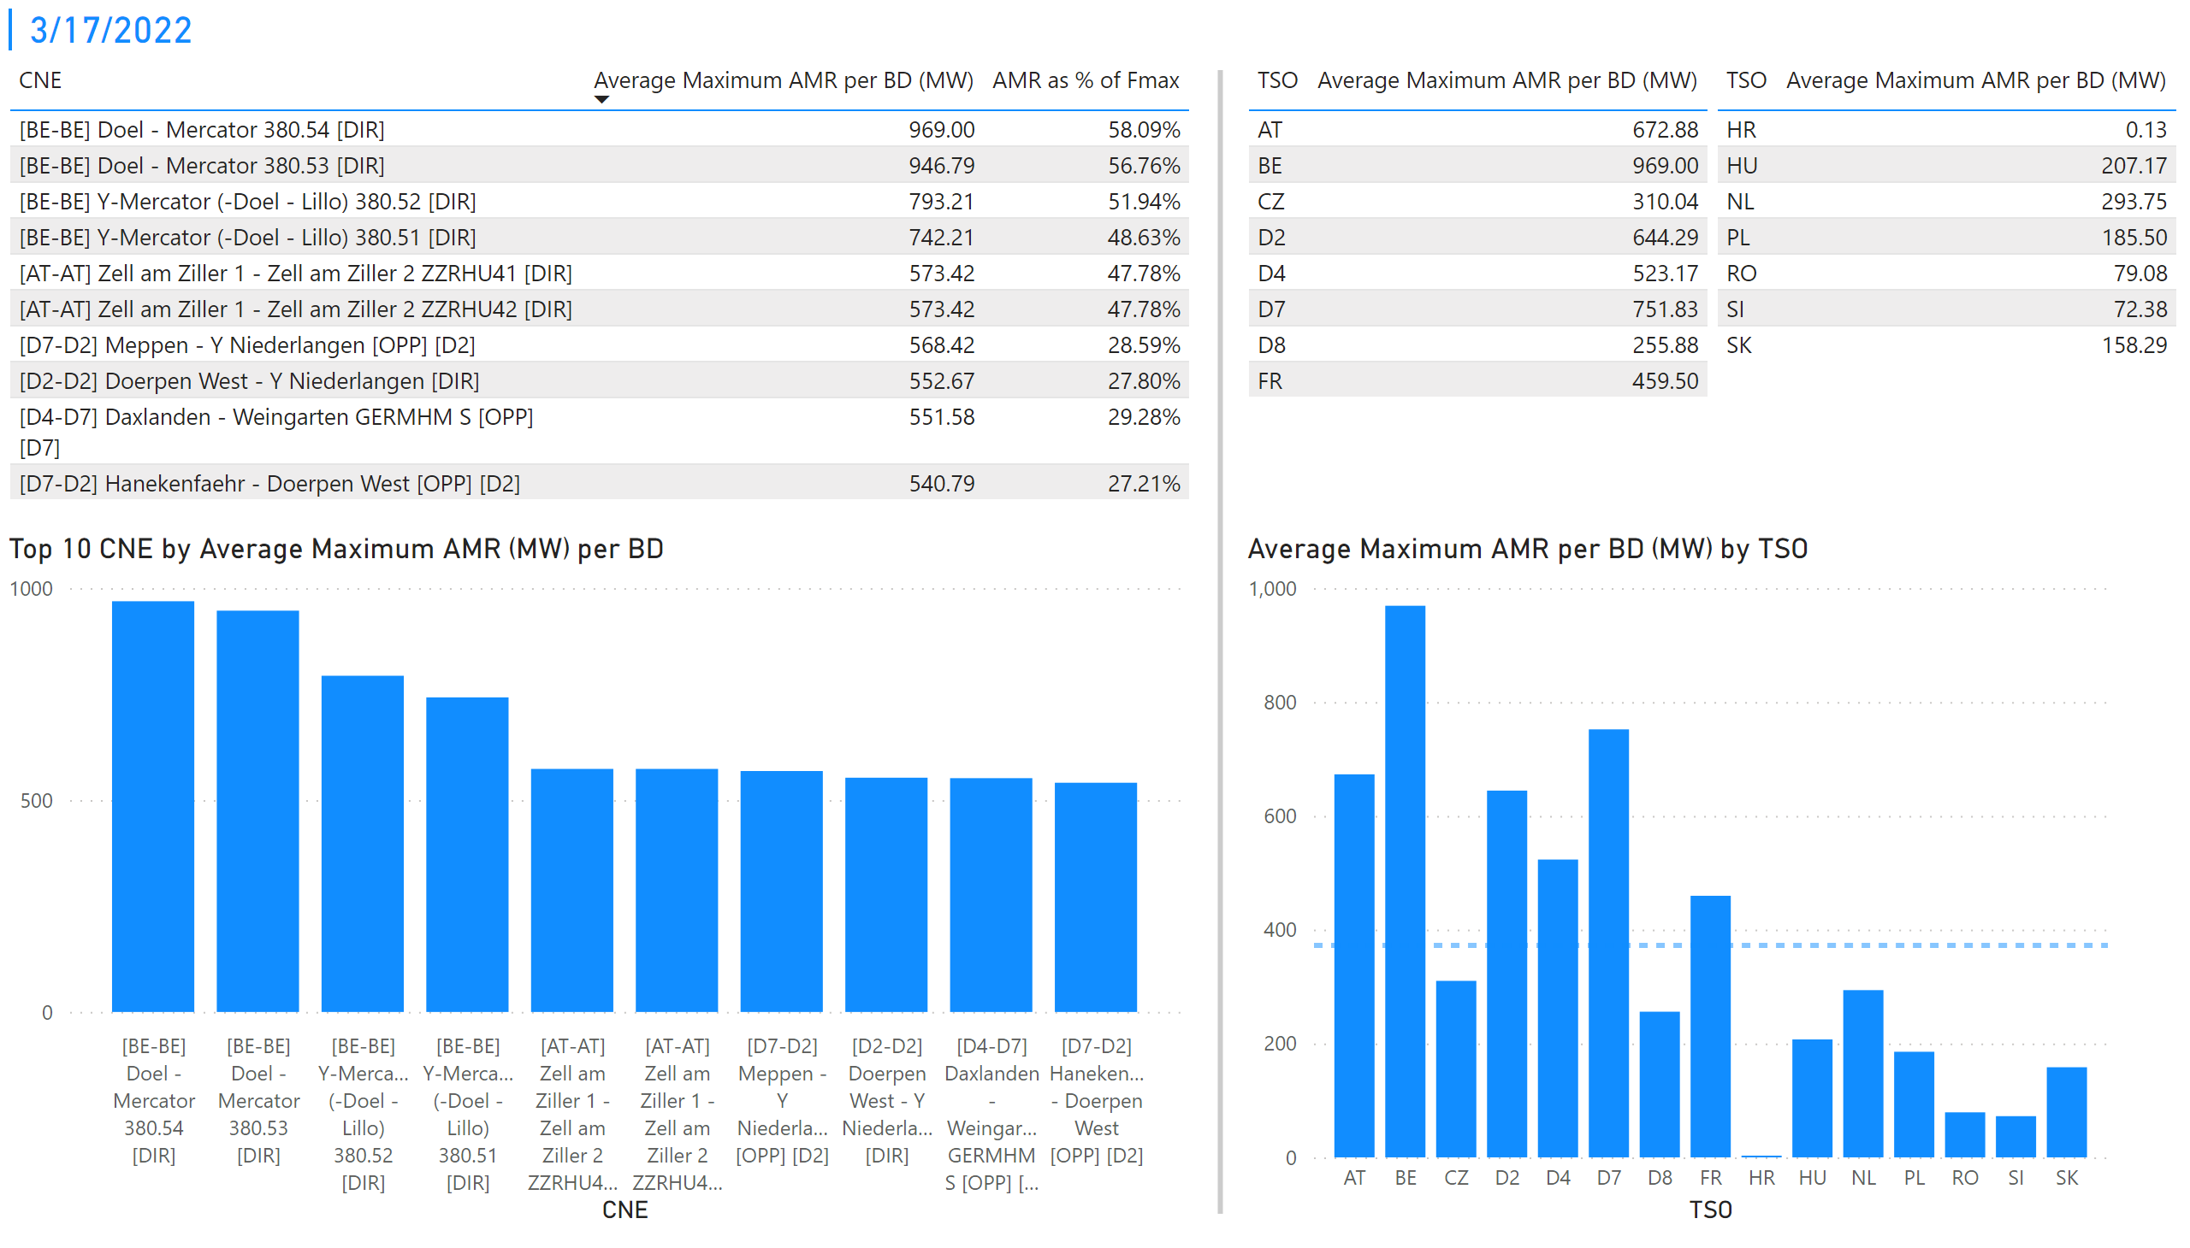
KPI 1 +2_17
KPI 1: Average maximum AMR per CNE per BD
KPI 2: Average maximum AMR per CNE per TSO
Notes:
tableEx
No alt text provided
Top 10 CNE by Average Maximum AMR (MW) per BD
No alt text provided
multiRowCard
No alt text provided
tableEx
No alt text provided
Average Maximum AMR per BD (MW) by TSO
No alt text provided
tableEx
No alt text provided
basicShape
No alt text provided

Slide 24
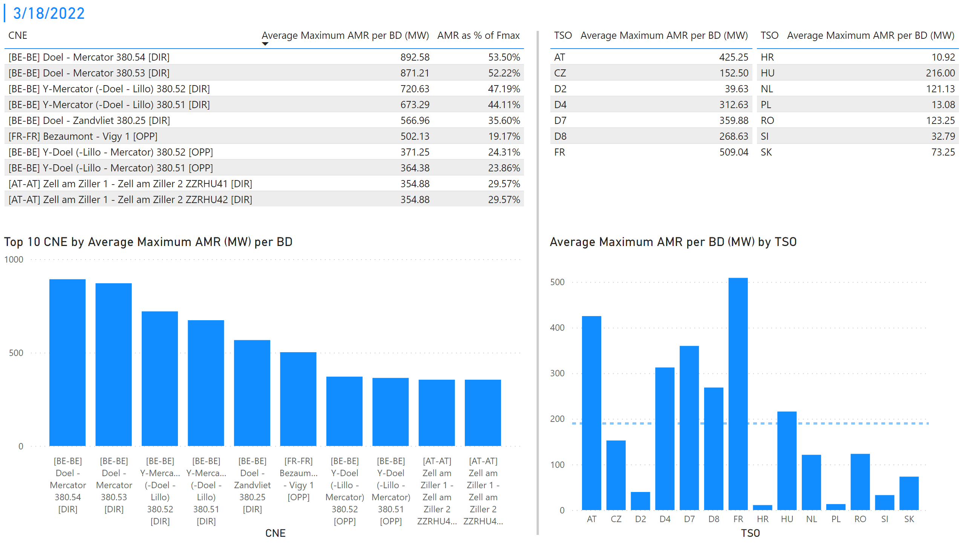
KPI 1 +2_18
KPI 1: Average maximum AMR per CNE per BD
KPI 2: Average maximum AMR per CNE per TSO
Notes:
tableEx
No alt text provided
Top 10 CNE by Average Maximum AMR (MW) per BD
No alt text provided
multiRowCard
No alt text provided
tableEx
No alt text provided
Average Maximum AMR per BD (MW) by TSO
No alt text provided
tableEx
No alt text provided
basicShape
No alt text provided

Slide 25
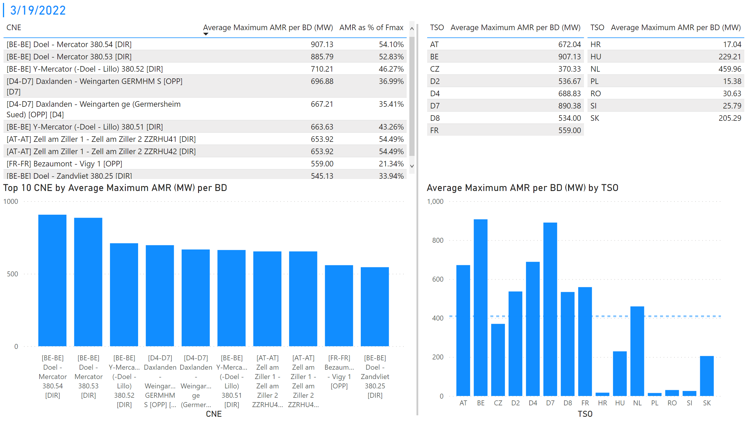
KPI 1 +2_19
KPI 1: Average maximum AMR per CNE per BD
KPI 2: Average maximum AMR per CNE per TSO
Notes:
tableEx
No alt text provided
Top 10 CNE by Average Maximum AMR (MW) per BD
No alt text provided
multiRowCard
No alt text provided
tableEx
No alt text provided
Average Maximum AMR per BD (MW) by TSO
No alt text provided
tableEx
No alt text provided
basicShape
No alt text provided

Slide 26
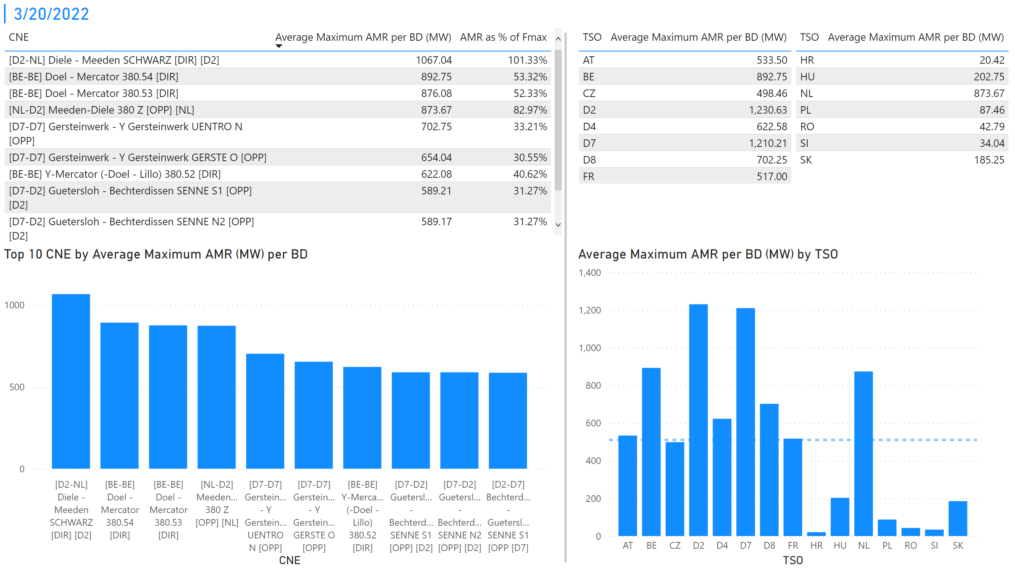
KPI 1 +2_20
KPI 1: Average maximum AMR per CNE per BD
KPI 2: Average maximum AMR per CNE per TSO
Notes:
tableEx
No alt text provided
Top 10 CNE by Average Maximum AMR (MW) per BD
No alt text provided
multiRowCard
No alt text provided
tableEx
No alt text provided
Average Maximum AMR per BD (MW) by TSO
No alt text provided
tableEx
No alt text provided
basicShape
No alt text provided

Slide 27
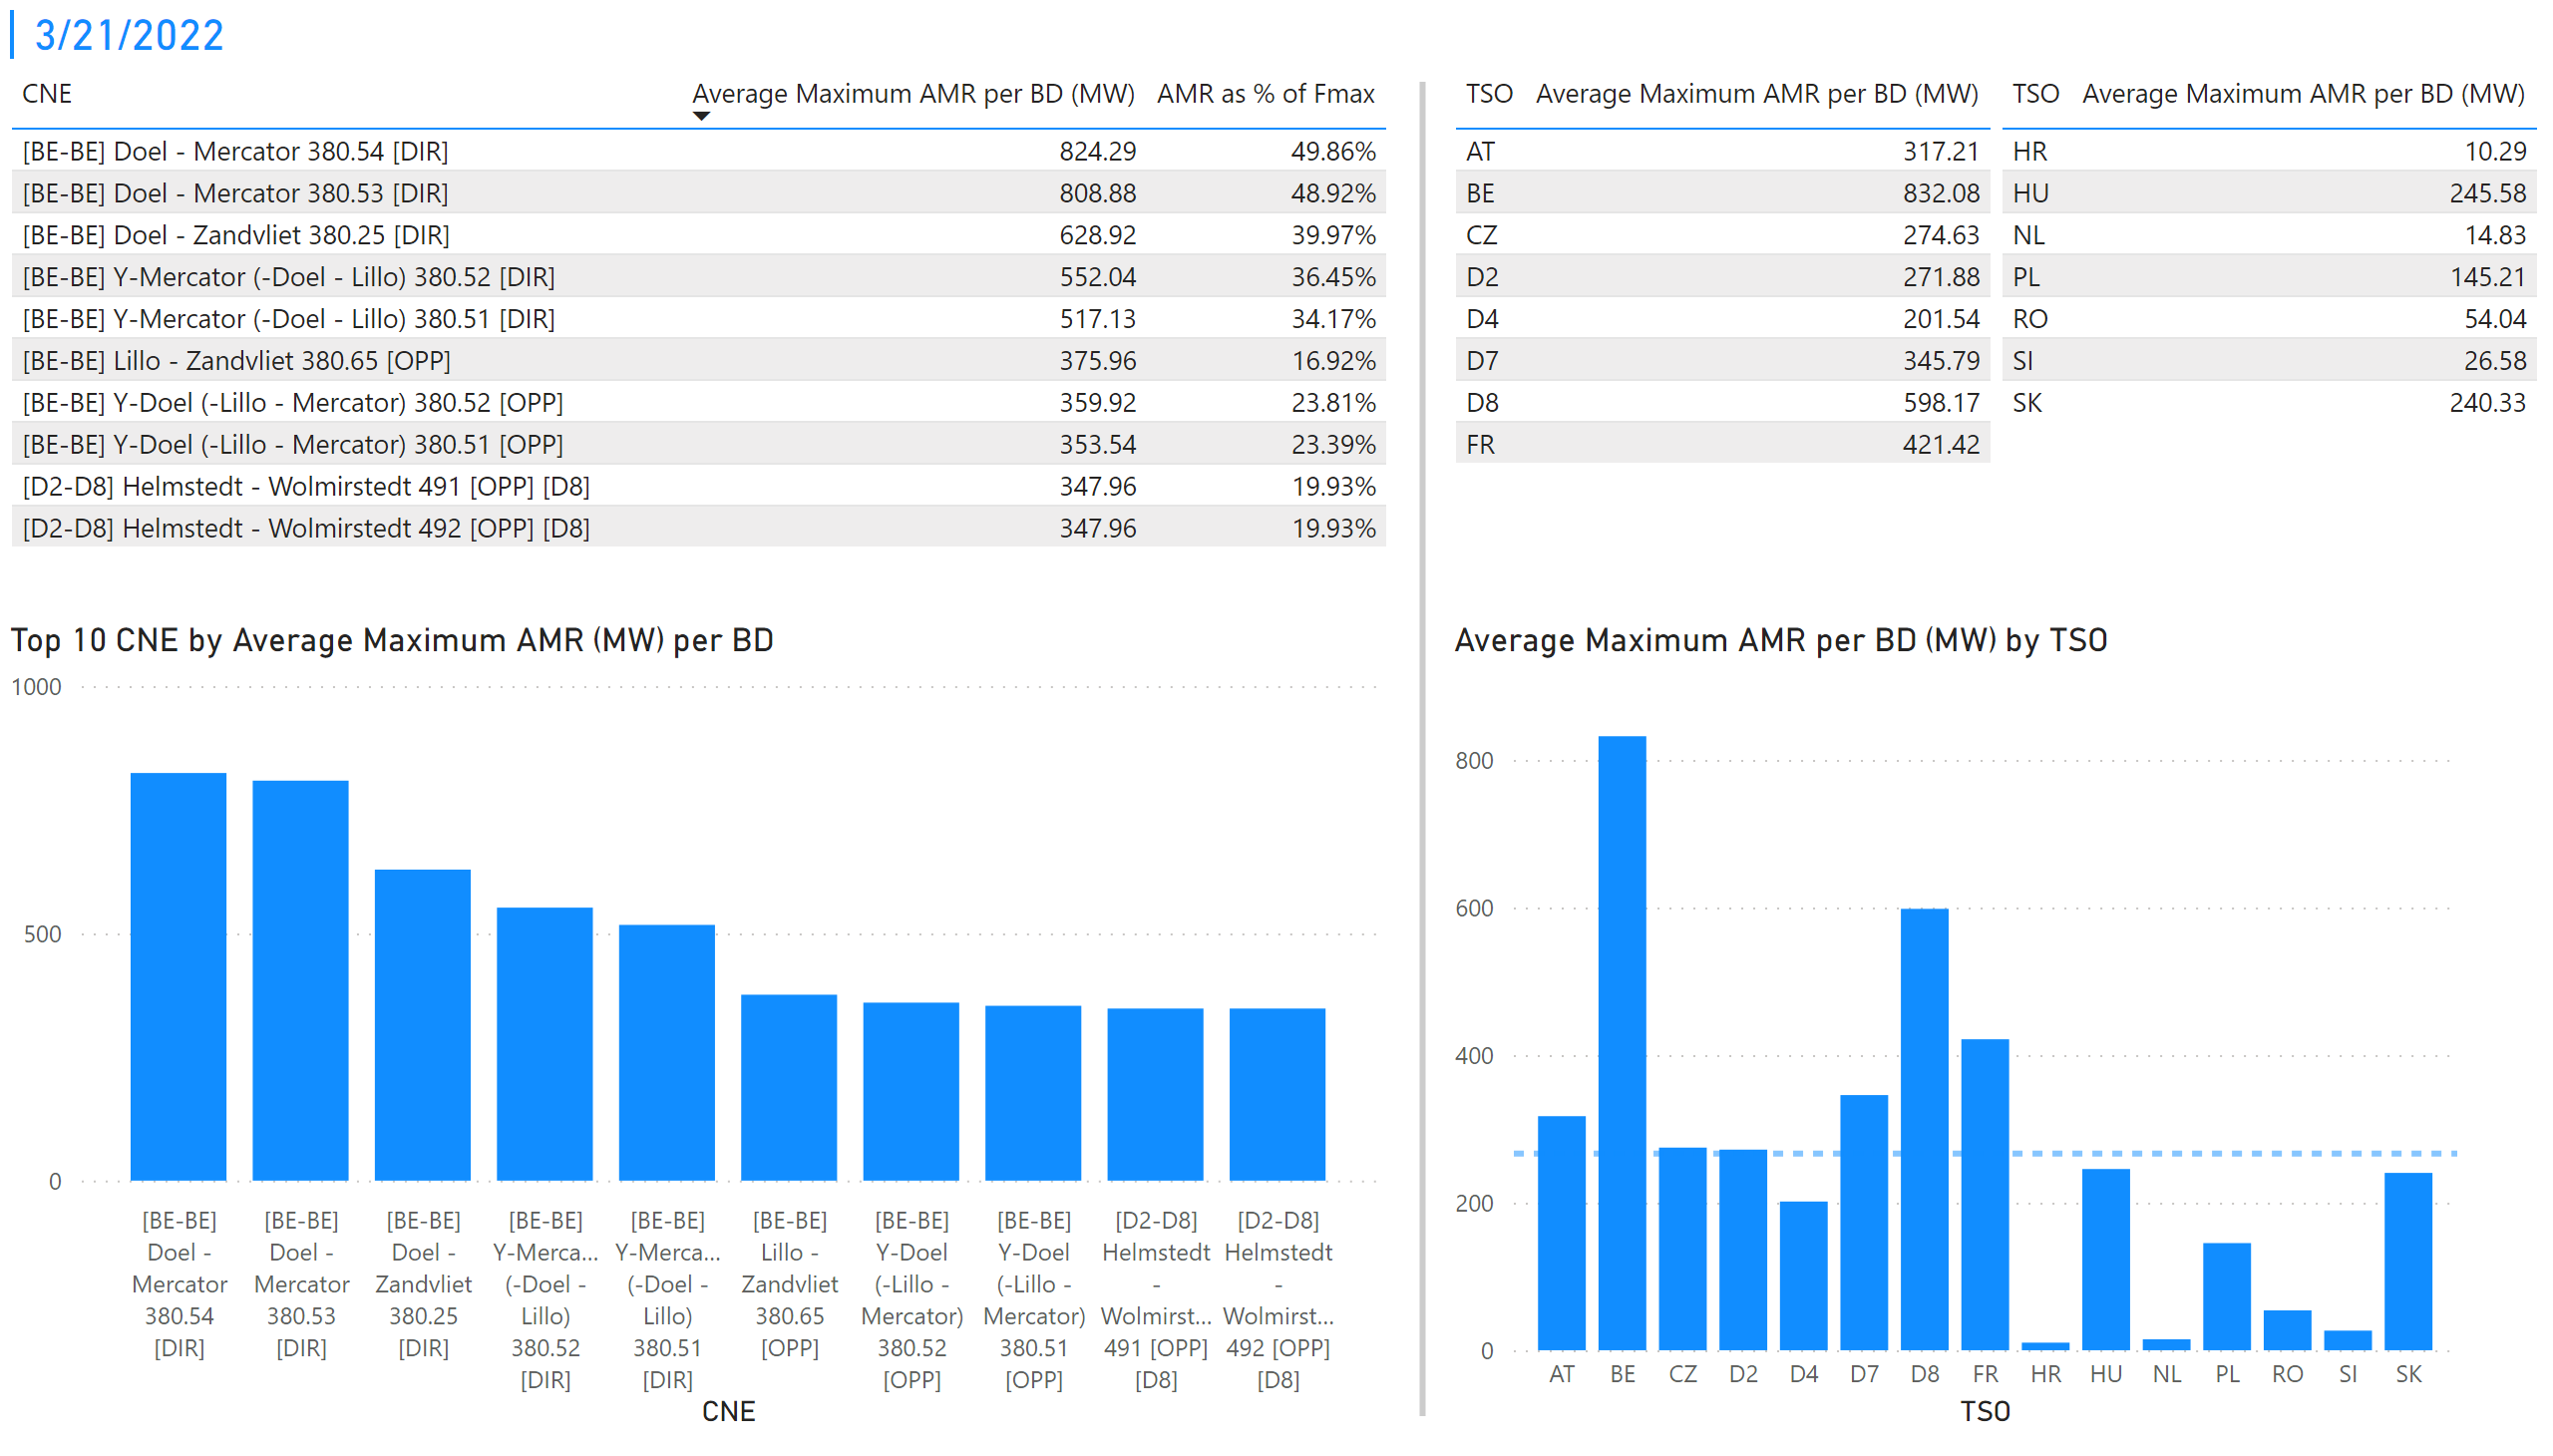
KPI 1 +2_21
KPI 1: Average maximum AMR per CNE per BD
KPI 2: Average maximum AMR per CNE per TSO
Notes:
tableEx
No alt text provided
Top 10 CNE by Average Maximum AMR (MW) per BD
No alt text provided
multiRowCard
No alt text provided
tableEx
No alt text provided
Average Maximum AMR per BD (MW) by TSO
No alt text provided
tableEx
No alt text provided
basicShape
No alt text provided

Slide 28
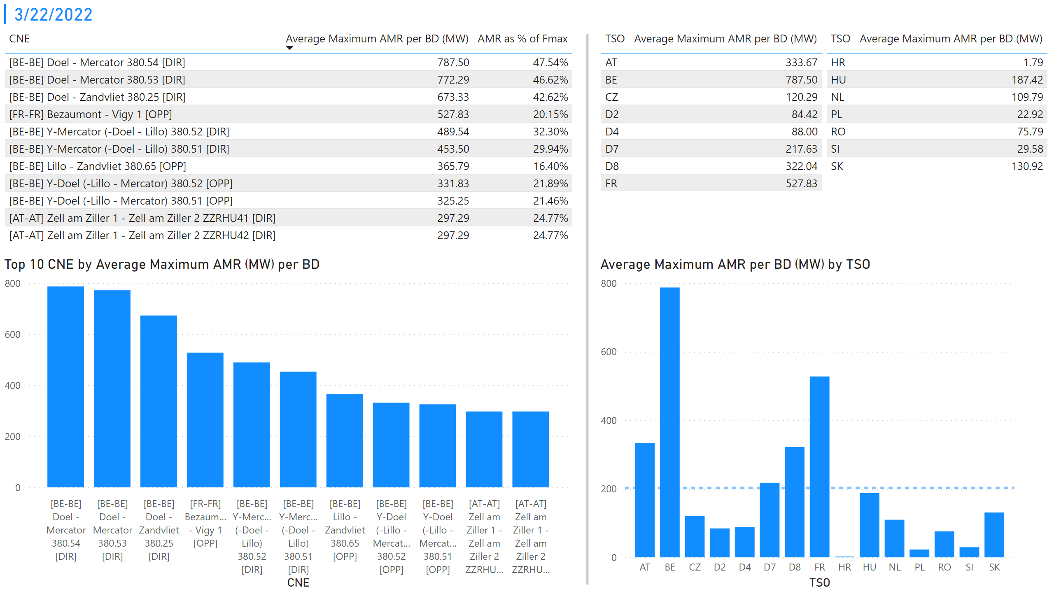
KPI 1 +2_22
KPI 1: Average maximum AMR per CNE per BD
KPI 2: Average maximum AMR per CNE per TSO
Notes:
tableEx
No alt text provided
Top 10 CNE by Average Maximum AMR (MW) per BD
No alt text provided
multiRowCard
No alt text provided
tableEx
No alt text provided
Average Maximum AMR per BD (MW) by TSO
No alt text provided
tableEx
No alt text provided
basicShape
No alt text provided

Slide 29
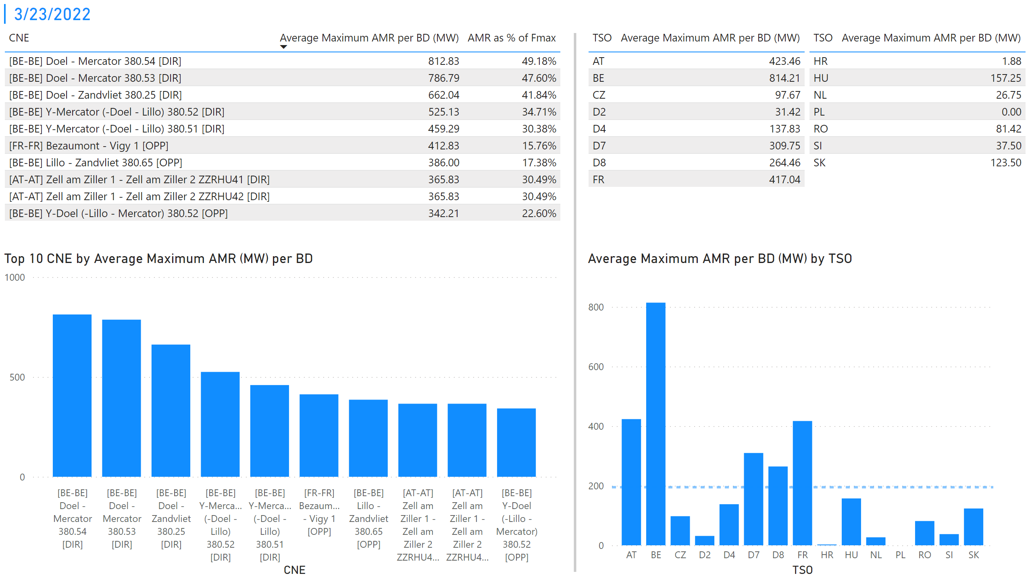
KPI 1 +2_23
KPI 1: Average maximum AMR per CNE per BD
KPI 2: Average maximum AMR per CNE per TSO
Notes:
tableEx
No alt text provided
Top 10 CNE by Average Maximum AMR (MW) per BD
No alt text provided
multiRowCard
No alt text provided
tableEx
No alt text provided
Average Maximum AMR per BD (MW) by TSO
No alt text provided
tableEx
No alt text provided
basicShape
No alt text provided

Slide 30
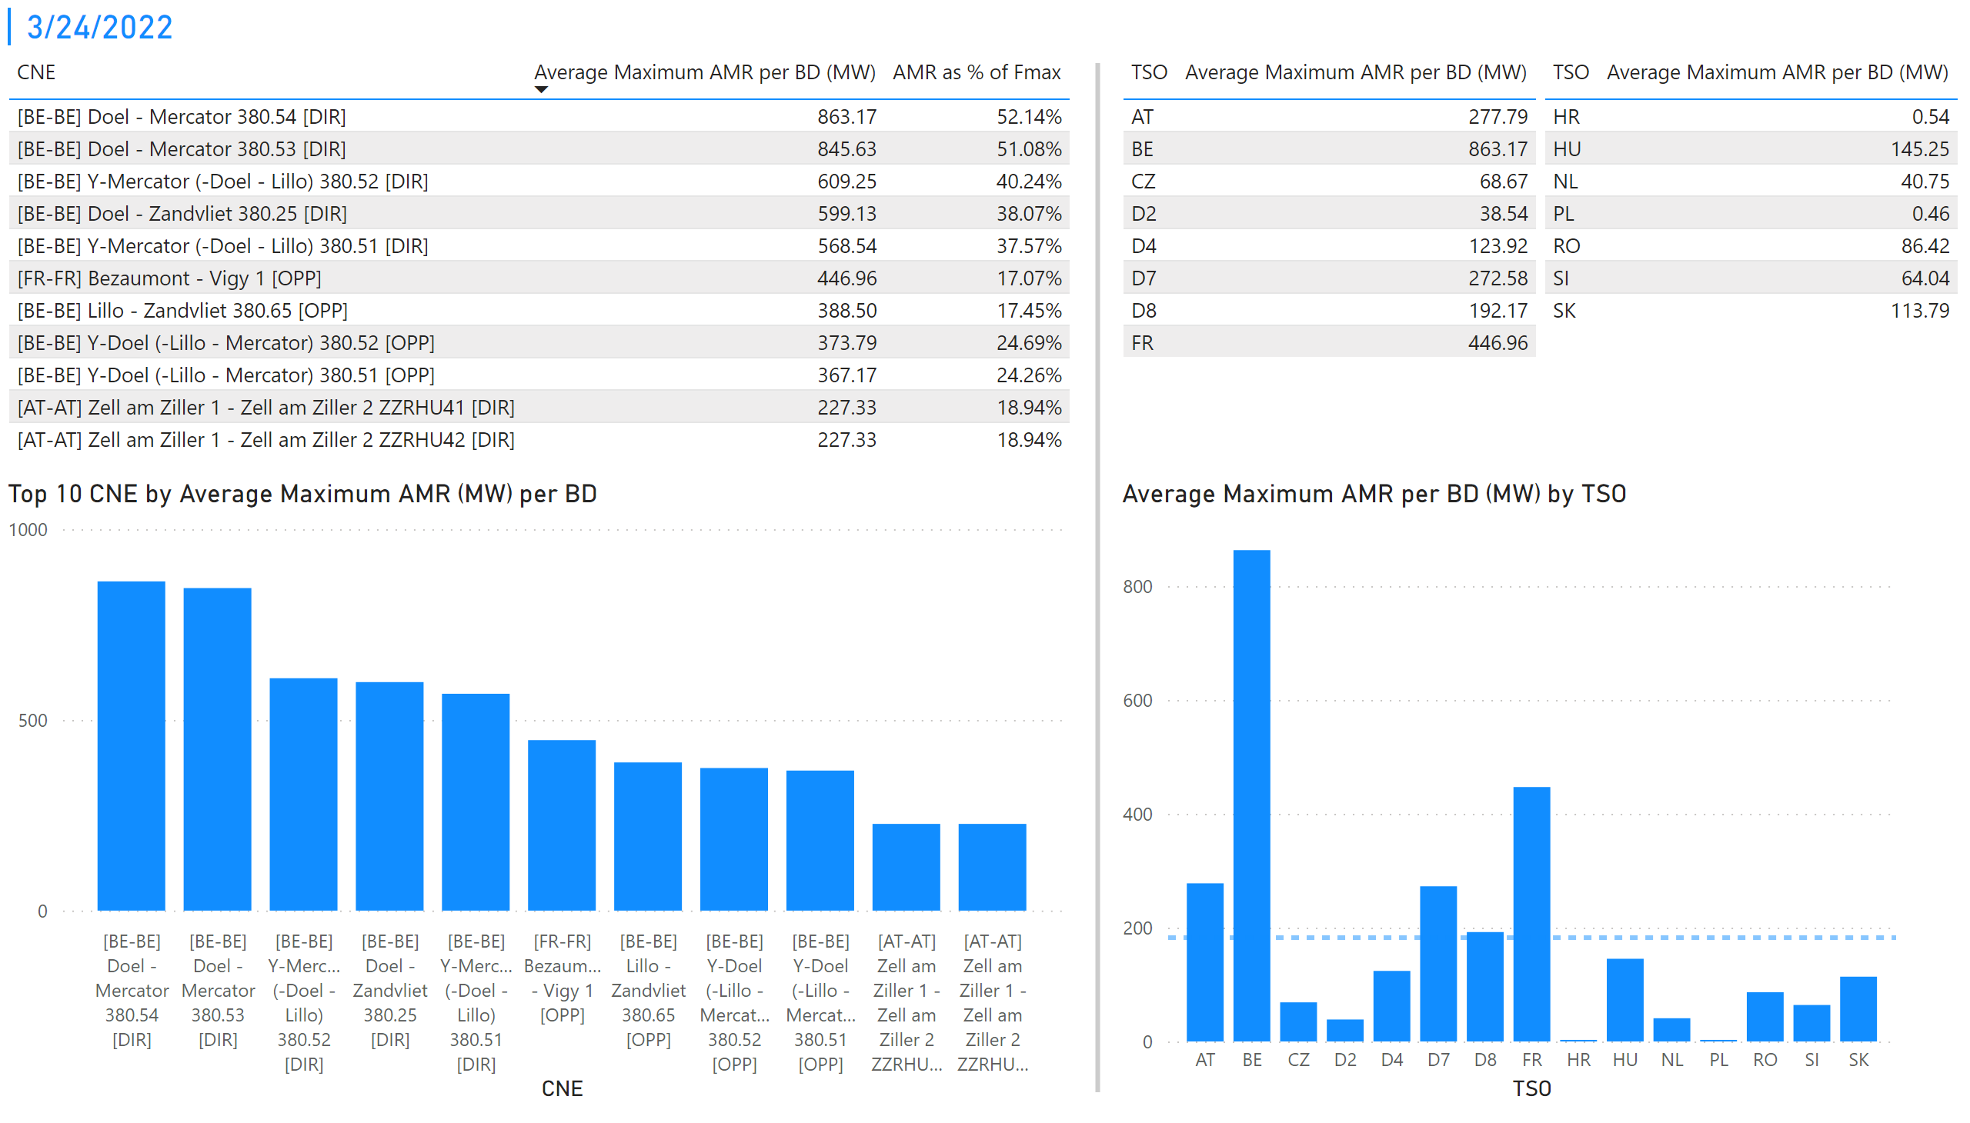
KPI 1 +2_24
KPI 1: Average maximum AMR per CNE per BD
KPI 2: Average maximum AMR per CNE per TSO
Notes:
tableEx
No alt text provided
Top 10 CNE by Average Maximum AMR (MW) per BD
No alt text provided
multiRowCard
No alt text provided
tableEx
No alt text provided
Average Maximum AMR per BD (MW) by TSO
No alt text provided
tableEx
No alt text provided
basicShape
No alt text provided

Slide 31
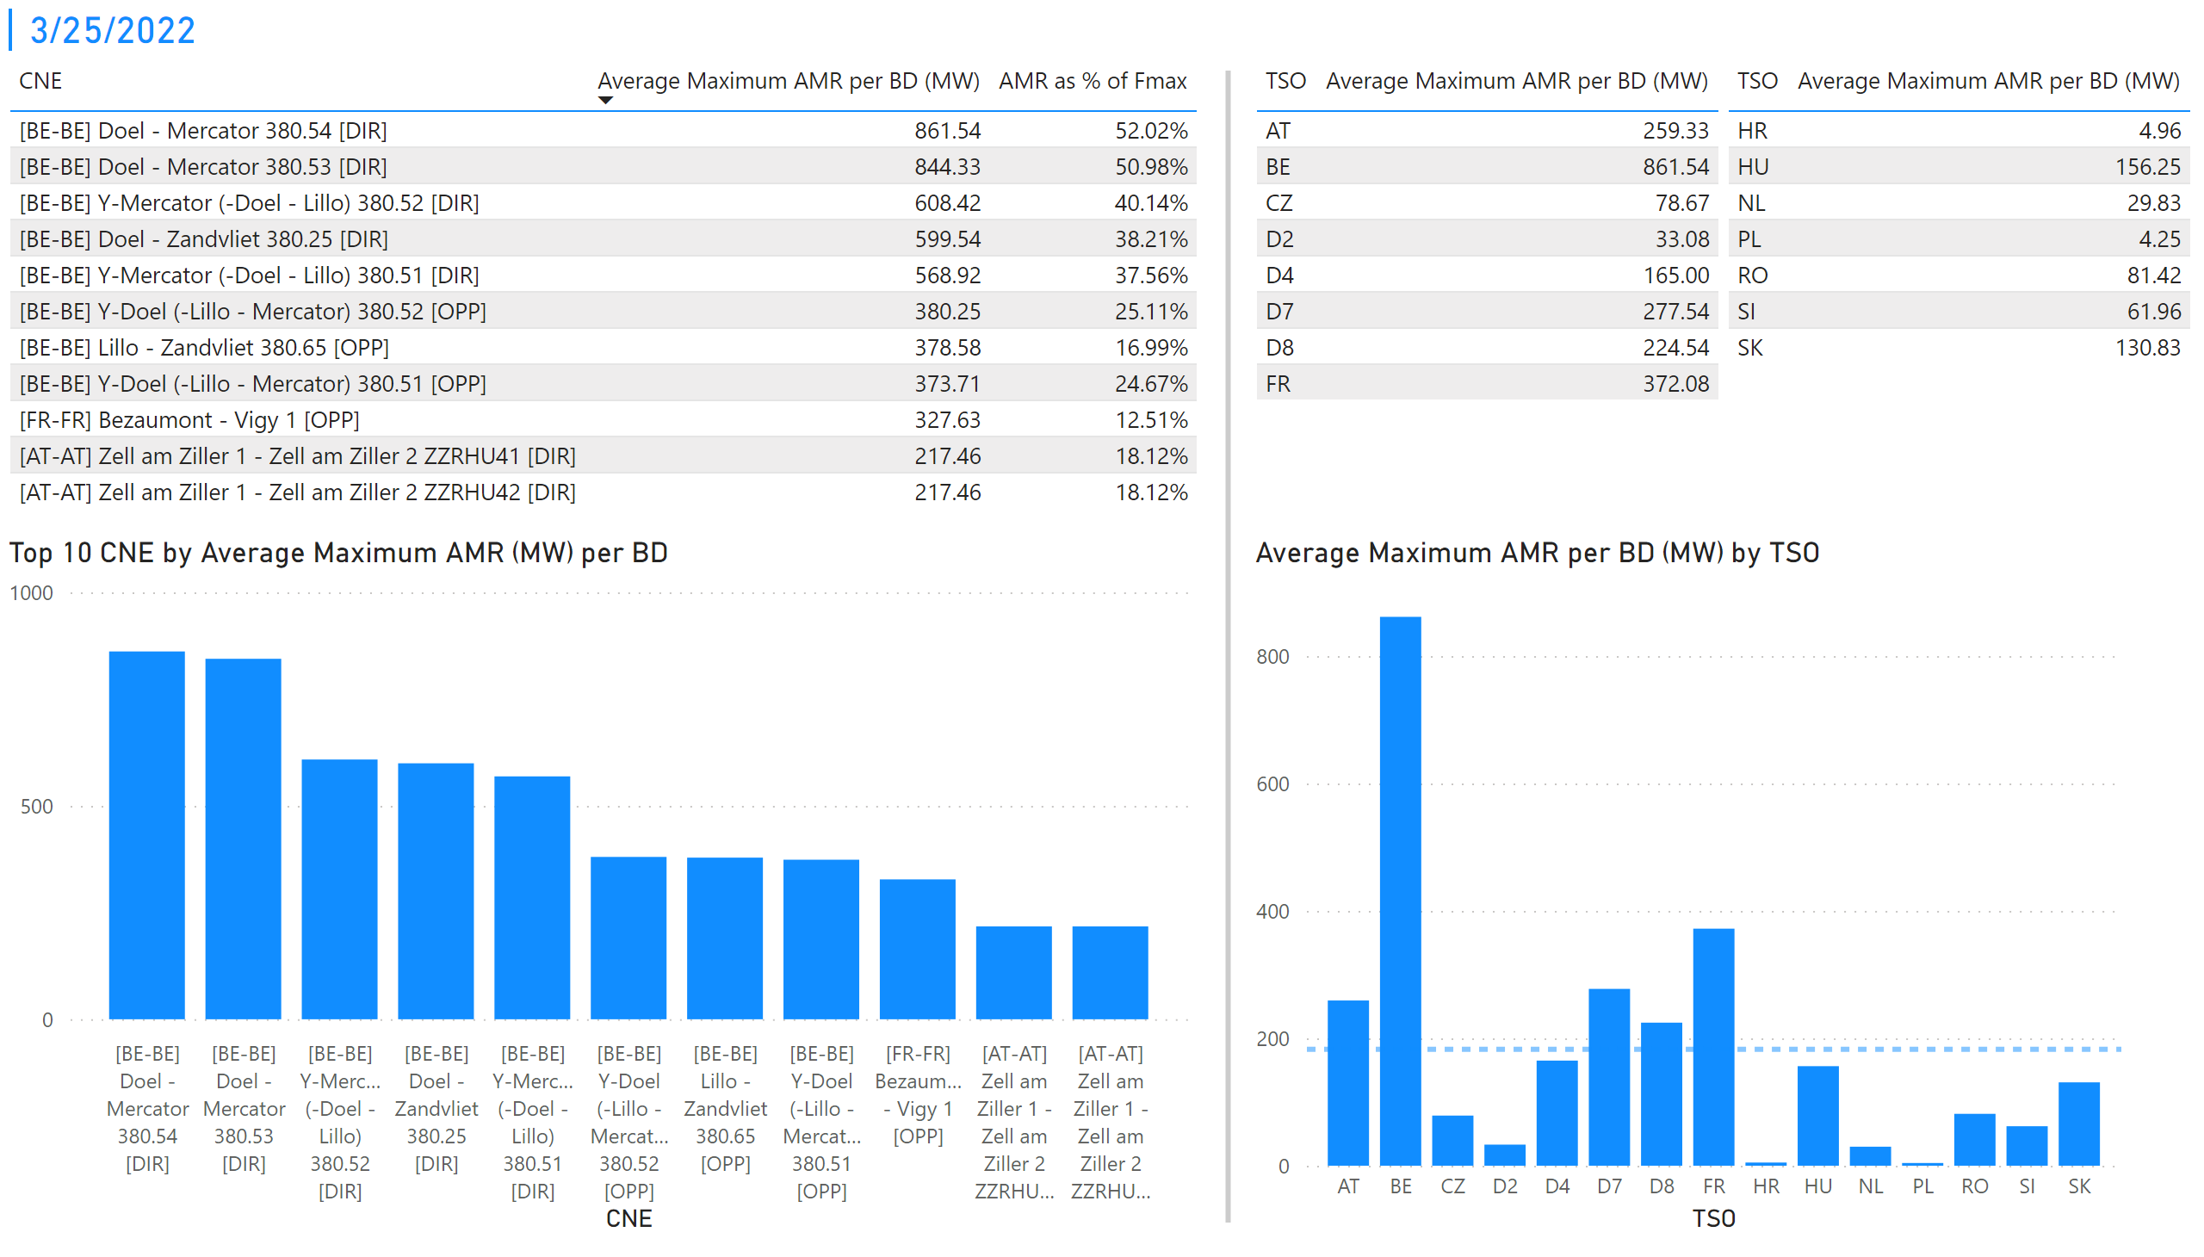
KPI 1 +2_25
KPI 1: Average maximum AMR per CNE per BD
KPI 2: Average maximum AMR per CNE per TSO
Notes:
tableEx
No alt text provided
Top 10 CNE by Average Maximum AMR (MW) per BD
No alt text provided
multiRowCard
No alt text provided
tableEx
No alt text provided
Average Maximum AMR per BD (MW) by TSO
No alt text provided
tableEx
No alt text provided
basicShape
No alt text provided

Slide 32
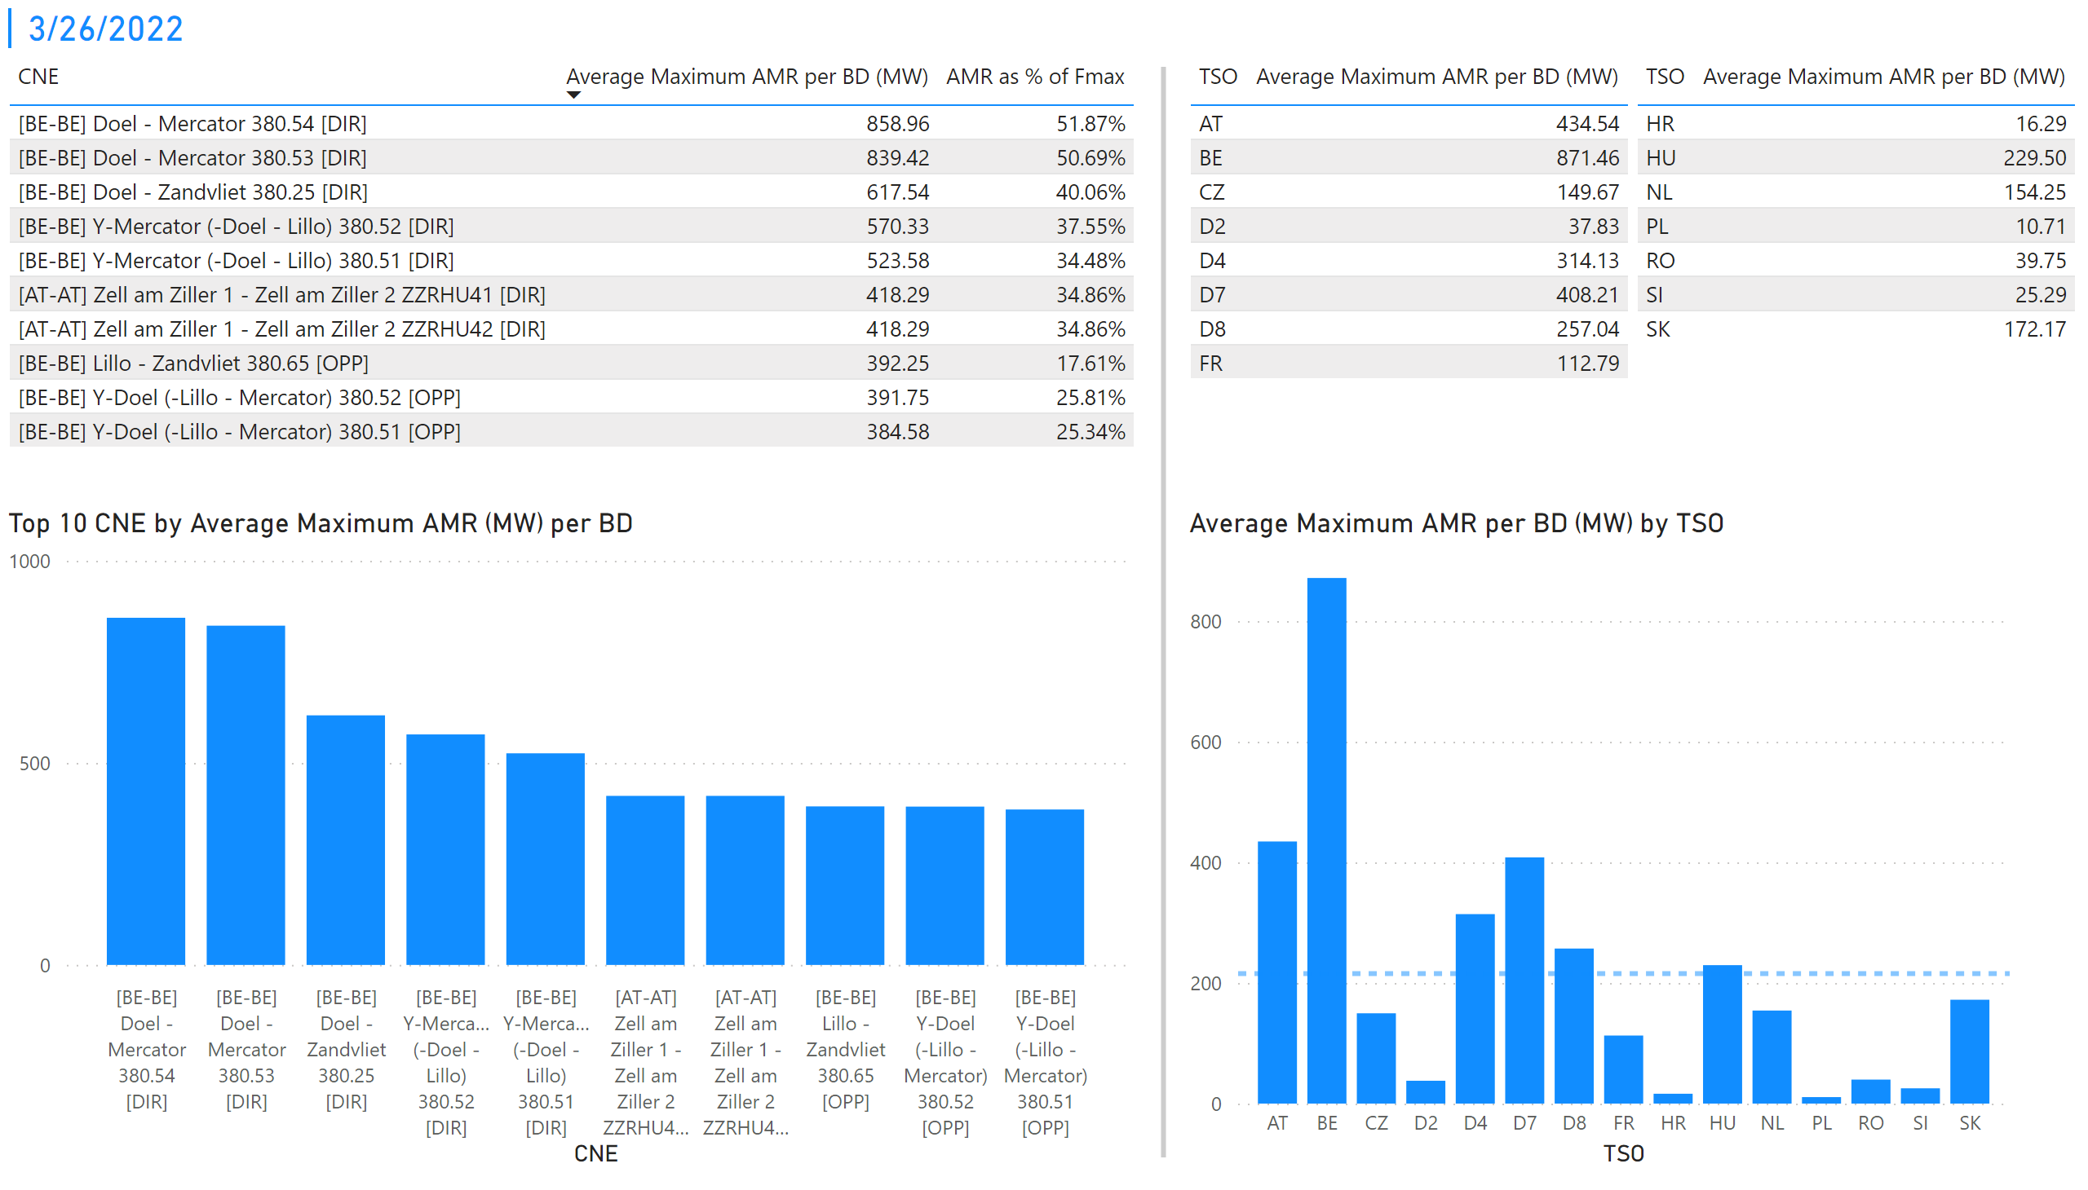
KPI 1 +2_26
KPI 1: Average maximum AMR per CNE per BD
KPI 2: Average maximum AMR per CNE per TSO
Notes:
tableEx
No alt text provided
Top 10 CNE by Average Maximum AMR (MW) per BD
No alt text provided
multiRowCard
No alt text provided
tableEx
No alt text provided
Average Maximum AMR per BD (MW) by TSO
No alt text provided
tableEx
No alt text provided
basicShape
No alt text provided

Slide 33
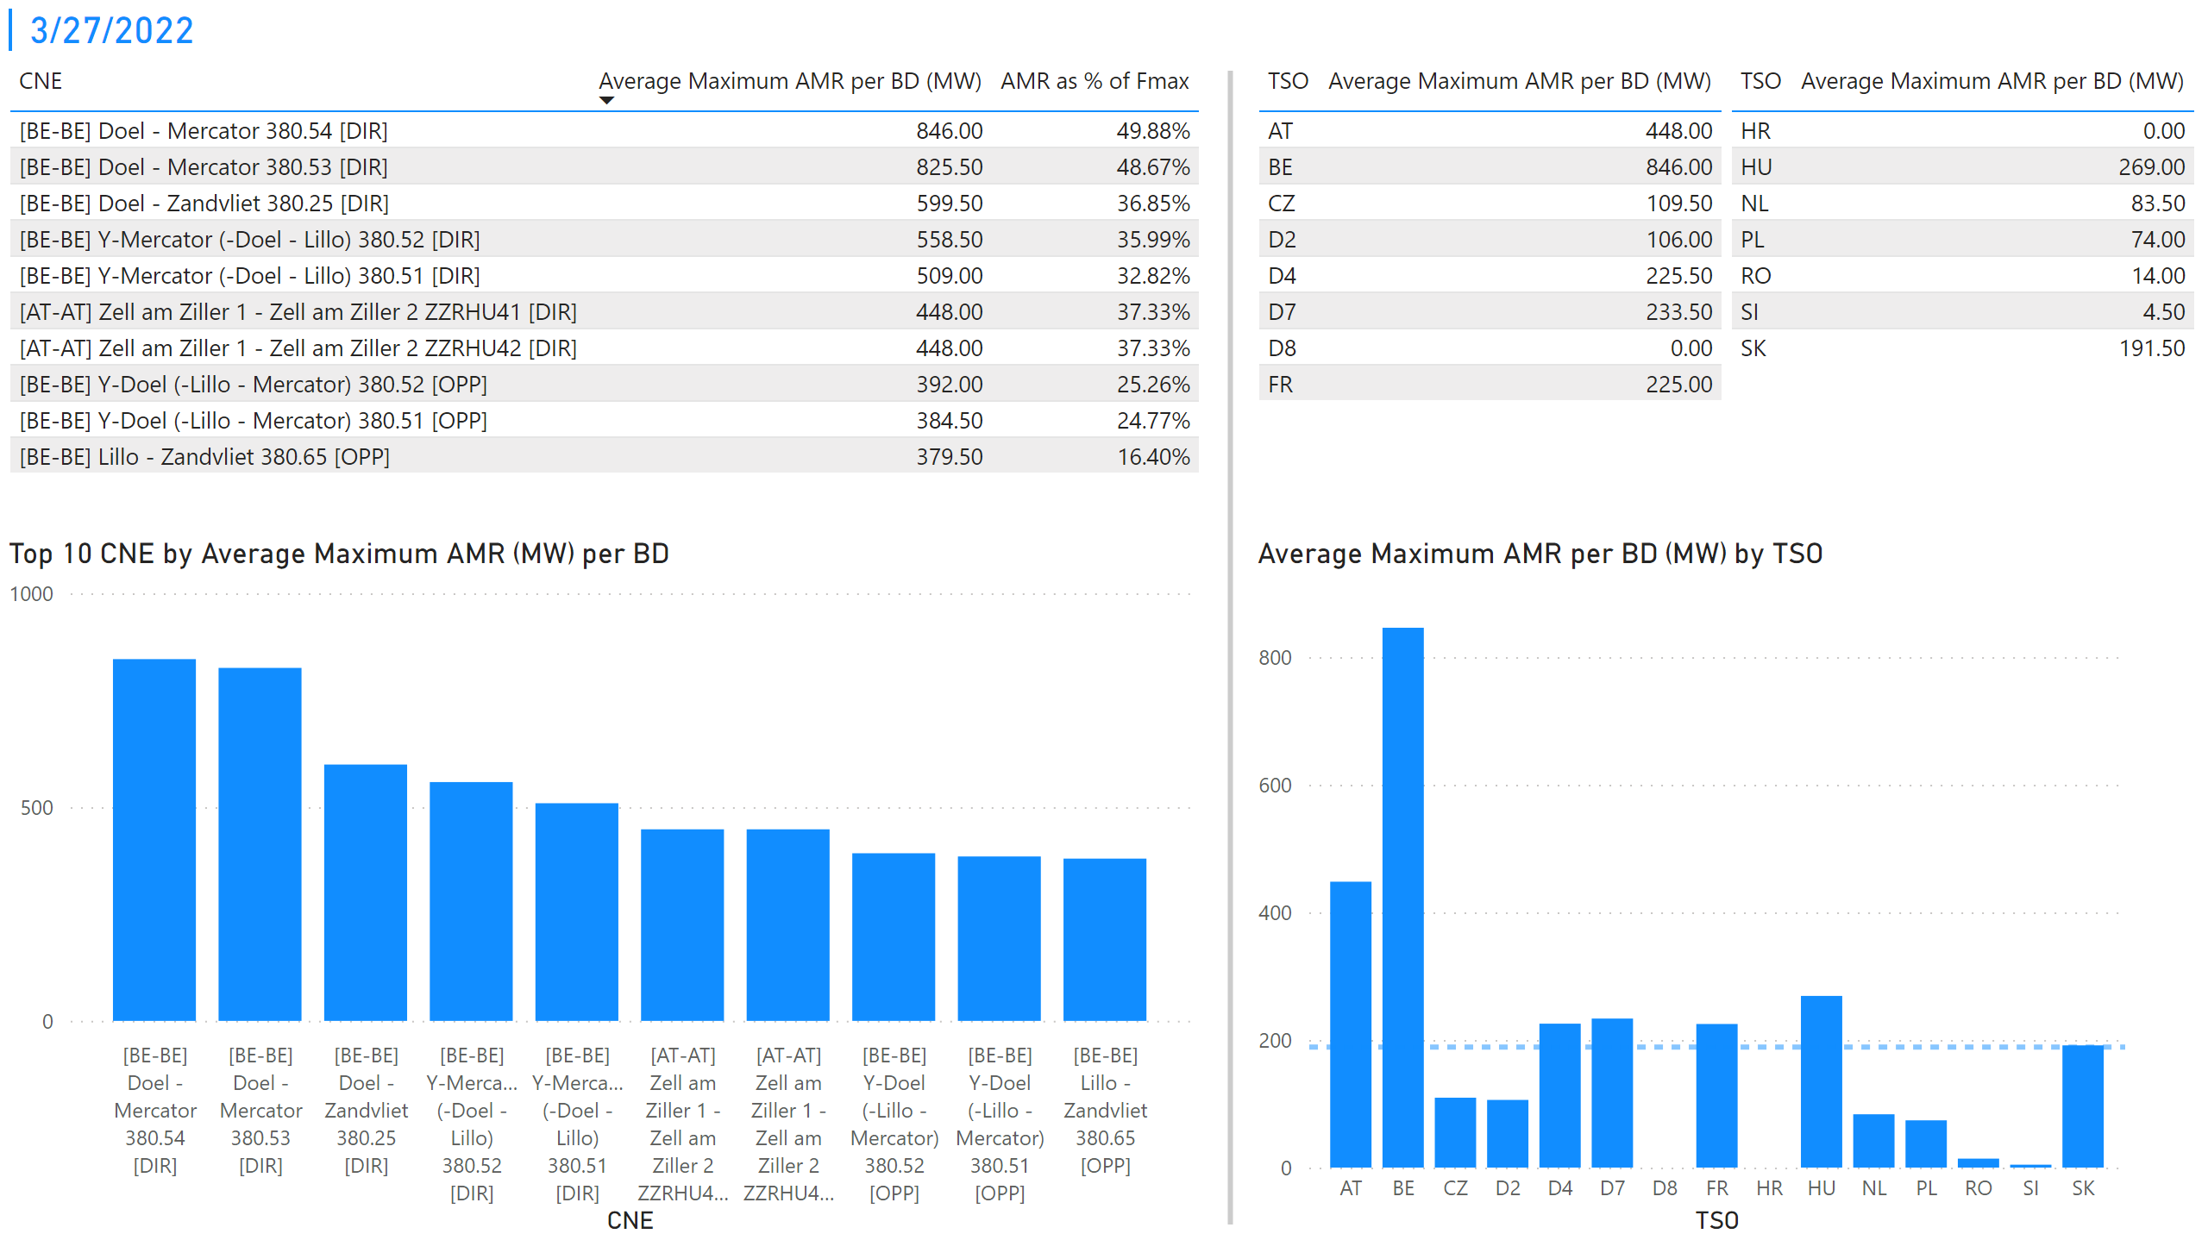
KPI 1 +2_28
KPI 1: Average maximum AMR per CNE per BD
KPI 2: Average maximum AMR per CNE per TSO
Notes:
tableEx
No alt text provided
Top 10 CNE by Average Maximum AMR (MW) per BD
No alt text provided
multiRowCard
No alt text provided
tableEx
No alt text provided
Average Maximum AMR per BD (MW) by TSO
No alt text provided
tableEx
No alt text provided
basicShape
No alt text provided

Slide 34
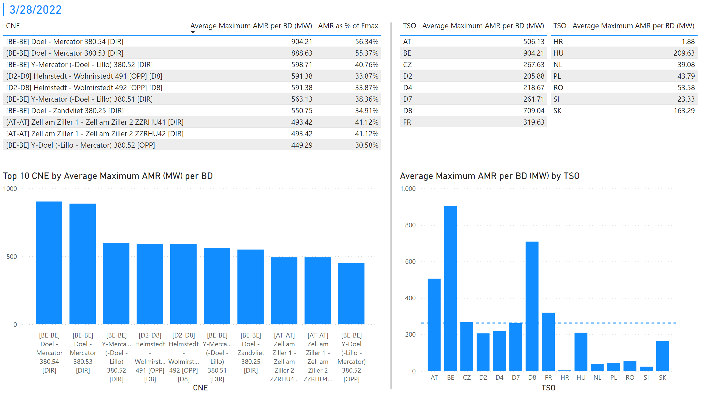
KPI 1 +2_29
KPI 1: Average maximum AMR per CNE per BD
KPI 2: Average maximum AMR per CNE per TSO
Notes:
tableEx
No alt text provided
Top 10 CNE by Average Maximum AMR (MW) per BD
No alt text provided
multiRowCard
No alt text provided
tableEx
No alt text provided
Average Maximum AMR per BD (MW) by TSO
No alt text provided
tableEx
No alt text provided
basicShape
No alt text provided

Slide 35
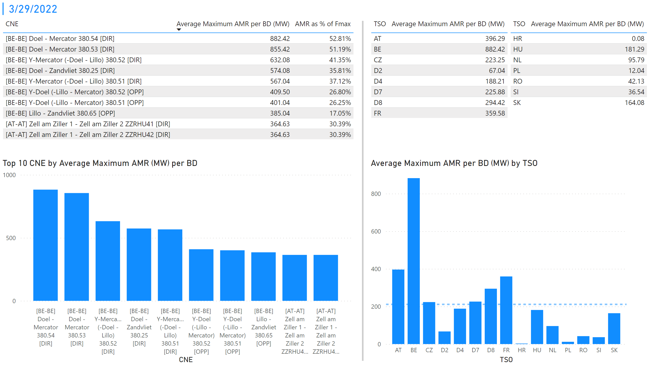
Duplikat von "KPI 1 +2_29"
KPI 1: Average maximum AMR per CNE per BD
KPI 2: Average maximum AMR per CNE per TSO
Notes:
tableEx
No alt text provided
Top 10 CNE by Average Maximum AMR (MW) per BD
No alt text provided
multiRowCard
No alt text provided
tableEx
No alt text provided
Average Maximum AMR per BD (MW) by TSO
No alt text provided
tableEx
No alt text provided
basicShape
No alt text provided

Slide 36
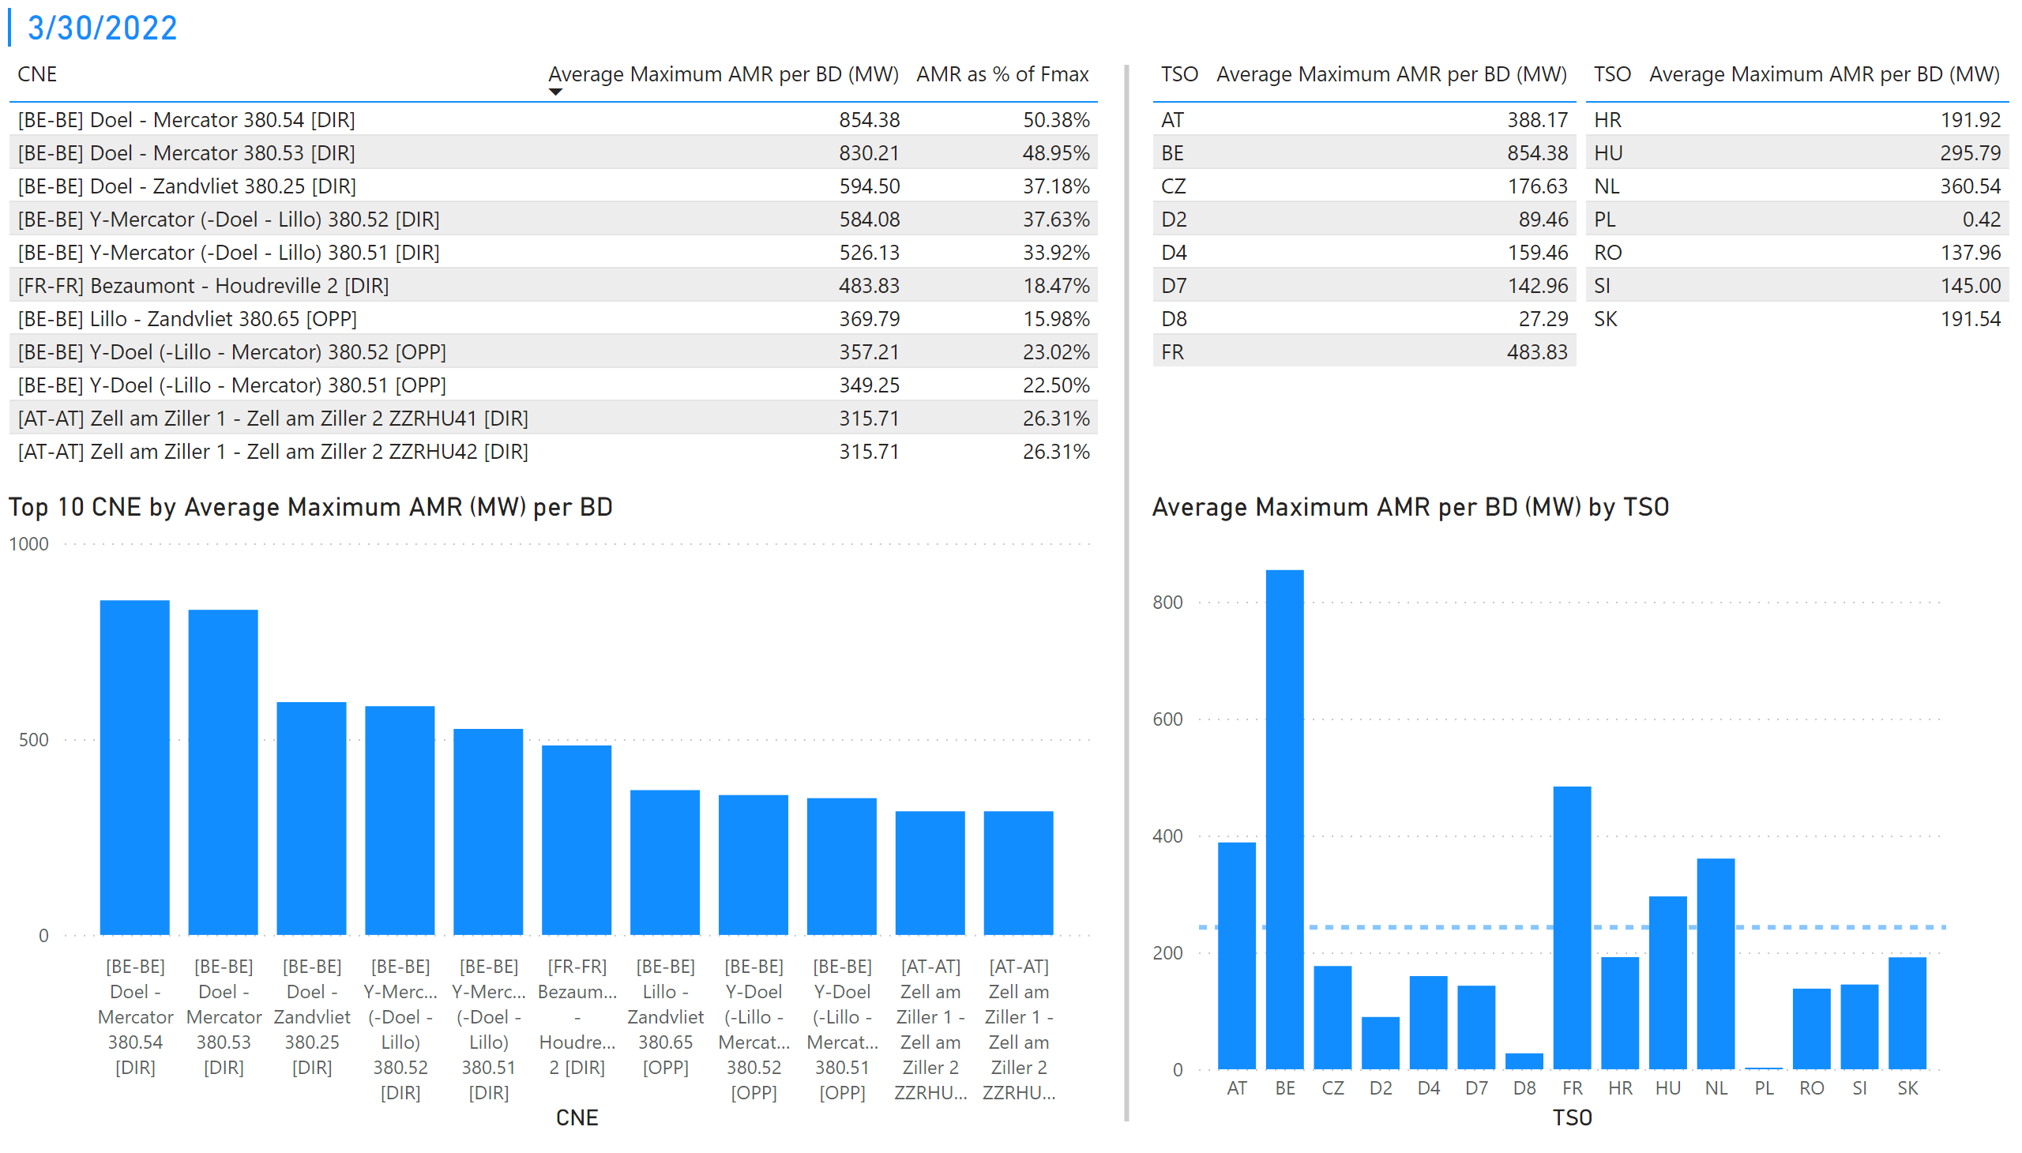
Duplikat von "Duplikat von "KPI 1 +2_29""
KPI 1: Average maximum AMR per CNE per BD
KPI 2: Average maximum AMR per CNE per TSO
Notes:
tableEx
No alt text provided
Top 10 CNE by Average Maximum AMR (MW) per BD
No alt text provided
multiRowCard
No alt text provided
tableEx
No alt text provided
Average Maximum AMR per BD (MW) by TSO
No alt text provided
tableEx
No alt text provided
basicShape
No alt text provided

Slide 37
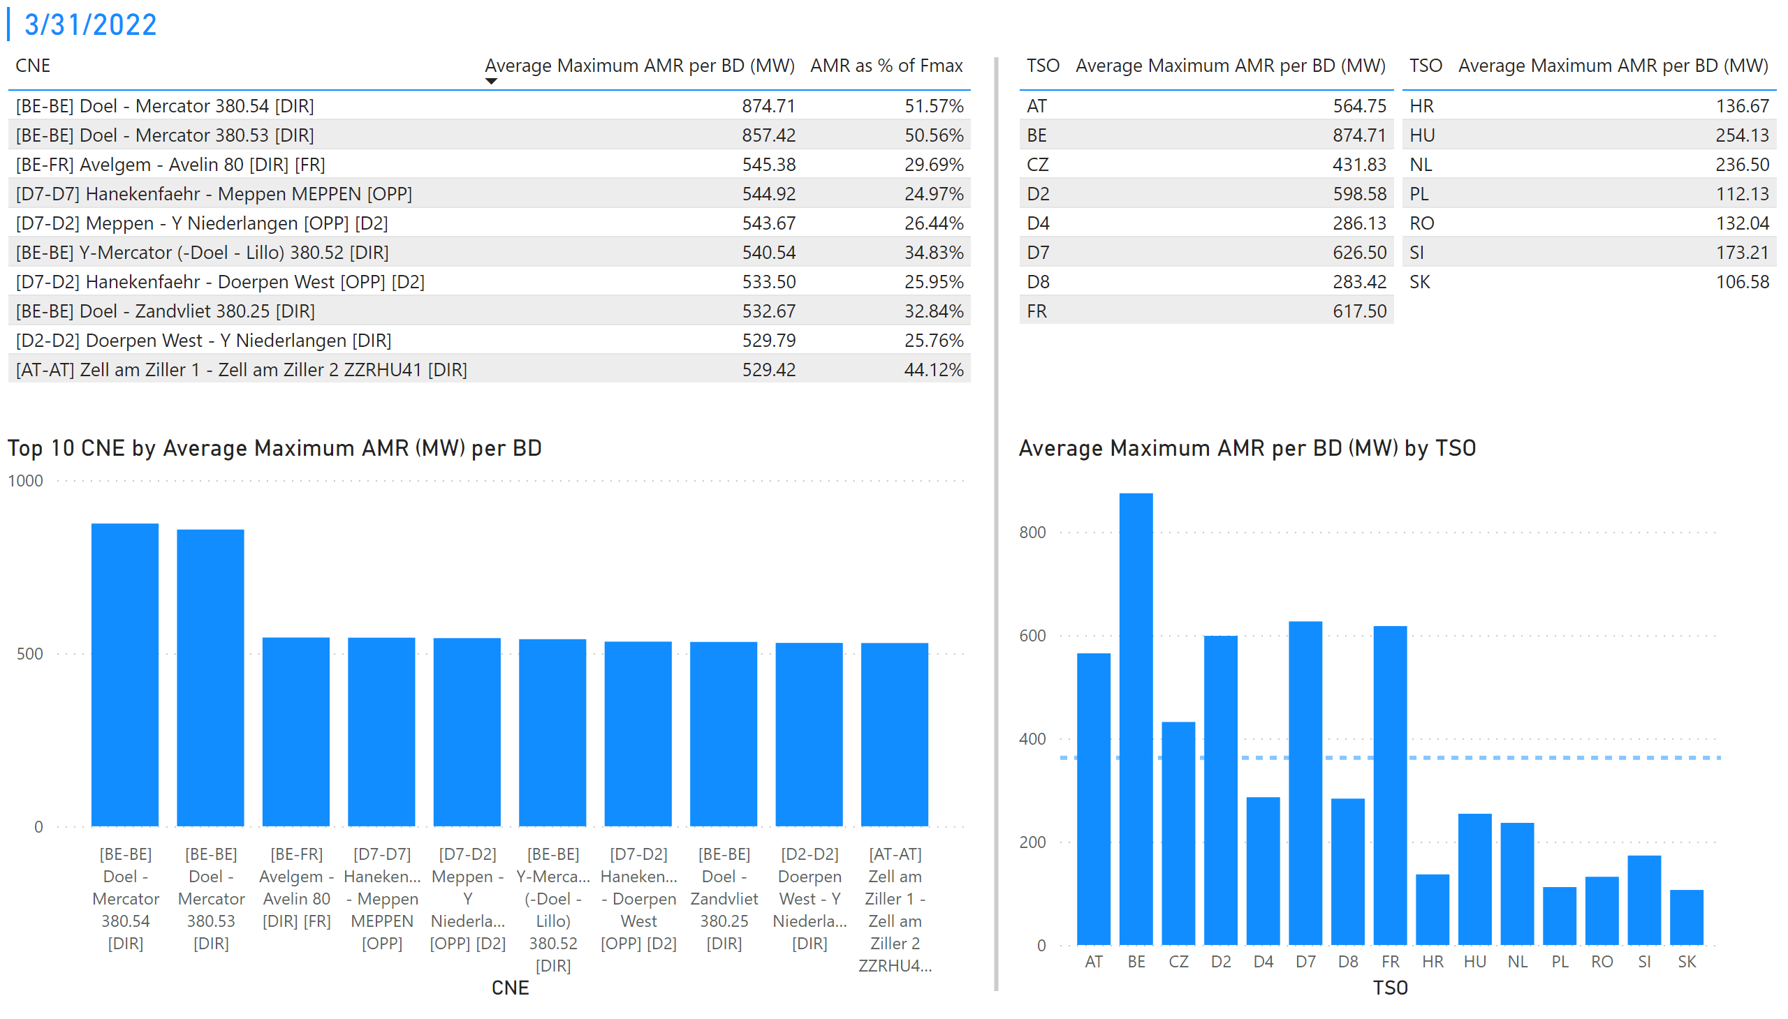
Duplikat von "Duplikat von "Duplikat von "KPI 1 +2_29"""
KPI 1: Average maximum AMR per CNE per BD
KPI 2: Average maximum AMR per CNE per TSO
Notes:
tableEx
No alt text provided
Top 10 CNE by Average Maximum AMR (MW) per BD
No alt text provided
multiRowCard
No alt text provided
tableEx
No alt text provided
Average Maximum AMR per BD (MW) by TSO
No alt text provided
tableEx
No alt text provided
basicShape
No alt text provided

Slide 38
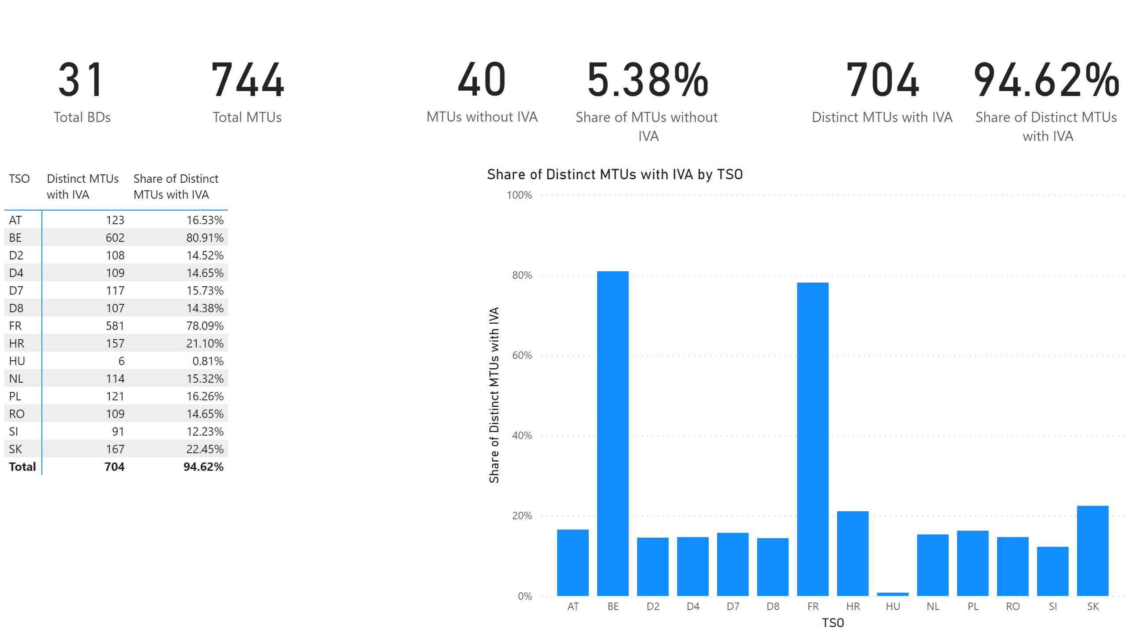
KPI 5
KPI 5: Share of MTUs with intervention per TSO
Notes:
pivotTable
No alt text provided
clusteredColumnChart
No alt text provided
card
No alt text provided
card
No alt text provided
card
No alt text provided
card
No alt text provided
card
No alt text provided
card
No alt text provided

Slide 39
KPI6_0901
    KPI 6: Total IVA applied per MTU for each CNE affected by TSO intervention
A list of CNECs with IVA applied is published on the JAO Publication Tool.
Notes:
clusteredColumnChart
No alt text provided.
clusteredColumnChart
No alt text provided.

Slide 40
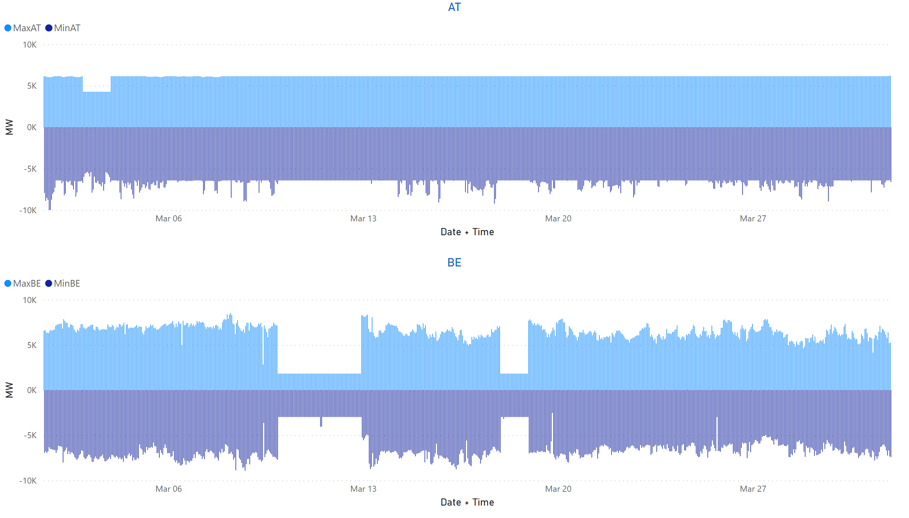
AT + BE
KPI 13: Min & max net positions per BZ hub
Notes:
AT
No alt text provided
BE
No alt text provided

Slide 41
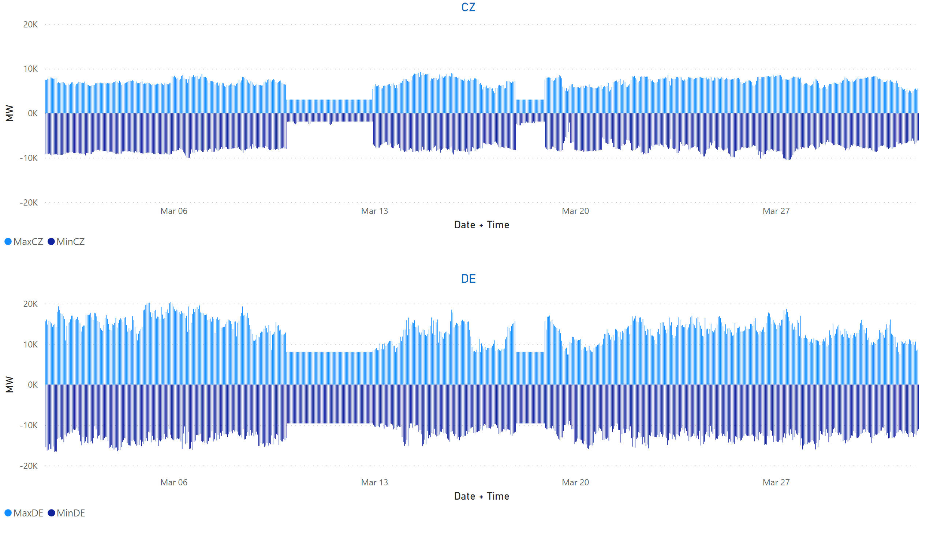
CZ+DE
KPI 13: Min & max net positions per BZ hub
Notes:
CZ
No alt text provided
DE
No alt text provided

Slide 42
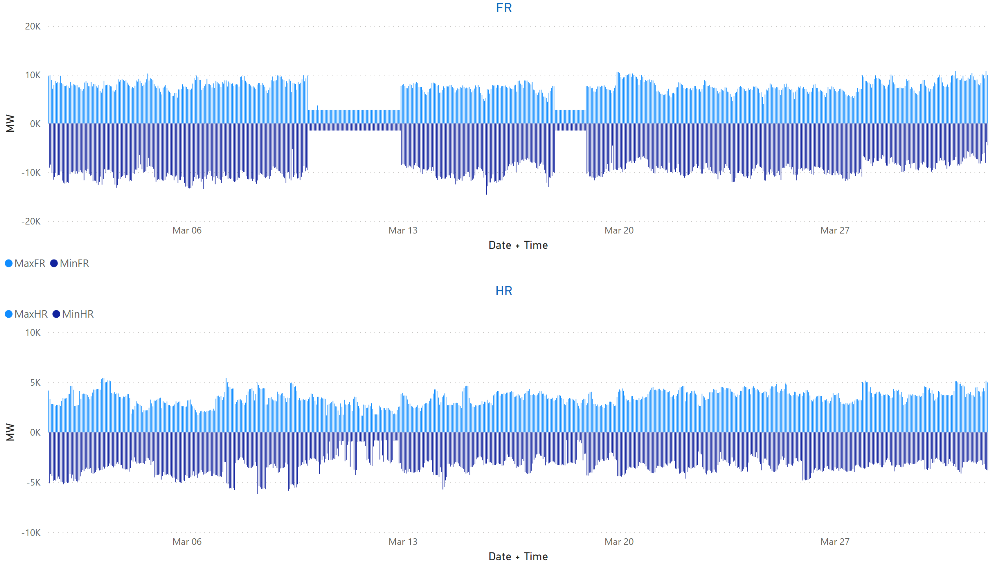
FR + HR
KPI 13: Min & max net positions per BZ hub
Notes:
FR
No alt text provided
HR
No alt text provided

Slide 43
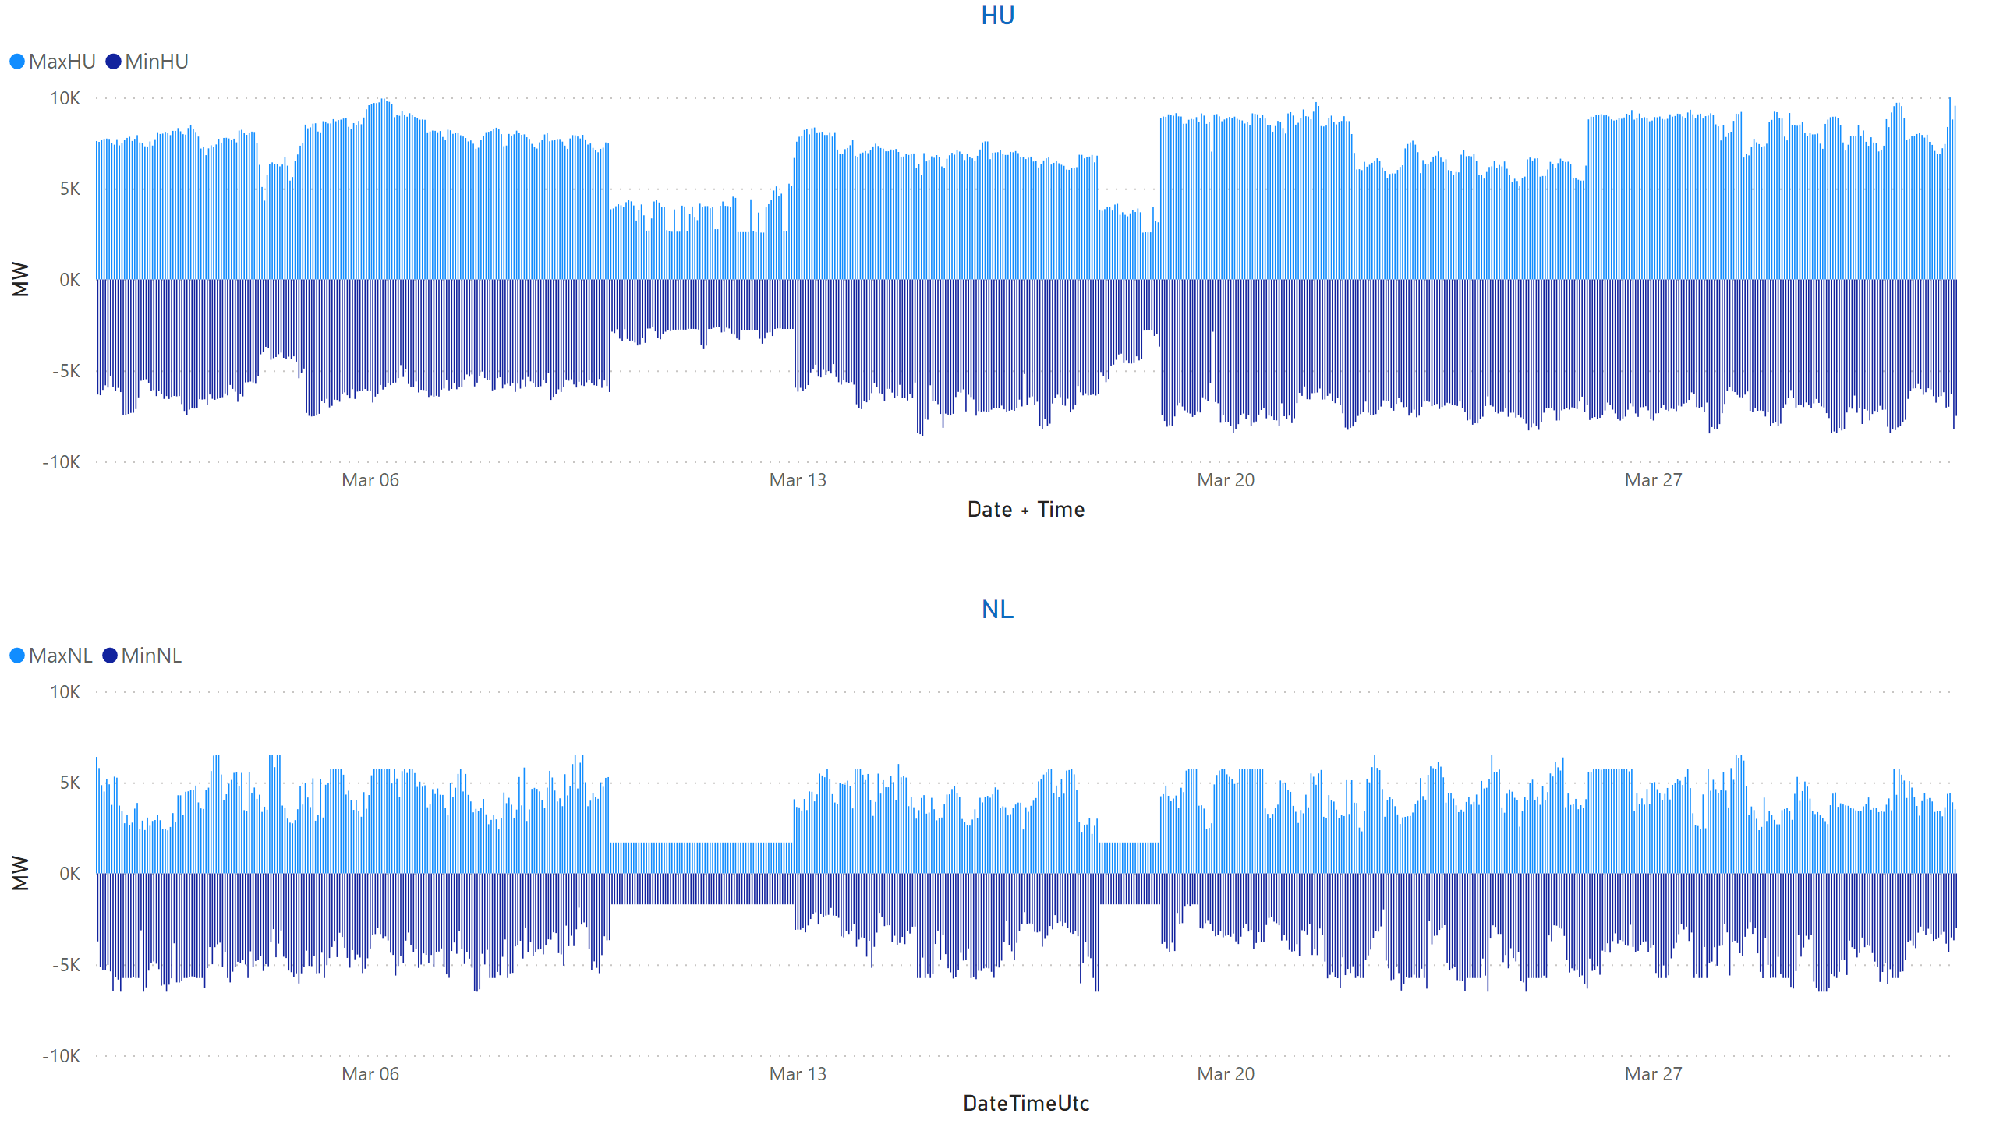
HU + NL
KPI 13: Min & max net positions per BZ hub
Notes:
HU
No alt text provided
NL
No alt text provided

Slide 44
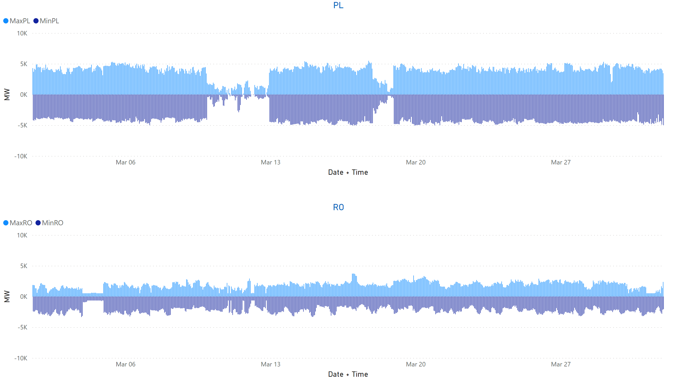
PL + RO
KPI 13: Min & max net positions per BZ hub
Notes:
PL
No alt text provided
RO
No alt text provided

Slide 45
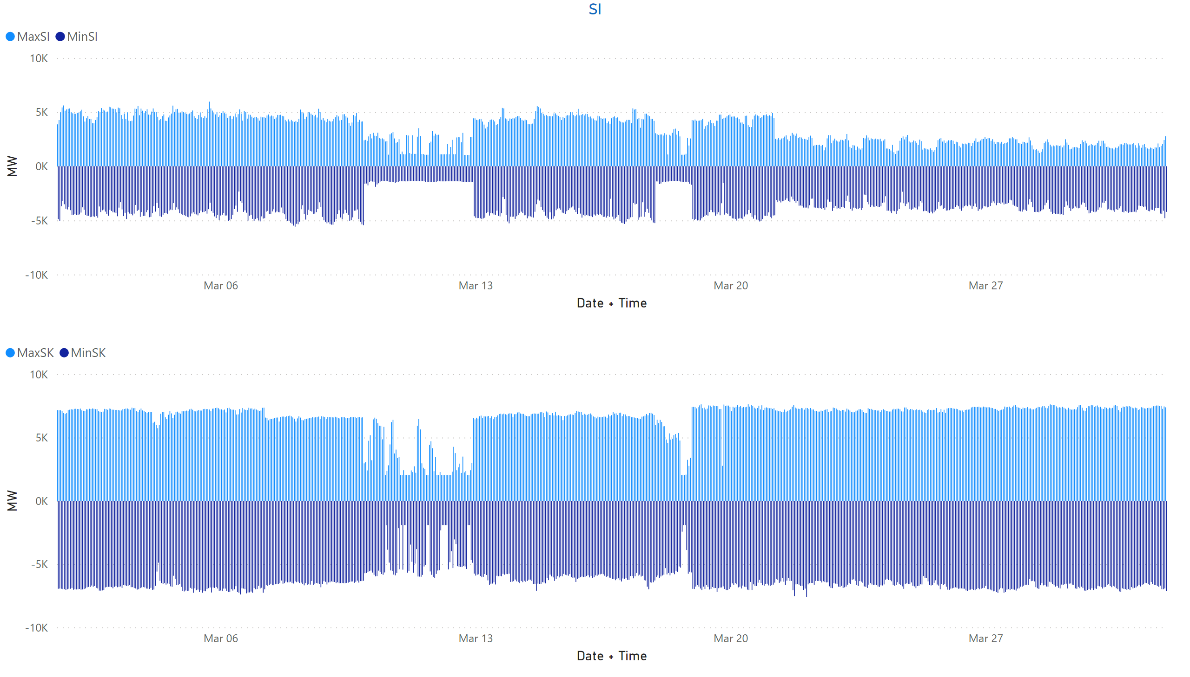
SI + SK
KPI 13: Min & max net positions per BZ hub
Notes:
clusteredColumnChart
No alt text provided
SI
No alt text provided

Slide 46
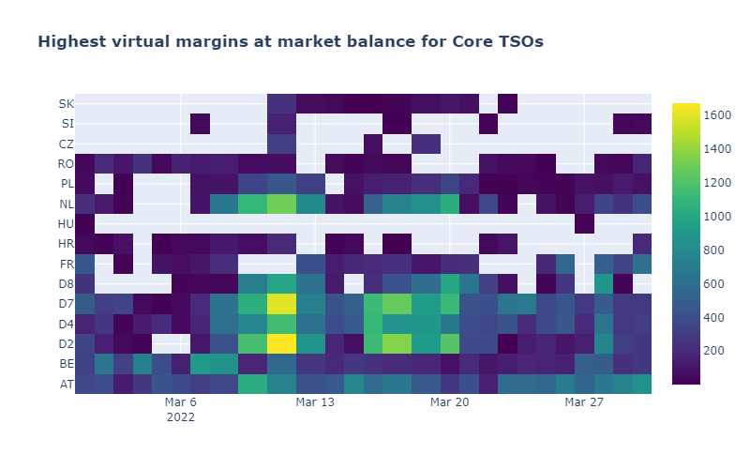
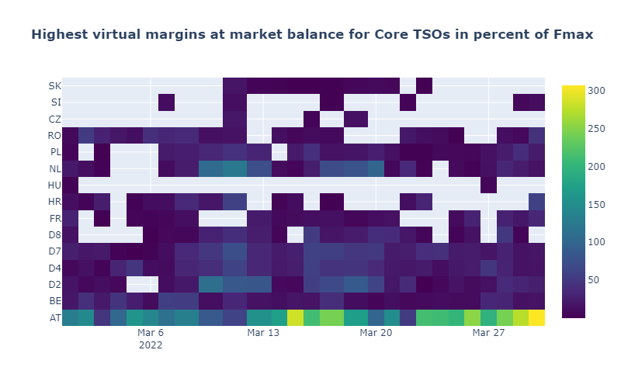
KPI 14a: Highest virtual margins at market balance for CORE TSOs
CORE TSOs

Slide 47
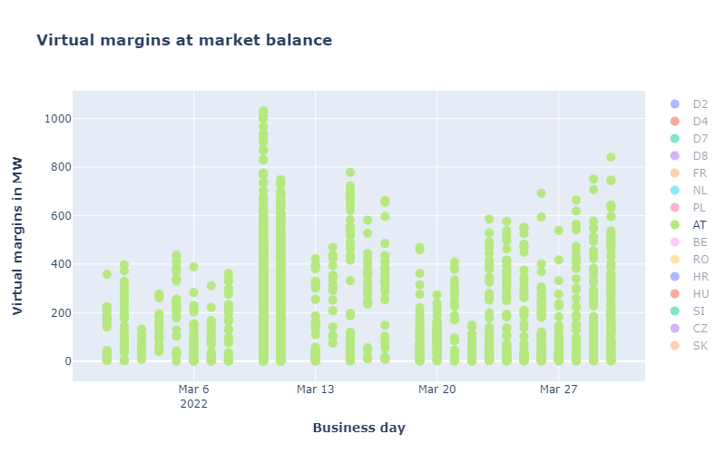
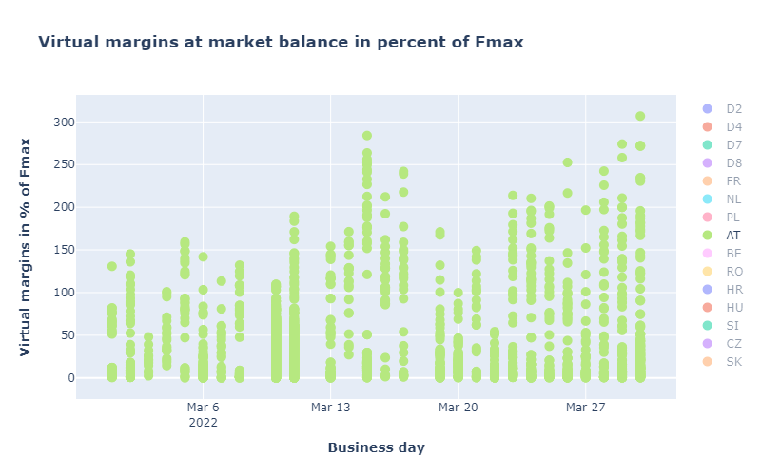
CORE TSOs
KPI 14b: AT: Virtual margins at market balance

Slide 48
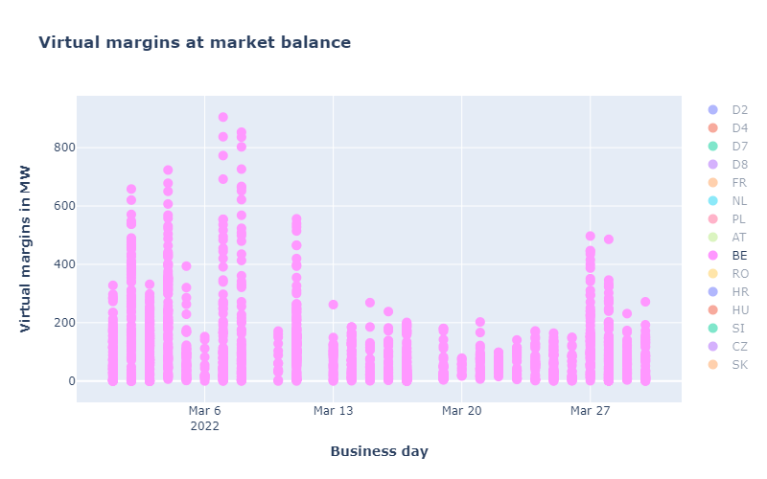
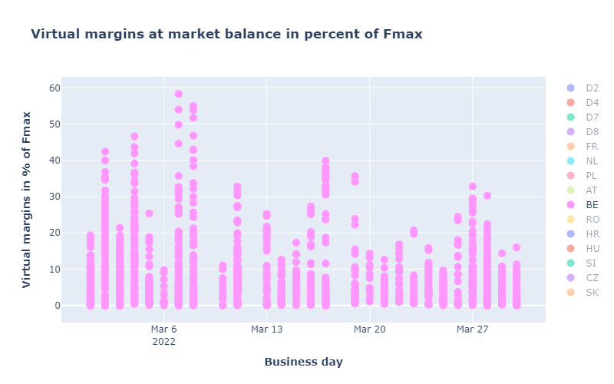
KPI 14b: BE: Virtual margins at market balance
CORE TSOs

Slide 49
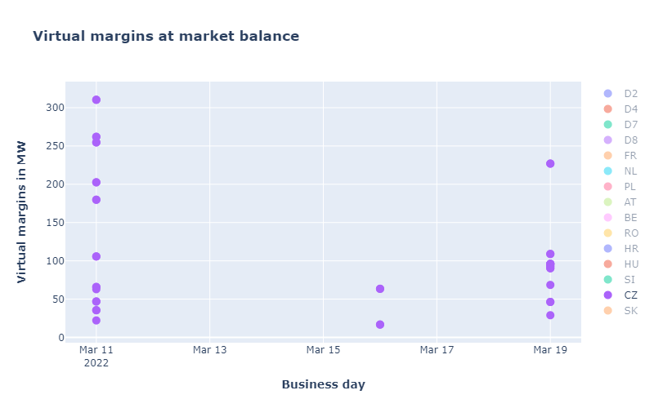
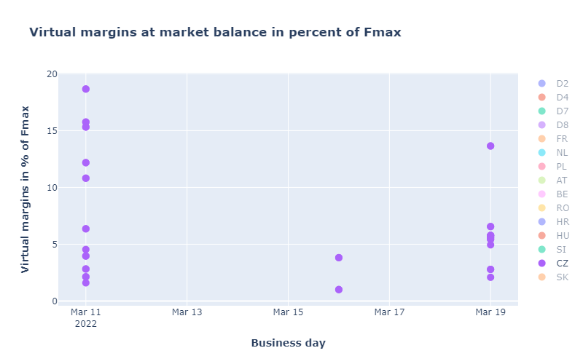
CORE TSOs
KPI 14b: CZ: Virtual margins at market balance

Slide 50
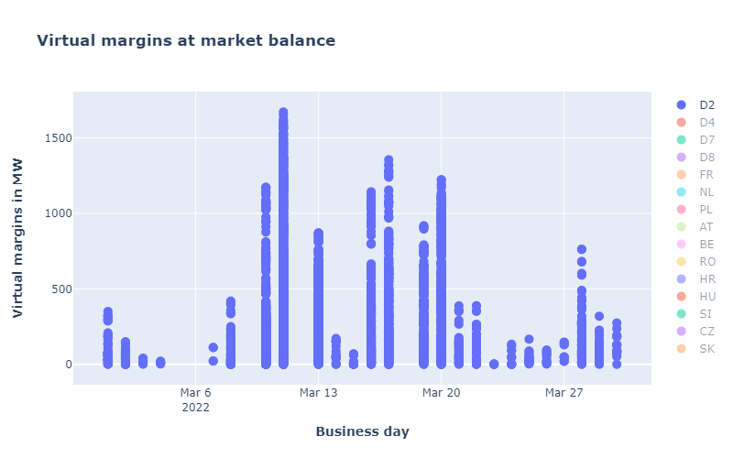
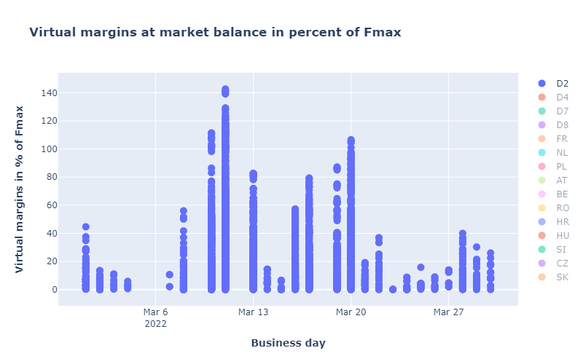
KPI 14b: D2: Virtual margins at market balance
CORE TSOs

Slide 51
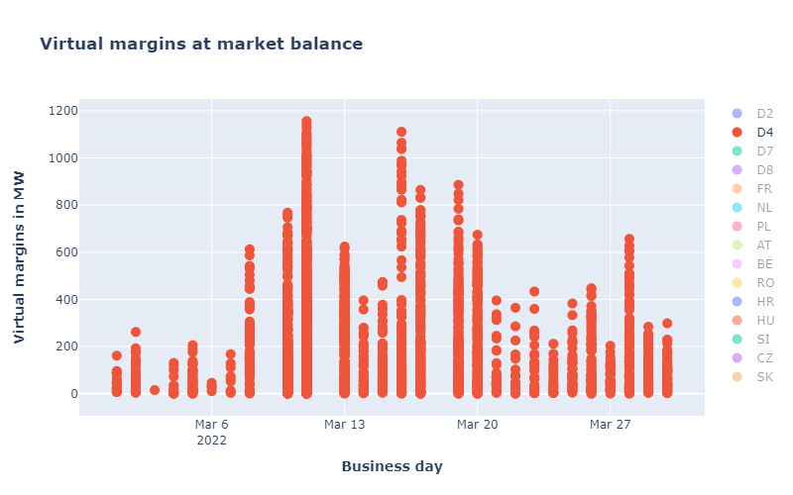
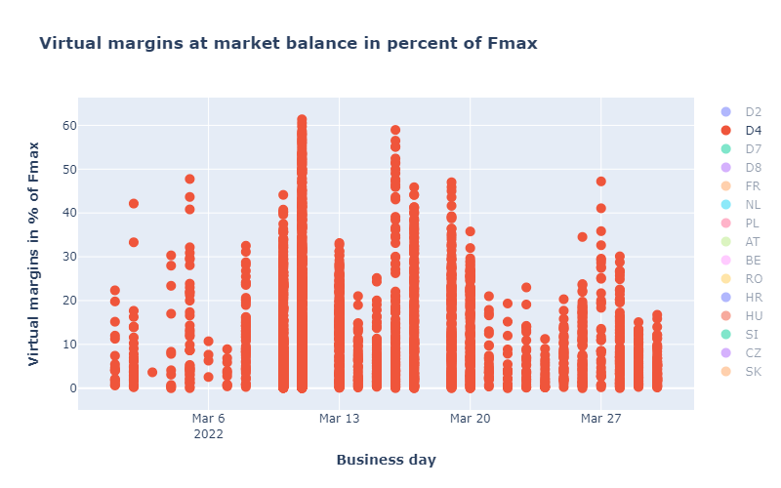
CORE TSOs
KPI 14b: D4: Virtual margins at market balance

Slide 52
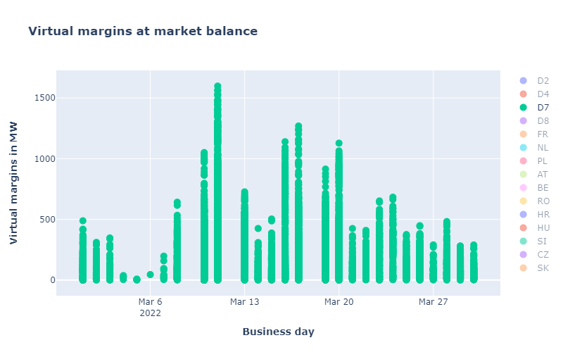

CORE TSOs
KPI 14b: D7: Virtual margins at market balance

Slide 53


CORE TSOs
KPI 14b: D8: Virtual margins at market balance

Slide 54


CORE TSOs
KPI 14b: FR: Virtual margins at market balance

Slide 55


CORE TSOs
KPI 14b: HR: Virtual margins at market balance

Slide 56


KPI 14b: HU: Virtual margins at market balance
CORE TSOs

Slide 57


KPI 14b: PL: Virtual margins at market balance
CORE TSOs

Slide 58


KPI 14b: NL: Virtual margins at market balance
CORE TSOs

Slide 59


CORE TSOs
KPI 14b: RO: Virtual margins at market balance

Slide 60


KPI 14b: SI: Virtual margins at market balance
CORE TSOs

Slide 61


KPI 14b: SK: Virtual margins at market balance
CORE TSOs

Slide 62

KPI 15: Non-Core exchanges delta flow
BD20220301 – BD20230331

Slide 63

KPI 15: Non-Core exchanges delta flow
BD20220301 – BD20220331

Slide 64

KPI 15: Non-Core delta exchanges
BD20220301 – BD20220331

Slide 65

Overview
NRAO – Applied Remedial Actions
On the analysis:
  The total number of MTUs (744 hours)
  was distributed as shown in the pie chart
  In the following plots, the relative time share
  relates to the hours labeled
  ‘NRAO Ran and Applied RAs’ (708 hours)

Slide 66

KPI 16: Relative Time Share of Applied RAs, by TSO, Type and Mode

Slide 67

KPI 16: Relative Time Share of Applied RAs, by TSO, Type and Mode
Relative Time Share of Applied PSTs in Preventive Mode

Slide 68

KPI 16: Relative Time Share of Applied RAs, by TSO, Type and Mode
Relative Time Share of Applied Topological RAs in Preventive Mode

Slide 69

KPI 16: Relative Time Share of Applied RAs, by TSO, Type and Mode
Relative Time Share of Applied PSTs in Curative Mode

Slide 70

KPI 16: Relative Time Share of Applied RAs, by TSO, Type and Mode
Relative Time Share of Applied Topological RAs in Curative Mode

Slide 71
KPI 17: Most limiting CNEC per TSO (NRAO)
TSCNET
  The graph below shows the distribution of CNECs which are the most limiting from NRAO perspective, these are the CNECs with lowest relative RAM per MTUs.
  As expected, there is redistributing of the most limiting CNECs. This is because the application of Remedial Actions does not eliminate flows but re-routes, reducing the flows on some limiting CNECs and increasing the load on others, which at the end impacts also the RAM values.
  In case of CZ and SI, there were no most limiting elements from NRAO perspective.
  In case of FR, there are 2 most limiting elements from NRAO perspective after the NRAO step.

Slide 72

KPI 18: Average variation of relative RAM before and after NRAO
TSCNET
  The graph shows average values of relative RAM before and after NRAO, per TSO on the most limiting CNECs from NRAO perspective. Selected CNECs before RAO are the same as after RAO, and average computed for MTUs when NRAO was used further in the process.
  Most limiting element from NRAO perspective is the one which has the lowest relRAM per MTU.
  To determent value of relative RAM, the following formula was used:
  $${RAM}_{rel}=\frac{{RAM}_{nrao}}{\sum_{\left(A, B\right) ∈ neighbouring Core bidding zones pairs }{\left|{PTDF}_{A→B, nrao}\right|}} if {RAM}_{nrao}≥0$$
  $${RAM}_{rel}={RAM}_{nrao} if {RAM}_{nrao}< 0$$
  The increment of relRAM values after RAO shows that the optimization performed did increase the capacity on some areas.
  In case of NL, it can be seen that RAM before RAO was negative and therefore relRAM= negativeRAM. After application of RAs, the flow on the element decreased leading to an increased RAM (equal or above 0), and this results in relRAM no longer being absolute (RAM) but calculated relative value.
  In case of CZ and SI, there were no most limiting elements from NRAO perspective.
  In case of PL, relRAM after RAO is not 0, but a small positive value (thus it cannot be properly viewed on the graph).

Slide 73
Parallel Run KPI report
CORE FB MC
KPI 7: Most often presolved CNEs (TOP 20) 202203
Total BDs: 27 (647 hours)
CNE | Distinct Hours | Hours CNE was presolved | Average RAM | Max of RAM | Min of RAM | Max of z2zPTDF | Max of sum z2z PTDF
[CZ-SK] Nosovice - Varin [DIR] [SK] | 629 | 1185 | 79% | 107% | 46% | 0,33966 | 1,64767
[SK-HU] Gabcikovo - Gonyu [OPP] [HU] | 611 | 878 | 85% | 108% | 62% | 0,1706 | 1,04996
[AT-AT] Westtirol 1 - Westtirol 2 WTRHU41 [OPP] | 610 | 1481 | 16% | 76% | 0% | 0,27892 | 1,17922
[CZ-PL] Wielopole - Nosovice [DIR] [PL] | 599 | 1128 | 68% | 96% | 29% | 0,0665 | 1,29742
[CZ-SK] Nosovice - Varin [OPP] [SK] | 599 | 1211 | 103% | 132% | 76% | 0,45678 | 1,63763
[HU-HU] Gonyu - Gyor [DIR] | 594 | 989 | 79% | 108% | 60% | 0,17797 | 1,3433
[HR-HR] 400kV Zerjavinec - Tumbri [OPP] | 591 | 1130 | 83% | 103% | 52% | 0,28752 | 1,15697
[HR-SI] 220kV Pehlin - Divaca [OPP] [HR] | 563 | 874 | 98% | 149% | 61% | 0,03071 | 0,47536
[BE-BE] PST Van Eyck 2 [DIR] [BE] | 558 | 1489 | 94% | 144% | 20% | 0,13763 | 0,87976
[BE-BE] PST Van Eyck 2 [OPP] [BE] | 543 | 1828 | 76% | 122% | 37% | 0,38529 | 0,90778
[SI-HR] 220kV Podlog - Zerjavinec [DIR] [SI] | 542 | 1281 | 69% | 99% | 22% | 0,05339 | 0,38036
[D4-D7] Daxlanden - Weingarten GERMHM S [OPP] [D7] | 537 | 1512 | 12% | 54% | 0% | 0,07469 | 0,42005
[HU-HU] Dunamenti - Oroszlany [DIR] | 525 | 913 | 79% | 123% | 44% | 0,02159 | 0,29976
[BE-BE] Achene - Gramme 380.10 [OPP] | 509 | 1150 | 76% | 126% | 52% | 0,35329 | 0,83475
[SI-HR] 220kV Podlog - Zerjavinec [OPP] [SI] | 407 | 803 | 114% | 156% | 80% | 0,14146 | 0,38255
[D4-D7] Daxlanden - Weingarten ge (Germersheim Sued) [OPP] [D4] | 402 | 1488 | 15% | 48% | 0% | 0,06927 | 0,42444
[D2-D7] Oberbachern - Meitingen OBACHE S [DIR] [D7] | 313 | 975 | 14% | 72% | 0% | 0,11472 | 0,5283
[D4-D7] Herbertingen - Tiengen TIENGN N [DIR] [D7] | 88 | 842 | 2% | 65% | 0% | 0,06153 | 0,23511
[FR-D7] Vigy - Ensdorf VIGY2 S [DIR] [D7] | 51 | 1154 | 2% | 63% | 0% | 0,14971 | 0,55417
[D7-D7] Lambsheim - Weingarten LAMBSH W [DIR] | 48 | 1027 | 0% | 0% | 0% | 0,05998 | 0,35689
*Please note that the shown z2zPTDF values do not correspond to the maximum zone-to-zone PTDFs according to equation 5 of the Day-ahead CCM and hence are not the ones used for the CNEC Selection. The z2zPTDFs are calculated only between neighbouring BZs by the scripts used for external parallel run reporting. See KPI reading guide on JAO.

Slide 74

Parallel Run KPI report
CORE FB MC
KPI 8a: Most limiting CNEs (TOP 20) 202203
Total BDs: 27 (647 hours)
CNE | Distinct Hours | Hours CNE has ShadowPrice | Max of Shadow Price | Average of RAM | Min of RAM | Max of RAM | Max of z2zPTDF | Max of sum z2z PTDF
[SK-PL] Lemesany - Krosno Iskrz 2 [OPP] [PL] | 104 | 110 | 1396,347 | 68% | 42% | 85% | 0,19268 | 1,3153
[D2-NL] Diele - Meeden SCHWARZ [OPP] [D2] | 82 | 82 | 29292146,680 | 31% | 0% | 75% | 0,03498 | 0,63557
[CZ-PL] Wielopole - Nosovice [DIR] [PL] | 81 | 81 | 1147,322 | 62% | 29% | 80% | 0,0535 | 1,18156
[D2-D4] Grafenrheinfeld - Stalldorf 416 [DIR] [D2] | 69 | 69 | 222688,816 | 21% | 0% | 33% | 0,08132 | 0,53819
[D2-D7] Grosskrotzenburg - Urberach UMAIN N2 [DIR] [D7] | 62 | 62 | 2407,278 | 24% | 12% | 37% | 0,07456 | 0,34853
[D7-D7] Buerstadt - Lambsheim BUERST W [DIR] | 59 | 59 | 1856,174 | 31% | 0% | 58% | 0,12723 | 0,53948
[SK-SK] V.Dur - Levice 2 [DIR] | 58 | 58 | 2212,657 | 32% | 24% | 46% | 0,17814 | 0,71441
[BE-BE] Achene - Gramme 380.10 [OPP] | 57 | 57 | 353,791 | 79% | 62% | 101% | 0,35329 | 0,83266
[NL-D2] Meeden-Diele 380 Z [OPP] [NL] | 57 | 57 | 34750079,560 | 24% | 0% | 69% | 0,30221 | 0,67284
[BE-BE] PST Zandvliet 1 [DIR] [BE] | 51 | 51 | 431,972 | 73% | 44% | 91% | 0,11375 | 0,92035
[D2-D7] Oberbachern - Meitingen OBACHE N [DIR] [D7] | 49 | 49 | 1170,700 | 24% | 14% | 40% | 0,09529 | 0,48815
[CZ-SK] Nosovice - Varin [DIR] [SK] | 49 | 49 | 898,275 | 65% | 46% | 80% | 0,33196 | 1,63589
[AT-AT] Bisamberg 2 - Wien Suedost 227 [DIR] | 47 | 47 | 2876,468 | 48% | 17% | 59% | 0,0296 | 0,20043
BE_AL_import | 47 | 47 | 143,999 | 100% | 100% | 100% | 0 | 0
[BE-FR] Avelgem - Avelin 80 [DIR] [FR] | 45 | 45 | 1507,261 | 83% | 55% | 109% | 0,38891 | 0,92769
[D4-D7] Daxlanden - Weingarten ge (Germersheim Sued) [OPP] [D4] | 45 | 49 | 9200,645 | 12% | 0% | 20% | 0,06771 | 0,38363
[SK-PL] Lemesany - Krosno Iskrz 1 [OPP] [PL] | 40 | 40 | 1174,862 | 62% | 35% | 89% | 0,20126 | 1,32964

Slide 75

Parallel Run KPI report
CORE FB MC
KPI 8b: Allocation Constraints 202203
Please note that Belgium only uses import constraints.

Slide 76


Parallel Run KPI report
KPI 9: Clearing prices, price spreads and price convergence
BD20220301

Slide 77


Parallel Run KPI report
KPI 9: Clearing prices, price spreads and price convergence
BD20220302

Slide 78


Parallel Run KPI report
KPI 9: Clearing prices, price spreads and price convergence
BD20220303

Slide 79


Parallel Run KPI report
KPI 9: Clearing prices, price spreads and price convergence
BD20220304

Slide 80


Parallel Run KPI report
KPI 9: Clearing prices, price spreads and price convergence
BD20220305

Slide 81


Parallel Run KPI report
KPI 9: Clearing prices, price spreads and price convergence
BD20220306

Slide 82


Parallel Run KPI report
KPI 9: Clearing prices, price spreads and price convergence
BD20220307

Slide 83


Parallel Run KPI report
KPI 9: Clearing prices, price spreads and price convergence
BD20220308

Slide 84


Parallel Run KPI report
KPI 9: Clearing prices, price spreads and price convergence
BD20220310

Slide 85


Parallel Run KPI report
KPI 9: Clearing prices, price spreads and price convergence
BD20220311

Slide 86


Parallel Run KPI report
KPI 9: Clearing prices, price spreads and price convergence
BD20220313

Slide 87


Parallel Run KPI report
KPI 9: Clearing prices, price spreads and price convergence
BD20220314

Slide 88


Parallel Run KPI report
KPI 9: Clearing prices, price spreads and price convergence
BD20220315

Slide 89


Parallel Run KPI report
KPI 9: Clearing prices, price spreads and price convergence
BD20220316

Slide 90


Parallel Run KPI report
KPI 9: Clearing prices, price spreads and price convergence
BD20220317

Slide 91


Parallel Run KPI report
KPI 9: Clearing prices, price spreads and price convergence
BD20220319

Slide 92


Parallel Run KPI report
KPI 9: Clearing prices, price spreads and price convergence
BD20220320

Slide 93


Parallel Run KPI report
KPI 9: Clearing prices, price spreads and price convergence
BD20220321

Slide 94


Parallel Run KPI report
KPI 9: Clearing prices, price spreads and price convergence
BD20220322

Slide 95


Parallel Run KPI report
KPI 9: Clearing prices, price spreads and price convergence
BD20220323

Slide 96


Parallel Run KPI report
KPI 9: Clearing prices, price spreads and price convergence
BD20220324

Slide 97


Parallel Run KPI report
KPI 9: Clearing prices, price spreads and price convergence
BD20220325

Slide 98


Parallel Run KPI report
KPI 9: Clearing prices, price spreads and price convergence
BD20220326

Slide 99


Parallel Run KPI report
KPI 9: Clearing prices, price spreads and price convergence
BD20220327

Slide 100


Parallel Run KPI report
KPI 9: Clearing prices, price spreads and price convergence
BD20220328

Slide 101


Parallel Run KPI report
KPI 9: Clearing prices, price spreads and price convergence
BD20220329

Slide 102


Parallel Run KPI report
KPI 9: Clearing prices, price spreads and price convergence
BD20220330

Slide 103
CORE FB MC
Parallel Run KPI report
KPI 10: Highest non-zero shadow prices in each hour for the simulated BD20220301 (part I)
Hour | MAX of ShadowPrice | RAM %
1 | 728,81 | 75%
[NL-D2] Meeden-Diele 380 Z [OPP] [NL] / N-1 Diele - Meeden WEISS/W | 176,94 | 28%
[D8-PL] Krajnik - Vierraden 1 [OPP] [PL] / N-1 Mikulowa - Pasikurowice | 12,72 | 19%
[D7-D7] Buerstadt - Lambsheim BUERST W [DIR] / N-1 Rheinau - Hoheneck KUGELB W | 728,81 | 28%
2 | 831,34 | 153%
[D8-D8] Pasewalk - Vierraden 306 [DIR] / N-1 Vierraden - Neuenhagen 304 | 192,12 | 21%
[AT-AT] Salzburg - Tauern 231A [DIR] / N-1 Salzburg - Tauern 232A | 78,61 | 86%
[D2-D7] Grosskrotzenburg - Urberach UMAIN N2 [DIR] [D7] / N-1 Dettingen - Grosskrotzenburg UMAIN S1 | 831,34 | 20%
[D7-D7] Buerstadt - Lambsheim BUERST W [DIR] / N-1 Rheinau - Hoheneck KUGELB W | 422,08 | 26%
3 | 617,4 | 124%
[CZ-PL] Wielopole - Nosovice [DIR] [PL] / N-1 Albrechtice - Dobrzen | 38,84 | 56%
[D7-D7] Buerstadt - Lambsheim BUERST W [DIR] / N-1 Rheinau - Hoheneck KUGELB W | 617,4 | 28%
[D7-D7] Paffendorf - Y Paffendorf SECHTM S [DIR] / N-1 Sechtem - Paffendorf - Oberzier SECHTM N | 219,85 | 40%
4 | 357,1 | 167%
[NL-D2] Meeden-Diele 380 Z [OPP] [NL] / N-1 Diele - Meeden WEISS/W | 33,81 | 32%
[CZ-PL] Wielopole - Nosovice [DIR] [PL] / N-1 Albrechtice - Dobrzen | 109,66 | 58%
[D7-D7] Buerstadt - Lambsheim BUERST W [DIR] / N-1 Rheinau - Hoheneck KUGELB W | 357,1 | 34%
[D7-D7] Paffendorf - Y Paffendorf SECHTM S [DIR] / N-1 Sechtem - Paffendorf - Oberzier SECHTM N | 161,72 | 43%
5 | 716,38 | 95%
[SK-PL] Lemesany - Krosno Iskrz 2 [OPP] [PL] / N-1 Lemesany - Krosno Iskrz 1 | 58,89 | 70%
[D2-D7] Grosskrotzenburg - Urberach UMAIN N2 [DIR] [D7] / N-1 Dettingen - Grosskrotzenburg UMAIN S1 | 716,38 | 26%
6 | 458,39 | 160%
[SK-PL] Lemesany - Krosno Iskrz 2 [OPP] [PL] / N-1 Lemesany - Krosno Iskrz 1 | 256,67 | 68%
[D2-D7] Grosskrotzenburg - Urberach UMAIN N2 [DIR] [D7] / N-1 Dettingen - Grosskrotzenburg UMAIN S1 | 458,39 | 26%
[D7-D7] Buerstadt - Lambsheim BUERST W [DIR] / N-1 Rheinau - Hoheneck KUGELB W | 15,73 | 38%
[D7-D7] Paffendorf - Rommerskirchen PAFFEN S [OPP] / N-1 Halfeshof - Opladen LEICHL W | 53,64 | 29%
7 | 14,93 | 121%
[BE-BE] PST Zandvliet 1 [DIR] [BE] / N-1 PST Zandvliet 2 | 14,93 | 54%
[BE-FR] Achene - Lonny 380.19 [DIR] [BE] / N-1 Avelgem - Mastaing 380.79 | 11,65 | 67%
8 | 92,48 | 111%
[BE-BE] PST Zandvliet 1 [DIR] [BE] / N-1 PST Zandvliet 2 | 92,48 | 53%
[SK-PL] Lemesany - Krosno Iskrz 2 [OPP] [PL] / N-1 Nosovice - Varin | 73,16 | 59%
9 | 359,6 | 219%
[D2-NL] Diele - Meeden SCHWARZ [DIR] [D2] / N-1 Gronau - Hanekenfaehr GRONAU W | 359,6 | 25%
[BE-BE] PST Zandvliet 1 [DIR] [BE] / N-1 PST Zandvliet 2 | 99,82 | 61%
[BE-BE] Achene - Gramme 380.10 [OPP] / N-1 Avelgem - Mastaing 380.79 | 3,44 | 74%
[SK-PL] Lemesany - Krosno Iskrz 2 [OPP] [PL] / N-1 Nosovice - Varin | 183,26 | 60%

Slide 104
CORE FB MC
Parallel Run KPI report
KPI 10: Highest non-zero shadow prices in each hour for the simulated BD20220301 (part II)
10 | 485,62 | 314%
[BE-BE] PST Van Eyck 2 [DIR] [BE] / N-1 PST Van Eyck 1 | 23,15 | 84%
[D2-D7] Grosskrotzenburg - Urberach UMAIN N2 [DIR] [D7] / N-1 Dettingen - Grosskrotzenburg UMAIN S1 | 336,11 | 33%
[BE-BE] PST Zandvliet 1 [DIR] [BE] / N-1 Rilland - Zandvliet 380 Grey/29 | 105,17 | 60%
[D7-D7] Y Paffendorf - Oberzier SECHTM N [DIR] / N-1 Sechtem - Paffendorf - Oberzier SECHTM S | 119,8 | 87%
[SK-PL] Lemesany - Krosno Iskrz 2 [OPP] [PL] / N-1 Nosovice - Varin | 485,62 | 50%
11 | 785,23 | 88%
[D2-D7] Grosskrotzenburg - Urberach UMAIN N2 [DIR] [D7] / N-1 Dettingen - Grosskrotzenburg UMAIN S1 | 785,23 | 31%
[SK-PL] Lemesany - Krosno Iskrz 2 [OPP] [PL] / N-1 Nosovice - Varin | 376,05 | 57%
12 | 933,9 | 91%
[D2-D7] Grosskrotzenburg - Urberach UMAIN N2 [DIR] [D7] / N-1 Dettingen - Grosskrotzenburg UMAIN S1 | 933,9 | 25%
[SK-PL] Lemesany - Krosno Iskrz 2 [OPP] [PL] / N-1 Nosovice - Varin | 309,71 | 66%
13 | 375,93 | 123%
[D2-D4] Grafenrheinfeld - Stalldorf 416 [DIR] [D2] / N-1 Hoepfingen - Hueffenhardt ge | 375,93 | 20%
[D2-D7] Grosskrotzenburg - Urberach UMAIN N2 [DIR] [D7] / N-1 Dettingen - Grosskrotzenburg UMAIN S1 | 39,82 | 29%
[SK-PL] Lemesany - Krosno Iskrz 2 [OPP] [PL] / N-1 Nosovice - Varin | 336,62 | 74%
14 | 378,2 | 244%
[D2-D4] Grafenrheinfeld - Stalldorf 416 [DIR] [D2] / N-1 Hoepfingen - Hueffenhardt ge | 123,53 | 20%
[D7-D7] Y Paffendorf - Oberzier SECHTM N [DIR] / N-1 Sechtem - Paffendorf - Oberzier SECHTM S | 2,83 | 84%
[AT-AT] Ernsthofen 2 - Weissenbach 202 [DIR] / N-1 Phyrn - Weissenbach 201A | 378,2 | 63%
[SK-PL] Lemesany - Krosno Iskrz 2 [OPP] [PL] / N-1 Nosovice - Varin | 133,54 | 77%
15 | 120,59 | 101%
[NL-D2] Meeden-Diele 380 Z [OPP] [NL] / N-1 COBRA HVDC | 0,3 | 28%
[SK-PL] Lemesany - Krosno Iskrz 2 [OPP] [PL] / N-1 Nosovice - Varin | 120,59 | 73%
19 | 128,47 | 147%
[D7-FR] Ensdorf - Vigy VIGY2 S [OPP] [FR] / N-1 Ensdorf - Vigy VIGY1 N | 0,17 | 44%
[AT-HU] Wien Suedost - Gyoer 245 [DIR] [AT] / N-1 Neusiedl - Wien Suedost 246A | 128,47 | 34%
[SK-PL] Lemesany - Krosno Iskrz 2 [OPP] [PL] / N-1 Nosovice - Varin | 10,86 | 70%
23 | 57,69 | 127%
[BE-BE] PST Zandvliet 1 [DIR] [BE] / N-1 PST Zandvliet 2 | 57,69 | 57%
[SK-PL] Lemesany - Krosno Iskrz 2 [OPP] [PL] / N-1 Nosovice - Varin | 46,16 | 70%
24 | 270,47 | 197%
[BE-BE] PST Zandvliet 1 [DIR] [BE] / N-1 Rilland - Zandvliet 380 Grey/29 | 95,4 | 53%
[SK-PL] Lemesany - Krosno Iskrz 2 [OPP] [PL] / N-1 Nosovice - Wielopole | 78,96 | 72%
[SK-PL] Lemesany - Krosno Iskrz 2 [OPP] [PL] / N-1 Nosovice - Varin | 270,47 | 71%
Total sum | 933,9 | 2657%

Slide 105
CORE FB MC
Parallel Run KPI report
KPI 10: Highest non-zero shadow prices in each hour for the simulated BD20220302 (part I)
Hour | MAX of ShadowPrice | RAM %
1 | 62,06 | 150%
[D2-NL] Diele - Meeden SCHWARZ [OPP] [D2] / N-1 Zwolle-Meeden 380 W | 2,76 | 37%
[D2-D7] Oberbachern - Meitingen OBACHE S [DIR] [D7] / N-1 Goldshoefe - Kupferzell - Stalldorf gr-rt | 33,55 | 27%
[SK-PL] Lemesany - Krosno Iskrz 2 [OPP] [PL] / N-1 Nosovice - Varin | 62,06 | 85%
2 | 65,23 | 102%
[D2-NL] Diele - Meeden SCHWARZ [OPP] [D2] / N-1 Zwolle-Meeden 380 W | 0,13 | 22%
[SK-PL] Lemesany - Krosno Iskrz 2 [OPP] [PL] / N-1 Nosovice - Wielopole | 65,23 | 80%
4 | 36,12 | 105%
[D2-NL] Diele - Meeden SCHWARZ [OPP] [D2] / N-1 Zwolle-Meeden 380 W | 0,03 | 25%
[SK-PL] Lemesany - Krosno Iskrz 2 [OPP] [PL] / N-1 Nosovice - Wielopole | 36,12 | 81%
5 | 79,05 | 112%
[D2-NL] Diele - Meeden SCHWARZ [OPP] [D2] / N-1 Zwolle-Meeden 380 W | 0,14 | 30%
[SK-PL] Lemesany - Krosno Iskrz 2 [OPP] [PL] / N-1 Nosovice - Varin | 79,05 | 83%
6 | 237,8 | 114%
[D2-NL] Diele - Meeden SCHWARZ [OPP] [D2] / N-1 Zwolle-Meeden 380 W | 0,85 | 34%
[SK-PL] Lemesany - Krosno Iskrz 2 [OPP] [PL] / N-1 Nosovice - Varin | 237,8 | 80%
7 | 372,74 | 117%
[D4-D7] Daxlanden - Weingarten ge (Germersheim Sued) [OPP] [D4] / N-1 Rheinau - Hoheneck KUGELB W | 17,63 | 20%
[D2-NL] Diele - Meeden SCHWARZ [OPP] [D2] / N-1 Zwolle-Meeden 380 W | 372,74 | 24%
[SK-PL] Lemesany - Krosno Iskrz 2 [OPP] [PL] / N-1 Nosovice - Varin | 37,19 | 73%
8 | 267,22 | 54%
[RO-RO] Resita - Timisoara c1 [DIR] / N-1 Resita - Timisoara c2 | 267,22 | 0%
[NL-NL] Eemshaven-Eemshaven het Hogeland 380 Z [DIR] / N-1 Eemshaven-Meeden-Zwolle 380 W | 199,72 | 20%
[D7-D7] Gronau - Gronau TR 441 E [DIR] / N-1 Doetinchem-Hengelo 380 W | 35,94 | 34%
9 | 336,6 | 279%
[SK-SK] V.Dur - Levice 2 [DIR] / N-1 V.Dur - Levice 1 | 1,76 | 41%
[D2-NL] Diele - Meeden SCHWARZ [OPP] [D2] / N-1 Zwolle-Meeden 380 W | 336,6 | 20%
[CZ-D2] Hradec - Etzenricht 441 [DIR] [D2] / N-1 Prestice - Etzenricht | 7,81 | 66%
[SK-PL] Lemesany - Krosno Iskrz 2 [OPP] [PL] / N-1 Nosovice - Wielopole | 41,34 | 74%
[SK-PL] Lemesany - Krosno Iskrz 2 [OPP] [PL] / N-1 Nosovice - Varin | 8,72 | 78%
10 | 271,71 | 43%
[D2-NL] Diele - Meeden SCHWARZ [OPP] [D2] / N-1 Zwolle-Meeden 380 W | 271,71 | 20%
[BE-BE] Y-Mercator (-Doel - Lillo) 380.52 [DIR] / N-1 Doel - Mercator 380.54 | 115,43 | 23%
11 | 255,02 | 183%
[D2-D4] Grafenrheinfeld - Stalldorf 416 [DIR] [D2] / N-1 Hoepfingen - Hueffenhardt ge | 165,01 | 24%
[D2-NL] Diele - Meeden SCHWARZ [OPP] [D2] / N-1 Zwolle-Meeden 380 W | 255,02 | 20%
[BE-BE] PST Van Eyck 2 [DIR] [BE] / N-1 PST Van Eyck 1 | 5,33 | 76%
[SK-PL] Lemesany - Krosno Iskrz 2 [OPP] [PL] / N-1 Nosovice - Varin | 56 | 63%

Slide 106
CORE FB MC
Parallel Run KPI report
KPI 10: Highest non-zero shadow prices in each hour for the simulated BD20220302 (part II)
12 | 397,25 | 171%
[D2-D4] Grafenrheinfeld - Stalldorf 416 [DIR] [D2] / N-1 Grafenrheinfeld - Hoepfingen ge (411) | 397,25 | 20%
[D2-NL] Diele - Meeden SCHWARZ [OPP] [D2] / N-1 Zwolle-Meeden 380 W | 95,6 | 20%
[SK-PL] Lemesany - Krosno Iskrz 2 [OPP] [PL] / N-1 Nosovice - Varin | 338,05 | 71%
[AT-AT] Ernsthofen 2 - Weissenbach 202 [DIR] / N-1 Ernsthofen 2 - Klaus 201B | 100,98 | 60%
13 | 393,62 | 185%
[D2-D4] Grafenrheinfeld - Stalldorf 416 [DIR] [D2] / N-1 Grafenrheinfeld - Hoepfingen ge (411) | 393,62 | 20%
[D2-NL] Diele - Meeden SCHWARZ [OPP] [D2] / N-1 Zwolle-Meeden 380 Z | 164,18 | 20%
[BE-BE] Achene - Gramme 380.10 [OPP] / N-1 Avelgem - Avelin 380.80 | 14,82 | 69%
[SK-PL] Lemesany - Krosno Iskrz 2 [OPP] [PL] / N-1 Nosovice - Varin | 275,06 | 77%
14 | 113,65 | 124%
[D2-NL] Diele - Meeden SCHWARZ [OPP] [D2] / N-1 Zwolle-Meeden 380 W | 113,65 | 20%
[D4-D7] Daxlanden - Weingarten GERMHM S [OPP] [D7] / N-1 Rheinau - Hoheneck KUGELB W | 71,07 | 22%
[SK-PL] Lemesany - Krosno Iskrz 2 [OPP] [PL] / N-1 Nosovice - Varin | 52,85 | 82%
15 | 308,01 | 94%
[D2-NL] Diele - Meeden SCHWARZ [OPP] [D2] / N-1 Zwolle-Meeden 380 W | 29,83 | 20%
[SK-PL] Lemesany - Krosno Iskrz 2 [OPP] [PL] / N-1 Nosovice - Varin | 308,01 | 74%
16 | 169,85 | 89%
[D2-NL] Diele - Meeden SCHWARZ [OPP] [D2] / N-1 Zwolle-Meeden 380 W | 155,21 | 20%
[SK-PL] Lemesany - Krosno Iskrz 2 [OPP] [PL] / N-1 Nosovice - Varin | 169,85 | 69%
17 | 152,27 | 198%
[SI-AT] 220 kV Podlog - Obersielach [OPP] [SI] / N-1 Maribor-Kainachtal 1 | 20,58 | 50%
[AT-HU] Wien Suedost - Gyoer 245 [DIR] [AT] / N-1 Neusiedl - Wien Suedost 246A | 18,08 | 53%
[D2-NL] Diele - Meeden SCHWARZ [OPP] [D2] / N-1 Zwolle-Meeden 380 W | 152,27 | 24%
[SK-PL] Lemesany - Krosno Iskrz 2 [OPP] [PL] / N-1 Nosovice - Varin | 66,85 | 72%
18 | 313,08 | 128%
[D7-FR] Ensdorf - Vigy VIGY2 S [OPP] [FR] / N-1 Ensdorf - Vigy VIGY1 N | 66,19 | 39%
[D2-NL] Diele - Meeden SCHWARZ [OPP] [D2] / N-1 Zwolle-Meeden 380 Z | 313,08 | 20%
[SK-PL] Lemesany - Krosno Iskrz 2 [OPP] [PL] / N-1 Nosovice - Varin | 69,56 | 69%
19 | 316,31 | 230%
[SK-SK] V.Dur - Levice 2 [DIR] / N-1 V.Dur - Levice 1 | 14,58 | 41%
[CZ-D2] Hradec - Etzenricht 441 [DIR] [D2] / N-1 Prestice - Kocin | 0,08 | 76%
[D2-NL] Diele - Meeden SCHWARZ [OPP] [D2] / N-1 Zwolle-Meeden 380 Z | 316,31 | 34%
[SK-PL] Lemesany - Krosno Iskrz 2 [OPP] [PL] / N-1 Nosovice - Varin | 36,24 | 79%

Slide 107
CORE FB MC
Parallel Run KPI report
KPI 10: Highest non-zero shadow prices in each hour for the simulated BD20220302 (part III)
20 | 132,99 | 237%
[AT-AT] Zell am Ziller 1 - Zell am Ziller 2 ZZRHU41 [OPP] / N-1 Zell am Ziller 1 - Zell am Ziller 2 ZZRHU42 | 1,34 | 124%
[D2-NL] Diele - Meeden SCHWARZ [OPP] [D2] / N-1 Zwolle-Meeden 380 Z | 132,99 | 37%
[SK-PL] Lemesany - Krosno Iskrz 2 [OPP] [PL] / N-1 Nosovice - Varin | 9,43 | 75%
22 | 232,55 | 193%
[HR-BA] 220kV Zakucac - Mostar [OPP] [HR] / N-1 Konjsko - Mostar | 1,36 | 51%
[D4-D7] Daxlanden - Weingarten ge (Germersheim Sued) [OPP] [D4] / N-1 Rheinau - Hoheneck KUGELB O | 49,08 | 20%
[SI-AT] 220 kV Podlog - Obersielach [OPP] [SI] / N-1 Maribor-Kainachtal 1 | 0,28 | 39%
[RO-RO] Resita - Timisoara c1 [DIR] / N-1 Portile de Fier - Djerdap | 0,25 | 22%
[D2-NL] Diele - Meeden SCHWARZ [OPP] [D2] / N-1 Zwolle-Meeden 380 Z | 232,55 | 36%
[D2-D7] Oberbachern - Meitingen OBACHE S [DIR] [D7] / N-1 Goldshoefe - Kupferzell - Stalldorf gr-rt | 7,68 | 26%
23 | 63,7 | 95%
[D4-D7] Daxlanden - Weingarten ge (Germersheim Sued) [OPP] [D4] / N-1 Rheinau - Hoheneck KUGELB W | 0,66 | 20%
[SK-PL] Lemesany - Krosno Iskrz 2 [OPP] [PL] / N-1 Nosovice - Varin | 63,7 | 75%
24 | 211,32 | 147%
[BE-BE] PST Zandvliet 1 [DIR] [BE] / N-1 PST Zandvliet 2 | 82,58 | 68%
[SK-PL] Lemesany - Krosno Iskrz 2 [OPP] [PL] / N-1 Nosovice - Varin | 211,32 | 79%
Total sum | 397,25 | 3152%

Slide 108
CORE FB MC
Parallel Run KPI report
KPI 10: Highest non-zero shadow prices in each hour for the simulated BD20220303 (part I)
Hour | MAX of ShadowPrice | RAM %
1 | 1324,85 | 185%
[PL-PL] Mikulowa AT1 [OPP] / N-1 Mikulowa AT2 | 382,87 | 83%
[RO-RO] Resita - Timisoara c1 [DIR] / N-1 Resita - Timisoara c2 | 1324,85 | 34%
[SK-PL] Lemesany - Krosno Iskrz 2 [OPP] [PL] / N-1 Nosovice - Varin | 542,82 | 69%
2 | 1137,17 | 177%
[PL-PL] Mikulowa AT1 [OPP] / N-1 Mikulowa AT2 | 517,43 | 77%
[RO-RO] Resita - Timisoara c1 [DIR] / N-1 Resita - Timisoara c2 | 1137,17 | 36%
[SK-PL] Lemesany - Krosno Iskrz 2 [OPP] [PL] / N-1 Nosovice - Varin | 487,46 | 65%
3 | 1232,22 | 174%
[PL-PL] Mikulowa AT1 [OPP] / N-1 Mikulowa AT2 | 664,91 | 77%
[RO-RO] Resita - Timisoara c1 [DIR] / N-1 Resita - Timisoara c2 | 1232,22 | 29%
[SK-PL] Lemesany - Krosno Iskrz 2 [OPP] [PL] / N-1 Nosovice - Varin | 381,27 | 68%
4 | 1375,86 | 226%
[PL-PL] Mikulowa AT1 [OPP] / N-1 Mikulowa AT2 | 320,15 | 78%
[RO-RO] Resita - Timisoara c1 [DIR] / N-1 Resita - Timisoara c2 | 1375,86 | 26%
[CZ-PL] Wielopole - Nosovice [DIR] [PL] / N-1 Albrechtice - Nosovice | 179,44 | 55%
[SK-PL] Lemesany - Krosno Iskrz 2 [OPP] [PL] / N-1 Nosovice - Wielopole | 309,56 | 67%
5 | 973,45 | 157%
[HR-BA] 220kV Zakucac - Mostar [OPP] [HR] / N-1 Konjsko - Mostar | 973,45 | 39%
[CZ-PL] Wielopole - Nosovice [DIR] [PL] / N-1 Albrechtice - Nosovice | 308,83 | 53%
[SK-PL] Lemesany - Krosno Iskrz 2 [OPP] [PL] / N-1 Nosovice - Wielopole | 229,68 | 66%
6 | 746,05 | 175%
[RO-RO] Resita - Timisoara c1 [DIR] / N-1 Resita - Timisoara c2 | 746,05 | 33%
[SK-PL] Lemesany - Krosno Iskrz 2 [OPP] [PL] / N-1 Nosovice - Wielopole | 235,22 | 71%
[SK-PL] Lemesany - Krosno Iskrz 2 [OPP] [PL] / N-1 Nosovice - Varin | 498,04 | 72%
7 | 3,39 | 31%
[NL-D2] Meeden-Diele 380 Z [DIR] [NL] / N-1 COBRA HVDC | 3,39 | 31%
8 | 184,58 | 25%
[NL-D2] Meeden-Diele 380 Z [DIR] [NL] / N-1 COBRA HVDC | 184,58 | 25%
10 | 43,67 | 66%
[BE-BE] PST Zandvliet 2 [DIR] [BE] / N-1 PST Zandvliet 1 | 43,67 | 66%
11 | 507,17 | 254%
[BE-BE] Achene - Gramme 380.10 [OPP] / N-1 Avelgem - Avelin 380.80 | 65,61 | 70%
[D2-D7] Grosskrotzenburg - Urberach UMAIN N2 [DIR] [D7] / N-1 Dettingen - Grosskrotzenburg UMAIN S1 | 192,66 | 31%
[D2-D7] Oberbachern - Meitingen OBACHE S [DIR] [D7] / N-1 Goldshoefe - Kupferzell - Stalldorf gr-rt | 385,53 | 20%
[SK-PL] Lemesany - Krosno Iskrz 2 [OPP] [PL] / N-1 Nosovice - Varin | 507,17 | 60%
[BE-BE] PST Zandvliet 2 [DIR] [BE] / N-1 PST Zandvliet 1 | 39,24 | 73%

Slide 109
CORE FB MC
Parallel Run KPI report
KPI 10: Highest non-zero shadow prices in each hour for the simulated BD20220303 (part II)
12 | 748,96 | 245%
[BE-BE] PST Zandvliet 1 [DIR] [BE] / N-1 PST Zandvliet 2 | 63,1 | 72%
[D2-D7] Grosskrotzenburg - Urberach UMAIN N2 [DIR] [D7] / N-1 Dettingen - Grosskrotzenburg UMAIN S1 | 748,96 | 30%
[SK-PL] Lemesany - Krosno Iskrz 2 [OPP] [PL] / N-1 Nosovice - Varin | 406,72 | 66%
[BE-FR] Avelgem - Avelin 80 [DIR] [FR] / N-1 Avelin - Mastaing 2 | 190,68 | 77%
13 | 503,75 | 238%
[BE-BE] PST Zandvliet 1 [DIR] [BE] / N-1 PST Zandvliet 2 | 424,33 | 73%
[D2-D7] Grosskrotzenburg - Urberach UMAIN N2 [DIR] [D7] / N-1 Dettingen - Grosskrotzenburg UMAIN S1 | 431,74 | 27%
[SK-PL] Lemesany - Krosno Iskrz 2 [OPP] [PL] / N-1 Nosovice - Varin | 503,75 | 61%
[BE-FR] Avelgem - Avelin 80 [DIR] [FR] / N-1 Avelin - Mastaing 2 | 33,7 | 76%
14 | 531,16 | 175%
[BE-BE] PST Zandvliet 1 [DIR] [BE] / N-1 PST Zandvliet 2 | 431,97 | 74%
[D2-D7] Grosskrotzenburg - Urberach UMAIN N2 [DIR] [D7] / N-1 Dettingen - Grosskrotzenburg UMAIN S1 | 531,16 | 25%
[SK-PL] Lemesany - Krosno Iskrz 2 [OPP] [PL] / N-1 Nosovice - Varin | 433,48 | 76%
15 | 557,84 | 173%
[BE-BE] PST Zandvliet 1 [DIR] [BE] / N-1 PST Zandvliet 2 | 136,58 | 73%
[D2-D7] Grosskrotzenburg - Urberach UMAIN N2 [DIR] [D7] / N-1 Dettingen - Grosskrotzenburg UMAIN S1 | 557,84 | 25%
[SK-PL] Lemesany - Krosno Iskrz 2 [OPP] [PL] / N-1 Nosovice - Varin | 507,42 | 74%
16 | 19,77 | 149%
[BE-BE] PST Zandvliet 1 [DIR] [BE] / N-1 PST Zandvliet 2 | 6,36 | 68%
[SK-PL] Lemesany - Krosno Iskrz 2 [OPP] [PL] / N-1 Nosovice - Varin | 19,77 | 82%
17 | 453,01 | 73%
[SK-PL] Lemesany - Krosno Iskrz 2 [OPP] [PL] / N-1 Nosovice - Varin | 453,01 | 73%
19 | 160,24 | 63%
[SK-PL] Lemesany - Krosno Iskrz 2 [OPP] [PL] / N-1 Nosovice - Varin | 160,24 | 63%
20 | 348,19 | 55%
[SK-PL] Lemesany - Krosno Iskrz 2 [OPP] [PL] / N-1 Nosovice - Varin | 348,19 | 55%
21 | 314,4 | 64%
[SK-PL] Lemesany - Krosno Iskrz 2 [OPP] [PL] / N-1 Nosovice - Varin | 314,4 | 64%
22 | 268,61 | 69%
[SK-PL] Lemesany - Krosno Iskrz 2 [OPP] [PL] / N-1 Nosovice - Varin | 268,61 | 69%
23 | 898,57 | 65%
[SK-PL] Lemesany - Krosno Iskrz 2 [OPP] [PL] / N-1 Nosovice - Varin | 898,57 | 65%
24 | 796,07 | 138%
[SK-PL] Lemesany - Krosno Iskrz 2 [OPP] [PL] / N-1 Nosovice - Varin | 796,07 | 66%
[BE-BE] PST Zandvliet 2 [DIR] [BE] / N-1 PST Zandvliet 1 | 7,47 | 71%
Total sum | 1375,86 | 2978%

Slide 110
CORE FB MC
Parallel Run KPI report
KPI 10: Highest non-zero shadow prices in each hour for the simulated BD20220304 (part I)
Hour | MAX of ShadowPrice | RAM %
1 | 2416,37 | 100%
[D2-D7] Oberbachern - Meitingen OBACHE S [DIR] [D7] / N-1 Goldshoefe - Kupferzell - Stalldorf gr-rt | 48,73 | 36%
[SK-PL] Lemesany - Krosno Iskrz 2 [OPP] [PL] / N-1 Nosovice - Varin | 1046,49 | 64%
[RO-RO] Portile de Fier - Urechesti [OPP] / N-1 Slatina - Portile de Fier | 2416,37 | 0%
2 | 3010,3 | 71%
[SK-PL] Lemesany - Krosno Iskrz 2 [OPP] [PL] / N-1 Nosovice - Varin | 1007,22 | 71%
[RO-RO] Portile de Fier - Urechesti [OPP] / N-1 Slatina - Portile de Fier | 3010,3 | 0%
3 | 3125,91 | 145%
[SK-PL] Lemesany - Krosno Iskrz 2 [OPP] [PL] / N-1 Nosovice - Wielopole | 111,45 | 72%
[SK-PL] Lemesany - Krosno Iskrz 2 [OPP] [PL] / N-1 Nosovice - Varin | 798,01 | 72%
[RO-RO] Portile de Fier - Urechesti [OPP] / N-1 Slatina - Portile de Fier | 3125,91 | 0%
4 | 2208,2 | 71%
[SK-PL] Lemesany - Krosno Iskrz 2 [OPP] [PL] / N-1 Nosovice - Varin | 869,64 | 71%
[RO-RO] Portile de Fier - Urechesti [OPP] / N-1 Slatina - Portile de Fier | 2208,2 | 0%
5 | 1193,53 | 76%
[SK-PL] Lemesany - Krosno Iskrz 2 [OPP] [PL] / N-1 Nosovice - Varin | 769,66 | 76%
[RO-RO] Portile de Fier - Urechesti [OPP] / N-1 Slatina - Portile de Fier | 1193,53 | 0%
6 | 15262,63 | 229%
[AT-AT] Zell am Ziller 1 - Zell am Ziller 2 ZZRHU41 [DIR] / N-1 Zell am Ziller 1 - Zell am Ziller 2 ZZRHU42 | 68,44 | 27%
[D2-NL] Diele - Meeden SCHWARZ [OPP] [D2] / N-1 Zwolle-Meeden 380 W | 6,52 | 60%
[SK-PL] Lemesany - Krosno Iskrz 2 [OPP] [PL] / N-1 Nosovice - Wielopole | 527,55 | 72%
[SK-PL] Lemesany - Krosno Iskrz 2 [OPP] [PL] / N-1 Nosovice - Varin | 57,85 | 71%
[RO-RO] Portile de Fier - Urechesti [OPP] / N-1 Slatina - Portile de Fier | 8177,96 | 0%
[RO-RO] Tantareni - Urechesti [DIR] / N-1 Slatina - Portile de Fier | 15262,63 | 0%
7 | 184,52 | 271%
[AT-AT] Strass - Thaur 273B [DIR] / N-1 Strass - Thaur 274B | 4,59 | 19%
[SK-PL] Lemesany - Krosno Iskrz 2 [OPP] [PL] / N-1 Nosovice - Wielopole | 1,82 | 65%
[SK-PL] Lemesany - Krosno Iskrz 2 [OPP] [PL] / N-1 Nosovice - Varin | 10,37 | 68%
[BE-FR] Avelgem - Avelin 80 [OPP] [FR] / N-1 Avelgem - Mastaing 380.79 | 0,39 | 59%
[NL-D2] Meeden-Diele 380 Z [DIR] [NL] / N-1 COBRA HVDC | 1,55 | 60%
[RO-RO] Tantareni - Urechesti [DIR] / N-1 Slatina - Portile de Fier | 184,52 | 0%

Slide 111
CORE FB MC
Parallel Run KPI report
KPI 10: Highest non-zero shadow prices in each hour for the simulated BD20220304 (part II)
8 | 381,47 | 386%
[HR-SI] 400kV Tumbri - Krsko 1 [OPP] [HR] / N-1 Tumbri - Krsko 2 | 2,01 | 80%
[CZ-D2] Hradec - Etzenricht 441 [DIR] [D2] / N-1 Prestice - Kocin | 0,76 | 80%
[AT-AT] Strass - Thaur 273B [DIR] / N-1 Strass - Thaur 274B | 29,47 | 32%
[SK-PL] Lemesany - Krosno Iskrz 2 [OPP] [PL] / N-1 Nosovice - Varin | 52,59 | 65%
[BE-FR] Avelgem - Avelin 80 [OPP] [FR] / N-1 Avelgem - Mastaing 380.79 | 0,48 | 74%
[RO-RO] PST Arad 400/220 3 [OPP] / N-1 Mintia - Arad | 93,69 | 6%
[RO-RO] Tantareni - Urechesti [DIR] / N-1 Slatina - Portile de Fier | 239,66 | 0%
[RO-RO] TR Portile de Fier 400/220 3 [DIR] / N-1 TR Portile de Fier 400/220 1 | 381,47 | 0%
[D7-FR] Ensdorf - Vigy VIGY2 S [OPP] [FR] / N-1 Achene - Lonny 380.19 | 1,22 | 49%
9 | 391,73 | 404%
[CZ-D2] Hradec - Etzenricht 441 [DIR] [D2] / N-1 Prestice - Kocin | 3,55 | 80%
[AT-AT] Strass - Thaur 273B [DIR] / N-1 Strass - Thaur 274B | 25,24 | 19%
[AT-SI] Obersielach - Podlog 247 [OPP] [AT] / N-1 Cirkovce-Podlog | 9,42 | 121%
[SK-PL] Lemesany - Krosno Iskrz 2 [OPP] [PL] / N-1 Nosovice - Wielopole | 46,76 | 68%
[BE-FR] Avelgem - Avelin 80 [OPP] [FR] / N-1 Avelgem - Mastaing 380.79 | 0,39 | 68%
[RO-RO] Tantareni - Urechesti [DIR] / N-1 Slatina - Portile de Fier | 37,48 | 0%
[RO-RO] TR Portile de Fier 400/220 3 [DIR] / N-1 TR Portile de Fier 400/220 1 | 391,73 | 0%
[D7-FR] Ensdorf - Vigy VIGY2 S [OPP] [FR] / N-1 Achene - Lonny 380.19 | 0,71 | 48%
[RO-RO] Tantareni - Urechesti [DIR] / N-1 PST Urechesti 400/220 1 | 113,1 | 0%
10 | 830,54 | 275%
[AT-AT] Westtirol 1 - Westtirol 2 WTRHU41 [OPP] / N-1 Westtirol - Leupolz | 27,61 | 19%
[RO-RO] TR Portile de Fier 400/220 1 [DIR] / N-1 TR Portile de Fier 400/220 2 | 222,86 | 0%
[BE-BE] PST Zandvliet 1 [DIR] [BE] / N-1 PST Zandvliet 2 | 27,87 | 85%
[SK-PL] Lemesany - Krosno Iskrz 2 [OPP] [PL] / N-1 Nosovice - Varin | 41,35 | 71%
[D2-D7] Oberbachern - Meitingen OBACHE S [DIR] [D7] / N-1 Grafenrheinfeld - Stalldorf rt (416) | 2,63 | 20%
[BE-FR] Avelgem - Avelin 80 [DIR] [FR] / N-1 Avelin - Mastaing 2 | 5,65 | 80%
[RO-RO] Tantareni - Urechesti [DIR] / N-1 Slatina - Portile de Fier | 830,54 | 0%
11 | 1264,08 | 269%
[BE-FR] Avelgem - Avelin 80 [DIR] [FR] / N-1 Achene - Lonny 380.19 | 5,79 | 77%
[BE-BE] PST Zandvliet 1 [DIR] [BE] / N-1 PST Zandvliet 2 | 80,8 | 86%
[D2-D7] Grosskrotzenburg - Urberach UMAIN N2 [DIR] [D7] / N-1 Dettingen - Grosskrotzenburg UMAIN S1 | 33,88 | 27%
[SK-PL] Lemesany - Krosno Iskrz 2 [OPP] [PL] / N-1 Nosovice - Varin | 22,43 | 79%
[RO-RO] Tantareni - Urechesti [DIR] / N-1 Slatina - Portile de Fier | 1264,08 | 0%
12 | 1225,67 | 163%
[SK-PL] Lemesany - Krosno Iskrz 2 [OPP] [PL] / N-1 Nosovice - Varin | 482,71 | 58%
[BE-BE] Achene - Gramme 380.10 [OPP] / N-1 Y-Horta (Mercator - Rodenhuize) 380.74 | 38,04 | 62%
[BE-BE] Y-Mercator (-Doel - Lillo) 380.52 [DIR] / N-1 Doel - Mercator 380.54 | 79,66 | 42%
[RO-RO] Tantareni - Urechesti [DIR] / N-1 Slatina - Portile de Fier | 1225,67 | 0%

Slide 112
CORE FB MC
Parallel Run KPI report
KPI 10: Highest non-zero shadow prices in each hour for the simulated BD20220304 (part III)
13 | 1444,22 | 245%
[AT-D2] St. Peter 2 - Pleinting 258 [OPP] [AT] / N-1 St. Peter - Altheim_Simbach 233_230 | 195,35 | 91%
[BE-FR] Avelgem - Avelin 380.80 [DIR] [BE] / N-1 Achene - Lonny 380.19 | 534,94 | 38%
[BE-BE] PST Van Eyck 2 [DIR] [BE] / N-1 PST Van Eyck 1 | 52,22 | 56%
[SK-PL] Lemesany - Krosno Iskrz 2 [OPP] [PL] / N-1 Nosovice - Varin | 493,64 | 60%
[RO-RO] Tantareni - Urechesti [DIR] / N-1 Slatina - Portile de Fier | 1444,22 | 0%
14 | 1158,66 | 178%
[BE-BE] PST Zandvliet 1 [DIR] [BE] / N-1 PST Zandvliet 2 | 5,99 | 90%
[D2-D7] Grosskrotzenburg - Urberach UMAIN N2 [DIR] [D7] / N-1 Dettingen - Grosskrotzenburg UMAIN S1 | 34,31 | 20%
[SK-PL] Lemesany - Krosno Iskrz 2 [OPP] [PL] / N-1 Nosovice - Varin | 582,92 | 68%
[RO-RO] Tantareni - Urechesti [DIR] / N-1 Slatina - Portile de Fier | 1158,66 | 0%
15 | 1034,97 | 158%
[BE-BE] PST Zandvliet 1 [DIR] [BE] / N-1 PST Zandvliet 2 | 11,13 | 91%
[SK-PL] Lemesany - Krosno Iskrz 2 [OPP] [PL] / N-1 Nosovice - Varin | 681,79 | 67%
[RO-RO] Tantareni - Urechesti [DIR] / N-1 Slatina - Portile de Fier | 1034,97 | 0%
16 | 2510,56 | 152%
[SK-PL] Lemesany - Krosno Iskrz 2 [OPP] [PL] / N-1 Nosovice - Varin | 335,41 | 80%
[BE-BE] PST Zandvliet 2 [DIR] [BE] / N-1 PST Zandvliet 1 | 49,3 | 72%
[RO-RO] Tantareni - Urechesti [DIR] / N-1 Slatina - Portile de Fier | 2510,56 | 0%
17 | 791,76 | 83%
[SK-PL] Lemesany - Krosno Iskrz 2 [OPP] [PL] / N-1 Nosovice - Varin | 216,09 | 81%
[RO-RO] TR Portile de Fier 400/220 1 [DIR] / N-1 TR Portile de Fier 400/220 3 | 791,76 | 2%
18 | 994,73 | 263%
[D7-FR] Ensdorf - Vigy VIGY2 S [OPP] [FR] / N-1 Ensdorf - Vigy VIGY1 N | 0,68 | 57%
[SK-SK] V.Dur - Levice 2 [DIR] / N-1 V.Dur - Levice 1 | 25,31 | 34%
[RO-RO] TR Portile de Fier 400/220 1 [DIR] / N-1 TR Portile de Fier 400/220 2 | 994,73 | 0%
[AT-AT] Strass - Thaur 273B [DIR] / N-1 Strass - Thaur 274B | 62 | 27%
[SK-PL] Lemesany - Krosno Iskrz 2 [OPP] [PL] / N-1 Nosovice - Varin | 118,2 | 73%
[BE-FR] Avelgem - Avelin 80 [OPP] [FR] / N-1 Avelgem - Mastaing 380.79 | 3,6 | 72%
19 | 699,31 | 348%
[AT-HU] Wien Suedost - Gyoer 245 [DIR] [AT] / N-1 Gyor - Neusiedl | 41,31 | 68%
[SK-SK] V.Dur - Levice 2 [DIR] / N-1 V.Dur - Levice 1 | 6,53 | 33%
[D7-FR] Ensdorf - Vigy VIGY1 N [OPP] [FR] / N-1 Ensdorf - Vigy VIGY2 S | 0,48 | 58%
[AT-AT] Strass - Thaur 273B [DIR] / N-1 Strass - Thaur 274B | 47,3 | 33%
[SK-PL] Lemesany - Krosno Iskrz 2 [OPP] [PL] / N-1 Nosovice - Varin | 88,1 | 71%
[BE-FR] Avelgem - Avelin 80 [OPP] [FR] / N-1 Avelgem - Mastaing 380.79 | 2,79 | 83%
[RO-RO] Tantareni - Urechesti [DIR] / N-1 Slatina - Portile de Fier | 271,93 | 0%
[RO-RO] TR Portile de Fier 400/220 1 [DIR] / N-1 TR Portile de Fier 400/220 3 | 699,31 | 0%

Slide 113
CORE FB MC
Parallel Run KPI report
KPI 10: Highest non-zero shadow prices in each hour for the simulated BD20220304 (part IV)
20 | 754,62 | 208%
[AT-AT] Westtirol 1 - Westtirol 2 WTRHU41 [OPP] / N-1 Buers - Westtirol ws (421) | 10,93 | 18%
[SK-SK] V.Dur - Levice 2 [DIR] / N-1 V.Dur - Levice 1 | 22,99 | 35%
[RO-RO] TR Portile de Fier 400/220 1 [DIR] / N-1 TR Portile de Fier 400/220 2 | 754,62 | 0%
[AT-AT] Strass - Thaur 273B [DIR] / N-1 Strass - Thaur 274B | 33,52 | 22%
[BE-BE] PST Zandvliet 1 [DIR] [BE] / N-1 PST Zandvliet 2 | 1,21 | 63%
[SK-PL] Lemesany - Krosno Iskrz 2 [OPP] [PL] / N-1 Nosovice - Varin | 102,7 | 69%
21 | 462,26 | 197%
[AT-AT] Westtirol 1 - Westtirol 2 WTRHU41 [OPP] / N-1 Buers - Westtirol ws (421) | 7,97 | 18%
[SI-AT] 220 kV Podlog - Obersielach [OPP] [SI] / N-1 Maribor-Kainachtal 1 | 19,98 | 41%
[RO-RO] TR Portile de Fier 400/220 1 [DIR] / N-1 TR Portile de Fier 400/220 2 | 462,26 | 5%
[BE-BE] PST Zandvliet 1 [DIR] [BE] / N-1 PST Zandvliet 2 | 1,65 | 70%
[SK-PL] Lemesany - Krosno Iskrz 2 [OPP] [PL] / N-1 Nosovice - Varin | 65,57 | 62%
23 | 767,23 | 166%
[BE-BE] PST Zandvliet 1 [DIR] [BE] / N-1 PST Zandvliet 2 | 144,99 | 67%
[D2-D7] Oberbachern - Meitingen OBACHE S [DIR] [D7] / N-1 Goldshoefe - Kupferzell - Stalldorf gr-rt | 330,52 | 31%
[SK-PL] Lemesany - Krosno Iskrz 2 [OPP] [PL] / N-1 Nosovice - Varin | 767,23 | 59%
[RO-RS] Portile de Fier - Djerdap [DIR] [RO] / N-1 Mintia - Arad | 4,97 | 9%
24 | 846,76 | 88%
[D2-D7] Oberbachern - Meitingen OBACHE S [DIR] [D7] / N-1 Goldshoefe - Kupferzell - Stalldorf gr-rt | 704,38 | 31%
[SK-PL] Lemesany - Krosno Iskrz 2 [OPP] [PL] / N-1 Nosovice - Varin | 846,76 | 57%
Total sum | 15262,63 | 4545%

Slide 114
CORE FB MC
Parallel Run KPI report
KPI 10: Highest non-zero shadow prices in each hour for the simulated BD20220305
Hour | MAX of ShadowPrice | RAM %
1 | 60,19 | 48%
[BE-BE] PST Van Eyck 2 [DIR] [BE] / N-1 PST Van Eyck 1 | 60,19 | 48%
2 | 388,55 | 202%
[SK-PL] Lemesany - Krosno Iskrz 2 [OPP] [PL] / N-1 Lemesany - Krosno Iskrz 1 | 388,55 | 80%
[D2-D7] Oberbachern - Meitingen OBACHE S [DIR] [D7] / N-1 Goldshoefe - Kupferzell - Stalldorf gr-rt | 115,88 | 37%
[BE-BE] PST Zandvliet 2 [DIR] [BE] / N-1 PST Zandvliet 1 | 9,27 | 85%
3 | 276,07 | 117%
[SK-PL] Lemesany - Krosno Iskrz 2 [OPP] [PL] / N-1 Lemesany - Krosno Iskrz 1 | 276,07 | 81%
[D2-D7] Oberbachern - Meitingen OBACHE S [DIR] [D7] / N-1 Goldshoefe - Kupferzell - Stalldorf gr-rt | 105,24 | 37%
6 | 434,07 | 111%
[SK-PL] Lemesany - Krosno Iskrz 2 [OPP] [PL] / N-1 Lemesany - Krosno Iskrz 1 | 434,07 | 77%
[D2-D7] Oberbachern - Meitingen OBACHE S [DIR] [D7] / N-1 Goldshoefe - Kupferzell - Stalldorf gr-rt | 171,49 | 34%
10 | 564,08 | 172%
[SK-PL] Lemesany - Krosno Iskrz 2 [OPP] [PL] / N-1 Lemesany - Krosno Iskrz 1 | 17,17 | 64%
[BE-BE] PST Zandvliet 1 [DIR] [BE] / N-1 PST Zandvliet 2 | 68,45 | 78%
[D2-D7] Grosskrotzenburg - Urberach UMAIN N2 [DIR] [D7] / N-1 Dettingen - Grosskrotzenburg UMAIN S1 | 564,08 | 30%
11 | 1357,97 | 213%
[AT-D2] St. Peter 2 - Pleinting 258 [OPP] [AT] / N-1 Pleinting - Pirach 257 | 696,22 | 105%
[BE-BE] PST Zandvliet 1 [DIR] [BE] / N-1 PST Zandvliet 2 | 179,79 | 89%
[AT-CH] Westtirol 1 - Pradella 427 [DIR] [AT] / N-1 Westtirol 1 - Pradella 428 | 1357,97 | 19%
12 | 1250,97 | 288%
[AT-D2] St. Peter 2 - Pleinting 258 [OPP] [AT] / N-1 Pleinting - Pirach 257 | 921,24 | 99%
[SK-PL] Lemesany - Krosno Iskrz 2 [OPP] [PL] / N-1 Lemesany - Krosno Iskrz 1 | 48 | 61%
[BE-BE] PST Zandvliet 2 [DIR] [BE] / N-1 PST Zandvliet 1 | 403,05 | 74%
[AT-CH] Westtirol 1 - Pradella 427 [DIR] [AT] / N-1 Westtirol 1 - Pradella 428 | 1250,97 | 19%
[AT-D7] Westtirol - Leupolz FUESSN O [OPP] [D7] / N-1 Buers - Westtirol rt (422) | 130,28 | 35%
13 | 1864,57 | 246%
[D8-D8] Pasewalk - Vierraden 306 [DIR] / N-1 Vierraden - Neuenhagen 304 | 1864,57 | 28%
[SK-PL] Lemesany - Krosno Iskrz 2 [OPP] [PL] / N-1 Lemesany - Krosno Iskrz 1 | 68,41 | 57%
[BE-BE] PST Van Eyck 2 [DIR] [BE] / N-1 PST Van Eyck 1 | 65,48 | 51%
[AT-CH] Westtirol 1 - Pradella 427 [DIR] [AT] / N-1 Westtirol 1 - Pradella 428 | 1012,5 | 20%
[BE-BE] Achene - Gramme 380.10 [OPP] / N-1 Y-Horta (Mercator - Rodenhuize) 380.74 | 353,79 | 66%
[AT-D7] Westtirol - Leupolz FUESSN O [OPP] [D7] / N-1 Dellmensingen - Obermooweiler gn | 1192,58 | 24%
14 | 2240,66 | 46%
[AT-CH] Westtirol 1 - Pradella 427 [DIR] [AT] / N-1 Westtirol 1 - Pradella 428 | 1375,02 | 19%
[AT-D7] Westtirol - Leupolz FUESSN O [OPP] [D7] / N-1 Buers - Westtirol rt (422) | 2240,66 | 27%
15 | 685,24 | 164%
[SK-PL] Lemesany - Krosno Iskrz 2 [OPP] [PL] / N-1 Lemesany - Krosno Iskrz 1 | 520,39 | 59%
[BE-BE] PST Zandvliet 2 [DIR] [BE] / N-1 PST Zandvliet 1 | 32,72 | 78%
[AT-D7] Westtirol - Leupolz FUESSN O [OPP] [D7] / N-1 Buers - Westtirol rt (422) | 685,24 | 28%
16 | 219,93 | 66%
[SK-PL] Lemesany - Krosno Iskrz 2 [OPP] [PL] / N-1 Lemesany - Krosno Iskrz 1 | 219,93 | 66%
23 | 35,06 | 63%
[BE-BE] PST Zandvliet 2 [DIR] [BE] / N-1 PST Zandvliet 1 | 35,06 | 63%
Total sum | 2240,66 | 1736%

Slide 115
CORE FB MC
Parallel Run KPI report
KPI 10: Highest non-zero shadow prices in each hour for the simulated BD20220306 (part I)
Hour | MAX of ShadowPrice | RAM %
1 | 143,16 | 117%
[BE-BE] PST Zandvliet 1 [DIR] [BE] / N-1 PST Zandvliet 2 | 9,8 | 70%
[D2-D7] Oberbachern - Meitingen OBACHE S [DIR] [D7] / N-1 Goldshoefe - Kupferzell - Stalldorf gr-rt | 143,16 | 46%
2 | 240,01 | 191%
[CZ-PL] Wielopole - Nosovice [DIR] [PL] / N-1 Albrechtice - Dobrzen | 240,01 | 68%
[BE-BE] PST Zandvliet 1 [DIR] [BE] / N-1 PST Zandvliet 2 | 6,53 | 71%
[D2-D7] Oberbachern - Meitingen OBACHE S [DIR] [D7] / N-1 Goldshoefe - Kupferzell - Stalldorf gr-rt | 40,03 | 51%
3 | 224,7 | 70%
[CZ-PL] Wielopole - Nosovice [DIR] [PL] / N-1 Albrechtice - Dobrzen | 224,7 | 70%
4 | 312,75 | 148%
[CZ-PL] Wielopole - Nosovice [DIR] [PL] / N-1 Albrechtice - Dobrzen | 211,22 | 68%
[AT-AT] Ernsthofen 2 - Weissenbach 202 [DIR] / N-1 Ernsthofen 2 - Klaus 201B | 312,75 | 80%
5 | 326,02 | 68%
[CZ-PL] Wielopole - Nosovice [DIR] [PL] / N-1 Albrechtice - Dobrzen | 326,02 | 68%
6 | 743,51 | 111%
[CZ-PL] Wielopole - Nosovice [DIR] [PL] / N-1 Albrechtice - Dobrzen | 743,51 | 66%
[D2-D7] Oberbachern - Meitingen OBACHE S [DIR] [D7] / N-1 Goldshoefe - Kupferzell - Stalldorf gr-rt | 14,73 | 45%
7 | 649,35 | 214%
[AT-AT] Salzburg - Tauern 231A [DIR] / N-1 Salzburg - Tauern 232A | 493,59 | 104%
[CZ-PL] Wielopole - Nosovice [DIR] [PL] / N-1 Albrechtice - Dobrzen | 533,92 | 69%
[D2-D7] Oberbachern - Meitingen OBACHE S [DIR] [D7] / N-1 Goldshoefe - Kupferzell - Stalldorf gr-rt | 649,35 | 41%
8 | 1170,33 | 280%
[AT-AT] Salzburg - Tauern 231A [DIR] / N-1 Salzburg - Tauern 232A | 349,51 | 115%
[D8-D8] Roehrsdorf - Roehrsdorf PST442 [DIR] / N-1 Hradec - Rohrsdorf 1 | 1170,33 | 24%
[CZ-PL] Wielopole - Nosovice [DIR] [PL] / N-1 Albrechtice - Dobrzen | 402,12 | 66%
[BE-FR] Avelgem - Avelin 80 [DIR] [FR] / N-1 Avelgem - Mastaing 380.79 | 242,92 | 74%
9 | 608,81 | 307%
[AT-AT] Salzburg - Tauern 231A [DIR] / N-1 Salzburg - Tauern 232A | 335,13 | 121%
[CZ-PL] Wielopole - Nosovice [DIR] [PL] / N-1 Albrechtice - Dobrzen | 608,81 | 66%
[D2-D7] Oberbachern - Meitingen OBACHE S [DIR] [D7] / N-1 Goldshoefe - Kupferzell - Stalldorf gr-rt | 217,34 | 38%
[BE-FR] Avelgem - Avelin 80 [DIR] [FR] / N-1 Avelgem - Mastaing 380.79 | 246,11 | 81%
10 | 634,94 | 309%
[CZ-PL] Wielopole - Nosovice [DIR] [PL] / N-1 Albrechtice - Dobrzen | 634,94 | 68%
[AT-AT] Tauern - Tauern TAPST [DIR] / N-1 Westtirol 1 - Westtirol 2 WTRHU41 | 611,63 | 47%
[BE-BE] PST Van Eyck 2 [DIR] [BE] / N-1 PST Van Eyck 1 | 14,27 | 98%
[D2-D7] Oberbachern - Meitingen OBACHE S [DIR] [D7] / N-1 Goldshoefe - Kupferzell - Stalldorf gr-rt | 136,7 | 23%
[BE-FR] Avelgem - Avelin 80 [DIR] [FR] / N-1 Avelgem - Mastaing 380.79 | 267,23 | 74%
11 | 4744,29 | 366%
[SK-PL] Lemesany - Krosno Iskrz 1 [OPP] [PL] / N-1 Lemesany - Krosno Iskrz 2 | 124,2 | 74%
[NL-D2] Meeden-Diele 380 Z [OPP] [NL] / N-1 Gronau - Gronau TR 441 E | 289,29 | 69%
[AT-AT] Tauern - Tauern TAPST [DIR] / N-1 Westtirol 1 - Westtirol 2 WTRHU41 | 4744,29 | 23%
[BE-BE] PST Van Eyck 2 [DIR] [BE] / N-1 PST Van Eyck 1 | 17,66 | 88%
[D2-D7] Oberbachern - Meitingen OBACHE S [DIR] [D7] / N-1 Goldshoefe - Kupferzell - Stalldorf gr-rt | 14,41 | 34%
[BE-FR] Avelgem - Avelin 380.80 [DIR] [BE] / N-1 Avelgem - Mastaing 380.79 | 635 | 79%

Slide 116
CORE FB MC
Parallel Run KPI report
KPI 10: Highest non-zero shadow prices in each hour for the simulated BD20220306 (part II)
12 | 4487,66 | 326%
[SK-PL] Lemesany - Krosno Iskrz 2 [OPP] [PL] / N-1 Lemesany - Krosno Iskrz 1 | 125,46 | 77%
[NL-D2] Meeden-Diele 380 Z [OPP] [NL] / N-1 Gronau - Gronau TR 441 E | 200,74 | 54%
[BE-BE] PST Van Eyck 2 [DIR] [BE] / N-1 PST Van Eyck 1 | 15,09 | 91%
[BE-FR] Avelgem - Avelin 380.80 [DIR] [BE] / N-1 Avelgem - Mastaing 380.79 | 541,89 | 81%
[AT-AT] Tauern - Tauern TAPST [DIR] / N-1 Schwarzenbach - Tauern 417B | 4487,66 | 24%
13 | 2971,34 | 285%
[AT-AT] Tauern - Tauern TAPST [DIR] / N-1 Westtirol 1 - Westtirol 2 WTRHU41 | 2971,34 | 24%
[BE-BE] PST Van Eyck 2 [DIR] [BE] / N-1 PST Van Eyck 1 | 19,93 | 95%
[BE-BE] PST Zandvliet 1 [DIR] [BE] / N-1 PST Zandvliet 2 | 29,75 | 79%
[BE-FR] Avelgem - Avelin 380.80 [DIR] [BE] / N-1 Avelgem - Mastaing 380.79 | 457,81 | 86%
14 | 1515,24 | 228%
[AT-D2] St. Peter 2 - Pleinting 258 [OPP] [AT] / N-1 Pleinting - Pirach 257 | 1515,24 | 0%
[NL-D2] Meeden-Diele 380 Z [OPP] [NL] / N-1 Gronau - Hanekenfaehr GRONAU W | 482,97 | 44%
[BE-BE] PST Zandvliet 1 [DIR] [BE] / N-1 PST Zandvliet 2 | 109,13 | 73%
[AT-SI] Obersielach - Podlog 247 [DIR] [AT] / N-1 Cirkovce-Podlog | 91,65 | 0%
[BE-FR] Avelgem - Avelin 80 [DIR] [FR] / N-1 Avelin - Mastaing 2 | 545,5 | 92%
[AT-AT] Tauern - Tauern TAPST [DIR] / N-1 Zell am Ziller 1 - Zell am Ziller 2 ZZRHU42 | 255,05 | 20%
15 | 2645,96 | 374%
[SK-PL] Lemesany - Krosno Iskrz 2 [OPP] [PL] / N-1 Lemesany - Krosno Iskrz 1 | 376,93 | 74%
[AT-AT] Tauern - Tauern TAPST [DIR] / N-1 Westtirol 1 - Westtirol 2 WTRHU41 | 2645,96 | 23%
[BE-BE] PST Van Eyck 2 [DIR] [BE] / N-1 PST Van Eyck 1 | 5,51 | 99%
[BE-BE] PST Zandvliet 1 [DIR] [BE] / N-1 PST Zandvliet 2 | 8,23 | 85%
[BE-FR] Avelgem - Avelin 80 [DIR] [FR] / N-1 Avelgem - Mastaing 380.79 | 206,95 | 94%
16 | 2015,61 | 143%
[AT-SI] Kainachtal - Maribor 473 [DIR] [AT] / N-1 Maribor-Kainachtal 2 | 36,55 | 21%
[NL-D2] Meeden-Diele 380 Z [OPP] [NL] / N-1 Gronau - Gronau TR 441 E | 51,82 | 33%
[AT-AT] Tauern - Tauern TAPST [DIR] / N-1 Westtirol 1 - Westtirol 2 WTRHU41 | 2015,61 | 23%
[SK-PL] Lemesany - Krosno Iskrz 2 [DIR] [SK] / N-1 Lemesany - Krosno Iskrz 1 | 571,79 | 66%
17 | 1183,48 | 107%
[AT-AT] Tauern - Tauern TAPST [DIR] / N-1 Westtirol 1 - Westtirol 2 WTRHU41 | 1183,48 | 36%
[SK-PL] Lemesany - Krosno Iskrz 2 [DIR] [SK] / N-1 Lemesany - Krosno Iskrz 1 | 214,63 | 70%
24 | 342,21 | 44%
[D2-D7] Oberbachern - Meitingen OBACHE S [DIR] [D7] / N-1 Goldshoefe - Kupferzell - Stalldorf gr-rt | 342,21 | 44%
Total sum | 4744,29 | 3687%

Slide 117
CORE FB MC
Parallel Run KPI report
KPI 10: Highest non-zero shadow prices in each hour for the simulated BD20220307 (part I)
Hour | MAX of ShadowPrice | RAM %
1 | 326,56 | 151%
[PL-PL] Mikulowa AT1 [OPP] / N-1 Mikulowa AT2 | 38,89 | 88%
[CZ-PL] Wielopole - Nosovice [DIR] [PL] / N-1 Albrechtice - Nosovice | 326,56 | 63%
2 | 1648,51 | 260%
[PL-PL] Mikulowa AT1 [OPP] / N-1 Mikulowa AT2 | 1648,51 | 70%
[BE-BE] PST Van Eyck 2 [DIR] [BE] / N-1 PST Van Eyck 1 | 1,63 | 73%
[AT-AT] Ernsthofen 2 - Weissenbach 202 [DIR] / N-1 Ernsthofen 2 - Klaus 201B | 150,72 | 53%
[SK-PL] Lemesany - Krosno Iskrz 2 [DIR] [SK] / N-1 Lemesany - Krosno Iskrz 1 | 96,45 | 65%
3 | 1188,41 | 213%
[PL-PL] Mikulowa AT1 [OPP] / N-1 Mikulowa AT2 | 1188,41 | 82%
[CZ-PL] Wielopole - Nosovice [DIR] [PL] / N-1 Albrechtice - Nosovice | 322,22 | 61%
[BE-BE] PST Van Eyck 2 [DIR] [BE] / N-1 PST Van Eyck 1 | 0,58 | 71%
4 | 1848,47 | 139%
[PL-PL] Mikulowa AT1 [OPP] / N-1 Mikulowa AT2 | 1848,47 | 69%
[BE-BE] PST Zandvliet 2 [DIR] [BE] / N-1 PST Zandvliet 1 | 80,92 | 70%
5 | 988,74 | 126%
[PL-PL] Mikulowa AT1 [OPP] / N-1 Mikulowa AT2 | 988,74 | 70%
[SK-PL] Lemesany - Krosno Iskrz 2 [DIR] [SK] / N-1 Lemesany - Krosno Iskrz 1 | 573,66 | 56%
6 | 32,89 | 76%
[BE-BE] PST Zandvliet 1 [DIR] [BE] / N-1 PST Zandvliet 2 | 32,89 | 76%
11 | 788,1 | 115%
[SK-PL] Lemesany - Krosno Iskrz 1 [OPP] [PL] / N-1 Nosovice - Varin | 200,07 | 77%
[BE-BE] Y-Mercator (-Doel - Lillo) 380.51 [DIR] / N-1 Doel - Mercator 380.53 | 788,1 | 38%
12 | 541,82 | 322%
[AT-D2] St. Peter 2 - Pleinting 258 [OPP] [AT] / N-1 Pleinting - Pirach 257 | 207,77 | 74%
[BE-BE] PST Zandvliet 1 [DIR] [BE] / N-1 PST Zandvliet 2 | 94,9 | 86%
[BE-FR] Avelgem - Avelin 80 [DIR] [FR] / N-1 Avelgem - Mastaing 380.79 | 338,36 | 89%
[SK-PL] Lemesany - Krosno Iskrz 1 [OPP] [PL] / N-1 Nosovice - Varin | 541,82 | 73%
13 | 574,72 | 309%
[AT-D2] St. Peter 2 - Pleinting 258 [OPP] [AT] / N-1 Pleinting - Pirach 257 | 49,64 | 71%
[BE-BE] Achene - Gramme 380.10 [OPP] / N-1 Avelgem - Avelin 380.80 | 269,42 | 75%
[BE-BE] PST Zandvliet 1 [DIR] [BE] / N-1 PST Zandvliet 2 | 405,63 | 86%
[SK-PL] Lemesany - Krosno Iskrz 1 [OPP] [PL] / N-1 Nosovice - Varin | 574,72 | 77%
14 | 768,65 | 340%
[AT-D2] St. Peter 2 - Pleinting 258 [OPP] [AT] / N-1 Pleinting - Pirach 257 | 90,2 | 78%
[D8-D8] Pasewalk - Vierraden 306 [DIR] / N-1 Vierraden - Neuenhagen 304 | 145,06 | 22%
[BE-BE] Achene - Gramme 380.10 [OPP] / N-1 Avelgem - Avelin 380.80 | 184,18 | 78%
[BE-BE] PST Zandvliet 1 [DIR] [BE] / N-1 PST Zandvliet 2 | 268,68 | 87%
[SK-PL] Lemesany - Krosno Iskrz 1 [OPP] [PL] / N-1 Nosovice - Varin | 768,65 | 76%

Slide 118
CORE FB MC
Parallel Run KPI report
KPI 10: Highest non-zero shadow prices in each hour for the simulated BD20220307 (part II)
15 | 844,14 | 90%
[D8-D8] Pasewalk - Vierraden 306 [DIR] / N-1 Vierraden - Neuenhagen 304 | 436,76 | 20%
[SK-PL] Lemesany - Krosno Iskrz 1 [OPP] [PL] / N-1 Nosovice - Varin | 844,14 | 71%
16 | 844,48 | 67%
[SK-PL] Lemesany - Krosno Iskrz 1 [OPP] [PL] / N-1 Nosovice - Varin | 844,48 | 67%
17 | 628,98 | 63%
[SK-PL] Lemesany - Krosno Iskrz 1 [OPP] [PL] / N-1 Nosovice - Varin | 628,98 | 63%
18 | 9,65 | 51%
[D2-NL] Diele - Meeden SCHWARZ [OPP] [D2] / N-1 Zwolle-Meeden 380 W | 9,65 | 51%
19 | 195,35 | 203%
[RO-RO] TR Rosiori 400/220 1 [DIR] / N-1 TR Iernut 400/220 1 | 3,64 | 33%
[SI-AT] 220 kV Podlog - Obersielach [OPP] [SI] / N-1 Maribor-Kainachtal 1 | 1,94 | 78%
[D2-NL] Diele - Meeden SCHWARZ [OPP] [D2] / N-1 Zwolle-Meeden 380 W | 195,35 | 25%
[SK-PL] Lemesany - Krosno Iskrz 1 [OPP] [PL] / N-1 Nosovice - Varin | 72,53 | 68%
21 | 112,63 | 105%
[D2-NL] Diele - Meeden SCHWARZ [OPP] [D2] / N-1 Zwolle-Meeden 380 W | 112,63 | 38%
[BE-BE] PST Zandvliet 1 [DIR] [BE] / N-1 Rilland - Zandvliet 380 Grey/29 | 18,82 | 67%
22 | 325,6 | 89%
[D4-D7] Daxlanden - Weingarten ge (Germersheim Sued) [OPP] [D4] / N-1 Rheinau - Hoheneck KUGELB W | 111,61 | 20%
[NL-D2] Meeden-Diele 380 Z [DIR] [NL] / N-1 COBRA HVDC | 76,95 | 47%
[BE-BE] Y-Mercator (-Doel - Lillo) 380.51 [DIR] / N-1 Doel - Mercator 380.53 | 325,6 | 22%
23 | 172,73 | 101%
[BE-FR] Avelgem - Avelin 80 [DIR] [FR] / N-1 Avelgem - Mastaing 380.79 | 5,43 | 72%
[BE-BE] Y-Mercator (-Doel - Lillo) 380.51 [DIR] / N-1 Doel - Mercator 380.53 | 172,73 | 29%
24 | 593,78 | 104%
[SK-PL] Lemesany - Krosno Iskrz 1 [OPP] [PL] / N-1 Nosovice - Varin | 266,51 | 83%
[BE-BE] Y-Mercator (-Doel - Lillo) 380.51 [DIR] / N-1 Doel - Mercator 380.53 | 593,78 | 21%
Total sum | 1848,47 | 2927%

Slide 119
CORE FB MC
Parallel Run KPI report
KPI 10: Highest non-zero shadow prices in each hour for the simulated BD20220308 (part I)
Hour | MAX of ShadowPrice | RAM %
1 | 1372,36 | 145%
[CZ-PL] Wielopole - Nosovice [DIR] [PL] / N-1 Albrechtice - Nosovice | 1036,6 | 67%
[AT-AT] Ernsthofen 2 - Weissenbach 202 [DIR] / N-1 Phyrn - Weissenbach 201A | 1372,36 | 44%
[BE-BE] Y-Mercator (-Doel - Lillo) 380.51 [DIR] / N-1 Doel - Mercator 380.53 | 0,31 | 34%
2 | 1147,32 | 104%
[CZ-PL] Wielopole - Nosovice [DIR] [PL] / N-1 Albrechtice - Nosovice | 1147,32 | 69%
[BE-BE] Y-Mercator (-Doel - Lillo) 380.51 [DIR] / N-1 Doel - Mercator 380.53 | 100,06 | 35%
3 | 3480,33 | 139%
[AT-AT] Hessenberg - Ternitz 225A [OPP] / N-1 Hessenberg - Ternitz 226A | 3480,33 | 50%
[SK-PL] Lemesany - Krosno Iskrz 1 [OPP] [PL] / N-1 Nosovice - Wielopole | 899,11 | 89%
4 | 3000,97 | 297%
[PL-PL] Mikulowa AT1 [OPP] / N-1 Mikulowa AT2 | 163,78 | 88%
[D2-NL] Diele - Meeden SCHWARZ [OPP] [D2] / N-1 Zwolle-Meeden 380 W | 3 | 20%
[CZ-PL] Wielopole - Nosovice [DIR] [PL] / N-1 Albrechtice - Nosovice | 116,04 | 67%
[AT-AT] Phyrn - Weissenbach 201A [DIR] / N-1 Ernsthofen 2 - Weissenbach 202 | 3000,97 | 42%
[SK-PL] Lemesany - Krosno Iskrz 1 [OPP] [PL] / N-1 Nosovice - Wielopole | 635,66 | 80%
5 | 1983,06 | 277%
[D2-NL] Diele - Meeden SCHWARZ [OPP] [D2] / N-1 Zwolle-Meeden 380 W | 198,94 | 21%
[CZ-PL] Wielopole - Nosovice [DIR] [PL] / N-1 Albrechtice - Nosovice | 563,07 | 66%
[BE-BE] PST Van Eyck 2 [DIR] [BE] / N-1 PST Van Eyck 1 | 1,26 | 57%
[AT-AT] Ernsthofen 2 - Weissenbach 202 [DIR] / N-1 Ernsthofen 2 - Klaus 201B | 1983,06 | 52%
[SK-PL] Lemesany - Krosno Iskrz 1 [OPP] [PL] / N-1 Nosovice - Wielopole | 312,64 | 81%
6 | 338,09 | 115%
[D2-NL] Diele - Meeden SCHWARZ [OPP] [D2] / N-1 Zwolle-Meeden 380 W | 338,09 | 38%
[SK-PL] Lemesany - Krosno Iskrz 1 [OPP] [PL] / N-1 Nosovice - Varin | 237,47 | 77%
7 | 51,79 | 182%
[D2-NL] Diele - Meeden SCHWARZ [OPP] [D2] / N-1 Zwolle-Meeden 380 W | 51,79 | 30%
[AT-AT] Zell am Ziller 1 - Zell am Ziller 2 ZZRHU41 [OPP] / N-1 Zell am Ziller 1 - Zell am Ziller 2 ZZRHU42 | 0,1 | 152%
10 | 341,27 | 169%
[BE-FR] Avelgem - Avelin 80 [DIR] [FR] / N-1 Avelgem - Mastaing 380.79 | 341,27 | 87%
[BE-BE] PST Van Eyck 2 [DIR] [BE] / N-1 Y-Bruegel (-Mercator - Verbrande Brug) 380.36 | 20,19 | 82%
11 | 2624,43 | 246%
[AT-AT] Ernsthofen 2 - Weissenbach 202 [DIR] / N-1 Ernsthofen 2 - Klaus 201B | 2624,43 | 54%
[BE-FR] Avelgem - Avelin 80 [DIR] [FR] / N-1 Avelin - Mastaing 2 | 1016,96 | 77%
[SK-PL] Lemesany - Krosno Iskrz 1 [OPP] [PL] / N-1 Nosovice - Varin | 604,12 | 73%
[BE-BE] Y-Mercator (-Doel - Lillo) 380.51 [DIR] / N-1 Doel - Mercator 380.53 | 349,5 | 42%

Slide 120
CORE FB MC
Parallel Run KPI report
KPI 10: Highest non-zero shadow prices in each hour for the simulated BD20220308 (part II)
12 | 1507,26 | 223%
[AT-D2] St. Peter 2 - Pleinting 258 [OPP] [AT] / N-1 Pleinting - Pirach 257 | 875,7 | 88%
[BE-FR] Avelgem - Avelin 80 [DIR] [FR] / N-1 Avelgem - Mastaing 380.79 | 1507,26 | 77%
[SK-PL] Lemesany - Krosno Iskrz 1 [OPP] [PL] / N-1 Nosovice - Varin | 908,16 | 58%
13 | 1230,46 | 319%
[AT-D2] St. Peter 2 - Pleinting 258 [OPP] [AT] / N-1 Pleinting - Pirach 257 | 644,82 | 94%
[BE-BE] PST Van Eyck 2 [DIR] [BE] / N-1 PST Van Eyck 1 | 71,61 | 63%
[BE-FR] Avelgem - Avelin 80 [DIR] [FR] / N-1 Avelgem - Mastaing 380.79 | 1230,46 | 94%
[SK-PL] Lemesany - Krosno Iskrz 1 [OPP] [PL] / N-1 Nosovice - Varin | 888,87 | 67%
14 | 1847,14 | 342%
[AT-D2] St. Peter 2 - Pleinting 258 [OPP] [AT] / N-1 Pleinting - Pirach 257 | 1847,14 | 92%
[BE-BE] PST Van Eyck 2 [DIR] [BE] / N-1 PST Van Eyck 1 | 10,17 | 57%
[D2-D7] Grosskrotzenburg - Urberach UMAIN N2 [DIR] [D7] / N-1 Dettingen - Grosskrotzenburg UMAIN S1 | 1484,87 | 28%
[BE-FR] Avelgem - Avelin 80 [DIR] [FR] / N-1 Avelgem - Mastaing 380.79 | 632,15 | 100%
[SK-PL] Lemesany - Krosno Iskrz 1 [OPP] [PL] / N-1 Nosovice - Varin | 538,57 | 65%
15 | 949,49 | 277%
[AT-D2] St. Peter 2 - Pleinting 258 [OPP] [AT] / N-1 Pleinting - Pirach 257 | 949,49 | 93%
[D4-D7] Daxlanden - Weingarten GERMHM S [OPP] [D7] / N-1 Rheinau - Hoheneck KUGELB W | 269,93 | 20%
[BE-FR] Avelgem - Avelin 80 [DIR] [FR] / N-1 Avelgem - Mastaing 380.79 | 309,79 | 102%
[SK-PL] Lemesany - Krosno Iskrz 1 [OPP] [PL] / N-1 Nosovice - Varin | 821,22 | 62%
16 | 1093,2 | 216%
[AT-D2] St. Peter 2 - Pleinting 258 [OPP] [AT] / N-1 Pleinting - Pirach 257 | 134,81 | 88%
[D4-D7] Daxlanden - Weingarten ge (Germersheim Sued) [OPP] [D4] / N-1 Rheinau - Hoheneck KUGELB W | 175,07 | 20%
[D2-NL] Diele - Meeden SCHWARZ [OPP] [D2] / N-1 Zwolle-Meeden 380 W | 522,51 | 20%
[D2-D7] Grosskrotzenburg - Urberach UMAIN N2 [DIR] [D7] / N-1 Dettingen - Grosskrotzenburg UMAIN S1 | 143,56 | 31%
[SK-PL] Lemesany - Krosno Iskrz 1 [OPP] [PL] / N-1 Nosovice - Varin | 1093,2 | 57%
17 | 1167,15 | 135%
[BE-FR] Avelgem - Avelin 380.80 [DIR] [BE] / N-1 Achene - Lonny 380.19 | 37,62 | 81%
[SK-PL] Lemesany - Krosno Iskrz 1 [OPP] [PL] / N-1 Nosovice - Varin | 1167,15 | 54%
18 | 104,75 | 88%
[D2-NL] Diele - Meeden SCHWARZ [OPP] [D2] / N-1 Zwolle-Meeden 380 Z | 0,3 | 32%
[SK-PL] Lemesany - Krosno Iskrz 1 [OPP] [PL] / N-1 Nosovice - Varin | 104,75 | 57%

Slide 121
CORE FB MC
Parallel Run KPI report
KPI 10: Highest non-zero shadow prices in each hour for the simulated BD20220308 (part III)
19 | 71,63 | 60%
[SK-PL] Lemesany - Krosno Iskrz 1 [OPP] [PL] / N-1 Nosovice - Varin | 71,63 | 60%
21 | 1255,76 | 164%
[BE-BE] PST Zandvliet 1 [DIR] [BE] / N-1 PST Zandvliet 2 | 140,14 | 79%
[D2-D7] Grosskrotzenburg - Urberach UMAIN N2 [DIR] [D7] / N-1 Dettingen - Grosskrotzenburg UMAIN S1 | 1255,76 | 22%
[SK-PL] Lemesany - Krosno Iskrz 1 [OPP] [PL] / N-1 Nosovice - Varin | 575,23 | 63%
22 | 1627,77 | 73%
[D2-D7] Grosskrotzenburg - Urberach UMAIN N2 [DIR] [D7] / N-1 Dettingen - Grosskrotzenburg UMAIN S1 | 1627,77 | 21%
[SK-PL] Lemesany - Krosno Iskrz 1 [OPP] [PL] / N-1 Nosovice - Varin | 1030,06 | 52%
23 | 2019,29 | 87%
[D2-D7] Grosskrotzenburg - Urberach UMAIN N2 [DIR] [D7] / N-1 Dettingen - Grosskrotzenburg UMAIN S1 | 2019,29 | 25%
[SK-PL] Lemesany - Krosno Iskrz 1 [OPP] [PL] / N-1 Nosovice - Varin | 830,97 | 62%
24 | 1247,61 | 138%
[D7-D7] Buerstadt - Lambsheim BUERST W [DIR] / N-1 Rheinau - Hoheneck KUGELB W | 1247,61 | 44%
[D7-D7] Paffendorf - Rommerskirchen PAFFEN S [OPP] / N-1 Halfeshof - Opladen LEICHL W | 1041,09 | 24%
[SK-PL] Lemesany - Krosno Iskrz 1 [OPP] [PL] / N-1 Nosovice - Varin | 998,59 | 69%
Total sum | 3480,33 | 3796%

Slide 122
CORE FB MC
Parallel Run KPI report
KPI 10: Highest non-zero shadow prices in each hour for the simulated BD20220310 (part I)
Hour | MAX of ShadowPrice | RAM %
1 | 11328,55 | 178%
[AT-HU] Neusiedl - Gyoer 246B [DIR] [AT] / N-1 Gyor - Wien | 1362,06 | 16%
[CZ-D8] Hradec - Rohrsdorf 446 [OPP] [D8] / N-1 Hradec - Rohrsdorf 1 | 467,93 | 20%
[HR-SI] 220kV Pehlin - Divaca [DIR] [HR] / N-1 Melina - Divaca | 78,79 | 89%
[D4-FR] Eichstetten - Muhlbach rt [OPP] [D4] / N-1 Muhlbach - Sierentz 2 | 960,42 | 0%
[D2-D2] Diele - Doerpen West [DIR] / N-1 Diele - Rhede -Doerpen West SCHWARZ | 6307,18 | 0%
[RO-RO] TR Iernut 400/220 1 [DIR] / N-1 TR Rosiori 400/220 1 | 44,39 | 36%
[NL-NL] Krimpen a/d IJssel-Geertruidenberg 380 W [OPP] / N-1 Krimpen a/d IJssel-Geertruidenberg 380 Z | 241,73 | 2%
[D2-D2] Conneforde - Unterweser GELB [OPP] / N-1 Sottrum - Landesbergen 2 | 11328,55 | 0%
[AT-AT] Tauern - Tauern TAPST [OPP] / N-1 Westtirol 1 - Westtirol 2 WTRHU41 | 2105,58 | 0%
[AT-AT] Oststeiermark - Wien Suedost 477 [DIR] / N-1 Kainachtal - Y_Mellach 476KT | 139,85 | 15%
[D7-D7] Rheinau - Hoheneck KUGELB W [DIR] / N-1 Lambsheim - Weingarten LAMBSH W | 5243,39 | 0%
[D4-CH] Kuehmoos - Laufenburg rt (Murg) [DIR] [D4] / N-1 Laufenburg - Tiengen ANDLSB | 2750,97 | 0%
2 | 52096,27 | 125%
[AT-HU] Neusiedl - Gyoer 246B [DIR] [AT] / N-1 Gyor - Wien | 414,15 | 18%
[HR-SI] 220kV Pehlin - Divaca [DIR] [HR] / N-1 Melina - Divaca | 240,45 | 91%
[D2-D2] Diele - Doerpen West [DIR] / N-1 Diele - Rhede -Doerpen West SCHWARZ | 20900,81 | 0%
[AT-D2] St. Peter 2 - Pleinting 258 [DIR] [AT] / N-1 Pleinting - Pirach 257 | 387,33 | 1%
[D2-D8] Helmstedt - Wolmirstedt 491 [DIR] [D8] / N-1 Helmstedt - Wolmirstedt 492 | 14151,9 | 0%
[D2-D2] Conneforde - Unterweser GELB [OPP] / N-1 Sottrum - Landesbergen 2 | 52096,27 | 0%
[NL-NL] Diemen-Lelystad 380 W [OPP] / N-1 Krimpen a/d IJssel-Geertruidenberg 380 W | 75,37 | 0%
[AT-AT] Tauern - Tauern TAPST [OPP] / N-1 Westtirol 1 - Westtirol 2 WTRHU41 | 2787,48 | 0%
[AT-AT] Oststeiermark - Wien Suedost 477 [DIR] / N-1 Kainachtal - Y_Mellach 476KT | 622,69 | 16%
[D4-D7] Daxlanden - Weingarten ge (Germersheim Sued) [OPP] [D4] / N-1 Buerstadt - Lambsheim BUERST W | 9200,64 | 0%
[D7-D7] Rheinau - Hoheneck KUGELB W [DIR] / N-1 Lambsheim - Weingarten LAMBSH W | 3718,78 | 0%
3 | 52473,68 | 153%
[AT-HU] Neusiedl - Gyoer 246B [DIR] [AT] / N-1 Gyor - Wien | 101,07 | 15%
[HR-SI] 220kV Pehlin - Divaca [DIR] [HR] / N-1 Melina - Divaca | 54,73 | 95%
[RO-RO] Resita - Timisoara c1 [DIR] / N-1 Resita - Timisoara c2 | 1964,67 | 28%
[AT-D2] St. Peter 2 - Pleinting 258 [DIR] [AT] / N-1 Pleinting - Pirach 257 | 401,26 | 0%
[D2-D8] Helmstedt - Wolmirstedt 491 [DIR] [D8] / N-1 Helmstedt - Wolmirstedt 492 | 14029,26 | 0%
[D2-D2] Conneforde - Unterweser GELB [OPP] / N-1 Sottrum - Landesbergen 2 | 52473,68 | 0%
[NL-NL] Diemen-Lelystad 380 W [OPP] / N-1 Krimpen a/d IJssel-Geertruidenberg 380 W | 2505,45 | 0%
[AT-AT] Tauern - Tauern TAPST [OPP] / N-1 Westtirol 1 - Westtirol 2 WTRHU41 | 2601,6 | 0%
[AT-AT] Oststeiermark - Wien Suedost 477 [DIR] / N-1 Kainachtal - Y_Mellach 476KT | 505,11 | 15%
[D4-D7] Daxlanden - Weingarten ge (Germersheim Sued) [OPP] [D4] / N-1 Buerstadt - Lambsheim BUERST W | 8114,2 | 0%
[D7-D7] Rheinau - Hoheneck KUGELB W [DIR] / N-1 Lambsheim - Weingarten LAMBSH W | 4000,83 | 0%
[D2-D2] Diele - Doerpen West [DIR] / N-1 Gronau - Gronau TR 441 E | 35442,39 | 0%

Slide 123
CORE FB MC
Parallel Run KPI report
KPI 10: Highest non-zero shadow prices in each hour for the simulated BD20220310 (part II)
4 | 47564,17 | 67%
[AT-AT] Strass - Zell 273A [OPP] [AT] / BASECASE | 1627,08 | 0%
[RO-RO] Resita - Timisoara c1 [DIR] / N-1 Resita - Timisoara c2 | 2339,77 | 25%
[D2-D8] Helmstedt - Wolmirstedt 491 [DIR] [D8] / N-1 Helmstedt - Wolmirstedt 492 | 11543,81 | 0%
[D2-D2] Conneforde - Unterweser GELB [OPP] / N-1 Sottrum - Landesbergen 2 | 47564,17 | 0%
[AT-AT] Tauern - Tauern TAPST [OPP] / N-1 Westtirol 1 - Westtirol 2 WTRHU41 | 1944,32 | 1%
[AT-AT] Oststeiermark - Wien Suedost 477 [DIR] / N-1 Kainachtal - Y_Mellach 476KT | 452,09 | 20%
[D7-D7] Mittelbexbach - Uchtelfangen BLIES N [OPP] / N-1 Mittelbexbach - Uchtelfangen BLIES S | 1024,54 | 0%
[D7-D7] Rheinau - Hoheneck KUGELB W [DIR] / N-1 Daxlanden - Weingarten ge | 9032,7 | 0%
[AT-AT] Bisamberg 2 - Wien Suedost 227 [OPP] / N-1 Kledering - Wien Suedost 228A | 243,63 | 22%
[D2-D2] Diele - Doerpen West [DIR] / N-1 Gronau - Gronau TR 441 E | 28092,42 | 0%
[D4-FR] Eichstetten - Muhlbach rt [OPP] [D4] / N-1 ALEGRO DC | 2651,25 | 0%
5 | 36688,57 | 177%
[AT-HU] Neusiedl - Gyoer 246B [DIR] [AT] / N-1 Gyor - Wien | 212,36 | 15%
[HR-SI] 220kV Pehlin - Divaca [DIR] [HR] / N-1 Melina - Divaca | 117,42 | 80%
[D7-D7] Bacharach - Weissenthurm SOONWD O [OPP] / N-1 Waldlaubersheim - Weissenthurm SOONWD W | 4308,73 | 0%
[D2-D8] Helmstedt - Wolmirstedt 491 [DIR] [D8] / N-1 Helmstedt - Wolmirstedt 492 | 8564,07 | 0%
[D2-D2] Conneforde - Unterweser GELB [OPP] / N-1 Sottrum - Landesbergen 2 | 36688,57 | 0%
[D7-D7] Mittelbexbach - Uchtelfangen BLIES S [OPP] / N-1 Mittelbexbach - Uchtelfangen BLIES N | 3507,72 | 0%
[AT-AT] Tauern - Tauern TAPST [OPP] / N-1 Westtirol 1 - Westtirol 2 WTRHU41 | 1467,64 | 1%
[AT-AT] Oststeiermark - Wien Suedost 477 [DIR] / N-1 Kainachtal - Y_Mellach 476KT | 315,68 | 21%
[SK-PL] Lemesany - Krosno Iskrz 1 [OPP] [PL] / N-1 Nosovice - Varin | 47,08 | 58%
[D2-D2] Diele - Doerpen West [DIR] / N-1 Gronau - Gronau TR 441 E | 22060,5 | 0%
[D4-FR] Eichstetten - Muhlbach rt [OPP] [D4] / N-1 ALEGRO DC | 607,81 | 0%
6 | 45553,38 | 182%
[AT-HU] Neusiedl - Gyoer 246B [DIR] [AT] / N-1 Gyor - Wien | 625,16 | 15%
[RO-RS] Portile de Fier - Djerdap [OPP] [RO] / N-1 Tantareni-Kozlodui | 33,87 | 68%
[HR-SI] 220kV Pehlin - Divaca [DIR] [HR] / N-1 Melina - Divaca | 119,42 | 82%
[D7-D7] Bacharach - Weissenthurm SOONWD O [OPP] / N-1 Waldlaubersheim - Weissenthurm SOONWD W | 2459,73 | 0%
[D2-D8] Helmstedt - Wolmirstedt 491 [DIR] [D8] / N-1 Helmstedt - Wolmirstedt 492 | 11679,94 | 0%
[D2-D2] Conneforde - Unterweser GELB [OPP] / N-1 Sottrum - Landesbergen 2 | 45553,38 | 0%
[AT-AT] Tauern - Tauern TAPST [OPP] / N-1 Westtirol 1 - Westtirol 2 WTRHU41 | 2011,28 | 0%
[AT-AT] Oststeiermark - Wien Suedost 477 [DIR] / N-1 Kainachtal - Y_Mellach 476KT | 309,95 | 16%
[D4-D7] Daxlanden - Weingarten ge (Germersheim Sued) [OPP] [D4] / N-1 Buerstadt - Lambsheim BUERST W | 5450,18 | 0%
[D2-D2] Diele - Doerpen West [DIR] / N-1 Gronau - Gronau TR 441 E | 26295,72 | 0%
[D4-FR] Eichstetten - Muhlbach rt [OPP] [D4] / N-1 ALEGRO DC | 1550,15 | 0%

Slide 124
CORE FB MC
Parallel Run KPI report
KPI 10: Highest non-zero shadow prices in each hour for the simulated BD20220310 (part III)
7 | 20627,1 | 36%
[AT-HU] Neusiedl - Gyoer 246B [DIR] [AT] / N-1 Gyor - Wien | 50,3 | 12%
[CZ-D8] Hradec - Rohrsdorf 446 [OPP] [D8] / N-1 Hradec - Rohrsdorf 1 | 732,8 | 10%
[AT-HU] Zurndorf - Gyoer 439B [DIR] [AT] / N-1 Szombathely - Zurndorf | 499,57 | 14%
[D2-D2] Doerpen West - Y Niederlangen [DIR] / N-1 Hanekenfaehr - Doerpen West EMSLD WB | 9187,13 | 0%
[AT-AT] Strass - Zell 273A [OPP] [AT] / N-1 Strass - Zell 274A | 176,89 | 0%
[D2-D8] Helmstedt - Wolmirstedt 491 [DIR] [D8] / N-1 Helmstedt - Wolmirstedt 492 | 4635,47 | 0%
[D2-D2] Conneforde - Unterweser GELB [OPP] / N-1 Sottrum - Landesbergen 2 | 20627,1 | 0%
[D4-D7] Daxlanden - Weingarten GERMHM S [OPP] [D7] / N-1 Achene - Gramme 380.10 | 1045,4 | 0%
[D4-D7] Daxlanden - Weingarten ge (Germersheim Sued) [OPP] [D4] / N-1 ALEGRO DC | 380,11 | 0%
[D4-D7] Daxlanden - Weingarten ge (Germersheim Sued) [OPP] [D4] / N-1 Buerstadt - Lambsheim BUERST W | 2638,92 | 0%
8 | 4641,04 | 40%
[AT-HU] Neusiedl - Gyoer 246B [DIR] [AT] / N-1 Gyor - Wien | 650,13 | 12%
[CZ-D8] Hradec - Rohrsdorf 446 [OPP] [D8] / N-1 Hradec - Rohrsdorf 1 | 465,95 | 13%
[AT-HU] Zurndorf - Gyoer 439B [DIR] [AT] / N-1 Szombathely - Zurndorf | 186,15 | 13%
[D2-D2] Diele - Doerpen West [DIR] / N-1 Diele - Rhede -Doerpen West SCHWARZ | 1361,09 | 0%
[D2-D8] Helmstedt - Wolmirstedt 491 [DIR] [D8] / N-1 Helmstedt - Wolmirstedt 492 | 307,39 | 2%
[D2-D2] Conneforde - Unterweser GELB [OPP] / N-1 Sottrum - Landesbergen 2 | 4641,04 | 0%
[AT-SI] Obersielach - Podlog 247 [DIR] [AT] / N-1 Cirkovce-Podlog | 271,61 | 0%
[D7-D7] Lambsheim - Weingarten LAMBSH W [DIR] / N-1 Rheinau - Hoheneck KUGELB W | 146,46 | 0%
[D4-D7] Pulverdingen - Hoheneck HO PU WS [OPP] [D7] / N-1 Lambsheim - Weingarten LAMBSH W | 82 | 0%
[D7-D7] Lambsheim - Weingarten LAMBSH W [DIR] / N-1 ALEGRO DC | 1481,62 | 0%
9 | 2678,43 | 419%
[CZ-D8] Hradec - Rohrsdorf 445 [OPP] [D8] / N-1 Hradec - Rohrsdorf 2 | 154,89 | 12%
[D4-D7] Daxlanden - Weingarten ge (Germersheim Sued) [OPP] [D4] / N-1 Rheinau - Hoheneck KUGELB O | 1233,75 | 0%
[RO-RO] Resita - Timisoara c1 [DIR] / N-1 Resita - Timisoara c2 | 54,23 | 27%
[D2-D2] Diele - Doerpen West [DIR] / N-1 Diele - Rhede -Doerpen West SCHWARZ | 820,33 | 0%
[D2-D2] Conneforde - Diele WEISS [DIR] / N-1 Conneforde - Diele ROT | 2421,81 | 0%
[HR-HR] 220kV Zakucac - Konjsko [OPP] / BASECASE | 79,33 | 75%
[D4-CH] Kuehmoos - Laufenburg rt (Murg) [DIR] [D4] / N-1 Laufenburg - Trossingen rt | 2678,43 | 0%
[SK-HU] Gabcikovo - Gonyu [OPP] [HU] / N-1 Gabcikovo - Gyor | 67,57 | 94%
[SK-HU] Levice - God [DIR] [HU] / N-1 R.Sobota - Sajoivanka | 64,55 | 68%
[D4-D7] Daxlanden - Weingarten ge (Germersheim Sued) [OPP] [D4] / N-1 ALEGRO DC | 482,68 | 0%
[AT-SI] Obersielach - Podlog 247 [OPP] [AT] / N-1 Cirkovce-Krsko | 108,96 | 52%
[SK-PL] Lemesany - Krosno Iskrz 1 [OPP] [PL] / N-1 Nosovice - Varin | 479,29 | 74%
[AT-AT] Schwarzenbach - Zell am Ziller 1 417A [DIR] / N-1 Tauern - Zell am Ziller 1 418 | 536,33 | 0%
[NL-BE] Maasbracht-Van Eyck 380 W [OPP] [NL] / N-1 Achene - Lonny 380.19 | 86,39 | 18%

Slide 125
CORE FB MC
Parallel Run KPI report
KPI 10: Highest non-zero shadow prices in each hour for the simulated BD20220310 (part IV)
10 | 24598,7 | 353%
[CZ-D8] Hradec - Rohrsdorf 445 [OPP] [D8] / N-1 Hradec - Rohrsdorf 2 | 365,36 | 6%
[D2-NL] Diele - Meeden SCHWARZ [DIR] [D2] / N-1 Gronau - Hanekenfaehr GRONAU W | 11614,84 | 0%
[D4-FR] Eichstetten - Muhlbach rt [OPP] [D4] / N-1 Muhlbach - Sierentz 2 | 329,14 | 0%
[D2-D2] Diele - Doerpen West [DIR] / N-1 Diele - Rhede -Doerpen West SCHWARZ | 24598,7 | 0%
[AT-SI] Kainachtal - Maribor 473 [DIR] [AT] / N-1 Obersielach - Podlog | 958,83 | 0%
[HR-HR] 220kV Zakucac - Konjsko [OPP] / BASECASE | 257,91 | 70%
[AT-AT] Sarasdorf - Zurndorf 439A [DIR] / N-1 Sarasdorf - Zurndorf 440A | 691,12 | 14%
[RO-RO] Paroseni - Targu Jiu Nord [OPP] / N-1 Sibiu Sud - Mintia | 79,17 | 23%
[D2-D8] Helmstedt - Wolmirstedt 491 [DIR] [D8] / N-1 Helmstedt - Wolmirstedt 492 | 4428,86 | 0%
[SK-HU] Gabcikovo - Gonyu [OPP] [HU] / N-1 Gabcikovo - Gyor | 461,24 | 102%
[SK-HU] Gabcikovo - Gonyu [DIR] [HU] / N-1 Gabcikovo - Gyor | 142,87 | 78%
[AT-SI] Obersielach - Podlog 247 [OPP] [AT] / N-1 Cirkovce-Podlog | 1308,48 | 60%
[D4-D7] Daxlanden - Weingarten ge (Germersheim Sued) [OPP] [D4] / N-1 ALEGRO DC | 3817,13 | 0%
11 | 10187,68 | 406%
[CZ-SK] Nosovice - Varin [DIR] [SK] / N-1 Lemesany - Krosno Iskrz 1 | 593,92 | 67%
[D4-D7] Daxlanden - Weingarten ge (Germersheim Sued) [OPP] [D4] / N-1 Rheinau - Hoheneck KUGELB W | 1525,33 | 0%
[RO-RO] Resita - Timisoara c1 [DIR] / N-1 Resita - Timisoara c2 | 41,33 | 31%
[D2-NL] Diele - Meeden SCHWARZ [DIR] [D2] / N-1 Zwolle-Meeden 380 W | 758,67 | 0%
[AT-HU] Zurndorf - Gyoer 439B [OPP] [AT] / BASECASE | 566,9 | 21%
[AT-AT] Obersielach - Rosegg 267C [OPP] / N-1 Feistritz - Obersielach 268 | 132,13 | 1%
[HR-HR] 220kV Zakucac - Konjsko [OPP] / BASECASE | 180,8 | 73%
[D2-D8] Helmstedt - Wolmirstedt 491 [DIR] [D8] / N-1 Helmstedt - Wolmirstedt 492 | 1111,14 | 0%
[SK-HU] Levice - God [DIR] [SK] / N-1 R.Sobota - Sajoivanka | 191,23 | 66%
[SK-HU] Gabcikovo - Gonyu [OPP] [HU] / N-1 Gabcikovo - Gyor | 10,02 | 99%
[AT-SI] Obersielach - Podlog 247 [OPP] [AT] / N-1 Cirkovce-Podlog | 865,94 | 49%
[D4-D7] Herbertingen - Tiengen TIENGN N [DIR] [D7] / N-1 ALEGRO DC | 10187,68 | 0%
[D4-FR] Eichstetten - Muhlbach rt [OPP] [D4] / N-1 Ensdorf - Vigy VIGY1 N | 1444,48 | 0%
12 | 7502,28 | 399%
[D8-D8] Pasewalk - Vierraden 306 [DIR] / N-1 Vierraden - Neuenhagen 304 | 639,5 | 0%
[CZ-SK] Nosovice - Varin [DIR] [SK] / N-1 Lemesany - Krosno Iskrz 1 | 644,57 | 71%
[RO-RO] Resita - Timisoara c1 [DIR] / N-1 Resita - Timisoara c2 | 737,2 | 30%
[D2-NL] Diele - Meeden SCHWARZ [DIR] [D2] / N-1 Zwolle-Meeden 380 W | 1045,96 | 0%
[AT-AT] Sarasdorf - Zurndorf 439A [OPP] / N-1 Sarasdorf - Zurndorf 440A | 477,8 | 25%
[D2-D8] Helmstedt - Wolmirstedt 491 [DIR] [D8] / N-1 Helmstedt - Wolmirstedt 492 | 785,94 | 0%
[SK-HU] Gabcikovo - Gonyu [OPP] [HU] / N-1 Gabcikovo - Gyor | 63,03 | 97%
[SK-HU] Levice - God [DIR] [HU] / N-1 R.Sobota - Sajoivanka | 299,8 | 67%
[SI-HR] 220kV Podlog - Zerjavinec [DIR] [SI] / N-1 Cirkovce-Podlog | 214,23 | 66%
[AT-SI] Obersielach - Podlog 247 [OPP] [AT] / N-1 Kainachtal - Obersielach 471 | 442,14 | 43%
[D4-D7] Daxlanden - Weingarten ge (Germersheim Sued) [OPP] [D4] / N-1 ALEGRO DC | 2550,91 | 0%
[D4-D7] Herbertingen - Tiengen TIENGN N [DIR] [D7] / N-1 ALEGRO DC | 7502,28 | 0%
[D4-FR] Eichstetten - Muhlbach rt [OPP] [D4] / N-1 Ensdorf - Vigy VIGY1 N | 550,76 | 0%

Slide 126
CORE FB MC
Parallel Run KPI report
KPI 10: Highest non-zero shadow prices in each hour for the simulated BD20220310 (part V)
13 | 4019,65 | 267%
[RO-RS] Portile de Fier - Djerdap [OPP] [RO] / N-1 Tantareni-Kozlodui | 689,48 | 66%
[CZ-SK] Nosovice - Varin [DIR] [SK] / N-1 Lemesany - Krosno Iskrz 1 | 428,9 | 71%
[AT-HU] Zurndorf - Gyoer 439B [OPP] [AT] / N-1 Szombathely - Zurndorf | 219,16 | 25%
[D2-NL] Diele - Meeden SCHWARZ [DIR] [D2] / N-1 Gronau - Gronau TR 441 E | 1513,94 | 0%
[RO-RO] Resita - Timisoara c1 [DIR] / N-1 Resita - Timisoara c2 | 4019,65 | 29%
[AT-SI] Kainachtal - Maribor 473 [DIR] [AT] / N-1 Maribor-Kainachtal 2 | 207,94 | 1%
[D2-D8] Helmstedt - Wolmirstedt 491 [DIR] [D8] / N-1 Helmstedt - Wolmirstedt 492 | 919,22 | 0%
[D8-D8] Lauchstaedt - Vieselbach 471 [DIR] / N-1 Lauchstaedt - Vieselbach 472 | 255,19 | 0%
[NL-D7] Maasbracht - Oberzier SELFK WS [DIR] [D7] / N-1 Maasbracht - Siersdorf SELFK SW/Z | 318,08 | 8%
[SI-HR] 220kV Podlog - Zerjavinec [DIR] [SI] / N-1 Cirkovce-Podlog | 1163,67 | 66%
[D4-D7] Daxlanden - Weingarten ge (Germersheim Sued) [OPP] [D4] / N-1 ALEGRO DC | 2949,15 | 0%
[D7-D7] Buerstadt - Y Pfungstadt RIED W [OPP] / N-1 Buerstadt - Pfungstadt RIED O | 1149 | 0%
[D7-D7] Buerstadt - Lambsheim BUERST W [DIR] / N-1 Rheinau - Hoheneck KUGELB O | 1176,66 | 0%
14 | 6924,86 | 398%
[AT-AT] Westtirol 1 - Westtirol 2 WTRHU41 [OPP] / N-1 Buers - Westtirol rt (422) | 2600,14 | 0%
[CZ-SK] Nosovice - Varin [DIR] [SK] / N-1 Lemesany - Krosno Iskrz 1 | 591,53 | 69%
[HR-SI] 220kV Pehlin - Divaca [DIR] [HR] / N-1 Melina - Divaca | 33,72 | 68%
[RO-RO] Resita - Timisoara c1 [DIR] / N-1 Resita - Timisoara c2 | 598,8 | 29%
[NL-D2] Meeden-Diele 380 Z [OPP] [NL] / N-1 Conneforde - Diele ROT | 588,68 | 0%
[AT-AT] Sarasdorf - Zurndorf 439A [OPP] / N-1 Sarasdorf - Zurndorf 440A | 691,63 | 24%
[SK-HU] Levice - God [DIR] [SK] / N-1 R.Sobota - Sajoivanka | 432,9 | 66%
[SK-HU] Gabcikovo - Gonyu [OPP] [HU] / N-1 Gabcikovo - Gyor | 170,73 | 98%
[AT-SI] Obersielach - Podlog 247 [OPP] [AT] / N-1 Cirkovce-Podlog | 1207,48 | 44%
[D2-D7] Oberbachern - Meitingen OBACHE S [DIR] [D7] / N-1 Grafenrheinfeld - Hoepfingen ge (411) | 900,93 | 0%
[D4-D7] Daxlanden - Weingarten ge (Germersheim Sued) [OPP] [D4] / N-1 ALEGRO DC | 4321,68 | 0%
[D4-CH] Kuehmoos - Laufenburg rt (Murg) [DIR] [D4] / N-1 Kuehmoos - Laufenburg br (Heimbach) | 6924,86 | 0%
[D4-FR] Eichstetten - Muhlbach rt [OPP] [D4] / N-1 Ensdorf - Vigy VIGY1 N | 678,13 | 0%
15 | 15847473,72 | 65%
[D8-D8] Pasewalk - Vierraden 306 [DIR] / N-1 Hagenwerder - Mikulowa 2 | 1335386,2 | 0%
[HR-SI] 400kV Tumbri - Krsko 1 [OPP] [HR] / N-1 Tumbri - Krsko 2 | 185,8 | 52%
[AT-HU] Zurndorf - Gyoer 439B [DIR] [AT] / N-1 Szombathely - Zurndorf | 1499,56 | 13%
[D7-D7] Bacharach - Weissenthurm SOONWD O [OPP] / N-1 Waldlaubersheim - Weissenthurm SOONWD W | 623508,47 | 0%
[D2-NL] Diele - Meeden SCHWARZ [DIR] [D2] / N-1 Zwolle-Meeden 380 W | 2703209,59 | 0%
[AT-SI] Kainachtal - Maribor 473 [DIR] [AT] / N-1 Maribor-Kainachtal 2 | 605,38 | 0%
[D2-D8] Helmstedt - Wolmirstedt 491 [DIR] [D8] / N-1 Helmstedt - Wolmirstedt 492 | 7021488,56 | 0%
[D8-D8] Lauchstaedt - Vieselbach 471 [DIR] / N-1 Lauchstaedt - Vieselbach 472 | 1076405,14 | 0%
[AT-D7] Westtirol 1 - Leupolz 412 [OPP] [AT] / N-1 Buers - Westtirol rt (422) | 59394,65 | 0%
[D2-D2] Diele - Doerpen West [DIR] / N-1 Gronau - Gronau TR 441 E | 3178356,9 | 0%
[D2-D7] Wehrendorf - Y St.Huelfe DUEMM S1 [OPP] [D7] / N-1 Gronau - Hanekenfaehr GRONAU W | 15847473,72 | 0%
[D2-D2] Diele - Doerpen West [DIR] / N-1 Gronau - Hanekenfaehr GRONAU W | 7359315 | 0%

Slide 127
CORE FB MC
Parallel Run KPI report
KPI 10: Highest non-zero shadow prices in each hour for the simulated BD20220310 (part VI)
16 | 559537,05 | 118%
[HR-SI] 220kV Pehlin - Divaca [DIR] [HR] / N-1 Melina - Divaca | 1651,25 | 67%
[D2-NL] Diele - Meeden SCHWARZ [DIR] [D2] / N-1 Gronau - Hanekenfaehr GRONAU W | 46348,04 | 0%
[RO-RO] Resita - Timisoara c1 [DIR] / N-1 Resita - Timisoara c2 | 725,43 | 30%
[D7-D2] Guetersloh - Bechterdissen SENNE S1 [OPP] [D2] / N-1 Guetersloh - Bechterdissen SENNE N2 | 559537,05 | 0%
[D2-D2] Diele - Doerpen West [DIR] / N-1 Diele - Rhede -Doerpen West SCHWARZ | 120991,8 | 0%
[AT-D2] St. Peter 2 - Pleinting 258 [DIR] [AT] / N-1 Slavetice - Durnrohr 1 | 3325,86 | 0%
[D2-D8] Helmstedt - Wolmirstedt 491 [DIR] [D8] / N-1 Helmstedt - Wolmirstedt 492 | 518788,54 | 0%
[AT-AT] Rosegg - Villach Sued 267B [DIR] / N-1 Feistritz - Villach 266C | 15140,13 | 7%
[AT-HU] Zurndorf - Gyoer 439B [DIR] [AT] / BASECASE | 2333,98 | 15%
[D4-D7] Daxlanden - Weingarten GERMHM S [OPP] [D7] / N-1 Revigny - Vigy | 71106,35 | 0%
[D7-D7] Lambsheim - Weingarten LAMBSH W [DIR] / N-1 ALEGRO DC | 67369,45 | 0%
[D2-D7] Wehrendorf - Y St.Huelfe DUEMM S1 [OPP] [D7] / N-1 Gronau - Hanekenfaehr GRONAU W | 463646,55 | 0%
[D2-D4] Grafenrheinfeld - Stalldorf rt [OPP] [D4] / N-1 ALEGRO DC | 4969,18 | 0%
17 | 4120,46 | 248%
[AT-HU] Neusiedl - Gyoer 246B [OPP] [AT] / N-1 Gyor - Wien | 2003,16 | 26%
[RO-RS] Portile de Fier - Djerdap [OPP] [RO] / N-1 Tantareni-Kozlodui | 331,5 | 77%
[AT-HU] Zurndorf - Gyoer 439B [DIR] [AT] / N-1 Szombathely - Zurndorf | 668,66 | 13%
[RO-RO] TR Rosiori 400/220 1 [DIR] / N-1 Rosiori - Gadalin | 1722,64 | 55%
[D4-FR] Eichstetten - Muhlbach rt [OPP] [D4] / N-1 Muhlbach - Sierentz 1 | 61,31 | 0%
[RO-RO] Resita - Timisoara c1 [DIR] / N-1 Resita - Timisoara c2 | 3548,22 | 30%
[D2-D2] Diele - Doerpen West [DIR] / N-1 Diele - Rhede -Doerpen West SCHWARZ | 793,73 | 0%
[NL-NL] Diemen-Lelystad 380 W [OPP] / N-1 Maasbracht-Dodewaard 380 W | 313,97 | 0%
[AT-SI] Obersielach - Podlog 247 [DIR] [AT] / N-1 Cirkovce-Podlog | 261,35 | 3%
[AT-D7] Westtirol - Leupolz FUESSN O [OPP] [D7] / N-1 Dellmensingen - Obermooweiler gn | 691,37 | 1%
[SK-PL] Lemesany - Krosno Iskrz 1 [OPP] [PL] / N-1 Nosovice - Varin | 412,59 | 43%
[D4-CH] Kuehmoos - Laufenburg rt (Murg) [DIR] [D4] / N-1 Kuehmoos - Laufenburg ge (Seelbach) | 4120,46 | 0%
[D7-D7] Guetersloh - Y Gersteinwerk GERSTE O [DIR] / N-1 Uentrop - Guetersloh - Enniger GUETER S | 2262,23 | 0%

Slide 128
CORE FB MC
Parallel Run KPI report
KPI 10: Highest non-zero shadow prices in each hour for the simulated BD20220310 (part VII)
18 | 32948,78 | 271%
[AT-SI] Kainachtal - Maribor 473 [OPP] [AT] / N-1 Maribor-Kainachtal 2 | 185,99 | 37%
[HR-BA] 220kV Zakucac - Mostar [OPP] [HR] / N-1 Konjsko - Mostar | 35,44 | 51%
[HR-SI] 220kV Pehlin - Divaca [OPP] [HR] / N-1 Melina - Divaca | 37,03 | 116%
[AT-HU] Zurndorf - Gyoer 439B [DIR] [AT] / N-1 Szombathely - Zurndorf | 29,02 | 12%
[D2-D2] Diele - Doerpen West [DIR] / N-1 Diele - Rhede -Doerpen West SCHWARZ | 3778,83 | 0%
[D7-D2] Wehrendorf - Ohlensehlen [OPP] [D2] / N-1 Landesbergen - Ovenstaedt 4 | 32948,78 | 0%
[D2-D8] Helmstedt - Wolmirstedt 491 [DIR] [D8] / N-1 Helmstedt - Wolmirstedt 492 | 15867,35 | 0%
[AT-AT] St. Peter 2 - Salzburg 455 [OPP] / N-1 St. Peter 2 - Salzburg 456 | 306,62 | 0%
[D4-D7] Daxlanden - Weingarten ge (Germersheim Sued) [OPP] [D4] / N-1 ALEGRO DC | 2013,85 | 0%
[D4-D7] Daxlanden - Weingarten ge (Germersheim Sued) [OPP] [D4] / N-1 Buerstadt - Lambsheim BUERST W | 4367,68 | 0%
[SK-PL] Lemesany - Krosno Iskrz 1 [OPP] [PL] / N-1 Nosovice - Varin | 427,26 | 55%
[AT-AT] Schwarzenbach - Zell am Ziller 1 417A [DIR] / N-1 Tauern - Zell am Ziller 1 418 | 405,82 | 0%
[D7-D7] Lambsheim - Weingarten LAMBSH W [DIR] / N-1 Rheinau - Hoheneck KUGELB W | 154,59 | 0%
19 | 7902,61 | 326%
[HR-BA] 220kV Zakucac - Mostar [OPP] [HR] / N-1 Konjsko - Mostar | 0,32 | 50%
[HR-SI] 220kV Pehlin - Divaca [OPP] [HR] / N-1 Melina - Divaca | 449,68 | 113%
[CZ-D8] Hradec - Rohrsdorf 446 [OPP] [D8] / N-1 Hradec - Rohrsdorf 1 | 213,51 | 11%
[CZ-SK] Nosovice - Varin [DIR] [SK] / N-1 Lemesany - Krosno Iskrz 1 | 695,1 | 56%
[D4-FR] Eichstetten - Muhlbach rt [OPP] [D4] / N-1 Muhlbach - Sierentz 2 | 0,89 | 0%
[D2-D2] Diele - Doerpen West [DIR] / N-1 Diele - Rhede -Doerpen West SCHWARZ | 3017,12 | 0%
[D2-D2] Conneforde - Diele WEISS [DIR] / N-1 Conneforde - Diele ROT | 7902,61 | 0%
[AT-SI] Kainachtal - Maribor 473 [DIR] [AT] / N-1 Maribor-Kainachtal 2 | 85,71 | 2%
[AT-AT] Sarasdorf - Zurndorf 439A [DIR] / N-1 Sarasdorf - Zurndorf 440A | 253,25 | 11%
[D2-D8] Helmstedt - Wolmirstedt 491 [DIR] [D8] / N-1 Helmstedt - Wolmirstedt 492 | 2027,1 | 0%
[SK-HU] Gabcikovo - Gonyu [DIR] [HU] / N-1 Gabcikovo - Gyor | 108,41 | 73%
[D4-D7] Daxlanden - Weingarten GERMHM S [OPP] [D7] / N-1 Achene - Gramme 380.10 | 663,78 | 0%
[NL-BE] Maasbracht-Van Eyck 380 W [OPP] [NL] / N-1 Achene - Lonny 380.19 | 22,53 | 10%
20 | 4045,22 | 487%
[HR-BA] 220kV Zakucac - Mostar [OPP] [HR] / N-1 Konjsko - Mostar | 58,4 | 50%
[HR-SI] 220kV Pehlin - Divaca [OPP] [HR] / N-1 Melina - Divaca | 359,22 | 108%
[RO-RS] Portile de Fier - Djerdap [OPP] [RO] / N-1 Tantareni-Kozlodui | 8,97 | 64%
[CZ-D8] Hradec - Rohrsdorf 446 [OPP] [D8] / N-1 Hradec - Rohrsdorf 1 | 216,22 | 11%
[CZ-SK] Nosovice - Varin [DIR] [SK] / N-1 Lemesany - Krosno Iskrz 1 | 898,28 | 61%
[D4-D7] Daxlanden - Weingarten ge (Germersheim Sued) [OPP] [D4] / N-1 Hoheneck - Pulverdingen ws | 1106,63 | 0%
[D2-D2] Diele - Doerpen West [DIR] / N-1 Diele - Rhede -Doerpen West SCHWARZ | 1780,6 | 0%
[D2-D8] Helmstedt - Wolmirstedt 491 [DIR] [D8] / N-1 Helmstedt - Wolmirstedt 492 | 749,85 | 0%
[NL-NL] Diemen-Lelystad 380 W [OPP] / BASECASE | 4045,22 | 0%
[SK-HU] Gabcikovo - Gonyu [OPP] [HU] / N-1 Gabcikovo - Gyor | 212,76 | 103%
[SK-HU] Gabcikovo - Gonyu [DIR] [HU] / N-1 Gabcikovo - Gyor | 472,48 | 77%
[AT-AT] Westtirol 1 - Westtirol 2 WTRHU41 [OPP] / N-1 Oberbrunn/Kruen - Silz 251 | 360,64 | 0%
[NL-BE] Maasbracht-Van Eyck 380 W [OPP] [NL] / N-1 Achene - Lonny 380.19 | 465,37 | 12%

Slide 129
CORE FB MC
Parallel Run KPI report
KPI 10: Highest non-zero shadow prices in each hour for the simulated BD20220310 (part VIII)
21 | 6144,36 | 392%
[HR-BA] 220kV Zakucac - Mostar [OPP] [HR] / N-1 Konjsko - Mostar | 1548,86 | 77%
[HR-SI] 400kV Tumbri - Krsko 1 [OPP] [HR] / N-1 Tumbri - Krsko 2 | 615,03 | 61%
[RO-RS] Portile de Fier - Djerdap [OPP] [RO] / N-1 Tantareni-Kozlodui | 245,5 | 62%
[HR-SI] 220kV Pehlin - Divaca [DIR] [HR] / N-1 Melina - Divaca | 2116,77 | 78%
[D4-D7] Daxlanden - Weingarten ge (Germersheim Sued) [OPP] [D4] / N-1 Rheinau - Hoheneck KUGELB W | 1333,21 | 0%
[D2-D2] Diele - Doerpen West [DIR] / N-1 Diele - Rhede -Doerpen West SCHWARZ | 2327,7 | 0%
[AT-AT] Sarasdorf - Zurndorf 439A [DIR] / N-1 Sarasdorf - Zurndorf 440A | 336,11 | 11%
[D2-D8] Helmstedt - Wolmirstedt 491 [DIR] [D8] / N-1 Helmstedt - Wolmirstedt 492 | 1083,37 | 0%
[NL-NL] Diemen-Lelystad 380 W [OPP] / N-1 Boxmeer-Dodewaard 380 Z | 6144,36 | 0%
[AT-SI] Obersielach - Podlog 247 [OPP] [AT] / N-1 Cirkovce-Podlog | 37,68 | 35%
[D4-D7] Daxlanden - Weingarten ge (Germersheim Sued) [OPP] [D4] / N-1 Buerstadt - Lambsheim BUERST W | 1593,88 | 0%
[SK-PL] Lemesany - Krosno Iskrz 1 [OPP] [PL] / N-1 Nosovice - Varin | 673,78 | 50%
[NL-BE] Maasbracht-Van Eyck 380 W [OPP] [NL] / N-1 Achene - Lonny 380.19 | 747,89 | 17%
22 | 2832,75 | 351%
[HR-BA] 220kV Zakucac - Mostar [OPP] [HR] / N-1 Konjsko - Mostar | 2832,75 | 93%
[RO-RS] Portile de Fier - Djerdap [OPP] [RO] / N-1 Tantareni-Kozlodui | 405,55 | 60%
[CZ-D8] Hradec - Rohrsdorf 446 [OPP] [D8] / N-1 Hradec - Rohrsdorf 1 | 61,21 | 12%
[HR-SI] 220kV Pehlin - Divaca [DIR] [HR] / N-1 Melina - Divaca | 2016,6 | 80%
[AT-HU] Zurndorf - Gyoer 439B [DIR] [AT] / N-1 Szombathely - Zurndorf | 1218,98 | 11%
[D2-D8] Helmstedt - Wolmirstedt 491 [DIR] [D8] / N-1 Helmstedt - Wolmirstedt 492 | 135,26 | 0%
[NL-NL] Eemshaven-Eemshaven het Hogeland 380 Z [DIR] / N-1 Eemshaven-Meeden-Zwolle 380 W | 613,16 | 0%
[NL-NL] Diemen-Lelystad 380 W [OPP] / N-1 Boxmeer-Dodewaard 380 Z | 2805,48 | 0%
[D7-D7] Buerstadt - Lambsheim BUERST W [DIR] / N-1 Rheinau - Hoheneck KUGELB W | 374,33 | 0%
[AT-D7] Westtirol - Leupolz FUESSN O [OPP] [D7] / N-1 Dellmensingen - Obermooweiler gn | 2076,74 | 0%
[SK-PL] Lemesany - Krosno Iskrz 1 [OPP] [PL] / N-1 Nosovice - Varin | 565,98 | 45%
[AT-SI] Obersielach - Podlog 247 [OPP] [AT] / N-1 Maribor-Kainachtal 1 | 663,25 | 37%
[NL-BE] Maasbracht-Van Eyck 380 W [OPP] [NL] / N-1 Achene - Lonny 380.19 | 403,73 | 12%

Slide 130
CORE FB MC
Parallel Run KPI report
KPI 10: Highest non-zero shadow prices in each hour for the simulated BD20220310 (part IX)
23 | 2007260,34 | 153%
[AT-SI] Kainachtal - Maribor 473 [OPP] [AT] / N-1 Maribor-Kainachtal 2 | 3865,33 | 31%
[HR-SI] 220kV Pehlin - Divaca [DIR] [HR] / N-1 Melina - Divaca | 2350,34 | 87%
[RO-RO] Resita - Timisoara c1 [DIR] / N-1 Resita - Timisoara c2 | 355,01 | 35%
[D2-NL] Diele - Meeden SCHWARZ [OPP] [D2] / N-1 Zwolle-Meeden 380 W | 263454,21 | 0%
[D2-D8] Helmstedt - Wolmirstedt 491 [DIR] [D8] / N-1 Helmstedt - Wolmirstedt 492 | 743385,52 | 0%
[D7-D2] Guetersloh - Bechterdissen SENNE N2 [OPP] [D2] / N-1 Guetersloh - Bechterdissen SENNE S1 | 880856,14 | 0%
[NL-NL] Diemen-Lelystad 380 W [OPP] / N-1 Boxmeer-Dodewaard 380 Z | 372623,98 | 0%
[D7-D7] Buerstadt - Lambsheim BUERST W [DIR] / N-1 Rheinau - Hoheneck KUGELB W | 432,31 | 0%
[AT-AT] St. Peter 2 - Salzburg 455 [OPP] / N-1 St. Peter 2 - Salzburg 456 | 2957,12 | 0%
[D7-D7] Rheinau - Hoheneck KUGELB W [DIR] / N-1 Rheinau - Hoheneck KUGELB O | 1349,52 | 0%
[D4-D7] Daxlanden - Weingarten GERMHM S [OPP] [D7] / N-1 Etzenricht - Schwandorf 457 | 189079,41 | 0%
[D2-D2] Diele - Doerpen West [DIR] / N-1 Zwolle-Meeden 380 W | 2007260,34 | 0%
[NL-NL] Krimpen a/d IJssel-Geertruidenberg 380 W [OPP] / N-1 Diemen-Lelystad 380 W | 805239,7 | 0%
24 | 5120,52 | 296%
[HR-SI] 220kV Pehlin - Divaca [OPP] [HR] / N-1 Melina - Divaca | 1949,83 | 90%
[CZ-SK] Nosovice - Varin [DIR] [SK] / N-1 Lemesany - Krosno Iskrz 1 | 457,87 | 62%
[HR-SI] 220kV Pehlin - Divaca [DIR] [HR] / N-1 Melina - Divaca | 1783,21 | 90%
[D2-D4] Grafenrheinfeld - Stalldorf 416 [DIR] [D2] / N-1 Grafenrheinfeld - Hoepfingen ge (411) | 1080,24 | 0%
[RO-RO] Resita - Timisoara c1 [DIR] / N-1 Resita - Timisoara c2 | 3110,29 | 42%
[AT-AT] Sarasdorf - Zurndorf 439A [DIR] / N-1 Sarasdorf - Zurndorf 440A | 185,79 | 11%
[D2-D2] Conneforde - Unterweser GELB [OPP] / N-1 Landesbergen - Ohlensehlen 1 | 2440,42 | 0%
[AT-SI] Obersielach - Podlog 247 [DIR] [AT] / N-1 Cirkovce-Podlog | 412,96 | 0%
[AT-AT] St. Peter 2 - Salzburg 455 [OPP] / N-1 St. Peter 2 - Salzburg 456 | 213,4 | 1%
[D4-CH] Kuehmoos - Laufenburg rt (Murg) [DIR] [D4] / N-1 Laufenburg - Tiengen ANDLSB | 5120,52 | 0%
[D7-D7] Lambsheim - Weingarten LAMBSH W [DIR] / N-1 ALEGRO DC | 663,14 | 0%
[D2-D2] Diele - Doerpen West [DIR] / BASECASE | 2781,62 | 0%
[NL-NL] Krimpen a/d IJssel-Geertruidenberg 380 W [OPP] / N-1 Diemen-Lelystad 380 W | 155,55 | 0%
Total sum | 15847473,72 | 5908%

Slide 131
CORE FB MC
Parallel Run KPI report
KPI 10: Highest non-zero shadow prices in each hour for the simulated BD20220311 (part I)
Hour | MAX of ShadowPrice | RAM %
1 | 198496980,8 | 0%
[NL-NL] Krimpen a/d IJssel-Geertruidenberg 380 W [OPP] / N-1 Krimpen a/d IJssel-Geertruidenberg 380 Z | 133553063,7 | 0%
[AT-AT] Obersielach - Rosegg 267C [OPP] / N-1 Feistritz - Obersielach 268 | 34170,81 | 0%
[D2-NL] Diele - Meeden SCHWARZ [OPP] [D2] / N-1 Zwolle-Meeden 380 W | 29292146,68 | 0%
[NL-D2] Meeden-Diele 380 Z [OPP] [NL] / N-1 Eemshaven-Meeden-Zwolle 380 Z | 34750079,56 | 0%
[D2-D8] Helmstedt - Wolmirstedt 491 [DIR] [D8] / N-1 Helmstedt - Wolmirstedt 492 | 1235573,88 | 0%
[D2-D4] Grafenrheinfeld - Stalldorf 416 [DIR] [D2] / N-1 Irsching - Ottenhofen 421 | 222688,82 | 0%
[NL-NL] Eemshaven-Eemshaven het Hogeland 380 Z [DIR] / N-1 Eemshaven-Meeden-Zwolle 380 W | 198496980,8 | 0%
[NL-NL] Diemen-Lelystad 380 W [OPP] / N-1 Maasbracht-Eindhoven 380 W | 135843920,7 | 0%
[D7-D7] Waldlaubersheim - Weissenthurm SOONWD W [OPP] / N-1 Bacharach - Weissenthurm SOONWD O | 273218,23 | 0%
[AT-D7] Westtirol 1 - Leupolz 412 [OPP] [AT] / N-1 Buers - Westtirol rt (422) | 102811,95 | 0%
[NL-NL] Zwolle-Meeden 380 Z [OPP] / N-1 Eemshaven-Meeden-Zwolle 380 W | 166929892,8 | 0%
[D7-D7] Rheinau - Hoheneck KUGELB W [DIR] / N-1 Etzenricht - Schwandorf 457 | 402749,01 | 0%
2 | 7521,74 | 246%
[AT-HU] Wien Suedost - Gyoer 245 [DIR] [AT] / N-1 Gyor - Neusiedl | 3508,68 | 16%
[CZ-SK] Nosovice - Varin [DIR] [SK] / N-1 Lemesany - Krosno Iskrz 1 | 761,05 | 70%
[HR-SI] 220kV Pehlin - Divaca [DIR] [HR] / N-1 Melina - Divaca | 100,94 | 72%
[RO-RO] TR Iernut 400/220 1 [DIR] / N-1 TR Rosiori 400/220 1 | 3031,98 | 35%
[AT-AT] Zell am Ziller 1 - Zell am Ziller 2 ZZRHU41 [DIR] / N-1 Zell am Ziller 1 - Zell am Ziller 2 ZZRHU42 | 405,29 | 0%
[D4-CH] Kuehmoos - Laufenburg rt (Murg) [DIR] [D4] / N-1 Laufenburg - Trossingen rt | 4217,8 | 0%
[RO-RO] Paroseni - Targu Jiu Nord [OPP] / N-1 Resita - Timisoara | 7521,74 | 39%
[D7-D7] Mittelbexbach - Uchtelfangen BLIES S [OPP] / N-1 Mittelbexbach - Uchtelfangen BLIES N | 1857,44 | 0%
[FR-D7] Vigy - Ensdorf VIGY2 S [DIR] [D7] / N-1 Ensdorf - Vigy VIGY1 N | 258,98 | 0%
[AT-HU] Zurndorf - Gyoer 439B [DIR] [AT] / BASECASE | 214,07 | 15%
[D7-D7] Buerstadt - Y Pfungstadt RIED W [OPP] / N-1 Buerstadt - Pfungstadt RIED O | 2897,1 | 0%
[D2-D7] Ohlensehlen - Y St.Huelfe DUEMM S1 [DIR] [D7] / N-1 Grohnde - Voerden - Bergshausen 1 | 1859,94 | 0%
[FR-D7] Vigy - Ensdorf VIGY2 S [DIR] [D7] / N-1 Aubange - Moulaine 220.513 | 78,51 | 0%

Slide 132
CORE FB MC
Parallel Run KPI report
KPI 10: Highest non-zero shadow prices in each hour for the simulated BD20220311 (part II)
3 | 22017635,51 | 123%
[AT-HU] Neusiedl - Gyoer 246B [DIR] [AT] / N-1 Gyor - Wien | 5675,75 | 17%
[D8-D8] Pasewalk - Vierraden 306 [DIR] / N-1 Hagenwerder - Mikulowa 2 | 697497,88 | 0%
[HR-SI] 220kV Pehlin - Divaca [DIR] [HR] / N-1 Melina - Divaca | 1326,85 | 70%
[RO-RO] Paroseni - Targu Jiu Nord [OPP] / N-1 Sibiu Sud - Mintia | 5015,49 | 36%
[D2-D8] Helmstedt - Wolmirstedt 491 [DIR] [D8] / N-1 Helmstedt - Wolmirstedt 492 | 2415272,67 | 0%
[NL-NL] Eemshaven-Eemshaven het Hogeland 380 Z [DIR] / N-1 Eemshaven-Meeden-Zwolle 380 W | 6479586,03 | 0%
[NL-NL] Diemen-Lelystad 380 W [OPP] / N-1 Maasbracht-Eindhoven 380 W | 5692119,35 | 0%
[AT-AT] Tauern - Tauern TAPST [OPP] / N-1 Westtirol 1 - Westtirol 2 WTRHU41 | 12894,03 | 0%
[D7-D7] Waldlaubersheim - Weissenthurm SOONWD W [OPP] / N-1 Bacharach - Weissenthurm SOONWD O | 108946,11 | 0%
[D2-D2] Diele - Doerpen West [DIR] / BASECASE | 22017635,51 | 0%
[NL-NL] Krimpen a/d IJssel-Geertruidenberg 380 W [OPP] / N-1 Diemen-Lelystad 380 W | 15150116,55 | 0%
[D2-D2] Diele - Rhede [DIR] / N-1 Gronau - Hanekenfaehr GRONAU W | 4203295,99 | 0%
[D7-D7] Rheinau - Hoheneck KUGELB W [DIR] / N-1 Etzenricht - Schwandorf 457 | 201978,42 | 0%
4 | 144153256 | 0%
[D8-D8] Pasewalk - Vierraden 306 [DIR] / N-1 Hagenwerder - Mikulowa 2 | 6879823,08 | 0%
[D7-D7] Bacharach - Weissenthurm SOONWD O [OPP] / N-1 Waldlaubersheim - Weissenthurm SOONWD W | 936795,94 | 0%
[AT-AT] Obersielach - Rosegg 267C [OPP] / N-1 Feistritz - Obersielach 268 | 5966,71 | 0%
[D2-D8] Helmstedt - Wolmirstedt 491 [DIR] [D8] / N-1 Helmstedt - Wolmirstedt 492 | 22488130,04 | 0%
[NL-NL] Diemen-Lelystad 380 W [OPP] / N-1 Geertruidenberg-Eindhoven 380 Z | 33348830,37 | 0%
[D2-D2] Diele - Rhede [DIR] / N-1 Gronau - Gronau TR 441 E | 36783101,94 | 0%
[AT-AT] St. Peter 2 - Salzburg 455 [OPP] / N-1 St. Peter 2 - Salzburg 456 | 13419,46 | 0%
[D2-D2] Conneforde - Unterweser GELB [OPP] / N-1 Conneforde - Diele ROT | 31398533 | 0%
[D2-D2] Diele - Doerpen West [DIR] / N-1 Gronau - Hanekenfaehr GRONAU W | 7461899,4 | 0%
[NL-NL] Krimpen a/d IJssel-Geertruidenberg 380 W [OPP] / N-1 Diemen-Lelystad 380 W | 48608743,37 | 0%
[D2-D2] Diele - Rhede [DIR] / N-1 Gronau - Hanekenfaehr GRONAU W | 144153256 | 0%
[D7-D7] Rheinau - Hoheneck KUGELB W [DIR] / N-1 Etzenricht - Schwandorf 457 | 1234588,26 | 0%

Slide 133
CORE FB MC
Parallel Run KPI report
KPI 10: Highest non-zero shadow prices in each hour for the simulated BD20220311 (part III)
5 | 4240,55 | 395%
[HR-SI] 220kV Pehlin - Divaca [OPP] [HR] / N-1 Melina - Divaca | 280,93 | 107%
[RO-RS] Portile de Fier - Djerdap [OPP] [RO] / N-1 Tantareni-Kozlodui | 327,78 | 82%
[CZ-SK] Nosovice - Varin [DIR] [SK] / N-1 Lemesany - Krosno Iskrz 1 | 459,38 | 70%
[D2-D2] Conneforde - Diele WEISS [DIR] / N-1 Conneforde - Diele ROT | 1108,58 | 0%
[AT-SI] Kainachtal - Maribor 473 [DIR] [AT] / N-1 Maribor-Kainachtal 2 | 363,3 | 0%
[AT-AT] Sarasdorf - Zurndorf 439A [DIR] / N-1 Sarasdorf - Zurndorf 440A | 388,05 | 12%
[RO-RO] Paroseni - Targu Jiu Nord [OPP] / N-1 Sibiu Sud - Mintia | 4240,55 | 29%
[D2-D8] Helmstedt - Wolmirstedt 491 [DIR] [D8] / N-1 Helmstedt - Wolmirstedt 492 | 519,6 | 0%
[SK-HU] Gabcikovo - Gonyu [OPP] [HU] / N-1 Gabcikovo - Gyor | 67,77 | 96%
[D4-D7] Herbertingen - Tiengen TIENGN N [DIR] [D7] / N-1 Pradella-Y/Punt LN300153 | 889,62 | 0%
[FR-D7] Vigy - Ensdorf VIGY2 S [DIR] [D7] / N-1 Maasbracht - Van Eyck 380 White/28 | 343,79 | 0%
[AT-D7] Westtirol - Leupolz FUESSN O [OPP] [D7] / N-1 Dellmensingen - Obermooweiler gn | 2478,39 | 0%
[D7-D7] Rheinau - Hoheneck KUGELB O [DIR] / N-1 Rheinau - Hoheneck KUGELB W | 643,78 | 0%
6 | 4330,73 | 279%
[HR-SI] 220kV Pehlin - Divaca [OPP] [HR] / N-1 Melina - Divaca | 1800,14 | 106%
[CZ-SK] Nosovice - Varin [DIR] [SK] / N-1 Lemesany - Krosno Iskrz 1 | 75,08 | 64%
[HR-SI] 220kV Pehlin - Divaca [DIR] [HR] / N-1 Melina - Divaca | 2720,77 | 74%
[AT-SI] Kainachtal - Maribor 473 [DIR] [AT] / BASECASE | 41,66 | 0%
[AT-AT] Sarasdorf - Zurndorf 439A [DIR] / N-1 Sarasdorf - Zurndorf 440A | 1882,46 | 11%
[RO-RO] Paroseni - Targu Jiu Nord [OPP] / N-1 Portile de Fier - Djerdap | 2317,8 | 24%
[D8-D8] Lauchstaedt - Vieselbach 471 [DIR] / N-1 Lauchstaedt - Vieselbach 472 | 4330,73 | 0%
[D4-CH] Kuehmoos - Laufenburg rt (Murg) [DIR] [D4] / N-1 Kuehmoos - Laufenburg br (Heimbach) | 3950,52 | 0%
[D4-D7] Daxlanden - Weingarten GERMHM S [OPP] [D7] / N-1 Grafenrheinfeld - Stalldorf rt (416) | 401,02 | 0%
[D4-FR] Eichstetten - Muhlbach rt [OPP] [D4] / N-1 ALEGRO DC | 474,38 | 0%
[D2-D4] Grafenrheinfeld - Stalldorf rt [OPP] [D4] / N-1 Rheinau - Hoheneck KUGELB O | 662,89 | 0%
[D2-D7] Ohlensehlen - Y St.Huelfe DUEMM S1 [DIR] [D7] / N-1 ALEGRO DC | 1575,56 | 0%
[FR-D7] Vigy - Ensdorf VIGY2 S [DIR] [D7] / N-1 Achene - Gramme 380.10 | 379,42 | 0%

Slide 134
CORE FB MC
Parallel Run KPI report
KPI 10: Highest non-zero shadow prices in each hour for the simulated BD20220311 (part IV)
7 | 6787,92 | 198%
[RO-RS] Portile de Fier - Djerdap [OPP] [RO] / N-1 Tantareni-Kozlodui | 786,88 | 64%
[HR-SI] 220kV Pehlin - Divaca [DIR] [HR] / N-1 Melina - Divaca | 25,29 | 60%
[AT-HU] Zurndorf - Gyoer 439B [DIR] [AT] / N-1 Szombathely - Zurndorf | 758,18 | 11%
[AT-SI] Obersielach - Podlog 247 [DIR] [AT] / BASECASE | 273,63 | 0%
[D4-D7] Daxlanden - Weingarten ge (Germersheim Sued) [OPP] [D4] / N-1 Rheinau - Hoheneck KUGELB O | 1621,31 | 0%
[D2-D8] Helmstedt - Wolmirstedt 491 [DIR] [D8] / N-1 Helmstedt - Wolmirstedt 492 | 1398,25 | 0%
[D2-D2] Conneforde - Unterweser GELB [OPP] / N-1 Hanekenfaehr - Doerpen West EMSLD WB | 1133,32 | 0%
[RO-RO] Paroseni - Targu Jiu Nord [OPP] / N-1 Resita - Timisoara | 6787,92 | 21%
[SK-PL] Lemesany - Krosno Iskrz 1 [OPP] [PL] / N-1 Nosovice - Varin | 1161,79 | 41%
[D4-CH] Kuehmoos - Laufenburg rt (Murg) [DIR] [D4] / N-1 Kuehmoos - Laufenburg br (Heimbach) | 2554,95 | 0%
[D2-D7] Oberbachern - Meitingen OBACHE S [DIR] [D7] / N-1 ALEGRO DC | 2494,84 | 0%
[D7-D7] Ensdorf - Uchtelfangen TAUBNT N [DIR] / N-1 Ensdorf - Vigy VIGY2 S | 386,43 | 0%
[D7-D7] Ensdorf - Uchtelfangen TAUBNT S [DIR] / N-1 Maasbracht - Van Eyck 380 White/28 | 102,3 | 0%
8 | 6835,14 | 283%
[AT-HU] Neusiedl - Gyoer 246B [OPP] [AT] / N-1 Gyor - Wien | 483,09 | 26%
[RO-RS] Portile de Fier - Djerdap [OPP] [RO] / N-1 Tantareni-Kozlodui | 853,79 | 62%
[CZ-SK] Nosovice - Varin [DIR] [SK] / N-1 Lemesany - Krosno Iskrz 1 | 285,36 | 56%
[HR-SI] 220kV Pehlin - Divaca [DIR] [HR] / N-1 Melina - Divaca | 155,34 | 56%
[D2-D4] Grafenrheinfeld - Stalldorf 416 [DIR] [D2] / N-1 Grafenrheinfeld - Hoepfingen ge (411) | 2348,46 | 0%
[AT-AT] Sarasdorf - Zurndorf 439A [DIR] / N-1 Sarasdorf - Zurndorf 440A | 795,97 | 13%
[D2-D8] Helmstedt - Wolmirstedt 491 [DIR] [D8] / N-1 Helmstedt - Wolmirstedt 492 | 2419,48 | 0%
[D2-D2] Conneforde - Unterweser GELB [OPP] / BASECASE | 2908,37 | 0%
[RO-RO] Urechesti - Targu Jiu Nord [DIR] / N-1 Sibiu Sud - Mintia | 6835,14 | 22%
[FR-D7] Vigy - Ensdorf VIGY2 S [DIR] [D7] / N-1 Maasbracht - Van Eyck 380 White/28 | 281,7 | 0%
[SK-PL] Lemesany - Krosno Iskrz 1 [OPP] [PL] / N-1 Nosovice - Varin | 664,98 | 48%
[D7-D7] Lambsheim - Weingarten LAMBSH W [DIR] / N-1 Rheinau - Hoheneck KUGELB O | 340,41 | 0%
[NL-D7] Maasbracht - Oberzier SELFK WS [DIR] [D7] / N-1 Oberzier - Siersdorf KIRCHB S | 54,18 | 0%

Slide 135
CORE FB MC
Parallel Run KPI report
KPI 10: Highest non-zero shadow prices in each hour for the simulated BD20220311 (part V)
9 | 8606,59 | 241%
[CZ-SK] Nosovice - Varin [DIR] [SK] / N-1 Lemesany - Krosno Iskrz 1 | 432,62 | 59%
[HR-SI] 220kV Pehlin - Divaca [DIR] [HR] / N-1 Melina - Divaca | 75,33 | 52%
[AT-SI] Obersielach - Podlog 247 [DIR] [AT] / N-1 Obersielach - Obersielach OSRHU41 | 8606,59 | 0%
[RO-RO] Paroseni - Targu Jiu Nord [OPP] / N-1 Sibiu Sud - Mintia | 1024 | 21%
[D2-D8] Helmstedt - Wolmirstedt 491 [DIR] [D8] / N-1 Helmstedt - Wolmirstedt 492 | 1499,48 | 0%
[NL-BE] Maasbracht-Van Eyck 380 W [OPP] [NL] / N-1 Maasbracht - Van Eyck 380 Black/27 | 34,94 | 1%
[NL-D7] Maasbracht - Oberzier SELFK WS [DIR] [D7] / N-1 Maasbracht - Siersdorf SELFK SW/Z | 129,7 | 0%
[AT-AT] Westtirol 1 - Westtirol 2 WTRHU41 [OPP] / N-1 Westtirol - Voehringen | 1769,4 | 0%
[AT-SI] Obersielach - Podlog 247 [OPP] [AT] / N-1 Kainachtal - Obersielach 471 | 8563,04 | 44%
[SK-PL] Lemesany - Krosno Iskrz 1 [OPP] [PL] / N-1 Nosovice - Varin | 54,65 | 49%
[AT-HU] Zurndorf - Gyoer 439B [DIR] [AT] / BASECASE | 375,62 | 16%
[D2-D2] Conneforde - Unterweser GELB [OPP] / N-1 Elsfleth West - Unterweser ROT | 3082,78 | 0%
[AT-D7] Westtirol - Leupolz FUESSN O [OPP] [D7] / N-1 Lavorgo - Musignano LN300031 | 8233,4 | 0%
10 | 12909,16 | 191%
[AT-HU] Neusiedl - Gyoer 246B [OPP] [AT] / N-1 Gyor - Wien | 3363,24 | 25%
[RO-RS] Portile de Fier - Djerdap [OPP] [RO] / N-1 Tantareni-Kozlodui | 890,56 | 83%
[AT-AT] Westtirol 1 - Westtirol 2 WTRHU41 [OPP] / N-1 Westtirol - Zell 275 | 1189,8 | 0%
[D2-D2] Diele - Doerpen West [DIR] / N-1 Diele - Rhede -Doerpen West SCHWARZ | 5858,52 | 0%
[AT-D2] St. Peter 2 - Pleinting 258 [DIR] [AT] / N-1 Pleinting - Pirach 257 | 4347,36 | 1%
[AT-AT] Sarasdorf - Zurndorf 439A [DIR] / N-1 Sarasdorf - Zurndorf 440A | 1311,52 | 12%
[NL-NL] Diemen-Lelystad 380 W [OPP] / N-1 Krimpen a/d IJssel-Geertruidenberg 380 W | 11923,69 | 0%
[NL-BE] Maasbracht-Van Eyck 380 W [OPP] [NL] / N-1 Maasbracht - Van Eyck 380 Black/27 | 1363,04 | 1%
[RO-RO] Paroseni - Targu Jiu Nord [OPP] / N-1 Resita - Timisoara | 5024,78 | 19%
[AT-D7] Westtirol - Leupolz FUESSN O [OPP] [D7] / N-1 Dellmensingen - Obermooweiler gn | 1650,75 | 0%
[D7-D7] Rheinau - Hoheneck KUGELB W [DIR] / N-1 Rheinau - Hoheneck KUGELB O | 12909,16 | 0%
[SK-PL] Lemesany - Krosno Iskrz 1 [OPP] [PL] / N-1 Nosovice - Varin | 109,56 | 50%
[D7-D7] Mittelbexbach - Uchtelfangen BLIES N [OPP] / N-1 Eichstetten - Muhlbach rt | 5174,2 | 0%

Slide 136
CORE FB MC
Parallel Run KPI report
KPI 10: Highest non-zero shadow prices in each hour for the simulated BD20220311 (part VI)
11 | 14435,32 | 178%
[AT-HU] Neusiedl - Gyoer 246B [OPP] [AT] / N-1 Gyor - Wien | 3195,98 | 24%
[HR-SI] 220kV Pehlin - Divaca [DIR] [HR] / N-1 Melina - Divaca | 1105,53 | 32%
[RO-RO] TR Rosiori 400/220 1 [DIR] / N-1 Rosiori - Gadalin | 5099,74 | 52%
[RO-RO] Resita - Timisoara c1 [DIR] / N-1 Resita - Timisoara c2 | 6969,5 | 22%
[AT-SI] Kainachtal - Maribor 473 [DIR] [AT] / N-1 Maribor-Kainachtal 2 | 138,13 | 0%
[NL-NL] Krimpen a/d IJssel-Geertruidenberg 380 W [OPP] / N-1 Krimpen a/d IJssel-Geertruidenberg 380 Z | 783,93 | 0%
[AT-AT] Sarasdorf - Zurndorf 439A [DIR] / N-1 Sarasdorf - Zurndorf 440A | 906,16 | 12%
[NL-D2] Meeden-Diele 380 Z [DIR] [NL] / N-1 Eemshaven-Meeden-Zwolle 380 W | 1889,76 | 0%
[AT-D7] Westtirol - Leupolz FUESSN O [OPP] [D7] / N-1 Dellmensingen - Obermooweiler gn | 8432,67 | 0%
[SK-PL] Lemesany - Krosno Iskrz 1 [OPP] [PL] / N-1 Nosovice - Varin | 577,4 | 35%
[D4-CH] Kuehmoos - Laufenburg rt (Murg) [DIR] [D4] / BASECASE | 13062,2 | 0%
[D7-D7] Ensdorf - Uchtelfangen TAUBNT S [DIR] / N-1 ALEGRO DC | 1379,13 | 0%
[AT-AT] Rosegg - Villach Sued 267B [DIR] / BASECASE | 14435,32 | 0%
12 | 6511,61 | 386%
[CZ-SK] Nosovice - Varin [DIR] [CZ] / N-1 Sokolnice - Stupava | 781,15 | 62%
[RO-RS] Portile de Fier - Djerdap [OPP] [RO] / N-1 Tantareni-Kozlodui | 56,17 | 96%
[CZ-D8] Hradec - Rohrsdorf 446 [OPP] [D8] / N-1 Hradec - Rohrsdorf 1 | 2120,4 | 16%
[D8-D8] Hagenwerder - Schmoelln 553 [OPP] / N-1 Hagenwerder - Schmoelln 554 | 1183,84 | 16%
[SK-HU] Levice - God [DIR] [SK] / N-1 R.Sobota - Sajoivanka | 170,9 | 61%
[SK-HU] Gabcikovo - Gonyu [DIR] [HU] / N-1 Gabcikovo - Gyor | 59,65 | 72%
[RO-RO] Paroseni - Targu Jiu Nord [OPP] / N-1 Resita - Timisoara | 1187,22 | 21%
[D2-D7] Oberbachern - Meitingen OBACHE S [DIR] [D7] / N-1 Goldshoefe - Kupferzell - Stalldorf gr-rt | 6511,61 | 0%
[D7-D7] Y Paffendorf - Oberzier SECHTM N [OPP] / N-1 Sechtem - Paffendorf - Oberzier SECHTM S | 319,75 | 5%
[NL-BE] Maasbracht-Van Eyck 380 W [DIR] [NL] / N-1 Gramme - Lixhe 380.11 | 576,76 | 37%
[AT-D7] Westtirol 1 - Leupolz 412 [OPP] [AT] / N-1 Buers - Westtirol rt (422) | 4336,03 | 0%
[AT-AT] Kainachtal - Obersielach 471 [OPP] / N-1 Kainachtal - Obersielach 472 | 97,35 | 0%
[NL-BE] Maasbracht-Van Eyck 380 W [OPP] [NL] / N-1 Y-Bruegel (-Mercator - Verbrande Brug) 380.35 | 1018,97 | 0%

Slide 137
CORE FB MC
Parallel Run KPI report
KPI 10: Highest non-zero shadow prices in each hour for the simulated BD20220311 (part VII)
13 | 6602,33 | 367%
[AT-AT] Westtirol 1 - Westtirol 2 WTRHU41 [OPP] / N-1 PST Buers BMT37 | 938,67 | 0%
[CZ-SK] Nosovice - Varin [DIR] [CZ] / N-1 Sokolnice - Stupava | 402,67 | 62%
[RO-RS] Portile de Fier - Djerdap [OPP] [RO] / N-1 Tantareni-Kozlodui | 213,04 | 98%
[CZ-D8] Hradec - Rohrsdorf 446 [OPP] [D8] / N-1 Hradec - Rohrsdorf 1 | 133,61 | 16%
[D4-D7] Daxlanden - Weingarten ge (Germersheim Sued) [OPP] [D4] / N-1 Rheinau - Hoheneck KUGELB O | 6602,33 | 0%
[RO-RO] Resita - Timisoara c1 [DIR] / N-1 Resita - Timisoara c2 | 1504,92 | 23%
[AT-AT] Hessenberg - Ternitz 225A [DIR] / N-1 Hessenberg - Ternitz 226A | 1180,97 | 9%
[NL-NL] Diemen-Lelystad 380 W [OPP] / N-1 Maasbracht-Eindhoven 380 W | 1226,27 | 13%
[D7-D7] Y Paffendorf - Oberzier SECHTM S [DIR] / N-1 Sechtem - Paffendorf - Oberzier SECHTM N | 961,9 | 35%
[NL-BE] Maasbracht-Van Eyck 380 W [OPP] [NL] / N-1 Aubange - Moulaine 220.513 | 373,07 | 0%
[AT-AT] Bisamberg 2 - Wien Suedost 227 [OPP] / N-1 Kledering - Wien Suedost 228A | 132,42 | 27%
[AT-SI] Obersielach - Podlog 247 [OPP] [AT] / N-1 Maribor-Kainachtal 1 | 246,95 | 84%
[D4-CH] Kuehmoos - Laufenburg rt (Murg) [DIR] [D4] / BASECASE | 2357,3 | 0%
14 | 8969,52 | 348%
[AT-AT] Westtirol 1 - Westtirol 2 WTRHU41 [OPP] / BASECASE | 1364,82 | 0%
[CZ-D8] Hradec - Rohrsdorf 446 [OPP] [D8] / N-1 Hradec - Rohrsdorf 1 | 315,08 | 16%
[CZ-SK] Nosovice - Varin [DIR] [SK] / N-1 Lemesany - Krosno Iskrz 1 | 318,72 | 63%
[HR-SI] 220kV Pehlin - Divaca [DIR] [HR] / N-1 Melina - Divaca | 209,58 | 54%
[RO-RO] Resita - Timisoara c1 [DIR] / N-1 Resita - Timisoara c2 | 402,11 | 21%
[AT-AT] Sarasdorf - Zurndorf 439A [DIR] / N-1 Sarasdorf - Zurndorf 440A | 120,99 | 11%
[D8-D8] Hagenwerder - Schmoelln 553 [OPP] / N-1 Hagenwerder - Schmoelln 554 | 526,59 | 16%
[NL-NL] Diemen-Lelystad 380 W [OPP] / N-1 Boxmeer-Dodewaard 380 Z | 3423,74 | 12%
[CZ-PL] Wielopole - Nosovice [DIR] [PL] / N-1 Albrechtice - Nosovice | 148,94 | 33%
[D7-D7] Y Paffendorf - Oberzier SECHTM S [DIR] / N-1 Sechtem - Paffendorf - Oberzier SECHTM N | 375,84 | 34%
[NL-BE] Maasbracht-Van Eyck 380 W [OPP] [NL] / N-1 Aubange - Moulaine 220.513 | 262,66 | 0%
[AT-SI] Obersielach - Podlog 247 [OPP] [AT] / N-1 Maribor-Kainachtal 1 | 437,22 | 86%
[D7-D7] Lambsheim - Weingarten LAMBSH W [DIR] / N-1 ALEGRO DC | 8969,52 | 0%

Slide 138
CORE FB MC
Parallel Run KPI report
KPI 10: Highest non-zero shadow prices in each hour for the simulated BD20220311 (part VIII)
15 | 7317,16 | 211%
[CZ-D8] Hradec - Rohrsdorf 446 [OPP] [D8] / N-1 Hradec - Rohrsdorf 1 | 396,22 | 15%
[CZ-SK] Nosovice - Varin [DIR] [SK] / N-1 Lemesany - Krosno Iskrz 1 | 381,09 | 62%
[RO-RO] Resita - Timisoara c1 [DIR] / N-1 Resita - Timisoara c2 | 3438,22 | 21%
[RO-RO] PST Arad 400/220 3 [DIR] / N-1 Portile de Fier - Djerdap | 2368,51 | 86%
[AT-AT] Westtirol 2 - Zell am Ziller 2 275 [OPP] / BASECASE | 1967,57 | 0%
[AT-AT] Sarasdorf - Zurndorf 439A [DIR] / N-1 Sarasdorf - Zurndorf 440A | 148,49 | 9%
[D8-D8] Hagenwerder - Schmoelln 553 [OPP] / N-1 Hagenwerder - Schmoelln 554 | 460,43 | 16%
[NL-NL] Diemen-Lelystad 380 W [OPP] / N-1 Krimpen a/d IJssel-Geertruidenberg 380 W | 7317,16 | 2%
[NL-BE] Maasbracht-Van Eyck 380 W [OPP] [NL] / N-1 Maasbracht - Van Eyck 380 Black/27 | 1112,3 | 0%
[D7-D7] Lambsheim - Weingarten LAMBSH W [DIR] / N-1 Eichstetten - Muhlbach rt | 2230,35 | 0%
[D7-D7] Lambsheim - Weingarten LAMBSH W [DIR] / N-1 Hoheneck - Pulverdingen ws | 5590,75 | 0%
[D2-D7] Oberbachern - Meitingen OBACHE S [DIR] [D7] / N-1 ALEGRO DC | 243,97 | 0%
[NL-NL] Krimpen a/d IJssel-Geertruidenberg 380 W [OPP] / N-1 Diemen-Lelystad 380 W | 137,91 | 0%
16 | 7151,15 | 257%
[AT-HU] Neusiedl - Gyoer 246B [OPP] [AT] / N-1 Gyor - Wien | 1095,18 | 26%
[CZ-SK] Nosovice - Varin [DIR] [SK] / N-1 Lemesany - Krosno Iskrz 1 | 312,37 | 61%
[RO-RO] TR Rosiori 400/220 1 [DIR] / N-1 Rosiori - Gadalin | 877,47 | 55%
[RO-RO] Resita - Timisoara c1 [DIR] / N-1 Resita - Timisoara c2 | 5808,83 | 22%
[RO-RO] PST Arad 400/220 3 [DIR] / N-1 Portile de Fier - Djerdap | 3227,7 | 81%
[AT-D4] Westtirol 2 - Buers 421 [DIR] [AT] / N-1 Buers - Westtirol rt (422) | 3165,08 | 0%
[AT-AT] Zell am Ziller 1 - Zell am Ziller 2 ZZRHU41 [DIR] / N-1 Zell am Ziller 1 - Zell am Ziller 2 ZZRHU42 | 324,41 | 0%
[AT-AT] Sarasdorf - Zurndorf 439A [DIR] / N-1 Sarasdorf - Zurndorf 440A | 387,96 | 10%
[NL-NL] Diemen-Lelystad 380 W [OPP] / N-1 Boxmeer-Dodewaard 380 Z | 4522,5 | 0%
[NL-BE] Maasbracht-Van Eyck 380 W [OPP] [NL] / N-1 Maasbracht - Van Eyck 380 Black/27 | 865,1 | 1%
[D7-D7] Rheinau - Hoheneck KUGELB W [DIR] / N-1 Rheinau - Hoheneck KUGELB O | 7151,15 | 0%
[D7-D7] Lambsheim - Weingarten LAMBSH W [DIR] / N-1 Eichstetten - Muhlbach rt | 1925,33 | 0%
[NL-D2] Meeden-Diele 380 Z [DIR] [NL] / N-1 Conneforde - Diele ROT | 267,64 | 0%

Slide 139
CORE FB MC
Parallel Run KPI report
KPI 10: Highest non-zero shadow prices in each hour for the simulated BD20220311 (part IX)
17 | 9307,41 | 175%
[AT-HU] Wien Suedost - Gyoer 245 [DIR] [AT] / N-1 Gyor - Neusiedl | 43,48 | 10%
[D8-D8] Pasewalk - Vierraden 306 [DIR] / N-1 Vierraden - Neuenhagen 304 | 6727,37 | 3%
[CZ-SK] Nosovice - Varin [DIR] [SK] / N-1 Lemesany - Krosno Iskrz 1 | 503,55 | 57%
[RO-RO] TR Rosiori 400/220 1 [DIR] / N-1 Rosiori - Gadalin | 4495,19 | 45%
[RO-RO] Resita - Timisoara c1 [DIR] / N-1 Resita - Timisoara c2 | 5414,29 | 29%
[AT-AT] Zell am Ziller 1 - Zell am Ziller 2 ZZRHU41 [DIR] / N-1 Zell am Ziller 1 - Zell am Ziller 2 ZZRHU42 | 1744,38 | 0%
[NL-NL] Diemen-Lelystad 380 W [OPP] / N-1 Boxmeer-Dodewaard 380 Z | 4682,75 | 0%
[CZ-PL] Wielopole - Nosovice [DIR] [PL] / N-1 Albrechtice - Dobrzen | 787,74 | 29%
[NL-BE] Maasbracht-Van Eyck 380 W [OPP] [NL] / N-1 Maasbracht - Van Eyck 380 Black/27 | 949,01 | 2%
[FR-D7] Vigy - Ensdorf VIGY2 S [DIR] [D7] / N-1 ALEGRO DC | 2568,62 | 0%
[AT-D7] Westtirol 1 - Leupolz 412 [OPP] [AT] / N-1 Buers - Westtirol rt (422) | 3043,07 | 0%
[D4-D7] Pulverdingen - Hoheneck HO PU WS [OPP] [D7] / N-1 Grafenrheinfeld - Oberhaid 423 | 9307,41 | 0%
[NL-D2] Meeden-Diele 380 Z [DIR] [NL] / N-1 Conneforde - Diele ROT | 415,19 | 0%
18 | 48255376,06 | 0%
[D8-D8] Pasewalk - Vierraden 306 [DIR] / N-1 Hagenwerder - Mikulowa 2 | 2830999,02 | 0%
[AT-AT] Strass - Zell 273A [OPP] [AT] / N-1 Westtirol - Zell 275 | 35348,69 | 0%
[D8-D8] Pasewalk - Vierraden 306 [DIR] / BASECASE | 30765,94 | 0%
[NL-NL] Krimpen a/d IJssel-Geertruidenberg 380 W [OPP] / N-1 Krimpen a/d IJssel-Geertruidenberg 380 Z | 13641862,3 | 0%
[D2-D8] Helmstedt - Wolmirstedt 491 [DIR] [D8] / N-1 Helmstedt - Wolmirstedt 492 | 7769842,97 | 0%
[D2-D2] Conneforde - Unterweser GELB [OPP] / N-1 Sottrum - Landesbergen 2 | 48255376,06 | 0%
[NL-NL] Diemen-Lelystad 380 W [OPP] / N-1 Krimpen a/d IJssel-Geertruidenberg 380 W | 20921126,86 | 0%
[NL-NL] Diemen-Lelystad 380 W [OPP] / N-1 Dodewaard-Doetinchem 380 W | 3790134,52 | 0%
[FR-D7] Vigy - Ensdorf VIGY2 S [DIR] [D7] / N-1 ALEGRO DC | 10679,73 | 0%
[D2-NL] Diele - Meeden SCHWARZ [OPP] [D2] / N-1 Zwolle-Hengelo 380 W | 13439458,56 | 0%
[D7-D7] Rheinau - Hoheneck KUGELB O [DIR] / N-1 Rheinau - Hoheneck KUGELB W | 245799,06 | 0%
[AT-D7] Westtirol - Leupolz FUESSN O [OPP] [D7] / N-1 Eichstetten - Kuehmoos rt (Kander) | 13960,36 | 0%
[NL-D2] Meeden-Diele 380 Z [DIR] [NL] / N-1 Maasbracht - Van Eyck 380 White/28 | 22241547,69 | 0%

Slide 140
CORE FB MC
Parallel Run KPI report
KPI 10: Highest non-zero shadow prices in each hour for the simulated BD20220311 (part X)
19 | 20362511,17 | 9%
[AT-HU] Wien Suedost - Gyoer 245 [DIR] [AT] / N-1 Gyor - Neusiedl | 9916,64 | 9%
[D8-D8] Pasewalk - Vierraden 306 [DIR] / N-1 Hagenwerder - Mikulowa 1 | 263132,29 | 0%
[NL-NL] Krimpen a/d IJssel-Geertruidenberg 380 W [OPP] / N-1 Krimpen a/d IJssel-Geertruidenberg 380 Z | 7886314,45 | 0%
[D2-D8] Helmstedt - Wolmirstedt 491 [DIR] [D8] / N-1 Helmstedt - Wolmirstedt 492 | 955680,93 | 0%
[NL-NL] Eemshaven-Eemshaven het Hogeland 380 Z [DIR] / N-1 Eemshaven-Meeden-Zwolle 380 W | 20362511,17 | 0%
[NL-NL] Diemen-Lelystad 380 W [OPP] / N-1 Maasbracht-Eindhoven 380 W | 14009471,17 | 0%
[NL-NL] Diemen-Lelystad 380 W [OPP] / N-1 Geertruidenberg-Eindhoven 380 G | 2383997,37 | 0%
[AT-AT] Schwarzenbach - Zell am Ziller 1 417A [DIR] / N-1 Tauern - Zell am Ziller 1 418 | 9496,85 | 0%
[D2-D2] Diele - Doerpen West [DIR] / N-1 Zwolle-Meeden 380 W | 10882938,95 | 0%
[NL-NL] Krimpen a/d IJssel-Geertruidenberg 380 W [OPP] / N-1 Diemen-Lelystad 380 W | 11629088,24 | 0%
[AT-D4] Westtirol 1 - Buers 422 [OPP] [AT] / N-1 Westtirol - Leupolz | 23233,95 | 0%
[NL-BE] Rilland-Zandvliet 380 W [OPP] [NL] / N-1 PST Zandvliet 2 | 2239432,24 | 0%
20 | 17767,44 | 170%
[AT-SI] Kainachtal - Maribor 473 [OPP] [AT] / N-1 Maribor-Kainachtal 2 | 1628,25 | 53%
[CZ-SK] Nosovice - Varin [DIR] [SK] / N-1 Lemesany - Krosno Iskrz 1 | 454,11 | 55%
[AT-HU] Zurndorf - Gyoer 439B [DIR] [AT] / N-1 Szombathely - Zurndorf | 1683,88 | 9%
[D4-FR] Eichstetten - Muhlbach rt [OPP] [D4] / N-1 Muhlbach - Sierentz 1 | 10897,03 | 0%
[AT-HU] Wien Suedost - Gyoer 245 [OPP] [AT] / N-1 Gyor - Neusiedl | 3018,61 | 30%
[AT-SI] Kainachtal - Maribor 473 [DIR] [AT] / N-1 Maribor-Kainachtal 2 | 1034,77 | 0%
[AT-AT] Obersielach - Rosegg 267C [OPP] / N-1 Feistritz - Obersielach 268 | 944,98 | 0%
[NL-NL] Diemen-Lelystad 380 W [OPP] / N-1 Geertruidenberg-Eindhoven 380 G | 17767,44 | 0%
[NL-BE] Maasbracht-Van Eyck 380 W [OPP] [NL] / N-1 Maasbracht - Van Eyck 380 Black/27 | 2141,83 | 1%
[RO-RO] Paroseni - Targu Jiu Nord [OPP] / N-1 Resita - Timisoara | 327,92 | 22%
[D4-D7] Hoheneck - Pulverdingen ws [DIR] [D4] / N-1 Daxlanden - Weingarten ge | 16984,71 | 0%
[AT-AT] Schwarzenbach - Zell am Ziller 1 417A [DIR] / N-1 Tauern - Zell am Ziller 1 418 | 1776,4 | 0%
[NL-BE] Rilland-Zandvliet 380 G [OPP] [NL] / N-1 PST Zandvliet 1 | 493,5 | 0%

Slide 141
CORE FB MC
Parallel Run KPI report
KPI 10: Highest non-zero shadow prices in each hour for the simulated BD20220311 (part XI)
21 | 5487,18 | 224%
[CZ-D8] Hradec - Rohrsdorf 446 [OPP] [D8] / N-1 Hradec - Rohrsdorf 1 | 183,55 | 11%
[CZ-SK] Nosovice - Varin [DIR] [SK] / N-1 Lemesany - Krosno Iskrz 1 | 108,06 | 57%
[AT-HU] Wien Suedost - Gyoer 245 [OPP] [AT] / N-1 Gyor - Neusiedl | 5487,18 | 32%
[AT-SI] Kainachtal - Maribor 473 [DIR] [AT] / N-1 Maribor-Kainachtal 2 | 1117,93 | 0%
[AT-AT] Sarasdorf - Zurndorf 439A [DIR] / N-1 Sarasdorf - Zurndorf 440A | 2829,3 | 8%
[RO-RO] Paroseni - Targu Jiu Nord [OPP] / N-1 Portile de Fier - Djerdap | 655,06 | 20%
[NL-NL] Diemen-Lelystad 380 W [OPP] / BASECASE | 162,03 | 0%
[CZ-PL] Wielopole - Nosovice [DIR] [PL] / N-1 Albrechtice - Dobrzen | 588,4 | 41%
[NL-BE] Maasbracht-Van Eyck 380 W [OPP] [NL] / N-1 Maasbracht - Van Eyck 380 Black/27 | 127,26 | 1%
[AT-CH] Westtirol 1 - Pradella 427 [DIR] [AT] / N-1 Westtirol 1 - Pradella 428 | 4925,86 | 0%
[AT-SI] Obersielach - Podlog 247 [OPP] [AT] / N-1 Maribor-Kainachtal 1 | 3462,91 | 54%
[NL-NL] Krimpen a/d IJssel-Geertruidenberg 380 W [OPP] / N-1 Diemen-Lelystad 380 W | 229,13 | 0%
[AT-D4] Westtirol 1 - Buers 422 [OPP] [AT] / N-1 Westtirol - Leupolz | 3495,41 | 0%
22 | 10590,05 | 280%
[AT-SI] Kainachtal - Maribor 473 [OPP] [AT] / N-1 Maribor-Kainachtal 2 | 1284,38 | 57%
[CZ-SK] Nosovice - Varin [DIR] [CZ] / N-1 Sokolnice - Stupava | 860,8 | 62%
[HR-SI] 220kV Pehlin - Divaca [OPP] [HR] / BASECASE | 510,59 | 88%
[CZ-D8] Hradec - Rohrsdorf 446 [OPP] [D8] / N-1 Hradec - Rohrsdorf 1 | 622,32 | 15%
[RO-RO] TR Rosiori 400/220 1 [DIR] / N-1 Rosiori - Gadalin | 159,69 | 50%
[NL-NL] Krimpen a/d IJssel-Geertruidenberg 380 W [OPP] / N-1 Krimpen a/d IJssel-Geertruidenberg 380 Z | 637,41 | 0%
[AT-AT] Hessenberg - Weissenbach 223 [OPP] / N-1 Hessenberg - Weissenbach 224 | 10590,05 | 0%
[AT-AT] Sarasdorf - Zurndorf 439A [DIR] / N-1 Sarasdorf - Zurndorf 440A | 21,66 | 8%
[NL-NL] Diemen-Lelystad 380 W [OPP] / N-1 Boxmeer-Dodewaard 380 Z | 337,42 | 0%
[AT-AT] Schwarzenbach - Zell am Ziller 1 417A [DIR] / BASECASE | 2529,25 | 0%
[D7-D7] Lambsheim - Weingarten LAMBSH W [DIR] / N-1 Grafenrheinfeld - Hoepfingen ge (411) | 579,37 | 0%
[D4-D7] Herbertingen - Tiengen TIENGN N [DIR] [D7] / N-1 ALEGRO DC | 3198,57 | 0%
[AT-D7] Westtirol - Leupolz FUESSN O [OPP] [D7] / N-1 ALEGRO DC | 9299,65 | 0%

Slide 142
CORE FB MC
Parallel Run KPI report
KPI 10: Highest non-zero shadow prices in each hour for the simulated BD20220311 (part XII)
23 | 3557,21 | 400%
[AT-SI] Kainachtal - Maribor 473 [OPP] [AT] / N-1 Maribor-Kainachtal 2 | 1146,33 | 52%
[HR-BA] 220kV Zakucac - Mostar [DIR] [HR] / N-1 Konjsko - Mostar | 42,5 | 89%
[HR-SI] 220kV Pehlin - Divaca [OPP] [HR] / N-1 Melina - Divaca | 213,75 | 105%
[SK-PL] Lemesany - Krosno Iskrz 2 [OPP] [PL] / N-1 Lemesany - Krosno Iskrz 1 | 47,99 | 61%
[CZ-D8] Hradec - Rohrsdorf 446 [OPP] [D8] / N-1 Hradec - Rohrsdorf 1 | 665,09 | 17%
[AT-SI] Kainachtal - Maribor 473 [DIR] [AT] / N-1 Maribor-Kainachtal 2 | 1230,4 | 0%
[CZ-SK] Nosovice - Varin [DIR] [SK] / N-1 Sokolnice - Stupava | 740,49 | 64%
[AT-AT] Sarasdorf - Zurndorf 439A [DIR] / N-1 Sarasdorf - Zurndorf 440A | 613,25 | 10%
[NL-BE] Maasbracht-Van Eyck 380 W [OPP] [NL] / N-1 Maasbracht - Van Eyck 380 Black/27 | 113,96 | 3%
[D2-D7] Oberbachern - Meitingen OBACHE S [DIR] [D7] / N-1 Goldshoefe - Kupferzell - Stalldorf gr-rt | 3039,1 | 0%
[D4-CH] Kuehmoos - Laufenburg rt (Murg) [DIR] [D4] / N-1 Kuehmoos - Laufenburg br (Heimbach) | 3557,21 | 0%
[D7-D7] Lambsheim - Weingarten LAMBSH W [DIR] / N-1 Goldshoefe - Kupferzell - Stalldorf gr-rt | 1257,96 | 0%
[NL-NL] Krimpen a/d IJssel-Geertruidenberg 380 W [OPP] / N-1 Diemen-Lelystad 380 W | 229,35 | 0%
24 | 2965,24 | 371%
[AT-AT] Westtirol 1 - Westtirol 2 WTRHU41 [OPP] / N-1 Buers - Westtirol ws (421) | 543,47 | 0%
[AT-SI] Kainachtal - Maribor 473 [OPP] [AT] / N-1 Maribor-Kainachtal 2 | 289,84 | 54%
[CZ-SK] Nosovice - Varin [DIR] [CZ] / N-1 Sokolnice - Stupava | 692,59 | 63%
[HR-BA] 220kV Zakucac - Mostar [OPP] [HR] / N-1 Konjsko - Mostar | 1828,06 | 97%
[CZ-D8] Hradec - Rohrsdorf 445 [OPP] [D8] / N-1 Hradec - Rohrsdorf 2 | 368,23 | 16%
[HR-SI] 220kV Pehlin - Divaca [DIR] [HR] / N-1 Melina - Divaca | 1416,35 | 76%
[RO-RO] TR Rosiori 400/220 1 [DIR] / N-1 Rosiori - Gadalin | 303,13 | 56%
[AT-AT] Sarasdorf - Zurndorf 439A [DIR] / N-1 Sarasdorf - Zurndorf 440A | 1169,82 | 9%
[NL-NL] Diemen-Lelystad 380 W [OPP] / N-1 Krimpen a/d IJssel-Oostzaan 380 Z | 1261,15 | 0%
[NL-BE] Maasbracht-Van Eyck 380 W [OPP] [NL] / N-1 Maasbracht - Van Eyck 380 Black/27 | 334,92 | 0%
[AT-D7] Westtirol - Leupolz FUESSN O [OPP] [D7] / N-1 Dellmensingen - Obermooweiler gn | 2965,24 | 0%
[D4-D7] Hoheneck - Pulverdingen ws [DIR] [D4] / N-1 Buerstadt - Lambsheim BUERST W | 2218,5 | 0%
[NL-NL] Krimpen a/d IJssel-Geertruidenberg 380 W [OPP] / N-1 Diemen-Lelystad 380 W | 103,6 | 0%
Total sum | 198496980,8 | 5331%

Slide 143
CORE FB MC
Parallel Run KPI report
KPI 10: Highest non-zero shadow prices in each hour for the simulated BD20220313 (part I)
Hour | MAX of ShadowPrice | RAM %
1 | 1714,32 | 108%
[D8-D8] Pasewalk - Vierraden 306 [DIR] / N-1 Vierraden - Neuenhagen 304 | 267,8 | 19%
[SK-SK] V.Dur - Levice 2 [DIR] / N-1 V.Dur - Levice 1 | 1589,57 | 29%
[D7-D2] Urberach - Grosskrotzenburg [OPP] [D2] / N-1 Dettingen - Grosskrotzenburg UMAIN S1 | 1714,32 | 20%
[NL-D2] Meeden-Diele 380 Z [OPP] [NL] / N-1 Gronau - Gronau TR 441 E | 269,57 | 20%
[D7-D7] Huellen - Y Huellen WESTFL W [OPP] / N-1 Hattingen - Witten KEMNAD S | 174,29 | 20%
2 | 1538,6 | 174%
[SK-PL] Lemesany - Krosno Iskrz 2 [OPP] [PL] / N-1 Lemesany - Krosno Iskrz 1 | 25,66 | 68%
[SK-SK] V.Dur - Levice 2 [DIR] / N-1 V.Dur - Levice 1 | 819,92 | 37%
[D7-D2] Urberach - Grosskrotzenburg [OPP] [D2] / N-1 Dettingen - Grosskrotzenburg UMAIN S1 | 1538,6 | 20%
[NL-D2] Meeden-Diele 380 Z [OPP] [NL] / N-1 Gronau - Hanekenfaehr GRONAU W | 68,47 | 23%
[D7-D7] Mengede - Y Huellen WESTFL W [DIR] / N-1 Hattingen - Witten KEMNAD S | 61,25 | 26%
3 | 1245,83 | 137%
[SK-PL] Lemesany - Krosno Iskrz 2 [OPP] [PL] / N-1 Lemesany - Krosno Iskrz 1 | 112,17 | 64%
[SK-SK] V.Dur - Levice 2 [DIR] / N-1 V.Dur - Levice 1 | 877,96 | 33%
[D7-D2] Urberach - Grosskrotzenburg [OPP] [D2] / N-1 Dettingen - Grosskrotzenburg UMAIN S1 | 1245,83 | 20%
[NL-D2] Meeden-Diele 380 Z [OPP] [NL] / N-1 Gronau - Hanekenfaehr GRONAU W | 102,48 | 20%
4 | 984,34 | 169%
[D8-D8] Pasewalk - Vierraden 306 [DIR] / N-1 Vierraden - Neuenhagen 304 | 162,28 | 20%
[SK-PL] Lemesany - Krosno Iskrz 2 [OPP] [PL] / N-1 Lemesany - Krosno Iskrz 1 | 216,23 | 69%
[SK-SK] V.Dur - Levice 2 [DIR] / N-1 V.Dur - Levice 1 | 265,51 | 41%
[D7-D2] Urberach - Grosskrotzenburg [OPP] [D2] / N-1 Dettingen - Grosskrotzenburg UMAIN S1 | 984,34 | 20%
[NL-D2] Meeden-Diele 380 Z [OPP] [NL] / N-1 Gronau - Gronau TR 441 E | 42,77 | 20%
5 | 922,31 | 191%
[SK-PL] Lemesany - Krosno Iskrz 2 [OPP] [PL] / N-1 Lemesany - Krosno Iskrz 1 | 103,13 | 65%
[SK-SK] V.Dur - Levice 2 [DIR] / N-1 V.Dur - Levice 1 | 922,31 | 33%
[D7-D2] Urberach - Grosskrotzenburg [OPP] [D2] / N-1 Dettingen - Grosskrotzenburg UMAIN S1 | 915,92 | 20%
[AT-AT] Tauern - Weissenbach 221 [OPP] / N-1 Tauern - Weissenbach 221 | 522,67 | 50%
[D7-D7] Mengede - Y Huellen WESTFL W [DIR] / N-1 Hattingen - Witten KEMNAD S | 84,04 | 23%
6 | 1145,92 | 140%
[SK-PL] Lemesany - Krosno Iskrz 2 [OPP] [PL] / N-1 Lemesany - Krosno Iskrz 1 | 96,02 | 65%
[SK-SK] V.Dur - Levice 2 [DIR] / N-1 V.Dur - Levice 1 | 1039,85 | 31%
[D7-D2] Urberach - Grosskrotzenburg [OPP] [D2] / N-1 Dettingen - Grosskrotzenburg UMAIN S1 | 1145,92 | 20%
[D7-D7] Mengede - Y Huellen WESTFL W [DIR] / N-1 Hattingen - Witten KEMNAD S | 4,82 | 24%
7 | 1524,72 | 66%
[SK-SK] V.Dur - Levice 2 [DIR] / N-1 V.Dur - Levice 1 | 1524,72 | 27%
[D7-D2] Urberach - Grosskrotzenburg [OPP] [D2] / N-1 Dettingen - Grosskrotzenburg UMAIN S1 | 1479,55 | 20%
[NL-D2] Meeden-Diele 380 Z [OPP] [NL] / N-1 Gronau - Gronau TR 441 E | 85,81 | 20%

Slide 144
CORE FB MC
Parallel Run KPI report
KPI 10: Highest non-zero shadow prices in each hour for the simulated BD20220313 (part II)
8 | 1430,01 | 282%
[SK-PL] Lemesany - Krosno Iskrz 2 [OPP] [PL] / N-1 Lemesany - Krosno Iskrz 1 | 46,45 | 62%
[SK-SK] V.Dur - Levice 2 [DIR] / N-1 V.Dur - Levice 1 | 1430,01 | 27%
[AT-AT] Tauern - Weissenbach 221 [OPP] / N-1 Tauern - Weissenbach 221 | 371,76 | 56%
[D2-D8] Altenfeld - Redwitz 459 [DIR] [D8] / N-1 Altenfeld - Redwitz 460 | 1183,25 | 20%
[NL-D2] Meeden-Diele 380 Z [OPP] [NL] / N-1 Gronau - Gronau TR 441 E | 352,84 | 20%
[BE-FR] Avelgem - Avelin 80 [DIR] [FR] / N-1 Avelgem - Mastaing 380.79 | 278,99 | 73%
[D7-D7] Huellen - Y Huellen WESTFL W [OPP] / N-1 Hattingen - Witten KEMNAD S | 184,36 | 24%
9 | 978,82 | 196%
[D2-NL] Diele - Meeden SCHWARZ [DIR] [D2] / N-1 Gronau - Gronau TR 441 E | 409,56 | 20%
[SK-SK] V.Dur - Levice 2 [DIR] / N-1 V.Dur - Levice 1 | 978,82 | 25%
[CZ-SK] Nosovice - Varin [DIR] [SK] / N-1 Sokolnice - Stupava | 416,78 | 56%
[D2-D8] Altenfeld - Redwitz 459 [DIR] [D8] / N-1 Altenfeld - Redwitz 460 | 628,1 | 20%
[BE-FR] Avelgem - Avelin 80 [DIR] [FR] / N-1 Avelgem - Mastaing 380.79 | 453,84 | 74%
10 | 1769,99 | 155%
[SK-PL] Lemesany - Krosno Iskrz 2 [OPP] [PL] / N-1 Lemesany - Krosno Iskrz 1 | 142,9 | 63%
[D7-D2] Urberach - Grosskrotzenburg [OPP] [D2] / N-1 Dettingen - Grosskrotzenburg UMAIN S1 | 295,83 | 20%
[NL-D2] Meeden-Diele 380 Z [OPP] [NL] / N-1 Gronau - Hanekenfaehr GRONAU W | 56,74 | 20%
[D7-D7] Mengede - Y Huellen WESTFL W [DIR] / N-1 Hattingen - Witten KEMNAD S | 923,46 | 32%
[AT-D7] Westtirol - Leupolz FUESSN O [OPP] [D7] / N-1 Buers - Westtirol rt (422) | 1769,99 | 21%
11 | 2246,01 | 219%
[D8-D8] Pasewalk - Vierraden 306 [DIR] / N-1 Vierraden - Neuenhagen 304 | 2246,01 | 20%
[SK-PL] Lemesany - Krosno Iskrz 2 [OPP] [PL] / N-1 Lemesany - Krosno Iskrz 1 | 867,38 | 45%
[AT-AT] Salzburg - Tauern 231A [DIR] / N-1 Salzburg - Tauern 232A | 2152,22 | 36%
[NL-D2] Meeden-Diele 380 Z [OPP] [NL] / N-1 Gronau - Gronau TR 441 E | 570,83 | 20%
[D2-D7] Grosskrotzenburg - Urberach UMAIN N2 [DIR] [D7] / N-1 Dettingen - Grosskrotzenburg UMAIN S1 | 900,56 | 20%
[BE-FR] Avelgem - Avelin 80 [DIR] [FR] / N-1 Avelgem - Mastaing 380.79 | 301,86 | 78%
12 | 2392,78 | 188%
[SK-PL] Lemesany - Krosno Iskrz 2 [OPP] [PL] / N-1 Lemesany - Krosno Iskrz 1 | 972,57 | 46%
[D2-NL] Diele - Meeden SCHWARZ [DIR] [D2] / N-1 Gronau - Gronau TR 441 E | 905,3 | 20%
[AT-AT] Salzburg - Tauern 231A [DIR] / N-1 Salzburg - Tauern 232A | 2392,78 | 36%
[D8-PL] Krajnik - Vierraden 1 [OPP] [PL] / N-1 Hagenwerder - Mikulowa 2 | 1240,43 | 13%
[BE-FR] Avelgem - Avelin 80 [DIR] [FR] / N-1 Avelgem - Mastaing 380.79 | 692,55 | 74%
13 | 2808,39 | 278%
[SK-PL] Lemesany - Krosno Iskrz 1 [OPP] [PL] / N-1 Lemesany - Krosno Iskrz 2 | 1174,86 | 35%
[D2-NL] Diele - Meeden SCHWARZ [DIR] [D2] / N-1 Gronau - Gronau TR 441 E | 580,83 | 20%
[AT-AT] Salzburg - Tauern 231A [DIR] / N-1 Salzburg - Tauern 232A | 2808,39 | 31%
[BE-BE] Achene - Gramme 380.10 [OPP] / N-1 Avelgem - Avelin 380.80 | 135,24 | 66%
[D8-PL] Krajnik - Vierraden 1 [OPP] [PL] / N-1 Hagenwerder - Mikulowa 2 | 1628,62 | 12%
[D4-D7] Herbertingen - Tiengen TIENGN N [DIR] [D7] / N-1 Pradella-Y/Punt LN300153 | 1694,38 | 25%
[BE-FR] Avelgem - Avelin 380.80 [DIR] [BE] / N-1 Avelgem - Mastaing 380.79 | 608,48 | 88%

Slide 145
CORE FB MC
Parallel Run KPI report
KPI 10: Highest non-zero shadow prices in each hour for the simulated BD20220313 (part III)
14 | 2114,17 | 189%
[D8-D8] Pasewalk - Vierraden 306 [DIR] / N-1 Vierraden - Neuenhagen 304 | 2114,17 | 19%
[SK-PL] Lemesany - Krosno Iskrz 1 [OPP] [PL] / N-1 Lemesany - Krosno Iskrz 2 | 650,36 | 46%
[D2-NL] Diele - Meeden SCHWARZ [DIR] [D2] / N-1 Gronau - Gronau TR 441 E | 1180,77 | 20%
[AT-AT] Salzburg - Tauern 231A [DIR] / N-1 Salzburg - Tauern 232A | 2046,86 | 33%
[BE-FR] Avelgem - Avelin 80 [DIR] [FR] / N-1 Avelgem - Mastaing 380.79 | 1079,77 | 71%
15 | 2712,5 | 226%
[D8-D8] Pasewalk - Vierraden 306 [DIR] / N-1 Vierraden - Neuenhagen 304 | 2712,5 | 19%
[SK-PL] Lemesany - Krosno Iskrz 2 [OPP] [PL] / N-1 Lemesany - Krosno Iskrz 1 | 915,47 | 44%
[D2-NL] Diele - Meeden SCHWARZ [DIR] [D2] / N-1 Gronau - Gronau TR 441 E | 1020,21 | 20%
[AT-AT] Salzburg - Tauern 231A [DIR] / N-1 Salzburg - Tauern 232A | 1852,14 | 34%
[D2-D7] Grosskrotzenburg - Urberach UMAIN N2 [DIR] [D7] / N-1 Dettingen - Grosskrotzenburg UMAIN S1 | 97,48 | 24%
[BE-FR] Avelgem - Avelin 80 [DIR] [FR] / N-1 Avelgem - Mastaing 380.79 | 811,12 | 85%
16 | 1903,7 | 191%
[SK-PL] Lemesany - Krosno Iskrz 2 [OPP] [PL] / N-1 Lemesany - Krosno Iskrz 1 | 1396,35 | 42%
[D2-NL] Diele - Meeden SCHWARZ [DIR] [D2] / N-1 Gronau - Gronau TR 441 E | 554,98 | 20%
[SK-SK] V.Dur - Levice 2 [DIR] / N-1 V.Dur - Levice 1 | 820,61 | 25%
[BE-BE] Achene - Gramme 380.10 [OPP] / N-1 Avelgem - Avelin 380.80 | 251,53 | 69%
[D8-PL] Krajnik - Vierraden 1 [OPP] [PL] / N-1 Hagenwerder - Mikulowa 2 | 1859 | 12%
[D2-D7] Grosskrotzenburg - Urberach UMAIN N2 [DIR] [D7] / N-1 Dettingen - Grosskrotzenburg UMAIN S1 | 1903,7 | 24%
17 | 1550,64 | 177%
[D8-D8] Pasewalk - Vierraden 306 [DIR] / N-1 Vierraden - Neuenhagen 304 | 1550,64 | 19%
[SK-PL] Lemesany - Krosno Iskrz 2 [OPP] [PL] / N-1 Lemesany - Krosno Iskrz 1 | 885,63 | 62%
[SK-SK] V.Dur - Levice 2 [DIR] / N-1 V.Dur - Levice 1 | 69,79 | 32%
[NL-D2] Meeden-Diele 380 Z [OPP] [NL] / N-1 Gronau - Gronau TR 441 E | 501,17 | 20%
[D7-D7] Buerstadt - Lambsheim BUERST W [DIR] / N-1 Rheinau - Hoheneck KUGELB W | 456,24 | 43%
18 | 1080,03 | 128%
[SK-PL] Lemesany - Krosno Iskrz 2 [OPP] [PL] / N-1 Lemesany - Krosno Iskrz 1 | 338,93 | 60%
[SK-SK] V.Dur - Levice 2 [DIR] / N-1 V.Dur - Levice 1 | 883,87 | 27%
[D7-D2] Urberach - Grosskrotzenburg [OPP] [D2] / N-1 Dettingen - Grosskrotzenburg UMAIN S1 | 1080,03 | 20%
[NL-D2] Meeden-Diele 380 Z [OPP] [NL] / N-1 Gronau - Gronau TR 441 E | 323,9 | 20%
19 | 1562,33 | 125%
[SK-PL] Lemesany - Krosno Iskrz 2 [OPP] [PL] / N-1 Lemesany - Krosno Iskrz 1 | 443,91 | 59%
[SK-SK] V.Dur - Levice 2 [DIR] / N-1 V.Dur - Levice 1 | 1562,33 | 26%
[NL-D2] Meeden-Diele 380 Z [OPP] [NL] / N-1 Gronau - Hanekenfaehr GRONAU W | 725,68 | 20%
[D2-D7] Grosskrotzenburg - Urberach UMAIN N2 [DIR] [D7] / N-1 Dettingen - Grosskrotzenburg UMAIN S1 | 724,14 | 20%

Slide 146
CORE FB MC
Parallel Run KPI report
KPI 10: Highest non-zero shadow prices in each hour for the simulated BD20220313 (part IV)
20 | 1559,7 | 151%
[SK-PL] Lemesany - Krosno Iskrz 2 [OPP] [PL] / N-1 Lemesany - Krosno Iskrz 1 | 596,53 | 55%
[SK-SK] V.Dur - Levice 2 [DIR] / N-1 V.Dur - Levice 1 | 1559,7 | 25%
[D7-D2] Urberach - Grosskrotzenburg [OPP] [D2] / N-1 Dettingen - Grosskrotzenburg UMAIN S1 | 900,51 | 20%
[NL-D2] Meeden-Diele 380 Z [OPP] [NL] / N-1 Gronau - Hanekenfaehr GRONAU W | 507,41 | 20%
[D7-D7] Mengede - Y Huellen WESTFL W [DIR] / N-1 Hattingen - Witten KEMNAD S | 1078,56 | 30%
21 | 2320,17 | 150%
[SK-PL] Lemesany - Krosno Iskrz 2 [OPP] [PL] / N-1 Lemesany - Krosno Iskrz 1 | 311,62 | 56%
[SK-SK] V.Dur - Levice 2 [DIR] / N-1 V.Dur - Levice 1 | 2200,15 | 25%
[NL-D2] Meeden-Diele 380 Z [OPP] [NL] / N-1 Gronau - Hanekenfaehr GRONAU W | 502,65 | 24%
[D2-D7] Grosskrotzenburg - Urberach UMAIN N2 [DIR] [D7] / N-1 Dettingen - Grosskrotzenburg UMAIN S1 | 2320,17 | 20%
[D7-D7] Huellen - Y Huellen WESTFL W [OPP] / N-1 Hattingen - Witten KEMNAD S | 798,75 | 24%
22 | 2476,2 | 127%
[SK-PL] Lemesany - Krosno Iskrz 2 [OPP] [PL] / N-1 Lemesany - Krosno Iskrz 1 | 233,24 | 56%
[SK-SK] V.Dur - Levice 2 [DIR] / N-1 V.Dur - Levice 1 | 2208,13 | 27%
[D7-D2] Urberach - Grosskrotzenburg [OPP] [D2] / N-1 Dettingen - Grosskrotzenburg UMAIN S1 | 2476,2 | 20%
[NL-D2] Meeden-Diele 380 Z [OPP] [NL] / N-1 Gronau - Hanekenfaehr GRONAU W | 629,28 | 24%
23 | 2407,28 | 132%
[SK-PL] Lemesany - Krosno Iskrz 2 [OPP] [PL] / N-1 Lemesany - Krosno Iskrz 1 | 186,61 | 68%
[SK-SK] V.Dur - Levice 2 [DIR] / N-1 V.Dur - Levice 1 | 2212,66 | 24%
[NL-D2] Meeden-Diele 380 Z [OPP] [NL] / N-1 Gronau - Gronau TR 441 E | 407,29 | 20%
[D2-D7] Grosskrotzenburg - Urberach UMAIN N2 [DIR] [D7] / N-1 Dettingen - Grosskrotzenburg UMAIN S1 | 2407,28 | 20%
24 | 1968,44 | 144%
[SK-PL] Lemesany - Krosno Iskrz 2 [OPP] [PL] / N-1 Lemesany - Krosno Iskrz 1 | 218,67 | 74%
[SK-SK] V.Dur - Levice 2 [DIR] / N-1 V.Dur - Levice 1 | 1492,49 | 24%
[NL-D2] Meeden-Diele 380 Z [OPP] [NL] / N-1 Gronau - Hanekenfaehr GRONAU W | 333,22 | 20%
[D2-D7] Grosskrotzenburg - Urberach UMAIN N2 [DIR] [D7] / N-1 Dettingen - Grosskrotzenburg UMAIN S1 | 1968,44 | 26%
Total sum | 2808,39 | 4042%

Slide 147
CORE FB MC
Parallel Run KPI report
KPI 10: Highest non-zero shadow prices in each hour for the simulated BD20220314 (part I)
Hour | MAX of ShadowPrice | RAM %
1 | 1682,04 | 85%
[CZ-SK] Nosovice - Varin [DIR] [SK] / N-1 Sokolnice - Stupava | 777,49 | 65%
[D2-D7] Grosskrotzenburg - Urberach UMAIN N2 [DIR] [D7] / N-1 Dettingen - Grosskrotzenburg UMAIN S1 | 1682,04 | 20%
2 | 1392,09 | 128%
[SK-SK] V.Dur - Levice 2 [DIR] / N-1 V.Dur - Levice 1 | 288,63 | 40%
[CZ-PL] Wielopole - Nosovice [DIR] [PL] / N-1 Albrechtice - Dobrzen | 277,18 | 63%
[D2-D7] Grosskrotzenburg - Urberach UMAIN N2 [DIR] [D7] / N-1 Dettingen - Grosskrotzenburg UMAIN S1 | 1392,09 | 24%
3 | 696,13 | 198%
[CZ-SK] Nosovice - Varin [DIR] [SK] / N-1 Sokolnice - Stupava | 228,59 | 73%
[NL-D2] Meeden-Diele 380 Z [OPP] [NL] / N-1 COBRA HVDC | 696,13 | 25%
[CZ-PL] Wielopole - Nosovice [DIR] [PL] / N-1 Albrechtice - Dobrzen | 252,25 | 66%
[D2-D7] Grosskrotzenburg - Urberach UMAIN N2 [DIR] [D7] / N-1 Dettingen - Grosskrotzenburg UMAIN S1 | 548 | 33%
4 | 698,35 | 207%
[D7-D7] Gronau - Gronau TR 441 E [OPP] / N-1 Kusenhorst - Niederrhein LIPPE N | 22,63 | 34%
[CZ-SK] Nosovice - Varin [DIR] [SK] / N-1 Sokolnice - Stupava | 220,19 | 72%
[CZ-PL] Wielopole - Nosovice [DIR] [PL] / N-1 Albrechtice - Dobrzen | 185,44 | 68%
[D2-D7] Grosskrotzenburg - Urberach UMAIN N2 [DIR] [D7] / N-1 Dettingen - Grosskrotzenburg UMAIN S1 | 698,35 | 34%
5 | 474,49 | 170%
[CZ-SK] Nosovice - Varin [DIR] [SK] / N-1 Sokolnice - Stupava | 242,89 | 70%
[CZ-PL] Wielopole - Nosovice [DIR] [PL] / N-1 Albrechtice - Dobrzen | 176,96 | 67%
[D2-D7] Grosskrotzenburg - Urberach UMAIN N2 [DIR] [D7] / N-1 Dettingen - Grosskrotzenburg UMAIN S1 | 474,49 | 32%
6 | 661,87 | 120%
[D2-NL] Diele - Meeden SCHWARZ [DIR] [D2] / N-1 Gronau - Hanekenfaehr GRONAU W | 275,36 | 25%
[CZ-SK] Nosovice - Varin [DIR] [SK] / N-1 Sokolnice - Stupava | 661,87 | 64%
[D2-D7] Grosskrotzenburg - Urberach UMAIN N2 [DIR] [D7] / N-1 Dettingen - Grosskrotzenburg UMAIN S1 | 515,88 | 31%
7 | 215,88 | 96%
[CZ-SK] Nosovice - Varin [DIR] [SK] / N-1 Sokolnice - Stupava | 100,29 | 69%
[D2-D7] Grosskrotzenburg - Urberach UMAIN N2 [DIR] [D7] / N-1 Dettingen - Grosskrotzenburg UMAIN S1 | 215,88 | 27%
8 | 472,58 | 107%
[CZ-SK] Nosovice - Varin [DIR] [SK] / N-1 Sokolnice - Stupava | 91,69 | 65%
[D2-NL] Diele - Meeden SCHWARZ [OPP] [D2] / N-1 Zwolle-Meeden 380 W | 274,54 | 20%
[D2-D7] Grosskrotzenburg - Urberach UMAIN N2 [DIR] [D7] / N-1 Dettingen - Grosskrotzenburg UMAIN S1 | 472,58 | 22%
9 | 275,73 | 286%
[RO-RO] TR Rosiori 400/220 1 [DIR] / N-1 Rosiori - Gadalin | 275,73 | 39%
[BE-BE] Achene - Gramme 380.10 [OPP] / N-1 Avelgem - Avelin 380.80 | 14,74 | 76%
[BE-BE] PST Zandvliet 1 [DIR] [BE] / N-1 PST Zandvliet 2 | 20,64 | 79%
[BE-FR] Avelgem - Avelin 80 [DIR] [FR] / N-1 Avelgem - Mastaing 380.79 | 2,83 | 93%

Slide 148
CORE FB MC
Parallel Run KPI report
KPI 10: Highest non-zero shadow prices in each hour for the simulated BD20220314 (part II)
10 | 616,99 | 171%
[CZ-SK] Nosovice - Varin [DIR] [SK] / N-1 Sokolnice - Stupava | 383,91 | 67%
[D2-D4] Grafenrheinfeld - Stalldorf 416 [DIR] [D2] / N-1 Hoepfingen - Hueffenhardt ge | 616,99 | 31%
[BE-BE] Achene - Gramme 380.10 [OPP] / N-1 Avelgem - Avelin 380.80 | 65,19 | 73%
11 | 752,93 | 152%
[RO-RO] TR Rosiori 400/220 1 [DIR] / N-1 Rosiori - Gadalin | 645,84 | 46%
[D2-D4] Grafenrheinfeld - Stalldorf 416 [DIR] [D2] / N-1 Hoepfingen - Hueffenhardt ge | 752,93 | 29%
[BE-FR] Achene - Lonny 380.19 [DIR] [BE] / N-1 Avelgem - Avelin 380.80 | 74,13 | 78%
12 | 551,67 | 231%
[RO-RO] TR Rosiori 400/220 1 [DIR] / N-1 Rosiori - Gadalin | 405,67 | 49%
[CZ-SK] Nosovice - Varin [DIR] [SK] / N-1 Sokolnice - Stupava | 109,46 | 73%
[D2-D4] Grafenrheinfeld - Stalldorf 416 [DIR] [D2] / N-1 Hoepfingen - Hueffenhardt ge | 551,67 | 33%
[BE-BE] Achene - Gramme 380.10 [OPP] / N-1 Avelgem - Avelin 380.80 | 55,71 | 76%
13 | 715,44 | 234%
[RO-RO] TR Rosiori 400/220 1 [DIR] / N-1 Rosiori - Gadalin | 715,44 | 48%
[D2-D4] Grafenrheinfeld - Stalldorf 416 [DIR] [D2] / N-1 Hoepfingen - Hueffenhardt ge | 678 | 29%
[BE-BE] Achene - Gramme 380.10 [OPP] / N-1 Avelgem - Avelin 380.80 | 118,09 | 76%
[BE-BE] PST Zandvliet 2 [DIR] [BE] / N-1 PST Zandvliet 1 | 68,57 | 81%
14 | 539,19 | 205%
[RO-RO] TR Rosiori 400/220 1 [DIR] / N-1 Rosiori - Gadalin | 539,19 | 48%
[BE-BE] Achene - Gramme 380.10 [OPP] / N-1 Avelgem - Avelin 380.80 | 38,79 | 76%
[BE-BE] PST Zandvliet 2 [DIR] [BE] / N-1 PST Zandvliet 1 | 51,7 | 81%
15 | 441,27 | 281%
[RO-RO] TR Rosiori 400/220 1 [DIR] / N-1 Rosiori - Gadalin | 441,27 | 48%
[CZ-SK] Nosovice - Varin [DIR] [SK] / N-1 Sokolnice - Stupava | 79,65 | 75%
[BE-BE] Achene - Gramme 380.10 [OPP] / N-1 Avelgem - Avelin 380.80 | 43,73 | 76%
[BE-BE] PST Zandvliet 2 [DIR] [BE] / N-1 PST Zandvliet 1 | 57,8 | 81%
16 | 589,3 | 138%
[D4-D7] Daxlanden - Weingarten ge (Germersheim Sued) [OPP] [D4] / N-1 Rheinau - Hoheneck KUGELB W | 589,3 | 20%
[RO-RO] TR Rosiori 400/220 1 [DIR] / N-1 Rosiori - Gadalin | 65,11 | 47%
[BE-BE] Achene - Gramme 380.10 [OPP] / N-1 Avelgem - Avelin 380.80 | 106,14 | 72%

Slide 149
CORE FB MC
Parallel Run KPI report
KPI 10: Highest non-zero shadow prices in each hour for the simulated BD20220314 (part III)
17 | 400,84 | 180%
[D2-D4] Grafenrheinfeld - Stalldorf 416 [DIR] [D2] / N-1 Grafenrheinfeld - Hoepfingen ge (411) | 9,16 | 20%
[D4-D7] Daxlanden - Weingarten ge (Germersheim Sued) [OPP] [D4] / N-1 Rheinau - Hoheneck KUGELB W | 400,84 | 20%
[RO-RO] TR Rosiori 400/220 1 [DIR] / N-1 Rosiori - Gadalin | 239,15 | 41%
[CZ-SK] Nosovice - Varin [DIR] [SK] / N-1 Sokolnice - Stupava | 37,44 | 75%
[D2-NL] Diele - Meeden SCHWARZ [OPP] [D2] / N-1 Gronau - Gronau TR 441 E | 389,36 | 24%
18 | 388,33 | 52%
[RO-RO] TR Rosiori 400/220 1 [DIR] / N-1 TR Iernut 400/220 1 | 388,33 | 28%
[D4-D7] Daxlanden - Weingarten GERMHM S [OPP] [D7] / N-1 Rheinau - Hoheneck KUGELB W | 2,15 | 24%
19 | 1896,18 | 94%
[D7-FR] Ensdorf - Vigy VIGY2 S [OPP] [FR] / N-1 Ensdorf - Vigy VIGY1 N | 2,21 | 30%
[SK-SK] V.Dur - Levice 2 [DIR] / N-1 V.Dur - Levice 1 | 126,3 | 41%
[RO-RO] TR Rosiori 400/220 1 [DIR] / N-1 TR Iernut 400/220 1 | 1896,18 | 24%
21 | 17,98 | 147%
[SK-SK] V.Dur - Levice 2 [DIR] / N-1 V.Dur - Levice 1 | 10,27 | 43%
[SI-AT] 220 kV Podlog - Obersielach [OPP] [SI] / N-1 Maribor-Kainachtal 1 | 17,98 | 32%
[CZ-SK] Nosovice - Varin [DIR] [SK] / N-1 Sokolnice - Stupava | 3,77 | 73%
22 | 24,92 | 60%
[SK-SK] V.Dur - Levice 2 [DIR] / N-1 V.Dur - Levice 1 | 24,92 | 37%
[D2-NL] Diele - Meeden SCHWARZ [OPP] [D2] / N-1 Zwolle-Hengelo 380 W | 0,09 | 23%
23 | 164,22 | 86%
[D4-D7] Daxlanden - Weingarten ge (Germersheim Sued) [OPP] [D4] / N-1 Rheinau - Hoheneck KUGELB W | 5,15 | 20%
[CZ-SK] Nosovice - Varin [DIR] [SK] / N-1 Sokolnice - Stupava | 164,22 | 66%
24 | 292,16 | 72%
[CZ-SK] Nosovice - Varin [DIR] [SK] / N-1 Sokolnice - Stupava | 292,16 | 72%
Total sum | 1896,18 | 3500%

Slide 150
CORE FB MC
Parallel Run KPI report
KPI 10: Highest non-zero shadow prices in each hour for the simulated BD20220315 (part I)
Hour | MAX of ShadowPrice | RAM %
1 | 449,65 | 97%
[D2-D4] Grafenrheinfeld - Stalldorf 416 [DIR] [D2] / N-1 Grafenrheinfeld - Hoepfingen ge (411) | 449,65 | 22%
[CZ-PL] Wielopole - Nosovice [DIR] [PL] / N-1 Albrechtice - Nosovice | 24,31 | 76%
2 | 225,63 | 100%
[D2-D4] Grafenrheinfeld - Stalldorf 416 [DIR] [D2] / N-1 Grafenrheinfeld - Hoepfingen ge (411) | 220,7 | 22%
[CZ-PL] Wielopole - Nosovice [DIR] [PL] / N-1 Albrechtice - Nosovice | 225,63 | 78%
3 | 230,63 | 97%
[CZ-PL] Wielopole - Nosovice [DIR] [PL] / N-1 Albrechtice - Nosovice | 230,63 | 77%
[D2-D7] Oberbachern - Meitingen OBACHE S [DIR] [D7] / N-1 Goldshoefe - Kupferzell - Stalldorf gr-rt | 99,75 | 20%
4 | 556,95 | 181%
[PL-PL] Mikulowa AT1 [OPP] / N-1 Mikulowa AT2 | 231,67 | 88%
[AT-AT] Tauern - Weissenbach 221 [OPP] / N-1 Tauern - Weissenbach 221 | 556,95 | 13%
[CZ-PL] Wielopole - Nosovice [DIR] [PL] / N-1 Albrechtice - Nosovice | 101,82 | 80%
6 | 462,75 | 210%
[AT-HU] Wien Suedost - Gyoer 245 [DIR] [AT] / N-1 Gyor - Neusiedl | 462,75 | 6%
[D4-D7] Daxlanden - Weingarten ge (Germersheim Sued) [OPP] [D4] / N-1 Rheinau - Hoheneck KUGELB W | 1,12 | 18%
[CZ-D2] Hradec - Etzenricht 441 [DIR] [D2] / N-1 Prestice - Etzenricht | 3,29 | 50%
[CZ-PL] Wielopole - Nosovice [DIR] [PL] / N-1 Albrechtice - Nosovice | 25,39 | 76%
[AT-AT] Bisamberg 2 - Wien Suedost 227 [DIR] / N-1 Bisamberg - Kledering 228B | 87,31 | 59%
7 | 217,42 | 56%
[D2-NL] Diele - Meeden SCHWARZ [OPP] [D2] / N-1 Zwolle-Meeden 380 W | 217,42 | 36%
[D4-D7] Daxlanden - Weingarten GERMHM S [OPP] [D7] / N-1 Rheinau - Hoheneck KUGELB W | 137,04 | 20%
8 | 31,47 | 65%
[D2-NL] Diele - Meeden SCHWARZ [OPP] [D2] / N-1 Zwolle-Meeden 380 Z | 31,47 | 65%
10 | 311,15 | 81%
[RO-RO] TR Iernut 400/220 1 [DIR] / N-1 TR Rosiori 400/220 1 | 2,86 | 19%
[D2-NL] Diele - Meeden SCHWARZ [OPP] [D2] / N-1 Zwolle-Meeden 380 W | 311,15 | 39%
[D4-D7] Daxlanden - Weingarten GERMHM S [OPP] [D7] / N-1 Rheinau - Hoheneck KUGELB W | 39,28 | 22%
11 | 372,13 | 111%
[D4-D7] Daxlanden - Weingarten ge (Germersheim Sued) [OPP] [D4] / N-1 Rheinau - Hoheneck KUGELB W | 76,17 | 20%
[D7-D7] Bacharach - Weissenthurm SOONWD O [OPP] / N-1 Waldlaubersheim - Weissenthurm SOONWD W | 12,09 | 29%
[RO-RO] TR Iernut 400/220 1 [DIR] / N-1 TR Rosiori 400/220 1 | 0,04 | 23%
[D2-NL] Diele - Meeden SCHWARZ [OPP] [D2] / N-1 Zwolle-Meeden 380 W | 372,13 | 20%
[D2-D7] Oberbachern - Meitingen OBACHE S [DIR] [D7] / N-1 Goldshoefe - Kupferzell - Stalldorf gr-rt | 29,93 | 20%

Slide 151
CORE FB MC
Parallel Run KPI report
KPI 10: Highest non-zero shadow prices in each hour for the simulated BD20220315 (part II)
12 | 233,4 | 52%
[D4-D7] Daxlanden - Weingarten ge (Germersheim Sued) [OPP] [D4] / N-1 Rheinau - Hoheneck KUGELB W | 28,91 | 20%
[D2-NL] Diele - Meeden SCHWARZ [OPP] [D2] / N-1 Zwolle-Meeden 380 W | 233,4 | 32%
13 | 202,66 | 72%
[D4-D7] Daxlanden - Weingarten ge (Germersheim Sued) [OPP] [D4] / N-1 Rheinau - Hoheneck KUGELB W | 202,66 | 20%
[D2-NL] Diele - Meeden SCHWARZ [OPP] [D2] / N-1 Gronau - Gronau TR 441 E | 169,16 | 53%
14 | 230,86 | 76%
[D4-D7] Daxlanden - Weingarten ge (Germersheim Sued) [OPP] [D4] / N-1 Rheinau - Hoheneck KUGELB W | 206,38 | 20%
[D2-NL] Diele - Meeden SCHWARZ [OPP] [D2] / N-1 Gronau - Gronau TR 441 E | 230,86 | 56%
15 | 251,46 | 77%
[D4-D7] Daxlanden - Weingarten ge (Germersheim Sued) [OPP] [D4] / N-1 Rheinau - Hoheneck KUGELB W | 251,46 | 20%
[D2-NL] Diele - Meeden SCHWARZ [OPP] [D2] / N-1 Gronau - Gronau TR 441 E | 211,43 | 57%
16 | 331,95 | 137%
[D4-D7] Daxlanden - Weingarten ge (Germersheim Sued) [OPP] [D4] / N-1 Rheinau - Hoheneck KUGELB W | 331,95 | 20%
[D2-NL] Diele - Meeden SCHWARZ [OPP] [D2] / N-1 Gronau - Gronau TR 441 E | 173,64 | 61%
[BE-BE] PST Van Eyck 2 [OPP] [BE] / N-1 Achene - Gramme 380.10 | 5,27 | 56%
17 | 222,1 | 95%
[D4-D7] Daxlanden - Weingarten ge (Germersheim Sued) [OPP] [D4] / N-1 Rheinau - Hoheneck KUGELB W | 222,1 | 20%
[D2-NL] Diele - Meeden SCHWARZ [OPP] [D2] / N-1 Gronau - Gronau TR 441 E | 186,39 | 75%
18 | 762,5 | 142%
[RO-RO] TR Rosiori 400/220 1 [DIR] / N-1 Rosiori - Gadalin | 762,5 | 25%
[SK-SK] V.Dur - Levice 2 [DIR] / N-1 V.Dur - Levice 1 | 261,56 | 30%
[D2-NL] Diele - Meeden SCHWARZ [OPP] [D2] / N-1 Gronau - Gronau TR 441 E | 227,37 | 70%
[FR-D7] Vigy - Ensdorf VIGY2 S [DIR] [D7] / N-1 Ensdorf - Vigy VIGY1 N | 44,32 | 16%
19 | 1104,17 | 128%
[D7-FR] Ensdorf - Vigy VIGY2 S [OPP] [FR] / N-1 Ensdorf - Vigy VIGY1 N | 50,56 | 20%
[RO-RO] TR Rosiori 400/220 1 [DIR] / N-1 Rosiori - Gadalin | 1104,17 | 27%
[SK-SK] V.Dur - Levice 2 [DIR] / N-1 V.Dur - Levice 1 | 554,51 | 31%
[D2-NL] Diele - Meeden SCHWARZ [OPP] [D2] / N-1 Zwolle-Meeden 380 W | 91,78 | 50%
20 | 428,07 | 78%
[RO-RO] TR Iernut 400/220 1 [DIR] / N-1 TR Rosiori 400/220 1 | 428,07 | 21%
[D2-NL] Diele - Meeden SCHWARZ [OPP] [D2] / N-1 Zwolle-Meeden 380 W | 0,02 | 57%
21 | 365,15 | 78%
[SK-SK] V.Dur - Levice 2 [DIR] / N-1 V.Dur - Levice 1 | 365,15 | 32%
[AT-AT] Hessenberg - Weissenbach 223 [OPP] / N-1 Hessenberg - Weissenbach 224 | 298,78 | 22%
[NL-NL] Eemshaven-Eemshaven het Hogeland 380 Z [DIR] / N-1 Eemshaven-Meeden-Zwolle 380 W | 30,2 | 24%

Slide 152
CORE FB MC
Parallel Run KPI report
KPI 10: Highest non-zero shadow prices in each hour for the simulated BD20220315 (part III)
22 | 258,12 | 181%
[AT-AT] Westtirol 1 - Westtirol 2 WTRHU41 [OPP] / N-1 Buers - Westtirol ws (421) | 3,12 | 18%
[RO-RO] TR Rosiori 400/220 1 [DIR] / N-1 Rosiori - Gadalin | 39,97 | 32%
[SK-SK] V.Dur - Levice 2 [DIR] / N-1 V.Dur - Levice 1 | 171,62 | 33%
[CZ-SK] Nosovice - Varin [DIR] [SK] / N-1 Sokolnice - Stupava | 17,35 | 67%
[D2-NL] Diele - Meeden SCHWARZ [OPP] [D2] / N-1 Zwolle-Meeden 380 W | 258,12 | 31%
23 | 169,92 | 74%
[SK-SK] V.Dur - Levice 2 [DIR] / N-1 V.Dur - Levice 1 | 92,68 | 37%
[D2-NL] Diele - Meeden SCHWARZ [OPP] [D2] / N-1 Zwolle-Meeden 380 W | 169,92 | 36%
24 | 50,58 | 56%
[D4-D7] Daxlanden - Weingarten ge (Germersheim Sued) [OPP] [D4] / N-1 Rheinau - Hoheneck KUGELB W | 3,04 | 20%
[D2-NL] Diele - Meeden SCHWARZ [OPP] [D2] / N-1 Zwolle-Meeden 380 W | 50,58 | 36%
Total sum | 1104,17 | 2243%

Slide 153
CORE FB MC
Parallel Run KPI report
KPI 10: Highest non-zero shadow prices in each hour for the simulated BD20220316 (part I)
Hour | MAX of ShadowPrice | RAM %
1 | 106,4 | 147%
[D2-NL] Diele - Meeden SCHWARZ [OPP] [D2] / N-1 Zwolle-Meeden 380 Z | 0,15 | 32%
[CZ-PL] Wielopole - Nosovice [DIR] [PL] / N-1 Albrechtice - Nosovice | 43,39 | 62%
[AT-AT] Bisamberg 2 - Wien Suedost 227 [DIR] / N-1 Bisamberg - Kledering 228B | 106,4 | 53%
2 | 393,06 | 113%
[CZ-D2] Hradec - Etzenricht 441 [DIR] [D2] / N-1 Prestice - Etzenricht | 59,17 | 52%
[CZ-PL] Wielopole - Nosovice [DIR] [PL] / N-1 Albrechtice - Nosovice | 393,06 | 61%
3 | 369,29 | 109%
[CZ-D2] Hradec - Etzenricht 441 [DIR] [D2] / N-1 Prestice - Etzenricht | 141,45 | 51%
[CZ-PL] Wielopole - Nosovice [DIR] [PL] / N-1 Albrechtice - Nosovice | 369,29 | 59%
4 | 368,96 | 108%
[CZ-D2] Hradec - Etzenricht 441 [DIR] [D2] / N-1 Prestice - Etzenricht | 42,98 | 50%
[CZ-PL] Wielopole - Nosovice [DIR] [PL] / N-1 Albrechtice - Nosovice | 368,96 | 58%
5 | 355,34 | 59%
[CZ-PL] Wielopole - Nosovice [DIR] [PL] / N-1 Albrechtice - Nosovice | 355,34 | 59%
6 | 250,76 | 34%
[RO-RO] TR Rosiori 400/220 1 [DIR] / N-1 Rosiori - Gadalin | 250,76 | 34%
8 | 632,04 | 20%
[RO-RO] TR Iernut 400/220 1 [DIR] / N-1 TR Rosiori 400/220 1 | 632,04 | 20%
12 | 587,28 | 100%
[D8-D8] Pasewalk - Vierraden 306 [DIR] / N-1 Vierraden - Neuenhagen 304 | 587,28 | 19%
[NL-NL] Diemen-Lelystad 380 W [OPP] / N-1 Boxmeer-Dodewaard 380 Z | 57,49 | 20%
[D7-D7] Waldlaubersheim - Weissenthurm SOONWD W [OPP] / N-1 Bacharach - Weissenthurm SOONWD O | 178,85 | 31%
[D7-D7] Huellen - Y Huellen WESTFL W [OPP] / N-1 Hattingen - Witten KEMNAD S | 255,04 | 30%
13 | 592,51 | 245%
[AT-D2] St. Peter 2 - Pleinting 258 [OPP] [AT] / N-1 Pleinting - Pirach 257 | 10,47 | 81%
[D8-D8] Pasewalk - Vierraden 306 [DIR] / N-1 Vierraden - Neuenhagen 304 | 592,51 | 19%
[D7-D7] Mengede - Y Huellen WESTFL W [DIR] / N-1 Hattingen - Witten KEMNAD S | 161,47 | 24%
[D7-D7] Waldlaubersheim - Weissenthurm SOONWD W [OPP] / N-1 Bacharach - Weissenthurm SOONWD O | 431,52 | 26%
[D7-D7] Huellen - Y Huellen WESTFL W [OPP] / N-1 Hattingen - Witten KEMNAD S | 379,98 | 20%
[PL-PL] Krosno Iskrzynia - Tarnow [OPP] / N-1 Nosovice - Varin | 64,51 | 75%

Slide 154
CORE FB MC
Parallel Run KPI report
KPI 10: Highest non-zero shadow prices in each hour for the simulated BD20220316 (part II)
14 | 533,65 | 248%
[AT-D2] St. Peter 2 - Pleinting 258 [OPP] [AT] / N-1 Pleinting - Pirach 257 | 17,36 | 84%
[D8-D8] Pasewalk - Vierraden 306 [DIR] / N-1 Vierraden - Neuenhagen 304 | 533,65 | 19%
[D7-D7] Mengede - Y Huellen WESTFL W [DIR] / N-1 Hattingen - Witten KEMNAD S | 178,44 | 22%
[D7-D7] Waldlaubersheim - Weissenthurm SOONWD W [OPP] / N-1 Bacharach - Weissenthurm SOONWD O | 421,77 | 27%
[PL-PL] Krosno Iskrzynia - Tarnow [OPP] / N-1 Nosovice - Varin | 66,34 | 75%
[D7-D7] Huellen - Y Huellen WESTFL W [OPP] / N-1 Eiberg - Hattingen WEITMR W | 362,92 | 20%
15 | 397,17 | 265%
[AT-D2] St. Peter 2 - Pleinting 258 [OPP] [AT] / N-1 Pleinting - Pirach 257 | 42,04 | 83%
[SK-SK] V.Dur - Levice 2 [DIR] / N-1 V.Dur - Levice 1 | 7,62 | 46%
[D7-D7] Mengede - Y Huellen WESTFL W [DIR] / N-1 Hattingen - Witten KEMNAD S | 313,45 | 21%
[D7-D7] Waldlaubersheim - Weissenthurm SOONWD W [OPP] / N-1 Bacharach - Weissenthurm SOONWD O | 397,17 | 23%
[PL-PL] Krosno Iskrzynia - Tarnow [OPP] / N-1 Nosovice - Varin | 146,48 | 72%
[D7-D7] Eiberg - Huellen HUELLN W [OPP] / N-1 Eiberg - Hattingen WEITMR W | 268,77 | 20%
16 | 705,16 | 265%
[AT-D2] St. Peter 2 - Pleinting 258 [OPP] [AT] / N-1 Pleinting - Pirach 257 | 123,71 | 90%
[D8-D8] Pasewalk - Vierraden 306 [DIR] / N-1 Vierraden - Neuenhagen 304 | 178,77 | 19%
[SK-SK] V.Dur - Levice 2 [DIR] / N-1 V.Dur - Levice 1 | 15,52 | 44%
[NL-NL] Diemen-Lelystad 380 W [OPP] / N-1 Boxmeer-Dodewaard 380 Z | 290,15 | 20%
[PL-PL] Krosno Iskrzynia - Tarnow [OPP] / N-1 Nosovice - Varin | 142,22 | 72%
[D7-D7] Eiberg - Huellen HUELLN W [OPP] / N-1 Hattingen - Witten KEMNAD S | 705,16 | 20%
17 | 372,92 | 243%
[AT-D2] St. Peter 2 - Pleinting 258 [OPP] [AT] / N-1 Pleinting - Pirach 257 | 214,4 | 77%
[SK-SK] V.Dur - Levice 2 [DIR] / N-1 V.Dur - Levice 1 | 53,3 | 34%
[NL-NL] Diemen-Lelystad 380 W [OPP] / N-1 Boxmeer-Dodewaard 380 Z | 269,88 | 20%
[D7-D7] Waldlaubersheim - Weissenthurm SOONWD W [OPP] / N-1 Bacharach - Weissenthurm SOONWD O | 66,21 | 22%
[PL-PL] Krosno Iskrzynia - Tarnow [OPP] / N-1 Nosovice - Varin | 126,34 | 70%
[D7-D7] Eiberg - Huellen HUELLN W [OPP] / N-1 Hattingen - Witten KEMNAD S | 372,92 | 20%

Slide 155
CORE FB MC
Parallel Run KPI report
KPI 10: Highest non-zero shadow prices in each hour for the simulated BD20220316 (part III)
19 | 4208,15 | 249%
[AT-HU] Wien Suedost - Gyoer 245 [DIR] [AT] / N-1 Gyor - Neusiedl | 4208,15 | 3%
[HR-BA] 220kV Zakucac - Mostar [OPP] [HR] / N-1 Konjsko - Mostar | 189,85 | 65%
[D2-D2] Altheim - Simbach 233/230 [DIR] / N-1 St. Peter - Altheim_Simbach 234_230 | 149,66 | 16%
[RO-RO] TR Rosiori 400/220 1 [DIR] / N-1 Rosiori - Gadalin | 694,95 | 18%
[CZ-PL] Wielopole - Nosovice [DIR] [PL] / N-1 Albrechtice - Nosovice | 234,11 | 60%
[NL-BE] Rilland-Zandvliet 380 W [DIR] [NL] / N-1 PST Zandvliet 2 | 54,68 | 26%
[D2-D7] Grosskrotzenburg - Urberach UMAIN N2 [DIR] [D7] / N-1 Dettingen - Grosskrotzenburg UMAIN S1 | 581,14 | 12%
[NL-D7] Maasbracht - Oberzier SELFK WS [DIR] [D7] / N-1 Maasbracht - Siersdorf SELFK SW/Z | 6,77 | 20%
[AT-SI] Obersielach - Podlog 247 [DIR] [AT] / N-1 Cirkovce-Podlog | 95,47 | 28%
20 | 679,83 | 73%
[SK-SK] V.Dur - Levice 2 [DIR] / N-1 V.Dur - Levice 1 | 399,9 | 33%
[D7-D2] Urberach - Grosskrotzenburg [OPP] [D2] / N-1 Dettingen - Grosskrotzenburg UMAIN S1 | 679,83 | 20%
[D8-PL] Mikulowa PST1 [OPP] [PL] / N-1 Hagenwerder - Mikulowa 1 | 152,45 | 20%
21 | 1077,33 | 117%
[D7-D2] Urberach - Grosskrotzenburg [OPP] [D2] / N-1 Dettingen - Grosskrotzenburg UMAIN S1 | 1077,33 | 20%
[NL-D2] Meeden-Diele 380 Z [OPP] [NL] / N-1 Gronau - Hanekenfaehr GRONAU W | 193,14 | 20%
[AT-AT] Bisamberg 2 - Wien Suedost 227 [DIR] / N-1 Bisamberg - Kledering 228B | 288,86 | 39%
[D8-PL] Mikulowa PST1 [OPP] [PL] / N-1 Hagenwerder - Mikulowa 1 | 841,53 | 15%
[D7-D7] Huellen - Y Huellen WESTFL W [OPP] / N-1 Hattingen - Witten KEMNAD S | 438,35 | 24%
22 | 1509,71 | 120%
[D2-NL] Diele - Meeden SCHWARZ [DIR] [D2] / N-1 Gronau - Gronau TR 441 E | 115,26 | 22%
[AT-AT] Bisamberg 2 - Wien Suedost 227 [DIR] / N-1 Bisamberg - Kledering 228B | 1509,71 | 38%
[D7-D7] Buerstadt - Lambsheim BUERST W [DIR] / N-1 Rheinau - Hoheneck KUGELB W | 197,95 | 32%
[D7-D7] Mengede - Y Huellen WESTFL W [DIR] / N-1 Hattingen - Witten KEMNAD S | 784,51 | 28%
23 | 1914,08 | 202%
[D7-D2] Urberach - Grosskrotzenburg [OPP] [D2] / N-1 Dettingen - Grosskrotzenburg UMAIN S1 | 694,43 | 20%
[NL-D2] Meeden-Diele 380 Z [OPP] [NL] / N-1 Gronau - Hanekenfaehr GRONAU W | 303,47 | 20%
[PL-PL] Krosno Iskrzynia - Rzeszow [OPP] / N-1 Krosno Iskrzynia - Tarnow | 23,74 | 60%
[AT-AT] Bisamberg 2 - Wien Suedost 227 [DIR] / N-1 Bisamberg - Kledering 228B | 1914,08 | 51%
[D7-D7] Buerstadt - Lambsheim BUERST W [DIR] / N-1 Rheinau - Hoheneck KUGELB W | 83,21 | 29%
[D7-D7] Huellen - Y Huellen WESTFL W [OPP] / N-1 Hattingen - Witten KEMNAD S | 498,17 | 23%
24 | 2360,66 | 117%
[NL-D2] Meeden-Diele 380 Z [OPP] [NL] / N-1 Gronau - Gronau TR 441 E | 94,57 | 22%
[AT-AT] Bisamberg 2 - Wien Suedost 227 [DIR] / N-1 Bisamberg - Kledering 228B | 2360,66 | 45%
[D7-D7] Buerstadt - Lambsheim BUERST W [DIR] / N-1 Rheinau - Hoheneck KUGELB W | 349,78 | 25%
[D7-D7] Mengede - Y Huellen WESTFL W [DIR] / N-1 Hattingen - Witten KEMNAD S | 1226,64 | 26%
Total sum | 4208,15 | 2834%

Slide 156
CORE FB MC
Parallel Run KPI report
KPI 10: Highest non-zero shadow prices in each hour for the simulated BD20220317 (part I)
Hour | MAX of ShadowPrice | RAM %
1 | 860,1 | 115%
[CZ-SK] Nosovice - Varin [DIR] [SK] / N-1 Sokolnice - Stupava | 468,45 | 63%
[D7-D7] Buerstadt - Lambsheim BUERST W [DIR] / N-1 Rheinau - Hoheneck KUGELB W | 300,28 | 27%
[D7-D7] Mengede - Y Huellen WESTFL W [DIR] / N-1 Hattingen - Witten KEMNAD S | 860,1 | 25%
2 | 1262,19 | 181%
[CZ-PL] Wielopole - Nosovice [DIR] [PL] / N-1 Albrechtice - Nosovice | 56,46 | 55%
[AT-AT] Bisamberg 2 - Wien Suedost 227 [DIR] / N-1 Bisamberg - Kledering 228B | 1262,19 | 50%
[D7-D7] Buerstadt - Lambsheim BUERST W [DIR] / N-1 Rheinau - Hoheneck KUGELB W | 308,79 | 30%
[D7-D7] Mengede - Y Huellen WESTFL W [DIR] / N-1 Hattingen - Witten KEMNAD S | 819,98 | 24%
[D7-D7] Huellen - Y Huellen WESTFL W [OPP] / N-1 Hattingen - Witten KEMNAD S | 64,91 | 21%
3 | 535,73 | 123%
[AT-AT] Bisamberg 2 - Wien Suedost 227 [DIR] / N-1 Bisamberg - Kledering 228B | 91,53 | 52%
[D7-D7] Buerstadt - Lambsheim BUERST W [DIR] / N-1 Rheinau - Hoheneck KUGELB W | 449,79 | 27%
[D7-D7] Mengede - Y Huellen WESTFL W [DIR] / N-1 Hattingen - Witten KEMNAD S | 535,73 | 24%
[D7-D7] Huellen - Y Huellen WESTFL W [OPP] / N-1 Hattingen - Witten KEMNAD S | 402,2 | 21%
4 | 719,71 | 122%
[CZ-PL] Wielopole - Nosovice [DIR] [PL] / N-1 Albrechtice - Dobrzen | 40,33 | 48%
[D7-D7] Buerstadt - Lambsheim BUERST W [DIR] / N-1 Rheinau - Hoheneck KUGELB W | 305,39 | 29%
[D7-D7] Mengede - Y Huellen WESTFL W [DIR] / N-1 Hattingen - Witten KEMNAD S | 719,71 | 24%
[D7-D7] Huellen - Y Huellen WESTFL W [OPP] / N-1 Hattingen - Witten KEMNAD S | 91,21 | 21%
5 | 1450,46 | 143%
[D7-D2] Urberach - Grosskrotzenburg [OPP] [D2] / N-1 Dettingen - Grosskrotzenburg UMAIN S1 | 400,43 | 20%
[CZ-PL] Wielopole - Nosovice [DIR] [PL] / N-1 Albrechtice - Dobrzen | 70,06 | 48%
[AT-AT] Bisamberg 2 - Wien Suedost 227 [DIR] / N-1 Bisamberg - Kledering 228B | 1450,46 | 49%
[D7-D7] Mengede - Y Huellen WESTFL W [DIR] / N-1 Hattingen - Witten KEMNAD S | 247,28 | 26%
6 | 918,11 | 144%
[D8-D8] Pasewalk - Vierraden 306 [DIR] / N-1 Vierraden - Neuenhagen 304 | 918,11 | 19%
[D7-D2] Urberach - Grosskrotzenburg [OPP] [D2] / N-1 Dettingen - Grosskrotzenburg UMAIN S1 | 444,68 | 20%
[NL-D2] Meeden-Diele 380 Z [OPP] [NL] / N-1 Gronau - Gronau TR 441 E | 70,53 | 20%
[CZ-PL] Wielopole - Nosovice [DIR] [PL] / N-1 Albrechtice - Dobrzen | 522,21 | 36%
[AT-AT] Bisamberg 2 - Wien Suedost 227 [DIR] / N-1 Bisamberg - Kledering 228B | 211,03 | 49%

Slide 157
CORE FB MC
Parallel Run KPI report
KPI 10: Highest non-zero shadow prices in each hour for the simulated BD20220317 (part II)
7 | 181,29 | 102%
[SK-SK] V.Dur - Levice 2 [DIR] / N-1 V.Dur - Levice 1 | 30,8 | 33%
[D7-D2] Urberach - Grosskrotzenburg [OPP] [D2] / N-1 Dettingen - Grosskrotzenburg UMAIN S1 | 127,78 | 20%
[AT-AT] Bisamberg 2 - Wien Suedost 227 [DIR] / N-1 Bisamberg - Kledering 228B | 181,29 | 49%
8 | 289,91 | 99%
[D2-D4] Grafenrheinfeld - Stalldorf 416 [DIR] [D2] / N-1 Grafenrheinfeld - Hoepfingen ge (411) | 57,57 | 20%
[D7-D7] Huellen - Y Huellen WESTFL W [OPP] / N-1 Hattingen - Witten KEMNAD S | 289,91 | 21%
[PL-PL] Krosno Iskrzynia - Tarnow [OPP] / N-1 Nosovice - Varin | 169,47 | 58%
9 | 435,73 | 123%
[D2-D4] Grafenrheinfeld - Stalldorf 416 [DIR] [D2] / N-1 Grafenrheinfeld - Hoepfingen ge (411) | 435,73 | 20%
[NL-D2] Meeden-Diele 380 Z [OPP] [NL] / N-1 Gronau - Hanekenfaehr GRONAU W | 166,74 | 20%
[D7-D7] Huellen - Y Huellen WESTFL W [OPP] / N-1 Hattingen - Witten KEMNAD S | 185,87 | 21%
[PL-PL] Krosno Iskrzynia - Tarnow [OPP] / N-1 Nosovice - Varin | 366,24 | 62%
10 | 1906,87 | 161%
[D2-D4] Grafenrheinfeld - Stalldorf 416 [DIR] [D2] / N-1 Grafenrheinfeld - Hoepfingen ge (411) | 983,5 | 20%
[NL-D2] Meeden-Diele 380 Z [OPP] [NL] / N-1 Gronau - Hanekenfaehr GRONAU W | 87,2 | 22%
[AT-AT] Bisamberg 2 - Wien Suedost 227 [DIR] / N-1 Bisamberg - Kledering 228B | 1906,87 | 39%
[D7-D7] Huellen - Y Huellen WESTFL W [OPP] / N-1 Hattingen - Witten KEMNAD S | 306,62 | 24%
[PL-PL] Krosno Iskrzynia - Tarnow [OPP] / N-1 Nosovice - Varin | 112,67 | 56%
11 | 2314,74 | 162%
[D2-D4] Grafenrheinfeld - Stalldorf 416 [DIR] [D2] / N-1 Grafenrheinfeld - Hoepfingen ge (411) | 1085,41 | 20%
[NL-NL] Diemen-Lelystad 380 W [OPP] / N-1 Boxmeer-Dodewaard 380 Z | 85,7 | 20%
[AT-AT] Bisamberg 2 - Wien Suedost 227 [DIR] / N-1 Bisamberg - Kledering 228B | 2314,74 | 43%
[D7-D7] Huellen - Y Huellen WESTFL W [OPP] / N-1 Hattingen - Witten KEMNAD S | 392,95 | 20%
[PL-PL] Krosno Iskrzynia - Tarnow [OPP] / N-1 Nosovice - Varin | 44,42 | 60%
12 | 2069,33 | 142%
[HR-BA] 220kV Zakucac - Mostar [OPP] [HR] / N-1 Konjsko - Mostar | 57,55 | 3%
[D2-D4] Grafenrheinfeld - Stalldorf 416 [DIR] [D2] / N-1 Grafenrheinfeld - Hoepfingen ge (411) | 1156,16 | 20%
[AT-AT] Bisamberg 2 - Wien Suedost 227 [DIR] / N-1 Bisamberg - Kledering 228B | 2069,33 | 40%
[D7-D7] Huellen - Y Huellen WESTFL W [OPP] / N-1 Hattingen - Witten KEMNAD S | 318 | 20%
[PL-PL] Krosno Iskrzynia - Tarnow [OPP] / N-1 Nosovice - Varin | 133,44 | 60%

Slide 158
CORE FB MC
Parallel Run KPI report
KPI 10: Highest non-zero shadow prices in each hour for the simulated BD20220317 (part III)
13 | 2087,89
[D2-D4] Grafenrheinfeld - Stalldorf 416 [DIR] [D2] / N-1 Grafenrheinfeld - Hoepfingen ge (411) | 1006,77
[AT-AT] Bisamberg 2 - Wien Suedost 227 [DIR] / N-1 Bisamberg - Kledering 228B | 2087,89
[D7-D7] Huellen - Y Huellen WESTFL W [OPP] / N-1 Hattingen - Witten KEMNAD S | 280,83
[PL-PL] Krosno Iskrzynia - Tarnow [OPP] / N-1 Nosovice - Varin | 134,07
14 | 587,52
[D2-D4] Grafenrheinfeld - Stalldorf 416 [DIR] [D2] / N-1 Grafenrheinfeld - Hoepfingen ge (411) | 517,12
[BE-FR] Achene - Lonny 19 [DIR] [FR] / N-1 Avelgem - Avelin 380.80 | 54,16
[CZ-PL] Wielopole - Nosovice [DIR] [PL] / N-1 Albrechtice - Dobrzen | 316,43
[AT-AT] Bisamberg 2 - Wien Suedost 227 [DIR] / N-1 Bisamberg - Kledering 228B | 587,52
[D7-D7] Waldlaubersheim - Weissenthurm SOONWD W [OPP] / N-1 Bacharach - Weissenthurm SOONWD O | 114,82
[D7-D7] Huellen - Y Huellen WESTFL W [OPP] / N-1 Hattingen - Witten KEMNAD S | 107,39
[PL-PL] Krosno Iskrzynia - Tarnow [OPP] / N-1 Nosovice - Varin | 73,48
15 | 413,66
[D2-D4] Grafenrheinfeld - Stalldorf 416 [DIR] [D2] / N-1 Grafenrheinfeld - Hoepfingen ge (411) | 393,12
[BE-FR] Achene - Lonny 19 [DIR] [FR] / N-1 Avelgem - Avelin 380.80 | 14,04
[CZ-PL] Wielopole - Nosovice [DIR] [PL] / N-1 Albrechtice - Dobrzen | 14,24
[D7-D7] Waldlaubersheim - Weissenthurm SOONWD W [OPP] / N-1 Bacharach - Weissenthurm SOONWD O | 213,12
[PL-PL] Krosno Iskrzynia - Tarnow [OPP] / N-1 Nosovice - Varin | 413,66
16 | 970,59
[AT-AT] Bisamberg 2 - Wien Suedost 227 [DIR] / N-1 Bisamberg - Kledering 228B | 970,59
[PL-PL] Krosno Iskrzynia - Tarnow [OPP] / N-1 Nosovice - Varin | 213,1
17 | 551,45
[D4-D7] Daxlanden - Weingarten ge (Germersheim Sued) [OPP] [D4] / N-1 Rheinau - Hoheneck KUGELB W | 59,25
[D2-NL] Diele - Meeden SCHWARZ [OPP] [D2] / N-1 Zwolle-Meeden 380 W | 126,36
[AT-AT] Bisamberg 2 - Wien Suedost 227 [DIR] / N-1 Bisamberg - Kledering 228B | 551,45
[PL-PL] Krosno Iskrzynia - Tarnow [OPP] / N-1 Nosovice - Varin | 89,86
18 | 300,14
[SK-SK] V.Dur - Levice 2 [DIR] / N-1 V.Dur - Levice 1 | 300,14
[D2-NL] Diele - Meeden SCHWARZ [OPP] [D2] / N-1 Zwolle-Meeden 380 Z | 138,97
[PL-PL] Krosno Iskrzynia - Tarnow [OPP] / N-1 Nosovice - Varin | 66,3

Slide 159
CORE FB MC
Parallel Run KPI report
KPI 10: Highest non-zero shadow prices in each hour for the simulated BD20220317 (part IV)
19 | 1253,2 | 191%
[RO-RO] TR Rosiori 400/220 1 [DIR] / N-1 Rosiori - Gadalin | 221,36 | 33%
[SK-SK] V.Dur - Levice 2 [DIR] / N-1 V.Dur - Levice 1 | 1253,2 | 28%
[D2-NL] Diele - Meeden SCHWARZ [OPP] [D2] / N-1 Zwolle-Meeden 380 W | 55,9 | 48%
[AT-AT] Strass - Thaur 273B [DIR] / N-1 Strass - Thaur 274B | 5,53 | 19%
[PL-PL] Krosno Iskrzynia - Tarnow [OPP] / N-1 Albrechtice - Dobrzen | 24,52 | 63%
20 | 394,32 | 63%
[SK-SK] V.Dur - Levice 2 [DIR] / N-1 V.Dur - Levice 1 | 394,32 | 31%
[AT-AT] Bisamberg 2 - Wien Suedost 227 [DIR] / N-1 Bisamberg - Kledering 228B | 40,47 | 32%
21 | 22,25 | 32%
[SK-SK] V.Dur - Levice 2 [DIR] / N-1 V.Dur - Levice 1 | 22,25 | 32%
23 | 320,16 | 92%
[PL-PL] Krosno Iskrzynia - Rzeszow [OPP] / N-1 Krosno Iskrzynia - Tarnow | 320,16 | 72%
[D2-D7] Oberbachern - Meitingen OBACHE N [DIR] [D7] / N-1 Goldshoefe - Kupferzell - Stalldorf gr-rt | 267,58 | 20%
24 | 229,75 | 151%
[SK-SK] V.Dur - Levice 2 [DIR] / N-1 V.Dur - Levice 1 | 84,43 | 33%
[PL-PL] Krosno Iskrzynia - Rzeszow [OPP] / N-1 Krosno Iskrzynia - Tarnow | 229,75 | 75%
[D2-D7] Grosskrotzenburg - Urberach UMAIN N2 [DIR] [D7] / N-1 Dettingen - Grosskrotzenburg UMAIN S1 | 214,86 | 24%
[D2-D7] Oberbachern - Meitingen OBACHE N [DIR] [D7] / N-1 Goldshoefe - Kupferzell - Stalldorf gr-rt | 180,59 | 20%
Total sum | 2314,74 | 3207%

Slide 160
CORE FB MC
Parallel Run KPI report
KPI 10: Highest non-zero shadow prices in each hour for the simulated BD20220319 (part I)
Hour | MAX of ShadowPrice | RAM %
1 | 293,48 | 127%
[SK-SK] V.Dur - Levice 2 [DIR] / N-1 V.Dur - Levice 1 | 111,96 | 36%
[AT-AT] Bisamberg 2 - Wien Suedost 227 [DIR] / N-1 Bisamberg - Kledering 228B | 293,48 | 57%
[D7-D7] Buerstadt - Lambsheim BUERST W [DIR] / N-1 Rheinau - Hoheneck KUGELB W | 237,45 | 33%
2 | 1408,77 | 144%
[D7-D7] Gronau - Gronau TR 441 E [OPP] / N-1 Kusenhorst - Niederrhein LIPPE N | 13,19 | 37%
[AT-AT] Bisamberg 2 - Wien Suedost 227 [DIR] / N-1 Bisamberg - Kledering 228B | 1408,77 | 53%
[D7-D7] Buerstadt - Lambsheim BUERST W [DIR] / N-1 Rheinau - Hoheneck KUGELB W | 175,23 | 35%
[D2-D7] Oberbachern - Meitingen OBACHE N [DIR] [D7] / N-1 Goldshoefe - Kupferzell - Stalldorf gr-rt | 298,2 | 20%
3 | 606,5 | 117%
[D2-D4] Grafenrheinfeld - Stalldorf 416 [DIR] [D2] / N-1 Hoepfingen - Hueffenhardt ge | 606,5 | 27%
[AT-AT] Bisamberg 2 - Wien Suedost 227 [DIR] / N-1 Bisamberg - Kledering 228B | 440,65 | 55%
[D7-D7] Buerstadt - Lambsheim BUERST W [DIR] / N-1 Rheinau - Hoheneck KUGELB W | 116,18 | 36%
4 | 627,23 | 25%
[D2-D4] Grafenrheinfeld - Stalldorf 416 [DIR] [D2] / N-1 Grafenrheinfeld - Hoepfingen ge (411) | 627,23 | 25%
5 | 469,57 | 168%
[D2-D4] Grafenrheinfeld - Stalldorf 416 [DIR] [D2] / N-1 Grafenrheinfeld - Hoepfingen ge (411) | 469,57 | 24%
[AT-AT] Salzburg - Tauern 231A [DIR] / N-1 Salzburg - Tauern 232A | 36,69 | 89%
[AT-AT] Bisamberg 2 - Wien Suedost 227 [DIR] / N-1 Bisamberg - Kledering 228B | 180,93 | 54%
6 | 998,13 | 79%
[D2-D4] Grafenrheinfeld - Stalldorf 416 [DIR] [D2] / N-1 Grafenrheinfeld - Hoepfingen ge (411) | 276,56 | 26%
[AT-AT] Bisamberg 2 - Wien Suedost 227 [DIR] / N-1 Bisamberg - Kledering 228B | 998,13 | 53%
7 | 53,57 | 118%
[CZ-SK] Nosovice - Varin [DIR] [SK] / N-1 Sokolnice - Stupava | 53,57 | 72%
[D7-D7] Buerstadt - Lambsheim BUERST W [DIR] / N-1 Rheinau - Hoheneck KUGELB W | 1,31 | 46%
8 | 691,25 | 96%
[CZ-SK] Nosovice - Varin [DIR] [SK] / N-1 Sokolnice - Stupava | 258,58 | 72%
[D2-D7] Grosskrotzenburg - Urberach UMAIN N2 [DIR] [D7] / N-1 Dettingen - Grosskrotzenburg UMAIN S1 | 691,25 | 25%
9 | 1190,84 | 80%
[D7-D2] Urberach - Grosskrotzenburg [OPP] [D2] / N-1 Dettingen - Grosskrotzenburg UMAIN S1 | 971,31 | 24%
[AT-AT] Bisamberg 2 - Wien Suedost 227 [DIR] / N-1 Bisamberg - Kledering 228B | 1190,84 | 56%
10 | 2129,59 | 74%
[D7-D2] Urberach - Grosskrotzenburg [OPP] [D2] / N-1 Dettingen - Grosskrotzenburg UMAIN S1 | 1066,22 | 23%
[AT-AT] Bisamberg 2 - Wien Suedost 227 [DIR] / N-1 Bisamberg - Kledering 228B | 2129,59 | 51%
11 | 2272,76 | 309%
[AT-D2] St. Peter 2 - Pleinting 258 [OPP] [AT] / N-1 Pleinting - Pirach 257 | 104,79 | 108%
[D2-D4] Grafenrheinfeld - Stalldorf 416 [DIR] [D2] / N-1 Grafenrheinfeld - Hoepfingen ge (411) | 241,83 | 20%
[D7-D2] Urberach - Grosskrotzenburg [OPP] [D2] / N-1 Dettingen - Grosskrotzenburg UMAIN S1 | 254,01 | 24%
[AT-AT] Bisamberg 2 - Wien Suedost 227 [DIR] / N-1 Bisamberg - Kledering 228B | 2272,76 | 50%
[BE-FR] Avelgem - Avelin 80 [DIR] [FR] / N-1 Avelgem - Mastaing 380.79 | 233,12 | 107%

Slide 161
CORE FB MC
Parallel Run KPI report
KPI 10: Highest non-zero shadow prices in each hour for the simulated BD20220319 (part II)
12 | 2119,18 | 133%
[BE-FR] Avelgem - Avelin 80 [DIR] [FR] / N-1 Avelgem - Mastaing 380.79 | 385,11 | 106%
[AT-D7] Westtirol - Leupolz FUESSN O [OPP] [D7] / N-1 Dellmensingen - Obermooweiler gn | 2119,18 | 27%
13 | 1208,55 | 284%
[AT-D2] St. Peter 2 - Pleinting 258 [OPP] [AT] / N-1 Pleinting - Pirach 257 | 848,66 | 103%
[D7-D2] Urberach - Grosskrotzenburg [OPP] [D2] / N-1 Dettingen - Grosskrotzenburg UMAIN S1 | 352,67 | 23%
[AT-AT] Bisamberg 2 - Wien Suedost 227 [DIR] / N-1 Bisamberg - Kledering 228B | 1208,55 | 49%
[BE-FR] Avelgem - Avelin 80 [DIR] [FR] / N-1 Avelgem - Mastaing 380.79 | 657,98 | 109%
14 | 1999,71 | 261%
[D8-D8] Pasewalk - Vierraden 306 [DIR] / N-1 Vierraden - Neuenhagen 304 | 976,53 | 31%
[AT-AT] Bisamberg 2 - Wien Suedost 227 [DIR] / N-1 Bisamberg - Kledering 228B | 1102,88 | 51%
[BE-FR] Avelgem - Avelin 80 [DIR] [FR] / N-1 Avelgem - Mastaing 380.79 | 390,03 | 106%
[D7-D7] Mengede - Y Huellen WESTFL W [DIR] / N-1 Hattingen - Witten KEMNAD S | 9,07 | 43%
[AT-D7] Westtirol - Leupolz FUESSN O [OPP] [D7] / N-1 Dellmensingen - Obermooweiler gn | 1999,71 | 30%
15 | 1043,58 | 274%
[AT-D2] St. Peter 2 - Pleinting 258 [OPP] [AT] / N-1 Pleinting - Pirach 257 | 646,83 | 114%
[D8-D8] Pasewalk - Vierraden 306 [DIR] / N-1 Vierraden - Neuenhagen 304 | 456,25 | 32%
[D4-D7] Daxlanden - Weingarten ge (Germersheim Sued) [OPP] [D4] / N-1 Rheinau - Hoheneck KUGELB W | 1043,58 | 20%
[AT-AT] Bisamberg 2 - Wien Suedost 227 [DIR] / N-1 Bisamberg - Kledering 228B | 905,87 | 51%
[D7-D7] Mengede - Y Huellen WESTFL W [DIR] / N-1 Hattingen - Witten KEMNAD S | 644,72 | 32%
[D7-D7] Huellen - Y Huellen WESTFL W [OPP] / N-1 Hattingen - Witten KEMNAD S | 537,72 | 25%
16 | 2876,47 | 144%
[D8-D8] Pasewalk - Vierraden 306 [DIR] / N-1 Vierraden - Neuenhagen 304 | 1386,88 | 30%
[CZ-D8] Hradec - Rohrsdorf 446 [OPP] [D8] / N-1 Hradec - Rohrsdorf 1 | 408,3 | 41%
[AT-AT] Bisamberg 2 - Wien Suedost 227 [DIR] / N-1 Bisamberg - Kledering 228B | 2876,47 | 51%
[D7-D7] Buerstadt - Y Pfungstadt RIED W [OPP] / N-1 Goldshoefe - Kupferzell - Stalldorf gr-rt | 998,81 | 21%
17 | 2815,69 | 109%
[CZ-D8] Hradec - Rohrsdorf 446 [OPP] [D8] / N-1 Hradec - Rohrsdorf 1 | 240,77 | 25%
[AT-AT] Bisamberg 2 - Wien Suedost 227 [DIR] / N-1 Bisamberg - Kledering 228B | 2815,69 | 38%
[D8-PL] Mikulowa PST1 [OPP] [PL] / N-1 Hagenwerder - Mikulowa 1 | 286,16 | 26%
[D7-D7] Buerstadt - Y Pfungstadt RIED W [OPP] / N-1 Grafenrheinfeld - Stalldorf rt (416) | 1084,47 | 20%
18 | 1296,66 | 167%
[CZ-SK] Nosovice - Varin [DIR] [CZ] / N-1 Sokolnice - Stupava | 461,19 | 61%
[CZ-D8] Hradec - Rohrsdorf 445 [OPP] [D8] / N-1 Hradec - Rohrsdorf 2 | 132,52 | 24%
[SK-SK] V.Dur - Levice 2 [DIR] / N-1 V.Dur - Levice 1 | 1296,66 | 29%
[D8-PL] Mikulowa PST1 [OPP] [PL] / N-1 Hagenwerder - Mikulowa 1 | 23,89 | 25%
[D7-D7] Mengede - Y Huellen WESTFL W [DIR] / N-1 Hattingen - Witten KEMNAD S | 646,43 | 28%

Slide 162
CORE FB MC
Parallel Run KPI report
KPI 10: Highest non-zero shadow prices in each hour for the simulated BD20220319 (part III)
19 | 1768,51 | 161%
[CZ-D8] Hradec - Rohrsdorf 446 [OPP] [D8] / N-1 Hradec - Rohrsdorf 1 | 81,78 | 22%
[SK-SK] V.Dur - Levice 2 [DIR] / N-1 V.Dur - Levice 1 | 1768,51 | 29%
[CZ-SK] Nosovice - Varin [DIR] [SK] / N-1 Sokolnice - Stupava | 600,75 | 57%
[NL-D2] Meeden-Diele 380 Z [OPP] [NL] / N-1 COBRA HVDC | 121,04 | 23%
[D7-D7] Mengede - Y Huellen WESTFL W [DIR] / N-1 Hattingen - Witten KEMNAD S | 430,58 | 29%
20 | 7633,91 | 280%
[AT-HU] Wien Suedost - Gyoer 245 [DIR] [AT] / N-1 Gyor - Neusiedl | 7633,91 | 18%
[RO-RO] TR Rosiori 400/220 1 [DIR] / N-1 Rosiori - Gadalin | 1012,38 | 28%
[D7-D2] Urberach - Grosskrotzenburg [OPP] [D2] / N-1 Dettingen - Grosskrotzenburg UMAIN S1 | 527,7 | 9%
[D2-D8] Altenfeld - Redwitz 459 [DIR] [D8] / N-1 Altenfeld - Redwitz 460 | 2448,91 | 5%
[NL-D2] Meeden-Diele 380 Z [OPP] [NL] / N-1 COBRA HVDC | 172,7 | 31%
[BE-BE] Lixhe - Gramme 380.11 [OPP] / N-1 Y-Andre Dumont (-Gramme - Van Eyck) 380.12 | 60,95 | 54%
[BE-BE] Achene - Gramme 380.10 [OPP] / N-1 PST Van Eyck 2 | 165,49 | 88%
[AT-AT] Bisamberg 2 - Wien Suedost 227 [DIR] / N-1 Bisamberg - Kledering 228B | 2092,78 | 17%
[D8-PL] Mikulowa PST1 [OPP] [PL] / N-1 Hagenwerder - Mikulowa 1 | 40,32 | 21%
[AT-CH] Westtirol 1 - Pradella 427 [DIR] [AT] / N-1 Westtirol 1 - Pradella 428 | 927,99 | 8%
21 | 4934,29 | 373%
[AT-HU] Wien Suedost - Gyoer 245 [DIR] [AT] / N-1 Gyor - Neusiedl | 4934,29 | 0%
[HR-SI] 220kV Pehlin - Divaca [OPP] [HR] / N-1 Melina - Divaca | 999,15 | 105%
[CZ-D8] Hradec - Rohrsdorf 445 [OPP] [D8] / N-1 Hradec - Rohrsdorf 2 | 13,36 | 1%
[D2-D2] Altheim - Sittling 219 [OPP] / N-1 Altheim - Sittling 220 | 2349,04 | 0%
[D2-D4] Grafenrheinfeld - Stalldorf 416 [DIR] [D2] / N-1 Grafenrheinfeld - Hoepfingen ge (411) | 907 | 0%
[RO-RO] TR Rosiori 400/220 1 [DIR] / N-1 TR Iernut 400/220 1 | 694,06 | 21%
[CZ-SK] Nosovice - Varin [DIR] [SK] / N-1 Sokolnice - Stupava | 428,34 | 63%
[NL-D2] Meeden-Diele 380 Z [OPP] [NL] / N-1 COBRA HVDC | 551,88 | 37%
[BE-BE] Lixhe - Gramme 380.11 [OPP] / N-1 Y-Andre Dumont (-Gramme - Van Eyck) 380.12 | 190,8 | 64%
[D7-D7] Buerstadt - Lambsheim BUERST W [DIR] / N-1 Rheinau - Hoheneck KUGELB W | 1415,41 | 0%
[BE-BE] PST Van Eyck 2 [OPP] [BE] / N-1 Achene - Gramme 380.10 | 330,4 | 83%
[AT-AT] Lienz 2 - Lienz 1 LIRHU42 [OPP] / N-1 Tauern - Tauern TARHU41 | 2058,41 | 0%

Slide 163
CORE FB MC
Parallel Run KPI report
KPI 10: Highest non-zero shadow prices in each hour for the simulated BD20220319 (part IV)
22 | 842,55 | 198%
[CZ-SK] Nosovice - Varin [DIR] [CZ] / N-1 Sokolnice - Stupava | 599,31 | 64%
[NL-D2] Meeden-Diele 380 Z [OPP] [NL] / N-1 COBRA HVDC | 29,88 | 41%
[D7-D7] Buerstadt - Lambsheim BUERST W [DIR] / N-1 Rheinau - Hoheneck KUGELB W | 232,8 | 32%
[D7-D7] Mengede - Y Huellen WESTFL W [DIR] / N-1 Hattingen - Witten KEMNAD S | 842,55 | 34%
[D8-PL] Mikulowa PST3 [OPP] [PL] / N-1 Hagenwerder - Mikulowa 2 | 180,73 | 26%
23 | 1872,2 | 166%
[D2-D4] Grafenrheinfeld - Stalldorf 416 [DIR] [D2] / N-1 Grafenrheinfeld - Hoepfingen ge (411) | 678,7 | 20%
[NL-D2] Meeden-Diele 380 Z [OPP] [NL] / N-1 COBRA HVDC | 111,23 | 37%
[AT-AT] Bisamberg 2 - Wien Suedost 227 [DIR] / N-1 Bisamberg - Kledering 228B | 1872,2 | 50%
[D7-D7] Mengede - Y Huellen WESTFL W [DIR] / N-1 Hattingen - Witten KEMNAD S | 522,74 | 32%
[D8-PL] Mikulowa PST3 [OPP] [PL] / N-1 Hagenwerder - Mikulowa 2 | 442,73 | 27%
24 | 2042,32 | 182%
[CZ-D8] Hradec - Rohrsdorf 446 [OPP] [D8] / N-1 Hradec - Rohrsdorf 1 | 165,23 | 38%
[D2-D4] Grafenrheinfeld - Stalldorf 416 [DIR] [D2] / N-1 Grafenrheinfeld - Hoepfingen ge (411) | 2042,32 | 20%
[NL-D2] Meeden-Diele 380 Z [OPP] [NL] / N-1 COBRA HVDC | 270,87 | 39%
[AT-AT] Bisamberg 2 - Wien Suedost 227 [DIR] / N-1 Bisamberg - Kledering 228B | 515,33 | 51%
[D8-PL] Mikulowa PST1 [OPP] [PL] / N-1 Hagenwerder - Mikulowa 1 | 371,12 | 34%
Total sum | 7633,91 | 4067%

Slide 164
CORE FB MC
Parallel Run KPI report
KPI 10: Highest non-zero shadow prices in each hour for the simulated BD20220320 (part I)
Hour | MAX of ShadowPrice | RAM %
1 | 1668,49 | 238%
[AT-D2] St. Peter 2 - Pleinting 258 [OPP] [AT] / N-1 Pleinting - Pirach 257 | 309,54 | 83%
[D7-D2] Urberach - Grosskrotzenburg [OPP] [D2] / N-1 Dettingen - Grosskrotzenburg UMAIN S1 | 1668,49 | 27%
[AT-AT] Salzburg - Tauern 231A [DIR] / N-1 Salzburg - Tauern 232A | 380,75 | 76%
[NL-D2] Meeden-Diele 380 Z [OPP] [NL] / N-1 COBRA HVDC | 427,97 | 20%
[D8-PL] Mikulowa PST3 [OPP] [PL] / N-1 Hagenwerder - Mikulowa 2 | 236,64 | 31%
2 | 1280,14 | 152%
[AT-AT] Salzburg - Tauern 231A [DIR] / N-1 Salzburg - Tauern 232A | 1280,14 | 61%
[NL-D2] Meeden-Diele 380 Z [OPP] [NL] / N-1 COBRA HVDC | 1108,8 | 20%
[D7-D7] Buerstadt - Lambsheim BUERST W [DIR] / N-1 Rheinau - Hoheneck KUGELB W | 749,1 | 38%
[D8-PL] Mikulowa PST3 [OPP] [PL] / N-1 Hagenwerder - Mikulowa 2 | 130,88 | 32%
3 | 1581,78 | 80%
[D2-D4] Grafenrheinfeld - Stalldorf 416 [DIR] [D2] / N-1 Grafenrheinfeld - Hoepfingen ge (411) | 1581,78 | 22%
[NL-D2] Meeden-Diele 380 Z [OPP] [NL] / N-1 Gronau - Gronau TR 441 E | 455,22 | 24%
[D8-PL] Mikulowa PST1 [OPP] [PL] / N-1 Hagenwerder - Mikulowa 1 | 308,64 | 34%
4 | 1347,89 | 151%
[AT-AT] Salzburg - Tauern 231A [DIR] / N-1 Salzburg - Tauern 232A | 1347,89 | 64%
[NL-D2] Meeden-Diele 380 Z [OPP] [NL] / N-1 COBRA HVDC | 866,3 | 20%
[D7-D7] Buerstadt - Lambsheim BUERST W [DIR] / N-1 Rheinau - Hoheneck KUGELB W | 750,98 | 34%
[D8-PL] Mikulowa PST1 [OPP] [PL] / N-1 Hagenwerder - Mikulowa 1 | 66,99 | 32%
5 | 1523,49 | 72%
[D2-D4] Grafenrheinfeld - Stalldorf 416 [DIR] [D2] / N-1 Grafenrheinfeld - Hoepfingen ge (411) | 1523,49 | 21%
[NL-D2] Meeden-Diele 380 Z [OPP] [NL] / N-1 COBRA HVDC | 465,22 | 20%
[D8-PL] Mikulowa PST1 [OPP] [PL] / N-1 Hagenwerder - Mikulowa 1 | 268,86 | 31%
6 | 1527,24 | 73%
[D2-D4] Grafenrheinfeld - Stalldorf 416 [DIR] [D2] / N-1 Grafenrheinfeld - Hoepfingen ge (411) | 1527,24 | 21%
[NL-D2] Meeden-Diele 380 Z [OPP] [NL] / N-1 COBRA HVDC | 473,35 | 20%
[D8-PL] Mikulowa PST1 [OPP] [PL] / N-1 Hagenwerder - Mikulowa 1 | 280,38 | 32%
7 | 1075,04 | 180%
[AT-D2] St. Peter 2 - Pleinting 258 [OPP] [AT] / N-1 Pleinting - Pirach 257 | 764,69 | 92%
[NL-D2] Meeden-Diele 380 Z [OPP] [NL] / N-1 COBRA HVDC | 1075,04 | 20%
[D7-D7] Buerstadt - Lambsheim BUERST W [DIR] / N-1 Rheinau - Hoheneck KUGELB W | 791,44 | 37%
[D8-PL] Mikulowa PST1 [OPP] [PL] / N-1 Hagenwerder - Mikulowa 1 | 14,57 | 31%

Slide 165
CORE FB MC
Parallel Run KPI report
KPI 10: Highest non-zero shadow prices in each hour for the simulated BD20220320 (part II)
8 | 1157,77 | 234%
[AT-D2] St. Peter 2 - Pleinting 258 [OPP] [AT] / N-1 Pleinting - Pirach 257 | 506,92 | 89%
[AT-AT] Bisamberg 2 - Wien Suedost 227 [DIR] / N-1 Bisamberg - Kledering 228B | 240,09 | 56%
[D7-D7] Buerstadt - Lambsheim BUERST W [DIR] / N-1 Rheinau - Hoheneck KUGELB W | 625,61 | 30%
[D8-PL] Mikulowa PST1 [OPP] [PL] / N-1 Hagenwerder - Mikulowa 1 | 49,88 | 30%
[D7-D7] Mengede - Y Huellen WESTFL W [DIR] / N-1 Escherbruch - Mengede RECKLI N | 1157,77 | 30%
9 | 1024,93 | 148%
[AT-D2] St. Peter 2 - Pleinting 258 [OPP] [AT] / N-1 Pleinting - Pirach 257 | 639,24 | 96%
[D7-D7] Mengede - Y Huellen WESTFL W [DIR] / N-1 Escherbruch - Mengede RECKLI N | 1007,95 | 29%
[D7-D7] Buerstadt - Y Pfungstadt RIED W [OPP] / N-1 Bacharach - Buerstadt - Waldlaubersheim WONNEG O | 1024,93 | 22%
10 | 1263,08 | 179%
[AT-D2] St. Peter 2 - Pleinting 258 [OPP] [AT] / N-1 Pleinting - Pirach 257 | 344,18 | 98%
[D8-PL] Mikulowa PST1 [OPP] [PL] / N-1 Hagenwerder - Mikulowa 1 | 193,81 | 27%
[D7-D7] Buerstadt - Y Pfungstadt RIED W [OPP] / N-1 Bacharach - Buerstadt - Waldlaubersheim WONNEG O | 1263,08 | 23%
[D7-D7] Mengede - Y Huellen WESTFL W [DIR] / N-1 Gronau - Hanekenfaehr GRONAU W | 789,24 | 30%
11 | 1579,15 | 132%
[D2-D2] Altheim - Simbach 233/230 [DIR] / N-1 St. Peter - Altheim_Simbach 234_230 | 1579,15 | 73%
[D7-D7] Buerstadt - Lambsheim BUERST W [DIR] / N-1 Rheinau - Hoheneck KUGELB W | 1449,4 | 28%
[D7-D7] Mengede - Y Huellen WESTFL W [DIR] / N-1 Gronau - Hanekenfaehr GRONAU W | 218,2 | 31%
12 | 1722,27 | 228%
[AT-AT] Salzburg - Tauern 231A [DIR] / N-1 Salzburg - Tauern 232A | 1517,04 | 37%
[NL-D2] Meeden-Diele 380 Z [OPP] [NL] / N-1 Gronau - Gronau TR 441 E | 214,32 | 20%
[CZ-PL] Wielopole - Nosovice [DIR] [PL] / N-1 Albrechtice - Dobrzen | 189,05 | 39%
[RO-RS] Portile de Fier - Djerdap [DIR] [RO] / N-1 Resita - Timisoara | 20,93 | 88%
[D7-D7] Buerstadt - Lambsheim BUERST W [DIR] / N-1 Rheinau - Hoheneck KUGELB W | 1722,27 | 26%
[D8-PL] Mikulowa PST1 [OPP] [PL] / N-1 Hagenwerder - Mikulowa 1 | 477,5 | 19%
13 | 1856,17 | 261%
[D2-NL] Diele - Meeden SCHWARZ [DIR] [D2] / N-1 Gronau - Gronau TR 441 E | 242,91 | 20%
[SI-AT] 220 kV Podlog - Obersielach [OPP] [SI] / N-1 Maribor-Kainachtal 1 | 205,39 | 44%
[AT-AT] Salzburg - Tauern 231A [DIR] / N-1 Salzburg - Tauern 232A | 1840,87 | 36%
[CZ-PL] Wielopole - Nosovice [DIR] [PL] / N-1 Albrechtice - Dobrzen | 52,2 | 37%
[RO-RS] Portile de Fier - Djerdap [DIR] [RO] / N-1 Resita - Timisoara | 37,67 | 85%
[D7-D7] Buerstadt - Lambsheim BUERST W [DIR] / N-1 Rheinau - Hoheneck KUGELB W | 1856,17 | 26%
[D8-PL] Mikulowa PST1 [OPP] [PL] / N-1 Hagenwerder - Mikulowa 1 | 409,5 | 13%

Slide 166
CORE FB MC
Parallel Run KPI report
KPI 10: Highest non-zero shadow prices in each hour for the simulated BD20220320 (part III)
14 | 2272,58 | 119%
[D7-D7] Buerstadt - Lambsheim BUERST W [DIR] / N-1 Rheinau - Hoheneck KUGELB W | 1160,15 | 29%
[D8-PL] Mikulowa PST1 [OPP] [PL] / N-1 Hagenwerder - Mikulowa 1 | 110,65 | 34%
[AT-D7] Westtirol - Leupolz FUESSN O [OPP] [D7] / N-1 Dellmensingen - Obermooweiler gn | 2272,58 | 20%
[D7-D7] Mengede - Y Huellen WESTFL W [DIR] / N-1 Escherbruch - Mengede RECKLI N | 240,45 | 36%
15 | 1424,16 | 101%
[D7-D7] Buerstadt - Lambsheim BUERST W [DIR] / N-1 Rheinau - Hoheneck KUGELB W | 1155,09 | 25%
[D8-PL] Mikulowa PST1 [OPP] [PL] / N-1 Hagenwerder - Mikulowa 1 | 258,57 | 27%
[AT-D7] Westtirol - Leupolz FUESSN O [OPP] [D7] / N-1 Dellmensingen - Obermooweiler gn | 1424,16 | 20%
[D7-D7] Mengede - Y Huellen WESTFL W [DIR] / N-1 Escherbruch - Mengede RECKLI N | 340,98 | 30%
16 | 889,41 | 228%
[SK-SK] V.Dur - Levice 2 [DIR] / N-1 V.Dur - Levice 1 | 6,89 | 29%
[CZ-SK] Nosovice - Varin [DIR] [SK] / N-1 Sokolnice - Stupava | 16,25 | 64%
[D7-D7] Buerstadt - Lambsheim BUERST W [DIR] / N-1 Rheinau - Hoheneck KUGELB W | 789,34 | 20%
[D8-PL] Mikulowa PST1 [OPP] [PL] / N-1 Hagenwerder - Mikulowa 1 | 73,09 | 30%
[PL-PL] Krosno Iskrzynia - Tarnow [OPP] / N-1 Nosovice - Varin | 184,38 | 58%
[D7-D7] Mengede - Y Huellen WESTFL W [DIR] / N-1 Escherbruch - Mengede RECKLI N | 889,41 | 28%
17 | 1178,8 | 379%
[AT-D2] St. Peter 2 - Pleinting 258 [OPP] [AT] / N-1 Pleinting - Pirach 257 | 160,7 | 96%
[RO-RO] TR Rosiori 400/220 1 [DIR] / N-1 Rosiori - Gadalin | 42,85 | 31%
[CZ-SK] Nosovice - Varin [DIR] [SK] / N-1 Sokolnice - Stupava | 422,07 | 50%
[AT-AT] Salzburg - Tauern 231A [DIR] / N-1 Salzburg - Tauern 232A | 412,37 | 78%
[NL-D2] Meeden-Diele 380 Z [OPP] [NL] / N-1 COBRA HVDC | 64,98 | 20%
[AT-AT] Bisamberg 2 - Wien Suedost 227 [DIR] / N-1 Bisamberg - Kledering 228B | 1059,94 | 56%
[D7-D7] Buerstadt - Lambsheim BUERST W [DIR] / N-1 Rheinau - Hoheneck KUGELB W | 495,33 | 20%
[D7-D7] Mengede - Y Huellen WESTFL W [DIR] / N-1 Escherbruch - Mengede RECKLI N | 1178,8 | 28%
18 | 1032,07 | 157%
[D8-D8] Pasewalk - Vierraden 306 [DIR] / N-1 Vierraden - Neuenhagen 304 | 1032,07 | 21%
[CZ-SK] Nosovice - Varin [DIR] [SK] / N-1 Sokolnice - Stupava | 507,41 | 67%
[NL-D2] Meeden-Diele 380 Z [OPP] [NL] / N-1 COBRA HVDC | 489,14 | 20%
[D7-D7] Buerstadt - Lambsheim BUERST W [DIR] / N-1 Rheinau - Hoheneck KUGELB W | 694,15 | 20%
[D7-D7] Mengede - Y Huellen WESTFL W [DIR] / N-1 Hattingen - Witten KEMNAD S | 578,39 | 29%
19 | 1138,2 | 208%
[D8-D8] Pasewalk - Vierraden 306 [DIR] / N-1 Vierraden - Neuenhagen 304 | 262,8 | 19%
[SK-SK] V.Dur - Levice 2 [DIR] / N-1 V.Dur - Levice 1 | 616,81 | 38%
[CZ-SK] Nosovice - Varin [DIR] [SK] / N-1 Sokolnice - Stupava | 135,21 | 77%
[NL-D2] Meeden-Diele 380 Z [OPP] [NL] / N-1 COBRA HVDC | 172,16 | 20%
[D7-D7] Buerstadt - Lambsheim BUERST W [DIR] / N-1 Rheinau - Hoheneck KUGELB W | 299,74 | 25%
[D7-D7] Mengede - Y Huellen WESTFL W [DIR] / N-1 Hattingen - Witten KEMNAD S | 1138,2 | 29%

Slide 167
CORE FB MC
Parallel Run KPI report
KPI 10: Highest non-zero shadow prices in each hour for the simulated BD20220320 (part IV)
20 | 1497,76 | 102%
[SK-SK] V.Dur - Levice 2 [DIR] / N-1 V.Dur - Levice 1 | 1164,15 | 30%
[NL-D2] Meeden-Diele 380 Z [OPP] [NL] / N-1 COBRA HVDC | 312,99 | 20%
[D7-D7] Buerstadt - Lambsheim BUERST W [DIR] / N-1 Rheinau - Hoheneck KUGELB W | 378,19 | 23%
[D7-D7] Mengede - Y Huellen WESTFL W [DIR] / N-1 Hattingen - Witten KEMNAD S | 1497,76 | 30%
21 | 1302,9 | 102%
[SK-SK] V.Dur - Levice 2 [DIR] / N-1 V.Dur - Levice 1 | 1142,49 | 31%
[NL-D2] Meeden-Diele 380 Z [OPP] [NL] / N-1 COBRA HVDC | 396,76 | 20%
[D7-D7] Buerstadt - Lambsheim BUERST W [DIR] / N-1 Rheinau - Hoheneck KUGELB W | 555,34 | 20%
[D7-D7] Mengede - Y Huellen WESTFL W [DIR] / N-1 Hattingen - Witten KEMNAD S | 1302,9 | 30%
22 | 1023,76 | 129%
[D8-D8] Pasewalk - Vierraden 306 [DIR] / N-1 Vierraden - Neuenhagen 304 | 73,87 | 24%
[SK-SK] V.Dur - Levice 2 [DIR] / N-1 V.Dur - Levice 1 | 1023,76 | 34%
[NL-D2] Meeden-Diele 380 Z [OPP] [NL] / N-1 COBRA HVDC | 456,06 | 20%
[D7-D7] Buerstadt - Lambsheim BUERST W [DIR] / N-1 Rheinau - Hoheneck KUGELB W | 814,3 | 20%
[D7-D7] Mengede - Y Huellen WESTFL W [DIR] / N-1 Hattingen - Witten KEMNAD S | 696,12 | 31%
23 | 2333,59 | 144%
[D8-D8] Pasewalk - Vierraden 306 [DIR] / N-1 Vierraden - Neuenhagen 304 | 497,68 | 20%
[NL-D2] Meeden-Diele 380 Z [OPP] [NL] / N-1 COBRA HVDC | 618,74 | 20%
[AT-AT] Bisamberg 2 - Wien Suedost 227 [DIR] / N-1 Bisamberg - Kledering 228B | 2333,59 | 54%
[D7-D7] Buerstadt - Lambsheim BUERST W [DIR] / N-1 Rheinau - Hoheneck KUGELB W | 917,47 | 21%
[D7-D7] Mengede - Y Huellen WESTFL W [DIR] / N-1 Hattingen - Witten KEMNAD S | 117,12 | 29%
24 | 977,07 | 159%
[AT-D2] St. Peter 2 - Pleinting 258 [OPP] [AT] / N-1 Pleinting - Pirach 257 | 592,51 | 89%
[SK-SK] V.Dur - Levice 2 [DIR] / N-1 V.Dur - Levice 1 | 313,97 | 30%
[NL-D2] Meeden-Diele 380 Z [OPP] [NL] / N-1 COBRA HVDC | 827,33 | 20%
[D7-D7] Buerstadt - Lambsheim BUERST W [DIR] / N-1 Rheinau - Hoheneck KUGELB W | 977,07 | 20%
Total sum | 2333,59 | 3953%

Slide 168
CORE FB MC
Parallel Run KPI report
KPI 10: Highest non-zero shadow prices in each hour for the simulated BD20220321 (part I)
Hour | MAX of ShadowPrice | RAM %
1 | 2165,28 | 96%
[NL-D2] Meeden-Diele 380 Z [OPP] [NL] / N-1 Gronau - Hanekenfaehr GRONAU W | 671,93 | 20%
[AT-AT] Bisamberg 2 - Wien Suedost 227 [DIR] / N-1 Bisamberg - Kledering 228B | 2165,28 | 42%
[D7-D7] Buerstadt - Lambsheim BUERST W [DIR] / N-1 Rheinau - Hoheneck KUGELB W | 479,09 | 34%
2 | 1536,51 | 105%
[D2-NL] Diele - Meeden SCHWARZ [DIR] [D2] / N-1 Doerpen West - Y Niederlangen EOWS | 473,2 | 24%
[AT-AT] Bisamberg 2 - Wien Suedost 227 [DIR] / N-1 Bisamberg - Kledering 228B | 1536,51 | 45%
[D7-D7] Buerstadt - Lambsheim BUERST W [DIR] / N-1 Rheinau - Hoheneck KUGELB W | 393,01 | 37%
3 | 1084,89 | 147%
[D2-NL] Diele - Meeden SCHWARZ [DIR] [D2] / N-1 Gronau - Hanekenfaehr GRONAU W | 200,88 | 47%
[D7-D7] Buerstadt - Lambsheim BUERST W [DIR] / N-1 Rheinau - Hoheneck KUGELB W | 361,3 | 38%
[AT-AT] Ernsthofen 2 - Weissenbach 202 [DIR] / N-1 Ernsthofen 2 - Klaus 201B | 1084,89 | 62%
4 | 347 | 133%
[D2-NL] Diele - Meeden SCHWARZ [DIR] [D2] / N-1 Gronau - Hanekenfaehr GRONAU W | 282,31 | 44%
[CZ-PL] Wielopole - Nosovice [DIR] [PL] / N-1 Albrechtice - Dobrzen | 13,48 | 54%
[D7-D7] Buerstadt - Lambsheim BUERST W [DIR] / N-1 Rheinau - Hoheneck KUGELB W | 347 | 35%
5 | 278,01 | 61%
[D2-D2] Conneforde - Diele ROT [DIR] / N-1 Conneforde - Diele WEISS | 278,01 | 22%
[D7-D7] Buerstadt - Lambsheim BUERST W [DIR] / N-1 Rheinau - Hoheneck KUGELB W | 204,58 | 39%
6 | 457,91 | 100%
[PL-PL] Krosno Iskrzynia - Rzeszow [OPP] / N-1 Krosno Iskrzynia - Tarnow | 202,96 | 54%
[AT-AT] Bisamberg 2 - Wien Suedost 227 [DIR] / N-1 Bisamberg - Kledering 228B | 457,91 | 46%
8 | 65,98 | 111%
[CZ-SK] Nosovice - Varin [DIR] [SK] / N-1 Sokolnice - Stupava | 65,98 | 46%
[PL-PL] Krosno Iskrzynia - Tarnow [OPP] / N-1 Nosovice - Varin | 31,21 | 45%
[D2-D7] Oberbachern - Meitingen OBACHE N [DIR] [D7] / N-1 Goldshoefe - Kupferzell - Stalldorf gr-rt | 37,2 | 20%
9 | 525,41 | 191%
[AT-D2] St. Peter 2 - Pleinting 258 [OPP] [AT] / N-1 Pleinting - Pirach 257 | 37,48 | 70%
[CZ-SK] Nosovice - Varin [DIR] [SK] / N-1 Sokolnice - Stupava | 193,38 | 53%
[D2-D7] Grosskrotzenburg - Urberach UMAIN N2 [DIR] [D7] / N-1 Dettingen - Grosskrotzenburg UMAIN S1 | 525,41 | 22%
[PL-PL] Krosno Iskrzynia - Tarnow [OPP] / N-1 Nosovice - Varin | 45,89 | 47%
10 | 1742,36 | 113%
[AT-D2] St. Peter 2 - Pleinting 258 [OPP] [AT] / N-1 Pleinting - Pirach 257 | 860,09 | 69%
[D2-D7] Grosskrotzenburg - Urberach UMAIN N2 [DIR] [D7] / N-1 Dettingen - Grosskrotzenburg UMAIN S1 | 1742,36 | 20%
[D8-PL] Mikulowa PST1 [OPP] [PL] / N-1 Hagenwerder - Mikulowa 1 | 37,25 | 25%

Slide 169
CORE FB MC
Parallel Run KPI report
KPI 10: Highest non-zero shadow prices in each hour for the simulated BD20220321 (part II)
11 | 1995,79 | 156%
[AT-D2] St. Peter 2 - Pleinting 258 [OPP] [AT] / N-1 Pleinting - Pirach 257 | 1166,07 | 64%
[D2-NL] Diele - Meeden SCHWARZ [DIR] [D2] / N-1 Gronau - Hanekenfaehr GRONAU W | 106,25 | 20%
[D2-D7] Grosskrotzenburg - Urberach UMAIN N2 [DIR] [D7] / N-1 Dettingen - Grosskrotzenburg UMAIN S1 | 1995,79 | 20%
[PL-PL] Krosno Iskrzynia - Tarnow [OPP] / N-1 Nosovice - Varin | 9,41 | 52%
12 | 1607,57 | 212%
[AT-D2] St. Peter 2 - Pleinting 258 [OPP] [AT] / N-1 Pleinting - Pirach 257 | 1034,25 | 64%
[BE-BE] Achene - Gramme 380.10 [OPP] / N-1 Avelgem - Avelin 380.80 | 73,25 | 73%
[D2-D7] Grosskrotzenburg - Urberach UMAIN N2 [DIR] [D7] / N-1 Dettingen - Grosskrotzenburg UMAIN S1 | 1607,57 | 23%
[PL-PL] Krosno Iskrzynia - Tarnow [OPP] / N-1 Nosovice - Varin | 26,04 | 52%
13 | 1347,74 | 165%
[AT-D2] St. Peter 2 - Pleinting 258 [OPP] [AT] / N-1 Pleinting - Pirach 257 | 823,95 | 66%
[BE-BE] Achene - Gramme 380.10 [OPP] / N-1 Avelgem - Avelin 380.80 | 60,95 | 75%
[D2-D7] Grosskrotzenburg - Urberach UMAIN N2 [DIR] [D7] / N-1 Dettingen - Grosskrotzenburg UMAIN S1 | 1347,74 | 24%
14 | 1286,87 | 175%
[AT-D2] St. Peter 2 - Pleinting 258 [OPP] [AT] / N-1 Pleinting - Pirach 257 | 795,11 | 64%
[BE-BE] Achene - Gramme 380.10 [OPP] / N-1 Avelgem - Avelin 380.80 | 58,28 | 89%
[D2-D7] Grosskrotzenburg - Urberach UMAIN N2 [DIR] [D7] / N-1 Dettingen - Grosskrotzenburg UMAIN S1 | 1286,87 | 23%
15 | 1176,73 | 163%
[D2-D2] Altheim - Simbach 233/230 [DIR] / N-1 St. Peter - Altheim_Simbach 234_230 | 1176,73 | 55%
[BE-BE] Achene - Gramme 380.10 [OPP] / N-1 Avelgem - Avelin 380.80 | 49,06 | 82%
[D2-D7] Grosskrotzenburg - Urberach UMAIN N2 [DIR] [D7] / N-1 Dettingen - Grosskrotzenburg UMAIN S1 | 996,17 | 25%
16 | 310,02 | 236%
[D2-D2] Altheim - Simbach 233/230 [DIR] / N-1 St. Peter - Altheim_Simbach 234_230 | 310,02 | 65%
[CZ-SK] Nosovice - Varin [DIR] [SK] / N-1 Sokolnice - Stupava | 138,54 | 56%
[BE-BE] Achene - Gramme 380.10 [OPP] / N-1 Avelgem - Avelin 380.80 | 7,73 | 91%
[D2-D7] Grosskrotzenburg - Urberach UMAIN N2 [DIR] [D7] / N-1 Dettingen - Grosskrotzenburg UMAIN S1 | 99,59 | 25%
17 | 315,57 | 54%
[PL-PL] Krosno Iskrzynia - Tarnow [OPP] / N-1 Nosovice - Varin | 315,57 | 54%

Slide 170
CORE FB MC
Parallel Run KPI report
KPI 10: Highest non-zero shadow prices in each hour for the simulated BD20220321 (part III)
18 | 168,04 | 168%
[AT-D2] St. Peter 2 - Pleinting 258 [OPP] [AT] / N-1 Pleinting - Pirach 257 | 97,99 | 46%
[SK-SK] V.Dur - Levice 2 [DIR] / N-1 V.Dur - Levice 1 | 168,04 | 27%
[D2-NL] Diele - Meeden SCHWARZ [OPP] [D2] / N-1 Zwolle-Meeden 380 W | 1,3 | 40%
[PL-PL] Krosno Iskrzynia - Tarnow [OPP] / N-1 Nosovice - Varin | 44,84 | 56%
19 | 425,54 | 26%
[SK-SK] V.Dur - Levice 2 [DIR] / N-1 V.Dur - Levice 1 | 425,54 | 26%
20 | 228,53 | 28%
[SK-SK] V.Dur - Levice 2 [DIR] / N-1 V.Dur - Levice 1 | 228,53 | 28%
21 | 267,06 | 121%
[D2-D4] Grafenrheinfeld - Stalldorf 416 [DIR] [D2] / N-1 Grafenrheinfeld - Hoepfingen ge (411) | 77,31 | 20%
[SK-SK] V.Dur - Levice 2 [DIR] / N-1 V.Dur - Levice 1 | 267,06 | 29%
[BE-BE] PST Zandvliet 1 [DIR] [BE] / N-1 PST Zandvliet 2 | 0,15 | 72%
22 | 203,28 | 126%
[CZ-SK] Nosovice - Varin [DIR] [CZ] / N-1 Sokolnice - Stupava | 203,28 | 59%
[D2-D4] Grafenrheinfeld - Stalldorf 416 [DIR] [D2] / N-1 Grafenrheinfeld - Hoepfingen ge (411) | 121,07 | 21%
[D7-D7] Buerstadt - Lambsheim BUERST W [DIR] / N-1 Rheinau - Hoheneck KUGELB W | 137,26 | 45%
23 | 181,65 | 168%
[CZ-SK] Nosovice - Varin [DIR] [CZ] / N-1 Sokolnice - Stupava | 175,02 | 65%
[BE-BE] PST Zandvliet 1 [DIR] [BE] / N-1 PST Zandvliet 2 | 42,05 | 62%
[D7-D7] Buerstadt - Lambsheim BUERST W [DIR] / N-1 Rheinau - Hoheneck KUGELB W | 181,65 | 41%
24 | 104,99 | 109%
[BE-FR] Achene - Lonny 19 [DIR] [FR] / N-1 Avelgem - Avelin 380.80 | 40,26 | 60%
[D7-D7] Buerstadt - Lambsheim BUERST W [DIR] / N-1 Rheinau - Hoheneck KUGELB W | 104,99 | 50%
Total sum | 2165,28 | 2964%

Slide 171
CORE FB MC
Parallel Run KPI report
KPI 10: Highest non-zero shadow prices in each hour for the simulated BD20220322 (part I)
Hour | MAX of ShadowPrice | RAM %
1 | 325,39 | 92%
[CZ-PL] Wielopole - Nosovice [DIR] [PL] / N-1 Albrechtice - Dobrzen | 99,58 | 66%
[D2-D7] Oberbachern - Meitingen OBACHE N [DIR] [D7] / N-1 Goldshoefe - Kupferzell - Stalldorf gr-rt | 325,39 | 26%
2 | 211,42 | 110%
[CZ-PL] Wielopole - Nosovice [DIR] [PL] / N-1 Albrechtice - Dobrzen | 121,34 | 74%
[D2-D7] Oberbachern - Meitingen OBACHE N [DIR] [D7] / N-1 Goldshoefe - Kupferzell - Stalldorf gr-rt | 211,42 | 36%
3 | 286,23 | 210%
[CZ-PL] Wielopole - Nosovice [DIR] [PL] / N-1 Albrechtice - Dobrzen | 86,31 | 70%
[AT-AT] Ernsthofen 2 - Weissenbach 202 [DIR] / N-1 Ernsthofen 2 - Klaus 201B | 162,56 | 107%
[D2-D7] Oberbachern - Meitingen OBACHE N [DIR] [D7] / N-1 Goldshoefe - Kupferzell - Stalldorf gr-rt | 286,23 | 34%
4 | 255,18 | 96%
[PL-PL] Mikulowa AT1 [OPP] / N-1 Mikulowa AT2 | 255,18 | 96%
5 | 101,81 | 74%
[CZ-PL] Wielopole - Nosovice [DIR] [PL] / N-1 Albrechtice - Dobrzen | 101,81 | 74%
8 | 5,87 | 228%
[CZ-D2] Hradec - Etzenricht 441 [DIR] [D2] / N-1 Prestice - Etzenricht | 0,06 | 57%
[D2-NL] Diele - Meeden SCHWARZ [OPP] [D2] / N-1 Zwolle-Meeden 380 Z | 5,87 | 20%
[BE-BE] Achene - Gramme 380.10 [OPP] / N-1 Avelgem - Avelin 380.80 | 0,04 | 76%
[BE-BE] PST Zandvliet 2 [DIR] [BE] / N-1 PST Zandvliet 1 | 1,45 | 76%
9 | 114,94 | 87%
[AT-D2] St. Peter 2 - Pleinting 258 [OPP] [AT] / N-1 Pleinting - Pirach 257 | 29,11 | 68%
[D2-D7] Oberbachern - Meitingen OBACHE N [DIR] [D7] / N-1 Goldshoefe - Kupferzell - Stalldorf gr-rt | 114,94 | 20%
10 | 111,82 | 206%
[BE-BE] Achene - Gramme 380.10 [OPP] / N-1 Avelgem - Avelin 380.80 | 17,97 | 79%
[BE-BE] PST Zandvliet 1 [DIR] [BE] / N-1 PST Zandvliet 2 | 13,95 | 81%
[D2-D7] Grosskrotzenburg - Urberach UMAIN N2 [DIR] [D7] / N-1 Dettingen - Grosskrotzenburg UMAIN S1 | 111,82 | 27%
[D2-D7] Oberbachern - Meitingen OBACHE N [DIR] [D7] / N-1 Goldshoefe - Kupferzell - Stalldorf gr-rt | 90,02 | 20%
11 | 473,19 | 106%
[BE-BE] Achene - Gramme 380.10 [OPP] / N-1 Avelgem - Avelin 380.80 | 21,58 | 82%
[D2-D7] Grosskrotzenburg - Urberach UMAIN N2 [DIR] [D7] / N-1 Dettingen - Grosskrotzenburg UMAIN S1 | 473,19 | 24%
12 | 664,4 | 120%
[D2-D4] Grafenrheinfeld - Stalldorf 416 [DIR] [D2] / N-1 Grafenrheinfeld - Hoepfingen ge (411) | 664,4 | 20%
[AT-AT] Salzburg - Tauern 231A [DIR] / N-1 Salzburg - Tauern 232A | 119,97 | 80%
[D2-D7] Grosskrotzenburg - Urberach UMAIN N2 [DIR] [D7] / N-1 Dettingen - Grosskrotzenburg UMAIN S1 | 6,74 | 20%

Slide 172
CORE FB MC
Parallel Run KPI report
KPI 10: Highest non-zero shadow prices in each hour for the simulated BD20220322 (part II)
13 | 593,62 | 180%
[D2-D4] Grafenrheinfeld - Stalldorf 416 [DIR] [D2] / N-1 Hoepfingen - Hueffenhardt ge | 593,62 | 20%
[BE-BE] Achene - Gramme 380.10 [OPP] / N-1 Avelgem - Avelin 380.80 | 25,73 | 78%
[AT-AT] Ernsthofen 2 - Weissenbach 202 [DIR] / N-1 Ernsthofen 2 - Klaus 201B | 270,67 | 82%
14 | 514,06 | 167%
[D2-D4] Grafenrheinfeld - Stalldorf 416 [DIR] [D2] / N-1 Grafenrheinfeld - Hoepfingen ge (411) | 514,06 | 20%
[AT-AT] Salzburg - Tauern 231A [DIR] / N-1 Salzburg - Tauern 232A | 256,63 | 74%
[BE-BE] Achene - Gramme 380.10 [OPP] / N-1 Avelgem - Avelin 380.80 | 27,16 | 74%
15 | 210,94 | 137%
[D2-D4] Grafenrheinfeld - Stalldorf 416 [DIR] [D2] / N-1 Grafenrheinfeld - Hoepfingen ge (411) | 210,94 | 21%
[D2-NL] Diele - Meeden SCHWARZ [DIR] [D2] / N-1 Gronau - Hanekenfaehr GRONAU W | 4,02 | 29%
[AT-AT] Ernsthofen 2 - Weissenbach 202 [DIR] / N-1 Ernsthofen 2 - Klaus 201B | 114,1 | 87%
18 | 105,62 | 102%
[AT-D2] St. Peter 2 - Pleinting 258 [OPP] [AT] / N-1 Pleinting - Pirach 257 | 2,04 | 69%
[D2-NL] Diele - Meeden SCHWARZ [OPP] [D2] / N-1 Zwolle-Meeden 380 W | 105,62 | 33%
22 | 38,96 | 49%
[D4-D7] Daxlanden - Weingarten ge (Germersheim Sued) [OPP] [D4] / N-1 Rheinau - Hoheneck KUGELB W | 11,85 | 20%
[D2-NL] Diele - Meeden SCHWARZ [OPP] [D2] / N-1 Zwolle-Meeden 380 W | 38,96 | 30%
23 | 127,1 | 87%
[D4-D7] Daxlanden - Weingarten ge (Germersheim Sued) [OPP] [D4] / N-1 Rheinau - Hoheneck KUGELB W | 7,71 | 20%
[D2-NL] Diele - Meeden SCHWARZ [OPP] [D2] / N-1 Zwolle-Meeden 380 W | 127,1 | 25%
[D7-D7] Buerstadt - Lambsheim BUERST W [DIR] / N-1 Rheinau - Hoheneck KUGELB W | 19,52 | 43%
Total sum | 664,4 | 2052%

Slide 173
CORE FB MC
Parallel Run KPI report
KPI 10: Highest non-zero shadow prices in each hour for the simulated BD20220323 (part I)
Hour | MAX of ShadowPrice | RAM %
1 | 762,07 | 98%
[D4-D7] Daxlanden - Weingarten ge (Germersheim Sued) [OPP] [D4] / N-1 Rheinau - Hoheneck KUGELB W | 11,21 | 20%
[D8-D8] Neuenhagen - Vierraden 304 [OPP] / N-1 Vierraden - Pasewalk 306 | 762,07 | 34%
[D7-D7] Buerstadt - Lambsheim BUERST W [DIR] / N-1 Rheinau - Hoheneck KUGELB W | 3,77 | 41%
[NL-D7] Maasbracht - Oberzier SELFK WS [DIR] [D7] / N-1 Avelgem - Avelin 380.80 | 0,36 | 2%
2 | 384,07 | 79%
[D4-D7] Daxlanden - Weingarten ge (Germersheim Sued) [OPP] [D4] / N-1 Rheinau - Hoheneck KUGELB W | 8,46 | 20%
[PL-PL] Mikulowa AT1 [OPP] / N-1 Mikulowa AT2 | 384,07 | 60%
3 | 148,74 | 65%
[CZ-PL] Wielopole - Nosovice [DIR] [PL] / N-1 Albrechtice - Dobrzen | 148,74 | 65%
4 | 116,38 | 102%
[D4-D7] Daxlanden - Weingarten ge (Germersheim Sued) [OPP] [D4] / N-1 Rheinau - Hoheneck KUGELB W | 19,83 | 20%
[CZ-PL] Wielopole - Nosovice [DIR] [PL] / N-1 Albrechtice - Dobrzen | 116,38 | 60%
[D2-D7] Oberbachern - Meitingen OBACHE N [DIR] [D7] / N-1 Goldshoefe - Kupferzell - Stalldorf gr-rt | 109,91 | 22%
5 | 264,02 | 71%
[D4-D7] Daxlanden - Weingarten ge (Germersheim Sued) [OPP] [D4] / N-1 Rheinau - Hoheneck KUGELB W | 63,58 | 20%
[PL-PL] Mikulowa AT1 [OPP] / N-1 Mikulowa AT2 | 264,02 | 51%
9 | 116,65 | 192%
[BE-BE] Achene - Gramme 380.10 [OPP] / N-1 Avelgem - Avelin 380.80 | 10,66 | 94%
[BE-BE] PST Zandvliet 1 [DIR] [BE] / N-1 PST Zandvliet 2 | 7,71 | 79%
[D2-D7] Oberbachern - Meitingen OBACHE N [DIR] [D7] / N-1 Goldshoefe - Kupferzell - Stalldorf gr-rt | 116,65 | 20%
10 | 311,89 | 98%
[BE-BE] Achene - Gramme 380.10 [OPP] / N-1 Avelgem - Avelin 380.80 | 155,34 | 78%
[D2-D7] Oberbachern - Meitingen OBACHE N [DIR] [D7] / N-1 Goldshoefe - Kupferzell - Stalldorf gr-rt | 311,89 | 20%
11 | 358,38 | 176%
[AT-AT] Salzburg - Tauern 231A [DIR] / N-1 Salzburg - Tauern 232A | 358,38 | 72%
[BE-BE] Achene - Gramme 380.10 [OPP] / N-1 Avelgem - Avelin 380.80 | 57,77 | 84%
[D2-D7] Oberbachern - Meitingen OBACHE N [DIR] [D7] / N-1 Goldshoefe - Kupferzell - Stalldorf gr-rt | 318,11 | 20%
12 | 612,78 | 183%
[BE-BE] Achene - Gramme 380.10 [OPP] / N-1 Avelgem - Avelin 380.80 | 69,24 | 86%
[D2-D7] Oberbachern - Meitingen OBACHE N [DIR] [D7] / N-1 Goldshoefe - Kupferzell - Stalldorf gr-rt | 344,01 | 20%
[AT-AT] Phyrn - Weissenbach 201A [DIR] / N-1 Tauern - Tauern TAPST | 612,78 | 77%

Slide 174
CORE FB MC
Parallel Run KPI report
KPI 10: Highest non-zero shadow prices in each hour for the simulated BD20220323 (part II)
13 | 1169,06 | 243%
[AT-AT] Westtirol 1 - Westtirol 2 WTRHU41 [OPP] / N-1 Westtirol - Leupolz | 59,07 | 21%
[RO-RO] Resita - Timisoara c1 [DIR] / N-1 Resita - Timisoara c2 | 66,9 | 30%
[CZ-PL] Wielopole - Nosovice [DIR] [PL] / N-1 Albrechtice - Dobrzen | 37,09 | 68%
[BE-BE] Achene - Gramme 380.10 [OPP] / N-1 Avelgem - Avelin 380.80 | 221,82 | 78%
[D2-D7] Oberbachern - Meitingen OBACHE N [DIR] [D7] / N-1 Goldshoefe - Kupferzell - Stalldorf gr-rt | 80,32 | 20%
[AT-AT] Phyrn - Weissenbach 201A [DIR] / N-1 Tauern - Tauern TAPST | 1169,06 | 26%
14 | 375,58 | 170%
[D2-D4] Grafenrheinfeld - Stalldorf 416 [DIR] [D2] / N-1 Hoepfingen - Hueffenhardt ge | 345,66 | 22%
[BE-BE] Achene - Gramme 380.10 [OPP] / N-1 Avelgem - Avelin 380.80 | 59,55 | 82%
[AT-AT] Phyrn - Weissenbach 201A [DIR] / N-1 Tauern - Tauern TAPST | 375,58 | 67%
15 | 554,86 | 139%
[BE-BE] Achene - Gramme 380.10 [OPP] / N-1 Avelgem - Avelin 380.80 | 127,58 | 79%
[D2-D7] Oberbachern - Meitingen OBACHE N [DIR] [D7] / N-1 Goldshoefe - Kupferzell - Stalldorf gr-rt | 33,74 | 20%
[AT-AT] Phyrn - Weissenbach 201A [DIR] / N-1 Tauern - Tauern TAPST | 554,86 | 40%
16 | 38,58 | 173%
[BE-BE] Achene - Gramme 380.10 [OPP] / N-1 Avelgem - Avelin 380.80 | 3,11 | 95%
[D4-D7] Daxlanden - Weingarten GERMHM S [OPP] [D7] / N-1 Rheinau - Hoheneck KUGELB W | 38,58 | 21%
[AT-AT] Phyrn - Weissenbach 201A [DIR] / N-1 Tauern - Tauern TAPST | 10,48 | 57%
17 | 62,78 | 108%
[D2-NL] Diele - Meeden SCHWARZ [OPP] [D2] / N-1 Zwolle-Meeden 380 W | 0,12 | 56%
[AT-AT] Bisamberg 2 - Wien Suedost 227 [DIR] / N-1 Bisamberg - Kledering 228B | 62,78 | 53%
19 | 401,72 | 136%
[BE-BE] PST Van Eyck 2 [OPP] [BE] / N-1 Achene - Lonny 380.19 | 0,28 | 51%
[NL-D2] Meeden-Diele 380 Z [DIR] [NL] / N-1 COBRA HVDC | 1,04 | 50%
[SK-SK] V.Dur - Levice 2 [DIR] / N-1 Gabcikovo - Gyor | 401,72 | 34%
20 | 35,86 | 96%
[D2-NL] Diele - Meeden SCHWARZ [OPP] [D2] / N-1 Gronau - Gronau TR 441 E | 0,07 | 61%
[SK-SK] V.Dur - Levice 2 [DIR] / N-1 Gabcikovo - Gyor | 35,86 | 35%
24 | 114,32 | 102%
[PL-PL] Krosno Iskrzynia - Rzeszow [OPP] / N-1 Krosno Iskrzynia - Tarnow | 114,32 | 59%
[D7-D7] Buerstadt - Lambsheim BUERST W [DIR] / N-1 Rheinau - Hoheneck KUGELB W | 44,06 | 43%
Total sum | 1169,06 | 2230%

Slide 175
CORE FB MC
Parallel Run KPI report
KPI 10: Highest non-zero shadow prices in each hour for the simulated BD20220324 (part I)
Hour | MAX of ShadowPrice | RAM %
1 | 723,28 | 95%
[BE-BE] PST Zandvliet 2 [DIR] [BE] / N-1 PST Zandvliet 1 | 0,23 | 71%
[PL-PL] Polaniec - Tarnow [DIR] / N-1 Polaniec - Rzeszow | 723,28 | 25%
2 | 636,79 | 133%
[AT-AT] Westtirol 1 - Westtirol 2 WTRHU41 [OPP] / N-1 Westtirol - Leupolz | 10,17 | 23%
[BE-BE] Achene - Gramme 380.10 [OPP] / N-1 Avelgem - Avelin 380.80 | 2,37 | 78%
[PL-PL] Polaniec - Tarnow [DIR] / N-1 Polaniec - Rzeszow | 636,79 | 31%
3 | 557,89 | 202%
[AT-AT] Westtirol 1 - Westtirol 2 WTRHU41 [OPP] / N-1 Westtirol - Leupolz | 0,83 | 26%
[BE-BE] Achene - Gramme 380.10 [OPP] / N-1 Avelgem - Avelin 380.80 | 5,81 | 81%
[D7-D7] Buerstadt - Lambsheim BUERST W [DIR] / N-1 Rheinau - Hoheneck KUGELB W | 11,18 | 58%
[PL-PL] Polaniec - Tarnow [DIR] / N-1 Polaniec - Rzeszow | 557,89 | 36%
4 | 520,97 | 178%
[AT-AT] Westtirol 1 - Westtirol 2 WTRHU41 [OPP] / N-1 Westtirol - Leupolz | 17,18 | 19%
[BE-BE] Achene - Gramme 380.10 [OPP] / N-1 Avelgem - Avelin 380.80 | 3,82 | 83%
[PL-PL] Polaniec - Tarnow [DIR] / N-1 Polaniec - Rzeszow | 520,97 | 37%
[D2-D7] Oberbachern - Meitingen OBACHE N [DIR] [D7] / N-1 Goldshoefe - Kupferzell - Stalldorf gr-rt | 31,73 | 40%
5 | 521,25 | 52%
[AT-AT] Westtirol 1 - Westtirol 2 WTRHU41 [OPP] / N-1 Westtirol - Leupolz | 15,77 | 19%
[PL-PL] Polaniec - Tarnow [DIR] / N-1 Polaniec - Rzeszow | 521,25 | 33%
6 | 522,52 | 76%
[D2-NL] Diele - Meeden SCHWARZ [OPP] [D2] / N-1 Zwolle-Meeden 380 W | 1,82 | 42%
[PL-PL] Polaniec - Tarnow [DIR] / N-1 Polaniec - Rzeszow | 522,52 | 34%
9 | 231,85 | 169%
[BE-BE] PST Zandvliet 1 [DIR] [BE] / N-1 PST Zandvliet 2 | 47,93 | 80%
[PL-PL] Krosno Iskrzynia - Tarnow [OPP] / N-1 Nosovice - Varin | 0,06 | 69%
[D2-D7] Oberbachern - Meitingen OBACHE N [DIR] [D7] / N-1 Goldshoefe - Kupferzell - Stalldorf gr-rt | 231,85 | 20%
10 | 1502,18 | 205%
[D8-D8] Neuenhagen - Vierraden 304 [DIR] / N-1 Vierraden - Pasewalk 306 | 220,47 | 24%
[CZ-SK] Nosovice - Varin [DIR] [SK] / N-1 Sokolnice - Stupava | 118,18 | 80%
[D2-D4] Grafenrheinfeld - Stalldorf 416 [DIR] [D2] / N-1 Hoepfingen - Hueffenhardt ge | 1502,18 | 10%
[AT-CH] Westtirol 1 - Pradella 427 [DIR] [AT] / N-1 Westtirol 1 - Pradella 428 | 139,04 | 18%
[PL-PL] Krosno Iskrzynia - Tarnow [OPP] / N-1 Nosovice - Varin | 36,46 | 74%

Slide 176
CORE FB MC
Parallel Run KPI report
KPI 10: Highest non-zero shadow prices in each hour for the simulated BD20220324 (part II)
11 | 534,74 | 169%
[BE-BE] Achene - Gramme 380.10 [OPP] / N-1 Avelgem - Avelin 380.80 | 45,89 | 86%
[D4-D7] Daxlanden - Weingarten GERMHM S [OPP] [D7] / N-1 Rheinau - Hoheneck KUGELB W | 37,77 | 27%
[AT-D7] Westtirol - Leupolz FUESSN O [OPP] [D7] / N-1 Dellmensingen - Obermooweiler gn | 226,4 | 36%
[D2-D7] Oberbachern - Meitingen OBACHE N [DIR] [D7] / N-1 Goldshoefe - Kupferzell - Stalldorf gr-rt | 534,74 | 20%
12 | 597,7 | 167%
[D2-D4] Grafenrheinfeld - Stalldorf 416 [DIR] [D2] / N-1 Hoepfingen - Hueffenhardt ge | 597,7 | 23%
[AT-AT] Salzburg - Tauern 231A [DIR] / N-1 Salzburg - Tauern 232A | 460,32 | 63%
[BE-BE] Achene - Gramme 380.10 [OPP] / N-1 Avelgem - Avelin 380.80 | 53,69 | 81%
13 | 705,99 | 230%
[AT-AT] Salzburg - Tauern 231A [DIR] / N-1 Salzburg - Tauern 232A | 705,99 | 63%
[CZ-PL] Wielopole - Nosovice [DIR] [PL] / N-1 Albrechtice - Dobrzen | 114,4 | 65%
[BE-BE] Achene - Gramme 380.10 [OPP] / N-1 Avelgem - Avelin 380.80 | 89,64 | 82%
[D2-D7] Oberbachern - Meitingen OBACHE N [DIR] [D7] / N-1 Goldshoefe - Kupferzell - Stalldorf gr-rt | 313,47 | 20%
14 | 859,32 | 124%
[D2-D4] Grafenrheinfeld - Stalldorf 416 [DIR] [D2] / N-1 Hoepfingen - Hueffenhardt ge | 387,44 | 20%
[BE-BE] Achene - Gramme 380.10 [OPP] / N-1 Avelgem - Avelin 380.80 | 71,39 | 81%
[AT-D7] Westtirol - Leupolz FUESSN O [OPP] [D7] / N-1 Dellmensingen - Obermooweiler gn | 859,32 | 23%
15 | 576 | 126%
[D2-D4] Grafenrheinfeld - Stalldorf 416 [DIR] [D2] / N-1 Grafenrheinfeld - Hoepfingen ge (411) | 330,48 | 20%
[BE-BE] Achene - Gramme 380.10 [OPP] / N-1 Avelgem - Avelin 380.80 | 34,72 | 85%
[AT-D7] Westtirol - Leupolz FUESSN O [OPP] [D7] / N-1 Dellmensingen - Obermooweiler gn | 576 | 22%
16 | 60,16 | 133%
[D2-D4] Grafenrheinfeld - Stalldorf 416 [DIR] [D2] / N-1 Grafenrheinfeld - Hoepfingen ge (411) | 40,11 | 20%
[BE-BE] Achene - Gramme 380.10 [OPP] / N-1 Avelgem - Avelin 380.80 | 5,86 | 85%
[AT-D7] Westtirol - Leupolz FUESSN O [OPP] [D7] / N-1 Beznau - Breite LN300028 | 60,16 | 28%
19 | 120,03 | 108%
[D2-NL] Diele - Meeden SCHWARZ [OPP] [D2] / N-1 Zwolle-Meeden 380 W | 0,23 | 61%
[FR-D7] Vigy - Ensdorf VIGY2 S [DIR] [D7] / N-1 Ensdorf - Vigy VIGY1 N | 0,44 | 11%
[SK-SK] V.Dur - Levice 2 [DIR] / N-1 Gabcikovo - Gyor | 120,03 | 36%

Slide 177
CORE FB MC
Parallel Run KPI report
KPI 10: Highest non-zero shadow prices in each hour for the simulated BD20220324 (part III)
22 | 105,26 | 196%
[D4-D7] Daxlanden - Weingarten ge (Germersheim Sued) [OPP] [D4] / N-1 Rheinau - Hoheneck KUGELB W | 25,91 | 20%
[D2-NL] Diele - Meeden SCHWARZ [OPP] [D2] / N-1 Zwolle-Meeden 380 W | 105,26 | 18%
[BE-BE] PST Zandvliet 1 [DIR] [BE] / N-1 PST Zandvliet 2 | 5,19 | 77%
[D7-D7] Buerstadt - Lambsheim BUERST W [DIR] / N-1 Rheinau - Hoheneck KUGELB W | 6,71 | 56%
[D2-D7] Oberbachern - Meitingen OBACHE N [DIR] [D7] / N-1 Goldshoefe - Kupferzell - Stalldorf gr-rt | 19,15 | 25%
23 | 692,89 | 60%
[PL-PL] Polaniec - Tarnow [DIR] / N-1 Polaniec - Rzeszow | 692,89 | 28%
[D2-D7] Oberbachern - Meitingen OBACHE N [DIR] [D7] / N-1 Goldshoefe - Kupferzell - Stalldorf gr-rt | 9,19 | 32%
24 | 637,96 | 127%
[BE-BE] PST Zandvliet 2 [DIR] [BE] / N-1 PST Zandvliet 1 | 15,87 | 70%
[PL-PL] Polaniec - Tarnow [DIR] / N-1 Polaniec - Rzeszow | 637,96 | 26%
[D2-D7] Oberbachern - Meitingen OBACHE N [DIR] [D7] / N-1 Goldshoefe - Kupferzell - Stalldorf gr-rt | 120,91 | 31%
Total sum | 1502,18 | 2551%

Slide 178
CORE FB MC
Parallel Run KPI report
KPI 10: Highest non-zero shadow prices in each hour for the simulated BD20220325 (part I)
Hour | MAX of ShadowPrice | RAM %
1 | 773,49 | 63%
[PL-PL] Mikulowa AT1 [OPP] / N-1 Mikulowa AT2 | 773,49 | 63%
2 | 607,94 | 115%
[PL-PL] Mikulowa AT1 [OPP] / N-1 Mikulowa AT2 | 607,94 | 79%
[D2-D7] Oberbachern - Meitingen OBACHE N [DIR] [D7] / N-1 Goldshoefe - Kupferzell - Stalldorf gr-rt | 46,87 | 37%
3 | 362,33 | 103%
[CZ-PL] Wielopole - Nosovice [DIR] [PL] / N-1 Albrechtice - Dobrzen | 155,44 | 67%
[D2-D7] Oberbachern - Meitingen OBACHE N [DIR] [D7] / N-1 Goldshoefe - Kupferzell - Stalldorf gr-rt | 362,33 | 36%
4 | 616,19 | 66%
[PL-PL] Mikulowa AT1 [OPP] / N-1 Mikulowa AT2 | 616,19 | 66%
5 | 523,14 | 72%
[PL-PL] Mikulowa AT1 [OPP] / N-1 Mikulowa AT2 | 523,14 | 72%
6 | 739,91 | 37%
[PL-PL] Polaniec - Tarnow [DIR] / N-1 Polaniec - Rzeszow | 739,91 | 37%
9 | 434,78 | 114%
[D2-NL] Diele - Meeden SCHWARZ [DIR] [D2] / N-1 Gronau - Hanekenfaehr GRONAU W | 11,24 | 20%
[BE-BE] PST Zandvliet 1 [DIR] [BE] / N-1 PST Zandvliet 2 | 116,13 | 74%
[D2-D7] Oberbachern - Meitingen OBACHE N [DIR] [D7] / N-1 Goldshoefe - Kupferzell - Stalldorf gr-rt | 434,78 | 20%
10 | 1170,7 | 87%
[AT-AT] Salzburg - Tauern 231A [DIR] / N-1 Salzburg - Tauern 232A | 875,73 | 67%
[D2-D7] Oberbachern - Meitingen OBACHE N [DIR] [D7] / N-1 Goldshoefe - Kupferzell - Stalldorf gr-rt | 1170,7 | 20%
11 | 1179,84 | 187%
[D2-NL] Diele - Meeden SCHWARZ [DIR] [D2] / N-1 Gronau - Hanekenfaehr GRONAU W | 153,88 | 20%
[D2-D4] Grafenrheinfeld - Stalldorf 416 [DIR] [D2] / N-1 Hoepfingen - Hueffenhardt ge | 1179,84 | 24%
[AT-AT] Salzburg - Tauern 231A [DIR] / N-1 Salzburg - Tauern 232A | 981,56 | 67%
[BE-BE] Achene - Gramme 380.10 [OPP] / N-1 Avelgem - Avelin 380.80 | 70,19 | 76%
12 | 1014,14 | 120%
[D2-NL] Diele - Meeden SCHWARZ [DIR] [D2] / N-1 Gronau - Gronau TR 441 E | 37,65 | 20%
[D2-D4] Grafenrheinfeld - Stalldorf 416 [DIR] [D2] / N-1 Hoepfingen - Hueffenhardt ge | 1014,14 | 23%
[BE-BE] Achene - Gramme 380.10 [OPP] / N-1 Avelgem - Avelin 380.80 | 88,91 | 77%
13 | 1053,16 | 199%
[D2-D2] Altheim - Simbach 233/230 [DIR] / N-1 St. Peter - Altheim_Simbach 234_230 | 199,11 | 80%
[D2-NL] Diele - Meeden SCHWARZ [DIR] [D2] / N-1 Gronau - Hanekenfaehr GRONAU W | 39,24 | 22%
[D2-D4] Grafenrheinfeld - Stalldorf 416 [DIR] [D2] / N-1 Hoepfingen - Hueffenhardt ge | 1053,16 | 22%
[BE-BE] Achene - Gramme 380.10 [OPP] / N-1 Avelgem - Avelin 380.80 | 91,79 | 75%

Slide 179
CORE FB MC
Parallel Run KPI report
KPI 10: Highest non-zero shadow prices in each hour for the simulated BD20220325 (part II)
14 | 886,48 | 219%
[D2-NL] Diele - Meeden SCHWARZ [DIR] [D2] / N-1 Gronau - Hanekenfaehr GRONAU W | 51,88 | 20%
[D2-D4] Grafenrheinfeld - Stalldorf 416 [DIR] [D2] / N-1 Hoepfingen - Hueffenhardt ge | 886,48 | 21%
[CZ-PL] Wielopole - Nosovice [DIR] [PL] / N-1 Albrechtice - Dobrzen | 3,16 | 65%
[BE-BE] Achene - Gramme 380.10 [OPP] / N-1 Avelgem - Avelin 380.80 | 96,74 | 81%
[AT-D7] Westtirol - Leupolz FUESSN O [OPP] [D7] / N-1 Dellmensingen - Obermooweiler gn | 413,64 | 32%
15 | 1029,84 | 71%
[D2-D4] Grafenrheinfeld - Stalldorf 416 [DIR] [D2] / N-1 Grafenrheinfeld - Hoepfingen ge (411) | 1029,84 | 20%
[D4-D7] Daxlanden - Weingarten ge (Germersheim Sued) [OPP] [D4] / N-1 Rheinau - Hoheneck KUGELB W | 8,56 | 20%
[AT-D7] Westtirol - Leupolz FUESSN O [OPP] [D7] / N-1 Dellmensingen - Obermooweiler gn | 331,92 | 31%
16 | 664,78 | 67%
[D2-D4] Grafenrheinfeld - Stalldorf 416 [DIR] [D2] / N-1 Grafenrheinfeld - Hoepfingen ge (411) | 664,78 | 20%
[AT-AT] Bisamberg 2 - Wien Suedost 227 [DIR] / N-1 Bisamberg - Kledering 228B | 37,15 | 48%
22 | 239,73 | 171%
[PL-PL] Krosno Iskrzynia - Rzeszow [OPP] / N-1 Krosno Iskrzynia - Tarnow | 13,33 | 58%
[BE-BE] PST Zandvliet 1 [DIR] [BE] / N-1 PST Zandvliet 2 | 32,67 | 76%
[D7-D7] Paffendorf - Rommerskirchen PAFFEN S [OPP] / N-1 Knapsack - Sechtem WABERG W | 44,61 | 33%
[SI-SI] 220kV Podlog - Bericevo [DIR] / N-1 Cirkovce-Krsko | 239,73 | 3%
23 | 956,32 | 146%
[BE-BE] PST Van Eyck 2 [DIR] [BE] / N-1 PST Van Eyck 1 | 73,84 | 79%
[D7-D7] Paffendorf - Rommerskirchen PAFFEN S [OPP] / N-1 Knapsack - Sechtem WABERG W | 489,4 | 28%
[PL-PL] Polaniec - Tarnow [DIR] / N-1 Polaniec - Rzeszow | 956,32 | 38%
24 | 796,09 | 144%
[BE-BE] PST Van Eyck 2 [DIR] [BE] / N-1 PST Van Eyck 1 | 117,09 | 76%
[D7-D7] Paffendorf - Rommerskirchen PAFFEN S [OPP] / N-1 Knapsack - Sechtem WABERG W | 771,5 | 29%
[PL-PL] Polaniec - Tarnow [DIR] / N-1 Polaniec - Rzeszow | 796,09 | 38%
Total sum | 1179,84 | 1979%

Slide 180
CORE FB MC
Parallel Run KPI report
KPI 10: Highest non-zero shadow prices in each hour for the simulated BD20220326 (part I)
Hour | MAX of ShadowPrice | RAM %
1 | 311,34 | 138%
[CZ-PL] Wielopole - Nosovice [DIR] [PL] / N-1 Albrechtice - Dobrzen | 252,11 | 67%
[D7-D7] Buerstadt - Lambsheim BUERST W [DIR] / N-1 Rheinau - Hoheneck KUGELB W | 311,34 | 44%
[D7-D7] Paffendorf - Rommerskirchen PAFFEN S [OPP] / N-1 Knapsack - Sechtem WABERG W | 236,15 | 27%
2 | 358,48 | 138%
[CZ-PL] Wielopole - Nosovice [DIR] [PL] / N-1 Albrechtice - Dobrzen | 312,49 | 66%
[D7-D7] Buerstadt - Lambsheim BUERST W [DIR] / N-1 Rheinau - Hoheneck KUGELB W | 358,48 | 43%
[D7-D7] Paffendorf - Rommerskirchen PAFFEN S [OPP] / N-1 Knapsack - Sechtem WABERG W | 272,28 | 28%
3 | 431,25 | 135%
[CZ-PL] Wielopole - Nosovice [DIR] [PL] / N-1 Albrechtice - Dobrzen | 196,2 | 67%
[D7-D7] Buerstadt - Lambsheim BUERST W [DIR] / N-1 Rheinau - Hoheneck KUGELB W | 431,25 | 40%
[D7-D7] Paffendorf - Rommerskirchen PAFFEN S [OPP] / N-1 Knapsack - Sechtem WABERG W | 324,47 | 29%
4 | 570,02 | 159%
[D2-NL] Diele - Meeden SCHWARZ [DIR] [D2] / N-1 Gronau - Hanekenfaehr GRONAU W | 570,02 | 52%
[CZ-PL] Wielopole - Nosovice [DIR] [PL] / N-1 Albrechtice - Dobrzen | 242,71 | 66%
[D7-D7] Buerstadt - Lambsheim BUERST W [DIR] / N-1 Rheinau - Hoheneck KUGELB W | 223,65 | 41%
5 | 282,75 | 119%
[D2-D4] Grafenrheinfeld - Stalldorf 416 [DIR] [D2] / N-1 Hoepfingen - Hueffenhardt ge | 252,79 | 33%
[CZ-PL] Wielopole - Nosovice [DIR] [PL] / N-1 Albrechtice - Dobrzen | 282,75 | 66%
[AT-CH] Westtirol 1 - Pradella 427 [DIR] [AT] / N-1 Westtirol 1 - Pradella 428 | 236,45 | 20%
6 | 454,73 | 83%
[CZ-PL] Wielopole - Nosovice [DIR] [PL] / N-1 Albrechtice - Dobrzen | 417,17 | 64%
[AT-CH] Westtirol 1 - Pradella 427 [DIR] [AT] / N-1 Westtirol 1 - Pradella 428 | 454,73 | 19%
7 | 275,34 | 253%
[D7-D7] Gronau - Gronau TR 441 E [OPP] / N-1 Gronau - Kusenhorst HAMALD | 180,06 | 45%
[CZ-PL] Wielopole - Nosovice [DIR] [PL] / N-1 Albrechtice - Dobrzen | 275,34 | 64%
[D7-D7] Buerstadt - Lambsheim BUERST W [DIR] / N-1 Rheinau - Hoheneck KUGELB W | 216,08 | 47%
[D7-D7] Y Paffendorf - Oberzier SECHTM S [DIR] / N-1 Sechtem - Paffendorf - Oberzier SECHTM N | 86,88 | 79%
[AT-CH] Westtirol 1 - Pradella 427 [DIR] [AT] / N-1 Westtirol 1 - Pradella 428 | 131,21 | 19%
8 | 543,46 | 224%
[D2-NL] Diele - Meeden SCHWARZ [DIR] [D2] / N-1 Gronau - Hanekenfaehr GRONAU W | 543,46 | 56%
[D2-D4] Grafenrheinfeld - Stalldorf 416 [DIR] [D2] / N-1 Hoepfingen - Hueffenhardt ge | 528,21 | 26%
[CZ-PL] Wielopole - Nosovice [DIR] [PL] / N-1 Albrechtice - Dobrzen | 111,35 | 61%
[PL-PL] Krosno Iskrzynia - Rzeszow [OPP] / N-1 Krosno Iskrzynia - Tarnow | 57,55 | 63%
[AT-CH] Westtirol 1 - Pradella 427 [DIR] [AT] / N-1 Westtirol 1 - Pradella 428 | 245,04 | 19%

Slide 181
CORE FB MC
Parallel Run KPI report
KPI 10: Highest non-zero shadow prices in each hour for the simulated BD20220326 (part II)
9 | 1216,92 | 133%
[D2-D4] Grafenrheinfeld - Stalldorf 416 [DIR] [D2] / N-1 Grafenrheinfeld - Hoepfingen ge (411) | 1216,92 | 20%
[D2-NL] Diele - Meeden SCHWARZ [DIR] [D2] / N-1 Gronau - Hanekenfaehr GRONAU W | 62,23 | 60%
[AT-AT] Bisamberg 2 - Wien Suedost 227 [DIR] / N-1 Bisamberg - Kledering 228B | 940,84 | 53%
10 | 1645,91 | 174%
[D2-D4] Grafenrheinfeld - Stalldorf 416 [DIR] [D2] / N-1 Grafenrheinfeld - Hoepfingen ge (411) | 247,87 | 20%
[D2-NL] Diele - Meeden SCHWARZ [DIR] [D2] / N-1 Gronau - Hanekenfaehr GRONAU W | 664,74 | 29%
[BE-BE] Achene - Gramme 380.10 [OPP] / N-1 Avelgem - Avelin 380.80 | 186,58 | 83%
[AT-CH] Westtirol 1 - Pradella 427 [DIR] [AT] / N-1 Westtirol 1 - Pradella 428 | 178,78 | 20%
[AT-D7] Westtirol - Leupolz FUESSN O [OPP] [D7] / N-1 Dellmensingen - Obermooweiler gn | 1645,91 | 22%
11 | 1541,26 | 258%
[D2-NL] Diele - Meeden SCHWARZ [DIR] [D2] / N-1 Gronau - Hanekenfaehr GRONAU W | 833,71 | 20%
[BE-BE] Achene - Gramme 380.10 [OPP] / N-1 Avelgem - Avelin 380.80 | 60,9 | 80%
[BE-FR] Avelgem - Avelin 380.80 [DIR] [BE] / N-1 Achene - Lonny 380.19 | 269,09 | 91%
[AT-AT] Bisamberg 2 - Wien Suedost 227 [DIR] / N-1 Bisamberg - Kledering 228B | 443,86 | 43%
[AT-D7] Westtirol - Leupolz FUESSN O [OPP] [D7] / N-1 Dellmensingen - Obermooweiler gn | 1541,26 | 25%
12 | 1676,19 | 156%
[D2-NL] Diele - Meeden SCHWARZ [DIR] [D2] / N-1 Gronau - Hanekenfaehr GRONAU W | 504,2 | 20%
[BE-FR] Avelgem - Avelin 80 [DIR] [FR] / N-1 Achene - Lonny 380.19 | 346,81 | 93%
[AT-D7] Westtirol - Leupolz FUESSN O [OPP] [D7] / N-1 Buers - Westtirol rt (422) | 1676,19 | 24%
[AT-D7] Westtirol - Leupolz FUESSN O [OPP] [D7] / N-1 Dellmensingen - Obermooweiler gn | 446,81 | 20%
13 | 1934,89 | 139%
[D2-NL] Diele - Meeden SCHWARZ [DIR] [D2] / N-1 Gronau - Gronau TR 441 E | 353,64 | 20%
[BE-FR] Avelgem - Avelin 380.80 [DIR] [BE] / N-1 Achene - Lonny 380.19 | 447,57 | 96%
[AT-D7] Westtirol - Leupolz FUESSN O [OPP] [D7] / N-1 Buers - Westtirol rt (422) | 1934,89 | 23%
14 | 2348,27 | 221%
[BE-FR] Avelgem - Avelin 80 [DIR] [FR] / N-1 Achene - Lonny 380.19 | 176,2 | 92%
[BE-BE] Achene - Gramme 380.10 [OPP] / N-1 Avelgem - Avelin 380.80 | 67,2 | 87%
[AT-CH] Westtirol 1 - Pradella 427 [DIR] [AT] / N-1 Westtirol 1 - Pradella 428 | 1026,41 | 21%
[AT-D7] Westtirol 1 - Leupolz 412 [OPP] [AT] / N-1 Buers - Westtirol rt (422) | 2348,27 | 20%
15 | 2200,25 | 127%
[BE-BE] Achene - Gramme 380.10 [OPP] / N-1 Avelgem - Avelin 380.80 | 145 | 88%
[AT-CH] Westtirol 1 - Pradella 427 [DIR] [AT] / N-1 Westtirol 1 - Pradella 428 | 1163,59 | 19%
[AT-D7] Westtirol - Leupolz FUESSN O [OPP] [D7] / N-1 Buers - Westtirol rt (422) | 2200,25 | 20%

Slide 182
CORE FB MC
Parallel Run KPI report
KPI 10: Highest non-zero shadow prices in each hour for the simulated BD20220326 (part III)
16 | 1590,44 | 164%
[BE-BE] Achene - Gramme 380.10 [OPP] / N-1 Avelgem - Avelin 380.80 | 29,35 | 101%
[AT-CH] Westtirol 1 - Pradella 427 [DIR] [AT] / N-1 Westtirol 1 - Pradella 428 | 658,42 | 19%
[AT-D7] Westtirol - Leupolz FUESSN O [OPP] [D7] / N-1 Buers - Westtirol rt (422) | 231,89 | 24%
[AT-D7] Westtirol - Leupolz FUESSN O [OPP] [D7] / N-1 Dellmensingen - Obermooweiler gn | 1590,44 | 20%
17 | 33,45 | 76%
[AT-AT] Bisamberg 2 - Wien Suedost 227 [DIR] / N-1 Bisamberg - Kledering 228B | 0,46 | 56%
[AT-CH] Westtirol 1 - Pradella 427 [DIR] [AT] / N-1 Westtirol 1 - Pradella 428 | 33,45 | 19%
Total sum | 2348,27 | 2697%

Slide 183
CORE FB MC
Parallel Run KPI report
KPI 10: Highest non-zero shadow prices in each hour for the simulated BD20220327 (part I)
Hour | MAX of ShadowPrice | RAM %
2 | 680,78 | 130%
[PL-PL] Mikulowa AT1 [OPP] / N-1 Mikulowa AT2 | 680,78 | 56%
[BE-BE] PST Van Eyck 2 [DIR] [BE] / N-1 PST Van Eyck 1 | 0,81 | 74%
3 | 552,76 | 154%
[PL-PL] Mikulowa AT1 [OPP] / N-1 Mikulowa AT2 | 552,76 | 54%
[AT-AT] Ernsthofen 2 - Weissenbach 202 [DIR] / N-1 Phyrn - Weissenbach 201A | 35,33 | 68%
[D2-D7] Oberbachern - Meitingen OBACHE N [DIR] [D7] / N-1 Goldshoefe - Kupferzell - Stalldorf gr-rt | 137,43 | 32%
4 | 595,29 | 88%
[PL-PL] Mikulowa AT1 [OPP] / N-1 Mikulowa AT2 | 595,29 | 54%
[D2-D7] Oberbachern - Meitingen OBACHE N [DIR] [D7] / N-1 Goldshoefe - Kupferzell - Stalldorf gr-rt | 48,98 | 34%
5 | 595,88 | 145%
[PL-PL] Mikulowa AT1 [OPP] / N-1 Mikulowa AT2 | 595,88 | 56%
[BE-BE] PST Van Eyck 2 [DIR] [BE] / N-1 PST Van Eyck 1 | 0,7 | 90%
6 | 616,95 | 138%
[PL-PL] Mikulowa AT1 [OPP] / N-1 Mikulowa AT2 | 616,95 | 53%
[BE-BE] PST Van Eyck 2 [DIR] [BE] / N-1 PST Van Eyck 1 | 0,74 | 85%
9 | 76,62 | 295%
[BE-BE] PST Van Eyck 2 [DIR] [BE] / N-1 PST Van Eyck 1 | 3,36 | 80%
[AT-AT] Strass - Thaur 273B [OPP] / N-1 Strass - Thaur 274B | 5,62 | 123%
[D7-D7] Y Paffendorf - Oberzier SECHTM S [DIR] / N-1 Sechtem - Paffendorf - Oberzier SECHTM N | 10,31 | 70%
[D2-D7] Oberbachern - Meitingen OBACHE N [DIR] [D7] / N-1 Goldshoefe - Kupferzell - Stalldorf gr-rt | 76,62 | 23%
10 | 721,66 | 143%
[AT-AT] Strass - Thaur 273B [OPP] / N-1 Strass - Thaur 274B | 221 | 122%
[D2-D7] Oberbachern - Meitingen OBACHE N [DIR] [D7] / N-1 Goldshoefe - Kupferzell - Stalldorf gr-rt | 721,66 | 21%
11 | 774,31 | 136%
[AT-AT] Strass - Thaur 273B [OPP] / N-1 Strass - Thaur 274B | 265,78 | 117%
[D2-D7] Oberbachern - Meitingen OBACHE N [DIR] [D7] / N-1 Goldshoefe - Kupferzell - Stalldorf gr-rt | 774,31 | 19%
12 | 755,75 | 211%
[AT-AT] Strass - Thaur 273B [OPP] / N-1 Strass - Thaur 274B | 209,9 | 107%
[BE-BE] PST Zandvliet 2 [DIR] [BE] / N-1 PST Zandvliet 1 | 42,51 | 85%
[D2-D7] Oberbachern - Meitingen OBACHE N [DIR] [D7] / N-1 Goldshoefe - Kupferzell - Stalldorf gr-rt | 755,75 | 19%
13 | 369,43 | 46%
[AT-CH] Westtirol 1 - Pradella 427 [DIR] [AT] / N-1 Westtirol 1 - Pradella 428 | 369,43 | 26%
[D2-D7] Oberbachern - Meitingen OBACHE N [DIR] [D7] / N-1 Goldshoefe - Kupferzell - Stalldorf gr-rt | 146,38 | 19%

Slide 184
CORE FB MC
Parallel Run KPI report
KPI 10: Highest non-zero shadow prices in each hour for the simulated BD20220327 (part II)
14 | 625,96 | 96%
[D2-D2] Altheim - Simbach 233/230 [DIR] / N-1 St. Peter - Altheim_Simbach 234_230 | 0,89 | 76%
[AT-CH] Westtirol 1 - Pradella 427 [DIR] [AT] / N-1 Westtirol 1 - Pradella 428 | 625,96 | 19%
15 | 250,28 | 43%
[AT-CH] Westtirol 1 - Pradella 427 [DIR] [AT] / N-1 Westtirol 1 - Pradella 428 | 250,28 | 19%
[AT-D7] Westtirol - Leupolz FUESSN O [OPP] [D7] / N-1 Dellmensingen - Obermooweiler gn | 0,29 | 24%
16 | 75,01 | 52%
[AT-CH] Westtirol 1 - Pradella 427 [DIR] [AT] / N-1 Westtirol 1 - Pradella 428 | 75,01 | 19%
[AT-D7] Westtirol - Leupolz FUESSN O [OPP] [D7] / N-1 Buers - Westtirol rt (422) | 0,06 | 33%
19 | 123,59 | 169%
[AT-HU] Wien Suedost - Gyoer 245 [DIR] [AT] / N-1 Gyor - Neusiedl | 5,3 | 67%
[D2-NL] Diele - Meeden SCHWARZ [OPP] [D2] / N-1 Zwolle-Meeden 380 W | 123,59 | 25%
[BE-BE] PST Zandvliet 1 [DIR] [BE] / N-1 PST Zandvliet 2 | 26,87 | 77%
21 | 29,25 | 46%
[D2-NL] Diele - Meeden SCHWARZ [OPP] [D2] / N-1 Zwolle-Meeden 380 W | 12,62 | 20%
[D2-D7] Grosskrotzenburg - Urberach UMAIN N2 [DIR] [D7] / N-1 Dettingen - Grosskrotzenburg UMAIN S1 | 29,25 | 26%
22 | 528,79 | 73%
[AT-AT] Bisamberg 2 - Wien Suedost 227 [DIR] / N-1 Bisamberg - Kledering 228B | 256,37 | 50%
[D2-D7] Grosskrotzenburg - Urberach UMAIN N2 [DIR] [D7] / N-1 Dettingen - Grosskrotzenburg UMAIN S1 | 528,79 | 23%
23 | 241,42 | 84%
[D2-NL] Diele - Meeden SCHWARZ [OPP] [D2] / N-1 Zwolle-Meeden 380 W | 53,88 | 20%
[D2-D7] Grosskrotzenburg - Urberach UMAIN N2 [DIR] [D7] / N-1 Dettingen - Grosskrotzenburg UMAIN S1 | 17,46 | 37%
[D2-D7] Oberbachern - Meitingen OBACHE N [DIR] [D7] / N-1 Goldshoefe - Kupferzell - Stalldorf gr-rt | 241,42 | 27%
Total sum | 774,31 | 2048%

Slide 185
CORE FB MC
Parallel Run KPI report
KPI 10: Highest non-zero shadow prices in each hour for the simulated BD20220328 (part I)
Hour | MAX of ShadowPrice | RAM %
1 | 726,52 | 91%
[PL-PL] Krosno Iskrzynia - Rzeszow [OPP] / N-1 Krosno Iskrzynia - Tarnow | 326,35 | 67%
[D2-D7] Grosskrotzenburg - Urberach UMAIN N2 [DIR] [D7] / N-1 Dettingen - Grosskrotzenburg UMAIN S1 | 726,52 | 24%
2 | 717,32 | 204%
[CZ-D2] Hradec - Etzenricht 441 [DIR] [D2] / N-1 Prestice - Etzenricht | 165,76 | 39%
[CZ-PL] Wielopole - Nosovice [DIR] [PL] / N-1 Albrechtice - Dobrzen | 125,65 | 67%
[D2-D7] Grosskrotzenburg - Urberach UMAIN N2 [DIR] [D7] / N-1 Dettingen - Grosskrotzenburg UMAIN S1 | 717,32 | 20%
[AT-AT] Ernsthofen 2 - Weissenbach 202 [DIR] / N-1 Ernsthofen 2 - Klaus 201B | 352,14 | 78%
3 | 504,01 | 239%
[D2-NL] Diele - Meeden SCHWARZ [DIR] [D2] / N-1 Gronau - Hanekenfaehr GRONAU W | 177,77 | 32%
[CZ-D2] Hradec - Etzenricht 441 [DIR] [D2] / N-1 Prestice - Etzenricht | 176,79 | 41%
[PL-PL] Krosno Iskrzynia - Rzeszow [OPP] / N-1 Krosno Iskrzynia - Tarnow | 236,46 | 67%
[D2-D7] Grosskrotzenburg - Urberach UMAIN N2 [DIR] [D7] / N-1 Dettingen - Grosskrotzenburg UMAIN S1 | 504,01 | 22%
[AT-AT] Ernsthofen 2 - Weissenbach 202 [DIR] / N-1 Phyrn - Weissenbach 201A | 269,5 | 78%
4 | 524,99 | 129%
[CZ-D2] Hradec - Etzenricht 441 [DIR] [D2] / N-1 Prestice - Etzenricht | 256,59 | 42%
[CZ-PL] Wielopole - Nosovice [DIR] [PL] / N-1 Albrechtice - Dobrzen | 156,82 | 66%
[D2-D7] Grosskrotzenburg - Urberach UMAIN N2 [DIR] [D7] / N-1 Dettingen - Grosskrotzenburg UMAIN S1 | 524,99 | 21%
5 | 837,03 | 128%
[D2-D4] Grafenrheinfeld - Stalldorf 416 [DIR] [D2] / N-1 Grafenrheinfeld - Hoepfingen ge (411) | 837,03 | 22%
[D2-NL] Diele - Meeden SCHWARZ [DIR] [D2] / N-1 Gronau - Hanekenfaehr GRONAU W | 18,31 | 40%
[CZ-PL] Wielopole - Nosovice [DIR] [PL] / N-1 Albrechtice - Dobrzen | 104,9 | 67%
6 | 464,52 | 153%
[CZ-PL] Wielopole - Nosovice [DIR] [PL] / N-1 Albrechtice - Dobrzen | 105,53 | 66%
[PL-PL] Krosno Iskrzynia - Rzeszow [OPP] / N-1 Krosno Iskrzynia - Tarnow | 304,17 | 68%
[D2-D7] Grosskrotzenburg - Urberach UMAIN N2 [DIR] [D7] / N-1 Dettingen - Grosskrotzenburg UMAIN S1 | 464,52 | 20%
7 | 409 | 174%
[BE-FR] Achene - Lonny 19 [DIR] [FR] / N-1 Avelgem - Avelin 380.80 | 18,57 | 68%
[CZ-PL] Wielopole - Nosovice [DIR] [PL] / N-1 Albrechtice - Dobrzen | 409 | 66%
[D2-D7] Grosskrotzenburg - Urberach UMAIN N2 [DIR] [D7] / N-1 Dettingen - Grosskrotzenburg UMAIN S1 | 199,98 | 20%
[D4-D7] Daxlanden - Weingarten GERMHM S [OPP] [D7] / N-1 Hoepfingen - Hueffenhardt ge | 46,56 | 20%
8 | 730,04 | 148%
[CZ-PL] Wielopole - Nosovice [DIR] [PL] / N-1 Albrechtice - Dobrzen | 730,04 | 55%
[BE-BE] Achene - Gramme 380.10 [OPP] / N-1 Avelgem - Avelin 380.80 | 6,36 | 75%
[AT-AT] Strass - Thaur 273B [DIR] / N-1 Strass - Thaur 274B | 331,6 | 18%

Slide 186
CORE FB MC
Parallel Run KPI report
KPI 10: Highest non-zero shadow prices in each hour for the simulated BD20220328 (part II)
9 | 658,01 | 73%
[D2-D4] Grafenrheinfeld - Stalldorf 416 [DIR] [D2] / N-1 Grafenrheinfeld - Hoepfingen ge (411) | 528,41 | 20%
[CZ-PL] Wielopole - Nosovice [DIR] [PL] / N-1 Albrechtice - Dobrzen | 658,01 | 53%
10 | 1168,95 | 144%
[D2-D4] Grafenrheinfeld - Stalldorf 416 [DIR] [D2] / N-1 Grafenrheinfeld - Hoepfingen ge (411) | 1168,95 | 20%
[D4-D7] Daxlanden - Weingarten ge (Germersheim Sued) [OPP] [D4] / N-1 Rheinau - Hoheneck KUGELB O | 57,59 | 20%
[BE-FR] Achene - Lonny 19 [DIR] [FR] / N-1 Avelgem - Avelin 380.80 | 101,82 | 45%
[PL-PL] Krosno Iskrzynia - Rzeszow [OPP] / N-1 Krosno Iskrzynia - Tarnow | 545,87 | 59%
11 | 877,65 | 158%
[D2-D4] Grafenrheinfeld - Stalldorf 416 [DIR] [D2] / N-1 Grafenrheinfeld - Hoepfingen ge (411) | 877,65 | 20%
[D7-D2] Urberach - Grosskrotzenburg [OPP] [D2] / N-1 Dettingen - Grosskrotzenburg UMAIN S1 | 292,79 | 20%
[CZ-PL] Wielopole - Nosovice [DIR] [PL] / N-1 Albrechtice - Dobrzen | 214,88 | 60%
[BE-FR] Achene - Lonny 380.19 [DIR] [BE] / N-1 Avelgem - Avelin 380.80 | 73,85 | 58%
12 | 769,89 | 144%
[D2-D4] Grafenrheinfeld - Stalldorf 416 [DIR] [D2] / N-1 Hoepfingen - Hueffenhardt ge | 769,89 | 20%
[CZ-PL] Wielopole - Nosovice [DIR] [PL] / N-1 Albrechtice - Dobrzen | 223,45 | 61%
[BE-FR] Achene - Lonny 380.19 [DIR] [BE] / N-1 Avelgem - Avelin 380.80 | 54,68 | 63%
13 | 1039,89 | 217%
[D7-D2] Urberach - Grosskrotzenburg [OPP] [D2] / N-1 Dettingen - Grosskrotzenburg UMAIN S1 | 1039,89 | 20%
[AT-AT] Salzburg - Tauern 231A [DIR] / N-1 Salzburg - Tauern 232A | 244,93 | 77%
[CZ-PL] Wielopole - Nosovice [DIR] [PL] / N-1 Albrechtice - Dobrzen | 219,59 | 57%
[BE-FR] Achene - Lonny 380.19 [DIR] [BE] / N-1 Avelgem - Avelin 380.80 | 45,14 | 62%
14 | 1005,34 | 228%
[D2-NL] Diele - Meeden SCHWARZ [DIR] [D2] / N-1 Gronau - Hanekenfaehr GRONAU W | 52,32 | 30%
[D7-D2] Urberach - Grosskrotzenburg [OPP] [D2] / N-1 Dettingen - Grosskrotzenburg UMAIN S1 | 1005,34 | 20%
[AT-AT] Salzburg - Tauern 231A [DIR] / N-1 Salzburg - Tauern 232A | 988,95 | 65%
[CZ-PL] Wielopole - Nosovice [DIR] [PL] / N-1 Albrechtice - Dobrzen | 119,54 | 54%
[BE-FR] Achene - Lonny 380.19 [DIR] [BE] / N-1 Avelgem - Avelin 380.80 | 27,09 | 58%
15 | 913,38 | 185%
[D2-NL] Diele - Meeden SCHWARZ [DIR] [D2] / N-1 Gronau - Hanekenfaehr GRONAU W | 263,47 | 28%
[D7-D2] Urberach - Grosskrotzenburg [OPP] [D2] / N-1 Dettingen - Grosskrotzenburg UMAIN S1 | 530,64 | 20%
[CZ-PL] Wielopole - Nosovice [DIR] [PL] / N-1 Albrechtice - Dobrzen | 137,58 | 53%
[BE-FR] Achene - Lonny 380.19 [DIR] [BE] / N-1 Avelgem - Avelin 380.80 | 120 | 61%
[AT-D7] Westtirol - Leupolz FUESSN O [OPP] [D7] / N-1 Dellmensingen - Obermooweiler gn | 913,38 | 24%

Slide 187
CORE FB MC
Parallel Run KPI report
KPI 10: Highest non-zero shadow prices in each hour for the simulated BD20220328 (part III)
16 | 497,67 | 221%
[D7-D2] Urberach - Grosskrotzenburg [OPP] [D2] / N-1 Dettingen - Grosskrotzenburg UMAIN S1 | 497,67 | 20%
[NL-D2] Meeden-Diele 380 Z [OPP] [NL] / N-1 Gronau - Gronau TR 441 E | 197,32 | 20%
[BE-FR] Achene - Lonny 19 [DIR] [FR] / N-1 Avelgem - Avelin 380.80 | 96,19 | 47%
[CZ-PL] Wielopole - Nosovice [DIR] [PL] / N-1 Albrechtice - Dobrzen | 91,7 | 53%
[PL-PL] Krosno Iskrzynia - Rzeszow [OPP] / N-1 Krosno Iskrzynia - Tarnow | 188,06 | 56%
[AT-D7] Westtirol - Leupolz FUESSN O [OPP] [D7] / N-1 Dellmensingen - Obermooweiler gn | 493,94 | 24%
17 | 588,9 | 154%
[D7-D2] Urberach - Grosskrotzenburg [OPP] [D2] / N-1 Dettingen - Grosskrotzenburg UMAIN S1 | 588,9 | 20%
[NL-D2] Meeden-Diele 380 Z [OPP] [NL] / N-1 Gronau - Gronau TR 441 E | 77,69 | 20%
[BE-FR] Achene - Lonny 380.19 [DIR] [BE] / N-1 Avelgem - Avelin 380.80 | 46,49 | 60%
[PL-PL] Krosno Iskrzynia - Rzeszow [OPP] / N-1 Krosno Iskrzynia - Tarnow | 423,84 | 54%
18 | 494,95 | 74%
[D2-D4] Grafenrheinfeld - Stalldorf 416 [DIR] [D2] / N-1 Grafenrheinfeld - Hoepfingen ge (411) | 423,49 | 20%
[PL-PL] Krosno Iskrzynia - Rzeszow [OPP] / N-1 Krosno Iskrzynia - Tarnow | 494,95 | 54%
19 | 197,72 | 58%
[PL-PL] Krosno Iskrzynia - Rzeszow [OPP] / N-1 Krosno Iskrzynia - Tarnow | 197,72 | 58%
22 | 146 | 93%
[BE-FR] Achene - Lonny 380.19 [DIR] [BE] / N-1 Avelgem - Avelin 380.80 | 88,27 | 49%
[BE-BE] PST Zandvliet 1 [DIR] [BE] / N-1 PST Zandvliet 2 | 146 | 44%
23 | 418,32 | 185%
[D2-D4] Grafenrheinfeld - Stalldorf 416 [DIR] [D2] / N-1 Grafenrheinfeld - Hoepfingen ge (411) | 139,2 | 27%
[BE-FR] Achene - Lonny 19 [DIR] [FR] / N-1 Avelgem - Avelin 380.80 | 71,47 | 35%
[PL-PL] Krosno Iskrzynia - Rzeszow [OPP] / N-1 Krosno Iskrzynia - Tarnow | 418,32 | 66%
[BE-BE] PST Zandvliet 1 [DIR] [BE] / N-1 PST Zandvliet 2 | 99,5 | 57%
24 | 726,69 | 62%
[D2-D4] Grafenrheinfeld - Stalldorf 416 [DIR] [D2] / N-1 Grafenrheinfeld - Hoepfingen ge (411) | 726,69 | 27%
[BE-FR] Achene - Lonny 19 [DIR] [FR] / N-1 Avelgem - Avelin 380.80 | 52,3 | 35%
Total sum | 1168,95 | 3263%

Slide 188
CORE FB MC
Parallel Run KPI report
KPI 10: Highest non-zero shadow prices in each hour for the simulated BD20220329 (part I)
Hour | MAX of ShadowPrice | RAM %
1 | 595,62 | 24%
[D2-D4] Grafenrheinfeld - Stalldorf 416 [DIR] [D2] / N-1 Grafenrheinfeld - Hoepfingen ge (411) | 595,62 | 24%
2 | 226,34 | 97%
[CZ-PL] Wielopole - Nosovice [DIR] [PL] / N-1 Albrechtice - Dobrzen | 199,54 | 67%
[D2-D7] Oberbachern - Meitingen OBACHE N [DIR] [D7] / N-1 Goldshoefe - Kupferzell - Stalldorf gr-rt | 226,34 | 29%
3 | 343,6 | 92%
[D2-D4] Grafenrheinfeld - Stalldorf 416 [DIR] [D2] / N-1 Grafenrheinfeld - Hoepfingen ge (411) | 343,6 | 26%
[CZ-PL] Wielopole - Nosovice [DIR] [PL] / N-1 Albrechtice - Dobrzen | 142,9 | 66%
4 | 221,17 | 99%
[D2-D4] Grafenrheinfeld - Stalldorf 416 [DIR] [D2] / N-1 Grafenrheinfeld - Hoepfingen ge (411) | 221,17 | 28%
[CZ-PL] Wielopole - Nosovice [DIR] [PL] / N-1 Albrechtice - Dobrzen | 173,02 | 70%
5 | 411,9 | 98%
[D2-D4] Grafenrheinfeld - Stalldorf 416 [DIR] [D2] / N-1 Grafenrheinfeld - Hoepfingen ge (411) | 411,9 | 22%
[CZ-PL] Wielopole - Nosovice [DIR] [PL] / N-1 Albrechtice - Dobrzen | 81,41 | 75%
7 | 377,84 | 358%
[AT-CZ] Duernrohr 1 - Slavetice 437 [OPP] [AT] / N-1 Slavetice - Durnrohr 2 | 3,86 | 69%
[AT-D2] St. Peter 2 - Pleinting 258 [OPP] [AT] / N-1 Pleinting - Pirach 257 | 0,02 | 83%
[AT-AT] Salzburg - Tauern 231A [DIR] / N-1 Salzburg - Tauern 232A | 17,58 | 129%
[D2-NL] Diele - Meeden SCHWARZ [OPP] [D2] / N-1 Zwolle-Meeden 380 W | 377,84 | 23%
[NL-NL] Krimpen a/d IJssel-Geertruidenberg 380 W [DIR] / N-1 Krimpen a/d IJssel-Geertruidenberg 380 Z | 22,85 | 54%
8 | 374,98 | 60%
[D2-NL] Diele - Meeden SCHWARZ [OPP] [D2] / N-1 Zwolle-Meeden 380 W | 374,98 | 20%
[D7-D7] Oberzier - Y Dahlem SELHN W [DIR] / N-1 Dahlem - Rommersheim SELHN O | 59,22 | 40%
13 | 90,94 | 66%
[BE-FR] Avelgem - Avelin 80 [DIR] [FR] / N-1 Achene - Lonny 380.19 | 90,94 | 66%
14 | 676,06 | 151%
[D8-D8] Pasewalk - Vierraden 306 [DIR] / N-1 Hagenwerder - Mikulowa 2 | 172,78 | 28%
[BE-FR] Avelgem - Avelin 80 [DIR] [FR] / N-1 Achene - Lonny 380.19 | 34,97 | 91%
[D2-D7] Grosskrotzenburg - Urberach UMAIN N2 [DIR] [D7] / N-1 Dettingen - Grosskrotzenburg UMAIN S1 | 381,99 | 22%
[PL-PL] Bujakow - Byczyna [OPP] / N-1 Kopanina - Liskovec | 676,06 | 10%
15 | 949,32 | 136%
[BE-FR] Achene - Lonny 19 [DIR] [FR] / N-1 Avelgem - Avelin 380.80 | 22,74 | 75%
[D2-D7] Grosskrotzenburg - Urberach UMAIN N2 [DIR] [D7] / N-1 Dettingen - Grosskrotzenburg UMAIN S1 | 381,99 | 20%
[D7-D7] Waldlaubersheim - Weissenthurm SOONWD W [OPP] / N-1 Bacharach - Weissenthurm SOONWD O | 15,85 | 28%
[PL-PL] Bujakow - Byczyna [OPP] / N-1 Kopanina - Liskovec | 949,32 | 13%

Slide 189
CORE FB MC
Parallel Run KPI report
KPI 10: Highest non-zero shadow prices in each hour for the simulated BD20220329 (part II)
16 | 405,29 | 119%
[BE-BE] Achene - Gramme 380.10 [OPP] / N-1 Avelgem - Avelin 380.80 | 35,72 | 75%
[D2-D7] Grosskrotzenburg - Urberach UMAIN N2 [DIR] [D7] / N-1 Dettingen - Grosskrotzenburg UMAIN S1 | 405,29 | 20%
[D7-D7] Waldlaubersheim - Weissenthurm SOONWD W [OPP] / N-1 Bacharach - Weissenthurm SOONWD O | 56,84 | 24%
17 | 401,66 | 40%
[D2-D7] Grosskrotzenburg - Urberach UMAIN N2 [DIR] [D7] / N-1 Dettingen - Grosskrotzenburg UMAIN S1 | 78,34 | 20%
[D7-D7] Waldlaubersheim - Weissenthurm SOONWD W [OPP] / N-1 Bacharach - Weissenthurm SOONWD O | 401,66 | 20%
18 | 153,58 | 112%
[D2-NL] Diele - Meeden SCHWARZ [OPP] [D2] / N-1 Zwolle-Meeden 380 W | 153,58 | 28%
[BE-BE] PST Zandvliet 2 [DIR] [BE] / N-1 PST Zandvliet 1 | 14,55 | 84%
19 | 351,11 | 250%
[AT-CZ] Duernrohr 1 - Slavetice 437 [OPP] [AT] / N-1 Slavetice - Durnrohr 2 | 3,28 | 62%
[D2-NL] Diele - Meeden SCHWARZ [OPP] [D2] / N-1 Zwolle-Meeden 380 W | 351,11 | 20%
[BE-BE] PST Van Eyck 2 [DIR] [BE] / N-1 PST Van Eyck 1 | 3,64 | 85%
[BE-BE] PST Zandvliet 1 [DIR] [BE] / N-1 PST Zandvliet 2 | 45,45 | 83%
20 | 233,08 | 173%
[CZ-SK] Nosovice - Varin [DIR] [SK] / N-1 Sokolnice - Stupava | 0,93 | 71%
[D2-NL] Diele - Meeden SCHWARZ [OPP] [D2] / N-1 Zwolle-Meeden 380 W | 233,08 | 21%
[BE-BE] PST Zandvliet 1 [DIR] [BE] / N-1 Rilland - Zandvliet 380 Grey/29 | 30,03 | 80%
21 | 191,71 | 198%
[D2-NL] Diele - Meeden SCHWARZ [OPP] [D2] / N-1 Zwolle-Meeden 380 W | 191,71 | 20%
[BE-FR] Avelgem - Avelin 80 [DIR] [FR] / N-1 Achene - Lonny 380.19 | 2,27 | 94%
[BE-BE] PST Zandvliet 1 [DIR] [BE] / N-1 Rilland - Zandvliet 380 Grey/29 | 36,48 | 76%
[SI-SI] 220kV Podlog - Bericevo [DIR] / N-1 Cirkovce-Krsko | 56,57 | 8%
22 | 153,53 | 99%
[D2-NL] Diele - Meeden SCHWARZ [OPP] [D2] / N-1 Zwolle-Meeden 380 W | 153,53 | 20%
[BE-FR] Avelgem - Avelin 80 [DIR] [FR] / N-1 Achene - Lonny 380.19 | 16,89 | 80%
23 | 165,06 | 105%
[D2-NL] Diele - Meeden SCHWARZ [OPP] [D2] / N-1 Zwolle-Meeden 380 W | 165,06 | 21%
[BE-FR] Avelgem - Avelin 80 [DIR] [FR] / N-1 Achene - Lonny 380.19 | 34,79 | 83%
24 | 150,56 | 73%
[BE-FR] Avelgem - Avelin 80 [DIR] [FR] / N-1 Achene - Lonny 380.19 | 150,56 | 73%
Total sum | 949,32 | 2349%

Slide 190
CORE FB MC
Parallel Run KPI report
KPI 10: Highest non-zero shadow prices in each hour for the simulated BD20220330 (part I)
Hour | MAX of ShadowPrice | RAM %
1 | 938,84 | 100%
[HR-BA] 220kV Zakucac - Mostar [OPP] [HR] / N-1 Konjsko - Mostar | 938,84 | 24%
[AT-AT] Phyrn - Weissenbach 201A [DIR] / N-1 Ernsthofen 2 - Weissenbach 202 | 244,38 | 57%
[D2-D7] Oberbachern - Meitingen OBACHE N [DIR] [D7] / N-1 Goldshoefe - Kupferzell - Stalldorf gr-rt | 524,55 | 20%
2 | 837,28 | 150%
[HR-BA] 220kV Zakucac - Mostar [OPP] [HR] / N-1 Konjsko - Mostar | 837,28 | 23%
[D7-D7] Bacharach - Weissenthurm SOONWD O [OPP] / N-1 Waldlaubersheim - Weissenthurm SOONWD W | 29,15 | 23%
[BE-BE] Achene - Gramme 380.10 [OPP] / N-1 Avelgem - Avelin 380.80 | 26,41 | 81%
[D2-D7] Oberbachern - Meitingen OBACHE N [DIR] [D7] / N-1 Goldshoefe - Kupferzell - Stalldorf gr-rt | 419,26 | 23%
3 | 930,02 | 255%
[HR-BA] 220kV Zakucac - Mostar [OPP] [HR] / N-1 Konjsko - Mostar | 930,02 | 28%
[D4-D7] Daxlanden - Weingarten ge (Germersheim Sued) [OPP] [D4] / N-1 Grafenrheinfeld - Hoepfingen ge (411) | 0,63 | 20%
[BE-BE] Achene - Gramme 380.10 [OPP] / N-1 Avelgem - Avelin 380.80 | 14,7 | 84%
[AT-AT] Tauern - Tauern TAPST [DIR] / N-1 Tauern - Weissenbach 221 | 1,75 | 96%
[D2-D7] Oberbachern - Meitingen OBACHE N [DIR] [D7] / N-1 Goldshoefe - Kupferzell - Stalldorf gr-rt | 321,69 | 27%
4 | 794,51 | 174%
[HR-BA] 220kV Zakucac - Mostar [OPP] [HR] / N-1 Konjsko - Mostar | 794,51 | 20%
[HR-SI] 220kV Pehlin - Divaca [DIR] [HR] / N-1 Melina - Divaca | 94,2 | 55%
[D4-D7] Daxlanden - Weingarten ge (Germersheim Sued) [OPP] [D4] / N-1 Grafenrheinfeld - Hoepfingen ge (411) | 50,36 | 20%
[AT-AT] Rosegg - Villach Sued 267B [DIR] / N-1 Feistritz - Obersielach 268 | 7,48 | 55%
[D2-D7] Oberbachern - Meitingen OBACHE N [DIR] [D7] / N-1 Goldshoefe - Kupferzell - Stalldorf gr-rt | 297,6 | 24%
5 | 354,47 | 105%
[HR-BA] 220kV Zakucac - Mostar [OPP] [HR] / N-1 Konjsko - Mostar | 354,47 | 21%
[AT-AT] Phyrn - Weissenbach 201A [DIR] / N-1 Ernsthofen 2 - Weissenbach 202 | 94,1 | 63%
[D2-D7] Oberbachern - Meitingen OBACHE N [DIR] [D7] / N-1 Goldshoefe - Kupferzell - Stalldorf gr-rt | 288,11 | 22%
7 | 34,12 | 286%
[CZ-D2] Hradec - Etzenricht 441 [DIR] [D2] / N-1 Prestice - Etzenricht | 0,45 | 53%
[D2-NL] Diele - Meeden SCHWARZ [OPP] [D2] / N-1 Zwolle-Meeden 380 Z | 34,12 | 20%
[BE-FR] Avelgem - Avelin 80 [DIR] [FR] / N-1 Achene - Lonny 380.19 | 1,98 | 94%
[AT-SI] Obersielach - Podlog 247 [OPP] [AT] / N-1 Cirkovce-Podlog | 4,33 | 44%
[AT-AT] Phyrn - Weissenbach 201A [DIR] / N-1 Ernsthofen 2 - Weissenbach 202 | 1,32 | 74%

Slide 191
CORE FB MC
Parallel Run KPI report
KPI 10: Highest non-zero shadow prices in each hour for the simulated BD20220330 (part II)
8 | 68,1 | 211%
[BE-FR] Avelgem - Avelin 80 [DIR] [FR] / N-1 Achene - Lonny 380.19 | 2,53 | 92%
[AT-SI] Obersielach - Podlog 247 [OPP] [AT] / N-1 Cirkovce-Podlog | 0,67 | 87%
[D7-D7] Gronau - Gronau TR 441 E [DIR] / N-1 Avelgem - Avelin 380.80 | 68,1 | 32%
11 | 142,66 | 53%
[D2-NL] Diele - Meeden SCHWARZ [OPP] [D2] / N-1 Zwolle-Meeden 380 Z | 142,66 | 31%
[D2-D7] Oberbachern - Meitingen OBACHE N [DIR] [D7] / N-1 Goldshoefe - Kupferzell - Stalldorf gr-rt | 17,61 | 22%
12 | 332,47 | 187%
[D2-NL] Diele - Meeden SCHWARZ [OPP] [D2] / N-1 Zwolle-Meeden 380 W | 332,47 | 20%
[BE-FR] Avelgem - Avelin 80 [DIR] [FR] / N-1 Achene - Lonny 380.19 | 113,29 | 73%
[BE-BE] PST Zandvliet 1 [DIR] [BE] / N-1 PST Zandvliet 2 | 31,02 | 72%
[D2-D7] Oberbachern - Meitingen OBACHE N [DIR] [D7] / N-1 Goldshoefe - Kupferzell - Stalldorf gr-rt | 47,39 | 22%
13 | 233,17 | 84%
[D2-NL] Diele - Meeden SCHWARZ [OPP] [D2] / N-1 Zwolle-Meeden 380 W | 233,17 | 20%
[BE-FR] Avelgem - Avelin 80 [DIR] [FR] / N-1 Achene - Lonny 380.19 | 204,98 | 64%
14 | 1817,72 | 100%
[BE-FR] Avelgem - Avelin 80 [DIR] [FR] / N-1 Achene - Lonny 380.19 | 193,77 | 71%
[RO-RO] Paroseni - Targu Jiu Nord [OPP] / N-1 Resita - Timisoara | 1817,72 | 10%
[D2-D7] Oberbachern - Meitingen OBACHE N [DIR] [D7] / N-1 Goldshoefe - Kupferzell - Stalldorf gr-rt | 2,22 | 20%
15 | 1509,09 | 118%
[D7-D7] Bacharach - Weissenthurm SOONWD O [OPP] / N-1 Waldlaubersheim - Weissenthurm SOONWD W | 539,45 | 20%
[BE-FR] Achene - Lonny 19 [DIR] [FR] / N-1 Avelgem - Avelin 380.80 | 193,09 | 65%
[RO-RO] Paroseni - Targu Jiu Nord [OPP] / N-1 Resita - Timisoara | 1509,09 | 13%
[D2-D7] Oberbachern - Meitingen OBACHE N [DIR] [D7] / N-1 Goldshoefe - Kupferzell - Stalldorf gr-rt | 511,25 | 20%
16 | 277,07 | 108%
[D2-D4] Grafenrheinfeld - Stalldorf 416 [DIR] [D2] / N-1 Grafenrheinfeld - Hoepfingen ge (411) | 277,07 | 20%
[D7-D7] Bacharach - Weissenthurm SOONWD O [OPP] / N-1 Waldlaubersheim - Weissenthurm SOONWD W | 263,67 | 20%
[BE-FR] Achene - Lonny 19 [DIR] [FR] / N-1 Avelgem - Avelin 380.80 | 104,83 | 68%
17 | 142,1 | 66%
[D7-D7] Bacharach - Weissenthurm SOONWD O [OPP] / N-1 Waldlaubersheim - Weissenthurm SOONWD W | 16,39 | 26%
[D2-NL] Diele - Meeden SCHWARZ [OPP] [D2] / N-1 Zwolle-Meeden 380 W | 72,85 | 20%
[D2-D7] Oberbachern - Meitingen OBACHE N [DIR] [D7] / N-1 Goldshoefe - Kupferzell - Stalldorf gr-rt | 142,1 | 20%
19 | 104,48 | 181%
[HR-SI] 220kV Pehlin - Divaca [DIR] [HR] / N-1 Melina - Divaca | 22,03 | 62%
[D2-NL] Diele - Meeden SCHWARZ [OPP] [D2] / N-1 Zwolle-Meeden 380 W | 6,39 | 21%
[BE-FR] Avelgem - Avelin 80 [DIR] [FR] / N-1 Achene - Lonny 380.19 | 13,82 | 85%
[D2-D7] Oberbachern - Meitingen OBACHE N [DIR] [D7] / N-1 Goldshoefe - Kupferzell - Stalldorf gr-rt | 104,48 | 14%

Slide 192
CORE FB MC
Parallel Run KPI report
KPI 10: Highest non-zero shadow prices in each hour for the simulated BD20220330 (part III)
21 | 48,14 | 168%
[AT-AT] Westtirol 1 - Westtirol 2 WTRHU41 [OPP] / N-1 Westtirol - Leupolz | 48,14 | 19%
[BE-FR] Avelgem - Avelin 80 [DIR] [FR] / N-1 Achene - Lonny 380.19 | 25,4 | 77%
[BE-BE] PST Zandvliet 1 [DIR] [BE] / N-1 PST Zandvliet 2 | 17,02 | 72%
22 | 1612,98 | 145%
[BE-FR] Avelgem - Avelin 80 [DIR] [FR] / N-1 Achene - Lonny 380.19 | 49,38 | 60%
[RO-RO] Paroseni - Targu Jiu Nord [OPP] / N-1 Resita - Timisoara | 1612,98 | 13%
[BE-BE] PST Zandvliet 1 [DIR] [BE] / N-1 PST Zandvliet 2 | 38,07 | 71%
23 | 259,19 | 73%
[BE-FR] Achene - Lonny 19 [DIR] [FR] / N-1 Avelgem - Avelin 380.80 | 10,29 | 43%
[D2-D7] Oberbachern - Meitingen OBACHE N [DIR] [D7] / N-1 Goldshoefe - Kupferzell - Stalldorf gr-rt | 259,19 | 30%
24 | 375,55 | 139%
[BE-FR] Avelgem - Avelin 80 [DIR] [FR] / N-1 Achene - Lonny 380.19 | 71,75 | 55%
[BE-BE] PST Zandvliet 1 [DIR] [BE] / N-1 PST Zandvliet 2 | 31,55 | 55%
[D2-D7] Oberbachern - Meitingen OBACHE N [DIR] [D7] / N-1 Goldshoefe - Kupferzell - Stalldorf gr-rt | 375,55 | 29%
Total sum | 1817,72 | 2703%

Slide 193


Parallel Run KPI report
KPI 11: Core Social Welfare
BD20220301

Slide 194


Parallel Run KPI report
KPI 11: Core Social Welfare
BD20220302

Slide 195


Parallel Run KPI report
KPI 11: Core Social Welfare
BD20220303

Slide 196


Parallel Run KPI report
KPI 11: Core Social Welfare
BD20220304

Slide 197


Parallel Run KPI report
KPI 11: Core Social Welfare
BD20220305

Slide 198


Parallel Run KPI report
KPI 11: Core Social Welfare
BD20220306

Slide 199


Parallel Run KPI report
KPI 11: Core Social Welfare
BD20220307

Slide 200


Parallel Run KPI report
KPI 11: Core Social Welfare
BD20220308

Slide 201


Parallel Run KPI report
KPI 11: Core Social Welfare
BD20220310

Slide 202


Parallel Run KPI report
KPI 11: Core Social Welfare
BD20220311

Slide 203


Parallel Run KPI report
KPI 11: Core Social Welfare
BD20220313

Slide 204


Parallel Run KPI report
KPI 11: Core Social Welfare
BD20220314

Slide 205


Parallel Run KPI report
KPI 11: Core Social Welfare
BD20220315

Slide 206


Parallel Run KPI report
KPI 11: Core Social Welfare
BD20220316

Slide 207


Parallel Run KPI report
KPI 11: Core Social Welfare
BD20220317

Slide 208


Parallel Run KPI report
KPI 11: Core Social Welfare
BD20220319

Slide 209


Parallel Run KPI report
KPI 11: Core Social Welfare
BD20220320

Slide 210


Parallel Run KPI report
KPI 11: Core Social Welfare
BD20220321

Slide 211


Parallel Run KPI report
KPI 11: Core Social Welfare
BD20220322

Slide 212


Parallel Run KPI report
KPI 11: Core Social Welfare
BD20220323

Slide 213


Parallel Run KPI report
KPI 11: Core Social Welfare
BD20220324

Slide 214


Parallel Run KPI report
KPI 11: Core Social Welfare
BD20220325

Slide 215


Parallel Run KPI report
KPI 11: Core Social Welfare
BD20220326

Slide 216


Parallel Run KPI report
KPI 11: Core Social Welfare
BD20220327

Slide 217


Parallel Run KPI report
KPI 11: Core Social Welfare
BD20220328

Slide 218


Parallel Run KPI report
KPI 11: Core Social Welfare
BD20220329

Slide 219


Parallel Run KPI report
KPI 11: Core Social Welfare
BD20220330

Slide 220

Parallel Run KPI report
KPI 12: Paradoxically rejected blocks (PRBs)

