Slide 1
Core FB MC
Core Parallel Run KPI report
April 2021

Slide 2
Parallel Run KPI report
Introduction
Context
  According to Article 28(4) of the Core FB DA CCM, Core TSOs
    shall continuously monitor the effects and the performance of the application of this methodology during the parallel run
    shall develop, in coordination with the Core regulatory authorities, the Agency and stakeholders, the monitoring and performance criteria and report on the outcome of this monitoring on quarterly basis in a report
  Core TSOs & NEMOs have aligned on the
    Specific KPIs with NRAs and this alignment resulted in the format of this KPI report
    Frequency of provision of the report, which was increased to monthly, going beyond formal requirements
    Agreement to have the increased frequency reflected in the Core CCM amendment (November 2020)
In the next slide the overview of the KPIs covered in this monthly KPI report is provided:
  KPIs related to Capacity Calculation in blue
  KPIs related to Market Coupling simulations in green

Slide 3
Parallel Run KPI report
Overview of Core FB MC Parallel Run KPIs
  Adjustment for minimum RAM and LTA Inclusion | Slide 7 - 36
    1. Average maximum AMR per CNE per BD
    2. Average maximum AMR per TSO per BD
    3. Average maximum AMR+LTAmargin per CNE per BD
    4. Average maximum AMR+LTAmargin per TSO per BD
  TSOs’ adjustment after validation | Slide 37 - 38
    5. Share of MTUs with intervention per TSO
    6. Total IVA applied per BD for each CNE affected by TSO intervention
  Power System Impact Analysis | Slide 39 - 63
    13. Min & max Net Position per BZ hub
    14. Virtual margins at MCP per TSO, per BD
    15. Flow deviation on non-Core borders
  Non-costly Remedial Action Optimization Analysis | Slide 64 - 71
    16. Relative Time Share of Applied RAs, by TSO, Type and Mode
    17. RAM before and after RAO per TSO
    18. Average sensitivity of RAs per TSO
Market Impact Assessment (FB Plain) | Slide 72 - 214
  7. Most often presolved CNEs (top 20)
  8a. Most limiting CNEs (top 20)
  8b. Allocation Constraints
  9. Clearing prices, price spread and price convergence
  10. CNECs with highest non-zero shadow price in each hour per day
  11. Core Social Welfare
    12. Paradoxically Rejected Block orders (PRB)

Slide 4
Parallel Run KPI report
Reporting period (Business days covered)
Context
The progressive transition towards ext//run started on the 16th of November 2020 and since 14th of April 2021 TSOs publish 7 out of 7 Business Days.
A Reading Guide with a description of the KPIs is available on JAO.
The KPI report contains the following 30 Business Days (highlighted in green):
xxx ‘21
M | T | W | T | F | S | S
 |  | 1 | 2 | 3 | 4 | 5
6 | 7 | 8 | 9 | 10 | 11 | 12
13 | 14 | 15 | 16 | 17 | 18 | 19
20 | 21 | 22 | 23 | 24 | 25 | 26
27 | 28 | 29 | 30

Slide 5
Parallel Run KPI report
Overview limitations & assumptions
Core project parties maintain an overview on the JAO website with the assumptions and limitations for specific Business days during the parallel run – see JAO website (LINK).
Note:Unknown issues can be present and can be discovered in the future as analysis continues. This might lead to the ex-post conclusion that results for certain BDs are invalid. German TSO names uses abbreviations: D2: Tennet GmbH, D4: TransnetBW, D7: Amprion, D8: 50Hertz
Description of issue / limitation | FROM BD | TO BD
Following issues with the individual validation, fallback has been activated to reduce capacities as explained in the assumptions list. Until August, Elia experienced inconsistencies in the application of fallback capacities, leading to sometimes smaller values that were applied compared to the assumptions list. Impacted BDs (TSOs): Apr 20 (DAVinCY TSOs), Apr 24 (Elia) | 16.11.2020 | 07.06.2022
There is a modelling issue for the power exchange between DE and DK2 via the Combined Grid Solution (HVDC). This issue inhibits all shifts of this net position for loop-flow and Fuaf calculation. | 15.04.2021 | 09.04.2022
Core TSOs recently discovered an inconsistency in the CGM impacting the Net Positions of Germany, Belgium and Poland in the CGM. As a consequence, the zero-balanced flows, RAMs and other relevant parameters of the capacity calculation are affected, especially for CNECs in and close to the affected bidding zones. |  | 09.04.2022
On 16th of March the entire grid of Ukraine and Moldovia have been synchronized with EU synchronous area. As the new connected TSOs are currently not sending their IGMs on a daily basis, it can lead to the incorrect F0,all and Fuaf flows calculation. Main impact is on the Core CNECs that are located in the vicinity of UA &MD. | 16.03.2022 | 06.04.2022
For BD 07/04 no remedial actions were applied leading to capacity without NRAO. | 07.04.2022 | 07.04.2022
Application of ultimate fallback by DAVinCy TSOs leading to reduced capacities with DFP-like results for several hubs Impacted BDs: Mar 10, Mar 11, Mar 12, Mar 18, Apr 20 | 03.03.2022 | 20.04.2022

Slide 6
Parallel Run KPI report
Overview limitations & assumptions (part II)
Core project parties maintain an overview on the JAO website with the assumptions and limitations for specific Business days during the parallel run – see JAO website (LINK).
For the reporting period TSOs apply the following Ramr values:
TSOs | Ramr values |  | Comments
 | BDs | Value
APG | 01/12/2021 - 30/11/2022 | 28.7% | In line with AT Action Plan
CEPS | Remaining EXT // run 2022 & | 70%
 | After Core FBDA Go Live
Eles | During EXT // run | 70% | For now, we are still investigating the possibility to apply for derogation for special cases like validation tool failure or special situations in the grid/market. (decision to be taken in Nov-Dec 2021)
 | & After FBMC go-live
Elia | Whole year | 70% minus excessive LF | In line with its derogation on loopflows, Elia defines the Ramr per CNEC per MTU taking 70% as a starting point and reducing in case of excessive loopflows
German TSOs | until BD 31/12/2021 | 21.3% | According to the German action plan linear trajectory each year: 2020: 11,5%, 2021: 21,3%, 2022: 31%, 2023: 40%, 2024: 50,5%, 2025: 60,3%, 2026: 70%
 | from BD 01/01/2022 | 31.0%
 |  |  | German Action Plan
HOPS |  | 70% | For majority of CNECs, while for specific CNECs identified based on internal analysis will be defined differently (20% - 70%). The start of the action plan is still under consideration (not yet defined). Derogation submitted for 2022.
MAVIR | During EXT // run | 70 % (for most CNEs) | Action plan to be adapted in Nov-Dec, 2021
 | & After FBMC go-live | 25-33% for selected CNEs
 |  | as described in action plan
PSE | During EXT // run | 14%-41% | linear trajectory till 2026 (70%). If element is commisioned, its Ramr = 0 for that year
 | & After FBMC go-live
RTE | whole year | 70%
SEPS | During EXT // run | 40-70% for vast majority of CNECs | Derogation submitted and approved for 2022
 | & After FBMC go-live | 30% for certain CNECs listed in the derogation ( min. 30% applies for at least 80% of all MTUs in 2022 )
TenneT NL | Whole year | 20% - 70% | Ramr values of action plan per CNEC per MTU are updated to consider derogation on loopflows.
 |  |  | From BD16/12/2021 the linear trajectory values of 2022 will be used
Transelectrica | 01.01.2022-31.12.2022 | 33% | Ramr value is updated each year taking into consideration our Action Plan. For 2022 Transelectrica will have a derogation for keeping the minimum capacity that is stated for the year 2021 in the Action Plan, which is 33%.

Slide 7
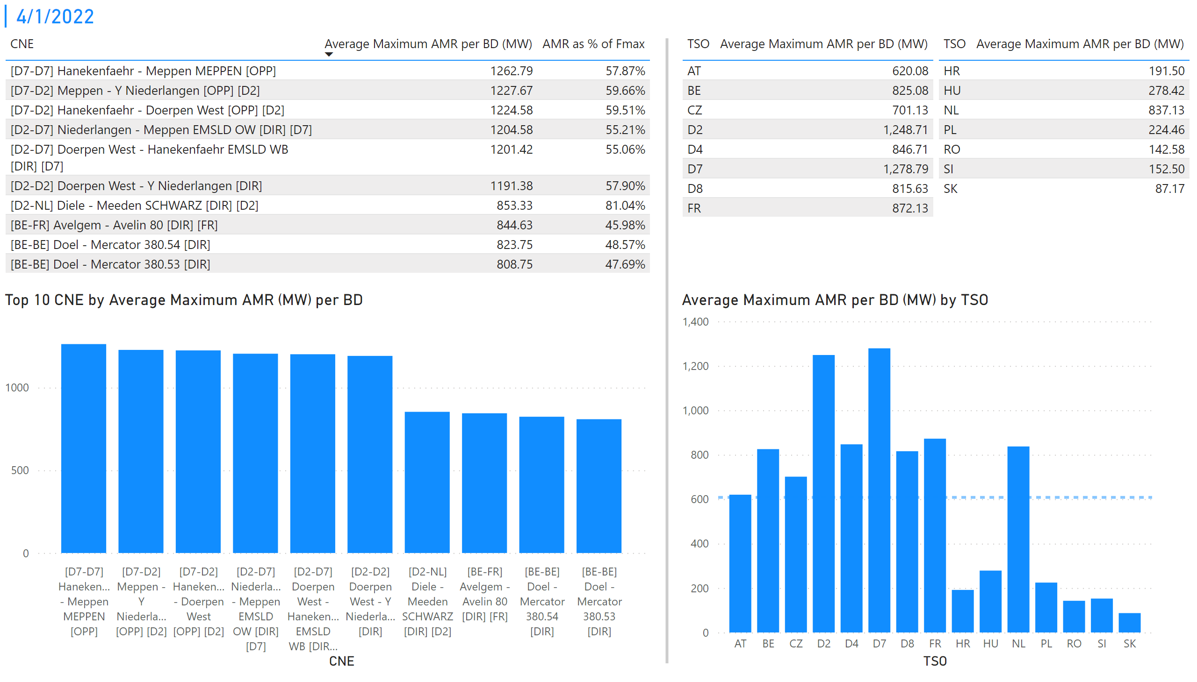
KPI 1 +2_1
KPI 1: Average maximum AMR per CNE per BD
KPI 2: Average maximum AMR per CNE per TSO
Notes:
tableEx
No alt text provided
Top 10 CNE by Average Maximum AMR (MW) per BD
No alt text provided
multiRowCard
No alt text provided
tableEx
No alt text provided
Average Maximum AMR per BD (MW) by TSO
No alt text provided
tableEx
No alt text provided
basicShape
No alt text provided

Slide 8
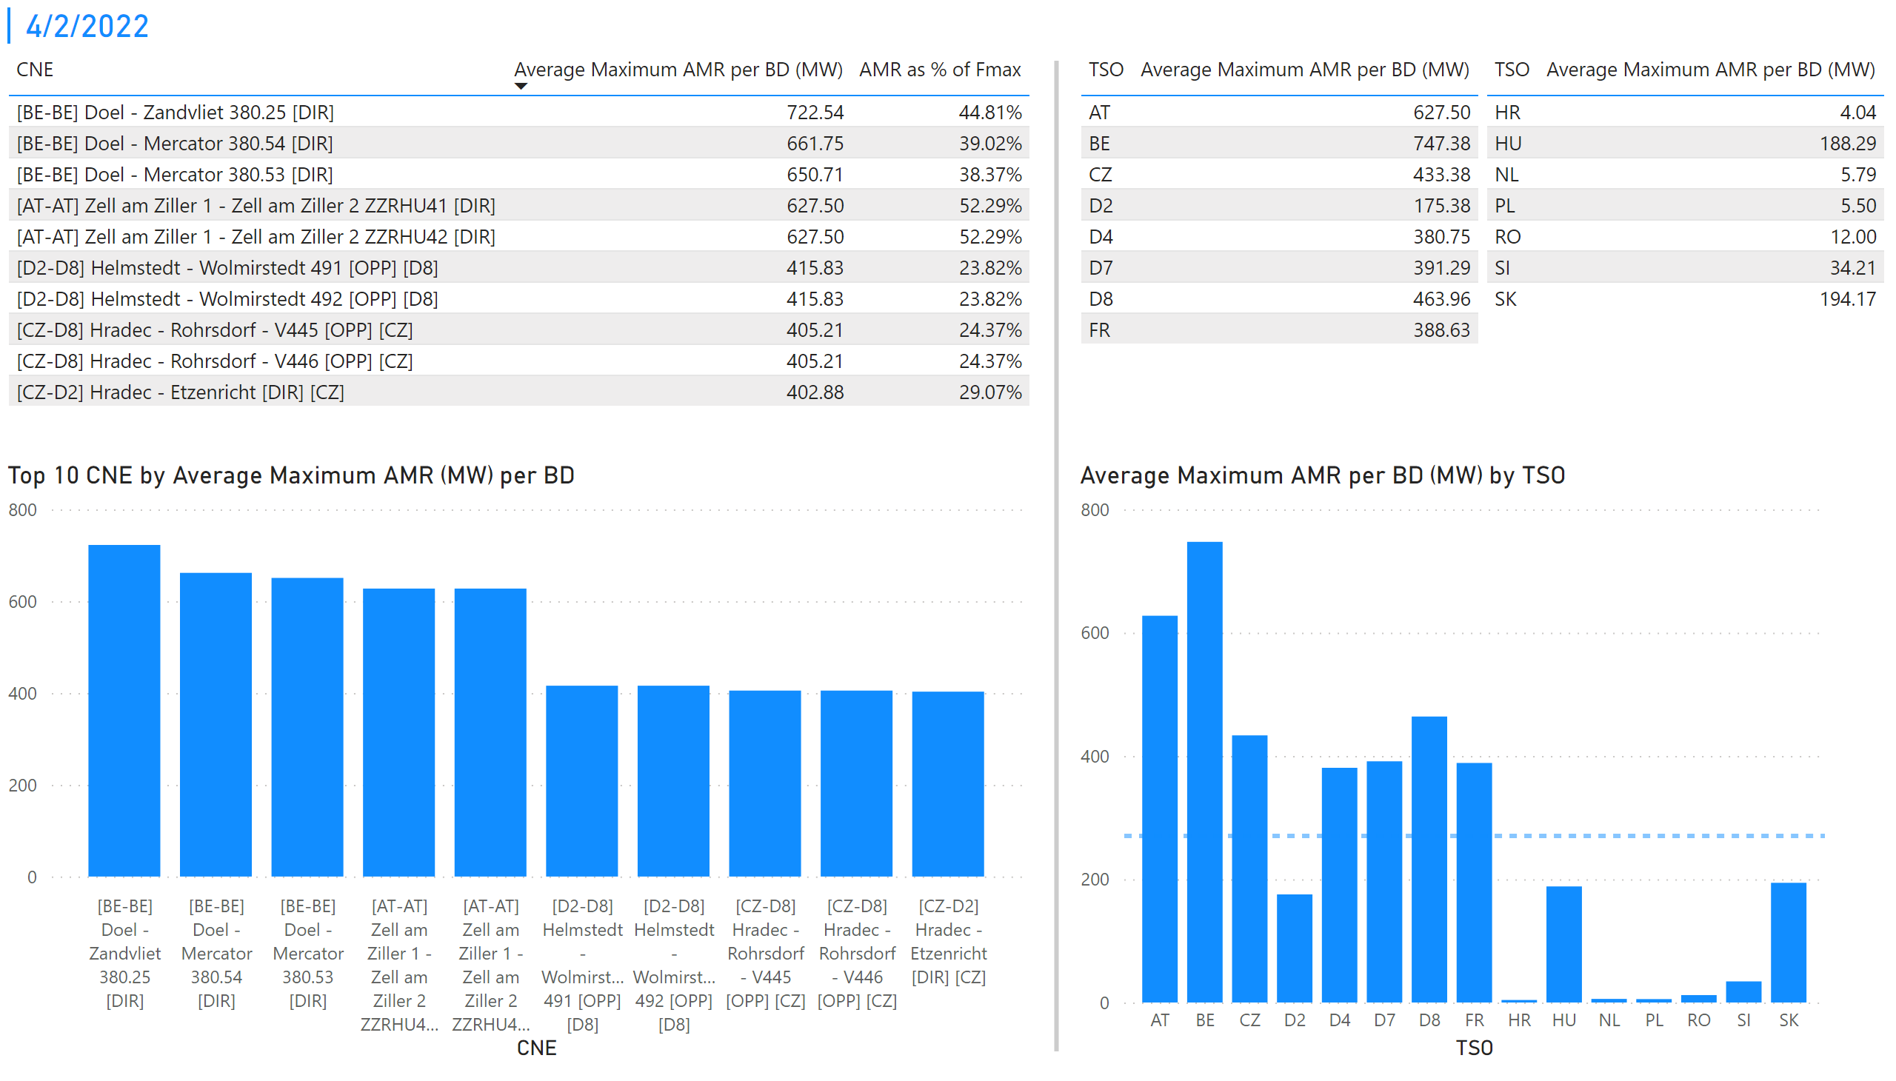
KPI 1 +2_2
KPI 1: Average maximum AMR per CNE per BD
KPI 2: Average maximum AMR per CNE per TSO
Notes:
tableEx
No alt text provided
Top 10 CNE by Average Maximum AMR (MW) per BD
No alt text provided
multiRowCard
No alt text provided
tableEx
No alt text provided
Average Maximum AMR per BD (MW) by TSO
No alt text provided
tableEx
No alt text provided
basicShape
No alt text provided

Slide 9
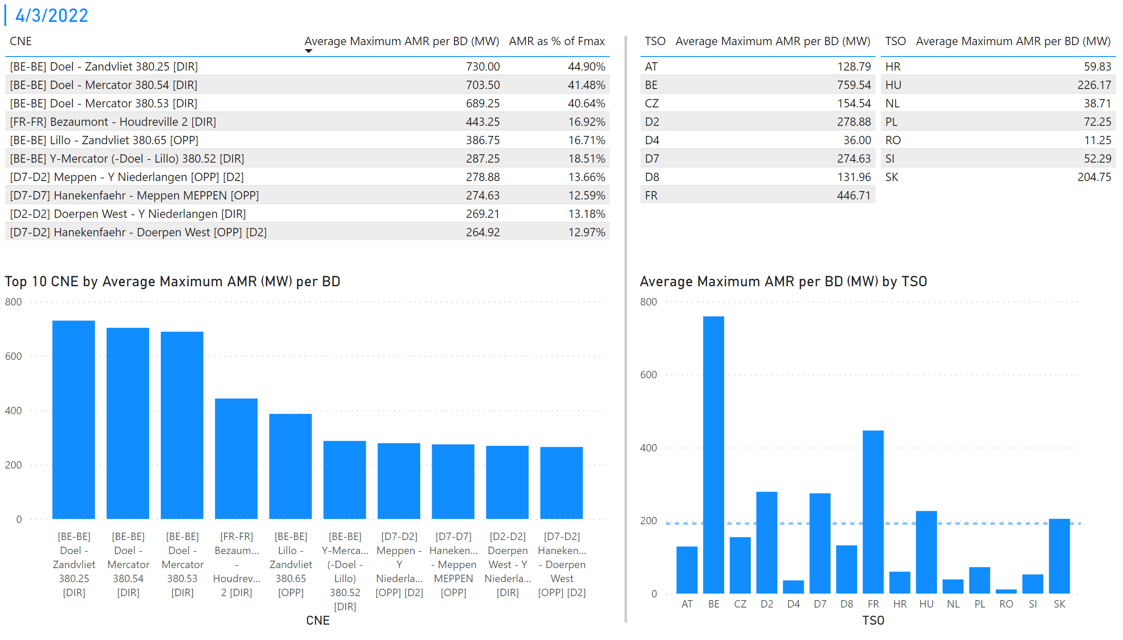
KPI 1 +2_3
KPI 1: Average maximum AMR per CNE per BD
KPI 2: Average maximum AMR per CNE per TSO
Notes:
tableEx
No alt text provided
Top 10 CNE by Average Maximum AMR (MW) per BD
No alt text provided
multiRowCard
No alt text provided
tableEx
No alt text provided
Average Maximum AMR per BD (MW) by TSO
No alt text provided
tableEx
No alt text provided
basicShape
No alt text provided

Slide 10
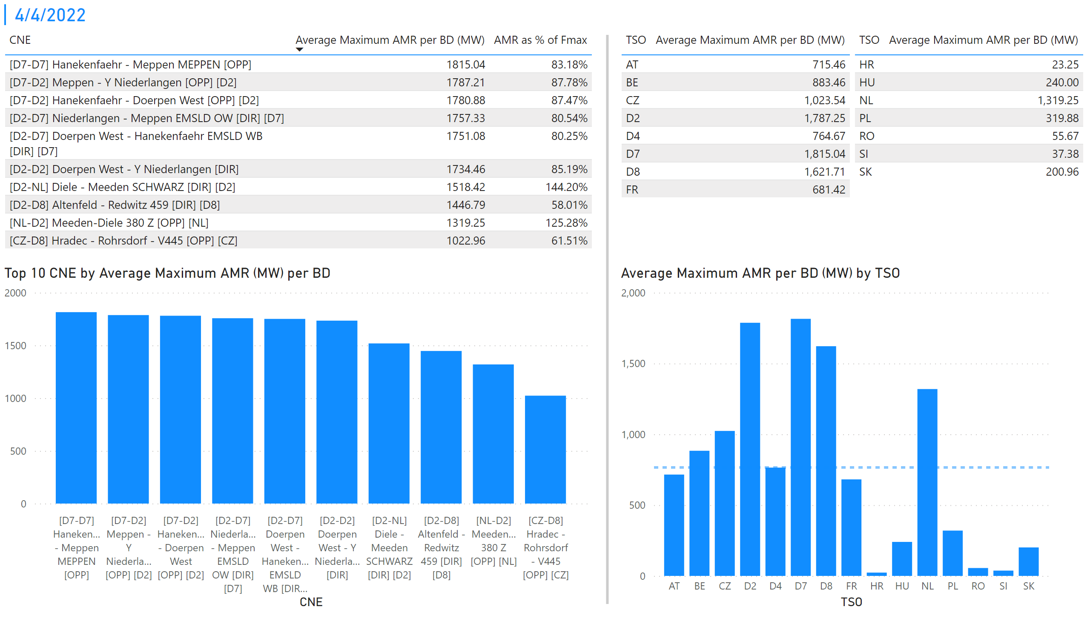
KPI 1 +2_4
KPI 1: Average maximum AMR per CNE per BD
KPI 2: Average maximum AMR per CNE per TSO
Notes:
tableEx
No alt text provided
Top 10 CNE by Average Maximum AMR (MW) per BD
No alt text provided
multiRowCard
No alt text provided
tableEx
No alt text provided
Average Maximum AMR per BD (MW) by TSO
No alt text provided
tableEx
No alt text provided
basicShape
No alt text provided

Slide 11
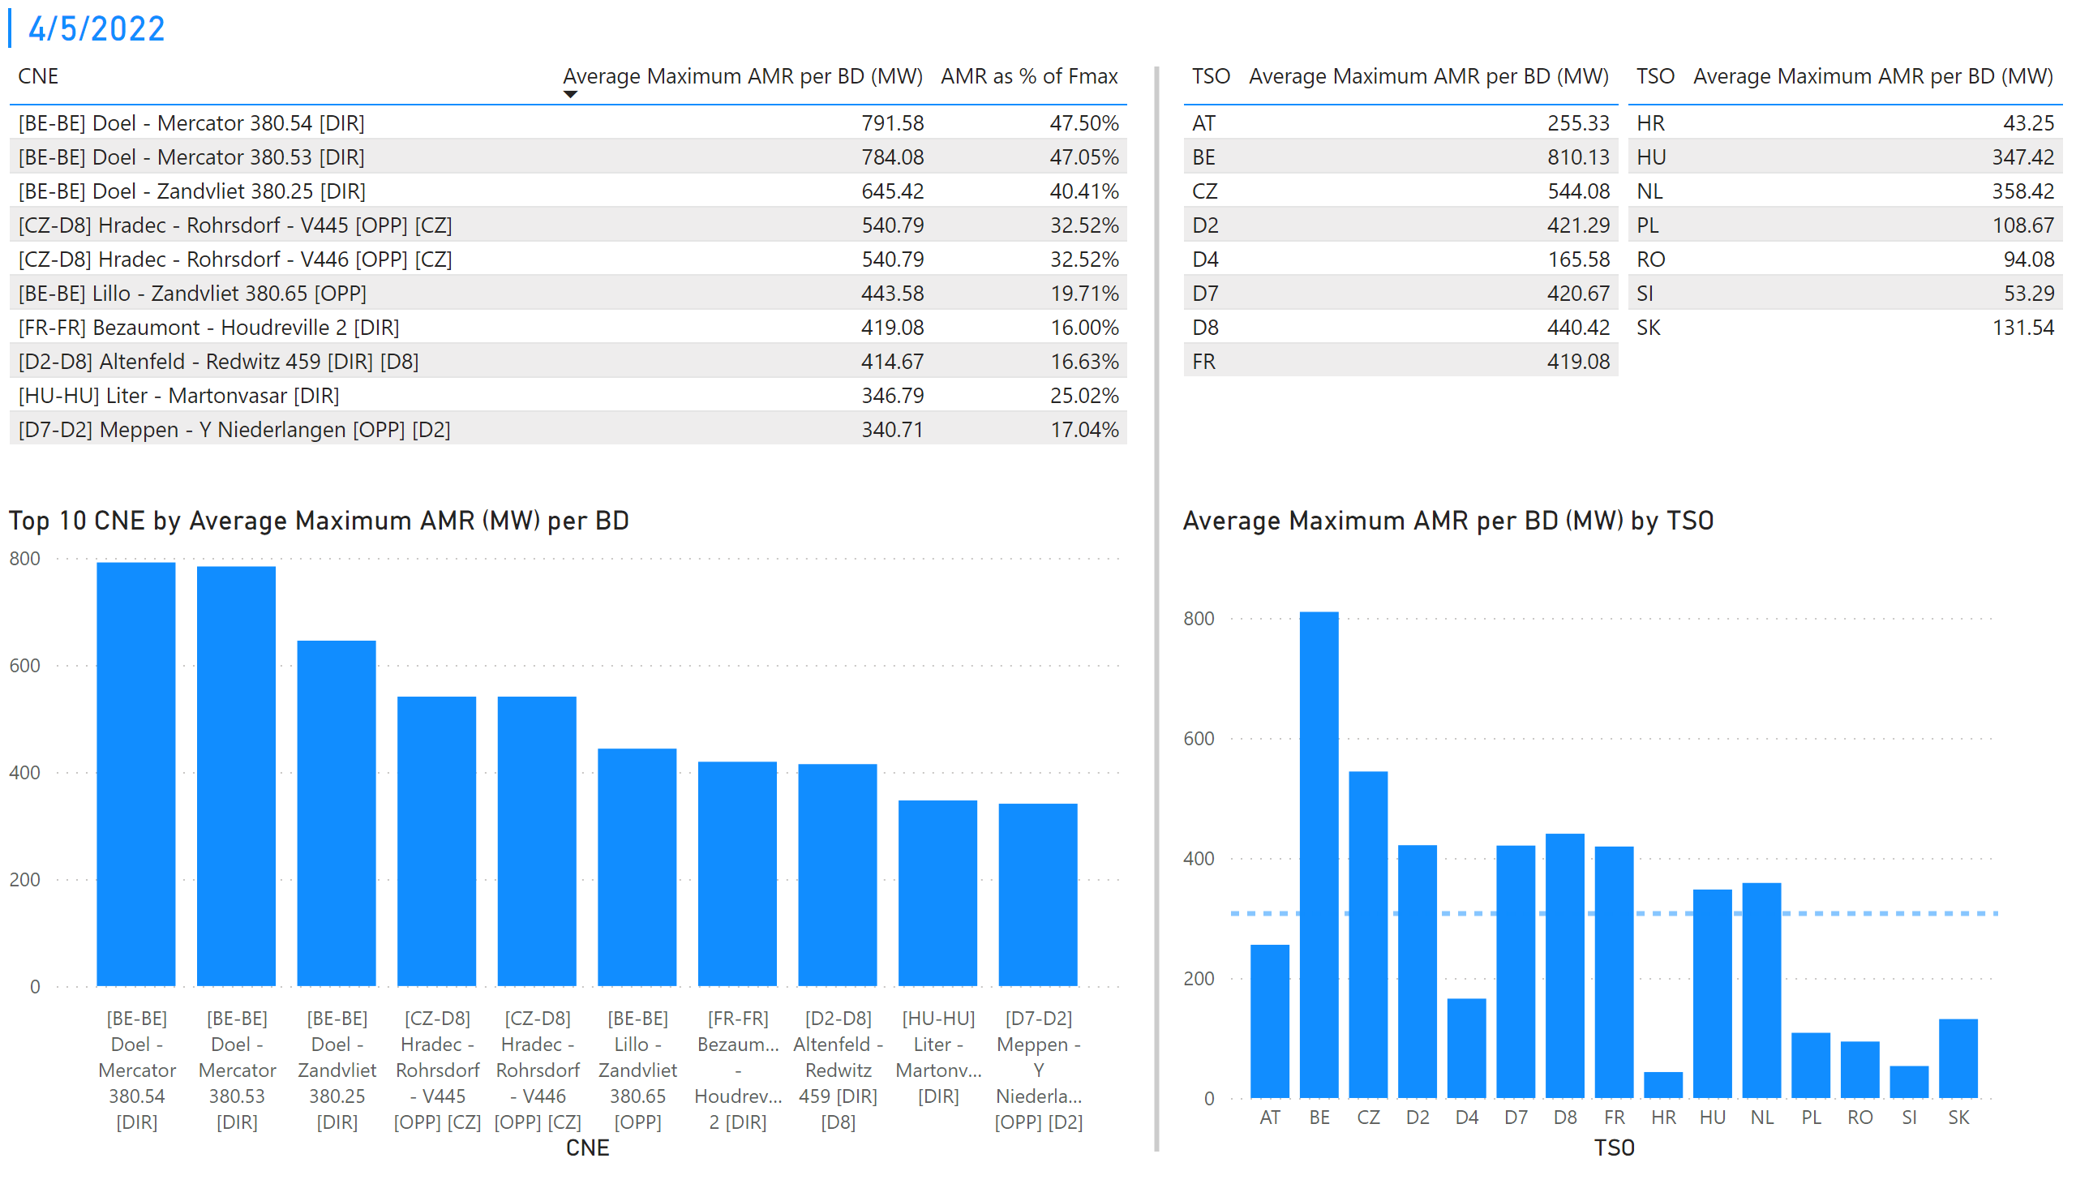
KPI 1 +2_5
KPI 1: Average maximum AMR per CNE per BD
KPI 2: Average maximum AMR per CNE per TSO
Notes:
tableEx
No alt text provided
Top 10 CNE by Average Maximum AMR (MW) per BD
No alt text provided
multiRowCard
No alt text provided
tableEx
No alt text provided
Average Maximum AMR per BD (MW) by TSO
No alt text provided
tableEx
No alt text provided
basicShape
No alt text provided

Slide 12
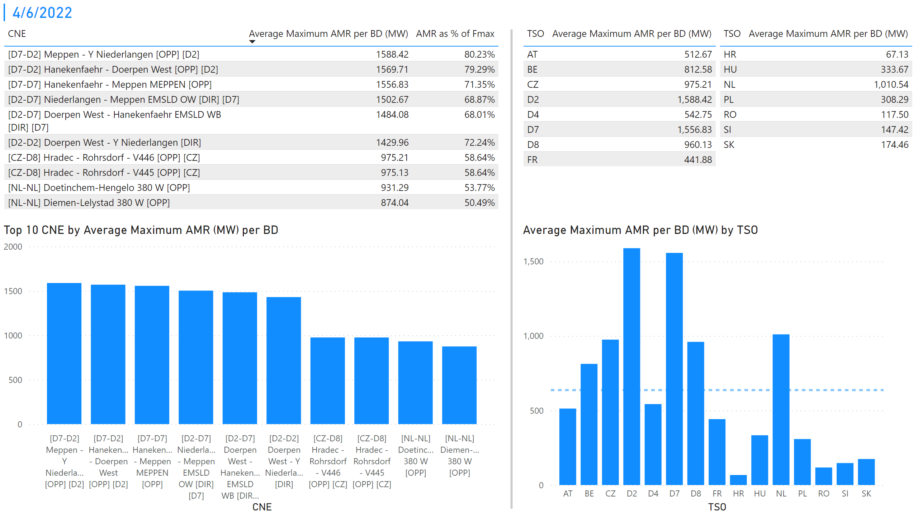
KPI 1 +2_6
KPI 1: Average maximum AMR per CNE per BD
KPI 2: Average maximum AMR per CNE per TSO
Notes:
tableEx
No alt text provided
Top 10 CNE by Average Maximum AMR (MW) per BD
No alt text provided
multiRowCard
No alt text provided
tableEx
No alt text provided
Average Maximum AMR per BD (MW) by TSO
No alt text provided
tableEx
No alt text provided
basicShape
No alt text provided

Slide 13
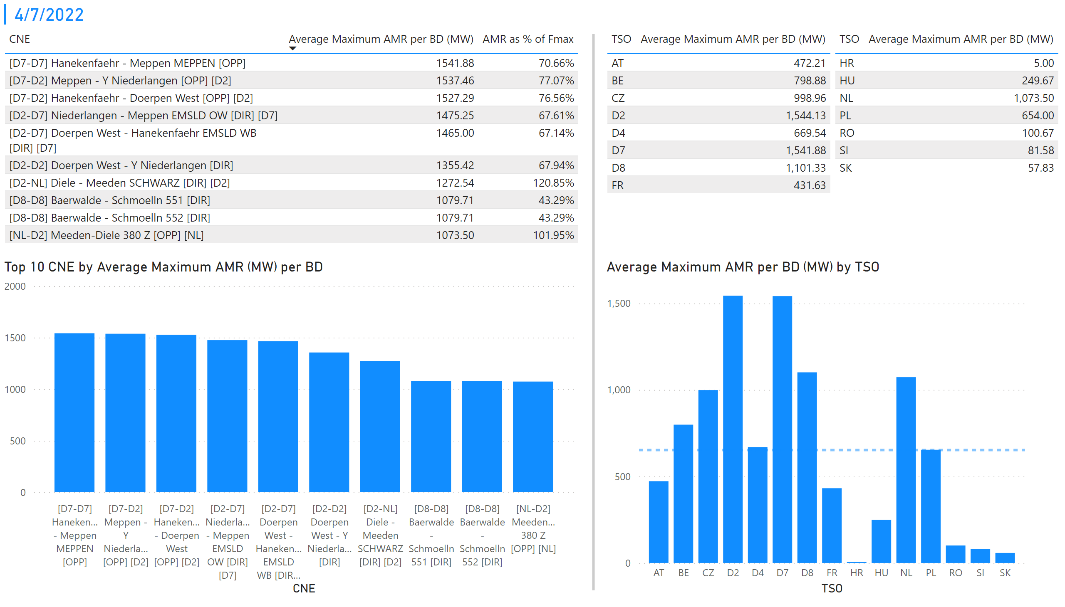
KPI 1 +2_7
KPI 1: Average maximum AMR per CNE per BD
KPI 2: Average maximum AMR per CNE per TSO
Notes:
tableEx
No alt text provided
Top 10 CNE by Average Maximum AMR (MW) per BD
No alt text provided
multiRowCard
No alt text provided
tableEx
No alt text provided
Average Maximum AMR per BD (MW) by TSO
No alt text provided
tableEx
No alt text provided
basicShape
No alt text provided

Slide 14
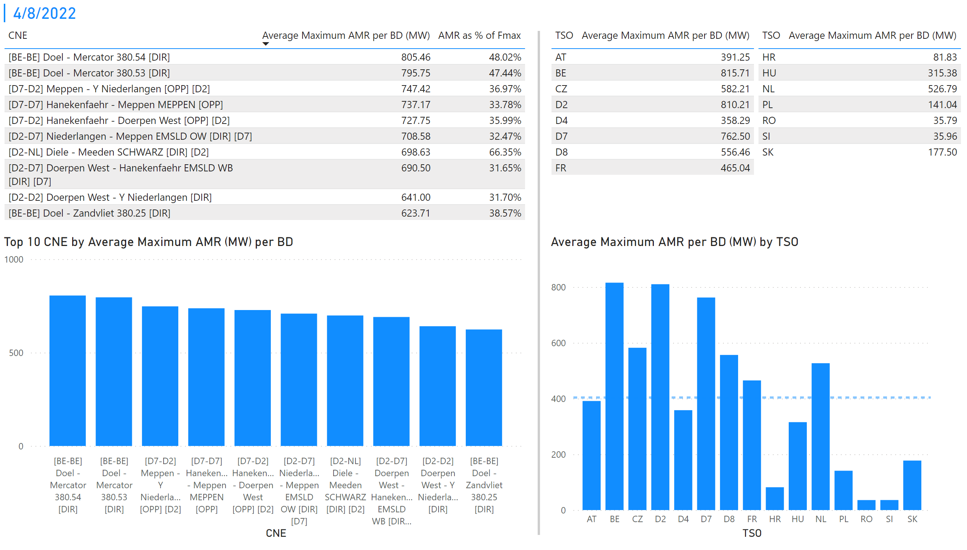
KPI 1 +2_8
KPI 1: Average maximum AMR per CNE per BD
KPI 2: Average maximum AMR per CNE per TSO
Notes:
tableEx
No alt text provided
Top 10 CNE by Average Maximum AMR (MW) per BD
No alt text provided
multiRowCard
No alt text provided
tableEx
No alt text provided
Average Maximum AMR per BD (MW) by TSO
No alt text provided
tableEx
No alt text provided
basicShape
No alt text provided

Slide 15
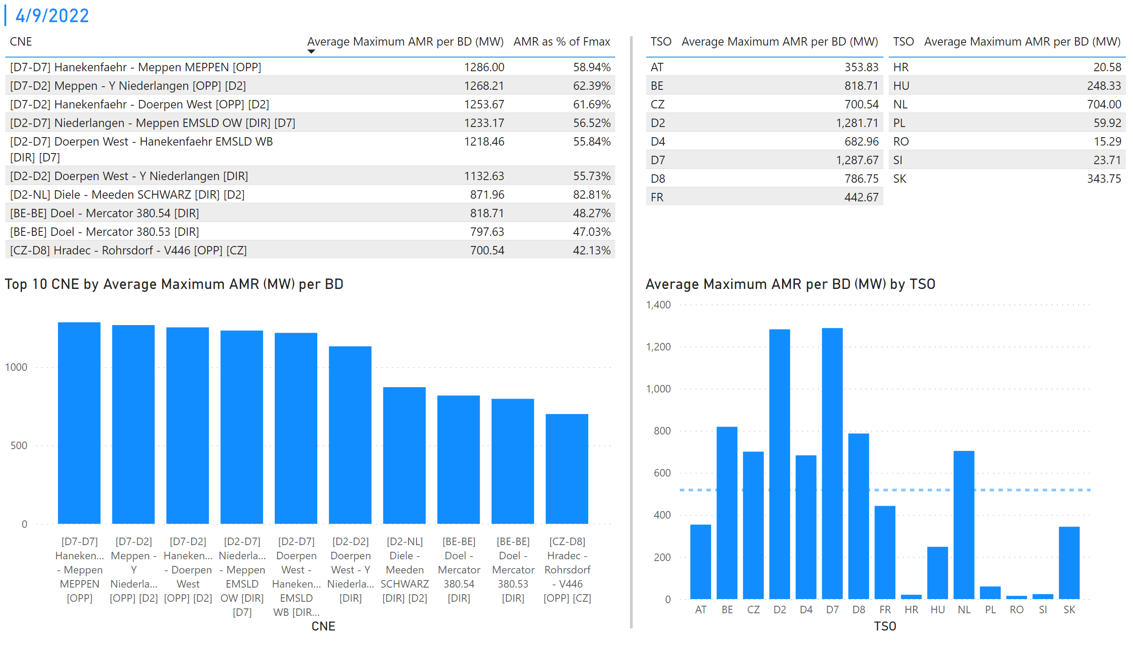
KPI 1 +2_9
KPI 1: Average maximum AMR per CNE per BD
KPI 2: Average maximum AMR per CNE per TSO
Notes:
tableEx
No alt text provided
Top 10 CNE by Average Maximum AMR (MW) per BD
No alt text provided
multiRowCard
No alt text provided
tableEx
No alt text provided
Average Maximum AMR per BD (MW) by TSO
No alt text provided
tableEx
No alt text provided
basicShape
No alt text provided

Slide 16
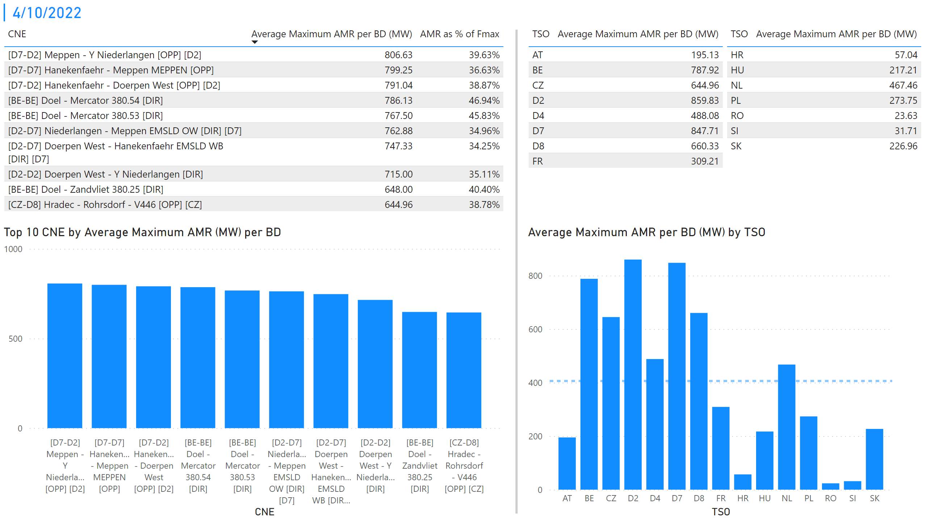
KPI 1 +2_10
KPI 1: Average maximum AMR per CNE per BD
KPI 2: Average maximum AMR per CNE per TSO
Notes:
tableEx
No alt text provided
Top 10 CNE by Average Maximum AMR (MW) per BD
No alt text provided
multiRowCard
No alt text provided
tableEx
No alt text provided
Average Maximum AMR per BD (MW) by TSO
No alt text provided
tableEx
No alt text provided
basicShape
No alt text provided

Slide 17
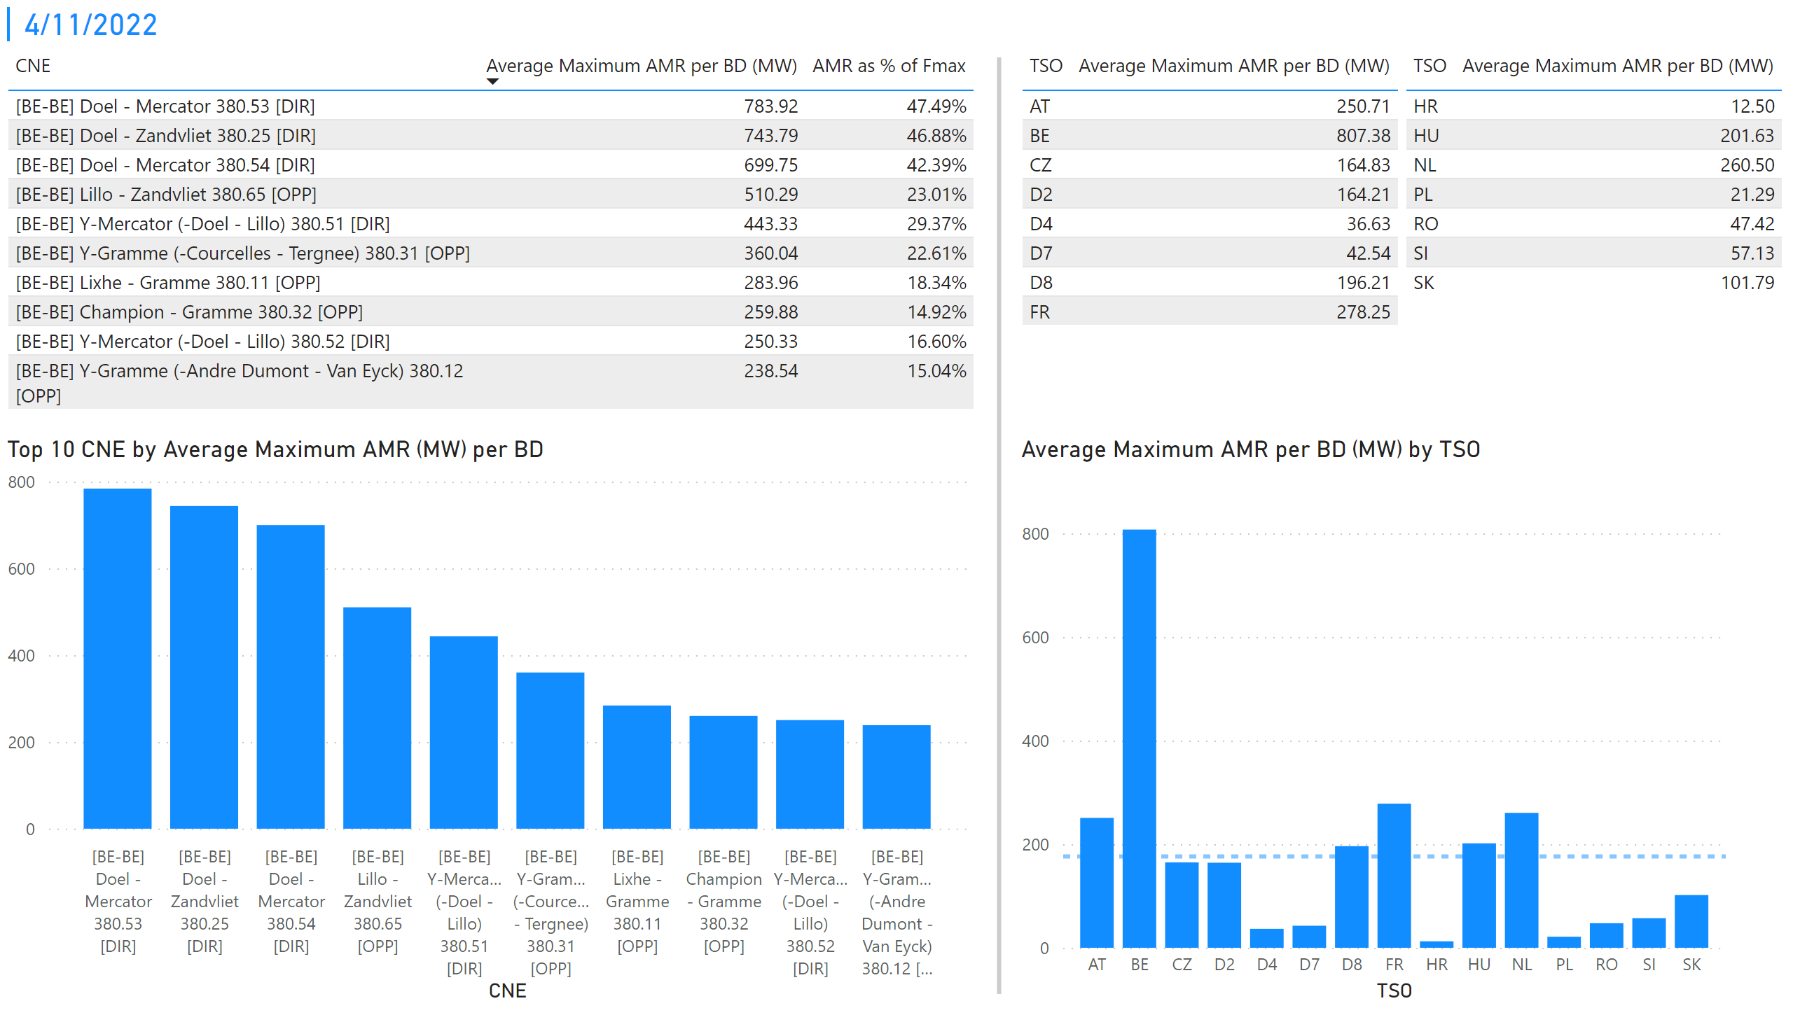
KPI 1 +2_11
KPI 1: Average maximum AMR per CNE per BD
KPI 2: Average maximum AMR per CNE per TSO
Notes:
tableEx
No alt text provided
Top 10 CNE by Average Maximum AMR (MW) per BD
No alt text provided
multiRowCard
No alt text provided
tableEx
No alt text provided
Average Maximum AMR per BD (MW) by TSO
No alt text provided
tableEx
No alt text provided
basicShape
No alt text provided

Slide 18
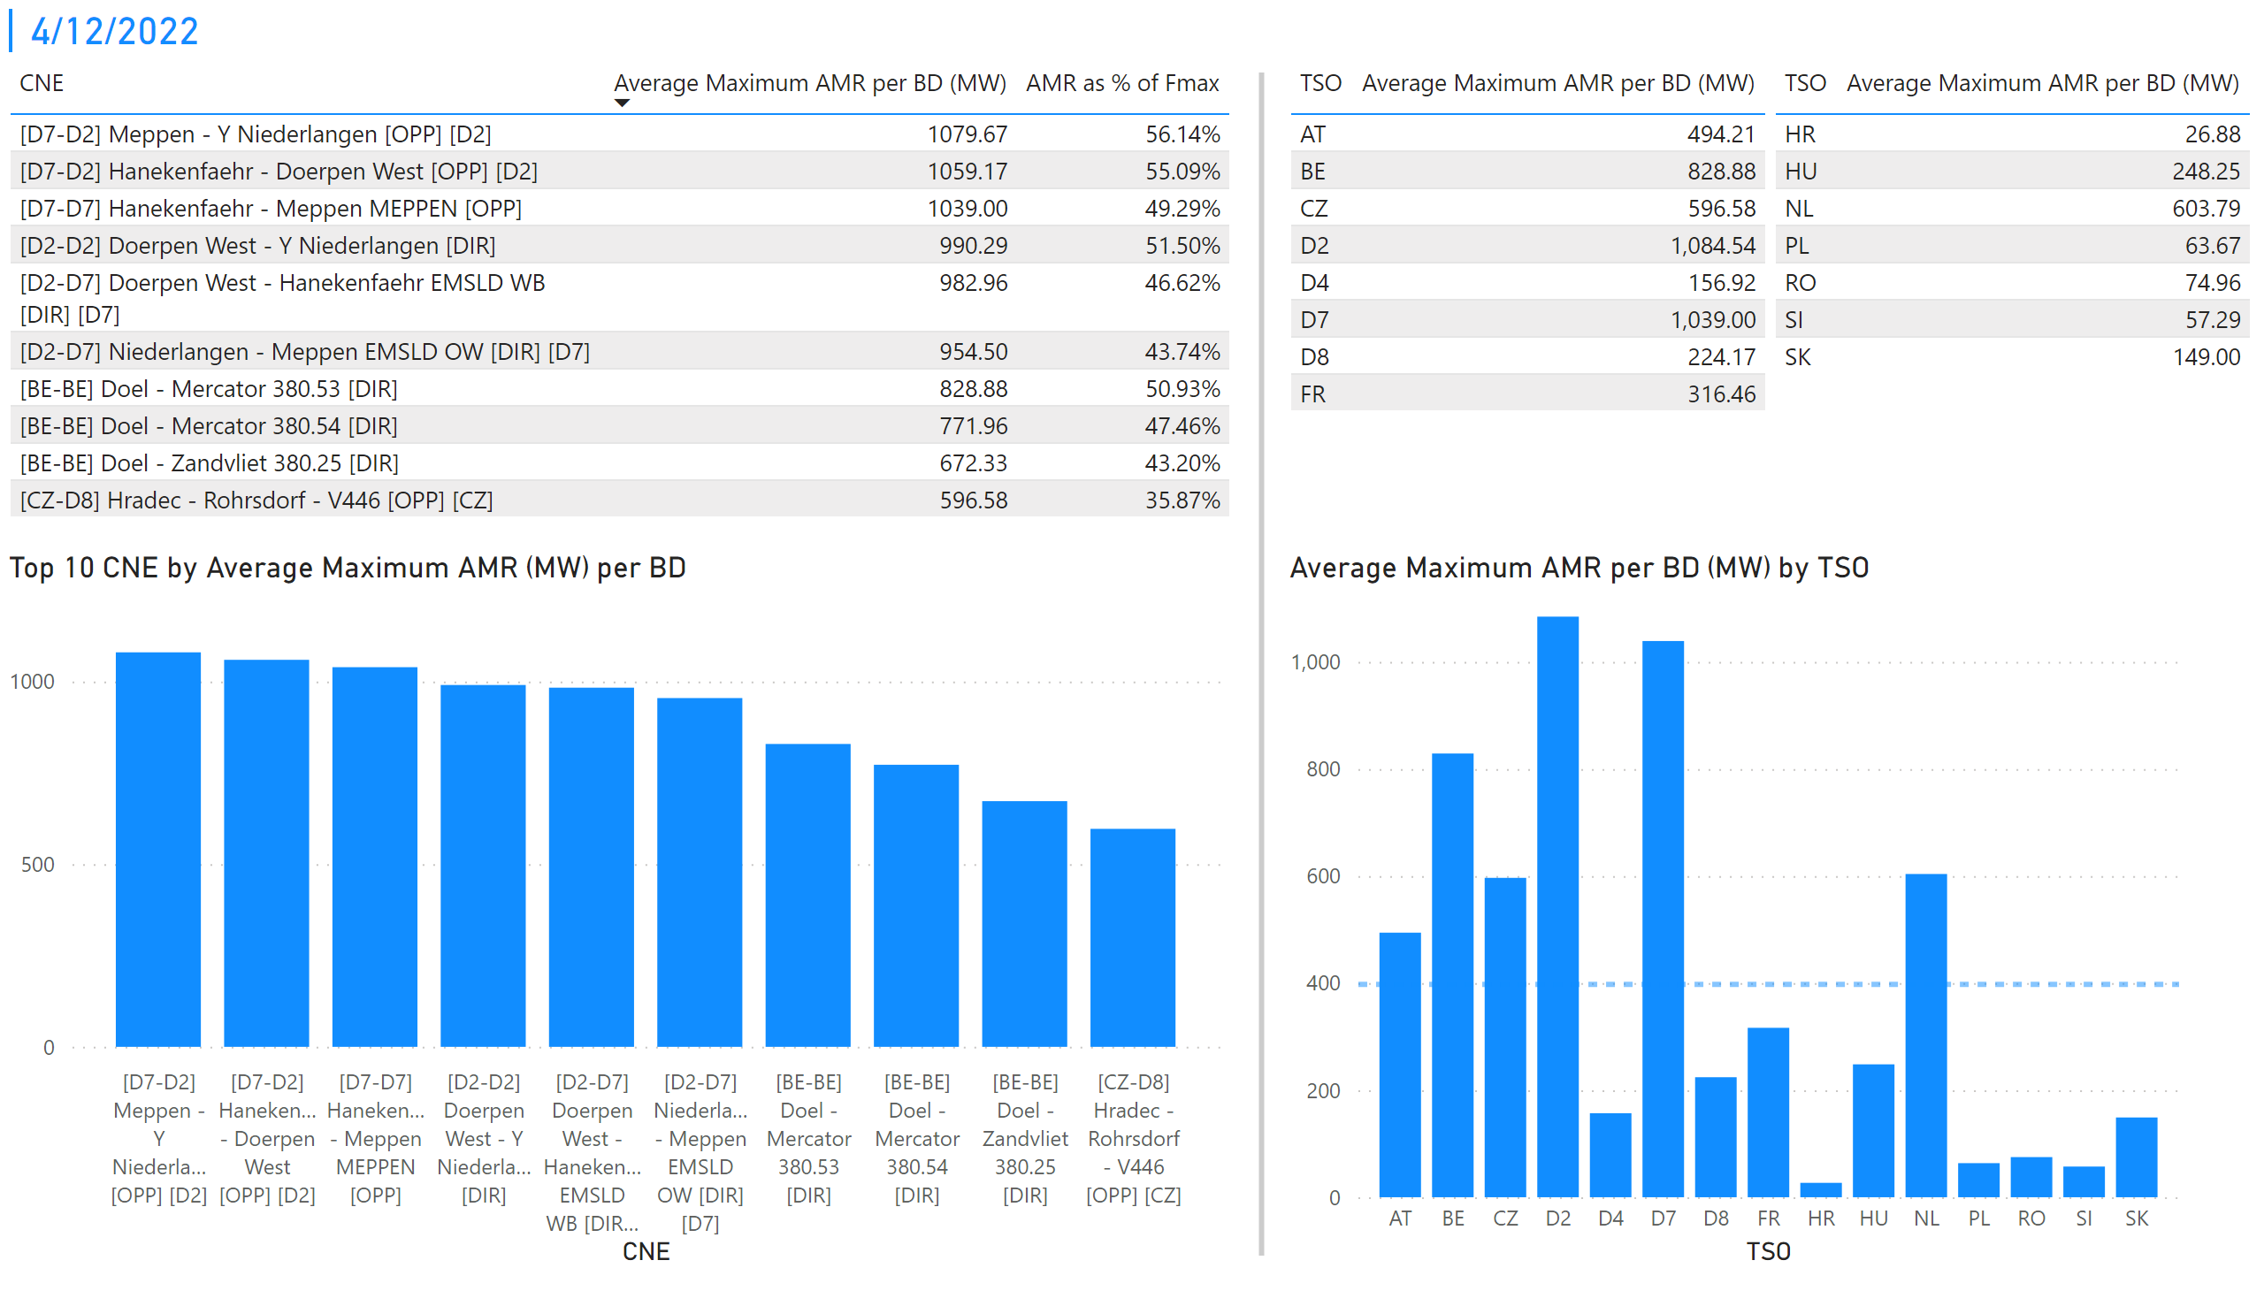
KPI 1 +2_12
KPI 1: Average maximum AMR per CNE per BD
KPI 2: Average maximum AMR per CNE per TSO
Notes:
tableEx
No alt text provided
Top 10 CNE by Average Maximum AMR (MW) per BD
No alt text provided
multiRowCard
No alt text provided
tableEx
No alt text provided
Average Maximum AMR per BD (MW) by TSO
No alt text provided
tableEx
No alt text provided
basicShape
No alt text provided

Slide 19
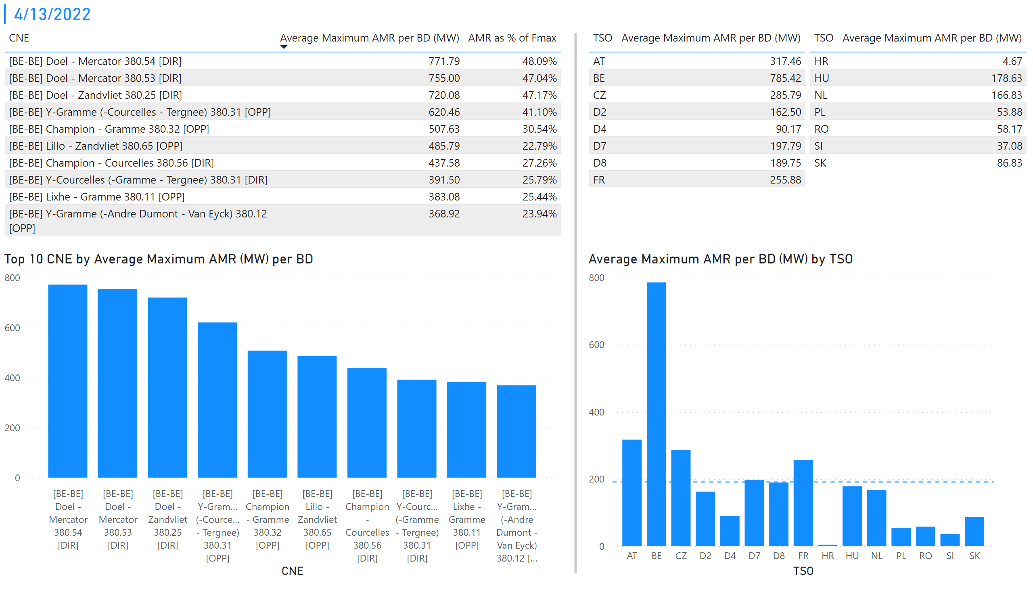
KPI 1 +2_13
KPI 1: Average maximum AMR per CNE per BD
KPI 2: Average maximum AMR per CNE per TSO
Notes:
tableEx
No alt text provided
Top 10 CNE by Average Maximum AMR (MW) per BD
No alt text provided
multiRowCard
No alt text provided
tableEx
No alt text provided
Average Maximum AMR per BD (MW) by TSO
No alt text provided
tableEx
No alt text provided
basicShape
No alt text provided

Slide 20
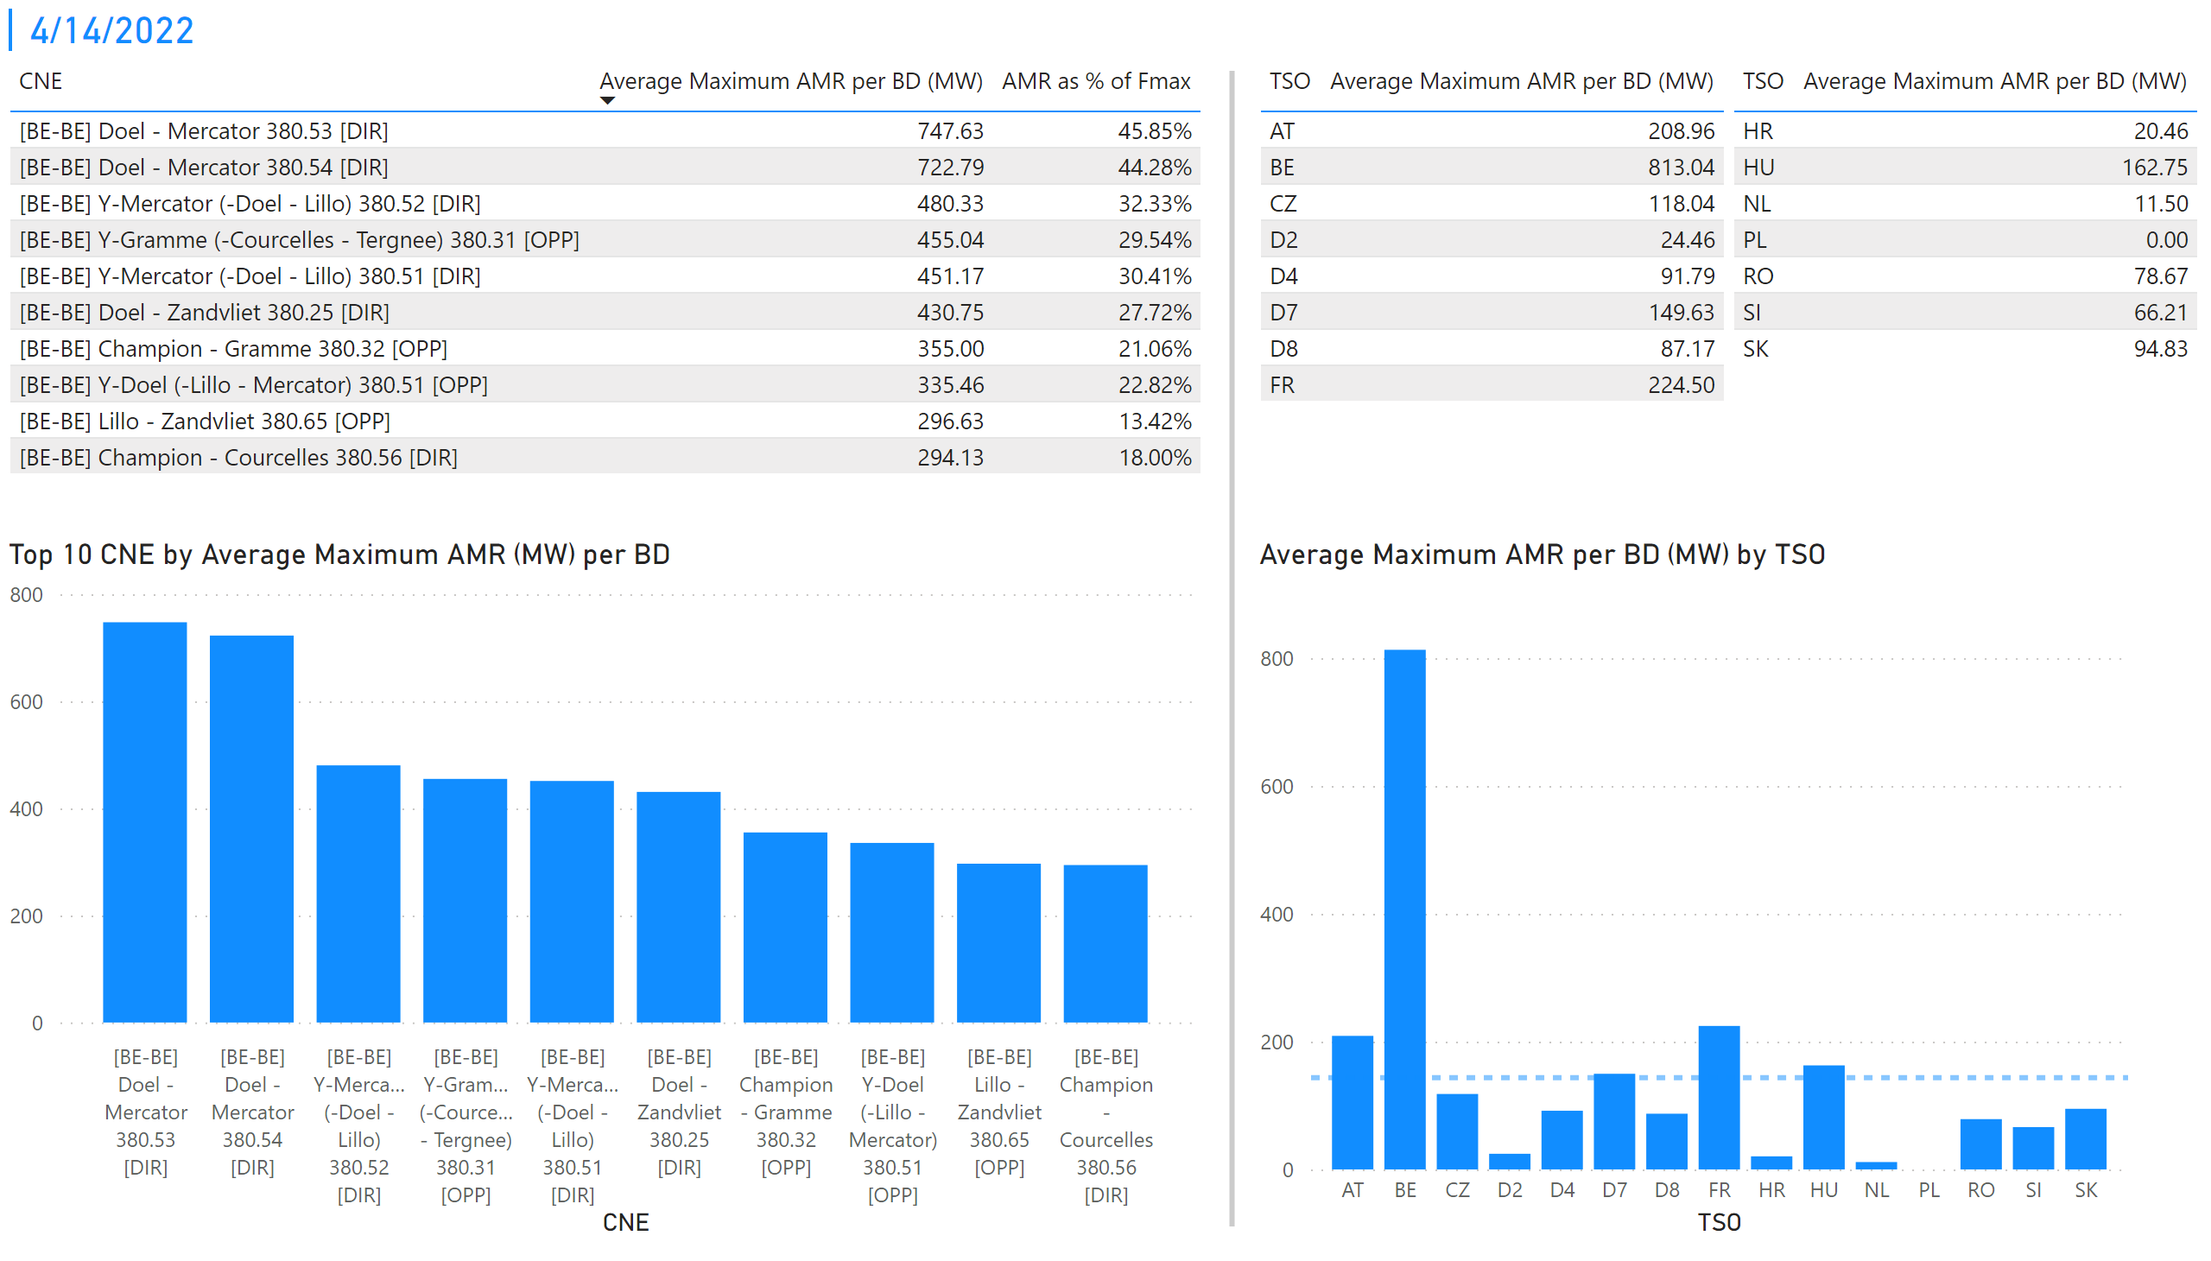
KPI 1 +2_14
KPI 1: Average maximum AMR per CNE per BD
KPI 2: Average maximum AMR per CNE per TSO
Notes:
tableEx
No alt text provided
Top 10 CNE by Average Maximum AMR (MW) per BD
No alt text provided
multiRowCard
No alt text provided
tableEx
No alt text provided
Average Maximum AMR per BD (MW) by TSO
No alt text provided
tableEx
No alt text provided
basicShape
No alt text provided

Slide 21
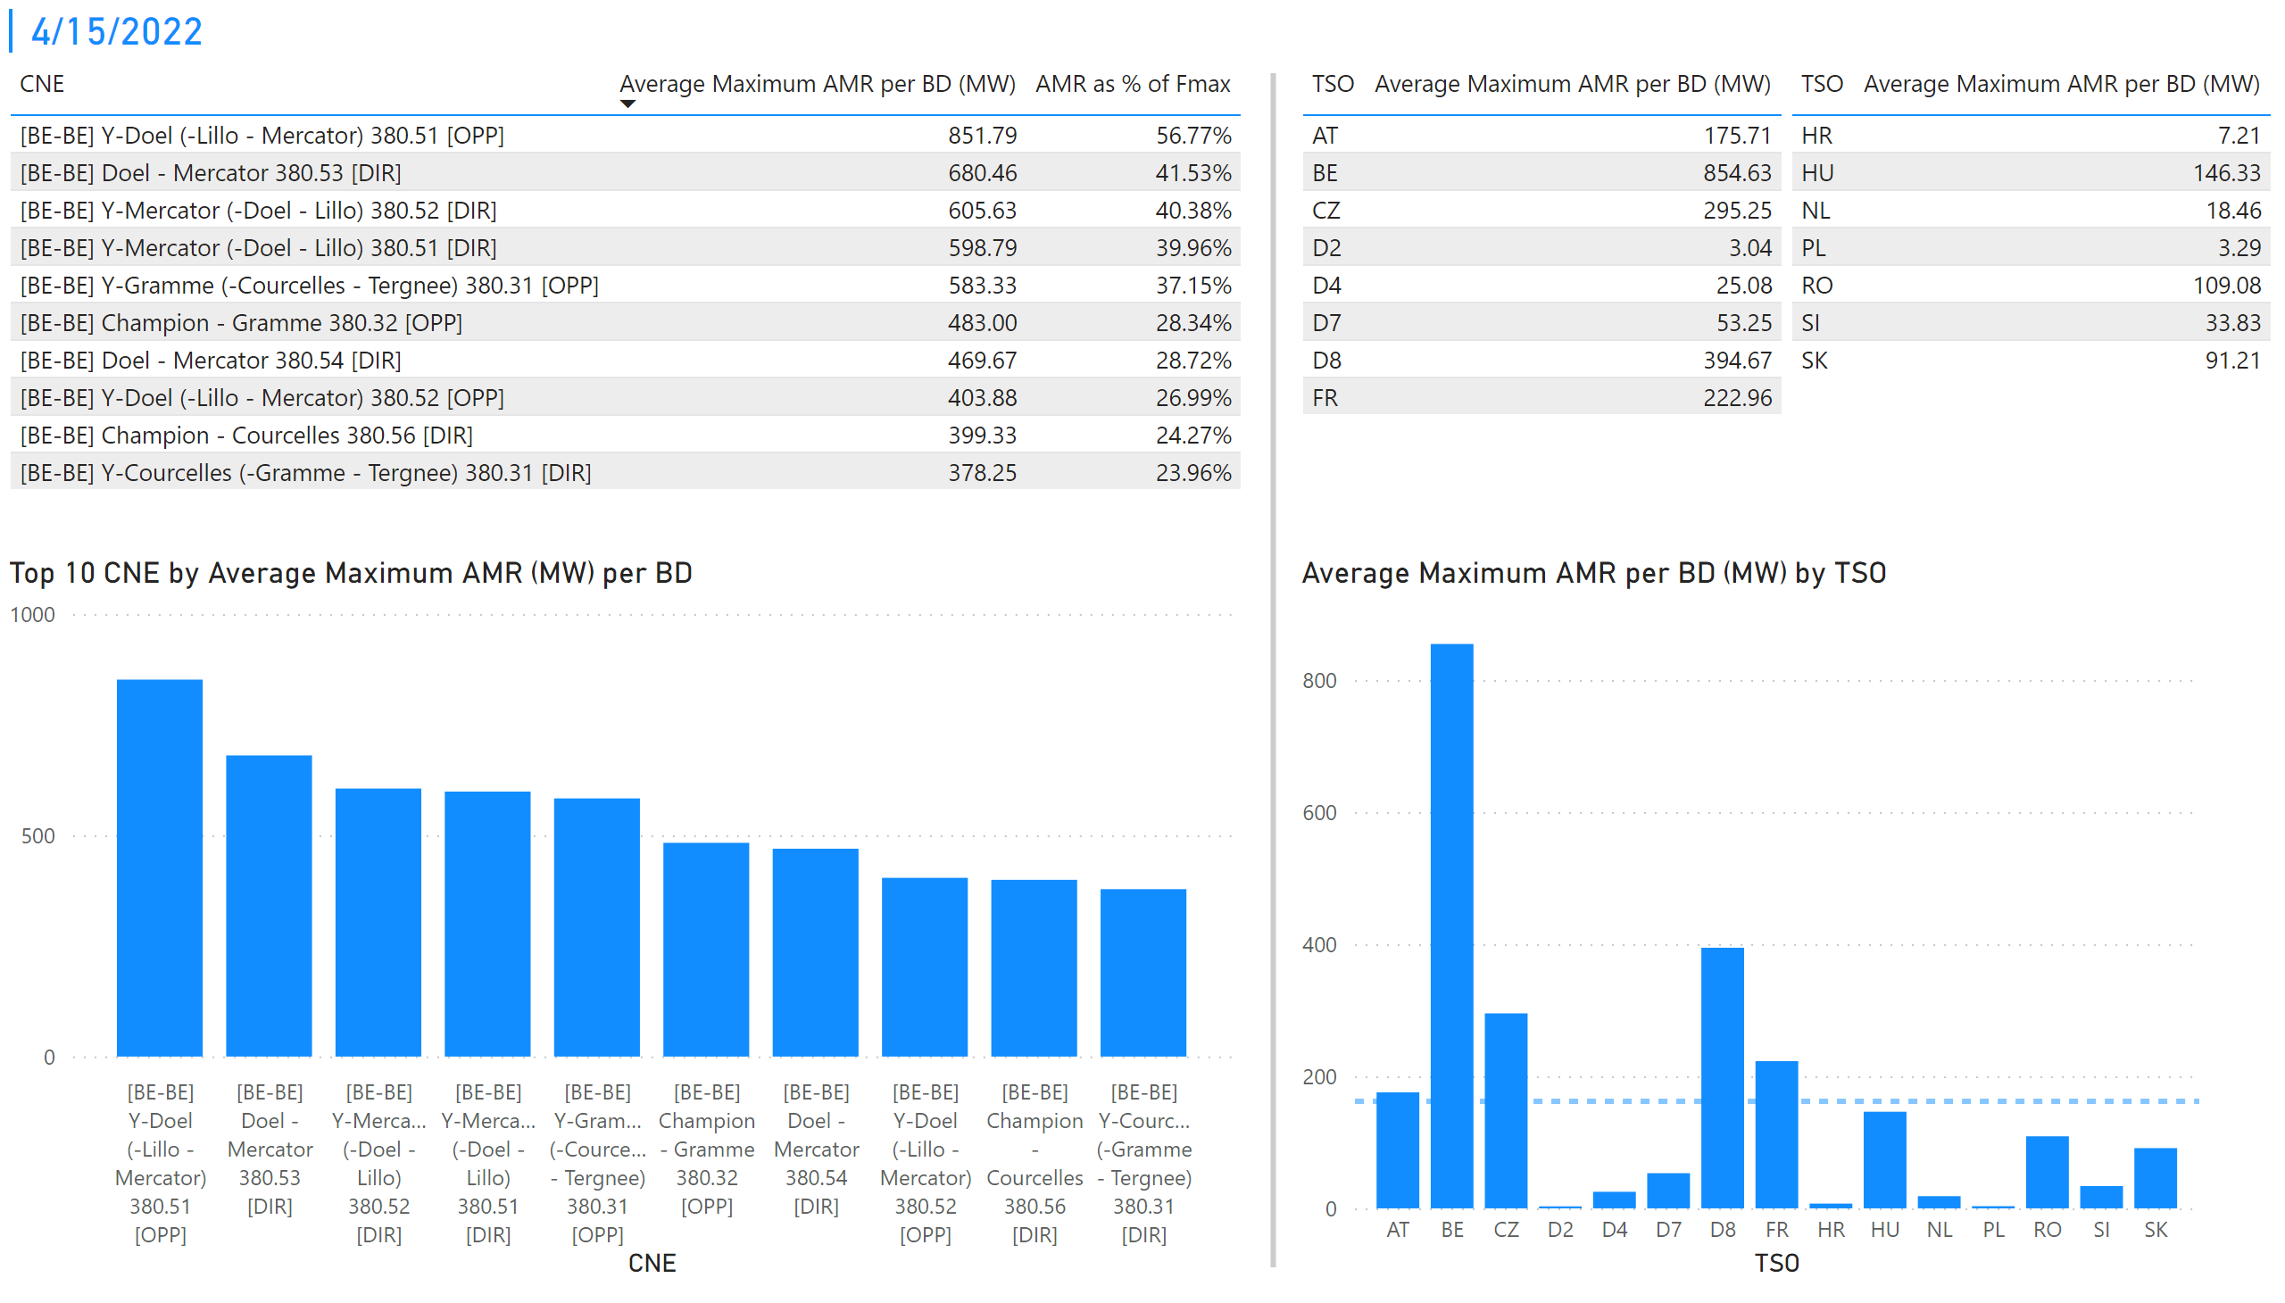
KPI 1 +2_15
KPI 1: Average maximum AMR per CNE per BD
KPI 2: Average maximum AMR per CNE per TSO
Notes:
tableEx
No alt text provided
Top 10 CNE by Average Maximum AMR (MW) per BD
No alt text provided
multiRowCard
No alt text provided
tableEx
No alt text provided
Average Maximum AMR per BD (MW) by TSO
No alt text provided
tableEx
No alt text provided
basicShape
No alt text provided

Slide 22
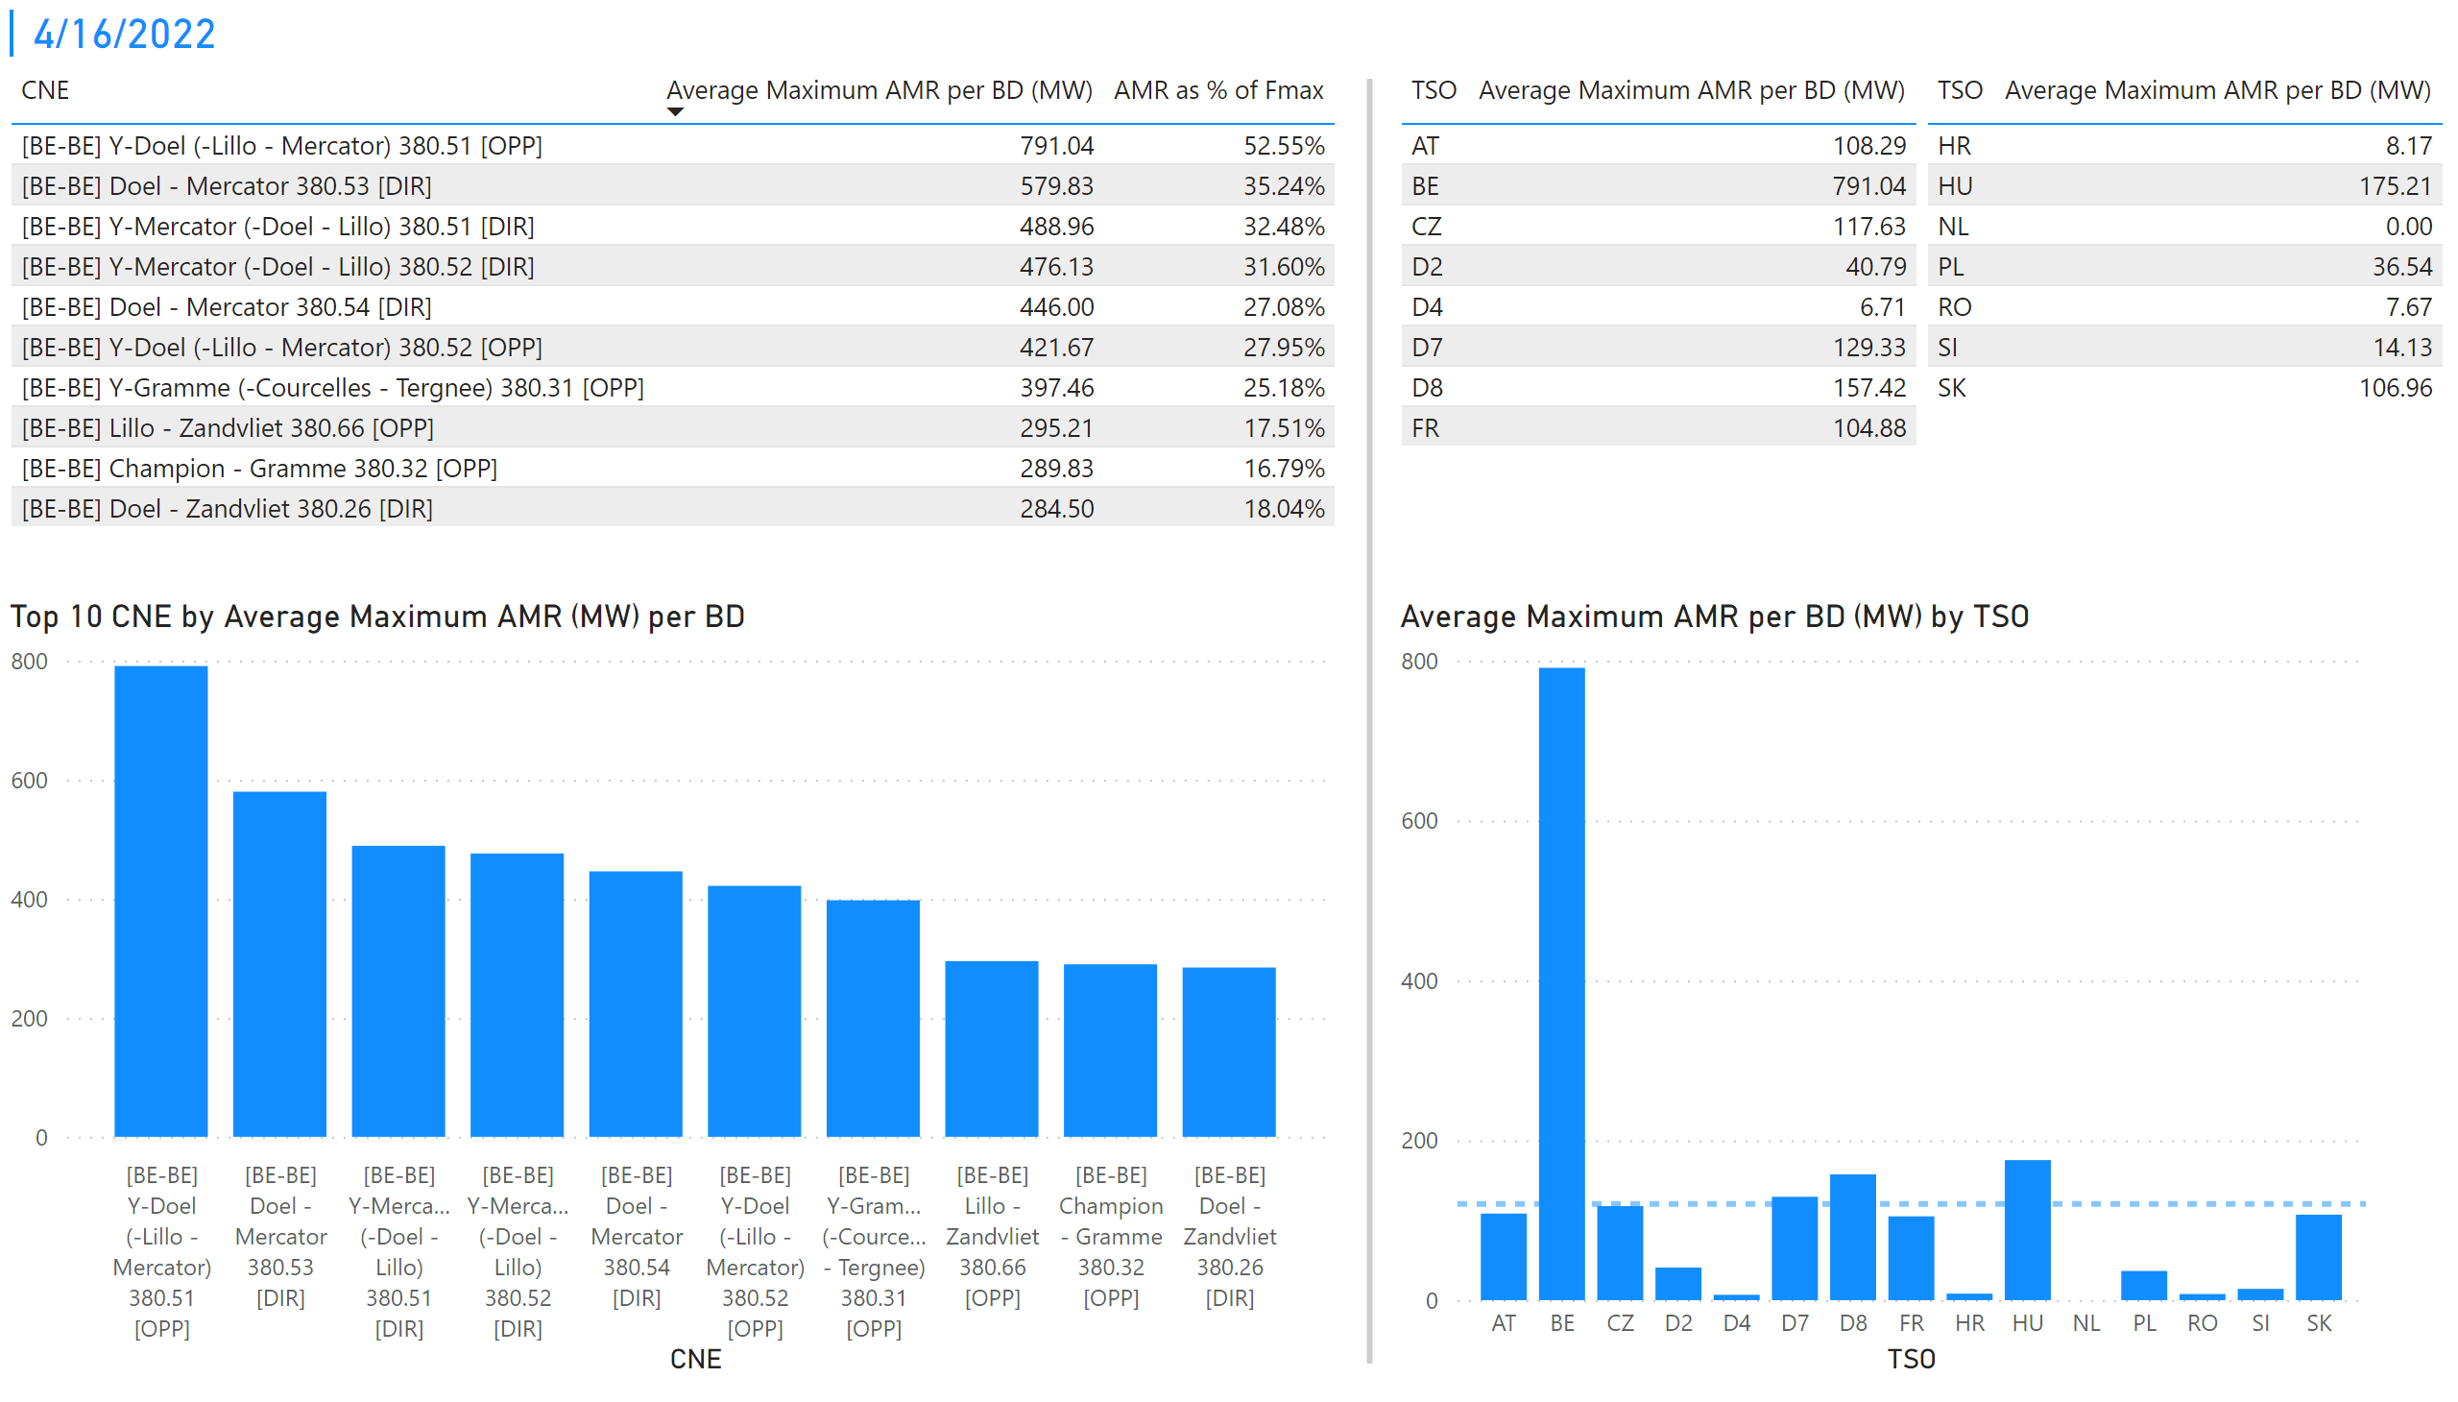
KPI 1 +2_16
KPI 1: Average maximum AMR per CNE per BD
KPI 2: Average maximum AMR per CNE per TSO
Notes:
tableEx
No alt text provided
Top 10 CNE by Average Maximum AMR (MW) per BD
No alt text provided
multiRowCard
No alt text provided
tableEx
No alt text provided
Average Maximum AMR per BD (MW) by TSO
No alt text provided
tableEx
No alt text provided
basicShape
No alt text provided

Slide 23
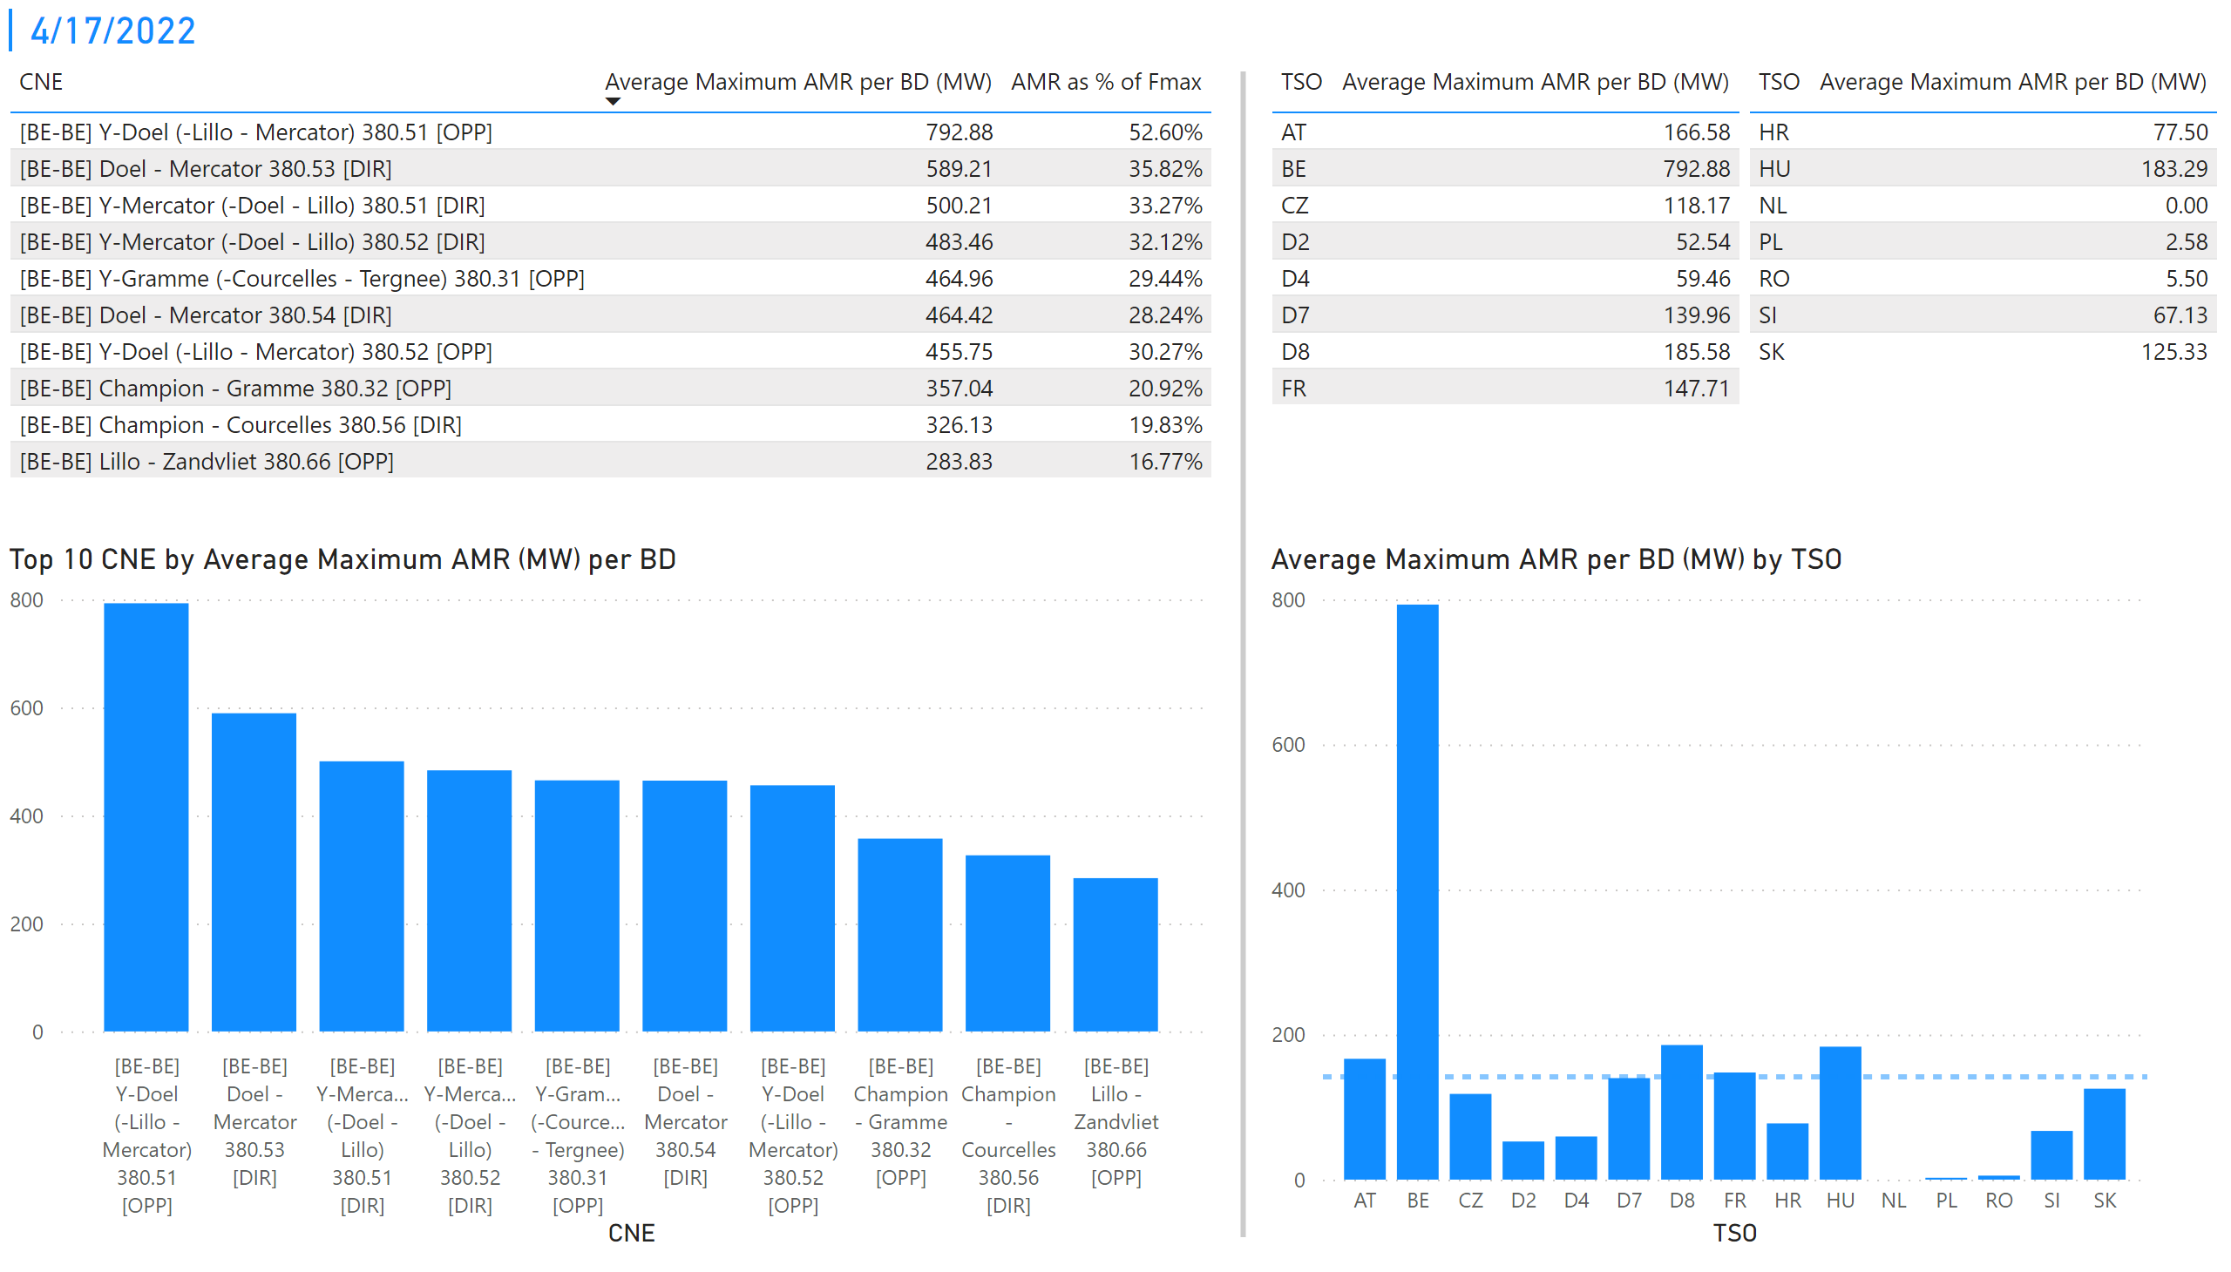
KPI 1 +2_17
KPI 1: Average maximum AMR per CNE per BD
KPI 2: Average maximum AMR per CNE per TSO
Notes:
tableEx
No alt text provided
Top 10 CNE by Average Maximum AMR (MW) per BD
No alt text provided
multiRowCard
No alt text provided
tableEx
No alt text provided
Average Maximum AMR per BD (MW) by TSO
No alt text provided
tableEx
No alt text provided
basicShape
No alt text provided

Slide 24
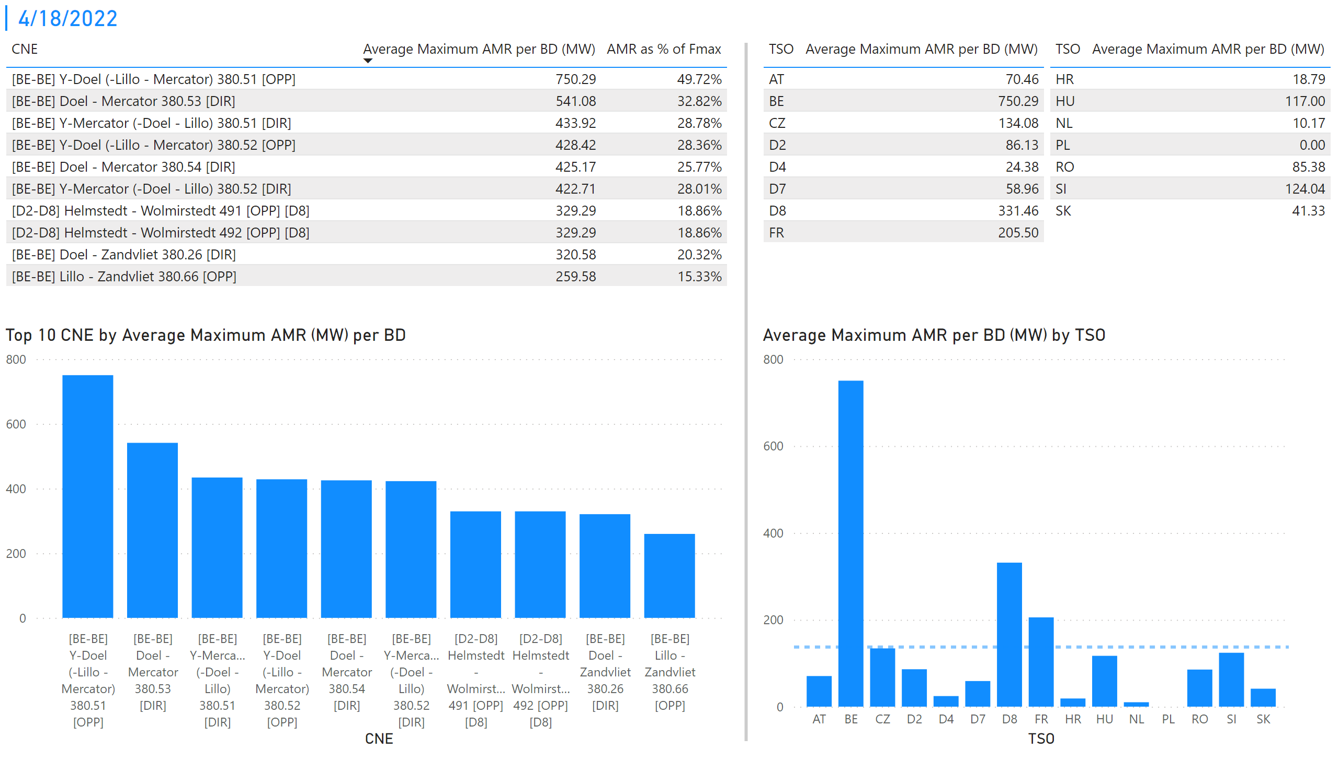
KPI 1 +2_18
KPI 1: Average maximum AMR per CNE per BD
KPI 2: Average maximum AMR per CNE per TSO
Notes:
tableEx
No alt text provided
Top 10 CNE by Average Maximum AMR (MW) per BD
No alt text provided
multiRowCard
No alt text provided
tableEx
No alt text provided
Average Maximum AMR per BD (MW) by TSO
No alt text provided
tableEx
No alt text provided
basicShape
No alt text provided

Slide 25
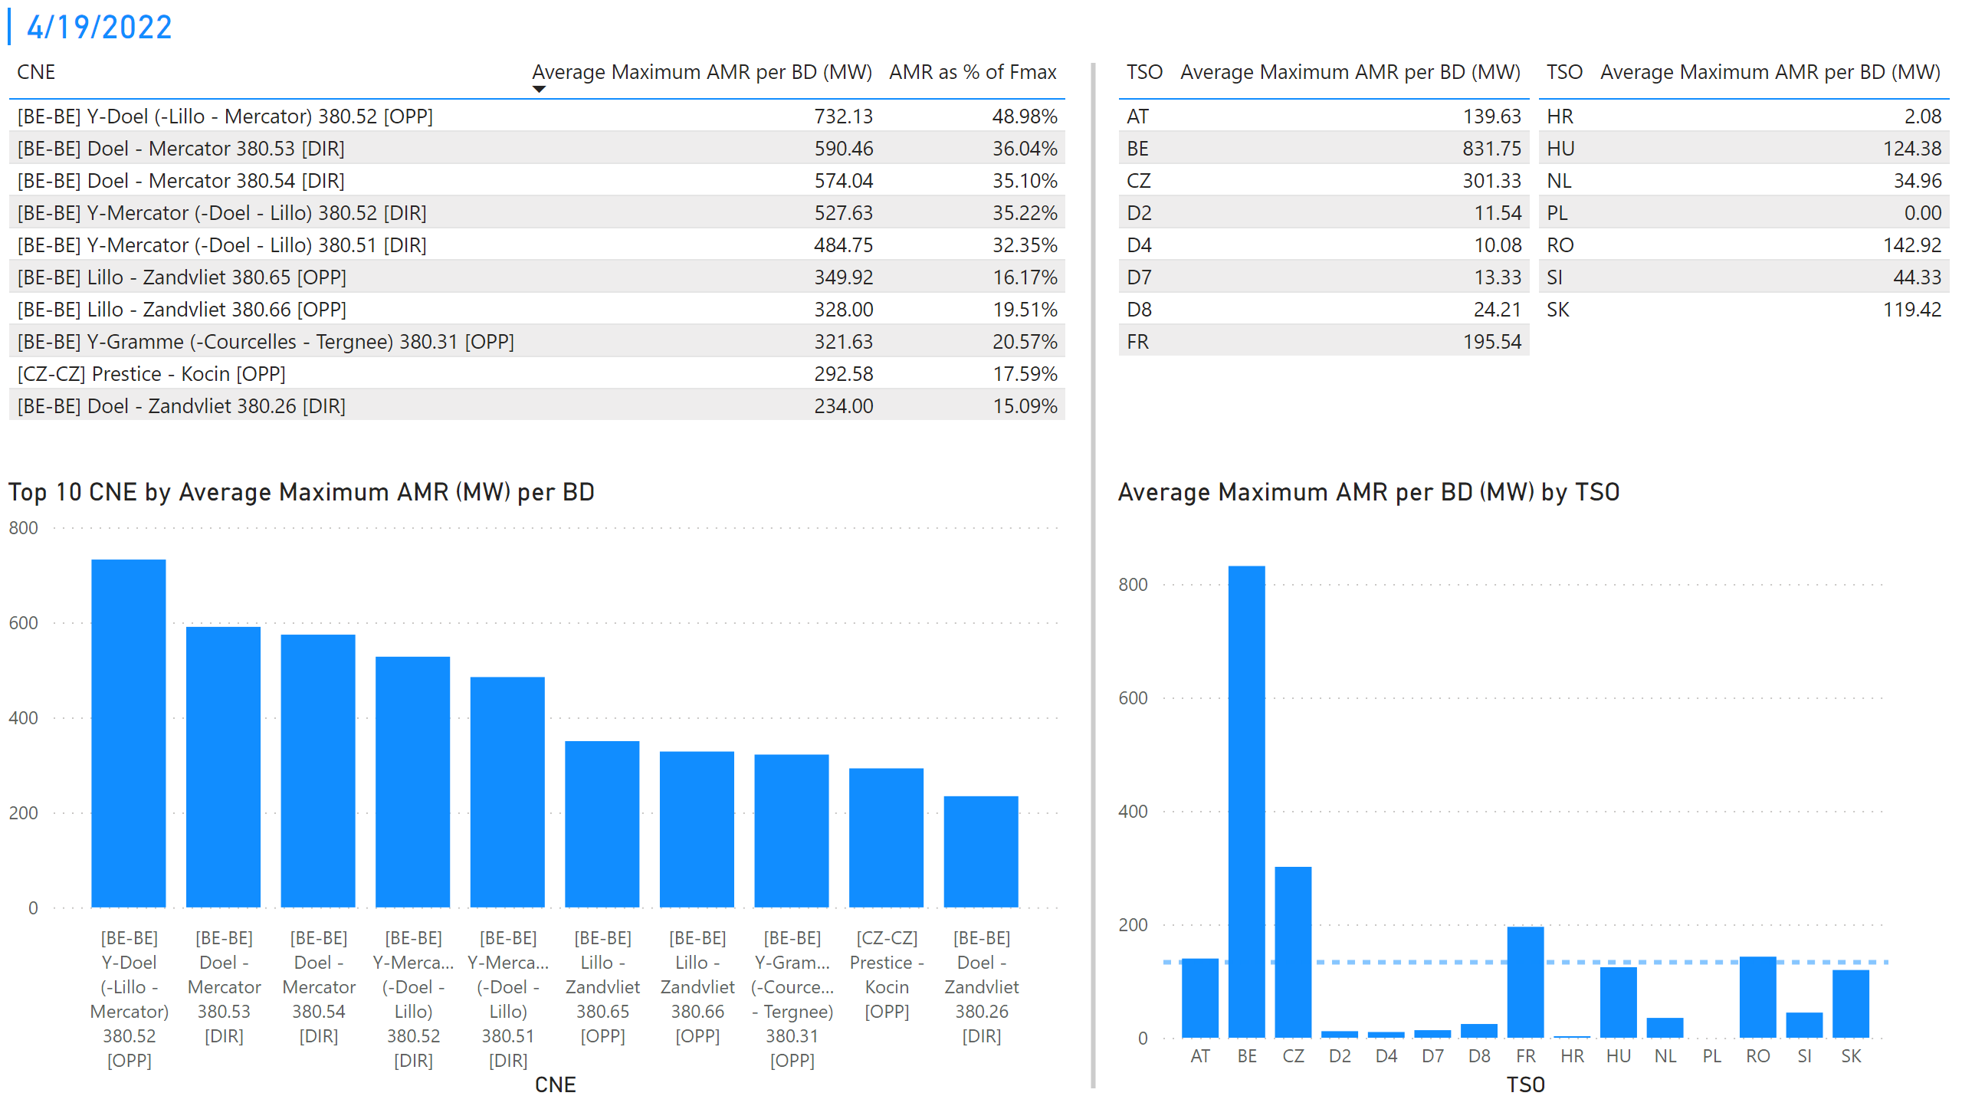
KPI 1 +2_19
KPI 1: Average maximum AMR per CNE per BD
KPI 2: Average maximum AMR per CNE per TSO
Notes:
tableEx
No alt text provided
Top 10 CNE by Average Maximum AMR (MW) per BD
No alt text provided
multiRowCard
No alt text provided
tableEx
No alt text provided
Average Maximum AMR per BD (MW) by TSO
No alt text provided
tableEx
No alt text provided
basicShape
No alt text provided

Slide 26
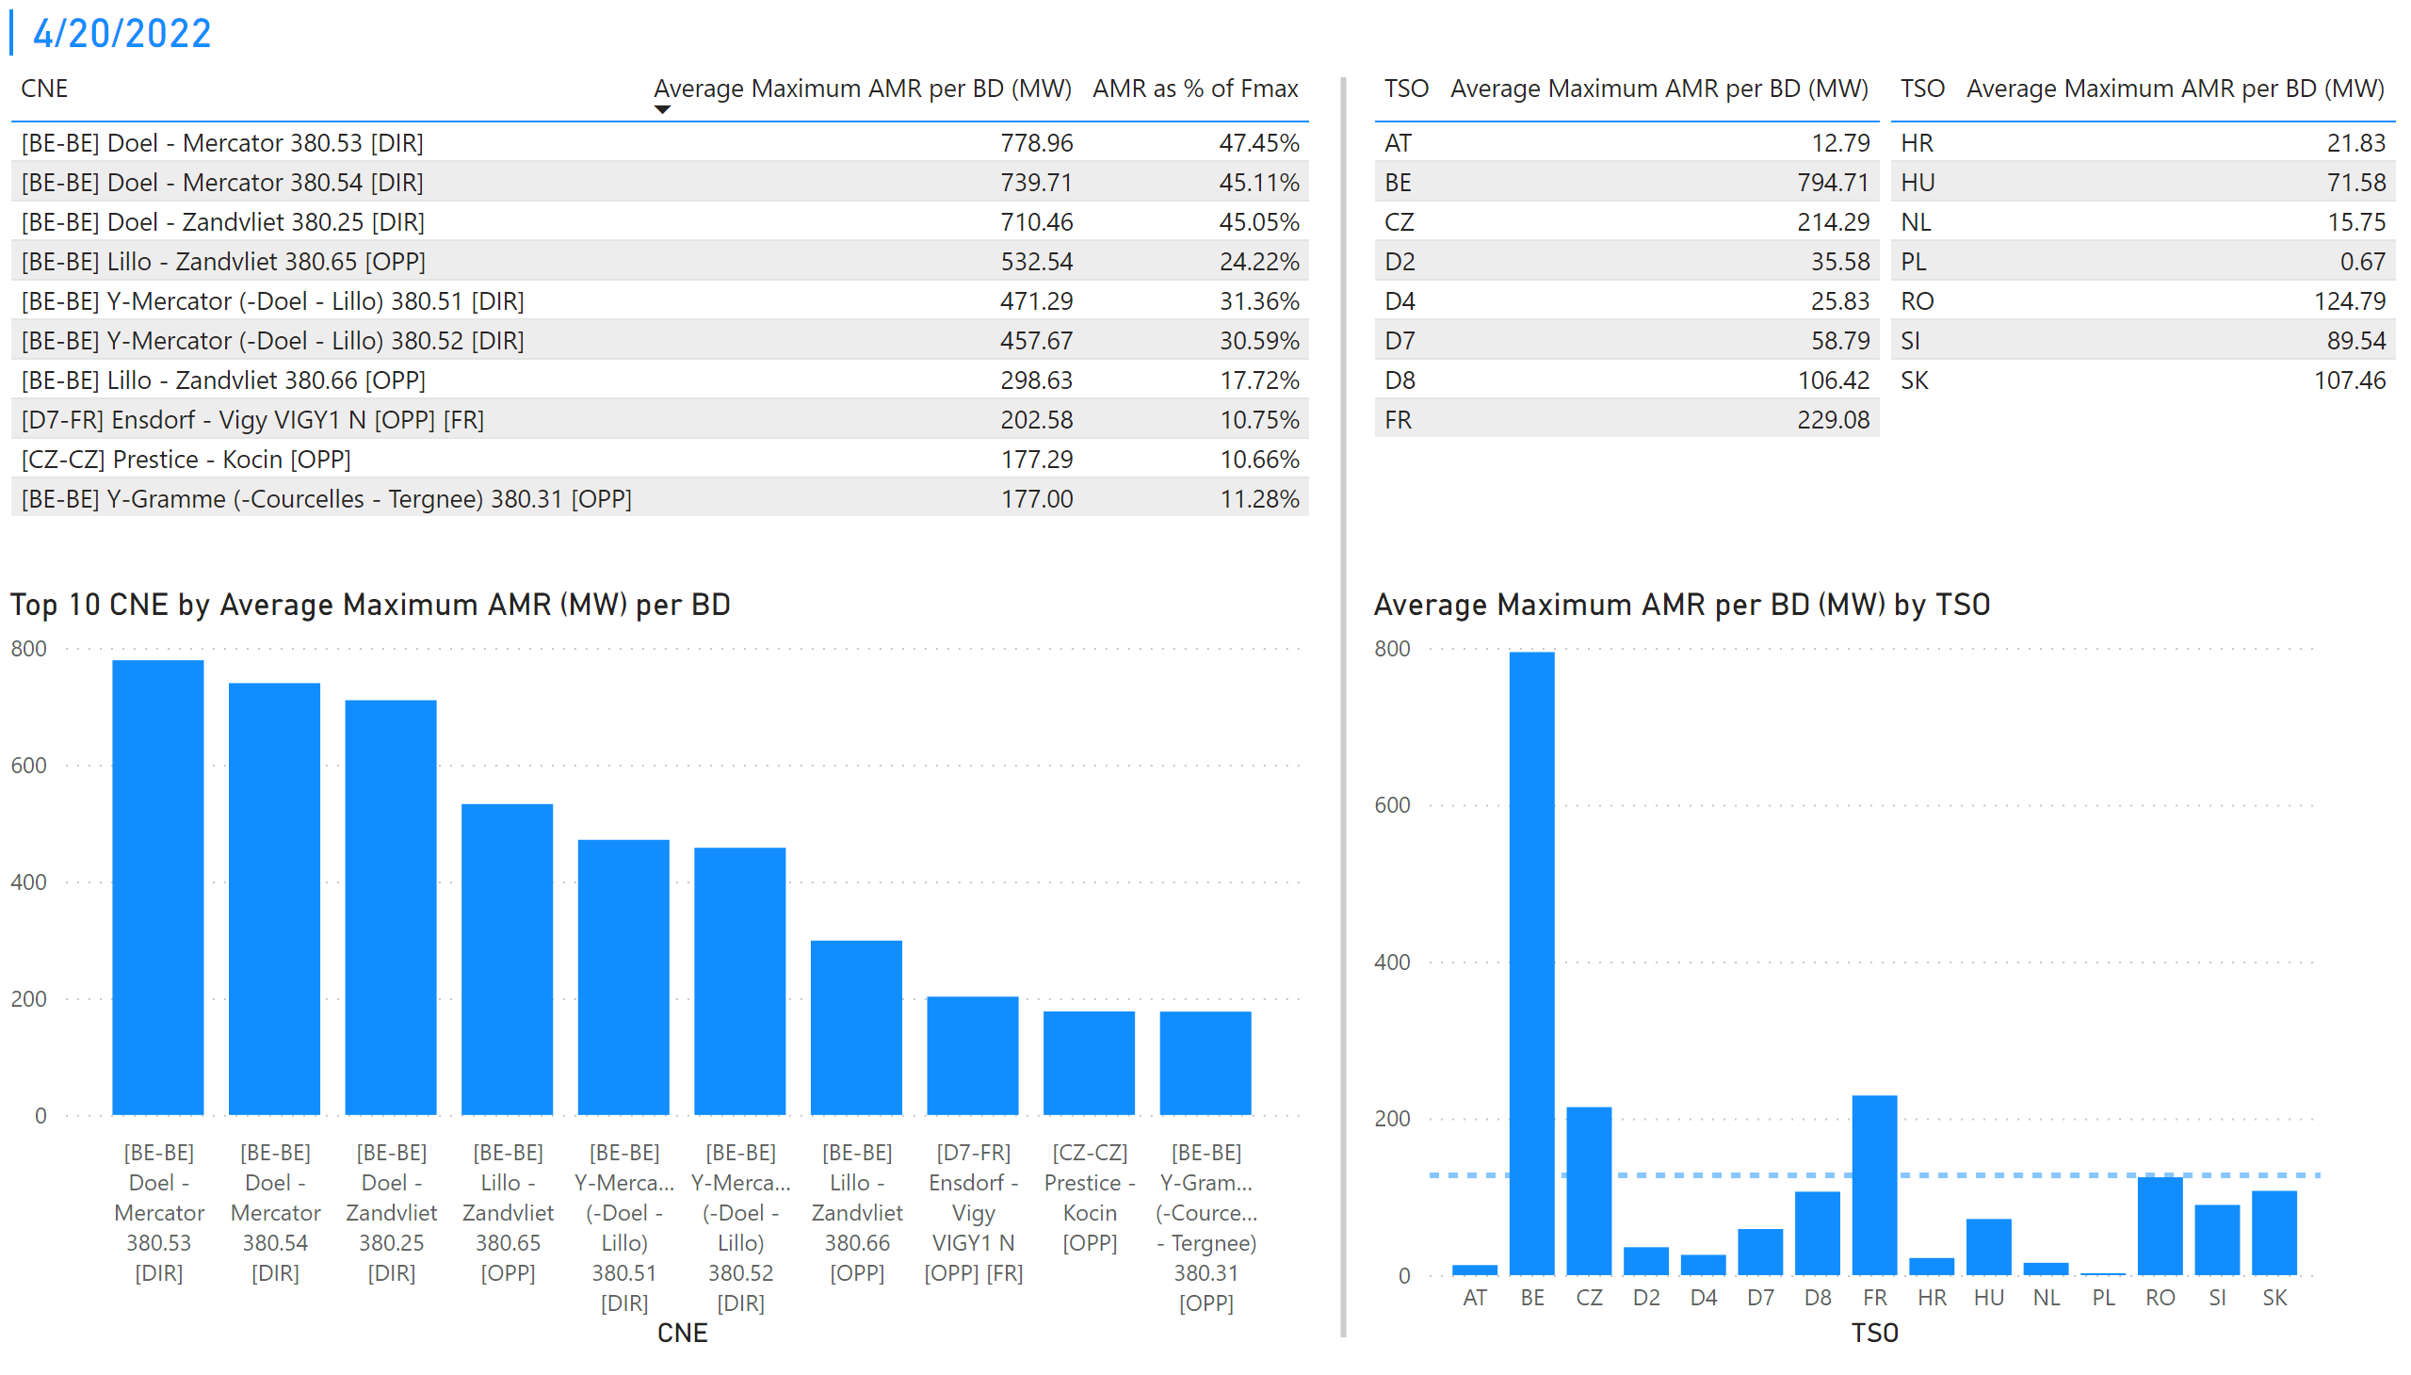
KPI 1 +2_20
KPI 1: Average maximum AMR per CNE per BD
KPI 2: Average maximum AMR per CNE per TSO
Notes:
tableEx
No alt text provided
Top 10 CNE by Average Maximum AMR (MW) per BD
No alt text provided
multiRowCard
No alt text provided
tableEx
No alt text provided
Average Maximum AMR per BD (MW) by TSO
No alt text provided
tableEx
No alt text provided
basicShape
No alt text provided

Slide 27
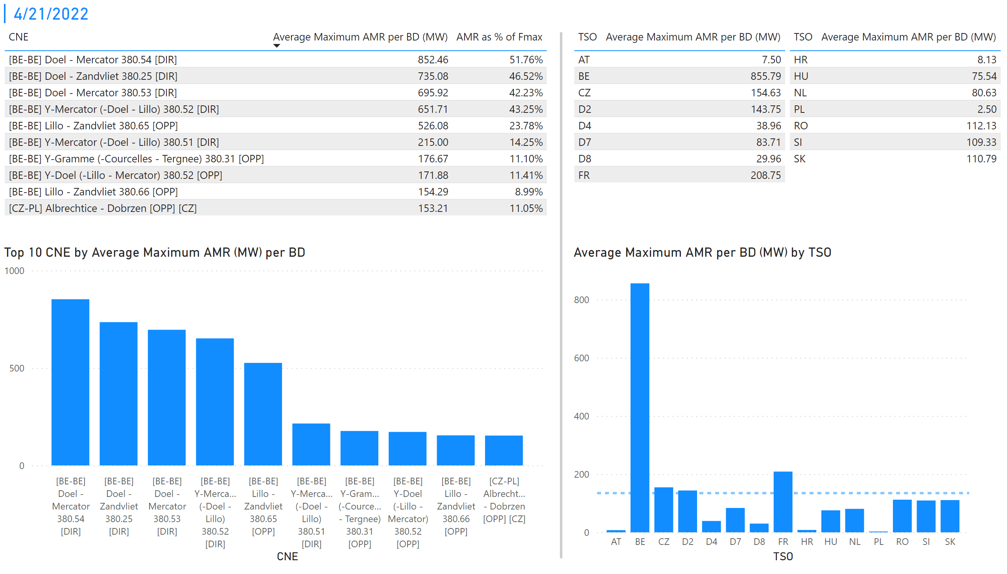
KPI 1 +2_21
KPI 1: Average maximum AMR per CNE per BD
KPI 2: Average maximum AMR per CNE per TSO
Notes:
tableEx
No alt text provided
Top 10 CNE by Average Maximum AMR (MW) per BD
No alt text provided
multiRowCard
No alt text provided
tableEx
No alt text provided
Average Maximum AMR per BD (MW) by TSO
No alt text provided
tableEx
No alt text provided
basicShape
No alt text provided

Slide 28
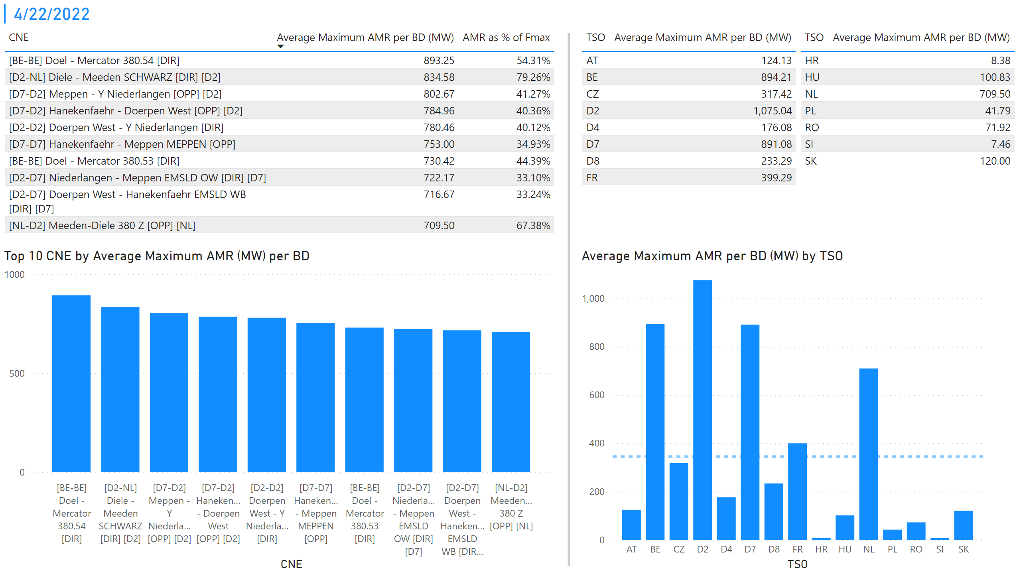
KPI 1 +2_22
KPI 1: Average maximum AMR per CNE per BD
KPI 2: Average maximum AMR per CNE per TSO
Notes:
tableEx
No alt text provided
Top 10 CNE by Average Maximum AMR (MW) per BD
No alt text provided
multiRowCard
No alt text provided
tableEx
No alt text provided
Average Maximum AMR per BD (MW) by TSO
No alt text provided
tableEx
No alt text provided
basicShape
No alt text provided

Slide 29
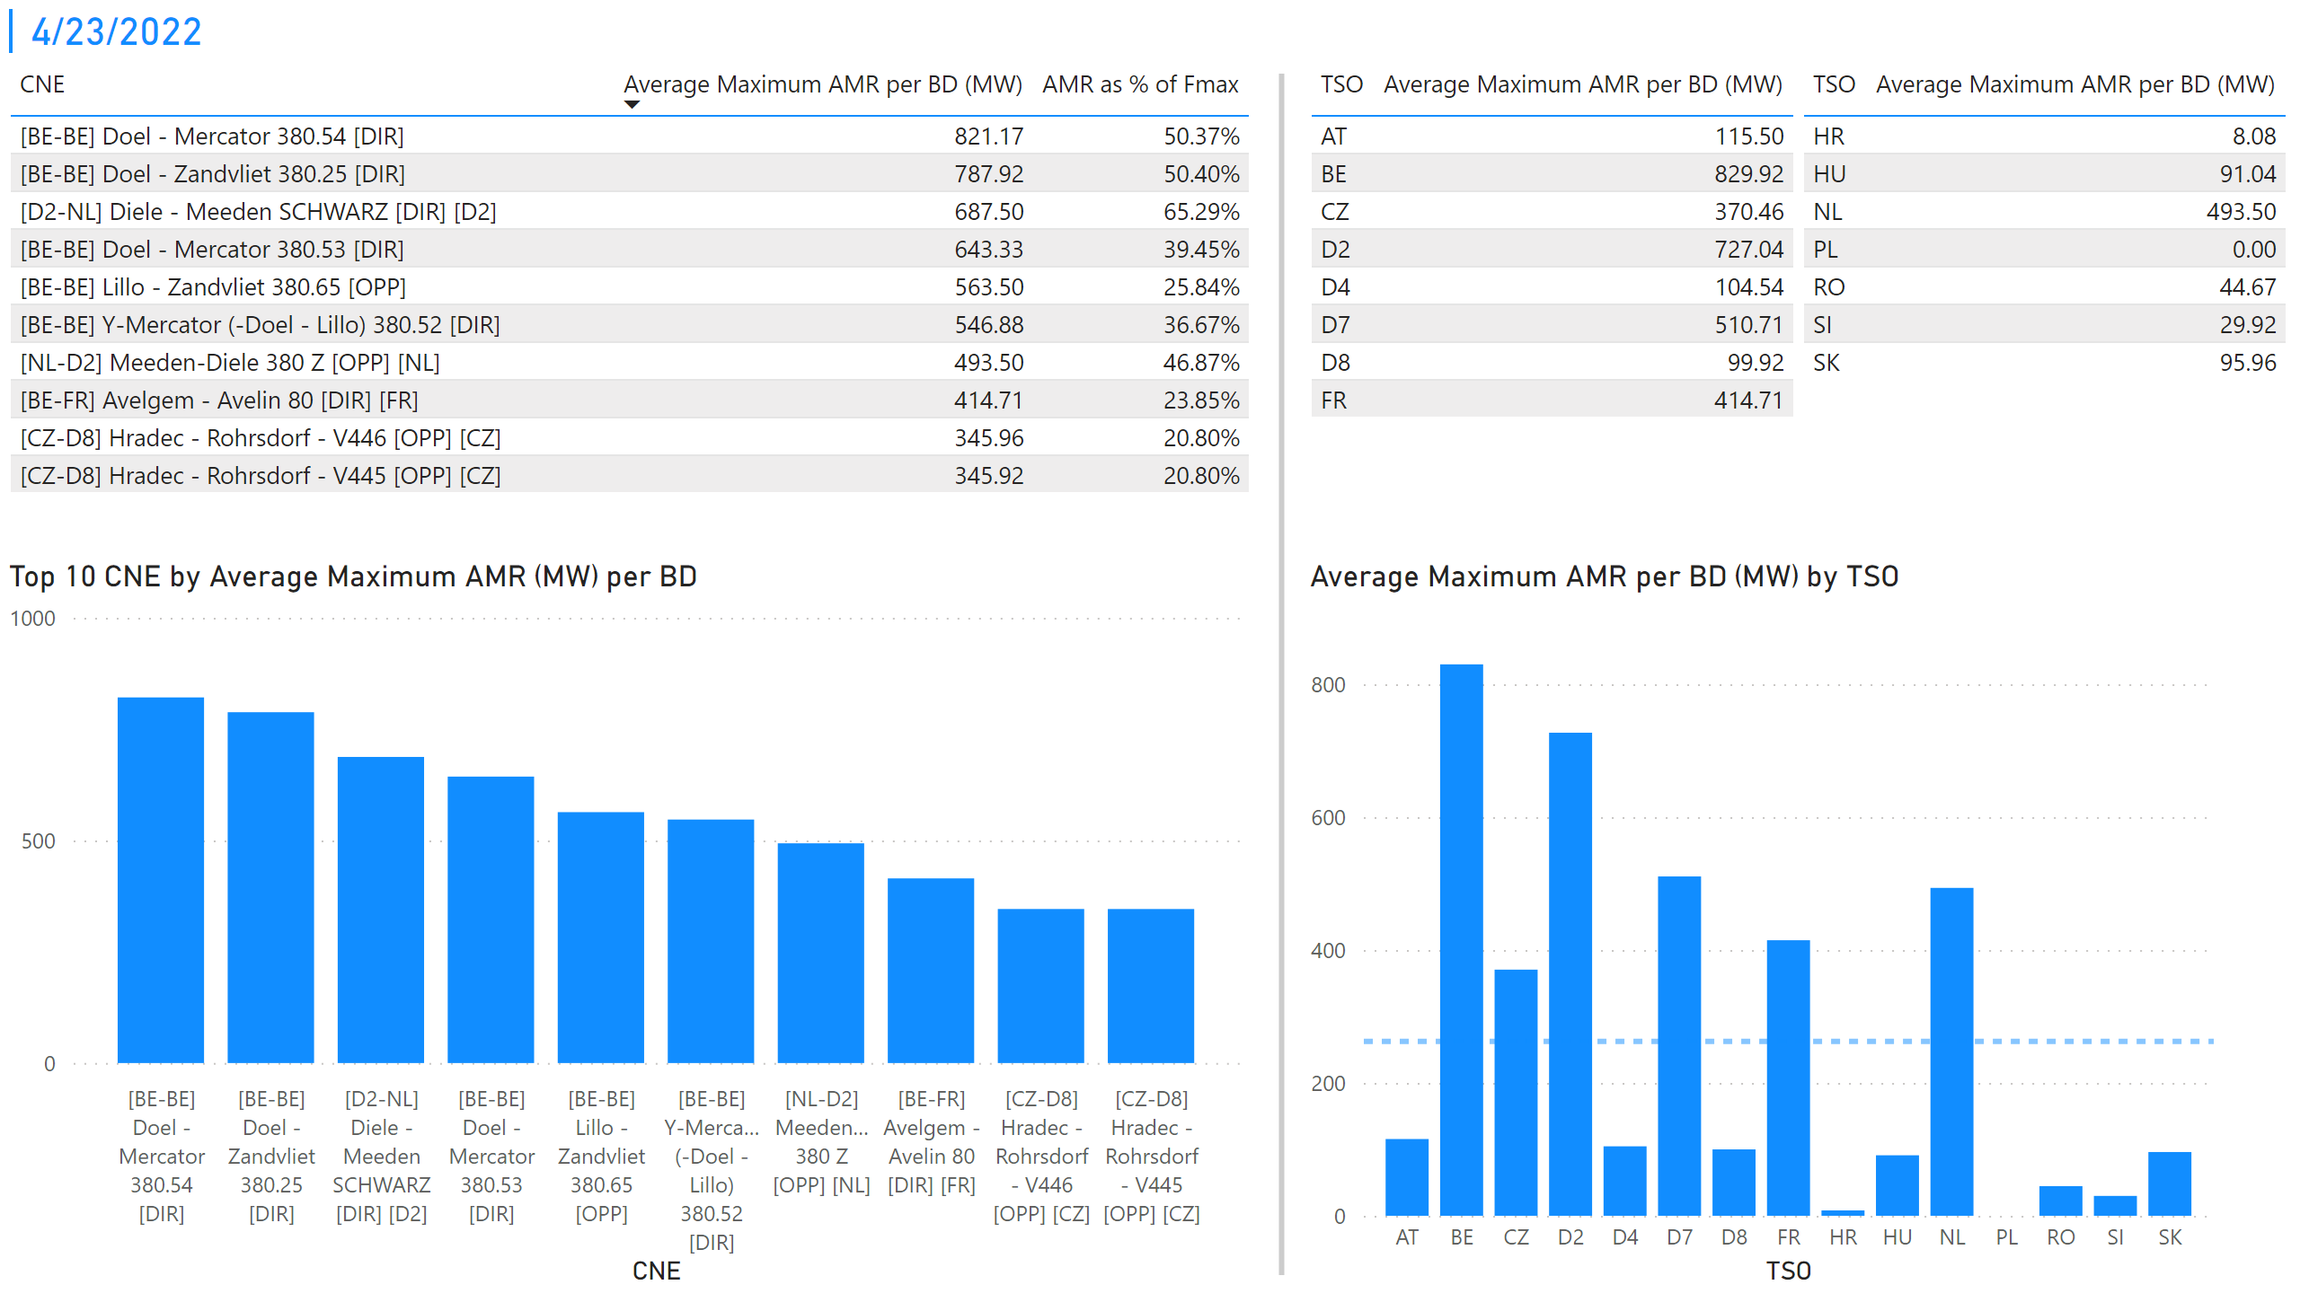
KPI 1 +2_23
KPI 1: Average maximum AMR per CNE per BD
KPI 2: Average maximum AMR per CNE per TSO
Notes:
tableEx
No alt text provided
Top 10 CNE by Average Maximum AMR (MW) per BD
No alt text provided
multiRowCard
No alt text provided
tableEx
No alt text provided
Average Maximum AMR per BD (MW) by TSO
No alt text provided
tableEx
No alt text provided
basicShape
No alt text provided

Slide 30
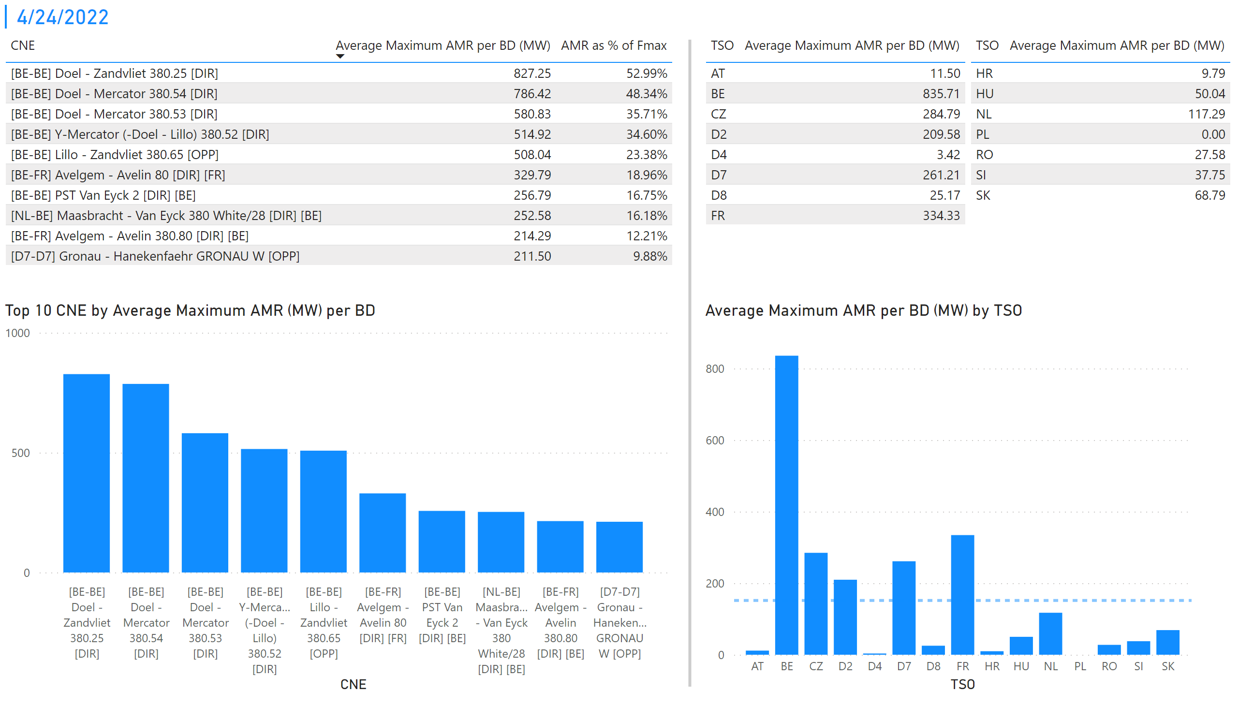
KPI 1 +2_24
KPI 1: Average maximum AMR per CNE per BD
KPI 2: Average maximum AMR per CNE per TSO
Notes:
tableEx
No alt text provided
Top 10 CNE by Average Maximum AMR (MW) per BD
No alt text provided
multiRowCard
No alt text provided
tableEx
No alt text provided
Average Maximum AMR per BD (MW) by TSO
No alt text provided
tableEx
No alt text provided
basicShape
No alt text provided

Slide 31
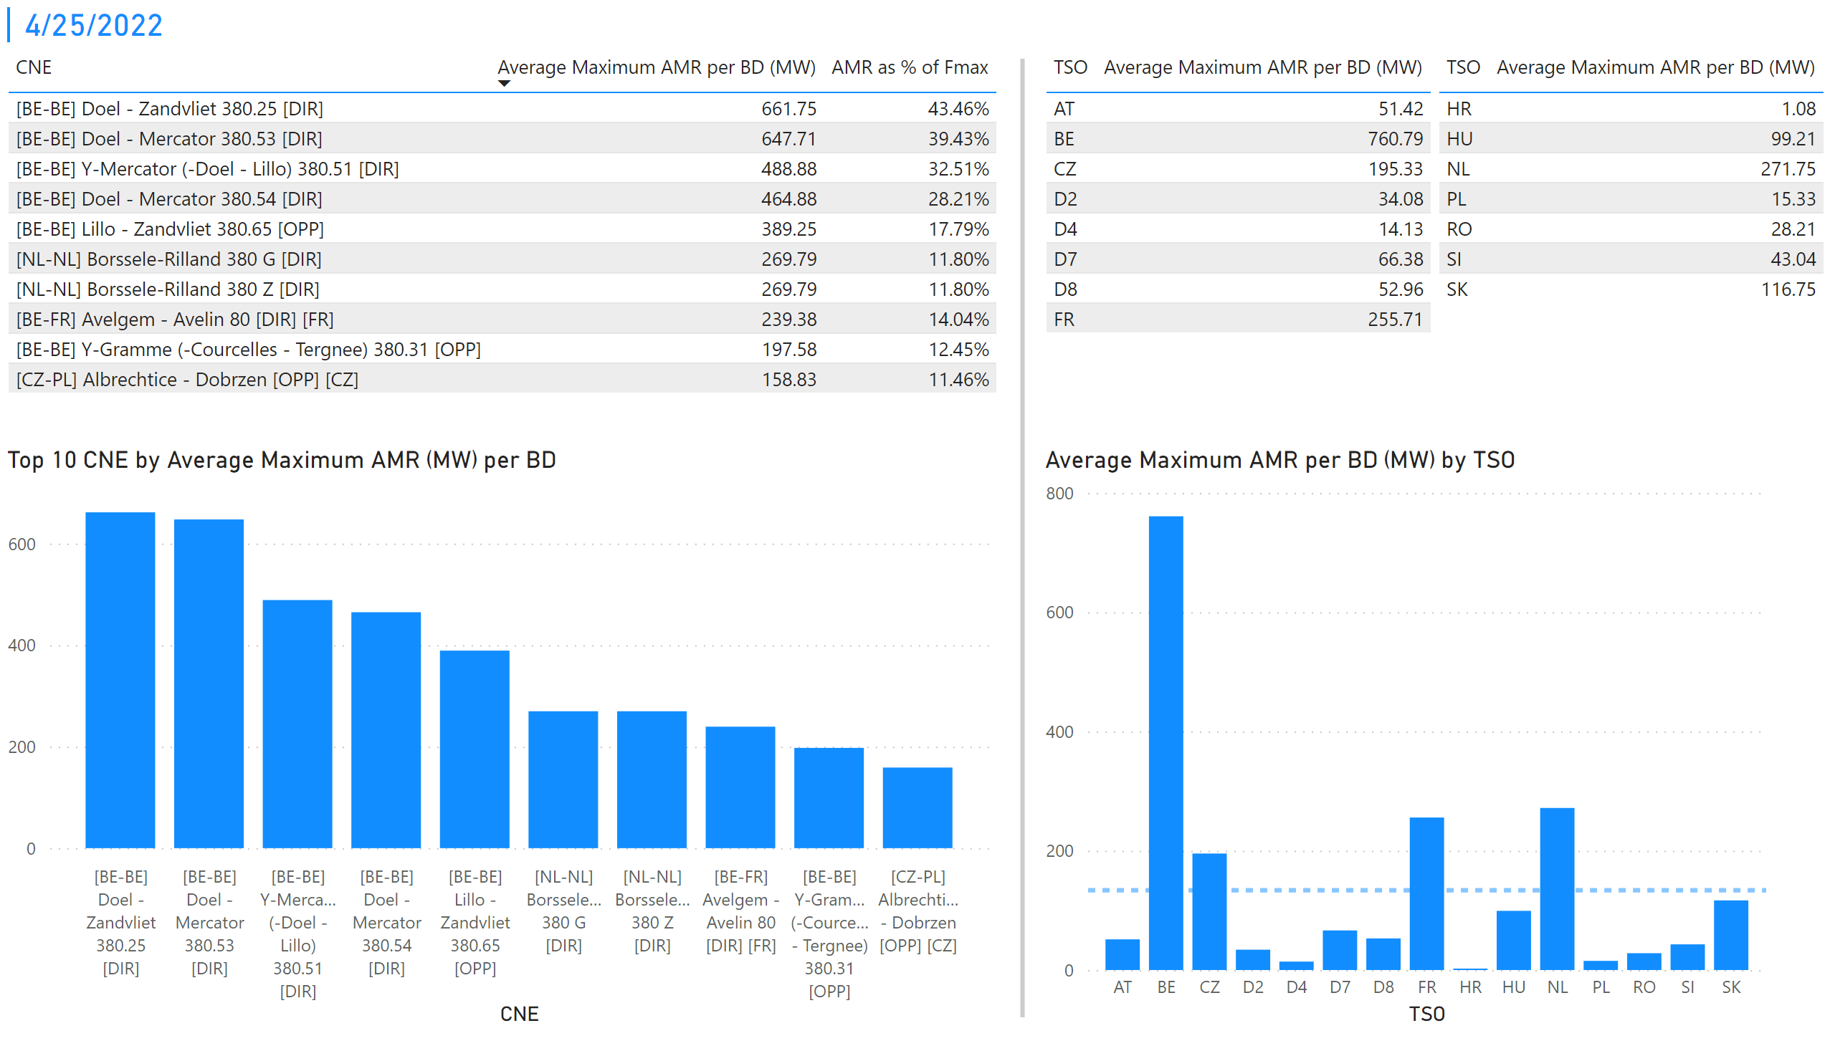
KPI 1 +2_25
KPI 1: Average maximum AMR per CNE per BD
KPI 2: Average maximum AMR per CNE per TSO
Notes:
tableEx
No alt text provided
Top 10 CNE by Average Maximum AMR (MW) per BD
No alt text provided
multiRowCard
No alt text provided
tableEx
No alt text provided
Average Maximum AMR per BD (MW) by TSO
No alt text provided
tableEx
No alt text provided
basicShape
No alt text provided

Slide 32
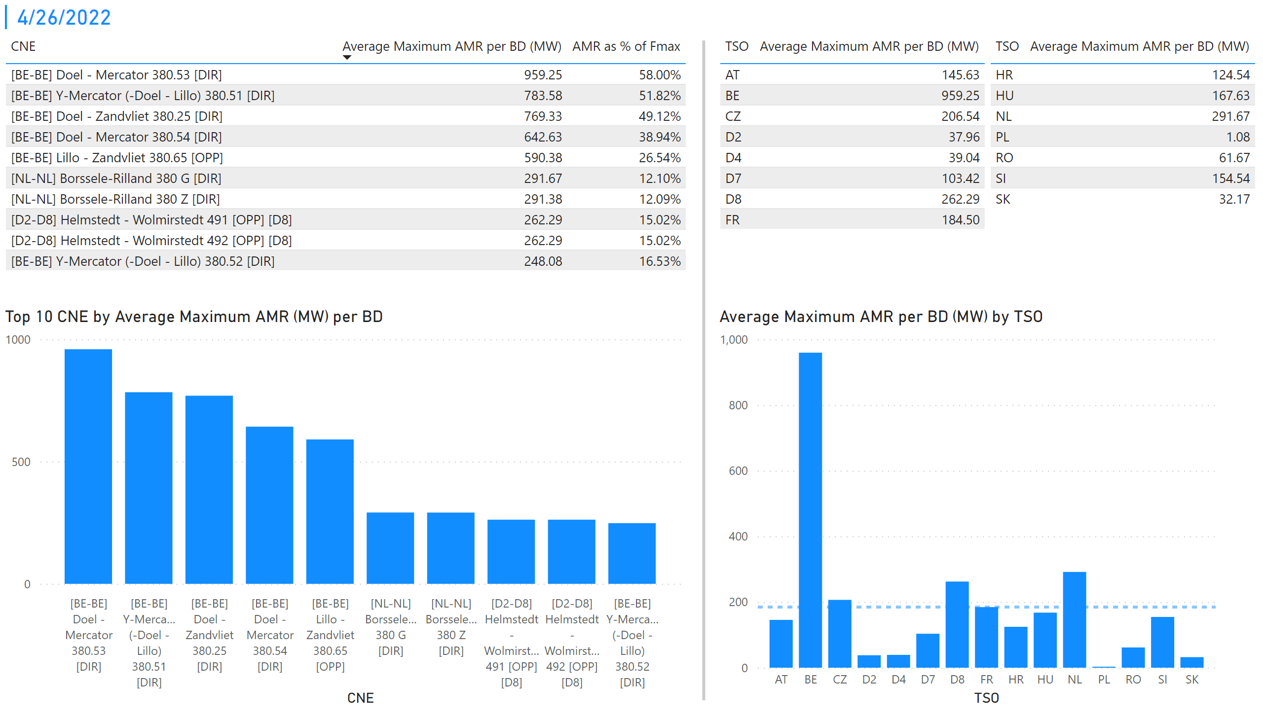
KPI 1 +2_26
KPI 1: Average maximum AMR per CNE per BD
KPI 2: Average maximum AMR per CNE per TSO
Notes:
tableEx
No alt text provided
Top 10 CNE by Average Maximum AMR (MW) per BD
No alt text provided
multiRowCard
No alt text provided
tableEx
No alt text provided
Average Maximum AMR per BD (MW) by TSO
No alt text provided
tableEx
No alt text provided
basicShape
No alt text provided

Slide 33
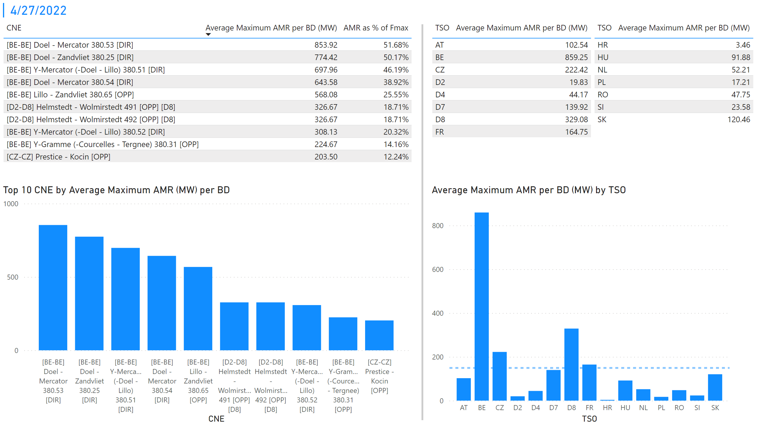
KPI 1 +2_28
KPI 1: Average maximum AMR per CNE per BD
KPI 2: Average maximum AMR per CNE per TSO
Notes:
tableEx
No alt text provided
Top 10 CNE by Average Maximum AMR (MW) per BD
No alt text provided
multiRowCard
No alt text provided
tableEx
No alt text provided
Average Maximum AMR per BD (MW) by TSO
No alt text provided
tableEx
No alt text provided
basicShape
No alt text provided

Slide 34
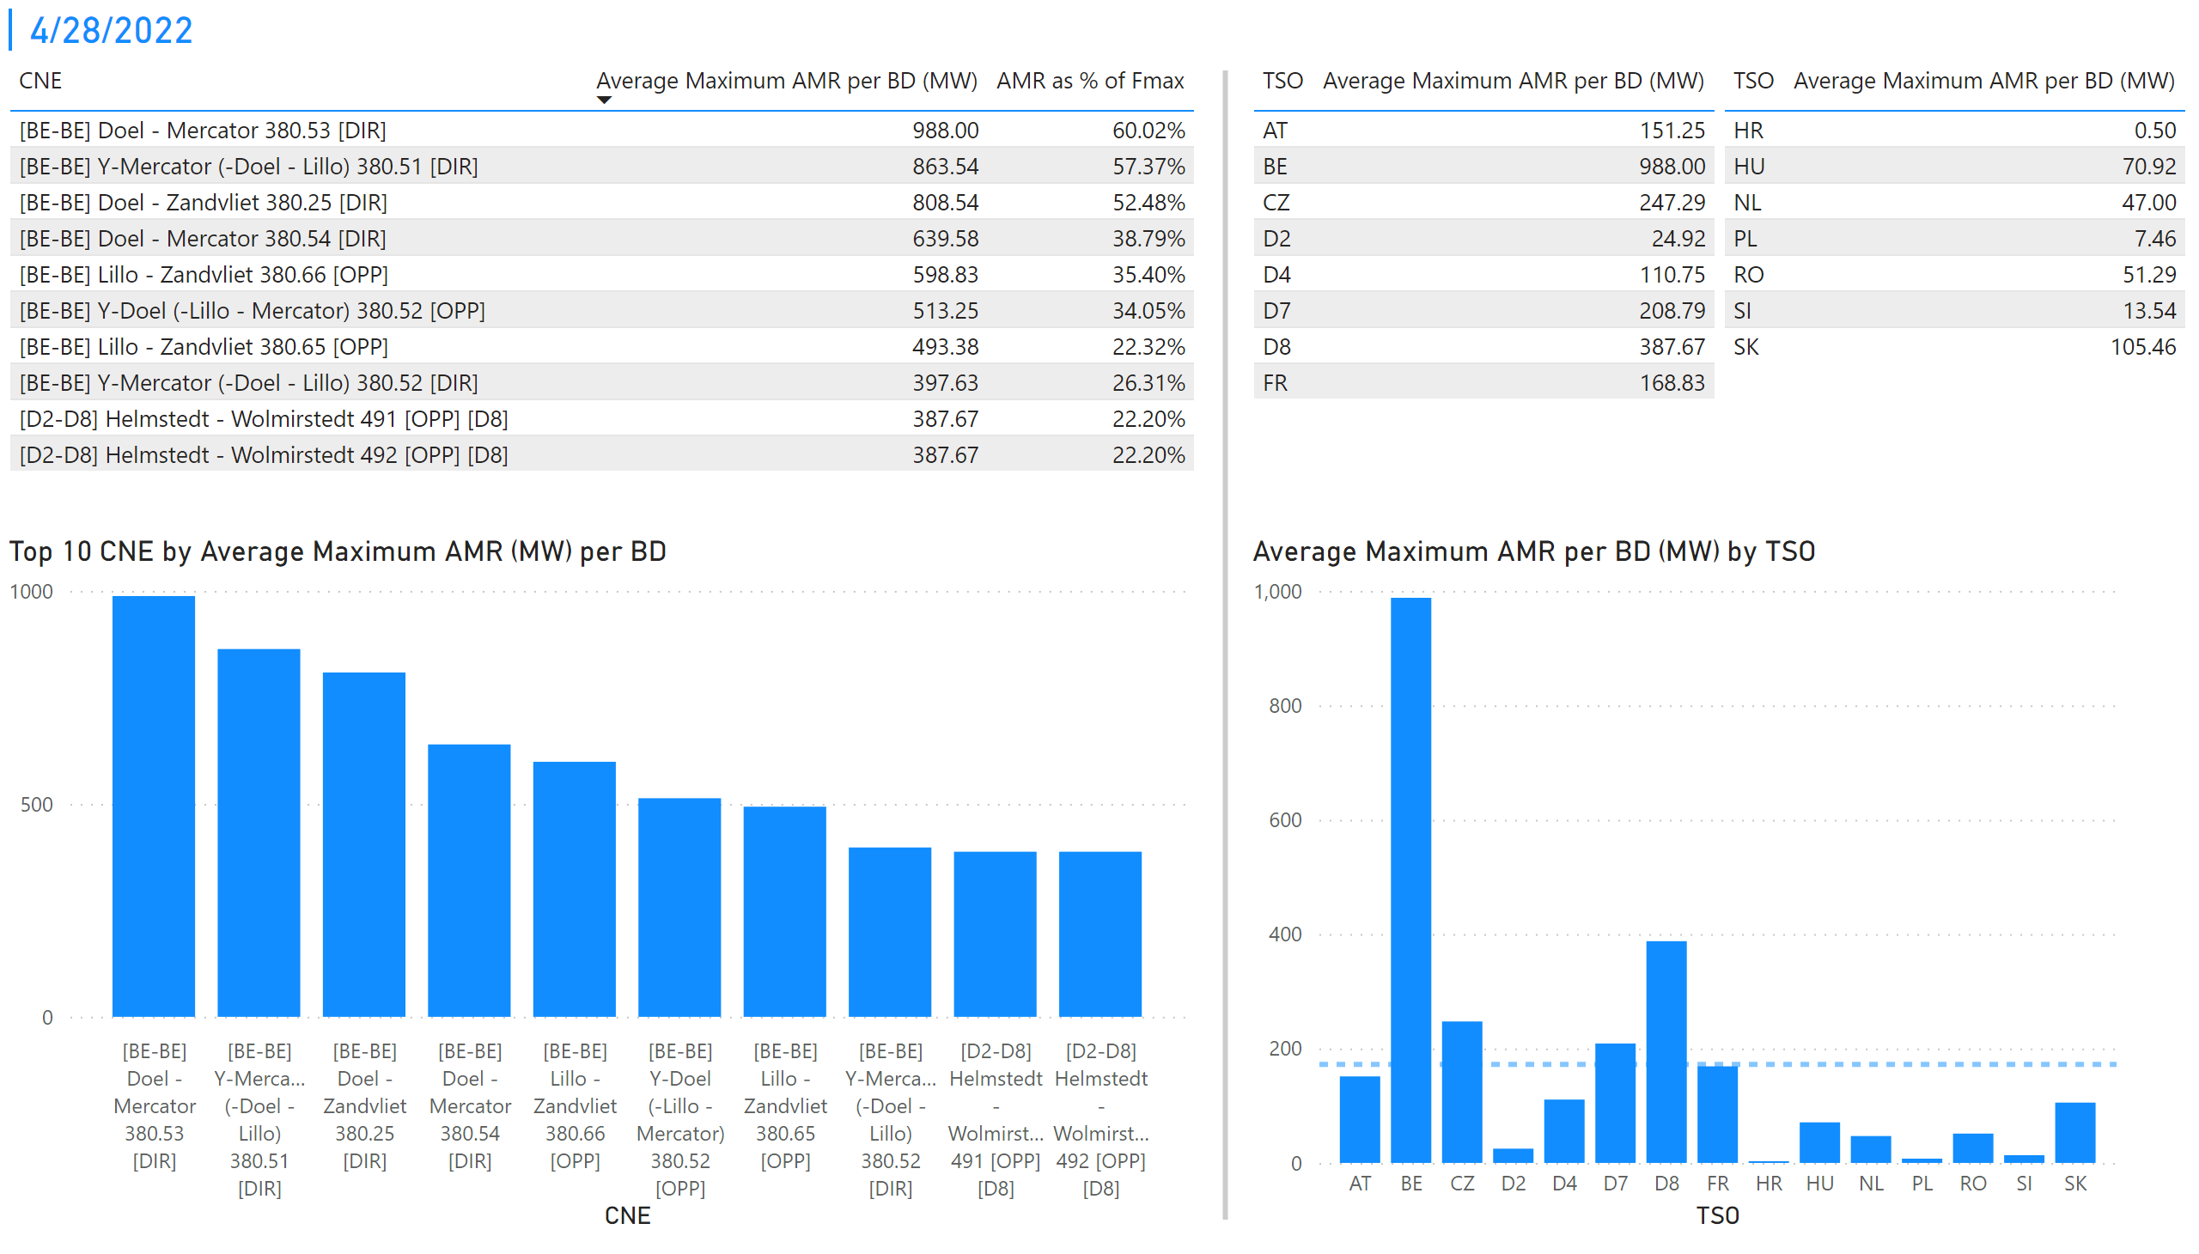
KPI 1 +2_29
KPI 1: Average maximum AMR per CNE per BD
KPI 2: Average maximum AMR per CNE per TSO
Notes:
tableEx
No alt text provided
Top 10 CNE by Average Maximum AMR (MW) per BD
No alt text provided
multiRowCard
No alt text provided
tableEx
No alt text provided
Average Maximum AMR per BD (MW) by TSO
No alt text provided
tableEx
No alt text provided
basicShape
No alt text provided

Slide 35
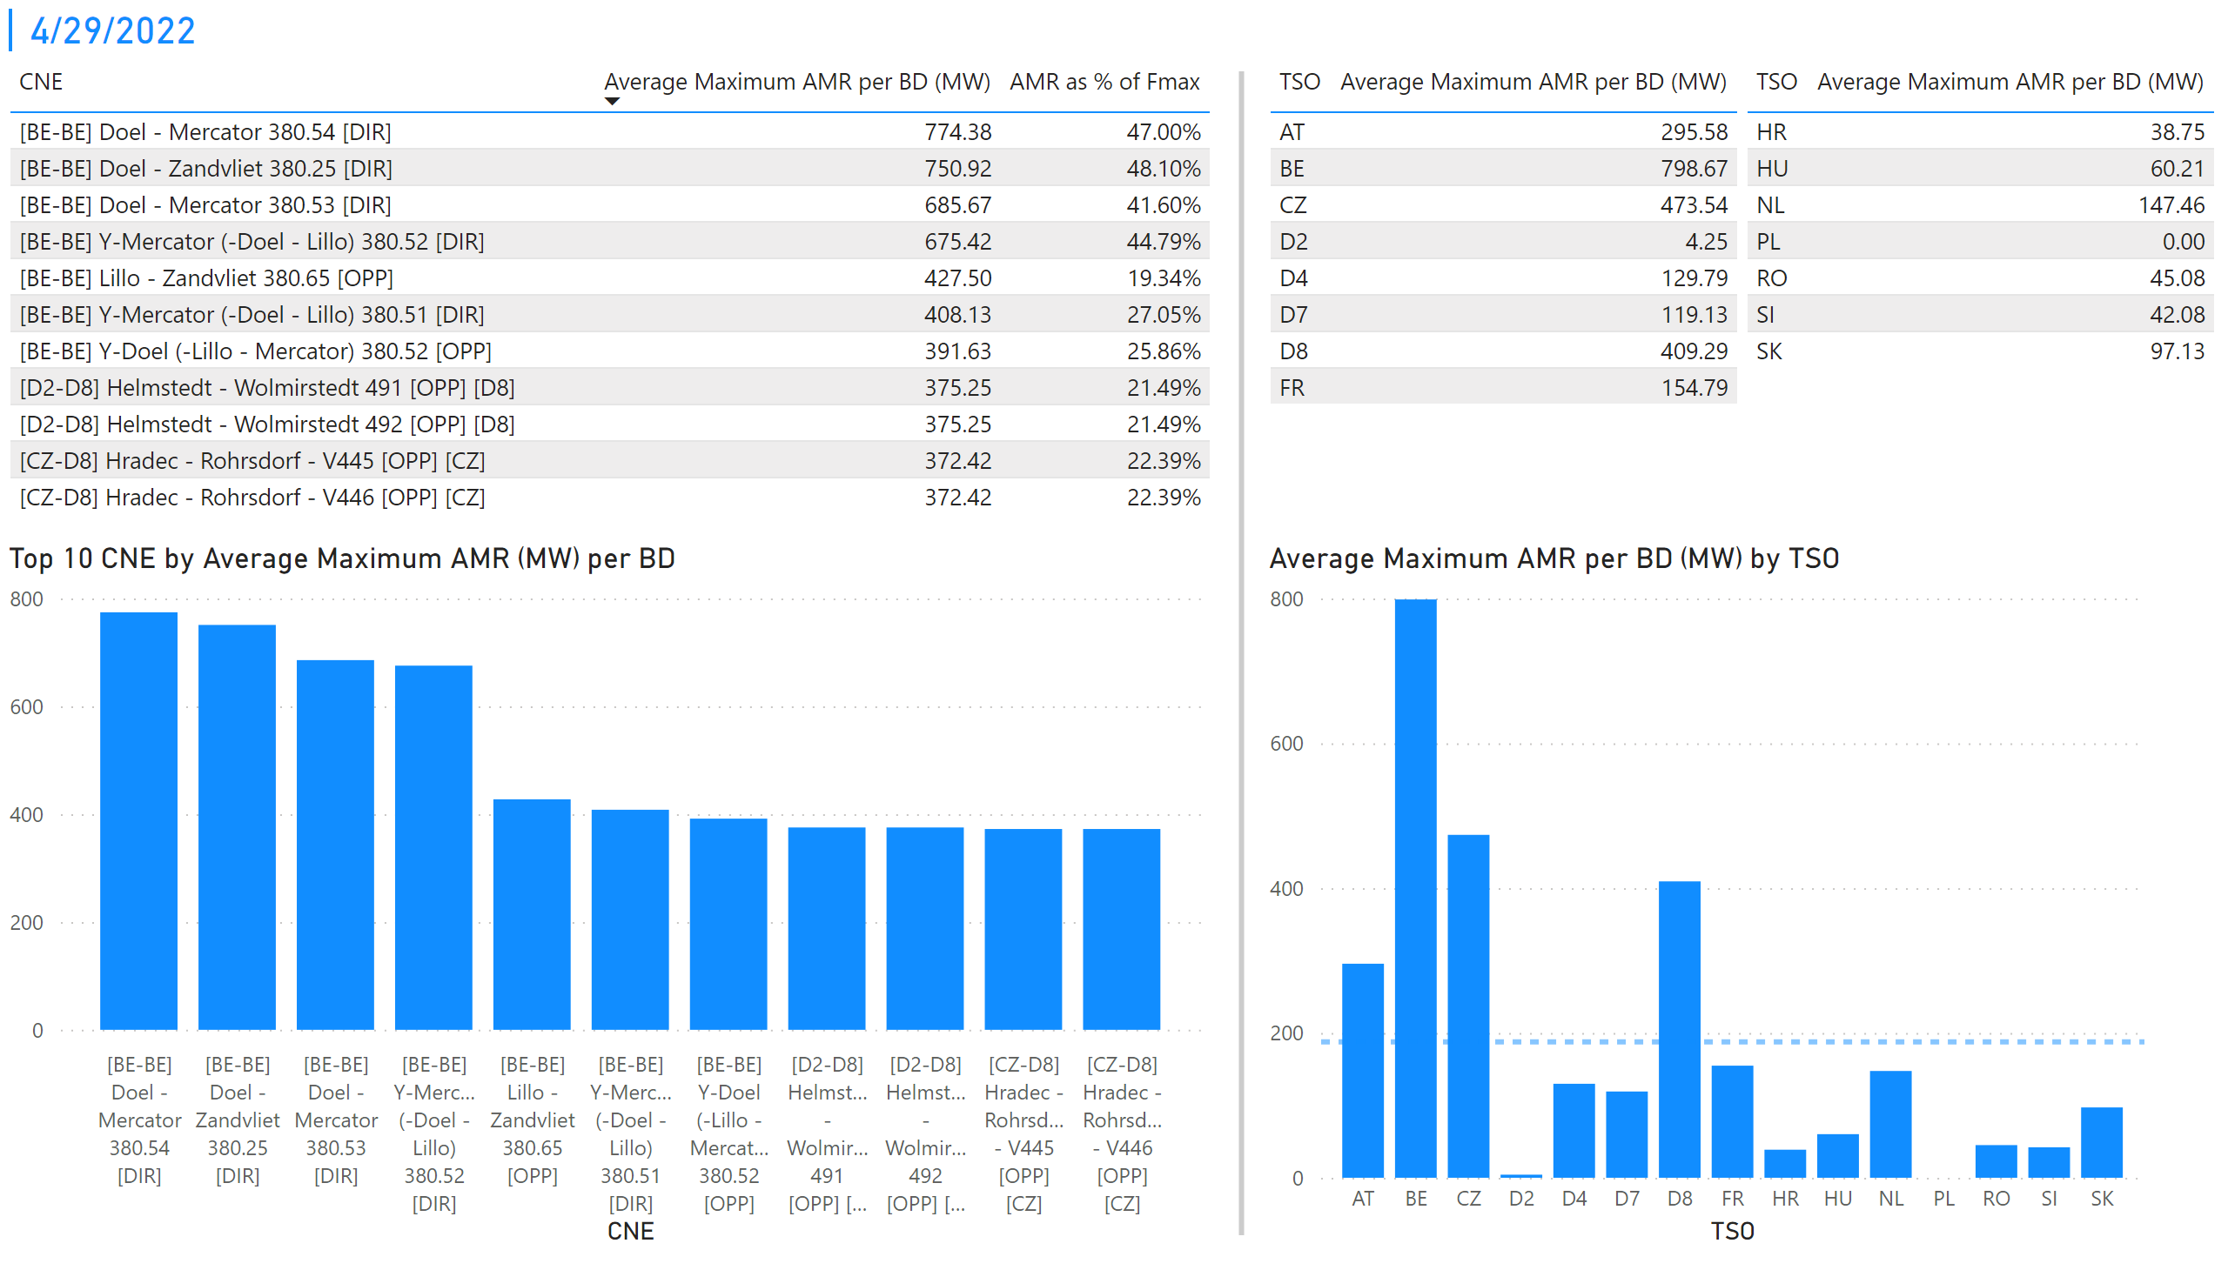
Duplikat von "KPI 1 +2_29"
KPI 1: Average maximum AMR per CNE per BD
KPI 2: Average maximum AMR per CNE per TSO
Notes:
tableEx
No alt text provided
Top 10 CNE by Average Maximum AMR (MW) per BD
No alt text provided
multiRowCard
No alt text provided
tableEx
No alt text provided
Average Maximum AMR per BD (MW) by TSO
No alt text provided
tableEx
No alt text provided
basicShape
No alt text provided

Slide 36
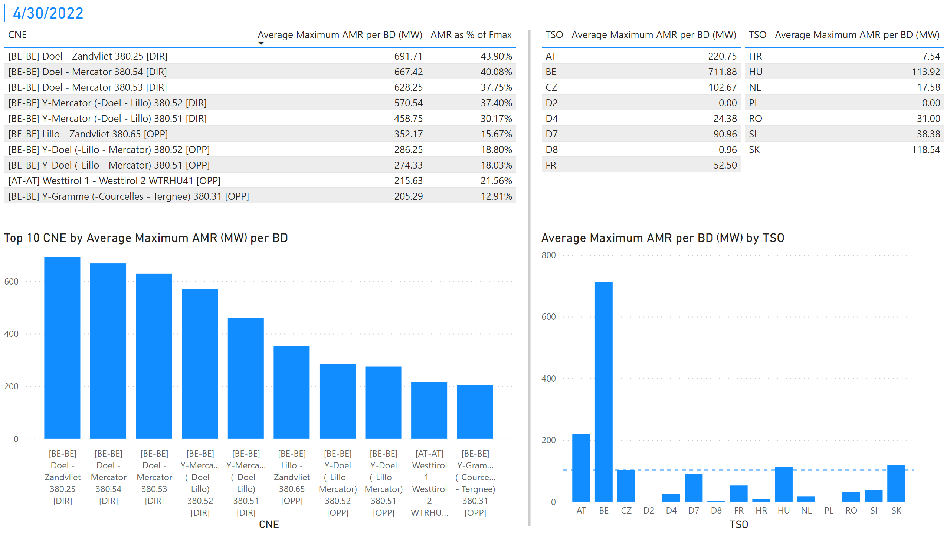
Duplikat von "Duplikat von "KPI 1 +2_29""
KPI 1: Average maximum AMR per CNE per BD
KPI 2: Average maximum AMR per CNE per TSO
Notes:
basicShape
No alt text provided
multiRowCard
No alt text provided
tableEx
No alt text provided
tableEx
No alt text provided
Top 10 CNE by Average Maximum AMR (MW) per BD
No alt text provided
Average Maximum AMR per BD (MW) by TSO
No alt text provided
tableEx
No alt text provided

Slide 37
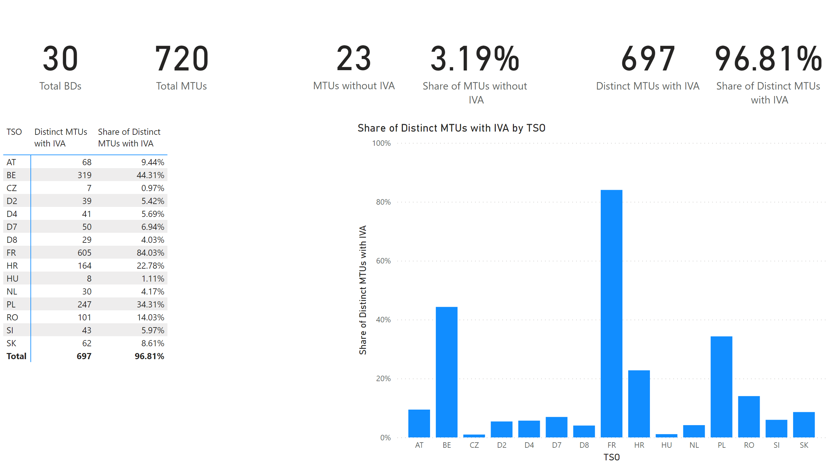
KPI 5
KPI 5: Share of MTUs with intervention per TSO
Notes:
pivotTable
No alt text provided
clusteredColumnChart
No alt text provided
card
No alt text provided
card
No alt text provided
card
No alt text provided
card
No alt text provided
card
No alt text provided
card
No alt text provided

Slide 38
KPI6_0901
    KPI 6: Total IVA applied per MTU for each CNE affected by TSO intervention
A list of CNECs with IVA applied is published on the JAO Publication Tool.
Notes:
clusteredColumnChart
No alt text provided.
clusteredColumnChart
No alt text provided.

Slide 39
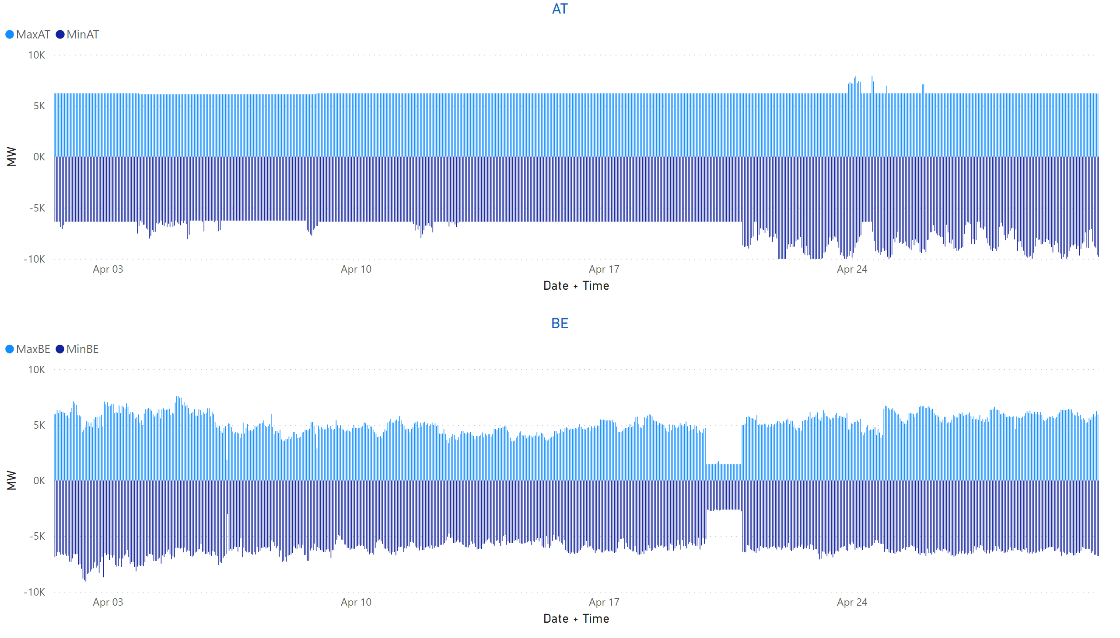
AT + BE
KPI 13: Min & max net positions per BZ hub
Notes:
AT
No alt text provided
BE
No alt text provided

Slide 40
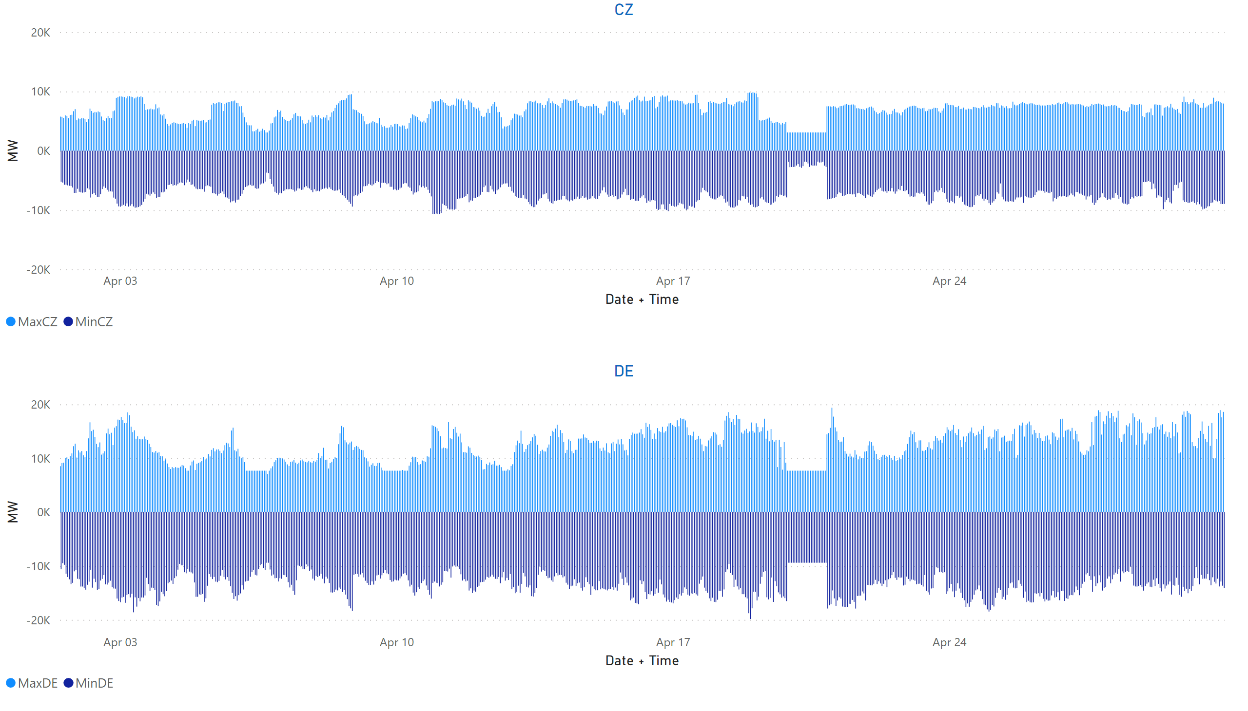
CZ+DE
KPI 13: Min & max net positions per BZ hub
Notes:
CZ
No alt text provided
DE
No alt text provided

Slide 41
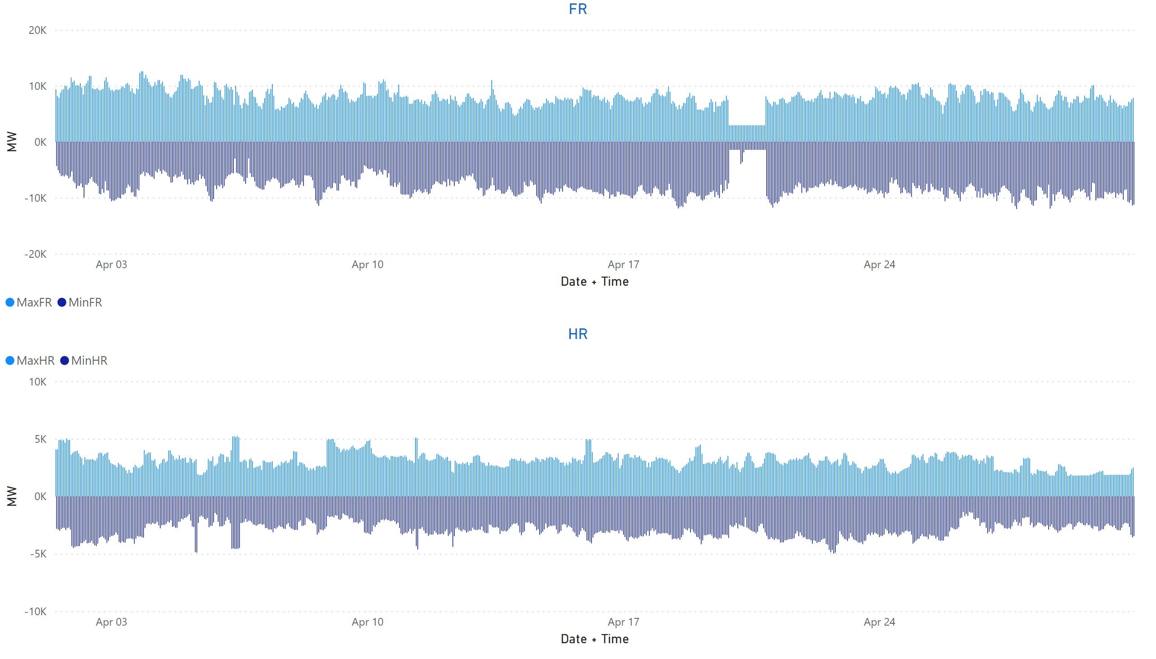
FR + HR
KPI 13: Min & max net positions per BZ hub
Notes:
FR
No alt text provided
HR
No alt text provided

Slide 42
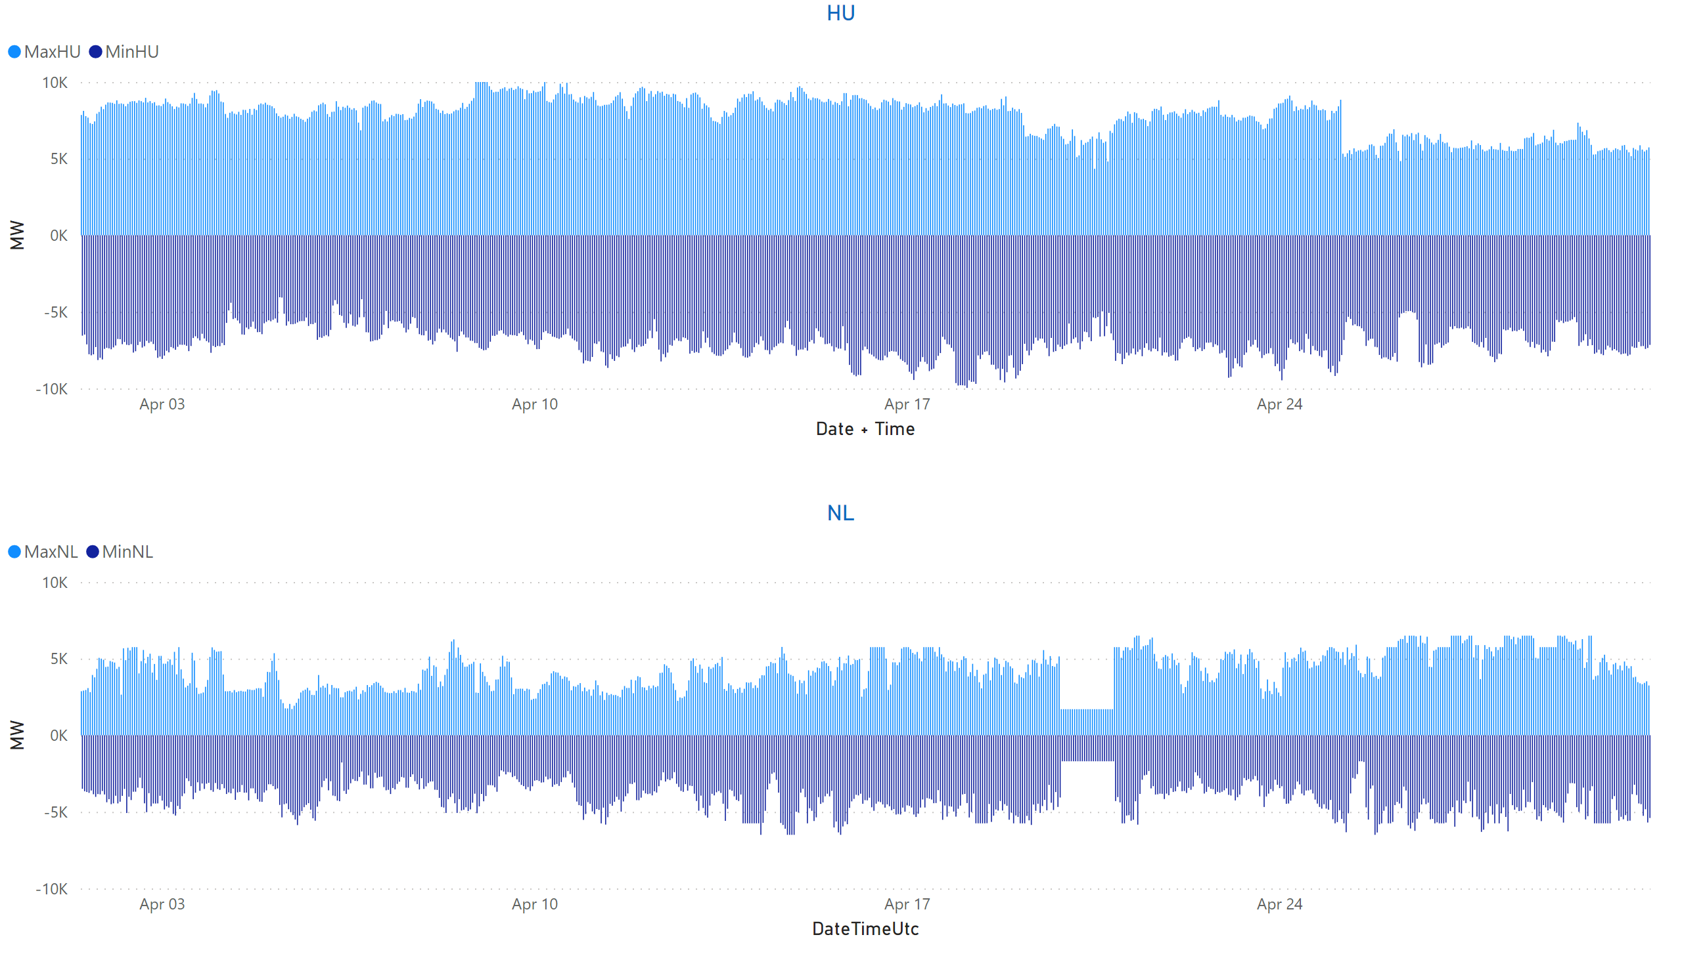
HU + NL
KPI 13: Min & max net positions per BZ hub
Notes:
HU
No alt text provided
NL
No alt text provided

Slide 43
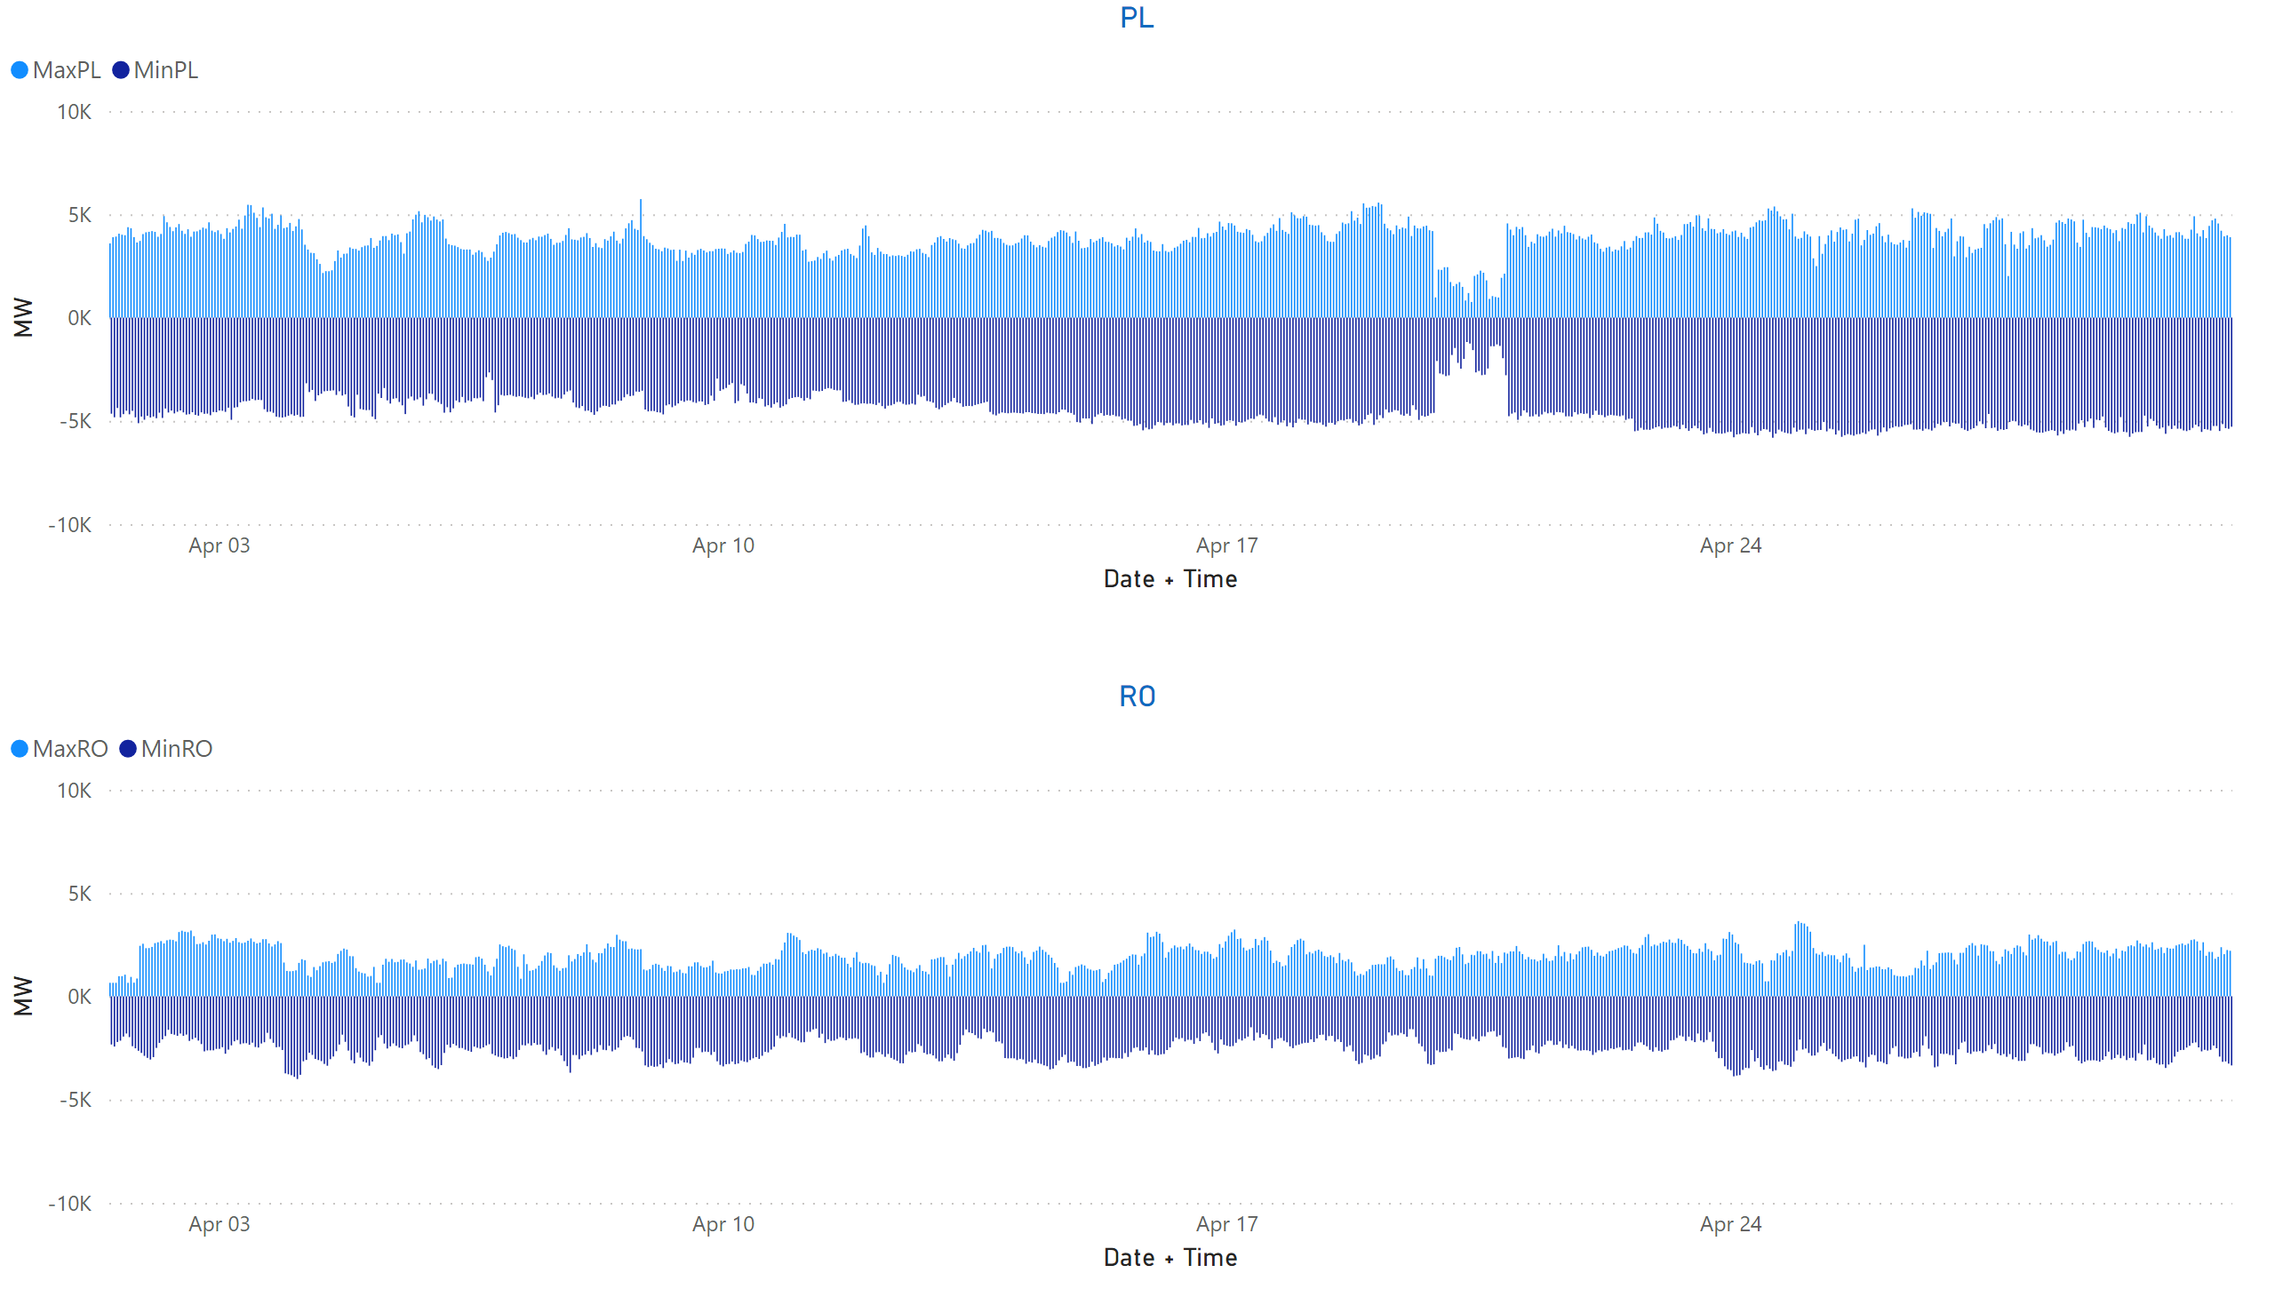
PL + RO
KPI 13: Min & max net positions per BZ hub
Notes:
PL
No alt text provided
RO
No alt text provided

Slide 44
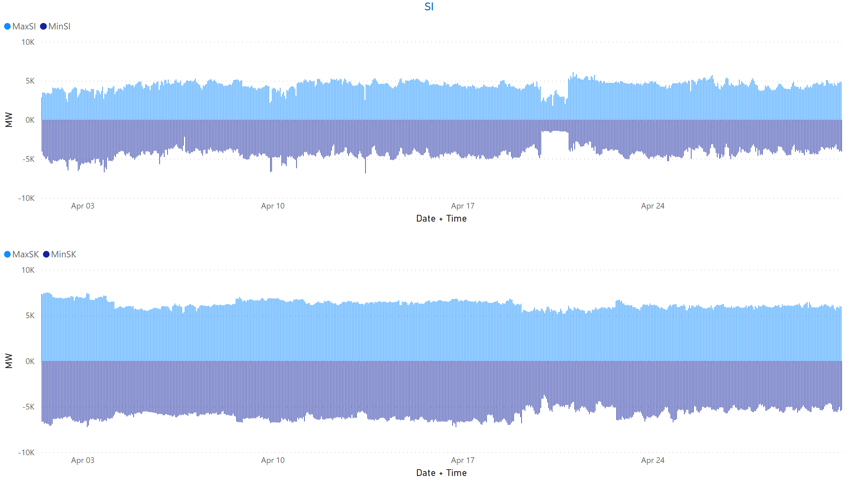
SI + SK
KPI 13: Min & max net positions per BZ hub
Notes:
clusteredColumnChart
No alt text provided
SI
No alt text provided

Slide 45
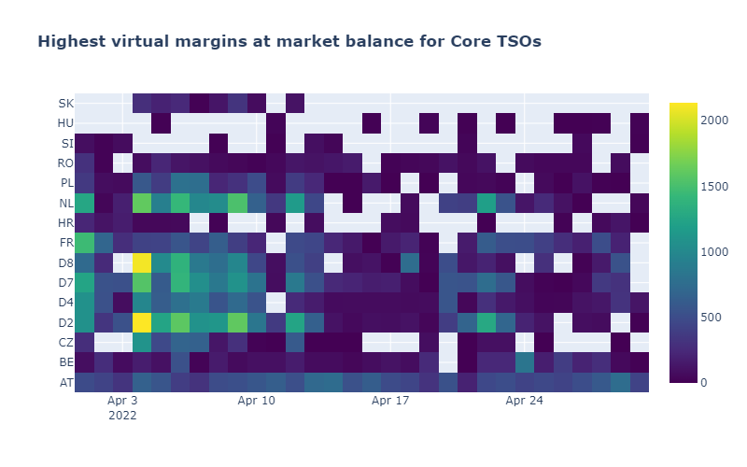
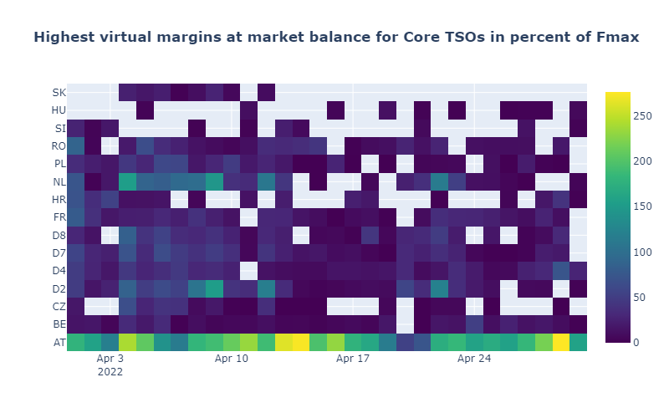
KPI 14a: Highest virtual margins at market balance for CORE TSOs
CORE TSOs

Slide 46
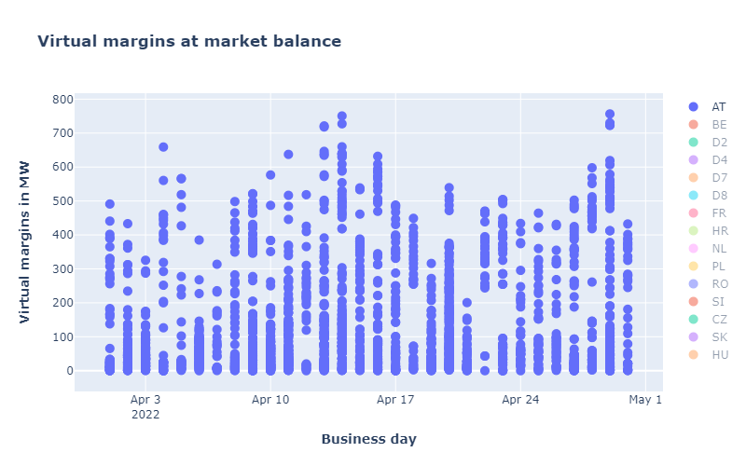
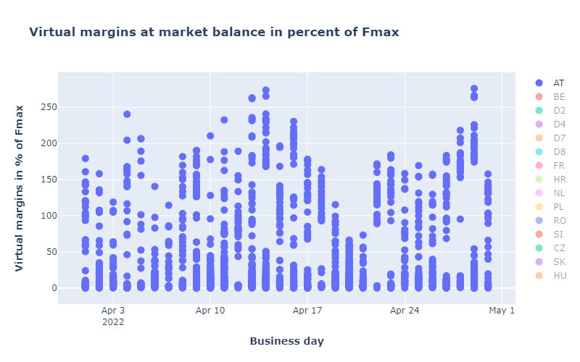
CORE TSOs
KPI 14b: AT: Virtual margins at market balance

Slide 47
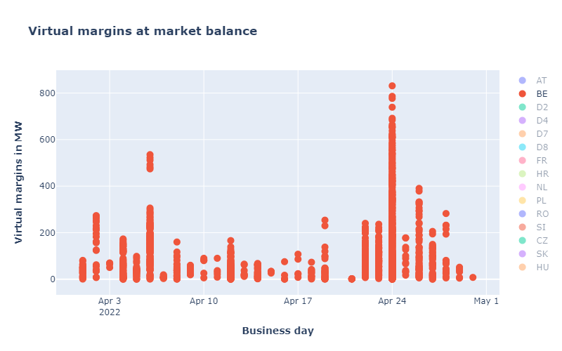
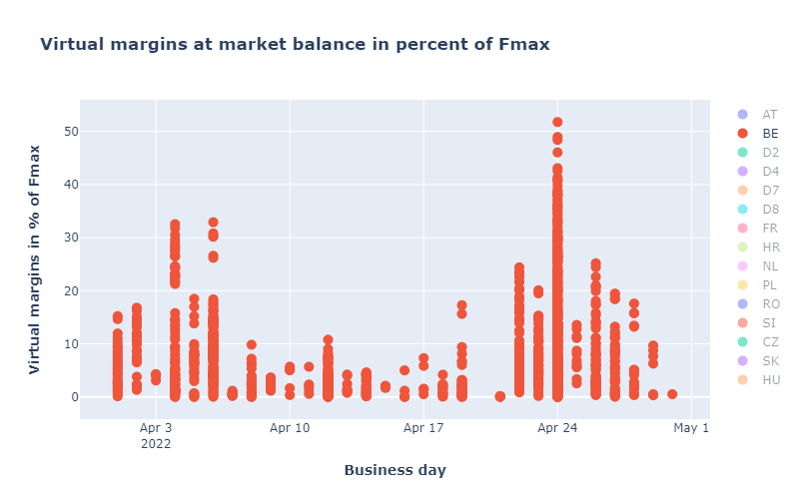
KPI 14b: BE: Virtual margins at market balance
CORE TSOs

Slide 48
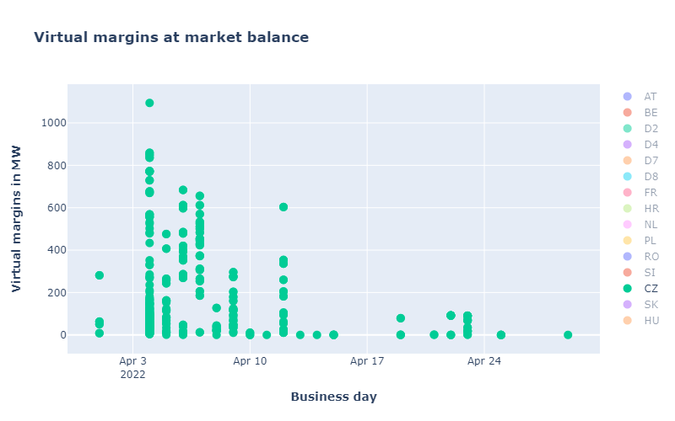
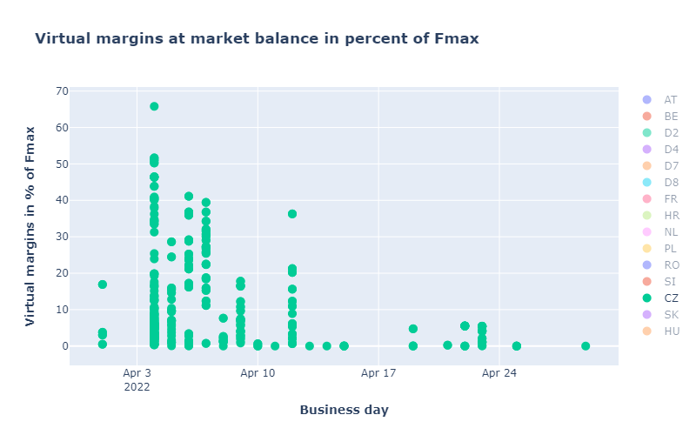
CORE TSOs
KPI 14b: CZ: Virtual margins at market balance

Slide 49
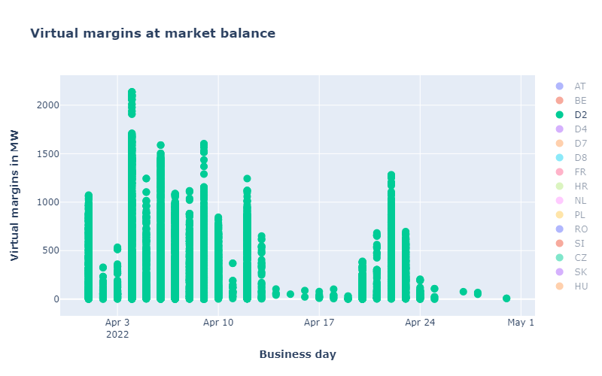
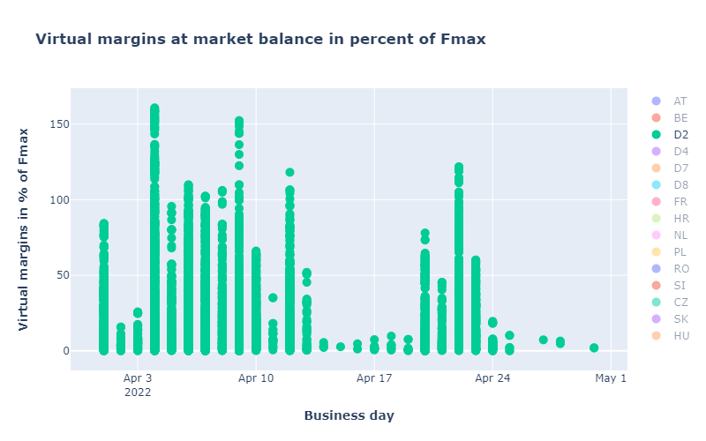
KPI 14b: D2: Virtual margins at market balance
CORE TSOs

Slide 50
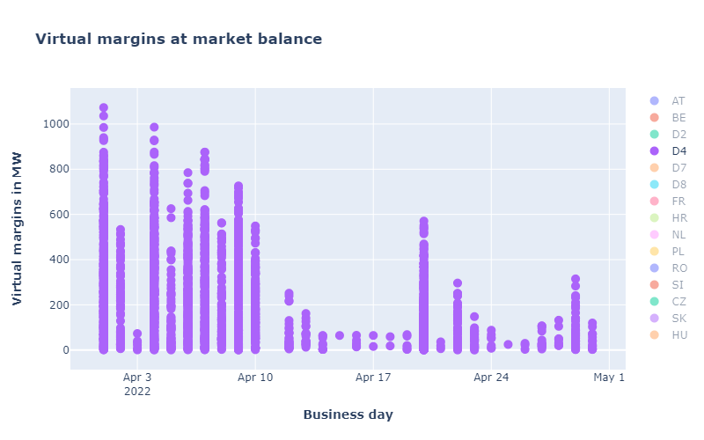
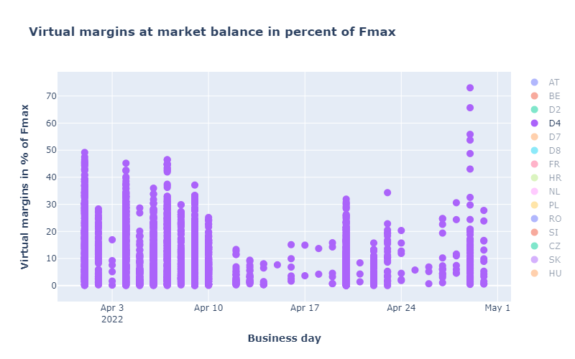
CORE TSOs
KPI 14b: D4: Virtual margins at market balance

Slide 51
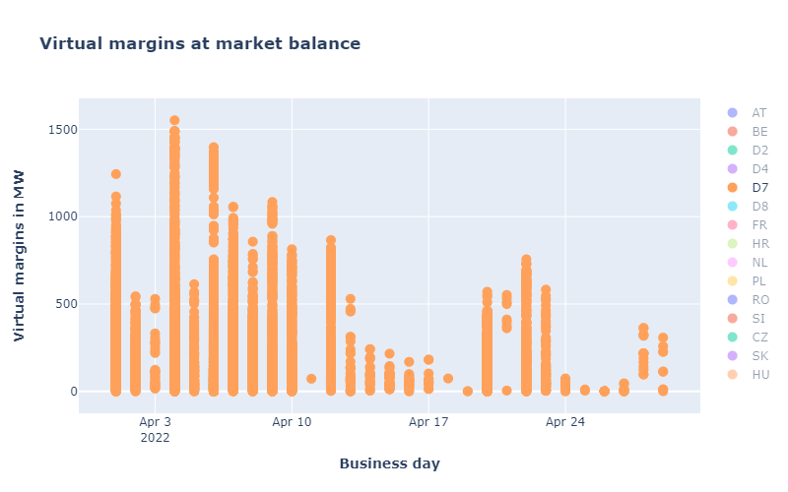

CORE TSOs
KPI 14b: D7: Virtual margins at market balance

Slide 52


CORE TSOs
KPI 14b: D8: Virtual margins at market balance

Slide 53


CORE TSOs
KPI 14b: FR: Virtual margins at market balance

Slide 54


CORE TSOs
KPI 14b: HR: Virtual margins at market balance

Slide 55


KPI 14b: HU: Virtual margins at market balance
CORE TSOs

Slide 56


KPI 14b: PL: Virtual margins at market balance
CORE TSOs

Slide 57


KPI 14b: NL: Virtual margins at market balance
CORE TSOs

Slide 58


CORE TSOs
KPI 14b: RO: Virtual margins at market balance

Slide 59


KPI 14b: SI: Virtual margins at market balance
CORE TSOs

Slide 60


KPI 14b: SK: Virtual margins at market balance
CORE TSOs

Slide 61

KPI 15: Non-Core exchanges delta flow
BD20220401 – BD20220430

Slide 62

KPI 15: Non-Core exchanges delta flow
BD20220401 – BD20220430

Slide 63

KPI 15: Non-Core delta exchanges
BD20220401 – BD20220430

Slide 64

Overview
NRAO – Applied Remedial Actions
On the analysis:
  The total number of MTUs (720 hours)
  was distributed as shown in the pie chart
  In the following plots, the relative time share
  relates to the hours labeled
  ‘NRAO Ran and Applied RAs’ (570 hours)

Slide 65

KPI 16: Relative Time Share of Applied RAs, by TSO, Type and Mode

Slide 66

KPI 16: Relative Time Share of Applied RAs, by TSO, Type and Mode
Relative Time Share of Applied PSTs in Preventive Mode

Slide 67

KPI 16: Relative Time Share of Applied RAs, by TSO, Type and Mode
Relative Time Share of Applied Topological RAs in Preventive Mode

Slide 68

KPI 16: Relative Time Share of Applied RAs, by TSO, Type and Mode
Relative Time Share of Applied PSTs in Curative Mode

Slide 69

KPI 16: Relative Time Share of Applied RAs, by TSO, Type and Mode
Relative Time Share of Applied Topological RAs in Curative Mode

Slide 70
KPI 17: Most limiting CNEC per TSO (NRAO)
TSCNET
  The graph below shows the distribution of CNECs which are the most limiting from NRAO perspective, these are the CNECs with lowest relative RAM per MTUs.
  As expected, there is redistributing of the most limiting CNECs. This is because the application of Remedial Actions does not eliminate flows but re-routes, reducing the flows on some limiting CNECs and increasing the load on others, which at the end impacts also the RAM values.
  In case of FR, there are 9 most limiting elements from NRAO perspective after the NRAO step.

Slide 71

KPI 18: Average variation of relative RAM before and after NRAO
TSCNET
  The graph shows average values of relative RAM before and after NRAO, per TSO on the most limiting CNECs from NRAO perspective. Selected CNECs before RAO are the same as after RAO, and average computed for MTUs when NRAO was used further in the process.
  Most limiting element from NRAO perspective is the one which has the lowest relRAM per MTU.
  To determent value of relative RAM, the following formula was used:
  $${RAM}_{rel}=\frac{{RAM}_{nrao}}{\sum_{\left(A, B\right) ∈ neighbouring Core bidding zones pairs }{\left|{PTDF}_{A→B, nrao}\right|}} if {RAM}_{nrao}≥0$$
  $${RAM}_{rel}={RAM}_{nrao} if {RAM}_{nrao}< 0$$
  The increment of relRAM values after RAO shows that the optimization performed did increase the capacity on some areas.
  In case of CZ and D4, it can be seen that RAM before RAO was negative and therefore relRAM= negativeRAM. After application of RAs, the flow on the element decreased leading to an increased RAM (equal or above 0), and this results in relRAM no longer being absolute (RAM) but calculated relative value.
  In case of FR, there were no most limiting elements from NRAO perspective.

Slide 72
Parallel Run KPI report
CORE FB MC
KPI 7: Most often presolved CNEs (TOP 20) 202204
@ ext//run coordinator: To be updated when MC Simulations are available
Total BDs: 30 (720 hours)
CNE | Distinct Hours | Hours CNE was presolved | Average RAM | Max of RAM | Min of RAM | Max of z2zPTDF | Max of sum z2z PTDF
BE_AL-DE_AL 01 | 720 | 720 | 0% | 0% | 0% | 0 | 0
[SK-UA] V.Kapusany - Mukachevo (WPS) [DIR] [SK] | 720 | 720 | 81% | 121% | 37% | 0,26929 | 0,97991
[HR-SI] 220kV Pehlin - Divaca [OPP] [HR] | 715 | 1390 | 85% | 130% | 41% | 0,03162 | 0,49645
[CZ-SK] Nosovice - Varin [OPP] [SK] | 707 | 1491 | 100% | 141% | 71% | 0,35992 | 1,39595
[HU-HU] Gonyu - Gyor [DIR] | 697 | 1498 | 74% | 105% | 55% | 0,19539 | 1,40976
[HR-HR] 400kV Zerjavinec - Tumbri [OPP] | 694 | 1391 | 74% | 113% | 39% | 0,26746 | 1,18569
[CZ-SK] Nosovice - Varin [DIR] [SK] | 687 | 1191 | 82% | 109% | 47% | 0,35558 | 1,39595
[BE-FR] Avelgem - Avelin 80 [OPP] [FR] | 680 | 953 | 66% | 144% | 20% | 0,17647 | 1,02938
[AT-AT] Westtirol 1 - Westtirol 2 WTRHU41 [OPP] | 678 | 1473 | 24% | 80% | 0% | 0,34458 | 1,42316
[BE-BE] PST Van Eyck 2 [OPP] [BE] | 655 | 2299 | 71% | 129% | 36% | 0,36712 | 0,84529
[BE-BE] PST Van Eyck 2 [DIR] [BE] | 643 | 1600 | 99% | 152% | 20% | 0,12425 | 0,85664
[AT-HU] Wien Suedost - Gyoer 245 [DIR] [AT] | 628 | 778 | 66% | 105% | 21% | 0,08031 | 0,31976
[SK-HU] Gabcikovo - Gonyu [OPP] [HU] | 563 | 1077 | 88% | 119% | 66% | 0,14018 | 1,06449
[NL-D7] Maasbracht - Oberzier SELFK WS [DIR] [D7] | 553 | 1973 | 55% | 109% | 0% | 0,29347 | 0,81657
[SI-HR] 220kV Podlog - Zerjavinec [DIR] [SI] | 516 | 1237 | 79% | 132% | 39% | 0,04875 | 0,36528
[SI-HR] 220kV Podlog - Zerjavinec [OPP] [SI] | 497 | 946 | 97% | 132% | 69% | 0,12921 | 0,36129
[AT-SI] Obersielach - Podlog 247 [OPP] [AT] | 450 | 918 | 107% | 195% | 7% | 0,07214 | 0,60662
[AT-SI] Obersielach - Podlog 247 [DIR] [AT] | 433 | 1079 | 50% | 140% | 0% | 0,2017 | 0,60666
[D4-D7] Daxlanden - Weingarten GERMHM S [OPP] [D7] | 406 | 1024 | 16% | 47% | 0% | 0,0746 | 0,4068
[D4-D7] Daxlanden - Weingarten ge (Germersheim Sued) [OPP] [D4] | 282 | 1003 | 18% | 49% | 0% | 0,07328 | 0,4048
*Please note that the shown z2zPTDF values do not correspond to the maximum zone-to-zone PTDFs according to equation 5 of the Day-ahead CCM and hence are not the ones used for the CNEC Selection. The z2zPTDFs are calculated only between neighbouring BZs by the scripts used for external parallel run reporting. See KPI reading guide on JAO.

Slide 73

Parallel Run KPI report
CORE FB MC
KPI 8a: Most limiting CNEs (TOP 20) 202204
@ ext//run coordinator: To be updated when MC Simulations are available
Total BDs: 30 (720 hours)
CNE | Distinct Hours | Hours CNE has ShadowPrice | Max of Shadow Price | Average of RAM | Min of RAM | Max of RAM | Max of z2zPTDF | Max of sum z2z PTDF
[NL-D2] Meeden-Diele 380 Z [OPP] [NL] | 198 | 198 | 10675,484 | 24% | 0% | 68% | 0,29444 | 0,65946
[AT-AT] Bisamberg 2 - Wien Suedost 227 [DIR] | 132 | 133 | 4268,574 | 33% | 19% | 48% | 0,05038 | 0,22243
[BE-FR] Achene - Lonny 19 [DIR] [FR] | 97 | 97 | 908,792 | 62% | 31% | 91% | 0,41614 | 0,9852
[D7-D7] Buerstadt - Lambsheim BUERST W [DIR] | 95 | 96 | 8078,488 | 26% | 20% | 51% | 0,17369 | 0,68046
[NL-NL] Diemen-Lelystad 380 W [OPP] | 94 | 94 | 2172,697 | 23% | 18% | 47% | 0,19005 | 0,46489
[BE-FR] Avelgem - Avelin 80 [DIR] [FR] | 82 | 82 | 1030,433 | 66% | 20% | 105% | 0,41421 | 1,0097
[CZ-PL] Wielopole - Nosovice [DIR] [PL] | 73 | 73 | 1520,714 | 51% | 24% | 72% | 0,03947 | 1,14161
[BE-BE] Achene - Gramme 380.10 [OPP] | 63 | 63 | 1284,865 | 78% | 52% | 105% | 0,41474 | 0,98356
[CZ-D8] Hradec - Rohrsdorf 446 [OPP] [D8] | 62 | 62 | 563,940 | 31% | 5% | 50% | 0,19622 | 1,20492
[PL-PL] Krosno Iskrzynia - Rzeszow [OPP] | 60 | 60 | 622,767 | 52% | 36% | 84% | 0,12778 | 1,13229
[AT-D2] St. Peter 2 - Pleinting 258 [OPP] [AT] | 55 | 55 | 1466,462 | 79% | 32% | 126% | 0,05881 | 0,49735
[D2-D7] Grosskrotzenburg - Urberach UMAIN N2 [DIR] [D7] | 52 | 52 | 3088,607 | 24% | 20% | 36% | 0,07473 | 0,35
[D2-NL] Diele - Meeden SCHWARZ [DIR] [D2] | 50 | 50 | 38582,681 | 35% | 0% | 80% | 0,27239 | 0,6332
[NL-D7] Maasbracht - Oberzier SELFK WS [DIR] [D7] | 48 | 55 | 2140,467 | 50% | 0% | 101% | 0,26246 | 0,67412
[PL-PL] Mikulowa AT1 [OPP] | 45 | 45 | 682,210 | 64% | 52% | 86% | 0,02425 | 0,54713
[AT-AT] Westtirol 1 - Westtirol 2 WTRHU41 [OPP] | 44 | 45 | 1031,567 | 14% | 0% | 37% | 0,28402 | 1,16742
[PL-PL] Polaniec - Tarnow [DIR] | 40 | 40 | 765,740 | 32% | 17% | 56% | 0,06357 | 0,63809
[D8-PL] Mikulowa PST1 [OPP] [PL] | 40 | 40 | 1701,433 | 30% | 5% | 60% | 0,38905 | 1,42602
[D8-PL] Krajnik - Vierraden 2 [OPP] [PL] | 40 | 40 | 2344,338 | 11% | 0% | 32% | 0,27856 | 1,0222
[AT-SI] Obersielach - Podlog 247 [DIR] [AT] | 35 | 35 | 1005,780 | 32% | 8% | 109% | 0,19499 | 0,57061
[SK-UA] V.Kapusany - Mukachevo (WPS) [DIR] [SK] | 35 | 35 | 1051,588 | 59% | 37% | 82% | 0,26801 | 0,9759

Slide 74

Parallel Run KPI report
CORE FB MC
KPI 8b: Allocation Constraints 202204
Please note that Belgium only uses import constraints.

Slide 75

Parallel Run KPI report
KPI 9: Clearing prices, price spreads and price convergence
BD20220401

Slide 76

Parallel Run KPI report
KPI 9: Clearing prices, price spreads and price convergence
BD20220402

Slide 77

Parallel Run KPI report
KPI 9: Clearing prices, price spreads and price convergence
BD20220403

Slide 78

Parallel Run KPI report
KPI 9: Clearing prices, price spreads and price convergence
BD20220404

Slide 79

Parallel Run KPI report
KPI 9: Clearing prices, price spreads and price convergence
BD20220405

Slide 80

Parallel Run KPI report
KPI 9: Clearing prices, price spreads and price convergence
BD20220406

Slide 81

Parallel Run KPI report
KPI 9: Clearing prices, price spreads and price convergence
BD20220407

Slide 82

Parallel Run KPI report
KPI 9: Clearing prices, price spreads and price convergence
BD20220408

Slide 83

Parallel Run KPI report
KPI 9: Clearing prices, price spreads and price convergence
BD20220409

Slide 84

Parallel Run KPI report
KPI 9: Clearing prices, price spreads and price convergence
BD20220410

Slide 85

Parallel Run KPI report
KPI 9: Clearing prices, price spreads and price convergence
BD20220411

Slide 86

Parallel Run KPI report
KPI 9: Clearing prices, price spreads and price convergence
BD20220412

Slide 87

Parallel Run KPI report
KPI 9: Clearing prices, price spreads and price convergence
BD20220413

Slide 88

Parallel Run KPI report
KPI 9: Clearing prices, price spreads and price convergence
BD20220414

Slide 89

Parallel Run KPI report
KPI 9: Clearing prices, price spreads and price convergence
BD20220415

Slide 90

Parallel Run KPI report
KPI 9: Clearing prices, price spreads and price convergence
BD20220416

Slide 91

Parallel Run KPI report
KPI 9: Clearing prices, price spreads and price convergence
BD20220417

Slide 92

Parallel Run KPI report
KPI 9: Clearing prices, price spreads and price convergence
BD20220418

Slide 93

Parallel Run KPI report
KPI 9: Clearing prices, price spreads and price convergence
BD20220419

Slide 94

Parallel Run KPI report
KPI 9: Clearing prices, price spreads and price convergence
BD20220420

Slide 95

Parallel Run KPI report
KPI 9: Clearing prices, price spreads and price convergence
BD20220421

Slide 96

Parallel Run KPI report
KPI 9: Clearing prices, price spreads and price convergence
BD20220422

Slide 97

Parallel Run KPI report
KPI 9: Clearing prices, price spreads and price convergence
BD20220423

Slide 98

Parallel Run KPI report
KPI 9: Clearing prices, price spreads and price convergence
BD20220424

Slide 99

Parallel Run KPI report
KPI 9: Clearing prices, price spreads and price convergence
BD20220425

Slide 100

Parallel Run KPI report
KPI 9: Clearing prices, price spreads and price convergence
BD20220426

Slide 101

Parallel Run KPI report
KPI 9: Clearing prices, price spreads and price convergence
BD20220427

Slide 102

Parallel Run KPI report
KPI 9: Clearing prices, price spreads and price convergence
BD20220428

Slide 103

Parallel Run KPI report
KPI 9: Clearing prices, price spreads and price convergence
BD20220429

Slide 104

Parallel Run KPI report
KPI 9: Clearing prices, price spreads and price convergence
BD20220430

Slide 105
CORE FB MC
Parallel Run KPI report
KPI 10: Highest non-zero shadow prices in each hour for the simulated BD20220401 (part I)
Hour | MAX of ShadowPrice | RAM %
1 | 949,04 | 146%
[HR-BA] 220kV Zakucac - Mostar [OPP] [HR] / N-1 Konjsko - Mostar | 949,04 | 17%
[NL-D2] Meeden-Diele 380 Z [OPP] [NL] / N-1 Gronau - Gronau TR 441 E | 243,92 | 20%
[BE-FR] Avelgem - Avelin 80 [DIR] [FR] / N-1 Achene - Lonny 380.19 | 334,41 | 32%
[D7-D7] Buerstadt - Lambsheim BUERST W [DIR] / N-1 Sechtem - Paffendorf - Oberzier SECHTM S | 512,95 | 20%
[AT-AT] Rosegg - Villach Sued 267B [DIR] / N-1 Feistritz - Obersielach 268 | 105,48 | 57%
2 | 687,52 | 80%
[NL-D2] Meeden-Diele 380 Z [OPP] [NL] / N-1 Gronau - Gronau TR 441 E | 297,76 | 20%
[BE-FR] Achene - Lonny 19 [DIR] [FR] / N-1 Avelgem - Avelin 380.80 | 292,4 | 40%
[D7-D7] Buerstadt - Lambsheim BUERST W [DIR] / N-1 Rheinau - Hoheneck KUGELB W | 687,52 | 20%
3 | 1351,34 | 111%
[HR-BA] 220kV Zakucac - Mostar [OPP] [HR] / N-1 Konjsko - Mostar | 1351,34 | 10%
[NL-D2] Meeden-Diele 380 Z [OPP] [NL] / N-1 COBRA HVDC | 147,76 | 20%
[BE-FR] Achene - Lonny 19 [DIR] [FR] / N-1 Avelgem - Avelin 380.80 | 227,4 | 39%
[RO-RO] Paroseni - Targu Jiu Nord [OPP] / N-1 Resita - Timisoara | 61,49 | 23%
[D7-D7] Buerstadt - Lambsheim BUERST W [DIR] / N-1 Avelgem - Avelin 380.80 | 693,33 | 20%
4 | 1171,09 | 173%
[HR-BA] 220kV Zakucac - Mostar [OPP] [HR] / N-1 Konjsko - Mostar | 1171,09 | 9%
[NL-D2] Meeden-Diele 380 Z [OPP] [NL] / N-1 COBRA HVDC | 17,43 | 20%
[BE-FR] Achene - Lonny 19 [DIR] [FR] / N-1 Avelgem - Avelin 380.80 | 124,23 | 45%
[RO-RO] Paroseni - Targu Jiu Nord [OPP] / N-1 Resita - Timisoara | 227,64 | 23%
[D7-D7] Buerstadt - Lambsheim BUERST W [DIR] / N-1 Sechtem - Paffendorf - Oberzier SECHTM S | 805,53 | 20%
[AT-AT] Rosegg - Villach Sued 267B [DIR] / N-1 Feistritz - Obersielach 268 | 41,09 | 56%
5 | 1095,86 | 146%
[HR-BA] 220kV Zakucac - Mostar [OPP] [HR] / N-1 Konjsko - Mostar | 1095,86 | 8%
[AT-AT] Tauern - Weissenbach 221 [OPP] / N-1 Tauern - Weissenbach 221 | 246,42 | 57%
[NL-D2] Meeden-Diele 380 Z [OPP] [NL] / N-1 COBRA HVDC | 150,11 | 20%
[BE-FR] Achene - Lonny 19 [DIR] [FR] / N-1 Avelgem - Avelin 380.80 | 244,93 | 42%
[D7-D7] Buerstadt - Lambsheim BUERST W [DIR] / N-1 Rheinau - Hoheneck KUGELB O | 642,61 | 20%
6 | 897,13 | 49%
[HR-BA] 220kV Zakucac - Mostar [OPP] [HR] / N-1 Konjsko - Mostar | 892,99 | 10%
[NL-D2] Meeden-Diele 380 Z [OPP] [NL] / N-1 COBRA HVDC | 66,37 | 20%
[D7-D7] Buerstadt - Lambsheim BUERST W [DIR] / N-1 Rheinau - Hoheneck KUGELB O | 897,13 | 20%
7 | 2036,9 | 63%
[D8-D8] Pasewalk - Vierraden 306 [DIR] / N-1 Vierraden - Neuenhagen 304 | 186,55 | 22%
[NL-D2] Meeden-Diele 380 Z [OPP] [NL] / N-1 COBRA HVDC | 67,21 | 20%
[RO-RO] Urechesti - Targu Jiu Nord [DIR] / N-1 Sibiu Sud - Mintia | 2036,9 | 0%
[D7-D7] Buerstadt - Lambsheim BUERST W [DIR] / N-1 Rheinau - Hoheneck KUGELB W | 1039,02 | 22%

Slide 106
CORE FB MC
Parallel Run KPI report
KPI 10: Highest non-zero shadow prices in each hour for the simulated BD20220401 (part II)
Hour | MAX of ShadowPrice | RAM %
8 | 1358,32 | 124%
[CZ-D8] Hradec - Rohrsdorf 446 [OPP] [D8] / N-1 Hradec - Rohrsdorf 1 | 2,53 | 36%
[D2-NL] Diele - Meeden SCHWARZ [DIR] [D2] / N-1 Gronau - Gronau TR 441 E | 201,17 | 20%
[RO-RO] Paroseni - Targu Jiu Nord [OPP] / N-1 Sibiu Sud - Mintia | 1358,32 | 0%
[BE-FR] Avelgem - Avelin 80 [DIR] [FR] / N-1 Achene - Lonny 380.19 | 100,42 | 37%
[D7-D7] Buerstadt - Lambsheim BUERST W [DIR] / N-1 Dahlem - Niederstedem SELHN W | 1199,09 | 20%
[D8-PL] Krajnik - Vierraden 2 [OPP] [PL] / N-1 Mikulowa - Pasikurowice | 33,51 | 11%
9 | 1608,25 | 189%
[AT-AT] Westtirol 1 - Westtirol 2 WTRHU41 [OPP] / N-1 Buers - Westtirol ws (421) | 5,62 | 19%
[CZ-D8] Hradec - Rohrsdorf 446 [OPP] [D8] / N-1 Hradec - Rohrsdorf 1 | 13,78 | 35%
[NL-D2] Meeden-Diele 380 Z [OPP] [NL] / N-1 COBRA HVDC | 276,65 | 20%
[RO-RO] Urechesti - Targu Jiu Nord [DIR] / N-1 Sibiu Sud - Mintia | 1608,25 | 0%
[D7-D7] Buerstadt - Lambsheim BUERST W [DIR] / N-1 Dahlem - Niederstedem SELHN W | 1478,45 | 20%
[D8-PL] Krajnik - Vierraden 2 [OPP] [PL] / N-1 Mikulowa - Pasikurowice | 61,93 | 2%
[AT-SI] Obersielach - Podlog 247 [DIR] [AT] / N-1 Cirkovce-Podlog | 0,35 | 93%
10 | 1604,65 | 91%
[NL-D2] Meeden-Diele 380 Z [OPP] [NL] / N-1 COBRA HVDC | 359,68 | 20%
[BE-FR] Avelgem - Avelin 80 [DIR] [FR] / N-1 Achene - Lonny 380.19 | 82,98 | 27%
[RO-RO] Paroseni - Targu Jiu Nord [OPP] / N-1 Resita - Timisoara | 1604,65 | 12%
[D7-D7] Buerstadt - Lambsheim BUERST W [DIR] / N-1 Dahlem - Niederstedem SELHN W | 996,43 | 20%
[D8-PL] Krajnik - Vierraden 2 [OPP] [PL] / N-1 Mikulowa - Pasikurowice | 83,65 | 13%
11 | 1978,36 | 206%
[AT-AT] Westtirol 1 - Westtirol 2 WTRHU41 [OPP] / N-1 Buers - Westtirol ws (421) | 23,44 | 19%
[CZ-D8] Hradec - Rohrsdorf 446 [OPP] [D8] / N-1 Hradec - Rohrsdorf 1 | 152,72 | 34%
[HR-BA] 220kV Zakucac - Mostar [OPP] [HR] / BASECASE | 390,63 | 8%
[NL-D2] Meeden-Diele 380 Z [OPP] [NL] / N-1 COBRA HVDC | 240,91 | 20%
[BE-FR] Avelgem - Avelin 80 [DIR] [FR] / N-1 Achene - Lonny 380.19 | 242,1 | 22%
[NL-NL] Dodewaard-Doetinchem 380 W [OPP] / N-1 Dodewaard-Doetinchem 380 Z | 0,25 | 20%
[PL-PL] Krosno Iskrzynia - Rzeszow [OPP] / N-1 Krosno Iskrzynia - Tarnow | 85,26 | 64%
[RO-RO] Paroseni - Targu Jiu Nord [OPP] / N-1 Resita - Timisoara | 1978,36 | 0%
[D7-D7] Buerstadt - Lambsheim BUERST W [DIR] / N-1 Dahlem - Niederstedem SELHN W | 572,58 | 20%
12 | 2045,91 | 208%
[CZ-D8] Hradec - Rohrsdorf 446 [OPP] [D8] / N-1 Hradec - Rohrsdorf 1 | 82,12 | 37%
[RO-RO] Resita - Timisoara c1 [DIR] / N-1 Resita - Timisoara c2 | 2045,91 | 0%
[HR-BA] 220kV Zakucac - Mostar [OPP] [HR] / BASECASE | 376,94 | 7%
[NL-D2] Meeden-Diele 380 Z [OPP] [NL] / N-1 COBRA HVDC | 129,71 | 20%
[CZ-PL] Wielopole - Nosovice [DIR] [PL] / N-1 Albrechtice - Nosovice | 124,38 | 56%
[PL-PL] Krosno Iskrzynia - Rzeszow [OPP] / N-1 Krosno Iskrzynia - Tarnow | 52,9 | 65%
[D7-D7] Buerstadt - Lambsheim BUERST W [DIR] / N-1 Dahlem - Niederstedem SELHN W | 928,92 | 20%
[D8-PL] Krajnik - Vierraden 2 [OPP] [PL] / N-1 Mikulowa - Pasikurowice | 231,72 | 3%

Slide 107
CORE FB MC
Parallel Run KPI report
KPI 10: Highest non-zero shadow prices in each hour for the simulated BD20220401 (part III)
Hour | MAX of ShadowPrice | RAM %
13 | 1866,14 | 471%
[CZ-D8] Hradec - Rohrsdorf 446 [OPP] [D8] / N-1 Hradec - Rohrsdorf 1 | 112,75 | 38%
[RO-RO] Resita - Timisoara c1 [DIR] / N-1 Resita - Timisoara c2 | 1866,14 | 0%
[HR-BA] 220kV Zakucac - Mostar [OPP] [HR] / BASECASE | 323,93 | 7%
[CZ-SK] Nosovice - Varin [DIR] [SK] / N-1 Sokolnice - Stupava | 12,52 | 90%
[BE-FR] Avelgem - Avelin 80 [DIR] [FR] / N-1 Achene - Lonny 380.19 | 444,34 | 20%
[CZ-PL] Wielopole - Nosovice [DIR] [PL] / N-1 Albrechtice - Nosovice | 125,94 | 57%
[NL-NL] Dodewaard-Doetinchem 380 W [OPP] / N-1 Dodewaard-Doetinchem 380 Z | 586,01 | 20%
[PL-PL] Krosno Iskrzynia - Rzeszow [OPP] / N-1 Krosno Iskrzynia - Tarnow | 2,81 | 71%
[D7-D7] Buerstadt - Lambsheim BUERST W [DIR] / N-1 Dahlem - Niederstedem SELHN W | 154,99 | 20%
[AT-SI] Obersielach - Podlog 247 [DIR] [AT] / N-1 Cirkovce-Podlog | 35,07 | 109%
[D7-D7] Y Paffendorf - Oberzier SECHTM S [DIR] / N-1 Sechtem - Paffendorf - Oberzier SECHTM N | 73,58 | 41%
14 | 1859,15 | 92%
[NL-D2] Meeden-Diele 380 Z [OPP] [NL] / N-1 COBRA HVDC | 179,09 | 20%
[BE-FR] Achene - Lonny 19 [DIR] [FR] / N-1 Avelgem - Avelin 380.80 | 192,89 | 36%
[RO-RO] Paroseni - Targu Jiu Nord [OPP] / N-1 Resita - Timisoara | 1859,15 | 16%
[D7-D7] Buerstadt - Lambsheim BUERST W [DIR] / N-1 Dahlem - Niederstedem SELHN W | 686,48 | 20%
15 | 1576,13 | 239%
[CZ-D8] Hradec - Rohrsdorf 446 [OPP] [D8] / N-1 Hradec - Rohrsdorf 1 | 65,4 | 33%
[RO-RO] Resita - Timisoara c1 [DIR] / N-1 Resita - Timisoara c2 | 1576,13 | 0%
[HR-BA] 220kV Zakucac - Mostar [OPP] [HR] / BASECASE | 205,43 | 6%
[AT-AT] Salzburg - Tauern 231A [DIR] / N-1 Salzburg - Tauern 232A | 47,61 | 56%
[NL-D2] Meeden-Diele 380 Z [OPP] [NL] / N-1 COBRA HVDC | 145,13 | 20%
[BE-FR] Achene - Lonny 19 [DIR] [FR] / N-1 Avelgem - Avelin 380.80 | 102,06 | 43%
[CZ-PL] Wielopole - Nosovice [DIR] [PL] / N-1 Albrechtice - Nosovice | 15,41 | 58%
[D7-D7] Buerstadt - Lambsheim BUERST W [DIR] / N-1 Dahlem - Niederstedem SELHN W | 732,32 | 22%
16 | 1611,95 | 157%
[CZ-D8] Hradec - Rohrsdorf 446 [OPP] [D8] / N-1 Hradec - Rohrsdorf 1 | 52,64 | 34%
[RO-RO] Resita - Timisoara c1 [DIR] / N-1 Resita - Timisoara c2 | 1611,95 | 0%
[AT-AT] Salzburg - Tauern 231A [DIR] / N-1 Salzburg - Tauern 232A | 355,66 | 72%
[NL-D2] Meeden-Diele 380 Z [OPP] [NL] / N-1 COBRA HVDC | 113,98 | 25%
[D7-D7] Buerstadt - Lambsheim BUERST W [DIR] / N-1 Dahlem - Niederstedem SELHN W | 852,71 | 27%
17 | 2005,19 | 154%
[AT-AT] Salzburg - Tauern 231A [DIR] / N-1 Salzburg - Tauern 232A | 239,29 | 78%
[NL-D2] Meeden-Diele 380 Z [OPP] [NL] / N-1 COBRA HVDC | 96,91 | 27%
[RO-RO] Urechesti - Targu Jiu Nord [DIR] / N-1 Sibiu Sud - Mintia | 2005,19 | 8%
[D7-D7] Buerstadt - Lambsheim BUERST W [DIR] / N-1 Dahlem - Niederstedem SELHN W | 739,36 | 27%
[D8-PL] Krajnik - Vierraden 2 [OPP] [PL] / N-1 Mikulowa - Pasikurowice | 18,89 | 14%
18 | 815,68 | 94%
[RO-RO] Resita - Timisoara c1 [DIR] / N-1 Resita - Timisoara c2 | 799,07 | 24%
[NL-D2] Meeden-Diele 380 Z [OPP] [NL] / N-1 COBRA HVDC | 61,28 | 25%
[D7-D7] Buerstadt - Lambsheim BUERST W [DIR] / N-1 Rheinau - Hoheneck KUGELB O | 815,68 | 24%
[D8-PL] Krajnik - Vierraden 2 [OPP] [PL] / N-1 Mikulowa - Pasikurowice | 63,97 | 22%

Slide 108
CORE FB MC
Parallel Run KPI report
KPI 10: Highest non-zero shadow prices in each hour for the simulated BD20220401 (part IV)
Hour | MAX of ShadowPrice | RAM %
19 | 858,18 | 87%
[RO-RO] Resita - Timisoara c1 [DIR] / N-1 Resita - Timisoara c2 | 811,74 | 24%
[NL-D2] Meeden-Diele 380 Z [OPP] [NL] / N-1 COBRA HVDC | 198,89 | 20%
[D7-D7] Buerstadt - Lambsheim BUERST W [DIR] / N-1 Rheinau - Hoheneck KUGELB O | 858,18 | 22%
[D8-PL] Krajnik - Vierraden 2 [OPP] [PL] / N-1 Mikulowa - Pasikurowice | 60,99 | 21%
20 | 968,46 | 64%
[NL-D2] Meeden-Diele 380 Z [OPP] [NL] / N-1 COBRA HVDC | 294,47 | 20%
[D7-D7] Buerstadt - Lambsheim BUERST W [DIR] / N-1 Rheinau - Hoheneck KUGELB O | 968,46 | 25%
[D8-PL] Krajnik - Vierraden 2 [OPP] [PL] / N-1 Mikulowa - Pasikurowice | 59,03 | 19%
21 | 1475,34 | 77%
[NL-D2] Meeden-Diele 380 Z [OPP] [NL] / N-1 COBRA HVDC | 736,51 | 23%
[RO-RO] Paroseni - Targu Jiu Nord [OPP] / N-1 Resita - Timisoara | 1475,34 | 7%
[D8-PL] Krajnik - Vierraden 2 [OPP] [PL] / N-1 Mikulowa - Pasikurowice | 61,92 | 22%
[D7-D7] Buerstadt - Lambsheim BUERST W [DIR] / N-1 Rheinau - Hoheneck KUGELB W | 1145,87 | 25%
22 | 1449,8 | 72%
[RO-RO] Resita - Timisoara c1 [DIR] / N-1 Resita - Timisoara c2 | 900,5 | 23%
[NL-NL] Diemen-Lelystad 380 W [OPP] / N-1 Diemen-Lelystad 380 Z | 1449,8 | 20%
[D7-D7] Buerstadt - Lambsheim BUERST W [DIR] / N-1 Rheinau - Hoheneck KUGELB O | 275,21 | 29%
23 | 922,42 | 74%
[NL-D2] Meeden-Diele 380 Z [OPP] [NL] / N-1 COBRA HVDC | 420,58 | 33%
[RO-RO] Paroseni - Targu Jiu Nord [OPP] / N-1 Resita - Timisoara | 902,12 | 13%
[D7-D7] Buerstadt - Lambsheim BUERST W [DIR] / N-1 Rheinau - Hoheneck KUGELB W | 922,42 | 28%
24 | 1187,94 | 61%
[HR-BA] 220kV Zakucac - Mostar [OPP] [HR] / N-1 Konjsko - Mostar | 1187,94 | 7%
[NL-D2] Meeden-Diele 380 Z [OPP] [NL] / N-1 COBRA HVDC | 722,78 | 29%
[D7-D7] Buerstadt - Lambsheim BUERST W [DIR] / N-1 Rheinau - Hoheneck KUGELB O | 781,99 | 26%
Total sum | 1475,34 | 435%

Slide 109
CORE FB MC
Parallel Run KPI report
KPI 10: Highest non-zero shadow prices in each hour for the simulated BD20220402 (part I)
Hour | MAX of ShadowPrice | RAM %
1 | 1166,51 | 74%
[D2-NL] Diele - Meeden SCHWARZ [DIR] [D2] / N-1 Doerpen West - Y Niederlangen EOWS | 1097,12 | 20%
[BE-FR] Avelgem - Avelin 80 [DIR] [FR] / N-1 Achene - Lonny 380.19 | 373,84 | 34%
[D2-D7] Grosskrotzenburg - Urberach UMAIN N2 [DIR] [D7] / N-1 Dettingen - Grosskrotzenburg UMAIN S1 | 1166,51 | 20%
2 | 1320,31 | 98%
[NL-NL] Diemen-Lelystad 380 W [OPP] / N-1 Diemen-Lelystad 380 Z | 503,63 | 27%
[D2-D4] Grafenrheinfeld - Stalldorf 416 [DIR] [D2] / N-1 Hoepfingen - Hueffenhardt ge | 1320,31 | 21%
[BE-FR] Avelgem - Avelin 80 [DIR] [FR] / N-1 Achene - Lonny 380.19 | 159,2 | 49%
3 | 2193,85 | 46%
[D7-D7] Gronau - Gronau TR 441 E [OPP] / N-1 Gronau - Kusenhorst HAMALD | 281,42 | 25%
[D2-D7] Grosskrotzenburg - Urberach UMAIN N2 [DIR] [D7] / N-1 Dettingen - Grosskrotzenburg UMAIN S1 | 2193,85 | 21%
4 | 1977,26 | 86%
[D2-NL] Diele - Meeden SCHWARZ [DIR] [D2] / N-1 Gronau - Hanekenfaehr GRONAU W | 274,5 | 42%
[D2-D4] Grafenrheinfeld - Stalldorf 416 [DIR] [D2] / N-1 Hoepfingen - Hueffenhardt ge | 44,59 | 22%
[D2-D7] Grosskrotzenburg - Urberach UMAIN N2 [DIR] [D7] / N-1 Dettingen - Grosskrotzenburg UMAIN S1 | 1977,26 | 22%
5 | 1817,49 | 59%
[D2-D4] Grafenrheinfeld - Stalldorf 416 [DIR] [D2] / N-1 Grafenrheinfeld - Hoepfingen ge (411) | 82,46 | 20%
[NL-NL] Diemen-Lelystad 380 Z [OPP] / N-1 Diemen-Lelystad 380 W | 391,03 | 20%
[D2-D7] Grosskrotzenburg - Urberach UMAIN N2 [DIR] [D7] / N-1 Dettingen - Grosskrotzenburg UMAIN S1 | 1817,49 | 20%
6 | 2193,18 | 54%
[D2-NL] Diele - Meeden SCHWARZ [DIR] [D2] / N-1 Gronau - Hanekenfaehr GRONAU W | 410,22 | 34%
[D2-D7] Grosskrotzenburg - Urberach UMAIN N2 [DIR] [D7] / N-1 Dettingen - Grosskrotzenburg UMAIN S1 | 2193,18 | 20%
7 | 2017,08 | 121%
[AT-AT] Salzburg - Tauern 231A [DIR] / N-1 Salzburg - Tauern 232A | 130,62 | 76%
[NL-NL] Diemen-Lelystad 380 Z [OPP] / N-1 Diemen-Lelystad 380 W | 508,36 | 25%
[D2-D7] Grosskrotzenburg - Urberach UMAIN N2 [DIR] [D7] / N-1 Dettingen - Grosskrotzenburg UMAIN S1 | 2017,08 | 20%
8 | 1447,6 | 64%
[D2-D2] Conneforde - Diele ROT [DIR] / N-1 Conneforde - Diele WEISS | 413,37 | 20%
[D2-D4] Grafenrheinfeld - Stalldorf 416 [DIR] [D2] / N-1 Hoepfingen - Hueffenhardt ge | 444,9 | 20%
[D2-D7] Grosskrotzenburg - Urberach UMAIN N2 [DIR] [D7] / N-1 Dettingen - Grosskrotzenburg UMAIN S1 | 1447,6 | 24%
9 | 476,35 | 154%
[NL-NL] Diemen-Lelystad 380 W [OPP] / N-1 Diemen-Lelystad 380 Z | 357,78 | 46%
[BE-FR] Avelgem - Avelin 80 [DIR] [FR] / N-1 Achene - Lonny 380.19 | 286,95 | 73%
[D2-D7] Grosskrotzenburg - Urberach UMAIN N2 [DIR] [D7] / N-1 Dettingen - Grosskrotzenburg UMAIN S1 | 476,35 | 36%
10 | 1076,79 | 124%
[D2-NL] Diele - Meeden SCHWARZ [DIR] [D2] / N-1 Gronau - Hanekenfaehr GRONAU W | 225,19 | 59%
[BE-FR] Avelgem - Avelin 80 [DIR] [FR] / N-1 Achene - Lonny 380.19 | 437,61 | 39%
[D2-D7] Grosskrotzenburg - Urberach UMAIN N2 [DIR] [D7] / N-1 Dettingen - Grosskrotzenburg UMAIN S1 | 1076,79 | 26%

Slide 110
CORE FB MC
Parallel Run KPI report
KPI 10: Highest non-zero shadow prices in each hour for the simulated BD20220402 (part II)
Hour | MAX of ShadowPrice | RAM %
11 | 2172,07 | 101%
[D7-D2] Urberach - Grosskrotzenburg [OPP] [D2] / N-1 Dettingen - Grosskrotzenburg UMAIN S1 | 2172,07 | 21%
[BE-FR] Achene - Lonny 19 [DIR] [FR] / N-1 Avelgem - Avelin 380.80 | 92,07 | 38%
[BE-FR] Avelgem - Avelin 80 [DIR] [FR] / N-1 Faux Fresnay - Mery | 99,35 | 43%
12 | 1473,79 | 182%
[D2-NL] Diele - Meeden SCHWARZ [DIR] [D2] / N-1 Gronau - Hanekenfaehr GRONAU W | 71,28 | 41%
[D7-D2] Urberach - Grosskrotzenburg [OPP] [D2] / N-1 Dettingen - Grosskrotzenburg UMAIN S1 | 1473,79 | 21%
[AT-AT] Salzburg - Tauern 231A [DIR] / N-1 Salzburg - Tauern 232A | 31,28 | 79%
[BE-FR] Avelgem - Avelin 80 [DIR] [FR] / N-1 Faux Fresnay - Mery | 384,41 | 41%
13 | 1087,61 | 230%
[D2-NL] Diele - Meeden SCHWARZ [DIR] [D2] / N-1 Gronau - Hanekenfaehr GRONAU W | 325,29 | 35%
[RO-RO] Resita - Timisoara c1 [DIR] / N-1 Resita - Timisoara c2 | 82,02 | 43%
[AT-AT] Salzburg - Tauern 231A [DIR] / N-1 Salzburg - Tauern 232A | 97,58 | 48%
[AT-AT] Tauern - Weissenbach 221 [OPP] / N-1 Tauern - Weissenbach 221 | 1087,61 | 32%
[D7-D7] Buerstadt - Lambsheim BUERST W [DIR] / N-1 Rheinau - Hoheneck KUGELB O | 375,56 | 27%
[BE-FR] Avelgem - Avelin 80 [DIR] [FR] / N-1 Avelin - Gavrelle 1 | 693 | 44%
14 | 1043,6 | 136%
[D2-NL] Diele - Meeden SCHWARZ [DIR] [D2] / N-1 Gronau - Hanekenfaehr GRONAU W | 193,89 | 26%
[AT-AT] Tauern - Weissenbach 221 [OPP] / N-1 Tauern - Weissenbach 221 | 1043,6 | 35%
[BE-BE] Achene - Gramme 380.10 [OPP] / N-1 Avelgem - Avelin 380.80 | 352,49 | 52%
[D7-D7] Buerstadt - Lambsheim BUERST W [DIR] / N-1 Rheinau - Hoheneck KUGELB O | 954,66 | 24%
15 | 842,19 | 134%
[AT-AT] Salzburg - Tauern 231A [DIR] / N-1 Salzburg - Tauern 232A | 842,19 | 52%
[BE-FR] Avelgem - Avelin 80 [DIR] [FR] / N-1 Achene - Lonny 380.19 | 487,2 | 53%
[D7-D7] Buerstadt - Lambsheim BUERST W [DIR] / N-1 Rheinau - Hoheneck KUGELB O | 744,74 | 29%
16 | 1483,68 | 168%
[D7-D2] Urberach - Grosskrotzenburg [OPP] [D2] / N-1 Dettingen - Grosskrotzenburg UMAIN S1 | 1483,68 | 20%
[AT-AT] Salzburg - Tauern 231A [DIR] / N-1 Salzburg - Tauern 232A | 768,98 | 55%
[BE-BE] Achene - Gramme 380.10 [OPP] / N-1 Avelgem - Avelin 380.80 | 129,39 | 64%
[D7-D7] Buerstadt - Lambsheim BUERST W [DIR] / N-1 Rheinau - Hoheneck KUGELB O | 135,65 | 29%
17 | 1651,02 | 196%
[AT-AT] Salzburg - Tauern 231A [DIR] / N-1 Salzburg - Tauern 232A | 431,38 | 72%
[BE-FR] Avelgem - Avelin 80 [DIR] [FR] / N-1 Achene - Lonny 380.19 | 47,15 | 56%
[BE-FR] Achene - Lonny 19 [DIR] [FR] / N-1 Avelgem - Avelin 380.80 | 66,27 | 49%
[D2-D7] Grosskrotzenburg - Urberach UMAIN N2 [DIR] [D7] / N-1 Dettingen - Grosskrotzenburg UMAIN S1 | 1651,02 | 20%
18 | 2113,24 | 20%
[D2-D7] Grosskrotzenburg - Urberach UMAIN N2 [DIR] [D7] / N-1 Dettingen - Grosskrotzenburg UMAIN S1 | 2113,24 | 20%
19 | 1390,79 | 97%
[BE-FR] Avelgem - Avelin 80 [DIR] [FR] / N-1 Achene - Lonny 380.19 | 128,88 | 68%
[D2-D7] Grosskrotzenburg - Urberach UMAIN N2 [DIR] [D7] / N-1 Dettingen - Grosskrotzenburg UMAIN S1 | 1390,79 | 29%

Slide 111
CORE FB MC
Parallel Run KPI report
KPI 10: Highest non-zero shadow prices in each hour for the simulated BD20220402 (part III)
Hour | MAX of ShadowPrice | RAM %
20 | 1089,89 | 196%
[AT-AT] Westtirol 1 - Westtirol 2 WTRHU41 [OPP] / N-1 Buers - Westtirol ws (421) | 66,39 | 28%
[BE-FR] Avelgem - Avelin 80 [DIR] [FR] / N-1 Achene - Lonny 380.19 | 55,27 | 70%
[PL-PL] Krosno Iskrzynia - Rzeszow [OPP] / N-1 Krosno Iskrzynia - Tarnow | 200,58 | 65%
[D2-D7] Grosskrotzenburg - Urberach UMAIN N2 [DIR] [D7] / N-1 Dettingen - Grosskrotzenburg UMAIN S1 | 1089,89 | 33%
21 | 2339,3 | 138%
[D2-D2] Conneforde - Diele WEISS [DIR] / N-1 Conneforde - Diele ROT | 2339,3 | 22%
[BE-FR] Avelgem - Avelin 80 [DIR] [FR] / N-1 Achene - Lonny 380.19 | 236,49 | 51%
[PL-PL] Krosno Iskrzynia - Rzeszow [OPP] / N-1 Krosno Iskrzynia - Tarnow | 3,69 | 65%
22 | 1552,87 | 121%
[AT-AT] Westtirol 1 - Westtirol 2 WTRHU41 [OPP] / N-1 Buers - Westtirol ws (421) | 6,29 | 37%
[D2-D4] Grafenrheinfeld - Stalldorf 416 [DIR] [D2] / N-1 Grafenrheinfeld - Hoepfingen ge (411) | 1552,87 | 27%
[D2-NL] Diele - Meeden SCHWARZ [DIR] [D2] / N-1 Gronau - Hanekenfaehr GRONAU W | 256,77 | 57%
23 | 1337,16 | 144%
[NL-NL] Diemen-Lelystad 380 W [OPP] / N-1 Diemen-Lelystad 380 Z | 1337,16 | 21%
[D2-D4] Grafenrheinfeld - Stalldorf 416 [DIR] [D2] / N-1 Hoepfingen - Hueffenhardt ge | 61,77 | 31%
[CZ-D2] Hradec - Etzenricht 441 [DIR] [D2] / N-1 Prestice - Etzenricht | 532,32 | 34%
[BE-FR] Avelgem - Avelin 80 [DIR] [FR] / N-1 Achene - Lonny 380.19 | 257,36 | 58%
24 | 1069,54 | 177%
[D2-D4] Grafenrheinfeld - Stalldorf 416 [DIR] [D2] / N-1 Hoepfingen - Hueffenhardt ge | 1069,54 | 35%
[CZ-D2] Hradec - Etzenricht 441 [DIR] [D2] / N-1 Prestice - Etzenricht | 445,82 | 35%
[BE-FR] Achene - Lonny 19 [DIR] [FR] / N-1 Avelgem - Avelin 380.80 | 67,89 | 31%
[D7-D7] Y Paffendorf - Oberzier SECHTM N [DIR] / N-1 Sechtem - Paffendorf - Oberzier SECHTM S | 8,63 | 76%
Total sum | 2339,3 | 776%

Slide 112
CORE FB MC
Parallel Run KPI report
KPI 10: Highest non-zero shadow prices in each hour for the simulated BD20220403 (part I)
Hour | MAX of ShadowPrice | RAM %
1 | 544,34 | 247%
[PL-PL] Mikulowa AT1 [OPP] / N-1 Mikulowa AT2 | 544,34 | 63%
[D7-D7] Gronau - Gronau TR 441 E [OPP] / N-1 Eemshaven-Meeden-Zwolle 380 W | 434,3 | 42%
[D7-D7] Y Paffendorf - Oberzier SECHTM N [DIR] / N-1 Sechtem - Paffendorf - Oberzier SECHTM S | 280,55 | 63%
[FR-D7] Vigy - Ensdorf VIGY2 S [OPP] [D7] / N-1 Ensdorf - Vigy VIGY1 N | 377,51 | 78%
2 | 609,52 | 294%
[PL-PL] Mikulowa AT1 [OPP] / N-1 Mikulowa AT2 | 609,52 | 63%
[D7-FR] Ensdorf - Vigy VIGY2 S [DIR] [FR] / N-1 Ensdorf - Vigy VIGY1 N | 404,98 | 87%
[NL-D2] Meeden-Diele 380 Z [OPP] [NL] / N-1 COBRA HVDC | 23,87 | 68%
[D7-D7] Y Paffendorf - Oberzier SECHTM N [DIR] / N-1 Sechtem - Paffendorf - Oberzier SECHTM S | 213,56 | 75%
3 | 628,1 | 310%
[D2-NL] Diele - Meeden SCHWARZ [DIR] [D2] / N-1 Gronau - Gronau TR 441 E | 238,96 | 80%
[PL-PL] Mikulowa AT1 [OPP] / N-1 Mikulowa AT2 | 628,1 | 63%
[D7-FR] Ensdorf - Vigy VIGY2 S [DIR] [FR] / N-1 Ensdorf - Vigy VIGY1 N | 332,63 | 89%
[D7-D7] Y Paffendorf - Oberzier SECHTM N [DIR] / N-1 Sechtem - Paffendorf - Oberzier SECHTM S | 206,98 | 77%
4 | 680,19 | 227%
[PL-PL] Mikulowa AT1 [OPP] / N-1 Mikulowa AT2 | 680,19 | 58%
[D7-FR] Ensdorf - Vigy VIGY2 S [DIR] [FR] / N-1 Ensdorf - Vigy VIGY1 N | 387,03 | 90%
[D7-D7] Y Paffendorf - Oberzier SECHTM N [DIR] / N-1 Sechtem - Paffendorf - Oberzier SECHTM S | 203,89 | 79%
5 | 678,49 | 294%
[PL-PL] Mikulowa AT1 [OPP] / N-1 Mikulowa AT2 | 678,49 | 52%
[D7-FR] Ensdorf - Vigy VIGY2 S [DIR] [FR] / N-1 Ensdorf - Vigy VIGY1 N | 264,2 | 95%
[NL-D7] Maasbracht-Oberzier 380 W [OPP] [NL] / N-1 Maasbracht - Siersdorf SELFK SW/Z | 49,69 | 72%
[D7-D7] Y Paffendorf - Oberzier SECHTM N [DIR] / N-1 Sechtem - Paffendorf - Oberzier SECHTM S | 235,48 | 74%
6 | 443,55 | 301%
[D2-NL] Diele - Meeden SCHWARZ [DIR] [D2] / N-1 Gronau - Hanekenfaehr GRONAU W | 357,03 | 67%
[PL-PL] Mikulowa AT1 [OPP] / N-1 Mikulowa AT2 | 443,55 | 69%
[D7-FR] Ensdorf - Vigy VIGY2 S [DIR] [FR] / N-1 Ensdorf - Vigy VIGY1 N | 276,47 | 91%
[D7-D7] Y Paffendorf - Oberzier SECHTM N [DIR] / N-1 Sechtem - Paffendorf - Oberzier SECHTM S | 184,43 | 75%
7 | 554,46 | 344%
[D2-NL] Diele - Meeden SCHWARZ [DIR] [D2] / N-1 Gronau - Hanekenfaehr GRONAU W | 348,71 | 62%
[PL-PL] Mikulowa AT1 [OPP] / N-1 Mikulowa AT2 | 554,46 | 58%
[AT-AT] Tauern - Weissenbach 221 [OPP] / N-1 Tauern - Weissenbach 221 | 125,33 | 59%
[D7-FR] Ensdorf - Vigy VIGY2 S [DIR] [FR] / N-1 Ensdorf - Vigy VIGY1 N | 321,97 | 91%
[D7-D7] Y Paffendorf - Oberzier SECHTM N [DIR] / N-1 Sechtem - Paffendorf - Oberzier SECHTM S | 206,53 | 73%
8 | 513,07 | 248%
[PL-PL] Mikulowa AT1 [OPP] / N-1 Mikulowa AT2 | 513,07 | 74%
[D7-FR] Ensdorf - Vigy VIGY2 S [DIR] [FR] / N-1 Ensdorf - Vigy VIGY1 N | 391,3 | 94%
[D7-D7] Y Paffendorf - Oberzier SECHTM N [DIR] / N-1 Sechtem - Paffendorf - Oberzier SECHTM S | 204,33 | 80%

Slide 113
CORE FB MC
Parallel Run KPI report
KPI 10: Highest non-zero shadow prices in each hour for the simulated BD20220403 (part II)
Hour | MAX of ShadowPrice | RAM %
9 | 456,26 | 363%
[PL-PL] Mikulowa AT1 [OPP] / N-1 Mikulowa AT2 | 456,26 | 72%
[NL-NL] Diemen-Lelystad 380 W [OPP] / N-1 Diemen-Lelystad 380 Z | 205,46 | 47%
[AT-AT] Tauern - Weissenbach 221 [OPP] / N-1 Tauern - Weissenbach 221 | 12,29 | 64%
[D7-FR] Ensdorf - Vigy VIGY2 S [DIR] [FR] / N-1 Ensdorf - Vigy VIGY1 N | 278,54 | 97%
[D7-D7] Y Paffendorf - Oberzier SECHTM N [DIR] / N-1 Sechtem - Paffendorf - Oberzier SECHTM S | 199,37 | 82%
10 | 1035,21 | 154%
[NL-NL] Diemen-Lelystad 380 W [OPP] / N-1 Diemen-Lelystad 380 Z | 1035,21 | 32%
[AT-AT] Tauern - Weissenbach 221 [OPP] / N-1 Tauern - Weissenbach 221 | 857,41 | 57%
[BE-FR] Achene - Lonny 19 [DIR] [FR] / N-1 Avelgem - Avelin 380.80 | 182 | 65%
11 | 1072,04 | 270%
[PL-PL] Mikulowa AT1 [OPP] / N-1 Mikulowa AT2 | 175,73 | 79%
[AT-AT] Tauern - Weissenbach 221 [OPP] / N-1 Tauern - Weissenbach 221 | 1072,04 | 46%
[D7-D7] Y Paffendorf - Oberzier SECHTM N [DIR] / N-1 Sechtem - Paffendorf - Oberzier SECHTM S | 154,82 | 66%
[FR-D7] Vigy - Ensdorf VIGY2 S [OPP] [D7] / N-1 Ensdorf - Vigy VIGY1 N | 290,78 | 78%
12 | 1158,3 | 303%
[AT-AT] Tauern - Weissenbach 221 [OPP] / N-1 Tauern - Weissenbach 221 | 1158,3 | 48%
[BE-BE] Achene - Gramme 380.10 [OPP] / N-1 Avelgem - Avelin 380.80 | 37,52 | 72%
[D2-D7] Oberbachern - Meitingen OBACHE N [DIR] [D7] / N-1 Meitingen - Oberbachern OBACHE S | 491,02 | 36%
[D7-D7] Y Paffendorf - Oberzier SECHTM N [DIR] / N-1 Sechtem - Paffendorf - Oberzier SECHTM S | 55,79 | 66%
[FR-D7] Vigy - Ensdorf VIGY2 S [OPP] [D7] / N-1 Ensdorf - Vigy VIGY1 N | 129,27 | 81%
13 | 2023,16 | 162%
[AT-AT] Tauern - Weissenbach 221 [OPP] / N-1 Tauern - Weissenbach 221 | 2023,16 | 39%
[D7-D7] Y Paffendorf - Oberzier SECHTM N [DIR] / N-1 Sechtem - Paffendorf - Oberzier SECHTM S | 185,03 | 57%
[FR-D7] Vigy - Ensdorf VIGY2 S [OPP] [D7] / N-1 Ensdorf - Vigy VIGY1 N | 451,53 | 66%
14 | 727,74 | 116%
[D7-D7] Y Paffendorf - Oberzier SECHTM N [DIR] / N-1 Sechtem - Paffendorf - Oberzier SECHTM S | 382,29 | 54%
[FR-D7] Vigy - Ensdorf VIGY2 S [OPP] [D7] / N-1 Ensdorf - Vigy VIGY1 N | 727,74 | 62%
15 | 600,16 | 120%
[D7-D7] Y Paffendorf - Oberzier SECHTM N [DIR] / N-1 Sechtem - Paffendorf - Oberzier SECHTM S | 315,26 | 56%
[FR-D7] Vigy - Ensdorf VIGY2 S [OPP] [D7] / N-1 Ensdorf - Vigy VIGY1 N | 600,16 | 64%
16 | 1083,87 | 213%
[NL-NL] Diemen-Lelystad 380 W [OPP] / N-1 Diemen-Lelystad 380 Z | 327,03 | 21%
[AT-AT] Salzburg - Tauern 231A [DIR] / N-1 Salzburg - Tauern 232A | 1083,87 | 62%
[D7-FR] Ensdorf - Vigy VIGY2 S [DIR] [FR] / N-1 Ensdorf - Vigy VIGY1 N | 365,87 | 72%
[D7-D7] Y Paffendorf - Oberzier SECHTM N [DIR] / N-1 Sechtem - Paffendorf - Oberzier SECHTM S | 267,73 | 58%
17 | 1252,16 | 177%
[D7-D7] Buerstadt - Lambsheim BUERST W [DIR] / N-1 Rheinau - Hoheneck KUGELB O | 480,99 | 43%
[AT-AT] Phyrn - Weissenbach 201A [DIR] / N-1 Ernsthofen 2 - Weissenbach 202 | 1252,16 | 46%
[NL-NL] Diemen-Lelystad 380 Z [OPP] / N-1 Diemen-Lelystad 380 W | 443,5 | 24%
[D7-D7] Y Paffendorf - Oberzier SECHTM N [DIR] / N-1 Sechtem - Paffendorf - Oberzier SECHTM S | 227,04 | 63%

Slide 114
CORE FB MC
Parallel Run KPI report
KPI 10: Highest non-zero shadow prices in each hour for the simulated BD20220403 (part III)
Hour | MAX of ShadowPrice | RAM %
18 | 939,83 | 222%
[NL-NL] Diemen-Lelystad 380 W [OPP] / N-1 Diemen-Lelystad 380 Z | 538,4 | 31%
[AT-AT] Salzburg - Tauern 231A [DIR] / N-1 Salzburg - Tauern 232A | 525,23 | 85%
[D7-D7] Y Paffendorf - Oberzier SECHTM N [DIR] / N-1 Sechtem - Paffendorf - Oberzier SECHTM S | 169,94 | 72%
[D2-D7] Grosskrotzenburg - Urberach UMAIN N2 [DIR] [D7] / N-1 Dettingen - Grosskrotzenburg UMAIN S1 | 939,83 | 34%
19 | 1511,03 | 87%
[NL-NL] Diemen-Lelystad 380 W [OPP] / N-1 Diemen-Lelystad 380 Z | 407,49 | 28%
[NL-D2] Meeden-Diele 380 Z [OPP] [NL] / N-1 Meppen - Niederlangen - Doerpen West EMSLD OW | 207,28 | 30%
[D2-D7] Grosskrotzenburg - Urberach UMAIN N2 [DIR] [D7] / N-1 Dettingen - Grosskrotzenburg UMAIN S1 | 1511,03 | 29%
20 | 1963,06 | 129%
[D2-NL] Diele - Meeden SCHWARZ [DIR] [D2] / N-1 Gronau - Hanekenfaehr GRONAU W | 147,45 | 43%
[D7-D7] Y Paffendorf - Oberzier SECHTM N [DIR] / N-1 Sechtem - Paffendorf - Oberzier SECHTM S | 96,26 | 62%
[D2-D7] Grosskrotzenburg - Urberach UMAIN N2 [DIR] [D7] / N-1 Dettingen - Grosskrotzenburg UMAIN S1 | 1963,06 | 24%
21 | 2172,7 | 98%
[D2-NL] Diele - Meeden SCHWARZ [DIR] [D2] / N-1 Gronau - Hanekenfaehr GRONAU W | 256,38 | 43%
[NL-NL] Diemen-Lelystad 380 W [OPP] / N-1 Diemen-Lelystad 380 Z | 2172,7 | 26%
[D2-D7] Grosskrotzenburg - Urberach UMAIN N2 [DIR] [D7] / N-1 Dettingen - Grosskrotzenburg UMAIN S1 | 1009,28 | 30%
22 | 2639,18 | 112%
[D2-NL] Diele - Meeden SCHWARZ [DIR] [D2] / N-1 Gronau - Hanekenfaehr GRONAU W | 161,77 | 33%
[BE-FR] Achene - Lonny 19 [DIR] [FR] / N-1 Avelgem - Avelin 380.80 | 908,79 | 40%
[NL-NL] Diemen-Lelystad 380 Z [OPP] / N-1 Diemen-Lelystad 380 W | 2250,14 | 20%
[D2-D7] Grosskrotzenburg - Urberach UMAIN N2 [DIR] [D7] / N-1 Dettingen - Grosskrotzenburg UMAIN S1 | 2639,18 | 20%
23 | 3088,61 | 108%
[NL-D2] Meeden-Diele 380 Z [OPP] [NL] / N-1 Gronau - Hanekenfaehr GRONAU W | 503,58 | 20%
[BE-FR] Avelgem - Avelin 80 [DIR] [FR] / N-1 Achene - Lonny 380.19 | 1030,43 | 39%
[D7-D7] Buerstadt - Lambsheim BUERST W [DIR] / N-1 Dahlem - Niederstedem SELHN W | 686,79 | 28%
[D2-D7] Grosskrotzenburg - Urberach UMAIN N2 [DIR] [D7] / N-1 Dettingen - Grosskrotzenburg UMAIN S1 | 3088,61 | 20%
24 | 2280,08 | 96%
[NL-NL] Diemen-Lelystad 380 W [OPP] / N-1 Diemen-Lelystad 380 Z | 378,73 | 20%
[NL-D2] Meeden-Diele 380 Z [OPP] [NL] / N-1 Gronau - Hanekenfaehr GRONAU W | 431,75 | 20%
[BE-FR] Avelgem - Avelin 80 [DIR] [FR] / N-1 Achene - Lonny 380.19 | 742,57 | 37%
[D2-D7] Grosskrotzenburg - Urberach UMAIN N2 [DIR] [D7] / N-1 Dettingen - Grosskrotzenburg UMAIN S1 | 2280,08 | 20%
Total sum | 3088,61 | 852%

Slide 115
CORE FB MC
Parallel Run KPI report
KPI 10: Highest non-zero shadow prices in each hour for the simulated BD20220404 (part I)
Hour | MAX of ShadowPrice | RAM %
1 | 1195,19 | 132%
[NL-NL] Diemen-Lelystad 380 W [OPP] / N-1 Diemen-Lelystad 380 Z | 1079,19 | 20%
[AT-AT] Salzburg - Tauern 231A [DIR] / N-1 Salzburg - Tauern 232A | 117,64 | 84%
[D7-D7] Buerstadt - Lambsheim BUERST W [DIR] / N-1 Rheinau - Hoheneck KUGELB O | 1195,19 | 28%
2 | 1604,02 | 142%
[AT-AT] Salzburg - Tauern 231A [DIR] / N-1 Salzburg - Tauern 232A | 242,79 | 88%
[NL-D2] Meeden-Diele 380 Z [OPP] [NL] / N-1 COBRA HVDC | 384,72 | 32%
[D7-D7] Buerstadt - Lambsheim BUERST W [DIR] / N-1 Rheinau - Hoheneck KUGELB O | 1604,02 | 22%
3 | 1558,74 | 98%
[NL-D2] Meeden-Diele 380 Z [OPP] [NL] / N-1 COBRA HVDC | 400,58 | 25%
[BE-FR] Achene - Lonny 19 [DIR] [FR] / N-1 Avelgem - Avelin 380.80 | 292,85 | 50%
[D7-D7] Buerstadt - Lambsheim BUERST W [DIR] / N-1 Rheinau - Hoheneck KUGELB O | 1558,74 | 23%
4 | 1355,8 | 147%
[CZ-D8] Hradec - Rohrsdorf 446 [OPP] [D8] / N-1 Hradec - Rohrsdorf 1 | 50,57 | 42%
[NL-D2] Meeden-Diele 380 Z [OPP] [NL] / N-1 COBRA HVDC | 516,56 | 25%
[BE-FR] Achene - Lonny 19 [DIR] [FR] / N-1 Avelgem - Avelin 380.80 | 361,42 | 55%
[D7-D7] Buerstadt - Lambsheim BUERST W [DIR] / N-1 Rheinau - Hoheneck KUGELB O | 1355,8 | 25%
5 | 1819 | 92%
[CZ-D8] Hradec - Rohrsdorf 446 [OPP] [D8] / N-1 Hradec - Rohrsdorf 1 | 146,98 | 40%
[NL-D2] Meeden-Diele 380 Z [OPP] [NL] / N-1 COBRA HVDC | 54,93 | 27%
[D7-D7] Buerstadt - Lambsheim BUERST W [DIR] / N-1 Rheinau - Hoheneck KUGELB O | 1819 | 25%
6 | 2080,96 | 99%
[CZ-D8] Hradec - Rohrsdorf 446 [OPP] [D8] / N-1 Hradec - Rohrsdorf 1 | 508,04 | 37%
[NL-D2] Meeden-Diele 380 Z [OPP] [NL] / N-1 COBRA HVDC | 323,83 | 20%
[D7-D7] Buerstadt - Lambsheim BUERST W [DIR] / N-1 Rheinau - Hoheneck KUGELB O | 2080,96 | 24%
[D8-PL] Krajnik - Vierraden 2 [OPP] [PL] / N-1 Mikulowa - Pasikurowice | 4,39 | 18%
7 | 2129,57 | 156%
[CZ-SK] Nosovice - Varin [DIR] [CZ] / N-1 Sokolnice - Stupava | 234 | 75%
[CZ-D8] Hradec - Rohrsdorf 446 [OPP] [D8] / N-1 Hradec - Rohrsdorf 1 | 505,86 | 38%
[NL-D2] Meeden-Diele 380 Z [OPP] [NL] / N-1 COBRA HVDC | 388,7 | 20%
[D7-D7] Buerstadt - Lambsheim BUERST W [DIR] / N-1 Rheinau - Hoheneck KUGELB O | 2129,57 | 24%
8 | 8078,49 | 236%
[CZ-SK] Nosovice - Varin [DIR] [CZ] / N-1 Sokolnice - Stupava | 363,17 | 69%
[CZ-D8] Hradec - Rohrsdorf 445 [OPP] [D8] / N-1 Hradec - Rohrsdorf 2 | 742,45 | 35%
[NL-D2] Meeden-Diele 380 Z [OPP] [NL] / N-1 COBRA HVDC | 1349,9 | 20%
[BE-BE] Achene - Gramme 380.10 [OPP] / N-1 Avelgem - Avelin 380.80 | 1284,87 | 73%
[D7-D7] Buerstadt - Lambsheim BUERST W [DIR] / N-1 Achene - Gramme 380.10 | 8078,49 | 20%
[PL-PL] Mikulowa AT2 [DIR] / N-1 Mikulowa - Pasikurowice | 1083,41 | 19%

Slide 116
CORE FB MC
Parallel Run KPI report
KPI 10: Highest non-zero shadow prices in each hour for the simulated BD20220404 (part II)
Hour | MAX of ShadowPrice | RAM %
9 | 6696,63 | 174%
[NL-D2] Meeden-Diele 380 Z [OPP] [NL] / N-1 COBRA HVDC | 1360,27 | 20%
[BE-FR] Achene - Lonny 19 [DIR] [FR] / N-1 Avelgem - Avelin 380.80 | 772,93 | 76%
[CZ-PL] Wielopole - Nosovice [DIR] [PL] / N-1 Albrechtice - Dobrzen | 1278,16 | 40%
[D8-PL] Mikulowa PST1 [OPP] [PL] / N-1 Hagenwerder - Mikulowa 1 | 1701,43 | 17%
[D7-D7] Buerstadt - Lambsheim BUERST W [DIR] / N-1 Achene - Gramme 380.10 | 6696,63 | 22%
10 | 1532,81 | 239%
[NL-D2] Meeden-Diele 380 Z [OPP] [NL] / N-1 COBRA HVDC | 1085,96 | 20%
[BE-FR] Achene - Lonny 19 [DIR] [FR] / N-1 Avelgem - Avelin 380.80 | 76,98 | 59%
[CZ-PL] Wielopole - Nosovice [DIR] [PL] / N-1 Albrechtice - Dobrzen | 635,2 | 38%
[SK-UA] V.Kapusany - Mukachevo (WPS) [DIR] [SK] / N-1 R.Sobota - Sajoivanka | 543,65 | 58%
[D7-D7] Buerstadt - Lambsheim BUERST W [DIR] / N-1 Achene - Lonny 380.19 | 1532,81 | 20%
[D7-D7] Eiberg - Y Ohligs OERKHS O [DIR] / N-1 Utfort - Selbeck - Osterath TOESEE W | 1150,38 | 24%
[PL-PL] Mikulowa AT2 [DIR] / N-1 Mikulowa - Pasikurowice | 1345,46 | 19%
11 | 1322,27 | 220%
[AT-CZ] Duernrohr 1 - Slavetice 437 [OPP] [AT] / N-1 Slavetice - Durnrohr 2 | 217,77 | 33%
[NL-D2] Meeden-Diele 380 Z [OPP] [NL] / N-1 COBRA HVDC | 1019,11 | 23%
[CZ-PL] Wielopole - Nosovice [DIR] [PL] / N-1 Albrechtice - Dobrzen | 403,27 | 36%
[SK-UA] V.Kapusany - Mukachevo (WPS) [DIR] [SK] / N-1 R.Sobota - Sajoivanka | 83,29 | 61%
[D8-PL] Mikulowa PST1 [OPP] [PL] / N-1 Hagenwerder - Mikulowa 1 | 334,48 | 23%
[D7-D7] Eiberg - Y Ohligs OERKHS O [DIR] / N-1 Utfort - Selbeck - Osterath TOESEE W | 1322,27 | 25%
[D7-D7] Buerstadt - Lambsheim BUERST W [DIR] / N-1 Rheinau - Hoheneck KUGELB W | 969,13 | 20%
12 | 1343,36 | 126%
[NL-NL] Ens-Zwolle 380 W [OPP] / N-1 Ens-Zwolle 380 Z | 861,82 | 20%
[CZ-PL] Wielopole - Nosovice [DIR] [PL] / N-1 Albrechtice - Nosovice | 866,1 | 34%
[D7-D7] Buerstadt - Lambsheim BUERST W [DIR] / N-1 Rheinau - Hoheneck KUGELB O | 641,22 | 24%
[D8-PL] Mikulowa PST1 [OPP] [PL] / N-1 Hagenwerder - Mikulowa 1 | 563,65 | 24%
[D7-D7] Eiberg - Y Ohligs OERKHS O [DIR] / N-1 Utfort - Selbeck - Osterath TOESEE W | 1343,36 | 24%
13 | 1225,83 | 152%
[NL-D2] Meeden-Diele 380 Z [OPP] [NL] / N-1 COBRA HVDC | 789,69 | 30%
[CZ-PL] Wielopole - Nosovice [DIR] [PL] / N-1 Albrechtice - Dobrzen | 1225,83 | 33%
[D7-D7] Buerstadt - Lambsheim BUERST W [DIR] / N-1 Rheinau - Hoheneck KUGELB O | 868,56 | 21%
[D8-PL] Mikulowa PST1 [OPP] [PL] / N-1 Hagenwerder - Mikulowa 1 | 999,49 | 22%
[D7-D7] Buerstadt - Lambsheim BUERST W [DIR] / N-1 Sechtem - Paffendorf - Oberzier SECHTM S | 14,61 | 21%
[D7-D7] Eiberg - Y Ohligs OERKHS O [DIR] / N-1 Utfort - Selbeck - Osterath TOESEE W | 1189,34 | 25%
14 | 2306,09 | 116%
[NL-D2] Meeden-Diele 380 Z [OPP] [NL] / N-1 COBRA HVDC | 913,82 | 26%
[CZ-PL] Wielopole - Nosovice [DIR] [PL] / N-1 Albrechtice - Dobrzen | 1408,15 | 24%
[D7-D7] Buerstadt - Lambsheim BUERST W [DIR] / N-1 Rheinau - Hoheneck KUGELB O | 828,81 | 22%
[D7-D7] Eiberg - Y Ohligs OERKHS O [DIR] / N-1 Utfort - Selbeck - Osterath TOESEE W | 1186,09 | 25%
[PL-PL] Mikulowa AT2 [DIR] / N-1 Mikulowa - Pasikurowice | 2306,09 | 20%

Slide 117
CORE FB MC
Parallel Run KPI report
KPI 10: Highest non-zero shadow prices in each hour for the simulated BD20220404 (part III)
Hour | MAX of ShadowPrice | RAM %
15 | 2468,24 | 120%
[NL-D2] Meeden-Diele 380 Z [OPP] [NL] / N-1 COBRA HVDC | 900,96 | 25%
[CZ-PL] Wielopole - Nosovice [DIR] [PL] / N-1 Albrechtice - Dobrzen | 1520,71 | 26%
[D7-D7] Buerstadt - Lambsheim BUERST W [DIR] / N-1 Rheinau - Hoheneck KUGELB O | 683,8 | 24%
[D7-D7] Eiberg - Y Ohligs OERKHS O [DIR] / N-1 Utfort - Selbeck - Osterath TOESEE W | 1045,17 | 25%
[PL-PL] Mikulowa AT2 [DIR] / N-1 Mikulowa - Pasikurowice | 2468,24 | 20%
16 | 2157,56 | 162%
[AT-CZ] Duernrohr 1 - Slavetice 437 [OPP] [AT] / N-1 Slavetice - Durnrohr 2 | 140,03 | 34%
[NL-D2] Meeden-Diele 380 Z [OPP] [NL] / N-1 COBRA HVDC | 827,97 | 30%
[CZ-PL] Wielopole - Nosovice [DIR] [PL] / N-1 Albrechtice - Dobrzen | 1302,73 | 26%
[D7-D7] Buerstadt - Lambsheim BUERST W [DIR] / N-1 Rheinau - Hoheneck KUGELB O | 667,79 | 26%
[PL-PL] Mikulowa AT2 [DIR] / N-1 Mikulowa - Pasikurowice | 2157,56 | 19%
[D7-D7] Eiberg - Y Ohligs OERKHS O [DIR] / N-1 Osterath - Rommerskirchen KNESTE W | 1002,01 | 26%
17 | 2083,32 | 184%
[AT-CZ] Duernrohr 1 - Slavetice 437 [OPP] [AT] / N-1 Slavetice - Durnrohr 2 | 48,69 | 34%
[NL-NL] Diemen-Lelystad 380 W [OPP] / N-1 Diemen-Lelystad 380 Z | 560,77 | 20%
[NL-D2] Meeden-Diele 380 Z [OPP] [NL] / N-1 COBRA HVDC | 717,36 | 30%
[CZ-PL] Wielopole - Nosovice [DIR] [PL] / N-1 Albrechtice - Dobrzen | 1407,14 | 27%
[D7-D7] Buerstadt - Lambsheim BUERST W [DIR] / N-1 Pradella-Y/Punt LN300153 | 261,63 | 27%
[D7-D7] Eiberg - Y Ohligs OERKHS O [DIR] / N-1 Utfort - Selbeck - Osterath TOESEE W | 1031,86 | 27%
[PL-PL] Mikulowa AT2 [DIR] / N-1 Mikulowa - Pasikurowice | 2083,32 | 19%
18 | 1537,07 | 118%
[NL-NL] Diemen-Lelystad 380 W [OPP] / N-1 Diemen-Lelystad 380 Z | 509,4 | 20%
[NL-NL] Ens-Zwolle 380 W [OPP] / N-1 Ens-Zwolle 380 Z | 861,43 | 20%
[CZ-PL] Wielopole - Nosovice [DIR] [PL] / N-1 Albrechtice - Dobrzen | 1227,83 | 32%
[D7-D7] Eiberg - Y Ohligs OERKHS O [DIR] / N-1 Utfort - Selbeck - Osterath TOESEE W | 1203,79 | 26%
[PL-PL] Mikulowa AT2 [DIR] / N-1 Mikulowa - Pasikurowice | 1537,07 | 19%
19 | 1258,94 | 259%
[CZ-SK] Nosovice - Varin [DIR] [CZ] / N-1 Sokolnice - Stupava | 119,7 | 66%
[CZ-D8] Hradec - Rohrsdorf 446 [OPP] [D8] / N-1 Hradec - Rohrsdorf 1 | 470,26 | 29%
[NL-NL] Diemen-Lelystad 380 W [OPP] / N-1 Diemen-Lelystad 380 Z | 1157,92 | 20%
[NL-D2] Meeden-Diele 380 Z [OPP] [NL] / N-1 COBRA HVDC | 378,89 | 26%
[CZ-PL] Wielopole - Nosovice [DIR] [PL] / N-1 Albrechtice - Dobrzen | 223,32 | 39%
[SK-UA] V.Kapusany - Mukachevo (WPS) [DIR] [SK] / N-1 R.Sobota - Sajoivanka | 283,01 | 55%
[D7-D7] Eiberg - Y Ohligs OERKHS O [DIR] / N-1 Osterath - Rommerskirchen KNESTE W | 1258,94 | 24%

Slide 118
CORE FB MC
Parallel Run KPI report
KPI 10: Highest non-zero shadow prices in each hour for the simulated BD20220404 (part IV)
Hour | MAX of ShadowPrice | RAM %
20 | 2344,34 | 192%
[CZ-SK] Nosovice - Varin [DIR] [SK] / N-1 Sokolnice - Stupava | 152,75 | 48%
[NL-D2] Meeden-Diele 380 Z [OPP] [NL] / N-1 COBRA HVDC | 1087,45 | 20%
[CZ-PL] Wielopole - Nosovice [DIR] [PL] / N-1 Albrechtice - Dobrzen | 1454,64 | 32%
[SK-UA] V.Kapusany - Mukachevo (WPS) [DIR] [SK] / N-1 R.Sobota - Sajoivanka | 196,13 | 48%
[D7-D7] Buerstadt - Lambsheim BUERST W [DIR] / N-1 Rheinau - Hoheneck KUGELB O | 1523,47 | 20%
[D7-D7] Eiberg - Y Ohligs OERKHS O [DIR] / N-1 Utfort - Selbeck - Osterath TOESEE W | 244,96 | 20%
[D8-PL] Krajnik - Vierraden 2 [OPP] [PL] / N-1 Hagenwerder - Mikulowa 2 | 2344,34 | 4%
21 | 1377,22 | 190%
[CZ-SK] Nosovice - Varin [DIR] [CZ] / N-1 Sokolnice - Stupava | 804,21 | 64%
[CZ-D8] Hradec - Rohrsdorf 446 [OPP] [D8] / N-1 Hradec - Rohrsdorf 1 | 563,94 | 28%
[NL-D2] Meeden-Diele 380 Z [OPP] [NL] / N-1 COBRA HVDC | 1377,22 | 20%
[CZ-PL] Wielopole - Nosovice [DIR] [PL] / N-1 Albrechtice - Dobrzen | 79,17 | 35%
[D7-D7] Buerstadt - Lambsheim BUERST W [DIR] / N-1 Rheinau - Hoheneck KUGELB O | 834,05 | 21%
[D7-D7] Eiberg - Y Ohligs OERKHS O [DIR] / N-1 Utfort - Selbeck - Osterath TOESEE W | 1308,8 | 21%
22 | 1542,73 | 233%
[NL-NL] Diemen-Lelystad 380 W [OPP] / N-1 Diemen-Lelystad 380 Z | 1542,73 | 20%
[CZ-SK] Nosovice - Varin [DIR] [SK] / N-1 Sokolnice - Stupava | 1023,21 | 53%
[BE-FR] Achene - Lonny 19 [DIR] [FR] / N-1 Avelgem - Avelin 380.80 | 115,95 | 67%
[CZ-PL] Wielopole - Nosovice [DIR] [PL] / N-1 Albrechtice - Dobrzen | 30,62 | 38%
[D7-D7] Buerstadt - Lambsheim BUERST W [DIR] / N-1 Rheinau - Hoheneck KUGELB O | 93,64 | 29%
[D7-D7] Eiberg - Y Ohligs OERKHS O [DIR] / N-1 Utfort - Selbeck - Osterath TOESEE W | 1260,95 | 26%
23 | 1389,48 | 193%
[NL-NL] Diemen-Lelystad 380 W [OPP] / N-1 Diemen-Lelystad 380 Z | 916,88 | 20%
[CZ-SK] Nosovice - Varin [DIR] [SK] / N-1 Sokolnice - Stupava | 948,95 | 59%
[NL-D2] Meeden-Diele 380 Z [OPP] [NL] / N-1 COBRA HVDC | 63,85 | 33%
[D8-PL] Mikulowa PST1 [OPP] [PL] / N-1 Hagenwerder - Mikulowa 1 | 18,37 | 30%
[D7-D7] Buerstadt - Lambsheim BUERST W [DIR] / N-1 Pradella-Y/Punt LN300153 | 544,19 | 24%
[D7-D7] Eiberg - Y Ohligs OERKHS O [DIR] / N-1 Utfort - Selbeck - Osterath TOESEE W | 1389,48 | 26%
24 | 987,88 | 198%
[NL-NL] Ens-Zwolle 380 W [OPP] / N-1 Ens-Zwolle 380 Z | 492,2 | 20%
[NL-D2] Meeden-Diele 380 Z [OPP] [NL] / N-1 COBRA HVDC | 247,64 | 32%
[SK-UA] V.Kapusany - Mukachevo (WPS) [DIR] [SK] / N-1 R.Sobota - Sajoivanka | 292,71 | 59%
[D7-D7] Buerstadt - Lambsheim BUERST W [DIR] / N-1 Achene - Gramme 380.10 | 883,85 | 28%
[D7-D7] Eiberg - Y Ohligs OERKHS O [DIR] / N-1 Utfort - Selbeck - Osterath TOESEE W | 987,88 | 27%
[D8-PL] Mikulowa PST3 [OPP] [PL] / N-1 Hagenwerder - Mikulowa 2 | 22,18 | 32%
Total sum | 2344,34 | 1005%

Slide 119
CORE FB MC
Parallel Run KPI report
KPI 10: Highest non-zero shadow prices in each hour for the simulated BD20220405 (part I)
Hour | MAX of ShadowPrice | RAM %
1 | 2078,44 | 141%
[NL-D2] Meeden-Diele 380 Z [OPP] [NL] / N-1 COBRA HVDC | 1112,26 | 20%
[CZ-PL] Wielopole - Nosovice [DIR] [PL] / N-1 Albrechtice - Dobrzen | 972,7 | 37%
[SK-UA] V.Kapusany - Mukachevo (WPS) [DIR] [SK] / N-1 R.Sobota - Sajoivanka | 97,98 | 61%
[D7-D7] Buerstadt - Lambsheim BUERST W [DIR] / N-1 Rheinau - Hoheneck KUGELB O | 1713,9 | 20%
[D8-PL] Krajnik - Vierraden 2 [OPP] [PL] / N-1 Mikulowa - Pasikurowice | 2078,44 | 3%
2 | 1161,32 | 195%
[CZ-D8] Hradec - Rohrsdorf 446 [OPP] [D8] / N-1 Hradec - Rohrsdorf 1 | 90,26 | 36%
[NL-D2] Meeden-Diele 380 Z [OPP] [NL] / N-1 Gronau - Gronau TR 441 E | 766,25 | 26%
[BE-FR] Avelgem - Avelin 80 [DIR] [FR] / N-1 Achene - Lonny 380.19 | 535,12 | 55%
[CZ-PL] Wielopole - Nosovice [DIR] [PL] / N-1 Albrechtice - Dobrzen | 629,51 | 37%
[D8-PL] Krajnik - Vierraden 2 [OPP] [PL] / N-1 Mikulowa - Pasikurowice | 927,63 | 21%
[D7-D7] Buerstadt - Y Pfungstadt RIED W [OPP] / N-1 Buerstadt - Pfungstadt RIED O | 1161,32 | 20%
3 | 2144,99 | 222%
[CZ-D8] Hradec - Rohrsdorf 446 [OPP] [D8] / N-1 Hradec - Rohrsdorf 1 | 449,45 | 35%
[NL-D2] Meeden-Diele 380 Z [OPP] [NL] / N-1 Gronau - Gronau TR 441 E | 635,27 | 22%
[BE-FR] Avelgem - Avelin 80 [DIR] [FR] / N-1 Achene - Lonny 380.19 | 32,94 | 63%
[SK-UA] V.Kapusany - Mukachevo (WPS) [DIR] [SK] / N-1 R.Sobota - Sajoivanka | 48,52 | 59%
[D8-PL] Krajnik - Vierraden 2 [OPP] [PL] / N-1 Mikulowa - Pasikurowice | 327,6 | 20%
[D7-D7] Buerstadt - Y Pfungstadt RIED W [OPP] / N-1 Buerstadt - Pfungstadt RIED O | 2144,99 | 23%
4 | 1993,11 | 237%
[CZ-D8] Hradec - Rohrsdorf 446 [OPP] [D8] / N-1 Hradec - Rohrsdorf 1 | 509,82 | 35%
[NL-D2] Meeden-Diele 380 Z [OPP] [NL] / N-1 Gronau - Gronau TR 441 E | 585,07 | 23%
[BE-FR] Avelgem - Avelin 80 [DIR] [FR] / N-1 Achene - Lonny 380.19 | 27,24 | 63%
[SK-UA] V.Kapusany - Mukachevo (WPS) [DIR] [SK] / N-1 R.Sobota - Sajoivanka | 60,35 | 59%
[D8-PL] Mikulowa PST1 [OPP] [PL] / N-1 Hagenwerder - Mikulowa 1 | 29,63 | 35%
[D7-D7] Buerstadt - Y Pfungstadt RIED W [OPP] / N-1 Buerstadt - Pfungstadt RIED O | 1993,11 | 23%
5 | 1300,81 | 301%
[CZ-D8] Hradec - Rohrsdorf 446 [OPP] [D8] / N-1 Hradec - Rohrsdorf 1 | 325 | 35%
[D7-D2] Urberach - Grosskrotzenburg [OPP] [D2] / N-1 Dettingen - Grosskrotzenburg UMAIN S1 | 1300,81 | 20%
[NL-D2] Meeden-Diele 380 Z [OPP] [NL] / N-1 Gronau - Gronau TR 441 E | 563,12 | 24%
[BE-FR] Avelgem - Avelin 80 [DIR] [FR] / N-1 Achene - Lonny 380.19 | 415,3 | 69%
[SK-UA] V.Kapusany - Mukachevo (WPS) [DIR] [SK] / N-1 R.Sobota - Sajoivanka | 112,64 | 58%
[D8-PL] Mikulowa PST1 [OPP] [PL] / N-1 Hagenwerder - Mikulowa 1 | 95,21 | 35%
[AT-AT] Phyrn - Weissenbach 201A [DIR] / N-1 Ernsthofen 2 - Weissenbach 202 | 131,89 | 61%
6 | 832,85 | 299%
[CZ-D8] Hradec - Rohrsdorf 446 [OPP] [D8] / N-1 Hradec - Rohrsdorf 1 | 211,07 | 36%
[CZ-SK] Nosovice - Varin [DIR] [SK] / N-1 Sokolnice - Stupava | 137,99 | 69%
[NL-D2] Meeden-Diele 380 Z [OPP] [NL] / N-1 Gronau - Gronau TR 441 E | 832,85 | 23%
[BE-FR] Avelgem - Avelin 80 [DIR] [FR] / N-1 Achene - Lonny 380.19 | 778,71 | 49%
[SK-UA] V.Kapusany - Mukachevo (WPS) [DIR] [SK] / N-1 R.Sobota - Sajoivanka | 528,82 | 59%
[BE-BE] PST Van Eyck 2 [DIR] [BE] / N-1 PST Van Eyck 1 | 56,65 | 63%

Slide 120
CORE FB MC
Parallel Run KPI report
KPI 10: Highest non-zero shadow prices in each hour for the simulated BD20220405 (part II)
Hour | MAX of ShadowPrice | RAM %
7 | 1011,72 | 343%
[AT-D2] St. Peter 2 - Pleinting 258 [OPP] [AT] / N-1 Pleinting - Pirach 257 | 48,85 | 107%
[CZ-D8] Hradec - Rohrsdorf 446 [OPP] [D8] / N-1 Hradec - Rohrsdorf 1 | 139,13 | 32%
[NL-NL] Diemen-Lelystad 380 W [OPP] / N-1 Diemen-Lelystad 380 Z | 1011,72 | 20%
[NL-D2] Meeden-Diele 380 Z [OPP] [NL] / N-1 COBRA HVDC | 127,19 | 20%
[BE-FR] Avelgem - Avelin 80 [DIR] [FR] / N-1 Achene - Lonny 380.19 | 238,36 | 69%
[CZ-PL] Wielopole - Nosovice [DIR] [PL] / N-1 Albrechtice - Dobrzen | 259,77 | 42%
[SK-UA] V.Kapusany - Mukachevo (WPS) [DIR] [SK] / N-1 R.Sobota - Sajoivanka | 281,66 | 53%
8 | 1853,09 | 140%
[RO-RO] Paroseni - Targu Jiu Nord [OPP] / N-1 Portile de Fier - Resita | 1853,09 | 2%
[NL-NL] Diemen-Lelystad 380 W [OPP] / N-1 Diemen-Lelystad 380 Z | 812,69 | 20%
[BE-FR] Avelgem - Avelin 80 [DIR] [FR] / N-1 Achene - Lonny 380.19 | 208,88 | 71%
[SK-UA] V.Kapusany - Mukachevo (WPS) [DIR] [SK] / N-1 R.Sobota - Sajoivanka | 1051,59 | 48%
9 | 1636,16 | 232%
[BE-FR] Avelgem - Avelin 80 [DIR] [FR] / N-1 Achene - Lonny 380.19 | 73,65 | 74%
[SK-UA] V.Kapusany - Mukachevo (WPS) [DIR] [SK] / N-1 R.Sobota - Sajoivanka | 821,09 | 52%
[BE-BE] Achene - Gramme 380.10 [OPP] / N-1 Avelgem - Avelin 380.80 | 193,3 | 84%
[RO-RO] Paroseni - Targu Jiu Nord [OPP] / N-1 Resita - Timisoara | 1636,16 | 2%
[NL-NL] Diemen-Lelystad 380 Z [OPP] / N-1 Diemen-Lelystad 380 W | 737,62 | 20%
10 | 791,63 | 204%
[BE-FR] Avelgem - Avelin 80 [DIR] [FR] / N-1 Achene - Lonny 380.19 | 178,74 | 65%
[CZ-PL] Wielopole - Nosovice [DIR] [PL] / N-1 Albrechtice - Dobrzen | 311,33 | 59%
[RO-RO] Paroseni - Targu Jiu Nord [OPP] / N-1 Resita - Timisoara | 36,67 | 11%
[NL-NL] Diemen-Lelystad 380 Z [OPP] / N-1 Diemen-Lelystad 380 W | 791,63 | 20%
[D7-D7] Y Paffendorf - Oberzier SECHTM N [DIR] / N-1 Sechtem - Paffendorf - Oberzier SECHTM S | 124,98 | 49%
11 | 707,51 | 197%
[BE-FR] Avelgem - Avelin 80 [DIR] [FR] / N-1 Achene - Lonny 380.19 | 203,8 | 56%
[CZ-PL] Wielopole - Nosovice [DIR] [PL] / N-1 Albrechtice - Dobrzen | 244,16 | 65%
[NL-NL] Diemen-Lelystad 380 Z [OPP] / N-1 Diemen-Lelystad 380 W | 707,51 | 20%
[D7-D7] Y Paffendorf - Oberzier SECHTM N [DIR] / N-1 Sechtem - Paffendorf - Oberzier SECHTM S | 94,09 | 56%
12 | 683,27 | 194%
[BE-FR] Avelgem - Avelin 80 [DIR] [FR] / N-1 Achene - Lonny 380.19 | 153,45 | 58%
[CZ-PL] Wielopole - Nosovice [DIR] [PL] / N-1 Albrechtice - Dobrzen | 269,43 | 64%
[NL-NL] Diemen-Lelystad 380 Z [OPP] / N-1 Diemen-Lelystad 380 W | 683,27 | 20%
[D7-D7] Y Paffendorf - Oberzier SECHTM N [DIR] / N-1 Sechtem - Paffendorf - Oberzier SECHTM S | 108,25 | 52%
13 | 722,65 | 167%
[BE-FR] Avelgem - Avelin 80 [DIR] [FR] / N-1 Achene - Lonny 380.19 | 257,28 | 48%
[CZ-PL] Wielopole - Nosovice [DIR] [PL] / N-1 Albrechtice - Dobrzen | 226,21 | 63%
[NL-NL] Diemen-Lelystad 380 Z [OPP] / N-1 Diemen-Lelystad 380 W | 722,65 | 20%
[D7-D7] Y Paffendorf - Oberzier SECHTM N [DIR] / N-1 Sechtem - Paffendorf - Oberzier SECHTM S | 75,94 | 36%

Slide 121
CORE FB MC
Parallel Run KPI report
KPI 10: Highest non-zero shadow prices in each hour for the simulated BD20220405 (part III)
Hour | MAX of ShadowPrice | RAM %
14 | 394,9 | 120%
[BE-FR] Avelgem - Avelin 80 [DIR] [FR] / N-1 Achene - Lonny 380.19 | 24,24 | 56%
[D7-D7] Niederstedem - Y Dahlem SELHN W [OPP] / N-1 Dahlem - Rommersheim SELHN O | 394,9 | 27%
[D7-D7] Y Paffendorf - Oberzier SECHTM N [DIR] / N-1 Sechtem - Paffendorf - Oberzier SECHTM S | 212,09 | 37%
15 | 510,32 | 113%
[BE-BE] Achene - Gramme 380.10 [OPP] / N-1 Avelgem - Avelin 380.80 | 76,35 | 54%
[D7-D7] Niederstedem - Y Dahlem SELHN W [OPP] / N-1 Dahlem - Rommersheim SELHN O | 510,32 | 23%
[D7-D7] Y Paffendorf - Oberzier SECHTM N [DIR] / N-1 Sechtem - Paffendorf - Oberzier SECHTM S | 220,96 | 36%
16 | 339,14 | 193%
[AT-AT] Salzburg - Tauern 231A [DIR] / N-1 Salzburg - Tauern 232A | 178,65 | 52%
[BE-BE] Achene - Gramme 380.10 [OPP] / N-1 Avelgem - Avelin 380.80 | 94,73 | 69%
[D7-D7] Niederstedem - Y Dahlem SELHN W [OPP] / N-1 Dahlem - Rommersheim SELHN O | 339,14 | 27%
[D7-D7] Y Paffendorf - Oberzier SECHTM N [DIR] / N-1 Sechtem - Paffendorf - Oberzier SECHTM S | 110,13 | 44%
17 | 240,98 | 78%
[D7-D7] Niederstedem - Y Dahlem SELHN W [OPP] / N-1 Dahlem - Rommersheim SELHN O | 240,98 | 34%
[D7-D7] Y Paffendorf - Oberzier SECHTM N [DIR] / N-1 Sechtem - Paffendorf - Oberzier SECHTM S | 150,15 | 44%
18 | 63,48 | 136%
[BE-BE] Achene - Gramme 380.10 [OPP] / N-1 Avelgem - Avelin 380.80 | 22,54 | 95%
[D7-D7] Buerstadt - Lambsheim BUERST W [DIR] / N-1 Rheinau - Hoheneck KUGELB W | 63,48 | 41%
19 | 91,53 | 109%
[NL-NL] Diemen-Lelystad 380 W [OPP] / N-1 Diemen-Lelystad 380 Z | 91,53 | 20%
[BE-BE] Achene - Gramme 380.10 [OPP] / N-1 Avelgem - Avelin 380.80 | 28,17 | 89%
20 | 303,24 | 228%
[AT-HU] Wien Suedost - Gyoer 245 [DIR] [AT] / N-1 Gyor - Neusiedl | 303,24 | 51%
[SK-UA] V.Kapusany - Mukachevo (WPS) [DIR] [SK] / N-1 R.Sobota - Sajoivanka | 13,85 | 72%
[BE-BE] Achene - Gramme 380.10 [OPP] / N-1 Avelgem - Avelin 380.80 | 0,06 | 105%
21 | 357,45 | 168%
[NL-NL] Diemen-Lelystad 380 W [OPP] / N-1 Diemen-Lelystad 380 Z | 174,61 | 20%
[AT-HU] Wien Suedost - Gyoer 245 [DIR] [AT] / N-1 Neusiedl - Wien Suedost 246A | 357,45 | 47%
[BE-BE] Achene - Gramme 380.10 [OPP] / N-1 Avelgem - Avelin 380.80 | 62,13 | 101%
22 | 648,9 | 112%
[NL-NL] Diemen-Lelystad 380 W [OPP] / N-1 Diemen-Lelystad 380 Z | 648,9 | 20%
[BE-BE] Achene - Gramme 380.10 [OPP] / N-1 Avelgem - Avelin 380.80 | 230,88 | 92%
23 | 527,02 | 192%
[BE-FR] Avelgem - Avelin 80 [DIR] [FR] / N-1 Achene - Lonny 380.19 | 150,01 | 69%
[BE-BE] Achene - Gramme 380.10 [OPP] / N-1 Avelgem - Avelin 380.80 | 80,89 | 74%
[NL-NL] Diemen-Lelystad 380 Z [OPP] / N-1 Diemen-Lelystad 380 W | 376,1 | 22%
[D2-D7] Grosskrotzenburg - Urberach UMAIN N2 [DIR] [D7] / N-1 Dettingen - Grosskrotzenburg UMAIN S1 | 527,02 | 27%
24 | 918,14 | 317%
[D7-FR] Ensdorf - Vigy VIGY2 S [DIR] [FR] / N-1 Ensdorf - Vigy VIGY1 N | 101,98 | 73%
[BE-FR] Avelgem - Avelin 80 [DIR] [FR] / N-1 Achene - Lonny 380.19 | 204,71 | 66%
[SK-UA] V.Kapusany - Mukachevo (WPS) [DIR] [SK] / N-1 R.Sobota - Sajoivanka | 55,11 | 81%
[D7-D7] Y Paffendorf - Oberzier SECHTM N [DIR] / N-1 Sechtem - Paffendorf - Oberzier SECHTM S | 21,72 | 64%
[D2-D7] Grosskrotzenburg - Urberach UMAIN N2 [DIR] [D7] / N-1 Dettingen - Grosskrotzenburg UMAIN S1 | 918,14 | 33%
Total sum | 918,14 | 1764%

Slide 122
CORE FB MC
Parallel Run KPI report
KPI 10: Highest non-zero shadow prices in each hour for the simulated BD20220406 (part I)
Hour | MAX of ShadowPrice | RAM %
1 | 1961,18 | 131%
[NL-NL] Diemen-Lelystad 380 W [OPP] / N-1 Diemen-Lelystad 380 Z | 1544,24 | 20%
[BE-BE] Achene - Gramme 380.10 [OPP] / N-1 Avelgem - Avelin 380.80 | 496,57 | 63%
[AT-AT] Bisamberg 2 - Wien Suedost 227 [DIR] / N-1 Bisamberg - Kledering 228B | 1961,18 | 48%
2 | 2782,22 | 149%
[NL-NL] Diemen-Lelystad 380 W [OPP] / N-1 Diemen-Lelystad 380 Z | 728,46 | 20%
[BE-BE] Achene - Gramme 380.10 [OPP] / N-1 Avelgem - Avelin 380.80 | 281,03 | 69%
[AT-AT] Bisamberg 2 - Wien Suedost 227 [DIR] / N-1 Bisamberg - Kledering 228B | 2782,22 | 36%
[D2-D7] Grosskrotzenburg - Urberach UMAIN N2 [DIR] [D7] / N-1 Dettingen - Grosskrotzenburg UMAIN S1 | 754,75 | 23%
3 | 1456,99 | 126%
[BE-BE] Achene - Gramme 380.10 [OPP] / N-1 Avelgem - Avelin 380.80 | 172,42 | 67%
[AT-AT] Bisamberg 2 - Wien Suedost 227 [DIR] / N-1 Bisamberg - Kledering 228B | 1254,18 | 39%
[D2-D7] Grosskrotzenburg - Urberach UMAIN N2 [DIR] [D7] / N-1 Dettingen - Grosskrotzenburg UMAIN S1 | 1456,99 | 20%
4 | 2794,82 | 168%
[D7-D2] Urberach - Grosskrotzenburg [OPP] [D2] / N-1 Dettingen - Grosskrotzenburg UMAIN S1 | 442,08 | 22%
[NL-NL] Diemen-Lelystad 380 W [OPP] / N-1 Diemen-Lelystad 380 Z | 487,52 | 20%
[NL-D2] Meeden-Diele 380 Z [OPP] [NL] / N-1 COBRA HVDC | 247,72 | 20%
[BE-FR] Achene - Lonny 19 [DIR] [FR] / N-1 Avelgem - Avelin 380.80 | 466,08 | 75%
[AT-AT] Bisamberg 2 - Wien Suedost 227 [DIR] / N-1 Bisamberg - Kledering 228B | 2794,82 | 31%
5 | 2913,48 | 117%
[NL-NL] Diemen-Lelystad 380 W [OPP] / N-1 Diemen-Lelystad 380 Z | 1192,57 | 20%
[BE-FR] Achene - Lonny 19 [DIR] [FR] / N-1 Avelgem - Avelin 380.80 | 501,8 | 68%
[AT-AT] Bisamberg 2 - Wien Suedost 227 [DIR] / N-1 Bisamberg - Kledering 228B | 2913,48 | 28%
6 | 2638,33 | 190%
[NL-D2] Meeden-Diele 380 Z [OPP] [NL] / N-1 COBRA HVDC | 528,62 | 20%
[BE-FR] Achene - Lonny 19 [DIR] [FR] / N-1 Avelgem - Avelin 380.80 | 804,05 | 50%
[SK-UA] V.Kapusany - Mukachevo (WPS) [DIR] [SK] / N-1 R.Sobota - Sajoivanka | 128,77 | 62%
[NL-NL] Diemen-Lelystad 380 Z [OPP] / N-1 Diemen-Lelystad 380 W | 131,67 | 20%
[AT-AT] Bisamberg 2 - Wien Suedost 227 [DIR] / N-1 Kledering - Wien Suedost 228A | 2638,33 | 38%
7 | 2044,32 | 173%
[NL-NL] Diemen-Lelystad 380 W [OPP] / N-1 Diemen-Lelystad 380 Z | 108,33 | 20%
[NL-D2] Meeden-Diele 380 Z [OPP] [NL] / N-1 COBRA HVDC | 232,12 | 20%
[BE-FR] Achene - Lonny 19 [DIR] [FR] / N-1 Avelgem - Avelin 380.80 | 703,22 | 46%
[SK-UA] V.Kapusany - Mukachevo (WPS) [DIR] [SK] / N-1 R.Sobota - Sajoivanka | 143,87 | 57%
[AT-AT] Bisamberg 2 - Wien Suedost 227 [DIR] / N-1 Bisamberg - Kledering 228B | 2044,32 | 31%
8 | 702,16 | 225%
[CZ-SK] Nosovice - Varin [DIR] [CZ] / N-1 Sokolnice - Stupava | 106,13 | 65%
[D8-D8] Pasewalk - Vierraden 306 [DIR] / N-1 Vierraden - Neuenhagen 304 | 632,33 | 20%
[NL-NL] Diemen-Lelystad 380 W [OPP] / N-1 Diemen-Lelystad 380 Z | 622,26 | 20%
[BE-FR] Achene - Lonny 19 [DIR] [FR] / N-1 Avelgem - Avelin 380.80 | 702,16 | 35%
[SK-UA] V.Kapusany - Mukachevo (WPS) [DIR] [SK] / N-1 R.Sobota - Sajoivanka | 682,89 | 44%
[PL-PL] Krosno Iskrzynia - Rzeszow [OPP] / N-1 Krosno Iskrzynia - Tarnow | 53,01 | 42%

Slide 123
CORE FB MC
Parallel Run KPI report
KPI 10: Highest non-zero shadow prices in each hour for the simulated BD20220406 (part II)
Hour | MAX of ShadowPrice | RAM %
9 | 771,24 | 204%
[CZ-SK] Nosovice - Varin [DIR] [CZ] / N-1 Sokolnice - Stupava | 258,49 | 62%
[D8-D8] Pasewalk - Vierraden 306 [DIR] / N-1 Vierraden - Neuenhagen 304 | 377,81 | 19%
[NL-NL] Diemen-Lelystad 380 W [OPP] / N-1 Diemen-Lelystad 380 Z | 748,59 | 20%
[NL-D2] Meeden-Diele 380 Z [OPP] [NL] / N-1 Gronau - Gronau TR 441 E | 110,47 | 26%
[BE-FR] Achene - Lonny 19 [DIR] [FR] / N-1 Avelgem - Avelin 380.80 | 771,24 | 36%
[SK-UA] V.Kapusany - Mukachevo (WPS) [DIR] [SK] / N-1 R.Sobota - Sajoivanka | 475,68 | 41%
10 | 927,03 | 200%
[D8-D8] Pasewalk - Vierraden 306 [DIR] / N-1 Vierraden - Neuenhagen 304 | 677,82 | 20%
[NL-D2] Meeden-Diele 380 Z [OPP] [NL] / N-1 Gronau - Gronau TR 441 E | 927,03 | 27%
[BE-FR] Avelgem - Avelin 80 [DIR] [FR] / N-1 Achene - Lonny 380.19 | 478,85 | 50%
[SK-UA] V.Kapusany - Mukachevo (WPS) [DIR] [SK] / N-1 R.Sobota - Sajoivanka | 288,3 | 37%
[PL-PL] Krosno Iskrzynia - Rzeszow [OPP] / N-1 Krosno Iskrzynia - Tarnow | 289,79 | 37%
[D7-D7] Niederstedem - Y Dahlem SELHN W [OPP] / N-1 Dahlem - Rommersheim SELHN O | 184,12 | 28%
11 | 1227,83 | 253%
[AT-CZ] Duernrohr 1 - Slavetice 437 [OPP] [AT] / N-1 Slavetice - Durnrohr 2 | 111,46 | 34%
[D8-D8] Pasewalk - Vierraden 306 [DIR] / N-1 Vierraden - Neuenhagen 304 | 829,33 | 20%
[NL-D2] Meeden-Diele 380 Z [OPP] [NL] / N-1 Gronau - Gronau TR 441 E | 1227,83 | 26%
[BE-FR] Achene - Lonny 19 [DIR] [FR] / N-1 Avelgem - Avelin 380.80 | 457,18 | 45%
[D4-D7] Hoheneck - Pulverdingen ws [DIR] [D4] / N-1 Donau Ost | 1165,03 | 20%
[PL-PL] Krosno Iskrzynia - Rzeszow [OPP] / N-1 Krosno Iskrzynia - Tarnow | 380,96 | 37%
[AT-AT] Ernsthofen 2 - Weissenbach 202 [DIR] / N-1 Ernsthofen 2 - Klaus 201B | 38,57 | 72%
12 | 662,71 | 705%
[HR-SI] 400kV Melina - Divaca [DIR] [HR] / N-1 Pehlin - Divaca | 5,54 | 56%
[CZ-D8] Hradec - Rohrsdorf 445 [OPP] [D8] / N-1 Hradec - Rohrsdorf 2 | 1,37 | 27%
[RO-RO] TR Portile de Fier 400/220 1 [OPP] / N-1 TR Portile de Fier 400/220 2 | 2,52 | 51%
[AT-AT] Salzburg - Tauern 231A [OPP] / N-1 Salzburg - Tauern 232A | 184,85 | 195%
[NL-D2] Meeden-Diele 380 Z [OPP] [NL] / N-1 Gronau - Gronau TR 441 E | 662,71 | 22%
[HU-HU] Gonyu - Gyor [DIR] / N-1 Gabcikovo - Gyor | 17,62 | 66%
[CZ-PL] Wielopole - Nosovice [DIR] [PL] / N-1 Albrechtice - Dobrzen | 569,11 | 36%
[SK-UA] V.Kapusany - Mukachevo (WPS) [DIR] [SK] / N-1 R.Sobota - Sajoivanka | 31,74 | 43%
[CZ-SK] Nosovice - Varin [OPP] [SK] / N-1 Sokolnice - Stupava | 30,14 | 136%
[BE-BE] Lixhe - Gramme 380.11 [OPP] / N-1 Y-Andre Dumont (-Gramme - Van Eyck) 380.12 | 106,18 | 25%
[BE-FR] Avelgem - Avelin 380.80 [DIR] [BE] / N-1 Achene - Lonny 380.19 | 587,36 | 19%
[D8-PL] Mikulowa PST1 [OPP] [PL] / N-1 Hagenwerder - Mikulowa 1 | 429,53 | 5%
[BE-BE] PST Van Eyck 2 [DIR] [BE] / N-1 ALEGRO DC | 550,36 | 23%
13 | 626,51 | 253%
[AT-CZ] Duernrohr 1 - Slavetice 437 [OPP] [AT] / N-1 Slavetice - Durnrohr 2 | 95,82 | 30%
[NL-D2] Meeden-Diele 380 Z [OPP] [NL] / N-1 Gronau - Gronau TR 441 E | 519,95 | 20%
[CZ-PL] Wielopole - Nosovice [DIR] [PL] / N-1 Albrechtice - Dobrzen | 467,54 | 35%
[SK-UA] V.Kapusany - Mukachevo (WPS) [DIR] [SK] / N-1 R.Sobota - Sajoivanka | 1,42 | 56%
[BE-FR] Achene - Lonny 380.19 [DIR] [BE] / N-1 Avelgem - Avelin 380.80 | 386,25 | 54%
[RO-RO] Paroseni - Targu Jiu Nord [OPP] / N-1 Resita - Timisoara | 3,28 | 17%
[D7-D7] Niederstedem - Y Dahlem SELHN W [OPP] / N-1 Dahlem - Rommersheim SELHN O | 626,51 | 21%
[D7-D7] Mengede - Y Huellen WESTFL W [DIR] / N-1 Hattingen - Witten KEMNAD S | 380,18 | 20%
[D8-PL] Krajnik - Vierraden 2 [OPP] [PL] / N-1 Hradec - Rohrsdorf 1 | 481,38 | 0%

Slide 124
CORE FB MC
Parallel Run KPI report
KPI 10: Highest non-zero shadow prices in each hour for the simulated BD20220406 (part III)
Hour | MAX of ShadowPrice | RAM %
14 | 622,11 | 449%
[AT-CZ] Duernrohr 1 - Slavetice 437 [OPP] [AT] / N-1 Slavetice - Durnrohr 2 | 1,68 | 36%
[HR-SI] 220kV Pehlin - Divaca [OPP] [HR] / N-1 Melina - Divaca | 11,14 | 112%
[AT-SI] Kainachtal - Maribor 473 [DIR] [AT] / N-1 Maribor-Kainachtal 2 | 7,56 | 33%
[RO-RO] Paroseni - Targu Jiu Nord [OPP] / N-1 Portile de Fier - Djerdap | 23,3 | 29%
[NL-D2] Meeden-Diele 380 Z [OPP] [NL] / N-1 Gronau - Gronau TR 441 E | 563,61 | 22%
[BE-FR] Achene - Lonny 19 [DIR] [FR] / N-1 Avelgem - Avelin 380.80 | 391,3 | 47%
[CZ-PL] Wielopole - Nosovice [DIR] [PL] / N-1 Albrechtice - Dobrzen | 237,43 | 37%
[SK-UA] V.Kapusany - Mukachevo (WPS) [DIR] [SK] / N-1 R.Sobota - Sajoivanka | 6,21 | 50%
[PL-PL] Krosno Iskrzynia - Rzeszow [OPP] / N-1 Krosno Iskrzynia - Tarnow | 124,96 | 41%
[D7-D7] Niederstedem - Y Dahlem SELHN W [OPP] / N-1 Dahlem - Rommersheim SELHN O | 622,11 | 20%
[D7-D7] Mengede - Y Huellen WESTFL W [DIR] / N-1 Hattingen - Witten KEMNAD S | 350,01 | 20%
[D8-PL] Krajnik - Vierraden 2 [OPP] [PL] / N-1 Hradec - Rohrsdorf 1 | 295,12 | 0%
15 | 656,65 | 304%
[AT-AT] Oststeiermark - Wien Suedost 477 [OPP] / N-1 Kainachtal - Y_Mellach 476KT | 10,55 | 60%
[RO-RO] Paroseni - Targu Jiu Nord [OPP] / N-1 Portile de Fier - Djerdap | 37,06 | 28%
[HR-HU] 400kV Zerjavinec - Heviz 2 [OPP] [HR] / N-1 Zerjavinec - Heviz 1 | 0,74 | 56%
[NL-D2] Meeden-Diele 380 Z [OPP] [NL] / N-1 Gronau - Gronau TR 441 E | 656,65 | 23%
[BE-FR] Achene - Lonny 19 [DIR] [FR] / N-1 Avelgem - Avelin 380.80 | 367,14 | 45%
[PL-PL] Krosno Iskrzynia - Rzeszow [OPP] / N-1 Krosno Iskrzynia - Tarnow | 299,89 | 36%
[D7-D7] Niederstedem - Y Dahlem SELHN W [OPP] / N-1 Dahlem - Rommersheim SELHN O | 640,61 | 25%
[D7-D7] Eiberg - Y Ohligs OERKHS O [DIR] / N-1 Utfort - Selbeck - Osterath TOESEE W | 248,85 | 23%
[D8-PL] Krajnik - Vierraden 2 [OPP] [PL] / N-1 Hagenwerder - Mikulowa 2 | 151,13 | 8%
16 | 827,71 | 345%
[AT-CZ] Duernrohr 1 - Slavetice 437 [OPP] [AT] / N-1 Slavetice - Durnrohr 2 | 159,34 | 34%
[AT-AT] Tauern - Weissenbach 221 [OPP] / N-1 Tauern - Weissenbach 221 | 78,39 | 117%
[RO-RO] Paroseni - Targu Jiu Nord [OPP] / N-1 Portile de Fier - Djerdap | 47,09 | 34%
[NL-D2] Meeden-Diele 380 Z [OPP] [NL] / N-1 COBRA HVDC | 827,71 | 20%
[BE-FR] Achene - Lonny 19 [DIR] [FR] / N-1 Avelgem - Avelin 380.80 | 329,35 | 58%
[PL-PL] Krosno Iskrzynia - Rzeszow [OPP] / N-1 Krosno Iskrzynia - Tarnow | 379,16 | 37%
[D7-D7] Niederstedem - Y Dahlem SELHN W [OPP] / N-1 Dahlem - Rommersheim SELHN O | 573,69 | 24%
[D7-D7] Eiberg - Y Ohligs OERKHS O [DIR] / N-1 Utfort - Selbeck - Osterath TOESEE W | 227,74 | 21%
[D8-PL] Krajnik - Vierraden 2 [OPP] [PL] / N-1 Hradec - Rohrsdorf 1 | 290,71 | 0%
17 | 688,46 | 459%
[AT-CZ] Duernrohr 1 - Slavetice 437 [OPP] [AT] / N-1 Slavetice - Durnrohr 2 | 63,45 | 36%
[HR-BA] 220kV Zakucac - Mostar [OPP] [HR] / N-1 Konjsko - Mostar | 4,96 | 60%
[AT-AT] Oststeiermark - Wien Suedost 477 [OPP] / N-1 Kainachtal - Y_Mellach 476KT | 33,79 | 54%
[AT-AT] Tauern - Weissenbach 221 [OPP] / N-1 Tauern - Weissenbach 221 | 101,48 | 100%
[RO-RO] Paroseni - Targu Jiu Nord [OPP] / N-1 Portile de Fier - Djerdap | 86,02 | 38%
[NL-D2] Meeden-Diele 380 Z [OPP] [NL] / N-1 COBRA HVDC | 688,46 | 20%
[BE-FR] Achene - Lonny 19 [DIR] [FR] / N-1 Avelgem - Avelin 380.80 | 159,29 | 65%
[PL-PL] Krosno Iskrzynia - Rzeszow [OPP] / N-1 Krosno Iskrzynia - Tarnow | 432,72 | 38%
[D7-D7] Niederstedem - Y Dahlem SELHN W [OPP] / N-1 Dahlem - Rommersheim SELHN O | 468,37 | 25%
[D7-D7] Eiberg - Y Ohligs OERKHS O [DIR] / N-1 Utfort - Selbeck - Osterath TOESEE W | 511,03 | 22%
[D8-PL] Krajnik - Vierraden 2 [OPP] [PL] / N-1 Hagenwerder - Mikulowa 2 | 251,73 | 2%

Slide 125
CORE FB MC
Parallel Run KPI report
KPI 10: Highest non-zero shadow prices in each hour for the simulated BD20220406 (part IV)
Hour | MAX of ShadowPrice | RAM %
18 | 671,51 | 336%
[AT-CZ] Duernrohr 1 - Slavetice 437 [OPP] [AT] / N-1 Slavetice - Durnrohr 2 | 56,54 | 38%
[HR-BA] 220kV Zakucac - Mostar [OPP] [HR] / N-1 Konjsko - Mostar | 26,1 | 57%
[AT-AT] Oststeiermark - Wien Suedost 477 [OPP] / N-1 Kainachtal - Y_Mellach 476KT | 96,01 | 46%
[NL-D2] Meeden-Diele 380 Z [OPP] [NL] / N-1 Gronau - Hanekenfaehr GRONAU W | 493,23 | 24%
[SK-UA] V.Kapusany - Mukachevo (WPS) [DIR] [SK] / N-1 R.Sobota - Sajoivanka | 8,37 | 49%
[PL-PL] Krosno Iskrzynia - Rzeszow [OPP] / N-1 Krosno Iskrzynia - Tarnow | 622,77 | 38%
[RO-RO] Paroseni - Targu Jiu Nord [OPP] / N-1 Resita - Timisoara | 138,76 | 34%
[D7-D7] Buerstadt - Y Pfungstadt RIED W [OPP] / N-1 Buerstadt - Pfungstadt RIED O | 671,51 | 20%
[D7-D7] Eiberg - Y Ohligs OERKHS O [DIR] / N-1 Utfort - Selbeck - Osterath TOESEE W | 464,89 | 20%
[D8-PL] Krajnik - Vierraden 2 [OPP] [PL] / N-1 Hagenwerder - Mikulowa 2 | 582,8 | 9%
19 | 1267,11 | 226%
[NL-D2] Meeden-Diele 380 Z [OPP] [NL] / N-1 Gronau - Gronau TR 441 E | 228,46 | 22%
[BE-FR] Achene - Lonny 19 [DIR] [FR] / N-1 Avelgem - Avelin 380.80 | 121,29 | 65%
[PL-PL] Krosno Iskrzynia - Rzeszow [OPP] / N-1 Krosno Iskrzynia - Tarnow | 392,48 | 40%
[D8-PL] Krajnik - Vierraden 2 [OPP] [PL] / N-1 Mikulowa - Pasikurowice | 223,94 | 7%
[AT-SI] Obersielach - Podlog 247 [DIR] [AT] / N-1 Cirkovce-Podlog | 32,27 | 39%
[D7-D7] Bischofsheim - Y Pfungstadt RIED W [DIR] / N-1 Pfungstadt - Urberach GRIESH O | 138,84 | 24%
[AT-AT] Bisamberg 2 - Wien Suedost 227 [DIR] / N-1 Kledering - Wien Suedost 228A | 1267,11 | 28%
20 | 965,03 | 212%
[D7-D2] Urberach - Grosskrotzenburg [OPP] [D2] / N-1 Dettingen - Grosskrotzenburg UMAIN S1 | 481,22 | 15%
[NL-D2] Meeden-Diele 380 Z [OPP] [NL] / N-1 Gronau - Gronau TR 441 E | 175,44 | 20%
[BE-FR] Achene - Lonny 19 [DIR] [FR] / N-1 Avelgem - Avelin 380.80 | 156,57 | 63%
[PL-PL] Krosno Iskrzynia - Rzeszow [OPP] / N-1 Krosno Iskrzynia - Tarnow | 498,19 | 41%
[AT-AT] Bisamberg 2 - Wien Suedost 227 [DIR] / N-1 Bisamberg - Kledering 228B | 965,03 | 27%
[D8-PL] Krajnik - Vierraden 2 [OPP] [PL] / N-1 Mikulowa - Pasikurowice | 472,9 | 3%
[AT-SI] Obersielach - Podlog 247 [DIR] [AT] / N-1 Cirkovce-Podlog | 127,87 | 43%
21 | 3059,46 | 270%
[HR-BA] 220kV Zakucac - Mostar [OPP] [HR] / N-1 Konjsko - Mostar | 15,89 | 56%
[D2-D2] Conneforde - Diele ROT [DIR] / N-1 Conneforde - Diele WEISS | 2828,69 | 0%
[AT-AT] Hessenberg - Weissenbach 223 [OPP] / N-1 Hessenberg - Weissenbach 224 | 1469,97 | 13%
[AT-AT] Salzburg - Tauern 231A [DIR] / N-1 Salzburg - Tauern 232A | 118,74 | 18%
[AT-HU] Wien Suedost - Gyoer 245 [DIR] [AT] / N-1 Neusiedl - Wien Suedost 246A | 665,08 | 38%
[PL-PL] Krosno Iskrzynia - Rzeszow [OPP] / N-1 Krosno Iskrzynia - Tarnow | 518,2 | 37%
[RO-RO] Paroseni - Targu Jiu Nord [OPP] / N-1 Resita - Timisoara | 28,24 | 21%
[BE-BE] PST Van Eyck 2 [OPP] [BE] / N-1 ALEGRO DC | 65,71 | 58%
[D8-PL] Mikulowa PST3 [OPP] [PL] / N-1 Hagenwerder - Mikulowa 2 | 455,77 | 0%
[D4-D7] Pulverdingen - Hoheneck HO PU WS [OPP] [D7] / N-1 Lambsheim - Weingarten LAMBSH W | 3059,46 | 2%
[NL-BE] Maasbracht-Van Eyck 380 W [OPP] [NL] / N-1 Gramme - Lixhe 380.11 | 160,62 | 29%

Slide 126
CORE FB MC
Parallel Run KPI report
KPI 10: Highest non-zero shadow prices in each hour for the simulated BD20220406 (part V)
Hour | MAX of ShadowPrice | RAM %
22 | 1275,07 | 175%
[HR-BA] 220kV Zakucac - Mostar [OPP] [HR] / N-1 Konjsko - Mostar | 20,47 | 38%
[NL-D2] Meeden-Diele 380 Z [OPP] [NL] / N-1 Gronau - Gronau TR 441 E | 600,22 | 20%
[BE-FR] Achene - Lonny 19 [DIR] [FR] / N-1 Avelgem - Avelin 380.80 | 789,47 | 46%
[PL-PL] Krosno Iskrzynia - Rzeszow [OPP] / N-1 Krosno Iskrzynia - Tarnow | 300,42 | 40%
[AT-AT] Bisamberg 2 - Wien Suedost 227 [DIR] / N-1 Bisamberg - Kledering 228B | 1275,07 | 31%
[D8-PL] Krajnik - Vierraden 2 [OPP] [PL] / N-1 Mikulowa - Pasikurowice | 188,35 | 0%
23 | 2747,74 | 192%
[CZ-D8] Hradec - Rohrsdorf 446 [OPP] [D8] / N-1 Hradec - Rohrsdorf 1 | 125,33 | 29%
[NL-D2] Meeden-Diele 380 Z [OPP] [NL] / N-1 Gronau - Gronau TR 441 E | 527,88 | 20%
[BE-FR] Achene - Lonny 19 [DIR] [FR] / N-1 Avelgem - Avelin 380.80 | 272,68 | 63%
[AT-AT] Bisamberg 2 - Wien Suedost 227 [DIR] / N-1 Bisamberg - Kledering 228B | 2747,74 | 34%
[D7-D7] Bischofsheim - Y Pfungstadt RIED W [DIR] / N-1 Pfungstadt - Urberach GRIESH O | 260,15 | 20%
[D7-D7] Buerstadt - Lambsheim BUERST W [DIR] / N-1 Rheinau - Hoheneck KUGELB W | 496,97 | 27%
24 | 2820,31 | 239%
[CZ-D8] Hradec - Rohrsdorf 446 [OPP] [D8] / N-1 Hradec - Rohrsdorf 1 | 216,82 | 31%
[D2-NL] Diele - Meeden SCHWARZ [DIR] [D2] / N-1 Gronau - Gronau TR 441 E | 644,41 | 20%
[BE-FR] Avelgem - Avelin 80 [DIR] [FR] / N-1 Achene - Lonny 380.19 | 427,95 | 56%
[CZ-PL] Wielopole - Nosovice [DIR] [PL] / N-1 Albrechtice - Dobrzen | 45,44 | 44%
[RO-RO] Paroseni - Targu Jiu Nord [OPP] / N-1 Resita - Timisoara | 219,67 | 35%
[D7-D7] Bischofsheim - Y Pfungstadt RIED W [DIR] / N-1 Pfungstadt - Urberach GRIESH O | 698,67 | 20%
[AT-AT] Bisamberg 2 - Wien Suedost 227 [DIR] / N-1 Kledering - Wien Suedost 228A | 2820,31 | 33%
Total sum | 2820,31 | 606%

Slide 127
CORE FB MC
Parallel Run KPI report
KPI 10: Highest non-zero shadow prices in each hour for the simulated BD20220407 (part I)
Hour | MAX of ShadowPrice | RAM %
1 | 2735,95 | 271%
[CZ-D8] Hradec - Rohrsdorf 446 [OPP] [D8] / N-1 Hradec - Rohrsdorf 1 | 111,34 | 33%
[NL-NL] Diemen-Lelystad 380 W [OPP] / N-1 Diemen-Lelystad 380 Z | 742,3 | 20%
[NL-D2] Meeden-Diele 380 Z [OPP] [NL] / N-1 COBRA HVDC | 717,08 | 21%
[BE-FR] Avelgem - Avelin 80 [DIR] [FR] / N-1 Achene - Lonny 380.19 | 251,19 | 72%
[BE-FR] Achene - Lonny 19 [DIR] [FR] / N-1 Avelgem - Avelin 380.80 | 189,67 | 66%
[AT-AT] Bisamberg 2 - Wien Suedost 227 [DIR] / N-1 Bisamberg - Kledering 228B | 2735,95 | 40%
[PL-PL] Mikulowa AT1 [DIR] / N-1 Mikulowa - Pasikurowice | 28,11 | 20%
2 | 1871,3 | 173%
[CZ-D8] Hradec - Rohrsdorf 446 [OPP] [D8] / N-1 Hradec - Rohrsdorf 1 | 1,01 | 35%
[NL-NL] Diemen-Lelystad 380 W [OPP] / N-1 Diemen-Lelystad 380 Z | 1163,38 | 20%
[BE-FR] Achene - Lonny 19 [DIR] [FR] / N-1 Avelgem - Avelin 380.80 | 378,43 | 78%
[AT-AT] Bisamberg 2 - Wien Suedost 227 [DIR] / N-1 Bisamberg - Kledering 228B | 1871,3 | 40%
3 | 1862,59 | 159%
[NL-NL] Diemen-Lelystad 380 W [OPP] / N-1 Diemen-Lelystad 380 Z | 204,76 | 22%
[NL-D2] Meeden-Diele 380 Z [OPP] [NL] / N-1 COBRA HVDC | 679,08 | 20%
[BE-FR] Achene - Lonny 19 [DIR] [FR] / N-1 Avelgem - Avelin 380.80 | 615,14 | 78%
[AT-AT] Bisamberg 2 - Wien Suedost 227 [DIR] / N-1 Bisamberg - Kledering 228B | 1862,59 | 39%
4 | 2108,11 | 141%
[NL-D2] Meeden-Diele 380 Z [OPP] [NL] / N-1 COBRA HVDC | 607,35 | 25%
[BE-FR] Achene - Lonny 380.19 [DIR] [BE] / N-1 Avelgem - Avelin 380.80 | 490,34 | 79%
[AT-AT] Bisamberg 2 - Wien Suedost 227 [DIR] / N-1 Bisamberg - Kledering 228B | 2108,11 | 38%
5 | 2785,5 | 176%
[CZ-D8] Hradec - Rohrsdorf 446 [OPP] [D8] / N-1 Hradec - Rohrsdorf 1 | 28,74 | 39%
[NL-D2] Meeden-Diele 380 Z [OPP] [NL] / N-1 COBRA HVDC | 397,38 | 24%
[BE-FR] Achene - Lonny 19 [DIR] [FR] / N-1 Avelgem - Avelin 380.80 | 266,53 | 77%
[AT-AT] Bisamberg 2 - Wien Suedost 227 [DIR] / N-1 Bisamberg - Kledering 228B | 2785,5 | 37%
6 | 3565,55 | 167%
[NL-NL] Diemen-Lelystad 380 W [OPP] / N-1 Diemen-Lelystad 380 Z | 594,99 | 22%
[NL-D2] Meeden-Diele 380 Z [OPP] [NL] / N-1 COBRA HVDC | 373,19 | 24%
[BE-FR] Achene - Lonny 19 [DIR] [FR] / N-1 Avelgem - Avelin 380.80 | 245,67 | 83%
[AT-AT] Bisamberg 2 - Wien Suedost 227 [DIR] / N-1 Bisamberg - Kledering 228B | 3565,55 | 38%
7 | 3341,29 | 165%
[NL-NL] Diemen-Lelystad 380 W [OPP] / N-1 Diemen-Lelystad 380 Z | 981,58 | 20%
[NL-D2] Meeden-Diele 380 Z [OPP] [NL] / N-1 COBRA HVDC | 140,59 | 30%
[BE-FR] Achene - Lonny 19 [DIR] [FR] / N-1 Avelgem - Avelin 380.80 | 341,18 | 79%
[AT-AT] Bisamberg 2 - Wien Suedost 227 [DIR] / N-1 Bisamberg - Kledering 228B | 3341,29 | 36%

Slide 128
CORE FB MC
Parallel Run KPI report
KPI 10: Highest non-zero shadow prices in each hour for the simulated BD20220407 (part II)
Hour | MAX of ShadowPrice | RAM %
8 | 3344,56 | 389%
[CZ-D8] Hradec - Rohrsdorf 446 [OPP] [D8] / N-1 Hradec - Rohrsdorf 1 | 74,19 | 34%
[NL-NL] Diemen-Lelystad 380 W [OPP] / N-1 Diemen-Lelystad 380 Z | 836,94 | 20%
[AT-AT] Salzburg - Tauern 231A [OPP] / N-1 Salzburg - Tauern 232A | 54,96 | 153%
[NL-D2] Meeden-Diele 380 Z [OPP] [NL] / N-1 COBRA HVDC | 579,83 | 35%
[BE-FR] Achene - Lonny 19 [DIR] [FR] / N-1 Avelgem - Avelin 380.80 | 345,95 | 80%
[AT-AT] Bisamberg 2 - Wien Suedost 227 [DIR] / N-1 Bisamberg - Kledering 228B | 3344,56 | 33%
[D8-PL] Mikulowa PST1 [OPP] [PL] / N-1 Hagenwerder - Mikulowa 1 | 33,79 | 34%
9 | 3848,14 | 219%
[CZ-D8] Hradec - Rohrsdorf 446 [OPP] [D8] / N-1 Hradec - Rohrsdorf 1 | 163,72 | 36%
[NL-NL] Diemen-Lelystad 380 W [OPP] / N-1 Diemen-Lelystad 380 Z | 733,72 | 20%
[NL-D2] Meeden-Diele 380 Z [OPP] [NL] / N-1 COBRA HVDC | 878,55 | 28%
[BE-FR] Achene - Lonny 19 [DIR] [FR] / N-1 Avelgem - Avelin 380.80 | 352,02 | 68%
[AT-AT] Bisamberg 2 - Wien Suedost 227 [DIR] / N-1 Bisamberg - Kledering 228B | 3848,14 | 34%
[D8-PL] Mikulowa PST1 [OPP] [PL] / N-1 Hagenwerder - Mikulowa 1 | 79,04 | 33%
10 | 3030,52 | 267%
[CZ-D8] Hradec - Rohrsdorf 446 [OPP] [D8] / N-1 Hradec - Rohrsdorf 1 | 86,75 | 36%
[NL-NL] Diemen-Lelystad 380 W [OPP] / N-1 Diemen-Lelystad 380 Z | 805,71 | 20%
[NL-D2] Meeden-Diele 380 Z [OPP] [NL] / N-1 COBRA HVDC | 914,36 | 27%
[BE-FR] Achene - Lonny 19 [DIR] [FR] / N-1 Avelgem - Avelin 380.80 | 175,21 | 68%
[PL-PL] Krosno Iskrzynia - Rzeszow [OPP] / N-1 Krosno Iskrzynia - Tarnow | 145,89 | 58%
[AT-AT] Bisamberg 2 - Wien Suedost 227 [DIR] / N-1 Bisamberg - Kledering 228B | 3030,52 | 32%
[D7-D7] Eiberg - Y Ohligs OERKHS O [DIR] / N-1 Utfort - Selbeck - Osterath TOESEE W | 571,49 | 26%
11 | 3344,43 | 190%
[CZ-D8] Hradec - Rohrsdorf 446 [OPP] [D8] / N-1 Hradec - Rohrsdorf 1 | 37,68 | 36%
[NL-NL] Diemen-Lelystad 380 W [OPP] / N-1 Diemen-Lelystad 380 Z | 1406,4 | 20%
[NL-D2] Meeden-Diele 380 Z [OPP] [NL] / N-1 COBRA HVDC | 456,31 | 30%
[BE-FR] Achene - Lonny 19 [DIR] [FR] / N-1 Avelgem - Avelin 380.80 | 197,25 | 72%
[AT-AT] Bisamberg 2 - Wien Suedost 227 [DIR] / N-1 Bisamberg - Kledering 228B | 3344,43 | 32%
12 | 3397,69 | 333%
[CZ-D8] Hradec - Rohrsdorf 446 [OPP] [D8] / N-1 Hradec - Rohrsdorf 1 | 13,81 | 39%
[NL-NL] Diemen-Lelystad 380 W [OPP] / N-1 Diemen-Lelystad 380 Z | 1129,05 | 20%
[AT-AT] Salzburg - Tauern 231A [OPP] / N-1 Salzburg - Tauern 232A | 292,41 | 143%
[NL-D2] Meeden-Diele 380 Z [OPP] [NL] / N-1 COBRA HVDC | 341,88 | 26%
[BE-FR] Achene - Lonny 19 [DIR] [FR] / N-1 Avelgem - Avelin 380.80 | 154,17 | 66%
[AT-AT] Bisamberg 2 - Wien Suedost 227 [DIR] / N-1 Bisamberg - Kledering 228B | 3397,69 | 38%

Slide 129
CORE FB MC
Parallel Run KPI report
KPI 10: Highest non-zero shadow prices in each hour for the simulated BD20220407 (part III)
Hour | MAX of ShadowPrice | RAM %
13 | 1202,46 | 395%
[AT-D2] St. Peter 2 - Pleinting 258 [OPP] [AT] / N-1 Pleinting - Pirach 257 | 317,28 | 65%
[NL-NL] Diemen-Lelystad 380 W [OPP] / N-1 Diemen-Lelystad 380 Z | 1202,46 | 20%
[AT-AT] Salzburg - Tauern 231A [OPP] / N-1 Salzburg - Tauern 232A | 285,69 | 147%
[NL-D2] Meeden-Diele 380 Z [OPP] [NL] / N-1 COBRA HVDC | 285,06 | 20%
[BE-FR] Achene - Lonny 19 [DIR] [FR] / N-1 Avelgem - Avelin 380.80 | 285,22 | 66%
[AT-AT] Bisamberg 2 - Wien Suedost 227 [DIR] / N-1 Bisamberg - Kledering 228B | 987,35 | 47%
[PL-PL] Polaniec - Tarnow [DIR] / N-1 Polaniec - Rzeszow | 233,49 | 31%
14 | 2011,22 | 143%
[AT-D2] St. Peter 2 - Pleinting 258 [OPP] [AT] / N-1 Pleinting - Pirach 257 | 570,68 | 54%
[NL-D2] Meeden-Diele 380 Z [OPP] [NL] / N-1 COBRA HVDC | 437,03 | 20%
[AT-AT] Bisamberg 2 - Wien Suedost 227 [DIR] / N-1 Bisamberg - Kledering 228B | 2011,22 | 40%
[D7-D7] Buerstadt - Lambsheim BUERST W [DIR] / N-1 Rheinau - Hoheneck KUGELB O | 957,2 | 29%
15 | 2229,7 | 178%
[AT-D2] St. Peter 2 - Pleinting 258 [OPP] [AT] / N-1 Pleinting - Pirach 257 | 197,45 | 56%
[CZ-D8] Hradec - Rohrsdorf 446 [OPP] [D8] / N-1 Hradec - Rohrsdorf 1 | 193,99 | 33%
[NL-D2] Meeden-Diele 380 Z [OPP] [NL] / N-1 COBRA HVDC | 76,6 | 24%
[AT-AT] Bisamberg 2 - Wien Suedost 227 [DIR] / N-1 Bisamberg - Kledering 228B | 2229,7 | 38%
[D7-D7] Buerstadt - Lambsheim BUERST W [DIR] / N-1 Rheinau - Hoheneck KUGELB W | 952,24 | 27%
16 | 2614,38 | 268%
[CZ-D8] Hradec - Rohrsdorf 446 [OPP] [D8] / N-1 Hradec - Rohrsdorf 1 | 189,06 | 34%
[NL-D2] Meeden-Diele 380 Z [OPP] [NL] / N-1 COBRA HVDC | 92,9 | 24%
[BE-BE] Achene - Gramme 380.10 [OPP] / N-1 Avelgem - Avelin 380.80 | 83,38 | 82%
[AT-AT] Bisamberg 2 - Wien Suedost 227 [DIR] / N-1 Bisamberg - Kledering 228B | 2614,38 | 41%
[D8-PL] Mikulowa PST1 [OPP] [PL] / N-1 Hagenwerder - Mikulowa 1 | 16,86 | 34%
[D7-D7] Bischofsheim - Y Pfungstadt RIED W [DIR] / N-1 Pfungstadt - Urberach GRIESH O | 565,29 | 23%
[D7-D7] Buerstadt - Lambsheim BUERST W [DIR] / N-1 Rheinau - Hoheneck KUGELB W | 186,34 | 30%
17 | 2953,18 | 175%
[CZ-D8] Hradec - Rohrsdorf 446 [OPP] [D8] / N-1 Hradec - Rohrsdorf 1 | 41,81 | 36%
[NL-NL] Diemen-Lelystad 380 W [OPP] / N-1 Diemen-Lelystad 380 Z | 962,87 | 20%
[BE-FR] Achene - Lonny 19 [DIR] [FR] / N-1 Avelgem - Avelin 380.80 | 317,51 | 79%
[AT-AT] Bisamberg 2 - Wien Suedost 227 [DIR] / N-1 Bisamberg - Kledering 228B | 2953,18 | 40%
18 | 1782,28 | 292%
[AT-D2] St. Peter 2 - Pleinting 258 [OPP] [AT] / N-1 Pleinting - Pirach 257 | 612,36 | 53%
[NL-D2] Meeden-Diele 380 Z [OPP] [NL] / N-1 COBRA HVDC | 527,19 | 29%
[BE-BE] Achene - Gramme 380.10 [OPP] / N-1 Avelgem - Avelin 380.80 | 132,51 | 97%
[PL-PL] Krosno Iskrzynia - Rzeszow [OPP] / N-1 Krosno Iskrzynia - Tarnow | 143,41 | 51%
[AT-AT] Bisamberg 2 - Wien Suedost 227 [DIR] / N-1 Bisamberg - Kledering 228B | 1782,28 | 35%
[D7-D7] Bischofsheim - Y Pfungstadt RIED W [DIR] / N-1 Pfungstadt - Urberach GRIESH O | 519,42 | 27%

Slide 130
CORE FB MC
Parallel Run KPI report
KPI 10: Highest non-zero shadow prices in each hour for the simulated BD20220407 (part IV)
Hour | MAX of ShadowPrice | RAM %
19 | 1372,36 | 294%
[AT-D2] St. Peter 2 - Pleinting 258 [OPP] [AT] / N-1 Pleinting - Pirach 257 | 671,52 | 56%
[CZ-D8] Hradec - Rohrsdorf 446 [OPP] [D8] / N-1 Hradec - Rohrsdorf 1 | 69,56 | 28%
[NL-NL] Diemen-Lelystad 380 W [OPP] / N-1 Diemen-Lelystad 380 Z | 477,21 | 20%
[NL-D2] Meeden-Diele 380 Z [OPP] [NL] / N-1 COBRA HVDC | 720,67 | 20%
[BE-FR] Achene - Lonny 19 [DIR] [FR] / N-1 Avelgem - Avelin 380.80 | 247,83 | 85%
[PL-PL] Krosno Iskrzynia - Rzeszow [OPP] / N-1 Krosno Iskrzynia - Tarnow | 280,59 | 47%
[AT-AT] Bisamberg 2 - Wien Suedost 227 [DIR] / N-1 Bisamberg - Kledering 228B | 1372,36 | 38%
20 | 1134,86 | 291%
[CZ-SK] Nosovice - Varin [DIR] [CZ] / N-1 Sokolnice - Stupava | 1134,86 | 62%
[CZ-D8] Hradec - Rohrsdorf 446 [OPP] [D8] / N-1 Hradec - Rohrsdorf 1 | 336,62 | 28%
[NL-NL] Diemen-Lelystad 380 W [OPP] / N-1 Diemen-Lelystad 380 Z | 393,75 | 20%
[NL-D2] Meeden-Diele 380 Z [OPP] [NL] / N-1 COBRA HVDC | 861,81 | 21%
[BE-FR] Achene - Lonny 19 [DIR] [FR] / N-1 Avelgem - Avelin 380.80 | 158,73 | 77%
[SK-UA] V.Kapusany - Mukachevo (WPS) [DIR] [SK] / N-1 R.Sobota - Sajoivanka | 33,04 | 57%
[D8-PL] Mikulowa PST1 [OPP] [PL] / N-1 Hagenwerder - Mikulowa 1 | 64,89 | 26%
21 | 2275,62 | 267%
[CZ-D8] Hradec - Rohrsdorf 445 [OPP] [D8] / N-1 Hradec - Rohrsdorf 2 | 135,16 | 28%
[NL-NL] Diemen-Lelystad 380 W [OPP] / N-1 Diemen-Lelystad 380 Z | 1262,11 | 20%
[NL-D2] Meeden-Diele 380 Z [OPP] [NL] / N-1 COBRA HVDC | 754,29 | 27%
[BE-FR] Achene - Lonny 19 [DIR] [FR] / N-1 Avelgem - Avelin 380.80 | 341,94 | 70%
[SK-UA] V.Kapusany - Mukachevo (WPS) [DIR] [SK] / N-1 R.Sobota - Sajoivanka | 469,12 | 59%
[AT-AT] Bisamberg 2 - Wien Suedost 227 [DIR] / N-1 Bisamberg - Kledering 228B | 2275,62 | 36%
[D8-PL] Mikulowa PST1 [OPP] [PL] / N-1 Hagenwerder - Mikulowa 1 | 82,8 | 28%
22 | 2932,26 | 292%
[CZ-D8] Hradec - Rohrsdorf 446 [OPP] [D8] / N-1 Hradec - Rohrsdorf 1 | 130,75 | 30%
[NL-NL] Diemen-Lelystad 380 W [OPP] / N-1 Diemen-Lelystad 380 Z | 1602,52 | 20%
[NL-D2] Meeden-Diele 380 Z [OPP] [NL] / N-1 COBRA HVDC | 608,5 | 32%
[BE-FR] Achene - Lonny 19 [DIR] [FR] / N-1 Avelgem - Avelin 380.80 | 364,08 | 71%
[SK-UA] V.Kapusany - Mukachevo (WPS) [DIR] [SK] / N-1 R.Sobota - Sajoivanka | 144,36 | 67%
[AT-AT] Bisamberg 2 - Wien Suedost 227 [DIR] / N-1 Bisamberg - Kledering 228B | 2932,26 | 42%
[D8-PL] Mikulowa PST1 [OPP] [PL] / N-1 Hagenwerder - Mikulowa 1 | 0,03 | 31%
23 | 3293,41 | 163%
[CZ-D8] Hradec - Rohrsdorf 446 [OPP] [D8] / N-1 Hradec - Rohrsdorf 1 | 81,78 | 32%
[NL-NL] Diemen-Lelystad 380 W [OPP] / N-1 Diemen-Lelystad 380 Z | 1615,6 | 20%
[BE-FR] Achene - Lonny 19 [DIR] [FR] / N-1 Avelgem - Avelin 380.80 | 531,46 | 68%
[AT-AT] Bisamberg 2 - Wien Suedost 227 [DIR] / N-1 Bisamberg - Kledering 228B | 3293,41 | 43%
24 | 4268,57 | 183%
[NL-NL] Diemen-Lelystad 380 W [OPP] / N-1 Diemen-Lelystad 380 Z | 1237,77 | 20%
[NL-D2] Meeden-Diele 380 Z [OPP] [NL] / N-1 COBRA HVDC | 657,82 | 21%
[BE-FR] Achene - Lonny 19 [DIR] [FR] / N-1 Avelgem - Avelin 380.80 | 490,03 | 68%
[AT-AT] Bisamberg 2 - Wien Suedost 227 [DIR] / N-1 Bisamberg - Kledering 228B | 4268,57 | 40%
[D8-PL] Mikulowa PST1 [OPP] [PL] / N-1 Hagenwerder - Mikulowa 1 | 22,72 | 34%
Total sum | 4268,57 | 1490%

Slide 131
CORE FB MC
Parallel Run KPI report
KPI 10: Highest non-zero shadow prices in each hour for the simulated BD20220408 (part I)
Hour | MAX of ShadowPrice | RAM %
1 | 3672,92 | 184%
[NL-NL] Diemen-Lelystad 380 W [OPP] / N-1 Diemen-Lelystad 380 Z | 1442,53 | 25%
[BE-FR] Achene - Lonny 19 [DIR] [FR] / N-1 Avelgem - Avelin 380.80 | 485,89 | 56%
[AT-AT] Bisamberg 2 - Wien Suedost 227 [DIR] / N-1 Bisamberg - Kledering 228B | 3672,92 | 40%
[D8-PL] Mikulowa PST1 [OPP] [PL] / N-1 Hagenwerder - Mikulowa 1 | 174,24 | 30%
[D7-D7] Buerstadt - Lambsheim BUERST W [DIR] / N-1 Rheinau - Hoheneck KUGELB W | 29,33 | 33%
2 | 3519,5 | 142%
[CZ-D8] Hradec - Rohrsdorf 446 [OPP] [D8] / N-1 Hradec - Rohrsdorf 1 | 29,7 | 34%
[NL-NL] Diemen-Lelystad 380 W [OPP] / N-1 Diemen-Lelystad 380 Z | 1327,53 | 20%
[BE-FR] Achene - Lonny 19 [DIR] [FR] / N-1 Avelgem - Avelin 380.80 | 558,56 | 50%
[AT-AT] Bisamberg 2 - Wien Suedost 227 [DIR] / N-1 Bisamberg - Kledering 228B | 3519,5 | 37%
3 | 2347,78 | 137%
[NL-NL] Diemen-Lelystad 380 W [OPP] / N-1 Diemen-Lelystad 380 Z | 1547,91 | 21%
[NL-D2] Meeden-Diele 380 Z [OPP] [NL] / N-1 COBRA HVDC | 74,8 | 20%
[BE-FR] Achene - Lonny 19 [DIR] [FR] / N-1 Avelgem - Avelin 380.80 | 618,54 | 53%
[AT-AT] Bisamberg 2 - Wien Suedost 227 [DIR] / N-1 Bisamberg - Kledering 228B | 2347,78 | 42%
4 | 2044,17 | 191%
[NL-D2] Meeden-Diele 380 Z [OPP] [NL] / N-1 COBRA HVDC | 1223,29 | 20%
[BE-FR] Achene - Lonny 19 [DIR] [FR] / N-1 Avelgem - Avelin 380.80 | 353,96 | 63%
[AT-AT] Bisamberg 2 - Wien Suedost 227 [DIR] / N-1 Bisamberg - Kledering 228B | 2044,17 | 39%
[D8-PL] Mikulowa PST1 [OPP] [PL] / N-1 Hagenwerder - Mikulowa 1 | 130,84 | 32%
[D7-D7] Buerstadt - Lambsheim BUERST W [DIR] / N-1 Rheinau - Hoheneck KUGELB W | 715,92 | 37%
5 | 1707,81 | 192%
[NL-NL] Diemen-Lelystad 380 W [OPP] / N-1 Diemen-Lelystad 380 Z | 1707,81 | 23%
[BE-FR] Achene - Lonny 19 [DIR] [FR] / N-1 Avelgem - Avelin 380.80 | 554,47 | 61%
[SK-UA] V.Kapusany - Mukachevo (WPS) [DIR] [SK] / N-1 R.Sobota - Sajoivanka | 89,44 | 63%
[AT-AT] Bisamberg 2 - Wien Suedost 227 [DIR] / N-1 Bisamberg - Kledering 228B | 1235,34 | 45%
6 | 1388,72 | 226%
[D2-D4] Grafenrheinfeld - Stalldorf 416 [DIR] [D2] / N-1 Grafenrheinfeld - Hoepfingen ge (411) | 100,62 | 20%
[NL-NL] Diemen-Lelystad 380 W [OPP] / N-1 Diemen-Lelystad 380 Z | 1388,72 | 26%
[BE-FR] Achene - Lonny 19 [DIR] [FR] / N-1 Avelgem - Avelin 380.80 | 457,18 | 71%
[SK-UA] V.Kapusany - Mukachevo (WPS) [DIR] [SK] / N-1 R.Sobota - Sajoivanka | 169,79 | 64%
[AT-AT] Bisamberg 2 - Wien Suedost 227 [DIR] / N-1 Bisamberg - Kledering 228B | 1234,93 | 45%
7 | 724,96 | 265%
[NL-NL] Diemen-Lelystad 380 W [OPP] / N-1 Diemen-Lelystad 380 Z | 724,96 | 33%
[NL-D2] Meeden-Diele 380 Z [OPP] [NL] / N-1 COBRA HVDC | 463,86 | 42%
[BE-FR] Achene - Lonny 19 [DIR] [FR] / N-1 Avelgem - Avelin 380.80 | 322,45 | 58%
[CZ-PL] Wielopole - Nosovice [DIR] [PL] / N-1 Albrechtice - Dobrzen | 45,76 | 51%
[AT-AT] Bisamberg 2 - Wien Suedost 227 [DIR] / N-1 Bisamberg - Kledering 228B | 384,54 | 41%
[D7-D7] Buerstadt - Lambsheim BUERST W [DIR] / N-1 Rheinau - Hoheneck KUGELB W | 153,45 | 40%

Slide 132
CORE FB MC
Parallel Run KPI report
KPI 10: Highest non-zero shadow prices in each hour for the simulated BD20220408 (part II)
Hour | MAX of ShadowPrice | RAM %
8 | 1792,45 | 188%
[NL-NL] Diemen-Lelystad 380 W [OPP] / N-1 Diemen-Lelystad 380 Z | 1792,45 | 20%
[BE-FR] Achene - Lonny 19 [DIR] [FR] / N-1 Avelgem - Avelin 380.80 | 177,36 | 60%
[CZ-PL] Wielopole - Nosovice [DIR] [PL] / N-1 Albrechtice - Dobrzen | 148,74 | 43%
[SK-UA] V.Kapusany - Mukachevo (WPS) [DIR] [SK] / N-1 R.Sobota - Sajoivanka | 32,12 | 65%
9 | 1126,75 | 162%
[NL-NL] Diemen-Lelystad 380 W [OPP] / N-1 Diemen-Lelystad 380 Z | 1126,75 | 20%
[BE-FR] Achene - Lonny 19 [DIR] [FR] / N-1 Avelgem - Avelin 380.80 | 113,28 | 75%
[CZ-PL] Wielopole - Nosovice [DIR] [PL] / N-1 Albrechtice - Dobrzen | 125,21 | 47%
[NL-NL] Krimpen a/d IJssel-Breukelen Kortrijk 380 W [OPP] / N-1 Oostzaan-Diemen 380 G | 869,11 | 20%
10 | 1811,43 | 120%
[NL-NL] Diemen-Lelystad 380 W [OPP] / N-1 Diemen-Lelystad 380 Z | 1811,43 | 20%
[CZ-PL] Dobrzen - Albrechtice [DIR] [PL] / N-1 Nosovice - Wielopole | 36,07 | 35%
[AT-AT] Bisamberg 2 - Wien Suedost 227 [DIR] / N-1 Bisamberg - Kledering 228B | 876,87 | 34%
[D7-D7] Buerstadt - Lambsheim BUERST W [DIR] / N-1 Achene - Gramme 380.10 | 730,23 | 32%
11 | 1856,48 | 127%
[NL-NL] Diemen-Lelystad 380 W [OPP] / N-1 Diemen-Lelystad 380 Z | 1856,48 | 20%
[BE-FR] Achene - Lonny 19 [DIR] [FR] / N-1 Avelgem - Avelin 380.80 | 149,98 | 46%
[AT-AT] Bisamberg 2 - Wien Suedost 227 [DIR] / N-1 Bisamberg - Kledering 228B | 1230,56 | 31%
[D7-D7] Buerstadt - Lambsheim BUERST W [DIR] / N-1 Pradella-Y/Punt LN300153 | 707,82 | 30%
12 | 1581,79 | 84%
[NL-NL] Diemen-Lelystad 380 W [OPP] / N-1 Diemen-Lelystad 380 Z | 1581,79 | 20%
[D7-D7] Buerstadt - Lambsheim BUERST W [DIR] / N-1 Achene - Gramme 380.10 | 559,81 | 32%
[AT-AT] Bisamberg 2 - Wien Suedost 227 [DIR] / N-1 Kledering - Wien Suedost 228A | 1528,55 | 32%
13 | 1208,32 | 130%
[CZ-PL] Wielopole - Nosovice [DIR] [PL] / N-1 Albrechtice - Dobrzen | 15,55 | 45%
[D7-D7] Buerstadt - Lambsheim BUERST W [DIR] / N-1 Rheinau - Hoheneck KUGELB O | 731,85 | 29%
[NL-NL] Krimpen a/d IJssel-Breukelen Kortrijk 380 W [OPP] / N-1 Oostzaan-Diemen 380 G | 1142,39 | 23%
[AT-AT] Bisamberg 2 - Wien Suedost 227 [DIR] / N-1 Kledering - Wien Suedost 228A | 1208,32 | 32%
14 | 1303,36 | 89%
[NL-NL] Diemen-Lelystad 380 W [OPP] / N-1 Diemen-Lelystad 380 Z | 988,43 | 26%
[AT-AT] Bisamberg 2 - Wien Suedost 227 [DIR] / N-1 Bisamberg - Kledering 228B | 1303,36 | 32%
[D7-D7] Buerstadt - Lambsheim BUERST W [DIR] / N-1 Rheinau - Hoheneck KUGELB O | 771,04 | 31%
15 | 1941,39 | 167%
[BE-FR] Achene - Lonny 19 [DIR] [FR] / N-1 Avelgem - Avelin 380.80 | 154,31 | 62%
[CZ-PL] Wielopole - Nosovice [DIR] [PL] / N-1 Albrechtice - Dobrzen | 58,41 | 52%
[NL-NL] Krimpen a/d IJssel-Breukelen Kortrijk 380 W [OPP] / N-1 Oostzaan-Diemen 380 G | 1941,39 | 20%
[AT-AT] Bisamberg 2 - Wien Suedost 227 [DIR] / N-1 Kledering - Wien Suedost 228A | 1272,42 | 33%

Slide 133
CORE FB MC
Parallel Run KPI report
KPI 10: Highest non-zero shadow prices in each hour for the simulated BD20220408 (part III)
Hour | MAX of ShadowPrice | RAM %
16 | 932,17 | 158%
[NL-NL] Diemen-Lelystad 380 W [OPP] / N-1 Diemen-Lelystad 380 Z | 353,17 | 37%
[CZ-PL] Wielopole - Nosovice [DIR] [PL] / N-1 Albrechtice - Dobrzen | 189,77 | 59%
[D2-D7] Grosskrotzenburg - Urberach UMAIN N2 [DIR] [D7] / N-1 Dettingen - Grosskrotzenburg UMAIN S1 | 430,25 | 30%
[AT-AT] Bisamberg 2 - Wien Suedost 227 [DIR] / N-1 Kledering - Wien Suedost 228A | 932,17 | 32%
17 | 989,76 | 141%
[NL-D2] Meeden-Diele 380 Z [OPP] [NL] / N-1 COBRA HVDC | 161,58 | 45%
[CZ-PL] Wielopole - Nosovice [DIR] [PL] / N-1 Albrechtice - Dobrzen | 61,58 | 64%
[AT-AT] Bisamberg 2 - Wien Suedost 227 [DIR] / N-1 Kledering - Wien Suedost 228A | 989,76 | 31%
18 | 450,85 | 102%
[PL-PL] Krosno Iskrzynia - Rzeszow [OPP] / N-1 Krosno Iskrzynia - Tarnow | 38,65 | 75%
[AT-AT] Bisamberg 2 - Wien Suedost 227 [DIR] / N-1 Kledering - Wien Suedost 228A | 450,85 | 26%
19 | 447,34 | 99%
[PL-PL] Krosno Iskrzynia - Rzeszow [OPP] / N-1 Krosno Iskrzynia - Tarnow | 43,24 | 75%
[AT-AT] Bisamberg 2 - Wien Suedost 227 [DIR] / N-1 Kledering - Wien Suedost 228A | 447,34 | 25%
22 | 462,46 | 25%
[NL-NL] Diemen-Lelystad 380 Z [OPP] / N-1 Diemen-Lelystad 380 W | 462,46 | 25%
23 | 752,52 | 56%
[AT-AT] Bisamberg 2 - Wien Suedost 227 [DIR] / N-1 Bisamberg - Kledering 228B | 535,79 | 33%
[NL-NL] Diemen-Lelystad 380 Z [OPP] / N-1 Diemen-Lelystad 380 W | 752,52 | 23%
24 | 1132,6 | 153%
[NL-D2] Meeden-Diele 380 Z [OPP] [NL] / N-1 COBRA HVDC | 248,02 | 33%
[BE-FR] Achene - Lonny 19 [DIR] [FR] / N-1 Avelgem - Avelin 380.80 | 89,86 | 63%
[AT-AT] Bisamberg 2 - Wien Suedost 227 [DIR] / N-1 Bisamberg - Kledering 228B | 1132,6 | 33%
[NL-NL] Diemen-Lelystad 380 Z [OPP] / N-1 Diemen-Lelystad 380 W | 557,24 | 24%
Total sum | 1132,6 | 734%

Slide 134
CORE FB MC
Parallel Run KPI report
KPI 10: Highest non-zero shadow prices in each hour for the simulated BD20220409 (part I)
Hour | MAX of ShadowPrice | RAM %
1 | 2553,52 | 141%
[NL-NL] Diemen-Lelystad 380 W [OPP] / N-1 Diemen-Lelystad 380 Z | 698,71 | 18%
[D2-D4] Grafenrheinfeld - Stalldorf 416 [DIR] [D2] / N-1 Hoepfingen - Hueffenhardt ge | 343,62 | 19%
[NL-BE] Maasbracht-Van Eyck 380 W [OPP] [NL] / N-1 Achene - Gramme 380.10 | 37,33 | 3%
[AT-AT] Bisamberg 2 - Wien Suedost 227 [DIR] / N-1 Bisamberg - Kledering 228B | 2553,52 | 30%
[D7-D7] Y Paffendorf - Oberzier SECHTM N [DIR] / N-1 Sechtem - Paffendorf - Oberzier SECHTM S | 110,48 | 50%
[D2-D7] Grosskrotzenburg - Urberach UMAIN N2 [DIR] [D7] / N-1 Dettingen - Grosskrotzenburg UMAIN S1 | 636,52 | 22%
2 | 923,07 | 74%
[D2-D4] Grafenrheinfeld - Stalldorf 416 [DIR] [D2] / N-1 Hoepfingen - Hueffenhardt ge | 923,07 | 20%
[AT-AT] Bisamberg 2 - Wien Suedost 227 [DIR] / N-1 Bisamberg - Kledering 228B | 189,31 | 34%
[NL-NL] Diemen-Lelystad 380 Z [OPP] / N-1 Diemen-Lelystad 380 W | 850,99 | 20%
3 | 1222,9 | 79%
[AT-AT] Bisamberg 2 - Wien Suedost 227 [DIR] / N-1 Bisamberg - Kledering 228B | 415,67 | 35%
[NL-NL] Diemen-Lelystad 380 Z [OPP] / N-1 Diemen-Lelystad 380 W | 1029,02 | 20%
[D2-D7] Grosskrotzenburg - Urberach UMAIN N2 [DIR] [D7] / N-1 Dettingen - Grosskrotzenburg UMAIN S1 | 1222,9 | 24%
4 | 1509,29 | 80%
[D7-D2] Urberach - Grosskrotzenburg [OPP] [D2] / N-1 Dettingen - Grosskrotzenburg UMAIN S1 | 1509,29 | 23%
[AT-AT] Bisamberg 2 - Wien Suedost 227 [DIR] / N-1 Bisamberg - Kledering 228B | 480,06 | 37%
[NL-NL] Diemen-Lelystad 380 Z [OPP] / N-1 Diemen-Lelystad 380 W | 874,03 | 20%
5 | 1407,25 | 142%
[D7-D2] Urberach - Grosskrotzenburg [OPP] [D2] / N-1 Dettingen - Grosskrotzenburg UMAIN S1 | 1407,25 | 23%
[BE-FR] Achene - Lonny 380.19 [DIR] [BE] / N-1 Avelgem - Avelin 380.80 | 90,85 | 63%
[AT-AT] Bisamberg 2 - Wien Suedost 227 [DIR] / N-1 Bisamberg - Kledering 228B | 373,51 | 37%
[NL-NL] Diemen-Lelystad 380 Z [OPP] / N-1 Diemen-Lelystad 380 W | 816,12 | 20%
6 | 1358,75 | 167%
[D7-D2] Urberach - Grosskrotzenburg [OPP] [D2] / N-1 Dettingen - Grosskrotzenburg UMAIN S1 | 1358,75 | 23%
[NL-NL] Diemen-Lelystad 380 W [OPP] / N-1 Diemen-Lelystad 380 Z | 247,51 | 20%
[NL-D2] Meeden-Diele 380 Z [OPP] [NL] / N-1 COBRA HVDC | 559,27 | 24%
[BE-FR] Achene - Lonny 19 [DIR] [FR] / N-1 Avelgem - Avelin 380.80 | 187 | 64%
[AT-AT] Bisamberg 2 - Wien Suedost 227 [DIR] / N-1 Bisamberg - Kledering 228B | 272,84 | 36%
7 | 2099,74 | 148%
[NL-NL] Diemen-Lelystad 380 W [OPP] / N-1 Diemen-Lelystad 380 Z | 2099,74 | 20%
[BE-BE] Achene - Gramme 380.10 [OPP] / N-1 Avelgem - Avelin 380.80 | 239,44 | 78%
[AT-AT] Bisamberg 2 - Wien Suedost 227 [DIR] / N-1 Bisamberg - Kledering 228B | 1123,92 | 31%
[AT-CH] Westtirol 1 - Pradella 427 [DIR] [AT] / N-1 Westtirol 1 - Pradella 428 | 128,77 | 19%

Slide 135
CORE FB MC
Parallel Run KPI report
KPI 10: Highest non-zero shadow prices in each hour for the simulated BD20220409 (part II)
Hour | MAX of ShadowPrice | RAM %
8 | 2884,99 | 144%
[NL-NL] Diemen-Lelystad 380 W [OPP] / N-1 Diemen-Lelystad 380 Z | 1625,97 | 20%
[BE-BE] Achene - Gramme 380.10 [OPP] / N-1 Avelgem - Avelin 380.80 | 24,3 | 77%
[AT-AT] Bisamberg 2 - Wien Suedost 227 [DIR] / N-1 Bisamberg - Kledering 228B | 2884,99 | 28%
[AT-CH] Westtirol 1 - Pradella 427 [DIR] [AT] / N-1 Westtirol 1 - Pradella 428 | 957,98 | 19%
9 | 1801,92 | 137%
[NL-NL] Diemen-Lelystad 380 W [OPP] / N-1 Diemen-Lelystad 380 Z | 1801,92 | 20%
[BE-FR] Achene - Lonny 380.19 [DIR] [BE] / N-1 Avelgem - Avelin 380.80 | 224,22 | 67%
[AT-AT] Bisamberg 2 - Wien Suedost 227 [DIR] / N-1 Bisamberg - Kledering 228B | 1601,22 | 30%
[AT-CH] Westtirol 1 - Pradella 427 [DIR] [AT] / N-1 Westtirol 1 - Pradella 428 | 294,32 | 19%
10 | 3573,5 | 158%
[NL-D2] Meeden-Diele 380 Z [OPP] [NL] / N-1 COBRA HVDC | 979,3 | 20%
[BE-FR] Achene - Lonny 19 [DIR] [FR] / N-1 Avelgem - Avelin 380.80 | 353,82 | 55%
[D7-D7] Buerstadt - Lambsheim BUERST W [DIR] / N-1 Rheinau - Hoheneck KUGELB W | 819,46 | 26%
[AT-AT] Bisamberg 2 - Wien Suedost 227 [DIR] / N-1 Kledering - Wien Suedost 228A | 3573,5 | 27%
[D8-PL] Mikulowa PST1 [OPP] [PL] / N-1 Vierraden - Krajnik 2 | 135,56 | 30%
11 | 2690,24 | 196%
[NL-D2] Meeden-Diele 380 Z [OPP] [NL] / N-1 Gronau - Gronau TR 441 E | 684,82 | 22%
[BE-FR] Achene - Lonny 380.19 [DIR] [BE] / N-1 Avelgem - Avelin 380.80 | 207,97 | 63%
[AT-AT] Bisamberg 2 - Wien Suedost 227 [DIR] / N-1 Bisamberg - Kledering 228B | 2690,24 | 28%
[D7-D7] Buerstadt - Lambsheim BUERST W [DIR] / N-1 Rheinau - Hoheneck KUGELB O | 867,8 | 24%
[D7-D7] Eiberg - Y Ohligs OERKHS O [DIR] / N-1 Utfort - Selbeck - Osterath TOESEE W | 483,8 | 27%
[D8-PL] Mikulowa PST1 [OPP] [PL] / N-1 Vierraden - Krajnik 2 | 155,89 | 31%
12 | 3070,38 | 211%
[CZ-D8] Hradec - Rohrsdorf 446 [OPP] [D8] / N-1 Hradec - Rohrsdorf 1 | 324,02 | 33%
[NL-D2] Meeden-Diele 380 Z [OPP] [NL] / N-1 Gronau - Gronau TR 441 E | 248,52 | 20%
[BE-FR] Achene - Lonny 19 [DIR] [FR] / N-1 Avelgem - Avelin 380.80 | 384,69 | 66%
[D7-D7] Buerstadt - Lambsheim BUERST W [DIR] / N-1 Rheinau - Hoheneck KUGELB W | 1170,57 | 29%
[AT-AT] Bisamberg 2 - Wien Suedost 227 [DIR] / N-1 Kledering - Wien Suedost 228A | 3070,38 | 27%
[D8-PL] Mikulowa PST1 [OPP] [PL] / N-1 Vierraden - Krajnik 2 | 165,5 | 37%
13 | 1972,41 | 216%
[CZ-D8] Hradec - Rohrsdorf 446 [OPP] [D8] / N-1 Hradec - Rohrsdorf 1 | 318,52 | 34%
[NL-D2] Meeden-Diele 380 Z [OPP] [NL] / N-1 Gronau - Gronau TR 441 E | 218,74 | 20%
[BE-FR] Achene - Lonny 380.19 [DIR] [BE] / N-1 Avelgem - Avelin 380.80 | 279,68 | 68%
[AT-AT] Bisamberg 2 - Wien Suedost 227 [DIR] / N-1 Bisamberg - Kledering 228B | 1563,66 | 30%
[D7-D7] Buerstadt - Y Pfungstadt RIED W [OPP] / N-1 Buerstadt - Pfungstadt RIED O | 1972,41 | 22%
[D8-PL] Mikulowa PST1 [OPP] [PL] / N-1 Vierraden - Krajnik 2 | 228,96 | 43%

Slide 136
CORE FB MC
Parallel Run KPI report
KPI 10: Highest non-zero shadow prices in each hour for the simulated BD20220409 (part III)
Hour | MAX of ShadowPrice | RAM %
14 | 2182,97 | 215%
[HR-BA] 220kV Zakucac - Mostar [OPP] [HR] / N-1 Konjsko - Mostar | 233,82 | 3%
[CZ-D8] Hradec - Rohrsdorf 446 [OPP] [D8] / N-1 Hradec - Rohrsdorf 1 | 210,04 | 33%
[NL-D2] Meeden-Diele 380 Z [OPP] [NL] / N-1 Gronau - Gronau TR 441 E | 214,29 | 20%
[BE-FR] Achene - Lonny 19 [DIR] [FR] / N-1 Avelgem - Avelin 380.80 | 279,68 | 62%
[AT-AT] Bisamberg 2 - Wien Suedost 227 [DIR] / N-1 Bisamberg - Kledering 228B | 2182,97 | 29%
[D7-D7] Buerstadt - Y Pfungstadt RIED W [OPP] / N-1 Buerstadt - Pfungstadt RIED O | 1891,01 | 20%
[D8-PL] Mikulowa PST1 [OPP] [PL] / N-1 Vierraden - Krajnik 2 | 226,17 | 48%
15 | 1836,9 | 217%
[HR-BA] 220kV Zakucac - Mostar [OPP] [HR] / N-1 Konjsko - Mostar | 593,29 | 0%
[CZ-D8] Hradec - Rohrsdorf 446 [OPP] [D8] / N-1 Hradec - Rohrsdorf 1 | 405,72 | 31%
[NL-D2] Meeden-Diele 380 Z [OPP] [NL] / N-1 Gronau - Gronau TR 441 E | 205,84 | 20%
[BE-FR] Achene - Lonny 19 [DIR] [FR] / N-1 Avelgem - Avelin 380.80 | 264,12 | 77%
[AT-AT] Bisamberg 2 - Wien Suedost 227 [DIR] / N-1 Bisamberg - Kledering 228B | 1832,89 | 29%
[D7-D7] Buerstadt - Y Pfungstadt RIED W [OPP] / N-1 Buerstadt - Pfungstadt RIED O | 1836,9 | 20%
[D8-PL] Mikulowa PST1 [OPP] [PL] / N-1 Vierraden - Krajnik 2 | 127,67 | 41%
16 | 2857,09 | 224%
[CZ-D8] Hradec - Rohrsdorf 446 [OPP] [D8] / N-1 Hradec - Rohrsdorf 1 | 137,42 | 30%
[NL-D2] Meeden-Diele 380 Z [OPP] [NL] / N-1 Gronau - Gronau TR 441 E | 174,23 | 30%
[BE-FR] Achene - Lonny 19 [DIR] [FR] / N-1 Avelgem - Avelin 380.80 | 230,43 | 82%
[AT-AT] Bisamberg 2 - Wien Suedost 227 [DIR] / N-1 Bisamberg - Kledering 228B | 2857,09 | 25%
[D7-D7] Buerstadt - Y Pfungstadt RIED W [OPP] / N-1 Buerstadt - Pfungstadt RIED O | 1620,07 | 21%
[D8-PL] Mikulowa PST1 [OPP] [PL] / N-1 Vierraden - Krajnik 2 | 118,39 | 36%
17 | 3093,11 | 177%
[NL-D2] Meeden-Diele 380 Z [OPP] [NL] / N-1 Gronau - Gronau TR 441 E | 199,72 | 33%
[BE-FR] Achene - Lonny 19 [DIR] [FR] / N-1 Avelgem - Avelin 380.80 | 231,05 | 68%
[AT-AT] Bisamberg 2 - Wien Suedost 227 [DIR] / N-1 Bisamberg - Kledering 228B | 3093,11 | 27%
[D7-D7] Buerstadt - Y Pfungstadt RIED W [OPP] / N-1 Buerstadt - Pfungstadt RIED O | 1598,39 | 21%
[D8-PL] Mikulowa PST1 [OPP] [PL] / N-1 Vierraden - Krajnik 2 | 161,29 | 28%
18 | 2170,84 | 187%
[NL-NL] Diemen-Lelystad 380 W [OPP] / N-1 Diemen-Lelystad 380 Z | 304,73 | 20%
[CZ-SK] Nosovice - Varin [DIR] [SK] / N-1 Sokolnice - Stupava | 344,39 | 47%
[NL-D2] Meeden-Diele 380 Z [OPP] [NL] / N-1 COBRA HVDC | 684,06 | 25%
[D7-D7] Buerstadt - Y Pfungstadt RIED W [OPP] / N-1 Buerstadt - Pfungstadt RIED O | 1047,05 | 20%
[D7-D7] Eiberg - Y Ohligs OERKHS O [DIR] / N-1 Utfort - Selbeck - Osterath TOESEE W | 932,71 | 24%
[AT-AT] Bisamberg 2 - Wien Suedost 227 [DIR] / N-1 Kledering - Wien Suedost 228A | 2170,84 | 25%
[D8-PL] Mikulowa PST1 [OPP] [PL] / N-1 Vierraden - Krajnik 2 | 61,2 | 26%

Slide 137
CORE FB MC
Parallel Run KPI report
KPI 10: Highest non-zero shadow prices in each hour for the simulated BD20220409 (part IV)
Hour | MAX of ShadowPrice | RAM %
19 | 1695,9 | 195%
[NL-NL] Diemen-Lelystad 380 W [OPP] / N-1 Diemen-Lelystad 380 Z | 793,26 | 20%
[CZ-SK] Nosovice - Varin [DIR] [SK] / N-1 Sokolnice - Stupava | 265,1 | 54%
[NL-D2] Meeden-Diele 380 Z [OPP] [NL] / N-1 COBRA HVDC | 388,35 | 20%
[AT-AT] Bisamberg 2 - Wien Suedost 227 [DIR] / N-1 Bisamberg - Kledering 228B | 1695,9 | 28%
[D7-D7] Buerstadt - Y Pfungstadt RIED W [OPP] / N-1 Buerstadt - Pfungstadt RIED O | 436,98 | 24%
[D7-D7] Eiberg - Y Ohligs OERKHS O [DIR] / N-1 Utfort - Selbeck - Osterath TOESEE W | 996,5 | 22%
[D8-PL] Mikulowa PST1 [OPP] [PL] / N-1 Vierraden - Krajnik 2 | 33,98 | 28%
20 | 2315,23 | 222%
[SK-SK] V.Dur - Levice 2 [DIR] / N-1 V.Dur - Levice 1 | 46,91 | 30%
[D7-D2] Urberach - Grosskrotzenburg [OPP] [D2] / N-1 Dettingen - Grosskrotzenburg UMAIN S1 | 281,48 | 20%
[NL-NL] Diemen-Lelystad 380 W [OPP] / N-1 Diemen-Lelystad 380 Z | 997,34 | 20%
[CZ-SK] Nosovice - Varin [DIR] [SK] / N-1 Sokolnice - Stupava | 239,17 | 64%
[NL-D2] Meeden-Diele 380 Z [OPP] [NL] / N-1 COBRA HVDC | 114,5 | 20%
[AT-AT] Bisamberg 2 - Wien Suedost 227 [DIR] / N-1 Bisamberg - Kledering 228B | 2315,23 | 27%
[D7-D7] Eiberg - Y Ohligs OERKHS O [DIR] / N-1 Utfort - Selbeck - Osterath TOESEE W | 984,54 | 21%
[AT-CH] Westtirol 1 - Pradella 427 [DIR] [AT] / N-1 Westtirol 1 - Pradella 428 | 217,62 | 19%
21 | 2358,07 | 186%
[AT-AT] Westtirol 1 - Westtirol 2 WTRHU41 [OPP] / N-1 Buers - Westtirol ws (421) | 78,17 | 27%
[NL-NL] Diemen-Lelystad 380 W [OPP] / N-1 Diemen-Lelystad 380 Z | 609,69 | 20%
[CZ-SK] Nosovice - Varin [DIR] [SK] / N-1 Sokolnice - Stupava | 333,27 | 55%
[NL-D2] Meeden-Diele 380 Z [OPP] [NL] / N-1 COBRA HVDC | 665,56 | 20%
[D7-D7] Buerstadt - Y Pfungstadt RIED W [OPP] / N-1 Buerstadt - Pfungstadt RIED O | 598,98 | 20%
[D7-D7] Eiberg - Y Ohligs OERKHS O [DIR] / N-1 Utfort - Selbeck - Osterath TOESEE W | 1005,4 | 20%
[AT-AT] Bisamberg 2 - Wien Suedost 227 [DIR] / N-1 Kledering - Wien Suedost 228A | 2358,07 | 24%
22 | 1114,86 | 169%
[NL-NL] Diemen-Lelystad 380 W [OPP] / N-1 Diemen-Lelystad 380 Z | 332,49 | 20%
[CZ-SK] Nosovice - Varin [DIR] [SK] / N-1 Sokolnice - Stupava | 212,41 | 57%
[NL-D2] Meeden-Diele 380 Z [OPP] [NL] / N-1 COBRA HVDC | 996,29 | 20%
[D7-D7] Eiberg - Y Ohligs OERKHS O [DIR] / N-1 Utfort - Selbeck - Osterath TOESEE W | 1114,86 | 20%
[D7-D7] Buerstadt - Lambsheim BUERST W [DIR] / N-1 Rheinau - Hoheneck KUGELB W | 543,85 | 27%
[AT-AT] Bisamberg 2 - Wien Suedost 227 [DIR] / N-1 Kledering - Wien Suedost 228A | 1018,06 | 25%
23 | 1167,84 | 156%
[CZ-SK] Nosovice - Varin [DIR] [SK] / N-1 Sokolnice - Stupava | 105,14 | 60%
[NL-D2] Meeden-Diele 380 Z [OPP] [NL] / N-1 COBRA HVDC | 1167,84 | 20%
[D7-D7] Eiberg - Y Ohligs OERKHS O [DIR] / N-1 Utfort - Selbeck - Osterath TOESEE W | 653,12 | 20%
[D8-PL] Krajnik - Vierraden 2 [OPP] [PL] / N-1 Hagenwerder - Mikulowa 2 | 75,1 | 7%
[D7-D7] Buerstadt - Lambsheim BUERST W [DIR] / N-1 Rheinau - Hoheneck KUGELB W | 909,9 | 21%
[AT-AT] Bisamberg 2 - Wien Suedost 227 [DIR] / N-1 Kledering - Wien Suedost 228A | 953,74 | 28%
24 | 1442,45 | 136%
[SK-SK] V.Dur - Levice 2 [DIR] / N-1 V.Dur - Levice 1 | 172,71 | 34%
[NL-D2] Meeden-Diele 380 Z [OPP] [NL] / N-1 COBRA HVDC | 1307,15 | 20%
[AT-AT] Bisamberg 2 - Wien Suedost 227 [DIR] / N-1 Bisamberg - Kledering 228B | 1211,49 | 28%
[D7-D7] Buerstadt - Lambsheim BUERST W [DIR] / N-1 Rheinau - Hoheneck KUGELB O | 1442,45 | 20%
[D7-D7] Eiberg - Y Ohligs OERKHS O [DIR] / N-1 Utfort - Selbeck - Osterath TOESEE W | 183,43 | 21%
[D8-PL] Krajnik - Vierraden 2 [OPP] [PL] / N-1 Hagenwerder - Mikulowa 2 | 65,33 | 14%
Total sum | 2358,07 | 1064%

Slide 138
CORE FB MC
Parallel Run KPI report
KPI 10: Highest non-zero shadow prices in each hour for the simulated BD20220410 (part I)
Hour | MAX of ShadowPrice | RAM %
1 | 1257,81 | 86%
[NL-D2] Meeden-Diele 380 Z [OPP] [NL] / N-1 Gronau - Gronau TR 441 E | 907,42 | 20%
[D7-D7] Buerstadt - Lambsheim BUERST W [DIR] / N-1 Sechtem - Paffendorf - Oberzier SECHTM N | 1257,81 | 20%
[D8-PL] Krajnik - Vierraden 2 [OPP] [PL] / N-1 Hagenwerder - Mikulowa 2 | 286,72 | 2%
[D7-D7] Y Paffendorf - Oberzier SECHTM N [DIR] / N-1 Sechtem - Paffendorf - Oberzier SECHTM S | 308,89 | 45%
2 | 1346,55 | 100%
[NL-D2] Meeden-Diele 380 Z [OPP] [NL] / N-1 Gronau - Gronau TR 441 E | 841,06 | 20%
[D7-D7] Buerstadt - Lambsheim BUERST W [DIR] / N-1 Sechtem - Paffendorf - Oberzier SECHTM N | 1346,55 | 20%
[D8-PL] Krajnik - Vierraden 2 [OPP] [PL] / N-1 Hagenwerder - Mikulowa 2 | 130,07 | 17%
[D7-D7] Y Paffendorf - Oberzier SECHTM N [DIR] / N-1 Sechtem - Paffendorf - Oberzier SECHTM S | 156,83 | 44%
3 | 1506,98 | 158%
[AT-HU] Wien Suedost - Gyoer 245 [DIR] [AT] / N-1 Gyor - Neusiedl | 279,77 | 59%
[CZ-SK] Nosovice - Varin [DIR] [SK] / N-1 Sokolnice - Stupava | 72,15 | 60%
[NL-D2] Meeden-Diele 380 Z [OPP] [NL] / N-1 Gronau - Hanekenfaehr GRONAU W | 977,15 | 20%
[D7-D7] Buerstadt - Lambsheim BUERST W [DIR] / N-1 Sechtem - Paffendorf - Oberzier SECHTM N | 1506,98 | 20%
[D8-PL] Krajnik - Vierraden 2 [OPP] [PL] / N-1 Hagenwerder - Mikulowa 2 | 260,56 | 0%
4 | 1412,05 | 102%
[NL-D2] Meeden-Diele 380 Z [OPP] [NL] / N-1 Gronau - Hanekenfaehr GRONAU W | 909,55 | 21%
[SK-UA] V.Kapusany - Mukachevo (WPS) [DIR] [SK] / N-1 R.Sobota - Sajoivanka | 140,18 | 61%
[D7-D7] Buerstadt - Lambsheim BUERST W [DIR] / N-1 Sechtem - Paffendorf - Oberzier SECHTM N | 1412,05 | 20%
[D8-PL] Krajnik - Vierraden 2 [OPP] [PL] / N-1 Hagenwerder - Mikulowa 2 | 227,26 | 0%
5 | 1351,6 | 158%
[AT-HU] Wien Suedost - Gyoer 245 [DIR] [AT] / N-1 Gyor - Neusiedl | 15,69 | 58%
[NL-D2] Meeden-Diele 380 Z [OPP] [NL] / N-1 Gronau - Gronau TR 441 E | 787,76 | 20%
[SK-UA] V.Kapusany - Mukachevo (WPS) [DIR] [SK] / N-1 R.Sobota - Sajoivanka | 105,87 | 61%
[D7-D7] Buerstadt - Lambsheim BUERST W [DIR] / N-1 Sechtem - Paffendorf - Oberzier SECHTM N | 1351,6 | 20%
[D8-PL] Krajnik - Vierraden 2 [OPP] [PL] / N-1 Hagenwerder - Mikulowa 2 | 160,77 | 0%
6 | 1328,91 | 98%
[AT-HU] Wien Suedost - Gyoer 245 [DIR] [AT] / N-1 Gyor - Neusiedl | 270,25 | 58%
[NL-D2] Meeden-Diele 380 Z [OPP] [NL] / N-1 Gronau - Hanekenfaehr GRONAU W | 877,44 | 20%
[D7-D7] Buerstadt - Lambsheim BUERST W [DIR] / N-1 Sechtem - Paffendorf - Oberzier SECHTM N | 1328,91 | 20%
[D8-PL] Krajnik - Vierraden 2 [OPP] [PL] / N-1 Hagenwerder - Mikulowa 2 | 208,12 | 0%
7 | 1283,13 | 61%
[D8-D8] Pasewalk - Vierraden 306 [DIR] / N-1 Hagenwerder - Mikulowa 2 | 309,07 | 21%
[NL-D2] Meeden-Diele 380 Z [OPP] [NL] / N-1 COBRA HVDC | 1269,21 | 20%
[D7-D7] Buerstadt - Lambsheim BUERST W [DIR] / N-1 Dahlem - Niederstedem SELHN W | 1283,13 | 20%
8 | 1248,98 | 80%
[D8-D8] Pasewalk - Vierraden 306 [DIR] / N-1 Hagenwerder - Mikulowa 2 | 278,26 | 20%
[NL-NL] Diemen-Lelystad 380 W [OPP] / N-1 Diemen-Lelystad 380 Z | 125,26 | 20%
[NL-D2] Meeden-Diele 380 Z [OPP] [NL] / N-1 Gronau - Hanekenfaehr GRONAU W | 872,24 | 21%
[D7-D7] Buerstadt - Lambsheim BUERST W [DIR] / N-1 Dahlem - Niederstedem SELHN W | 1248,98 | 20%

Slide 139
CORE FB MC
Parallel Run KPI report
KPI 10: Highest non-zero shadow prices in each hour for the simulated BD20220410 (part II)
Hour | MAX of ShadowPrice | RAM %
9 | 1203,21 | 87%
[NL-NL] Diemen-Lelystad 380 W [OPP] / N-1 Diemen-Lelystad 380 Z | 337,59 | 20%
[NL-D2] Meeden-Diele 380 Z [OPP] [NL] / N-1 Gronau - Hanekenfaehr GRONAU W | 813,45 | 20%
[D7-D7] Buerstadt - Lambsheim BUERST W [DIR] / N-1 Dahlem - Niederstedem SELHN W | 274,03 | 27%
[D7-D7] Buerstadt - Y Pfungstadt RIED W [OPP] / N-1 Buerstadt - Pfungstadt RIED O | 1203,21 | 20%
[D8-PL] Krajnik - Vierraden 2 [OPP] [PL] / N-1 Hagenwerder - Mikulowa 2 | 185,49 | 0%
10 | 993,93 | 96%
[NL-D2] Meeden-Diele 380 Z [OPP] [NL] / N-1 Gronau - Gronau TR 441 E | 751,21 | 20%
[AT-AT] Bisamberg 2 - Wien Suedost 227 [DIR] / N-1 Bisamberg - Kledering 228B | 388,55 | 31%
[D7-D7] Buerstadt - Lambsheim BUERST W [DIR] / N-1 Dahlem - Niederstedem SELHN W | 595,5 | 26%
[D7-D7] Buerstadt - Y Pfungstadt RIED W [OPP] / N-1 Buerstadt - Pfungstadt RIED O | 993,93 | 20%
[D8-PL] Krajnik - Vierraden 2 [OPP] [PL] / N-1 Hagenwerder - Mikulowa 2 | 224,36 | 0%
11 | 1381,42 | 62%
[NL-D2] Meeden-Diele 380 Z [OPP] [NL] / N-1 Gronau - Gronau TR 441 E | 584,31 | 22%
[D7-D7] Buerstadt - Lambsheim BUERST W [DIR] / N-1 Dahlem - Niederstedem SELHN W | 1381,42 | 20%
[D8-PL] Krajnik - Vierraden 2 [OPP] [PL] / N-1 Hagenwerder - Mikulowa 2 | 126,98 | 20%
12 | 1162,22 | 127%
[NL-D2] Meeden-Diele 380 Z [OPP] [NL] / N-1 Gronau - Gronau TR 441 E | 197,51 | 25%
[BE-FR] Achene - Lonny 19 [DIR] [FR] / N-1 Avelgem - Avelin 380.80 | 255,91 | 56%
[D7-D7] Buerstadt - Lambsheim BUERST W [DIR] / N-1 Dahlem - Niederstedem SELHN W | 1162,22 | 22%
[D8-PL] Krajnik - Vierraden 2 [OPP] [PL] / N-1 Hagenwerder - Mikulowa 2 | 95,5 | 24%
13 | 1087,32 | 135%
[NL-D2] Meeden-Diele 380 Z [OPP] [NL] / N-1 COBRA HVDC | 263,7 | 20%
[BE-BE] Achene - Gramme 380.10 [OPP] / N-1 Avelgem - Avelin 380.80 | 336,07 | 60%
[D7-D7] Buerstadt - Lambsheim BUERST W [DIR] / N-1 Dahlem - Niederstedem SELHN W | 1087,32 | 24%
[D8-PL] Krajnik - Vierraden 2 [OPP] [PL] / N-1 Hagenwerder - Mikulowa 2 | 99,32 | 32%
14 | 1187,36 | 129%
[NL-D2] Meeden-Diele 380 Z [OPP] [NL] / N-1 COBRA HVDC | 213,16 | 20%
[BE-FR] Achene - Lonny 19 [DIR] [FR] / N-1 Avelgem - Avelin 380.80 | 185,69 | 46%
[D7-D7] Buerstadt - Lambsheim BUERST W [DIR] / N-1 Achene - Gramme 380.10 | 1187,36 | 21%
[D8-PL] Mikulowa PST1 [OPP] [PL] / N-1 Vierraden - Krajnik 2 | 94,78 | 42%
15 | 460,72 | 121%
[NL-D2] Meeden-Diele 380 Z [OPP] [NL] / N-1 COBRA HVDC | 82,63 | 20%
[BE-FR] Achene - Lonny 19 [DIR] [FR] / N-1 Avelgem - Avelin 380.80 | 72,19 | 52%
[D7-D7] Buerstadt - Lambsheim BUERST W [DIR] / N-1 Achene - Gramme 380.10 | 460,72 | 22%
[D8-PL] Krajnik - Vierraden 2 [OPP] [PL] / N-1 Hagenwerder - Mikulowa 2 | 63,73 | 28%
16 | 159,27 | 118%
[NL-D2] Meeden-Diele 380 Z [OPP] [NL] / N-1 COBRA HVDC | 159,27 | 20%
[BE-FR] Achene - Lonny 19 [DIR] [FR] / N-1 Avelgem - Avelin 380.80 | 36,28 | 61%
[D7-D7] Buerstadt - Y Pfungstadt RIED W [OPP] / N-1 Buerstadt - Pfungstadt RIED O | 149,19 | 20%
[D8-PL] Krajnik - Vierraden 2 [OPP] [PL] / N-1 Hagenwerder - Mikulowa 2 | 36,84 | 17%

Slide 140
CORE FB MC
Parallel Run KPI report
KPI 10: Highest non-zero shadow prices in each hour for the simulated BD20220410 (part III)
Hour | MAX of ShadowPrice | RAM %
17 | 596,73 | 70%
[NL-D2] Meeden-Diele 380 Z [OPP] [NL] / N-1 COBRA HVDC | 596,73 | 20%
[D7-D7] Buerstadt - Lambsheim BUERST W [DIR] / N-1 Grafenrheinfeld - Stalldorf rt (416) | 579,29 | 20%
[D8-PL] Mikulowa PST1 [OPP] [PL] / N-1 Vierraden - Krajnik 2 | 52,6 | 31%
18 | 1625,6 | 95%
[D7-D2] Urberach - Grosskrotzenburg [OPP] [D2] / N-1 Dettingen - Grosskrotzenburg UMAIN S1 | 350,33 | 21%
[NL-NL] Diemen-Lelystad 380 W [OPP] / N-1 Diemen-Lelystad 380 Z | 1625,6 | 20%
[NL-D2] Meeden-Diele 380 Z [OPP] [NL] / N-1 COBRA HVDC | 95,8 | 20%
[AT-AT] Bisamberg 2 - Wien Suedost 227 [DIR] / N-1 Bisamberg - Kledering 228B | 817,27 | 34%
19 | 988,24 | 60%
[D7-D2] Urberach - Grosskrotzenburg [OPP] [D2] / N-1 Dettingen - Grosskrotzenburg UMAIN S1 | 988,24 | 20%
[NL-D2] Meeden-Diele 380 Z [OPP] [NL] / N-1 COBRA HVDC | 572,7 | 20%
[NL-NL] Krimpen a/d IJssel-Breukelen Kortrijk 380 W [OPP] / N-1 Oostzaan-Diemen 380 G | 85,25 | 20%
20 | 724,86 | 75%
[NL-NL] Diemen-Lelystad 380 W [OPP] / N-1 Diemen-Lelystad 380 Z | 724,86 | 20%
[CZ-PL] Wielopole - Nosovice [DIR] [PL] / N-1 Albrechtice - Dobrzen | 331,68 | 56%
21 | 267,94 | 75%
[AT-AT] Westtirol 1 - Westtirol 2 WTRHU41 [OPP] / N-1 Buers - Westtirol ws (421) | 47,94 | 19%
[D2-NL] Diele - Meeden SCHWARZ [DIR] [D2] / N-1 Gronau - Hanekenfaehr GRONAU W | 254,25 | 36%
[NL-NL] Diemen-Lelystad 380 W [OPP] / N-1 Diemen-Lelystad 380 Z | 267,94 | 20%
22 | 272,08 | 100%
[NL-NL] Diemen-Lelystad 380 W [OPP] / N-1 Diemen-Lelystad 380 Z | 68,82 | 26%
[CZ-PL] Wielopole - Nosovice [DIR] [PL] / N-1 Albrechtice - Dobrzen | 7,04 | 54%
[D2-D7] Oberbachern - Meitingen OBACHE N [DIR] [D7] / N-1 Meitingen - Oberbachern OBACHE S | 272,08 | 20%
23 | 520,12 | 78%
[CZ-PL] Wielopole - Nosovice [DIR] [PL] / N-1 Albrechtice - Dobrzen | 286,71 | 58%
[D2-D7] Oberbachern - Meitingen OBACHE N [DIR] [D7] / N-1 Meitingen - Oberbachern OBACHE S | 520,12 | 20%
24 | 595,47 | 42%
[D2-D4] Grafenrheinfeld - Stalldorf 416 [DIR] [D2] / N-1 Grafenrheinfeld - Hoepfingen ge (411) | 375,47 | 20%
[D2-D8] Helmstedt - Wolmirstedt 491 [OPP] [D8] / N-1 Helmstedt - Wolmirstedt 492 | 595,47 | 23%
Total sum | 1625,6 | 595%

Slide 141
CORE FB MC
Parallel Run KPI report
KPI 10: Highest non-zero shadow prices in each hour for the simulated BD20220411 (part I)
Hour | MAX of ShadowPrice | RAM %
1 | 662,82 | 202%
[PL-PL] Mikulowa AT1 [OPP] / N-1 Mikulowa AT2 | 662,82 | 68%
[D2-D7] Oberbachern - Meitingen OBACHE N [DIR] [D7] / N-1 Meitingen - Oberbachern OBACHE S | 175,85 | 36%
[NL-NL] Diemen-Lelystad 380 Z [OPP] / N-1 Diemen-Lelystad 380 W | 261,81 | 31%
[D7-D7] Y Paffendorf - Oberzier SECHTM N [DIR] / N-1 Sechtem - Paffendorf - Oberzier SECHTM S | 61,52 | 67%
2 | 640,37 | 171%
[PL-PL] Mikulowa AT1 [OPP] / N-1 Mikulowa AT2 | 640,37 | 70%
[NL-NL] Diemen-Lelystad 380 Z [OPP] / N-1 Diemen-Lelystad 380 W | 283,25 | 32%
[D7-D7] Y Paffendorf - Oberzier SECHTM N [DIR] / N-1 Sechtem - Paffendorf - Oberzier SECHTM S | 66,74 | 69%
3 | 903,83 | 163%
[D8-D8] Pasewalk - Vierraden 306 [OPP] / N-1 Vierraden - Neuenhagen 304 | 903,83 | 66%
[NL-NL] Diemen-Lelystad 380 Z [OPP] / N-1 Diemen-Lelystad 380 W | 257,45 | 29%
[D7-D7] Y Paffendorf - Oberzier SECHTM N [DIR] / N-1 Sechtem - Paffendorf - Oberzier SECHTM S | 55,74 | 68%
4 | 923,82 | 163%
[D8-D8] Pasewalk - Vierraden 306 [OPP] / N-1 Vierraden - Neuenhagen 304 | 923,82 | 68%
[NL-NL] Diemen-Lelystad 380 Z [OPP] / N-1 Diemen-Lelystad 380 W | 37,91 | 30%
[D7-D7] Y Paffendorf - Oberzier SECHTM N [DIR] / N-1 Sechtem - Paffendorf - Oberzier SECHTM S | 6,04 | 66%
5 | 655,39 | 169%
[NL-NL] Diemen-Lelystad 380 W [OPP] / N-1 Diemen-Lelystad 380 Z | 6,72 | 29%
[D8-D8] Pasewalk - Vierraden 306 [OPP] / N-1 Vierraden - Neuenhagen 304 | 655,39 | 73%
[CZ-PL] Wielopole - Nosovice [DIR] [PL] / N-1 Albrechtice - Dobrzen | 27,74 | 67%
6 | 639,37 | 53%
[PL-PL] Mikulowa AT1 [OPP] / N-1 Mikulowa AT2 | 639,37 | 53%
12 | 82,89 | 226%
[NL-NL] Diemen-Lelystad 380 W [OPP] / N-1 Diemen-Lelystad 380 Z | 7,86 | 32%
[BE-BE] Achene - Gramme 380.10 [OPP] / N-1 Avelgem - Avelin 380.80 | 6,53 | 70%
[RO-RO] Paroseni - Targu Jiu Nord [OPP] / N-1 Resita - Timisoara | 0,34 | 28%
[AT-AT] Bisamberg 2 - Wien Suedost 227 [DIR] / N-1 Bisamberg - Kledering 228B | 82,89 | 32%
[BE-BE] PST Zandvliet 1 [DIR] [BE] / N-1 PST Zandvliet 2 | 2,28 | 64%
13 | 514,76 | 124%
[BE-BE] Achene - Gramme 380.10 [OPP] / N-1 Avelgem - Avelin 380.80 | 130,91 | 72%
[AT-AT] Bisamberg 2 - Wien Suedost 227 [DIR] / N-1 Bisamberg - Kledering 228B | 514,76 | 32%
[D2-D7] Oberbachern - Meitingen OBACHE N [DIR] [D7] / N-1 Meitingen - Oberbachern OBACHE S | 75,55 | 20%

Slide 142
CORE FB MC
Parallel Run KPI report
KPI 10: Highest non-zero shadow prices in each hour for the simulated BD20220411 (part II)
Hour | MAX of ShadowPrice | RAM %
14 | 436,02 | 107%
[BE-BE] Achene - Gramme 380.10 [OPP] / N-1 Avelgem - Avelin 380.80 | 155,58 | 74%
[AT-AT] Bisamberg 2 - Wien Suedost 227 [DIR] / N-1 Bisamberg - Kledering 228B | 436,02 | 33%
15 | 769,9 | 108%
[BE-BE] Achene - Gramme 380.10 [OPP] / N-1 Avelgem - Avelin 380.80 | 165,38 | 77%
[AT-AT] Bisamberg 2 - Wien Suedost 227 [DIR] / N-1 Bisamberg - Kledering 228B | 769,9 | 31%
16 | 640 | 146%
[RO-RO] Resita - Timisoara c1 [DIR] / N-1 Resita - Timisoara c2 | 197,81 | 36%
[BE-BE] Achene - Gramme 380.10 [OPP] / N-1 Avelgem - Avelin 380.80 | 99,55 | 79%
[AT-AT] Bisamberg 2 - Wien Suedost 227 [DIR] / N-1 Bisamberg - Kledering 228B | 640 | 32%
17 | 88,72 | 122%
[BE-BE] Achene - Gramme 380.10 [OPP] / N-1 Avelgem - Avelin 380.80 | 11,83 | 76%
[AT-AT] Bisamberg 2 - Wien Suedost 227 [DIR] / N-1 Bisamberg - Kledering 228B | 88,72 | 46%
20 | 406,02 | 83%
[AT-HU] Wien Suedost - Gyoer 245 [DIR] [AT] / N-1 Gyor - Neusiedl | 406,02 | 63%
[D7-D7] Gronau - Gronau TR 441 E [DIR] / N-1 Doetinchem-Hengelo 380 Z | 11,7 | 20%
21 | 1044,3 | 101%
[AT-HU] Wien Suedost - Gyoer 245 [DIR] [AT] / N-1 Gyor - Neusiedl | 1044,3 | 62%
[D2-NL] Diele - Meeden SCHWARZ [OPP] [D2] / N-1 Zwolle-Meeden 380 W | 1,87 | 20%
[AT-AT] Tauern - Weissenbach 221 [DIR] / N-1 Tauern - Weissenbach 221 | 9,04 | 19%
24 | 4,26 | 109%
[BE-BE] Achene - Gramme 380.10 [OPP] / N-1 Avelgem - Avelin 380.80 | 2,16 | 69%
[D7-D7] Buerstadt - Lambsheim BUERST W [DIR] / N-1 Dahlem - Rommersheim SELHN O | 4,26 | 40%
Total sum | 1044,3 | 776%

Slide 143
CORE FB MC
Parallel Run KPI report
KPI 10: Highest non-zero shadow prices in each hour for the simulated BD20220412 (part I)
Hour | MAX of ShadowPrice | RAM %
1 | 342,94 | 167%
[BE-FR] Achene - Lonny 19 [DIR] [FR] / N-1 Avelgem - Avelin 380.80 | 2,55 | 57%
[AT-AT] Bisamberg 2 - Wien Suedost 227 [DIR] / N-1 Bisamberg - Kledering 228B | 342,94 | 41%
[PL-PL] Krosno Iskrzynia - Tarnow [OPP] / N-1 Nosovice - Varin | 127,24 | 69%
2 | 353,87 | 255%
[RO-RO] Paroseni - Targu Jiu Nord [OPP] / N-1 Portile de Fier - Resita | 219,51 | 27%
[NL-NL] Diemen-Lelystad 380 W [OPP] / N-1 Diemen-Lelystad 380 Z | 2,04 | 20%
[BE-FR] Achene - Lonny 19 [DIR] [FR] / N-1 Avelgem - Avelin 380.80 | 4,19 | 59%
[AT-AT] Bisamberg 2 - Wien Suedost 227 [DIR] / N-1 Bisamberg - Kledering 228B | 353,87 | 38%
[D7-D7] Buerstadt - Lambsheim BUERST W [DIR] / N-1 Dahlem - Rommersheim SELHN O | 0,57 | 46%
[PL-PL] Krosno Iskrzynia - Tarnow [OPP] / N-1 Nosovice - Varin | 203,07 | 66%
3 | 248,62 | 184%
[NL-NL] Diemen-Lelystad 380 W [OPP] / N-1 Diemen-Lelystad 380 Z | 123,56 | 20%
[BE-FR] Achene - Lonny 19 [DIR] [FR] / N-1 Avelgem - Avelin 380.80 | 43,95 | 63%
[AT-AT] Bisamberg 2 - Wien Suedost 227 [DIR] / N-1 Bisamberg - Kledering 228B | 248,62 | 39%
[PL-PL] Krosno Iskrzynia - Tarnow [OPP] / N-1 Nosovice - Varin | 140,75 | 63%
4 | 134,27 | 188%
[D2-NL] Diele - Meeden SCHWARZ [DIR] [D2] / N-1 Gronau - Hanekenfaehr GRONAU W | 90,77 | 24%
[BE-FR] Achene - Lonny 19 [DIR] [FR] / N-1 Avelgem - Avelin 380.80 | 14,53 | 63%
[AT-AT] Bisamberg 2 - Wien Suedost 227 [DIR] / N-1 Bisamberg - Kledering 228B | 116,29 | 39%
[PL-PL] Krosno Iskrzynia - Tarnow [OPP] / N-1 Nosovice - Varin | 134,27 | 62%
5 | 96,88 | 206%
[D2-NL] Diele - Meeden SCHWARZ [DIR] [D2] / N-1 Gronau - Hanekenfaehr GRONAU W | 25,84 | 20%
[CZ-SK] Nosovice - Varin [DIR] [SK] / N-1 Sokolnice - Stupava | 96,88 | 66%
[BE-FR] Achene - Lonny 19 [DIR] [FR] / N-1 Avelgem - Avelin 380.80 | 5,36 | 55%
[PL-PL] Krosno Iskrzynia - Tarnow [OPP] / N-1 Nosovice - Varin | 48,09 | 64%
6 | 210,77 | 230%
[CZ-SK] Nosovice - Varin [DIR] [CZ] / N-1 Sokolnice - Stupava | 171,22 | 64%
[CZ-D8] Hradec - Rohrsdorf 446 [OPP] [D8] / N-1 Hradec - Rohrsdorf 1 | 18,9 | 40%
[BE-FR] Achene - Lonny 19 [DIR] [FR] / N-1 Avelgem - Avelin 380.80 | 1,12 | 60%
[AT-AT] Bisamberg 2 - Wien Suedost 227 [DIR] / N-1 Bisamberg - Kledering 228B | 210,77 | 46%
[D8-PL] Mikulowa PST1 [OPP] [PL] / N-1 Vierraden - Krajnik 2 | 3,73 | 20%
7 | 285,04 | 101%
[CZ-SK] Nosovice - Varin [DIR] [SK] / N-1 Sokolnice - Stupava | 188,4 | 63%
[AT-AT] Hessenberg - Weissenbach 223 [OPP] / N-1 Hessenberg - Weissenbach 224 | 285,04 | 19%
[D8-PL] Mikulowa PST1 [OPP] [PL] / N-1 Vierraden - Krajnik 2 | 14,34 | 19%
8 | 274,24 | 125%
[CZ-D8] Hradec - Rohrsdorf 446 [OPP] [D8] / N-1 Hradec - Rohrsdorf 1 | 15,12 | 25%
[CZ-SK] Nosovice - Varin [DIR] [SK] / N-1 Sokolnice - Stupava | 274,24 | 63%
[AT-SI] Obersielach - Podlog 247 [DIR] [AT] / N-1 Cirkovce-Podlog | 198,24 | 18%
[D8-PL] Mikulowa PST1 [OPP] [PL] / N-1 Vierraden - Krajnik 2 | 30,43 | 19%

Slide 144
CORE FB MC
Parallel Run KPI report
KPI 10: Highest non-zero shadow prices in each hour for the simulated BD20220412 (part II)
Hour | MAX of ShadowPrice | RAM %
9 | 304,97 | 155%
[CZ-SK] Nosovice - Varin [DIR] [CZ] / N-1 Sokolnice - Stupava | 112,09 | 60%
[CZ-D8] Hradec - Rohrsdorf 446 [OPP] [D8] / N-1 Hradec - Rohrsdorf 1 | 19,62 | 21%
[RO-RO] Paroseni - Targu Jiu Nord [OPP] / N-1 Resita - Timisoara | 0,97 | 0%
[AT-AT] Bisamberg 2 - Wien Suedost 227 [DIR] / N-1 Bisamberg - Kledering 228B | 304,97 | 31%
[AT-SI] Obersielach - Podlog 247 [DIR] [AT] / N-1 Cirkovce-Podlog | 153,04 | 24%
[D8-PL] Mikulowa PST1 [OPP] [PL] / N-1 Vierraden - Krajnik 2 | 9,18 | 20%
10 | 83,94 | 128%
[NL-D2] Meeden-Diele 380 Z [OPP] [NL] / N-1 Gronau - Gronau TR 441 E | 42,62 | 20%
[BE-FR] Achene - Lonny 19 [DIR] [FR] / N-1 Avelgem - Avelin 380.80 | 55,49 | 61%
[D7-D7] Buerstadt - Lambsheim BUERST W [DIR] / N-1 Dahlem - Rommersheim SELHN O | 83,94 | 47%
11 | 1079,06 | 140%
[BE-FR] Achene - Lonny 19 [DIR] [FR] / N-1 Avelgem - Avelin 380.80 | 60,02 | 65%
[AT-AT] Bisamberg 2 - Wien Suedost 227 [DIR] / N-1 Bisamberg - Kledering 228B | 1079,06 | 35%
[D2-D7] Grosskrotzenburg - Urberach UMAIN N2 [DIR] [D7] / N-1 Dettingen - Grosskrotzenburg UMAIN S1 | 845,3 | 20%
[D8-PL] Mikulowa PST1 [OPP] [PL] / N-1 Vierraden - Krajnik 2 | 67,08 | 20%
12 | 1304,84 | 148%
[NL-D2] Meeden-Diele 380 Z [OPP] [NL] / N-1 Gronau - Gronau TR 441 E | 143,74 | 20%
[BE-FR] Achene - Lonny 380.19 [DIR] [BE] / N-1 Avelgem - Avelin 380.80 | 335,53 | 71%
[AT-AT] Bisamberg 2 - Wien Suedost 227 [DIR] / N-1 Bisamberg - Kledering 228B | 1304,84 | 32%
[D2-D7] Grosskrotzenburg - Urberach UMAIN N2 [DIR] [D7] / N-1 Dettingen - Grosskrotzenburg UMAIN S1 | 135,17 | 25%
13 | 2057,8 | 157%
[D8-D8] Pasewalk - Vierraden 306 [DIR] / N-1 Hagenwerder - Mikulowa 2 | 69,52 | 20%
[D2-NL] Diele - Meeden SCHWARZ [DIR] [D2] / N-1 Gronau - Gronau TR 441 E | 144,59 | 20%
[BE-FR] Achene - Lonny 380.19 [DIR] [BE] / N-1 Avelgem - Avelin 380.80 | 461,59 | 61%
[AT-AT] Bisamberg 2 - Wien Suedost 227 [DIR] / N-1 Bisamberg - Kledering 228B | 2057,8 | 35%
[D2-D7] Grosskrotzenburg - Urberach UMAIN N2 [DIR] [D7] / N-1 Dettingen - Grosskrotzenburg UMAIN S1 | 436,7 | 20%
14 | 2222,47 | 187%
[D8-D8] Pasewalk - Vierraden 306 [DIR] / N-1 Hagenwerder - Mikulowa 2 | 218,73 | 20%
[NL-D2] Meeden-Diele 380 Z [OPP] [NL] / N-1 Gronau - Gronau TR 441 E | 206,56 | 20%
[BE-FR] Achene - Lonny 380.19 [DIR] [BE] / N-1 Avelgem - Avelin 380.80 | 299,09 | 65%
[AT-AT] Bisamberg 2 - Wien Suedost 227 [DIR] / N-1 Bisamberg - Kledering 228B | 2222,47 | 31%
[D7-D7] Buerstadt - Lambsheim BUERST W [DIR] / N-1 Dahlem - Rommersheim SELHN O | 442,34 | 50%
15 | 2289,18 | 192%
[D8-D8] Pasewalk - Vierraden 306 [DIR] / N-1 Hagenwerder - Mikulowa 2 | 306,53 | 20%
[NL-D2] Meeden-Diele 380 Z [OPP] [NL] / N-1 Gronau - Gronau TR 441 E | 208,34 | 20%
[BE-FR] Achene - Lonny 380.19 [DIR] [BE] / N-1 Avelgem - Avelin 380.80 | 310,3 | 72%
[AT-AT] Bisamberg 2 - Wien Suedost 227 [DIR] / N-1 Bisamberg - Kledering 228B | 2289,18 | 29%
[D7-D7] Buerstadt - Lambsheim BUERST W [DIR] / N-1 Dahlem - Rommersheim SELHN O | 484,36 | 51%

Slide 145
CORE FB MC
Parallel Run KPI report
KPI 10: Highest non-zero shadow prices in each hour for the simulated BD20220412 (part III)
Hour | MAX of ShadowPrice | RAM %
16 | 2227,17 | 180%
[D8-D8] Pasewalk - Vierraden 306 [DIR] / N-1 Hagenwerder - Mikulowa 2 | 213,02 | 20%
[NL-D2] Meeden-Diele 380 Z [OPP] [NL] / N-1 Gronau - Gronau TR 441 E | 216,31 | 20%
[BE-FR] Achene - Lonny 380.19 [DIR] [BE] / N-1 Avelgem - Avelin 380.80 | 290,37 | 64%
[AT-AT] Bisamberg 2 - Wien Suedost 227 [DIR] / N-1 Bisamberg - Kledering 228B | 2227,17 | 31%
[D7-D7] Buerstadt - Lambsheim BUERST W [DIR] / N-1 Dahlem - Rommersheim SELHN O | 448,32 | 45%
17 | 1729,43 | 190%
[CZ-D8] Hradec - Rohrsdorf 446 [OPP] [D8] / N-1 Hradec - Rohrsdorf 1 | 55,51 | 33%
[NL-D2] Meeden-Diele 380 Z [OPP] [NL] / N-1 Gronau - Gronau TR 441 E | 254,58 | 20%
[BE-FR] Achene - Lonny 380.19 [DIR] [BE] / N-1 Avelgem - Avelin 380.80 | 187,5 | 55%
[AT-AT] Bisamberg 2 - Wien Suedost 227 [DIR] / N-1 Bisamberg - Kledering 228B | 1729,43 | 41%
[D7-D7] Buerstadt - Lambsheim BUERST W [DIR] / N-1 Dahlem - Rommersheim SELHN O | 357,84 | 41%
18 | 1331,8 | 165%
[NL-NL] Diemen-Lelystad 380 W [OPP] / N-1 Diemen-Lelystad 380 Z | 488,98 | 20%
[BE-FR] Achene - Lonny 380.19 [DIR] [BE] / N-1 Avelgem - Avelin 380.80 | 128,45 | 57%
[AT-AT] Bisamberg 2 - Wien Suedost 227 [DIR] / N-1 Bisamberg - Kledering 228B | 1331,8 | 32%
[BE-BE] PST Zandvliet 2 [DIR] [BE] / N-1 PST Zandvliet 1 | 3,24 | 56%
19 | 1402,31 | 221%
[D2-NL] Diele - Meeden SCHWARZ [DIR] [D2] / N-1 Gronau - Gronau TR 441 E | 266,81 | 21%
[CZ-SK] Nosovice - Varin [DIR] [SK] / N-1 Sokolnice - Stupava | 217,68 | 59%
[BE-FR] Achene - Lonny 380.19 [DIR] [BE] / N-1 Avelgem - Avelin 380.80 | 116,44 | 59%
[AT-AT] Bisamberg 2 - Wien Suedost 227 [DIR] / N-1 Bisamberg - Kledering 228B | 1402,31 | 28%
[BE-BE] PST Zandvliet 2 [DIR] [BE] / N-1 Rilland - Zandvliet 380 White/30 | 99,12 | 54%
20 | 619,37 | 193%
[CZ-SK] Nosovice - Varin [DIR] [CZ] / N-1 Sokolnice - Stupava | 619,37 | 60%
[D2-NL] Diele - Meeden SCHWARZ [DIR] [D2] / N-1 Gronau - Gronau TR 441 E | 262,06 | 20%
[BE-FR] Achene - Lonny 380.19 [DIR] [BE] / N-1 Avelgem - Avelin 380.80 | 36,67 | 51%
[AT-SI] Obersielach - Podlog 247 [DIR] [AT] / N-1 Cirkovce-Podlog | 374,89 | 20%
[BE-BE] PST Zandvliet 2 [DIR] [BE] / N-1 Rilland - Zandvliet 380 White/30 | 113,64 | 43%
21 | 689,92 | 200%
[CZ-SK] Nosovice - Varin [DIR] [CZ] / N-1 Sokolnice - Stupava | 689,92 | 60%
[SI-AT] 220 kV Podlog - Obersielach [OPP] [SI] / N-1 Maribor-Kainachtal 1 | 507,36 | 45%
[NL-NL] Krimpen a/d IJssel-Geertruidenberg 380 W [DIR] / N-1 Krimpen a/d IJssel-Geertruidenberg 380 Z | 66,86 | 33%
[NL-D2] Meeden-Diele 380 Z [OPP] [NL] / N-1 Gronau - Gronau TR 441 E | 531,75 | 20%
[D7-D7] Eiberg - Y Ohligs OERKHS O [DIR] / N-1 Utfort - Selbeck - Osterath TOESEE W | 398,03 | 24%
[D8-PL] Mikulowa PST1 [OPP] [PL] / N-1 Vierraden - Krajnik 2 | 17,22 | 19%

Slide 146
CORE FB MC
Parallel Run KPI report
KPI 10: Highest non-zero shadow prices in each hour for the simulated BD20220412 (part IV)
Hour | MAX of ShadowPrice | RAM %
22 | 763,97 | 184%
[CZ-SK] Nosovice - Varin [DIR] [CZ] / N-1 Sokolnice - Stupava | 627,95 | 60%
[NL-D2] Meeden-Diele 380 Z [OPP] [NL] / N-1 Gronau - Gronau TR 441 E | 763,97 | 20%
[BE-FR] Achene - Lonny 380.19 [DIR] [BE] / N-1 Avelgem - Avelin 380.80 | 132,58 | 44%
[BE-BE] PST Zandvliet 2 [DIR] [BE] / N-1 Rilland - Zandvliet 380 White/30 | 287,45 | 45%
[D8-PL] Mikulowa PST1 [OPP] [PL] / N-1 Vierraden - Krajnik 2 | 74,02 | 16%
23 | 645,16 | 166%
[CZ-SK] Nosovice - Varin [DIR] [SK] / N-1 Sokolnice - Stupava | 508,7 | 63%
[NL-D2] Meeden-Diele 380 Z [OPP] [NL] / N-1 Gronau - Gronau TR 441 E | 218,69 | 20%
[BE-FR] Achene - Lonny 380.19 [DIR] [BE] / N-1 Avelgem - Avelin 380.80 | 239,94 | 43%
[NL-NL] Krimpen a/d IJssel-Breukelen Kortrijk 380 W [OPP] / N-1 Oostzaan-Diemen 380 G | 645,16 | 20%
[D8-PL] Mikulowa PST1 [OPP] [PL] / N-1 Vierraden - Krajnik 2 | 49,33 | 20%
24 | 1121,5 | 176%
[CZ-SK] Nosovice - Varin [DIR] [CZ] / N-1 Sokolnice - Stupava | 525,43 | 67%
[D2-NL] Diele - Meeden SCHWARZ [DIR] [D2] / N-1 Gronau - Gronau TR 441 E | 1121,5 | 20%
[NL-NL] Krimpen a/d IJssel-Geertruidenberg 380 W [DIR] / N-1 Krimpen a/d IJssel-Geertruidenberg 380 Z | 343,63 | 29%
[BE-FR] Achene - Lonny 380.19 [DIR] [BE] / N-1 Avelgem - Avelin 380.80 | 159,91 | 37%
[D8-PL] Mikulowa PST1 [OPP] [PL] / N-1 Vierraden - Krajnik 2 | 62,38 | 23%
Total sum | 1121,5 | 525%

Slide 147
CORE FB MC
Parallel Run KPI report
KPI 10: Highest non-zero shadow prices in each hour for the simulated BD20220413 (part I)
Hour | MAX of ShadowPrice | RAM %
1 | 1719,39 | 204%
[NL-NL] Diemen-Lelystad 380 W [OPP] / N-1 Diemen-Lelystad 380 Z | 411,34 | 20%
[NL-D2] Meeden-Diele 380 Z [OPP] [NL] / N-1 Gronau - Hanekenfaehr GRONAU W | 161,44 | 24%
[BE-FR] Achene - Lonny 19 [DIR] [FR] / N-1 Avelgem - Avelin 380.80 | 27,06 | 51%
[AT-AT] Bisamberg 2 - Wien Suedost 227 [DIR] / N-1 Bisamberg - Kledering 228B | 1719,39 | 34%
[D2-D7] Grosskrotzenburg - Urberach UMAIN N2 [DIR] [D7] / N-1 Dettingen - Grosskrotzenburg UMAIN S1 | 787,27 | 22%
[PL-PL] Krosno Iskrzynia - Tarnow [OPP] / N-1 Nosovice - Varin | 82,66 | 53%
2 | 620,23 | 196%
[NL-D2] Meeden-Diele 380 Z [OPP] [NL] / N-1 Gronau - Hanekenfaehr GRONAU W | 424,12 | 24%
[BE-FR] Achene - Lonny 19 [DIR] [FR] / N-1 Avelgem - Avelin 380.80 | 70,92 | 61%
[AT-AT] Bisamberg 2 - Wien Suedost 227 [DIR] / N-1 Bisamberg - Kledering 228B | 620,23 | 39%
[D2-D7] Grosskrotzenburg - Urberach UMAIN N2 [DIR] [D7] / N-1 Dettingen - Grosskrotzenburg UMAIN S1 | 604,03 | 21%
[PL-PL] Krosno Iskrzynia - Tarnow [OPP] / N-1 Nosovice - Varin | 164,46 | 52%
3 | 595,14 | 111%
[NL-NL] Diemen-Lelystad 380 W [OPP] / N-1 Diemen-Lelystad 380 Z | 317,22 | 26%
[D2-D4] Grafenrheinfeld - Stalldorf 416 [DIR] [D2] / N-1 Hoepfingen - Hueffenhardt ge | 595,14 | 24%
[PL-PL] Krosno Iskrzynia - Tarnow [OPP] / N-1 Nosovice - Varin | 51,87 | 60%
4 | 246,25 | 197%
[D2-NL] Diele - Meeden SCHWARZ [DIR] [D2] / N-1 Gronau - Hanekenfaehr GRONAU W | 191,31 | 48%
[CZ-PL] Wielopole - Nosovice [DIR] [PL] / N-1 Albrechtice - Dobrzen | 113,45 | 54%
[D2-D7] Grosskrotzenburg - Urberach UMAIN N2 [DIR] [D7] / N-1 Dettingen - Grosskrotzenburg UMAIN S1 | 246,25 | 32%
[PL-PL] Krosno Iskrzynia - Tarnow [OPP] / N-1 Nosovice - Varin | 34,17 | 63%
5 | 279,49 | 109%
[D2-D4] Grafenrheinfeld - Stalldorf 416 [DIR] [D2] / N-1 Hoepfingen - Hueffenhardt ge | 214,55 | 26%
[AT-CH] Westtirol 1 - Pradella 427 [DIR] [AT] / N-1 Westtirol 1 - Pradella 428 | 279,49 | 19%
[PL-PL] Krosno Iskrzynia - Tarnow [OPP] / N-1 Nosovice - Varin | 176,02 | 63%
6 | 310,88 | 52%
[CZ-PL] Wielopole - Nosovice [DIR] [PL] / N-1 Albrechtice - Dobrzen | 310,88 | 52%
10 | 218,22 | 83%
[CZ-PL] Wielopole - Nosovice [DIR] [PL] / N-1 Albrechtice - Dobrzen | 1,95 | 58%
[D2-D7] Oberbachern - Meitingen OBACHE N [DIR] [D7] / N-1 Meitingen - Oberbachern OBACHE S | 218,22 | 25%
11 | 994,1 | 78%
[CZ-PL] Wielopole - Nosovice [DIR] [PL] / N-1 Albrechtice - Dobrzen | 56,07 | 56%
[D2-D7] Oberbachern - Meitingen OBACHE N [DIR] [D7] / N-1 Meitingen - Oberbachern OBACHE S | 994,1 | 22%
12 | 1117,74 | 101%
[AT-AT] Salzburg - Tauern 231A [DIR] / N-1 Salzburg - Tauern 232A | 89,04 | 48%
[AT-AT] Bisamberg 2 - Wien Suedost 227 [DIR] / N-1 Bisamberg - Kledering 228B | 315,57 | 34%
[D2-D7] Oberbachern - Meitingen OBACHE N [DIR] [D7] / N-1 Meitingen - Oberbachern OBACHE S | 1117,74 | 20%

Slide 148
CORE FB MC
Parallel Run KPI report
KPI 10: Highest non-zero shadow prices in each hour for the simulated BD20220413 (part II)
Hour | MAX of ShadowPrice | RAM %
13 | 912,36 | 169%
[D2-NL] Diele - Meeden SCHWARZ [DIR] [D2] / N-1 Gronau - Hanekenfaehr GRONAU W | 20,36 | 33%
[AT-AT] Salzburg - Tauern 231A [DIR] / N-1 Salzburg - Tauern 232A | 239,54 | 50%
[CZ-PL] Wielopole - Nosovice [DIR] [PL] / N-1 Albrechtice - Dobrzen | 18,66 | 66%
[D2-D7] Oberbachern - Meitingen OBACHE N [DIR] [D7] / N-1 Meitingen - Oberbachern OBACHE S | 912,36 | 20%
14 | 734,6 | 80%
[CZ-PL] Wielopole - Nosovice [DIR] [PL] / N-1 Albrechtice - Dobrzen | 55,94 | 60%
[D2-D7] Oberbachern - Meitingen OBACHE N [DIR] [D7] / N-1 Meitingen - Oberbachern OBACHE S | 734,6 | 20%
15 | 773,87 | 79%
[CZ-PL] Wielopole - Nosovice [DIR] [PL] / N-1 Albrechtice - Dobrzen | 58,52 | 60%
[D2-D7] Oberbachern - Meitingen OBACHE N [DIR] [D7] / N-1 Meitingen - Oberbachern OBACHE S | 773,87 | 20%
16 | 445,49 | 122%
[CZ-PL] Wielopole - Nosovice [DIR] [PL] / N-1 Albrechtice - Dobrzen | 5,12 | 60%
[RO-RO] Paroseni - Targu Jiu Nord [OPP] / N-1 Resita - Timisoara | 268,73 | 43%
[D2-D7] Oberbachern - Meitingen OBACHE N [DIR] [D7] / N-1 Meitingen - Oberbachern OBACHE S | 445,49 | 20%
17 | 97,21 | 58%
[RO-RO] Resita - Timisoara c1 [DIR] / N-1 Resita - Timisoara c2 | 97,21 | 38%
[D2-D7] Oberbachern - Meitingen OBACHE N [DIR] [D7] / N-1 Meitingen - Oberbachern OBACHE S | 59,74 | 20%
23 | 22,77 | 117%
[PL-PL] Mikulowa AT1 [OPP] / N-1 Mikulowa AT2 | 22,77 | 75%
[NL-NL] Diemen-Lelystad 380 W [OPP] / N-1 Diemen-Lelystad 380 Z | 0,17 | 20%
[AT-AT] Zell am Ziller 1 - Zell am Ziller 2 ZZRHU41 [DIR] / N-1 Zell am Ziller 1 - Zell am Ziller 2 ZZRHU42 | 2,99 | 22%
24 | 607,13 | 70%
[PL-PL] Mikulowa AT1 [OPP] / N-1 Mikulowa AT2 | 607,13 | 70%
Total sum | 912,36 | 695%

Slide 149
CORE FB MC
Parallel Run KPI report
KPI 10: Highest non-zero shadow prices in each hour for the simulated BD20220414 (part I)
Hour | MAX of ShadowPrice | RAM %
1 | 682,21 | 91%
[AT-AT] Westtirol 1 - Westtirol 2 WTRHU41 [OPP] / N-1 Westtirol - Leupolz | 109,67 | 19%
[PL-PL] Mikulowa AT1 [OPP] / N-1 Mikulowa AT2 | 682,21 | 72%
2 | 587,57 | 90%
[AT-AT] Westtirol 1 - Westtirol 2 WTRHU41 [OPP] / N-1 Westtirol - Leupolz | 40,39 | 19%
[PL-PL] Mikulowa AT1 [OPP] / N-1 Mikulowa AT2 | 587,57 | 71%
3 | 544,79 | 195%
[AT-AT] Westtirol 1 - Westtirol 2 WTRHU41 [OPP] / N-1 Westtirol - Leupolz | 95,31 | 19%
[PL-PL] Mikulowa AT1 [OPP] / N-1 Mikulowa AT2 | 544,79 | 70%
[CZ-PL] Wielopole - Nosovice [DIR] [PL] / N-1 Albrechtice - Dobrzen | 9,16 | 62%
[BE-BE] PST Van Eyck 2 [OPP] [BE] / N-1 Achene - Lonny 380.19 | 0,23 | 44%
4 | 541,5 | 70%
[PL-PL] Mikulowa AT1 [OPP] / N-1 Mikulowa AT2 | 541,5 | 70%
5 | 486,63 | 73%
[PL-PL] Mikulowa AT1 [OPP] / N-1 Mikulowa AT2 | 486,63 | 73%
6 | 184,51 | 79%
[AT-AT] Westtirol 1 - Westtirol 2 WTRHU41 [OPP] / N-1 Buers - Westtirol ws (421) | 36,74 | 19%
[CZ-PL] Wielopole - Nosovice [DIR] [PL] / N-1 Albrechtice - Dobrzen | 184,51 | 60%
9 | 125,61 | 162%
[BE-FR] Achene - Lonny 19 [DIR] [FR] / N-1 Avelgem - Avelin 380.80 | 8,31 | 81%
[CZ-PL] Wielopole - Nosovice [DIR] [PL] / N-1 Albrechtice - Dobrzen | 5,29 | 62%
[AT-CH] Westtirol 1 - Pradella 427 [DIR] [AT] / N-1 Westtirol 1 - Pradella 428 | 125,61 | 19%
10 | 32,58 | 116%
[BE-BE] Achene - Gramme 380.10 [OPP] / N-1 Avelgem - Avelin 380.80 | 1,58 | 73%
[D2-D7] Grosskrotzenburg - Urberach UMAIN N2 [DIR] [D7] / N-1 Dettingen - Grosskrotzenburg UMAIN S1 | 8,37 | 24%
[AT-D4] Meiningen - Buers 406A [OPP] [AT] / N-1 Herbertingen - Tiengen rt (Tiengen Nord) | 32,58 | 20%
12 | 89,82 | 66%
[BE-FR] Achene - Lonny 380.19 [DIR] [BE] / N-1 PST Van Eyck 2 | 3,92 | 46%
[D2-D7] Grosskrotzenburg - Urberach UMAIN N2 [DIR] [D7] / N-1 Dettingen - Grosskrotzenburg UMAIN S1 | 89,82 | 20%
13 | 73,25 | 63%
[D7-D2] Urberach - Grosskrotzenburg [OPP] [D2] / N-1 Dettingen - Grosskrotzenburg UMAIN S1 | 73,25 | 20%
[BE-FR] Achene - Lonny 380.19 [DIR] [BE] / N-1 PST Van Eyck 2 | 3,2 | 43%
20 | 36,14 | 183%
[AT-AT] Bisamberg 2 - Wien Suedost 227 [DIR] / N-1 Bisamberg - Kledering 228B | 36,14 | 38%
[BE-BE] PST Van Eyck 2 [OPP] [BE] / N-1 Achene - Lonny 380.19 | 0,07 | 39%
[AT-SI] Obersielach - Podlog 247 [DIR] [AT] / N-1 Cirkovce-Podlog | 34,92 | 41%
[PL-PL] Krosno Iskrzynia - Tarnow [OPP] / N-1 Nosovice - Varin | 0,76 | 65%
21 | 211,72 | 183%
[SI-AT] 220 kV Podlog - Obersielach [OPP] [SI] / N-1 Maribor-Kainachtal 1 | 211,72 | 41%
[AT-AT] Bisamberg 2 - Wien Suedost 227 [DIR] / N-1 Bisamberg - Kledering 228B | 179,69 | 39%
[BE-BE] PST Van Eyck 2 [OPP] [BE] / N-1 Achene - Lonny 380.19 | 0,33 | 36%
[PL-PL] Krosno Iskrzynia - Tarnow [OPP] / N-1 Nosovice - Varin | 5,98 | 67%
24 | 46,42 | 156%
[BE-FR] Achene - Lonny 19 [DIR] [FR] / N-1 Avelgem - Avelin 380.80 | 2,11 | 65%
[AT-CH] Westtirol 1 - Pradella 427 [DIR] [AT] / N-1 Westtirol 1 - Pradella 428 | 46,42 | 21%
[PL-PL] Krosno Iskrzynia - Tarnow [OPP] / N-1 Nosovice - Varin | 15,32 | 70%
Total sum | 682,21 | 1527%

Slide 150
CORE FB MC
Parallel Run KPI report
KPI 10: Highest non-zero shadow prices in each hour for the simulated BD20220415 (part I)
Hour | MAX of ShadowPrice | RAM %
1 | 257,51 | 57%
[CZ-PL] Wielopole - Nosovice [DIR] [PL] / N-1 Albrechtice - Dobrzen | 257,51 | 57%
2 | 200,08 | 232%
[D2-NL] Diele - Meeden SCHWARZ [DIR] [D2] / N-1 Gronau - Hanekenfaehr GRONAU W | 29,54 | 71%
[PL-PL] Mikulowa AT1 [OPP] / N-1 Mikulowa AT2 | 66,92 | 76%
[CZ-PL] Wielopole - Nosovice [DIR] [PL] / N-1 Albrechtice - Dobrzen | 200,08 | 56%
[D2-D7] Grosskrotzenburg - Urberach UMAIN N2 [DIR] [D7] / N-1 Dettingen - Grosskrotzenburg UMAIN S1 | 94,6 | 29%
3 | 207,2 | 104%
[D2-NL] Diele - Meeden SCHWARZ [DIR] [D2] / N-1 Gronau - Hanekenfaehr GRONAU W | 207,2 | 52%
[CZ-PL] Wielopole - Nosovice [DIR] [PL] / N-1 Albrechtice - Dobrzen | 187,11 | 52%
4 | 214,72 | 98%
[D2-NL] Diele - Meeden SCHWARZ [DIR] [D2] / N-1 Gronau - Hanekenfaehr GRONAU W | 214,72 | 49%
[CZ-PL] Wielopole - Nosovice [DIR] [PL] / N-1 Albrechtice - Dobrzen | 181,05 | 49%
5 | 175,45 | 105%
[D2-NL] Diele - Meeden SCHWARZ [DIR] [D2] / N-1 Gronau - Hanekenfaehr GRONAU W | 116,58 | 54%
[CZ-PL] Wielopole - Nosovice [DIR] [PL] / N-1 Albrechtice - Dobrzen | 175,45 | 51%
6 | 163,26 | 75%
[CZ-PL] Wielopole - Nosovice [DIR] [PL] / N-1 Albrechtice - Dobrzen | 163,26 | 51%
[D2-D7] Grosskrotzenburg - Urberach UMAIN N2 [DIR] [D7] / N-1 Dettingen - Grosskrotzenburg UMAIN S1 | 134,49 | 24%
7 | 213,12 | 47%
[D2-NL] Diele - Meeden SCHWARZ [DIR] [D2] / N-1 Gronau - Hanekenfaehr GRONAU W | 213,12 | 47%
8 | 297,06 | 112%
[D2-NL] Diele - Meeden SCHWARZ [DIR] [D2] / N-1 Gronau - Hanekenfaehr GRONAU W | 297,06 | 52%
[AT-AT] Bisamberg 2 - Wien Suedost 227 [DIR] / N-1 Bisamberg - Kledering 228B | 208,91 | 38%
[D2-D7] Grosskrotzenburg - Urberach UMAIN N2 [DIR] [D7] / N-1 Dettingen - Grosskrotzenburg UMAIN S1 | 31,12 | 23%
10 | 507,65 | 29%
[NL-NL] Diemen-Lelystad 380 W [OPP] / N-1 Diemen-Lelystad 380 Z | 507,65 | 29%
11 | 192,57 | 93%
[D2-NL] Diele - Meeden SCHWARZ [DIR] [D2] / N-1 Gronau - Hanekenfaehr GRONAU W | 160,36 | 60%
[AT-AT] Bisamberg 2 - Wien Suedost 227 [DIR] / N-1 Bisamberg - Kledering 228B | 192,57 | 34%
12 | 245,8 | 105%
[NL-NL] Diemen-Lelystad 380 W [OPP] / N-1 Diemen-Lelystad 380 Z | 245,8 | 23%
[BE-FR] Achene - Lonny 380.19 [DIR] [BE] / N-1 PST Van Eyck 2 | 36,02 | 39%
[RO-RO] Paroseni - Targu Jiu Nord [OPP] / N-1 Resita - Timisoara | 0,79 | 14%
[AT-AT] Bisamberg 2 - Wien Suedost 227 [DIR] / N-1 Bisamberg - Kledering 228B | 219,8 | 30%
13 | 576,79 | 129%
[NL-NL] Diemen-Lelystad 380 W [OPP] / N-1 Diemen-Lelystad 380 Z | 293,99 | 23%
[BE-FR] Achene - Lonny 380.19 [DIR] [BE] / N-1 Avelgem - Avelin 380.80 | 94,48 | 62%
[AT-AT] Bisamberg 2 - Wien Suedost 227 [DIR] / N-1 Bisamberg - Kledering 228B | 576,79 | 27%
[AT-SI] Obersielach - Podlog 247 [DIR] [AT] / N-1 Cirkovce-Podlog | 12,98 | 17%

Slide 151
CORE FB MC
Parallel Run KPI report
KPI 10: Highest non-zero shadow prices in each hour for the simulated BD20220415 (part II)
Hour | MAX of ShadowPrice | RAM %
14 | 266,33 | 127%
[D2-NL] Diele - Meeden SCHWARZ [DIR] [D2] / N-1 Gronau - Hanekenfaehr GRONAU W | 28,18 | 57%
[AT-AT] Bisamberg 2 - Wien Suedost 227 [DIR] / N-1 Bisamberg - Kledering 228B | 258,56 | 26%
[AT-CH] Westtirol 1 - Pradella 427 [DIR] [AT] / N-1 Westtirol 1 - Pradella 428 | 184,89 | 21%
[AT-D7] Westtirol - Leupolz FUESSN O [OPP] [D7] / N-1 Buers - Westtirol rt (422) | 266,33 | 22%
15 | 389,19 | 136%
[D2-NL] Diele - Meeden SCHWARZ [DIR] [D2] / N-1 Gronau - Hanekenfaehr GRONAU W | 45,02 | 49%
[AT-AT] Bisamberg 2 - Wien Suedost 227 [DIR] / N-1 Bisamberg - Kledering 228B | 389,19 | 26%
[AT-CH] Westtirol 1 - Pradella 427 [DIR] [AT] / N-1 Westtirol 1 - Pradella 428 | 179,38 | 19%
[D2-D7] Grosskrotzenburg - Urberach UMAIN N2 [DIR] [D7] / N-1 Dettingen - Grosskrotzenburg UMAIN S1 | 81,82 | 22%
[AT-D7] Westtirol - Leupolz FUESSN O [OPP] [D7] / N-1 Buers - Westtirol rt (422) | 216,64 | 20%
16 | 613,75 | 195%
[NL-NL] Diemen-Lelystad 380 W [OPP] / N-1 Diemen-Lelystad 380 Z | 118,71 | 24%
[CZ-PL] Wielopole - Nosovice [DIR] [PL] / N-1 Albrechtice - Dobrzen | 78,58 | 54%
[BE-FR] Achene - Lonny 380.19 [DIR] [BE] / N-1 PST Van Eyck 2 | 24,79 | 45%
[AT-AT] Bisamberg 2 - Wien Suedost 227 [DIR] / N-1 Bisamberg - Kledering 228B | 613,75 | 28%
[D2-D7] Grosskrotzenburg - Urberach UMAIN N2 [DIR] [D7] / N-1 Dettingen - Grosskrotzenburg UMAIN S1 | 13,05 | 21%
[AT-D7] Westtirol - Leupolz FUESSN O [OPP] [D7] / N-1 Buers - Westtirol rt (422) | 68,9 | 22%
17 | 357,34 | 119%
[D2-NL] Diele - Meeden SCHWARZ [DIR] [D2] / N-1 Gronau - Hanekenfaehr GRONAU W | 70,11 | 49%
[AT-AT] Bisamberg 2 - Wien Suedost 227 [DIR] / N-1 Bisamberg - Kledering 228B | 357,34 | 38%
[PL-PL] Polaniec - Tarnow [DIR] / N-1 Polaniec - Rzeszow | 283,3 | 31%
18 | 76,96 | 30%
[NL-NL] Diemen-Lelystad 380 W [OPP] / N-1 Diemen-Lelystad 380 Z | 76,96 | 30%
19 | 19,21 | 79%
[NL-NL] Diemen-Lelystad 380 W [OPP] / N-1 Diemen-Lelystad 380 Z | 19,21 | 26%
[PL-PL] Krosno Iskrzynia - Tarnow [OPP] / N-1 Nosovice - Wielopole | 0,75 | 53%
21 | 23,41 | 59%
[AT-AT] Westtirol 1 - Westtirol 2 WTRHU41 [OPP] / N-1 Buers - Westtirol ws (421) | 9,63 | 19%
[NL-NL] Diemen-Lelystad 380 W [OPP] / N-1 Diemen-Lelystad 380 Z | 23,41 | 40%
22 | 359,96 | 70%
[AT-AT] Westtirol 1 - Westtirol 2 WTRHU41 [OPP] / N-1 Buers - Westtirol ws (421) | 64,93 | 19%
[D7-D2] Urberach - Grosskrotzenburg [OPP] [D2] / N-1 Dettingen - Grosskrotzenburg UMAIN S1 | 120,48 | 20%
[NL-NL] Diemen-Lelystad 380 W [OPP] / N-1 Diemen-Lelystad 380 Z | 359,96 | 31%
23 | 300,89 | 127%
[AT-AT] Westtirol 1 - Westtirol 2 WTRHU41 [OPP] / N-1 Buers - Westtirol ws (421) | 43,13 | 21%
[NL-NL] Diemen-Lelystad 380 W [OPP] / N-1 Diemen-Lelystad 380 Z | 296,24 | 27%
[CZ-PL] Wielopole - Nosovice [DIR] [PL] / N-1 Albrechtice - Dobrzen | 131,07 | 59%
[D2-D7] Grosskrotzenburg - Urberach UMAIN N2 [DIR] [D7] / N-1 Dettingen - Grosskrotzenburg UMAIN S1 | 300,89 | 20%
24 | 559,44 | 95%
[NL-NL] Diemen-Lelystad 380 W [OPP] / N-1 Diemen-Lelystad 380 Z | 155,33 | 23%
[D2-D7] Oberbachern - Meitingen OBACHE N [DIR] [D7] / N-1 Meitingen - Oberbachern OBACHE S | 559,44 | 20%
[PL-PL] Polaniec - Tarnow [DIR] / N-1 Polaniec - Rzeszow | 434,14 | 33%
[D2-D7] Grosskrotzenburg - Urberach UMAIN N2 [DIR] [D7] / N-1 Dettingen - Grosskrotzenburg UMAIN S1 | 24,09 | 20%
Total sum | 613,75 | 1037%

Slide 152
CORE FB MC
Parallel Run KPI report
KPI 10: Highest non-zero shadow prices in each hour for the simulated BD20220416 (part I)
Hour | MAX of ShadowPrice | RAM %
1 | 294,09 | 122%
[AT-AT] Westtirol 1 - Westtirol 2 WTRHU41 [OPP] / N-1 Buers - Westtirol ws (421) | 120,41 | 19%
[PL-PL] Mikulowa AT1 [OPP] / N-1 Mikulowa AT2 | 288,95 | 63%
[D7-D2] Urberach - Grosskrotzenburg [OPP] [D2] / N-1 Dettingen - Grosskrotzenburg UMAIN S1 | 294,09 | 20%
[D2-D7] Oberbachern - Meitingen OBACHE N [DIR] [D7] / N-1 Meitingen - Oberbachern OBACHE S | 213,14 | 20%
2 | 476,82 | 149%
[AT-AT] Westtirol 1 - Westtirol 2 WTRHU41 [OPP] / N-1 Westtirol - Leupolz | 59,23 | 19%
[PL-PL] Mikulowa AT1 [OPP] / N-1 Mikulowa AT2 | 476,82 | 56%
[NL-D2] Meeden-Diele 380 Z [OPP] [NL] / N-1 COBRA HVDC | 7,62 | 55%
[D2-D7] Oberbachern - Meitingen OBACHE N [DIR] [D7] / N-1 Meitingen - Oberbachern OBACHE S | 378,98 | 20%
3 | 554,94 | 146%
[AT-AT] Westtirol 1 - Westtirol 2 WTRHU41 [OPP] / N-1 Westtirol - Leupolz | 101,31 | 19%
[PL-PL] Mikulowa AT1 [OPP] / N-1 Mikulowa AT2 | 554,94 | 54%
[NL-D2] Meeden-Diele 380 Z [OPP] [NL] / N-1 COBRA HVDC | 44,65 | 51%
[D2-D7] Grosskrotzenburg - Urberach UMAIN N2 [DIR] [D7] / N-1 Dettingen - Grosskrotzenburg UMAIN S1 | 80,76 | 23%
4 | 494,06 | 145%
[AT-AT] Westtirol 1 - Westtirol 2 WTRHU41 [OPP] / N-1 Westtirol - Leupolz | 75,29 | 23%
[PL-PL] Mikulowa AT1 [OPP] / N-1 Mikulowa AT2 | 494,06 | 56%
[NL-D2] Meeden-Diele 380 Z [OPP] [NL] / N-1 COBRA HVDC | 68,38 | 46%
[D2-D7] Oberbachern - Meitingen OBACHE N [DIR] [D7] / N-1 Meitingen - Oberbachern OBACHE S | 135,62 | 20%
5 | 504,55 | 151%
[AT-AT] Westtirol 1 - Westtirol 2 WTRHU41 [OPP] / N-1 Buers - Westtirol ws (421) | 61,13 | 30%
[PL-PL] Mikulowa AT1 [OPP] / N-1 Mikulowa AT2 | 504,55 | 56%
[NL-D2] Meeden-Diele 380 Z [OPP] [NL] / N-1 COBRA HVDC | 141,78 | 45%
[D2-D7] Oberbachern - Meitingen OBACHE N [DIR] [D7] / N-1 Meitingen - Oberbachern OBACHE S | 45,72 | 20%
6 | 521,22 | 118%
[AT-AT] Westtirol 1 - Westtirol 2 WTRHU41 [OPP] / N-1 Westtirol - Leupolz | 116,81 | 19%
[PL-PL] Mikulowa AT1 [OPP] / N-1 Mikulowa AT2 | 521,22 | 56%
[NL-D2] Meeden-Diele 380 Z [OPP] [NL] / N-1 COBRA HVDC | 153,78 | 43%
7 | 616,59 | 143%
[AT-AT] Westtirol 1 - Westtirol 2 WTRHU41 [OPP] / N-1 Westtirol - Leupolz | 104,95 | 19%
[PL-PL] Mikulowa AT1 [OPP] / N-1 Mikulowa AT2 | 616,59 | 56%
[D7-D7] Gronau - Gronau TR 441 E [OPP] / N-1 Eemshaven-Meeden-Zwolle 380 W | 23,6 | 48%
[AT-CH] Westtirol 1 - Pradella 427 [DIR] [AT] / N-1 Westtirol 1 - Pradella 428 | 176,72 | 19%
8 | 492,48 | 94%
[AT-AT] Westtirol 1 - Westtirol 2 WTRHU41 [OPP] / N-1 Westtirol - Leupolz | 42,84 | 19%
[PL-PL] Mikulowa AT1 [OPP] / N-1 Mikulowa AT2 | 492,48 | 55%
[AT-CH] Westtirol 1 - Pradella 427 [DIR] [AT] / N-1 Westtirol 1 - Pradella 428 | 304,21 | 19%
9 | 391,25 | 94%
[AT-AT] Westtirol 1 - Westtirol 2 WTRHU41 [OPP] / N-1 Buers - Westtirol ws (421) | 17,53 | 19%
[AT-AT] Westtirol 1 - Westtirol 2 WTRHU41 [OPP] / N-1 Westtirol - Leupolz | 40,32 | 19%
[PL-PL] Mikulowa AT1 [OPP] / N-1 Mikulowa AT2 | 391,25 | 56%
10 | 265,89 | 74%
[AT-AT] Westtirol 1 - Westtirol 2 WTRHU41 [OPP] / N-1 Westtirol - Leupolz | 45,41 | 19%
[PL-PL] Mikulowa AT1 [OPP] / N-1 Mikulowa AT2 | 265,89 | 55%

Slide 153
CORE FB MC
Parallel Run KPI report
KPI 10: Highest non-zero shadow prices in each hour for the simulated BD20220416 (part II)
Hour | MAX of ShadowPrice | RAM %
11 | 155,16 | 190%
[PL-PL] Mikulowa AT1 [OPP] / N-1 Mikulowa AT2 | 155,16 | 55%
[BE-FR] Achene - Lonny 19 [DIR] [FR] / N-1 Avelgem - Avelin 380.80 | 5,75 | 91%
[AT-CH] Westtirol 1 - Pradella 427 [DIR] [AT] / N-1 Westtirol 1 - Pradella 428 | 116,8 | 19%
[D2-D7] Grosskrotzenburg - Urberach UMAIN N2 [DIR] [D7] / N-1 Dettingen - Grosskrotzenburg UMAIN S1 | 31,11 | 24%
12 | 131,58 | 110%
[BE-BE] Achene - Gramme 380.10 [OPP] / N-1 Avelgem - Avelin 380.80 | 28,17 | 90%
[AT-CH] Westtirol 1 - Pradella 427 [DIR] [AT] / N-1 Westtirol 1 - Pradella 428 | 131,58 | 19%
13 | 148,31 | 188%
[AT-D2] St. Peter 2 - Pleinting 258 [OPP] [AT] / N-1 Pleinting - Pirach 257 | 147,1 | 96%
[BE-BE] Achene - Gramme 380.10 [OPP] / N-1 Avelgem - Avelin 380.80 | 148,31 | 93%
14 | 229,41 | 178%
[AT-D2] St. Peter 2 - Pleinting 258 [OPP] [AT] / N-1 Pleinting - Pirach 257 | 229,41 | 90%
[BE-BE] Achene - Gramme 380.10 [OPP] / N-1 Avelgem - Avelin 380.80 | 202,01 | 88%
15 | 1138,49 | 221%
[AT-D2] St. Peter 2 - Pleinting 258 [OPP] [AT] / N-1 Pleinting - Pirach 257 | 0,33 | 84%
[AT-HU] Neusiedl - Gyoer 246B [DIR] [AT] / N-1 Gyor - Wien | 1138,49 | 53%
[BE-BE] Achene - Gramme 380.10 [OPP] / N-1 Avelgem - Avelin 380.80 | 21,82 | 84%
16 | 1299,32 | 146%
[AT-D2] St. Peter 2 - Pleinting 258 [OPP] [AT] / N-1 Pleinting - Pirach 257 | 29,95 | 93%
[AT-HU] Neusiedl - Gyoer 246B [DIR] [AT] / N-1 Gyor - Wien | 1299,32 | 53%
17 | 1532,05 | 149%
[AT-D2] St. Peter 2 - Pleinting 258 [OPP] [AT] / N-1 Pleinting - Pirach 257 | 58,68 | 103%
[AT-HU] Neusiedl - Gyoer 246B [DIR] [AT] / N-1 Gyor - Wien | 1532,05 | 46%
19 | 147,57 | 58%
[PL-PL] Mikulowa AT1 [OPP] / N-1 Mikulowa AT2 | 147,57 | 58%
20 | 76,18 | 213%
[AT-HU] Neusiedl - Gyoer 246B [DIR] [AT] / N-1 Gyor - Wien | 76,18 | 52%
[PL-PL] Mikulowa AT1 [OPP] / N-1 Mikulowa AT2 | 70,81 | 54%
[BE-FR] Avelgem - Avelin 80 [OPP] [FR] / N-1 Achene - Lonny 380.19 | 17,86 | 42%
[BE-BE] PST Zandvliet 2 [OPP] [BE] / N-1 PST Zandvliet 1 | 12,38 | 65%
22 | 150,66 | 79%
[AT-AT] Westtirol 1 - Westtirol 2 WTRHU41 [OPP] / N-1 Buers - Westtirol ws (421) | 21,59 | 19%
[PL-PL] Mikulowa AT1 [OPP] / N-1 Mikulowa AT2 | 150,66 | 60%
23 | 1,56 | 95%
[AT-AT] Westtirol 1 - Westtirol 2 WTRHU41 [OPP] / N-1 Buers - Westtirol ws (421) | 0,33 | 22%
[PL-PL] Mikulowa AT1 [OPP] / N-1 Mikulowa AT2 | 1,56 | 73%
24 | 175,94 | 179%
[AT-AT] Westtirol 1 - Westtirol 2 WTRHU41 [OPP] / N-1 Buers - Westtirol ws (421) | 14,36 | 25%
[PL-PL] Mikulowa AT1 [OPP] / N-1 Mikulowa AT2 | 43,32 | 76%
[BE-BE] PST Van Eyck 2 [OPP] [BE] / N-1 Achene - Lonny 380.19 | 1,73 | 56%
[D2-D7] Oberbachern - Meitingen OBACHE N [DIR] [D7] / N-1 Meitingen - Oberbachern OBACHE S | 175,94 | 22%
Total sum | 1532,05 | 1806%

Slide 154
CORE FB MC
Parallel Run KPI report
KPI 10: Highest non-zero shadow prices in each hour for the simulated BD20220417 (part I)
Hour | MAX of ShadowPrice | RAM %
1 | 477,58 | 108%
[D8-D8] Pasewalk - Vierraden 306 [OPP] / N-1 Vierraden - Neuenhagen 304 | 477,58 | 54%
[NL-D2] Meeden-Diele 380 Z [OPP] [NL] / N-1 COBRA HVDC | 134,83 | 54%
2 | 635,19 | 49%
[D8-D8] Pasewalk - Vierraden 306 [OPP] / N-1 Vierraden - Neuenhagen 304 | 635,19 | 49%
3 | 202,71 | 113%
[PL-PL] Mikulowa AT1 [OPP] / N-1 Mikulowa AT2 | 189,04 | 64%
[NL-D2] Meeden-Diele 380 Z [OPP] [NL] / N-1 COBRA HVDC | 202,71 | 49%
4 | 514,9 | 104%
[D8-D8] Pasewalk - Vierraden 306 [OPP] / N-1 Vierraden - Neuenhagen 304 | 514,9 | 51%
[NL-D2] Meeden-Diele 380 Z [OPP] [NL] / N-1 COBRA HVDC | 14,85 | 53%
5 | 665,4 | 50%
[D8-D8] Pasewalk - Vierraden 306 [OPP] / N-1 Vierraden - Neuenhagen 304 | 665,4 | 50%
6 | 433,53 | 125%
[PL-PL] Mikulowa AT1 [OPP] / N-1 Mikulowa AT2 | 433,53 | 61%
[NL-D2] Meeden-Diele 380 Z [OPP] [NL] / N-1 COBRA HVDC | 0,93 | 64%
7 | 481,44 | 58%
[PL-PL] Mikulowa AT1 [OPP] / N-1 Mikulowa AT2 | 481,44 | 58%
8 | 388,78 | 60%
[PL-PL] Mikulowa AT1 [OPP] / N-1 Mikulowa AT2 | 388,78 | 60%
9 | 257,13 | 60%
[PL-PL] Mikulowa AT1 [OPP] / N-1 Mikulowa AT2 | 257,13 | 60%
10 | 107,67 | 85%
[D8-D8] Pasewalk - Vierraden 306 [OPP] / N-1 Vierraden - Neuenhagen 304 | 107,67 | 44%
[AT-AT] Tauern - Weissenbach 221 [OPP] / N-1 Tauern - Tauern TAPST | 9,18 | 42%
12 | 158,49 | 81%
[BE-BE] Achene - Gramme 380.10 [OPP] / N-1 Avelgem - Avelin 380.80 | 158,49 | 81%
13 | 115,69 | 74%
[BE-BE] Achene - Gramme 380.10 [OPP] / N-1 Avelgem - Avelin 380.80 | 115,69 | 74%
14 | 143,68 | 73%
[BE-BE] Achene - Gramme 380.10 [OPP] / N-1 Avelgem - Avelin 380.80 | 143,68 | 73%
15 | 0,19 | 170%
[AT-D2] St. Peter 2 - Pleinting 258 [OPP] [AT] / N-1 Pleinting - Pirach 257 | 0,19 | 97%
[BE-BE] Achene - Gramme 380.10 [OPP] / N-1 Avelgem - Avelin 380.80 | 0,16 | 73%
19 | 369,62 | 55%
[D8-D8] Pasewalk - Vierraden 306 [OPP] / N-1 Vierraden - Neuenhagen 304 | 369,62 | 55%
20 | 59,18 | 136%
[PL-PL] Mikulowa AT1 [OPP] / N-1 Mikulowa AT2 | 59,18 | 78%
[NL-D2] Meeden-Diele 380 Z [OPP] [NL] / N-1 COBRA HVDC | 0,88 | 38%
[AT-AT] Strass - Thaur 273B [DIR] / N-1 Strass - Thaur 274B | 33,03 | 20%
22 | 69,08 | 58%
[AT-AT] Westtirol 1 - Westtirol 2 WTRHU41 [OPP] / N-1 Buers - Westtirol ws (421) | 9,44 | 19%
[NL-D2] Meeden-Diele 380 Z [OPP] [NL] / N-1 COBRA HVDC | 69,08 | 39%
23 | 57,91 | 62%
[D2-D7] Oberbachern - Meitingen OBACHE N [DIR] [D7] / N-1 Meitingen - Oberbachern OBACHE S | 18,84 | 20%
[PL-PL] Polaniec - Tarnow [DIR] / N-1 Polaniec - Rzeszow | 57,91 | 43%
24 | 375,06 | 83%
[D2-D4] Grafenrheinfeld - Stalldorf 416 [DIR] [D2] / N-1 Grafenrheinfeld - Hoepfingen ge (411) | 375,06 | 20%
[CZ-PL] Wielopole - Nosovice [DIR] [PL] / N-1 Albrechtice - Dobrzen | 1,86 | 63%
Total sum | 665,4 | 1603%

Slide 155
CORE FB MC
Parallel Run KPI report
KPI 10: Highest non-zero shadow prices in each hour for the simulated BD20220418 (part I)
Hour | MAX of ShadowPrice | RAM %
9 | 96,9 | 351%
[AT-AT] Westtirol 1 - Westtirol 2 WTRHU41 [OPP] / N-1 Buers - Westtirol ws (421) | 5,36 | 19%
[PL-PL] Mikulowa AT1 [OPP] / N-1 Mikulowa AT2 | 5,37 | 86%
[NL-D2] Meeden-Diele 380 Z [OPP] [NL] / N-1 COBRA HVDC | 96,9 | 20%
[CZ-PL] Wielopole - Nosovice [DIR] [PL] / N-1 Albrechtice - Dobrzen | 2,72 | 72%
[BE-BE] Achene - Gramme 380.10 [OPP] / N-1 Avelgem - Avelin 380.80 | 6,53 | 70%
[PL-PL] Krosno Iskrzynia - Rzeszow [OPP] / N-1 Krosno Iskrzynia - Tarnow | 0,18 | 84%
10 | 52,08 | 101%
[BE-BE] Achene - Gramme 380.10 [OPP] / N-1 Avelgem - Avelin 380.80 | 2,47 | 79%
[D2-D7] Grosskrotzenburg - Urberach UMAIN N2 [DIR] [D7] / N-1 Dettingen - Grosskrotzenburg UMAIN S1 | 52,08 | 22%
11 | 119,81 | 156%
[RO-RO] TR Rosiori 400/220 1 [DIR] / N-1 Rosiori - Gadalin | 119,81 | 24%
[BE-FR] Avelgem - Avelin 80 [DIR] [FR] / N-1 Achene - Lonny 380.19 | 0,34 | 105%
[D2-D7] Grosskrotzenburg - Urberach UMAIN N2 [DIR] [D7] / N-1 Dettingen - Grosskrotzenburg UMAIN S1 | 1,86 | 27%
13 | 352,04 | 237%
[AT-D2] St. Peter 2 - Pleinting 258 [OPP] [AT] / N-1 Pleinting - Pirach 257 | 62,32 | 86%
[RO-RO] TR Rosiori 400/220 1 [DIR] / N-1 Rosiori - Gadalin | 352,04 | 26%
[AT-AT] Salzburg - Tauern 231A [DIR] / N-1 Salzburg - Tauern 232A | 182,8 | 30%
[BE-BE] Achene - Gramme 380.10 [OPP] / N-1 Avelgem - Avelin 380.80 | 76,79 | 95%
14 | 352,29 | 229%
[AT-D2] St. Peter 2 - Pleinting 258 [OPP] [AT] / N-1 Pleinting - Pirach 257 | 41,75 | 70%
[HR-BA] 220kV Zakucac - Mostar [DIR] [HR] / N-1 Konjsko - Mostar | 21,04 | 34%
[RO-RO] TR Rosiori 400/220 1 [DIR] / N-1 Rosiori - Gadalin | 352,29 | 26%
[BE-BE] Achene - Gramme 380.10 [OPP] / N-1 Avelgem - Avelin 380.80 | 2,19 | 99%
15 | 440,06 | 234%
[AT-D2] St. Peter 2 - Pleinting 258 [OPP] [AT] / N-1 Pleinting - Pirach 257 | 59,97 | 64%
[HR-BA] 220kV Zakucac - Mostar [DIR] [HR] / N-1 Konjsko - Mostar | 3,08 | 37%
[RO-RO] TR Rosiori 400/220 1 [DIR] / N-1 Rosiori - Gadalin | 440,06 | 32%
[BE-FR] Achene - Lonny 380.19 [DIR] [BE] / N-1 Avelgem - Avelin 380.80 | 0,55 | 102%
16 | 289,69 | 130%
[HR-BA] 220kV Zakucac - Mostar [DIR] [HR] / N-1 Konjsko - Mostar | 125,71 | 41%
[RO-RO] TR Rosiori 400/220 1 [DIR] / N-1 Rosiori - Gadalin | 289,69 | 30%
[D8-PL] Mikulowa PST1 [OPP] [PL] / N-1 Hagenwerder - Mikulowa 1 | 1,93 | 60%
17 | 12,52 | 31%
[RO-RO] TR Rosiori 400/220 1 [DIR] / N-1 Rosiori - Gadalin | 12,52 | 31%
Total sum | 440,06 | 1468%

Slide 156
CORE FB MC
Parallel Run KPI report
KPI 10: Highest non-zero shadow prices in each hour for the simulated BD20220419 (part I)
Hour | MAX of ShadowPrice | RAM %
1 | 134,8 | 114%
[CZ-PL] Wielopole - Nosovice [DIR] [PL] / N-1 Albrechtice - Dobrzen | 134,8 | 69%
[BE-BE] PST Van Eyck 2 [OPP] [BE] / N-1 Achene - Lonny 380.19 | 0,32 | 46%
2 | 240,93 | 68%
[CZ-PL] Wielopole - Nosovice [DIR] [PL] / N-1 Albrechtice - Dobrzen | 240,93 | 68%
3 | 199,99 | 117%
[CZ-PL] Wielopole - Nosovice [DIR] [PL] / N-1 Albrechtice - Dobrzen | 199,99 | 68%
[BE-BE] PST Van Eyck 2 [OPP] [BE] / N-1 Achene - Lonny 380.19 | 0,49 | 49%
4 | 175,47 | 121%
[CZ-PL] Wielopole - Nosovice [DIR] [PL] / N-1 Albrechtice - Dobrzen | 175,47 | 69%
[BE-BE] PST Van Eyck 2 [OPP] [BE] / N-1 PST Van Eyck 1 | 0,44 | 52%
5 | 98,44 | 118%
[CZ-PL] Wielopole - Nosovice [DIR] [PL] / N-1 Albrechtice - Dobrzen | 98,44 | 70%
[BE-BE] PST Van Eyck 2 [OPP] [BE] / N-1 PST Van Eyck 1 | 0,25 | 48%
6 | 169,96 | 117%
[PL-PL] Krosno Iskrzynia - Rzeszow [OPP] / N-1 Krosno Iskrzynia - Tarnow | 169,96 | 68%
[BE-BE] PST Van Eyck 2 [OPP] [BE] / N-1 PST Van Eyck 1 | 0,42 | 49%
7 | 96,13 | 122%
[SK-PL] Lemesany - Krosno Iskrz 2 [OPP] [PL] / N-1 Lemesany - Krosno Iskrz 1 | 96,13 | 69%
[BE-BE] PST Van Eyck 2 [OPP] [BE] / N-1 Achene - Lonny 380.19 | 0,23 | 53%
8 | 128,54 | 117%
[AT-HU] Wien Suedost - Gyoer 245 [DIR] [AT] / N-1 Gyor - Neusiedl | 128,54 | 64%
[D2-NL] Diele - Meeden SCHWARZ [OPP] [D2] / N-1 Gronau - Gronau TR 441 E | 0,19 | 53%
11 | 317,37 | 164%
[AT-D2] St. Peter 2 - Pleinting 258 [OPP] [AT] / N-1 Pleinting - Pirach 257 | 317,37 | 48%
[AT-AT] Obersielach - Rosegg 267C [OPP] / N-1 Feistritz - Obersielach 268 | 39,58 | 18%
[BE-BE] Achene - Gramme 380.10 [OPP] / N-1 Avelgem - Avelin 380.80 | 72,46 | 79%
[AT-SI] Obersielach - Podlog 247 [DIR] [AT] / N-1 Kainachtal - Obersielach 471 | 158,48 | 19%
12 | 742,21 | 214%
[AT-D2] St. Peter 2 - Pleinting 258 [OPP] [AT] / N-1 Pleinting - Pirach 257 | 742,21 | 45%
[AT-AT] Obersielach - Rosegg 267C [OPP] / N-1 Feistritz - Obersielach 268 | 220,23 | 18%
[BE-BE] Achene - Gramme 380.10 [OPP] / N-1 Avelgem - Avelin 380.80 | 114,71 | 75%
[AT-SI] Obersielach - Podlog 247 [DIR] [AT] / N-1 Cirkovce-Krsko | 111,54 | 15%
[BE-BE] PST Zandvliet 2 [DIR] [BE] / N-1 Rilland - Zandvliet 380 White/30 | 10,16 | 60%
13 | 628,58 | 192%
[AT-D2] St. Peter 2 - Pleinting 258 [OPP] [AT] / N-1 Pleinting - Pirach 257 | 628,58 | 49%
[BE-BE] Achene - Gramme 380.10 [OPP] / N-1 Avelgem - Avelin 380.80 | 138,89 | 71%
[BE-BE] PST Zandvliet 1 [DIR] [BE] / N-1 PST Zandvliet 2 | 51,91 | 58%
[AT-SI] Obersielach - Podlog 247 [DIR] [AT] / N-1 Cirkovce-Krsko | 466,03 | 15%

Slide 157
CORE FB MC
Parallel Run KPI report
KPI 10: Highest non-zero shadow prices in each hour for the simulated BD20220419 (part II)
Hour | MAX of ShadowPrice | RAM %
14 | 727,47 | 200%
[AT-D2] St. Peter 2 - Pleinting 258 [OPP] [AT] / N-1 Pleinting - Pirach 257 | 727,47 | 43%
[AT-AT] Obersielach - Rosegg 267C [OPP] / N-1 Feistritz - Obersielach 268 | 225,24 | 22%
[BE-BE] Achene - Gramme 380.10 [OPP] / N-1 Avelgem - Avelin 380.80 | 88,91 | 74%
[BE-BE] PST Zandvliet 1 [DIR] [BE] / N-1 Rilland - Zandvliet 380 Grey/29 | 130,4 | 61%
15 | 778,48 | 327%
[AT-D2] St. Peter 2 - Pleinting 258 [OPP] [AT] / N-1 Pleinting - Pirach 257 | 778,48 | 32%
[AT-AT] Obersielach - Rosegg 267C [OPP] / N-1 Feistritz - Obersielach 268 | 231,86 | 28%
[BE-BE] Achene - Gramme 380.10 [OPP] / N-1 Avelgem - Avelin 380.80 | 83,69 | 79%
[PL-PL] Krosno Iskrzynia - Rzeszow [OPP] / N-1 Krosno Iskrzynia - Tarnow | 60,11 | 56%
[SI-HR] 220kV Podlog - Zerjavinec [DIR] [SI] / N-1 Cirkovce-Krsko | 11,77 | 63%
[BE-BE] PST Zandvliet 1 [DIR] [BE] / N-1 Rilland - Zandvliet 380 Grey/29 | 94,79 | 68%
16 | 626,24 | 351%
[AT-D2] St. Peter 2 - Pleinting 258 [OPP] [AT] / N-1 Pleinting - Pirach 257 | 626,24 | 47%
[AT-AT] Obersielach - Rosegg 267C [OPP] / N-1 Feistritz - Obersielach 268 | 60,08 | 27%
[BE-FR] Achene - Lonny 19 [DIR] [FR] / N-1 Avelgem - Avelin 380.80 | 36,57 | 72%
[PL-PL] Krosno Iskrzynia - Rzeszow [OPP] / N-1 Krosno Iskrzynia - Tarnow | 126,63 | 61%
[BE-BE] PST Zandvliet 1 [DIR] [BE] / N-1 PST Zandvliet 2 | 36,68 | 61%
[SI-HR] 220kV Podlog - Zerjavinec [DIR] [SI] / N-1 Cirkovce-Krsko | 33,17 | 64%
[AT-SI] Obersielach - Podlog 247 [DIR] [AT] / N-1 Kainachtal - Obersielach 471 | 81,74 | 18%
17 | 672,11 | 376%
[AT-D2] St. Peter 2 - Pleinting 258 [OPP] [AT] / N-1 Pleinting - Pirach 257 | 672,11 | 61%
[RO-RO] TR Rosiori 400/220 1 [DIR] / N-1 Rosiori - Gadalin | 10,27 | 22%
[AT-AT] Tauern - Weissenbach 221 [DIR] / N-1 Tauern - Weissenbach 221 | 38,49 | 40%
[BE-BE] Achene - Gramme 380.10 [OPP] / N-1 Avelgem - Avelin 380.80 | 10,2 | 85%
[PL-PL] Krosno Iskrzynia - Rzeszow [OPP] / N-1 Krosno Iskrzynia - Tarnow | 171,04 | 58%
[BE-BE] PST Zandvliet 1 [DIR] [BE] / N-1 PST Zandvliet 2 | 2,21 | 78%
[AT-SI] Obersielach - Podlog 247 [DIR] [AT] / N-1 Kainachtal - Obersielach 471 | 57,59 | 33%
18 | 465,52 | 304%
[AT-D2] St. Peter 2 - Pleinting 258 [OPP] [AT] / N-1 Pleinting - Pirach 257 | 465,52 | 49%
[RO-RO] TR Rosiori 400/220 1 [DIR] / N-1 Rosiori - Gadalin | 19,16 | 24%
[NL-NL] Krimpen a/d IJssel-Geertruidenberg 380 W [DIR] / N-1 Krimpen a/d IJssel-Geertruidenberg 380 Z | 3,47 | 81%
[AT-AT] Tauern - Weissenbach 221 [DIR] / N-1 Tauern - Weissenbach 221 | 211,53 | 29%
[PL-PL] Krosno Iskrzynia - Rzeszow [OPP] / N-1 Krosno Iskrzynia - Tarnow | 168,73 | 59%
[NL-D7] Maasbracht - Oberzier SELFK WS [DIR] [D7] / N-1 Achene - Gramme 380.10 | 1,47 | 62%

Slide 158
CORE FB MC
Parallel Run KPI report
KPI 10: Highest non-zero shadow prices in each hour for the simulated BD20220419 (part III)
Hour | MAX of ShadowPrice | RAM %
19 | 841,44 | 305%
[AT-D2] St. Peter 2 - Pleinting 258 [OPP] [AT] / N-1 Pleinting - Pirach 257 | 284,26 | 45%
[AT-HU] Wien Suedost - Gyoer 245 [DIR] [AT] / N-1 Gyor - Neusiedl | 841,44 | 63%
[RO-RO] TR Rosiori 400/220 1 [DIR] / N-1 Rosiori - Gadalin | 49,74 | 27%
[AT-AT] Hessenberg - Weissenbach 223 [OPP] / N-1 Hessenberg - Weissenbach 224 | 115,85 | 34%
[BE-FR] Achene - Lonny 380.19 [DIR] [BE] / N-1 Avelgem - Avelin 380.80 | 2,65 | 84%
[NL-NL] Krimpen a/d IJssel-Geertruidenberg 380 Z [DIR] / N-1 Krimpen a/d IJssel-Geertruidenberg 380 W | 4,29 | 53%
20 | 1103,19 | 190%
[AT-D2] St. Peter 2 - Pleinting 258 [OPP] [AT] / N-1 Pleinting - Pirach 257 | 266,76 | 62%
[AT-HU] Wien Suedost - Gyoer 245 [DIR] [AT] / N-1 Gyor - Neusiedl | 1103,19 | 65%
[NL-D7] Maasbracht - Oberzier SELFK WS [DIR] [D7] / N-1 Achene - Gramme 380.10 | 0,26 | 63%
21 | 1629,13 | 194%
[AT-D2] St. Peter 2 - Pleinting 258 [OPP] [AT] / N-1 Pleinting - Pirach 257 | 166,64 | 65%
[AT-HU] Wien Suedost - Gyoer 245 [DIR] [AT] / N-1 Gyor - Neusiedl | 1629,13 | 65%
[NL-D7] Maasbracht - Oberzier SELFK WS [DIR] [D7] / N-1 Achene - Gramme 380.10 | 0,08 | 64%
22 | 10,09 | 71%
[BE-BE] Achene - Gramme 380.10 [OPP] / N-1 Avelgem - Avelin 380.80 | 10,09 | 71%
24 | 177,91 | 172%
[BE-BE] Achene - Gramme 380.10 [OPP] / N-1 PST Van Eyck 2 | 0,47 | 62%
[PL-PL] Krosno Iskrzynia - Rzeszow [OPP] / N-1 Krosno Iskrzynia - Tarnow | 25,46 | 64%
[AT-AT] Bisamberg 2 - Wien Suedost 227 [DIR] / N-1 Bisamberg - Kledering 228B | 177,91 | 46%
Total sum | 1629,13 | 933%

Slide 159
CORE FB MC
Parallel Run KPI report
KPI 10: Highest non-zero shadow prices in each hour for the simulated BD20220420 (part I)
Hour | MAX of ShadowPrice | RAM %
1 | 18440,66 | 139%
[AT-SI] Kainachtal - Maribor 473 [OPP] [AT] / N-1 Maribor-Kainachtal 2 | 27,06 | 38%
[CZ-SK] Liskovec - P. Bystrica [DIR] [CZ] / N-1 Nosovice - Varin | 147,68 | 64%
[AT-HU] Zurndorf - Gyoer 439B [DIR] [AT] / N-1 Szombathely - Zurndorf | 279,03 | 19%
[D2-D2] Diele - Doerpen West [DIR] / N-1 Diele - Rhede -Doerpen West SCHWARZ | 8859,85 | 0%
[D2-D8] Helmstedt - Wolmirstedt 491 [DIR] [D8] / N-1 Helmstedt - Wolmirstedt 492 | 6784,98 | 0%
[D2-D2] Conneforde - Unterweser GELB [OPP] / N-1 Sottrum - Landesbergen 2 | 18440,66 | 0%
[NL-D2] Meeden-Diele 380 Z [OPP] [NL] / N-1 COBRA HVDC | 2219,29 | 0%
[AT-AT] Westtirol 1 - Westtirol 2 WTRHU41 [OPP] / N-1 Westtirol - Voehringen | 6,35 | 0%
[AT-SI] Obersielach - Podlog 247 [DIR] [AT] / N-1 Maribor-Kainachtal 1 | 644,22 | 8%
[NL-BE] Maasbracht-Van Eyck 380 W [OPP] [NL] / N-1 Achene - Lonny 380.19 | 105,81 | 10%
[D7-D7] Lambsheim - Weingarten LAMBSH W [DIR] / N-1 ALEGRO DC | 1972,24 | 0%
2 | 1971,55 | 66%
[AT-AT] Westtirol 1 - Westtirol 2 WTRHU41 [OPP] / N-1 Buers - Westtirol rt (422) | 304,88 | 0%
[CZ-D8] Hradec - Rohrsdorf 446 [OPP] [D8] / N-1 Hradec - Rohrsdorf 1 | 135,27 | 13%
[AT-HU] Zurndorf - Gyoer 439B [DIR] [AT] / N-1 Szombathely - Zurndorf | 198,51 | 18%
[D4-FR] Eichstetten - Muhlbach rt [OPP] [D4] / N-1 Muhlbach - Sierentz 1 | 207,61 | 0%
[NL-D2] Meeden-Diele 380 Z [OPP] [NL] / N-1 COBRA HVDC | 736,22 | 0%
[D8-D8] Neuenhagen - Vierraden 304 [OPP] / N-1 Vierraden - Pasewalk 306 | 1150,82 | 19%
[D4-D7] Daxlanden - Weingarten ge (Germersheim Sued) [OPP] [D4] / N-1 ALEGRO DC | 1971,55 | 0%
[NL-BE] Maasbracht-Van Eyck 380 W [OPP] [NL] / N-1 Achene - Lonny 380.19 | 5,81 | 8%
[NL-D7] Maasbracht - Oberzier SELFK WS [DIR] [D7] / N-1 Achene - Gramme 380.10 | 26,71 | 8%
3 | 2202,72 | 165%
[CZ-SK] Liskovec - P. Bystrica [DIR] [CZ] / N-1 Nosovice - Varin | 48,11 | 63%
[CZ-D8] Hradec - Rohrsdorf 446 [OPP] [D8] / N-1 Hradec - Rohrsdorf 1 | 144,7 | 12%
[AT-HU] Zurndorf - Gyoer 439B [DIR] [AT] / N-1 Szombathely - Zurndorf | 179,56 | 18%
[D4-FR] Eichstetten - Muhlbach rt [OPP] [D4] / N-1 Muhlbach - Sierentz 1 | 194,77 | 0%
[NL-D2] Meeden-Diele 380 Z [OPP] [NL] / N-1 COBRA HVDC | 779,18 | 0%
[D8-D8] Neuenhagen - Vierraden 304 [OPP] / N-1 Vierraden - Pasewalk 306 | 1066,8 | 19%
[AT-SI] Obersielach - Podlog 247 [OPP] [AT] / N-1 Cirkovce-Podlog | 47,8 | 45%
[AT-AT] Westtirol 1 - Westtirol 2 WTRHU41 [OPP] / N-1 Westtirol - Voehringen | 300,53 | 0%
[D4-D7] Daxlanden - Weingarten ge (Germersheim Sued) [OPP] [D4] / N-1 ALEGRO DC | 2202,72 | 0%
[NL-D7] Maasbracht - Oberzier SELFK WS [DIR] [D7] / N-1 Achene - Gramme 380.10 | 36,22 | 6%
4 | 2336,25 | 166%
[AT-SI] Kainachtal - Maribor 473 [OPP] [AT] / N-1 Maribor-Kainachtal 2 | 30,03 | 42%
[CZ-SK] Liskovec - P. Bystrica [DIR] [CZ] / N-1 Nosovice - Varin | 105,48 | 65%
[CZ-D8] Hradec - Rohrsdorf 446 [OPP] [D8] / N-1 Hradec - Rohrsdorf 1 | 154,56 | 13%
[AT-HU] Zurndorf - Gyoer 439B [DIR] [AT] / N-1 Szombathely - Zurndorf | 171,09 | 19%
[D4-FR] Eichstetten - Muhlbach rt [OPP] [D4] / N-1 Muhlbach - Sierentz 2 | 402,19 | 0%
[NL-D2] Meeden-Diele 380 Z [OPP] [NL] / N-1 COBRA HVDC | 834,41 | 2%
[D8-D8] Neuenhagen - Vierraden 304 [OPP] / N-1 Vierraden - Pasewalk 306 | 1117,25 | 18%
[AT-AT] Westtirol 1 - Westtirol 2 WTRHU41 [OPP] / N-1 Westtirol - Voehringen | 322,3 | 0%
[D4-D7] Daxlanden - Weingarten ge (Germersheim Sued) [OPP] [D4] / N-1 ALEGRO DC | 2336,25 | 0%
[NL-BE] Maasbracht-Van Eyck 380 W [OPP] [NL] / N-1 Achene - Lonny 380.19 | 23,82 | 7%

Slide 160
CORE FB MC
Parallel Run KPI report
KPI 10: Highest non-zero shadow prices in each hour for the simulated BD20220420 (part II)
Hour | MAX of ShadowPrice | RAM %
5 | 1607,8 | 59%
[CZ-D8] Hradec - Rohrsdorf 446 [OPP] [D8] / N-1 Hradec - Rohrsdorf 1 | 33,46 | 14%
[AT-HU] Zurndorf - Gyoer 439B [DIR] [AT] / N-1 Szombathely - Zurndorf | 190,16 | 19%
[D2-NL] Diele - Meeden SCHWARZ [DIR] [D2] / N-1 Gronau - Hanekenfaehr GRONAU W | 400,44 | 8%
[D4-FR] Eichstetten - Muhlbach rt [OPP] [D4] / N-1 Muhlbach - Sierentz 1 | 926,7 | 0%
[D4-CH] Kuehmoos - Laufenburg rt (Murg) [DIR] [D4] / N-1 Laufenburg - Trossingen rt | 486,17 | 0%
[D8-D8] Neuenhagen - Vierraden 304 [OPP] / N-1 Vierraden - Pasewalk 306 | 1607,8 | 19%
[D4-D7] Hoheneck - Pulverdingen ws [DIR] [D4] / N-1 Herbertingen - Hoheneck - Metzingen sw | 1162,69 | 0%
[AT-AT] Westtirol 1 - Westtirol 2 WTRHU41 [OPP] / N-1 Westtirol - Voehringen | 301,16 | 0%
[NL-D7] Maasbracht - Oberzier SELFK WS [DIR] [D7] / N-1 Achene - Gramme 380.10 | 38,1 | 0%
6 | 4190,16 | 126%
[CZ-SK] Liskovec - P. Bystrica [DIR] [CZ] / N-1 Nosovice - Varin | 247,4 | 66%
[CZ-D8] Hradec - Rohrsdorf 446 [OPP] [D8] / N-1 Hradec - Rohrsdorf 1 | 419,4 | 12%
[AT-HU] Zurndorf - Gyoer 439B [DIR] [AT] / N-1 Szombathely - Zurndorf | 504,08 | 18%
[D4-FR] Eichstetten - Muhlbach rt [OPP] [D4] / N-1 Daxlanden - Weingarten ge | 471,73 | 0%
[RO-RO] TR Rosiori 400/220 1 [DIR] / N-1 Rosiori - Gadalin | 272,24 | 30%
[D2-D2] Diele - Doerpen West [DIR] / N-1 Diele - Rhede -Doerpen West SCHWARZ | 906,28 | 1%
[D2-D2] Conneforde - Unterweser GELB [OPP] / N-1 Sottrum - Landesbergen 2 | 4190,16 | 0%
[AT-AT] Westtirol 1 - Westtirol 2 WTRHU41 [OPP] / N-1 Westtirol - Voehringen | 195,21 | 0%
[NL-D7] Maasbracht-Oberzier 380 W [DIR] [NL] / N-1 Eiberg - Ohligs - Opladen OERKHS O | 91,16 | 0%
[D4-D7] Herbertingen - Hoheneck HERBTG W [OPP] [D7] / N-1 Hoheneck - Pulverdingen ws | 1971,56 | 0%
7 | 34722,3 | 157%
[CZ-SK] Liskovec - P. Bystrica [DIR] [CZ] / N-1 Nosovice - Varin | 854,98 | 67%
[AT-HU] Zurndorf - Gyoer 439B [DIR] [AT] / N-1 Szombathely - Zurndorf | 444,35 | 15%
[RO-RO] TR Rosiori 400/220 1 [DIR] / N-1 Rosiori - Gadalin | 180,5 | 27%
[D2-D2] Conneforde - Diele ROT [DIR] / N-1 Conneforde - Diele WEISS | 10997,08 | 0%
[NL-NL] Krimpen a/d IJssel-Geertruidenberg 380 W [DIR] / N-1 Krimpen a/d IJssel-Geertruidenberg 380 Z | 387,6 | 4%
[D2-D8] Helmstedt - Wolmirstedt 491 [DIR] [D8] / N-1 Helmstedt - Wolmirstedt 492 | 21055,17 | 0%
[D7-D2] Guetersloh - Bechterdissen SENNE N2 [OPP] [D2] / N-1 Guetersloh - Bechterdissen SENNE S1 | 34722,3 | 0%
[NL-D7] Maasbracht-Oberzier 380 W [DIR] [NL] / N-1 Sechtem - Paffendorf - Oberzier SECHTM N | 642,7 | 0%
[D4-D7] Hoheneck - Pulverdingen ws [DIR] [D4] / N-1 Herbertingen - Hoheneck - Metzingen sw | 2466,56 | 0%
[D4-D7] Pulverdingen - Hoheneck HO PU WS [OPP] [D7] / N-1 Lambsheim - Weingarten LAMBSH W | 3788,5 | 0%
[AT-SI] Obersielach - Podlog 247 [OPP] [AT] / N-1 Maribor-Kainachtal 1 | 259,63 | 43%
8 | 2667,73 | 155%
[AT-HU] Zurndorf - Gyoer 439B [DIR] [AT] / N-1 Szombathely - Zurndorf | 246,01 | 16%
[RO-RO] TR Rosiori 400/220 1 [DIR] / N-1 Rosiori - Gadalin | 134,58 | 27%
[D2-D8] Helmstedt - Wolmirstedt 491 [DIR] [D8] / N-1 Helmstedt - Wolmirstedt 492 | 841,31 | 0%
[PL-PL] Polaniec - Tarnow [DIR] / N-1 Polaniec - Rzeszow | 748,21 | 23%
[AT-SI] Obersielach - Podlog 247 [OPP] [AT] / N-1 Cirkovce-Podlog | 106,16 | 37%
[D7-D7] Y Paffendorf - Oberzier SECHTM S [OPP] / N-1 Sechtem - Paffendorf - Oberzier SECHTM N | 30,48 | 10%
[FR-D7] Vigy - Ensdorf VIGY2 S [DIR] [D7] / N-1 Ensdorf - Vigy VIGY1 N | 191,38 | 8%
[NL-D7] Maasbracht - Oberzier SELFK WS [DIR] [D7] / N-1 ALEGRO DC | 163,78 | 5%
[D2-D2] Conneforde - Unterweser GELB [OPP] / N-1 Conneforde - Diele ROT | 2667,73 | 0%
[AT-AT] Kainachtal - Y_Mellach 476KT [DIR] / N-1 Kainachtal - Y_Mellach 475KT | 88,32 | 29%

Slide 161
CORE FB MC
Parallel Run KPI report
KPI 10: Highest non-zero shadow prices in each hour for the simulated BD20220420 (part III)
Hour | MAX of ShadowPrice | RAM %
9 | 532,49 | 86%
[AT-HU] Zurndorf - Gyoer 439B [DIR] [AT] / N-1 Szombathely - Zurndorf | 238,41 | 15%
[RO-RO] TR Rosiori 400/220 1 [DIR] / N-1 Rosiori - Gadalin | 1,44 | 31%
[AT-SI] Kainachtal - Maribor 473 [DIR] [AT] / N-1 Maribor-Kainachtal 2 | 30,71 | 1%
[D2-D8] Helmstedt - Wolmirstedt 491 [DIR] [D8] / N-1 Helmstedt - Wolmirstedt 492 | 74,62 | 0%
[D2-D2] Conneforde - Unterweser GELB [OPP] / N-1 Sottrum - Landesbergen 2 | 55,68 | 0%
[PL-PL] Polaniec - Tarnow [DIR] / N-1 Polaniec - Rzeszow | 532,49 | 24%
[NL-D7] Maasbracht - Oberzier SELFK WS [DIR] [D7] / N-1 ALEGRO DC | 26,39 | 9%
[NL-BE] Maasbracht-Van Eyck 380 W [OPP] [NL] / N-1 Y-Bruegel (-Mercator - Verbrande Brug) 380.36 | 1,61 | 7%
10 | 481,99 | 295%
[CZ-SK] Liskovec - P. Bystrica [DIR] [CZ] / N-1 Nosovice - Varin | 291,14 | 85%
[HR-BA] 220kV Zakucac - Mostar [OPP] [HR] / N-1 Konjsko - Mostar | 14,03 | 83%
[AT-HU] Zurndorf - Gyoer 439B [DIR] [AT] / N-1 Szombathely - Zurndorf | 159,23 | 15%
[RO-RO] TR Portile de Fier 400/220 1 [OPP] / N-1 TR Portile de Fier 400/220 2 | 5,18 | 57%
[AT-SI] Kainachtal - Maribor 473 [DIR] [AT] / N-1 Maribor-Kainachtal 2 | 154,61 | 0%
[D2-D2] Altheim - Sittling 220 [OPP] / N-1 St. Peter - Pleinting 258 | 10,73 | 13%
[D2-D8] Helmstedt - Wolmirstedt 491 [DIR] [D8] / N-1 Helmstedt - Wolmirstedt 492 | 318,72 | 0%
[D2-D2] Conneforde - Unterweser GELB [OPP] / N-1 Hanekenfaehr - Doerpen West EMSLD WB | 136,86 | 0%
[NL-BE] Maasbracht-Van Eyck 380 W [OPP] [NL] / N-1 ALEGRO DC | 16,08 | 10%
[PL-PL] Polaniec - Tarnow [DIR] / N-1 Polaniec - Rzeszow | 481,99 | 22%
[AT-CH] Westtirol 1 - Pradella 427 [DIR] [AT] / N-1 Westtirol 1 - Pradella 428 | 370,03 | 0%
[NL-BE] Maasbracht-Van Eyck 380 W [OPP] [NL] / N-1 Achene - Lonny 380.19 | 10,6 | 9%
11 | 429,89 | 258%
[AT-AT] Westtirol 1 - Westtirol 2 WTRHU41 [OPP] / N-1 Westtirol - Leupolz | 133,81 | 1%
[CZ-SK] Liskovec - P. Bystrica [DIR] [CZ] / N-1 Nosovice - Varin | 308,46 | 76%
[HR-BA] 220kV Zakucac - Mostar [OPP] [HR] / N-1 Konjsko - Mostar | 50,28 | 38%
[RO-RO] TR Rosiori 400/220 1 [DIR] / N-1 Rosiori - Gadalin | 16,61 | 29%
[D4-FR] Eichstetten - Muhlbach rt [OPP] [D4] / N-1 Muhlbach - Sierentz 1 | 15,55 | 0%
[D2-D2] Conneforde - Diele ROT [DIR] / N-1 Conneforde - Diele WEISS | 429,89 | 0%
[AT-SI] Kainachtal - Maribor 473 [DIR] [AT] / N-1 Maribor-Kainachtal 2 | 110,45 | 3%
[AT-AT] Sarasdorf - Zurndorf 439A [DIR] / N-1 Sarasdorf - Zurndorf 440A | 140,36 | 18%
[D2-D8] Helmstedt - Wolmirstedt 491 [DIR] [D8] / N-1 Helmstedt - Wolmirstedt 492 | 345,8 | 0%
[SK-UA] V.Kapusany - Mukachevo (WPS) [DIR] [SK] / N-1 R.Sobota - Sajoivanka | 5,98 | 72%
[PL-PL] Polaniec - Tarnow [DIR] / N-1 Polaniec - Rzeszow | 327,13 | 20%
[NL-D7] Maasbracht - Oberzier SELFK WS [DIR] [D7] / N-1 Achene - Gramme 380.10 | 17,49 | 2%
[D4-D7] Daxlanden - Weingarten GERMHM S [OPP] [D7] / N-1 Daxlanden - Philippsburg ge | 143,48 | 0%
12 | 1032,68 | 228%
[AT-AT] Westtirol 1 - Westtirol 2 WTRHU41 [OPP] / N-1 Westtirol - Leupolz | 450,75 | 0%
[HR-BA] 220kV Zakucac - Mostar [OPP] [HR] / N-1 Konjsko - Mostar | 38,58 | 34%
[CZ-D8] Hradec - Rohrsdorf 446 [OPP] [D8] / N-1 Hradec - Rohrsdorf 1 | 75,63 | 5%
[D2-NL] Diele - Meeden SCHWARZ [DIR] [D2] / N-1 Gronau - Gronau TR 441 E | 1032,68 | 0%
[AT-SI] Kainachtal - Maribor 473 [DIR] [AT] / N-1 Maribor-Kainachtal 2 | 68,2 | 0%
[AT-AT] Sarasdorf - Zurndorf 439A [DIR] / N-1 Sarasdorf - Zurndorf 440A | 51,89 | 19%
[D2-D8] Helmstedt - Wolmirstedt 491 [DIR] [D8] / N-1 Helmstedt - Wolmirstedt 492 | 344,95 | 0%
[SK-UA] V.Kapusany - Mukachevo (WPS) [OPP] [SK] / N-1 R.Sobota - Sajoivanka | 2,87 | 101%
[NL-BE] Rilland-Zandvliet 380 G [DIR] [NL] / N-1 PST Zandvliet 1 | 245,77 | 16%
[RO-RO] Paroseni - Targu Jiu Nord [OPP] / N-1 Resita - Timisoara | 14,43 | 31%
[PL-PL] Polaniec - Tarnow [DIR] / N-1 Polaniec - Rzeszow | 765,74 | 22%
[NL-D7] Maasbracht - Oberzier SELFK WS [DIR] [D7] / N-1 Achene - Gramme 380.10 | 149,22 | 0%
[NL-D7] Maasbracht - Oberzier SELFK WS [DIR] [D7] / N-1 ALEGRO DC | 427,58 | 0%

Slide 162
CORE FB MC
Parallel Run KPI report
KPI 10: Highest non-zero shadow prices in each hour for the simulated BD20220420 (part IV)
Hour | MAX of ShadowPrice | RAM %
13 | 10675,48 | 338%
[AT-AT] Westtirol 1 - Westtirol 2 WTRHU41 [OPP] / N-1 Westtirol - Leupolz | 841,23 | 13%
[AT-SI] Kainachtal - Maribor 473 [OPP] [AT] / N-1 Maribor-Kainachtal 2 | 32,02 | 56%
[SK-SK] Gabcikovo - P.Biskupice [DIR] / N-1 V.Dur - Krizovany | 176,89 | 88%
[CZ-D8] Hradec - Rohrsdorf 445 [OPP] [D8] / N-1 Hradec - Rohrsdorf 2 | 483,09 | 4%
[HR-SI] 220kV Pehlin - Divaca [DIR] [HR] / N-1 Melina - Divaca | 0,97 | 75%
[AT-HU] Zurndorf - Gyoer 439B [DIR] [AT] / N-1 Szombathely - Zurndorf | 454 | 20%
[NL-D2] Meeden-Diele 380 Z [OPP] [NL] / N-1 Hanekenfaehr - Kusenhorst - Kottigerhook MUENST | 10675,48 | 0%
[AT-AT] Oststeiermark - Wien Suedost 477 [OPP] / N-1 Kainachtal - Y_Mellach 476KT | 238,5 | 0%
[SK-UA] V.Kapusany - Mukachevo (WPS) [DIR] [SK] / N-1 R.Sobota - Sajoivanka | 50,13 | 82%
[NL-D7] Maasbracht - Oberzier SELFK WS [DIR] [D7] / N-1 Achene - Gramme 380.10 | 201,95 | 0%
[NL-D7] Maasbracht - Oberzier SELFK WS [DIR] [D7] / N-1 ALEGRO DC | 2140,47 | 0%
[D4-FR] Eichstetten - Muhlbach rt [OPP] [D4] / N-1 Ensdorf - Vigy VIGY1 N | 505,99 | 0%
[NL-NL] Lelystad-Ens 380 W [DIR] / N-1 Lelystad-Ens 380 Z | 2285,17 | 0%
14 | 1772,72 | 363%
[AT-SI] Kainachtal - Maribor 473 [OPP] [AT] / N-1 Maribor-Kainachtal 2 | 6,12 | 54%
[SK-SK] Bosaca - Varin [DIR] / N-1 Nosovice - Varin | 48,78 | 56%
[CZ-D8] Hradec - Rohrsdorf 445 [OPP] [D8] / N-1 Hradec - Rohrsdorf 2 | 380,75 | 5%
[HR-SI] 220kV Pehlin - Divaca [DIR] [HR] / N-1 Melina - Divaca | 11,94 | 71%
[AT-HU] Zurndorf - Gyoer 439B [DIR] [AT] / N-1 Szombathely - Zurndorf | 130,63 | 20%
[SK-UA] V.Kapusany - Mukachevo (WPS) [OPP] [SK] / N-1 R.Sobota - Sajoivanka | 17,96 | 100%
[NL-BE] Rilland-Zandvliet 380 G [DIR] [NL] / N-1 PST Zandvliet 1 | 164,07 | 19%
[NL-BE] Maasbracht-Van Eyck 380 W [OPP] [NL] / N-1 ALEGRO DC | 279,44 | 5%
[PL-PL] Polaniec - Tarnow [DIR] / N-1 Polaniec - Rzeszow | 497,77 | 30%
[AT-CH] Westtirol 1 - Pradella 427 [DIR] [AT] / N-1 Westtirol 1 - Pradella 428 | 1772,72 | 0%
[NL-BE] Maasbracht-Van Eyck 380 W [OPP] [NL] / N-1 Achene - Lonny 380.19 | 68,97 | 3%
[AT-D7] Westtirol 1 - Leupolz 412 [OPP] [AT] / N-1 Buers - Westtirol rt (422) | 367,36 | 0%
[NL-D7] Maasbracht - Oberzier SELFK WS [DIR] [D7] / N-1 ALEGRO DC | 73,45 | 0%
15 | 2254,22 | 341%
[AT-AT] Westtirol 1 - Westtirol 2 WTRHU41 [OPP] / N-1 Westtirol - Leupolz | 160,15 | 3%
[CZ-SK] Liskovec - P. Bystrica [DIR] [CZ] / N-1 Nosovice - Varin | 552,41 | 74%
[HR-BA] 220kV Zakucac - Mostar [OPP] [HR] / N-1 Konjsko - Mostar | 21,71 | 49%
[HR-SI] 220kV Pehlin - Divaca [OPP] [HR] / N-1 Melina - Divaca | 4,21 | 109%
[CZ-D8] Hradec - Rohrsdorf 446 [OPP] [D8] / N-1 Hradec - Rohrsdorf 1 | 58,95 | 9%
[D2-NL] Diele - Meeden SCHWARZ [DIR] [D2] / N-1 Zwolle-Meeden 380 W | 2254,22 | 0%
[AT-SI] Kainachtal - Maribor 473 [DIR] [AT] / N-1 Maribor-Kainachtal 2 | 120,93 | 0%
[AT-AT] Sarasdorf - Zurndorf 439A [DIR] / N-1 Sarasdorf - Zurndorf 440A | 205,91 | 17%
[NL-BE] Rilland-Zandvliet 380 G [DIR] [NL] / N-1 PST Zandvliet 1 | 421,68 | 23%
[PL-PL] Krosno Iskrzynia - Rzeszow [OPP] / N-1 Krosno Iskrzynia - Tarnow | 180,26 | 56%
[AT-CH] Westtirol 1 - Pradella 427 [DIR] [AT] / N-1 Westtirol 1 - Pradella 428 | 438,97 | 0%
[NL-D7] Maasbracht - Oberzier SELFK WS [DIR] [D7] / N-1 Achene - Gramme 380.10 | 217,78 | 0%
[NL-D7] Maasbracht - Oberzier SELFK WS [DIR] [D7] / N-1 ALEGRO DC | 1094,79 | 0%

Slide 163
CORE FB MC
Parallel Run KPI report
KPI 10: Highest non-zero shadow prices in each hour for the simulated BD20220420 (part V)
Hour | MAX of ShadowPrice | RAM %
16 | 2026,84 | 233%
[AT-AT] Westtirol 1 - Westtirol 2 WTRHU41 [OPP] / N-1 Westtirol - Leupolz | 1031,57 | 0%
[CZ-SK] Liskovec - P. Bystrica [DIR] [CZ] / N-1 Nosovice - Varin | 91,39 | 80%
[HR-BA] 220kV Zakucac - Mostar [OPP] [HR] / N-1 Konjsko - Mostar | 5,72 | 45%
[CZ-D8] Hradec - Rohrsdorf 446 [OPP] [D8] / N-1 Hradec - Rohrsdorf 1 | 258,44 | 12%
[AT-HU] Zurndorf - Gyoer 439B [DIR] [AT] / N-1 Szombathely - Zurndorf | 62,12 | 18%
[D2-NL] Diele - Meeden SCHWARZ [DIR] [D2] / N-1 Gronau - Hanekenfaehr GRONAU W | 887,19 | 0%
[D8-D8] Neuenhagen - Vierraden 304 [OPP] / N-1 Vierraden - Pasewalk 306 | 1,35 | 19%
[D4-D7] Hoheneck - Pulverdingen ws [DIR] [D4] / N-1 Herbertingen - Hoheneck - Metzingen sw | 2026,84 | 0%
[PL-PL] Krosno Iskrzynia - Rzeszow [OPP] / N-1 Krosno Iskrzynia - Tarnow | 316,88 | 59%
[D4-FR] Eichstetten - Muhlbach rt [OPP] [D4] / N-1 Ensdorf - Vigy VIGY1 N | 596,03 | 0%
[NL-D7] Maasbracht - Oberzier SELFK WS [DIR] [D7] / N-1 Maasbracht - Van Eyck 380 White/28 | 201,88 | 0%
17 | 1058,58 | 276%
[AT-AT] Westtirol 1 - Westtirol 2 WTRHU41 [OPP] / N-1 Westtirol - Leupolz | 370,58 | 0%
[CZ-SK] Liskovec - P. Bystrica [DIR] [CZ] / N-1 Nosovice - Varin | 238,19 | 80%
[HR-SI] 220kV Pehlin - Divaca [OPP] [HR] / BASECASE | 83,11 | 87%
[CZ-D8] Hradec - Rohrsdorf 446 [OPP] [D8] / N-1 Hradec - Rohrsdorf 1 | 311,05 | 14%
[D2-NL] Diele - Meeden SCHWARZ [DIR] [D2] / N-1 Gronau - Hanekenfaehr GRONAU W | 642,6 | 0%
[RO-RO] TR Rosiori 400/220 1 [DIR] / N-1 Rosiori - Gadalin | 17,49 | 25%
[AT-SI] Kainachtal - Maribor 473 [DIR] [AT] / N-1 Maribor-Kainachtal 2 | 106,3 | 0%
[NL-NL] Krimpen a/d IJssel-Geertruidenberg 380 W [DIR] / N-1 Krimpen a/d IJssel-Geertruidenberg 380 Z | 170,13 | 20%
[AT-AT] Sarasdorf - Zurndorf 439A [DIR] / N-1 Sarasdorf - Zurndorf 440A | 149,17 | 15%
[NL-D2] Meeden-Diele 380 Z [DIR] [NL] / N-1 Eemshaven-Meeden-Zwolle 380 Z | 854,48 | 0%
[PL-PL] Polaniec - Tarnow [DIR] / N-1 Polaniec - Rzeszow | 519,71 | 35%
[NL-D7] Maasbracht - Oberzier SELFK WS [DIR] [D7] / N-1 Achene - Gramme 380.10 | 126,9 | 0%
[NL-D7] Maasbracht - Oberzier SELFK WS [DIR] [D7] / N-1 ALEGRO DC | 1058,58 | 0%
18 | 3731,97 | 131%
[HR-SI] 220kV Pehlin - Divaca [OPP] [HR] / BASECASE | 21,03 | 87%
[AT-HU] Zurndorf - Gyoer 439B [DIR] [AT] / N-1 Szombathely - Zurndorf | 51,48 | 17%
[D4-CH] Kuehmoos - Laufenburg br (Heimbach) [DIR] [D4] / N-1 Kuehmoos - Laufenburg ge (Seelbach) | 792,06 | 0%
[D2-D8] Helmstedt - Wolmirstedt 491 [DIR] [D8] / N-1 Helmstedt - Wolmirstedt 492 | 1166,01 | 0%
[D2-D2] Conneforde - Unterweser GELB [OPP] / N-1 Sottrum - Landesbergen 2 | 3731,97 | 0%
[D4-D7] Hoheneck - Pulverdingen ws [DIR] [D4] / N-1 Herbertingen - Hoheneck - Metzingen sw | 776,26 | 0%
[PL-PL] Polaniec - Tarnow [DIR] / N-1 Polaniec - Rzeszow | 667,46 | 26%
[AT-AT] Westtirol 1 - Westtirol 2 WTRHU41 [OPP] / N-1 Westtirol - Voehringen | 350,37 | 0%
[D4-FR] Eichstetten - Muhlbach rt [OPP] [D4] / N-1 Eichstetten - Vogelgrun ge | 211,82 | 0%
[NL-D7] Maasbracht - Oberzier SELFK WS [DIR] [D7] / N-1 Maasbracht - Van Eyck 380 White/28 | 152,36 | 0%
19 | 99269,05 | 177%
[CZ-SK] Liskovec - P. Bystrica [DIR] [CZ] / N-1 Nosovice - Varin | 400,05 | 73%
[D8-D8] Pasewalk - Vierraden 306 [DIR] / N-1 Hagenwerder - Mikulowa 2 | 13166,28 | 0%
[HR-SI] 220kV Pehlin - Divaca [OPP] [HR] / BASECASE | 33,5 | 86%
[AT-HU] Zurndorf - Gyoer 439B [DIR] [AT] / N-1 Szombathely - Zurndorf | 274,15 | 18%
[D2-NL] Diele - Meeden SCHWARZ [DIR] [D2] / N-1 Zwolle-Meeden 380 Z | 38582,68 | 0%
[D2-D2] Diele - Doerpen West [DIR] / N-1 Diele - Rhede -Doerpen West SCHWARZ | 96389,91 | 0%
[D2-D8] Helmstedt - Wolmirstedt 491 [DIR] [D8] / N-1 Helmstedt - Wolmirstedt 492 | 39545,26 | 0%
[D4-D7] Daxlanden - Weingarten GERMHM S [OPP] [D7] / N-1 Achene - Gramme 380.10 | 6206,88 | 0%
[AT-AT] Westtirol 1 - Westtirol 2 WTRHU41 [OPP] / N-1 Westtirol - Voehringen | 165,3 | 0%
[NL-D7] Maasbracht - Oberzier SELFK WS [DIR] [D7] / N-1 Achene - Gramme 380.10 | 329,73 | 1%
[D2-D2] Conneforde - Unterweser GELB [OPP] / N-1 Conneforde - Diele WEISS | 99269,05 | 0%

Slide 164
CORE FB MC
Parallel Run KPI report
KPI 10: Highest non-zero shadow prices in each hour for the simulated BD20220420 (part VI)
Hour | MAX of ShadowPrice | RAM %
20 | 15165,21 | 174%
[AT-AT] Westtirol 1 - Westtirol 2 WTRHU41 [OPP] / N-1 Buers - Westtirol rt (422) | 275,75 | 0%
[CZ-SK] Liskovec - P. Bystrica [DIR] [CZ] / N-1 Nosovice - Varin | 378,13 | 77%
[HR-BA] 220kV Zakucac - Mostar [OPP] [HR] / N-1 Konjsko - Mostar | 98,17 | 54%
[AT-HU] Zurndorf - Gyoer 439B [DIR] [AT] / N-1 Szombathely - Zurndorf | 409,01 | 15%
[RO-RO] TR Rosiori 400/220 1 [DIR] / N-1 Rosiori - Gadalin | 187,07 | 18%
[D7-D2] Guetersloh - Bechterdissen SENNE S1 [OPP] [D2] / N-1 Guetersloh - Bechterdissen SENNE N2 | 15165,21 | 0%
[D2-D2] Diele - Doerpen West [DIR] / N-1 Diele - Rhede -Doerpen West SCHWARZ | 5533 | 0%
[D2-D2] Conneforde - Diele WEISS [DIR] / N-1 Conneforde - Diele ROT | 14119,2 | 0%
[D2-D8] Helmstedt - Wolmirstedt 491 [DIR] [D8] / N-1 Helmstedt - Wolmirstedt 492 | 11451,31 | 0%
[D4-D7] Daxlanden - Weingarten GERMHM S [OPP] [D7] / N-1 Eichstetten - Muhlbach rt | 4108,32 | 0%
[AT-CH] Westtirol 1 - Pradella 427 [DIR] [AT] / N-1 Westtirol 1 - Pradella 428 | 300,01 | 0%
[NL-BE] Maasbracht-Van Eyck 380 W [OPP] [NL] / N-1 Y-Bruegel (-Mercator - Verbrande Brug) 380.36 | 220,8 | 10%
21 | 27110,42 | 151%
[CZ-SK] Liskovec - P. Bystrica [DIR] [CZ] / N-1 Nosovice - Varin | 324,44 | 80%
[D8-D8] Pasewalk - Vierraden 306 [DIR] / N-1 Hagenwerder - Mikulowa 2 | 587,33 | 0%
[HR-BA] 220kV Zakucac - Mostar [OPP] [HR] / N-1 Konjsko - Mostar | 282,71 | 47%
[AT-HU] Zurndorf - Gyoer 439B [DIR] [AT] / N-1 Szombathely - Zurndorf | 617,55 | 16%
[D7-D2] Guetersloh - Bechterdissen SENNE S1 [OPP] [D2] / N-1 Guetersloh - Bechterdissen SENNE N2 | 27110,42 | 0%
[D2-D2] Diele - Doerpen West [DIR] / N-1 Diele - Rhede -Doerpen West SCHWARZ | 5548,58 | 0%
[D2-D2] Conneforde - Diele WEISS [DIR] / N-1 Conneforde - Diele ROT | 16851,31 | 0%
[D2-D8] Helmstedt - Wolmirstedt 491 [DIR] [D8] / N-1 Helmstedt - Wolmirstedt 492 | 18683,02 | 0%
[AT-CH] Westtirol 1 - Pradella 427 [DIR] [AT] / N-1 Westtirol 1 - Pradella 428 | 586,18 | 0%
[D4-D7] Daxlanden - Weingarten ge (Germersheim Sued) [OPP] [D4] / N-1 ALEGRO DC | 5901,66 | 0%
[NL-BE] Maasbracht-Van Eyck 380 W [OPP] [NL] / N-1 Y-Bruegel (-Mercator - Verbrande Brug) 380.36 | 108,45 | 8%
22 | 16309,23 | 142%
[AT-SI] Kainachtal - Maribor 473 [OPP] [AT] / N-1 Maribor-Kainachtal 2 | 13,29 | 37%
[CZ-SK] Liskovec - P. Bystrica [DIR] [CZ] / N-1 Nosovice - Varin | 282,97 | 74%
[AT-HU] Zurndorf - Gyoer 439B [DIR] [AT] / N-1 Szombathely - Zurndorf | 473,52 | 17%
[D2-D2] Conneforde - Diele ROT [DIR] / N-1 Conneforde - Diele WEISS | 5803,76 | 0%
[D2-D2] Diele - Doerpen West [DIR] / N-1 Diele - Rhede -Doerpen West SCHWARZ | 7123,96 | 0%
[D2-D8] Helmstedt - Wolmirstedt 491 [DIR] [D8] / N-1 Helmstedt - Wolmirstedt 492 | 6800,26 | 0%
[D2-D2] Conneforde - Unterweser GELB [OPP] / N-1 Sottrum - Landesbergen 2 | 16309,23 | 0%
[AT-SI] Obersielach - Podlog 247 [DIR] [AT] / N-1 Maribor-Kainachtal 1 | 1005,78 | 9%
[D4-D7] Daxlanden - Weingarten ge (Germersheim Sued) [OPP] [D4] / N-1 ALEGRO DC | 1814,31 | 0%
[NL-D7] Maasbracht - Oberzier SELFK WS [DIR] [D7] / N-1 Achene - Gramme 380.10 | 74,53 | 5%
[D4-FR] Eichstetten - Muhlbach rt [OPP] [D4] / N-1 Ensdorf - Vigy VIGY2 S | 301,04 | 0%

Slide 165
CORE FB MC
Parallel Run KPI report
KPI 10: Highest non-zero shadow prices in each hour for the simulated BD20220420 (part VII)
Hour | MAX of ShadowPrice | RAM %
23 | 2136,18 | 33%
[AT-AT] Westtirol 1 - Westtirol 2 WTRHU41 [OPP] / N-1 Buers - Westtirol rt (422) | 480,6 | 0%
[CZ-D8] Hradec - Rohrsdorf 446 [OPP] [D8] / N-1 Hradec - Rohrsdorf 1 | 231,94 | 13%
[AT-HU] Zurndorf - Gyoer 439B [DIR] [AT] / N-1 Szombathely - Zurndorf | 400,56 | 17%
[D2-D2] Conneforde - Diele ROT [DIR] / N-1 Conneforde - Diele WEISS | 1893,32 | 0%
[D2-D2] Diele - Doerpen West [DIR] / N-1 Diele - Rhede -Doerpen West SCHWARZ | 1260,92 | 3%
[D2-D2] Conneforde - Unterweser GELB [OPP] / N-1 Sottrum - Ovenstaedt 3 | 1987,23 | 0%
[NL-D7] Maasbracht-Oberzier 380 W [DIR] [NL] / N-1 Eiberg - Ohligs - Opladen OERKHS O | 72,47 | 0%
[D4-D7] Herbertingen - Hoheneck HERBTG W [OPP] [D7] / N-1 Hoheneck - Pulverdingen ws | 2136,18 | 0%
[D4-FR] Eichstetten - Muhlbach rt [OPP] [D4] / N-1 Eichstetten - Vogelgrun ge | 518,62 | 0%
24 | 1851,54 | 136%
[HR-SI] 220kV Pehlin - Divaca [OPP] [HR] / BASECASE | 34,9 | 80%
[CZ-D8] Hradec - Rohrsdorf 445 [OPP] [D8] / N-1 Hradec - Rohrsdorf 2 | 72,75 | 15%
[D4-FR] Eichstetten - Muhlbach rt [OPP] [D4] / N-1 Muhlbach - Sierentz 1 | 323,72 | 0%
[D4-CH] Kuehmoos - Laufenburg br (Heimbach) [DIR] [D4] / N-1 Kuehmoos - Laufenburg ge (Seelbach) | 1254,72 | 0%
[AT-AT] Sarasdorf - Zurndorf 439A [DIR] / N-1 Sarasdorf - Zurndorf 440A | 454,92 | 16%
[D8-D8] Neuenhagen - Vierraden 304 [OPP] / N-1 Vierraden - Pasewalk 306 | 1851,54 | 18%
[AT-CH] Westtirol 1 - Pradella 427 [DIR] [AT] / N-1 Westtirol 1 - Pradella 428 | 917,02 | 0%
[NL-BE] Maasbracht-Van Eyck 380 W [OPP] [NL] / N-1 Gramme - Lixhe 380.11 | 11,7 | 8%
[AT-D7] Westtirol 1 - Leupolz 412 [OPP] [AT] / N-1 Buers - Westtirol rt (422) | 127,35 | 0%
Total sum | 2136,18 | 169%

Slide 166
CORE FB MC
Parallel Run KPI report
KPI 10: Highest non-zero shadow prices in each hour for the simulated BD20220421 (part I)
Hour | MAX of ShadowPrice | RAM %
1 | 268,2 | 132%
[PL-PL] Krosno Iskrzynia - Rzeszow [OPP] / N-1 Krosno Iskrzynia - Tarnow | 268,2 | 66%
[BE-BE] PST Van Eyck 2 [OPP] [BE] / N-1 Achene - Gramme 380.10 | 0,76 | 66%
2 | 294,06 | 124%
[PL-PL] Krosno Iskrzynia - Rzeszow [OPP] / N-1 Krosno Iskrzynia - Tarnow | 294,06 | 61%
[BE-BE] PST Van Eyck 2 [OPP] [BE] / N-1 Achene - Gramme 380.10 | 0,89 | 62%
3 | 256,87 | 125%
[PL-PL] Krosno Iskrzynia - Rzeszow [OPP] / N-1 Krosno Iskrzynia - Tarnow | 256,87 | 63%
[BE-BE] PST Van Eyck 2 [OPP] [BE] / N-1 Achene - Gramme 380.10 | 0,78 | 62%
4 | 498,26 | 140%
[PL-CZ] Kopanina - Liskovec [DIR] [PL] / N-1 Albrechtice - Dobrzen | 498,26 | 65%
[BE-BE] PST Van Eyck 2 [OPP] [BE] / N-1 PST Van Eyck 1 | 0,52 | 75%
5 | 176,38 | 194%
[PL-CZ] Kopanina - Liskovec [DIR] [PL] / N-1 Albrechtice - Dobrzen | 176,38 | 61%
[PL-PL] Krosno Iskrzynia - Rzeszow [OPP] / N-1 Krosno Iskrzynia - Tarnow | 170,15 | 62%
[BE-BE] PST Van Eyck 2 [OPP] [BE] / N-1 PST Van Eyck 1 | 0,71 | 71%
6 | 358,06 | 127%
[PL-PL] Krosno Iskrzynia - Rzeszow [OPP] / N-1 Krosno Iskrzynia - Tarnow | 358,06 | 57%
[BE-BE] PST Van Eyck 2 [OPP] [BE] / N-1 Achene - Gramme 380.10 | 1,09 | 70%
7 | 138,38 | 143%
[PL-PL] Krosno Iskrzynia - Rzeszow [OPP] / N-1 Krosno Iskrzynia - Tarnow | 47,13 | 50%
[AT-SI] Obersielach - Podlog 247 [DIR] [AT] / N-1 Kainachtal - Obersielach 471 | 138,38 | 19%
[NL-D7] Maasbracht - Oberzier SELFK WS [DIR] [D7] / N-1 Achene - Gramme 380.10 | 0,23 | 74%
8 | 543,34 | 110%
[PL-PL] Polaniec - Tarnow [DIR] / N-1 Polaniec - Rzeszow | 543,34 | 17%
[AT-SI] Obersielach - Podlog 247 [DIR] [AT] / N-1 Kainachtal - Obersielach 471 | 322,74 | 17%
[NL-D7] Maasbracht - Oberzier SELFK WS [DIR] [D7] / N-1 Achene - Gramme 380.10 | 0,9 | 75%
9 | 252,44 | 141%
[PL-PL] Polaniec - Tarnow [DIR] / N-1 Polaniec - Rzeszow | 123,1 | 26%
[AT-SI] Obersielach - Podlog 247 [DIR] [AT] / N-1 Kainachtal - Obersielach 471 | 252,44 | 31%
[NL-D7] Maasbracht - Oberzier SELFK WS [DIR] [D7] / N-1 Achene - Gramme 380.10 | 0,29 | 84%
12 | 248,84 | 228%
[D2-D2] Altheim - Simbach 233/230 [DIR] / N-1 St. Peter - Altheim_Simbach 234_230 | 248,84 | 54%
[BE-BE] Achene - Gramme 380.10 [OPP] / N-1 Avelgem - Avelin 380.80 | 38,59 | 82%
[PL-PL] Krosno Iskrzynia - Rzeszow [OPP] / N-1 Krosno Iskrzynia - Tarnow | 37,72 | 50%
[AT-SI] Obersielach - Podlog 247 [DIR] [AT] / N-1 Cirkovce-Podlog | 31,89 | 42%
13 | 318,88 | 178%
[AT-D2] St. Peter 2 - Pleinting 258 [OPP] [AT] / N-1 Pleinting - Pirach 257 | 318,88 | 50%
[BE-BE] Achene - Gramme 380.10 [OPP] / N-1 Avelgem - Avelin 380.80 | 129,74 | 81%
[AT-SI] Obersielach - Podlog 247 [DIR] [AT] / N-1 Cirkovce-Podlog | 199,66 | 47%

Slide 167
CORE FB MC
Parallel Run KPI report
KPI 10: Highest non-zero shadow prices in each hour for the simulated BD20220421 (part II)
Hour | MAX of ShadowPrice | RAM %
14 | 373,17 | 178%
[AT-D2] St. Peter 2 - Pleinting 258 [OPP] [AT] / N-1 Pleinting - Pirach 257 | 373,17 | 48%
[BE-BE] Achene - Gramme 380.10 [OPP] / N-1 Avelgem - Avelin 380.80 | 182,28 | 87%
[AT-SI] Obersielach - Podlog 247 [DIR] [AT] / N-1 Cirkovce-Podlog | 103,13 | 42%
15 | 479,1 | 167%
[AT-D2] St. Peter 2 - Pleinting 258 [OPP] [AT] / N-1 Pleinting - Pirach 257 | 479,1 | 46%
[BE-BE] Achene - Gramme 380.10 [OPP] / N-1 Avelgem - Avelin 380.80 | 192,47 | 89%
[AT-SI] Obersielach - Podlog 247 [DIR] [AT] / N-1 Cirkovce-Podlog | 350,81 | 32%
16 | 460,4 | 187%
[AT-D2] St. Peter 2 - Pleinting 258 [OPP] [AT] / N-1 Pleinting - Pirach 257 | 428,04 | 56%
[D2-NL] Diele - Meeden SCHWARZ [DIR] [D2] / N-1 Gronau - Gronau TR 441 E | 67,05 | 20%
[BE-BE] Achene - Gramme 380.10 [OPP] / N-1 Avelgem - Avelin 380.80 | 118,97 | 85%
[AT-SI] Obersielach - Podlog 247 [DIR] [AT] / N-1 Cirkovce-Podlog | 460,4 | 26%
17 | 370,54 | 215%
[AT-D2] St. Peter 2 - Pleinting 258 [OPP] [AT] / N-1 Pleinting - Pirach 257 | 370,54 | 59%
[BE-FR] Achene - Lonny 380.19 [DIR] [BE] / N-1 Avelgem - Avelin 380.80 | 9,95 | 84%
[PL-PL] Krosno Iskrzynia - Rzeszow [OPP] / N-1 Krosno Iskrzynia - Tarnow | 209,53 | 48%
[AT-SI] Obersielach - Podlog 247 [DIR] [AT] / N-1 Cirkovce-Podlog | 352,69 | 24%
18 | 262,67 | 256%
[D8-D8] Pasewalk - Vierraden 306 [DIR] / N-1 Vierraden - Neuenhagen 304 | 71,91 | 25%
[D2-D2] Altheim - Simbach 233/230 [DIR] / N-1 St. Peter - Altheim_Simbach 234_230 | 262,67 | 79%
[PL-PL] Krosno Iskrzynia - Rzeszow [OPP] / N-1 Krosno Iskrzynia - Tarnow | 82,63 | 50%
[BE-BE] PST Van Eyck 2 [OPP] [BE] / N-1 Achene - Gramme 380.10 | 0,84 | 68%
[AT-SI] Obersielach - Podlog 247 [DIR] [AT] / N-1 Cirkovce-Podlog | 23,95 | 35%
19 | 246,29 | 263%
[AT-D2] St. Peter 2 - Pleinting 258 [OPP] [AT] / N-1 Pleinting - Pirach 257 | 167,51 | 60%
[AT-HU] Wien Suedost - Gyoer 245 [DIR] [AT] / N-1 Neusiedl - Wien Suedost 246A | 173,5 | 54%
[PL-PL] Krosno Iskrzynia - Rzeszow [OPP] / N-1 Krosno Iskrzynia - Tarnow | 88,25 | 51%
[BE-BE] PST Van Eyck 2 [OPP] [BE] / N-1 Achene - Gramme 380.10 | 0,58 | 71%
[AT-SI] Obersielach - Podlog 247 [DIR] [AT] / N-1 Kainachtal - Obersielach 471 | 246,29 | 27%
20 | 253,5 | 188%
[AT-D2] St. Peter 2 - Pleinting 258 [OPP] [AT] / N-1 Pleinting - Pirach 257 | 102,02 | 53%
[PL-PL] Krosno Iskrzynia - Rzeszow [OPP] / N-1 Krosno Iskrzynia - Tarnow | 61,26 | 47%
[BE-BE] PST Van Eyck 2 [OPP] [BE] / N-1 Achene - Gramme 380.10 | 0,42 | 68%
[AT-SI] Obersielach - Podlog 247 [DIR] [AT] / N-1 Kainachtal - Obersielach 471 | 253,5 | 20%
21 | 1614,01 | 188%
[D8-D8] Pasewalk - Vierraden 306 [DIR] / N-1 Vierraden - Neuenhagen 304 | 585,64 | 19%
[AT-HU] Wien Suedost - Gyoer 245 [DIR] [AT] / N-1 Neusiedl - Wien Suedost 246A | 1614,01 | 42%
[PL-PL] Krosno Iskrzynia - Rzeszow [OPP] / N-1 Krosno Iskrzynia - Tarnow | 10,43 | 51%
[BE-BE] PST Van Eyck 2 [OPP] [BE] / N-1 Achene - Gramme 380.10 | 0,64 | 75%
23 | 317,87 | 85%
[D8-D8] Pasewalk - Vierraden 306 [DIR] / N-1 Vierraden - Neuenhagen 304 | 116,18 | 20%
[NL-D2] Meeden-Diele 380 Z [OPP] [NL] / N-1 Gronau - Gronau TR 441 E | 40,79 | 20%
[PL-PL] Krosno Iskrzynia - Rzeszow [OPP] / N-1 Krosno Iskrzynia - Tarnow | 317,87 | 46%
24 | 294,66 | 160%
[D8-D8] Pasewalk - Vierraden 306 [DIR] / N-1 Vierraden - Neuenhagen 304 | 68,26 | 20%
[NL-D2] Meeden-Diele 380 Z [OPP] [NL] / N-1 Gronau - Hanekenfaehr GRONAU W | 114,94 | 23%
[BE-BE] Achene - Gramme 380.10 [OPP] / N-1 Avelgem - Avelin 380.80 | 22,13 | 72%
[PL-PL] Krosno Iskrzynia - Rzeszow [OPP] / N-1 Krosno Iskrzynia - Tarnow | 294,66 | 45%
Total sum | 1614,01 | 1888%

Slide 168
CORE FB MC
Parallel Run KPI report
KPI 10: Highest non-zero shadow prices in each hour for the simulated BD20220422 (part I)
Hour | MAX of ShadowPrice | RAM %
1 | 430,56 | 151%
[NL-D2] Meeden-Diele 380 Z [OPP] [NL] / N-1 Gronau - Gronau TR 441 E | 430,56 | 20%
[BE-FR] Achene - Lonny 19 [DIR] [FR] / N-1 Avelgem - Avelin 380.80 | 95,03 | 70%
[PL-PL] Krosno Iskrzynia - Rzeszow [OPP] / N-1 Krosno Iskrzynia - Tarnow | 207,06 | 61%
2 | 272,13 | 159%
[NL-D2] Meeden-Diele 380 Z [OPP] [NL] / N-1 Gronau - Hanekenfaehr GRONAU W | 128,64 | 20%
[BE-FR] Avelgem - Avelin 80 [DIR] [FR] / N-1 Achene - Lonny 380.19 | 63,43 | 85%
[PL-PL] Krosno Iskrzynia - Rzeszow [OPP] / N-1 Krosno Iskrzynia - Tarnow | 272,13 | 55%
3 | 302,63 | 160%
[NL-D2] Meeden-Diele 380 Z [OPP] [NL] / N-1 Gronau - Hanekenfaehr GRONAU W | 27,58 | 23%
[BE-FR] Achene - Lonny 19 [DIR] [FR] / N-1 Avelgem - Avelin 380.80 | 6,95 | 82%
[PL-PL] Krosno Iskrzynia - Rzeszow [OPP] / N-1 Krosno Iskrzynia - Tarnow | 302,63 | 55%
4 | 677,74 | 168%
[NL-D2] Meeden-Diele 380 Z [OPP] [NL] / N-1 Gronau - Hanekenfaehr GRONAU W | 3,48 | 21%
[BE-FR] Achene - Lonny 19 [DIR] [FR] / N-1 Avelgem - Avelin 380.80 | 1,99 | 82%
[PL-CZ] Kopanina - Liskovec [DIR] [PL] / N-1 Albrechtice - Dobrzen | 677,74 | 65%
5 | 674,21 | 159%
[NL-D2] Meeden-Diele 380 Z [OPP] [NL] / N-1 Gronau - Hanekenfaehr GRONAU W | 3,53 | 20%
[BE-FR] Achene - Lonny 19 [DIR] [FR] / N-1 Avelgem - Avelin 380.80 | 2,05 | 78%
[PL-CZ] Kopanina - Liskovec [DIR] [PL] / N-1 Albrechtice - Dobrzen | 674,21 | 61%
6 | 488,25 | 202%
[D2-NL] Diele - Meeden SCHWARZ [DIR] [D2] / N-1 Gronau - Gronau TR 441 E | 0,98 | 20%
[BE-FR] Achene - Lonny 19 [DIR] [FR] / N-1 Avelgem - Avelin 380.80 | 2,38 | 76%
[PL-CZ] Kopanina - Liskovec [DIR] [PL] / N-1 Albrechtice - Dobrzen | 488,25 | 53%
[PL-PL] Krosno Iskrzynia - Rzeszow [OPP] / N-1 Krosno Iskrzynia - Tarnow | 155,42 | 53%
7 | 292,96 | 41%
[PL-PL] Krosno Iskrzynia - Rzeszow [OPP] / N-1 Krosno Iskrzynia - Tarnow | 292,96 | 41%
8 | 88,91 | 40%
[PL-PL] Krosno Iskrzynia - Rzeszow [OPP] / N-1 Krosno Iskrzynia - Tarnow | 88,91 | 40%
11 | 449,17 | 180%
[D8-D8] Pasewalk - Vierraden 306 [DIR] / N-1 Vierraden - Neuenhagen 304 | 296,14 | 20%
[D7-D2] Urberach - Grosskrotzenburg [OPP] [D2] / N-1 Dettingen - Grosskrotzenburg UMAIN S1 | 79,79 | 20%
[NL-D2] Meeden-Diele 380 Z [OPP] [NL] / N-1 Gronau - Gronau TR 441 E | 52,07 | 20%
[BE-FR] Achene - Lonny 19 [DIR] [FR] / N-1 Avelgem - Avelin 380.80 | 17,79 | 81%
[PL-PL] Krosno Iskrzynia - Rzeszow [OPP] / N-1 Krosno Iskrzynia - Tarnow | 449,17 | 39%
12 | 547,68 | 189%
[D8-D8] Pasewalk - Vierraden 306 [DIR] / N-1 Vierraden - Neuenhagen 304 | 547,68 | 23%
[D7-D2] Urberach - Grosskrotzenburg [OPP] [D2] / N-1 Dettingen - Grosskrotzenburg UMAIN S1 | 0,04 | 20%
[NL-D2] Meeden-Diele 380 Z [OPP] [NL] / N-1 Gronau - Gronau TR 441 E | 97,95 | 20%
[BE-FR] Avelgem - Avelin 80 [DIR] [FR] / N-1 Achene - Lonny 380.19 | 101,79 | 81%
[PL-PL] Krosno Iskrzynia - Rzeszow [OPP] / N-1 Krosno Iskrzynia - Tarnow | 506,67 | 46%
13 | 416 | 277%
[AT-D2] St. Peter 2 - Pleinting 258 [OPP] [AT] / N-1 Pleinting - Pirach 257 | 415,69 | 108%
[D8-D8] Pasewalk - Vierraden 306 [DIR] / N-1 Vierraden - Neuenhagen 304 | 167,24 | 26%
[D2-NL] Diele - Meeden SCHWARZ [DIR] [D2] / N-1 Gronau - Gronau TR 441 E | 416 | 20%
[BE-FR] Avelgem - Avelin 80 [DIR] [FR] / N-1 Achene - Lonny 380.19 | 276,15 | 75%
[PL-PL] Krosno Iskrzynia - Rzeszow [OPP] / N-1 Krosno Iskrzynia - Tarnow | 294,94 | 47%

Slide 169
CORE FB MC
Parallel Run KPI report
KPI 10: Highest non-zero shadow prices in each hour for the simulated BD20220422 (part II)
Hour | MAX of ShadowPrice | RAM %
14 | 546,78 | 364%
[AT-D2] St. Peter 2 - Pleinting 258 [OPP] [AT] / N-1 Pleinting - Pirach 257 | 546,78 | 104%
[CZ-D8] Hradec - Rohrsdorf 446 [OPP] [D8] / N-1 Hradec - Rohrsdorf 1 | 83,63 | 50%
[NL-D2] Meeden-Diele 380 Z [OPP] [NL] / N-1 Gronau - Gronau TR 441 E | 385,71 | 20%
[BE-FR] Avelgem - Avelin 80 [DIR] [FR] / N-1 Achene - Lonny 380.19 | 245,4 | 80%
[PL-PL] Krosno Iskrzynia - Rzeszow [OPP] / N-1 Krosno Iskrzynia - Tarnow | 200,91 | 44%
[BE-BE] PST Zandvliet 1 [DIR] [BE] / N-1 PST Zandvliet 2 | 123,48 | 66%
15 | 562,3 | 424%
[AT-D2] St. Peter 2 - Pleinting 258 [OPP] [AT] / N-1 Pleinting - Pirach 257 | 562,3 | 106%
[RO-RO] Paroseni - Targu Jiu Nord [OPP] / N-1 Portile de Fier - Resita | 54,77 | 49%
[CZ-D8] Hradec - Rohrsdorf 446 [OPP] [D8] / N-1 Hradec - Rohrsdorf 1 | 108,74 | 50%
[D2-NL] Diele - Meeden SCHWARZ [DIR] [D2] / N-1 Gronau - Gronau TR 441 E | 345,21 | 20%
[BE-FR] Avelgem - Avelin 80 [DIR] [FR] / N-1 Achene - Lonny 380.19 | 253,27 | 86%
[PL-PL] Krosno Iskrzynia - Rzeszow [OPP] / N-1 Krosno Iskrzynia - Tarnow | 198,08 | 42%
[BE-BE] PST Zandvliet 1 [DIR] [BE] / N-1 PST Zandvliet 2 | 150,25 | 72%
16 | 619,75 | 294%
[AT-D2] St. Peter 2 - Pleinting 258 [OPP] [AT] / N-1 Pleinting - Pirach 257 | 619,75 | 103%
[CZ-D8] Hradec - Rohrsdorf 446 [OPP] [D8] / N-1 Hradec - Rohrsdorf 1 | 106,68 | 45%
[NL-D2] Meeden-Diele 380 Z [OPP] [NL] / N-1 Gronau - Gronau TR 441 E | 269,16 | 20%
[BE-FR] Avelgem - Avelin 80 [DIR] [FR] / N-1 Achene - Lonny 380.19 | 350,11 | 81%
[PL-CZ] Kopanina - Liskovec [DIR] [PL] / N-1 Albrechtice - Dobrzen | 430,41 | 46%
17 | 1702,65 | 281%
[AT-D2] St. Peter 2 - Pleinting 258 [OPP] [AT] / N-1 Pleinting - Pirach 257 | 78,07 | 96%
[NL-D2] Meeden-Diele 380 Z [OPP] [NL] / N-1 Gronau - Gronau TR 441 E | 284,79 | 20%
[BE-FR] Achene - Lonny 19 [DIR] [FR] / N-1 Avelgem - Avelin 380.80 | 402,16 | 66%
[PL-CZ] Kopanina - Liskovec [DIR] [PL] / N-1 Albrechtice - Dobrzen | 1702,65 | 39%
[PL-PL] Krosno Iskrzynia - Rzeszow [OPP] / N-1 Krosno Iskrzynia - Tarnow | 142,89 | 40%
[D8-PL] Krajnik - Vierraden 2 [OPP] [PL] / N-1 Mikulowa - Pasikurowice | 823,32 | 20%
18 | 585,87 | 298%
[AT-D2] St. Peter 2 - Pleinting 258 [OPP] [AT] / N-1 Pleinting - Pirach 257 | 24,13 | 103%
[RO-RO] Paroseni - Targu Jiu Nord [OPP] / N-1 Portile de Fier - Resita | 137,59 | 46%
[NL-D2] Meeden-Diele 380 Z [OPP] [NL] / N-1 Gronau - Gronau TR 441 E | 237,72 | 20%
[BE-FR] Achene - Lonny 380.19 [DIR] [BE] / N-1 Avelgem - Avelin 380.80 | 146 | 66%
[PL-PL] Krosno Iskrzynia - Rzeszow [OPP] / N-1 Krosno Iskrzynia - Tarnow | 585,87 | 41%
[D8-PL] Krajnik - Vierraden 2 [OPP] [PL] / N-1 Mikulowa - Pasikurowice | 439,25 | 21%
19 | 178,85 | 173%
[D8-D8] Pasewalk - Vierraden 306 [DIR] / N-1 Vierraden - Neuenhagen 304 | 46,68 | 21%
[NL-D2] Meeden-Diele 380 Z [OPP] [NL] / N-1 Gronau - Gronau TR 441 E | 68,01 | 20%
[BE-FR] Avelgem - Avelin 80 [DIR] [FR] / N-1 Achene - Lonny 380.19 | 64,79 | 69%
[CZ-PL] Wielopole - Nosovice [DIR] [PL] / N-1 Albrechtice - Dobrzen | 178,85 | 42%
[D7-D7] Pfungstadt - Urberach GRIESH O [OPP] / N-1 Bacharach - Buerstadt - Waldlaubersheim WONNEG O | 110,95 | 22%

Slide 170
CORE FB MC
Parallel Run KPI report
KPI 10: Highest non-zero shadow prices in each hour for the simulated BD20220422 (part III)
Hour | MAX of ShadowPrice | RAM %
21 | 108,51 | 132%
[NL-D2] Meeden-Diele 380 Z [OPP] [NL] / N-1 COBRA HVDC | 108,51 | 20%
[CZ-PL] Wielopole - Nosovice [DIR] [PL] / N-1 Albrechtice - Dobrzen | 39,97 | 41%
[BE-BE] Achene - Gramme 380.10 [OPP] / N-1 Avelgem - Avelin 380.80 | 6,07 | 71%
22 | 300,58 | 130%
[RO-RO] Resita - Timisoara c1 [DIR] / N-1 Resita - Timisoara c2 | 196,68 | 48%
[NL-D2] Meeden-Diele 380 Z [OPP] [NL] / N-1 COBRA HVDC | 300,58 | 20%
[BE-FR] Achene - Lonny 380.19 [DIR] [BE] / N-1 Avelgem - Avelin 380.80 | 48,42 | 62%
23 | 210,04 | 86%
[D7-D2] Urberach - Grosskrotzenburg [OPP] [D2] / N-1 Dettingen - Grosskrotzenburg UMAIN S1 | 156,07 | 21%
[NL-D2] Meeden-Diele 380 Z [OPP] [NL] / N-1 COBRA HVDC | 157,78 | 20%
[PL-PL] Krosno Iskrzynia - Rzeszow [OPP] / N-1 Krosno Iskrzynia - Tarnow | 210,04 | 45%
24 | 554,8 | 97%
[D7-D2] Urberach - Grosskrotzenburg [OPP] [D2] / N-1 Dettingen - Grosskrotzenburg UMAIN S1 | 554,8 | 22%
[NL-D2] Meeden-Diele 380 Z [OPP] [NL] / N-1 COBRA HVDC | 53,07 | 20%
[PL-PL] Krosno Iskrzynia - Rzeszow [OPP] / N-1 Krosno Iskrzynia - Tarnow | 15,27 | 55%
Total sum | 554,8 | 444%

Slide 171
CORE FB MC
Parallel Run KPI report
KPI 10: Highest non-zero shadow prices in each hour for the simulated BD20220423 (part I)
Hour | MAX of ShadowPrice | RAM %
1 | 725,38 | 190%
[CZ-D8] Hradec - Rohrsdorf 446 [OPP] [D8] / N-1 Hradec - Rohrsdorf 1 | 269,19 | 38%
[CZ-SK] Nosovice - Varin [DIR] [SK] / N-1 Sokolnice - Stupava | 16,18 | 69%
[NL-D2] Meeden-Diele 380 Z [OPP] [NL] / N-1 COBRA HVDC | 420,01 | 20%
[AT-AT] Bisamberg 2 - Wien Suedost 227 [DIR] / N-1 Bisamberg - Kledering 228B | 4,28 | 41%
[D2-D7] Grosskrotzenburg - Urberach UMAIN N2 [DIR] [D7] / N-1 Dettingen - Grosskrotzenburg UMAIN S1 | 725,38 | 22%
2 | 441,58 | 194%
[CZ-SK] Nosovice - Varin [DIR] [SK] / N-1 Sokolnice - Stupava | 84,1 | 67%
[NL-D2] Meeden-Diele 380 Z [OPP] [NL] / N-1 COBRA HVDC | 441,58 | 20%
[BE-FR] Avelgem - Avelin 80 [DIR] [FR] / N-1 Achene - Lonny 380.19 | 112,99 | 80%
[D2-D7] Grosskrotzenburg - Urberach UMAIN N2 [DIR] [D7] / N-1 Dettingen - Grosskrotzenburg UMAIN S1 | 66,02 | 27%
3 | 451,49 | 182%
[NL-D2] Meeden-Diele 380 Z [OPP] [NL] / N-1 COBRA HVDC | 451,49 | 20%
[BE-FR] Avelgem - Avelin 80 [DIR] [FR] / N-1 Achene - Lonny 380.19 | 93,71 | 87%
[BE-BE] Achene - Gramme 380.10 [OPP] / N-1 Avelgem - Avelin 380.80 | 23,63 | 75%
4 | 140,96 | 137%
[NL-D2] Meeden-Diele 380 Z [OPP] [NL] / N-1 COBRA HVDC | 53,13 | 26%
[BE-FR] Avelgem - Avelin 80 [DIR] [FR] / N-1 Achene - Lonny 380.19 | 21,58 | 84%
[D2-D7] Grosskrotzenburg - Urberach UMAIN N2 [DIR] [D7] / N-1 Dettingen - Grosskrotzenburg UMAIN S1 | 140,96 | 27%
5 | 23,36 | 110%
[NL-D2] Meeden-Diele 380 Z [OPP] [NL] / N-1 COBRA HVDC | 23,36 | 27%
[BE-FR] Avelgem - Avelin 80 [DIR] [FR] / N-1 Achene - Lonny 380.19 | 2,11 | 83%
7 | 41,5 | 183%
[CZ-SK] Nosovice - Varin [DIR] [SK] / N-1 Sokolnice - Stupava | 1,43 | 74%
[NL-D2] Meeden-Diele 380 Z [OPP] [NL] / N-1 Gronau - Gronau TR 441 E | 41,5 | 30%
[BE-FR] Avelgem - Avelin 80 [DIR] [FR] / N-1 Achene - Lonny 380.19 | 4,68 | 78%
8 | 5,31 | 200%
[AT-D2] St. Peter 2 - Pleinting 258 [OPP] [AT] / N-1 Pleinting - Pirach 257 | 5,31 | 122%
[BE-FR] Achene - Lonny 19 [DIR] [FR] / N-1 Avelgem - Avelin 380.80 | 0,03 | 78%
9 | 34,77 | 236%
[AT-D2] St. Peter 2 - Pleinting 258 [OPP] [AT] / N-1 Pleinting - Pirach 257 | 34,77 | 122%
[NL-D2] Meeden-Diele 380 Z [OPP] [NL] / N-1 Gronau - Gronau TR 441 E | 14,72 | 28%
[BE-FR] Avelgem - Avelin 80 [DIR] [FR] / N-1 Achene - Lonny 380.19 | 7,06 | 85%
10 | 757,28 | 237%
[AT-D2] St. Peter 2 - Pleinting 258 [OPP] [AT] / N-1 Pleinting - Pirach 257 | 757,28 | 126%
[NL-D2] Meeden-Diele 380 Z [OPP] [NL] / N-1 Gronau - Gronau TR 441 E | 261,53 | 35%
[BE-FR] Avelgem - Avelin 80 [DIR] [FR] / N-1 Achene - Lonny 380.19 | 375,64 | 77%
11 | 1238,79 | 281%
[AT-D2] St. Peter 2 - Pleinting 258 [OPP] [AT] / N-1 Pleinting - Pirach 257 | 1238,79 | 109%
[NL-D2] Meeden-Diele 380 Z [OPP] [NL] / N-1 Gronau - Gronau TR 441 E | 197,86 | 20%
[BE-FR] Avelgem - Avelin 80 [DIR] [FR] / N-1 Achene - Lonny 380.19 | 560,41 | 81%
[BE-BE] PST Zandvliet 2 [DIR] [BE] / N-1 PST Zandvliet 1 | 15,28 | 71%

Slide 172
CORE FB MC
Parallel Run KPI report
KPI 10: Highest non-zero shadow prices in each hour for the simulated BD20220423 (part II)
Hour | MAX of ShadowPrice | RAM %
12 | 1322,23 | 314%
[AT-D2] St. Peter 2 - Pleinting 258 [OPP] [AT] / N-1 Pleinting - Pirach 257 | 1322,23 | 108%
[NL-D2] Meeden-Diele 380 Z [OPP] [NL] / N-1 Gronau - Gronau TR 441 E | 206,8 | 20%
[BE-FR] Avelgem - Avelin 80 [DIR] [FR] / N-1 Achene - Lonny 380.19 | 529,46 | 88%
[AT-AT] Bisamberg 2 - Wien Suedost 227 [DIR] / N-1 Bisamberg - Kledering 228B | 1168,93 | 25%
[BE-BE] PST Zandvliet 2 [DIR] [BE] / N-1 PST Zandvliet 1 | 118,87 | 73%
13 | 1368,85 | 266%
[AT-D2] St. Peter 2 - Pleinting 258 [OPP] [AT] / N-1 Pleinting - Pirach 257 | 1368,85 | 91%
[BE-FR] Achene - Lonny 19 [DIR] [FR] / N-1 Avelgem - Avelin 380.80 | 655,65 | 79%
[AT-AT] Bisamberg 2 - Wien Suedost 227 [DIR] / N-1 Bisamberg - Kledering 228B | 1080,6 | 27%
[BE-BE] PST Zandvliet 2 [DIR] [BE] / N-1 PST Zandvliet 1 | 720,27 | 70%
14 | 1461 | 333%
[AT-D2] St. Peter 2 - Pleinting 258 [OPP] [AT] / N-1 Pleinting - Pirach 257 | 1461 | 96%
[AT-AT] Bisamberg 2 - Wien Suedost 227 [DIR] / N-1 Bisamberg - Kledering 228B | 431,38 | 34%
[D8-PL] Mikulowa PST1 [OPP] [PL] / N-1 Hagenwerder - Mikulowa 1 | 5,79 | 54%
[BE-BE] PST Zandvliet 2 [DIR] [BE] / N-1 PST Zandvliet 1 | 370,29 | 72%
[BE-FR] Avelgem - Avelin 80 [DIR] [FR] / N-1 Faux Fresnay - Mery | 837,14 | 77%
15 | 1458,23 | 287%
[AT-D2] St. Peter 2 - Pleinting 258 [OPP] [AT] / N-1 Pleinting - Pirach 257 | 1458,23 | 96%
[BE-FR] Avelgem - Avelin 380.80 [DIR] [BE] / N-1 Achene - Lonny 380.19 | 639,37 | 88%
[AT-AT] Bisamberg 2 - Wien Suedost 227 [DIR] / N-1 Bisamberg - Kledering 228B | 474,05 | 31%
[BE-BE] PST Zandvliet 1 [DIR] [BE] / N-1 PST Zandvliet 2 | 363,09 | 72%
16 | 1466,46 | 282%
[AT-D2] St. Peter 2 - Pleinting 258 [OPP] [AT] / N-1 Pleinting - Pirach 257 | 1466,46 | 93%
[BE-FR] Avelgem - Avelin 80 [DIR] [FR] / N-1 Achene - Lonny 380.19 | 427,7 | 86%
[AT-AT] Bisamberg 2 - Wien Suedost 227 [DIR] / N-1 Bisamberg - Kledering 228B | 1212,18 | 29%
[BE-BE] PST Zandvliet 2 [DIR] [BE] / N-1 PST Zandvliet 1 | 84,89 | 74%
17 | 1370,19 | 245%
[AT-D2] St. Peter 2 - Pleinting 258 [OPP] [AT] / N-1 Pleinting - Pirach 257 | 1370,19 | 97%
[NL-D2] Meeden-Diele 380 Z [OPP] [NL] / N-1 Gronau - Gronau TR 441 E | 43,7 | 20%
[BE-FR] Avelgem - Avelin 380.80 [DIR] [BE] / N-1 Achene - Lonny 380.19 | 286,94 | 97%
[AT-AT] Bisamberg 2 - Wien Suedost 227 [DIR] / N-1 Bisamberg - Kledering 228B | 1064,41 | 32%
18 | 739,6 | 290%
[AT-D2] St. Peter 2 - Pleinting 258 [OPP] [AT] / N-1 Pleinting - Pirach 257 | 739,6 | 109%
[CZ-SK] Nosovice - Varin [DIR] [SK] / N-1 Sokolnice - Stupava | 65,13 | 70%
[BE-FR] Avelgem - Avelin 80 [DIR] [FR] / N-1 Achene - Lonny 380.19 | 141,1 | 91%
[AT-CH] Westtirol 1 - Pradella 427 [DIR] [AT] / N-1 Westtirol 1 - Pradella 428 | 465,29 | 19%

Slide 173
CORE FB MC
Parallel Run KPI report
KPI 10: Highest non-zero shadow prices in each hour for the simulated BD20220423 (part III)
Hour | MAX of ShadowPrice | RAM %
19 | 397,72 | 236%
[AT-D2] St. Peter 2 - Pleinting 258 [OPP] [AT] / N-1 Pleinting - Pirach 257 | 254,44 | 117%
[BE-FR] Avelgem - Avelin 80 [DIR] [FR] / N-1 Achene - Lonny 380.19 | 41,12 | 100%
[AT-CH] Westtirol 1 - Pradella 427 [DIR] [AT] / N-1 Westtirol 1 - Pradella 428 | 397,72 | 19%
20 | 61,94 | 68%
[D8-D8] Pasewalk - Vierraden 306 [DIR] / N-1 Vierraden - Neuenhagen 304 | 61,94 | 38%
[NL-D2] Meeden-Diele 380 Z [OPP] [NL] / N-1 Gronau - Gronau TR 441 E | 1,23 | 30%
21 | 373,52 | 224%
[D8-D8] Pasewalk - Vierraden 306 [DIR] / N-1 Vierraden - Neuenhagen 304 | 373,52 | 31%
[NL-D2] Meeden-Diele 380 Z [OPP] [NL] / N-1 Gronau - Gronau TR 441 E | 73,85 | 26%
[SK-UA] V.Kapusany - Mukachevo (WPS) [DIR] [SK] / N-1 R.Sobota - Sajoivanka | 7,6 | 79%
[BE-BE] Achene - Gramme 380.10 [OPP] / N-1 Avelgem - Avelin 380.80 | 1,79 | 88%
22 | 538 | 74%
[D8-D8] Pasewalk - Vierraden 306 [DIR] / N-1 Vierraden - Neuenhagen 304 | 423,9 | 34%
[NL-D2] Meeden-Diele 380 Z [OPP] [NL] / N-1 COBRA HVDC | 230,42 | 20%
[AT-CH] Westtirol 1 - Pradella 427 [DIR] [AT] / N-1 Westtirol 1 - Pradella 428 | 538 | 19%
23 | 612,74 | 163%
[CZ-D8] Hradec - Rohrsdorf 446 [OPP] [D8] / N-1 Hradec - Rohrsdorf 1 | 124,36 | 46%
[NL-D2] Meeden-Diele 380 Z [OPP] [NL] / N-1 COBRA HVDC | 612,74 | 20%
[BE-BE] Achene - Gramme 380.10 [OPP] / N-1 Avelgem - Avelin 380.80 | 72,45 | 77%
[AT-CH] Westtirol 1 - Pradella 427 [DIR] [AT] / N-1 Westtirol 1 - Pradella 428 | 415,26 | 20%
24 | 1008,61 | 101%
[CZ-D8] Hradec - Rohrsdorf 446 [OPP] [D8] / N-1 Hradec - Rohrsdorf 1 | 136,78 | 49%
[NL-D2] Meeden-Diele 380 Z [OPP] [NL] / N-1 Gronau - Gronau TR 441 E | 86,92 | 32%
[AT-CH] Westtirol 1 - Pradella 427 [DIR] [AT] / N-1 Westtirol 1 - Pradella 428 | 1008,61 | 20%
Total sum | 1008,61 | 865%

Slide 174
CORE FB MC
Parallel Run KPI report
KPI 10: Highest non-zero shadow prices in each hour for the simulated BD20220424 (part I)
Hour | MAX of ShadowPrice | RAM %
1 | 1103,86 | 93%
[NL-D2] Meeden-Diele 380 Z [OPP] [NL] / N-1 COBRA HVDC | 1103,86 | 21%
[BE-FR] Avelgem - Avelin 80 [DIR] [FR] / N-1 Achene - Lonny 380.19 | 80,56 | 73%
2 | 203,17 | 111%
[NL-D2] Meeden-Diele 380 Z [OPP] [NL] / N-1 Gronau - Hanekenfaehr GRONAU W | 203,17 | 34%
[BE-FR] Avelgem - Avelin 80 [DIR] [FR] / N-1 Achene - Lonny 380.19 | 3,57 | 76%
3 | 118,26 | 132%
[D2-NL] Diele - Meeden SCHWARZ [DIR] [D2] / N-1 Gronau - Hanekenfaehr GRONAU W | 118,26 | 31%
[BE-FR] Avelgem - Avelin 80 [DIR] [FR] / N-1 Achene - Lonny 380.19 | 27,76 | 81%
[BE-BE] Doel - Mercator 380.54 [DIR] / N-1 Y-Doel (-Lillo - Mercator) 380.52 | 12,11 | 20%
4 | 95,27 | 110%
[D2-NL] Diele - Meeden SCHWARZ [DIR] [D2] / N-1 Gronau - Gronau TR 441 E | 95,27 | 32%
[BE-FR] Avelgem - Avelin 80 [DIR] [FR] / N-1 Achene - Lonny 380.19 | 22,9 | 78%
5 | 4,21 | 125%
[D2-NL] Diele - Meeden SCHWARZ [DIR] [D2] / N-1 Gronau - Gronau TR 441 E | 3,39 | 43%
[BE-FR] Avelgem - Avelin 80 [DIR] [FR] / N-1 Achene - Lonny 380.19 | 4,21 | 83%
6 | 25,58 | 141%
[D2-NL] Diele - Meeden SCHWARZ [DIR] [D2] / N-1 Gronau - Gronau TR 441 E | 19,71 | 54%
[BE-FR] Avelgem - Avelin 80 [DIR] [FR] / N-1 Achene - Lonny 380.19 | 25,58 | 86%
7 | 91,41 | 123%
[NL-D2] Meeden-Diele 380 Z [OPP] [NL] / N-1 Gronau - Hanekenfaehr GRONAU W | 77,75 | 44%
[BE-FR] Avelgem - Avelin 80 [DIR] [FR] / N-1 Achene - Lonny 380.19 | 91,41 | 80%
8 | 166,17 | 129%
[NL-D2] Meeden-Diele 380 Z [OPP] [NL] / N-1 Gronau - Hanekenfaehr GRONAU W | 166,17 | 41%
[BE-FR] Avelgem - Avelin 80 [DIR] [FR] / N-1 Achene - Lonny 380.19 | 59,96 | 88%
9 | 210,7 | 129%
[D2-NL] Diele - Meeden SCHWARZ [DIR] [D2] / N-1 Gronau - Gronau TR 441 E | 60,48 | 50%
[BE-FR] Avelgem - Avelin 80 [DIR] [FR] / N-1 Achene - Lonny 380.19 | 210,7 | 79%
10 | 309,67 | 61%
[BE-FR] Avelgem - Avelin 80 [DIR] [FR] / N-1 Achene - Lonny 380.19 | 309,67 | 61%
11 | 371,69 | 57%
[BE-FR] Avelgem - Avelin 80 [DIR] [FR] / N-1 Achene - Lonny 380.19 | 371,69 | 57%
12 | 345,06 | 62%
[BE-FR] Avelgem - Avelin 80 [DIR] [FR] / N-1 Achene - Lonny 380.19 | 345,06 | 62%
13 | 512,31 | 75%
[BE-FR] Avelgem - Avelin 80 [DIR] [FR] / N-1 Achene - Lonny 380.19 | 512,31 | 55%
[D2-D2] Conneforde - Unterweser GELB [DIR] / N-1 Wehrendorf - Ohlensehlen - St.Huelfe DUEMM S1 | 314,76 | 20%
14 | 492,9 | 53%
[BE-FR] Avelgem - Avelin 80 [DIR] [FR] / N-1 Achene - Lonny 380.19 | 492,9 | 53%
15 | 385,3 | 190%
[AT-D2] St. Peter 2 - Pleinting 258 [OPP] [AT] / N-1 Pleinting - Pirach 257 | 264,36 | 110%
[RO-RO] TR Portile de Fier 400/220 1 [OPP] / N-1 TR Portile de Fier 400/220 2 | 129,48 | 20%
[BE-FR] Avelgem - Avelin 80 [DIR] [FR] / N-1 Achene - Lonny 380.19 | 385,3 | 61%
16 | 406,14 | 153%
[BE-FR] Avelgem - Avelin 80 [DIR] [FR] / N-1 Achene - Lonny 380.19 | 260,95 | 72%
[D2-D2] Conneforde - Unterweser GELB [DIR] / N-1 Wehrendorf - Ohlensehlen - St.Huelfe DUEMM S1 | 406,14 | 22%
[BE-FR] Aubange - Moulaine 220.513 [DIR] [BE] / N-1 Achene - Lonny 380.19 | 56,56 | 59%
Total sum | 1103,86 | 1745%

Slide 175
CORE FB MC
Parallel Run KPI report
KPI 10: Highest non-zero shadow prices in each hour for the simulated BD20220425 (part I)
Hour | MAX of ShadowPrice | RAM %
1 | 81,18 | 74%
[CZ-PL] Wielopole - Nosovice [DIR] [PL] / N-1 Albrechtice - Dobrzen | 81,18 | 55%
[D2-D7] Grosskrotzenburg - Urberach UMAIN N2 [DIR] [D7] / N-1 Dettingen - Grosskrotzenburg UMAIN S1 | 52,14 | 20%
2 | 181,78 | 73%
[CZ-PL] Wielopole - Nosovice [DIR] [PL] / N-1 Albrechtice - Dobrzen | 181,78 | 52%
[D2-D7] Grosskrotzenburg - Urberach UMAIN N2 [DIR] [D7] / N-1 Dettingen - Grosskrotzenburg UMAIN S1 | 174,55 | 21%
3 | 80,84 | 150%
[BE-FR] Avelgem - Avelin 80 [DIR] [FR] / N-1 Achene - Lonny 380.19 | 5,43 | 69%
[CZ-PL] Wielopole - Nosovice [DIR] [PL] / N-1 Albrechtice - Dobrzen | 80,84 | 54%
[D2-D7] Grosskrotzenburg - Urberach UMAIN N2 [DIR] [D7] / N-1 Dettingen - Grosskrotzenburg UMAIN S1 | 43,49 | 27%
4 | 20,69 | 59%
[CZ-PL] Wielopole - Nosovice [DIR] [PL] / N-1 Albrechtice - Dobrzen | 20,69 | 59%
10 | 473,43 | 44%
[RO-RO] Resita - Timisoara c1 [DIR] / N-1 Resita - Timisoara c2 | 473,43 | 44%
11 | 1422,12 | 33%
[RO-RO] Paroseni - Targu Jiu Nord [OPP] / N-1 Portile de Fier - Resita | 1422,12 | 33%
12 | 1253,1 | 45%
[RO-RO] Resita - Timisoara c1 [DIR] / N-1 Resita - Timisoara c2 | 1253,1 | 45%
13 | 1177,44 | 42%
[RO-RO] Resita - Timisoara c1 [DIR] / N-1 Resita - Timisoara c2 | 1177,44 | 42%
14 | 1074,71 | 43%
[RO-RO] Resita - Timisoara c1 [DIR] / N-1 Resita - Timisoara c2 | 1074,71 | 43%
15 | 1564,39 | 30%
[RO-RO] Paroseni - Targu Jiu Nord [OPP] / N-1 Portile de Fier - Resita | 1564,39 | 30%
16 | 665,72 | 30%
[RO-RO] Paroseni - Targu Jiu Nord [OPP] / N-1 Portile de Fier - Djerdap | 665,72 | 30%
18 | 53,75 | 105%
[AT-D2] St. Peter 2 - Pleinting 258 [OPP] [AT] / N-1 Pleinting - Pirach 257 | 2,35 | 85%
[NL-D2] Meeden-Diele 380 Z [OPP] [NL] / N-1 Eemshaven-Meeden-Zwolle 380 Z | 53,75 | 20%
21 | 95,89 | 78%
[AT-HU] Wien Suedost - Gyoer 245 [DIR] [AT] / N-1 Gyor - Neusiedl | 59,41 | 39%
[NL-D2] Meeden-Diele 380 Z [OPP] [NL] / N-1 Eemshaven-Meeden-Zwolle 380 Z | 95,89 | 39%
24 | 40,18 | 78%
[D2-NL] Diele - Meeden SCHWARZ [OPP] [D2] / N-1 Zwolle-Meeden 380 W | 1,5 | 40%
[PL-PL] Polaniec - Tarnow [DIR] / N-2 Tucznawa - Skawina and Byczyna - Skawina | 40,18 | 38%
Total sum | 1564,39 | 884%

Slide 176
CORE FB MC
Parallel Run KPI report
KPI 10: Highest non-zero shadow prices in each hour for the simulated BD20220426 (part I)
Hour | MAX of ShadowPrice | RAM %
1 | 249,93 | 146%
[HR-BA] 220kV Zakucac - Mostar [OPP] [HR] / N-1 Konjsko - Mostar | 249,93 | 8%
[PL-PL] Mikulowa AT1 [OPP] / N-1 Mikulowa AT2 | 19,62 | 74%
[BE-FR] Avelgem - Avelin 80 [DIR] [FR] / N-1 Achene - Lonny 380.19 | 29,49 | 64%
2 | 853,45 | 123%
[HR-BA] 220kV Zakucac - Mostar [OPP] [HR] / N-1 Konjsko - Mostar | 853,45 | 0%
[BE-FR] Avelgem - Avelin 80 [DIR] [FR] / N-1 Achene - Lonny 380.19 | 97,97 | 67%
[PL-PL] Polaniec - Tarnow [DIR] / N-2 Tucznawa - Skawina and Byczyna - Skawina | 96,37 | 56%
3 | 599,59 | 78%
[HR-BA] 220kV Zakucac - Mostar [OPP] [HR] / N-1 Konjsko - Mostar | 599,59 | 10%
[BE-FR] Avelgem - Avelin 80 [DIR] [FR] / N-1 Achene - Lonny 380.19 | 106,27 | 69%
4 | 35,97 | 143%
[BE-FR] Avelgem - Avelin 80 [DIR] [FR] / N-1 Achene - Lonny 380.19 | 35,97 | 75%
[CZ-PL] Wielopole - Nosovice [DIR] [PL] / N-1 Albrechtice - Dobrzen | 28,27 | 68%
5 | 25,88 | 140%
[BE-FR] Avelgem - Avelin 80 [DIR] [FR] / N-1 Achene - Lonny 380.19 | 0,43 | 73%
[CZ-PL] Wielopole - Nosovice [DIR] [PL] / N-1 Albrechtice - Dobrzen | 25,88 | 67%
6 | 117,64 | 190%
[NL-D7] Maasbracht - Oberzier SELFK WS [DIR] [D7] / N-1 Avelgem - Avelin 380.80 | 0,25 | 87%
[AT-AT] Kledering - Wien Suedost 228A [DIR] / N-1 Bisamberg - Wien Suedost 227 | 117,64 | 21%
[PL-PL] Polaniec - Tarnow [DIR] / N-2 Tucznawa - Skawina and Byczyna - Skawina | 25,61 | 51%
[PL-PL] Polaniec - Klikowa [DIR] / N-1 Polaniec - Tarnow | 63,7 | 31%
7 | 242,5 | 74%
[NL-D7] Maasbracht - Oberzier SELFK WS [DIR] [D7] / N-1 ALEGRO DC | 242,5 | 74%
8 | 254,21 | 72%
[NL-D7] Maasbracht - Oberzier SELFK WS [DIR] [D7] / N-1 ALEGRO DC | 254,21 | 72%
9 | 196,72 | 75%
[NL-D7] Maasbracht - Oberzier SELFK WS [DIR] [D7] / N-1 ALEGRO DC | 196,72 | 75%
10 | 27,3 | 242%
[BE-BE] PST Zandvliet 1 [DIR] [BE] / N-1 PST Zandvliet 2 | 27,3 | 70%
[NL-D7] Maasbracht - Oberzier SELFK WS [DIR] [D7] / N-1 ALEGRO DC | 25,5 | 86%
[NL-D7] Maasbracht - Oberzier SELFK WS [DIR] [D7] / N-1 Avelgem - Avelin 380.80 | 6,08 | 86%
11 | 166,09 | 221%
[BE-BE] PST Zandvliet 1 [DIR] [BE] / N-1 PST Zandvliet 2 | 7,15 | 65%
[NL-D7] Maasbracht - Oberzier SELFK WS [DIR] [D7] / N-1 ALEGRO DC | 166,09 | 77%
[NL-D7] Maasbracht - Oberzier SELFK WS [DIR] [D7] / N-1 Avelgem - Avelin 380.80 | 1,59 | 80%

Slide 177
CORE FB MC
Parallel Run KPI report
KPI 10: Highest non-zero shadow prices in each hour for the simulated BD20220426 (part II)
Hour | MAX of ShadowPrice | RAM %
12 | 149,23 | 152%
[BE-BE] Achene - Gramme 380.10 [OPP] / N-1 Avelgem - Avelin 380.80 | 0,73 | 66%
[NL-D7] Maasbracht - Oberzier SELFK WS [DIR] [D7] / N-1 ALEGRO DC | 149,23 | 86%
13 | 73,19 | 232%
[BE-BE] Achene - Gramme 380.10 [OPP] / N-1 Avelgem - Avelin 380.80 | 42,54 | 69%
[BE-BE] PST Zandvliet 1 [DIR] [BE] / N-1 PST Zandvliet 2 | 73,19 | 63%
[NL-D7] Maasbracht - Oberzier SELFK WS [DIR] [D7] / N-1 ALEGRO DC | 23,07 | 101%
14 | 76,72 | 95%
[NL-D7] Maasbracht - Oberzier SELFK WS [DIR] [D7] / N-1 ALEGRO DC | 76,72 | 95%
15 | 72,17 | 95%
[NL-D7] Maasbracht - Oberzier SELFK WS [DIR] [D7] / N-1 ALEGRO DC | 72,17 | 95%
16 | 114,35 | 88%
[NL-D7] Maasbracht - Oberzier SELFK WS [DIR] [D7] / N-1 ALEGRO DC | 114,35 | 88%
17 | 85,88 | 84%
[NL-D7] Maasbracht - Oberzier SELFK WS [DIR] [D7] / N-1 ALEGRO DC | 85,88 | 84%
18 | 66,2 | 77%
[NL-D7] Maasbracht - Oberzier SELFK WS [DIR] [D7] / N-1 ALEGRO DC | 66,2 | 77%
19 | 128,79 | 70%
[NL-D7] Maasbracht - Oberzier SELFK WS [DIR] [D7] / N-1 ALEGRO DC | 128,79 | 70%
20 | 29,19 | 97%
[AT-AT] Hessenberg - Weissenbach 223 [OPP] / N-1 Hessenberg - Weissenbach 224 | 5,91 | 28%
[NL-D7] Maasbracht - Oberzier SELFK WS [DIR] [D7] / N-1 ALEGRO DC | 29,19 | 69%
21 | 905,89 | 153%
[AT-AT] Hessenberg - Weissenbach 223 [OPP] / N-1 Hessenberg - Weissenbach 224 | 905,89 | 21%
[AT-HU] Wien Suedost - Gyoer 245 [DIR] [AT] / N-1 Neusiedl - Wien Suedost 246A | 584,94 | 57%
[AT-SI] Obersielach - Podlog 247 [DIR] [AT] / N-1 Kainachtal - Obersielach 471 | 18,17 | 17%
[NL-D7] Maasbracht - Oberzier SELFK WS [DIR] [D7] / N-1 ALEGRO DC | 20,19 | 59%
23 | 30,53 | 53%
[NL-D2] Meeden-Diele 380 Z [DIR] [NL] / N-1 COBRA HVDC | 30,53 | 53%
Total sum | 905,89 | 1196%

Slide 178
CORE FB MC
Parallel Run KPI report
KPI 10: Highest non-zero shadow prices in each hour for the simulated BD20220427 (part I)
Hour | MAX of ShadowPrice | RAM %
1 | 399,71 | 27%
[PL-PL] Polaniec - Tarnow [DIR] / N-2 Tucznawa - Skawina and Byczyna - Skawina | 399,71 | 27%
2 | 299,17 | 104%
[BE-FR] Achene - Lonny 19 [DIR] [FR] / N-1 Avelgem - Avelin 380.80 | 1,51 | 74%
[PL-PL] Polaniec - Tarnow [DIR] / N-2 Tucznawa - Skawina and Byczyna - Skawina | 299,17 | 30%
3 | 223,12 | 35%
[PL-PL] Polaniec - Tarnow [DIR] / N-2 Tucznawa - Skawina and Byczyna - Skawina | 223,12 | 35%
4 | 137,74 | 34%
[PL-PL] Polaniec - Tarnow [DIR] / N-2 Tucznawa - Skawina and Byczyna - Skawina | 137,74 | 34%
5 | 228,56 | 31%
[PL-PL] Polaniec - Tarnow [DIR] / N-2 Tucznawa - Skawina and Byczyna - Skawina | 228,56 | 31%
6 | 252,54 | 107%
[NL-D7] Maasbracht - Oberzier SELFK WS [DIR] [D7] / N-1 Achene - Gramme 380.10 | 0,47 | 80%
[PL-PL] Polaniec - Tarnow [DIR] / N-2 Tucznawa - Skawina and Byczyna - Skawina | 252,54 | 28%
7 | 46,44 | 74%
[NL-D7] Maasbracht - Oberzier SELFK WS [DIR] [D7] / N-1 ALEGRO DC | 46,44 | 74%
8 | 260,8 | 282%
[AT-HU] Wien Suedost - Gyoer 245 [DIR] [AT] / N-1 Neusiedl - Wien Suedost 246A | 260,8 | 63%
[AT-SI] Obersielach - Podlog 247 [DIR] [AT] / N-1 Kainachtal - Obersielach 471 | 138,58 | 40%
[NL-D2] Meeden-Diele 380 Z [DIR] [NL] / N-1 COBRA HVDC | 1,66 | 78%
[NL-D7] Maasbracht - Oberzier SELFK WS [DIR] [D7] / N-1 ALEGRO DC | 169,63 | 72%
[PL-PL] Polaniec - Tarnow [DIR] / N-2 Tucznawa - Skawina and Byczyna - Skawina | 36,15 | 29%
10 | 196 | 193%
[D8-D8] Pasewalk - Vierraden 306 [DIR] / N-1 Vierraden - Neuenhagen 304 | 78,31 | 35%
[AT-AT] Bisamberg 2 - Wien Suedost 227 [DIR] / N-1 Bisamberg - Kledering 228B | 196 | 22%
[AT-AT] Bisamberg 2 - Wien Suedost 227 [DIR] / N-1 Kledering - Wien Suedost 228A | 69,49 | 23%
[NL-D7] Maasbracht - Oberzier SELFK WS [DIR] [D7] / N-1 Achene - Gramme 380.10 | 0,67 | 88%
[PL-PL] Polaniec - Tarnow [DIR] / N-2 Tucznawa - Skawina and Byczyna - Skawina | 59,87 | 24%
11 | 184,04 | 233%
[D8-D8] Pasewalk - Vierraden 306 [DIR] / N-1 Vierraden - Neuenhagen 304 | 62,64 | 31%
[BE-FR] Avelgem - Avelin 80 [DIR] [FR] / N-1 Achene - Lonny 380.19 | 28,92 | 86%
[AT-AT] Bisamberg 2 - Wien Suedost 227 [DIR] / N-1 Bisamberg - Kledering 228B | 184,04 | 19%
[BE-BE] PST Zandvliet 2 [DIR] [BE] / N-1 PST Zandvliet 1 | 23,43 | 72%
[PL-PL] Polaniec - Tarnow [DIR] / N-2 Tucznawa - Skawina and Byczyna - Skawina | 54,06 | 25%
12 | 271,08 | 162%
[D8-D8] Pasewalk - Vierraden 306 [DIR] / N-1 Vierraden - Neuenhagen 304 | 79,97 | 34%
[BE-BE] Achene - Gramme 380.10 [OPP] / N-1 Avelgem - Avelin 380.80 | 1,88 | 80%
[AT-AT] Bisamberg 2 - Wien Suedost 227 [DIR] / N-1 Bisamberg - Kledering 228B | 271,08 | 19%
[PL-PL] Polaniec - Tarnow [DIR] / N-2 Tucznawa - Skawina and Byczyna - Skawina | 61,92 | 29%

Slide 179
CORE FB MC
Parallel Run KPI report
KPI 10: Highest non-zero shadow prices in each hour for the simulated BD20220427 (part II)
Hour | MAX of ShadowPrice | RAM %
13 | 227,55 | 155%
[D8-D8] Pasewalk - Vierraden 306 [DIR] / N-1 Vierraden - Neuenhagen 304 | 66,7 | 30%
[BE-BE] Achene - Gramme 380.10 [OPP] / N-1 Avelgem - Avelin 380.80 | 1,56 | 78%
[PL-PL] Polaniec - Tarnow [DIR] / N-2 Tucznawa - Skawina and Byczyna - Skawina | 51,48 | 28%
[AT-AT] Bisamberg 2 - Kledering 228B [DIR] / N-1 Bisamberg - Wien Suedost 227 | 227,55 | 19%
14 | 195,52 | 134%
[D8-D8] Pasewalk - Vierraden 306 [DIR] / N-1 Vierraden - Neuenhagen 304 | 176,25 | 20%
[AT-AT] Bisamberg 2 - Wien Suedost 227 [DIR] / N-1 Kledering - Wien Suedost 228A | 195,52 | 19%
[NL-D7] Maasbracht - Oberzier SELFK WS [DIR] [D7] / N-1 Achene - Gramme 380.10 | 0,91 | 64%
[PL-PL] Polaniec - Tarnow [DIR] / N-2 Tucznawa - Skawina and Byczyna - Skawina | 140,47 | 32%
15 | 415,36 | 182%
[D8-D8] Pasewalk - Vierraden 306 [DIR] / N-1 Vierraden - Neuenhagen 304 | 57,62 | 31%
[AT-AT] Bisamberg 2 - Wien Suedost 227 [DIR] / N-1 Bisamberg - Kledering 228B | 169,71 | 19%
[NL-D7] Maasbracht - Oberzier SELFK WS [DIR] [D7] / N-1 Achene - Gramme 380.10 | 1,07 | 81%
[AT-AT] Kledering - Wien Suedost 228A [DIR] / N-1 Bisamberg - Wien Suedost 227 | 415,36 | 19%
[PL-PL] Polaniec - Tarnow [DIR] / N-2 Tucznawa - Skawina and Byczyna - Skawina | 37,39 | 33%
16 | 724,69 | 260%
[AT-HU] Neusiedl - Gyoer 246B [DIR] [AT] / N-1 Gyor - Wien | 21,61 | 62%
[D8-D8] Pasewalk - Vierraden 306 [DIR] / N-1 Vierraden - Neuenhagen 304 | 7,23 | 30%
[AT-AT] Bisamberg 2 - Wien Suedost 227 [DIR] / N-1 Kledering - Wien Suedost 228A | 724,69 | 25%
[NL-D7] Maasbracht - Oberzier SELFK WS [DIR] [D7] / N-1 Achene - Gramme 380.10 | 1,08 | 53%
[NL-D7] Maasbracht - Oberzier SELFK WS [DIR] [D7] / N-1 ALEGRO DC | 10,62 | 54%
[PL-PL] Polaniec - Tarnow [DIR] / N-2 Tucznawa - Skawina and Byczyna - Skawina | 2,84 | 37%
17 | 726,11 | 149%
[D8-D8] Pasewalk - Vierraden 306 [DIR] / N-1 Vierraden - Neuenhagen 304 | 110,44 | 22%
[AT-AT] Bisamberg 2 - Wien Suedost 227 [DIR] / N-1 Kledering - Wien Suedost 228A | 726,11 | 21%
[NL-D7] Maasbracht - Oberzier SELFK WS [DIR] [D7] / N-1 Achene - Gramme 380.10 | 1,47 | 73%
[PL-PL] Polaniec - Tarnow [DIR] / N-2 Tucznawa - Skawina and Byczyna - Skawina | 86,94 | 33%
18 | 394,68 | 199%
[D8-D8] Pasewalk - Vierraden 306 [DIR] / N-1 Vierraden - Neuenhagen 304 | 10,56 | 20%
[SI-AT] 220 kV Podlog - Obersielach [OPP] [SI] / N-1 Maribor-Kainachtal 1 | 32,31 | 49%
[AT-AT] Bisamberg 2 - Wien Suedost 227 [DIR] / N-1 Bisamberg - Kledering 228B | 394,68 | 23%
[NL-D7] Maasbracht - Oberzier SELFK WS [DIR] [D7] / N-1 Boxmeer-Dodewaard 380 Z | 0,62 | 75%
[PL-PL] Polaniec - Tarnow [DIR] / N-2 Tucznawa - Skawina and Byczyna - Skawina | 6,75 | 33%
19 | 177,66 | 135%
[D8-D8] Pasewalk - Vierraden 306 [DIR] / N-1 Vierraden - Neuenhagen 304 | 18,27 | 20%
[D7-D7] Gronau - Gronau TR 441 E [DIR] / N-1 Meppen - Niederlangen - Doerpen West EMSLD OW | 0,68 | 38%
[AT-SI] Obersielach - Podlog 247 [DIR] [AT] / N-1 Cirkovce-Podlog | 50,67 | 38%
[D7-D7] Gronau - Gronau TR 441 E [DIR] / N-1 ALEGRO DC | 177,66 | 40%

Slide 180
CORE FB MC
Parallel Run KPI report
KPI 10: Highest non-zero shadow prices in each hour for the simulated BD20220427 (part III)
Hour | MAX of ShadowPrice | RAM %
20 | 184,31 | 208%
[AT-HU] Wien Suedost - Gyoer 245 [DIR] [AT] / N-1 Neusiedl - Wien Suedost 246A | 184,31 | 62%
[D2-NL] Diele - Meeden SCHWARZ [OPP] [D2] / N-1 Gronau - Gronau TR 441 E | 34,15 | 81%
[AT-SI] Obersielach - Podlog 247 [DIR] [AT] / N-1 Cirkovce-Podlog | 104,61 | 30%
[PL-PL] Polaniec - Tarnow [DIR] / N-2 Tucznawa - Skawina and Byczyna - Skawina | 26,15 | 35%
21 | 413,48 | 263%
[AT-HU] Wien Suedost - Gyoer 245 [DIR] [AT] / N-1 Neusiedl - Wien Suedost 246A | 413,48 | 67%
[D2-NL] Diele - Meeden SCHWARZ [OPP] [D2] / N-1 Gronau - Gronau TR 441 E | 16,52 | 83%
[AT-AT] Bisamberg 2 - Wien Suedost 227 [DIR] / N-1 Bisamberg - Kledering 228B | 56,41 | 31%
[AT-SI] Obersielach - Podlog 247 [DIR] [AT] / N-1 Cirkovce-Podlog | 230,94 | 46%
[PL-PL] Polaniec - Tarnow [DIR] / N-2 Tucznawa - Skawina and Byczyna - Skawina | 55,86 | 36%
22 | 99,68 | 103%
[D2-NL] Diele - Meeden SCHWARZ [OPP] [D2] / N-1 Gronau - Gronau TR 441 E | 99,68 | 34%
[AT-AT] Bisamberg 2 - Wien Suedost 227 [DIR] / N-1 Bisamberg - Kledering 228B | 20,49 | 36%
[PL-PL] Polaniec - Tarnow [DIR] / N-2 Tucznawa - Skawina and Byczyna - Skawina | 30,56 | 33%
24 | 445,4 | 52%
[AT-HU] Wien Suedost - Gyoer 245 [DIR] [AT] / N-1 Gyor - Neusiedl | 183,55 | 41%
[PL-PL] Polaniec - Klikowa [DIR] / N-1 Polaniec - Tarnow | 445,4 | 11%
Total sum | 445,4 | 626%

Slide 181
CORE FB MC
Parallel Run KPI report
KPI 10: Highest non-zero shadow prices in each hour for the simulated BD20220428 (part I)
Hour | MAX of ShadowPrice | RAM %
1 | 83,06 | 38%
[PL-PL] Polaniec - Tarnow [DIR] / N-2 Tucznawa - Skawina and Byczyna - Skawina | 83,06 | 38%
2 | 45,07 | 40%
[PL-PL] Polaniec - Tarnow [DIR] / N-2 Tucznawa - Skawina and Byczyna - Skawina | 45,07 | 40%
3 | 69,16 | 38%
[PL-PL] Polaniec - Tarnow [DIR] / N-2 Tucznawa - Skawina and Byczyna - Skawina | 69,16 | 38%
7 | 115,63 | 93%
[D7-FR] Ensdorf - Vigy VIGY1 N [OPP] [FR] / N-1 Ensdorf - Vigy VIGY2 S | 115,63 | 21%
[NL-D7] Maasbracht - Oberzier SELFK WS [DIR] [D7] / N-1 ALEGRO DC | 19,27 | 72%
24 | 47,41 | 33%
[PL-PL] Polaniec - Tarnow [DIR] / N-2 Tucznawa - Skawina and Byczyna - Skawina | 47,41 | 33%
Total sum | 115,63 | 241%

Slide 182
CORE FB MC
Parallel Run KPI report
KPI 10: Highest non-zero shadow prices in each hour for the simulated BD20220429 (part I)
Hour | MAX of ShadowPrice | RAM %
7 | 16,08 | 65%
[NL-D7] Maasbracht - Oberzier SELFK WS [DIR] [D7] / N-1 ALEGRO DC | 16,08 | 65%
Total sum | 16,08 | 65%

Slide 183
CORE FB MC
Parallel Run KPI report
KPI 10: Highest non-zero shadow prices in each hour for the simulated BD20220430 (part I)
Hour | MAX of ShadowPrice | RAM %
16 | 8,74 | 202%
[AT-D2] St. Peter 2 - Pleinting 258 [OPP] [AT] / N-1 Pleinting - Pirach 257 | 8,74 | 79%
[BE-BE] Lixhe - Gramme 380.11 [OPP] / N-1 Y-Andre Dumont (-Gramme - Van Eyck) 380.12 | 0,83 | 55%
[AT-SI] Obersielach - Podlog 247 [DIR] [AT] / N-1 Cirkovce-Podlog | 1,29 | 42%
[NL-D2] Meeden-Diele 380 Z [DIR] [NL] / N-1 COBRA HVDC | 8,32 | 27%
21 | 206,17 | 243%
[AT-D2] St. Peter 2 - Pleinting 258 [OPP] [AT] / N-1 Pleinting - Pirach 257 | 53,31 | 66%
[AT-HU] Wien Suedost - Gyoer 245 [DIR] [AT] / N-1 Gyor - Neusiedl | 13,1 | 59%
[BE-BE] PST Van Eyck 2 [OPP] [BE] / N-1 PST Van Eyck 1 | 0,09 | 55%
[AT-SI] Obersielach - Podlog 247 [DIR] [AT] / N-1 Cirkovce-Podlog | 206,17 | 30%
[NL-D2] Meeden-Diele 380 Z [DIR] [NL] / N-1 Zwolle-Hengelo 380 W | 2,14 | 32%
Total sum | 206,17 | 445%

Slide 184


Parallel Run KPI report
KPI 11: Core Social Welfare
BD20220401
Sum of PS_CORE | Sum of CS_CORE | Sum of CI_CORE
584 251 650 | 2 673 385 947 | 16 708 280

Slide 185


Parallel Run KPI report
KPI 11: Core Social Welfare
BD20220402
Sum of PS_CORE | Sum of CS_CORE | Sum of CI_CORE
500 745 668 | 2 493 539 388 | 23 418 083

Slide 186


Parallel Run KPI report
KPI 11: Core Social Welfare
BD20220403
Sum of PS_CORE | Sum of CS_CORE | Sum of CI_CORE
447 836 401 | 2 506 035 426 | 31 415 969

Slide 187


Parallel Run KPI report
KPI 11: Core Social Welfare
BD20220404
Sum of PS_CORE | Sum of CS_CORE | Sum of CI_CORE
561 872 814 | 2 650 715 805 | 51 246 293

Slide 188


Parallel Run KPI report
KPI 11: Core Social Welfare
BD20220405
Sum of PS_CORE | Sum of CS_CORE | Sum of CI_CORE
487 941 985 | 2 561 534 173 | 23 257 001

Slide 189


Parallel Run KPI report
KPI 11: Core Social Welfare
BD20220406
Sum of PS_CORE | Sum of CS_CORE | Sum of CI_CORE
521 771 786 | 2 536 047 036 | 27 929 642

Slide 190


Parallel Run KPI report
KPI 11: Core Social Welfare
BD20220407
Sum of PS_CORE | Sum of CS_CORE | Sum of CI_CORE
587 141 457 | 2 627 220 914 | 34 926 520

Slide 191


Parallel Run KPI report
KPI 11: Core Social Welfare
BD20220408
Sum of PS_CORE | Sum of CS_CORE | Sum of CI_CORE
517 808 571 | 2 695 725 407 | 23 464 335

Slide 192


Parallel Run KPI report
KPI 11: Core Social Welfare
BD20220409
Sum of PS_CORE | Sum of CS_CORE | Sum of CI_CORE
434 472 207 | 2 361 677 219 | 33 161 637

Slide 193


Parallel Run KPI report
KPI 11: Core Social Welfare
BD20220410
Sum of PS_CORE | Sum of CS_CORE | Sum of CI_CORE
403 680 674 | 2 442 031 363 | 17 678 759

Slide 194


Parallel Run KPI report
KPI 11: Core Social Welfare
BD20220411
Sum of PS_CORE | Sum of CS_CORE | Sum of CI_CORE
559 083 549 | 2 489 204 152 | 5 418 985

Slide 195


Parallel Run KPI report
KPI 11: Core Social Welfare
BD20220412
Sum of PS_CORE | Sum of CS_CORE | Sum of CI_CORE
542 629 492 | 2 419 475 817 | 14 552 622

Slide 196


Parallel Run KPI report
KPI 11: Core Social Welfare
BD20220413
Sum of PS_CORE | Sum of CS_CORE | Sum of CI_CORE
452 275 678 | 2 380 014 088 | 7 358 871

Slide 197


Parallel Run KPI report
KPI 11: Core Social Welfare
BD20220414
Sum of PS_CORE | Sum of CS_CORE | Sum of CI_CORE
462 745 864 | 2 360 873 673 | 3 278 431

Slide 198


Parallel Run KPI report
KPI 11: Core Social Welfare
BD20220415
Sum of PS_CORE | Sum of CS_CORE | Sum of CI_CORE
486 703 214 | 2 201 315 309 | 5 584 048

Slide 199


Parallel Run KPI report
KPI 11: Core Social Welfare
BD20220416
Sum of PS_CORE | Sum of CS_CORE | Sum of CI_CORE
489 262 966 | 1 986 887 501 | 4 080 274

Slide 200


Parallel Run KPI report
KPI 11: Core Social Welfare
BD20220417
Sum of PS_CORE | Sum of CS_CORE | Sum of CI_CORE
483 192 549 | 2 010 807 266 | 2 511 753

Slide 201


Parallel Run KPI report
KPI 11: Core Social Welfare
BD20220418
Sum of PS_CORE | Sum of CS_CORE | Sum of CI_CORE
488 118 989 | 2 155 101 015 | 1 325 847

Slide 202


Parallel Run KPI report
KPI 11: Core Social Welfare
BD20220419
Sum of PS_CORE | Sum of CS_CORE | Sum of CI_CORE
480 023 427 | 2 361 092 949 | 5 860 231

Slide 203


Parallel Run KPI report
KPI 11: Core Social Welfare
BD20220420
Sum of PS_CORE | Sum of CS_CORE | Sum of CI_CORE
512 945 059 | 2 282 251 078 | 6 592 679

Slide 204


Parallel Run KPI report
KPI 11: Core Social Welfare
BD20220421
Sum of PS_CORE | Sum of CS_CORE | Sum of CI_CORE
482 003 769 | 2 281 049 608 | 5 146 882

Slide 205


Parallel Run KPI report
KPI 11: Core Social Welfare
BD20220422
Sum of PS_CORE | Sum of CS_CORE | Sum of CI_CORE
511 129 663 | 2 258 461 989 | 9 601 653

Slide 206


Parallel Run KPI report
KPI 11: Core Social Welfare
BD20220423
Sum of PS_CORE | Sum of CS_CORE | Sum of CI_CORE
463 419 265 | 2 073 422 076 | 18 703 682

Slide 207


Parallel Run KPI report
KPI 11: Core Social Welfare
BD20220424
Sum of PS_CORE | Sum of CS_CORE | Sum of CI_CORE
408 822 220 | 2 007 935 864 | 5 722 952

Slide 208


Parallel Run KPI report
KPI 11: Core Social Welfare
BD20220425
Sum of PS_CORE | Sum of CS_CORE | Sum of CI_CORE
420 181 615 | 2 306 345 028 | 3 052 762

Slide 209


Parallel Run KPI report
KPI 11: Core Social Welfare
BD20220426
Sum of PS_CORE | Sum of CS_CORE | Sum of CI_CORE
467 347 491 | 2 234 329 271 | 5 119 708

Slide 210


Parallel Run KPI report
KPI 11: Core Social Welfare
BD20220427
Sum of PS_CORE | Sum of CS_CORE | Sum of CI_CORE
519 614 297 | 2 235 763 847 | 2 822 768

Slide 211


Parallel Run KPI report
KPI 11: Core Social Welfare
BD20220428
Sum of PS_CORE | Sum of CS_CORE | Sum of CI_CORE
513 529 405 | 2 110 212 844 | 1 153 541

Slide 212


Parallel Run KPI report
KPI 11: Core Social Welfare
BD20220429
Sum of PS_CORE | Sum of CS_CORE | Sum of CI_CORE
471 952 172 | 2 272 637 142 | 1 537 303

Slide 213


Parallel Run KPI report
KPI 11: Core Social Welfare
BD20220430
Sum of PS_CORE | Sum of CS_CORE | Sum of CI_CORE
411 637 297 | 1 939 659 880 | 1 128 565

Slide 214

Parallel Run KPI report
KPI 12: Paradoxically rejected blocks (PRBs)

