Slide 1
Core FB MC
Core Operational KPI report
09-06.30-06.2022

Slide 2
Core Operational KPI report
Introduction
Context
  According to Article 25(7) of the First amendment of the Day-ahead Capacity Calculation Methodology (DA CCM), Core TSOs
    “Core TSOs shall provide Core regulatory authorities on a monthly basis the underlying capacity calculation and market coupling data related to the quarterly reports.”
  Until a fully automated tool is available (Analytical & Reporting Tool), TSOs provide a subset of KPIs that were also reported on during the external parallel run
  A Reading Guide with a description of the KPIs is available on JAO
In the next slide the overview of the KPIs covered in this monthly KPI report is provided:
  KPIs related to Capacity Calculation in blue
  KPIs related to Market Coupling results in green

Slide 3
Core Operational KPI report
Overview of KPIs
  Adjustment for minimum RAM inclusion
    1. Average maximum AMR per TSO
    2. Occurrences of RAM < 20%
  TSOs’ adjustment after validation
    3. Share of MTUs with intervention per TSO
  Power System Impact Analysis
    4. Min & max Net Position per BZ hub
  Non-costly Remedial Action Optimization Analysis
    5. Relative Time Share of Applied RAs, by TSO, Type and Mode
    6. Most limiting CNEC per TSO (NRAO)
    7. Average variation of relative RAM before and after NRAO
Market Impact Assessment
  8. Most often presolved CNEs (top 20)
  9a. Most limiting CNEs (top 20)
  9b. Allocation Constraints
  10. Clearing prices, price spread and price convergence

Slide 4
Core Operational KPI report
Overview Ramr values
For the reporting period TSOs apply the following Ramr values – see JAO website (LINK):

Slide 5
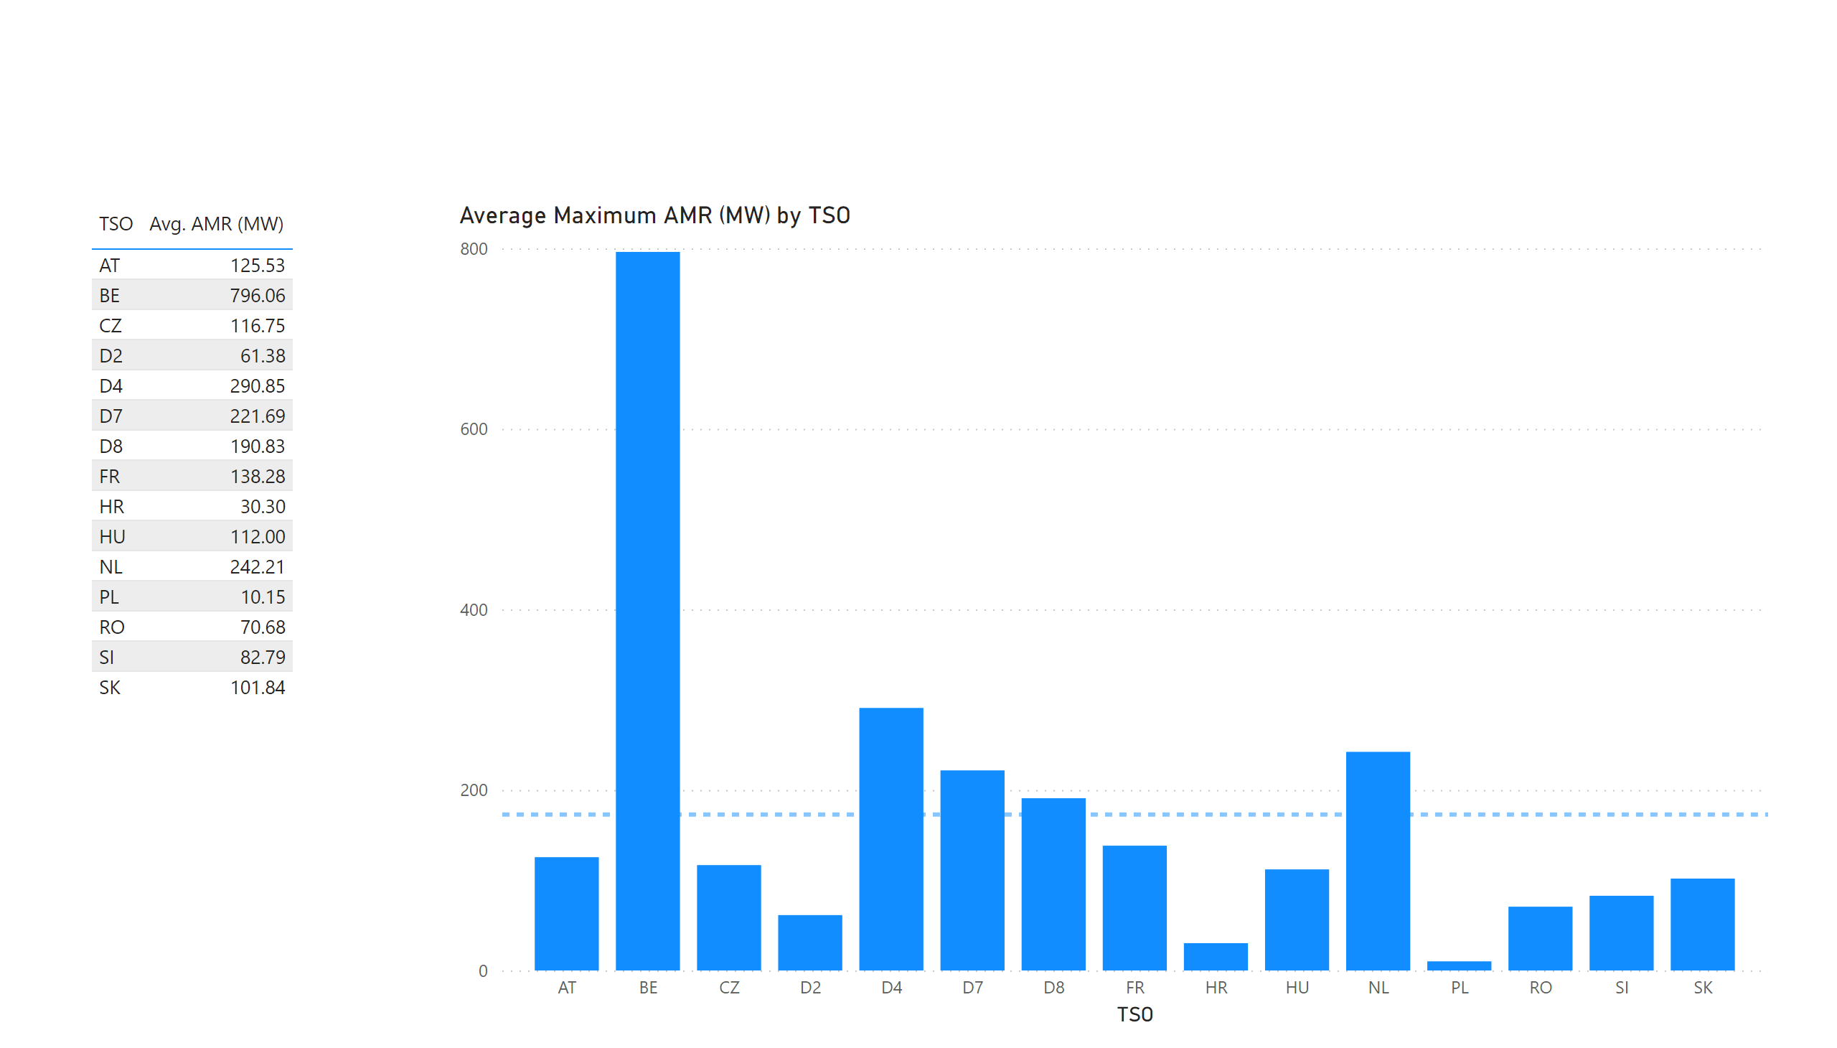
KPI 1 +2_1
KPI 1: Average maximum AMR per TSO
Notes:
tableEx
No alt text provided.
Top 10 CNE by Average Maximum AMR (MW) per BD
No alt text provided.
multiRowCard
No alt text provided.
tableEx
No alt text provided.
Average Maximum AMR per BD (MW) by TSO
No alt text provided.
tableEx
No alt text provided.
basicShape
No alt text provided.

Slide 6


KPI 1 +2_1
KPI 2: Occurrences of RAM < 20%
$RAM \left[\% of Fmax\right] :\frac{RAM0_{Core}+AMR −CVA−IVA+3 }{F_{Max}}$ < 20%
$Filters :CNEC==True \& IVA>0$ & BranchStatus == OK & domainLimit_region == TRUE (only presolved CNEC)
 | CNECs minRAM<20% Fmax +3MW | Distinct MTUs (CNECs minRAM<20% Fmax +3MW) | CNECs with 0 RAM capacity: all observations | Distinct MTUs (CNECs with 0 RAM capacity)
AT - APG | 62 | 29 | 1 | 1
BE - Elia | 0 | 0 | 0 | 0
CZ - CEPS | 0 | 0 | 0 | 0
D2 – TenneTGmbH | 5 | 5 | 0 | 0
D4 – TransnetBW | 22 | 9 | 0 | 0
D7 – Amprion | 22 | 16 | 0 | 0
D8 - 50Hertz | 5 | 4 | 0 | 0
FR - RTE | 0 | 0 | 0 | 0
HR - HOPS | 24 | 24 | 15 | 15
HU - MAVIR | 0 | 0 | 0 | 0
NL - TenneTBV | 3 | 3 | 0 | 0
PL - PSE | 11 | 11 | 0 | 0
RO - Transelectrica | 132 | 54 | 54 | 18
SI - ELES | 0 | 0 | 0 | 0
SK - SEPS | 0 | 0 | 0 | 0
Notes:
tableEx
No alt text provided.
Top 10 CNE by Average Maximum AMR (MW) per BD
No alt text provided.
multiRowCard
No alt text provided.
tableEx
No alt text provided.
Average Maximum AMR per BD (MW) by TSO
No alt text provided.
tableEx
No alt text provided.
basicShape
No alt text provided.

Slide 7
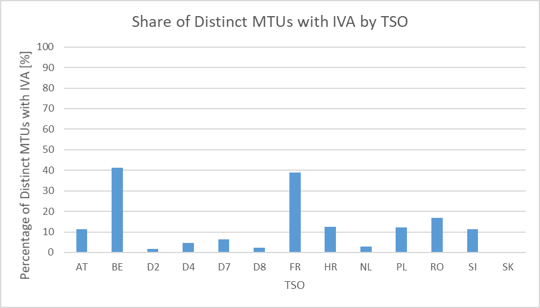
KPI 5
KPI 3: Share of MTUs with intervention per TSO
22 Totals BDs | 528 Total MTUs | 114 MTUs without IVA | 21,6% Share of MTUs without IVA | 414 Distinct MTUs with IVA | 78,4% Share of MTUs with IVA
TSO | Distinct MTUs with IVA | Share of distinct MTUs with IVA
AT | 59 | 11,17%
BE | 217 | 41,10%
D2 | 9 | 1,70%
D4 | 24 | 4,55%
D7 | 33 | 6,25%
D8 | 12 | 2,27%
FR | 206 | 39,02%
HR | 66 | 12,50%
NL | 15 | 2,84%
PL | 65 | 12,31%
RO | 89 | 16,86%
SI | 60 | 11,36%
SK | 2 | 0,38%
Total | 414 | 78,41%
Please note that the interventions by DAVinCy TSOs (APG, German TSOs and TenneT NL) were affected by an incorrect central forecast of the exchanges between Austria and Italy.
Notes:
pivotTable
No alt text provided.
clusteredColumnChart
No alt text provided.
card
No alt text provided.
card
No alt text provided.
card
No alt text provided.
card
No alt text provided.
card
No alt text provided.
card
No alt text provided.

Slide 8
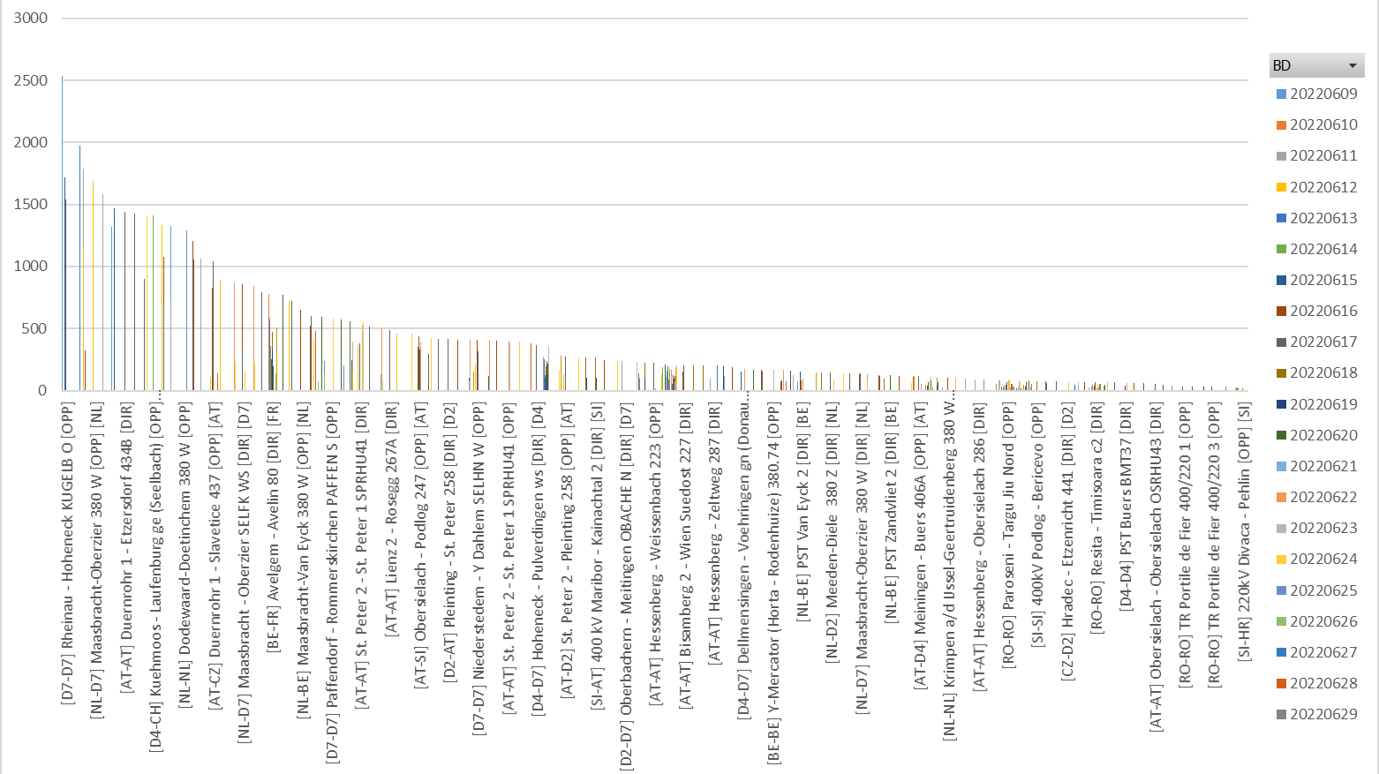
KPI 5
KPI 3: Share of MTUs with intervention per TSO
Notes:
pivotTable
No alt text provided.
clusteredColumnChart
No alt text provided.
card
No alt text provided.
card
No alt text provided.
card
No alt text provided.
card
No alt text provided.
card
No alt text provided.
card
No alt text provided.

Slide 9
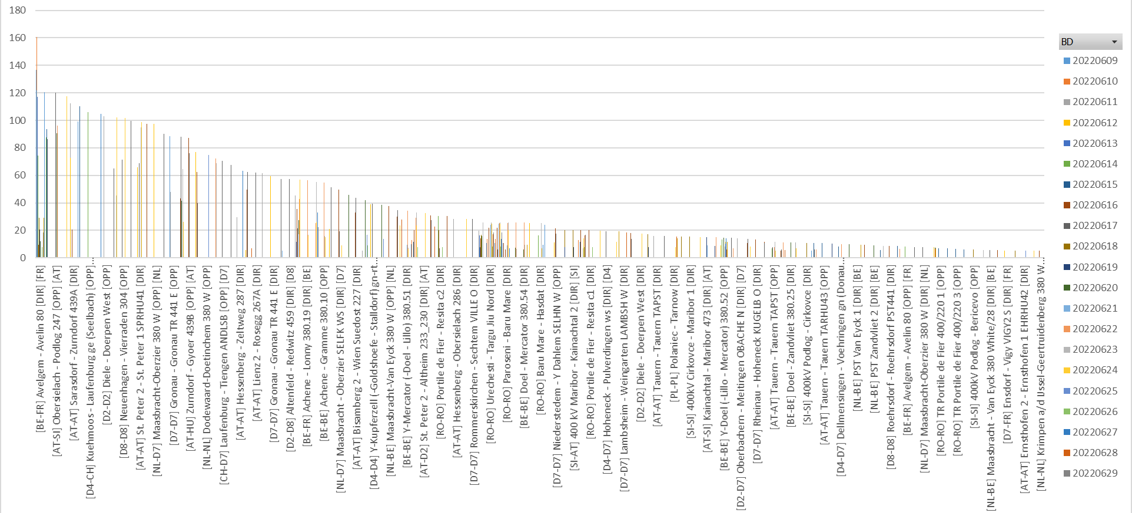
KPI 5
KPI 3: Share of MTUs with intervention per TSO
Notes:
pivotTable
No alt text provided.
clusteredColumnChart
No alt text provided.
card
No alt text provided.
card
No alt text provided.
card
No alt text provided.
card
No alt text provided.
card
No alt text provided.
card
No alt text provided.

Slide 10
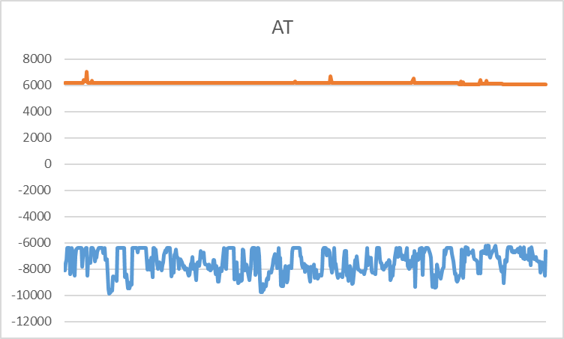
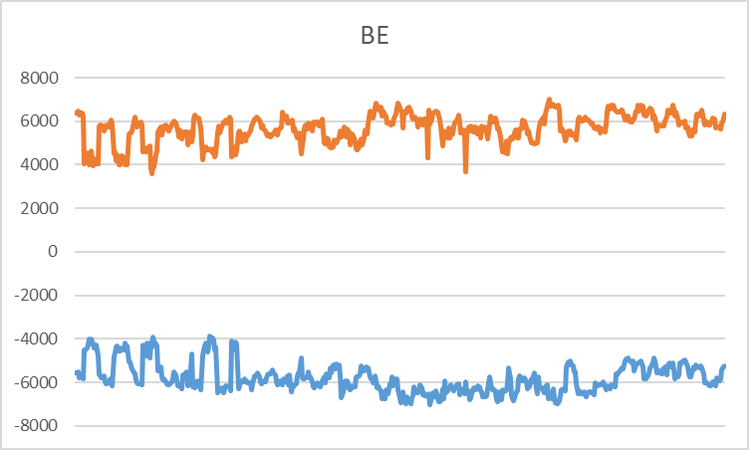
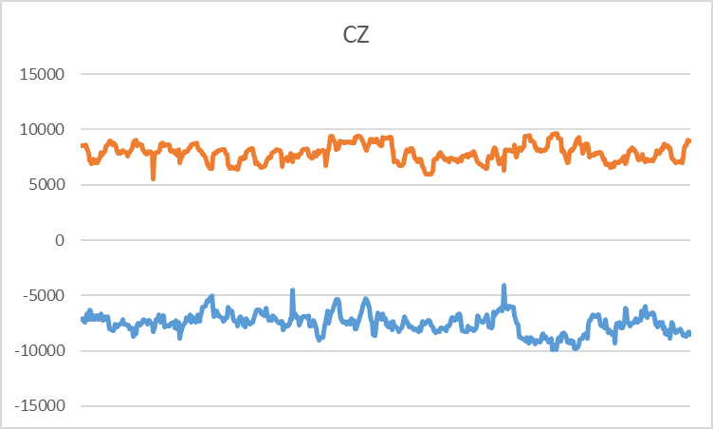
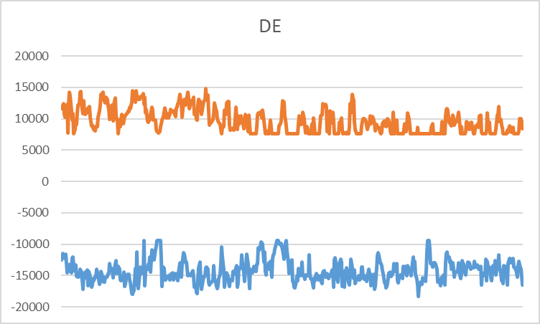
AT + BE
KPI 4: Min & max net positions per BZ hub
Notes:
AT
No alt text provided.
BE
No alt text provided.

Slide 11
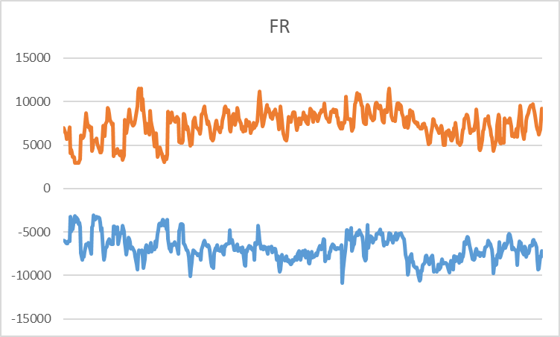
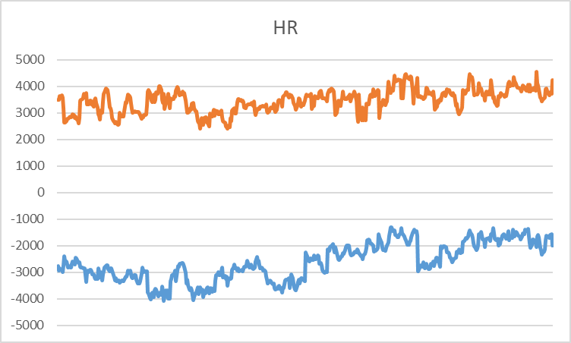
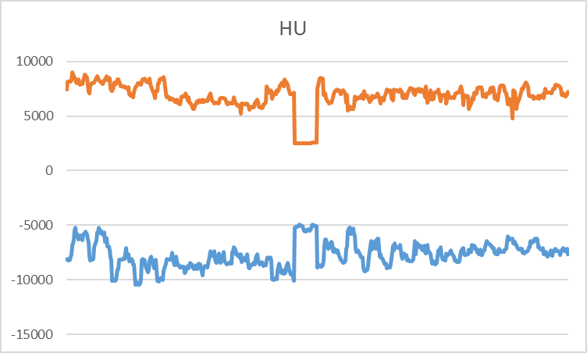
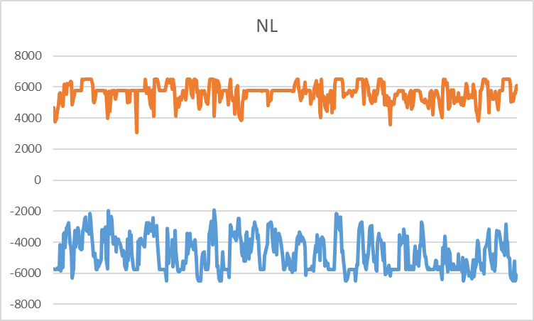
AT + BE
KPI 4: Min & max net positions per BZ hub
Notes:
AT
No alt text provided.
BE
No alt text provided.

Slide 12
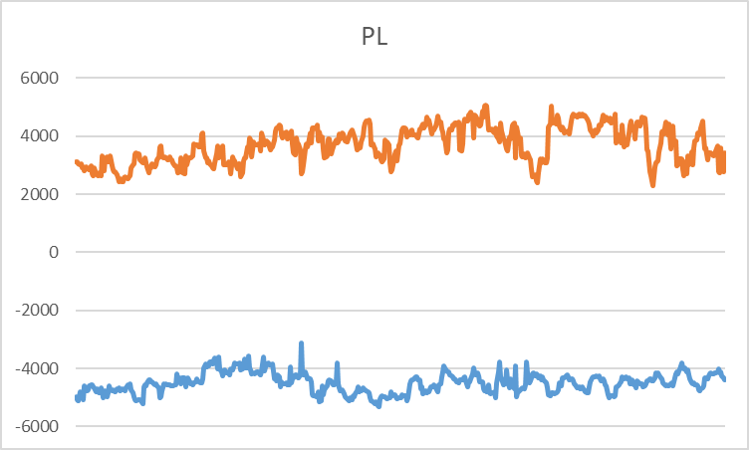
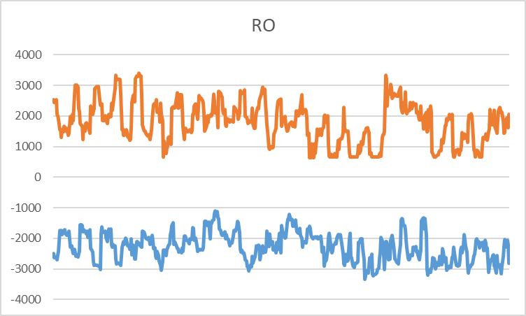
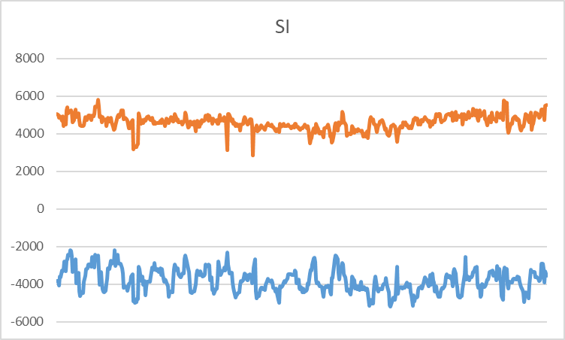
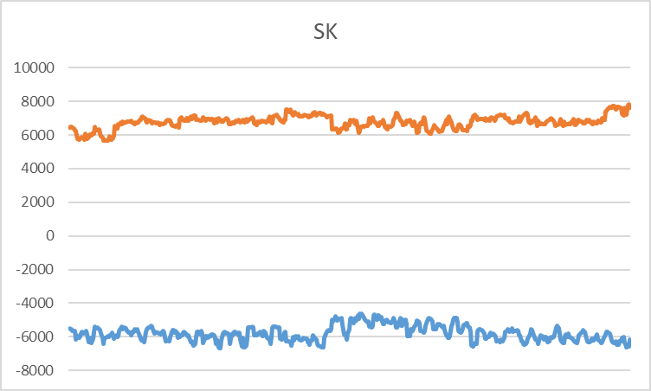
AT + BE
KPI 4: Min & max net positions per BZ hub
Notes:
AT
No alt text provided.
BE
No alt text provided.

Slide 13
Overview
NRAO – Applied Remedial Actions
On the analysis:
  The total number of MTUs (528 hours)
  was distributed as shown in the pie chart
  In the following plots, the relative time share
  relates to the hours labeled
  ‘NRAO Ran and Applied RAs’ (368 hours)

Slide 14
KPI 5: Relative Time Share of Applied RAs, by TSO, Type and Mode
  The graph below shows the distribution applied RAs, by TSO, Type (PST or Topological RA) and Mode (Preventive or Curative).
  During the analysed period, there were no Curative PST RAs applied.

Slide 15
KPI 5: Relative Time Share of Applied RAs, by TSO, Type and Mode
Relative Time Share of Applied PSTs in Preventive Mode

Slide 16
KPI 5: Relative Time Share of Applied RAs, by TSO, Type and Mode
Relative Time Share of Applied Topological RAs in Preventive Mode

Slide 17
KPI 5: Relative Time Share of Applied RAs, by TSO, Type and Mode
Relative Time Share of Applied Topological RAs in Curative Mode

Slide 18
KPI 6: Most limiting CNEC per TSO (NRAO)
  The graph below shows the distribution of CNECs which are the most limiting from NRAO perspective, these are the CNECs with lowest relative RAM per MTUs.
  As expected, there is redistributing of the most limiting CNECs. This is because the application of Remedial Actions does not eliminate flows but re-routes, reducing the flows on some limiting CNECs and increasing the load on others, which at the end impacts also the RAM values.
  In case of CZ and SK, there were no most limiting elements from NRAO perspective.
  In case of HU, there is 1 most limiting element from NRAO perspective after the NRAO step.

Slide 19
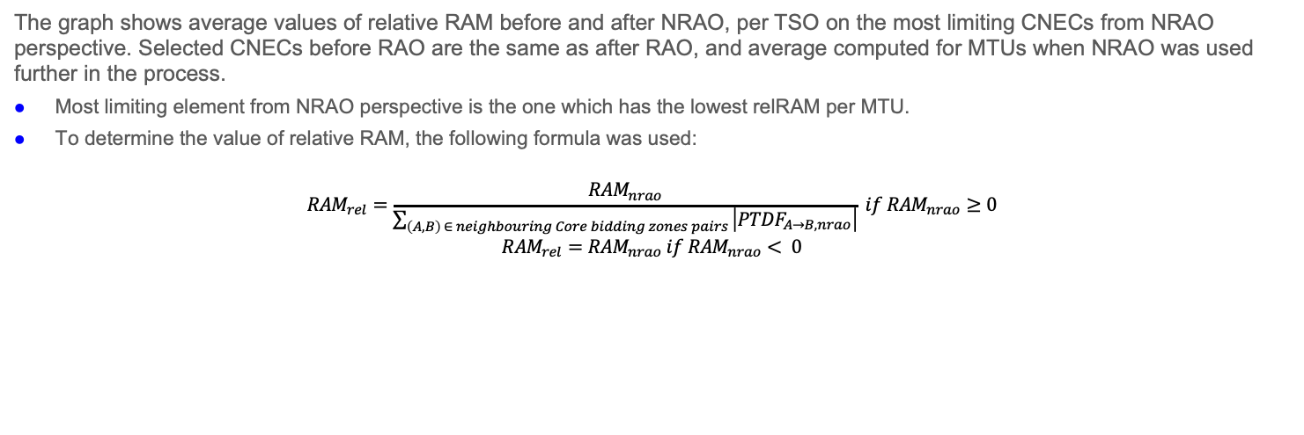
KPI 7: Average variation of relative RAM before and after NRAO
  The graph shows average values of relative RAM before and after NRAO, per TSO on the most limiting CNECs from NRAO perspective. Selected CNECs before RAO are the same as after RAO, and average computed for MTUs when NRAO was used further in the process.
  Most limiting element from NRAO perspective is the one which has the lowest relRAM per MTU.
  To determine the value of relative RAM, the following formula was used:
  $${RAM}_{rel}=\frac{{RAM}_{nrao}}{\sum_{\left(A, B\right) ∈ neighbouring Core bidding zones pairs }{\left|{PTDF}_{A→B, nrao}\right|}} if {RAM}_{nrao}≥0$$
  $${RAM}_{rel}={RAM}_{nrao} if {RAM}_{nrao}< 0$$
  The increment of relRAM values after RAO shows that the optimization performed did increase the capacity on some areas.
  In case of CZ, HU and SK, there were no most limiting elements from NRAO perspective.

Slide 20
KPI 8: Most often presolved CNEs (TOP 20)
Total BDs: 22 (528 hours)
Row Labels​ | Distinct Count of MTU​ | Count of MTU​ | Average of RAM [%]​ | Max of RAM [%]​ | Min of RAM [%]​ | Max of CB_maxZ2ZPTDF​ | Sum of CB_maxZ2ZPTDF​
[HR-SI] 220kV Pehlin - Divaca [OPP] [HR]​ | 528​ | 1053​ | 88.29%​ | 1.28342246​ | 0.564171123​ | 0.2169​ | 180.47745​
[HR-SI] 220kV Pehlin - Divaca [DIR] [HR]​ | 528​ | 531​ | 83.68%​ | 1.22459893​ | 0.518716578​ | 0.2169​ | 102.82256​
[SK-UA] V.Kapusany - Mukachevo (WPS) [OPP] [SK]​ | 528​ | 718​ | 88.24%​ | 1.265625​ | 0.587316176​ | 0.35775​ | 231.69973​
[SK-UA] V.Kapusany - Mukachevo (WPS) [DIR] [SK]​ | 528​ | 528​ | 88.32%​ | 1.195772059​ | 0.535845588​ | 0.35775​ | 167.52797​
[NL-D7] Maasbracht - Oberzier SELFK WS [DIR] [D7]​ | 521​ | 2712​ | 72.72%​ | 1.079676674​ | 0.08891455​ | 0.33224​ | 739.38328​
[HR-BA] 220kV Zakucac - Mostar [OPP] [HR]​ | 510​ | 510​ | 51.24%​ | 1.421052632​ | 0​ | 0.17744​ | 64.75309​
[SK-SK] Gabcikovo - P.Biskupice [DIR]​ | 507​ | 507​ | 82.68%​ | 0.974050633​ | 0.662658228​ | 0.32472​ | 126.30114​
[SK-HU] Gabcikovo - Gonyu [OPP] [HU]​ | 506​ | 978​ | 78.24%​ | 1.025270758​ | 0.58700361​ | 0.29355​ | 224.07908​
[CZ-PL] Wielopole - Nosovice [DIR] [PL]​ | 499​ | 646​ | 60.03%​ | 0.839968153​ | 0.413043478​ | 0.3349​ | 189.77614​
[RO-RO] TR Rosiori 400/220 1 [DIR]​ | 498​ | 498​ | 50.95%​ | 0.86​ | 0.2475​ | 0.13771​ | 56.43155​
[AT-D2] St. Peter 2 - Pleinting 258 [OPP] [AT]​ | 497​ | 641​ | 96.38%​ | 1.443820225​ | 0.310861423​ | 0.1599​ | 78.20653​
[RO-RS] Portile de Fier - Djerdap [OPP] [RO]​ | 496​ | 524​ | 77.70%​ | 1.113051471​ | 0.230698529​ | 0.5522​ | 223.87856​
[CZ-SK] Liskovec - P. Bystrica [DIR] [CZ]​ | 489​ | 489​ | 73.31%​ | 0.984555985​ | 0.579150579​ | 0.0837​ | 35.25716​
[NL-BE] PST Van Eyck 2 [DIR] [BE]​ | 487​ | 1016​ | 87.94%​ | 1.1795053​ | 0.544169611​ | 0.37322​ | 322.85989​
[PL-PL] Krosno Iskrzynia - Rzeszow [OPP]​ | 484​ | 484​ | 56.28%​ | 0.92839196​ | 0.275397797​ | 0.35075​ | 134.87712​
[SI-HR] 220kV Podlog - Zerjavinec [DIR] [SI]​ | 469​ | 835​ | 79.52%​ | 1.128289474​ | 0.151315789​ | 0.13825​ | 81.47411​
[NL-BE] PST Van Eyck 2 [OPP] [BE]​ | 468​ | 1315​ | 78.75%​ | 1.118037135​ | 0.299646643​ | 0.35784​ | 408.72396​
[PL-PL] Krosno Iskrzynia - Rzeszow [DIR]​ | 466​ | 466​ | 123.32%​ | 1.54​ | 0.871859296​ | 0.35075​ | 129.59802​
[NL-BE] PST Zandvliet 2 [DIR] [BE]​ | 462​ | 462​ | 85.43%​ | 1.236737401​ | 0.510954064​ | 0.37129​ | 151.47481​
[AT-CZ] Duernrohr 1 - Slavetice 437 [OPP] [AT]​ | 454​ | 460​ | 73.28%​ | 1.011954573​ | 0.215780036​ | 0.35057​ | 134.98218​
Please note that the shown z2zPTDF values do not correspond to the maximum zone-to-zone PTDFs according to equation 5 of the Day-ahead CCM and hence are not the ones used for the CNEC Selection. The z2zPTDFs are calculated only between neighbouring BZs by the scripts used for external parallel run reporting. See KPI reading guide on JAO.

Slide 21
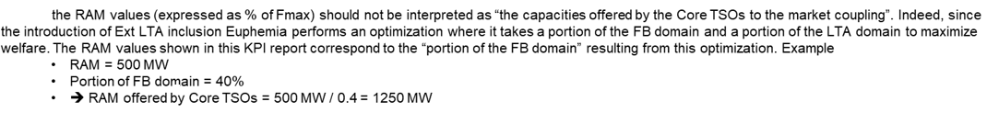
KPI 9a: Most limiting CNEs (TOP 20)
Total BDs: 22 (528 hours)
CNE | Distinct hours CNE has shadow price | Max de ShadowPrice | AVG of Ram/Fmax | MIN of Ram/Fmax | MAX of Ram/Fmax | MaxZ2ZPtdf
[D4-D7] Hoheneck - Pulverdingen ws [OPP] [D4] | 151 | 2206,222432 | 20% | 17% | 29% | 0,12485
[PL-PL] Krosno Iskrzynia - Rzeszow [OPP] | 121 | 853,520897 | 50% | 28% | 77% | 0,35075
[AT-SI] Obersielach - Podlog 247 [DIR] [AT] | 84 | 432,6906006 | 19% | 1% | 52% | 0,22917
[BE-FR] Avelgem - Avelin 80 [DIR] [FR] | 79 | 561,4111845 | 79% | 19% | 143% | 0,39642
[HR-BA] 220kV Zakucac - Mostar [OPP] [HR] | 74 | 1320,05573 | 8% | 0% | 32% | 0,17744
[NL-D7] Maasbracht - Oberzier SELFK WS [DIR] [D7] | 65 | 923,2000784 | 67% | 9% | 96% | 0,33224
[D4-CH] Kuehmoos - Laufenburg br (Heimbach) [DIR] [D4] | 62 | 760,2290254 | 37% | 19% | 74% | 0,16747
[AT-D4] Meiningen - Buers 406A [OPP] [AT] | 44 | 2485,907372 | 19% | 5% | 30% | 0,11158
[NL-D2]Meeden-Diele 380 Z [DIR] [D2] | 43 | 1050,664255 | 63% | 20% | 116% | 0,27243
[NL-D7] Maasbracht-Oberzier 380 W [DIR] [D7] | 43 | 105,09641 | 49% | 20% | 75% | 0,6082
[RO-RO] Paroseni - Targu Jiu Nord [OPP] | 43 | 1959,441049 | 22% | 0% | 48% | 0,09896
[AT-CH] Meiningen - Ruetli 408 [DIR] [AT] | 41 | 1183,751103 | 19% | 15% | 23% | 0,13093
[AT-SI]220 kV Podlog - Obersielach [OPP] [SI] | 39 | 362,0152859 | 19% | 0% | 54% | 0,2709
[PL-PL] Mikulowa PST3 [DIR] | 39 | 354,1741104 | 42% | 19% | 86% | 0,40088
[D4-CH] Trossingen - Laufenburg rt [DIR] [D4] | 36 | 1746,084063 | 20% | 19% | 28% | 0,07495
[D7-D7] Buerstadt - Lambsheim BUERST W | 31 | 740,940223 | 30% | 19% | 47% | 0,20303
[D8-D8] Pasewalk - Vierraden 306 [OPP] | 30 | 1676,735925 | 26% | 19% | 37% | 0,10887
[BE-BE] PST Zandvliet 2 | 29 | 320,6129275 | 80% | 58% | 95% | 0,34931
[AT-D2] St, Peter 2 - Pleinting 258 [OPP] [AT] | 28 | 738,0710043 | 78% | 55% | 110% | 0,12899
[NL-D2]Meeden-Diele 380 Z [OPP] [D2] | 23 | 425,706002 | 24% | 20% | 38% | 0,2506
Note :

Slide 22
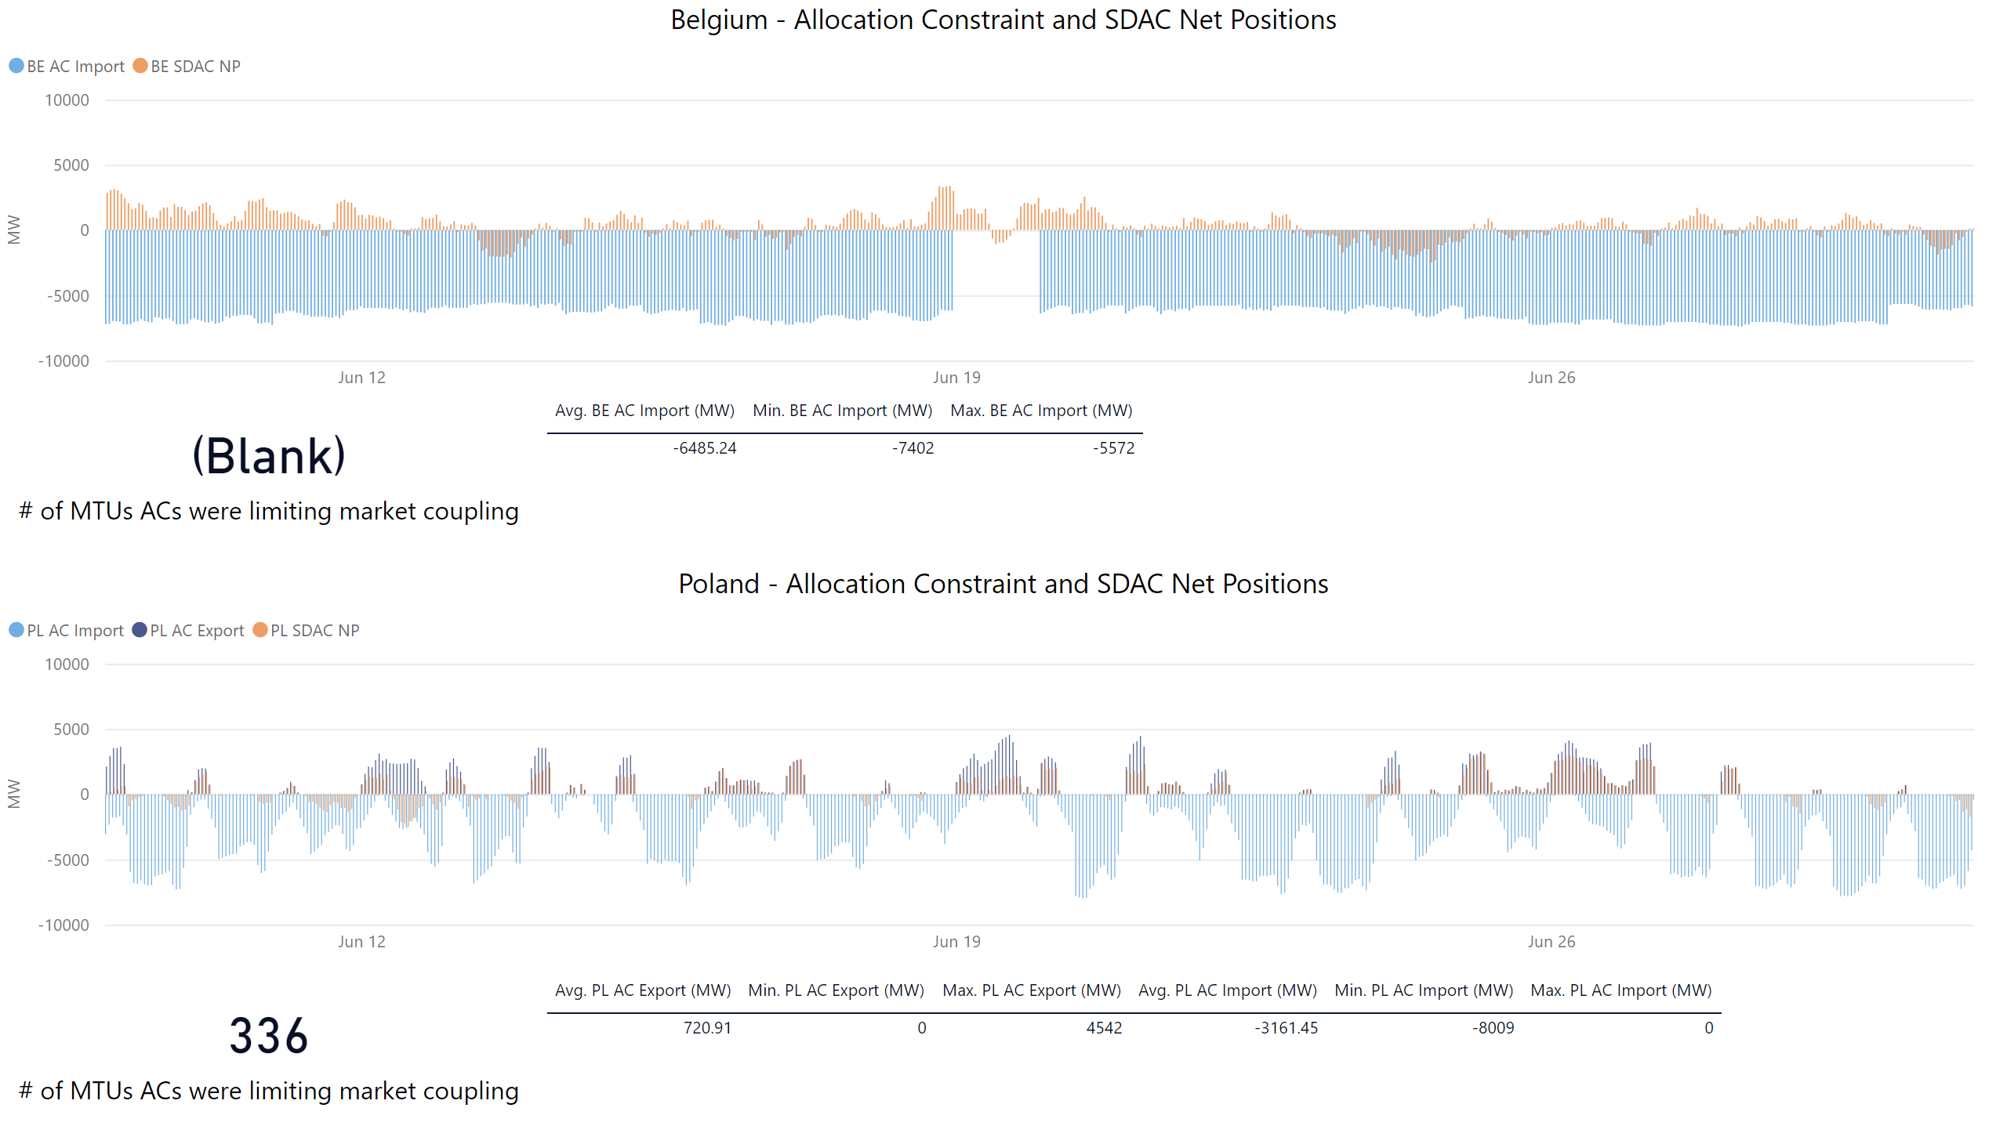
KPI 9b: Allocation Constraints
0
Please note that Belgium only uses import constraints.
An AC is identified as limiting the market coupling when it has a positive shadow price as calculated by EUPHEMIA. This differs to the approach taken during external parallel run, when we identified a AC as limiting if SDAC NP = AC due to absence of shadow prices for ACs in that period.

Slide 23
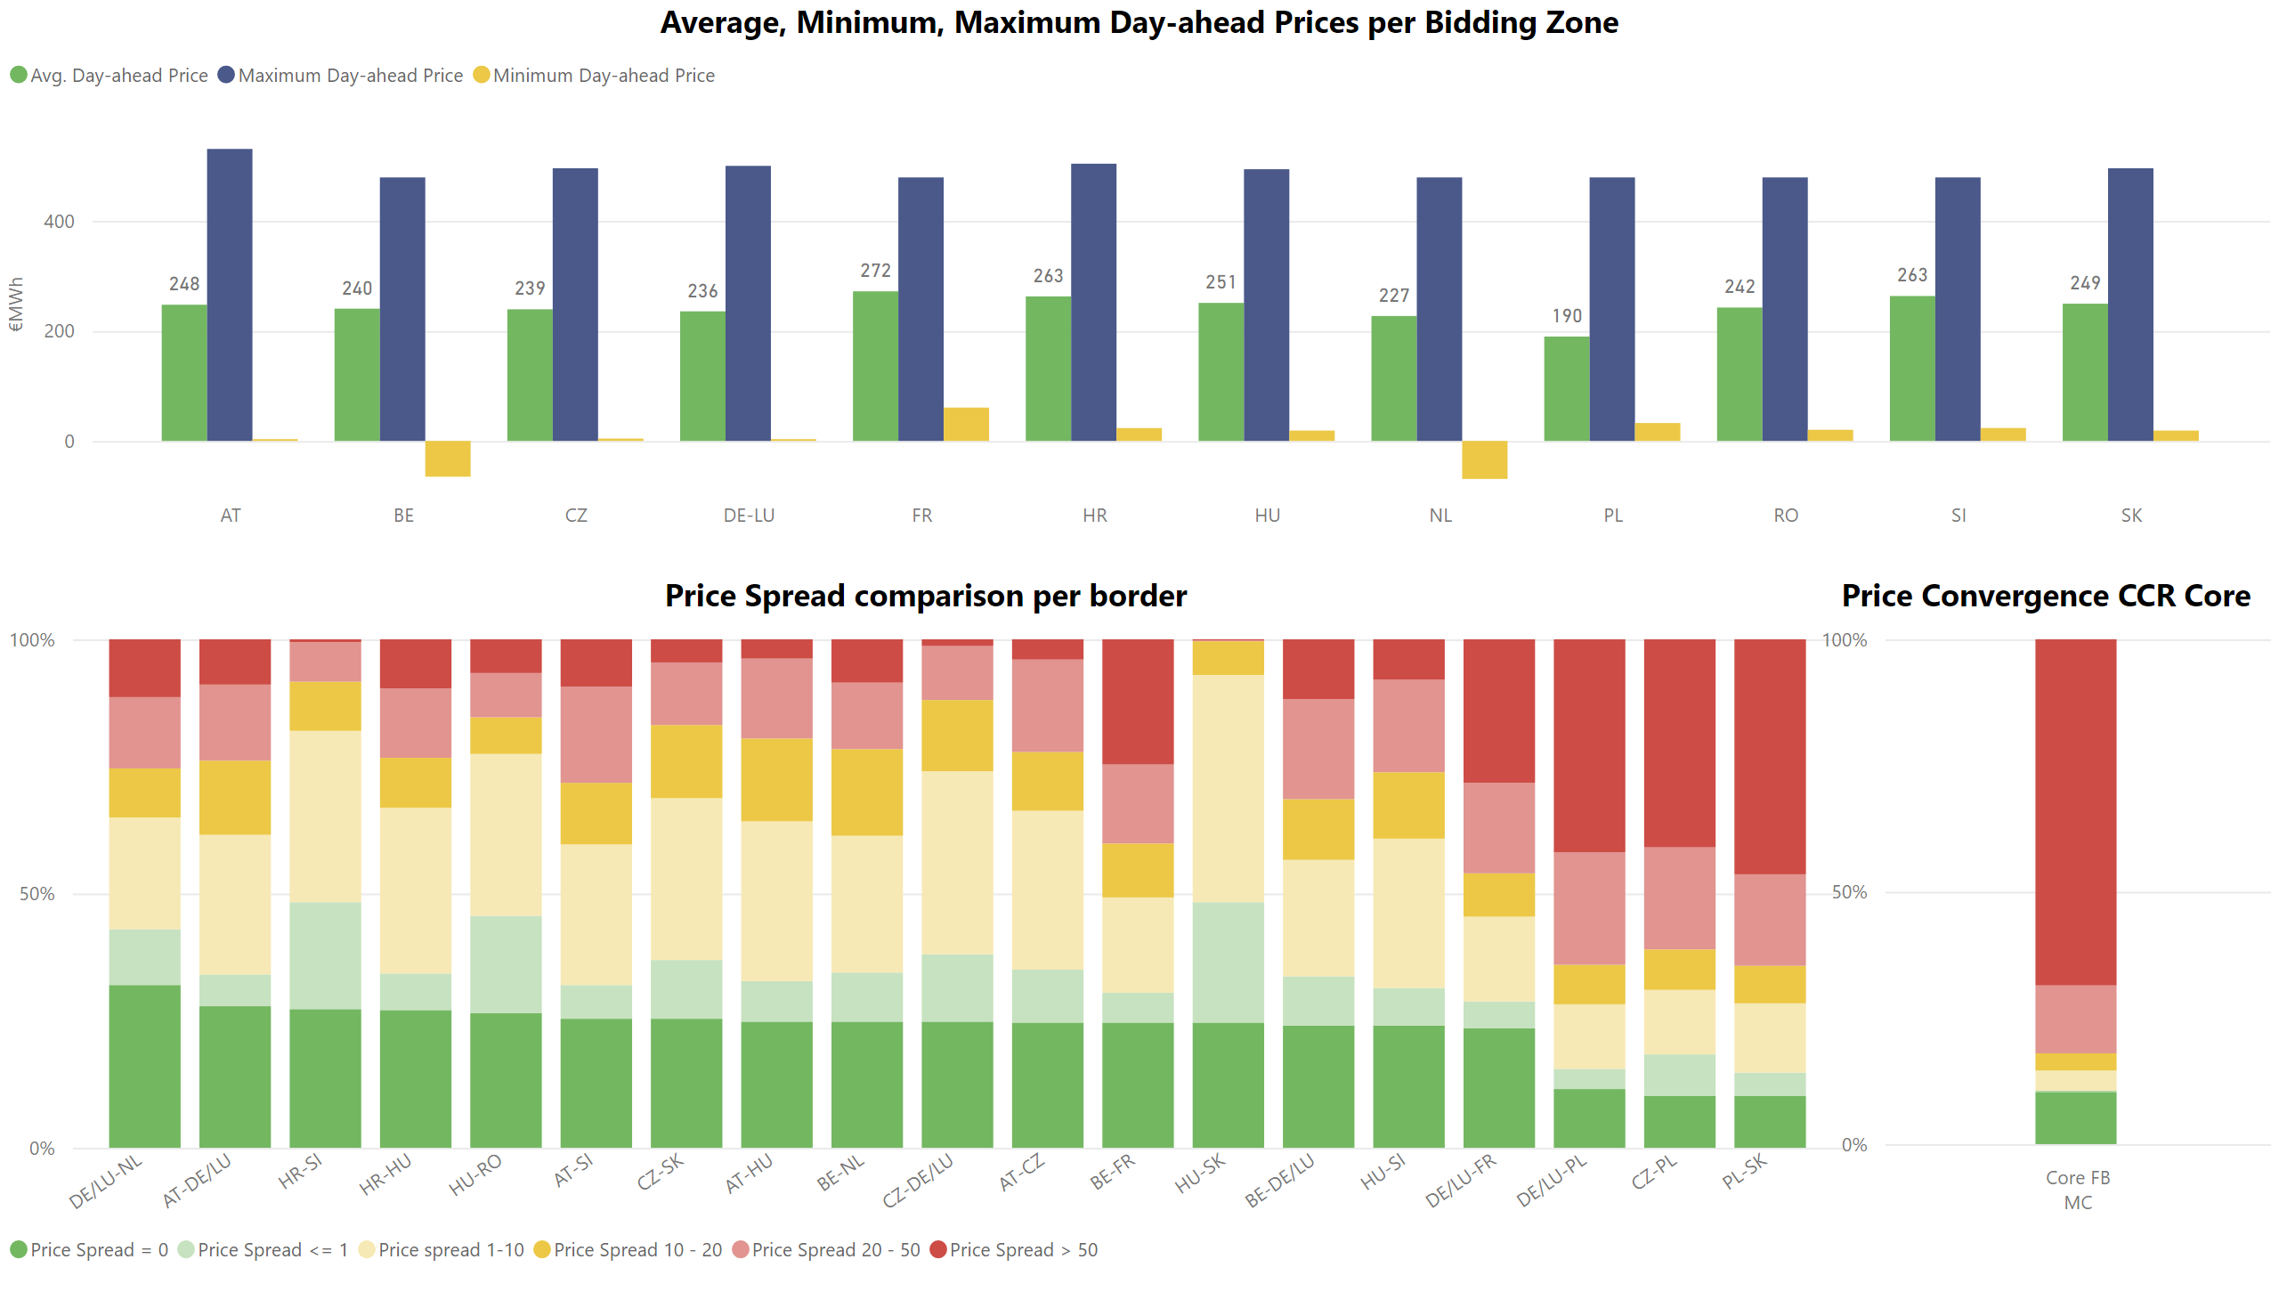
KPI 10: Clearing prices, price spreads and price convergence

