Slide 1
Core FB MC
Core Operational KPI report
July 2022

Slide 2
Core Operational KPI report
Introduction
Context
  According to Article 25(7) of the Core FB DA CCM, Core TSOs
    “Core TSOs shall provide Core regulatory authorities on a monthly basis the underlying capacity calculation and market coupling data related to the quarterly reports.”
  Core TSOs & NEMOs have aligned on the
    Specific KPIs with NRAs and this alignment resulted in the format of this KPI report
    Frequency of provision of the report, which was increased to monthly, going beyond formal requirements
    Agreement to have the increased frequency reflected in the Core CCM amendment (November 2020)
  A Reading Guide with a description of the KPIs is available on JAO
In the next slide the overview of the KPIs covered in this monthly KPI report is provided:
  KPIs related to Capacity Calculation in blue
  KPIs related to Market Coupling results in green

Slide 3
Core Operational KPI report
Overview of KPIs
  Adjustment for minimum RAM inclusion
    1. Average maximum AMR per TSO
    2. Occurrences of RAM < 20%
  TSOs’ adjustment after validation
    3. Share of MTUs with intervention per TSO
  Power System Impact Analysis
    4. Min & max Net Position per BZ hub
  Non-costly Remedial Action Optimization Analysis
    5. Relative Time Share of Applied RAs, by TSO, Type and Mode
    6. Most limiting CNEC per TSO (NRAO)
    7. Average variation of relative RAM before and after NRAO
Market Impact Assessment
  8. Most often presolved CNEs (top 20)
  9a. Most limiting CNEs (top 20)
  9b. Allocation Constraints
  10. Clearing prices, price spread and price convergence

Slide 4
Core Operational KPI report
Overview Ramr values
For the reporting period TSOs apply the following Ramr values – see JAO website (LINK):

Slide 5
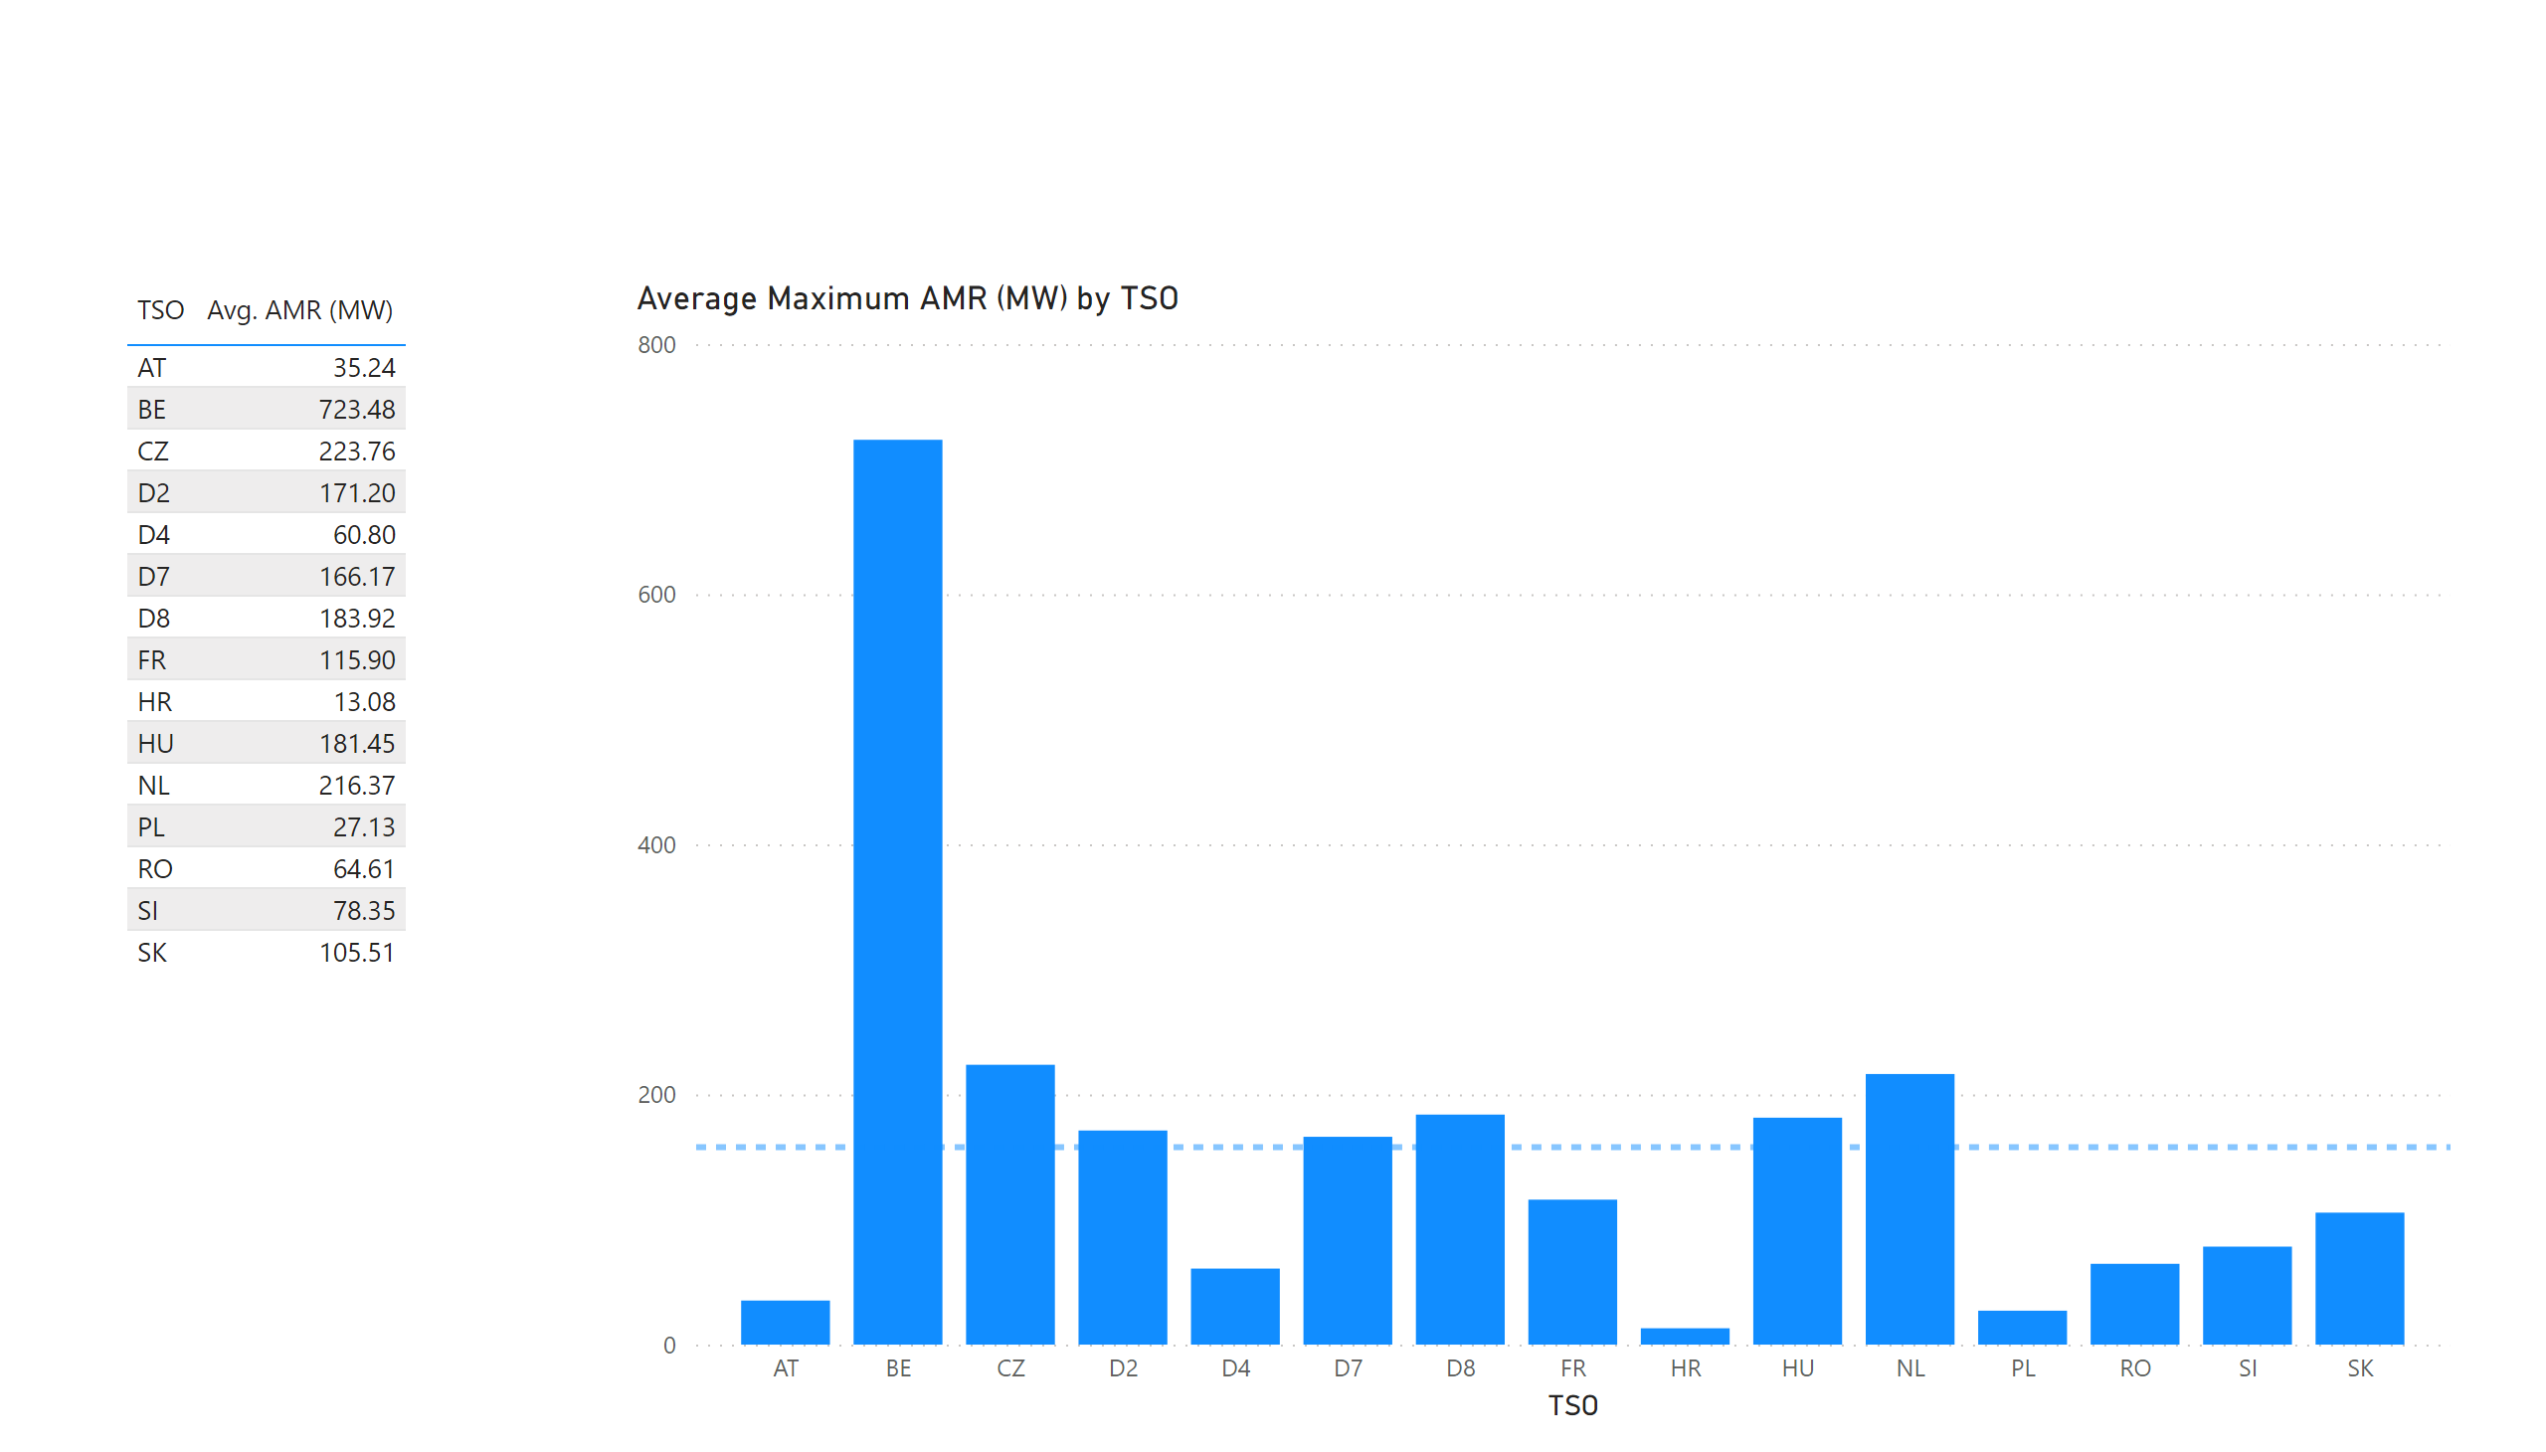
KPI 1 +2_1
KPI 1: Average maximum AMR per TSO
Notes:
tableEx
No alt text provided.
Top 10 CNE by Average Maximum AMR (MW) per BD
No alt text provided.
multiRowCard
No alt text provided.
tableEx
No alt text provided.
Average Maximum AMR per BD (MW) by TSO
No alt text provided.
tableEx
No alt text provided.
basicShape
No alt text provided.

Slide 6

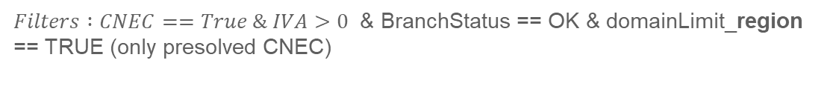
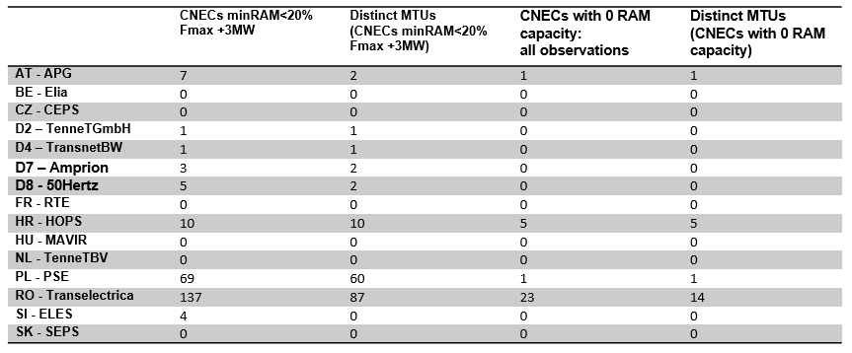
KPI 1 +2_1
KPI 2: Occurrences of RAM < 20%
Notes:
tableEx
No alt text provided.
Top 10 CNE by Average Maximum AMR (MW) per BD
No alt text provided.
multiRowCard
No alt text provided.
tableEx
No alt text provided.
Average Maximum AMR per BD (MW) by TSO
No alt text provided.
tableEx
No alt text provided.
basicShape
No alt text provided.

Slide 7
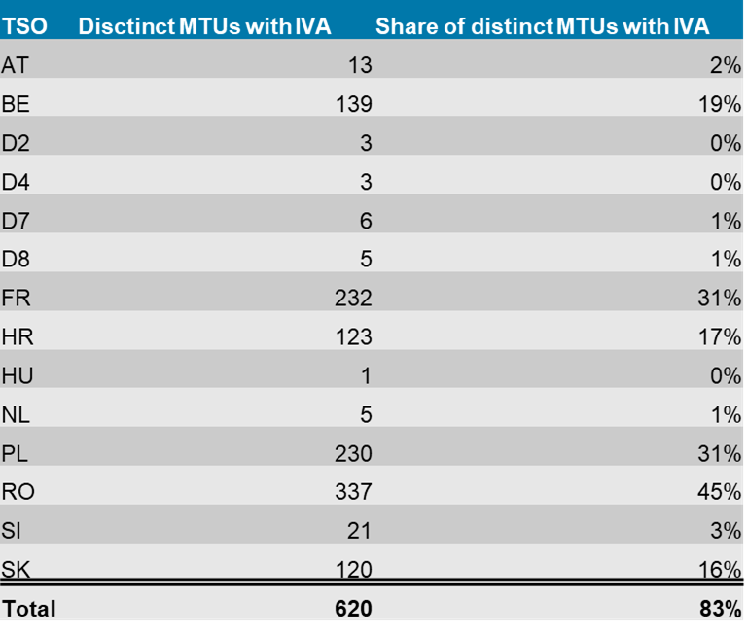
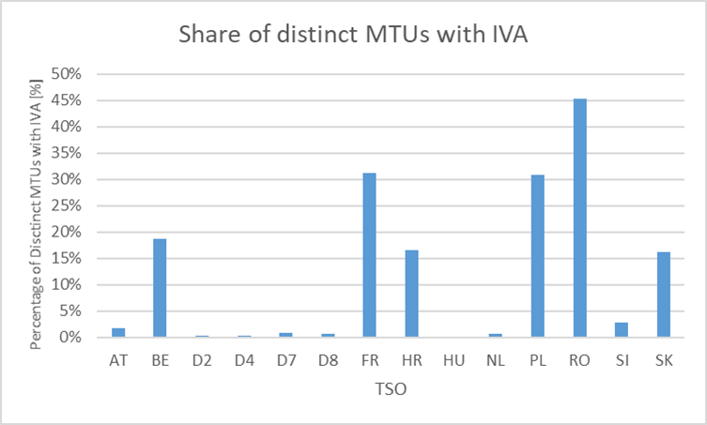
KPI 5
KPI 3: Share of MTUs with intervention per TSO
31 Totals BDs | 744 Total MTUs | 124 MTUs without IVA | 17% Share of MTUs without IVA | 620 Distinct MTUs with IVA | 83% Share of MTUs with IVA
Notes:
pivotTable
No alt text provided.
clusteredColumnChart
No alt text provided.
card
No alt text provided.
card
No alt text provided.
card
No alt text provided.
card
No alt text provided.
card
No alt text provided.
card
No alt text provided.

Slide 8
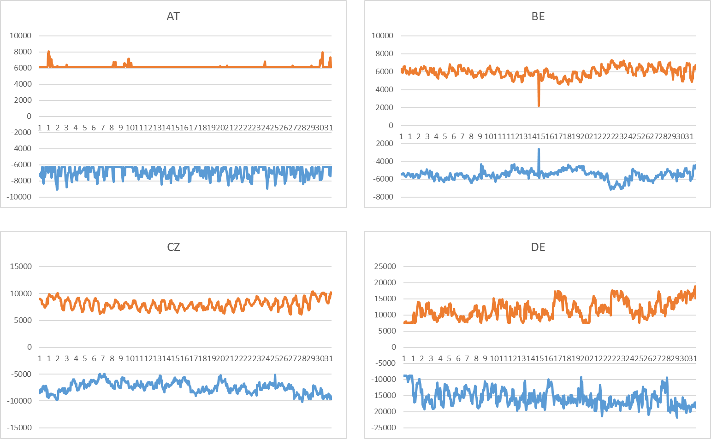
AT + BE
KPI 4: Min & max net positions per BZ hub
Notes:
AT
No alt text provided.
BE
No alt text provided.

Slide 9
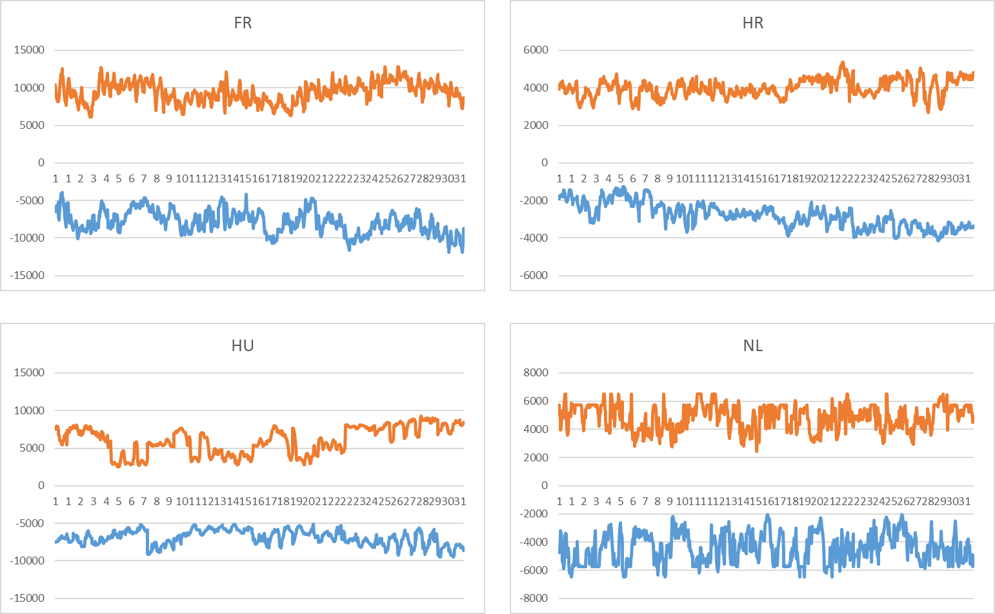
AT + BE
KPI 4: Min & max net positions per BZ hub
Notes:
AT
No alt text provided.
BE
No alt text provided.

Slide 10
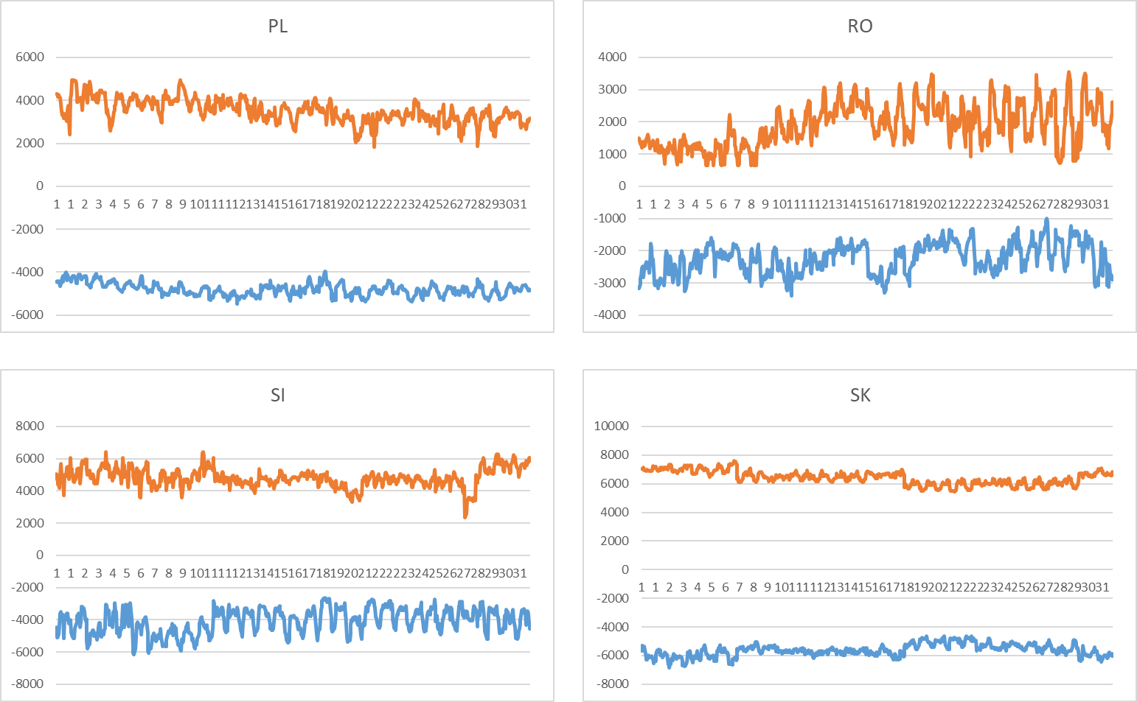
AT + BE
KPI 4: Min & max net positions per BZ hub
Notes:
AT
No alt text provided.
BE
No alt text provided.

Slide 11
Overview
NRAO – Applied Remedial Actions
On the analysis:
  The total number of MTUs (744 hours)
  was distributed as shown in the pie chart
  In the following plots, the relative time share
  relates to the hours labeled
  ‘NRAO Ran and Applied RAs’ (551 hours)

Slide 12
KPI 5: Relative Time Share of Applied RAs, by TSO, Type and Mode
  The graph below shows the distribution applied RAs, by TSO, Type (PST or Topological RA) and Mode (Preventive or Curative).
  During the analysed period, there were no Curative PST RAs applied.

Slide 13
KPI 5: Relative Time Share of Applied RAs, by TSO, Type and Mode
Relative Time Share of Applied PSTs in Preventive Mode

Slide 14
KPI 5: Relative Time Share of Applied RAs, by TSO, Type and Mode
Relative Time Share of Applied Topological RAs in Preventive Mode

Slide 15
KPI 5: Relative Time Share of Applied RAs, by TSO, Type and Mode
Relative Time Share of Applied PSTs in Curative Mode

Slide 16
KPI 5: Relative Time Share of Applied RAs, by TSO, Type and Mode
Relative Time Share of Applied Topological RAs in Curative Mode

Slide 17
KPI 6: Most limiting CNEC per TSO (NRAO)
  The graph below shows the distribution of CNECs which are the most limiting from NRAO perspective, these are the CNECs with lowest relative RAM per MTUs.
  As expected, there is redistributing of the most limiting CNECs. This is because the application of Remedial Actions does not eliminate flows but re-routes, reducing the flows on some limiting CNECs and increasing the load on others, which at the end impacts also the RAM values.
  In case of CZ, there is 1 most limiting element from NRAO perspective after the NRAO step.

Slide 18
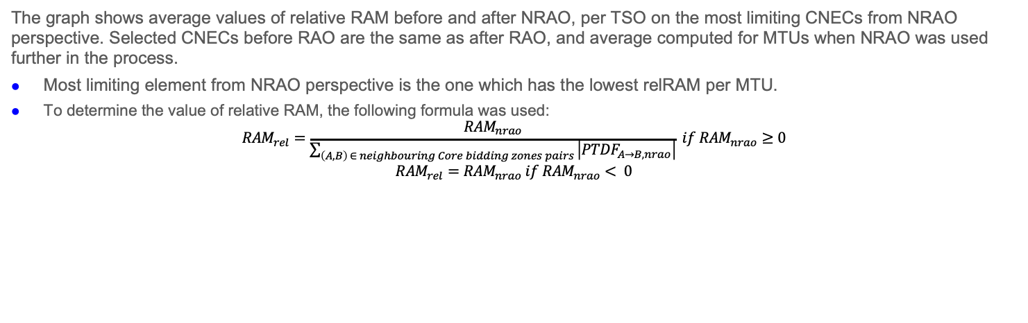
KPI 7: Average variation of relative RAM before and after NRAO
  The graph shows average values of relative RAM before and after NRAO, per TSO on the most limiting CNECs from NRAO perspective. Selected CNECs before RAO are the same as after RAO, and average computed for MTUs when NRAO was used further in the process.
  Most limiting element from NRAO perspective is the one which has the lowest relRAM per MTU.
  To determine the value of relative RAM, the following formula was used:
  $${RAM}_{rel}=\frac{{RAM}_{nrao}}{\sum_{\left(A, B\right) ∈ neighbouring Core bidding zones pairs }{\left|{PTDF}_{A→B, nrao}\right|}} if {RAM}_{nrao}≥0$$
  $${RAM}_{rel}={RAM}_{nrao} if {RAM}_{nrao}< 0$$
  The increment of relRAM values after RAO shows that the optimization performed did increase the capacity on some areas.
  In case of CZ, there were no most limiting elements from NRAO perspective.

Slide 19
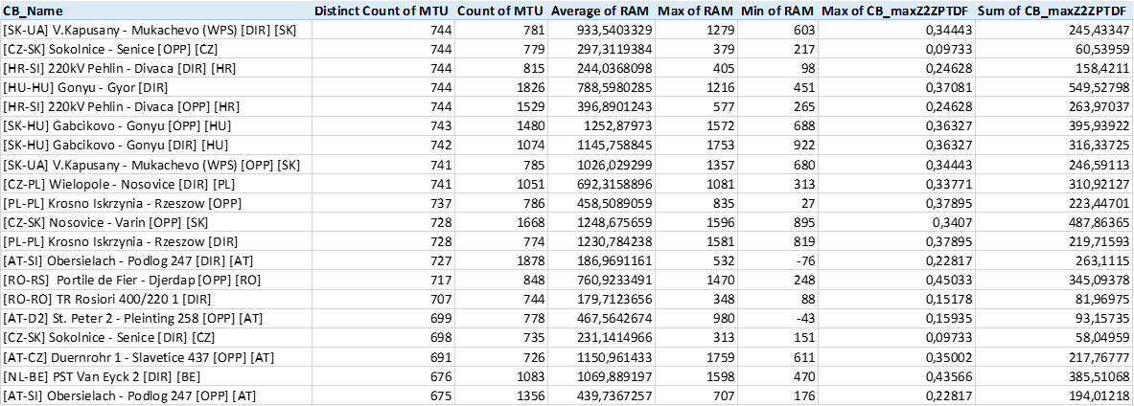
KPI 8: Most often presolved CNEs (TOP 20)
Total BDs: 31 (744 hours)
*Please note that the shown z2zPTDF values do not correspond to the maximum zone-to-zone PTDFs according to equation 5 of the Day-ahead CCM and hence are not the ones used for the CNEC Selection. The z2zPTDFs are calculated only between neighbouring BZs by the scripts used for external parallel run reporting. See KPI reading guide on JAO.

Slide 20
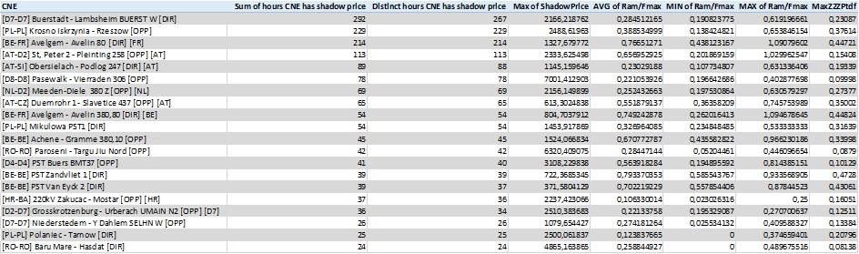
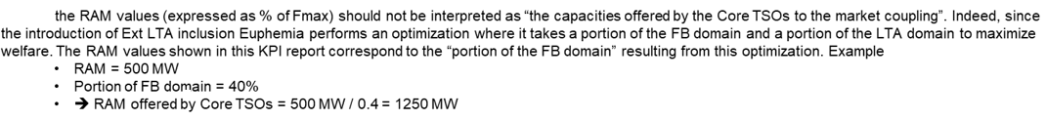
KPI 9a: Most limiting CNEs (TOP 20)
Total BDs: 31 (744 hours)
Note :

Slide 21
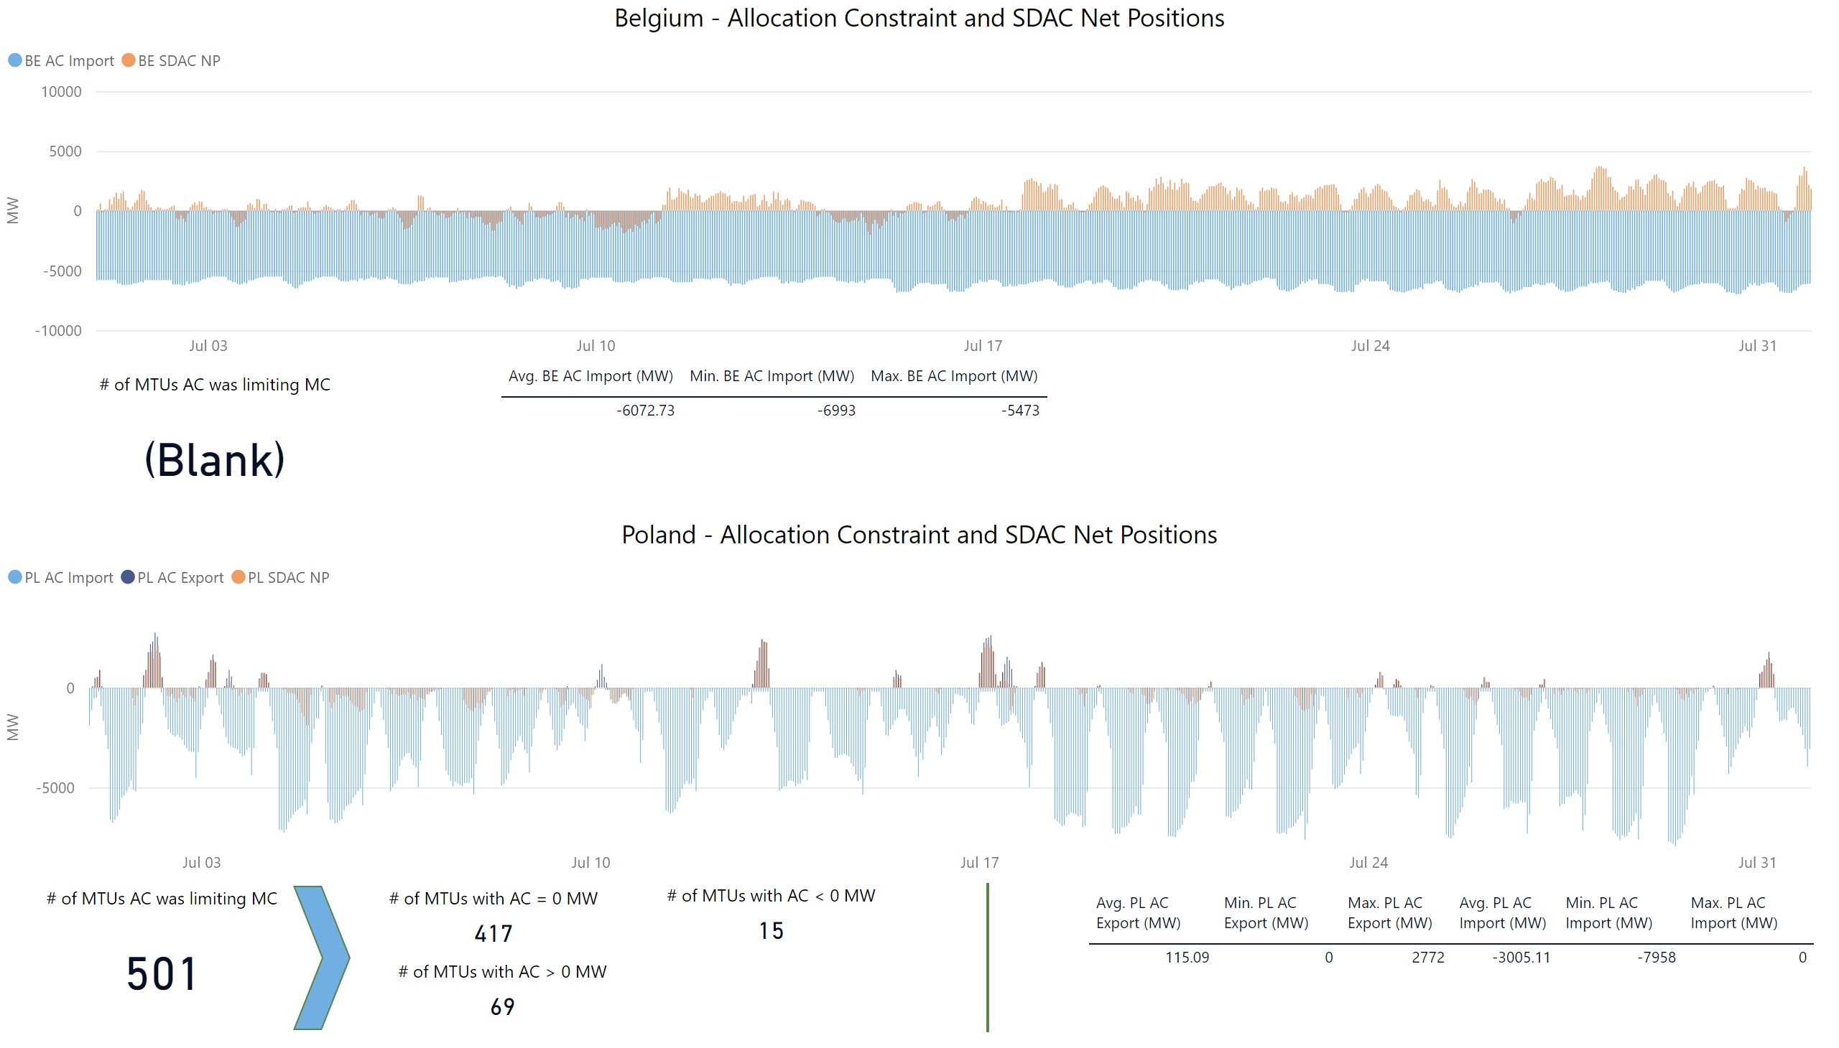
KPI 9b: Allocation Constraints
0
Please note that Belgium only uses import constraints.

Slide 22
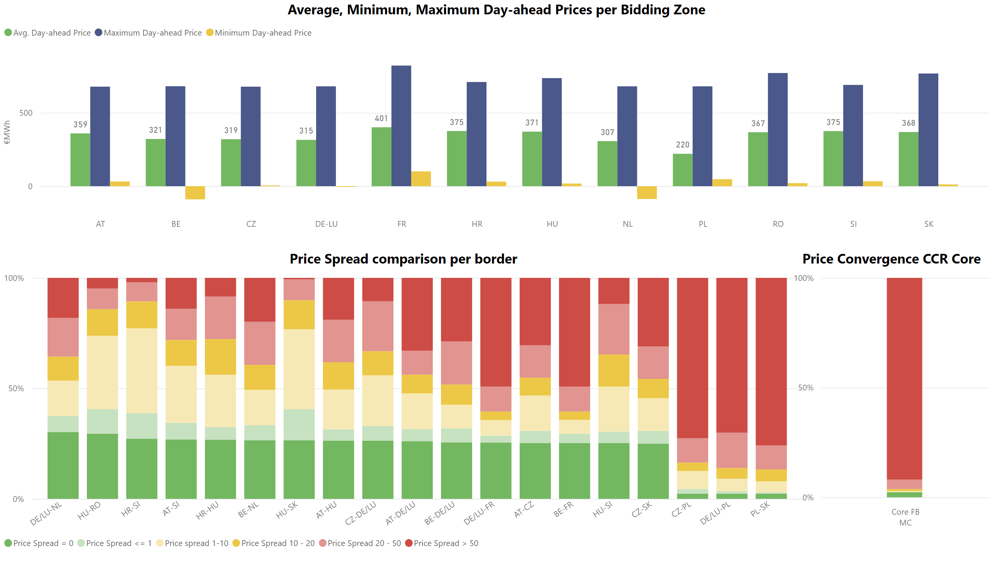
KPI 10: Clearing prices, price spreads and price convergence

