Slide 1
Core IDCC
External Parallel Run KPI Report
01/03/2023 – 31/05/2023

Slide 2
Parallel Run KPIs
Introduction
Context
  According to Article 26(4) of the Core FB ID CCM, Core TSOs shall:
    continuously monitor the effects and the performance of the application of this methodology during the parallel run
    develop, in coordination with the Core regulatory authorities, the Agency and stakeholders, the monitoring and performance criteria and report on the outcome of this monitoring on quarterly basis in a report
  IDCC external // run started on 5th of December 2022. Since this business day, results of capacity calculation have been published on JAO website [LINK]
On the next slide the overview of the KPIs covered in this KPI report is provided.
  A Reading Guide with a detail description of the KPIs is also available on JAO [LINK]

Slide 3
Parallel Run KPIs
Overview of parallel run KPIs
ATC related KPIs
    Duration curve of Core oriented bidding zone borders with simultaneous zero (or negative) ID ATCs​
    Frequency of zero and negative ID ATCs by oriented Core bidding zone border, and Core average​
    Frequency of isolated BZs of zero (or negative) ID ATCs in import, export and both directions​
    Mean positive ID ATCs by oriented Core bidding zone border, and Core average​
    TSOs’ adjustment after validation
    Share of MTUs with intervention per TSO
    Limiting elements
    Limiting constraints of the ATC domain​
    Most often pre-solved CNECs​
    Net positions
    Min/Max Net Positions​
      Based on final FB domain
      Based on final ID ATC

Slide 4
Parallel Run KPIs
Reporting period and limitations
Reporting period
  This KPI report covers three months (March - May) of IDCC ext//run, i.e. period 01/03/2023 – 31/05/2023.
  Results of BD 03/03 are excluded due to failure of IDCC process on this day (Zero Capacity Fallback was applied).
  As a result, KPI report contains results of 91 business days.
Limitations observed during reporting period:
  During considered months of external // run, most of TSOs were still working on the development/optimization of their local validation tools and/or processes. For this reason, individual validation adjustments (IVAs) applied by TSOs and monitored by KPI 5 shouldn´t be considered as values that would have been applied in case of a live IDCC process.
  For the same reason, also final ATC values might not be fully representative for some timestamps of the reporting period.
  KPI 6 (Limiting constraints of the ATC domain) at TSO level is not possible to add for French TSO due to the dynamically changing FR CBCO ID. This report will be available only after a change in Data Quality Check which is a source for this KPI. This is expected to be implemented in Q1 2024.

Slide 5
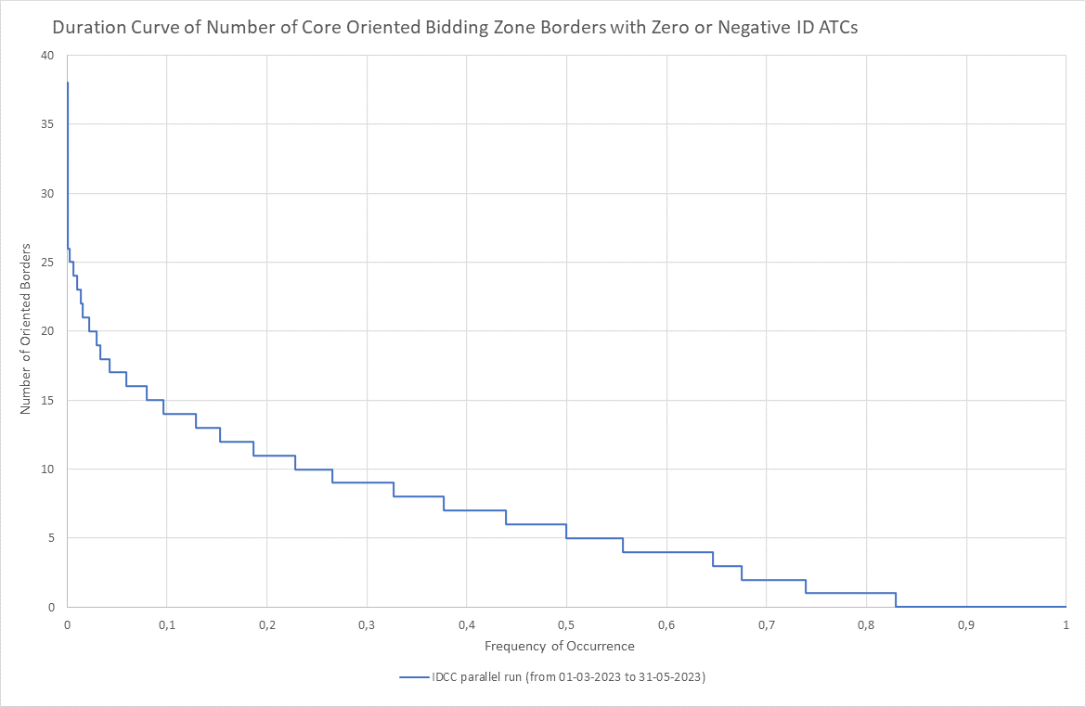
KPI 1
Duration curve of Core oriented bidding zone borders with simultaneous zero (or negative) ID ATCs​

Slide 6
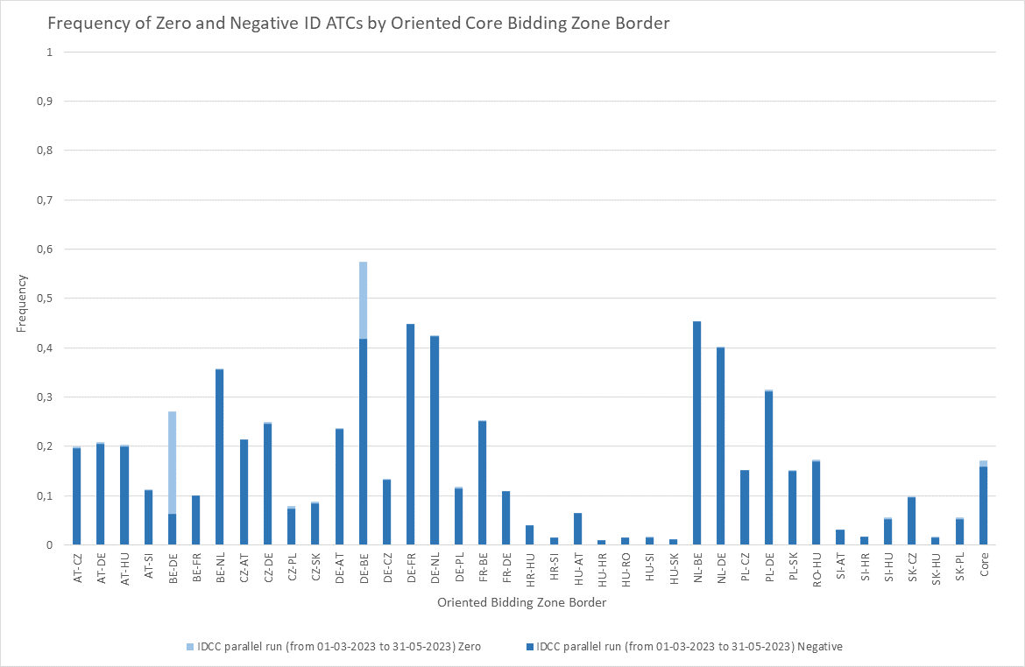
KPI 2
Frequency of zero and negative ID ATCs by oriented Core bidding zone border, and Core average​

Slide 7
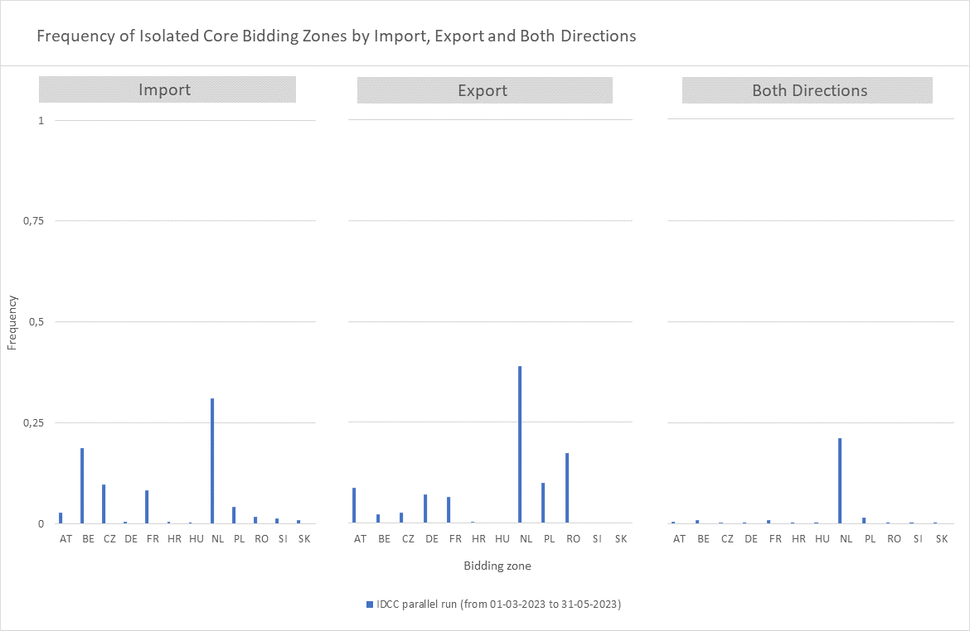
KPI 3
Frequency of isolated BZs of zero (or negative) ID ATCs in import, export and both directions​​

Slide 8
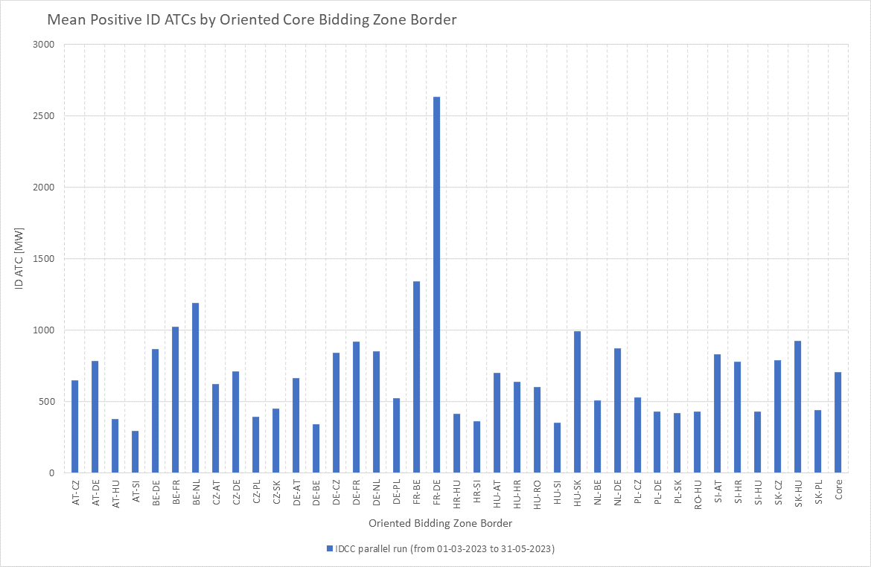
KPI 4
Mean positive ID ATCs by oriented Core bidding zone border, and Core average​

Slide 9
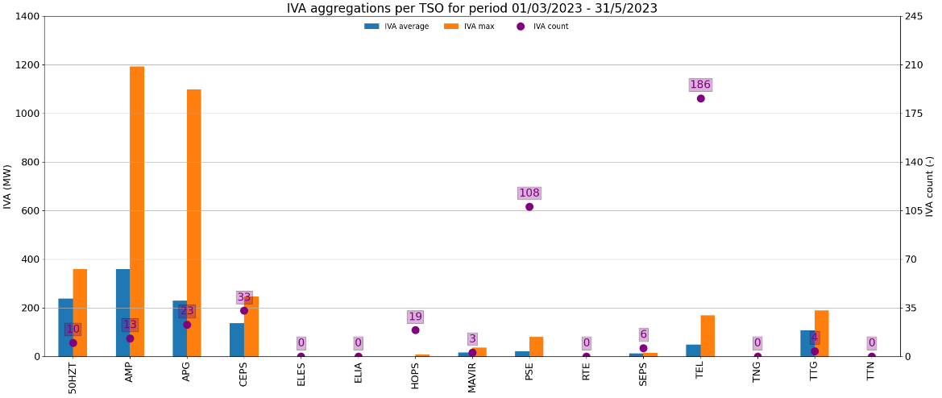
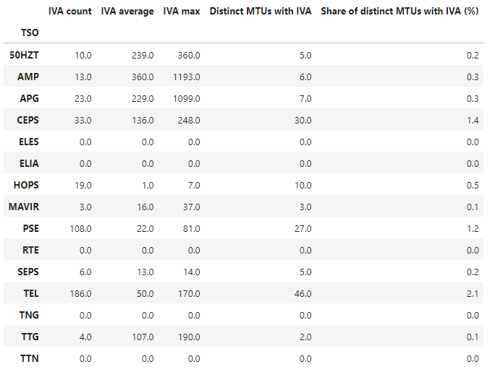
KPI 5
Share of MTUs with intervention per TSO
Most of the TSOs applying IVA so far reported that their IVA values were sent by mistake/ were too strict – they should not be considered as go-live local validation tool setup

Slide 10
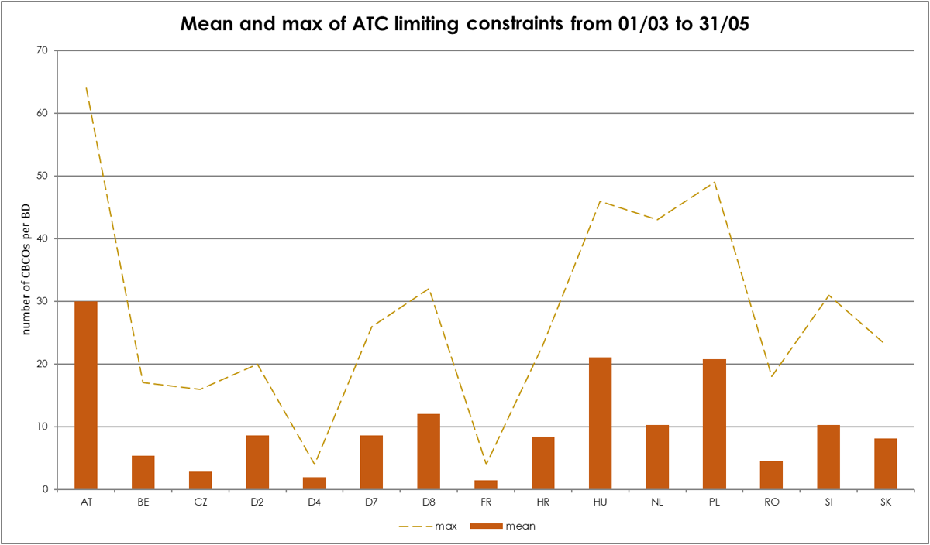
KPI 6
Limiting constraints of the ATC domain​

Slide 11
KPI 6
Limiting constraints of the ATC domain​

Slide 12
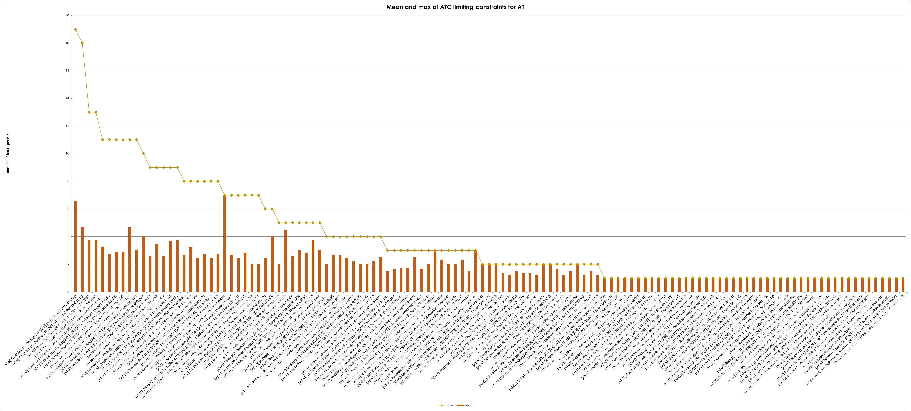
KPI 6
Limiting constraints of the ATC domain​

Slide 13
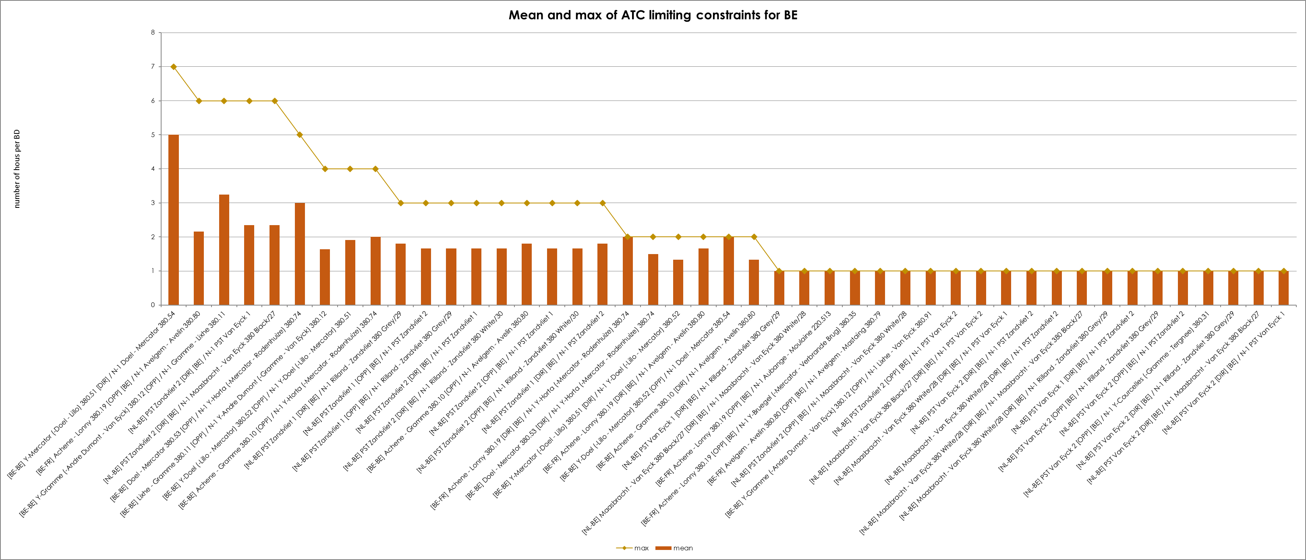
KPI 6
Limiting constraints of the ATC domain​

Slide 14
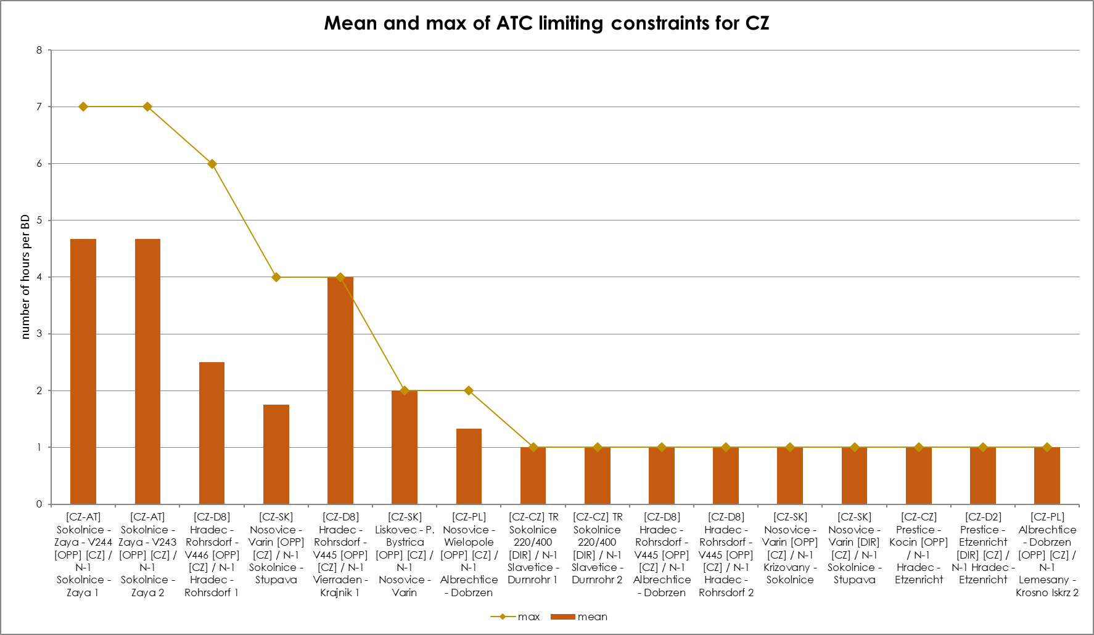
KPI 6
Limiting constraints of the ATC domain​

Slide 15
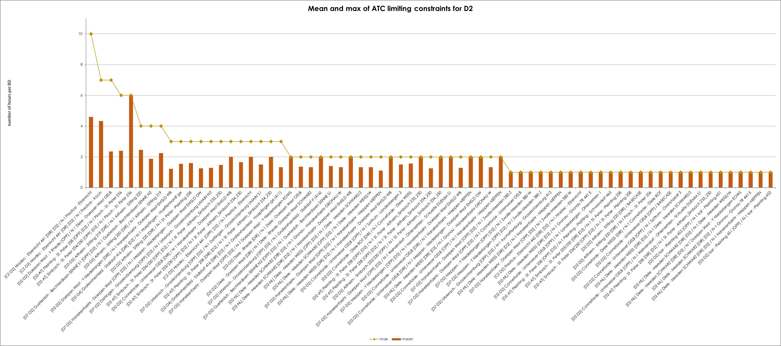
KPI 6
Limiting constraints of the ATC domain​

Slide 16
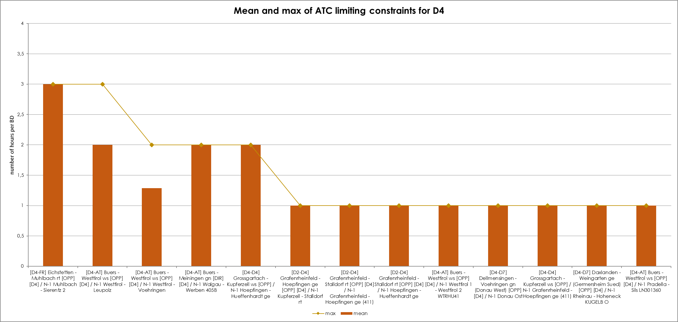
KPI 6
Limiting constraints of the ATC domain​

Slide 17
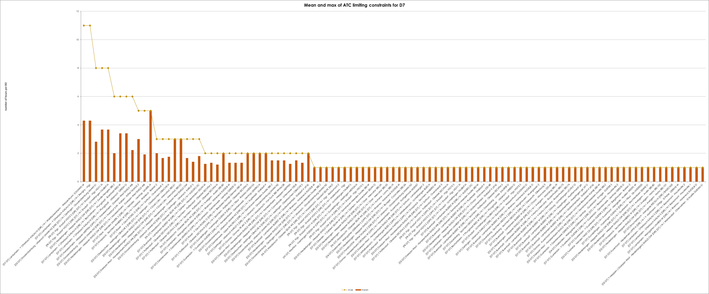
KPI 6
Limiting constraints of the ATC domain​

Slide 18
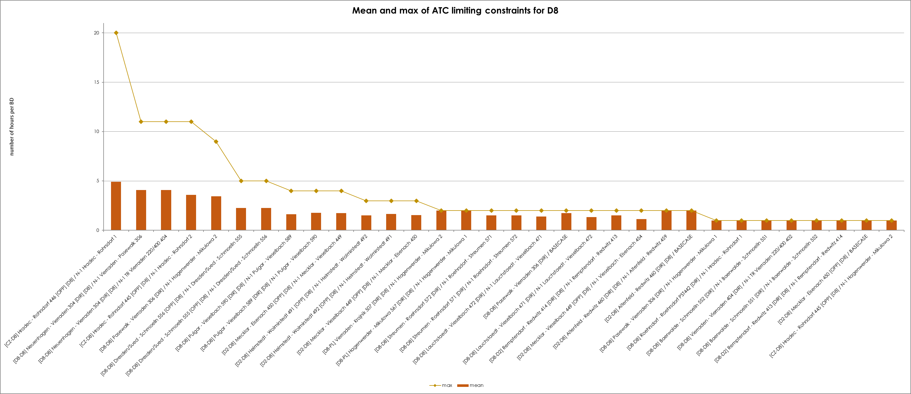
KPI 6
Limiting constraints of the ATC domain​

Slide 19
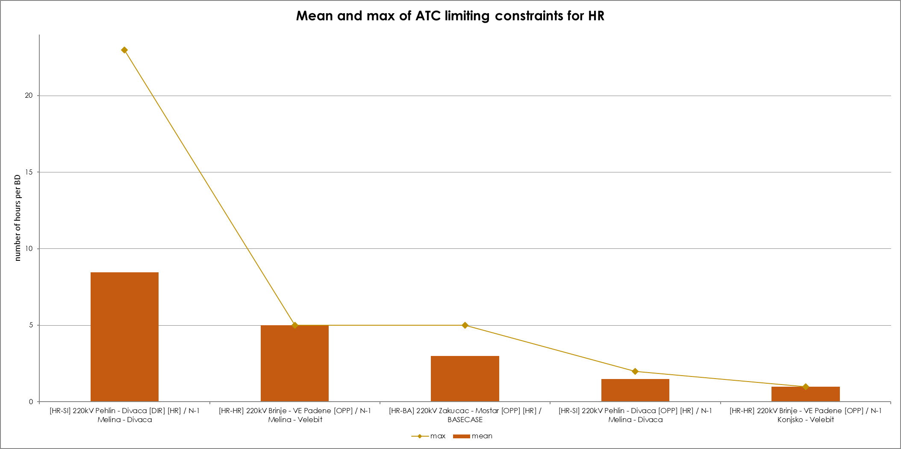
KPI 6
Limiting constraints of the ATC domain​

Slide 20
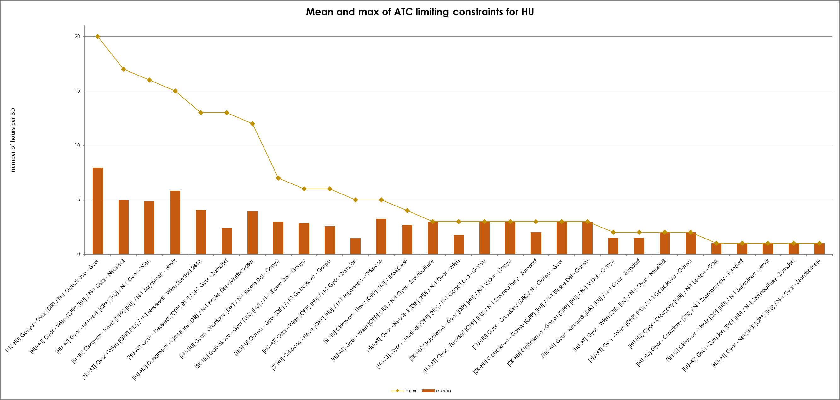
KPI 6
Limiting constraints of the ATC domain​

Slide 21
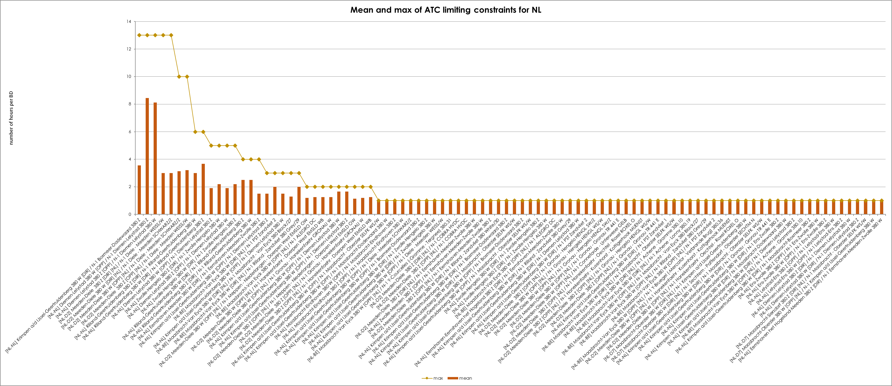
KPI 6
Limiting constraints of the ATC domain​

Slide 22
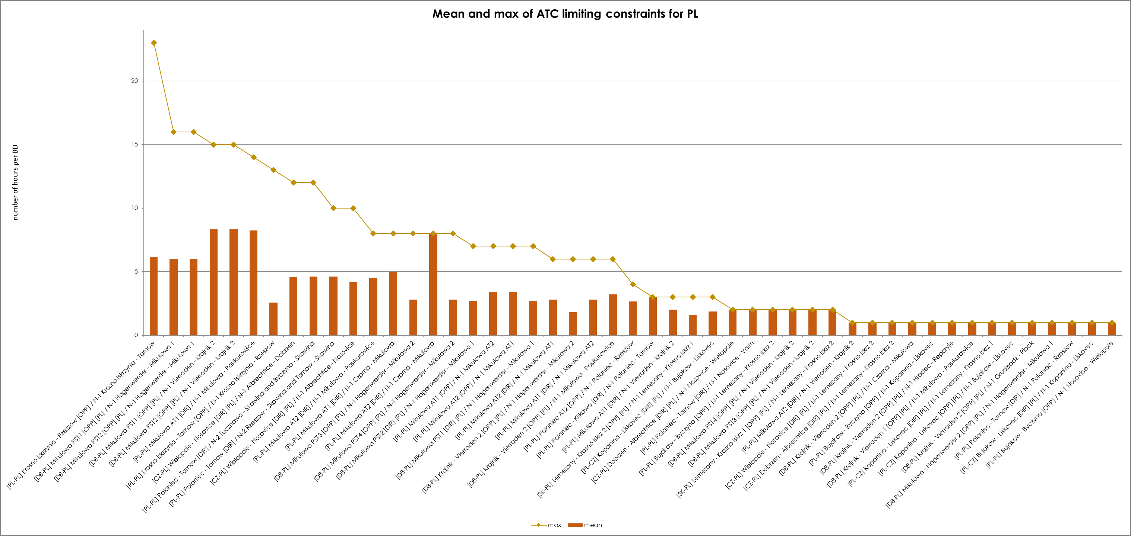
KPI 6
Limiting constraints of the ATC domain​

Slide 23
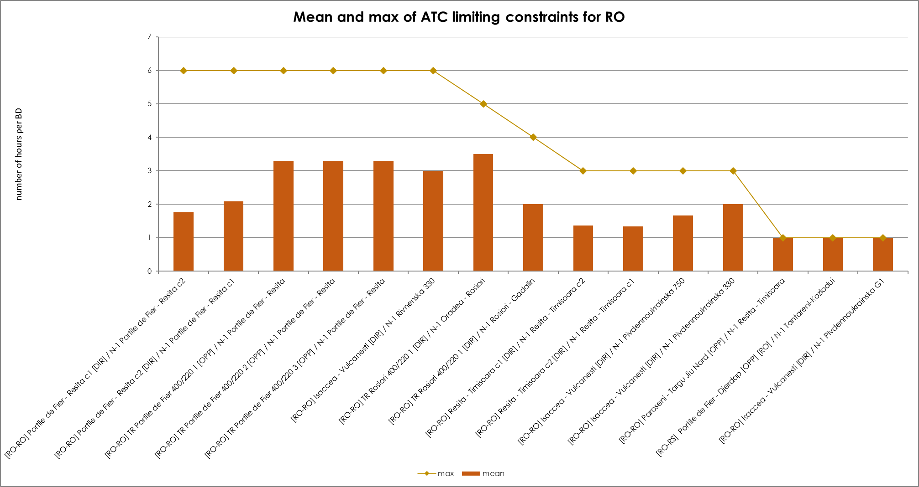
KPI 6
Limiting constraints of the ATC domain​

Slide 24
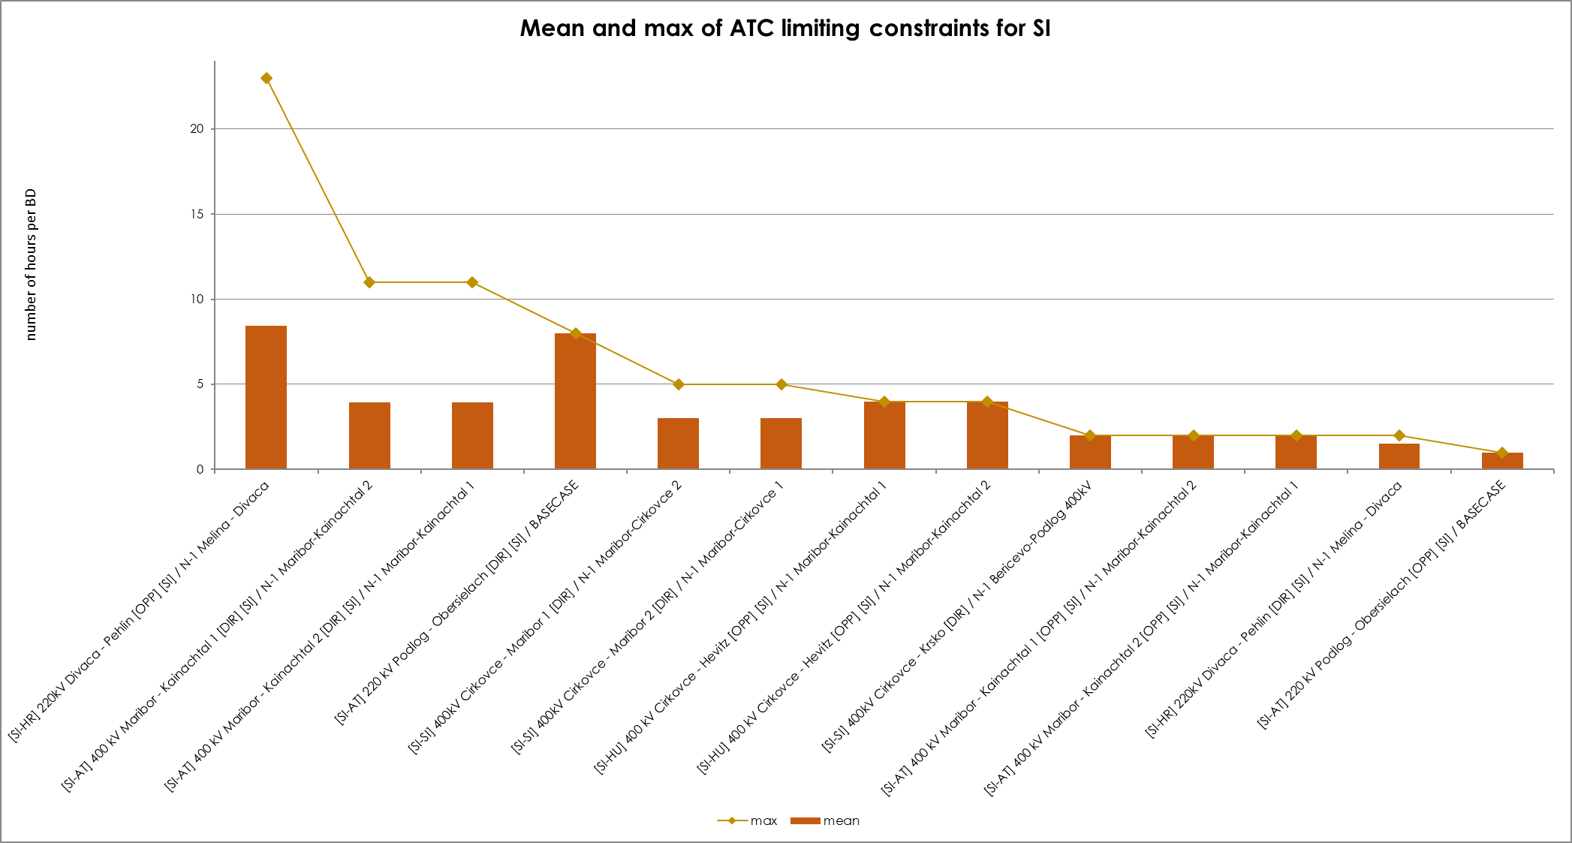
KPI 6
Limiting constraints of the ATC domain​

Slide 25
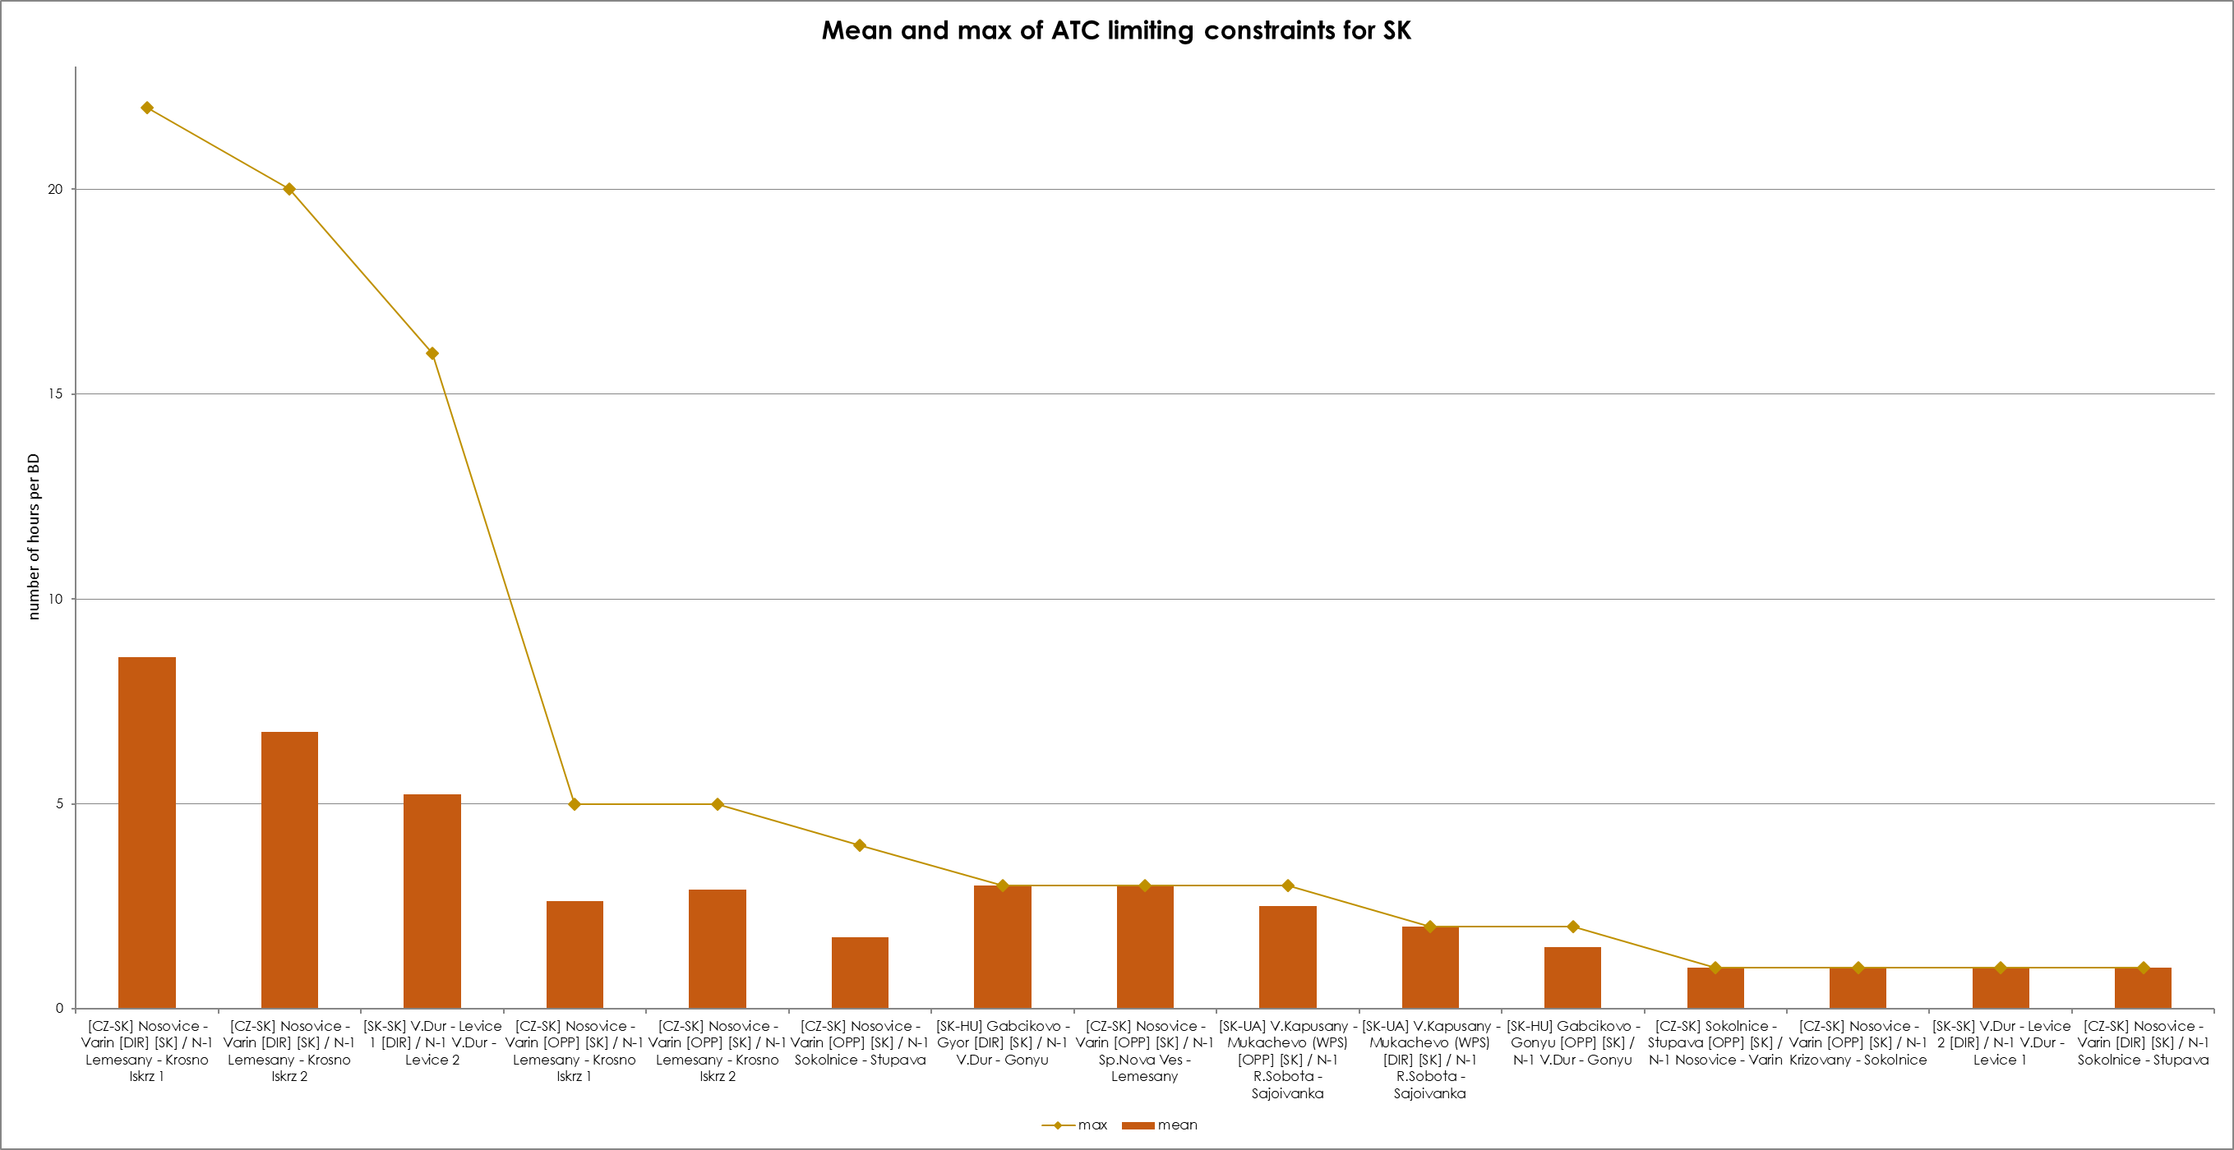
KPI 6
Limiting constraints of the ATC domain​

Slide 26
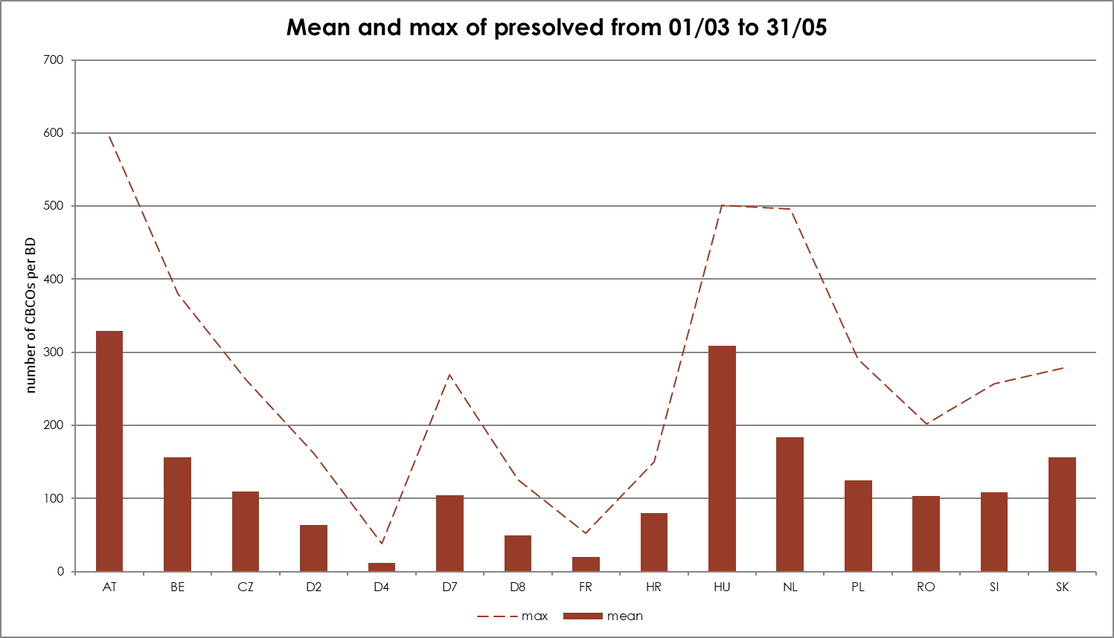
KPI 7
Most often pre-solved CNECs​
Notes:
D2: TTG
D4: TransnetBW
D7: Amprion
D8: 50Hz

Slide 27
KPI 7
Most often pre-solved CNECs​

Slide 28
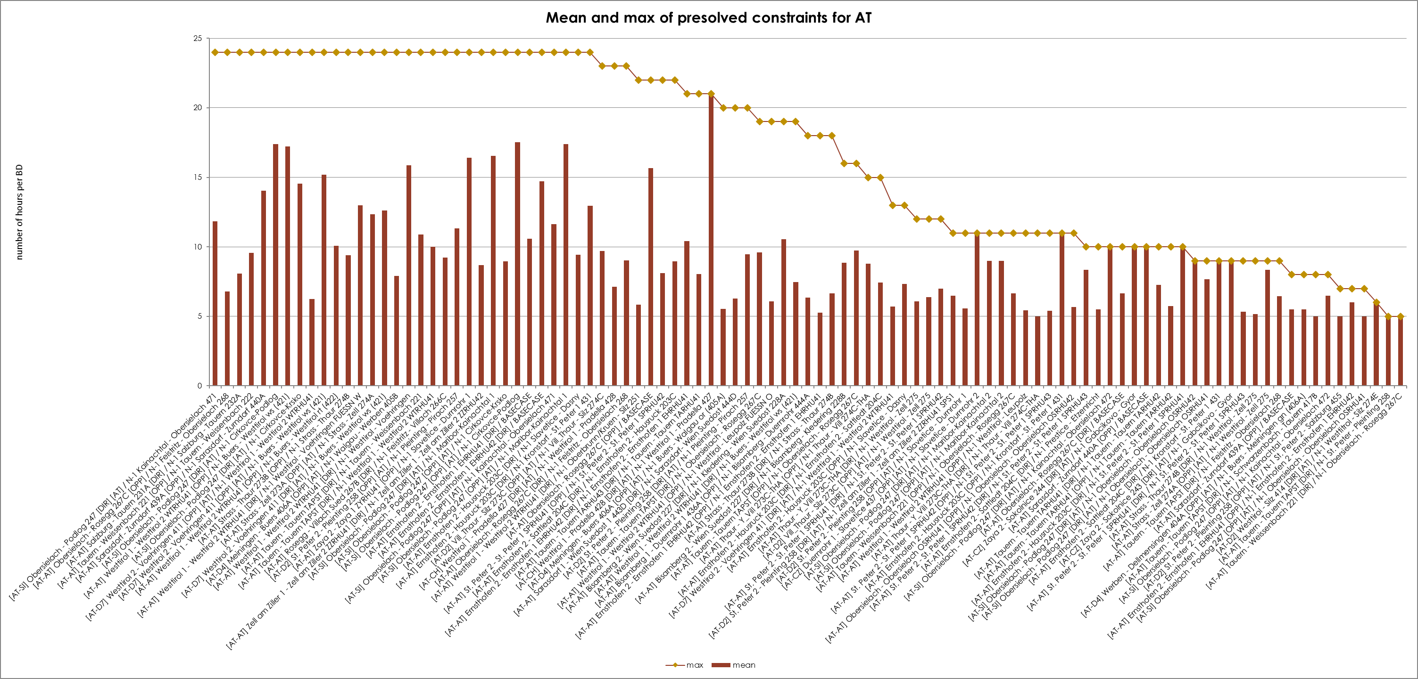
KPI 7
Most often pre-solved CNECs​

Slide 29
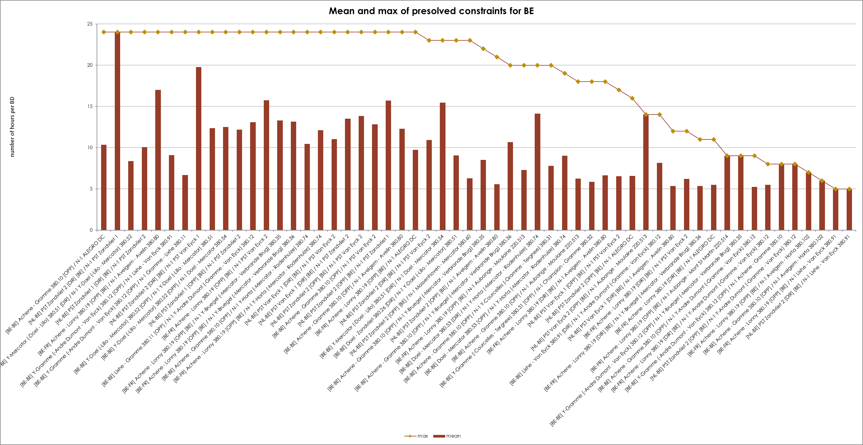
KPI 7
Most often pre-solved CNECs​

Slide 30
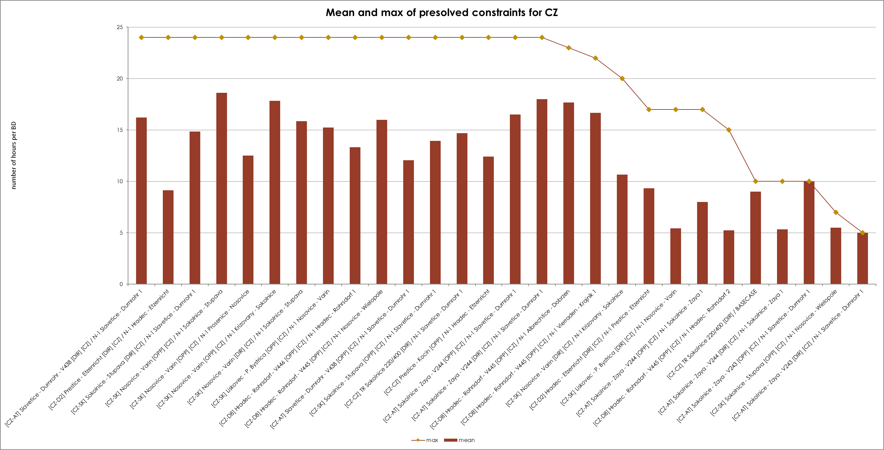
KPI 7
Most often pre-solved CNECs​

Slide 31
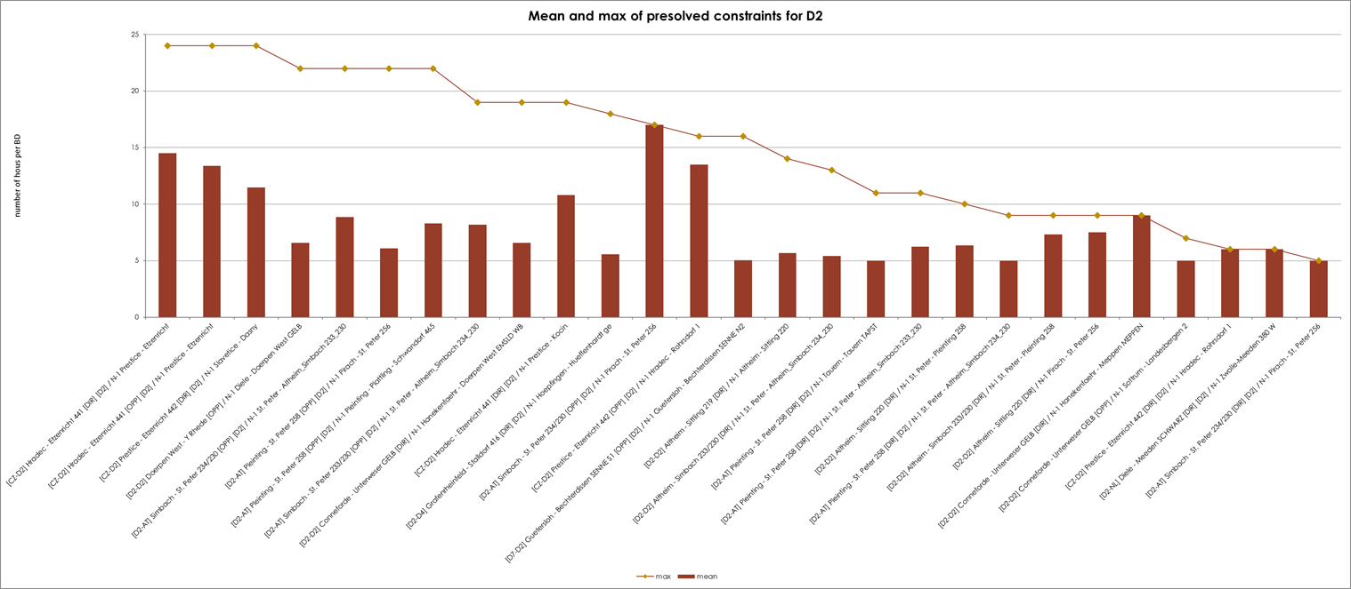
KPI 7
Most often pre-solved CNECs​

Slide 32
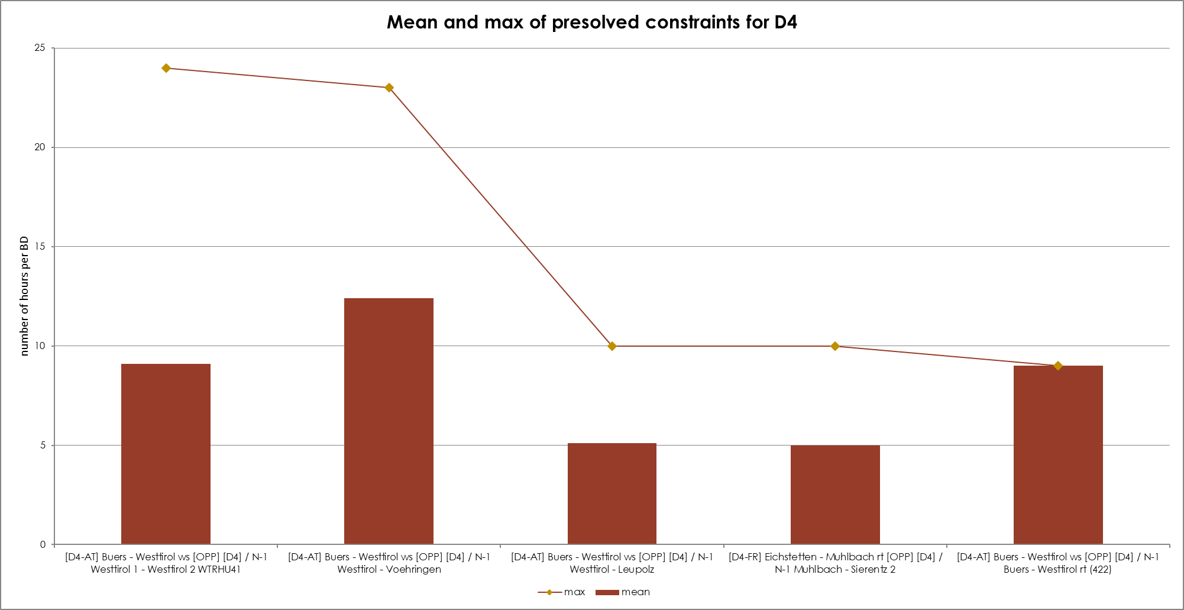
KPI 7
Most often pre-solved CNECs​

Slide 33
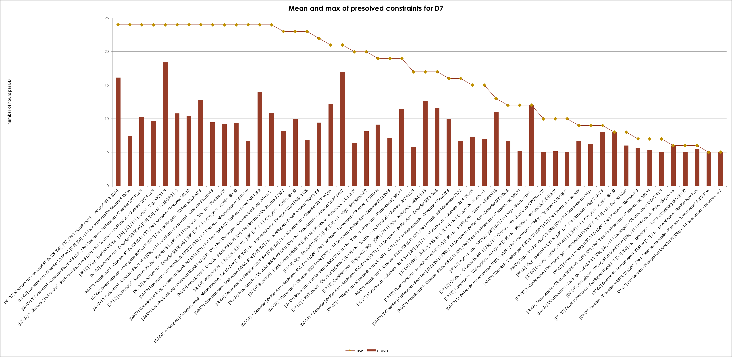
KPI 7
Most often pre-solved CNECs​

Slide 34
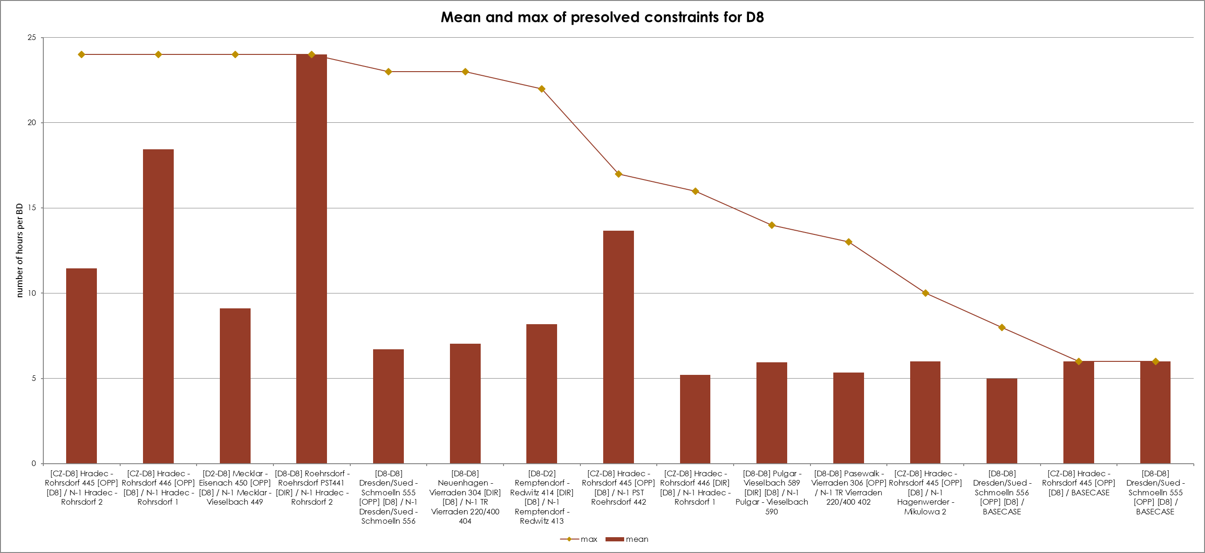
KPI 7
Most often pre-solved CNECs​

Slide 35
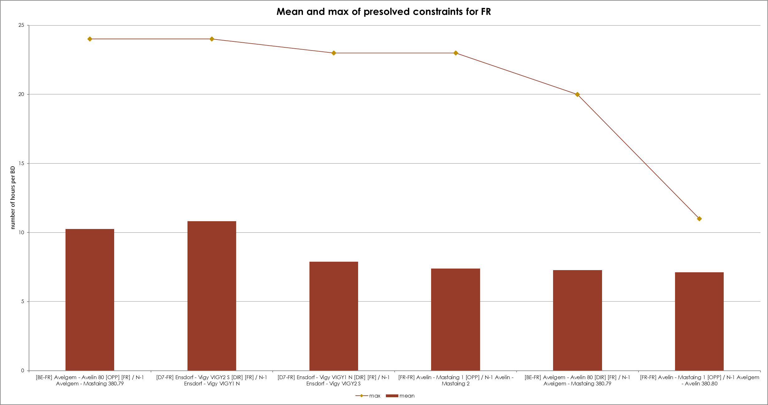
KPI 7
Most often pre-solved CNECs​

Slide 36
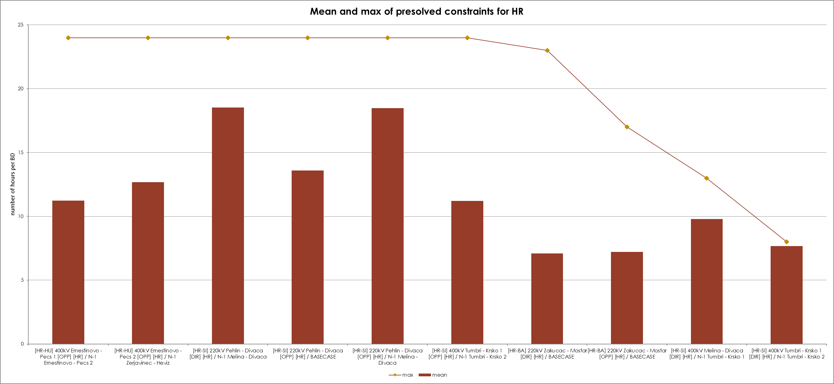
KPI 7
Most often pre-solved CNECs​

Slide 37
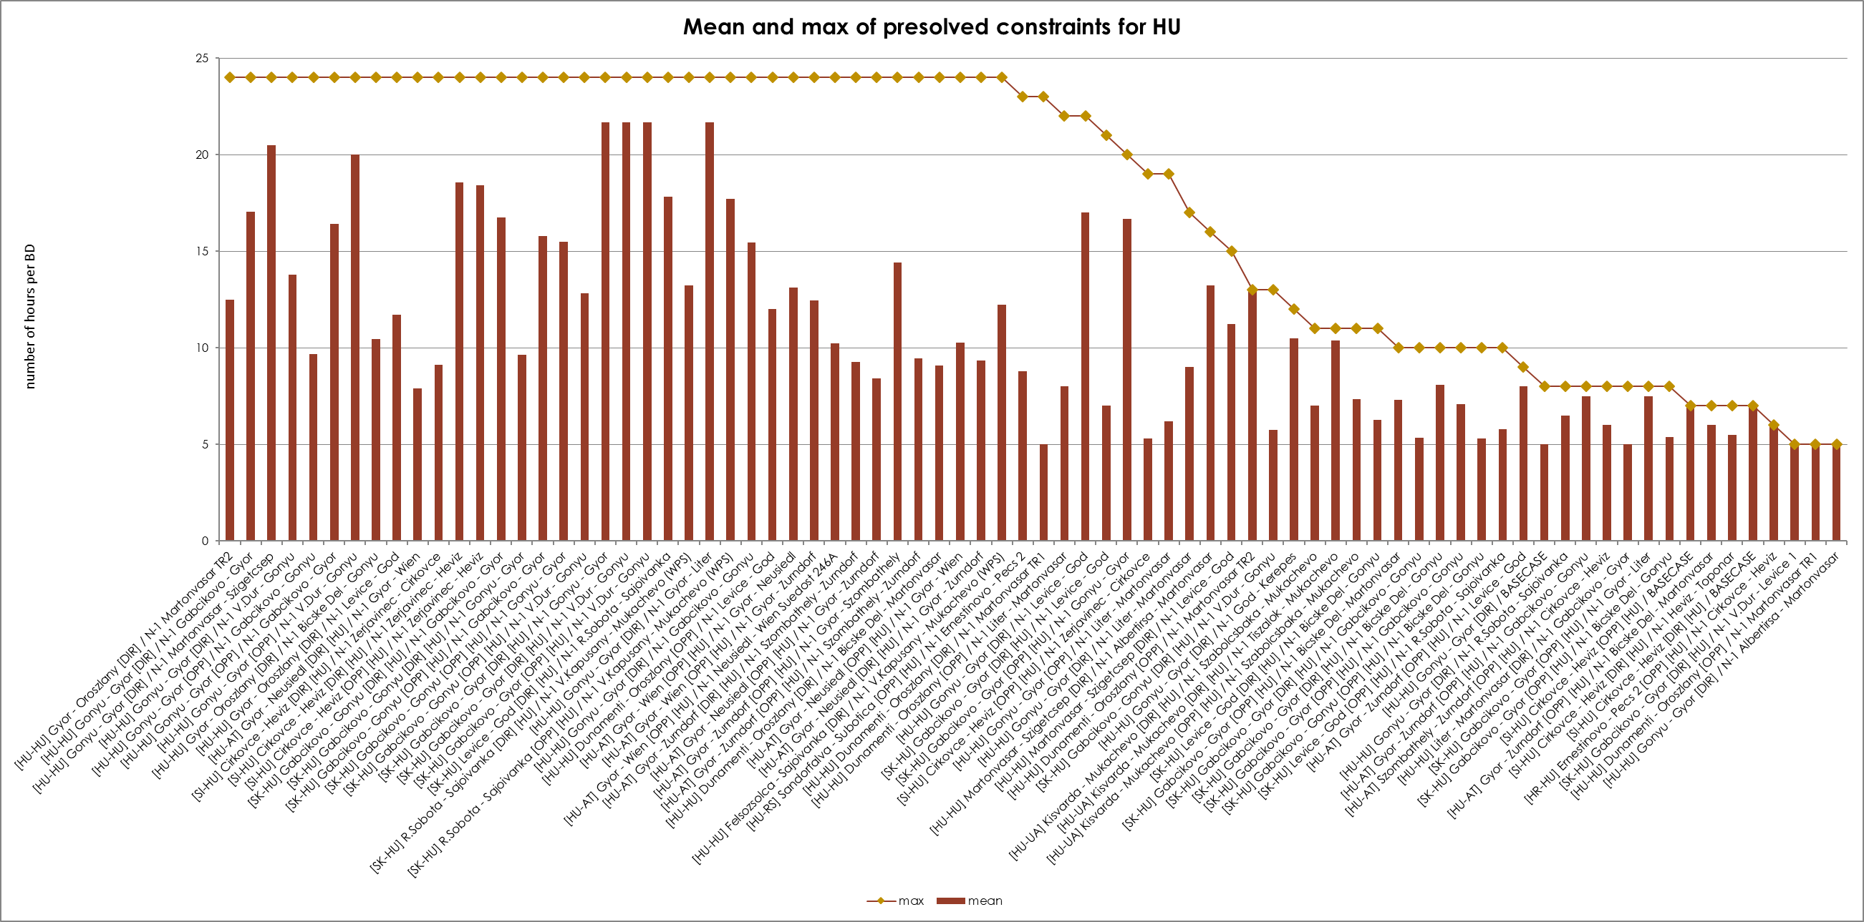
KPI 7
Most often pre-solved CNECs​

Slide 38
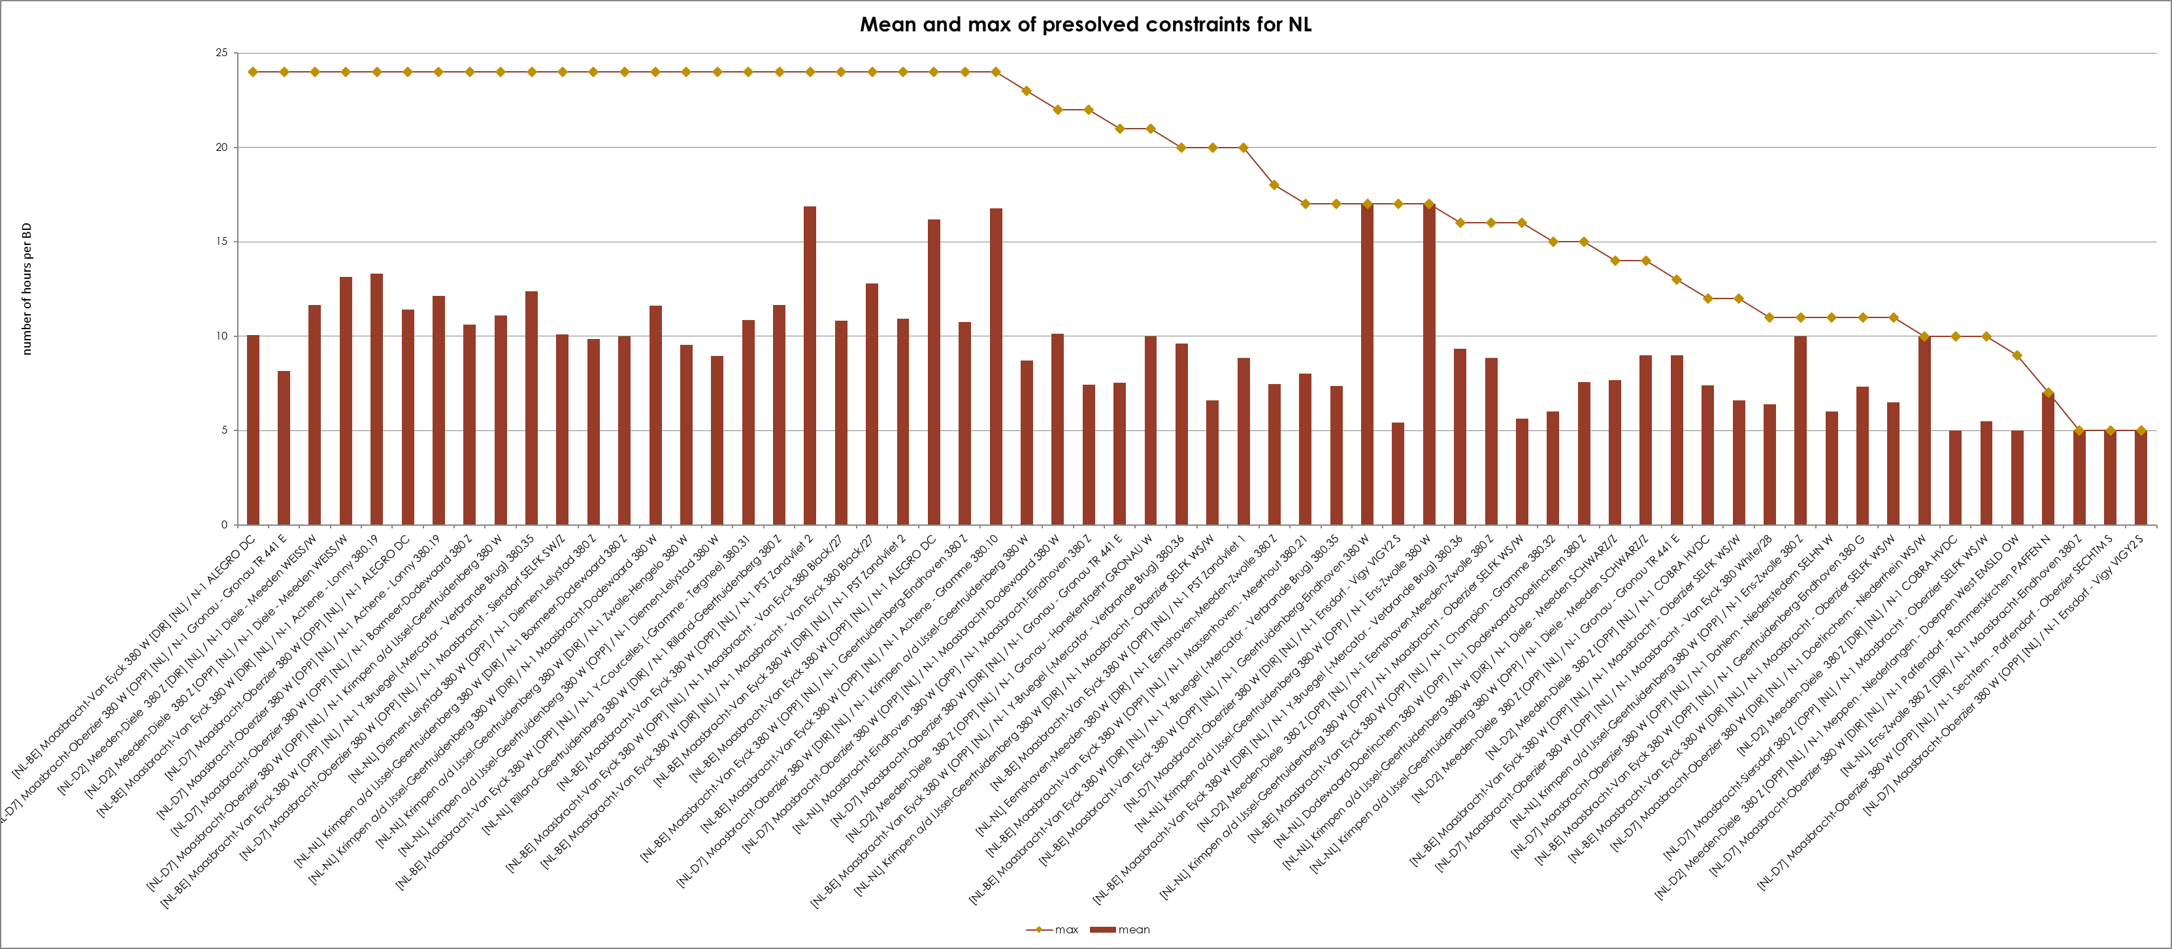
KPI 7
Most often pre-solved CNECs​

Slide 39
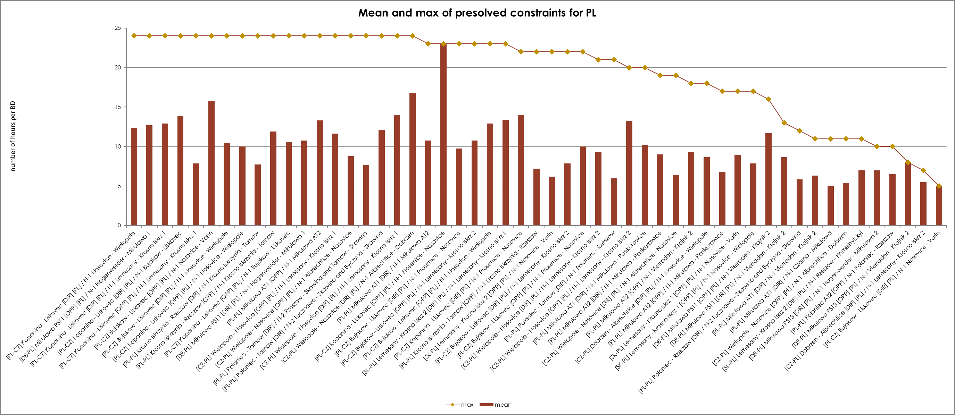
KPI 7
Most often pre-solved CNECs​

Slide 40
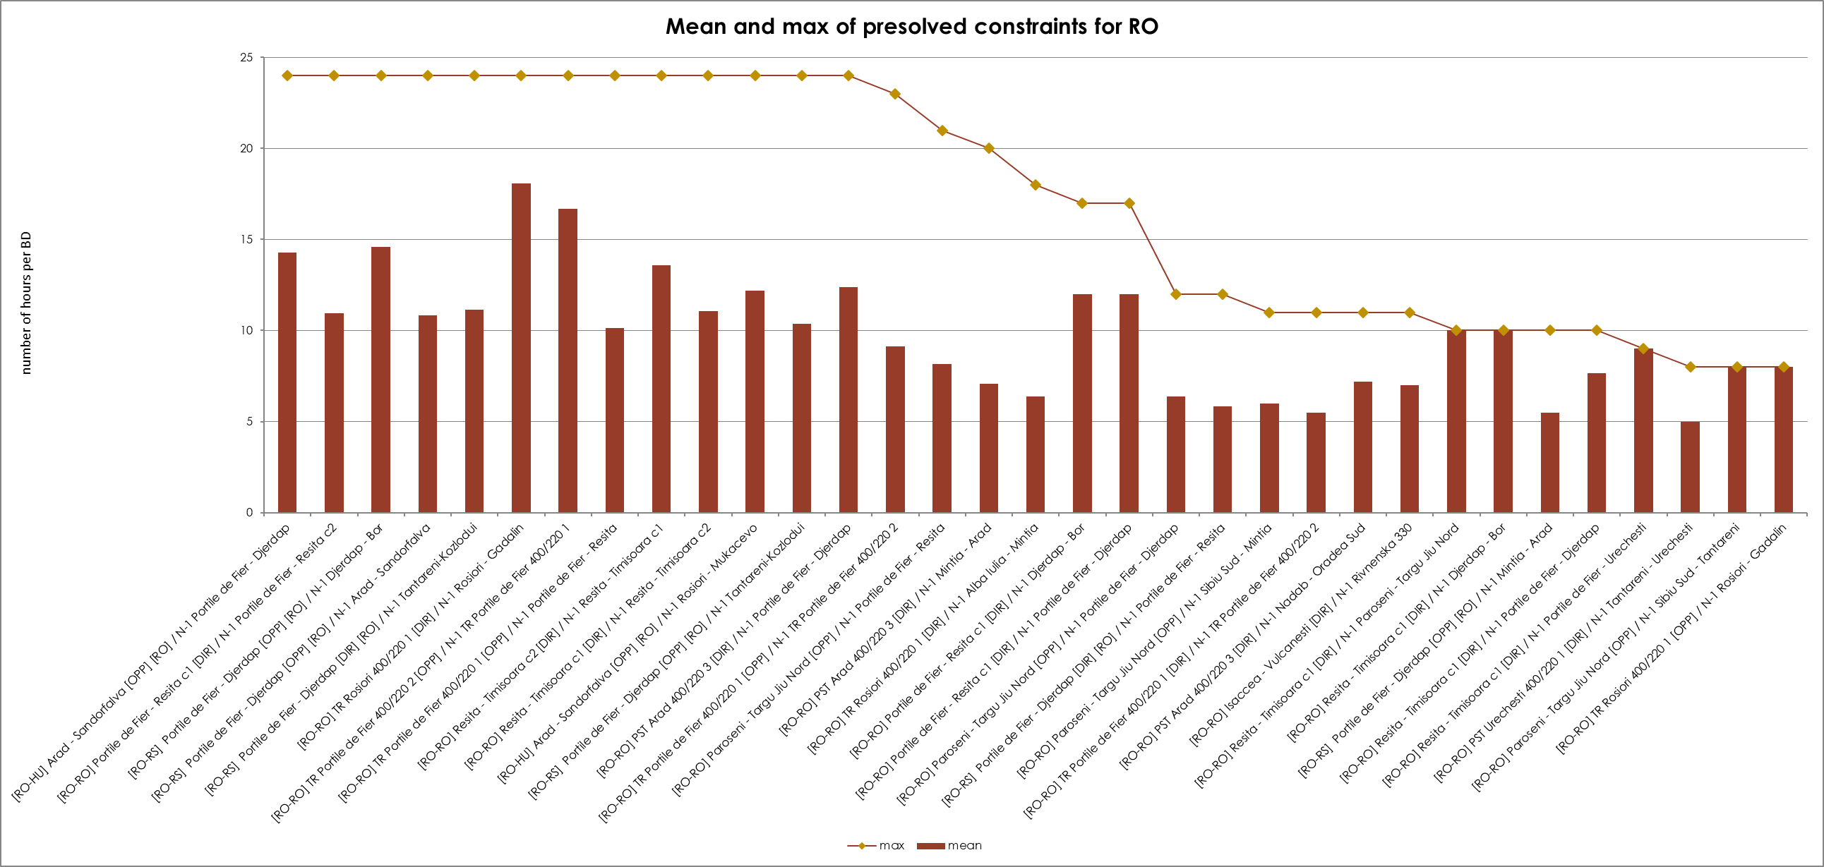
KPI 7
Most often pre-solved CNECs​

Slide 41
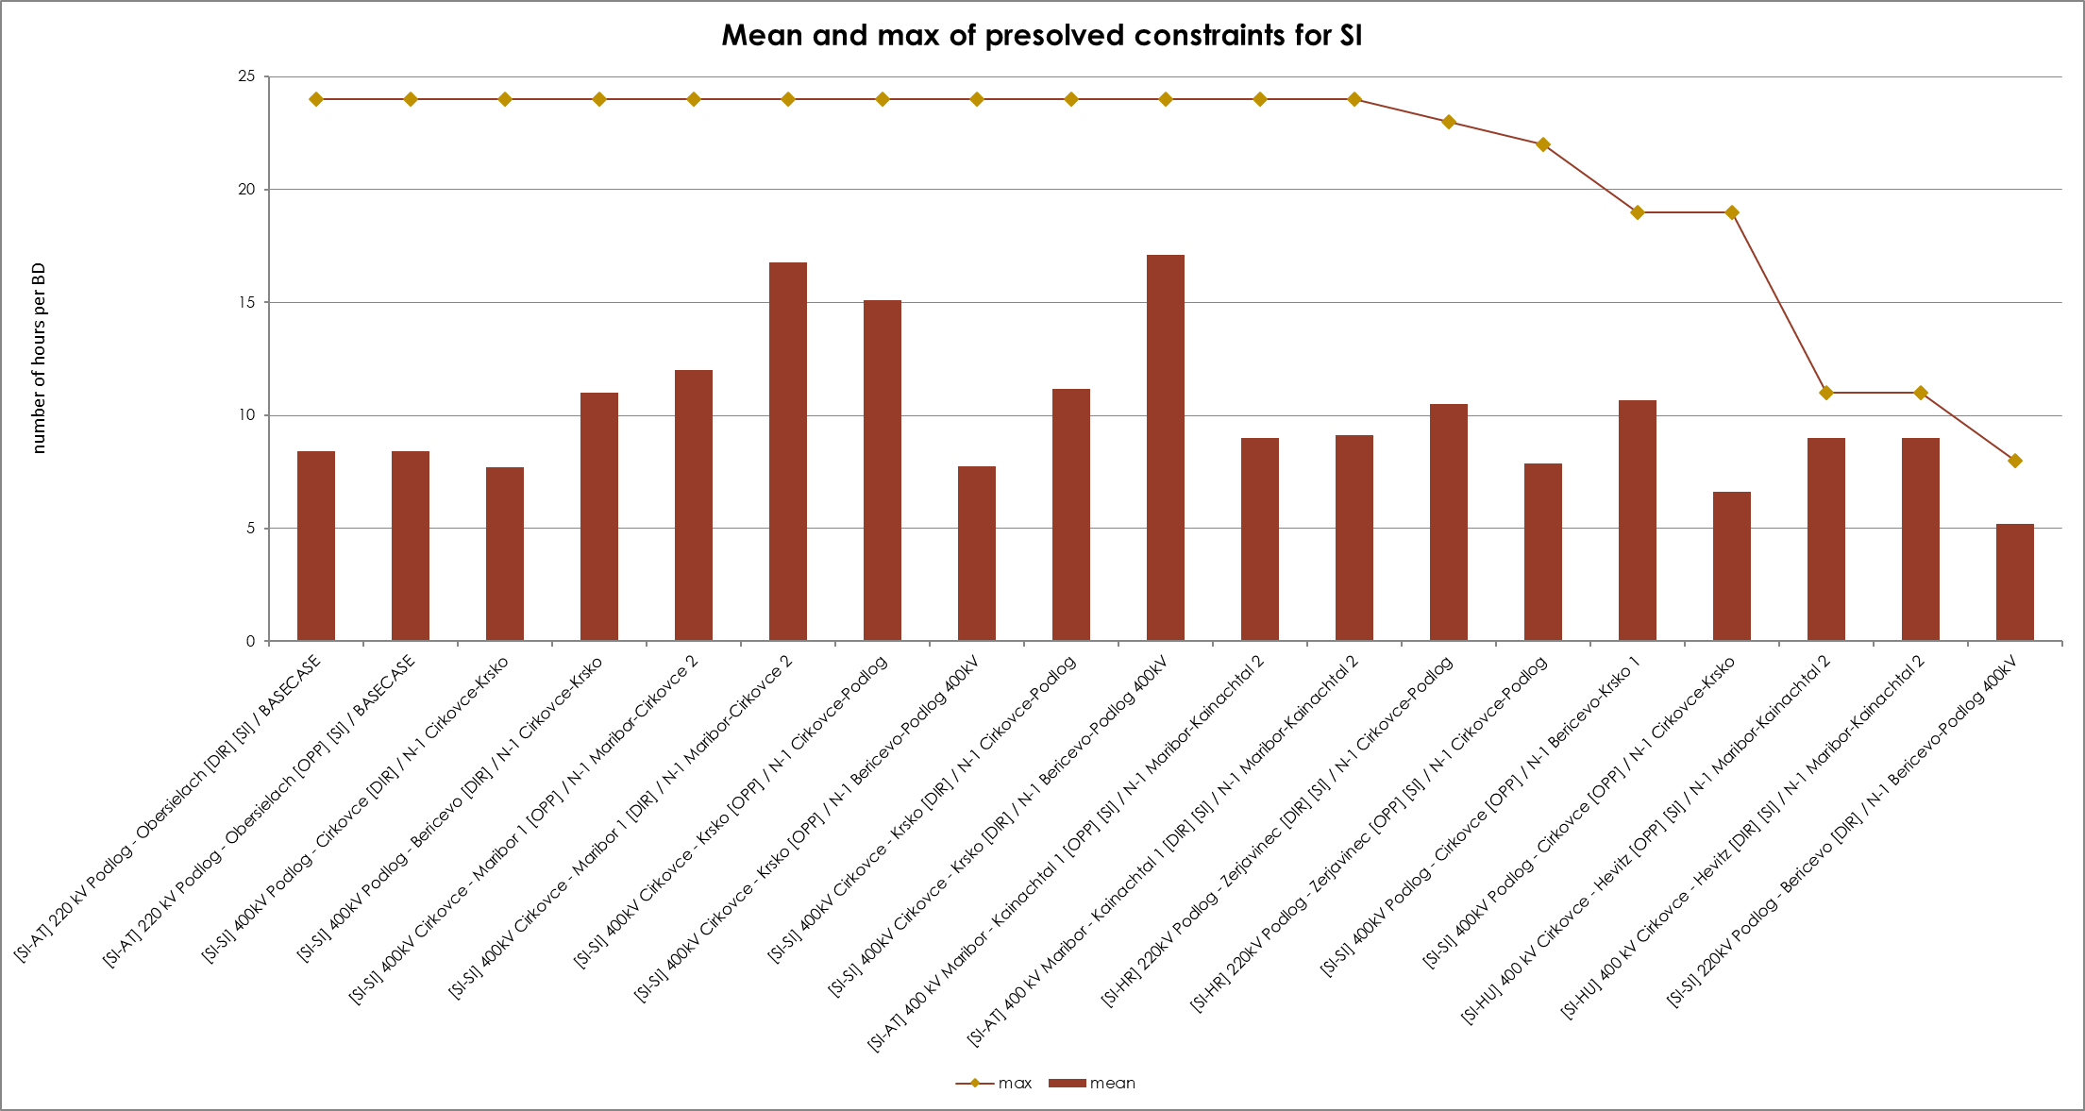
KPI 7
Most often pre-solved CNECs​

Slide 42
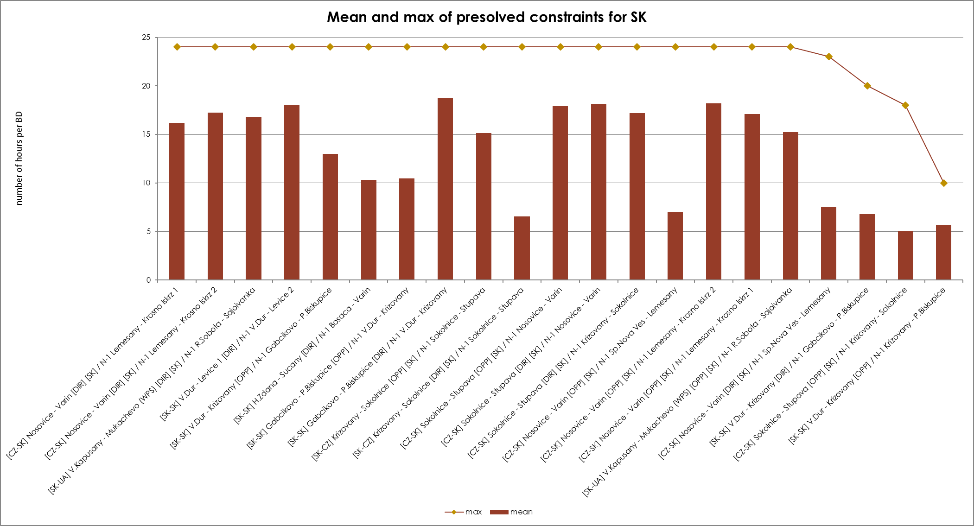
KPI 7
Most often pre-solved CNECs​

Slide 43
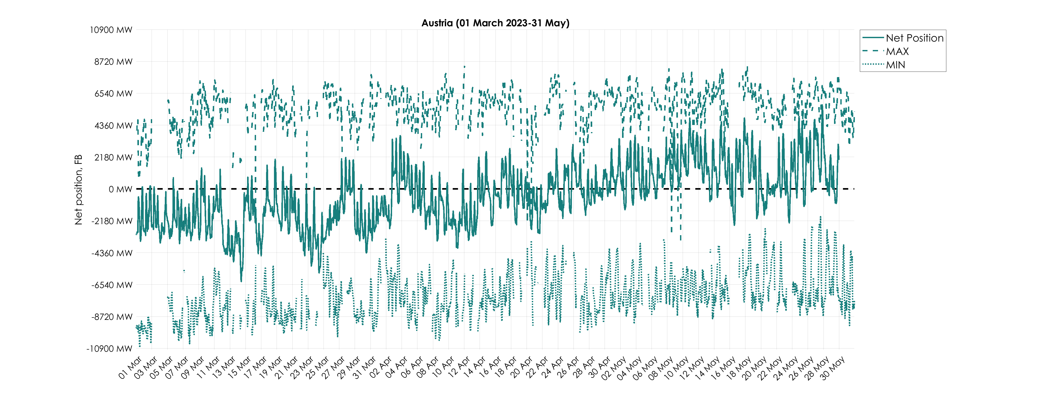
KPI 8 – Min and Max Net Positions per bidding zone
(a) Based on final FB domain
Missing values of min and max net positions for some timestamps are caused by empty domains.
(Data sources: F832 - Final AAC for FB NP and F818 - MIN/MAX Net position )

Slide 44
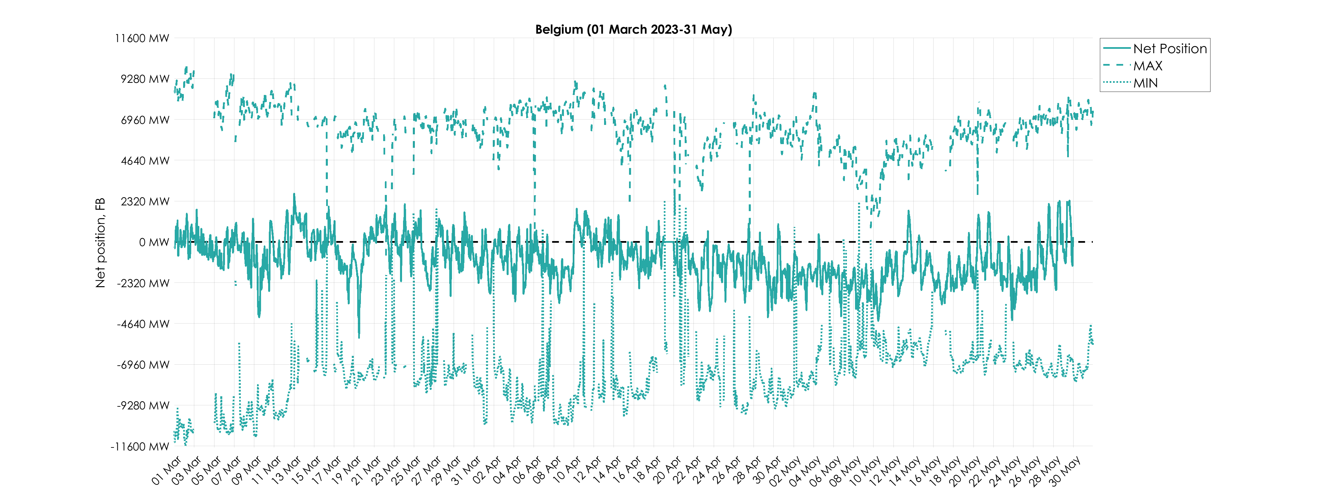
KPI 8 – Min and Max Net Positions per bidding zone
(a) Based on final FB domain
Missing values of min and max net positions for some timestamps are caused by empty domains.
(Data sources: F832 - Final AAC for FB NP and F818 - MIN/MAX Net position )

Slide 45
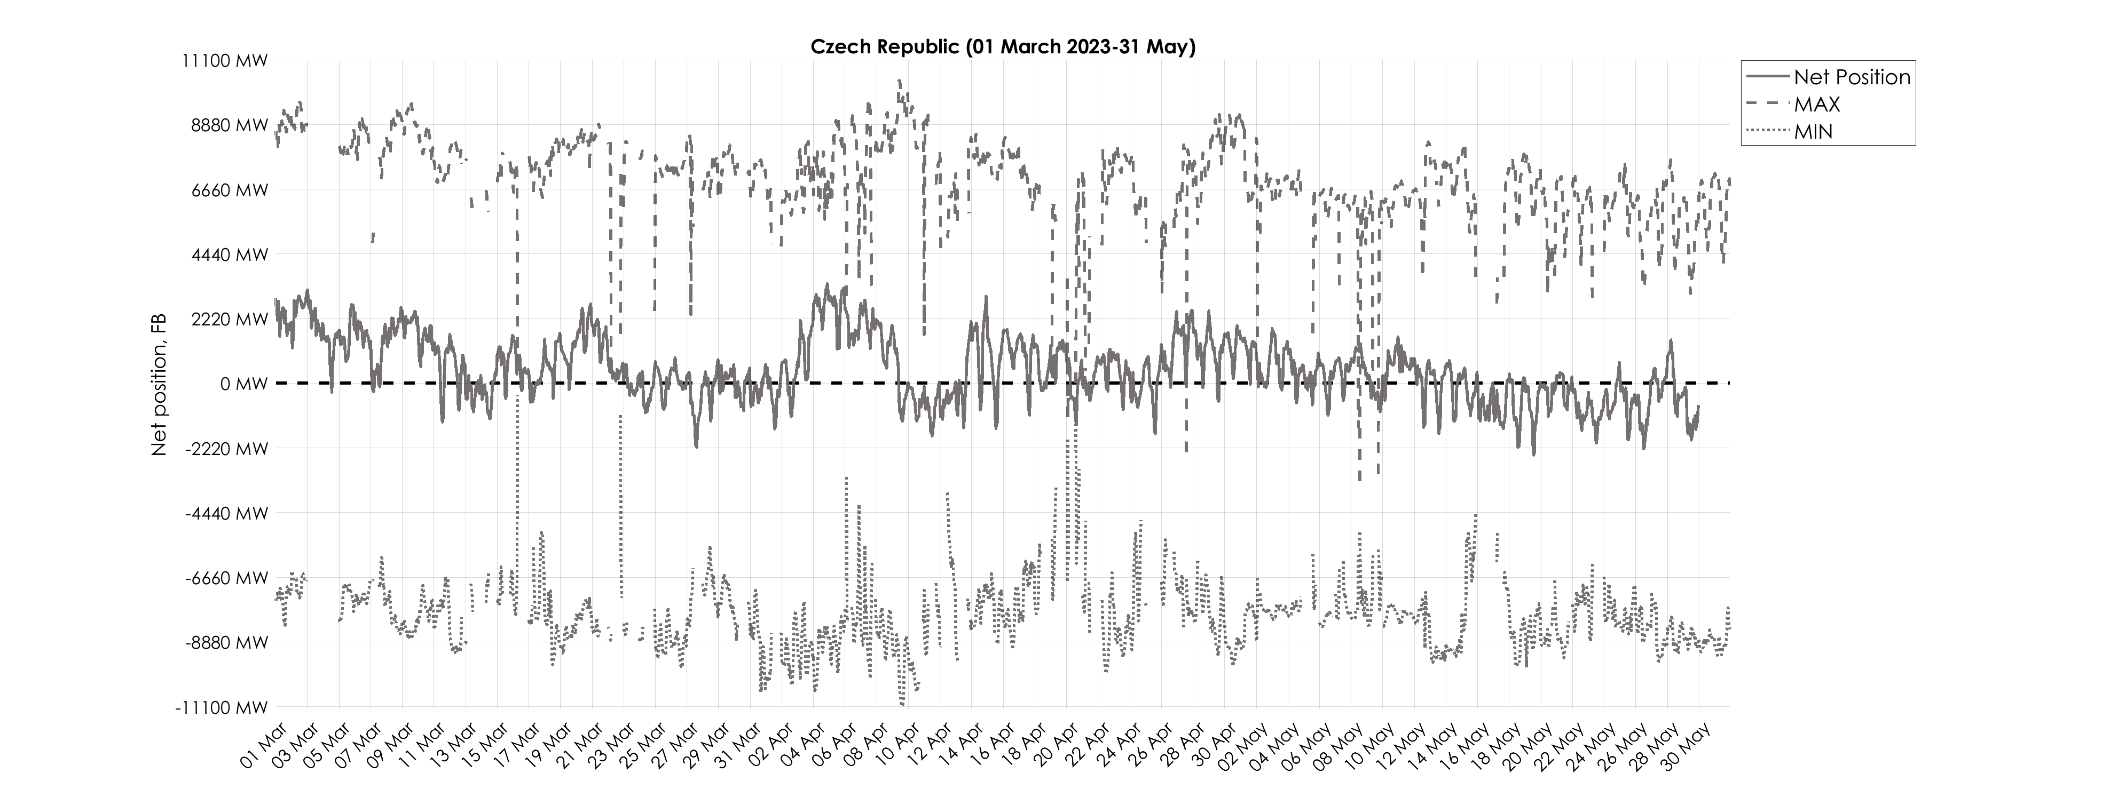
KPI 8 – Min and Max Net Positions per bidding zone
(a) Based on final FB domain
Missing values of min and max net positions for some timestamps are caused by empty domains.
(Data sources: F832 - Final AAC for FB NP and F818 - MIN/MAX Net position )

Slide 46
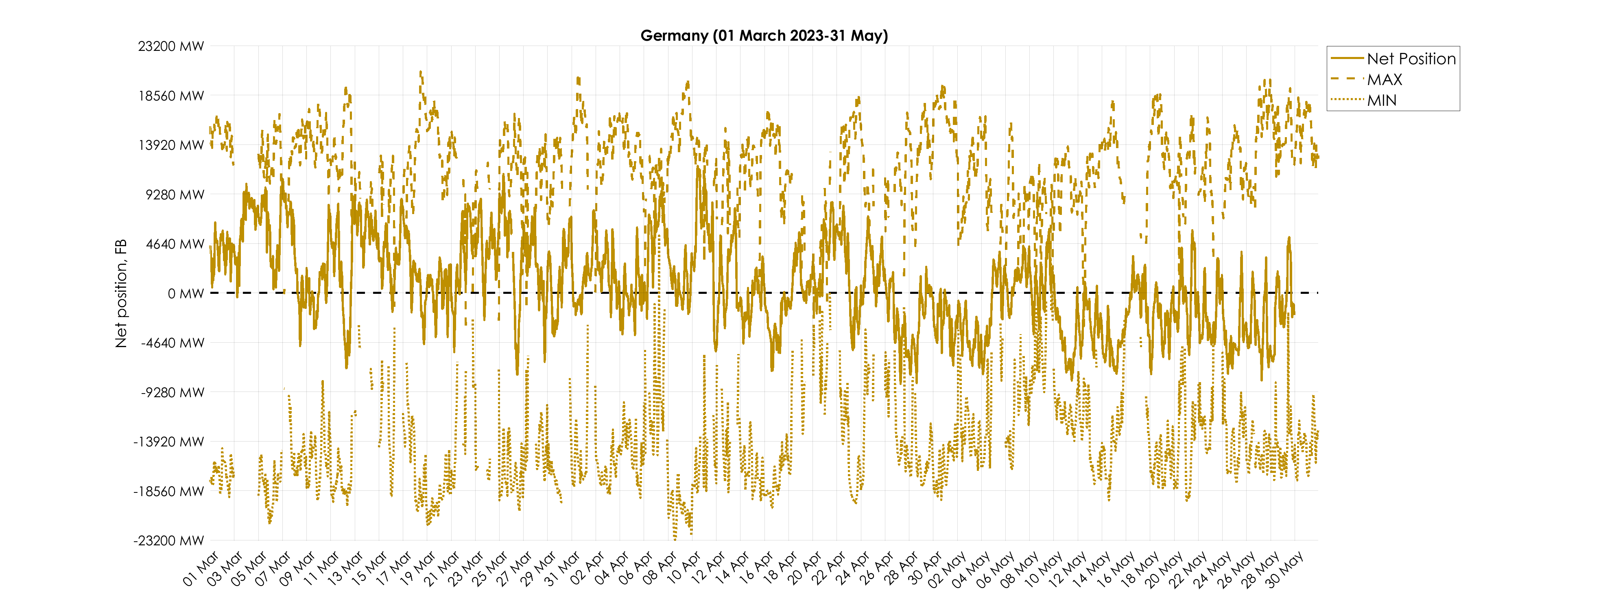
KPI 8 – Min and Max Net Positions per bidding zone
(a) Based on final FB domain
Missing values of min and max net positions for some timestamps are caused by empty domains.
(Data sources: F832 - Final AAC for FB NP and F818 - MIN/MAX Net position )

Slide 47
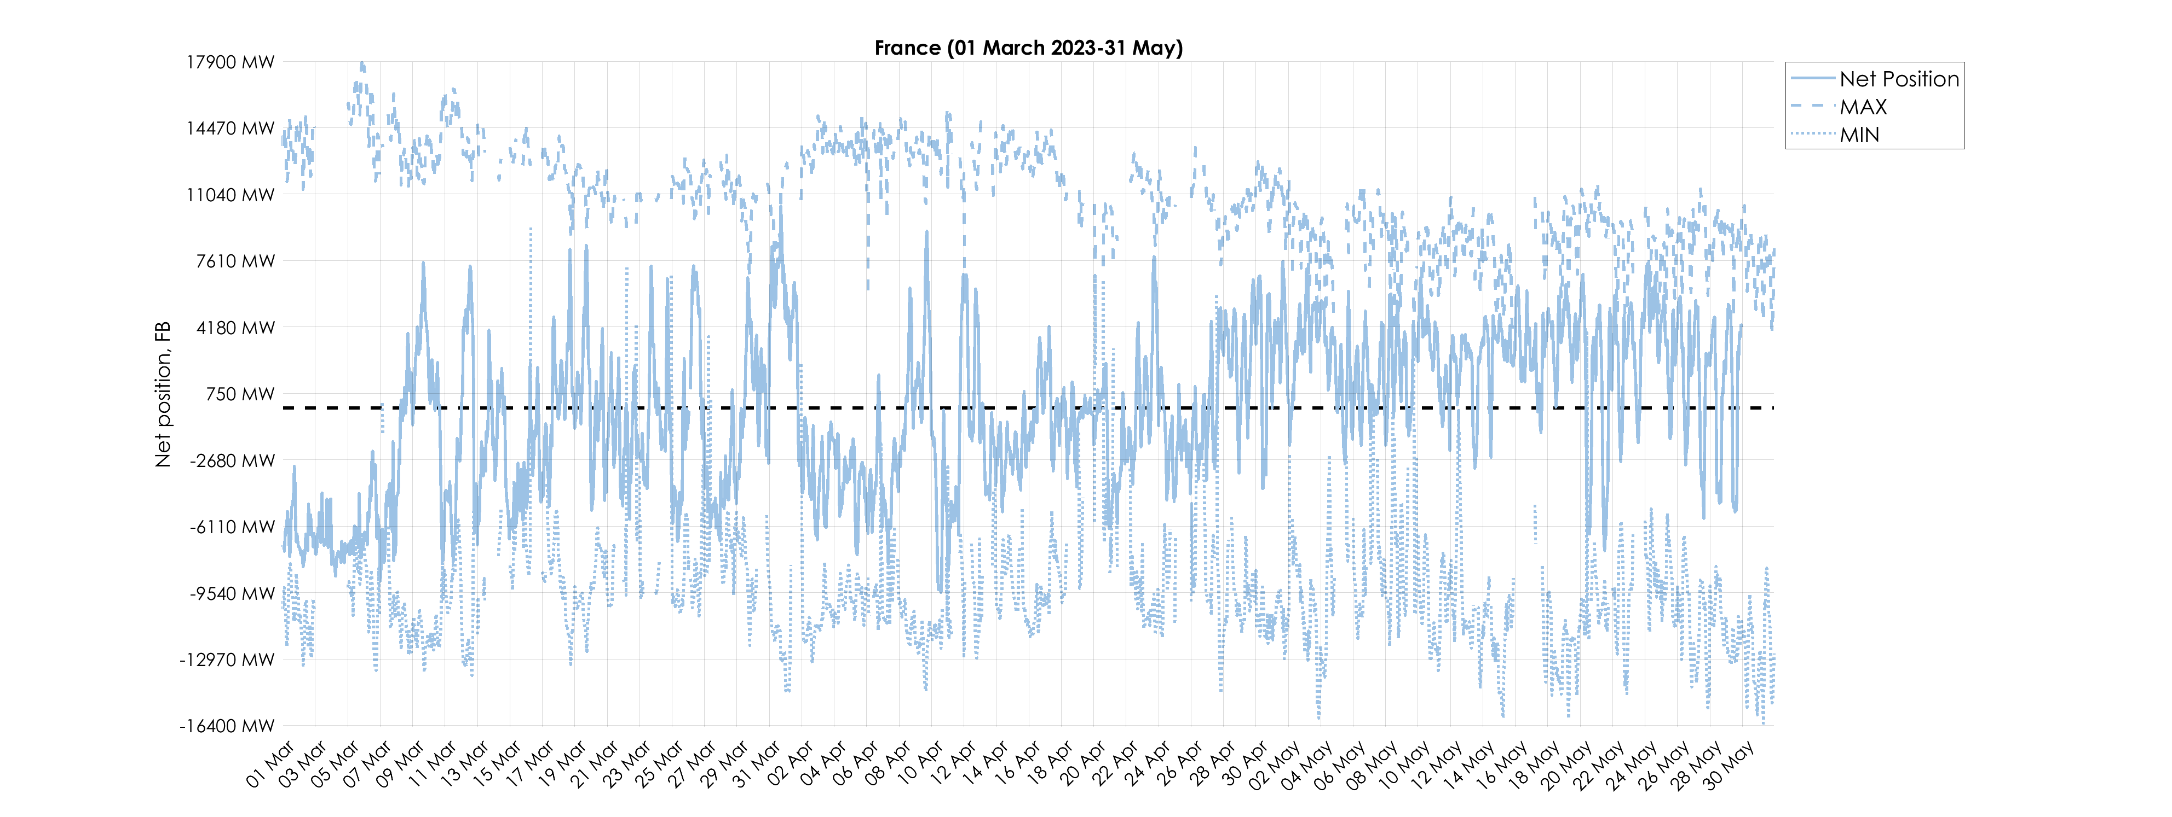
KPI 8 – Min and Max Net Positions per bidding zone
(a) Based on final FB domain
Missing values of min and max net positions for some timestamps are caused by empty domains.
(Data sources: F832 - Final AAC for FB NP and F818 - MIN/MAX Net position )

Slide 48
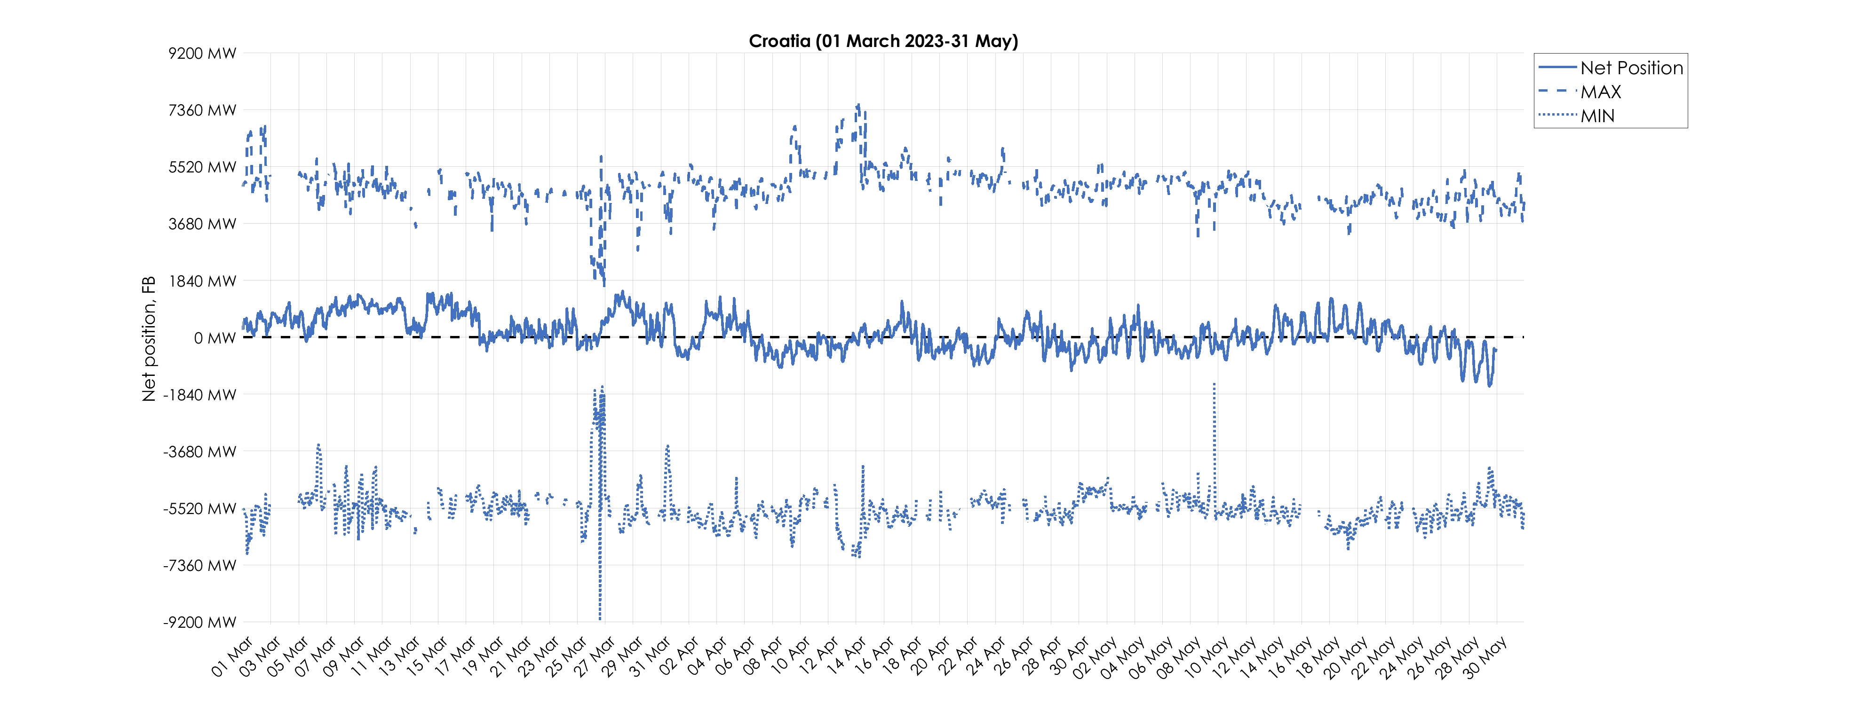
KPI 8 – Min and Max Net Positions per bidding zone
(a) Based on final FB domain
Missing values of min and max net positions for some timestamps are caused by empty domains.
(Data sources: F832 - Final AAC for FB NP and F818 - MIN/MAX Net position )

Slide 49
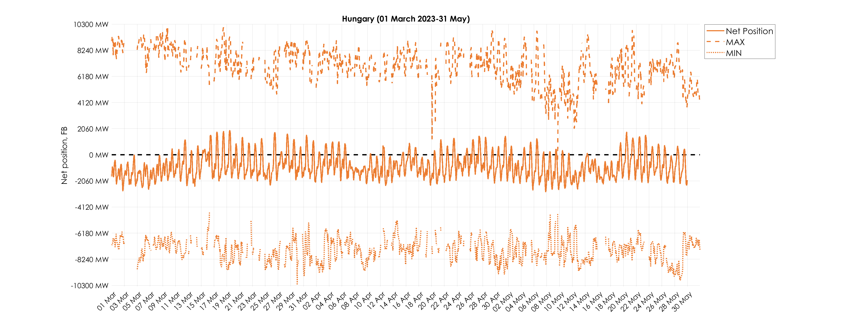
KPI 8 – Min and Max Net Positions per bidding zone
(a) Based on final FB domain
Missing values of min and max net positions for some timestamps are caused by empty domains.
(Data sources: F832 - Final AAC for FB NP and F818 - MIN/MAX Net position )

Slide 50
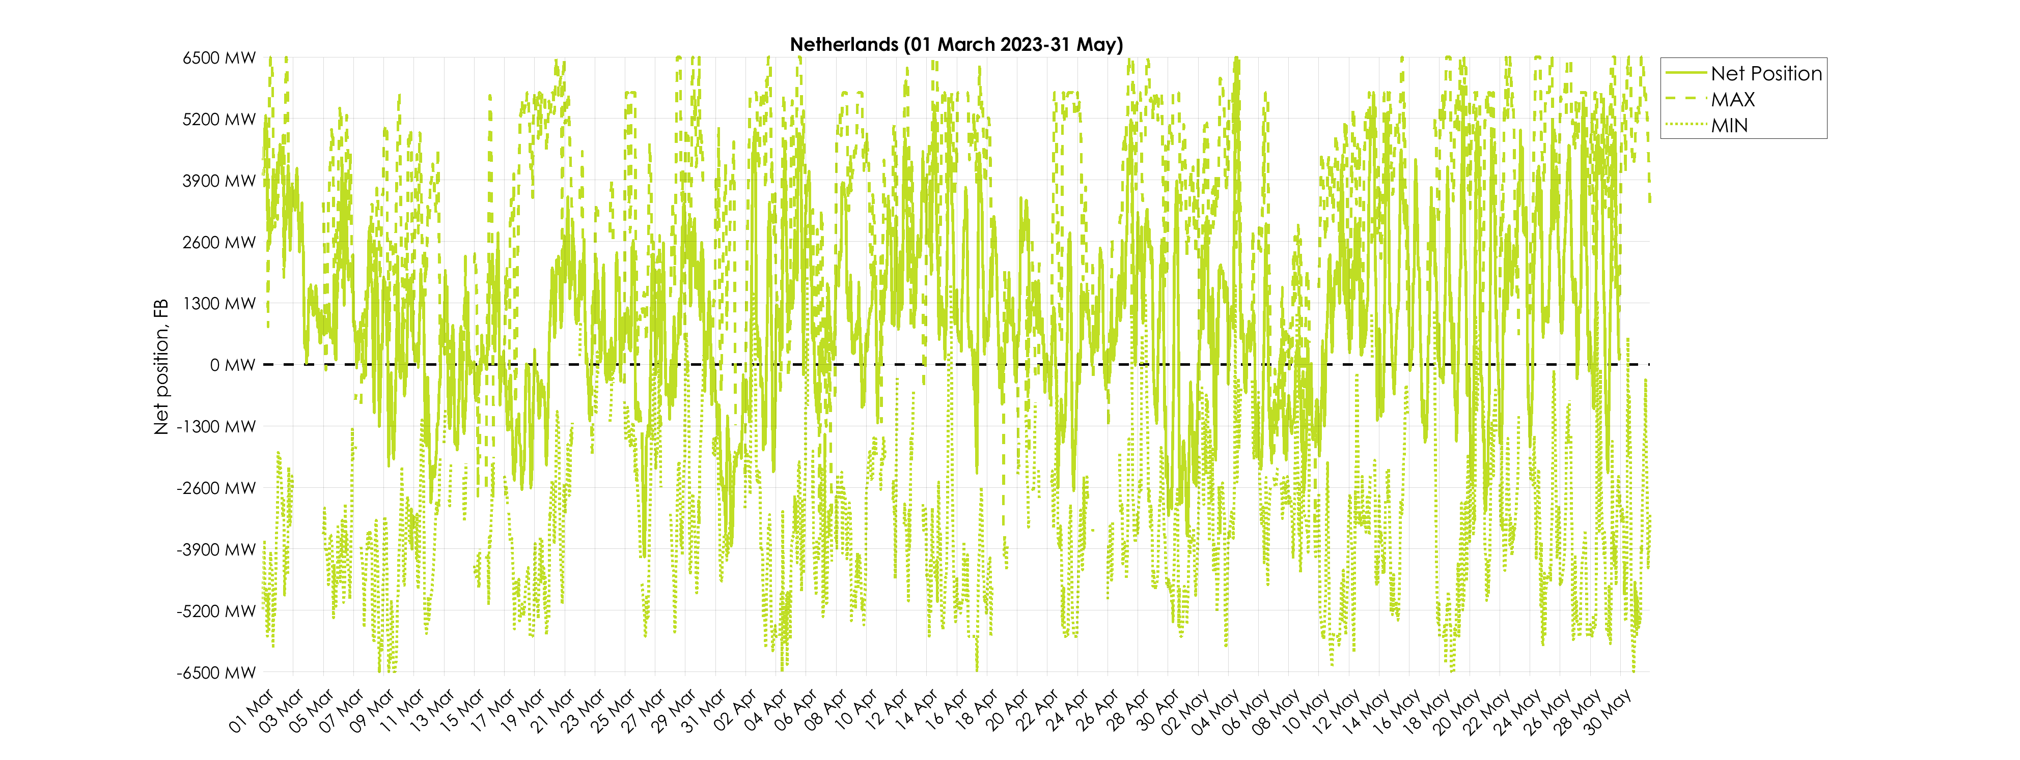
KPI 8 – Min and Max Net Positions per bidding zone
(a) Based on final FB domain
Missing values of min and max net positions for some timestamps are caused by empty domains.
(Data sources: F832 - Final AAC for FB NP and F818 - MIN/MAX Net position )

Slide 51
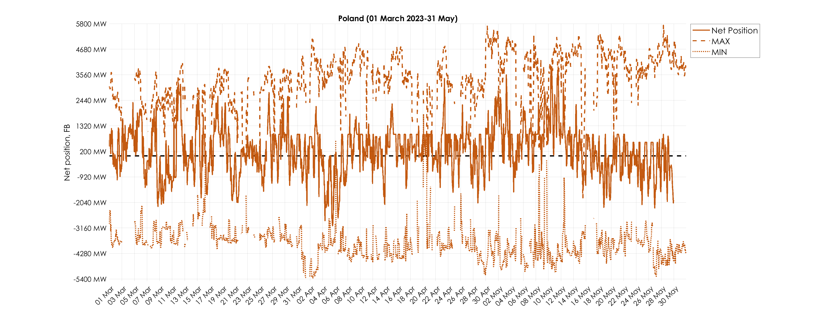
KPI 8 – Min and Max Net Positions per bidding zone
(a) Based on final FB domain
Missing values of min and max net positions for some timestamps are caused by empty domains.
(Data sources: F832 - Final AAC for FB NP and F818 - MIN/MAX Net position )

Slide 52
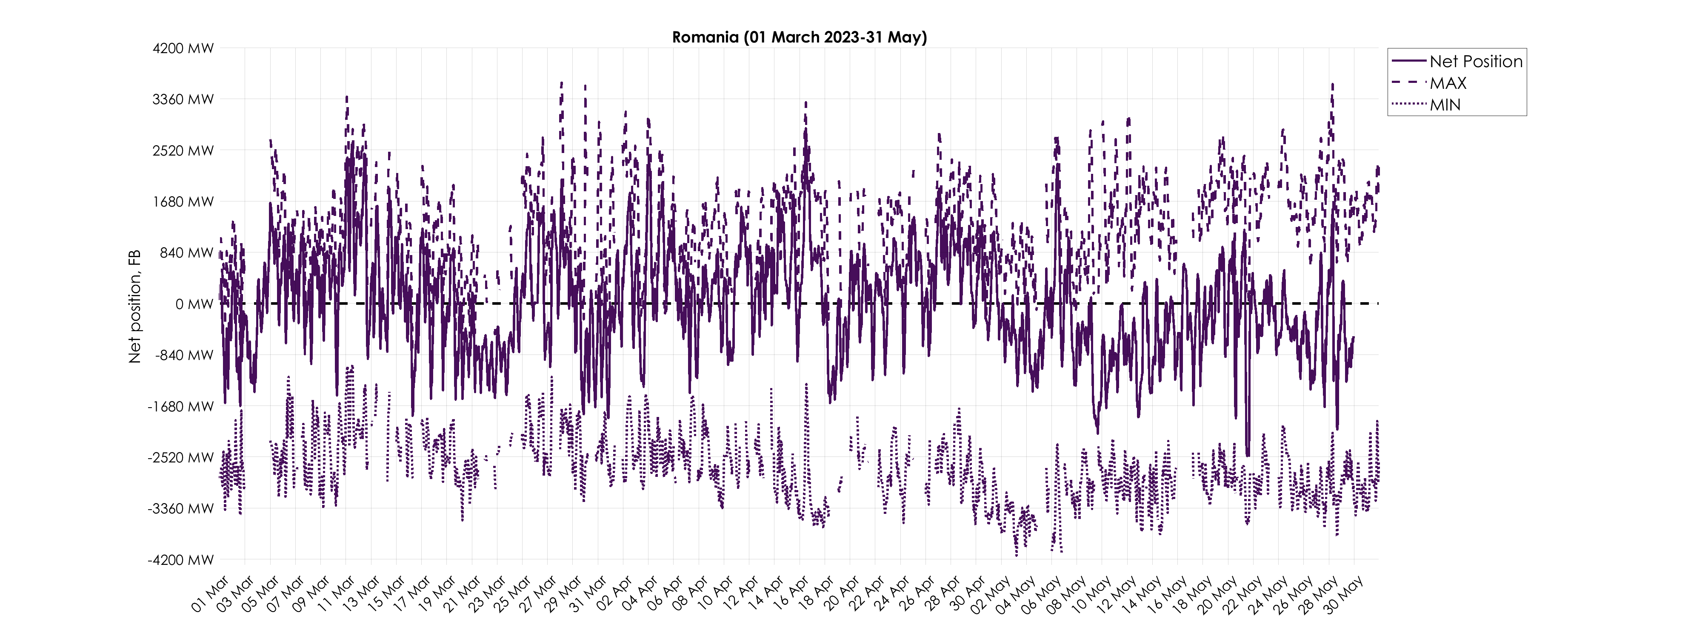
KPI 8 – Min and Max Net Positions per bidding zone
(a) Based on final FB domain
Missing values of min and max net positions for some timestamps are caused by empty domains.
(Data sources: F832 - Final AAC for FB NP and F818 - MIN/MAX Net position )

Slide 53
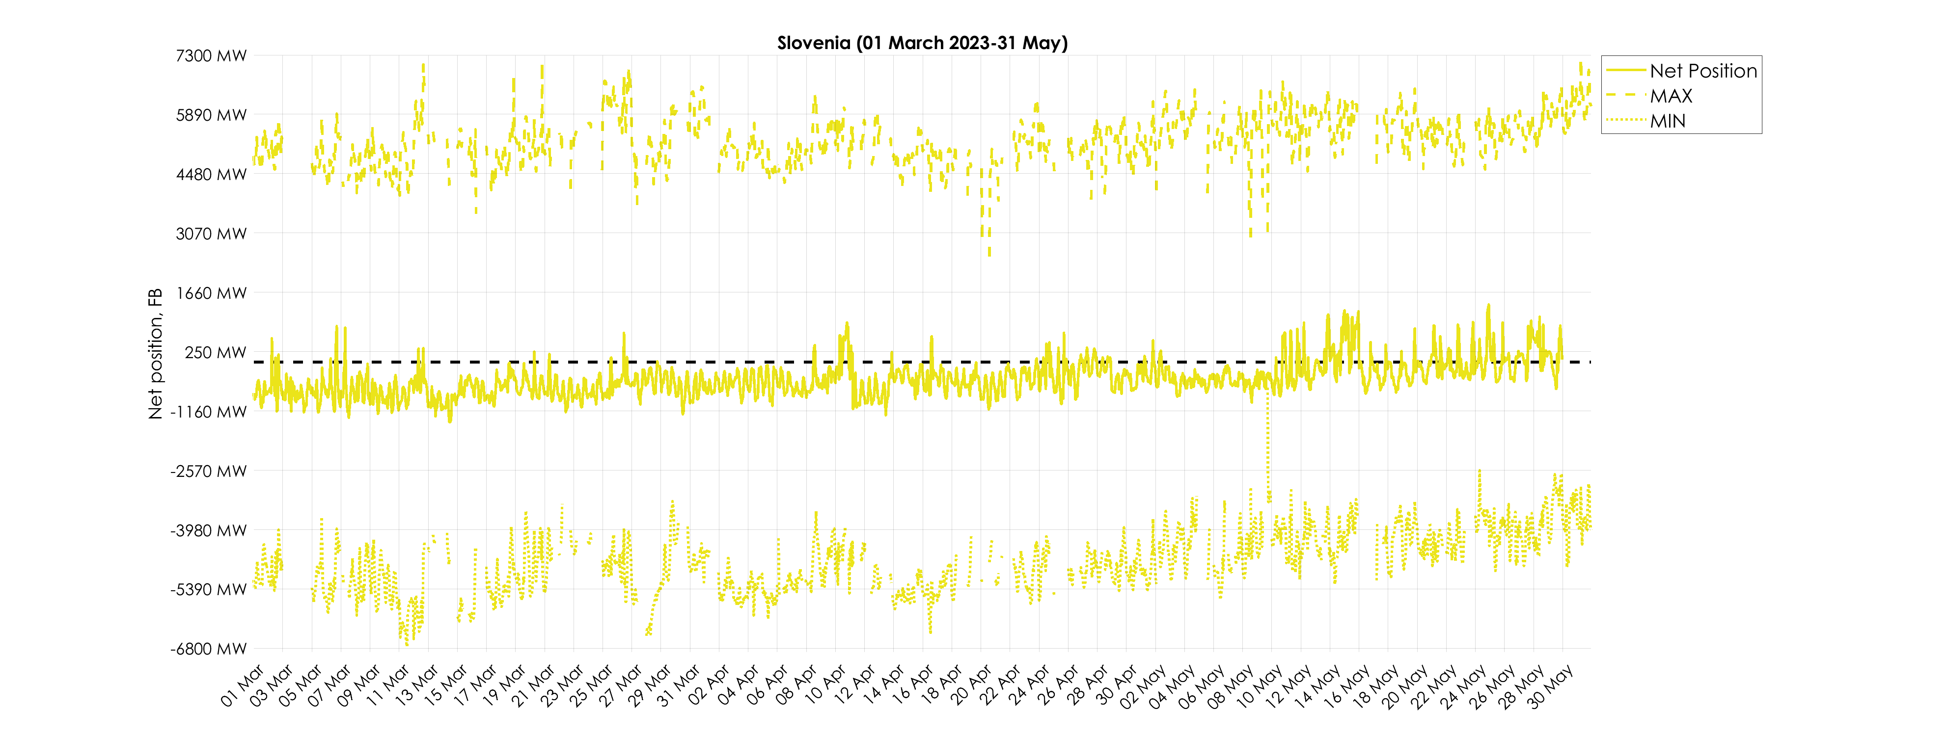
KPI 8 – Min and Max Net Positions per bidding zone
(a) Based on final FB domain
Missing values of min and max net positions for some timestamps are caused by empty domains.
(Data sources: F832 - Final AAC for FB NP and F818 - MIN/MAX Net position )

Slide 54
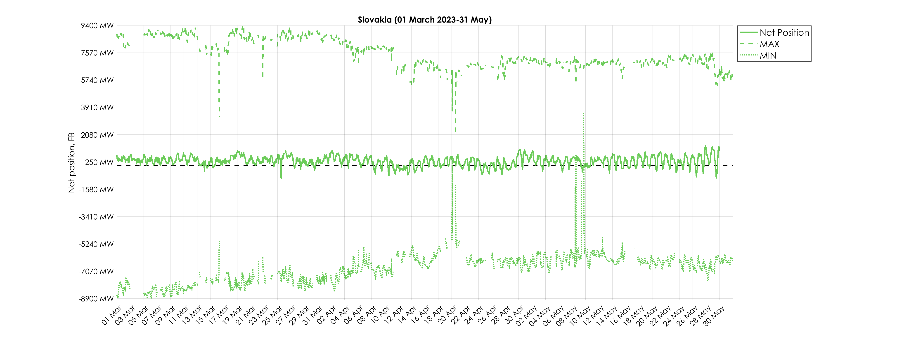
KPI 8 – Min and Max Net Positions per bidding zone
(a) Based on final FB domain
Missing values of min and max net positions for some timestamps are caused by empty domains.
(Data sources: F832 - Final AAC for FB NP and F818 - MIN/MAX Net position )

Slide 55
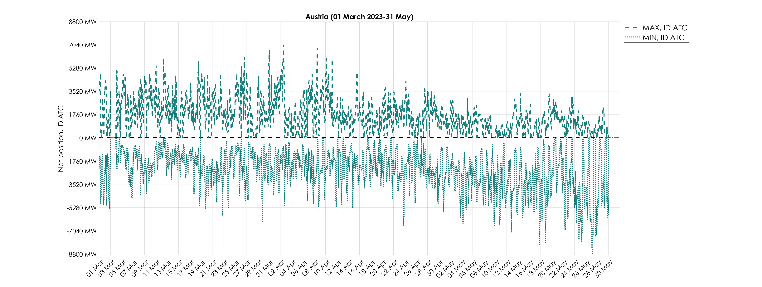
KPI 8 – Min and Max Net Positions per bidding zone
(b) Based on final ID ATC
(Data sources: F922 - Final ATC )

Slide 56

KPI 8 – Min and Max Net Positions per bidding zone
(b) Based on final ID ATC
(Data sources: F922 - Final ATC )

Slide 57

KPI 8 – Min and Max Net Positions per bidding zone
(b) Based on final ID ATC
(Data sources: F922 - Final ATC )

Slide 58

KPI 8 – Min and Max Net Positions per bidding zone
(b) Based on final ID ATC
(Data sources: F922 - Final ATC )

Slide 59

KPI 8 – Min and Max Net Positions per bidding zone
(b) Based on final ID ATC
(Data sources: F922 - Final ATC )

Slide 60

KPI 8 – Min and Max Net Positions per bidding zone
(b) Based on final ID ATC
(Data sources: F922 - Final ATC )

Slide 61

KPI 8 – Min and Max Net Positions per bidding zone
(b) Based on final ID ATC
(Data sources: F922 - Final ATC )

Slide 62

KPI 8 – Min and Max Net Positions per bidding zone
(b) Based on final ID ATC
(Data sources: F922 - Final ATC )

Slide 63

KPI 8 – Min and Max Net Positions per bidding zone
(b) Based on final ID ATC
(Data sources: F922 - Final ATC )

Slide 64

KPI 8 – Min and Max Net Positions per bidding zone
(b) Based on final ID ATC
(Data sources: F922 - Final ATC )

Slide 65

KPI 8 – Min and Max Net Positions per bidding zone
(b) Based on final ID ATC
(Data sources: F922 - Final ATC )

Slide 66

KPI 8 – Min and Max Net Positions per bidding zone
(b) Based on final ID ATC
(Data sources: F922 - Final ATC )

