Slide 1
Quarterly JAO Open Call 18.02.2025
Our client's satisfaction is critical for us.

Slide 2
Introduction

Slide 3
Agenda
1. Retrospection
2. New Service Desk Concept
3. Finance related updates
4. Changes and Improvements
5. Auction Calendar
6. User Group Updates
7. Q & A

Slide 4
Retrospection DdoS Attack
JAO was not directly targeted as such but impacted as a consequence.
This incident was caused by a type of cyberattack called Distributed Denial of Service (DDoS) targeting a full range of IP addresses used by our IT infrastructure service provider.
Traffic analysis confirmed that DDoS protection was active and prevented a larger outage.

Slide 5
Retrospection eCAT outage
On January 24th, 2025, at 09:41, the daily and intraday auction processes were disrupted due to issues with both the IT primary system and the switch to the backup system.
The incident caused system unavailability and operational delays. Back-up procedure was initiated by JAO and a second round for each affected auction was performed.

Slide 6
New Service Desk Concept
New Microsoft Dynamics based ticketing platform
Goals:
easy access for the customers via email
multi-level ticket handling
detailed customer feedbacks
Planned Go-live date: Q2 2025

Slide 7
Finance Related Updates
Inside Business Payment
Starting from June 1st, 2024, this is the sole method for processing fund transfers.
Credit Limit
Credit limit shall always be greater than zero (Article 19; 20; 21; 22 of the HAR)
Cash collateral and or Bank guarantee
Daily updates
10th Working day Self-billing – update the credit limit
16th Working day debit of the business accounts – update the credit limit

Slide 8
Finance Related Updates UIOSI – 15MTU
If the Power Exchange price file is submitted with 24 positions (60min MTU), nothing changes
If the Power Exchange price file is submitted with 96 positions (15min MTU), the compensation calculation will be based on 96 positions as well
The capacity will be replicated four times
Multiplied by each quarter of hour spread
Then divided by 4 to have the compensation amount for each quarter of hour.

Slide 9
Finance Related Updates UIOSO – 15MTU
60
MTU
15
MTU
Allocation * Spread/4
In Area-Out Area
Quarter of hour | Allocation Country A (MW) | Allocation Country B (MW) | PX price A (EUR/MWh) | PX price B (EUR/MWh) | Spread A>B (EUR/MWh) | Spread B>A (EUR/MWh) | UIOSI A>B (EUR) | UIOSI B>A (EUR)
Q1 | 100 | 100 | 70 | 40 | -30 | 30 | 0 | 750
Q2 | 100 | 100 | 70 | 80 | 10 | -10 | 250 | 0
Q3 | 100 | 100 | 70 | 30 | -40 | 40 | 0 | 1000
Q4 | 100 | 100 | 70 | 35 | -35 | 35 | 0 | 875
Total |  |  |  |  |  |  | 250 | 2625

Slide 10
Annual Survey
Changes and Improvements
Recap
Resale on French borders
Annual Survey
Envision multimedia-based expertise and cross-media growth strategies
Visualise quality intellectual capital
Engage worldwide methodologies with web-enabled technologies
Seasonal Auction for Nemolink
Pursue scalable customer service through sustainable strategies
Engage top-line web services with cutting-edge deliverables
Quarterly open tests

Slide 11
Auction Calendar
ES<>PT
EE->LV Q Base 1 – Q2 2025
Nemolink Y Base 11 2026
Eleclink Q Base 3 - Q2 2025
19.02.2025
27.02.2025
12.03.2025
25.02.2025
11.03.2025
13.03.2025
Eleclink H Base 1 Winter
Eleclink Y Base 1 - 2027
Vikinglink Q Base 2 – Q2 2025

Slide 12
Auction Calendar
Eleclink Q Base 1 – 2025 Q4
Eleclink Q Base 3 -2025 Q3
25.03.2025
02.04.2025
12.12.2024
26.03.2025
03.04.2025
Nemolink Y Base 6 -2026
IFA1 Q Base 3 -2025 Q3
Vikinglink Q Base 1 2025 Q3

Slide 13
Concept of the User Group
What is the User Group?
Purpose
The User group has been established to provide advice to JAO on matters related to the IT interfaces and services provided by JAO.
Enhancing our understanding to continuously improve our services.
How did it work?
Biannual meetings organized for a select group of market participants.

Slide 14
Evolution of the User Group
Bigger focus on operation matter
Involvement in test
Sharing best practice
Call for candidates

Slide 15
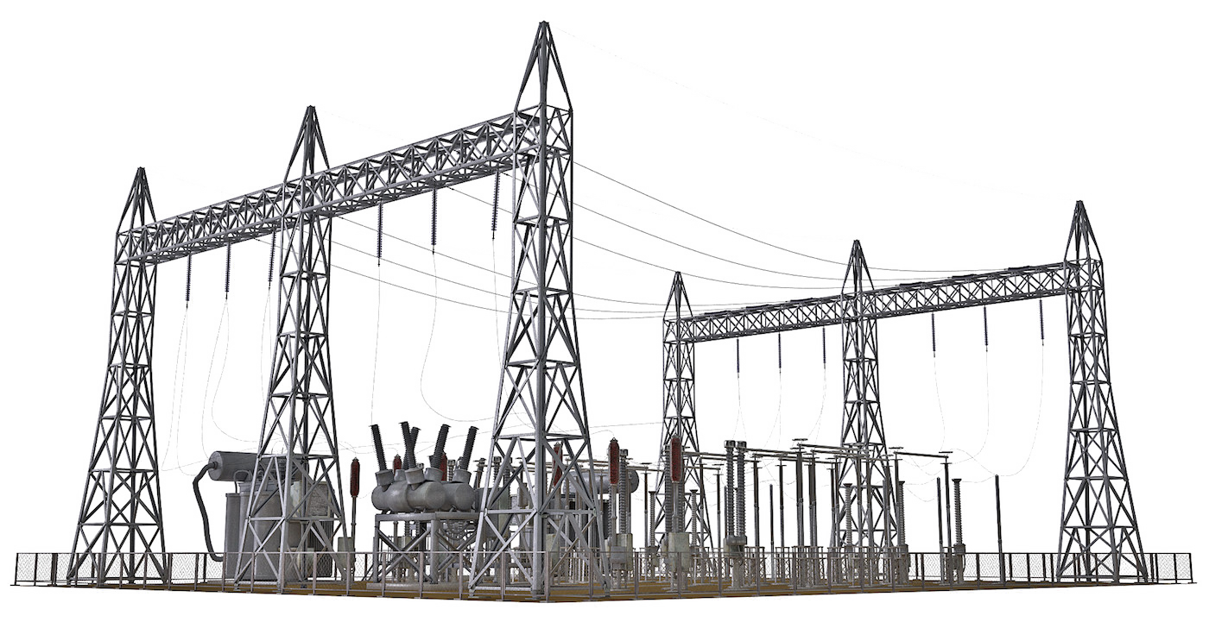
Q & A
Enel Global Trading:
UIOSI in case of 15 MTU Could you please provide a clear example of how the UIOSI will be evaluated under the new market conditions in the case of a 15-minute MTU? Additionally, for Physical Transmission Capacity, will it be possible to use the capacity for just 15 minutes instead of one hour? Moreover, for extra-EU capacity (borders with Serbia, Switzerland, or the UK), will it retain hourly granularity, or will it shift to 15-minute granularity?
SEFE Energy:
How can we find out when bids can be submitted in a test environment?
Exxon Mobile:
Remit Reporting for Priminary and Secondary allocations going forward. Will JAO confirm they report both on behalf of the TSO to ACER?
EDF Trading Ltd:
Are there any plans to introduce a JAO test environment? This will be very helpful especially with the new Helix platform going live.

Slide 16
Thank you!

