Slide 1
Core IDCC(c) Operational KPI report
External // run KPI report
Q1 2025: 17/12/2024 – 31/03/2025

Slide 2
External // run KPI report
Introduction, reporting period and limitations
Context
  According to Article 26(4) of the Core FB ID CCM, “Core TSOs shall continuously monitor the effects and the performance of the application of this methodology during the parallel run. And shall develop, in coordination with the Core regulatory authorities, the Agency and stakeholders, the monitoring and performance criteria and report on the outcome of this monitoring on quarterly basis in a report”.
  IDCC(c) external // run started on 17th of December 2024. The results of IDCC(c) have been published on [JAO website]
Reporting period
  This report covers 3.5 months (17/12/2024 – 31/03/2025) of IDCC(c) EXT //run results in the Core region.
  11 business days have been excluded from the computation of KPIs due to:
  For 4 business days the IDCC(c) process failed due to the merging package delivery. The implementation of an automatic merging solution is deployed since 13th February, and this issue is solved. For the rest of the excluded days, the problems identified were occasional and solved.
  For information, the business days with an IDCF of 1:15 instead of 2:15:
    29/12/2024, 30/12/2024, 09/01/2025, 17/01/2025, 23/01/2025, 24/01/2025, 30/03/2025
Disclaimers (if any)
  Until 07/03 the results are impacted by incorrect AACs due to incorrect MTU configuration for some border directions.
  TSOs are still developing their individual validation tools. ĆEPS, Elia, RTE, SEPS perform validation (Status on 02/04)
BD | Reason | Fallback/ Process failure
18/12/2024 | Manual selection of CGM of the incorrect BD | DA Domain AAC Fallback
26/12/2024 | Isolated issue with duplicated merging request
28/12/2024 | Merging package delivery failed
23/01/2025 | 15 min MTU go-live FR borders – rejected AACs | Process failure
04/02/2025 | Merging package delivery failed | DA Domain AAC Fallback
07/03/2025 | Viking link configuration missing in new tool version
BD | Reason | Fallback/ Process failure
14/03/2025 | XBID integration testing – rejected merging package but delivered timely | DA Domain AAC Fallback
19/03/2025 | AAC incorrect time resolution | N/A
22/03/2025 | Failure to receive AAC timely | Process failure
28/03/2025 | Excluded for the KPIs 2A, 3A and 4A because IDCC(b) process failure – No comparison possible
30/03/2025 | Hour change - Clock change issue | N/A

Slide 3
External // run KPI report
Overview of the KPIs covered during the // run
ATC related KPIs
    Duration curve of Number of Core Oriented Bidding Zone Borders with Zero or Negative ID ATCs​
    Frequency of Zero and Negative ID ATCs by Oriented Core Bidding Zone Border​
      Delta comparison with IDCC(b) run at ~4:30
    Frequency of isolated Core Bidding Zones of zero (or negative) ID ATCs in import, export and both directions​
      Delta comparison with IDCC(b) run at ~4:30
    Mean positive ID ATCs by Oriented Core Bidding Zone Border
      Delta comparison with IDCC(b) run at ~4:30
    TSOs’ adjustment after validation
    Share of MTUs with intervention during IVA validation per TSO (IVA aggregations per TSO)
    Limiting elements
    Limiting constraints of the ATC domain​
      20 most limiting ATC constraints
      Mean and Max of ATC limiting constraints
      Mean and Max of ATC limiting constraints per TSO
      ATC Based Validation - Aggregations
    Most often used pre-solved CNECs​
      20 most limiting pre-solved constraints
      Mean and Max of pre-solved constraints
      Mean and Max of pre-solved constraints per TSO
    Net positions
    Min and Max Net Positions per Bidding Zone​
      Based on final FB domain
      Based on final ID ATC
    Reading Guide with a detail description of the KPIs available on [JAO]
Included only as of IDCC(c) go-live date

Slide 4
External // run KPI report
Conclusions
  Core TSOs are glad to report the current process stability with ~92% of business days successfully completed.
  According to the ATC related KPIs (ATCs, bidding zone isolation), which compare the available cross-zonal capacities at ~4:30 with and without IDCC(c) run, there is an overall "reflow" effect of the IDCC(c) calculation, in which the available capacity domain space is redistributed across all borders.
  This results in a lower negative or zero ATC frequency, which leads to less bidding zone isolation frequency. A general decrease of negative ATCs and of bidding zone isolation, means reopening border directions in the IDCC(c) calculation, which were closed during IDCC(b) for longer periods. This decreases the ID ATC levels on other borders (those who would be used if the considered borders were not reopened). Instead of less often open border directions, these are more often open with in general a bit less positive ID ATCs everywhere else.
  In short the available capacities are redistributed around the market point, or "reflowed" as we call it.
  This effect has been quite stable since the start of the parallel run and was expected by experts. It is thus concluded that the parallel run is going according to expectations.
  Disclaimer: not all TSO's have started performing the individual validation step. This will be resolved soon Core TSOs deem the current // run results representative, thus no significant impact is expected from the deployment of individual validation

Slide 5
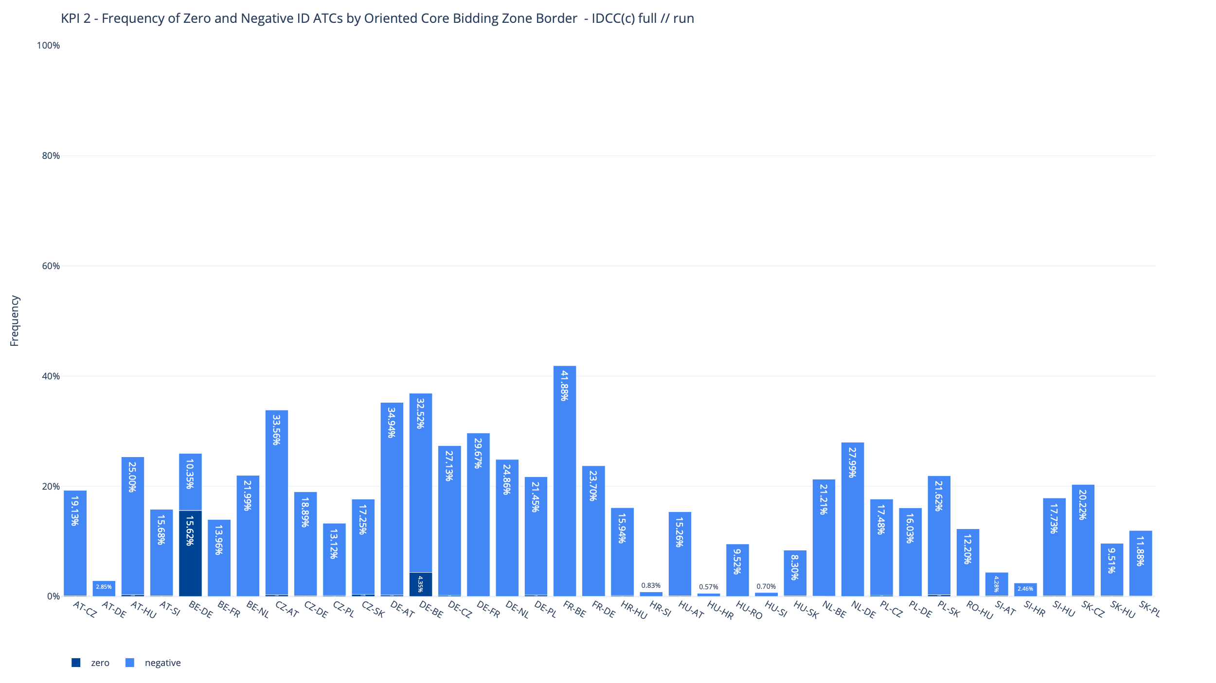
KPI 2
Frequency of Zero and Negative ID ATCs by Oriented Core Bidding Zone Border​

Slide 6
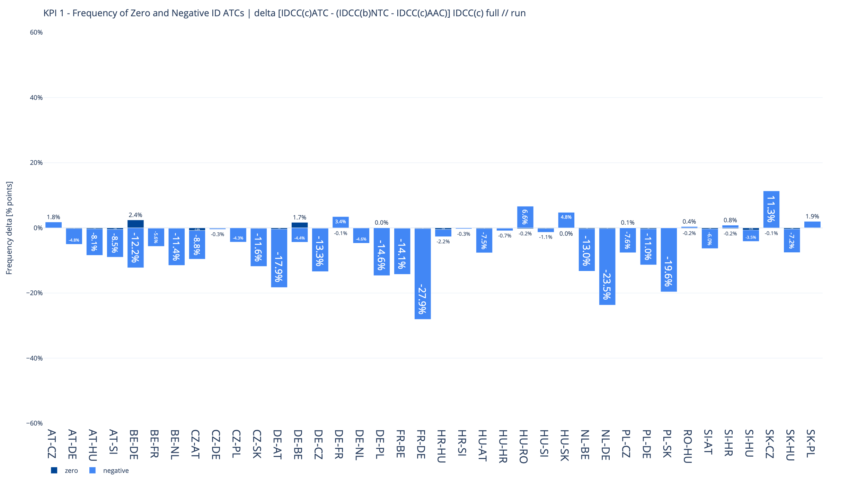
KPI 2A - Delta comparison with IDCC(b) run at ~4:30
Frequency of Zero and Negative ID ATCs by Oriented Core Bidding Zone Border​

Slide 7
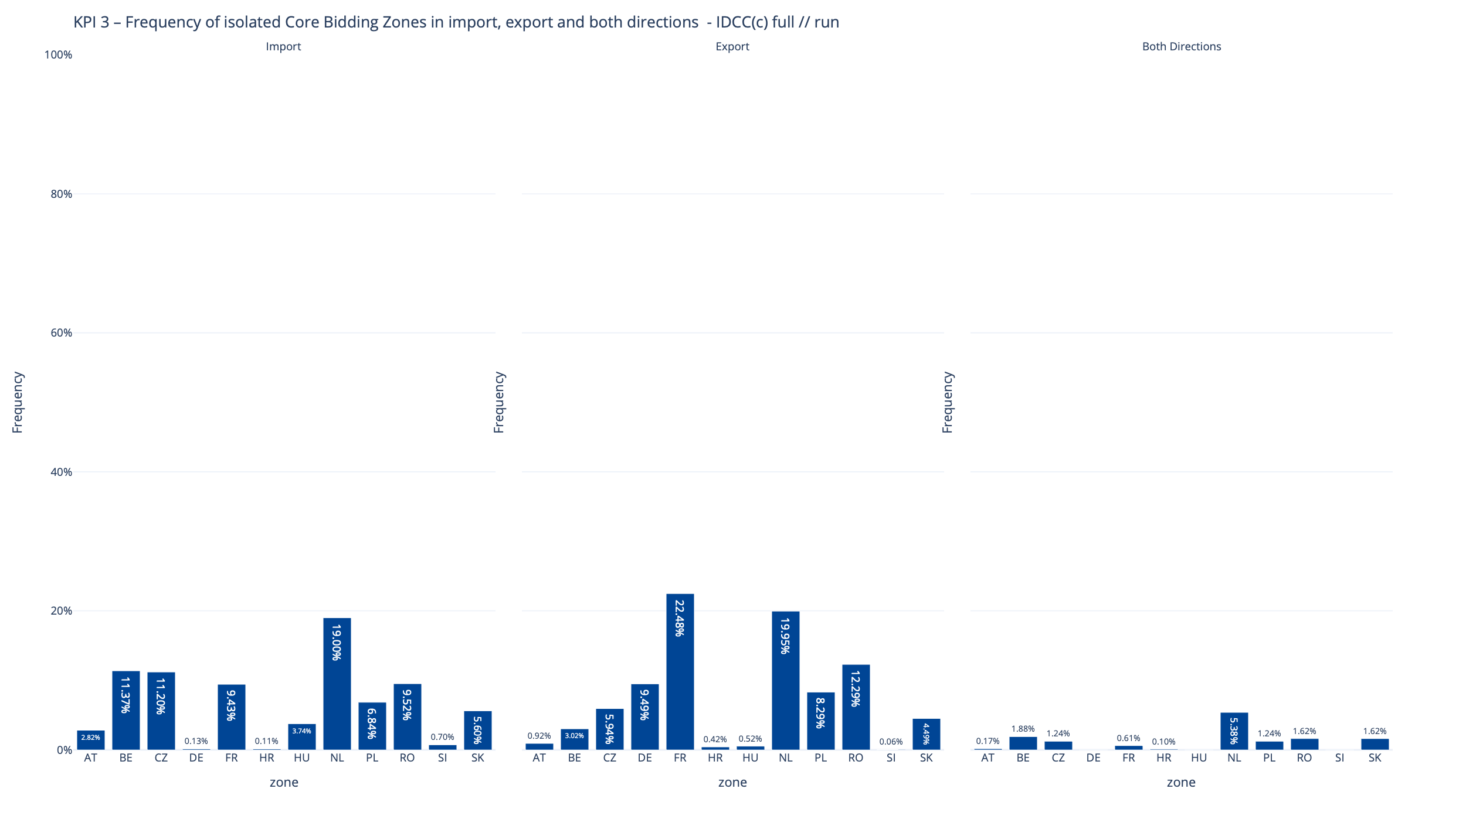
KPI 3
Frequency of isolated Core Bidding Zones of zero (or negative) ID ATCs in import, export and both directions ​​

Slide 8
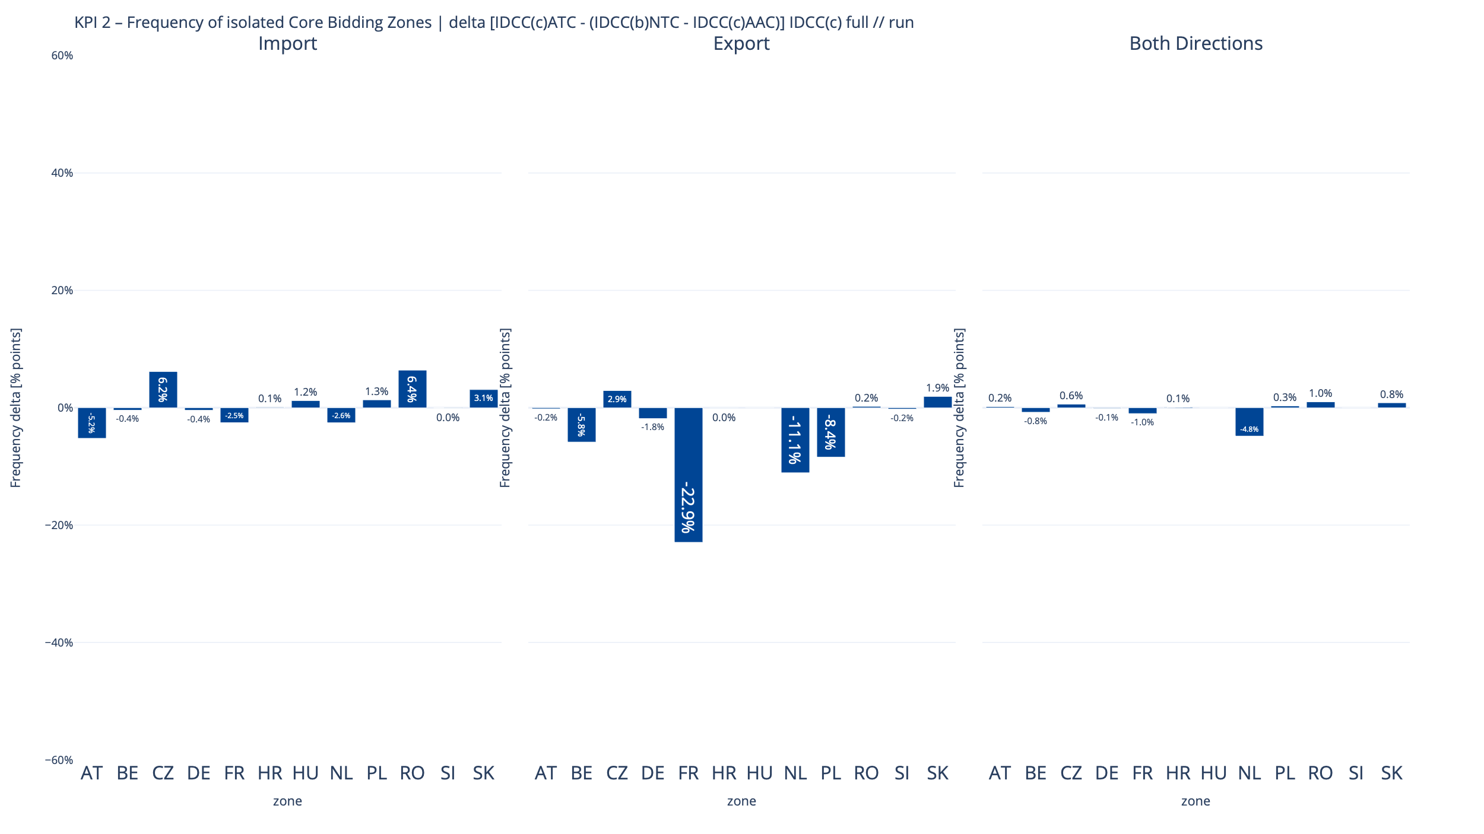
KPI 3A - Delta comparison with IDCC(b) run at ~4:30
Frequency of isolated Core Bidding Zones of zero (or negative) ID ATCs in import, export and both directions ​​

Slide 9
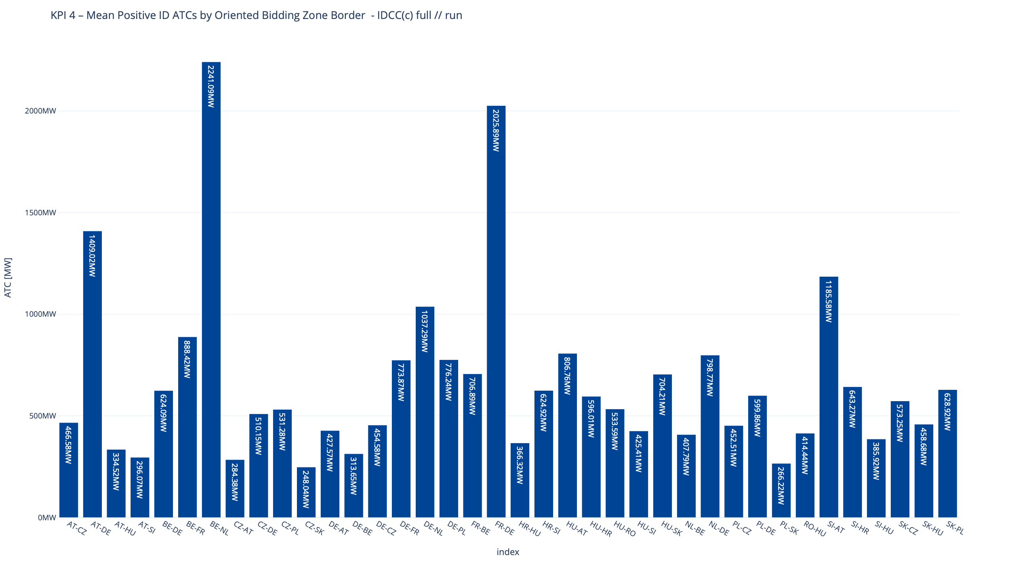
KPI 4
Mean positive ID ATCs by Oriented Core Bidding Zone Border

Slide 10
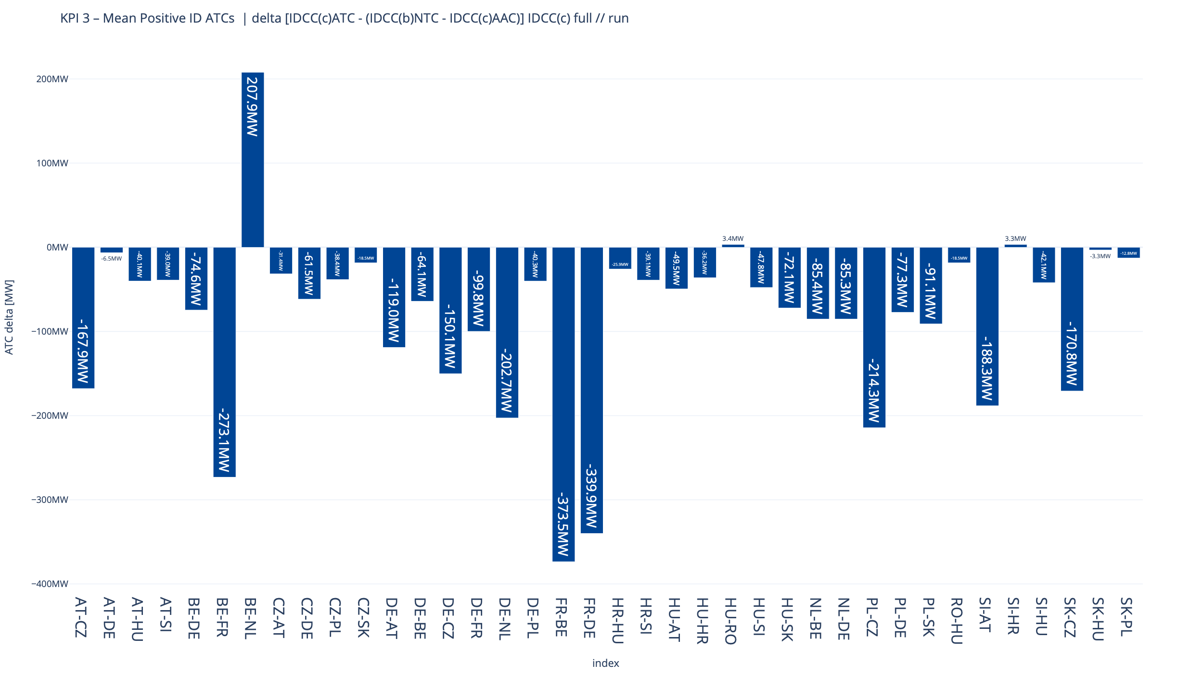
KPI 4A - Delta comparison with IDCC(b) run at ~4:30
Mean positive ID ATCs by Oriented Core Bidding Zone Border

Slide 11
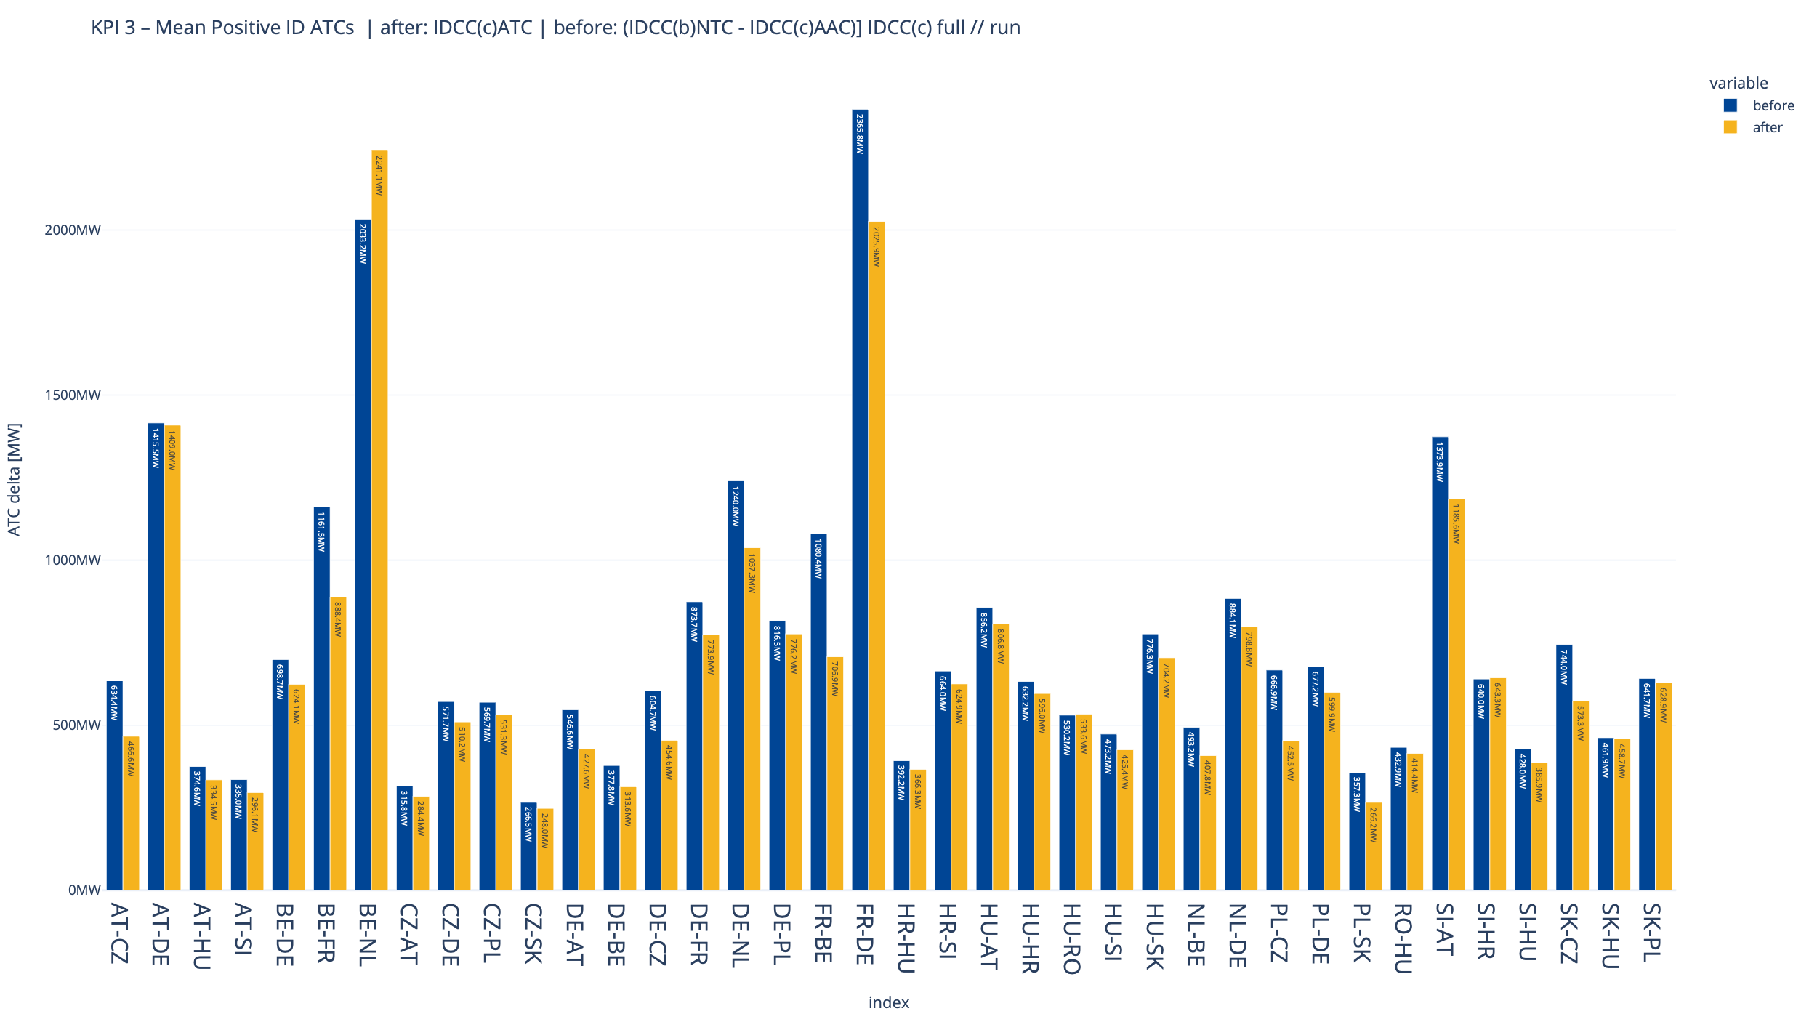
KPI 4A - Delta comparison with IDCC(b) run at ~4:30
Mean positive ID ATCs by Oriented Core Bidding Zone Border

Slide 12
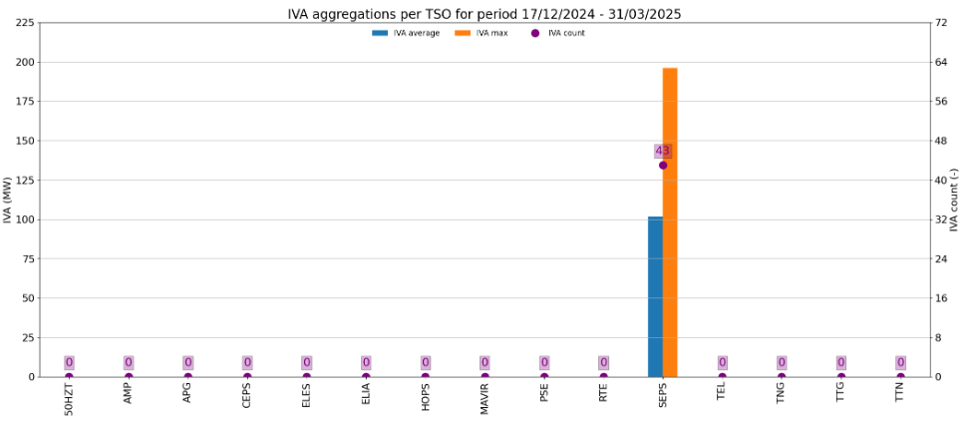
KPI 5
Share of MTUs with intervention during IVA validation per TSO (IVA aggregations per TSO)

Slide 13
KPI 6A & 6B - Limiting constraints of the ATC domain​
20 most limiting ATC constraints & Mean and Max of ATC limiting constraints

Slide 14
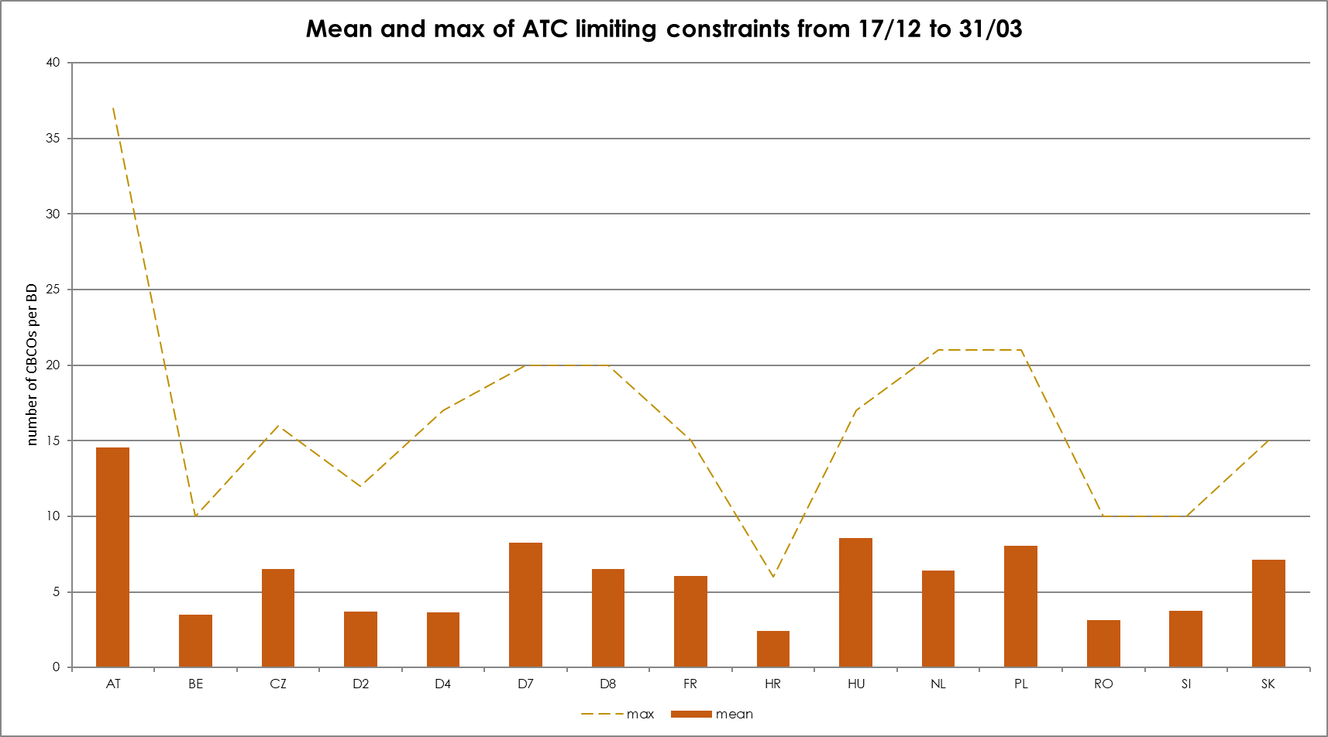
KPI 6A & 6B - Limiting constraints of the ATC domain​
20 most limiting ATC constraints & Mean and Max of ATC limiting constraints

Slide 15
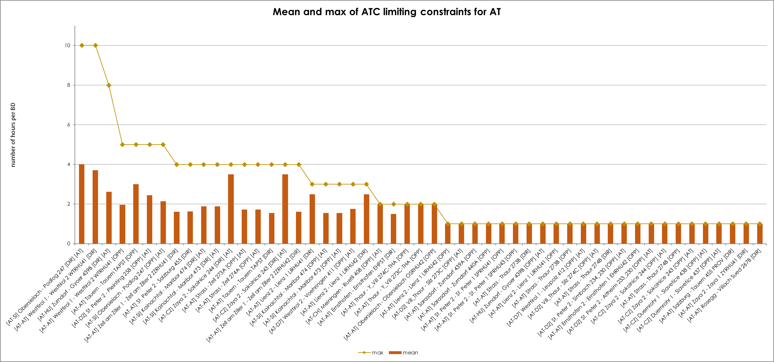
KPI 6C - Limiting constraints of the ATC domain​
Mean and Max of ATC limiting constraints per TSO - APG

Slide 16
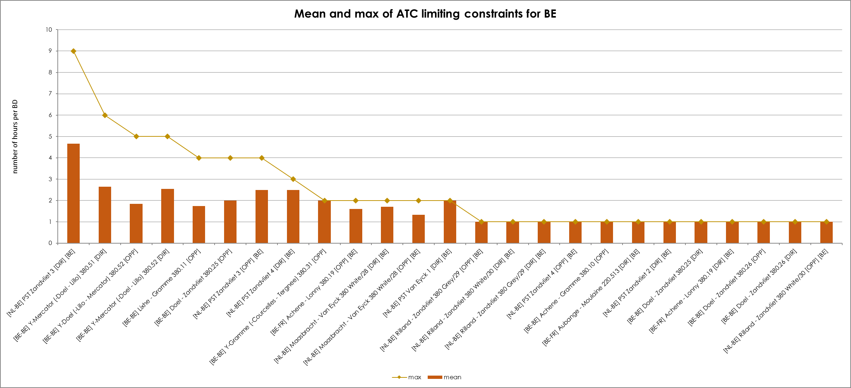
KPI 6C - Limiting constraints of the ATC domain​
Mean and Max of ATC limiting constraints per TSO - Elia

Slide 17
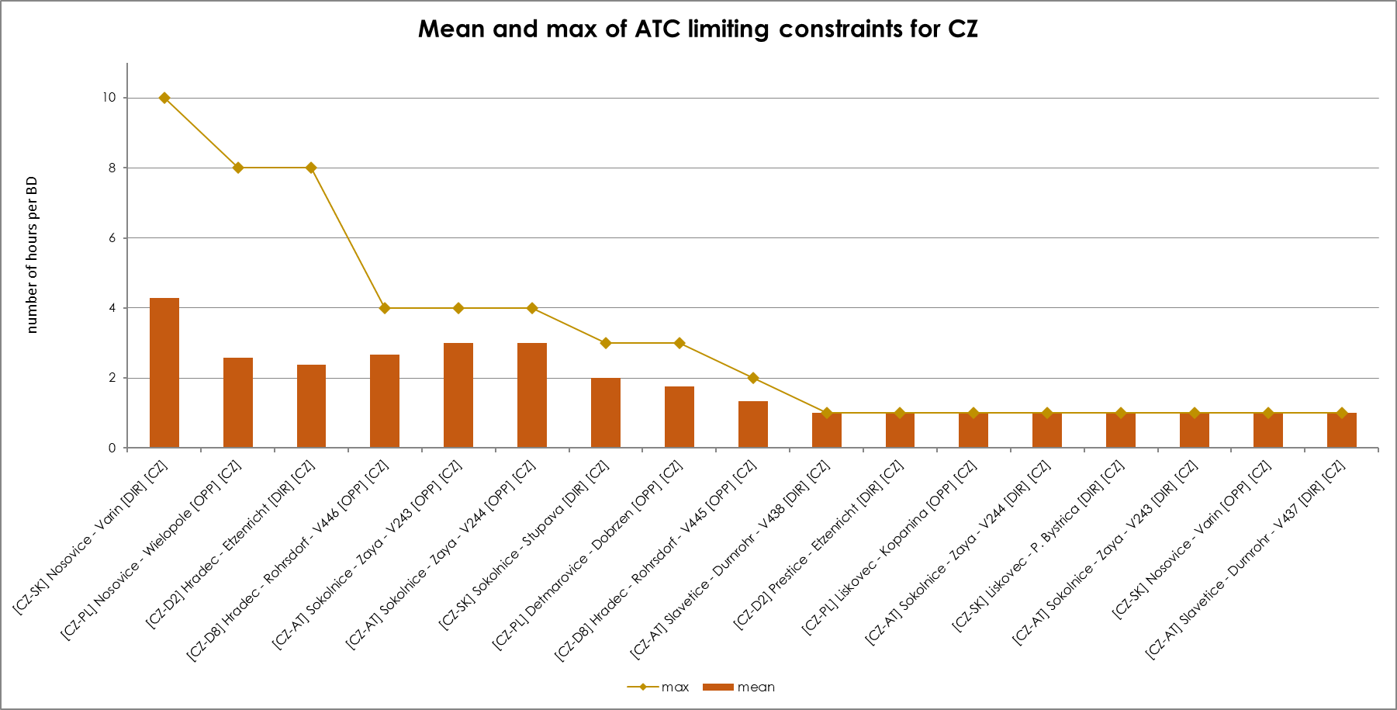
KPI 6C - Limiting constraints of the ATC domain​
Mean and Max of ATC limiting constraints per TSO – CEPS

Slide 18
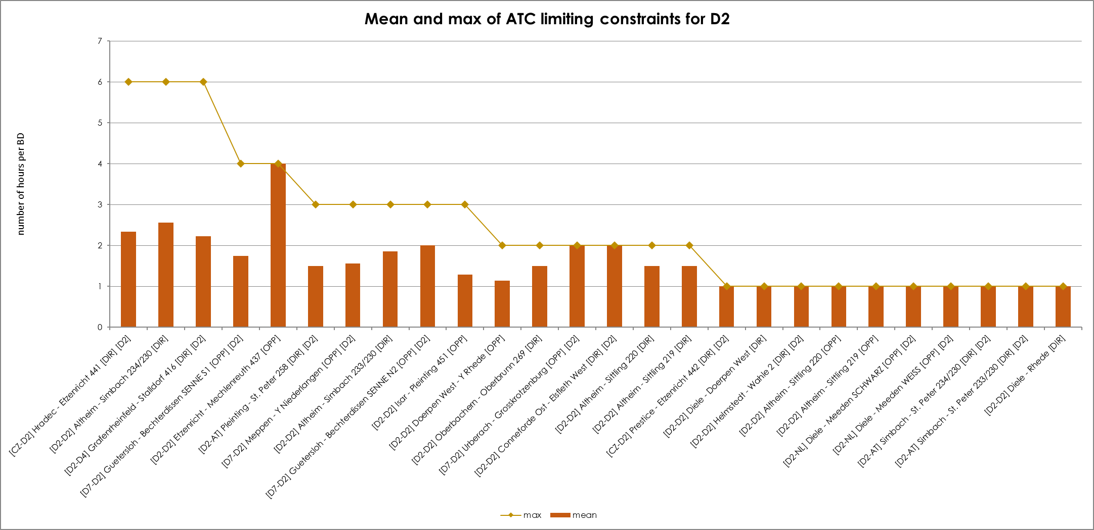
KPI 6C - Limiting constraints of the ATC domain​
Mean and Max of ATC limiting constraints per TSO – Tennet Germany

Slide 19
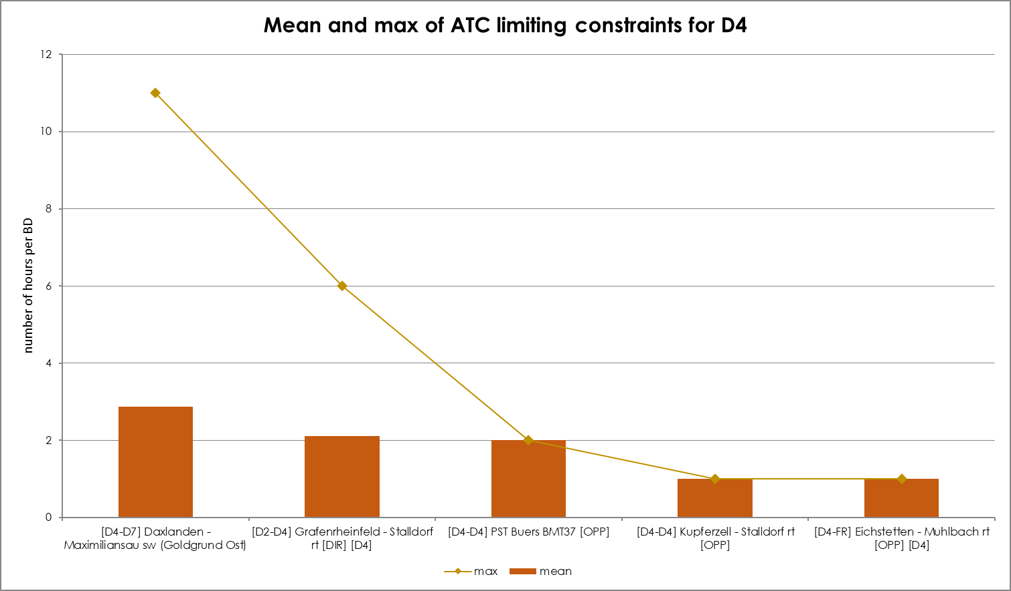
KPI 6C - Limiting constraints of the ATC domain​
Mean and Max of ATC limiting constraints per TSO – Transnet

Slide 20
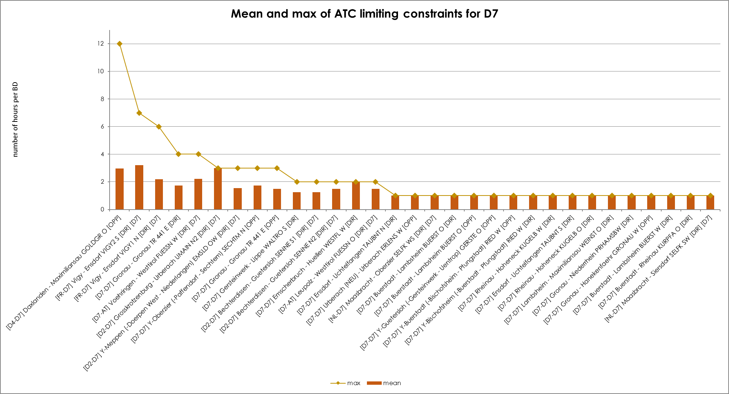
KPI 6C - Limiting constraints of the ATC domain​
Mean and Max of ATC limiting constraints per TSO – Amprion

Slide 21
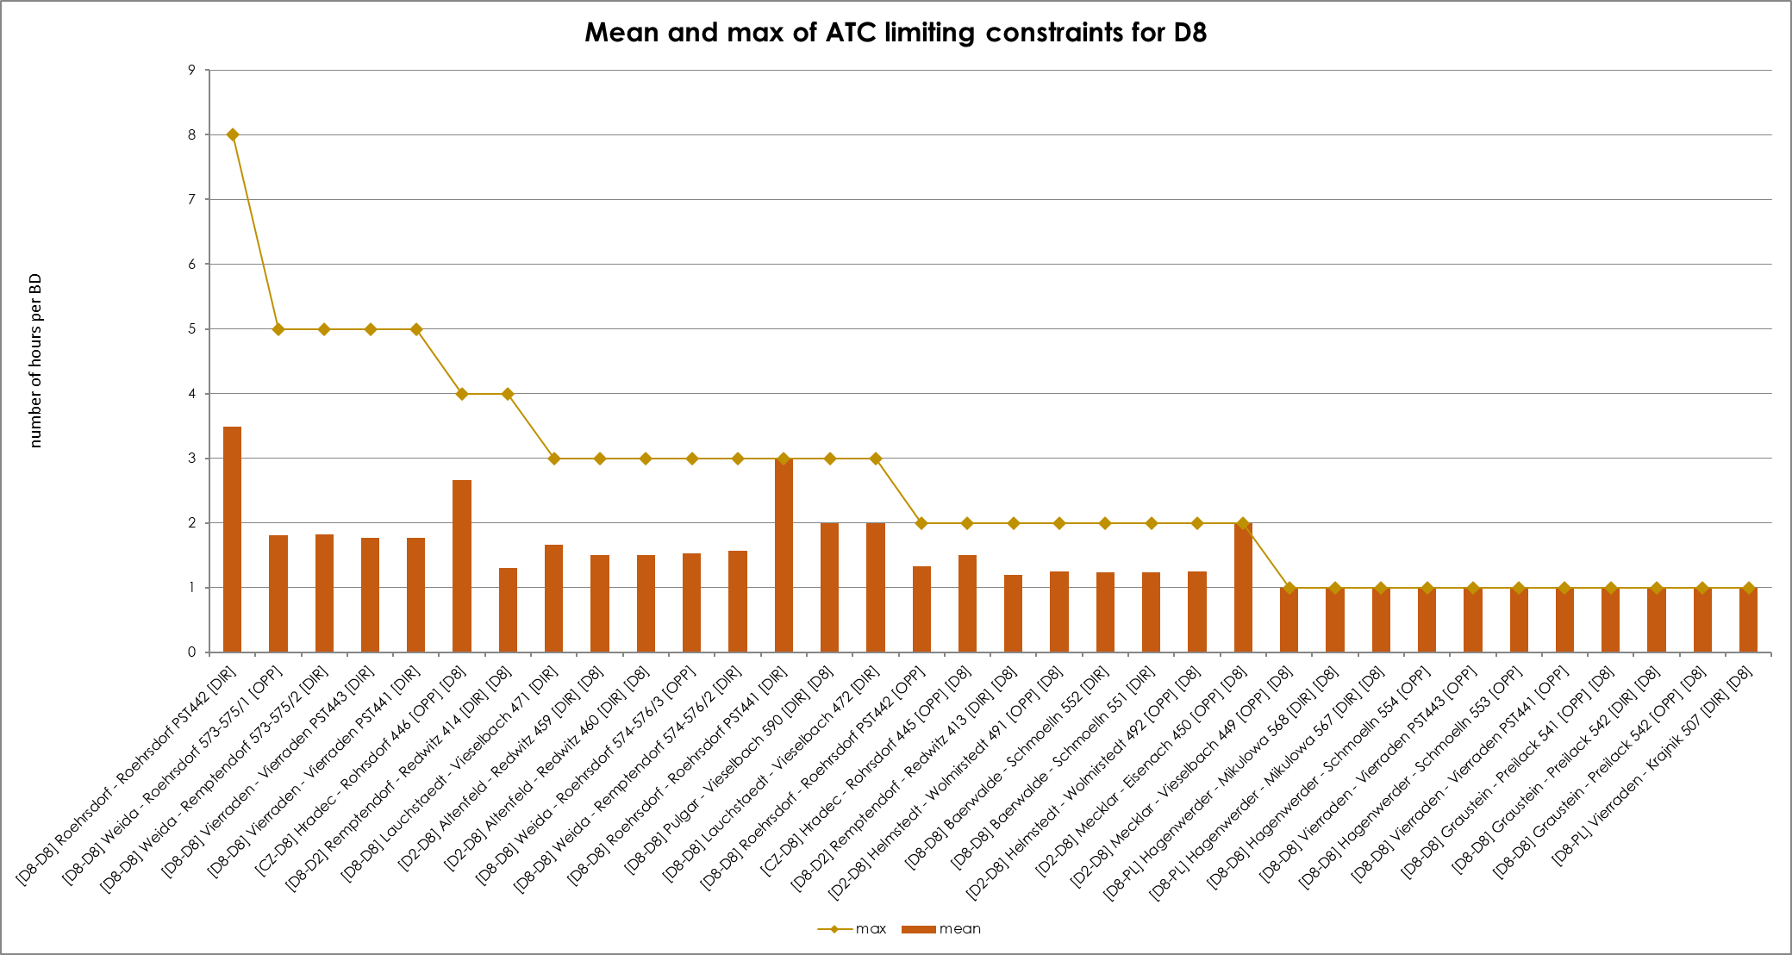
KPI 6C - Limiting constraints of the ATC domain​
Mean and Max of ATC limiting constraints per TSO – 50Hertz

Slide 22
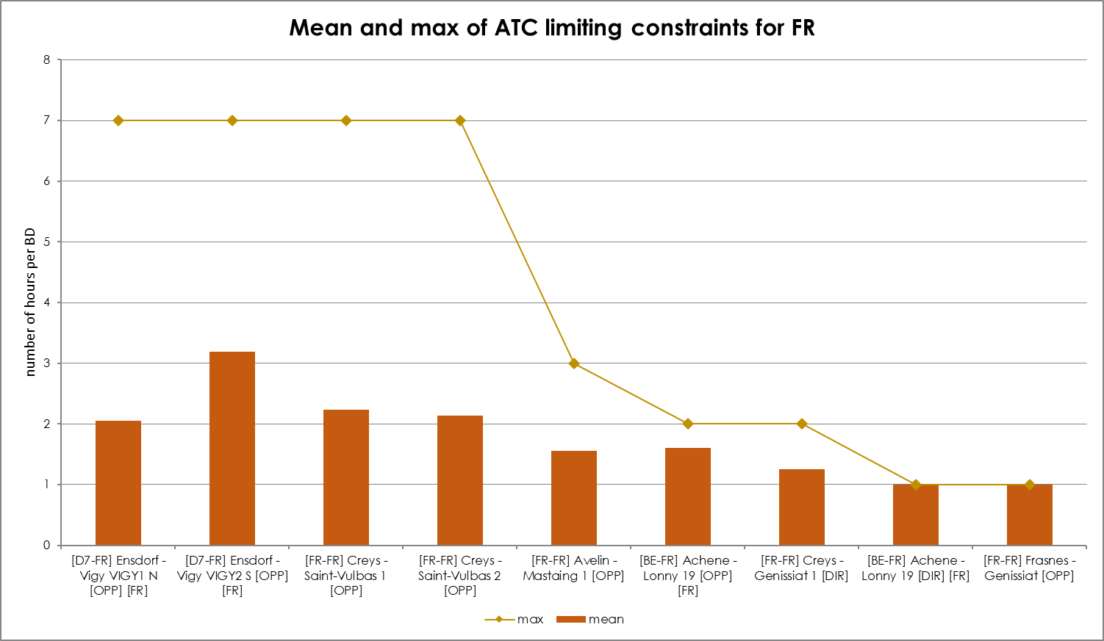
KPI 6C - Limiting constraints of the ATC domain​
Mean and Max of ATC limiting constraints per TSO – RTE

Slide 23
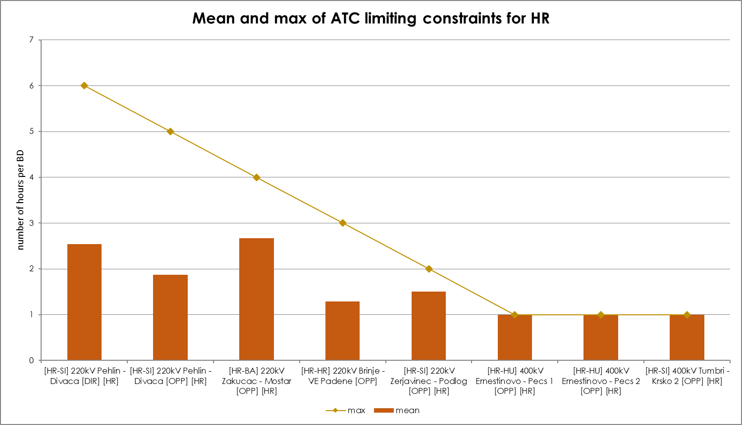
KPI 6C - Limiting constraints of the ATC domain​
Mean and Max of ATC limiting constraints per TSO – HOPS

Slide 24
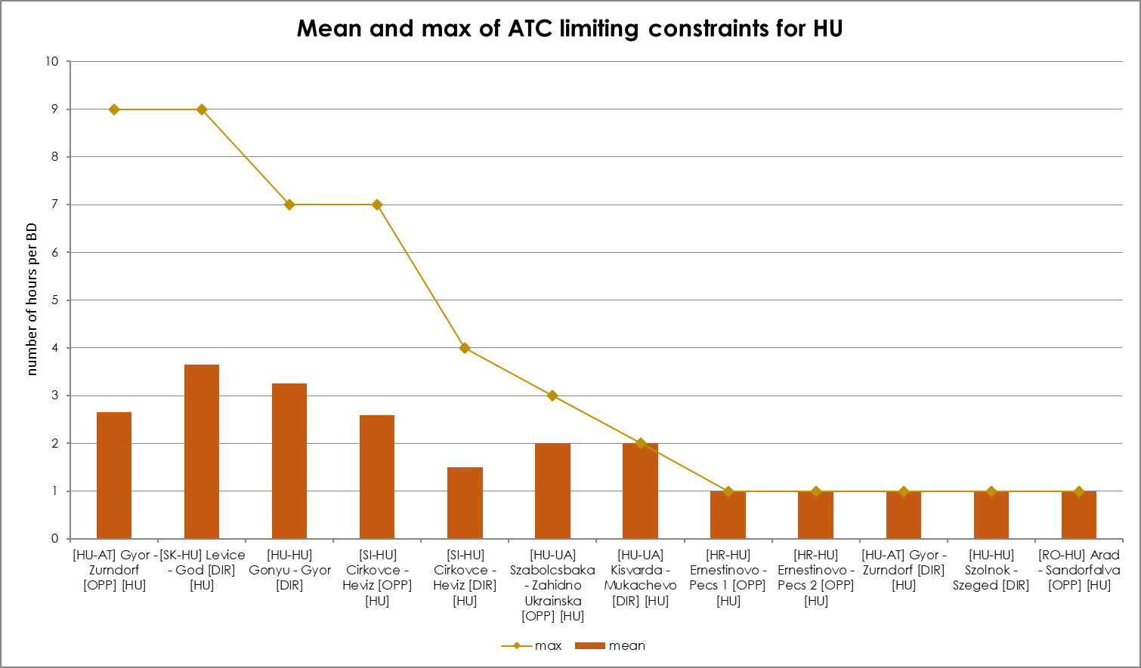
KPI 6C - Limiting constraints of the ATC domain​
Mean and Max of ATC limiting constraints per TSO – MAVIR

Slide 25
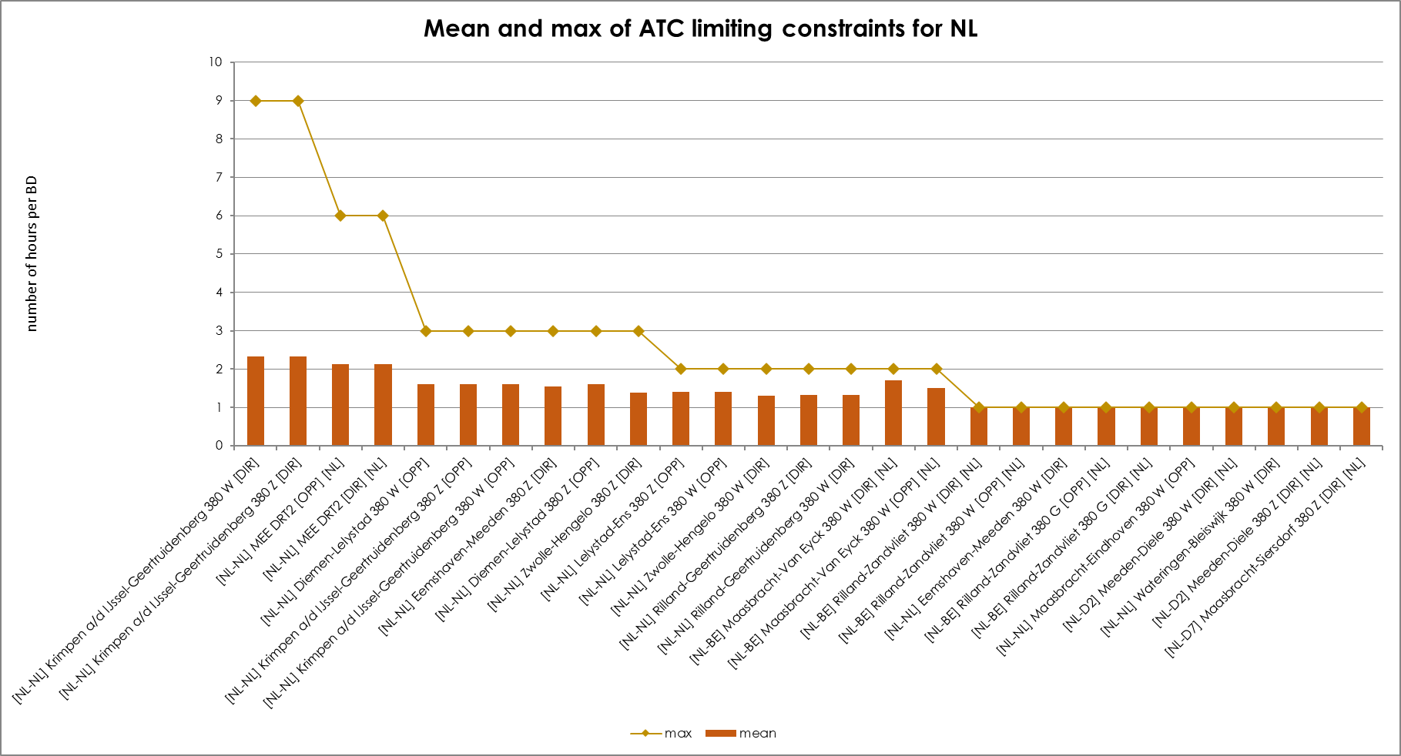
KPI 6C - Limiting constraints of the ATC domain​
Mean and Max of ATC limiting constraints per TSO – Tennet Netherlands

Slide 26
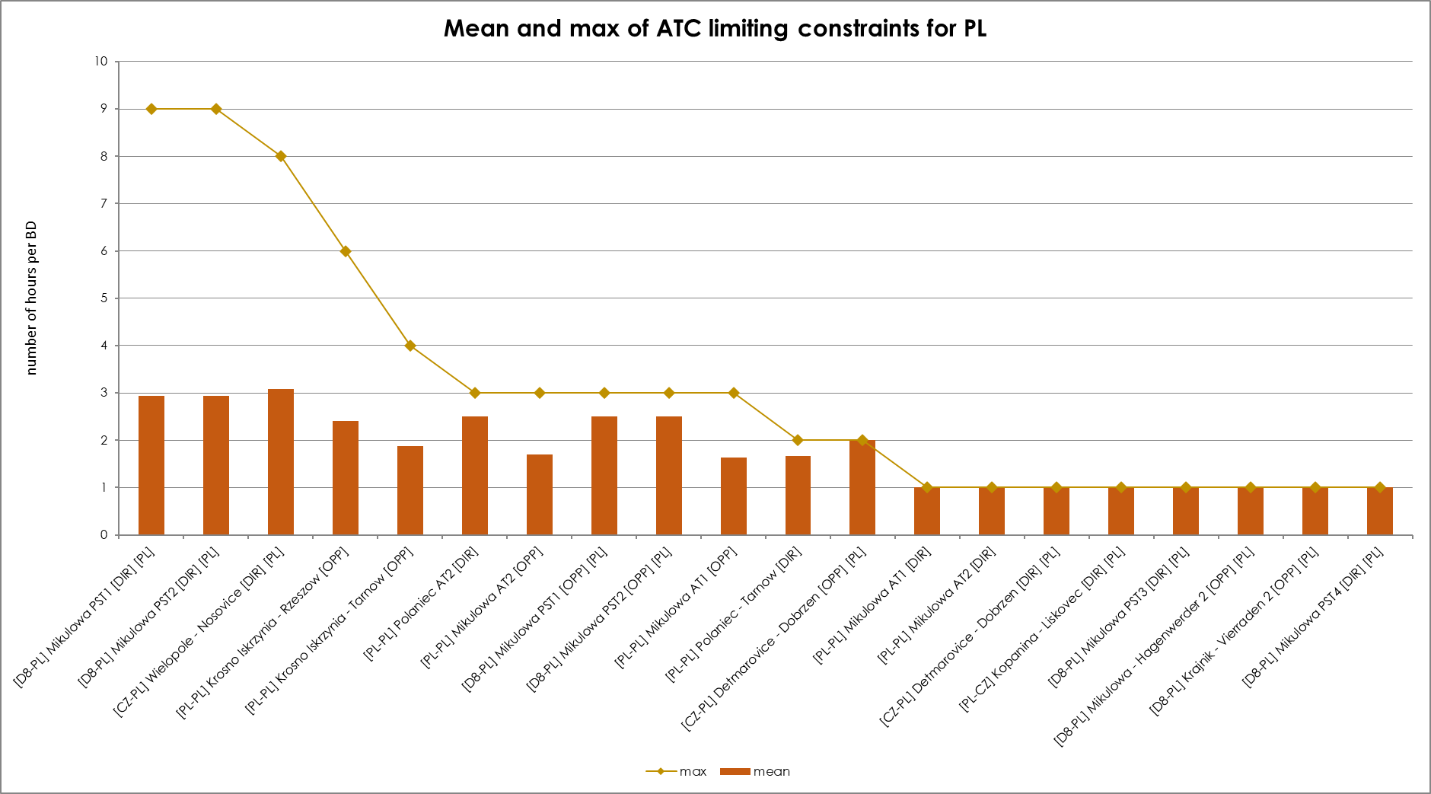
KPI 6C - Limiting constraints of the ATC domain​
Mean and Max of ATC limiting constraints per TSO – PSE

Slide 27
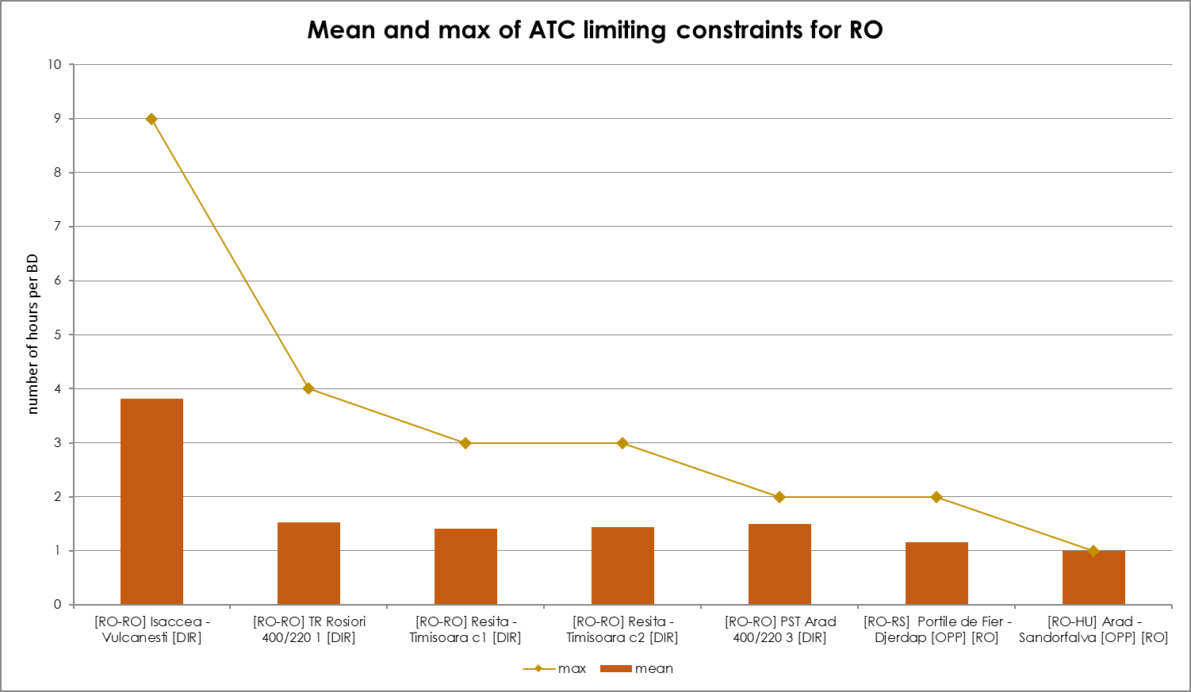
KPI 6C - Limiting constraints of the ATC domain​
Mean and Max of ATC limiting constraints per TSO – Transelectrica

Slide 28
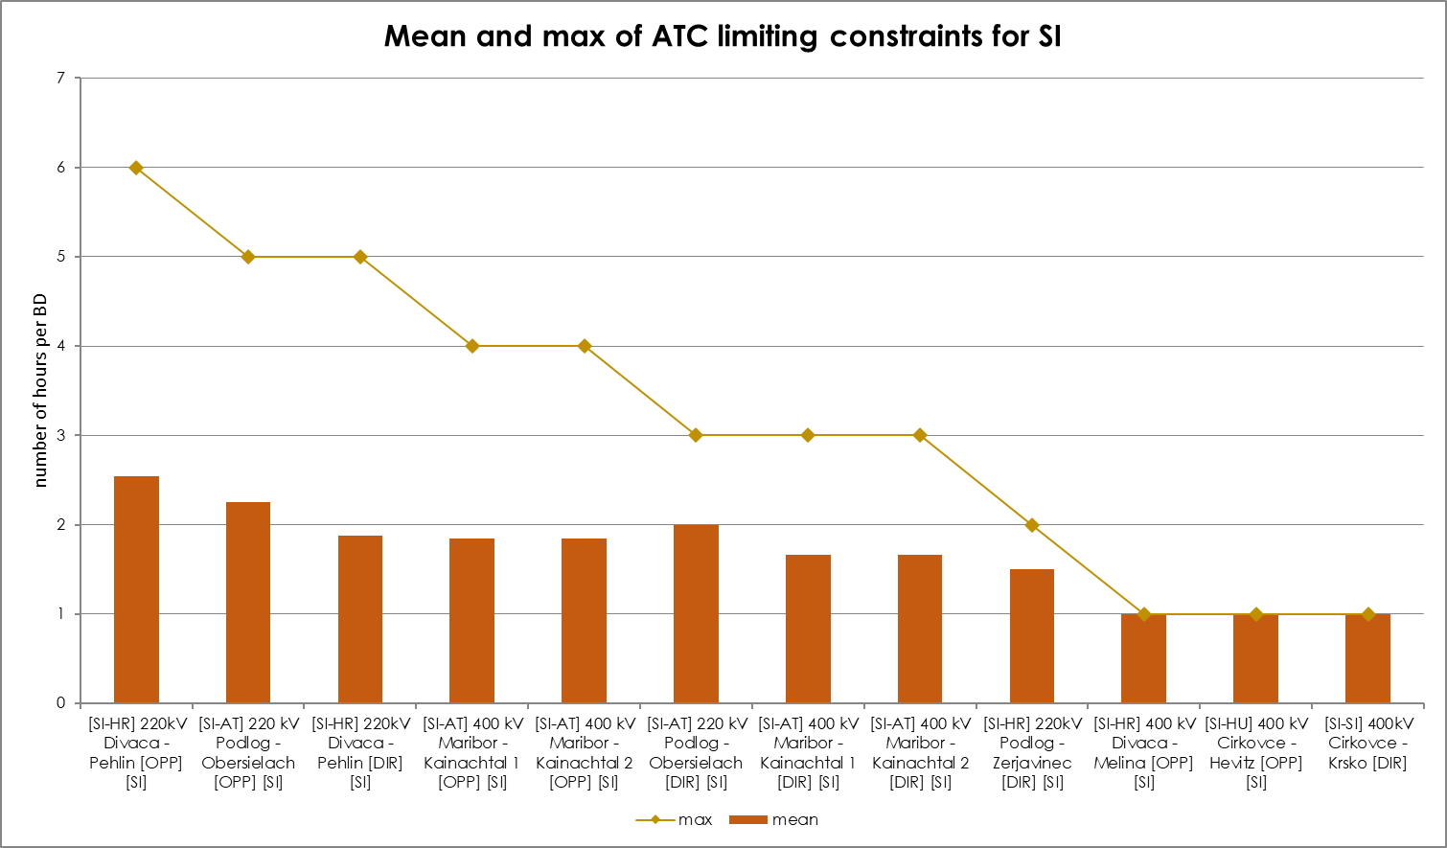
KPI 6C - Limiting constraints of the ATC domain​
Mean and Max of ATC limiting constraints per TSO – ELES

Slide 29
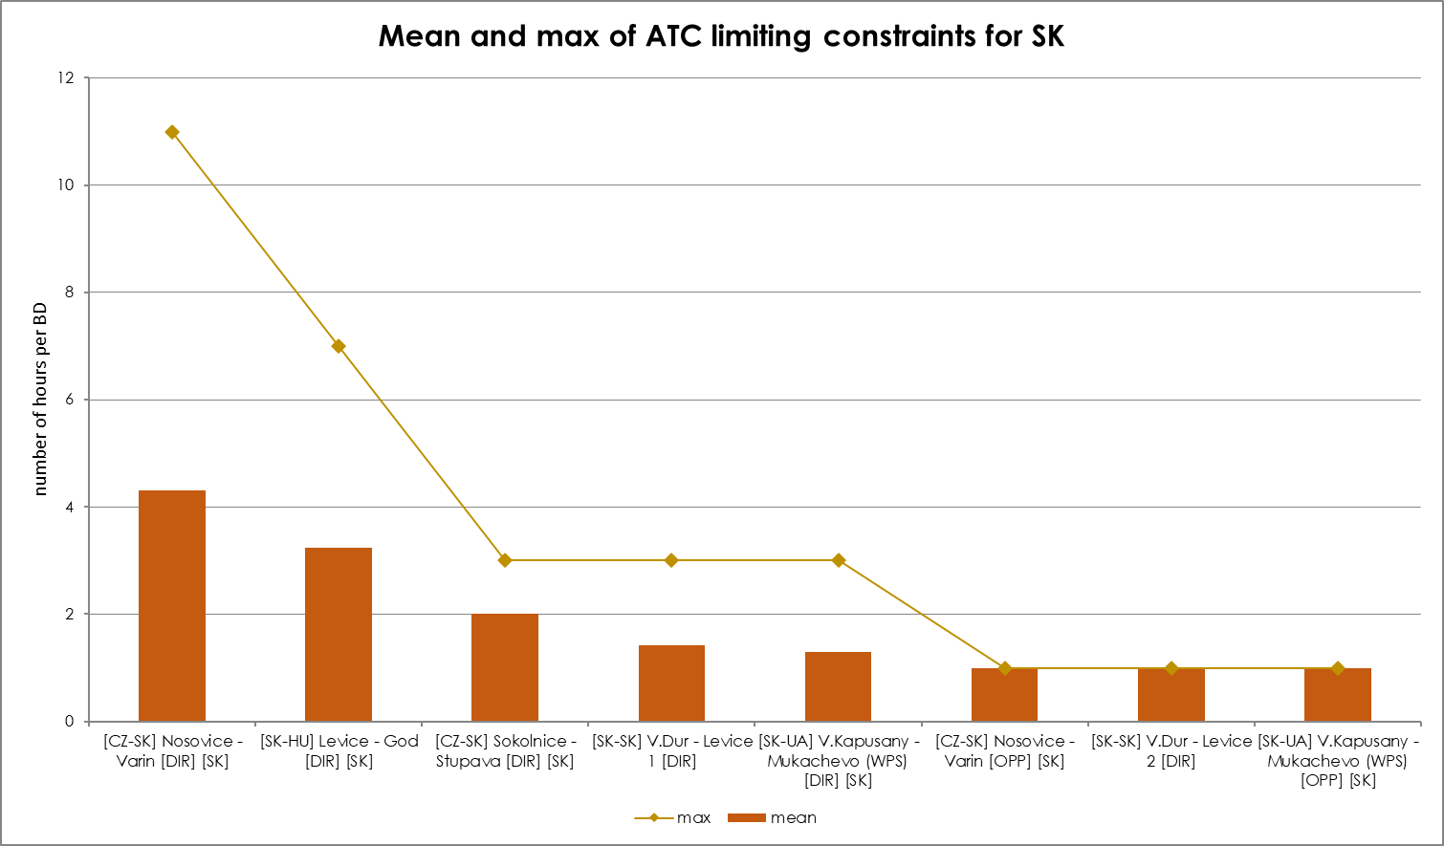
KPI 6C - Limiting constraints of the ATC domain​
Mean and Max of ATC limiting constraints per TSO - SEPS

Slide 30
KPI 6D
ATC Based Validation - Aggregations
No ATC validation performed since start of the IDCC(c) ext//run

Slide 31
KPI 7A & 7B - Most often used pre-solved CNEsC​
20 most limiting pre-solved constraints & Mean and Max of pre-solved constraints

Slide 32
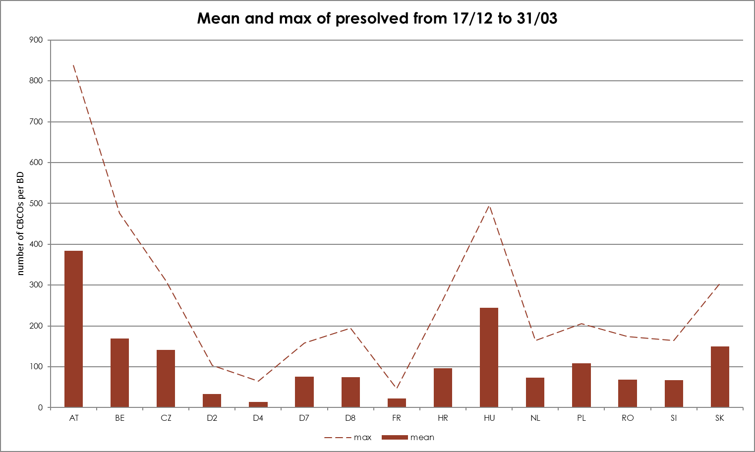
KPI 7A & 7B - Most often used pre-solved CNECs​
20 most limiting pre-solved constraints & Mean and Max of pre-solved constraints

Slide 33
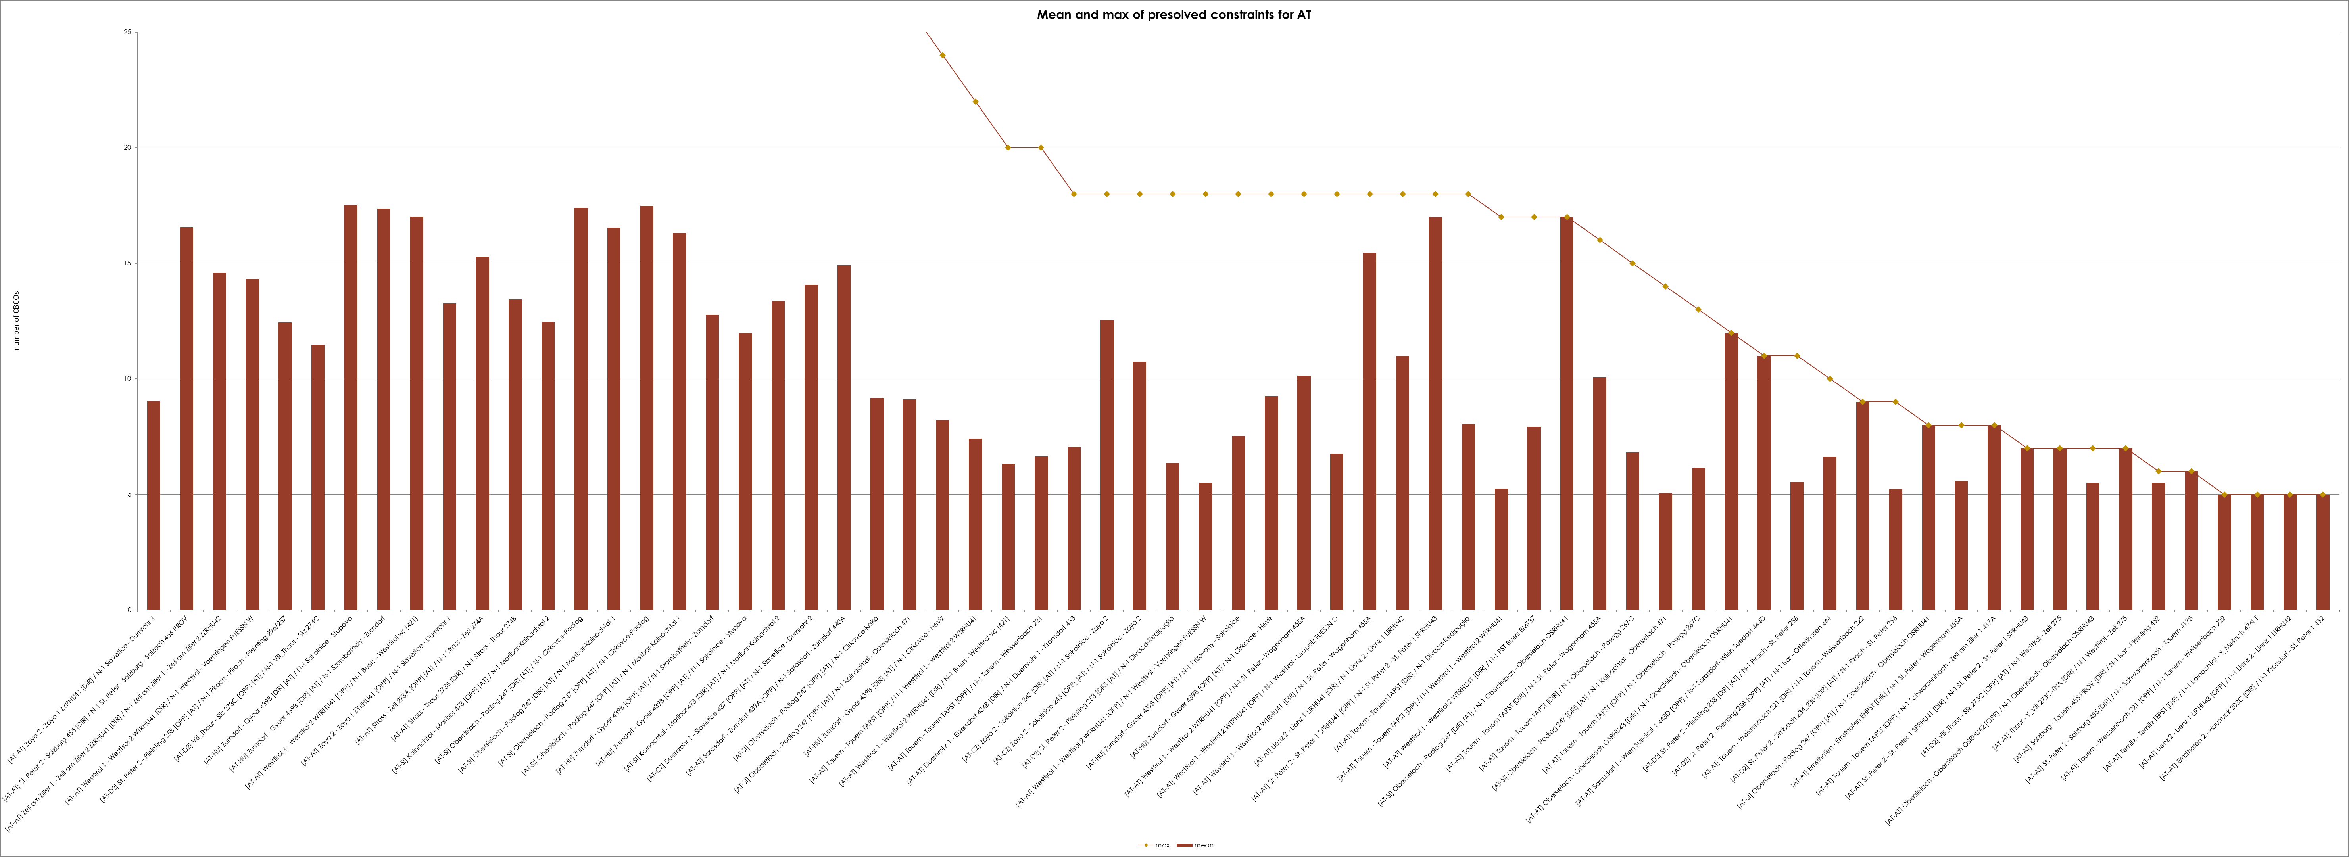
KPI 7C - Most often used pre-solved CNECs​ ​
Mean and Max of pre-solved constraints per TSO - APG

Slide 34
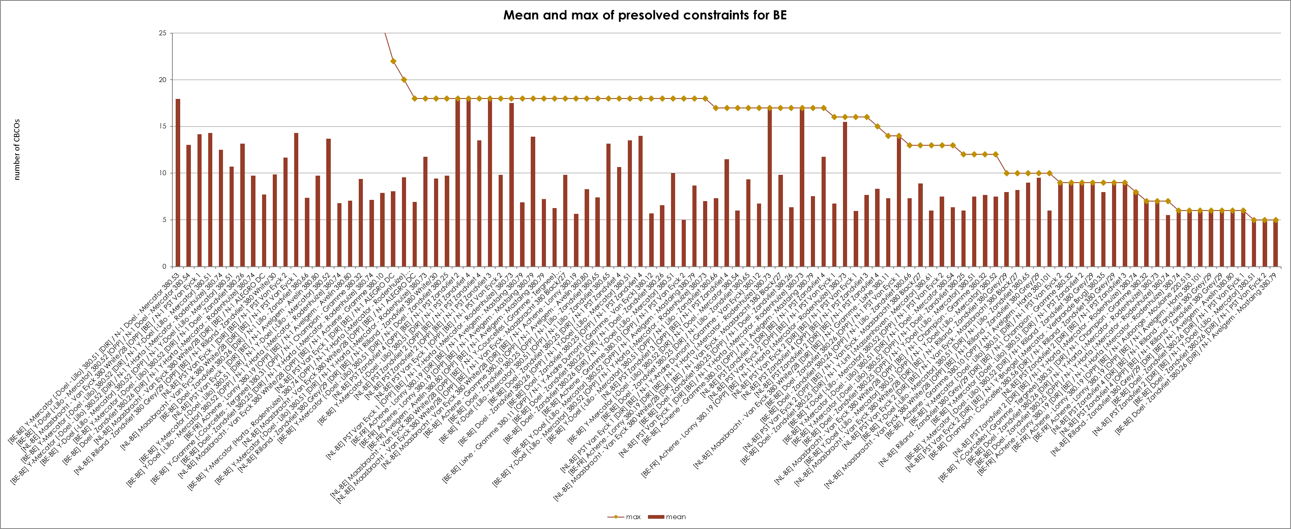
KPI 7C - Most often used pre-solved CNECs​ ​
Mean and Max of pre-solved constraints per TSO - Elia

Slide 35
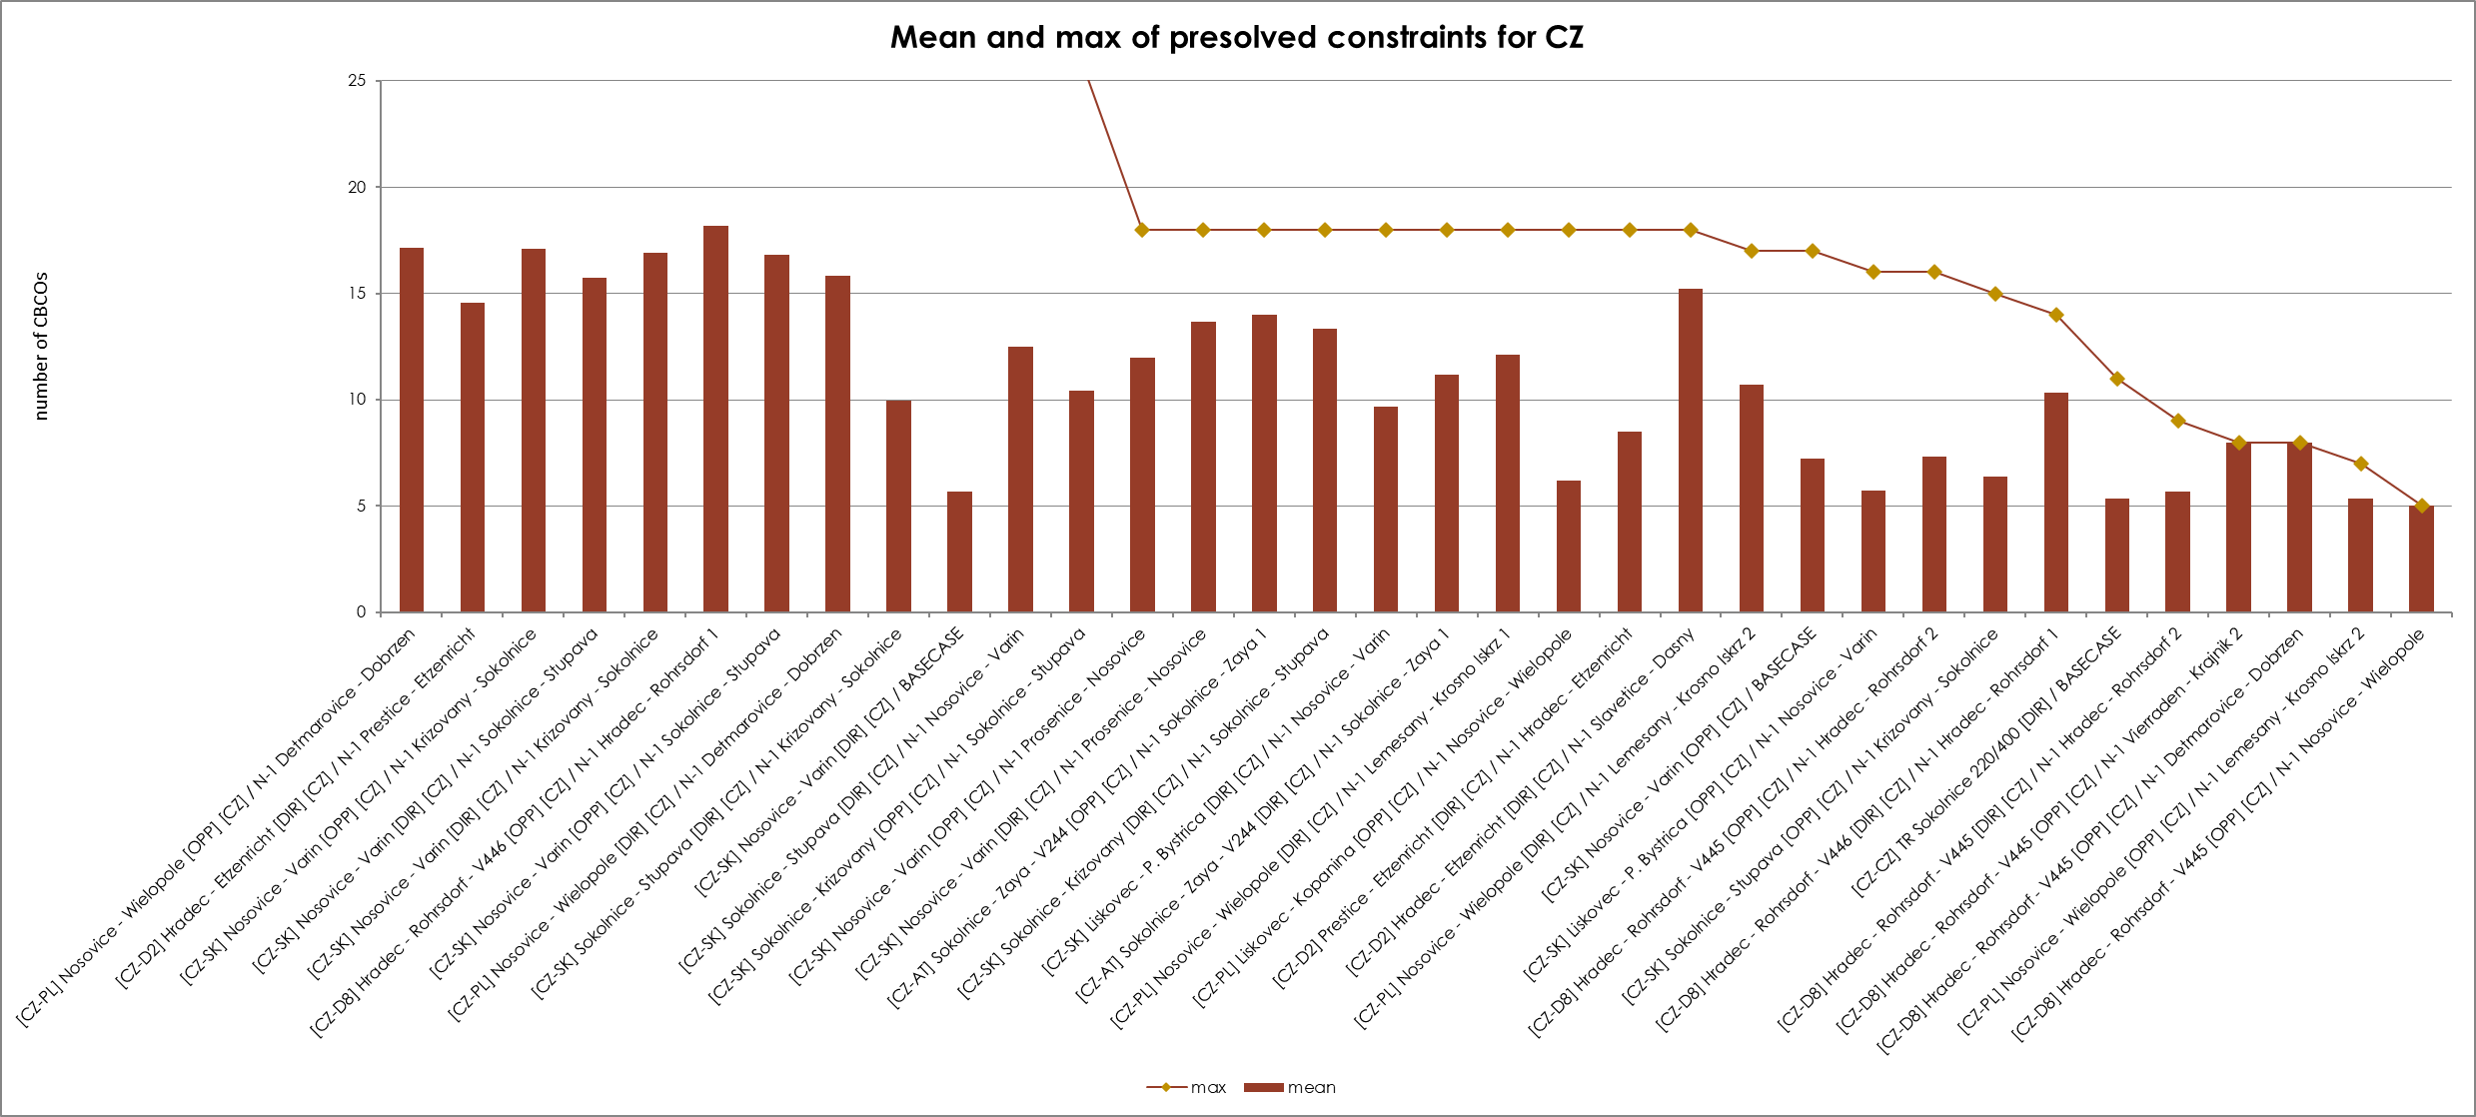
KPI 7C - Most often used pre-solved CNECs​ ​
Mean and Max of pre-solved constraints per TSO – CEPS

Slide 36
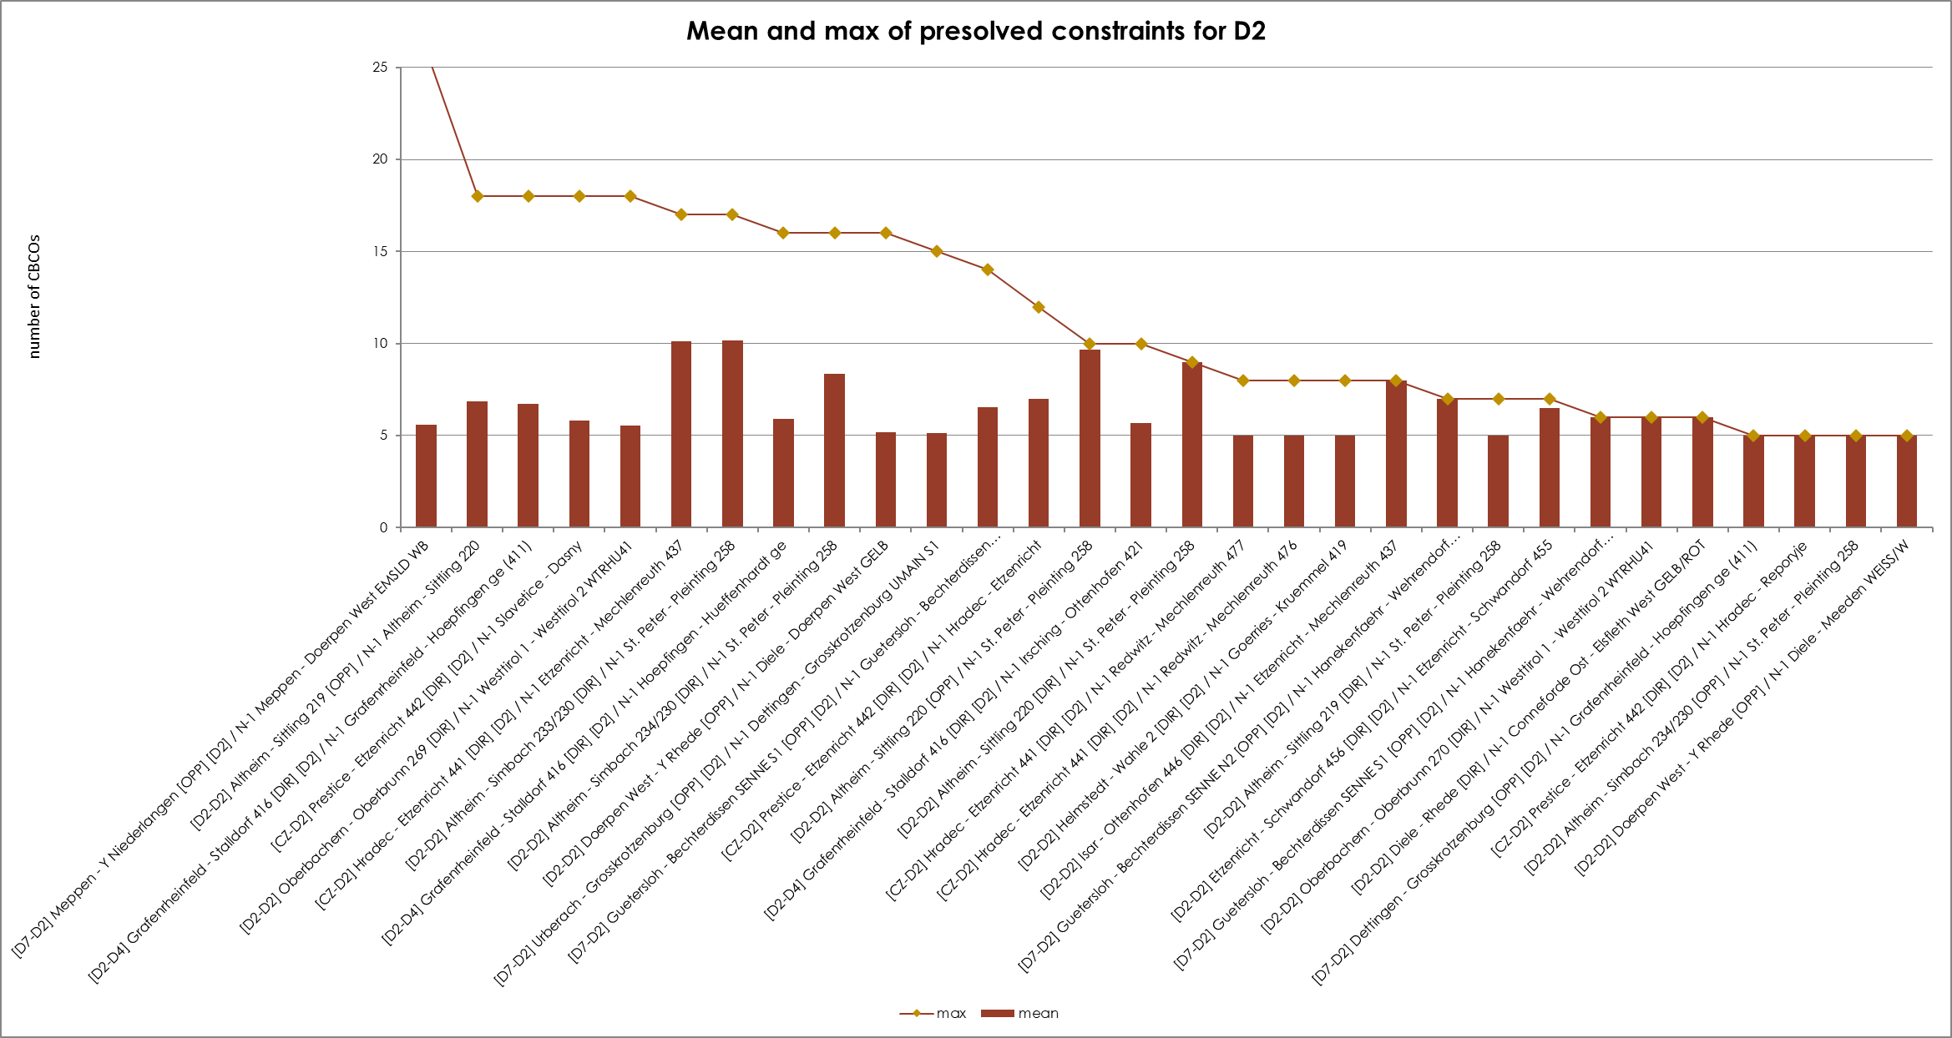
KPI 7C - Most often used pre-solved CNECs​ ​
Mean and Max of pre-solved constraints per TSO – Tennet Germany

Slide 37
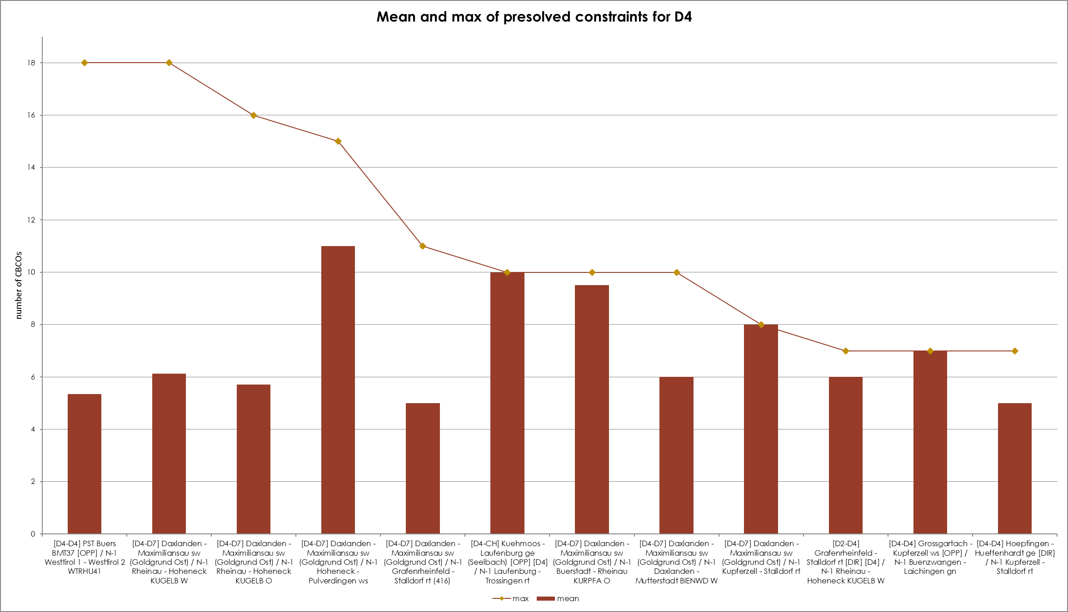
KPI 7C - Most often used pre-solved CNECs​ ​
Mean and Max of pre-solved constraints per TSO - Transnet

Slide 38
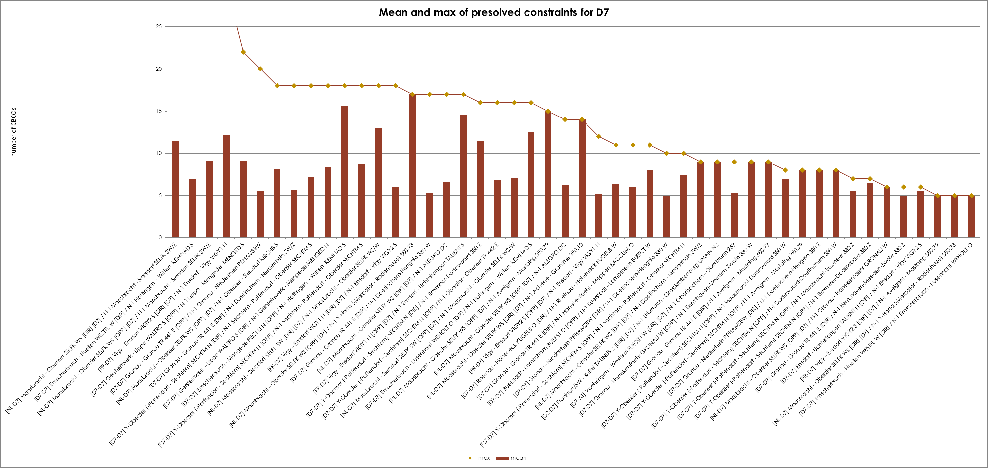
KPI 7C - Most often used pre-solved CNECs​ ​
Mean and Max of pre-solved constraints per TSO - Amprion

Slide 39
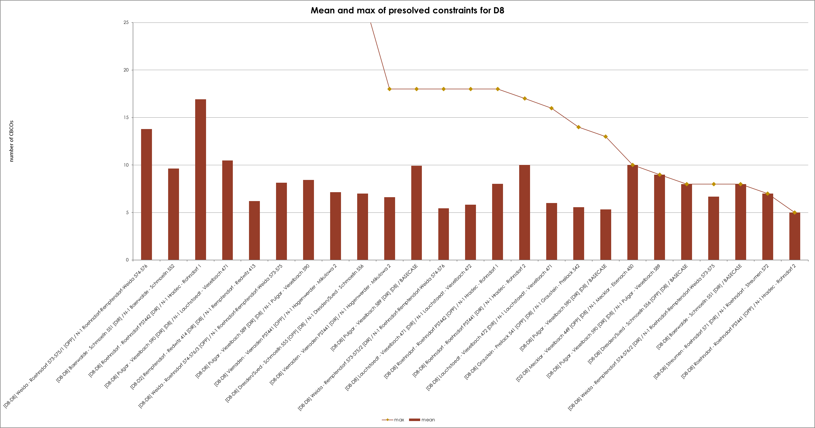
KPI 7C - Most often used pre-solved CNECs​ ​
Mean and Max of pre-solved constraints per TSO – 50Hertz

Slide 40
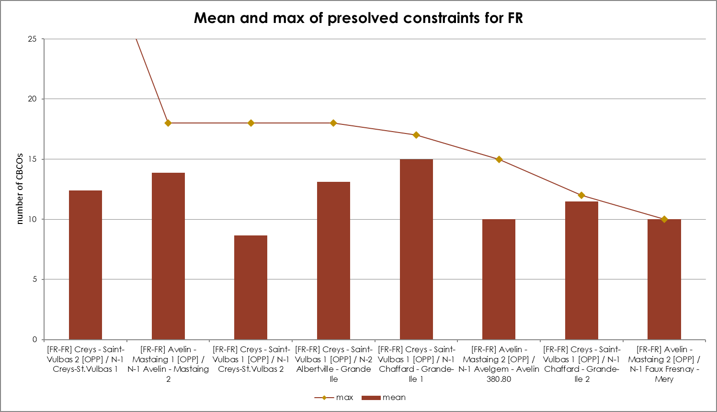
KPI 7C - Most often used pre-solved CNECs​ ​
Mean and Max of pre-solved constraints per TSO – RTE

Slide 41
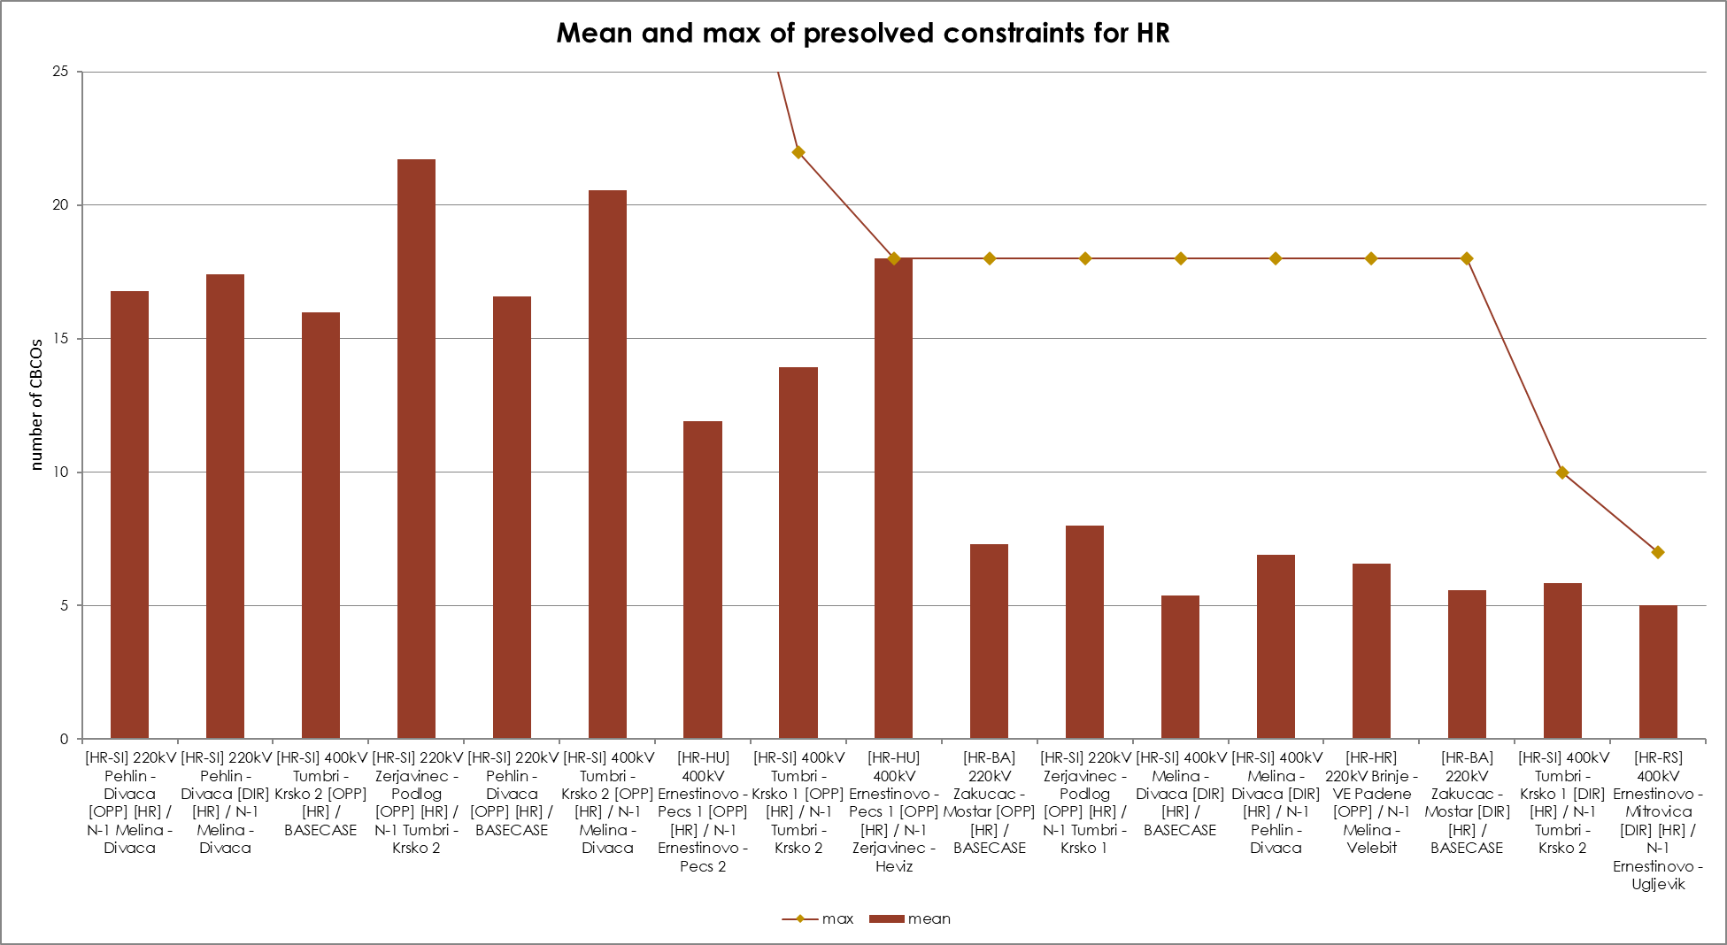
KPI 7C - Most often used pre-solved CNECs​ ​
Mean and Max of pre-solved constraints per TSO – HOPS

Slide 42
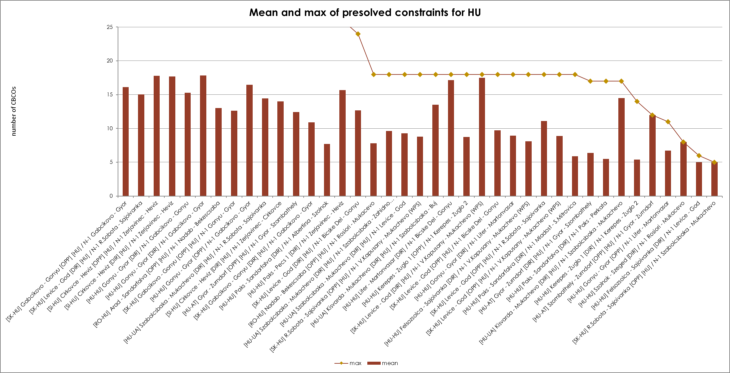
KPI 7C - Most often used pre-solved CNECs​ ​
Mean and Max of pre-solved constraints per TSO – MAVIR

Slide 43
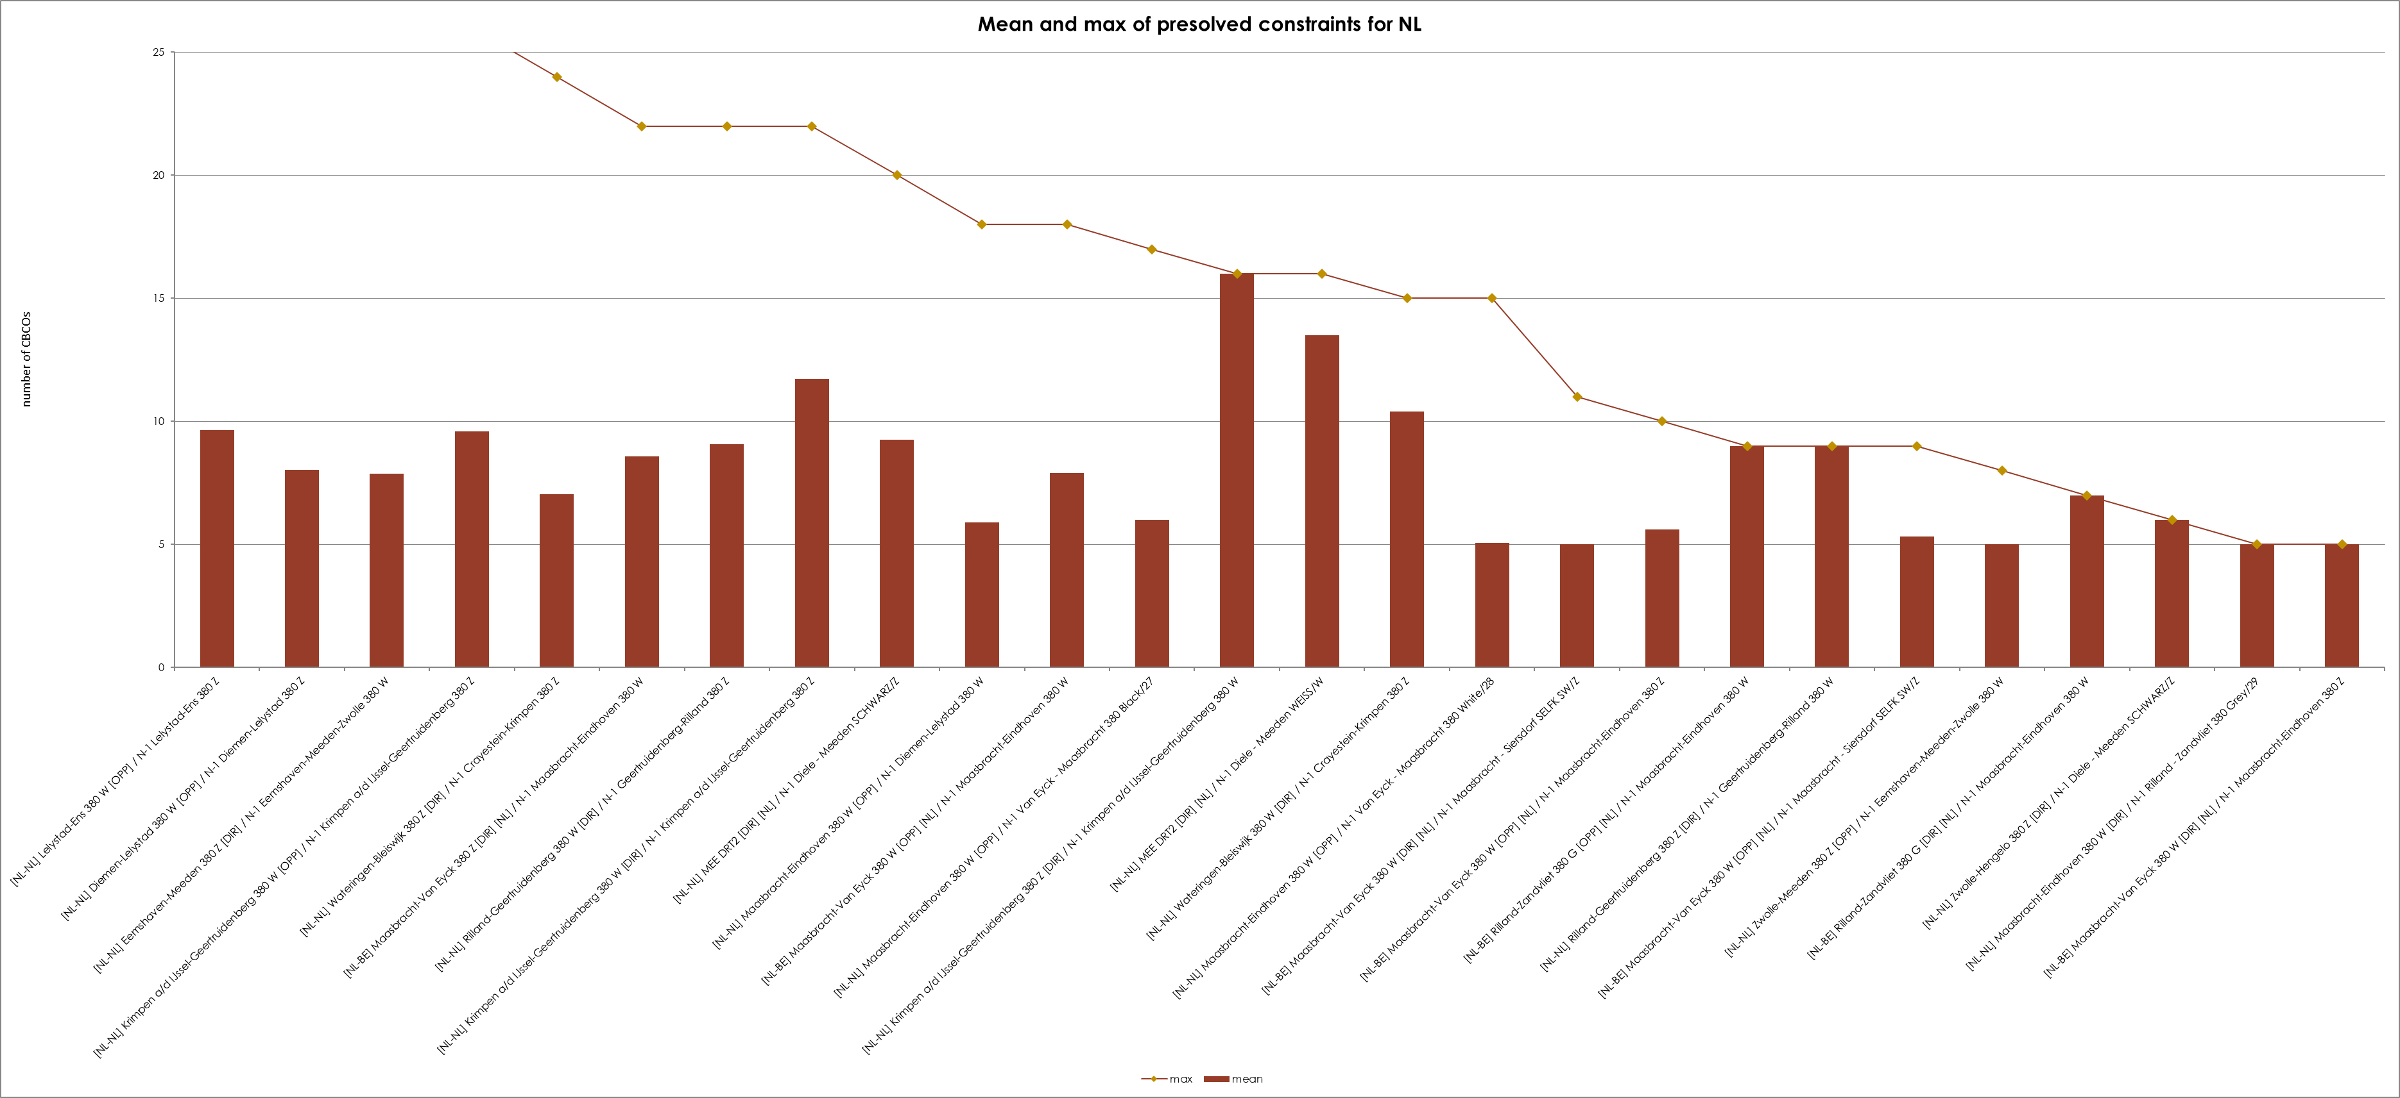
KPI 7C - Most often used pre-solved CNECs​ ​
Mean and Max of pre-solved constraints per TSO – Tennet Netherlands

Slide 44
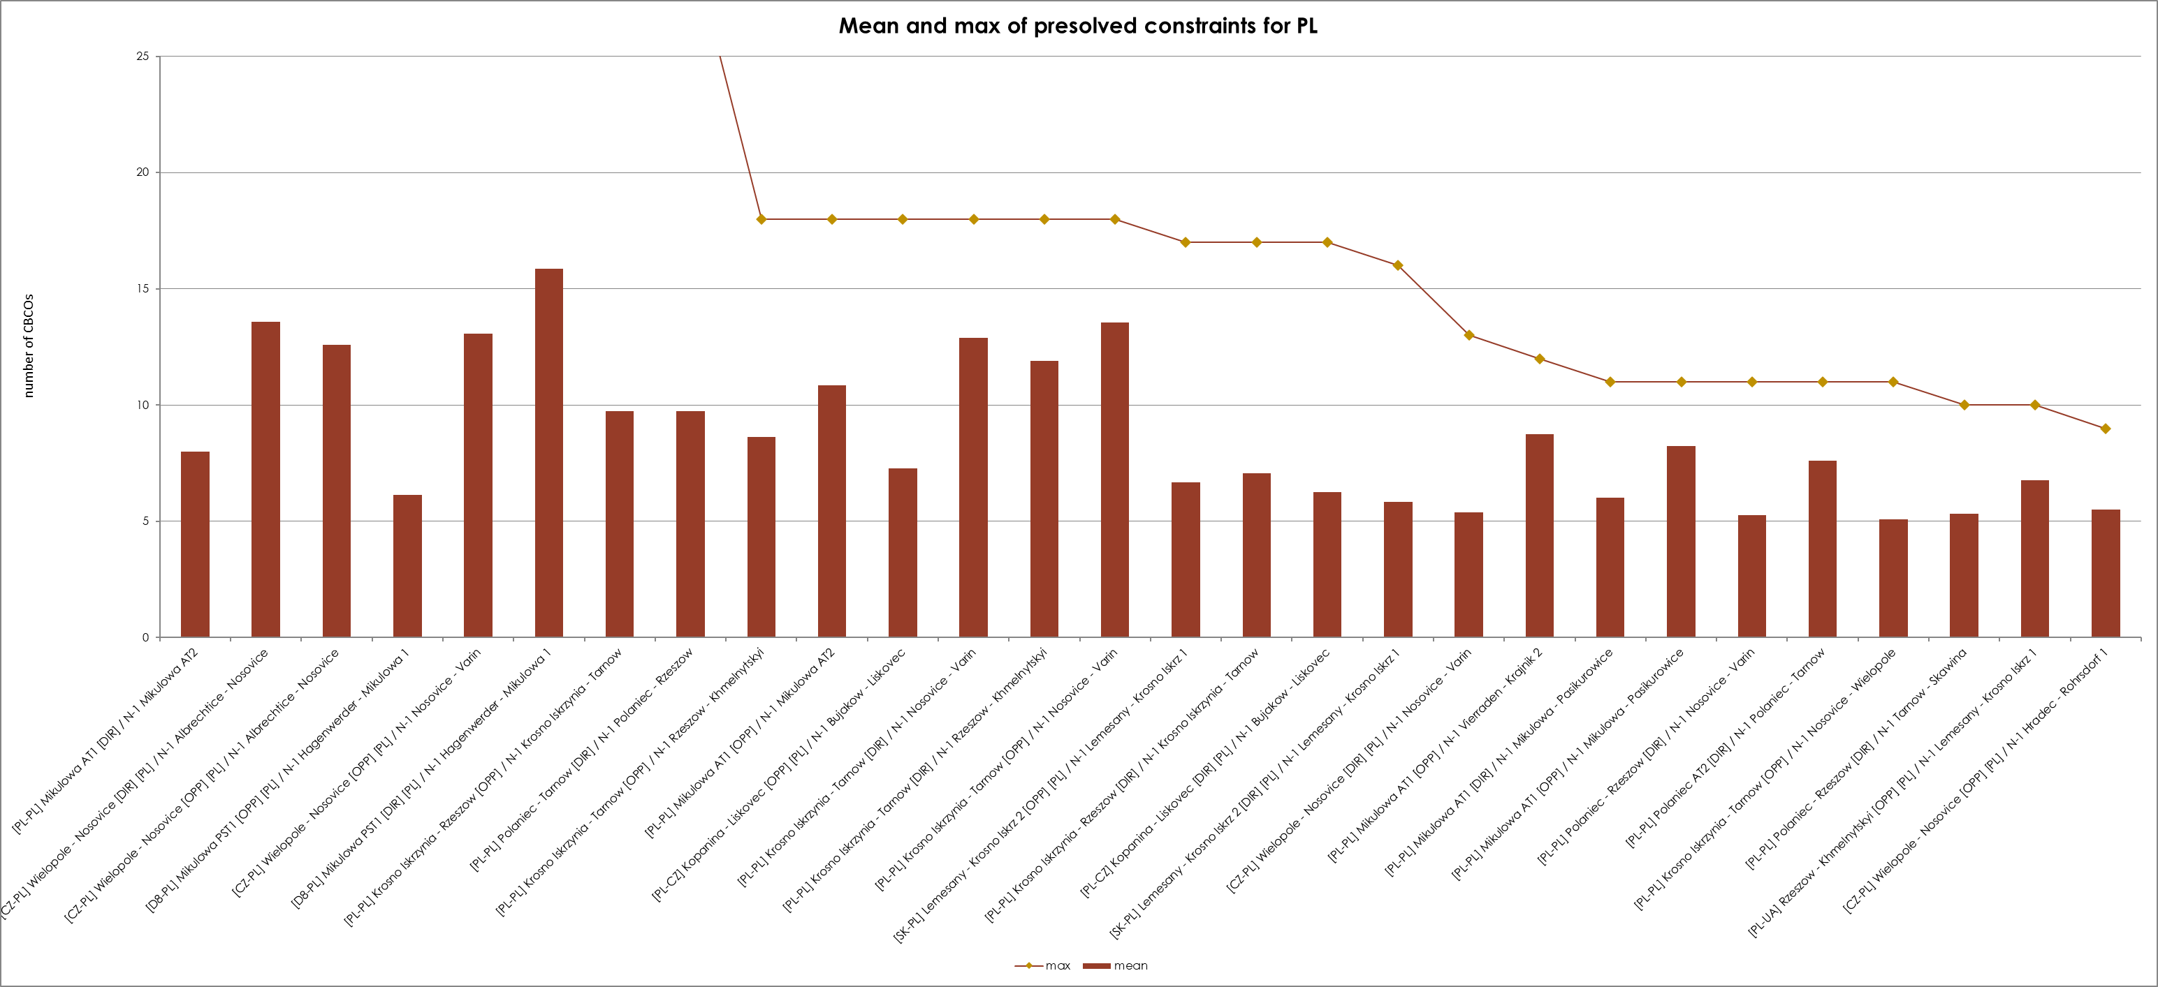
KPI 7C - Most often used pre-solved CNECs​ ​
Mean and Max of pre-solved constraints per TSO – PSE

Slide 45
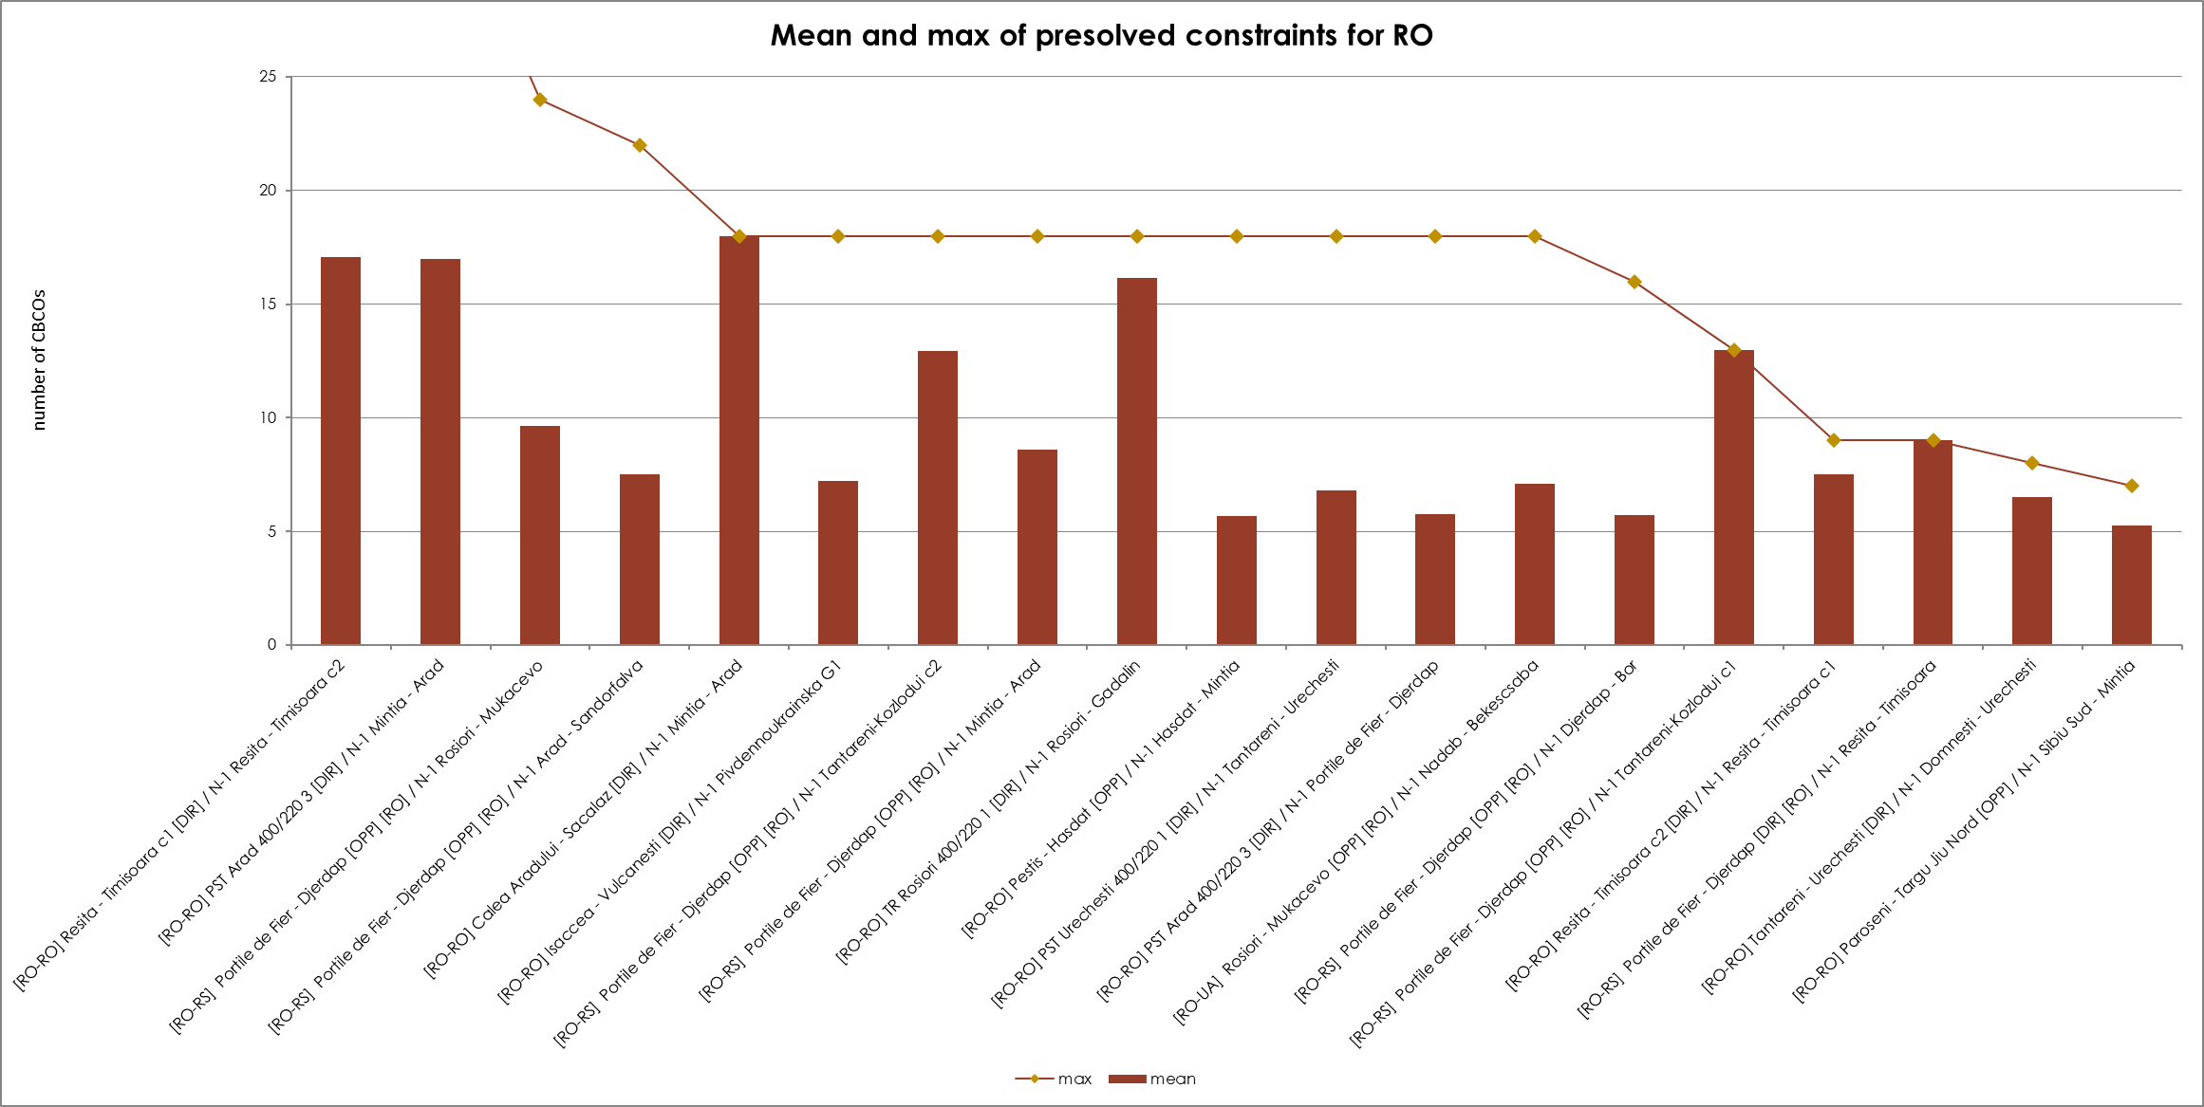
KPI 7C - Most often used pre-solved CNECs​ ​
Mean and Max of pre-solved constraints per TSO – Transeletrica

Slide 46
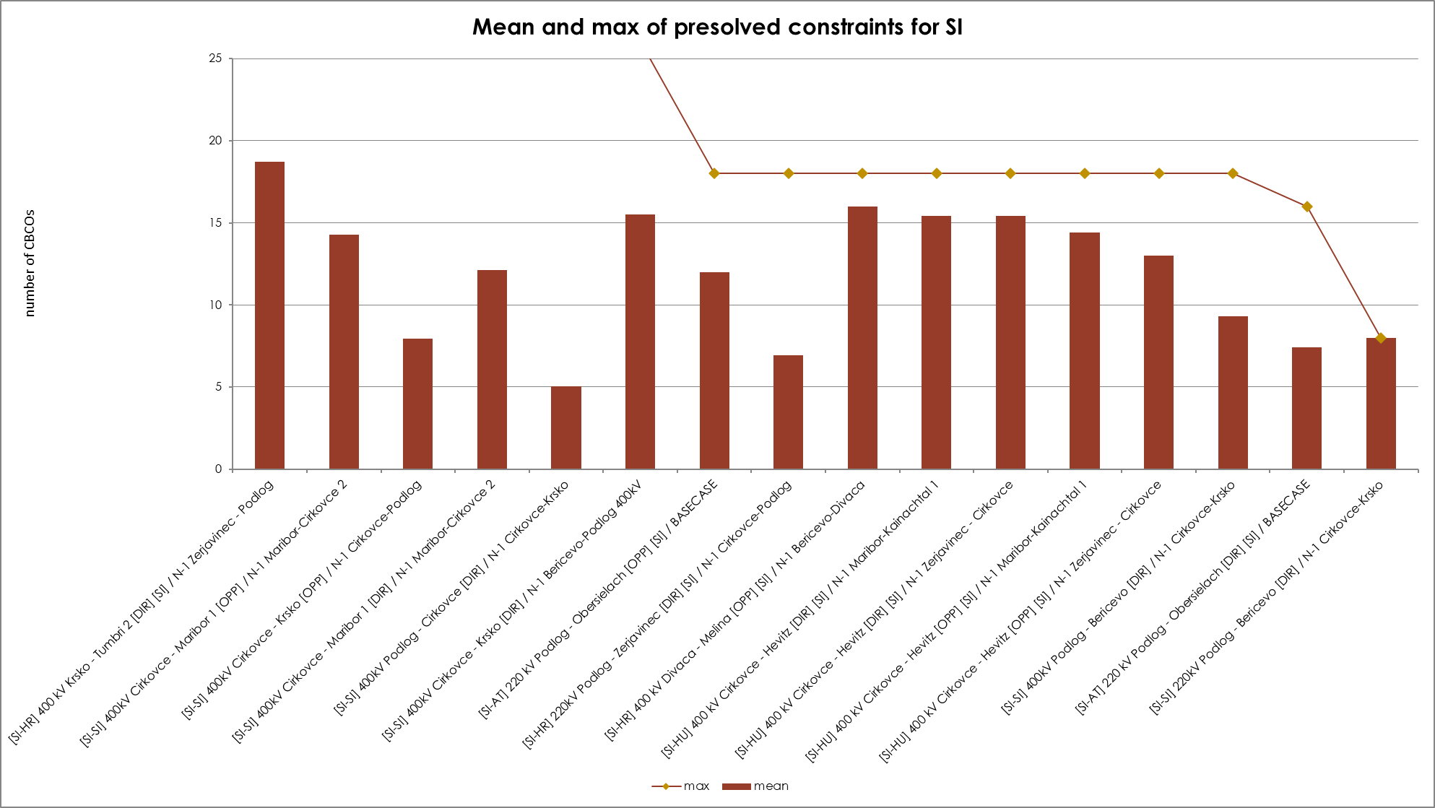
KPI 7C - Most often used pre-solved CNECs​ ​
Mean and Max of pre-solved constraints per TSO – ELES

Slide 47
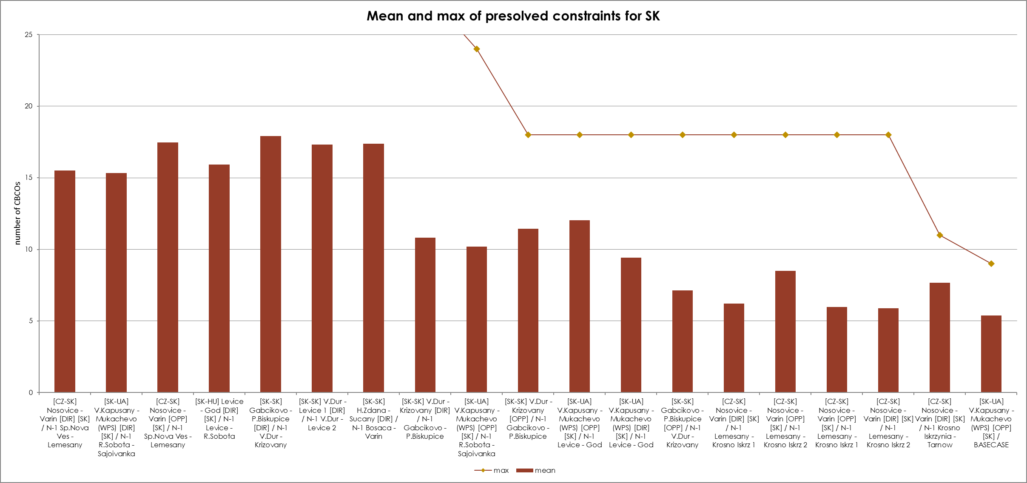
KPI 7C - Most often used pre-solved CNECs​ ​
Mean and Max of pre-solved constraints per TSO - SEPS

Slide 48
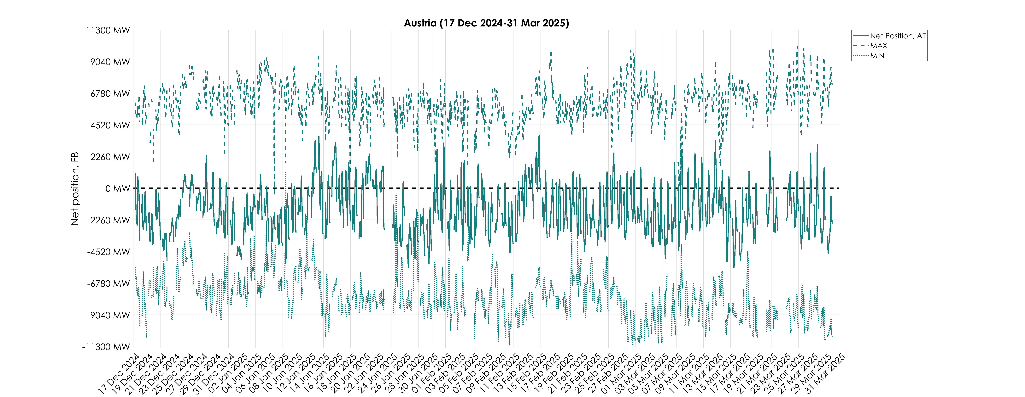
KPI 8A – Min and Max Net Positions per Bidding Zone​
Based on final FB domain – Austria

Slide 49
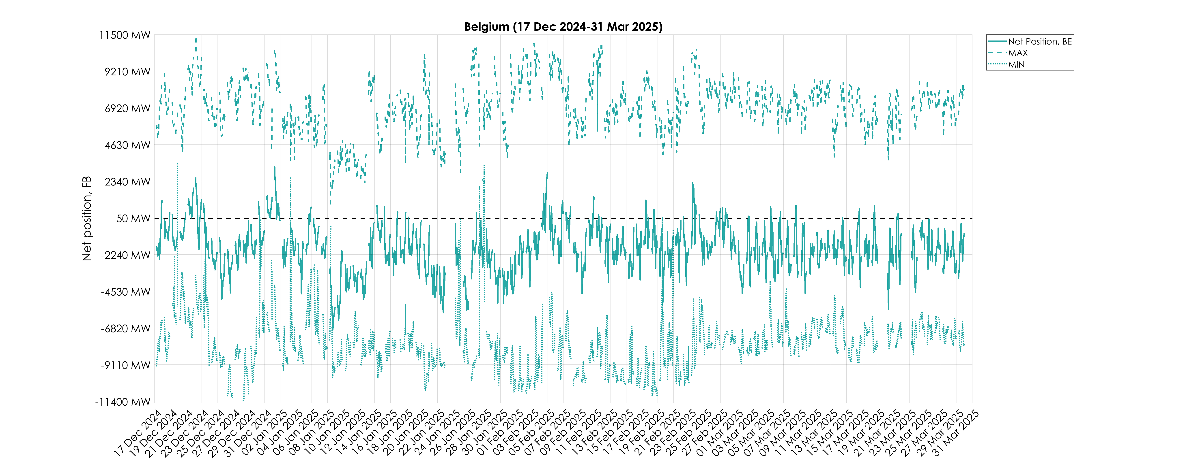
KPI 8A – Min and Max Net Positions per Bidding Zone​
Based on final FB domain – Belgium

Slide 50
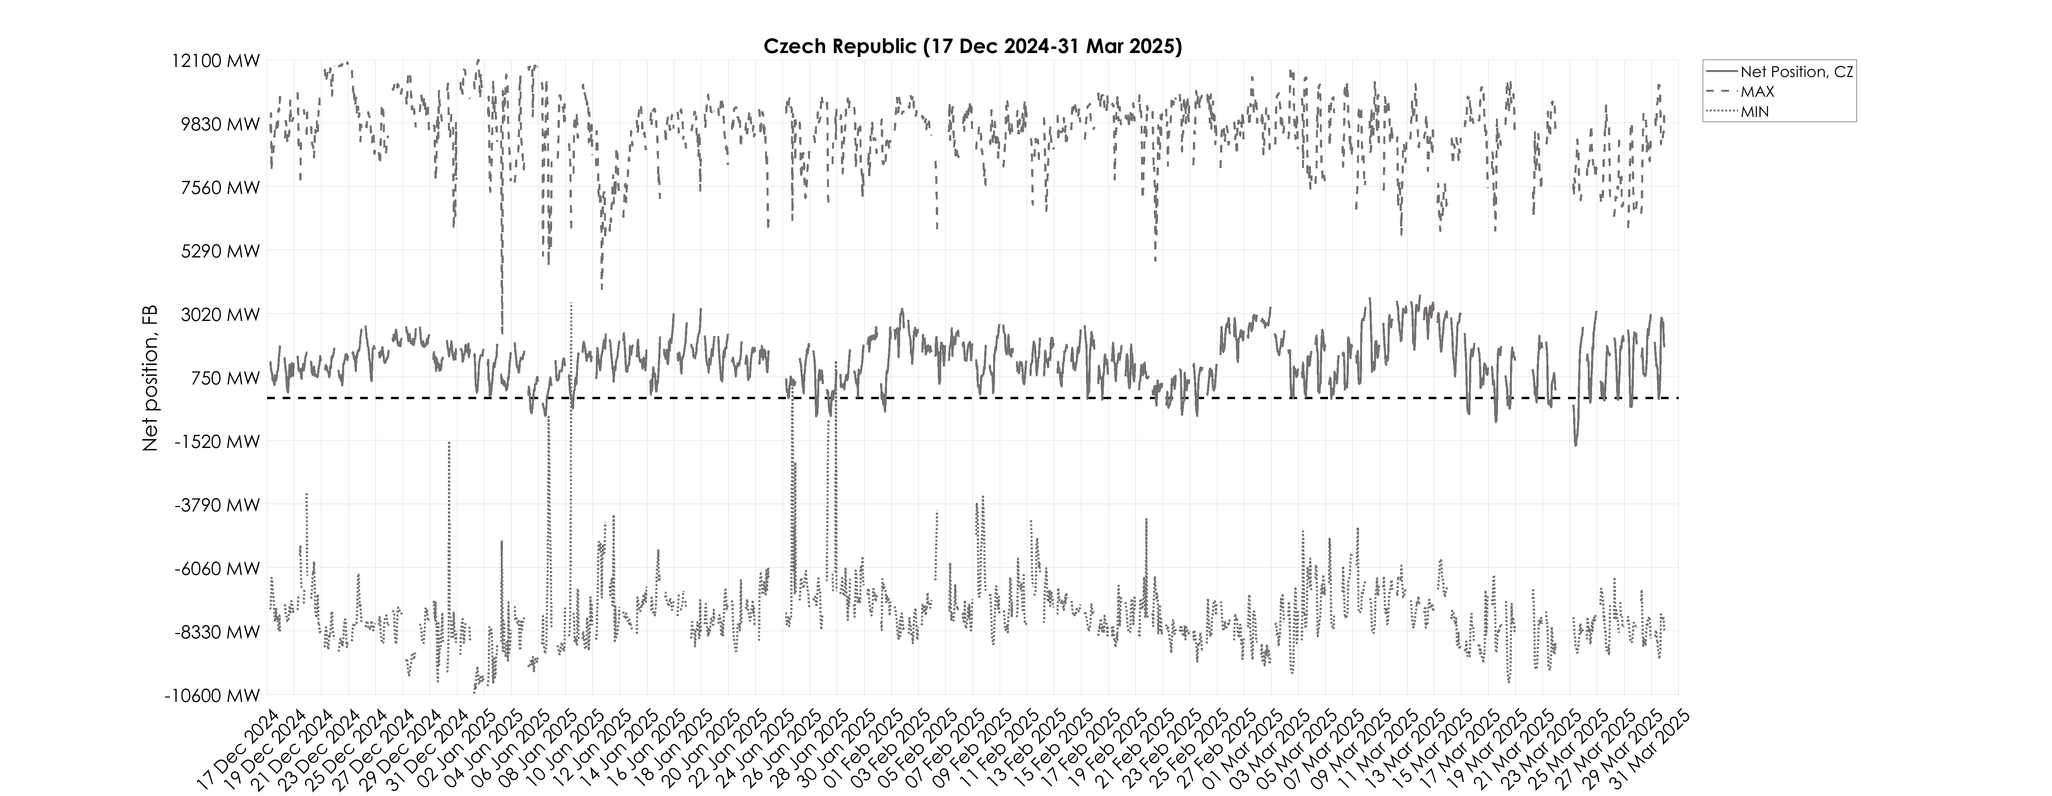
KPI 8A – Min and Max Net Positions per Bidding Zone​
Based on final FB domain – Czech Republic

Slide 51
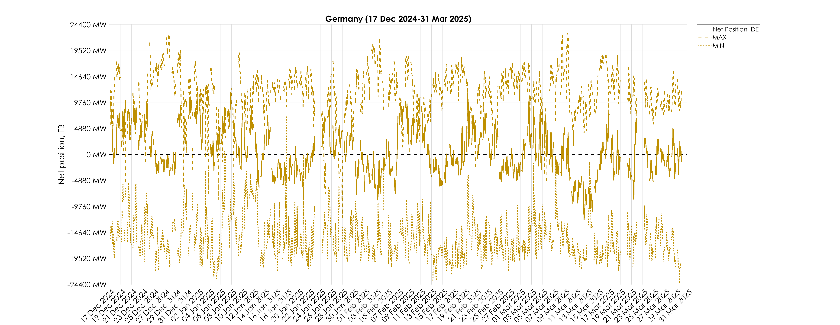
KPI 8A – Min and Max Net Positions per Bidding Zone​
Based on final FB domain – Germany

Slide 52
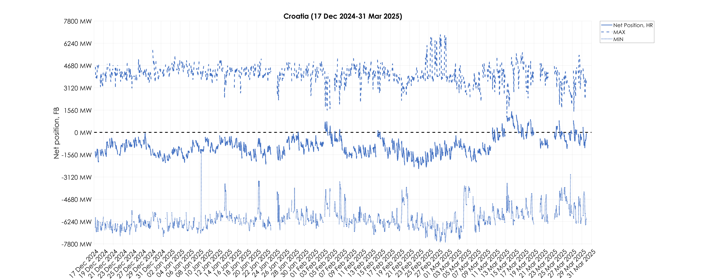
KPI 8A – Min and Max Net Positions per Bidding Zone​
Based on final FB domain – Croatia

Slide 53
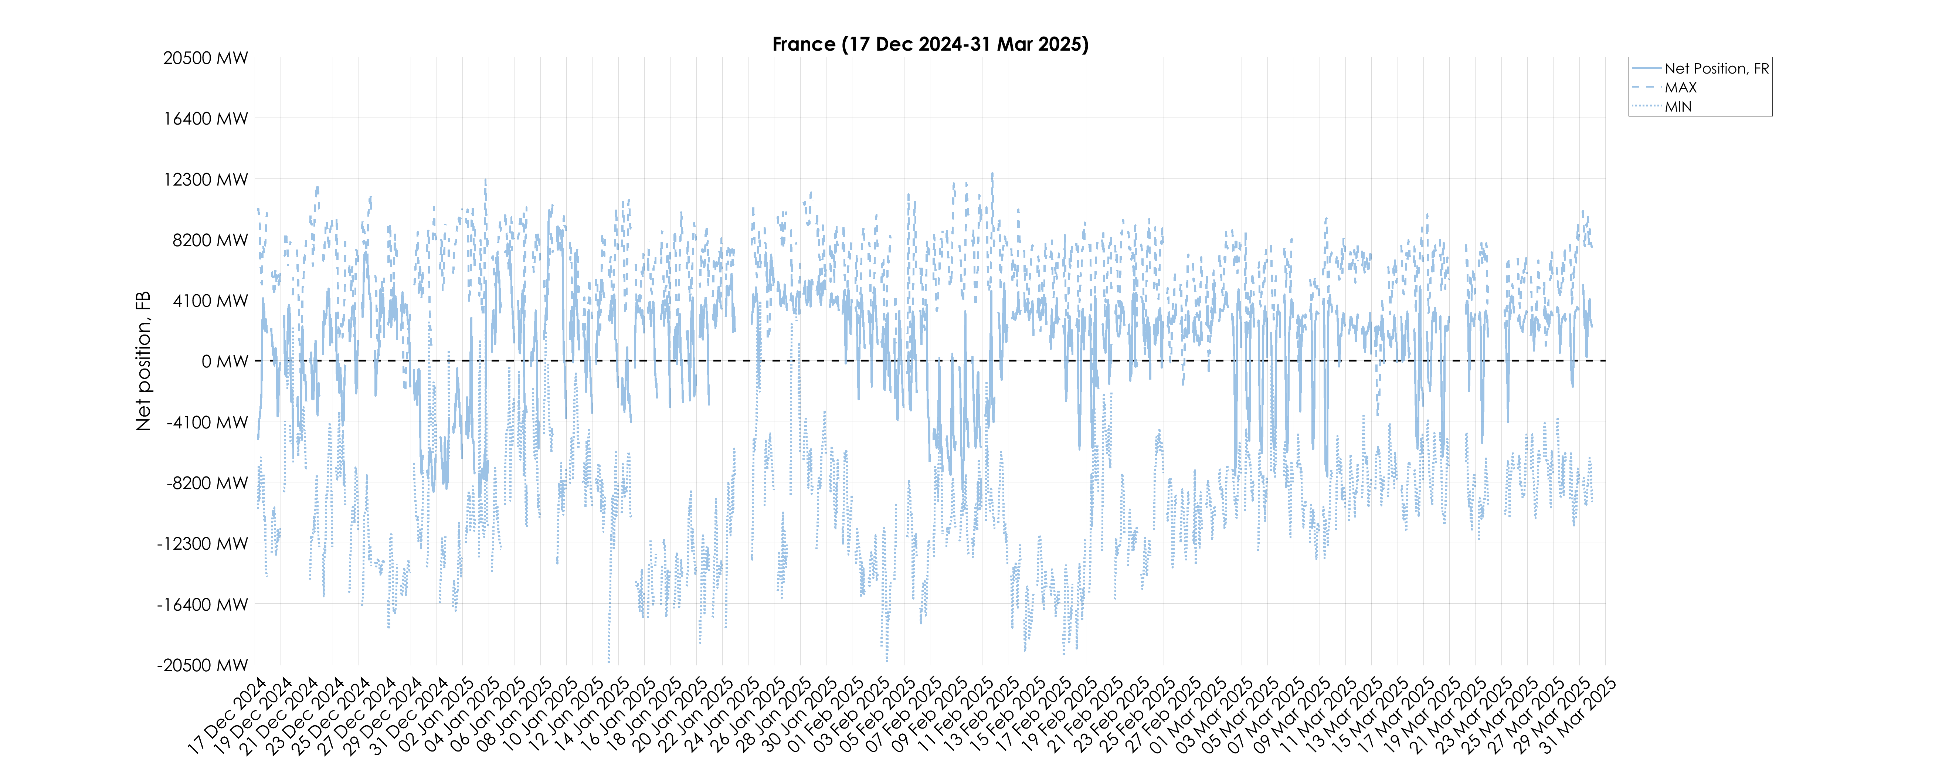
KPI 8A – Min and Max Net Positions per Bidding Zone​
Based on final FB domain – France

Slide 54
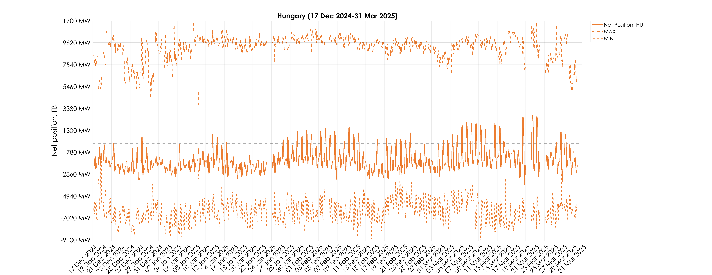
KPI 8A – Min and Max Net Positions per Bidding Zone​
Based on final FB domain – Hungary

Slide 55
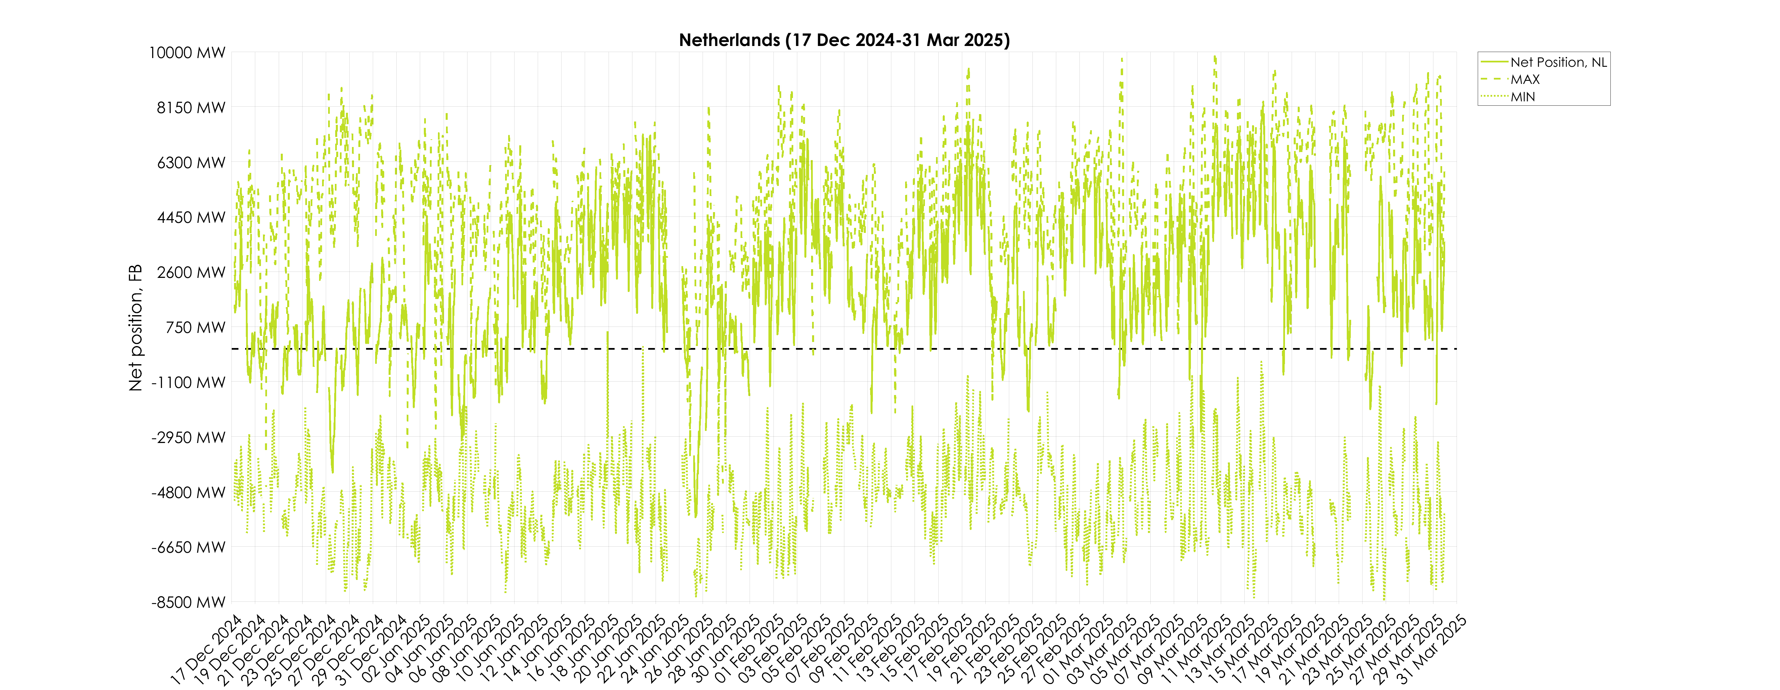
KPI 8A – Min and Max Net Positions per Bidding Zone​
Based on final FB domain – Netherlands

Slide 56
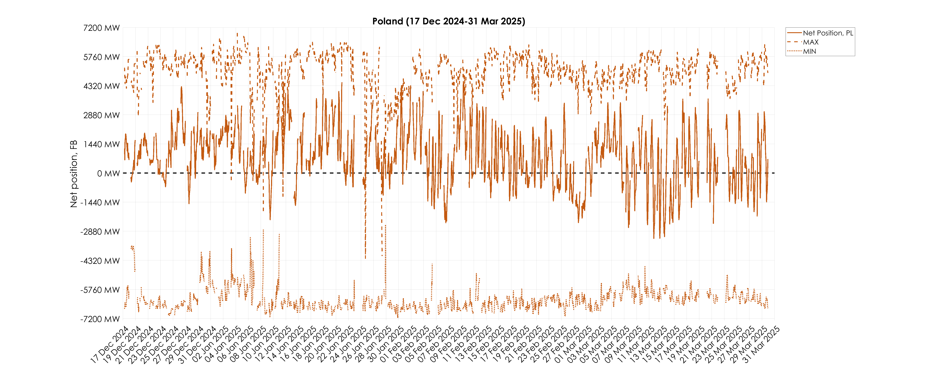
KPI 8A – Min and Max Net Positions per Bidding Zone​
Based on final FB domain – Poland

Slide 57
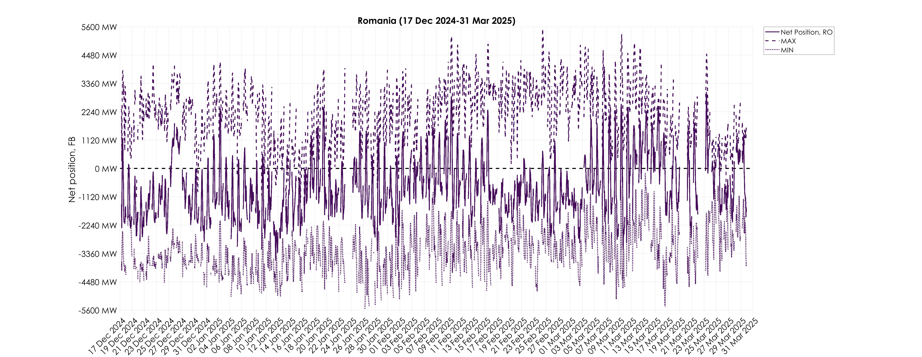
KPI 8A – Min and Max Net Positions per Bidding Zone​
Based on final FB domain – Romania

Slide 58

KPI 8A – Min and Max Net Positions per Bidding Zone​
Based on final FB domain – Slovenia

Slide 59

KPI 8A – Min and Max Net Positions per Bidding Zone​
Based on final FB domain – Slovakia

Slide 60

KPI 8B – Min and Max Net Positions per Bidding Zone​
Based on final ID ATC – Austria

Slide 61

KPI 8B – Min and Max Net Positions per Bidding Zone​
Based on final ID ATC – Belgium

Slide 62

KPI 8B – Min and Max Net Positions per Bidding Zone​
Based on final ID ATC – Czech Republic

Slide 63

KPI 8B – Min and Max Net Positions per Bidding Zone​
Based on final ID ATC – Germany

Slide 64

KPI 8B – Min and Max Net Positions per Bidding Zone​
Based on final ID ATC – France

Slide 65

KPI 8B – Min and Max Net Positions per Bidding Zone​
Based on final ID ATC – Croatia

Slide 66

KPI 8B – Min and Max Net Positions per Bidding Zone​
Based on final ID ATC – Hungary

Slide 67

KPI 8B – Min and Max Net Positions per Bidding Zone​
Based on final ID ATC – Netherlands

Slide 68

KPI 8B – Min and Max Net Positions per Bidding Zone​
Based on final ID ATC – Poland

Slide 69

KPI 8B – Min and Max Net Positions per Bidding Zone​
Based on final ID ATC – Romania

Slide 70

KPI 8B – Min and Max Net Positions per Bidding Zone​
Based on final ID ATC – Slovenia

Slide 71

KPI 8B – Min and Max Net Positions per Bidding Zone​
Based on final ID ATC – Slovakia

