Slide 1
Quarterly JAO Open Call 17.06.2025
Our client's satisfaction is critical for us.

Slide 2
Introduction

Slide 3
Agenda
1. User Group – Status Update
2. Settlement calculation
3. Curtailment messages
4. Financial Updates
5. Auction Calendar
6. Status Update: CRM project
7. Orion: The Allocation Tool
8. Open Test
9. Test surveys reminder
10. Q&A

Slide 4
User Group status update

Slide 5
User Group status update
SCOPE of the User Group:​
Enables collaboration on key areas;​
Facilitates exchange on IT tools, services & expectations;​
Supports ongoing improvement of JAO’s offerings.​
Initial Version of the User Group
Started with 14 Market Participants, holding biannual workshops.
Key objectives:
Enhanced communication;
Promoting awareness of upcoming system developments while collecting feature requests from users
Upgraded User Group​
Capacity up to 25 Market Participants;​
Few previous members remain in the group as per their request.
Ambition: What Will Be Different?
Enhanced participant engagement;
Fresh ideas, perspectives, and feedback;
Focus shifted towards operational topics ;
Two-way exchange => driving the development of more tailored and effective services.
Notes:
JAO is actively executing its strategic plan to strengthen and future-proof service resilience while adapting to evolving threats.

Slide 6
2. Settlement Calculation

Slide 7
2. Settlement Calculation
There are several charge types that can be found on settlements. Let’s consider a settlement file for the MP “X” :
ALLOC = meaning the allocated capacity to company “X” on a certain border => in this case 24MW at a price of 10.54 euro.
UIOSI= Use It or Sell it compensation, applicable for PTR products, meaning the capacity which was not nominated and resold automatically on short- term.
Example in settlement file: company “X” did not nominate the capacity of 196 MW => UIOSI compensation is 196MW x 1,04 euro => 203.84 euro.

Slide 8
RESALE= Marking in the below settlement the resold capacity of 27MW at a price of 20 euro:
CFCCU= Compensation for capacity curtailment, in this case company “X” is compensated for 5MW at the price of 2.46 euro => curtailment compensation is 12.3 euro CFACL= Compensation for Auction Cancellation, applicable when an auction is cancelled after the auction is finished (as fees have already been blocked from MPs accounts. In order to balance out the charge, JAO pays back the amounts in the form of a CFACL compensation).
CFNCU= Compensation for Nomination Curtailment = reduction of the nominated PTRs by the TSOs in order to guarantee the stability of the grid. It is applied in case the TSOs did not reduce the allocated PTR within the timeframe for curtailment of capacity and after the nomination deadline.

Slide 9
For more information please access our website
Financial information section:
http://www.jao.eu/resource-center/financial-information
When are the invoices and selfbilling issued?

Slide 10
3. Curtailment messages

Slide 11
3. Curtailment messages
Context: JAO has taken note of participants' feedback regarding the high volume of messages received when curtailments are published
Interim Solution: implemented daily curtailment updates on our website: www.jao.eu/news, while curtailments received after the daily update were published separately.​ ​
Proposed Approach: we are considering publishing all curtailment notifications exclusively on our website.​ ​ => This would replace the current email-based distribution and avoid situations where the volume of emails becomes excessive.
​ ! Your Input Needed:​ ​ Please take a moment to complete the below short survey, before 1st July 2025. Please note that answers are anonymous.​ ​ ​ Curtailment messages survey​ ​ ​ JAO is compliant with the General Data Protection Regulation (GDPR). To learn more about how we collect, store, and process your personal data, please review our Privacy Policy.​

Slide 12
4. Financial Updates

Slide 13
Finance Related Updates
Inside Business Payment
How it works?
All requests submitted before 11:00 AM will be processed within the same business day.

Slide 14
Credit limit Update
Intraday Credit limit update
Currently there is one credit limit update a day (8pm)
By Q4 additional update in the morning
Available only during working days
In case of issues the morning updates will be cancelled
Increased auction experience

Slide 15
5. Auction Calendar

Slide 16
Auction Calendar
Upcoming Yearly Auctions
IFA1 Y Base 8 2026
IFA1 Y Base 2 - 2027
18.06.2025
23.07.2025
09.09.2025
22.07.2025
31.07.2025
IF1 Y Base 7 2026
Eleclink Y Base 6 - 2026
Nemolink Y Base 2 – 2027

Slide 17
Auction Calendar
Upcoming Yearly Auctions
Nemolink Y Base 8 – 2026
Denmark - Netherland Y Base 1 -2026
12.09.2025
25.09.2025
16.09.2025
29.09.2025
Vikinglink Y Base 2 -2026
France-Switzerland Y Base 2 -2026

Slide 18
6. CRM Project - status update

Slide 19
New Service Desk
Microsoft Dynamics based ticketing platform
Goals:
easy access for the customers via email
multi-level ticket handling
detailed customer feedbacks
trainings via tutorial videos
Planned Go-live date: end of July 2025

Slide 20
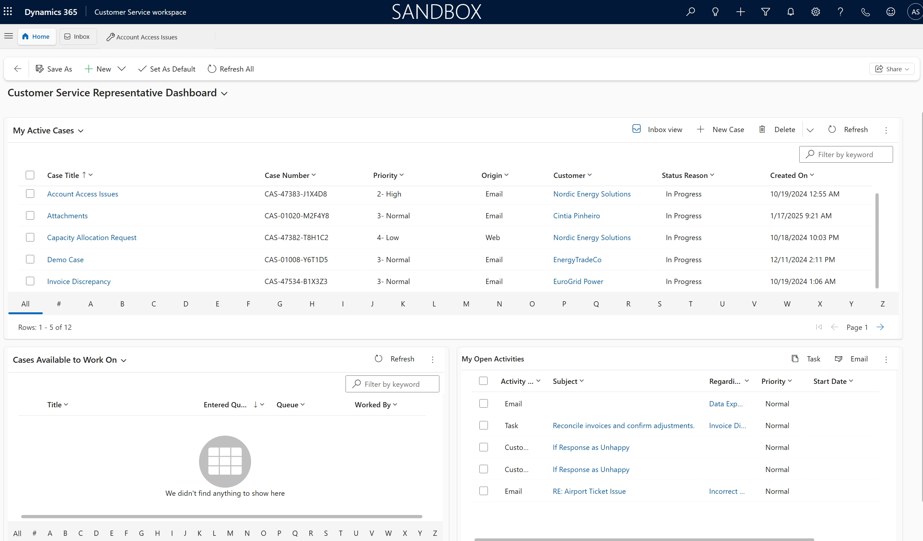

Slide 21
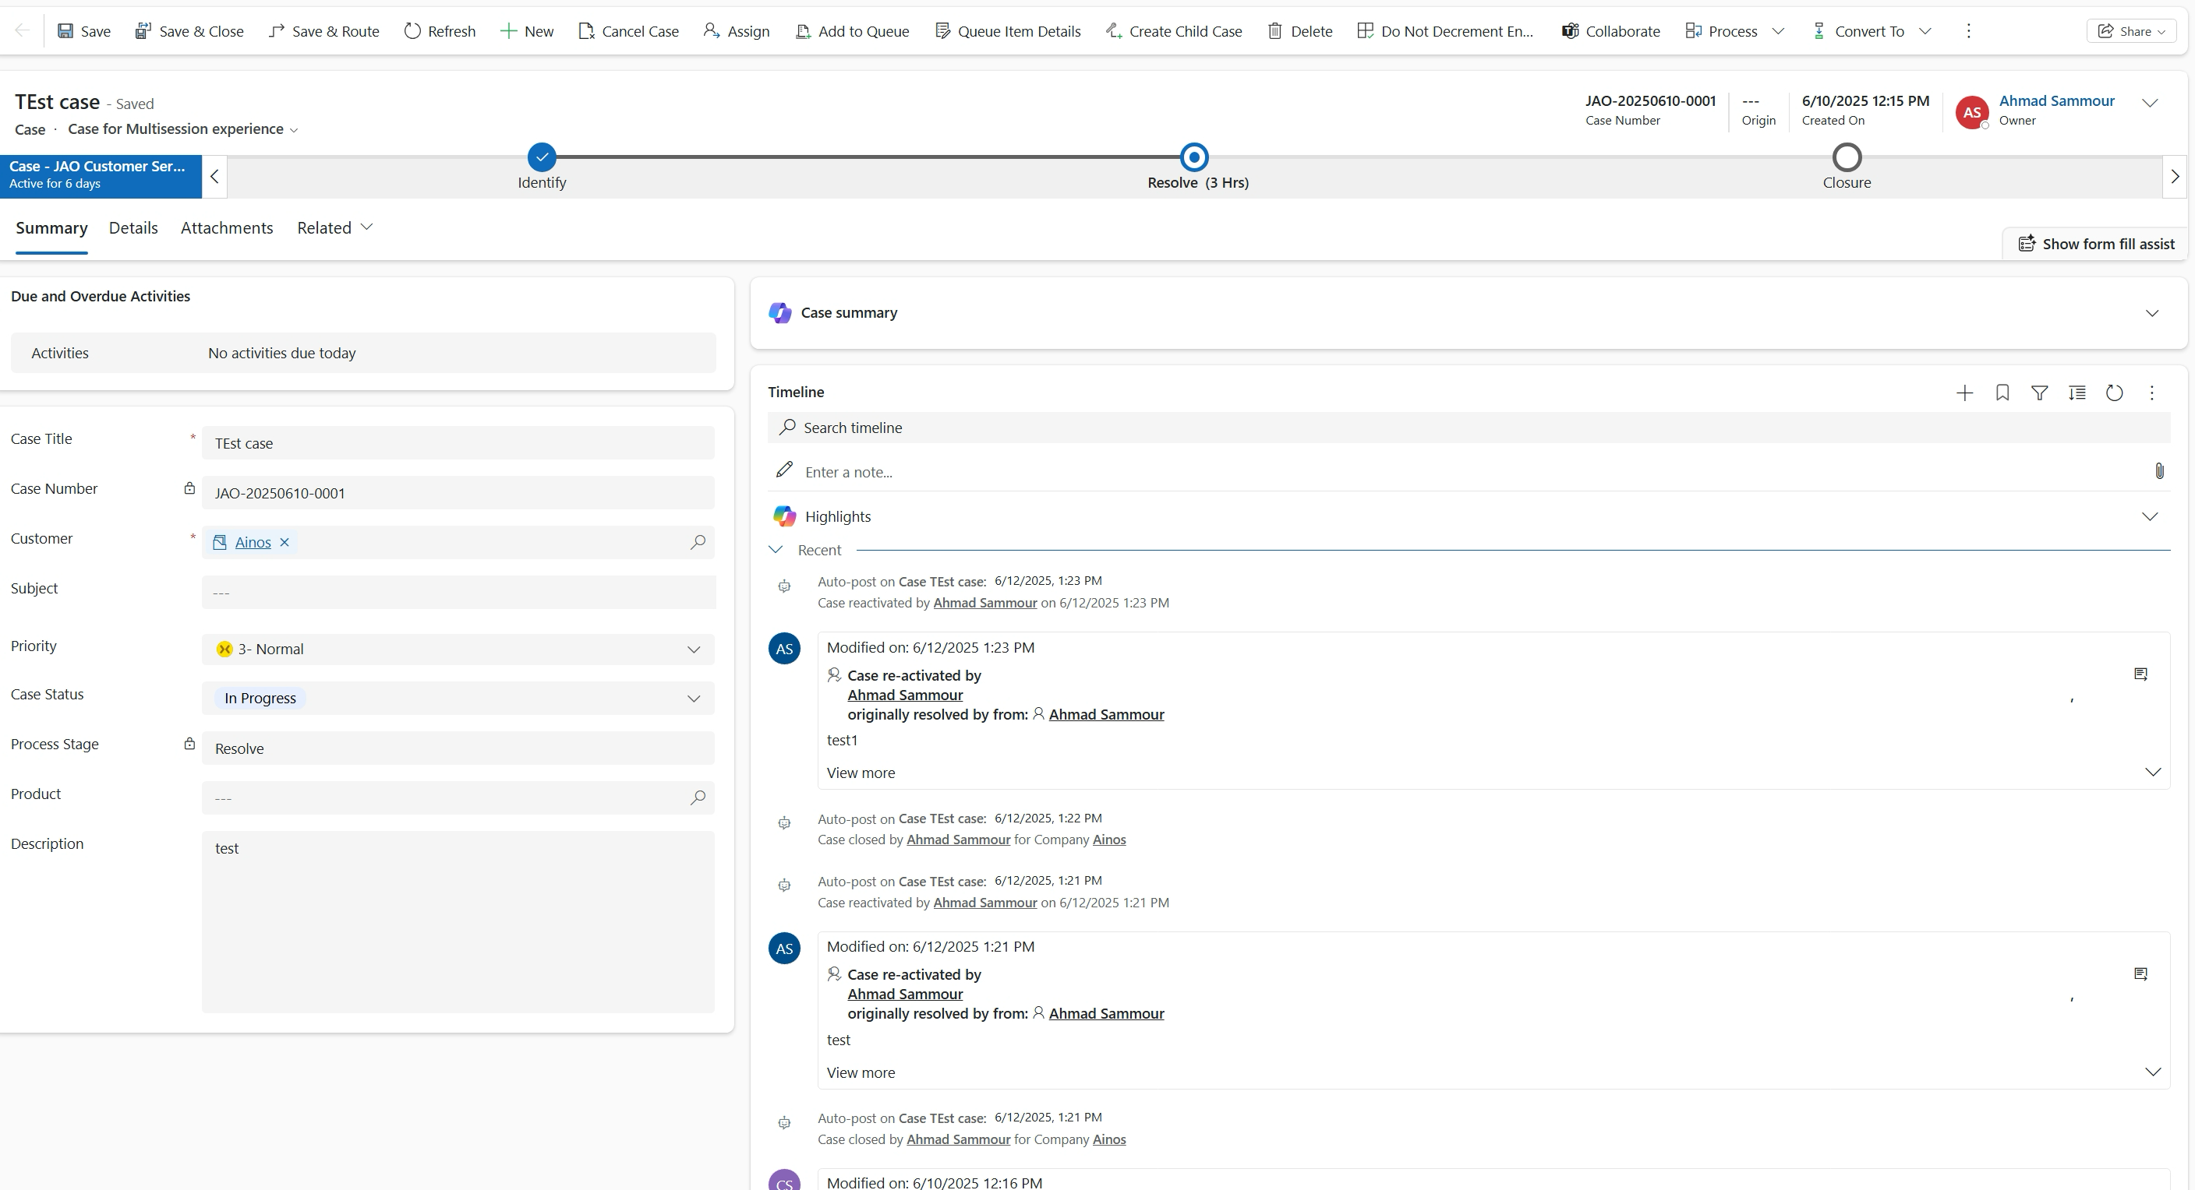

Slide 22
Customer Relationship Management Tool Status Update
Completion rate of phase 1
Phase 1 – Ticketing platform
Phase 2 – Registration
Phase 3 – AI solutions
04.02.2025
Implementation validation
03.04.2025
Kick-off
14.04.2025
04.05.2025 Spec validation
21.07.2025
Planned Go-live
01.08.2025
Phase 2 Kick-off
Phase 2
Planification
Documentation
Solution Design
Interface preparation
Post go-live documentation
Proof of concept
Procurement
Functional analysis
Process mapping
Implementation settings
Tutorials
Testing

Slide 23
7. Orion: The Allocation Tool

Slide 24
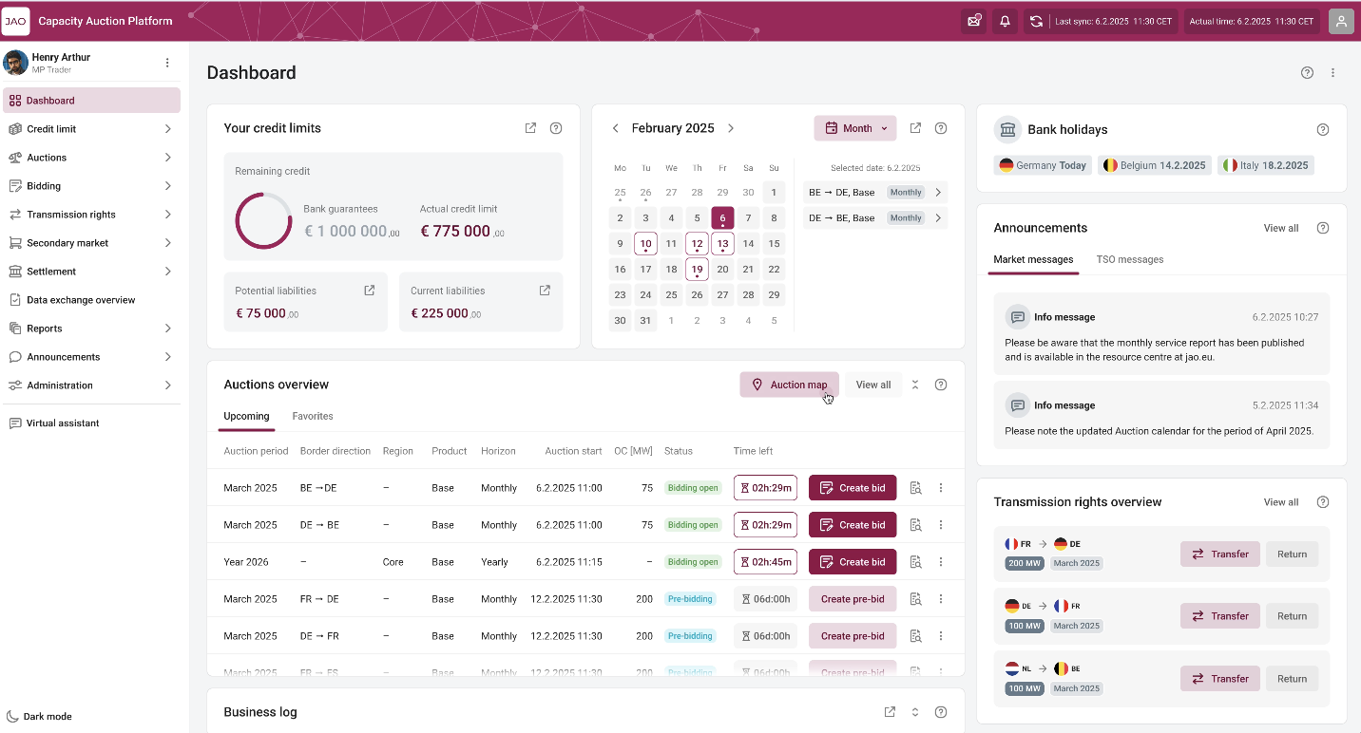
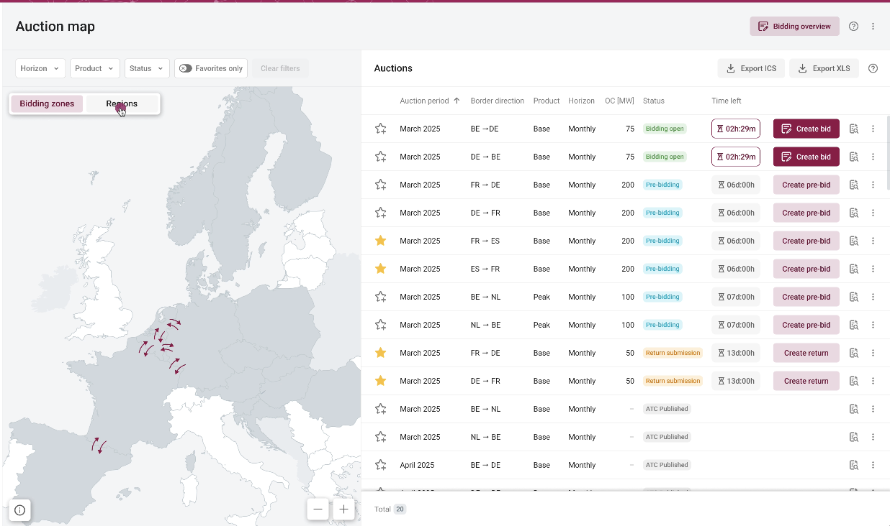
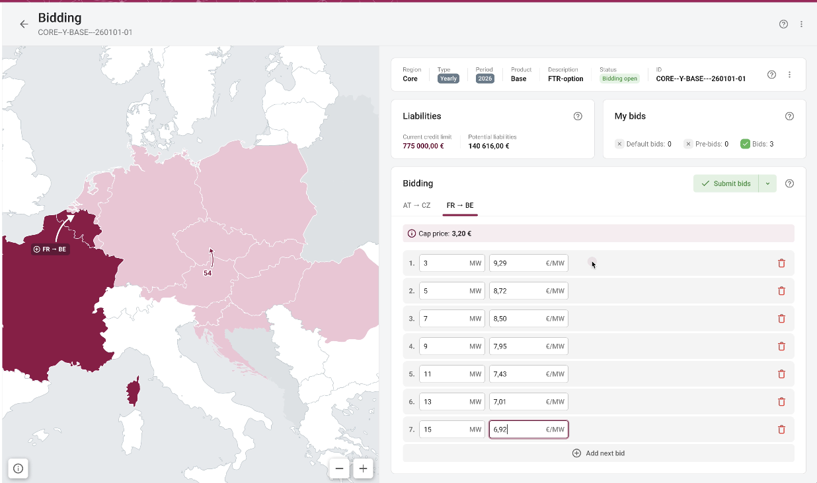
Orion The new allocation platform
ORION: New Auction Platform
Actual start: April-2025 | Target Go-Live: September-2027
Business rationale: eCat is outdated, inflexible and vendor-dependent. The project aims to build an internally owned and operated auction platform with improved functionality, scalability and maintainability
Objectives:
Enable better time-to-market for auction evolution
Reduce vendor dependency
Better user experience
Ownership of platform and IP

Slide 25
Demo

Slide 26
Roadmap and Key Milestones
2025
2026
2027
April 2025: project kickoff
March 2027:
Demos for MPs
Sept 2027:
Go-Live
Q4 2027:
hyper care
Q2-Q3 2025: Agile Design phase (Detailed specification, UX, UI,)
Q4 2025 -> Q4 2026:
Agile Implementation and validation phase
April 2027
Testing phases (Access to the test environment)
Q3 2026 -> Q4 2026:
Infrastructure setup and availability/recoverability
May 2027:
Member tests
Post-Q4 2027: Optimization and Ongoing Enhancements
Continue leveraging platform flexibility for continuous improvement.
Q3 2025 -> Q2 2027:
Parallel project integration process

Slide 27
8. Open Test

Slide 28
Open Test Regular free test sessions
Date
21-23.07
Registration open:
18.06 – 14.07
Via email by answering the invitation email
Long-term and Short-term auctions
API
Resale
Real time
New Trader UI

Slide 29
9. Test Surveys Reminder

Slide 30
9. Test Surveys Reminder
eCAT 7: New Trader UI Training Session Survey SDAC Decoupling training session with Market Participants survey
Deadline for both surveys has been extended to 01/07/2025. If you have not yet had the opportunity to complete them, we kindly encourage you to take a few minutes to share your feedback. Your insights are highly valued and will greatly assist us in enhancing the quality of our services. You may each surveys at the below links:
eCAT 7: New Trader UI Training Session SDAC Decoupling training session with Market Participants

Slide 31
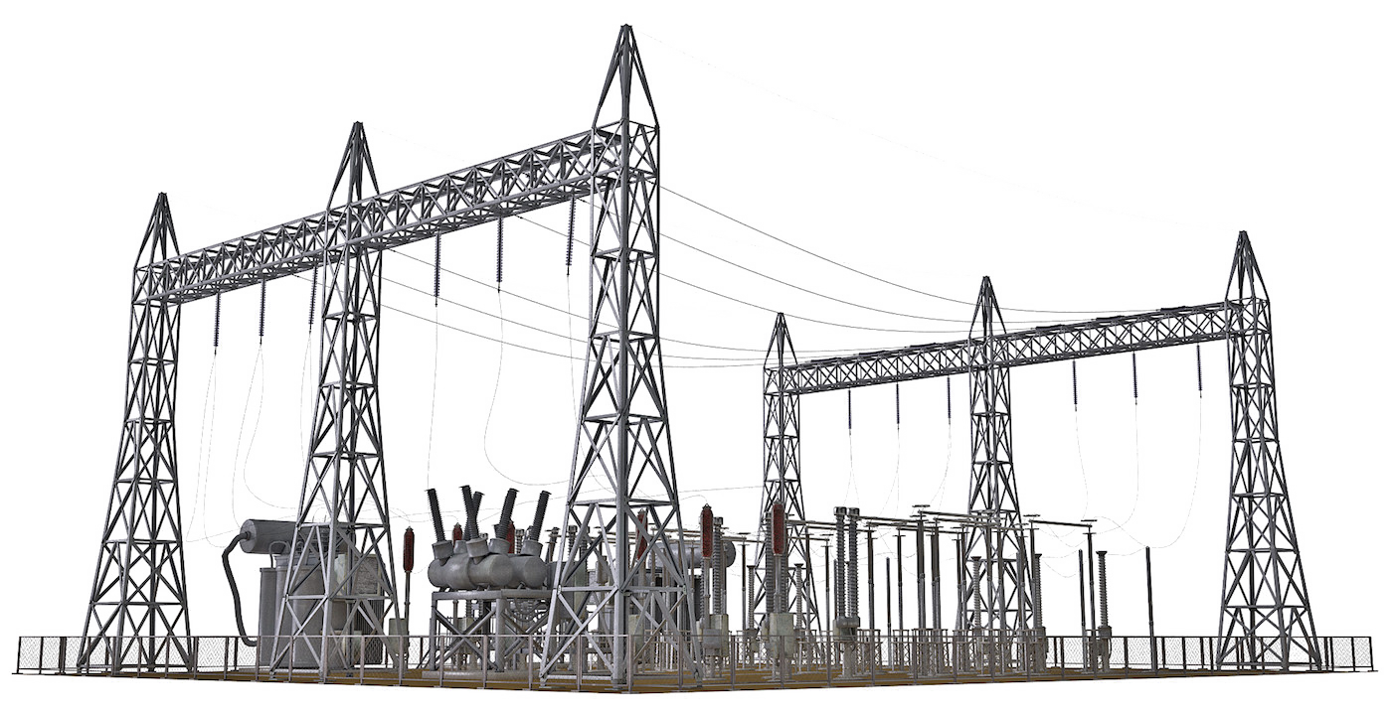
Q & A
It would be very useful to have an additional Full decoupling session with right timings before the 15-MTU is implemented for SDAC, given that in the session in April the shadow auctions were run even before the auction bidding time had closed.
Notes:
we will keep doing it
JAO will keep monitoring regulatory changes that are expected to be published in May 2025 through the revised Implementing Regulation
What is already in 15MTU will stay 15 MTU. Furthermore, the TSO will announce the upcoming changes, if any.

Slide 32
Thank you!

