Slide 1
Decoupling training session with Market Participants
SDAC Information package
03/03/2021
Operations Committee (OPSCOM)

Slide 2
Background & Goal
Date and timeslot
Scenario: Full decoupling of MRC
Operational process and timings
Coordination
Evaluation and reporting
Backup: Fallback Solutions per Interconnector and Bidding Zone

Slide 3
1) Background & Goal
SDAC Operations
Since the Go-Live of Multi Regional Coupling (MRC, i.e. the predecessor of SDAC) in 2014, more than 2500 successful market coupling session have been realized.
Due to more and more countries and borders becoming part of SDAC, the complexity of operations is increasing. This is reflected in the increasing number of parties, systems and regional sets of procedures involved.
In the last 20 months, 3 major incidents have happened that led to a partial decoupling of the SDAC Market. More specifically, the incident of 07/06/2019 led to a decoupling of CWE, the incident of 04/02/2020 led to a decoupling of one of the NEMOs in CWE, and the incident of 13/01/2021 led to a decoupling of 5 NEMOs.
As part of the evaluation of these 3 incidents, a recommendation was made to perform training sessions involving all operational parties (TSOs, NEMOs, CCPs, Shadow Auction entities, etc.) including Market participants.
In addition, EFET & EURELECTRIC on behalf of the Market Participants have requested for realistic decoupling training sessions.
Goal
This training session is organized to give all parties involved in a possible Day Ahead market decoupling the opportunity to validate that they are properly prepared to handle such an incident in real operations and real-life conditions.

Slide 4
2) Date and timeslot
Date
03/03/2021
Timeslot
13:00-18:00 CET (to have results available from the Fallback auctions)

Slide 5
3) Scenario: Full decoupling of MRC
Full vs partial decoupling
Because of all the operational mitigating measures in place, a partial decoupling is more likely to occur than a full decoupling.
However, in order to make the training session interesting for all participating parties, it has been decided to train for a full decoupling scenario.
After the MRC full decoupling is declared, fallback mechanisms will be activated, where applicable, such as: Shadow/Explicit Auctions, local auctions or regional coupled auctions run by NEMOs.
How it will be simulated
There are various issues that can lead to a full decoupling of MRC.
Based on 7 years of DA Market Coupling operations, starting with NWE, now MRC, and soon SDAC, we have decided to simulate:
  A trigger that is in line with the facts likely to lead to a full decoupling.
  A scenario that is besides representative, also possible to “simulate in a controlled manner” so that there are no distracting complications.
It will be simulated that there are technical issues with the central calculation process, meaning that no market coupling results will be available at MRC level.
The TSOs, NEMOs and JAO will handle everything in line with the procedures.
The market participants are expected to respond/act, based on the operational messages from their respective NEMOs and JAO, exactly like in real operations.
The complete process chain will be addressed (incl. nomination and matching1).
  Except for Nordic market participants, which are not required to nominate towards eSett following the Nordic-Baltic regional coupling

Slide 6
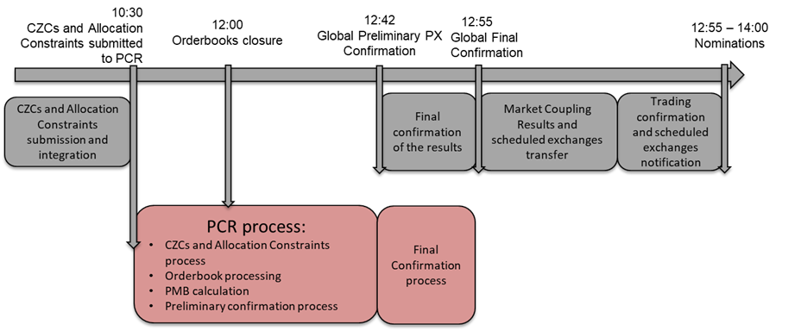
4) Operational process and timings 1/3 as described in the operational procedures
Normal process and timings
To start with, the TSOs provide cross border interconnector capacities to the coupling system (PMB, meaning PCR Matcher Broker) via NEMOs systems and Market Participants send orders for buying and/or selling through the Local Trading System of their NEMO.
At 12:00 (production time), the local order books of each NEMO are closed and submitted to the PMB, which subsequently starts the calculation with the EUPHEMIA algorithm. The results of this calculation are subsequently shared and validated by each NEMO before the results can be published towards Market Participants with a preliminary status. After a last round of validations (mainly performed by the TSOs) the results are confirmed as firm and final.
Once the results are firm, they are sent to the Shipping Agents who will nominate towards the TSOs.

Slide 7
4) Operational process and timings 2/3 as described in the operational procedures
09:00 13:00 Start of the Market Coupling Session
09:15 13:10 Latest Time to start an IC for issues in the Configuration Synchronization step
09:45 13:20 Deadline to skip the Configuration Synchronization step
10:30 13:30 Target Time for submission of the Network Data in the PMB
11:00 13:35 Latest time to start an IC for Network Data missing in PMB (TSOs can join the call)
11:15 13:40 Risk of Partial Decoupling for one or more interconnectors (at regional level)
11:45 13:45 Deadline to declare Partial Decoupling for an interconnector (at regional level)
12:00 14:00 PX OBK Gate Closure Time
12:10 14:10 PMB GCT // Reception of all OBK in PMBs → Start of Calculation
12:10 14:10 Latest Time to start an IC for OBK related reasons (TSOs can join the call)
12:20 14:20 End of Calculation
12:22 14:22 Reception of Results in all PX Systems + Start of 12 min Confirmation process
12:34 14:34 Deadline to send the Preliminary Confirmations → Generation of GPC
12:42 14:42 Publication of Preliminary Results and sending to the TSOs →
Start of 10 min Final Confirmation process
Message ExC_02: Delay in Market Coupling Results publication=>MPs invited to update Shadow Auction bids*
12:52 14:52 Deadline to send the Final Confirmations
12:53 14:53 Reception of all Final Confirmations in the PMB → Sending of GFC
12:54 14:54 Reception of Global Final Confirmation in the Local PMBs
12:55 14:55 Publication of Final Results → Start of Notification Process
13:05 15:05 Latest time to Start an IC and invite TSOs
13:20 15:20 Deadline to send the message for Risk of Full Decoupling to the TSOs/market
Message ExC_03b: Further delay Market Coupling session and risk of Full decoupling
=>MPs invited to update Shadow Auction bids*
13:40 15:40 Closure of shadow auction bidding process by JAO
13:50 15:50 Deadline to declare Full Decoupling
Message ExC_04b: Declaration of Full decoupling
14:00 16:00 Publication of shadow auction process results to relevant parties
After 14:00 after 16:00 Local NEMO process for running local auctions or regional coupled auctions, depending on local/regional fallback rules. These auctions will be followed by nominations towards the TSOs.
16:00 after 17:30 Nordic-Baltic regional coupling results publication
*for borders where Shadow Auctions apply
-- NEMOs&TSOs Debrief call will be next day (09:00 – 10:00)
Production
Training
Pre-Coupling
Coupling
Note: Relevant decoupling steps and messages for Market Participants indicated in yellow.
Additional regional messages that might apply are not included, because these depend on the regions.

Slide 8
4) Operational process and timings 3/3
Regional specificities
To be updated by each individual NEMO as needed
Regional timings
…
Regional Messages
…

Slide 9
5) Coordination
To be updated by each individual NEMO as needed
Registration process
In case applicable, the respective NEMO(s) and/or JAO will contact the market participants regarding the process to follow.
JAO: MPs should register for the test with JAO by sending the email to helpdesk@jao.eu. Deadline to register is 19/02.
Environments to connect to
JAO: For MPs the JAO test environment will be eCAT UAT.
Connectivity establishment
JAO: Connectivity will be made available for JAO eCAT few days before the training.

Slide 10
6) Evaluation and reporting
Evaluation
In order to jointly learn and profit as much as possible from this joint training session, it is foreseen to evaluate the session and to address the following questions
What went well?
What needs more attention?
Need for more training sessions?
Ideas for the future?
Reporting
The findings will be captured in a report that will be shared in due time.

Slide 11
Backup slide 1: Fallback solution per Interconnector
Options
Depending on the Interconnector/border, the following Fallback solutions may be used:
Capacity goes to Intraday;
Day Ahead Explicit auction;
Shadow auction via JAO;
Capacity goes back to the interconnector owner.
Regional Coupling (implicit allocation)
Interconnector | Fallback solution
SEM interconnectors:
NI – ROI | NI-ROI always remains coupled
Nordic-Baltic interconnectors:
Nordic internal borders | Always remain coupled through Nordic internal coupling
Baltic internal borders | Always remain coupled through Nordic internal coupling
NO2-NL (NorNed) | Shadow Auctions via JAO
NO2-DE (NordLink) | Shadow Auctions via JAO
DK1-DE | Shadow Auctions via JAO
DK1-NL (COBRA cable) | Shadow Auctions via JAO
DK2-DE (Kontek cable) | Shadow Auctions via JAO
SE4-DE (Baltic Cable) | Capacity goes back to the interconnector owner
PLA-PL | Capacity goes back to the interconnector owner
PLA-SE4 (SwePol Link) | In case of decoupling of TGE, the capacity remains available until 13:50. In other cases, the capacity goes back to the interconnector owner.
PLA-LT | In case of decoupling of TGE, the capacity remains available until 13:50. In other cases, the capacity goes back to the interconnector owner.
SE4-LT (NordBalt) | Capacity goes to Intraday auctions
EE-FI (EstLink) | Capacity goes to Intraday auctions
CWE internal borders:
AT – DE | Shadow Auctions via JAO
NL – BE | Shadow Auctions via JAO
BE – FR | Shadow Auctions via JAO
FR – DE | Shadow Auctions via JAO
NL – DE | Shadow Auctions via JAO
BE – DE (ALEGrO) (BE-ALBE, DE-ALDE) | Shadow Auction via JAO
SWE interconnectors:
FR-ES | Shadow Auctions via JAO
IBWT internal borders:
IT – FR | Shadow Auctions via JAO
IT – SI | Shadow Auctions via JAO or capacity goes to Intraday
IT – AT | Shadow Auctions via JAO
IT – GR | Shadow Auctions via JAO
AT – SI | Shadow Auctions via JAO
SI – HR | Shadow Auctions via JAO

Slide 12
Backup slide 2: Fallback solution per Bidding Zone
To be updated by each individual NEMO as needed
Options
Depending on the local/regional procedures, the following Fallback solutions may be used:
Local auctions run by the relevant NEMOs
Regional Coupling (implicit allocation)
Bidding Zone | Fallback solution
CWE Bidding Zones (FR, DE/LU, NL, BE, AT) | Local auction run by the relevant NEMOs
SEM (ROI and NI) | Local auction run by the relevant NEMO
Nordic Bidding Zones (DK, NO, SE and FI) | Nordic-Baltic regional coupling between the relevant NEMOs

